Slide 1


AMBER - EHN2
AUG System

Slide 2



AMBER – Hydrogen TPC experiment
Later this year the AMBER experiment will operate with a TPC containing hydrogen in EHN2.
This equipment has significant risks:
  Pressure vessel
  ATEX zone
  High voltage
The AUL system in EHN2 has been out of service for some time.
New AUG buttons have been installed by EN/EL but are not yet in service.
Request from EP Safety Office to complete the commissioning before AMBER TPC operation!

Slide 3
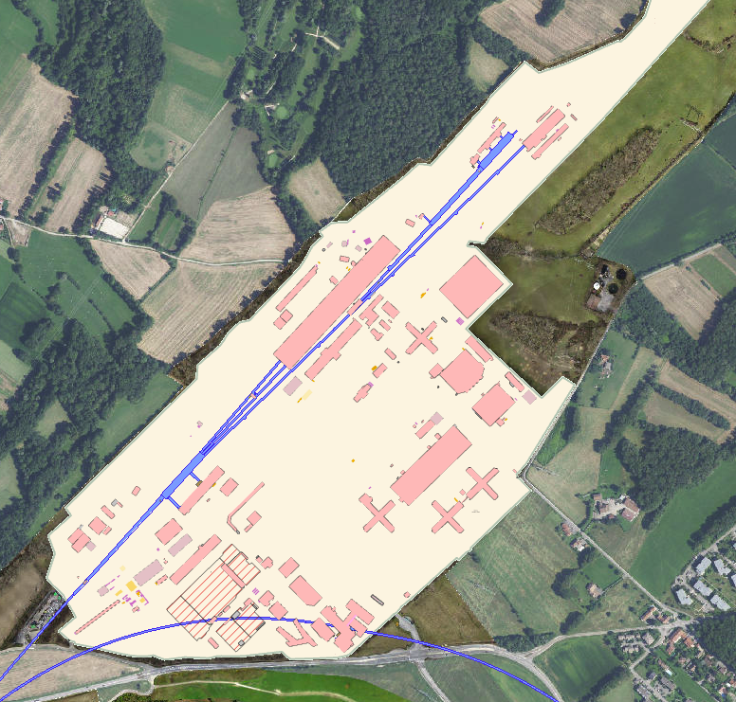
AUG connection - What will be the consequences?
EN/EL had some difficulties with the 18kV circuit breakers due to the age of the equipment during the 2025 AUG testing in the North Area. The AUG control racks are planned for replacement during LS3.
Completing the connection and test of the new AUG in EHN2 before LS3 carries the risk of power cut. This work will be announced as a power cut.
EN/EL will be in position to restore power as quickly as possible.
We will go through the normal process for this type of intervention (FOM, TIOC etc.)
Power Cut

Slide 4
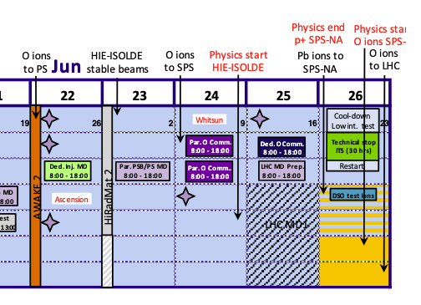
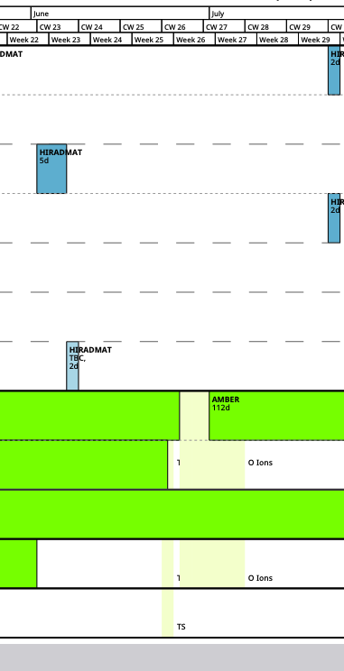
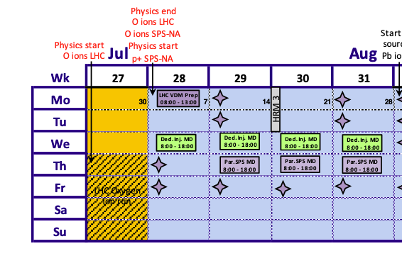
When should we do it?
Expected duration 1 day (Max)
Options:
Wednesday 11th June
Wednesday 18th June
Monday 23rd June
Thursday 26th June
(must be working day, cannot be 24th-25th June due to ITS)
Ideally we would select one as a proposal for FOM & TIOC.

