Slide 1
TBI – vacuum anomalies
Anthony Harrison TE-VSC
13th May 2025

Slide 2
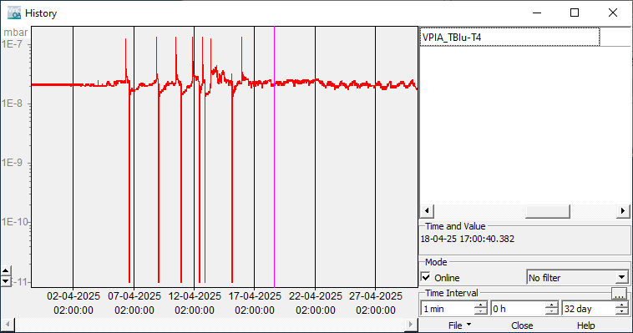
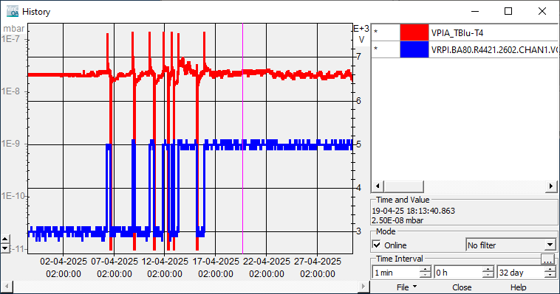
TBIu T4
Ion pump power supply operating in STEP mode – automatically switches between 3kV, 5kV or 7kV depending on pressure.
Pressure of T4 TBIu fluctuating around switch-over limit 3kV-5kV (2x10⁻⁸mbar)
Power supply set to FIXED 5kV (15/04/2025)
Measurement stable (only beam induced pressure spikes)
Place for your logo

Slide 3
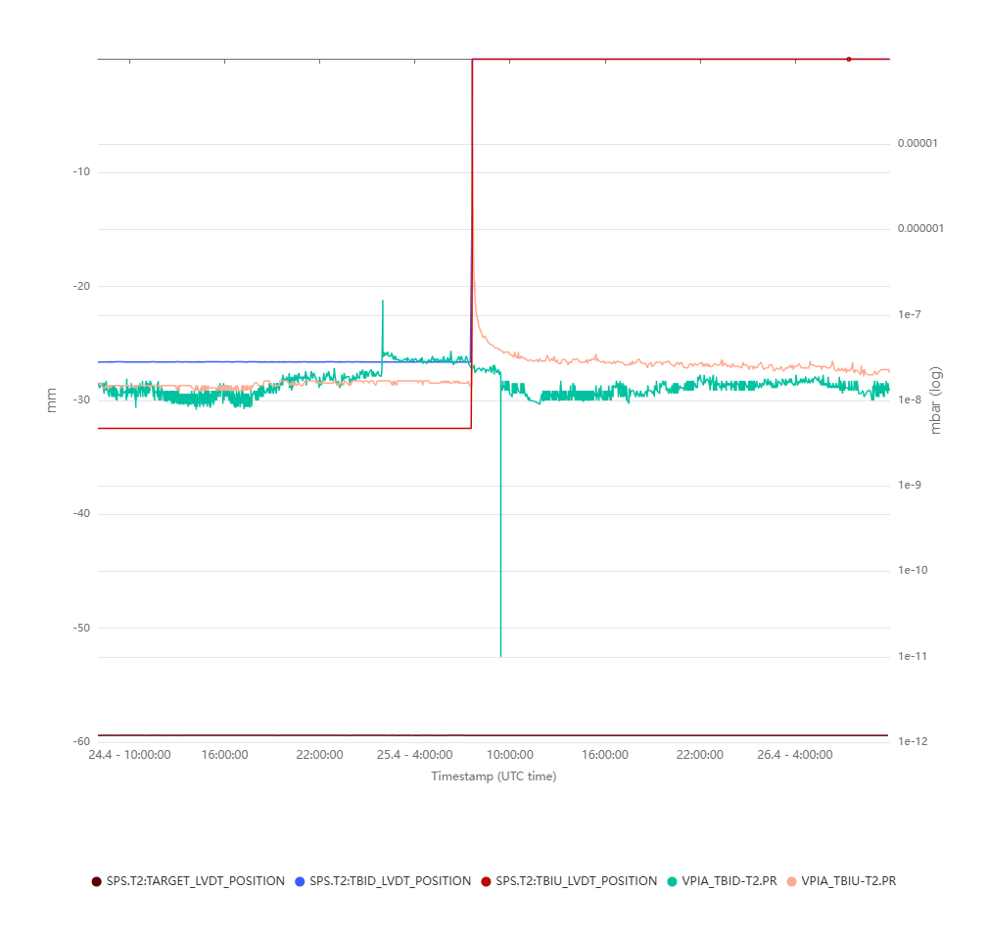
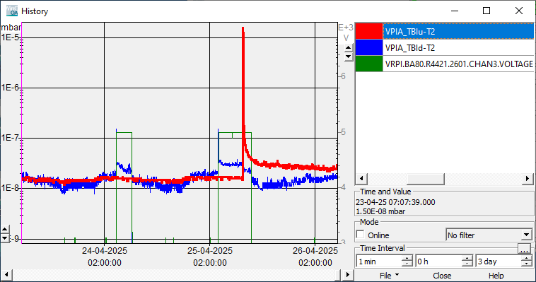
T2 TBIu
Single pressure spike (25/04/2025 @09:37), coincides with movement of T2 TBIu.
T2 TBIu spikes due to ion pump power supply STEP mode – all TBI have been set to FIXED 5kV

Slide 4
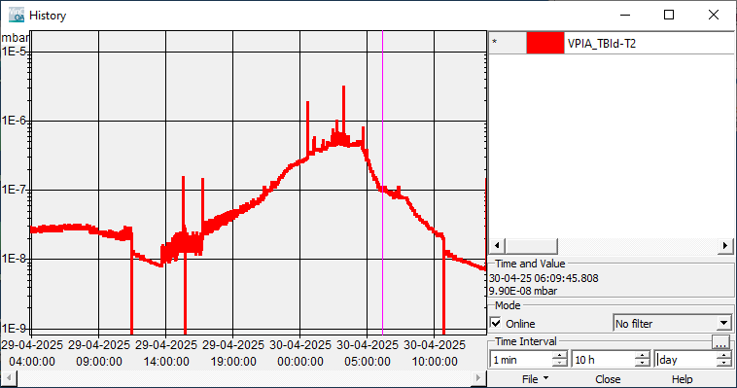
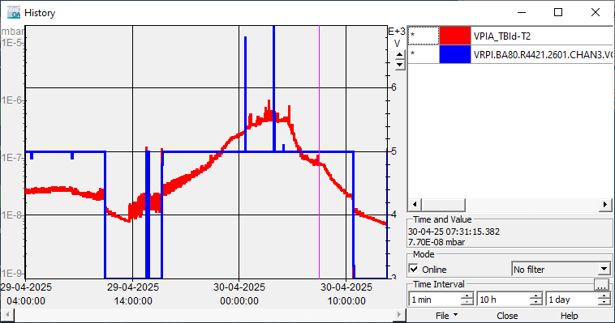
T2 TBId
SFTPRO increased from 30 units (intensity 3x10¹²) to 100 units (intensity 1x10¹³) from 29/04/2025 @~14:00
Pressure slowly increased starting from 29/04/2025 @14:00
TE-VSC Piquet called 30/04/2025 @4:00
  TE-VSC requested beam to be stopped on T2 to evaluate issue was beam induced heating or vacuum leak at 04:30.
  Pressure immediately reduced – indicating beam induced heating.
  SFTPRO beam restarted at 06:00 until 08:00 100 units (intensity 1x10¹³), pressure continued to reduce
Beam stop
SFTPRO 100units
SFTPRO 100units

Slide 5
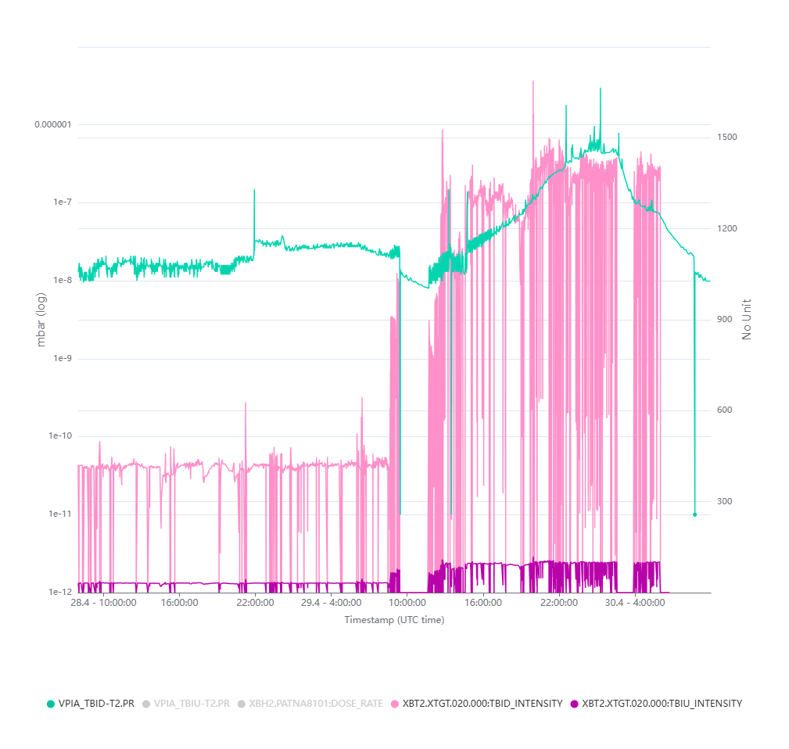
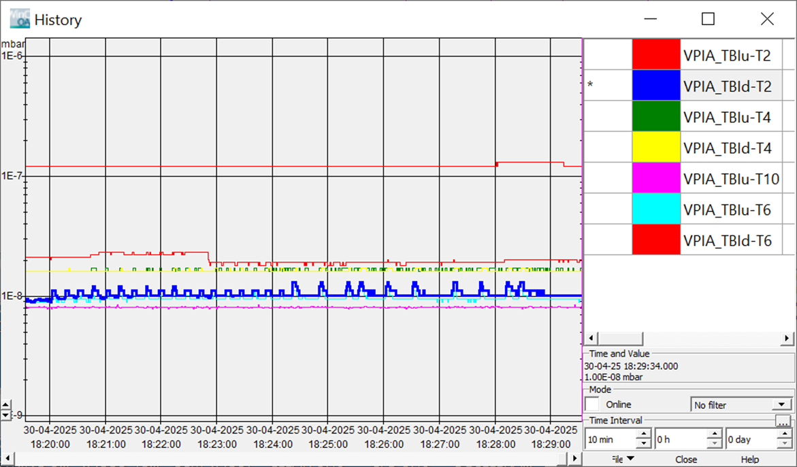
T2 TBId
Low pressure ripple slowly builds up over several hours.
Pressure plateaus ~8x10⁻⁷mbar.

Slide 6
Actions following CCC meeting (02/05/2025 @11:30)
Without the T2 target "IN", vacuum recovery, same as "no beam" (with SFTPRO + AWAKE)
With the 180 mm target (same as T4), the vacuum level is stable (as in T4) (with SFTPRO + AWAKE)
The levels are similar with the ones in 2021/2 and with the TBID of T6 when at similar intensity
1. TE-VSC will implement an interlock of 1x10⁻⁶ mbar on this pump to avoid stopping it ;
SIS interlock already implemented 2022 at 1.6x10⁻⁶mbar
2. T2 intensity limited to 80 units for now and we will compensate with collimators opening; The experiment & the SPS coordinator are informed and also agree.
Interlock confirmed and nominal intensity resumed with agreement (06/05/2025 @17:00)
3. SY-STI, SY-BI & TE-VSC to prepare spare TBId in case of failure.
Preparations starting this week, approx. up to 2 weeks to validate vacuum & BI equipment. This will be returned to storage after. <5 days required before installation if required
4. We keep monitoring the situation and get together for another meeting if necessary ...
TE-VSC daily monitoring

Slide 7
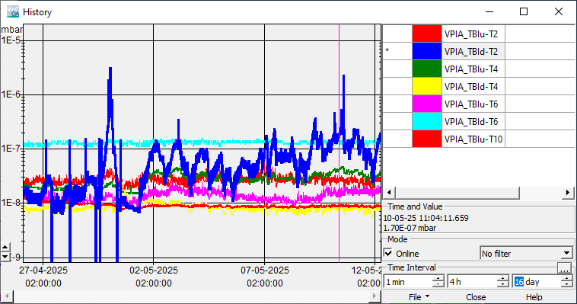
Current situation
? Spike not attributed to TBId T2 movement
All ion pumps on TBI set to FIXED mode 5kV.
Continued pressure fluctuations (beam induced) but not considered problematic at these levels.
TBId T2 pressure operating below the 1x10⁻⁶ mbar SIS interlock threshold.

