Slide 1
F61.MBXHD025 Vacuum Chamber Post-Mortem Report
Dipanwita Banerjee
EATM – 184th Meeting
13 May 2023
Dipanwita Banerjee, Philippe Boisseaux-Bourgeois, Michael Lazzaroni, Miguel Lino Dos Santos, Damien Brethoux, Aboubakr Ebn Rahmoun, Sedat Altun, Angelo Petrellese, Ramon Folch, Giulia Romagnoli, …..

Slide 2
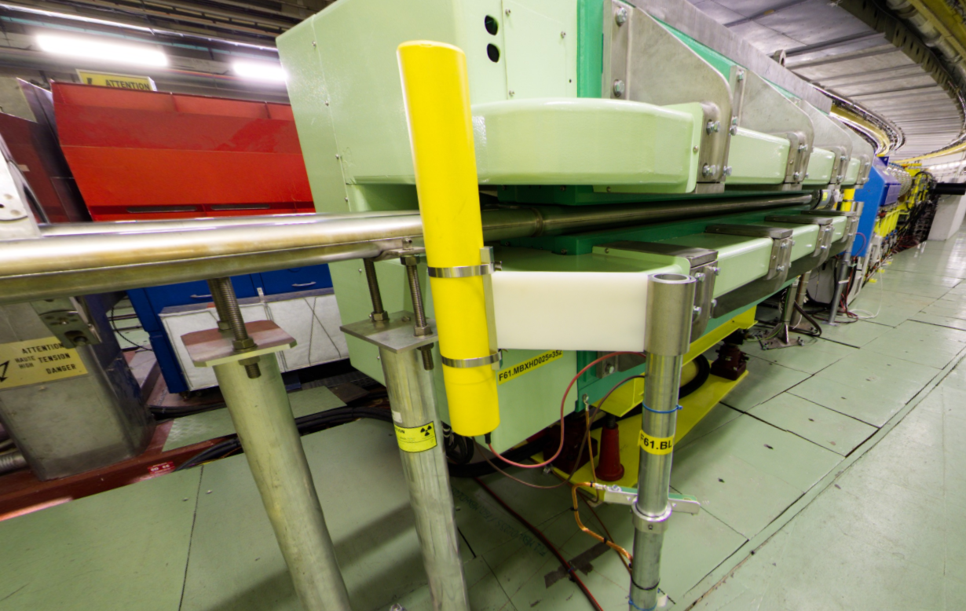
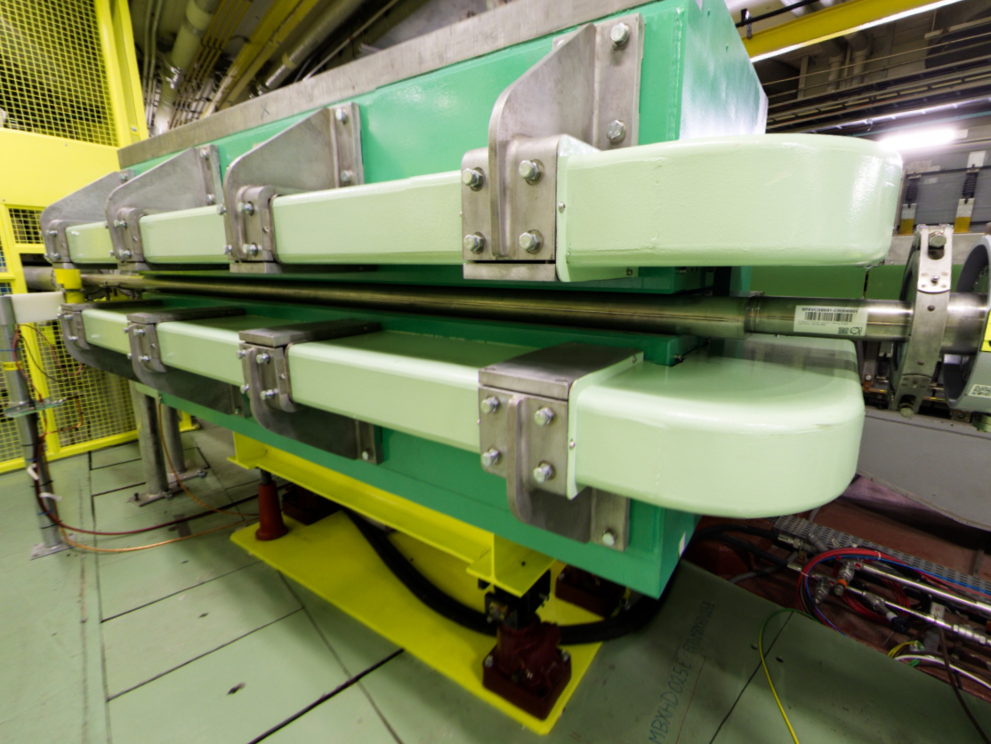
Vacuum Chamber of F61.MBXHD025 Magnet
Vacuum Chamber position F61.XVC025
Installation in YETS 24-25
Vacuum Chamber Installation in F61.MBXHD025 for CHIMERA/HEARTS
ECR EDMS 3138917 - PSZ-V-EC-0001

Slide 3
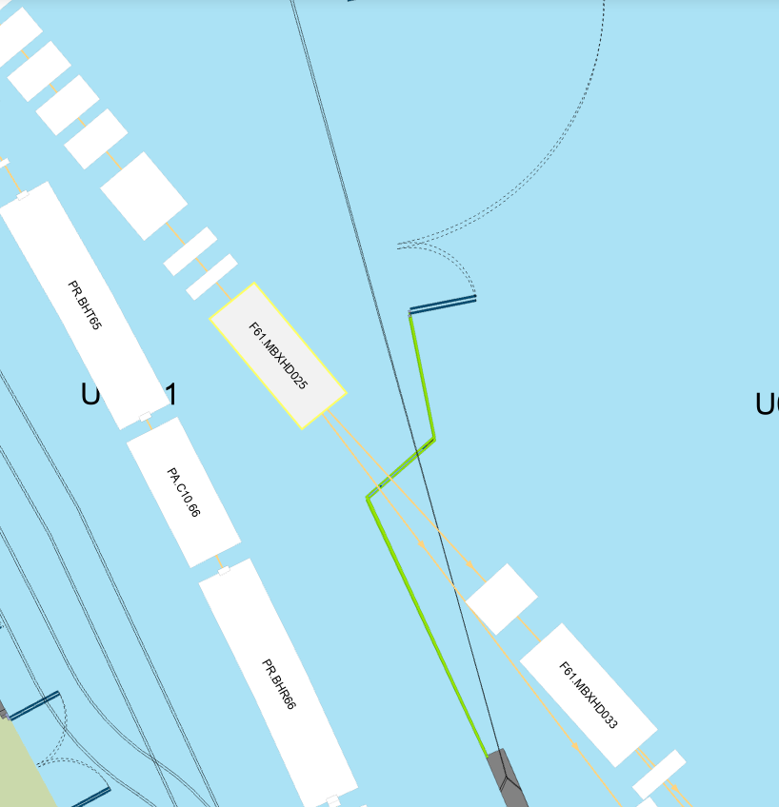
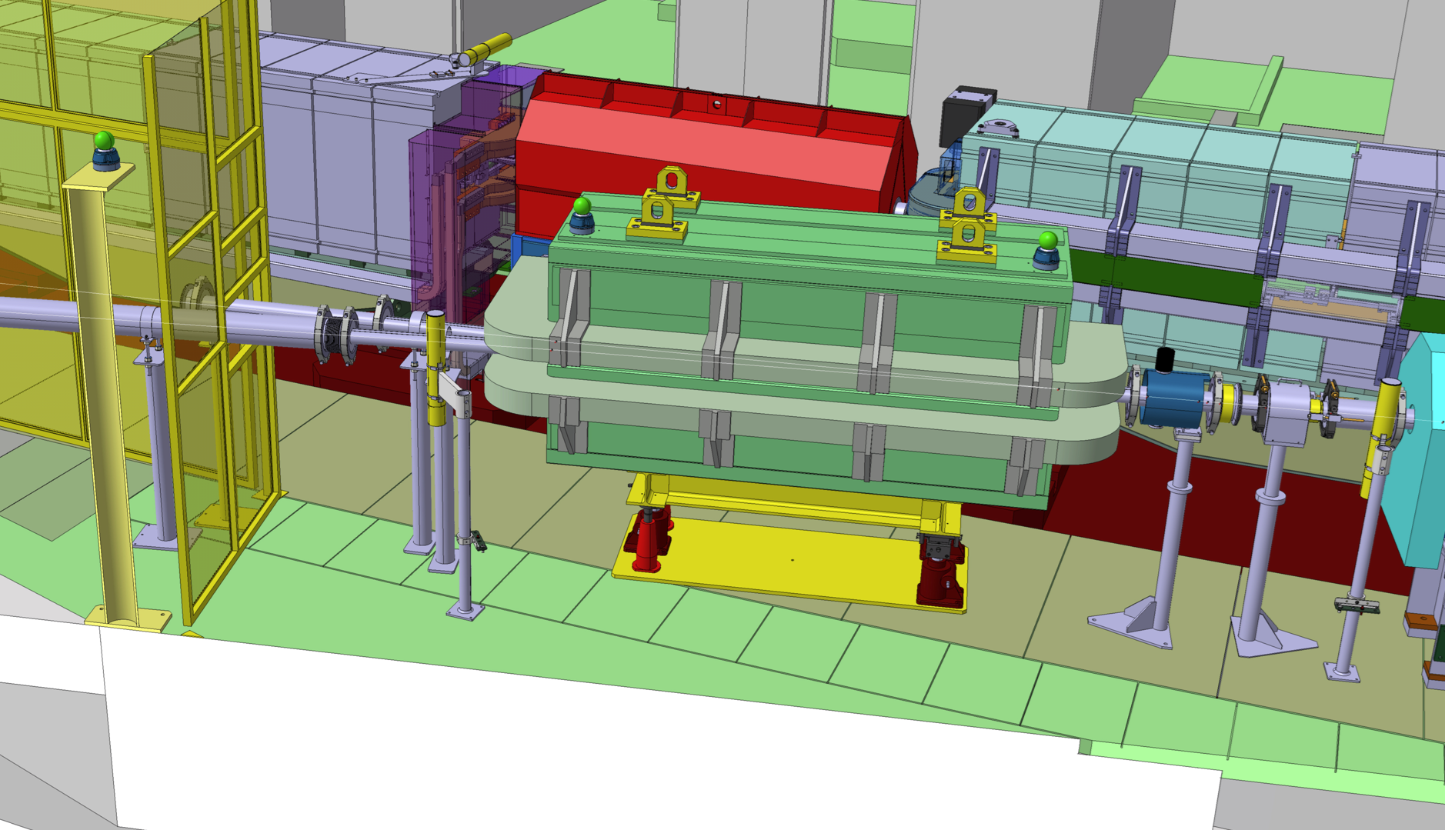
Position
Extraction line from PS ring towards the East Area.
PS ring
F6D to Dump
F61 to East Area
PS ring
F6D to Dump

Slide 4
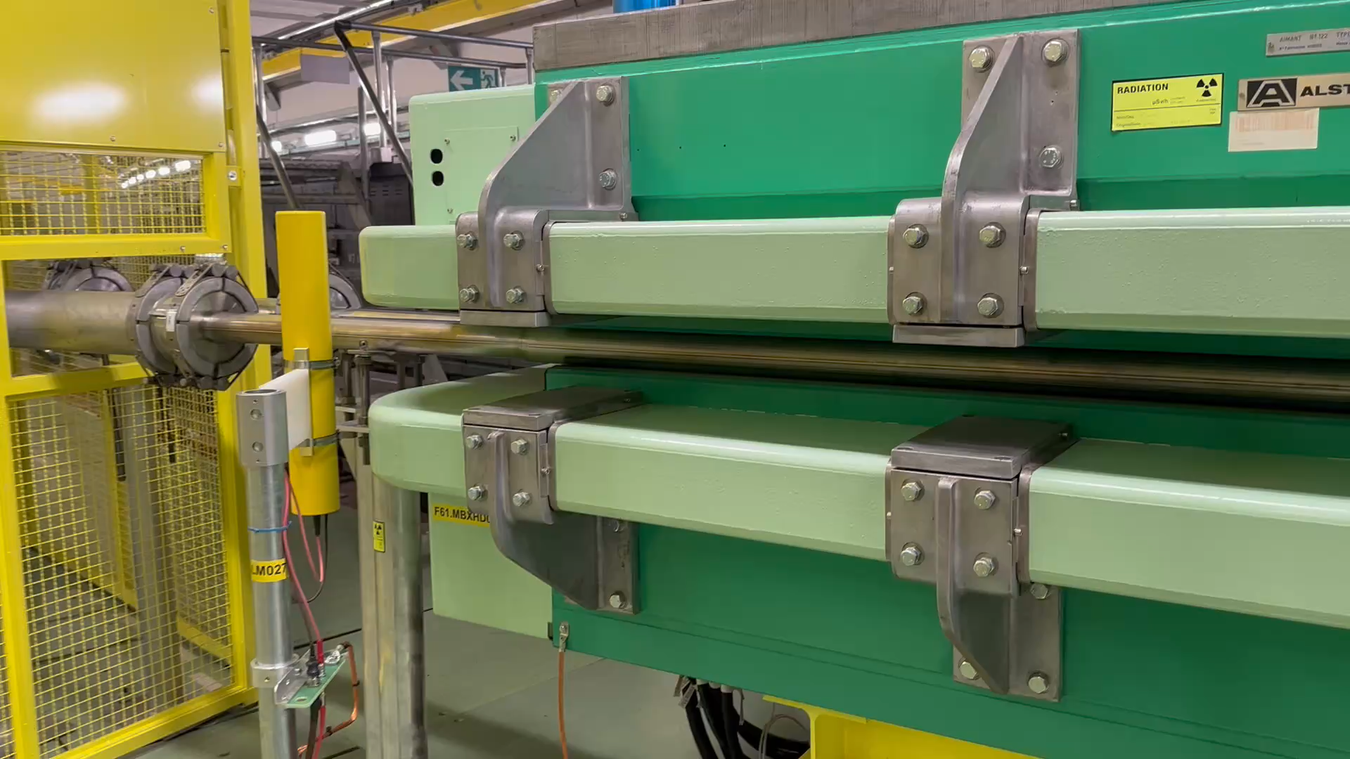
Displacement of chamber
Displacement discovered during the polarity check by the physicist team
After discussion with the experts, it was decided to remove the chamber from the beamline

Slide 5
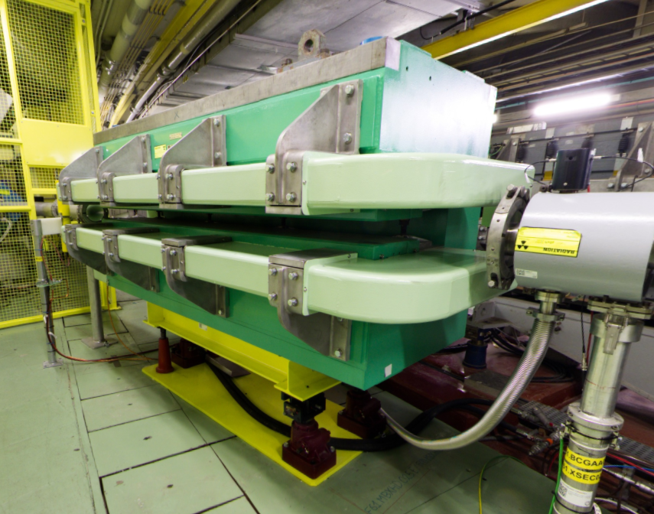
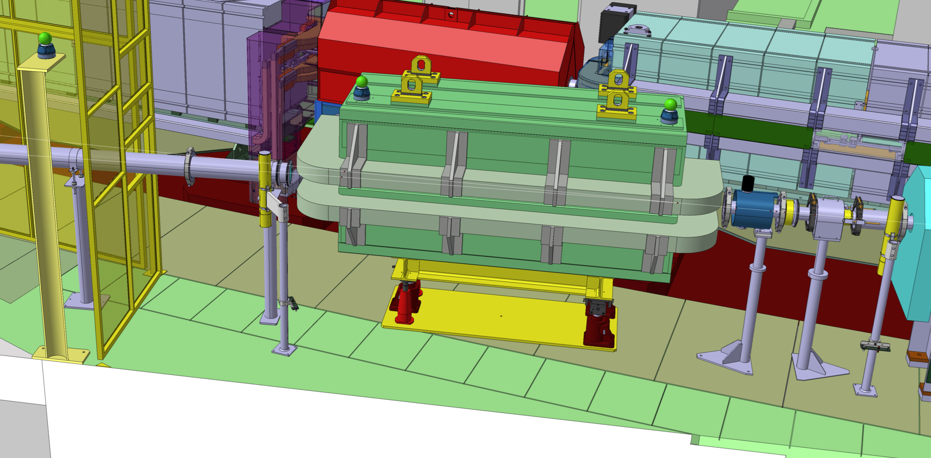
Removal of Y Chamber
Following the movement discovered, Y chamber removed
XSEC maintained on primary vacuum connected to upstream part
2 vacuum windows removed from the line compared to before YETS

Slide 6
Post-Mortem
Internal (BE-EA) meetings/review organized to understand how and why the chamber problem occurred:
Analyze history
Find positive and negative aspect during design, fabrication, installation
Try to improve design and installation strategy for vacuum chambers inside magnets for future cases
Several expert meetings with TE-MSC and TE-VSC groups on going, to find out the best way to solve the problem:
TE-VSC shared a similar case of a problem occurred on TT2 line magnet during LS1
TE-MSC willing to work together to organize a test on a spare magnet before installation

Slide 7
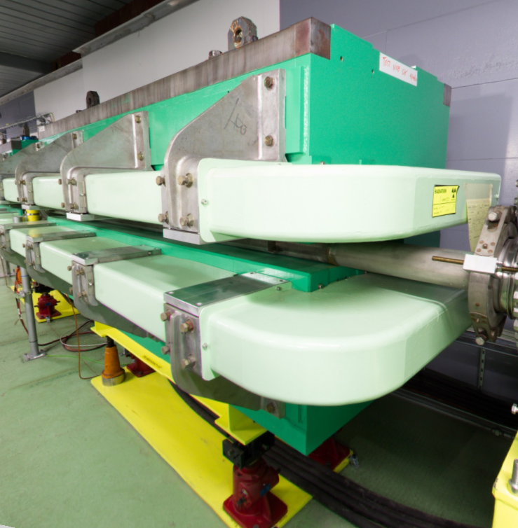
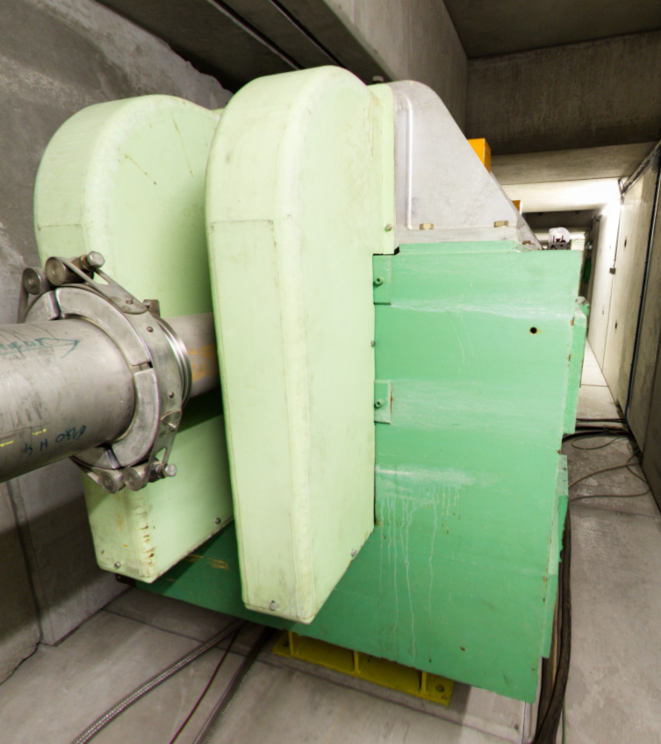
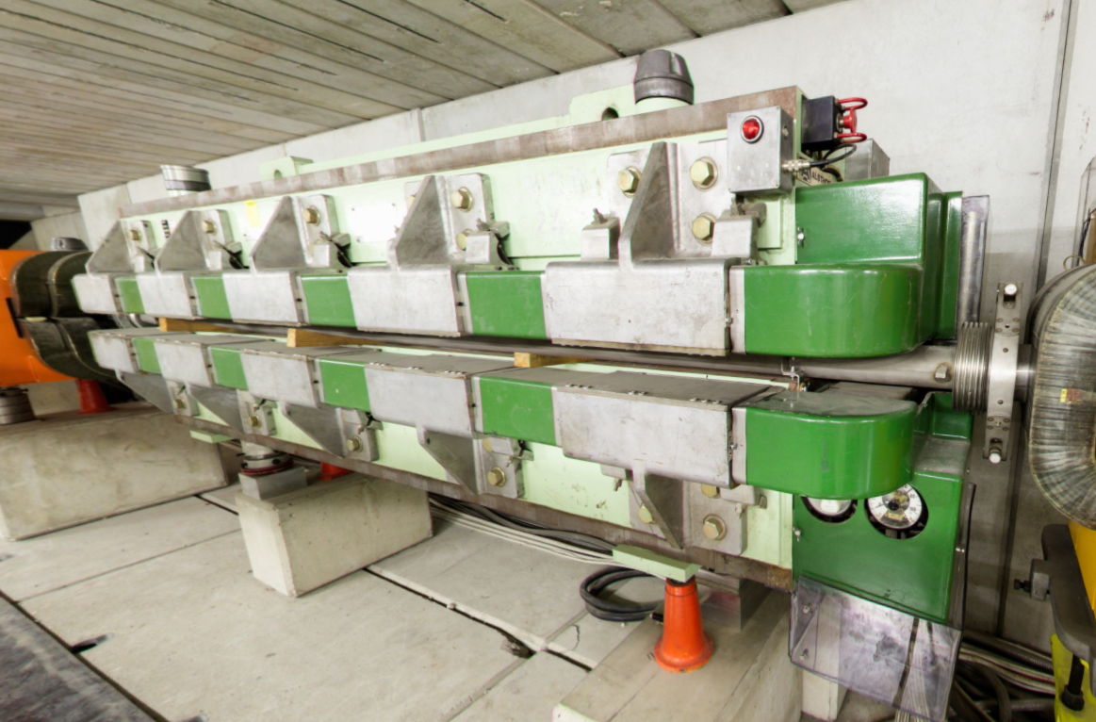
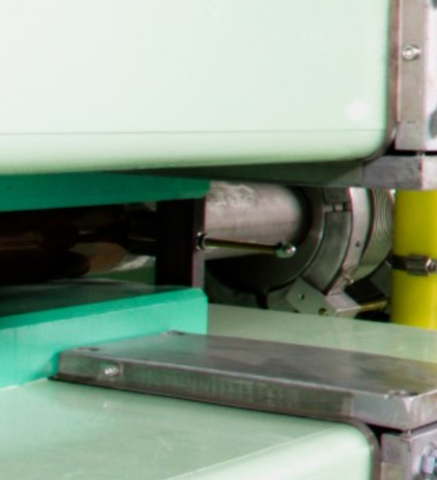
Post-Mortem Findings
Different kind of MCB magnets found in the North and East Area with different fixation points
Chamber material was SS 304 L instead of 316 LN that is more common, but this was not the main reason of the movement
Magnet patrol was done but not with the real working currents/magnets settings
The chamber was not fixed inside the magnet and not electrically insolated!
Most probably the movement was due to the induced currents in the chamber by the magnet magnetic field

Slide 8
Next Steps
Solution to apply (based on TE-VSC experience), to break/stop conductivity:
Isolated a flange upstream or downstream (enamel flange);
Check the chamber grounding connections;
Fix the chamber inside the magnet (upstream and downstream);
Additional steps:
Use kapton foil around the chamber
Write engineering specification and ECR for chamber assembly and installation
Run a test with a spare magnet to verify mechanically and electrically the assembly
Test with magnetic field? (check with SY-EPC)
Goal: install modified chamber during technical stop 24-25th June.

Slide 9
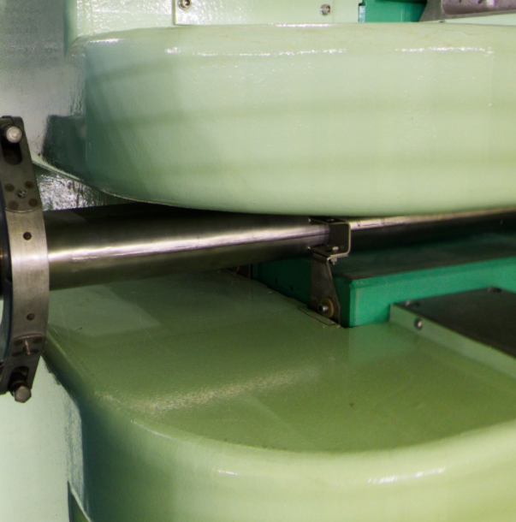
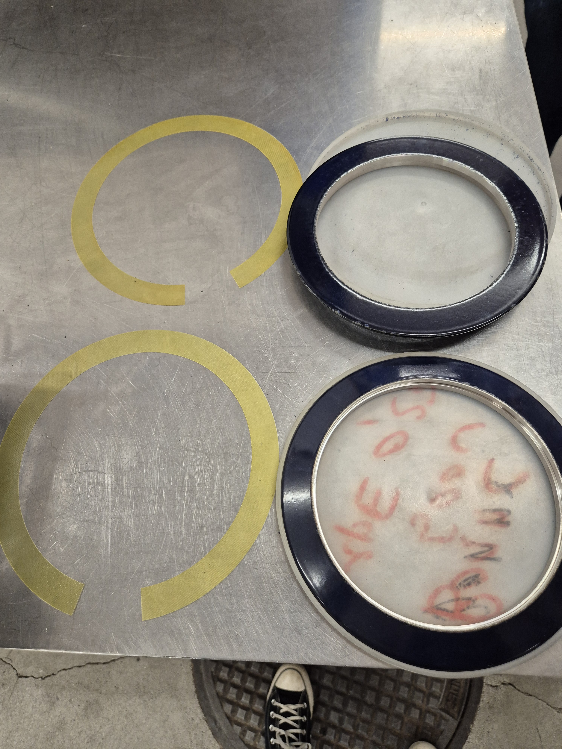
Solution Proposal
4 fixation points to the magnet yoke
Ground connection in the XSEC
Supports NOT connected to ground
Enamel flanges mounted on the bellow
+ Kapton foil around the chamber

Slide 10
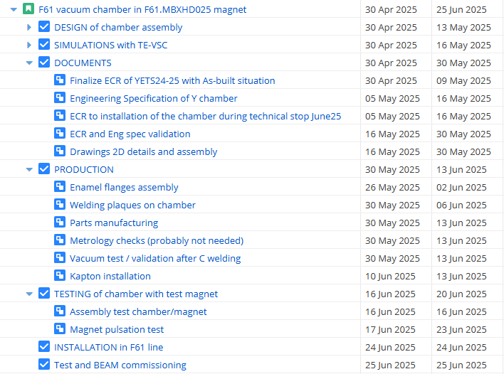
Planning
Really challenging planning mainly for documents approval and simulation cross-check!
Magnet test to be organized in collaboration with TE-MSC and SY-EPC

Slide 11
THANK YOU!!

