Slide 1
BWS LHC CONS
Status update
BWS LHC CONS #28
J. Emery
12.05.2025

Slide 2
April/May 2025
15.04.2025 - April BWS LHC CONS meeting #27
https://indico.cern.ch/event/1545809/
Easter time
Mechanical design frozen after VDAM last suggestions.
Drawings being finalized and reviewed before manufacturing.
Other tasks
- Test rig V3 new bearings
- Test rig V3 integration into the laser calibration bench
- Optical ruler reflective pattern design
- Carbon wire mobile connection to the card study (Jean & Christophe proposal)

Slide 3
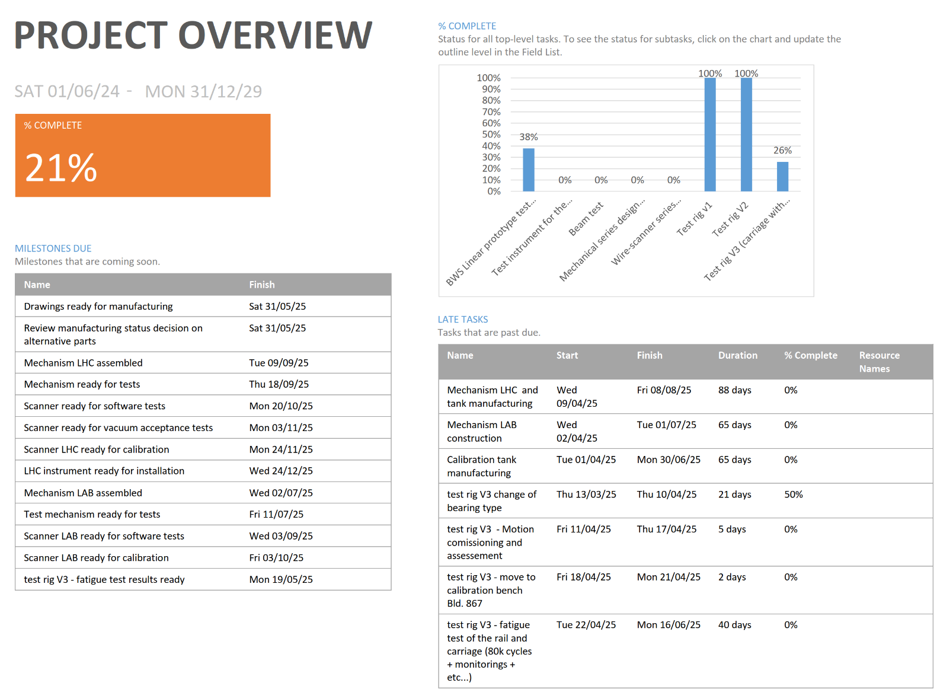
MS project update
Added:
- Optical rule drawings investigation
- Test rig V3 bearings change
- Test rig V3 move to calibration bench
- Mechanism LAB in-vacuum cablings alternative tests (Jean & Christophe's solution) – task 48
Adjusted:
- Prototype drawings ready for manufacturing
- Test rig V3 commissioning and life tests
https://confluence.cern.ch/x/RapJIw

Slide 4
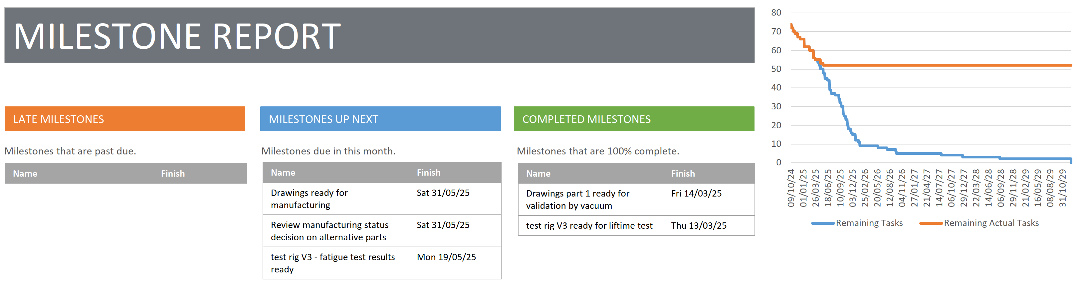

Slide 5
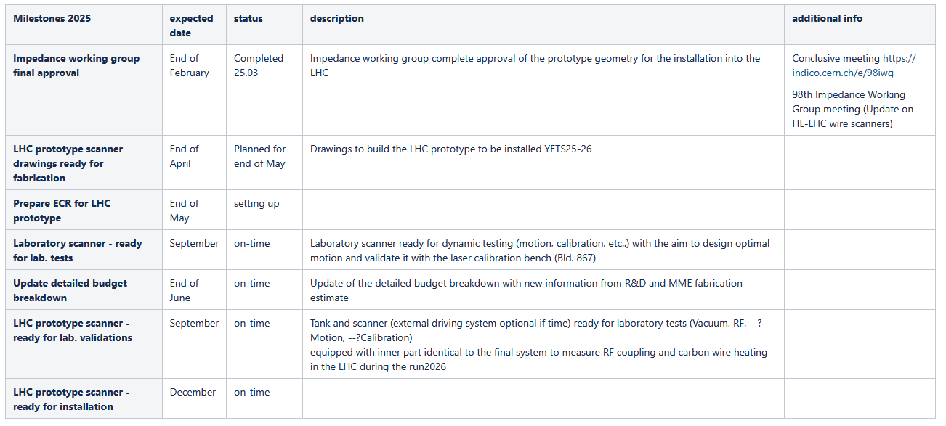
Milestones 2025
https://confluence.cern.ch/x/i6VJIw

Slide 6
On-going request for the installation YETS 25-26
Cablings:
copper for pick-up antenna
RQF3080062 - Cable installation, number of cables: 2, length: ~90m, LHC, YETS 25-26
Fiber optics for the optical encoder
RQF3080177 - Fiber Optics installation: LHC - YETS 25-26
=> Missing exact position (~2m upstream of Beam 1 tank?)
=> Fibres to be added to PLAN 12763 contribution from EN-EL / Optical fibers
=> https://plan.cern.ch/app/activity/12763
=> Who could make this change to the PLAN activity?
ECR:
- Do you have already all the information to start the document?

Slide 7
Investigations on the electrical connection
Jean is now investigating the design to propose a solution.
Flex or wires (with guiding system from Christophe) could be envisaged.
The optimum solution will be tested on the Laboratory scanner.
Next meeting for more details.

Slide 8
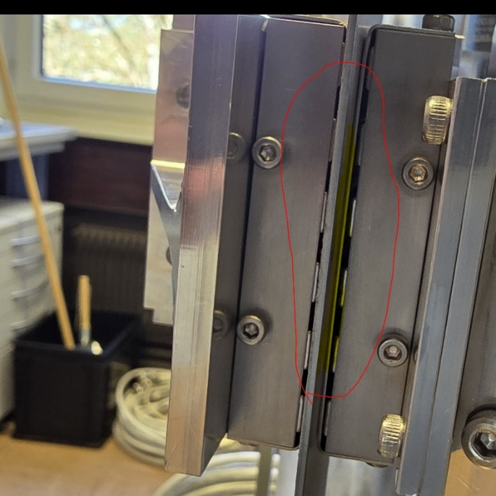
Test rig V3 status
Test Rig V3 (TR3) ceramic bearings broke during magnetic alignment
- Ceramic bearings too fragile for the forces at play with our magnetic system ?
- Magnetic parts alignments to be verified to minimize forces on the carriage ?
Move to stainless steel cage.
Impact on the interface with the rail (ceramic-stainless steel) & temperature cycling?
Bench being modified with these new parts.
Next :
- recommission of the system
- dynamic tests with new motion patterns (Marie)
- Move the TR3 to Bld. 867 to perform calibration with laser

Slide 9
Laser calibration bench for performance assessments of the test rig and laboratory scanner
Nabil studied the integration of the Test Rig V3 (TR3) on the laser calibration bench.
We can use the opposite side of the cutout – maybe the Hybrid+ tank can even stay
2 pieces to manufacture to hold the TR3 at the same height as Hybird+ beam center
Linear stages can be moved and realigned.
Calibration software ready for calibration of LIU type system
with RESOLVER and for optical ruler pre-process information.
Not sure we need the optical encoder analog signal
as in the LIU rotary calibration bench
=> This would require to integrate picoscopes into python code

Slide 10
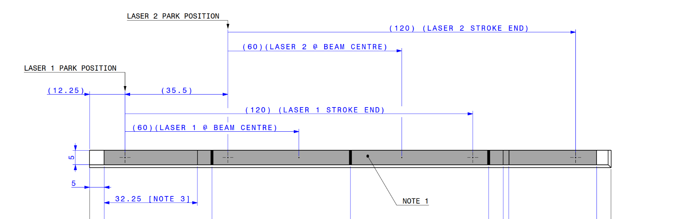
Optical encoder optimization
Selection of 2 reflective patterns compatible with existing lens head and distance:
1) 15um reflective pad 30um pitch. 2) 20um reflective pad, 40um pitch (~as rotary system)
Integration of absolute references markings to fit the existing acquisition and processing of this encoder.
This new configuration will require to have a calibration (from a bench or by calculation) for each laser head (1 & 2).
There will be markings to discover which laser head is connected to which acquisition channel. (missing feature on the rotary system)
See Harry’s presentation for details

Slide 11
Next planned activities
Lauch the fabrication of the LHC and LAB prototype
Launch the optical ruler fabrication
Operate the rig V3 to test:
new bearings, new motion trajectories, lifetime and prepare calibration with a laser
Work on the ECR & Budget cost breakdown update
(Should we already schedule a work meeting on these subjects?)
Prepare a proposal for the carbon wire signal routing using flex or wires.
Study how to integrate the optical rule on the linear motor bench for tests.
Technical board preparation (for the 5th June or 26th June ?):
- Wire scanner's magnetic drive oscillations (Jonathan & all)
- LHC prototype mechanical design review and RF simulation ?

