Slide 1

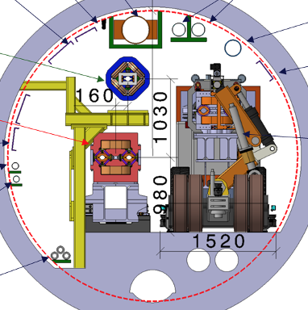

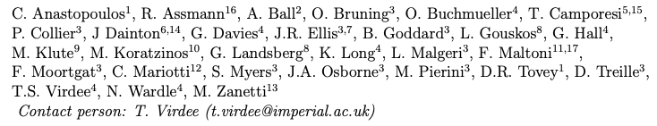
LEP3: A high luminosity electron-positron Higgs boson factory in the LHC tunnel
A possible back-up to the preferred option (FCC-ee and FCC-hh) for the next accelerator for CERN
Updated Version of the 10-page Document submitted recently.

Slide 2
Layout
Technical Parameters and status
R&D needs – same as for FCC-ee. Two are of particular relevance for LEP3 – high power fundamental power couplers, nested superconducting quadrupoles/sextupoles
Physics running scenarios: (centre-of-mass energies, luminosities, ..);
Resource requirements (capital cost for construction of the accelerator and the detectors)
Annual cost of operation at each stage, human resources;
Environmental impact (peak (MW) and integrated energy consumption 250 MW at ZH and 185 MW at Z, ~TWh during running.
CO₂ equivalent cost of construction – little construction is envisaged
Timeline (technically limited? Start data-taking ~ 5 years after HL-LHC stop; time for approval/feasibility? TDRs by mid-2030’s).
Physics potential - will be compared by Physics Preparatory Groups (PPG))
Acknowledgements.

Slide 3
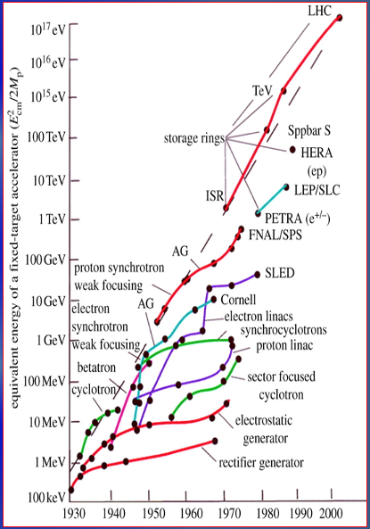
Possibilities for PP’s Future
We support FCC-ee and FCC-hh as the preferred option for CERN’s future
Longer-Term Aim in PP: an accelerator with constituent √s ~10 times higher than LHC (1-2 TeV).
If FCC(ee) or CEPC is built then a ~100 TeV hadron collider would be the obvious next step.
Muon colliders may provide alternative approach to reach constituent com energies of 10 TeV or higher. (This programme could have milestones along the way that would deliver physics as the R&D progresses - muon driven neutrino beams for experiments such as nuSTORM or those on neutrino/antineutrino factories.)

Slide 4
Setting the Scene 1: 2019 ESPP
Recall Recommendations 2019 ESPP
The successful completion of the HL-LHC
Neutrino Platform
An electron-positron Higgs factory is the highest-priority next collider.
R&D effort focused on advanced accelerator technologies, in particular that for high-field superconducting magnets, including high-temperature superconductors
investigate the technical and financial feasibility of a future hadron collider at CERN with √s ~ 100 TeV and with an e⁺e⁻ Higgs and electroweak factory as a possible first stage.
Point e. clearly points to the FCC project, which has been extensively discussed.
Notes:
At the Large Hadron Collider (LHC) at CERN, Geneva we can probe Nature moments after the Big Bang to tackle the questions about the origin, evolution and composition of our universe. These include: What is the origin of mass? What constitutes dark matter? How many dimensions of space and time do we live in? Why is the universe composed of matter and not antimatter? The answers have the potential of altering our perception of how Nature operates at the fundamental level.
The discovery in July 2012 of the Higgs boson at the Large Hadron Collider (LHC), one of the most important of this new century, completes the particle content of the standard model (SM) of particle physics, a theory that describes our visible universe in exquisite detail.
This talk will briefly look into the evolution of our universe from the Big Bang, the fundamental particles and their interactions, the journey to the discovery of the Higgs boson, and look ahead. The CMS experiment is used as an example to briefly recall the physics of the LHC, outline some of the challenges faced during its construction, and major physics results produced so far, including the searches for widely anticipated new physics beyond the SM.

Slide 5
Setting the Scene 2: Request for Alternatives
We support FCC-ee and FCC-hh as the preferred option for CERN’s future, as it addresses both of ESPP2019 recommendations (c) and (e).
ESG Guidance
However, the ESG's remit explicitly states that “The Strategy update should include the preferred option for the next collider at CERN and prioritised alternative options to be pursued if the chosen preferred plan turns out not to be feasible or competitive”.
It is imperative that the European HEP community should provide explicit feedback on both the preferred and alternative options for this “next collider at CERN”, which will be the Laboratory's next flagship project, and an explanation of any specific prioritisation.
Notes:
At the Large Hadron Collider (LHC) at CERN, Geneva we can probe Nature moments after the Big Bang to tackle the questions about the origin, evolution and composition of our universe. These include: What is the origin of mass? What constitutes dark matter? How many dimensions of space and time do we live in? Why is the universe composed of matter and not antimatter? The answers have the potential of altering our perception of how Nature operates at the fundamental level.
The discovery in July 2012 of the Higgs boson at the Large Hadron Collider (LHC), one of the most important of this new century, completes the particle content of the standard model (SM) of particle physics, a theory that describes our visible universe in exquisite detail.
This talk will briefly look into the evolution of our universe from the Big Bang, the fundamental particles and their interactions, the journey to the discovery of the Higgs boson, and look ahead. The CMS experiment is used as an example to briefly recall the physics of the LHC, outline some of the challenges faced during its construction, and major physics results produced so far, including the searches for widely anticipated new physics beyond the SM.

Slide 6
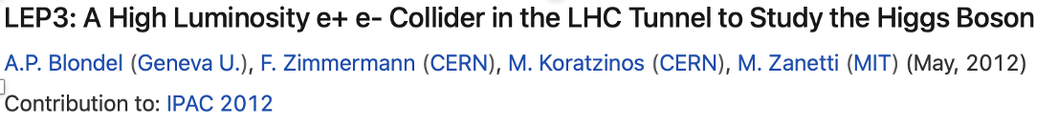
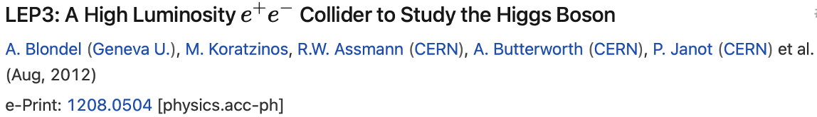
Setting the Scene 3
It is desirable that any back-up to FCC should present fewer technical and/or financial difficulties than those associated with this preferred option, as well as have excellent physics potential.
To minimize the possibility of such difficulties, the LEP3 strategy is to re-use, as much as possible, the existing infrastructure of CERN, utilise maximally the R&D already carried out, and keep the required financing within the envelope of the current budget of CERN.
Corollary: Any other proposal, with a cost similar to the one for FCC, would have similar issues.
Several others have also discussed such a possibility in the past.
e.g. 2013 ESPP, a Higgs factory (LEP3) was proposed but not pursued any further. [https://cds.cern.ch/record/1471486].
Notes:
At the Large Hadron Collider (LHC) at CERN, Geneva we can probe Nature moments after the Big Bang to tackle the questions about the origin, evolution and composition of our universe. These include: What is the origin of mass? What constitutes dark matter? How many dimensions of space and time do we live in? Why is the universe composed of matter and not antimatter? The answers have the potential of altering our perception of how Nature operates at the fundamental level.
The discovery in July 2012 of the Higgs boson at the Large Hadron Collider (LHC), one of the most important of this new century, completes the particle content of the standard model (SM) of particle physics, a theory that describes our visible universe in exquisite detail.
This talk will briefly look into the evolution of our universe from the Big Bang, the fundamental particles and their interactions, the journey to the discovery of the Higgs boson, and look ahead. The CMS experiment is used as an example to briefly recall the physics of the LHC, outline some of the challenges faced during its construction, and major physics results produced so far, including the searches for widely anticipated new physics beyond the SM.

Slide 7
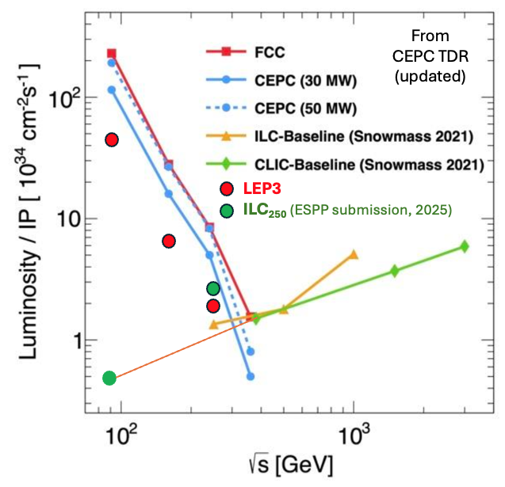
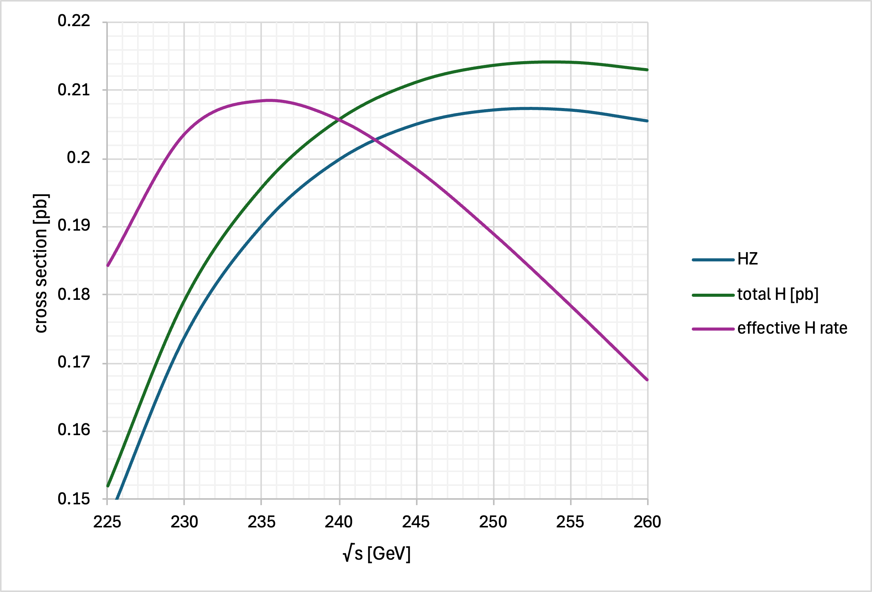
e⁺e⁻ Colliders: Instantaneous Luminosity
In circular e+e- colliders, for the same synchrotron power loss, at a lower energy, more current can be put to increase luminosity.
LEP3: Run at √s =230 GeV
Only 10% higher energy than LEP.
18% lower synchrotron power loss at √s=230 GeV compared with 240 GeV.

Slide 8
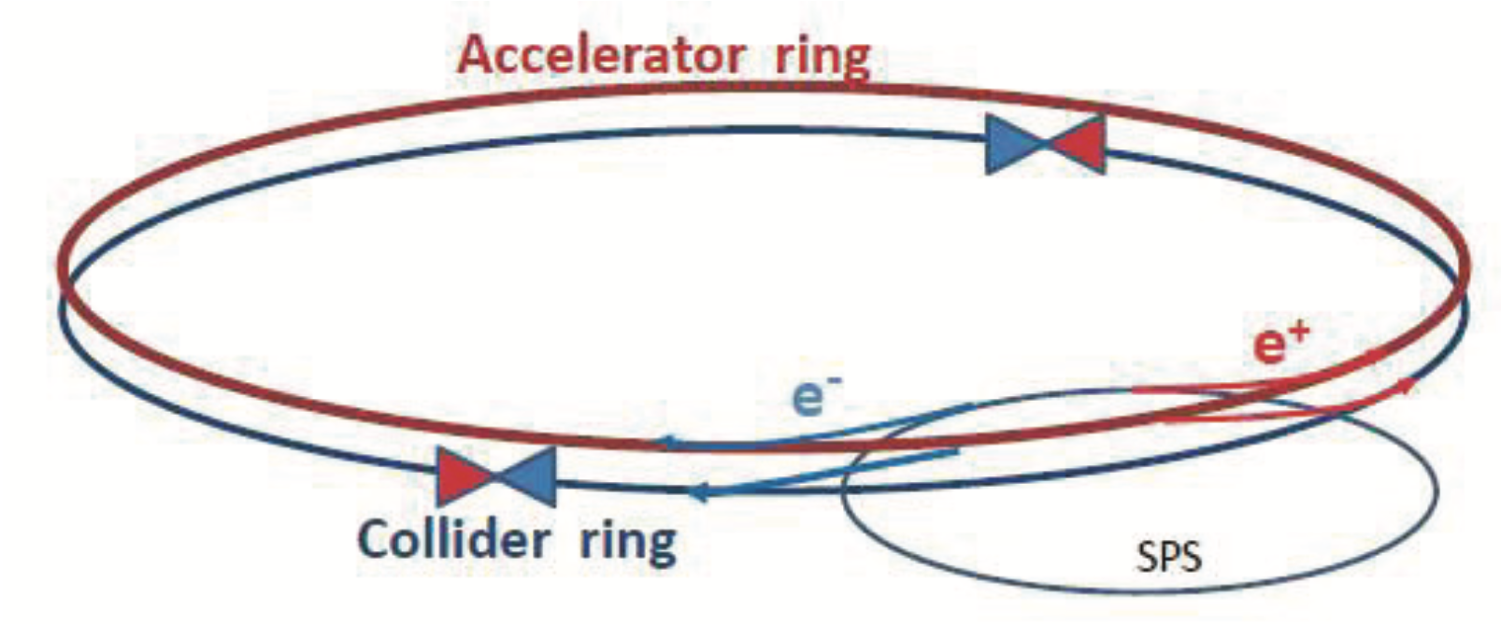
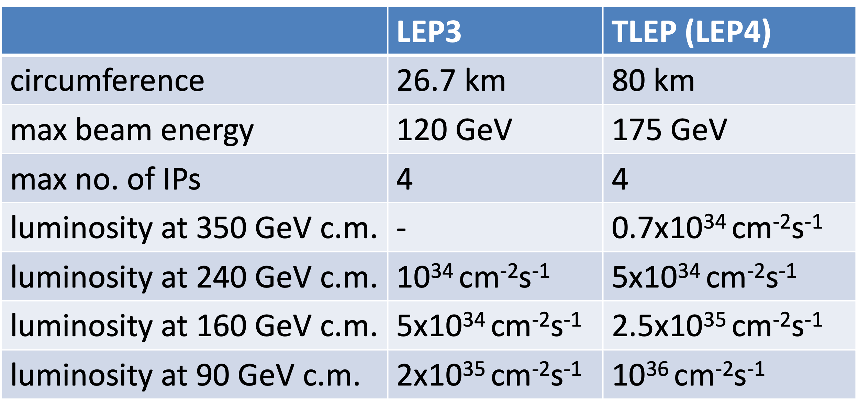
Follow ESPP2013 proposal & FCC(ee) Design
LEP3 installed in the existing LHC/LEP tunnel
Design of LEP3 could follow closely that outlined in FCC MTR and [ESPP 2013: https://cds.cern.ch/record/1471486].
Separate full energy collider and accelerator (booster) rings, the latter for top-up injection. Electrons and positrons in the collider ring travel in separate beam pipes.
With top-up - beam lifetime ~ 15 minutes (expected to be dominated by loss due radiative Bhabhas) top up ~ few 10¹⁰ electron/s
Earlier work (2013)
Note ratio of Lumi (1/5)

Slide 9
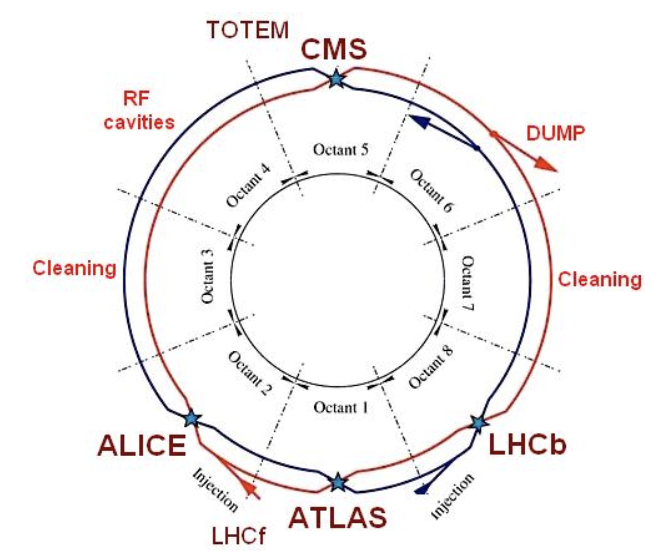
LEP3
The arcs are 2.45-km long, and the straight sections are 545-m long. The inner diameter of the tunnel varies between 3.8m in the arcs and ~ 4.4 m in the straight sections.
RF in even number LSS ( two LSS for the collider, two LSS for the booster)
Either deploy two new experiment or use re-purposed ATLAS and CMS experiments

Slide 10
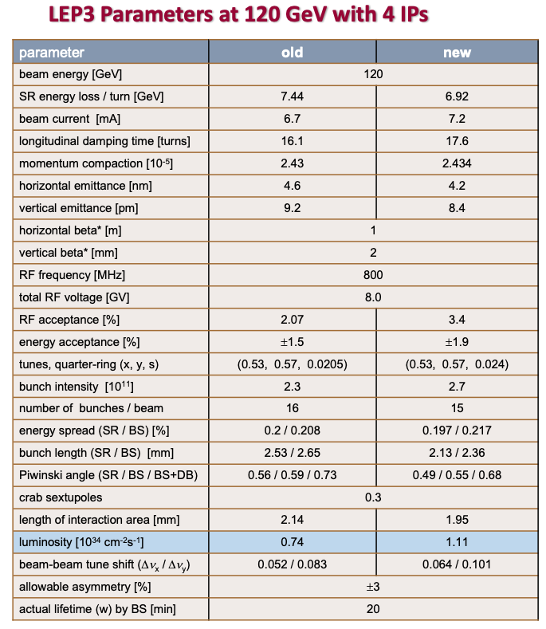
LEP3 Principal Parameters
parameter | Z | HZ
beam energy [GeV] | 45.6 | 120
SR energy loss / turn [GeV] | 0.144 | 6.92
beam current [mA] | 346 | 7.2
longitudinal damping time [turns] | 316 | 17.6
momentum compaction [10⁻⁵] | 2.43 | 2.43
horizontal emittance [nm] | 0.61 | 4.2
vertical emittance [pm] | 1.4 | 8.4
horizontal beta* [m] | 0.5 | 1
vertical beta* [mm] | 1 | 2
RF frequency [MHz] | 800 | 800
total RF voltage [GV] | 0.2 | 8.0
RF acceptance [%] | 1.5 | 3.4
energy acceptance [%] | ±1.2 | ±1.9
tunes, quarter-ring (x, y, s) | (0.56, 0.59, 0.0072) | (0.53, 0.57, 0.024)
bunch intensity [10¹¹] | 0.8 | 2.7
number of bunches / beam | 2400 | 15
energy spread (SR / BS) [%] | 0.075 / 0.099 | 0.197 / 0.217
bunch length (SR / BS) [mm] | 2.67 / 3.58 | 2.13 / 2.36
Piwinski angle (SR / BS / BS+DB) | 2.3 / 3.1 / 3.4 | 0.49 / 0.55 / 0.68
crab sextupoles | 0.8 | 0.3
length of interaction area [mm] | 1.0 | 1.95
luminosity [10³⁴ cm⁻²s⁻¹] | 52 | 1.11
beam-beam tune shift (Δν_{x} / Δν_{y}) | 0.044 / 0.126 | 0.064 / 0.101
allowable asymmetry [%] | ±5 | ±3
actual lifetime (w) by BS [min] | defined by vertical aperture | 20
2017 Study with lattice proposed by K Oide
https://indico.cern.ch/event/687994/
5.83
1.5 2Xpts 230GeV

Slide 11
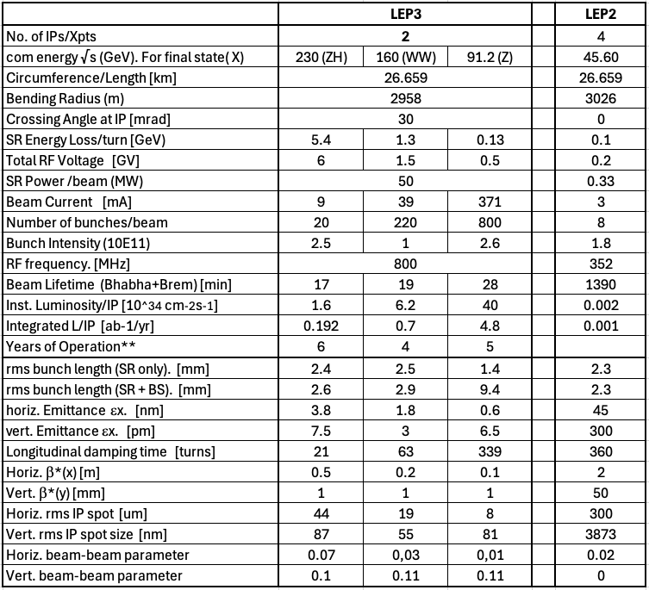
LEP3 Principal Parameters
Updated Table: Our List of Parameters

Slide 12
LEP3 Principal Parameters Abstracted
No. of IPs 2
Highest c.o.m. energy 230 GeV
SR power loss Fix at 50 MW
SR energy loss/turn ~ 5.4 GeV
Total rf Voltage ~ 6 GV (800 MHz, 20MV/m SCRF cavities)
Inst Luminosity ~ 1.6, 6.2, 40 10³⁴ cm⁻²s⁻¹ at 230 GeV, WW threshold and Z- pole resp.
Crossing angle 30 mrad
Running Scenario ~ 20 years programme
e.g. 6 yrs at 230 GeV, 4 years around WW, 5 years around Z
Est. total no. of Events 4.2 x10⁵ H, (cf. 6/22 x10⁵H for ILC₂₅₀/FCC-ee resp.)
1.7 x 10⁷ WW at 163 GeV,
1.7 x 10¹² Z at 91.2 GeV (cf. 0.001, 6.10¹²H for ILC₂₅₀ and FCC-ee)
Running time: 185 days of operation at 75% efficiency, with top-up running, giving 1.2 10⁷ s/year of running
LEP3 can be competitive with alternatives wrt Higgs and E-W physics

Slide 13
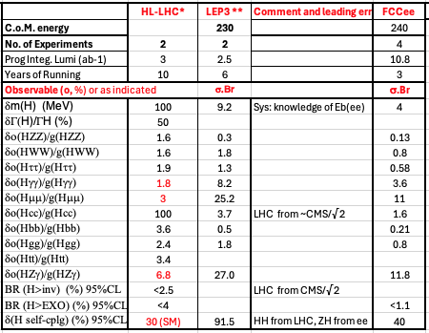
Higgs boson physics
Preliminary
To be checked and updated
LEP3 can be competitive with other alternatives
LEP3 ~ 4.2x10⁵ H bosons (6 yrs 2 expts) cf FCC(ee) ~2.2 × 10⁶ (3 yrs 4 expts)

Slide 14
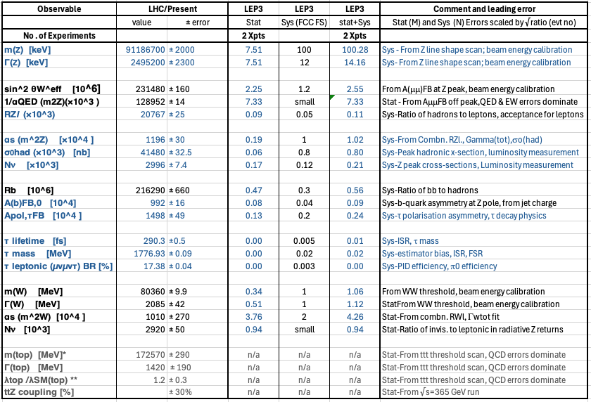
E-W physics
~1.7x10¹² Z bosons (over 6 yrs at/around 91.2 GeV),
and ~ 3.6×10⁷ WW pairs (over 4 yrs at/around √s=163 GeV)
cf FCC(ee) ~6 × 10¹² and ~1.5 × 10⁸ resp.
Preliminary
To be checked and updated

Slide 15
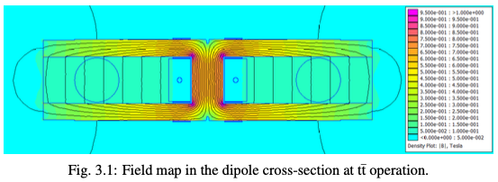
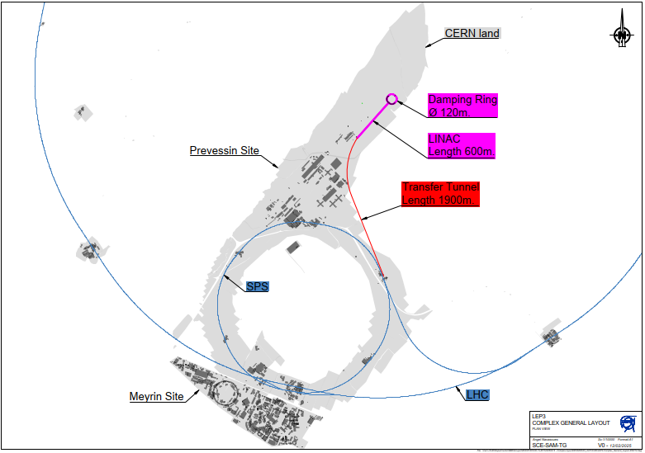
Choice of Components: Dipole Magnets & Injector
Follow FCC(ee) design
Instantaneous Luminosity [CEPC or FCC(ee) / LEP3] ~5; ~ 1.6×10³⁴ cm⁻²s⁻¹ per IP
2 new Experiments but could reuse existing ATLAS and CMS experiments, suitably modified.
Use FCC designs
for magnets
Dedicated linac injector on Prevessin site
as per FCC MTR;
Injection energy lowered from 20 to 10 GeV.
(Sensitive to field quality of bending magnets
at injection.)
FCC Feasibility Study

Slide 16
Choice of Components: RF System
RF: Energy loss/turn @ √s=230 GeV: 5.4 GeV.
  A total 6.0 GV to be installed, with the same margin as FCCee
  As overall cost is dominated by the cost of the RF system (>1.5 BCHF), it is under intense study by CERN’s RF Group.
Current thoughts:
For Z running: Use 800MHz 1-cell cavities/CRM. The beam current is too high to use 800 MHz multi-cell cavities. Separate cavities for electrons and positrons. Reuse the power couplers for WW and ZH running (a costly item)
For WW and ZH running, and booster: use 800 MHz 4-cell sc bulk niobium cavities run at 2K. One set for the booster (accelerator) and one set for the collider, one set in each of two LSS. The two colliding beams share RF.

Slide 17
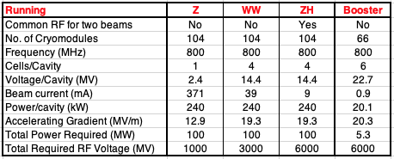
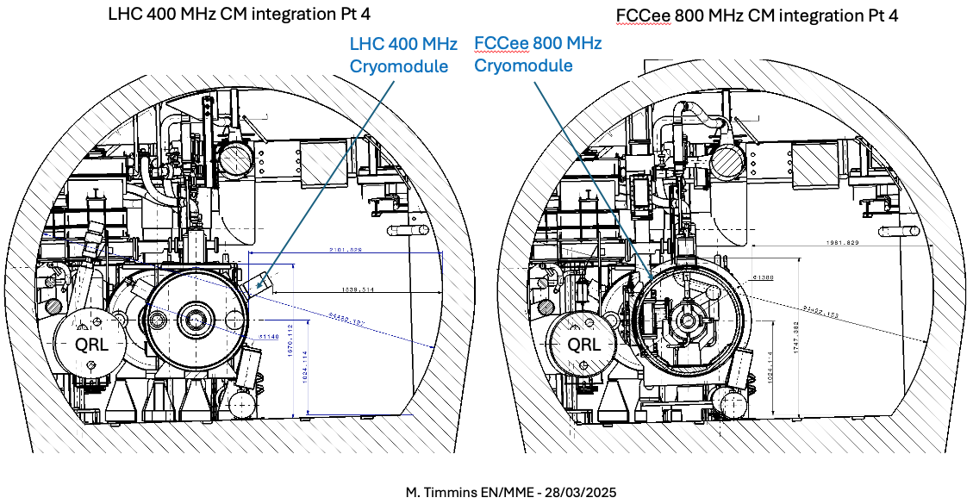
Choice of Components: RF System

Slide 18
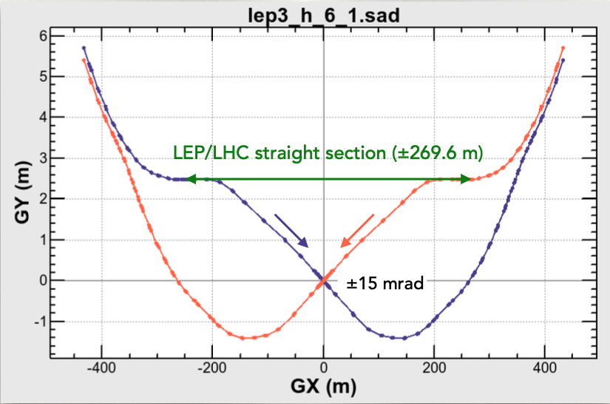
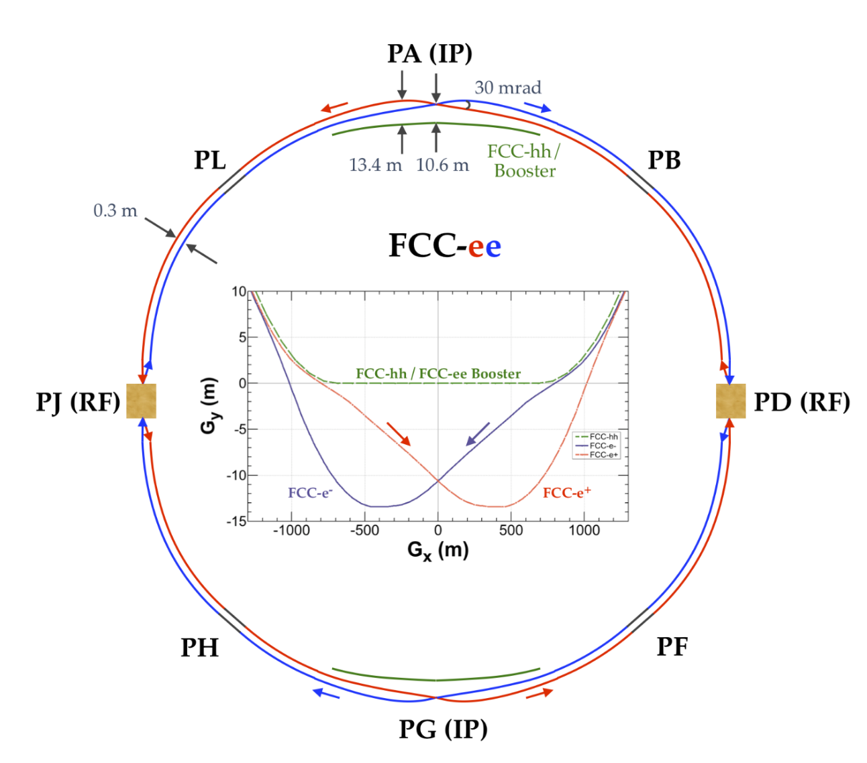
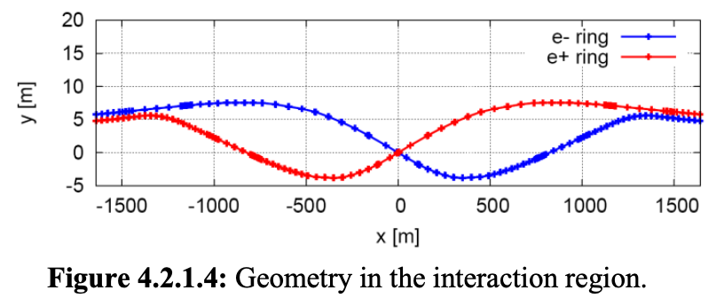
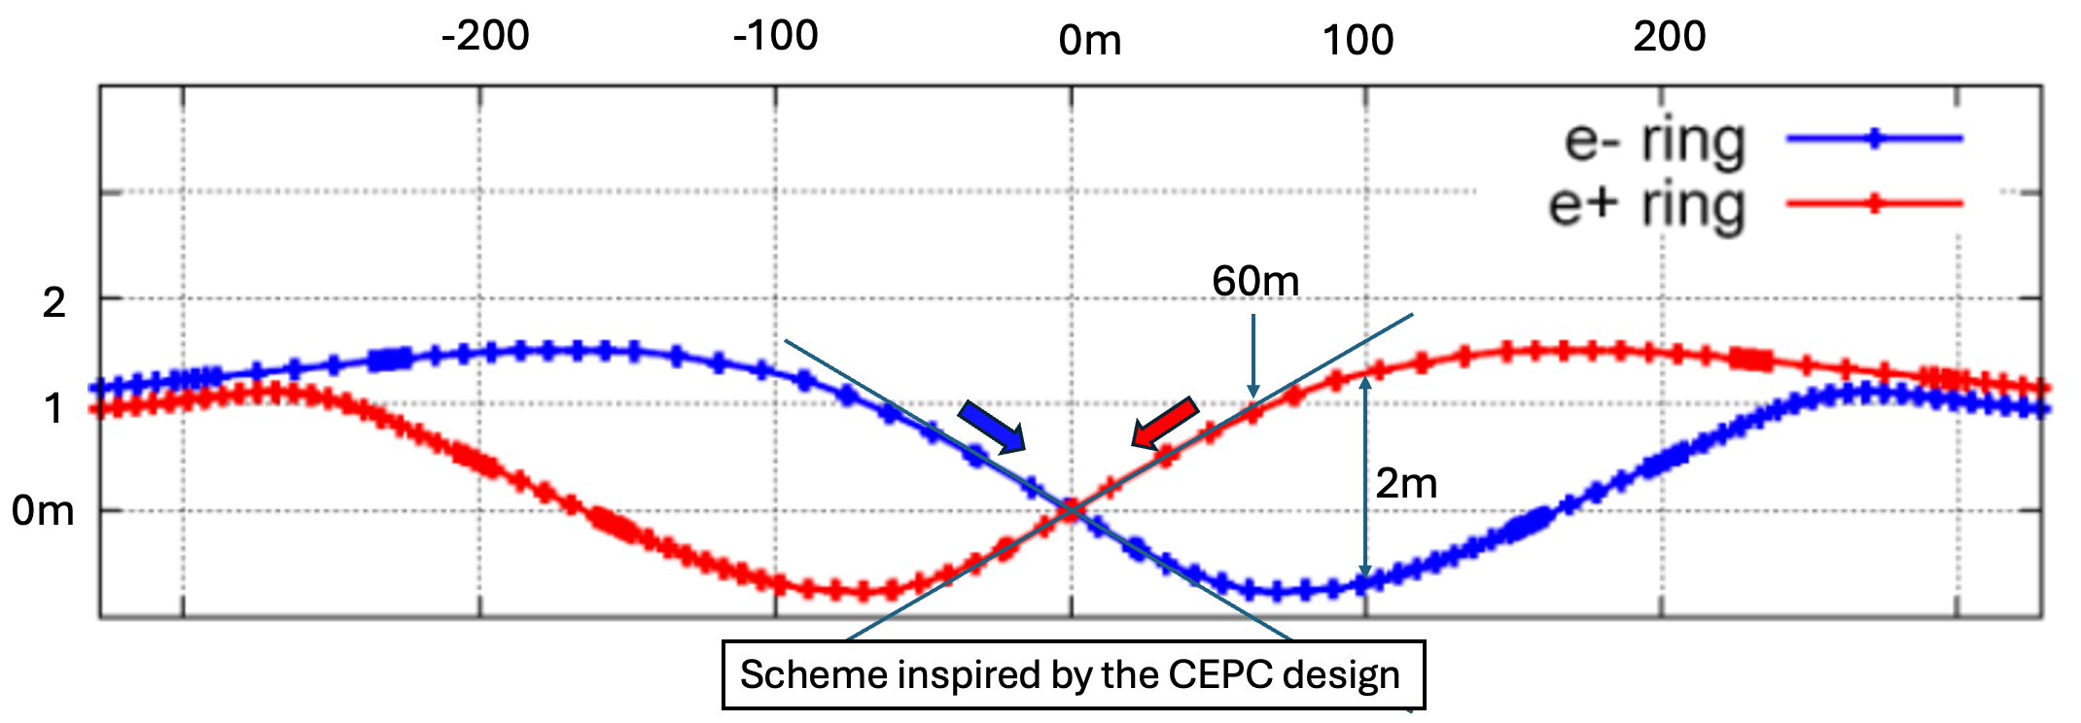
Crossing Angle
LEP3
CEPC
CEPC: No bending magnets placed in straight section within 70m of the collision points.
CEPC-> LEP3

Slide 19
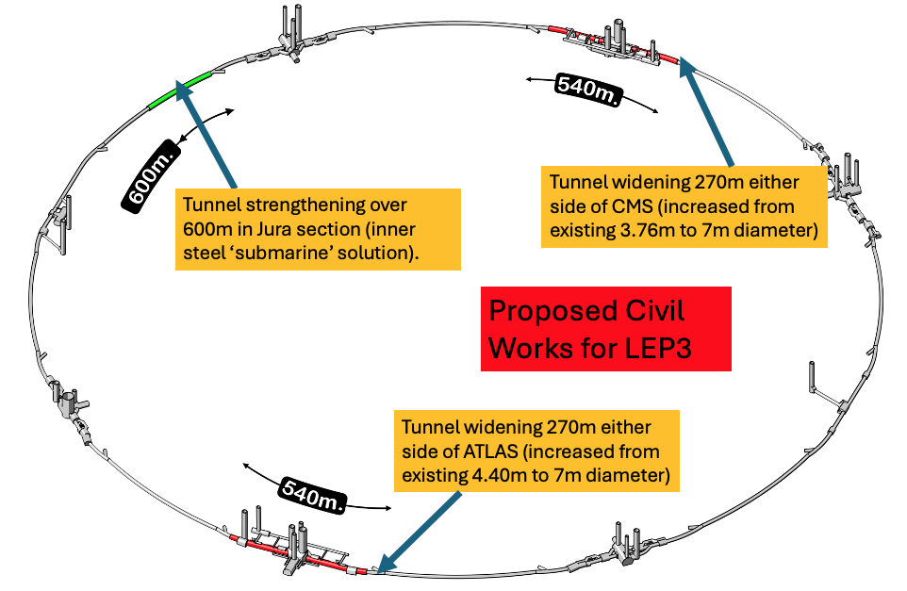
Cvil Engineering
  40 years old infrastructure, some parts need maintainance
  High lumi acheived by crab-waist → large xing-angle → need to widen the LSS cross section on either side of the experiments
  possibly need of by-passes (avoidable possibly not needed)
  Overall civil engineering cost estimated: 165 MCHF

Slide 20
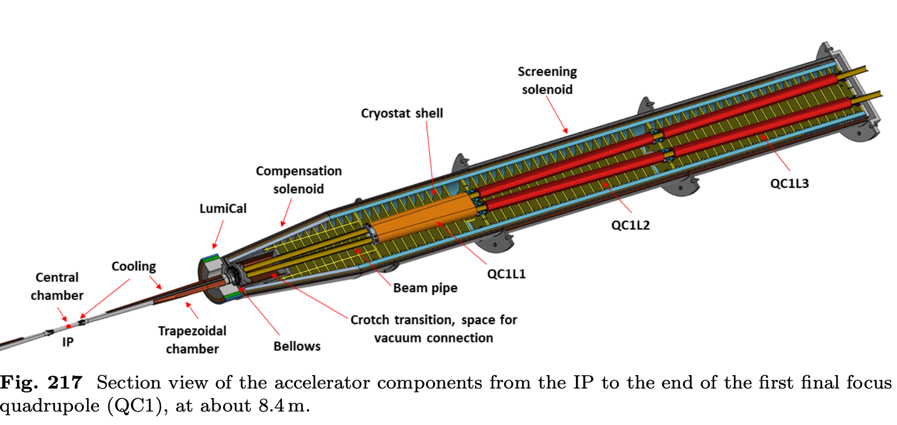
Experiments-Machine Detector Interface
Assume that the ATLAS and CMS experiments can be re-used with suitable modifcation or rebuilding of the inner trackers and the integration of focusing quadrupoles some 2m from the IP. Same magnets but at lower fields. Trackers costing around MCHF 100/per experiment are assumed. (Should save the community >1BCHF)
Exploit all R&D done for ILC, CLIC and FCC(ee) detectors as well as LHC upgrades.
Baseline: Accelerator(booster) beam passes through tracker. If too much of perturbation then need bypasses.
All of the above need detailed studies.
From FCC MTR: Integration of IR optics. Independent beam pipes ~ 1-2m from IP.

Slide 21
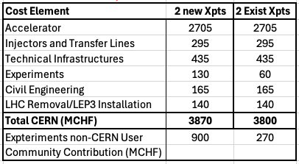
Cost
Use the FCCee costing methodology.
Costs mostly scaled from FCC(ee) MTR costs: scaled according to numbers of components required. RF costs from CERN-RF Group.
With assumed schedule (see next) LEP3 cost could be paid for before startup within the standard CERN budget, allowing pursuit of other future-oriented initiatives [e.g. R&D on rf cavities (high gradient, low power), power couplers, nested sc quads/sextupoles, high-field magnets, muon collider demonstrator]
Cost: assumes careful removal of LHC machine in case it is needed later as an injector.
Sustainability is an important issue: use ideas/proposals from the other projects

Slide 22
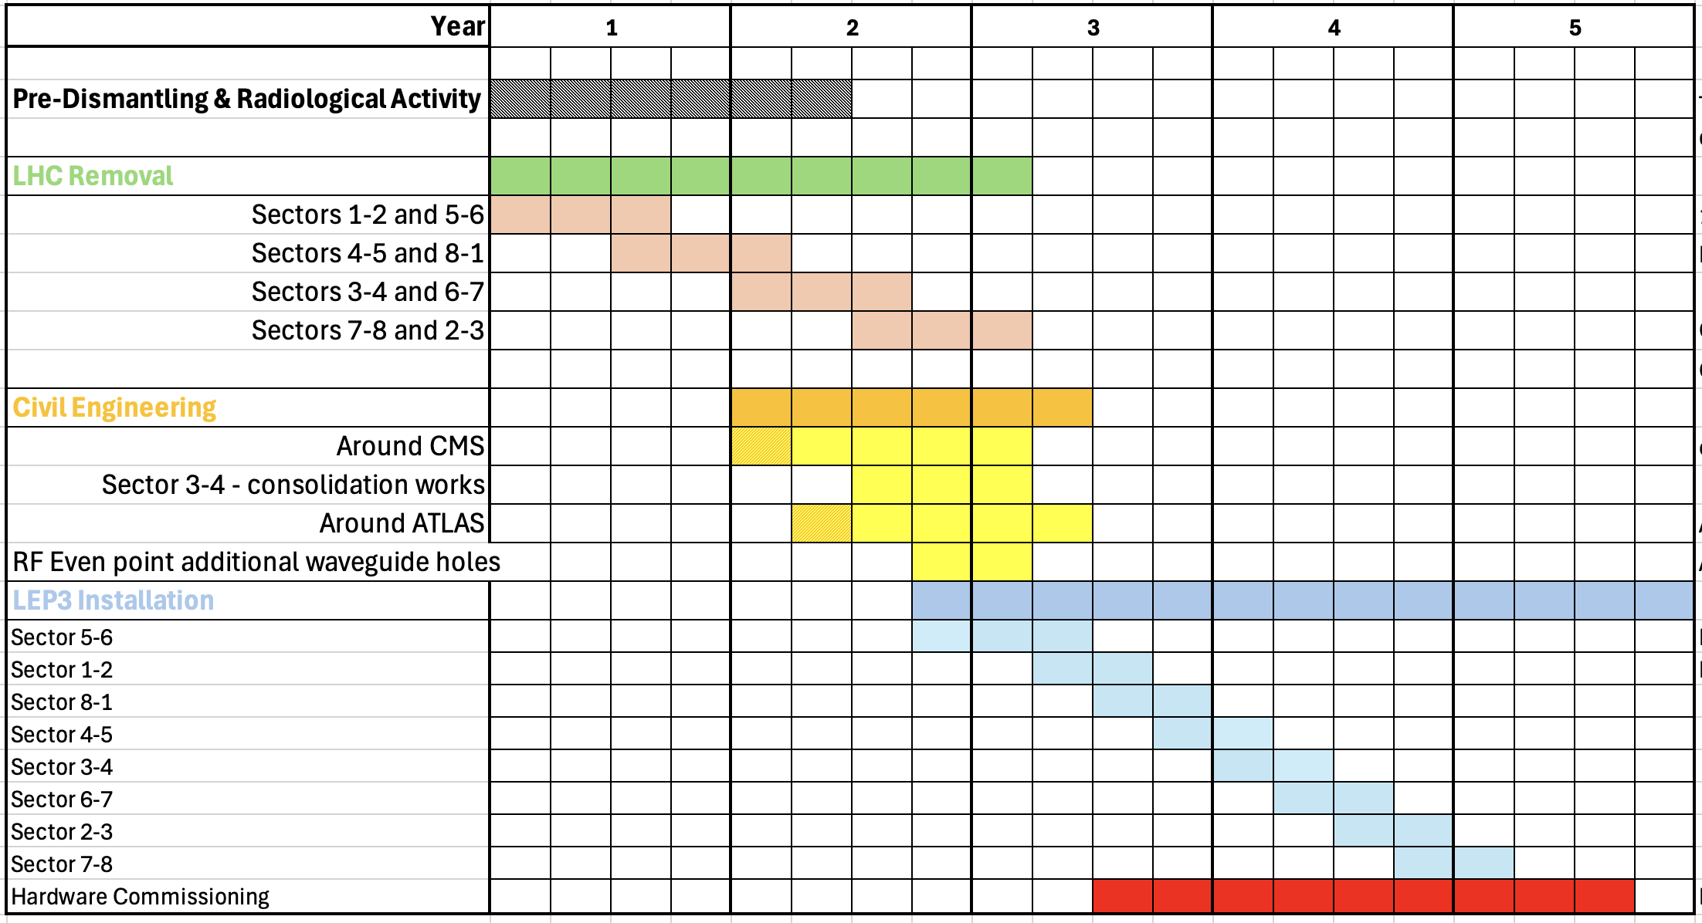
Example Shutdown Schedule: After LHC stops

Slide 23
Power Consumption
We estimate that the total power consumption at the highest LEP3
energy will be about 225 MW, and about 185 MW at the Z pole.
Usage of high-temperature superconducting arc quadrupoles and sextupoles (HTS) magnets would help keeping low these
figures.
Assume the same klystron efficiency as FCC
Assume superconducting quads and sextupoles, making full use of the LHC cryogenic line in place

Slide 24
Possibilities: The Future Beyond LEP3
Aim: an accelerator with constituent √s ~10 times higher than LHC (1-2 TeV).
If FCC(ee) or CEPC is built then a ~100 TeV hadron collider would be the obvious next step.
R&D Goal: Develop high field magnets - followed by the setting up for industrial production to provide solid cost estimates.
Muon colliders may provide alternative approach to reach constituent com energies of 10 TeV or higher. R&D Goal: on muon colliders – programme could have milestones along the way that would deliver physics as the R&D progresses - muon driven neutrino beams for experiments such as nuSTORM or those on neutrino/antineutrino factories.
-If FCC-ee proceeds, then the required tunnel would already exist.
However, if FCC-ee does not proceed, the FCC-hh tunnel could also be dug later, profiting from the site studies currently underway, and giving due time for magnet development and industrialization.
-If it turns out that the muon collider is the preferred path, the required tunnel would be smaller than even the LEP/LHC tunnel, which could host an intermediate/injector ring.
-After LEP3 (i.e. after around 30 years from today) perhaps via a worldwide strategy.

Slide 25
Synergies (Later talks)
LEPZ - A Future Use of the LHC Tunnel
M.Drewes, E. and M. Shaposhnikov
Includes a Z factory similar to LEP3 Z running.
LHeC: The Large Hadron electron Collider (LHeC) as a bridge project for CERN
J. d’Hondt et al.
See later talk by Oliver Bruning
The Muon Collider
D. Schulte et al
See later talk by D. Schulte

Slide 26
Summary
We support (FCC-ee + FCC-hh) as the preferred option for CERN’s future
ESPP requests an alternative/ backup option for the preferred one.
An e⁺e⁻ collider in the LHC tunnel, referred to here as LEP3, is proposed as an a backup option
Compared to the linear e⁺e⁻ colliders proposed, LEP3 provides similar luminosity for ZH production, higher luminosity at lower energies and options for multiple experiments, all at much lower cost.
LEP3 is a reasonable (perhaps the best) backup option
Leaves room (time, budget, resources) for further development of THE machine that can probe directly the energy frontier at a constituent √s ~ 10 times LHC.
No showstoppers have yet been identified, and we consider this proposal to be sufficiently interesting to deserve further study. We have identified important areas that would require deeper investigation before CERN could commit to LEP3.

