Slide 1
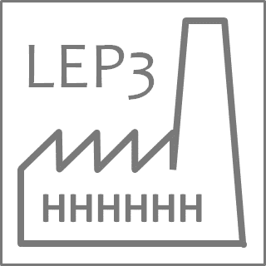
LEP3 parameters and other topics
LEP3 day,
28/5/2025
M. Koratzinos

Slide 2
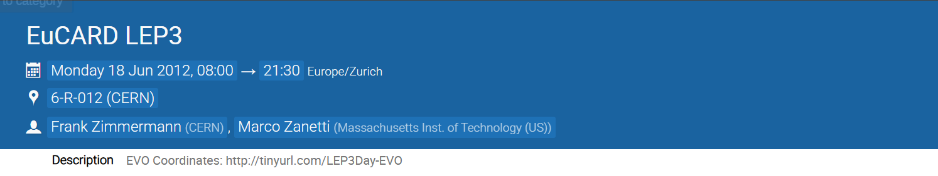
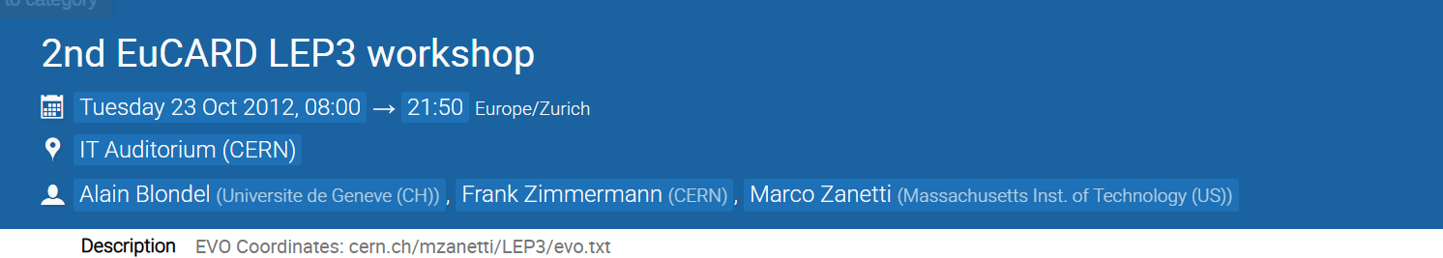
History
LEP3 is not a new idea…
This is actually the third LEP3 day held at CERN and the 6th indico event…
…so after 13 years, we are making a comeback!

Slide 3
Strategic choices of LEP3
Reuse the LHC tunnel
Utilize most of the FCC-ee work done so far
Have two experiments, most probably re-purpose ATLAS and CMS (for four experiments: pay for four, get performance from three)
Reduce the ZH energy to 115GeV per beam
Use nested HTS magnets operated at 40K (gain in performance and reduce power consumption)
Give up running at the ttbar threshold

Slide 4
The big picture
LEP3 is very similar to FCC-ee, only a factor 3.4 smaller. We can use the work already carried out at FCC on optics, RF, etc.
First number to decide is beam energy: we have chosen 115GeV per beam, lower than FCC
What luminosity performance should we expect? To first order, luminosity is directly proportional to the bending radius for the same SR power consumption, beam-beam parameter and beam energy (see further)
FCC-ee for two experiments reaches a luminosity of ~7.5E34 at 120GeV for 4 experiments (latest numbers). This would mean a luminosity of 8.6 for 2 experiments
Therefore, the LEP3 luminosity achievable for 2 experiments would be 2.5E34 at 240GeV.
Going to 230GeV this number should become 2.9E34

Slide 5
LEP3 studies
Early studies were agnostic re the size of the ring.
FCC finally focused on a 91 km design
An attempt was made in 2017 to transfer the FCC knowledge to a LEP3 lattice
This was never given high priority and an optics design needs to be redone to obtain solid results.
The study, suitably updated for the new beam energy and packing factor (nesting a quads and sextupoles) gives a luminosity of 1.6E34 at 230GeV and two experiments.
A new, low emittance lattice would push the luminosity to beyond 2.5E34

Slide 6
Higgs rate

Slide 7
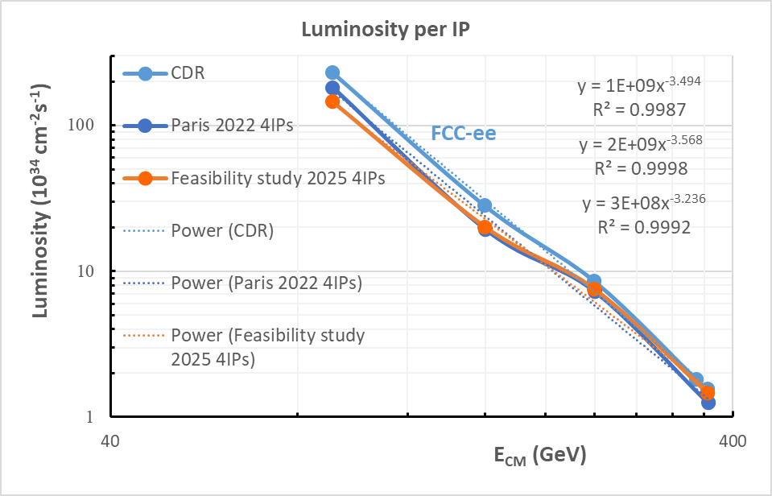
FCC luminosities
Power law varies between -3.6 and -3.2. Latest is -3.2
Empirical formula from FCC suggests that luminosity drops a bit more steeply than the expected E_{beam}⁻³

Slide 8
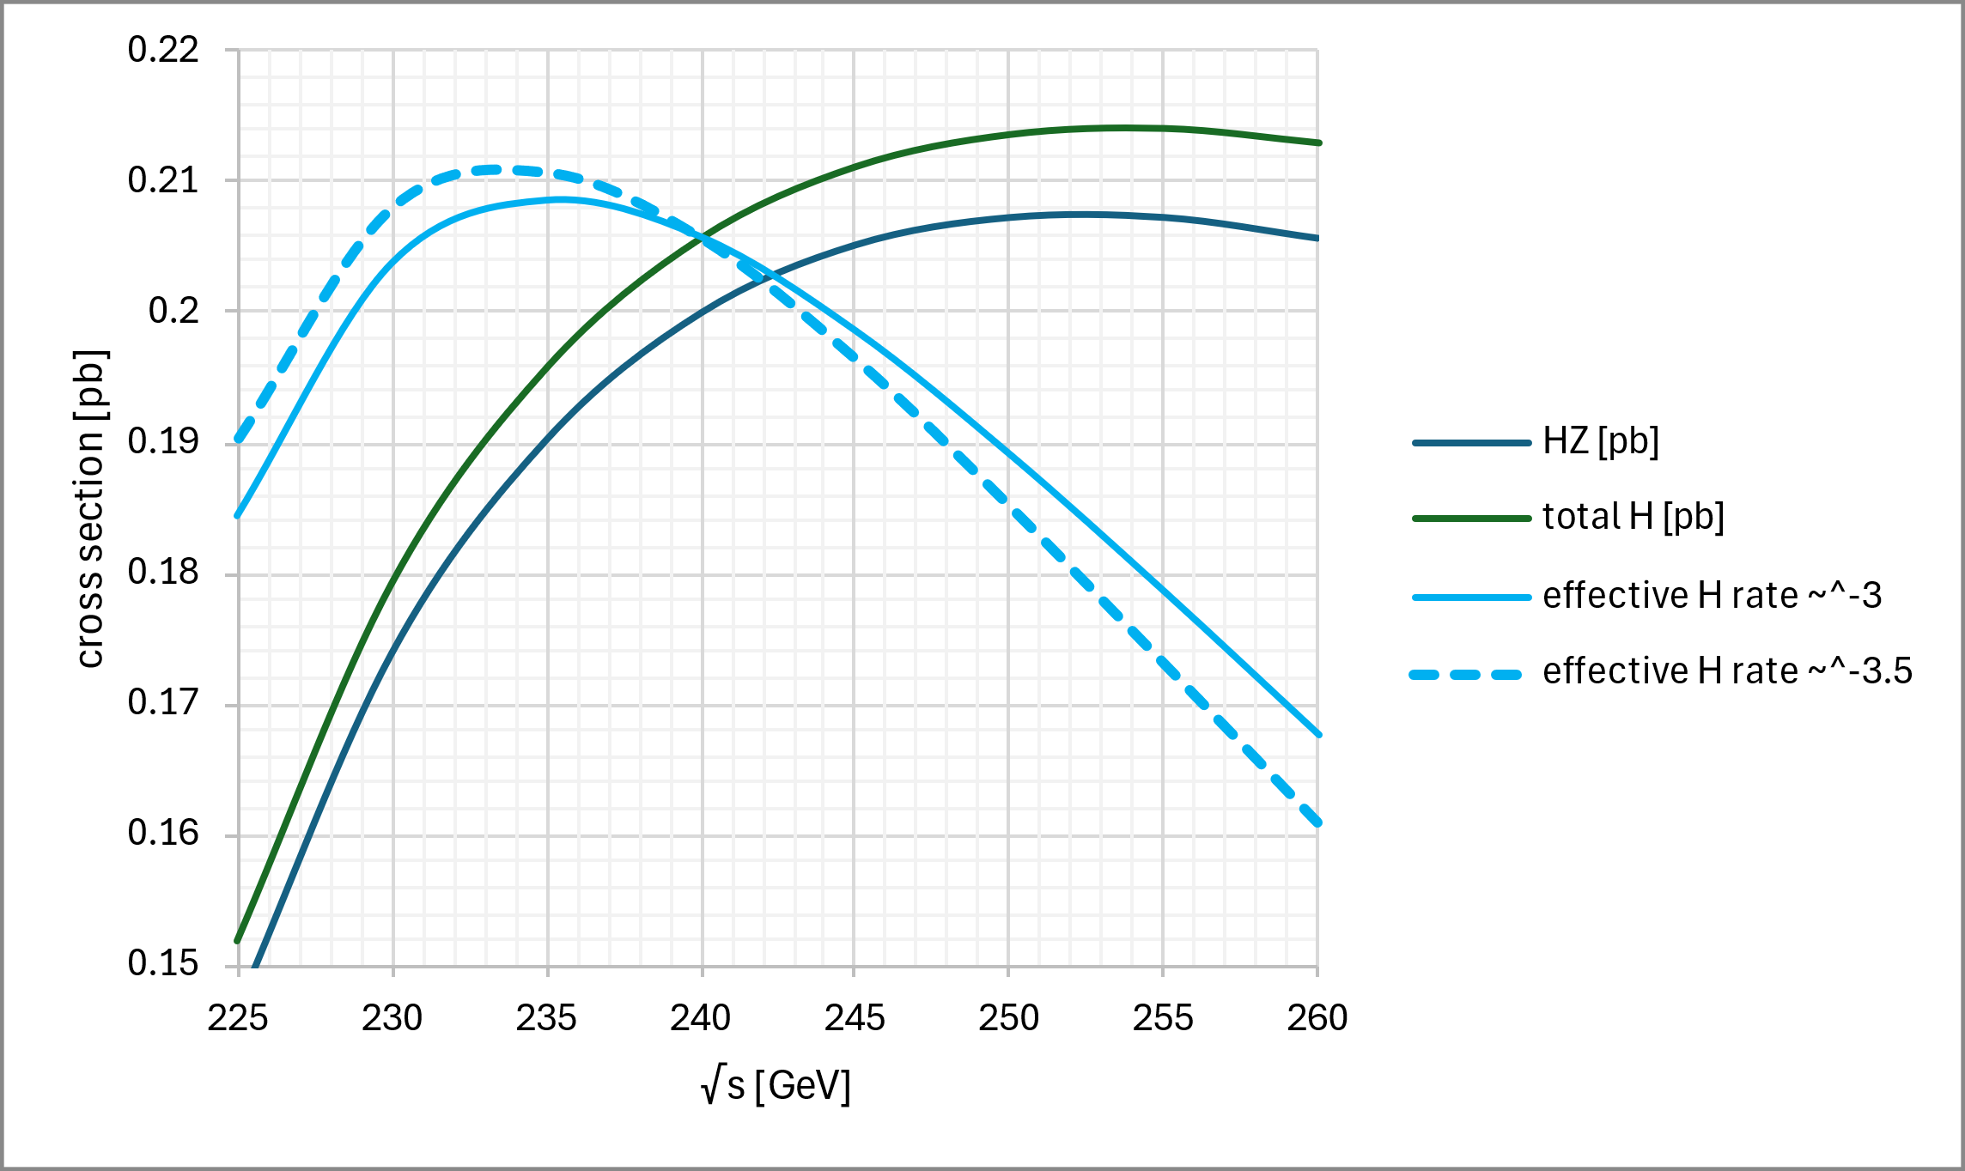
Higgs effective rate
In a circular collider, the maximum Higgs rate is not at maximum cross section!
To first order, we expect a power law of E_{beam}⁻³.
If we do the best fit to FCC luminosities over the range 45-182.5GeV, we get a power law of E_{beam}^{-3.6} to E_{beam}^{-3.2}
Power law of -3: maximum at 236GeV. At 230GeV we are 2.2% lower than max
Power law -3.5: maximum rate at 233GeV. At 230GeV we are 1.4% lower than max
Choose beam energy of 115GeV

Slide 9
luminosity

Slide 10

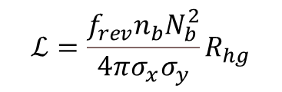
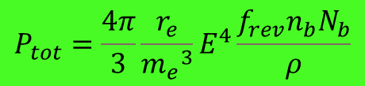
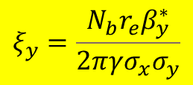
Luminosity of circular colliders
The usual luminosity formula is this:
$$ℒ=\frac{f_{rev}n_{b}N_{b}^{2}}{4πσ_{x}σ_{y}}R_{hg}$$
$$ξ_{y}=\frac{{N_{b}r}_{e}β_{y}^{∗}}{2πγσ_{x}σ_{y}}$$
$$P_{tot}=\frac{4π}{3}\frac{r_{e}}{{m_{e}}^{3}}E^{4}\frac{f_{rev}n_{b}N_{b}}{ρ}$$
This is not very informative as to what luminosities might be achievable. But if we express the above formula in terms of 1/ total synchrotron radiation power and 2/vertical beam-beam parameter we get:
$$ℒ=const×P_{tot} \frac{ρ}{{E_{0}}^{3}}ξ_{y}\frac{R_{hg}}{β_{y}^{∗}}$$
The vertical beam-beam parameter (or tune shift) is a measure of disruption of the colliding beams and in a variety of accelerators can take a maximum value of ~0.1 to ~0.13
https://cds.cern.ch/record/1757596/files/CERN-ACC-NOTE-2014-0066.pdf

Slide 11
Luminosity of circular colliders (2)
In natural units, the achievable luminosity is:
$$ℒ={6.0×10}^{34}\left(\frac{P_{tot}}{50MW}\right)\left(\frac{ρ}{10km}\right){\left(\frac{120GeV}{E_{0}}\right)}^{3}\left(\frac{ξ_{y}}{0.1}\right)\left(\frac{R_{hg}}{0.84}\right){\left(\frac{1mm}{β_{y}^{∗}}\right)cm}^{−2}s^{−1}$$
Note that the above formula does not tell you how to design your collider; simply gives you the maximum performance. You need to design the optics so that your beam lifetimes are sufficient

Slide 12
Latest parameter list
Parameter | LEP2 | LEP3 (ZH) | LEP3 (WW) | LEP3 (Z)
beam energy [GeV] | 45.6 | 115 | 80 | 45.6
number of experiments | 4 | 2 | 2 | 2
Circumference [m] | 26659 | 26659 | 26659 | 26659
crossing angle at the IP [mrad] | 0 | 30 | 30 | 30
Bending radius [m] | 3026 | 2958 | 2958 | 2958
SR power per beam [MW] | 0.33 | 50 | 50 | 50
beam current [mA] | 3 | 9 | 39 | 371
number bunches/beam | 8 | 20 | 220 | 800
bunch intensity [1011] | 1.8 | 2.5 | 1.0 | 2.6
SR energy loss / turn [GeV] | 0.1 | 5.4 | 1.3 | 0.13
total RF voltage [GV] | 0.2 | 6.0 | 1.5 | 0.50
RF frequency [MHz] | 352 | 800 | 800 | 800
longitudinal damping time [turns] | 360 | 21 | 63 | 339
horizontal beta* [m] | 2.0 | 0.5 | 0.2 | 0.1
vertical beta* [mm] | 50 | 1.0 | 1.0 | 1.0
horizontal emittance [nm] | 45 | 3.8 | 1.8 | 0.6
vertical emittance [pm] | 300 | 7.5 | 3.0 | 6.5
horizontal rms IP spot size [um] | 300 | 44 | 19 | 8
vertical rms IP spot size [nm] | 3873 | 87 | 55 | 81
horiz. beam-beam parameter | 0.02 | 0.07 | 0.03 | 0.01
vert. beam-beam parameter | 0.00 | 0.10 | 0.11 | 0.11
rms bunch length SR only [mm] | 2.3 | 2.4 | 2.5 | 1.4
rms bunch length with SR + BS [mm] | 2.3 | 2.6 | 2.9 | 9.4
beam lifetime rad Bhabha + BS [min] | 1390 | 17 | 19 | 28
luminosity per IP [1034 cm-2s-1] | 0.002 | 1.6 | 6.2 | 40
integrated luminosity/year [ab-1] | 0.001 | 0.4 | 1.5 | 9.5
years of operation |  | 5 | 3 | 5
total number of events [10^6] |  | 0.39 | 112 | 9.4E+05
Ratio between FCC FS and LEP3:
Z: ratio 3.6
WW ratio 3.2
ZH ratio 4.7

Slide 13
LEP3 Optics

Slide 14
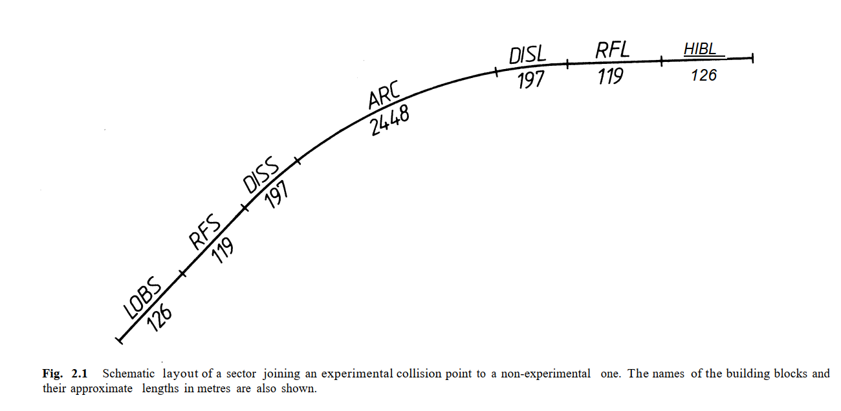
LEP FODO
At LEP, the arc length is 2448m and contains 31 cells
LEP FODO cell length is 79m

Slide 15
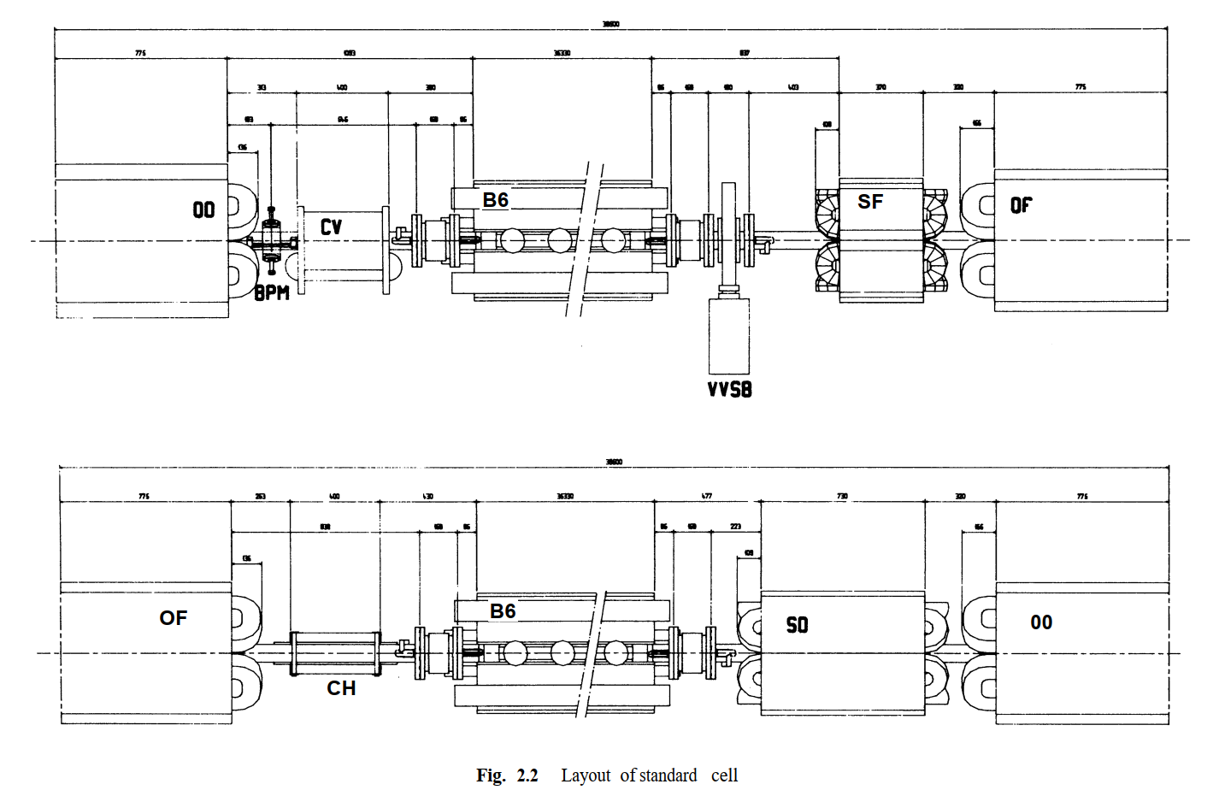
LEP standard cell
Half cell length 39.5 m

Slide 16
FODO cell size, bending radius
 | FODO length (m) | Dipole length | Packing factor (%) | Bending radius (m) | Horiz. Emit.
LEP | 79 | 72.7 | 92% | 3026 | 50nm
FCC-ee | 52.2 | 45.4 | 87% | 10021 | 0.7nm
LEP3 (2017 design) | 27 | 21.8 | 80% | 2755 | 4.2nm
For LEP3, we cannot simply scale down the FCC FODO length by a factor 3.4 (to 15m) because the packing factor would be lousy
The LEP3 2017 design has a FODO length of 27m – probably as much as one can push it
As a result, horizontal emittance of LEP3 is higher than FCC
Emittance goes as (FODO length/bending radius)³, so in this case a factor 5.4
This in return means larger beam sizes at the place of the final focus quads, therefore we might need larger aperture magnets, or increase L* (the distance of the last FF quad from the IP, for FCC: 2.2m)

Slide 17
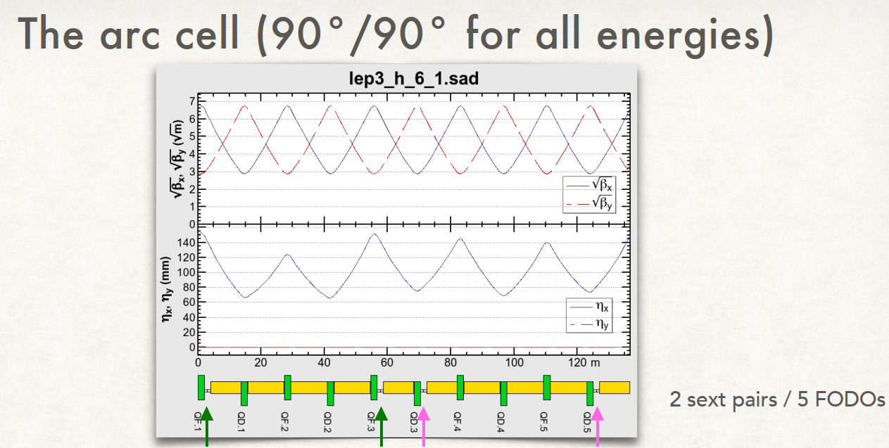
LEP3 cell
Much more focusing than LEP, and less than FCC
Half cell length 13.5 m
Inevitably, packing factor suffers (80%)
Quad length: 2m
Sext. Length: 1.8m
Total number of sss: 1900

Slide 18
LEP3 FODO cell
LEP3 2017 design had a dipole bending radius of 2755m
Quads and sextupoles occupy 27.2 / 136m (20%); packing factor is 80%
By nesting sextupoles inside quads the packing factor becomes 85% ➔ bending radius is increased to 2960m
By using different length QF/QD magnets we can go to 88% packing factor
(all correctors are also nested)
➔ then we can reach a bending radius of 3000m, close to the 3026m of LEP

Slide 19
LEP3 optics
LEP3 would benefit from a modern design low emittance lattice, like the ones used for light sources
We will then be able to gain in multiple fronts: emittances, packing factor, etc.
This will be number 1 in our priority list for next year, if we get the green light.

Slide 20
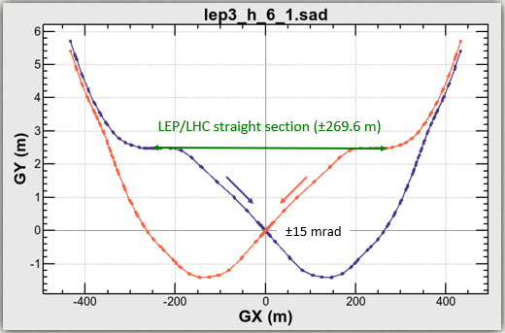
IR design
The old 2017 design needs to be modified.
Distance of the two beams: ~4m
(currently the IP is 2.5m off)
Relatively simple task to move the IP back to zero

Slide 21
Injector complex

Slide 22
LEP3 injector
The energy of the injector is determined by the minimum field of the booster magnets and the energy swing
For FCC, injector energy is 20GeV.
LEP3 has magnets that are a factor 3.4 stronger
We can safely reduce the energy to 10GeV
This makes the injector shorter and cheaper
This in turn possibly allows a different placement resulting in a much shorter transfer line (see John Osborne’s talk)

Slide 23
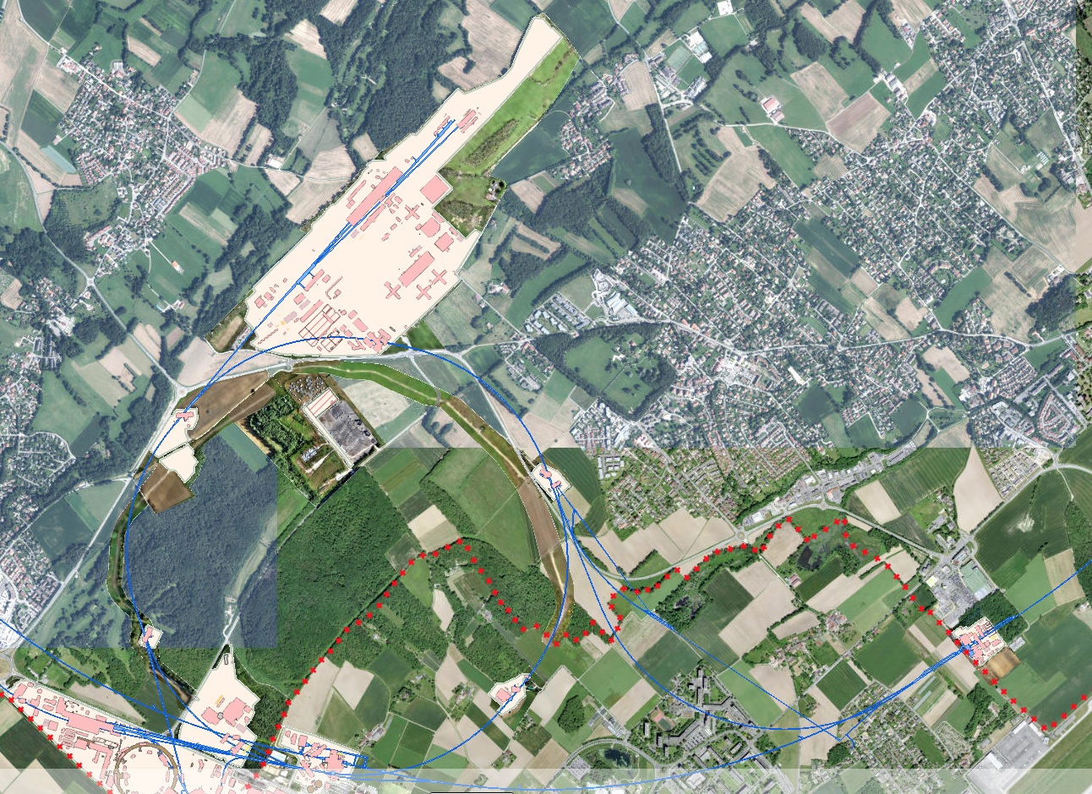
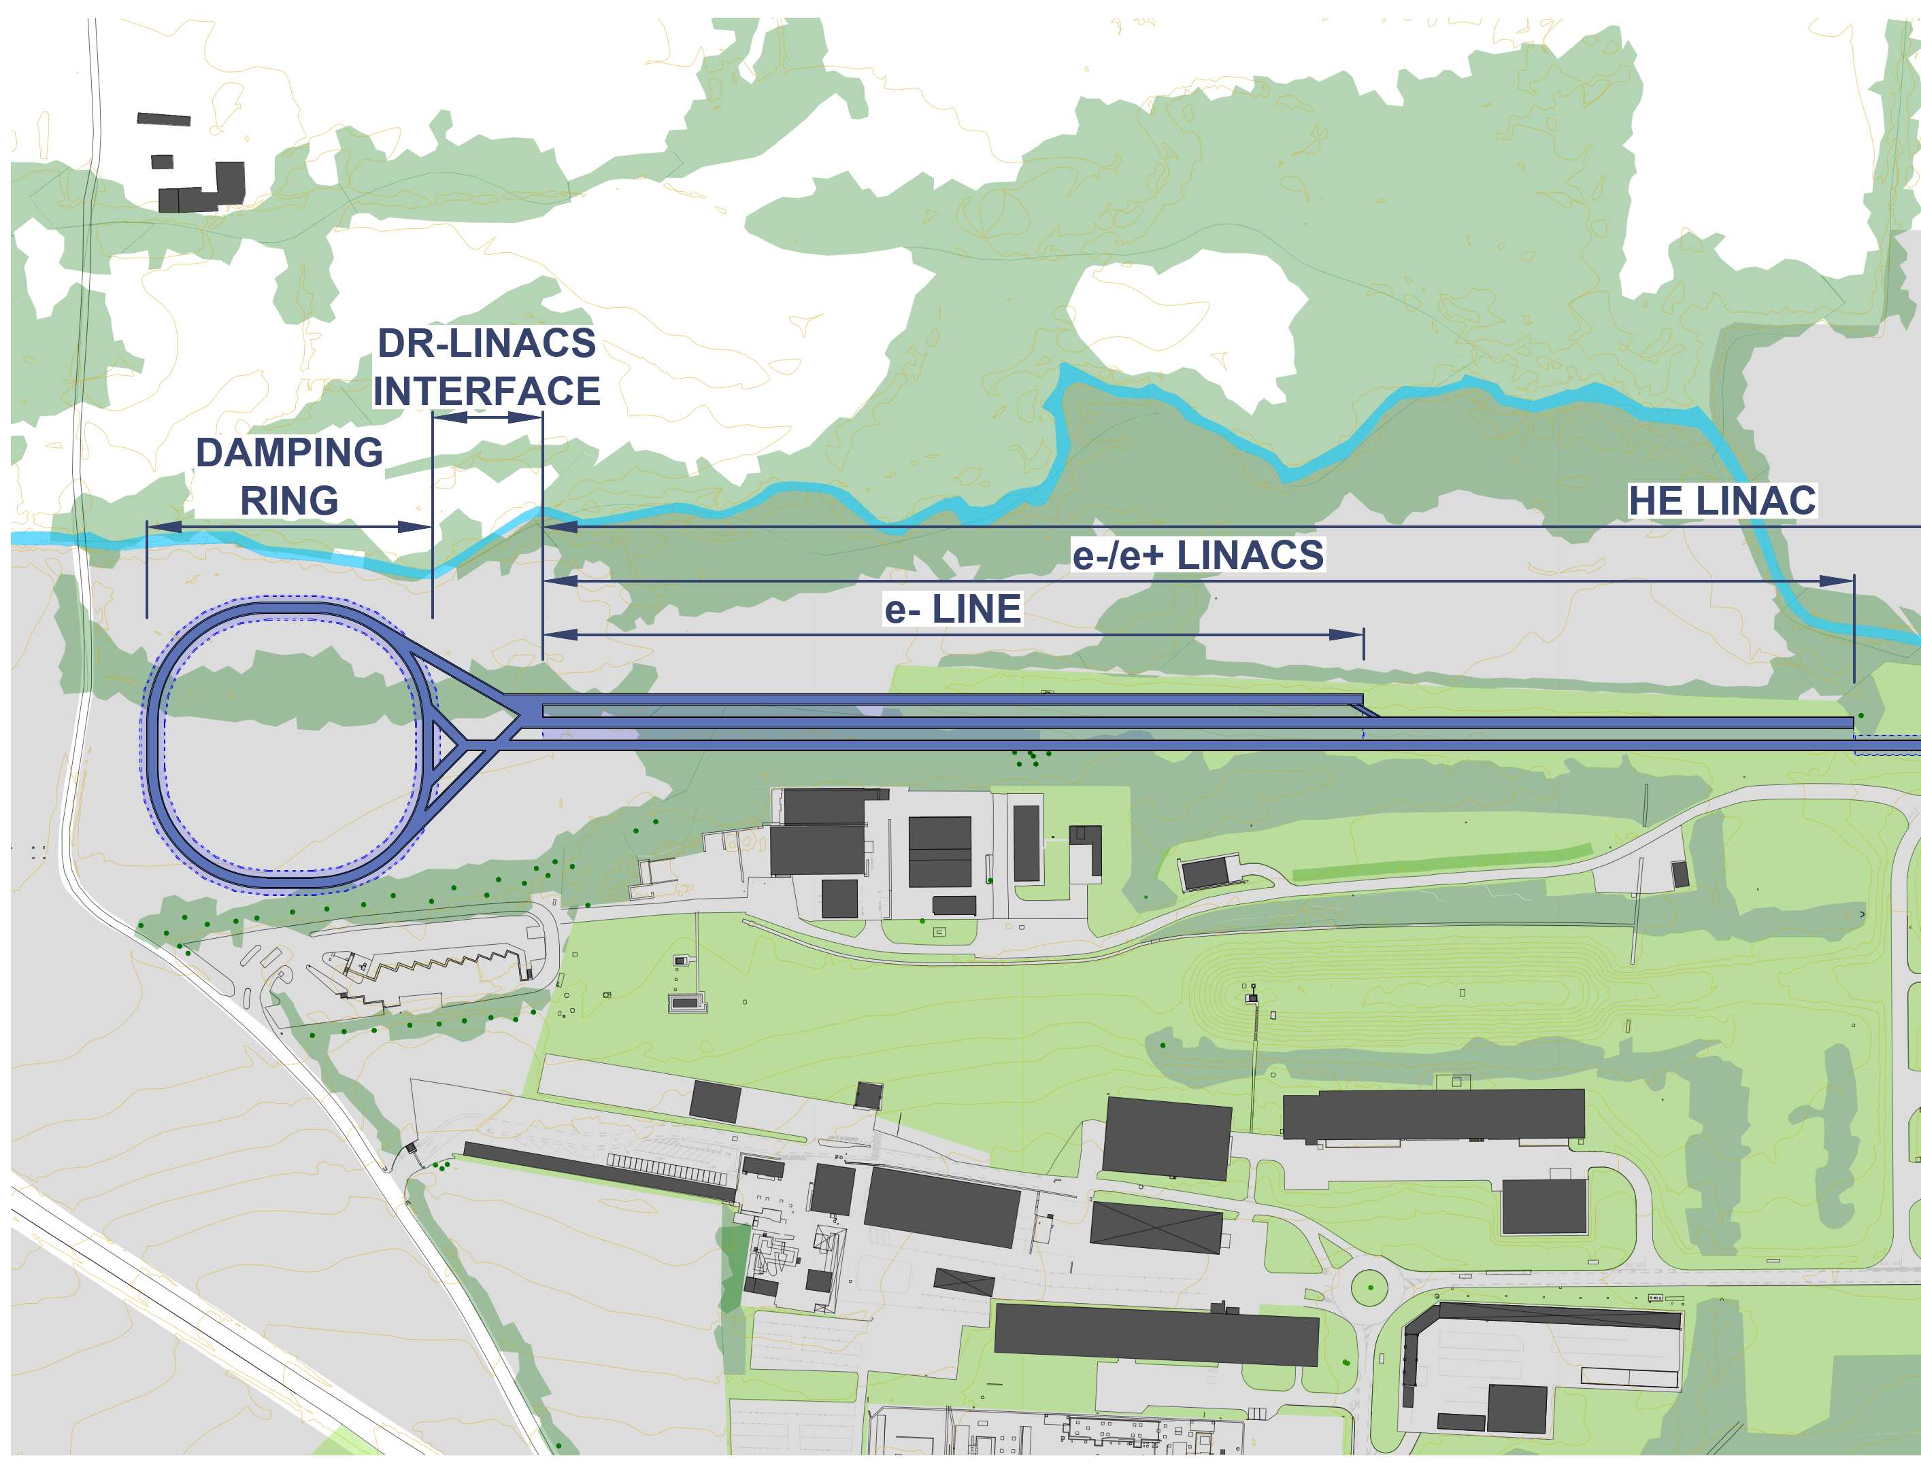
Injector placement
Transfer line ca 1 km
1 km

Slide 24
RF

Slide 25
RF strategy
Together with the RF group, we can come up with an RF design that respects all our requirements: see the talk by Ivan
We have opted for a pure 800MHz system (cheaper to build and operate than a hybrid 400-800MHz system
For the Z running: single cell; for the WW and ZH collider: 4-cell for the booster: 6-cell
We use a single RF system at the ZH and a double at the Z (and currently a double system at the WW)
We have four LSS to fit the RF for the collider and the booster, each 545m long

Slide 26
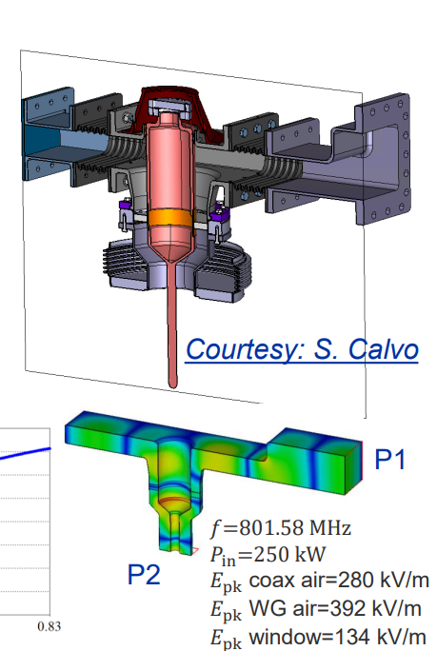
Fundamental power couplers
At LEP3 we are not limited by the achievable gradient, but by the amount of power we can put in the cavities (the Fundamental Power Couplers)
Current state of the art of these couplers is 250kW for 800MHz
If we were able to get 22% more power from these couplers, then 6-cell cavities (which are more space efficient) would fit, and the collider would not need 4-cell cavities
This would make the system cheaper (less cryomodules) and shorter
Some R&D on this topic would be very beneficial for LEP3

Slide 27
Does the RF fit in the LEP3 tunnel?
LEP3 has 8 LSS, each 545m long (4360m total)
Two will be used by the experiments (plus polarimeters, plus depolarizers?)
Two are difficult to access
We are planning to fit the collider RF in two LSSs and the booster RF in two other LSSs
LEP3 at ZH: SR loss: 5.4GeV; installed RF: 6.0GV
(the LEP3 RF system is 52% of the FCC one)
We have fitted the RF system in the 545m available using 4 LSSs

Slide 28
LEP3 RF configuration -ZH
Point 1
Point 2
Point 3
Point 4
H (115GeV)
Beam 1
DET1
Beam 1
Beam 1
Beam 1
Beam 2
Beam 2
Beam 2
Beam 2
800 MHz
20 bunches
Booster
Booster
800 MHz
Booster
Booster
Point 5
Point 6
Point 7
Point 8
Beam 1
DET2
Beam 1
Beam 1
Beam 1
Beam 2
Beam 2
Beam 2
Beam 2
800 MHz
Booster
Booster
800 MHz
Booster
Booster

Slide 29
LEP3 RF configuration -Z
Point 1
Point 2
Point 3
Point 4
Z (45GeV)
Beam 1
DET1
Beam 1
Beam 1
Beam 1
Beam 2
Beam 2
Beam 2
Beam 2
800 MHz
800 bunches
Booster
Booster
800 MHz
Booster
Booster
Point 5
Point 6
Point 7
Point 8
Beam 1
DET2
Beam 1
Beam 1
Beam 1
800 MHz
Beam 2
Beam 2
Beam 2
Beam 2
Booster
Booster
800 MHz
Booster
Booster

Slide 30
RF integration
Space is more tight in LEP3 than FCC with the exception of height:
  LEP3: diameter: 4.4m height: 3.6m
  FCC: diameter: 5.5m height: 3.2m
Integration will be difficult because we have (in the Z running mode) three beampipes. Two need to bypass the cryomodules
LEP3 plans to use 800MHz modules that are more compact than 400MHz
R&D on compact cryomodules would be appreciated!

Slide 31
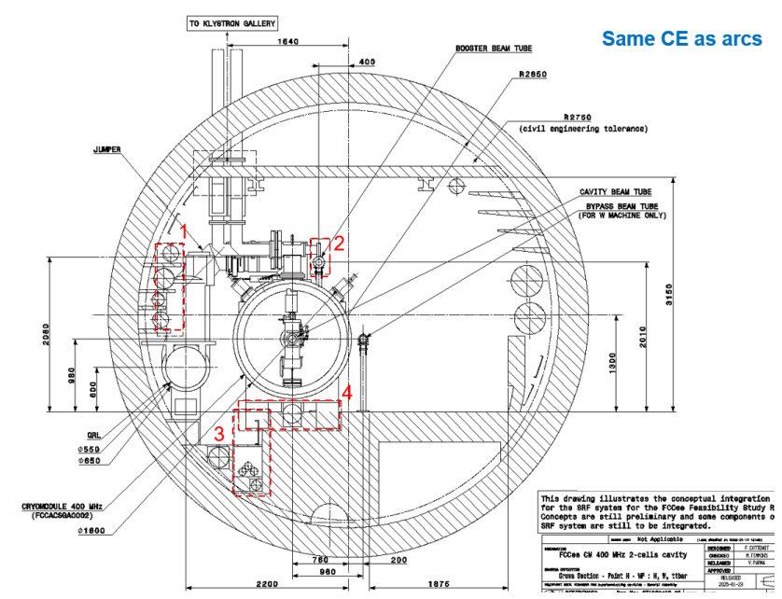
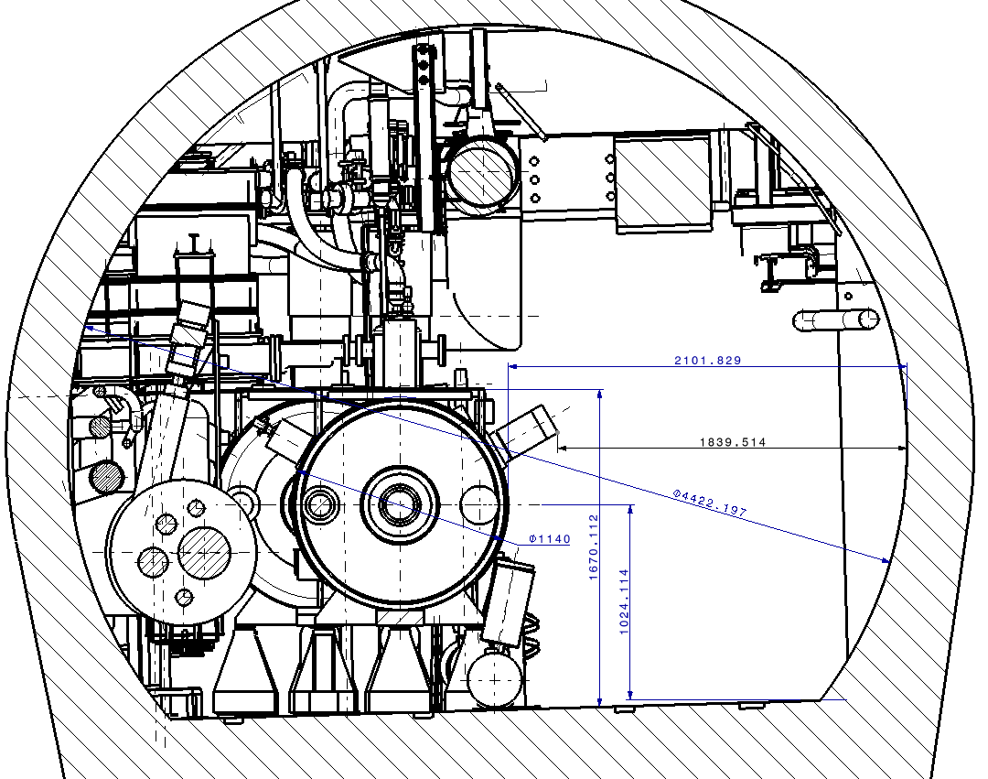
Compare tunnel sizes @RF areas
LHC 400MHz
FCC-ee 400MHz
LEP3 has more head room!
LEP3 3.6m
FCC 3.2m

Slide 32
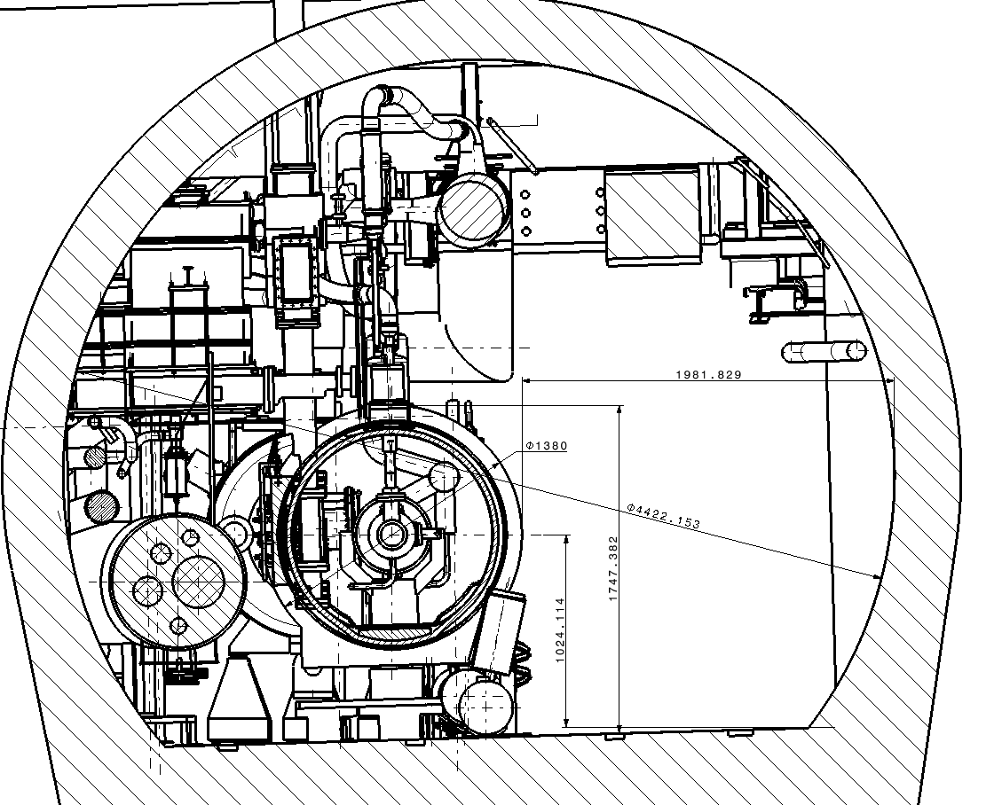
First LEP3 integration studies
LHC 400 MHz CM integration Pt 4
LHC 400 MHz Cryomodule
FCCee 800 MHz Cryomodule
FCCee 800 MHz CM integration Pt 4
QRL
QRL
The two beam pipes bypassing the system are not shown!
M. Timmins EN/MME - 28/03/2025

Slide 33
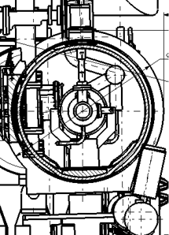
New integration drawings
What is not shown are the other two beam lines, the second collider line and the booster line.
More integration work needed
Overtaking unit

Slide 34
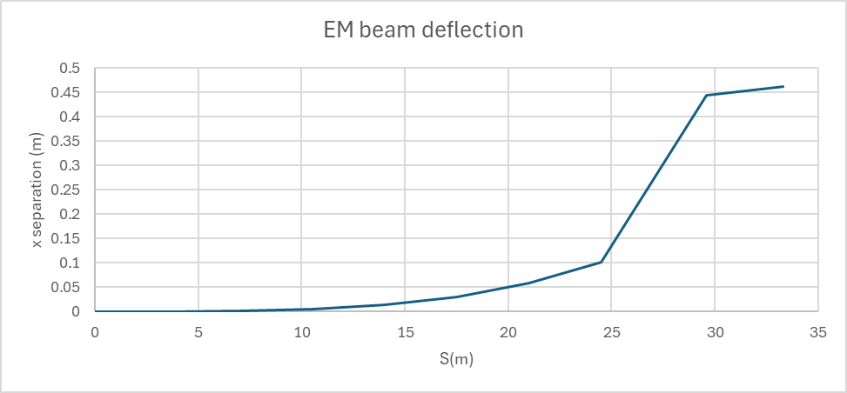
EM separators
A design is now available for FCC.
FCC separators are 2.5m long and deflect the beam by 40urad at 182.5GeV
Scaling to 115GeV, the beam deflection will be 63urad
A toy system with 7 separators every 3.5m and 2 dipoles (same strength as the arcs, 5m long each) takes ~33m of longitudinal space.
EM sep
EM sep
EM sep
EM sep
EM sep
EM sep
EM sep
dipole
dipole

Slide 35
Power consumption

Slide 36
LEP3 power consumption – FCC as basis
FCC |  | Z | LEP3-Z | W | LEP3-W | H | LEP3-H | TT
Beam energy (GeV) |  | 45.6 | 45.6 | 80 | 80 | 120 | 115 | 182.5
Magnet current |  | 25% | 85% | 44% | 150% | 66% | 210% | 100%
Power factor |  | 6% | 21% | 19% | 66% | 43% | 133% | 100%
PRF EL (MW) | Collider | 146 | 146 | 146 | 146 | 146 | 146 | 146
PRFb EL (MW) | Booster | 2 | 2 | 2 | 2 | 2 | 2 | 2
Pcryo (MW) | Collider | 1.2 | 10 | 11.5 | 21 | 11.5 | 21 | 27.6
Pcryo (MW) | Booster | 0.35 | 1.3 | 0.80 | 2.5 | 1.50 | 4.9 | 7.40
Pcv (MW) | all | 25 | 9 | 26 | 13 | 28 | 18 | 33
PEL magnets (MW) | Collider | 6 | 13 | 17 | 20 | 39 | 29 | 89
PEL magnets (MW) | Booster | 1 | 2 | 3 | 7 | 5 | 15 | 11
Experiments (MW) | Pt A & G | 10 | 5 | 10 | 5 | 10 | 5 | 10
Data centers (MW) | Pt A & G | 4 | 2 | 4 | 2 | 4 | 2 | 4
General services (MW) |  | 26 | 7 | 26 | 7 | 26 | 7 | 26
Power during beam operation (MW) |  | 222 | 200 | 247 | 226 | 273 | 250 | 357
Average power / year (MW) |  | 122 |  | 138 |  | 152 |  | 202
Notes: this assumes the same klystron efficiency as FCC
We here assume superconducting quads and sextupoles, making full use of the LHC cryogenic line in place

Slide 37
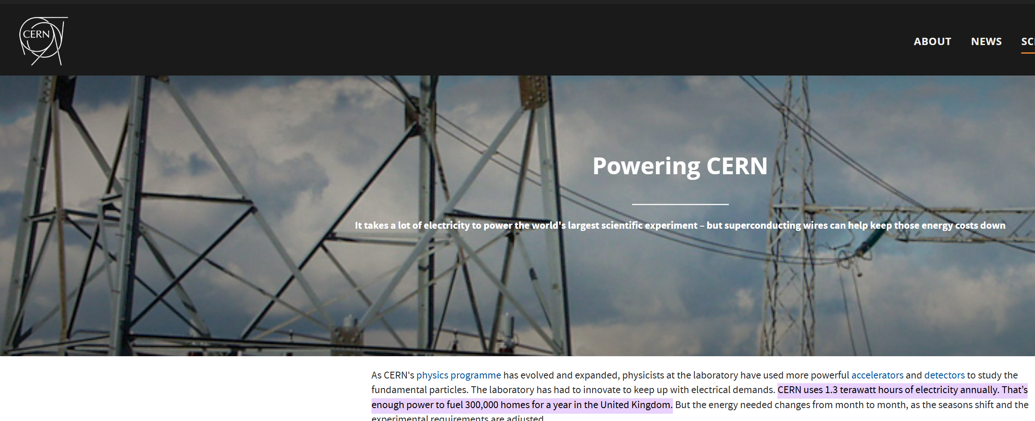
From power consumption to energy per year
FCC-ee, ttbar operation, new numbers: 357MW, 1.8TWh
LEP3, ZH at 230GeV operation, 250MW, 1.3TWh
From the CERN web pages:

Slide 38
Critical energy

Slide 39
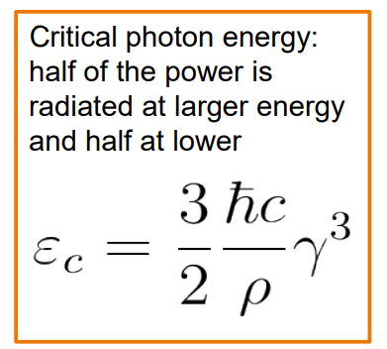
SR critical energy
Critical synchrotron radiation photon energy is important regarding the radiation dose in the tunnel
The factor E^3/rho is:
FCC at 182.5GeV: 606
LEP3 at 115GeV: 506 (16% lower than FCC at 182.5GeV)
LEP3 is slightly below FCC

Slide 40
polarization

Slide 41
Polarization
When we talk about polarization for LEP3 (and FCC) we refer to transverse polarization which can be used as an accurate means of measuring the beam energy using the resonant depolarization method (RDP):
  Built up 5% or more transverse polarization (or inject polarized bunches)
  Measure and monitor the polarization levels
  Use a resonator to find the ‘spin tune’ by destroying polarization for a specific bunch
  Spin tune is proportional to energy
A second method is also considered: free spin presession (FSP), relying on injecting polarized bunches. If it could be made to work, it has many advantages over the RDP method

Slide 42
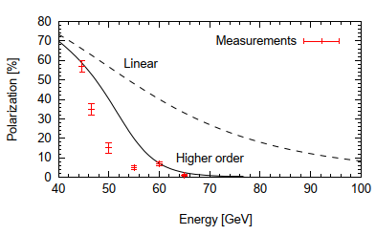
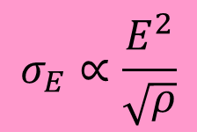
Polarization at the Z and WW
LEP only saw polarization up to 60GeV
Problem is that energy spread increases with energy squared and decreases with the square root of the bending radius
If the energy spread is larger than ~52MeV in the case of LEP, the distribution hits half integer spin tune resonance bands and the bunch quickly depolarizes
In the case of FCC, due to the large bending radius, polarization is expected at the Z and WW energies
LEP3 can get polarization at the Z, but will be difficult for the WW running
$$σ_{E}∝\frac{E^{2}}{\sqrt{ρ}}$$

Slide 43
Energy determination
LEP achieved an energy uncertainty for the Z mass of ~2MeV
FCC is expected to achieve a systematic error of 100keV or lower. This is achieved by performing ~10,000 depolarization measurements instead of ~30 (and a lot of hard work on the systematics)
LEP3 can achieve similar systematic error on the Z
On the W, FCC is hoping to achieve ~160keV using RDP.
Work is needed to determine if LEP3 can make the RDP or FSP methods work (maybe not routinely, but with special optics)

Slide 44
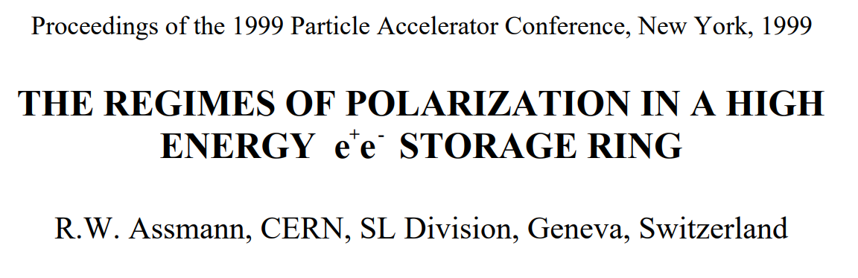
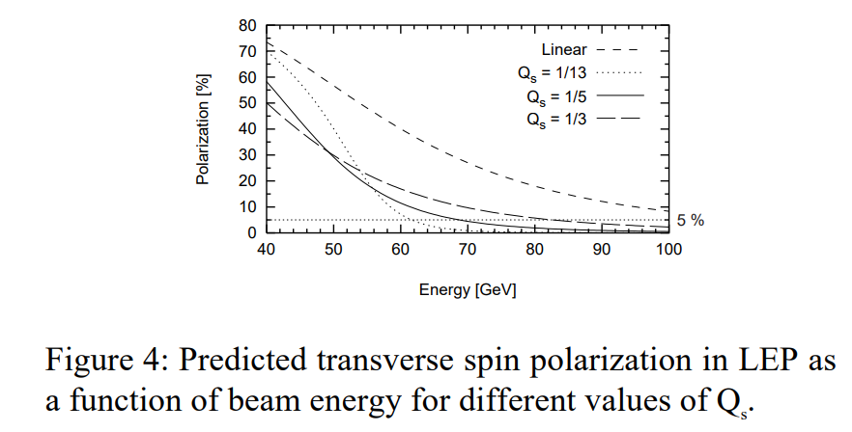
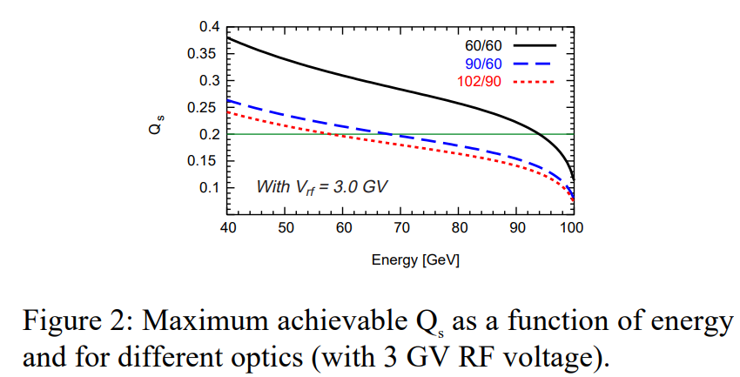
https://accelconf.web.cern.ch/p99/papers/thp24.pdf
WW running: can LEP3 measure the energy?
The prediction is that for very high synchrotron tune values, detectable levels of polarization might be possible

Slide 45
Polarization times: FCC and LEP3
machine | Circumf (m) | Radius (m) | energy | tau_pol (hours) | pol to 5% (mins)
FCC - 45 | 90658 | 10021 | 45 | 215.9 | 650
FCC - 80 | 90658 | 10021 | 80 | 12.2 | 37
LEP3 - 45 | 26660 | 2958 | 45 | 5 | 15
LEP3 - 80 | 26660 | 2958 | 80 | 0.3 | 1
FCC-ee at the Z needs polarization wigglers.
LEP3 at the Z (or W) needs no polarization wigglers

Slide 46
Conclusions
LEP3 can operate at a beam energy of 115GeV (ZH), as well as 80 (WW) and 45GeV (Z)
Luminosity for the Higgs running will be 1.6E34 (if we use the FCC lattice) or better (if we use a new low-emittance lattice)
LEP3 will need 6GV of RF that can fit in 2+2 LSSs
Power demand at top energy will be ~250MW
LEP3 aims to deliver twice the number of Higgs events per year at half the cost if the ILC
If we think it merits further study, a task force should be formed that can provide solid numbers in a couple of years.

Slide 47
Task force topics (non-exhaustive)
Low emittance lattice
Interaction region optics
Polarization at the WW (and Z)
R&D on power couplers
Compact RF cryomodules
Integration of the RF

Slide 48
Extra slides

Slide 49
Why so much RF voltage at the Z?
The voltage at the Z is to push the synchrotron tune
Otherwise, RDP would not work
Since we are limited by power per cavity, we essentially have RF voltage for free
See Ivan’s talk
For the Z running, we have changed parameters to respect two aspects: the spin modulation index, a figure of merit for spin depolarization measurements, and the threshold of x-z instability (given by Qs/xix ). For the former, the problem was that the momentum compaction factor is much smaller compared to LEP (and similar to FCC). To compensate for that, we have increased Qs by increasing RF voltage. Then, to keep a reasonable beam-beam vertical tune shift, we increased the vertical emittance and decreased the number of bunches. This in turn helped in increasing the bunch length (which is good for x-z instability, resistive wall power, etc.)

Slide 50

Power consumption
FCC data taken from:

Slide 51
Assumptions
Ratio of bending radii: 10021/2958 = 3.4
Dipole current factor:
  if FCC-ee 182.5GeV is 100%, then LEP3 is 115/182.5*3.4=2.1
  LEP3 at 80GeV 80/182.5*3.4=1.5
  LEP3 at 45.6GeV = 0.85
Dipole current power factor:
  115GeV: 2.1^2 = 4.41
  80GeV: 1.5^2 = 2.25
  45.6GeV: 0.85^2 = 0.73
  Dipole circuit power factor (=1.0 for FCC at 182.5GeV):
  115GeV: 2.1^2/3.4 = 1.30
  80GeV: 1.5^2/3.4 = 0.66
  45.6GeV: 0.85^2/3.4 = 0.21

Slide 52
Assumptions 2
RF cryo power: next slide
Cooling and ventilation: there is a constant part, and a part increasing as beam energy squared. A simple model gives: Pcv=25+8*power ratio.
I assume that the constant part will be divided by 3.4 for LEP3, and for the second part the power ratio will be followed.
  PCV@Z: 7.4+8*0.21=9MW
  PCV@W: 7.4+8*.66=13MW
  PCV@H: 7.4+8*1.33=18MW
Data centers and experiments: proportional to the no. of experiments; divide by 2
General services: divide by 3.4
Booster magnets: use the FCC numbers times the power factor

Slide 53
Collider magnet power consumption HTS option
Storage Ring | FCC-tt | LEP3 - Z | LEP3 - WW | LEP3 - ZH | comments
Beam Energy (GeV) | 182.5 | 45.6 | 80 | 115
Magnet current - dipoles | 100% | 85% | 150% | 210%
Magnet current - quads | 100% | - | - | 200% | KO private communication
Magnet current - sexts | 100% | - | - | 425% | KO private communication
Power ratio | 100% | 21% | 66% | 130%
Dipoles (MW) | 13.3 | 2.8 | 8.8 | 17.3 | Ratio is 2.2^2/3.5
Quadrupoles (MW) | 22.6 | 4 | 4 | 4 | s/c, 2 cryocooler/SSS
Sextupoles (MW) | 20.5 | 4 | 4 | 4 | “
Power cables (MW) | 20 |  |  |  | Individually powered
Total magnet losses | 76.4 | 11 | 17 | 25
Power demand (MW) | 89 | 13 | 20 | 29
Assume that quads and sextupoles will be superconducting (cryogenic distribution line already existing)
For FCC:
P_{ELmagnets} = 76 / ηconversion / ηdistribution
P_{ELmagnets} = 76 / 0.9 / 0.95 = 89MW

Slide 54
RF cryo power consumption assumptions
Power is static+dynamic
Dynamic losses per 4-cell cavity is 17W
Static is ~14W/cavity.
Sum is 31W per cavity*416 cavities =12kW
Carnot ratio is 1700, so total wall plug power is 21MW
For FCC ttbar total consumption is 28MW (dynamic is 26.5W and static also ~14W/cavity)
For the booster, LEP3 will be dominated by static, but LEP3 has 66% of the FCC cryomodules, so power will be 7.4*0.66=4.9MW

