Slide 1
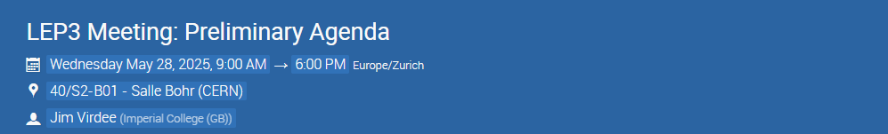

Civil Engineering for LEP3
28 May 2025
John Osborne SCE-SAM-FS

Slide 2
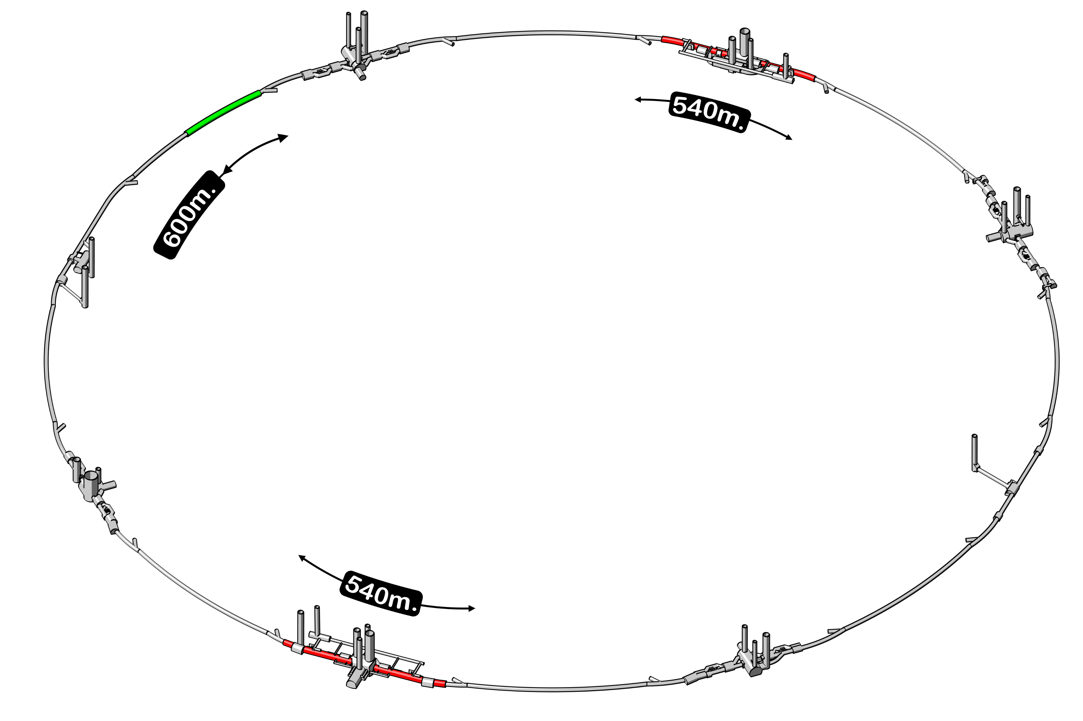
Tunnel widening 270m either side of CMS (increased from existing 3.76m to 7m diameter)
Tunnel widening for LEP3 after initial studies
Tunnel widening 270m either side of ATLAS (increased from existing 4.40m to 7m diameter)

Slide 3
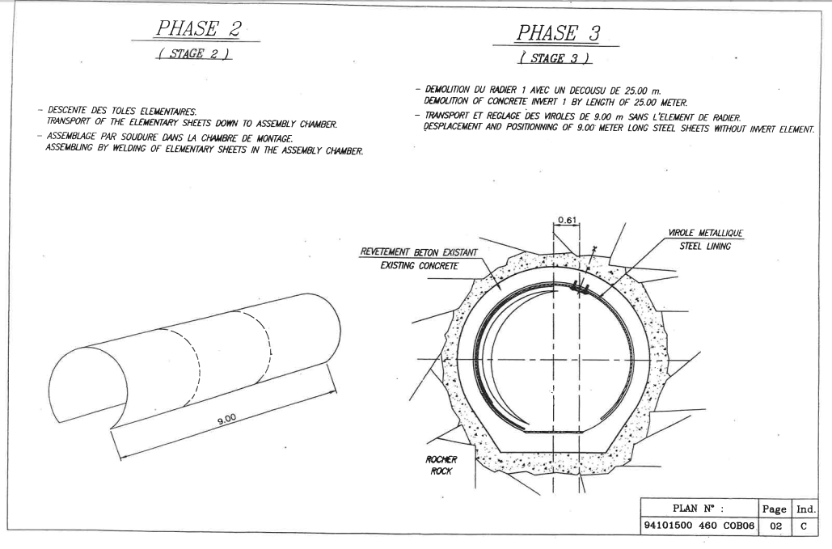
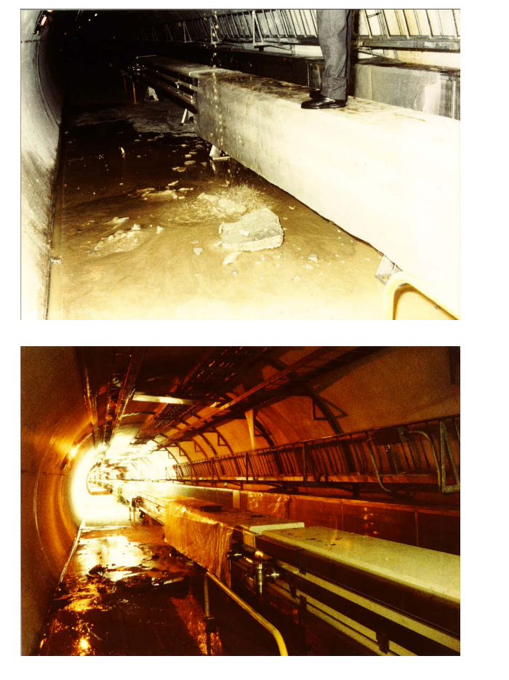
Tunnel strengthening over 600m in Jura section (inner steel ‘submarine’ solution).
Other civil works
Multiple waveguides cores also required (to be defined)
Shielded bridge across the experimental caverns of ALICE and LHCb - similar to that already in place at point4
Assuming no additional surface buildings required (apart from Injector complex)

Slide 4
LEP3
Tunnel enlargement
CMS

Slide 5
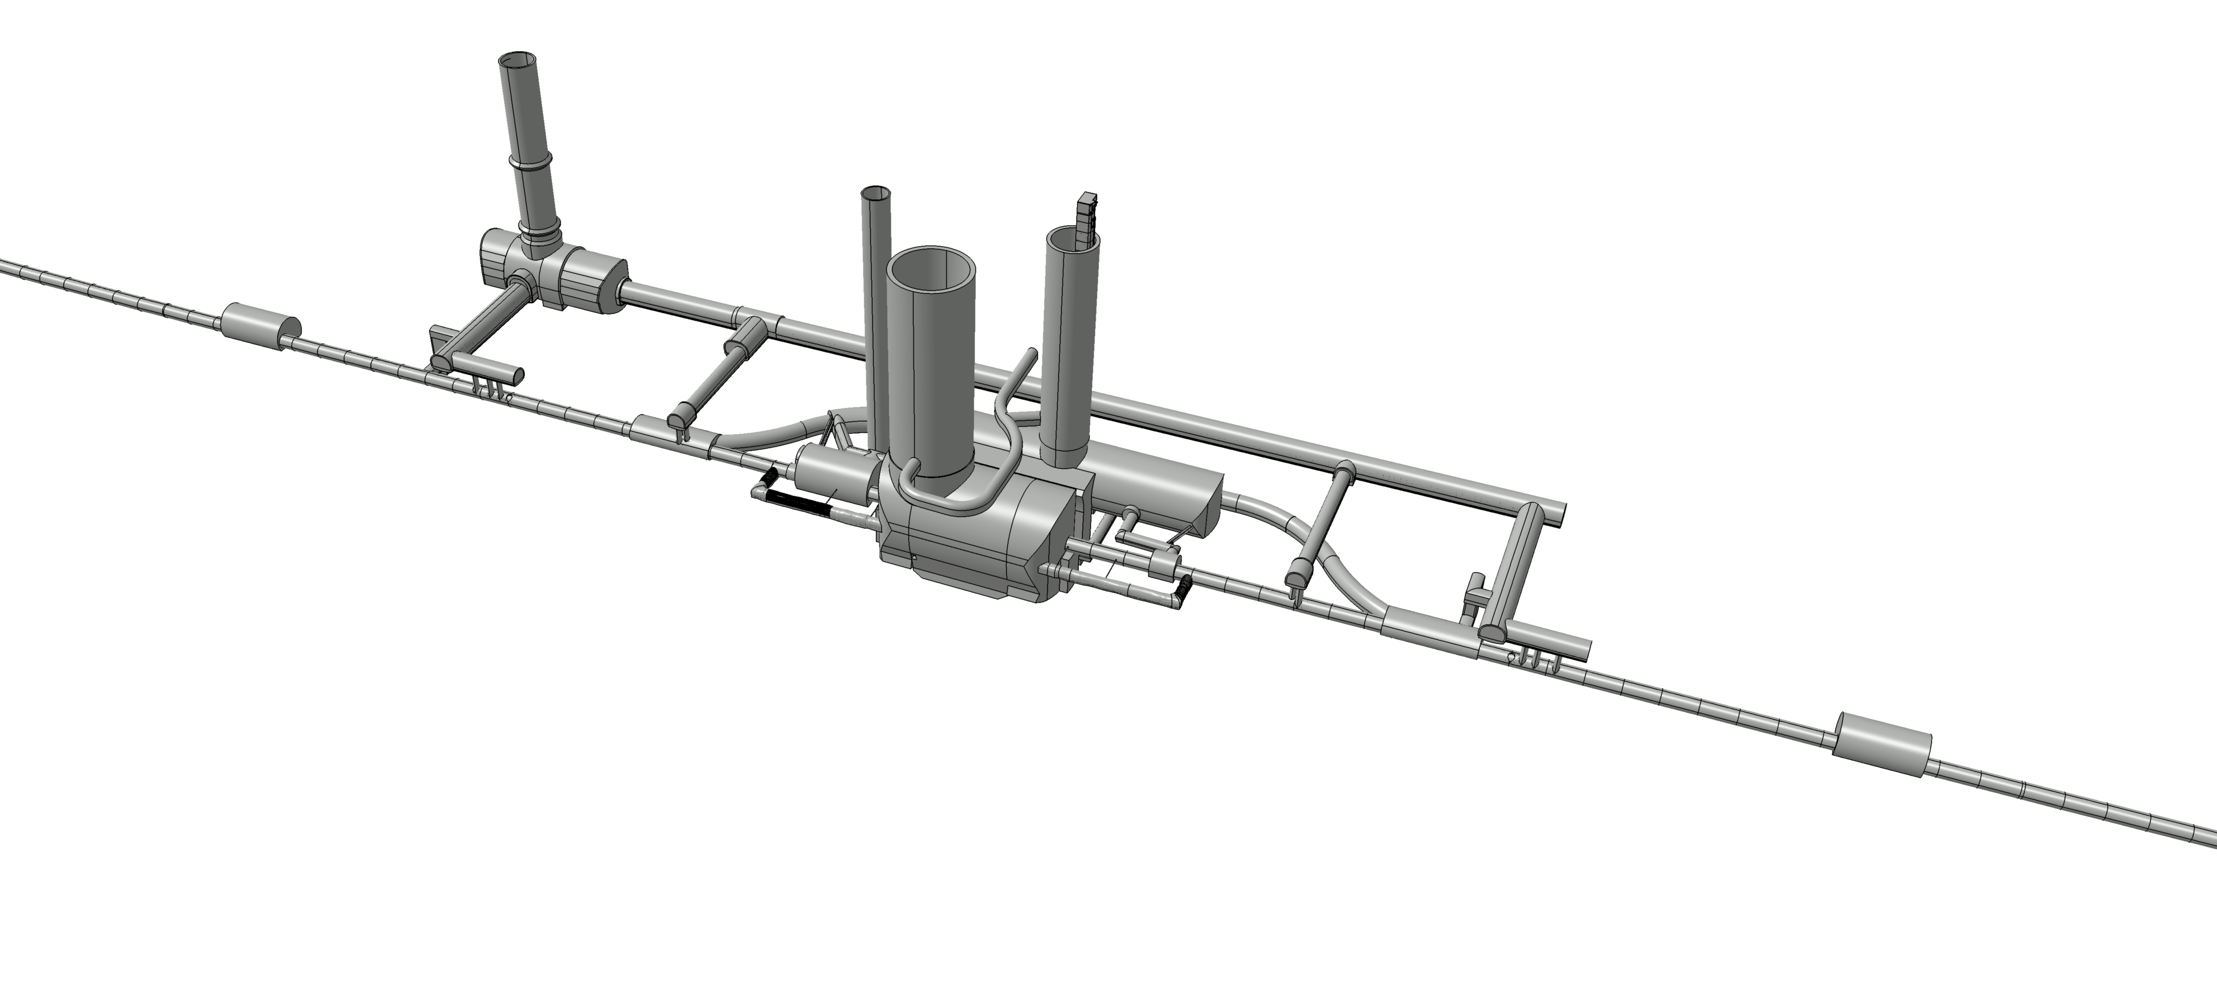
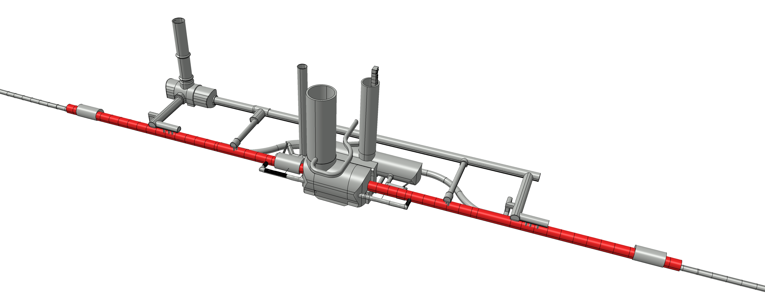
R57
RR57
R57
UJ57
R56
UJ56
R54
RZ54
R54
UJ53
CMS existing layout
R53
RR53
R53
Tunnel enlargement along 540 metres for crossing angle

Slide 6
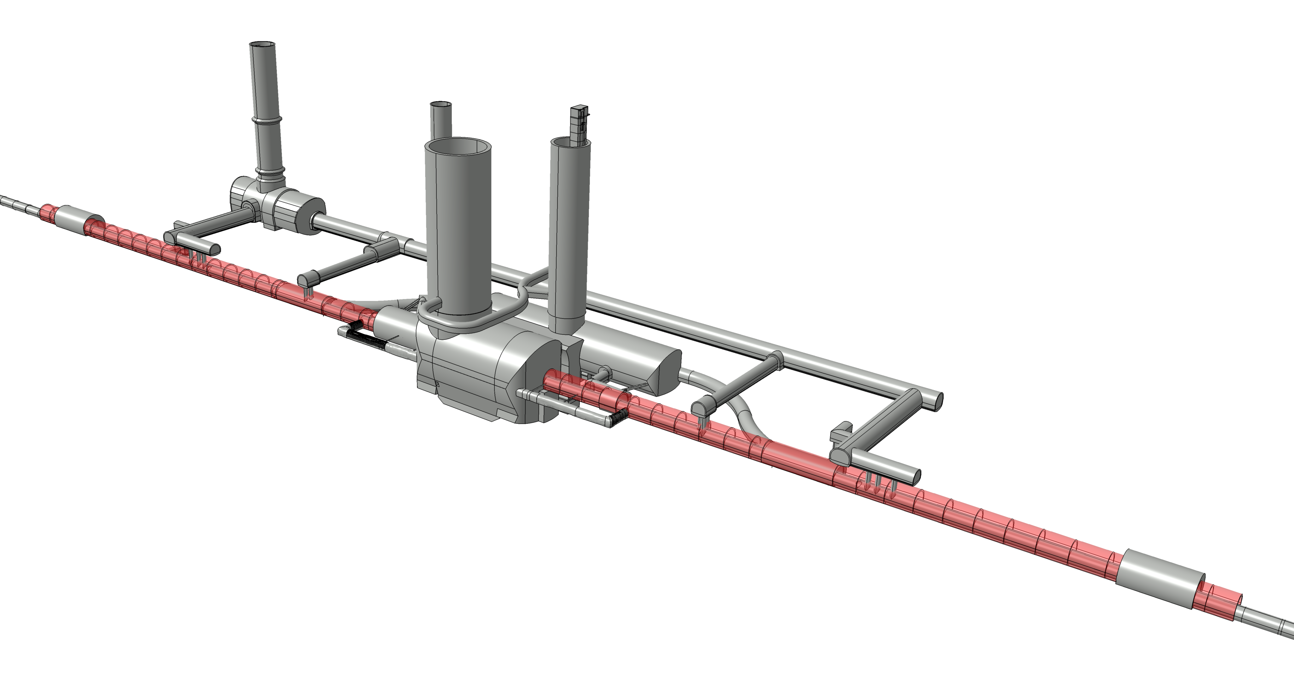
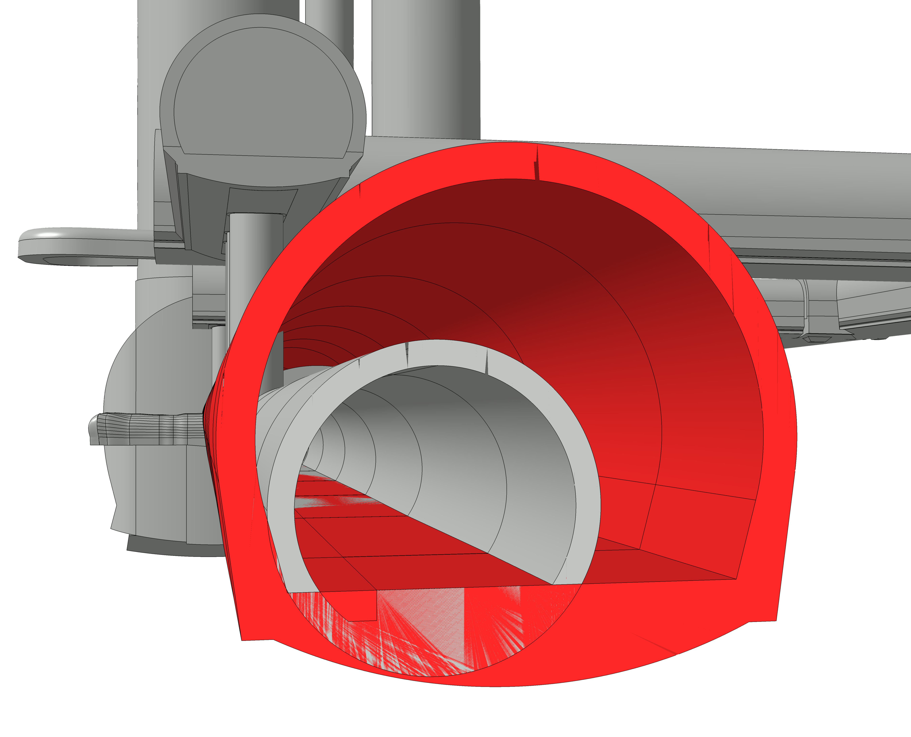
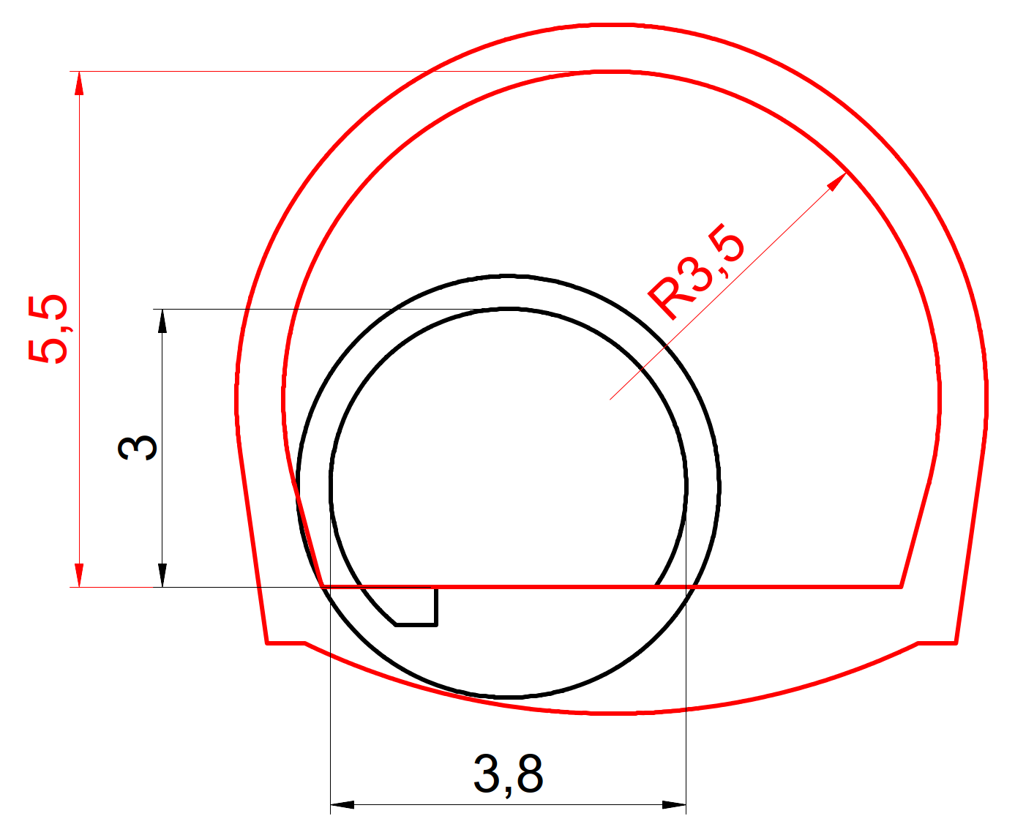
New 7m tunnel (in red)
Height can be optimised
Section view
LHC

Slide 7
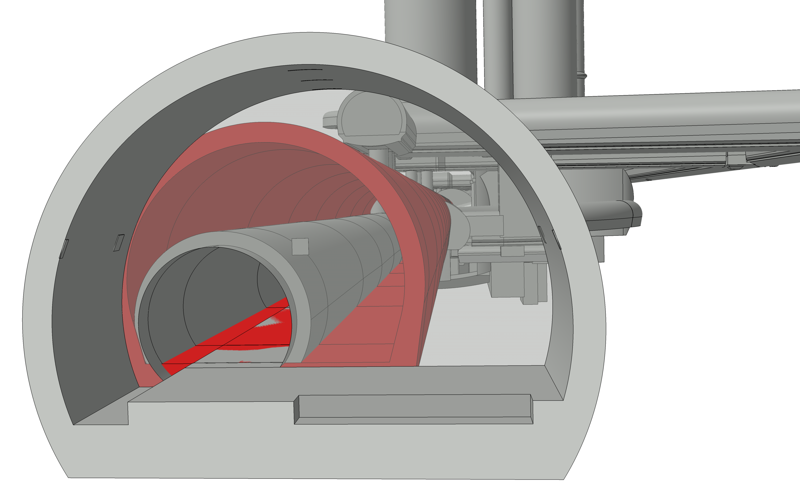
Leave RR’s ‘untouched’ if LEP3 tunnel not centred on existing LHC alignment
Section view
LHC
RR53

Slide 8
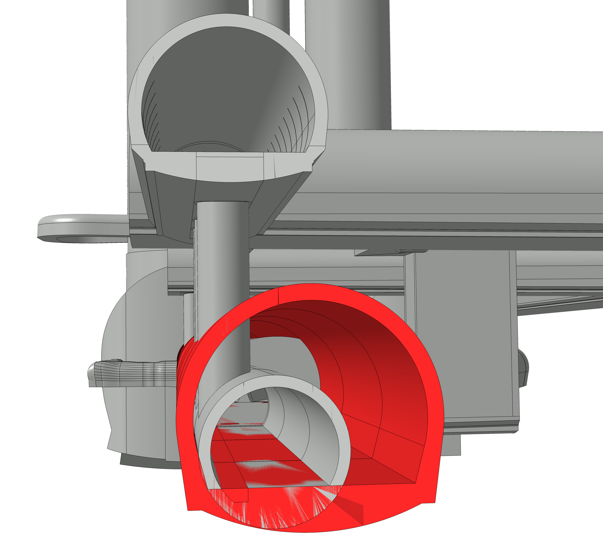
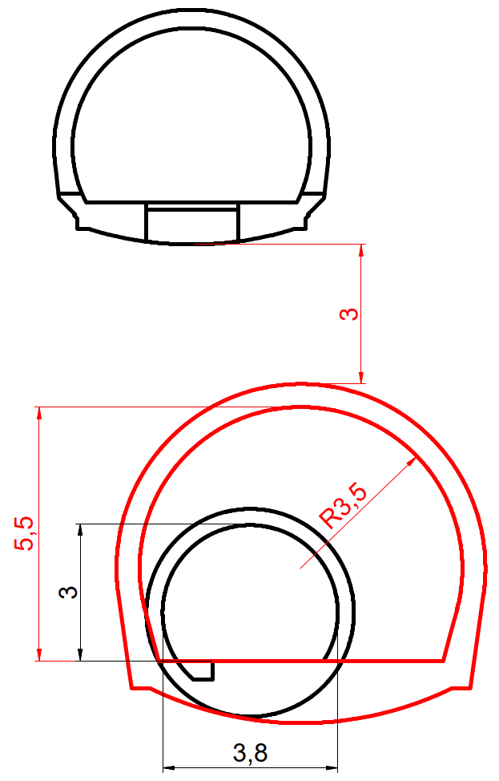
Very close to HL-LHC UA gallery
UA53
Section view
LHC

Slide 9
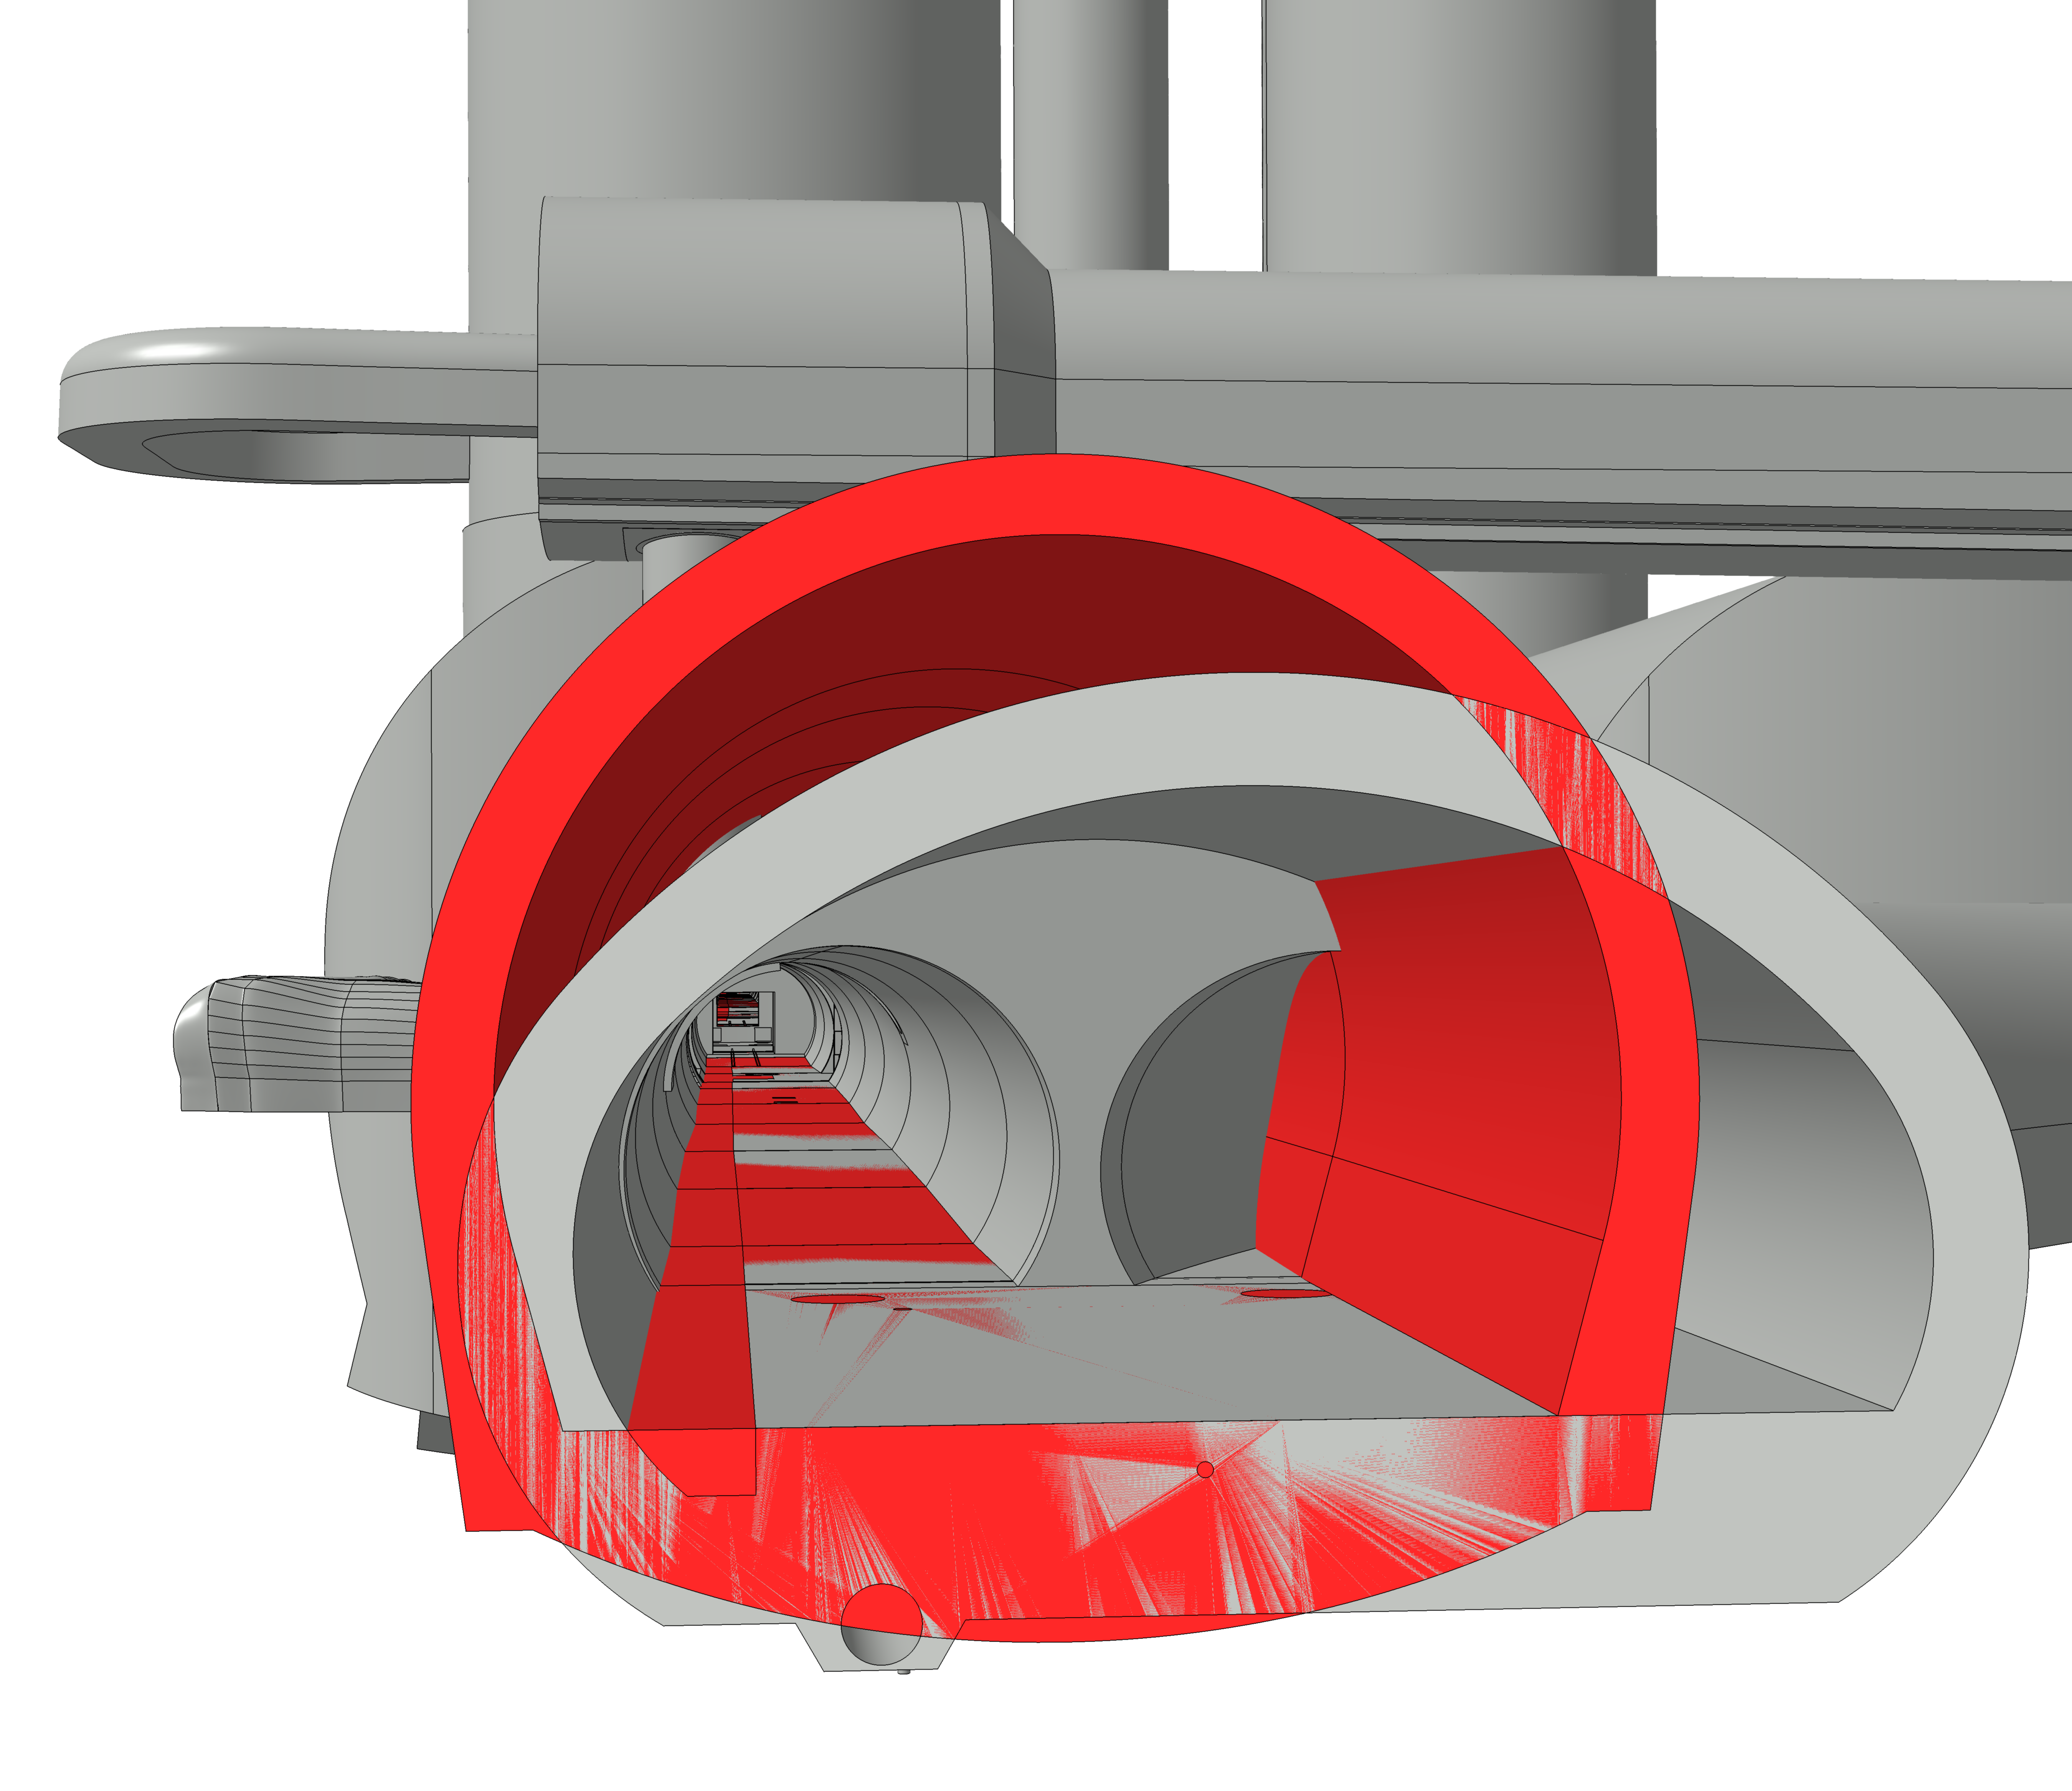
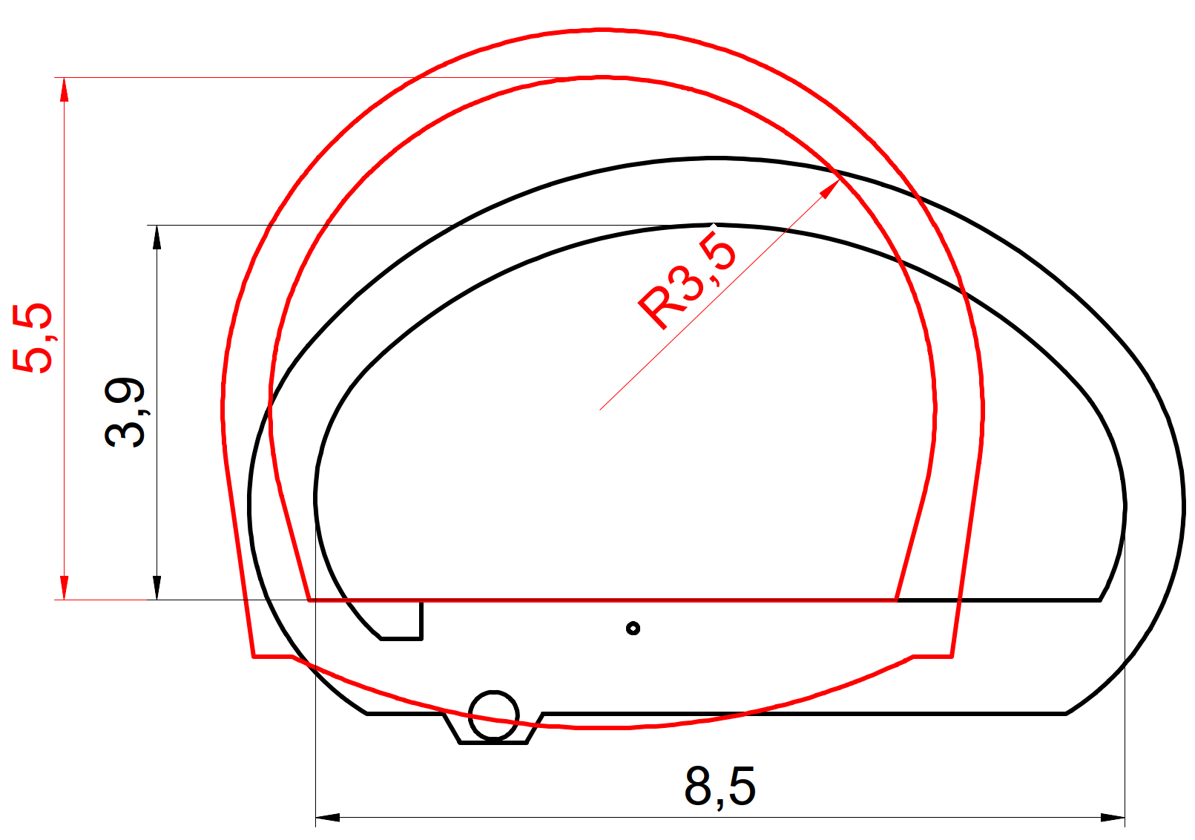
Leave UJ’s ‘untouched’
Modify new enlarged tunnel after UJ’s
How to maintain transport route ?
Section view
LHC
UJ53

Slide 10
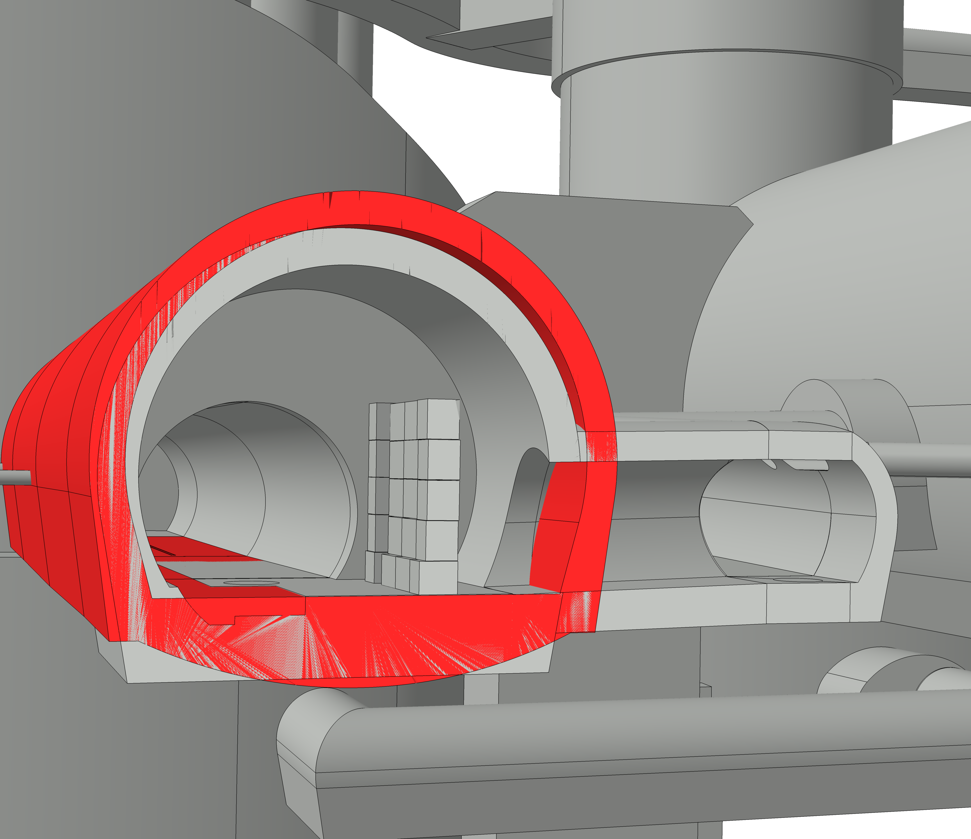
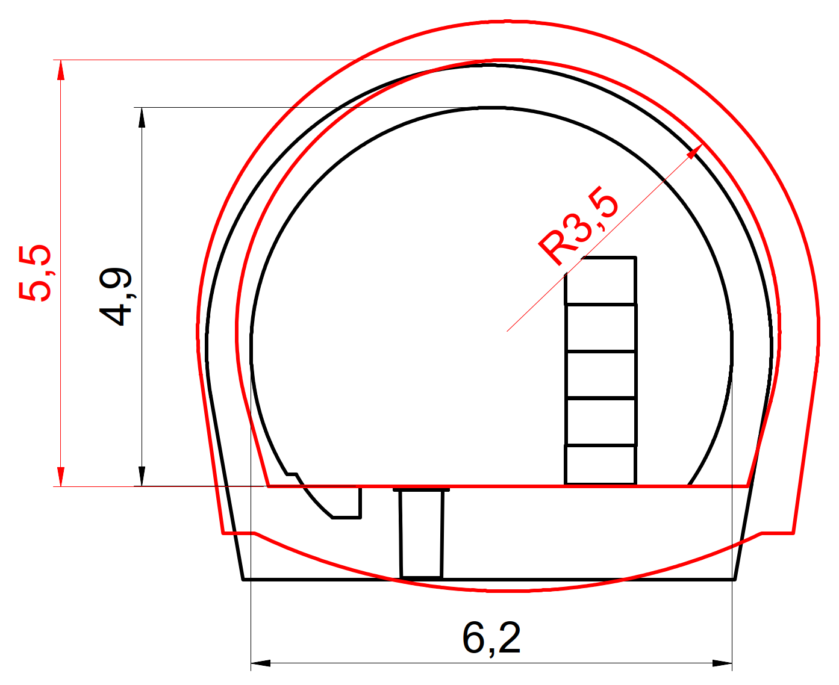
Leave RZ’s ‘untouched’
Section view
R54
RZ54

Slide 11
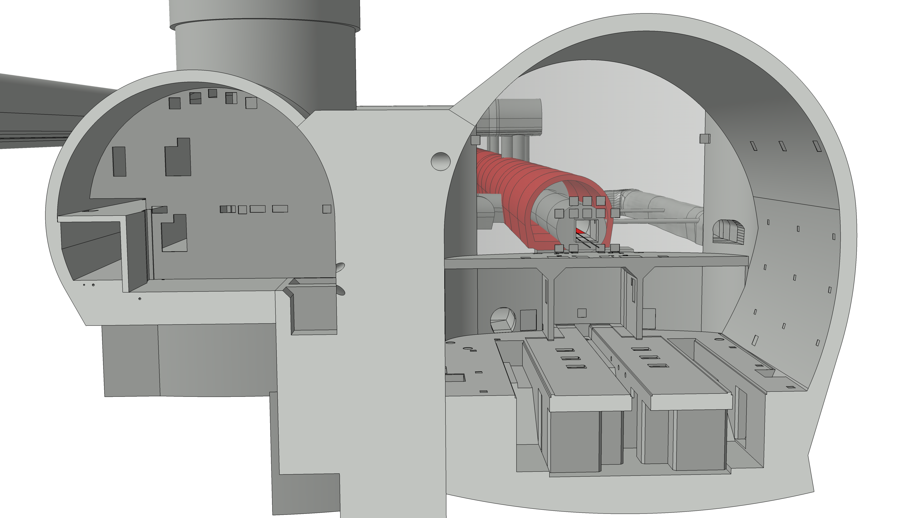
LEP3 not centred on CMS cavern. OK ?
CMS Blockhouses to be modified
Section view
UXC55

Slide 12
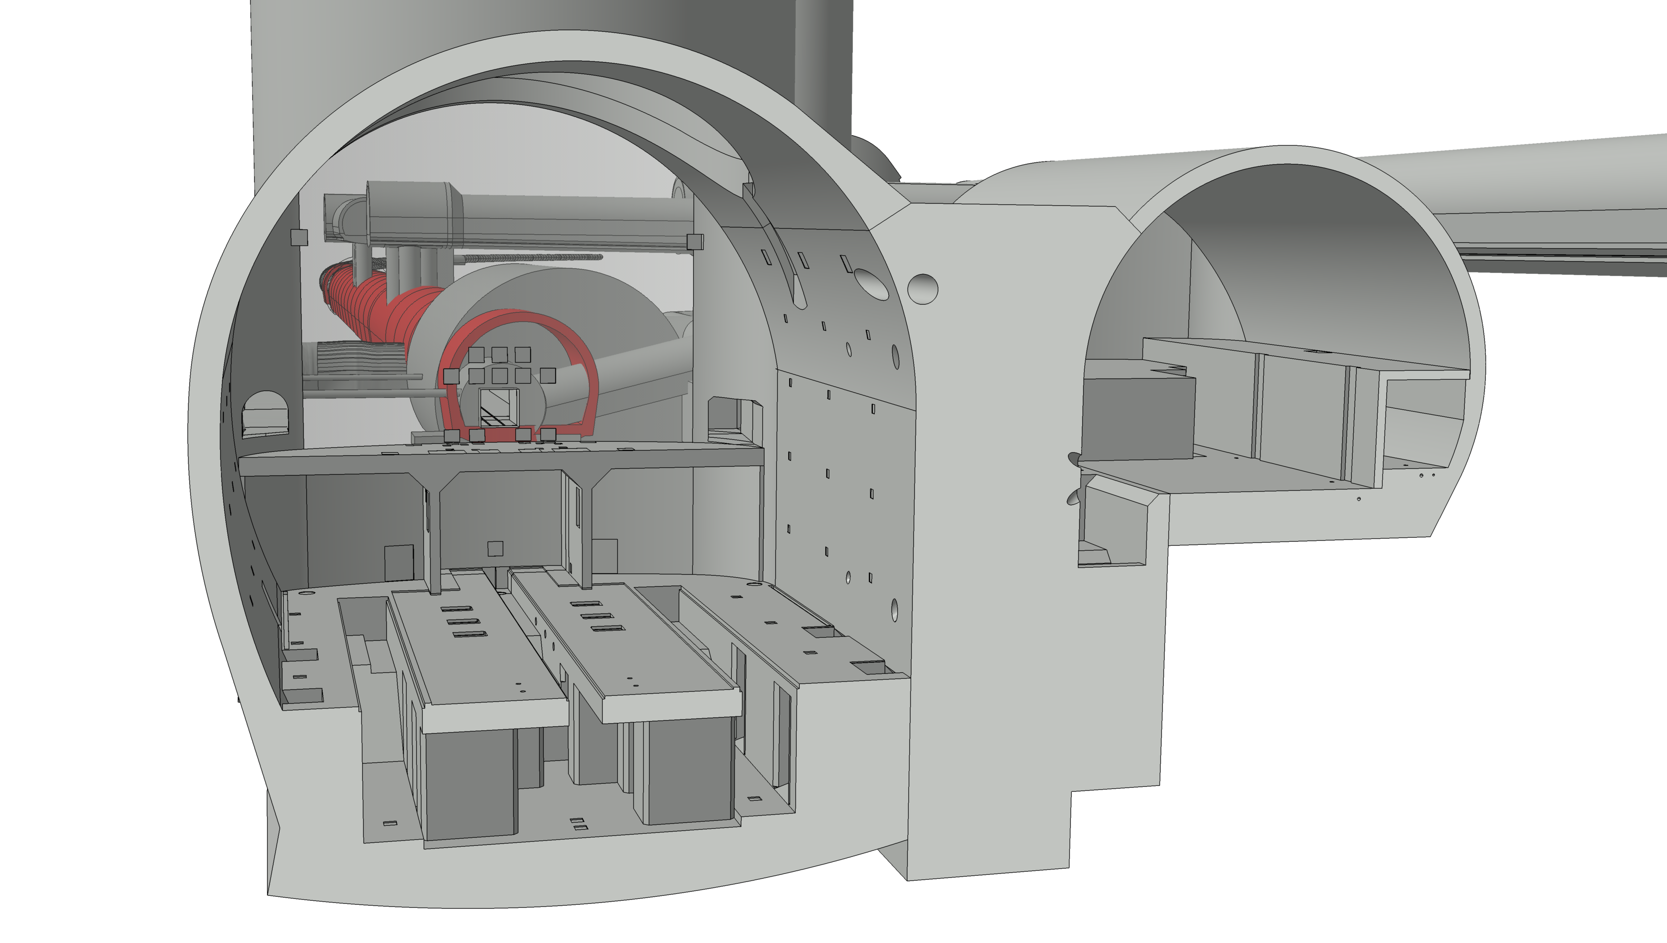
LEP3 booster in survey galleries ?
Section view
UXC55

Slide 13
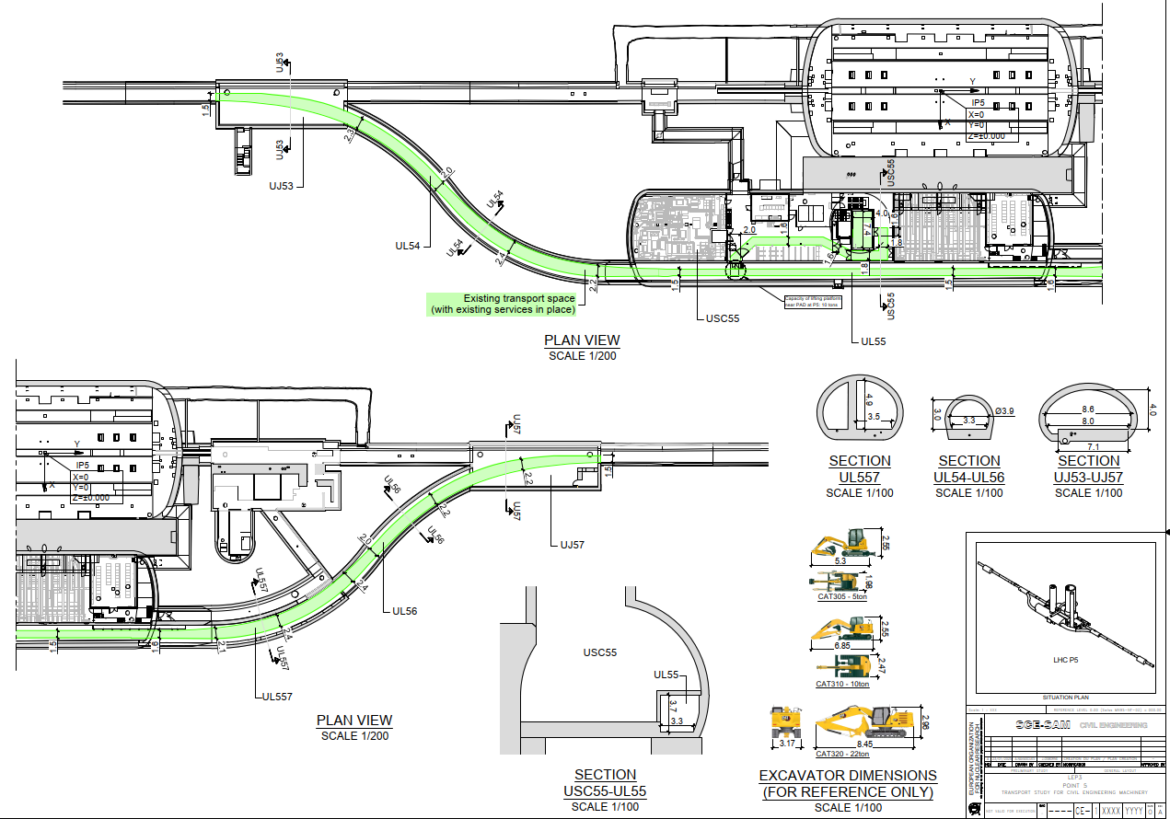
Access constraints - CMS

Slide 14
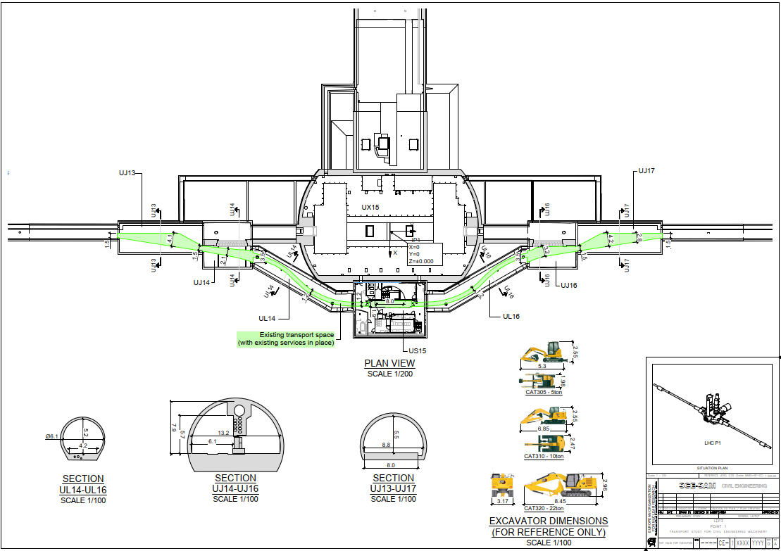
Access constraints - ATLAS

Slide 15
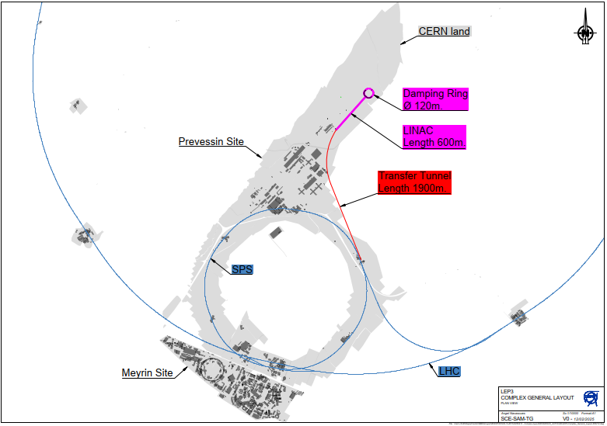
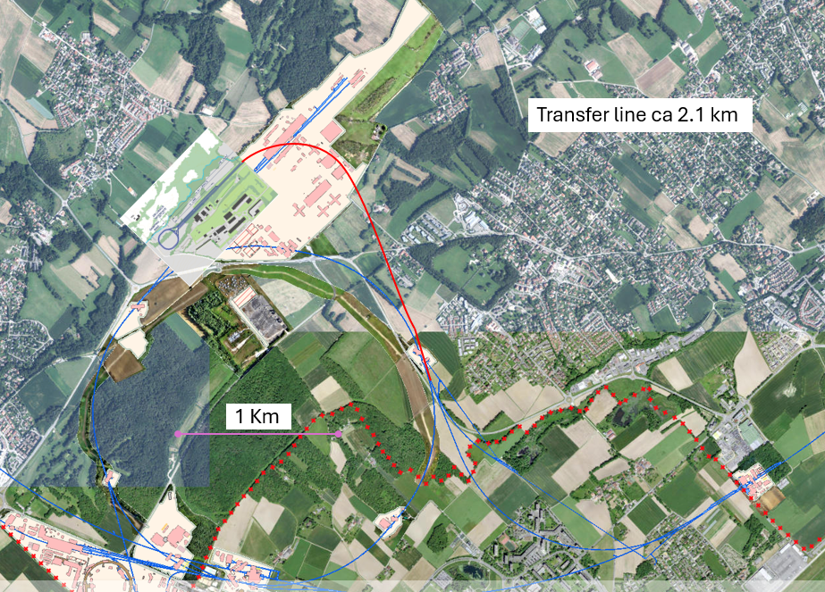
Possible options for Injection Complex and transfer tunnel to SPS/LEP3 via existing TI8
Credit : Paul Collier (using ‘FCC’ injector position)
Credit : Angel Navascues Cornago

Slide 16
LEP3
LSS Extension up to 2km
ATLAS-CMS

Slide 17
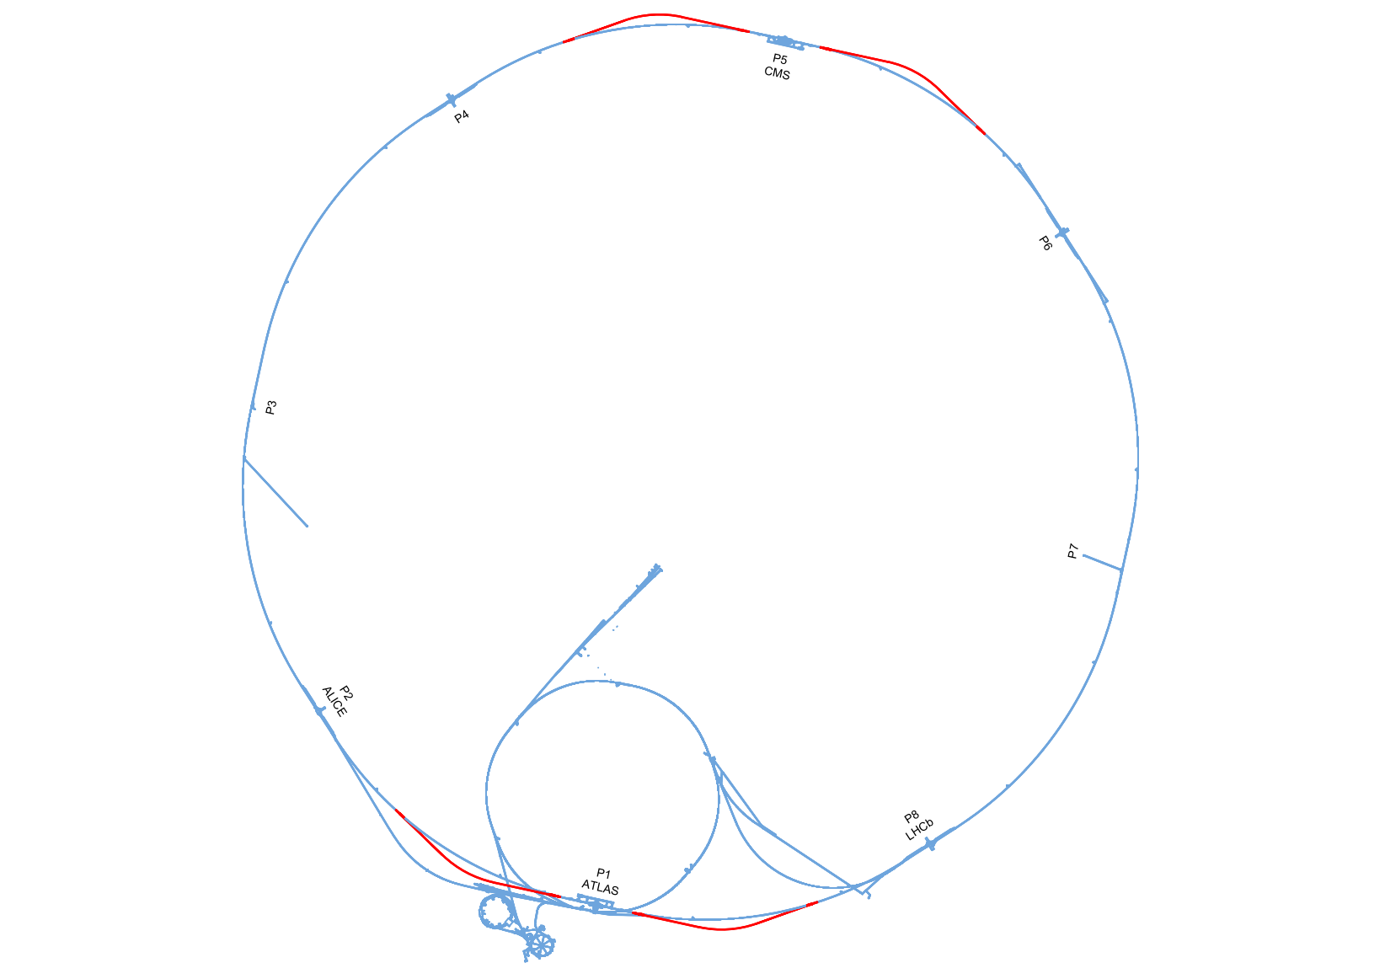

Slide 18
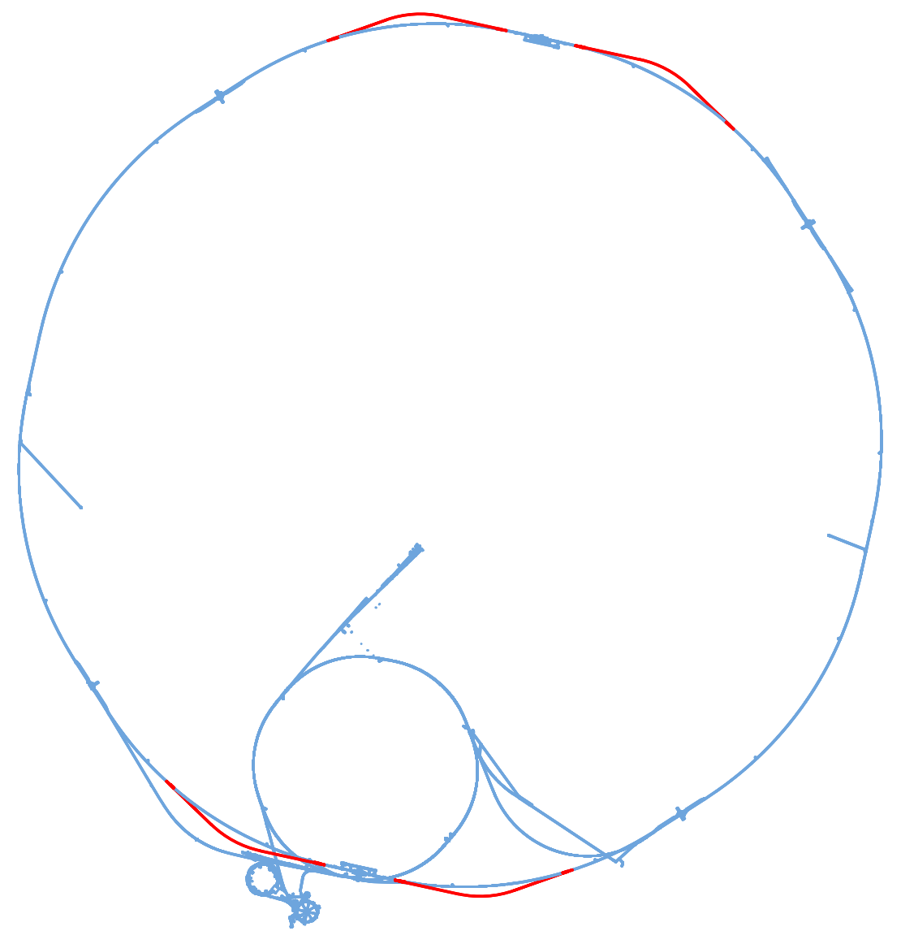
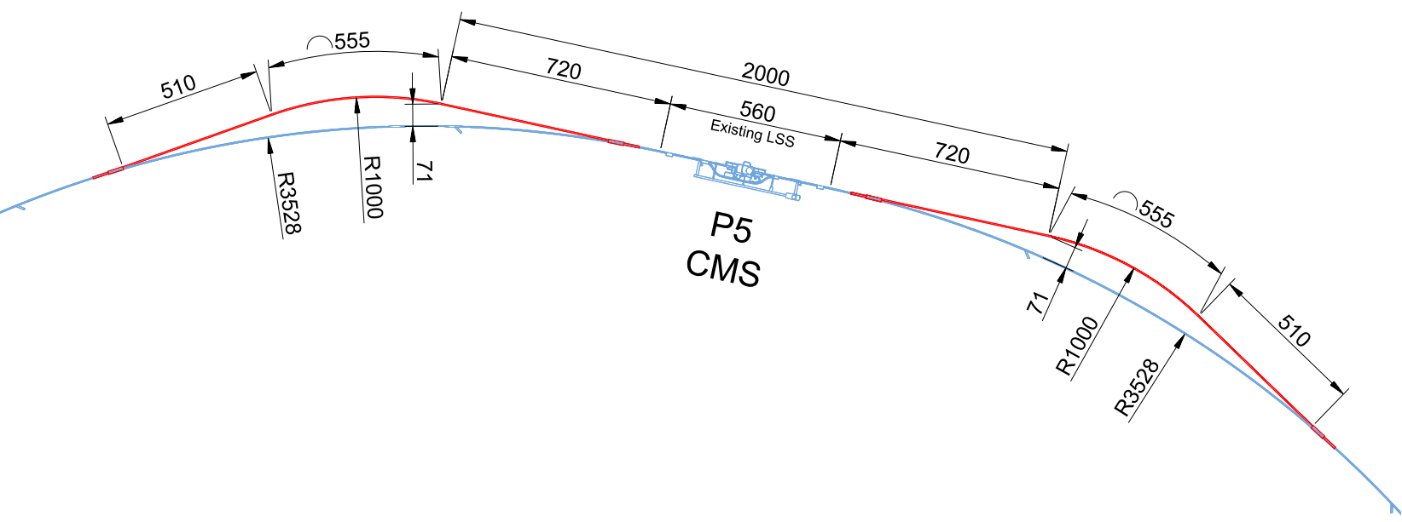
Junction cavern
Junction cavern
Junction cavern
Junction cavern

Slide 19
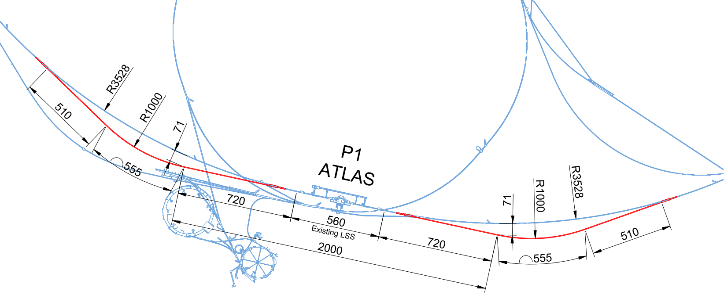
Junction cavern
Junction cavern
Junction cavern
Junction cavern

Slide 20
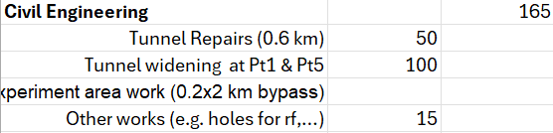
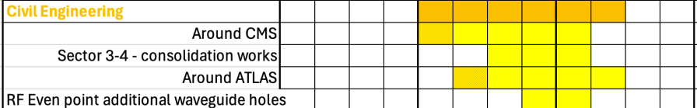
Next Steps
It appears that existing shafts can be used for the construction works, assuming no new shafts needed to route new services (maybe existing services need to be removed in the tunnels)
Serious tunnel integration study required (including RF tunnels) with machine lattice files
After this integration study, a more serious cost estimate can be produced with the assistance of external experts
Transport/logistic study
Injection complex/transfer tunnel to be developed
RP study needed for radioactive spoil/ construction methodology assessment
All existing infrastructure needs to be removed for civil works for tunnel enlargements
Initial cost and schedule estimate for European Strategy update 2025 :
1.5yrs needed for sector 3-4 repairs (not including removal of all equipment) removed.

Slide 21
BACK UP

Slide 22
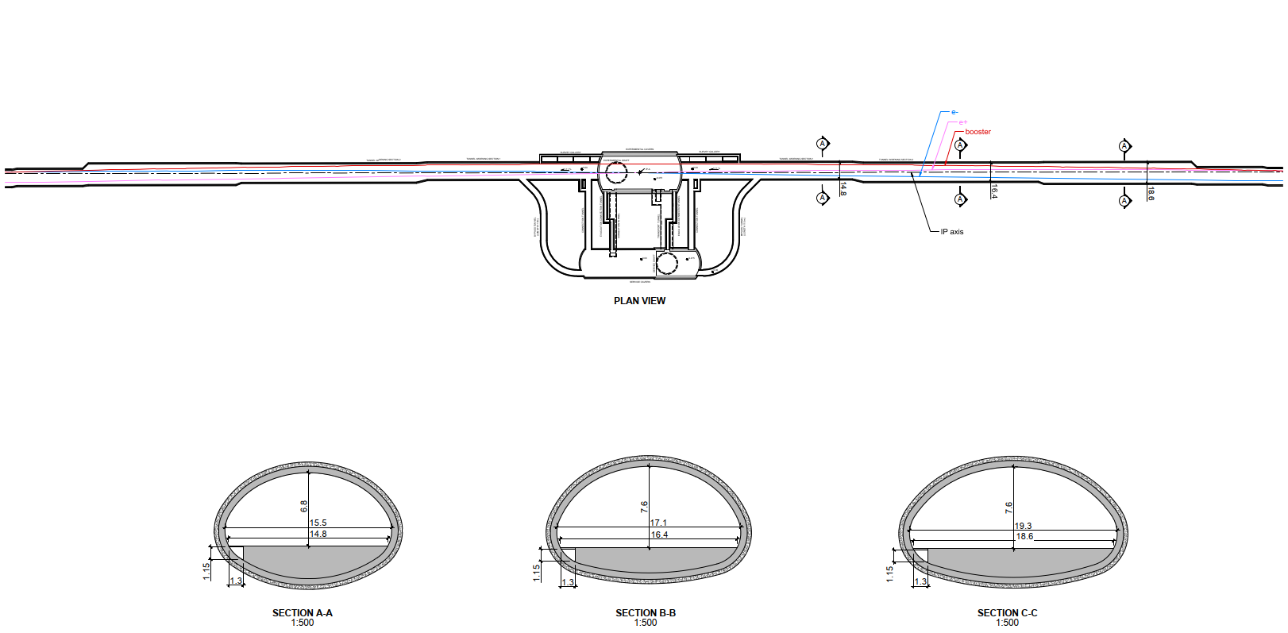
FCC tunnel widening

Slide 23
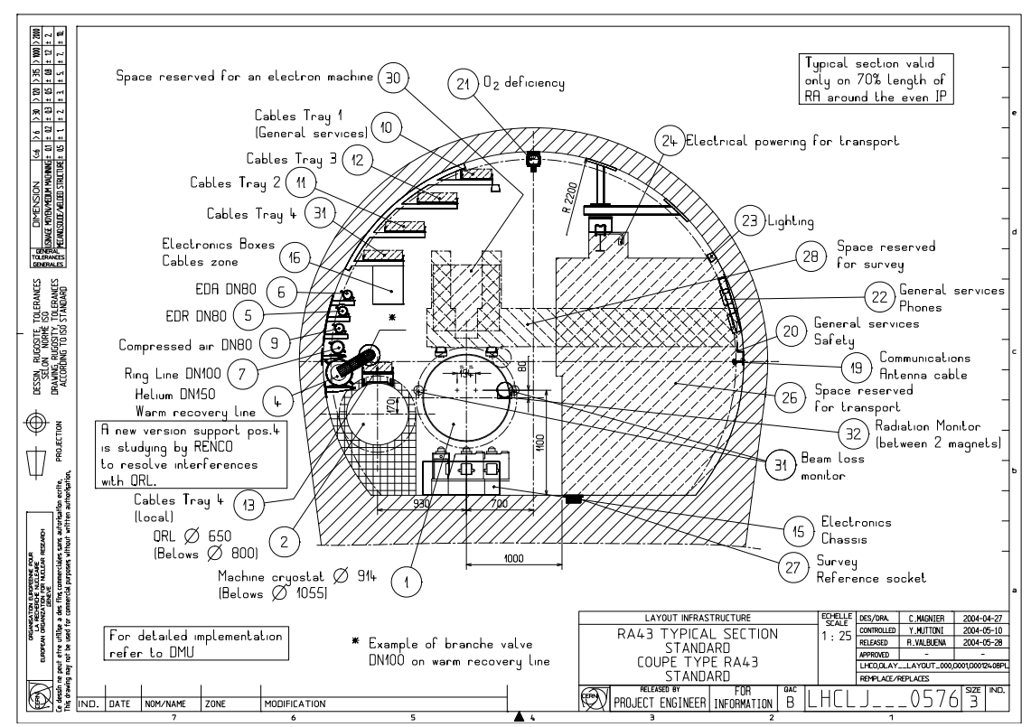
https://cernbox.cern.ch/index.php/s/L7XW1g6R2LMoBGt
All existing LHC cross sections can be found here :
For example RA43 :

