Slide 1
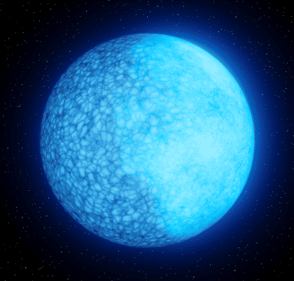
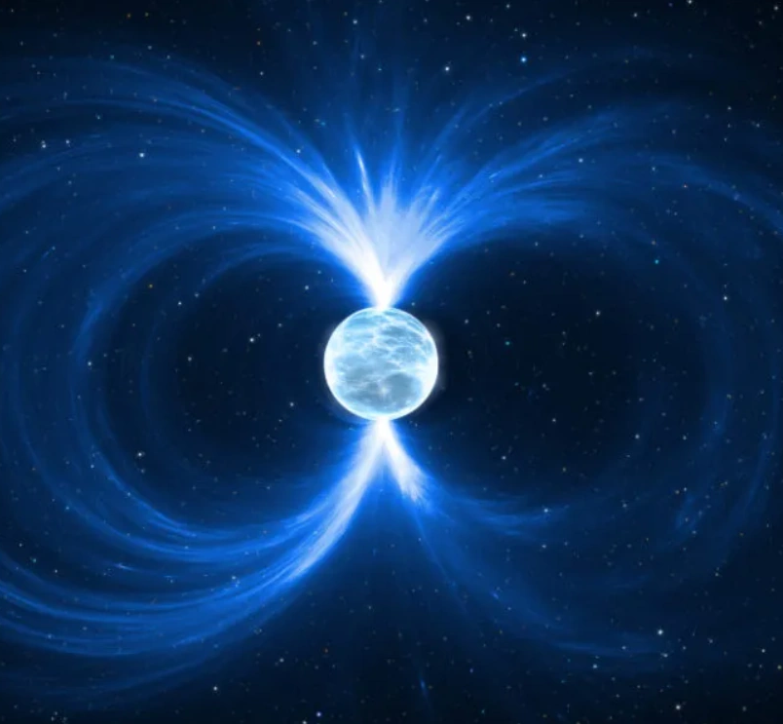
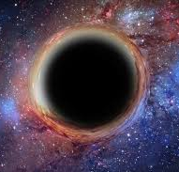
Probing WISPs with neutron stars
Jamie McDonald University of Manchester
1st UNDARK Workshop
Astrophysical Probes of Dark Sectors with Radiowave Observations | 29th September to 3rd October, 2025, La Laguna, Tenerife
3rd Training School COST Action COSMIC WISPers (CA21106) | 16–19 Sept 2025 Annecy

Slide 2
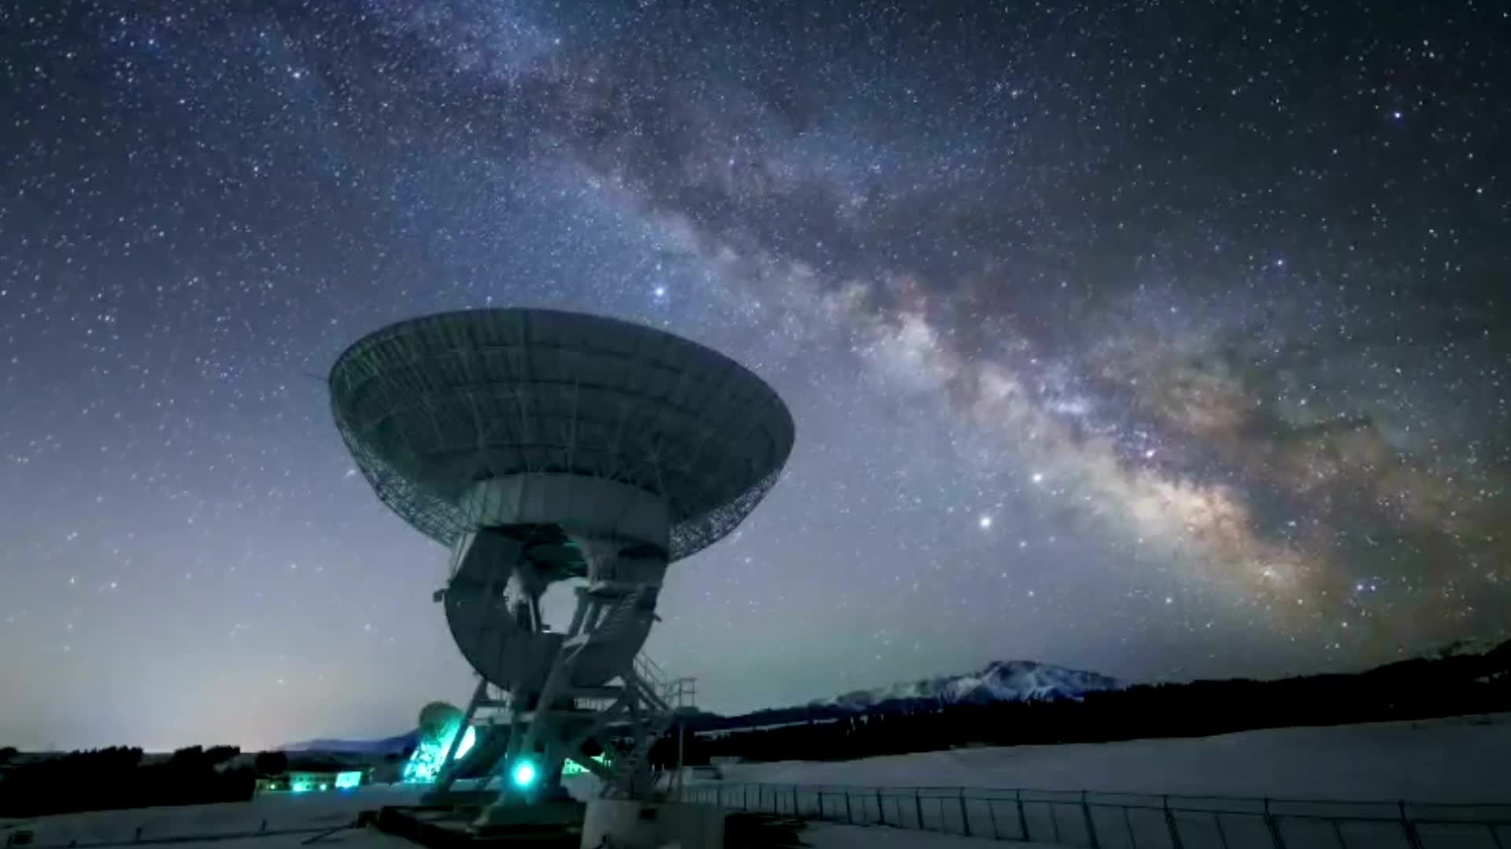
Contents
Superradiance in stars
Axion dark matter detection with neutron stars
Astrophysical Detection of High-Frequency Gravitational Waves

Slide 3
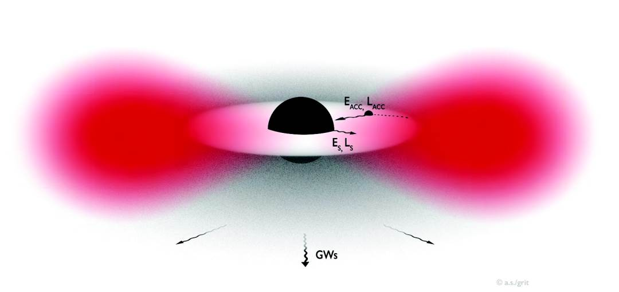
Superradiance

Slide 4
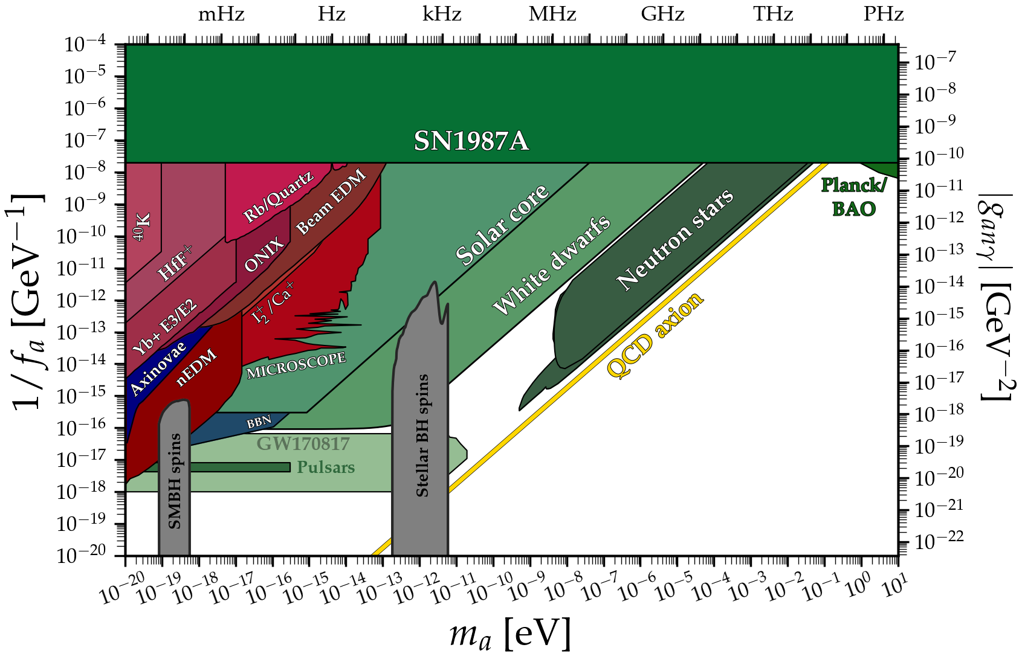
Constraining Axions with BH Superradiance
Exploring the String Axiverse with Precision Black Hole Physics
Arvanitaki, Dubovsky https://arxiv.org/abs/1004.3558
Bosenova collapse of axion cloud around a rotating black hole Yoshino, Kodama
https://arxiv.org/pdf/1203.5070
Discovering the QCD Axion with Black Holes and Gravitational Waves
Arvanitaki, Baryakhtar, Huang
https://arxiv.org/pdf/1411.2263
Superradiance
Brito, Cardoso, Pani
https://arxiv.org/pdf/1501.06570
Black hole superradiance of self-interacting scalar fields
Baryakhtar, Galanis, Lasenby, Simon https://arxiv.org/pdf/2011.11646
Superradiance Exclusions in the Landscape of Type IIB String Theory
Mehtaa, Demirtasb, Longb,Marsh, McAllister, Stott
https://arxiv.org/pdf/2011.08693
Properties of Ultralight Bosons from Heavy Quasar Spins via Superradiance
Unal, Pacucci, Loeb
https://arxiv.org/pdf/2012.12790
Getting More Out of Black Hole Superradiance: a Statistically Rigorous Approach to Ultralight Boson Constraints
Hoof, Marsh, Sisk-Reynés, Matthews, Reynolds
https://arxiv.org/pdf/2406.10337
Stepping Up Superradiance Constraints on Axions Witte, Mummery
https://arxiv.org/pdf/2412.03655

Slide 5
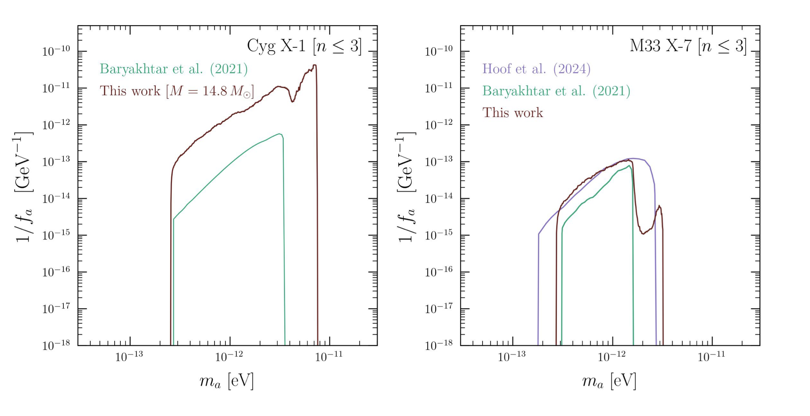
Constraints on Light Fields - State of the art
Superradiance - Kerr Black Holes
See Sam Witte’s talk
https://arxiv.org/pdf/2412.03655

Slide 6
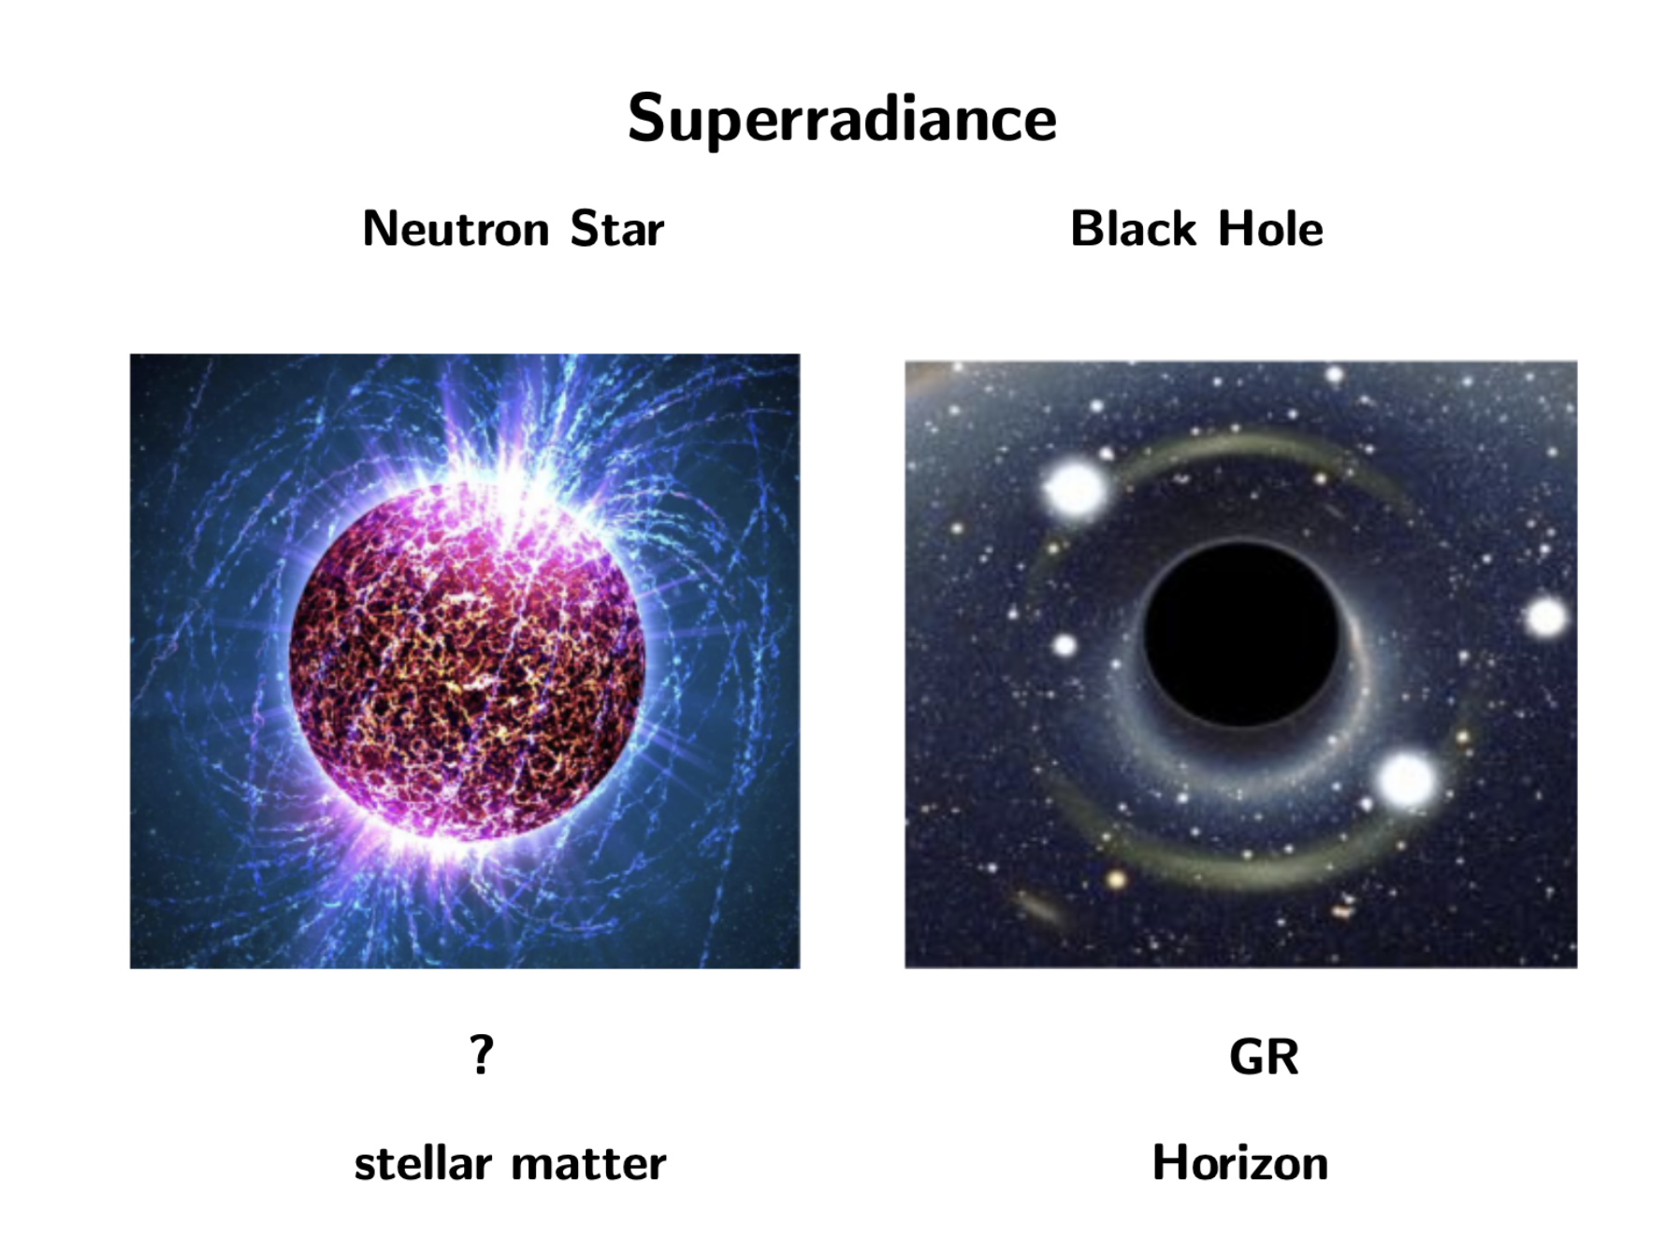
Superradiance in Stars

Slide 8
Superradiance in Stars
Superradiance in Stars: Non-equilibrium approach to damping of fields in stellar media
Chadha-Day, Garbrecht, JM
JCAP 12 (2022) 008
Superradiance in Stars
Cardoso, Brito, Rosa
Phys. Rev. D 91 (2015) 12, 124026
Superradiance in rotating stars and pulsar-timing constraints on dark photons
Cardoso, Pani, Yu
Phys. Rev. D 95, 124056 (2017)
Axion Superradiance in Rotating Neutron Stars
Day, JM
JCAP 10 (2019) 051
Particle Probes with Superradiance Pulsars
Kaplan, Rajendran, Riggins
[hep-ph1908.10440]

Slide 9
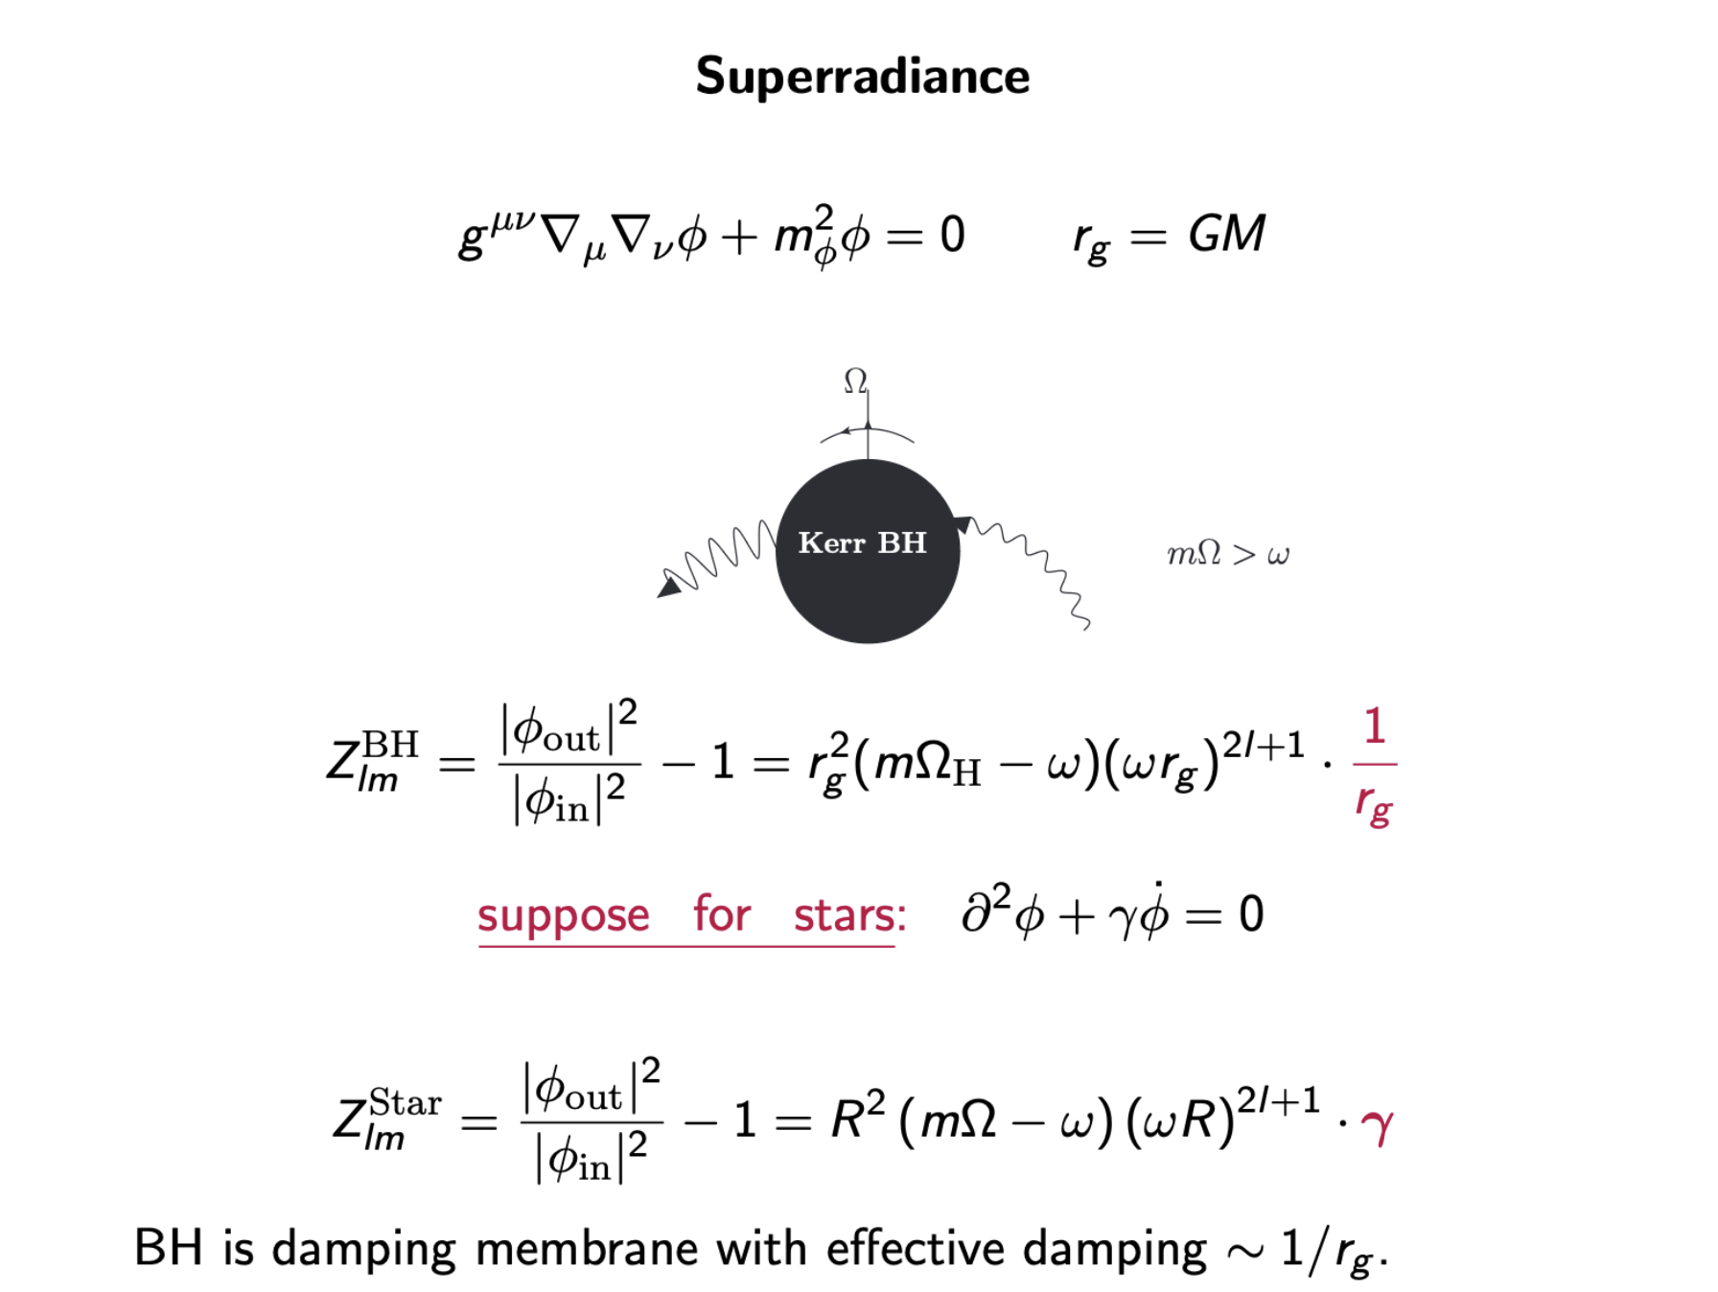
Cardoso, Brito, Rosa Phys. Rev. D 91 (2015) 12, 124026

Slide 10
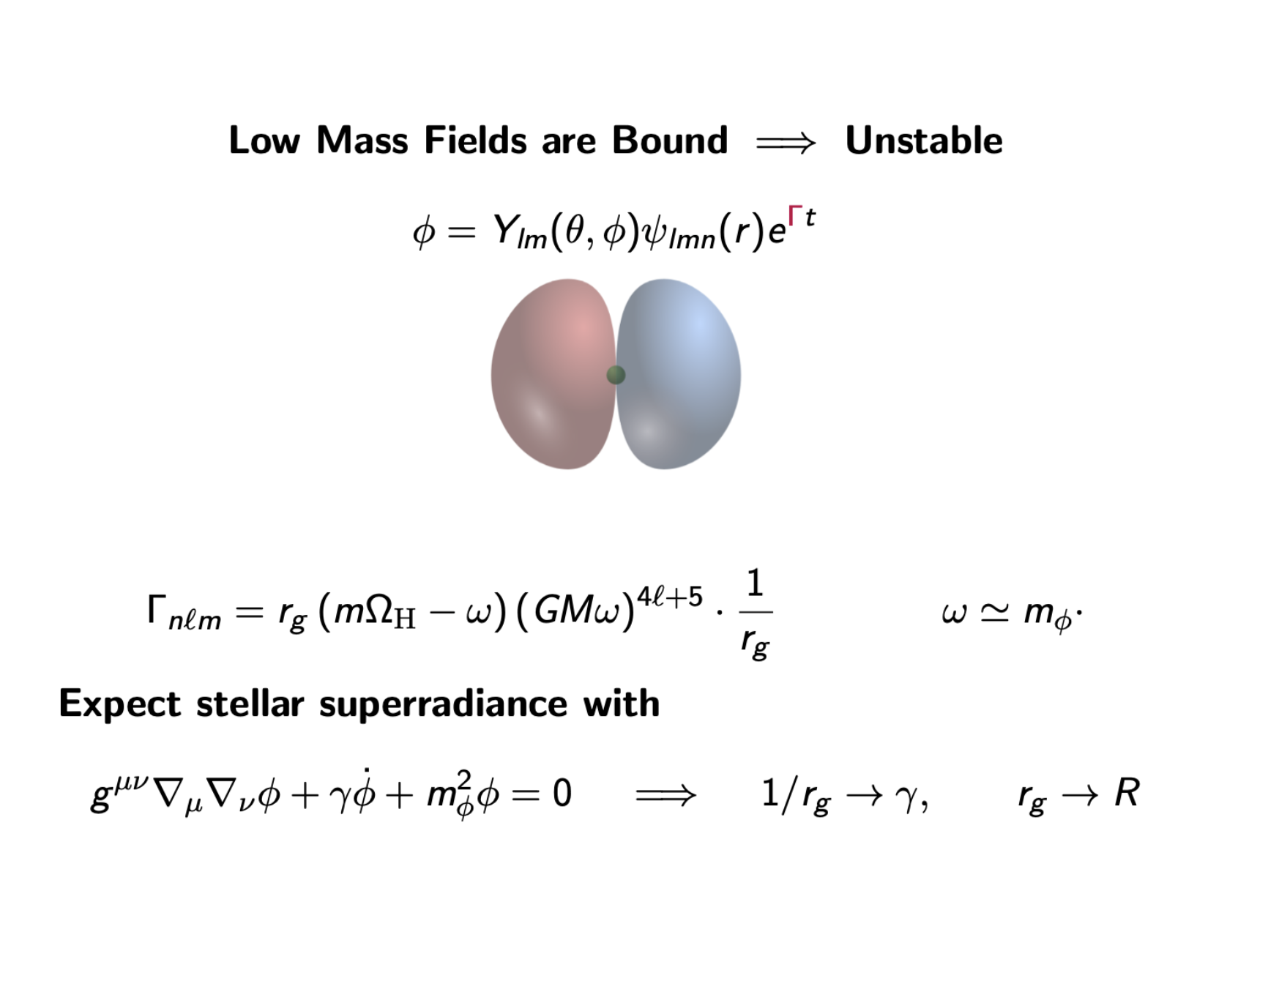

Slide 11
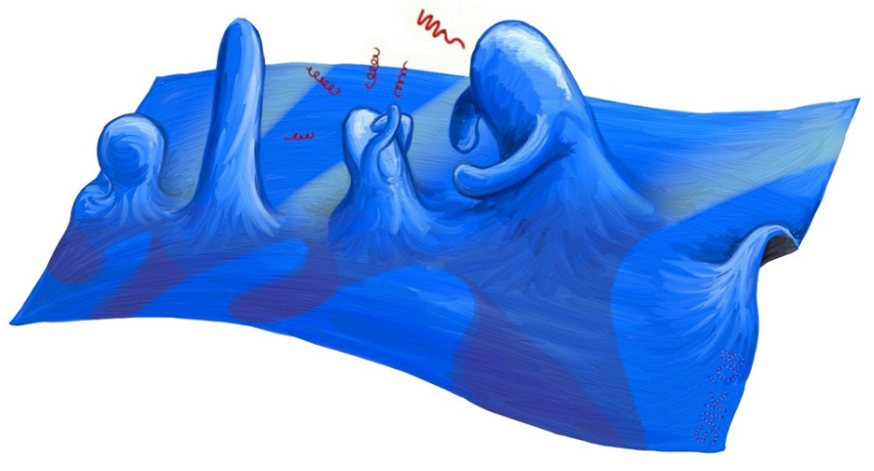
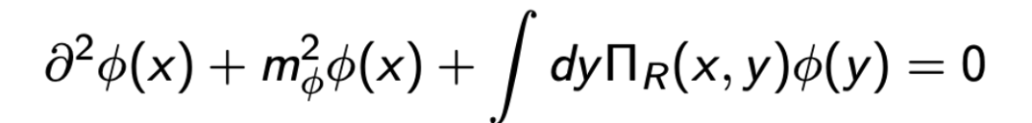
Path Integral
$Z=∫dφ ∫dψ d\overline{ψ} e^{S[ψ , φ]}$
Non-Eq QFT
$$φ$$
$$ψ$$
Dynamical Equation for $φ$
Superradiance in Stars: Non-equilibrium approach to damping of fields in stellar media
Chadha-Day, Garbrecht, JM, (2022)

Slide 12
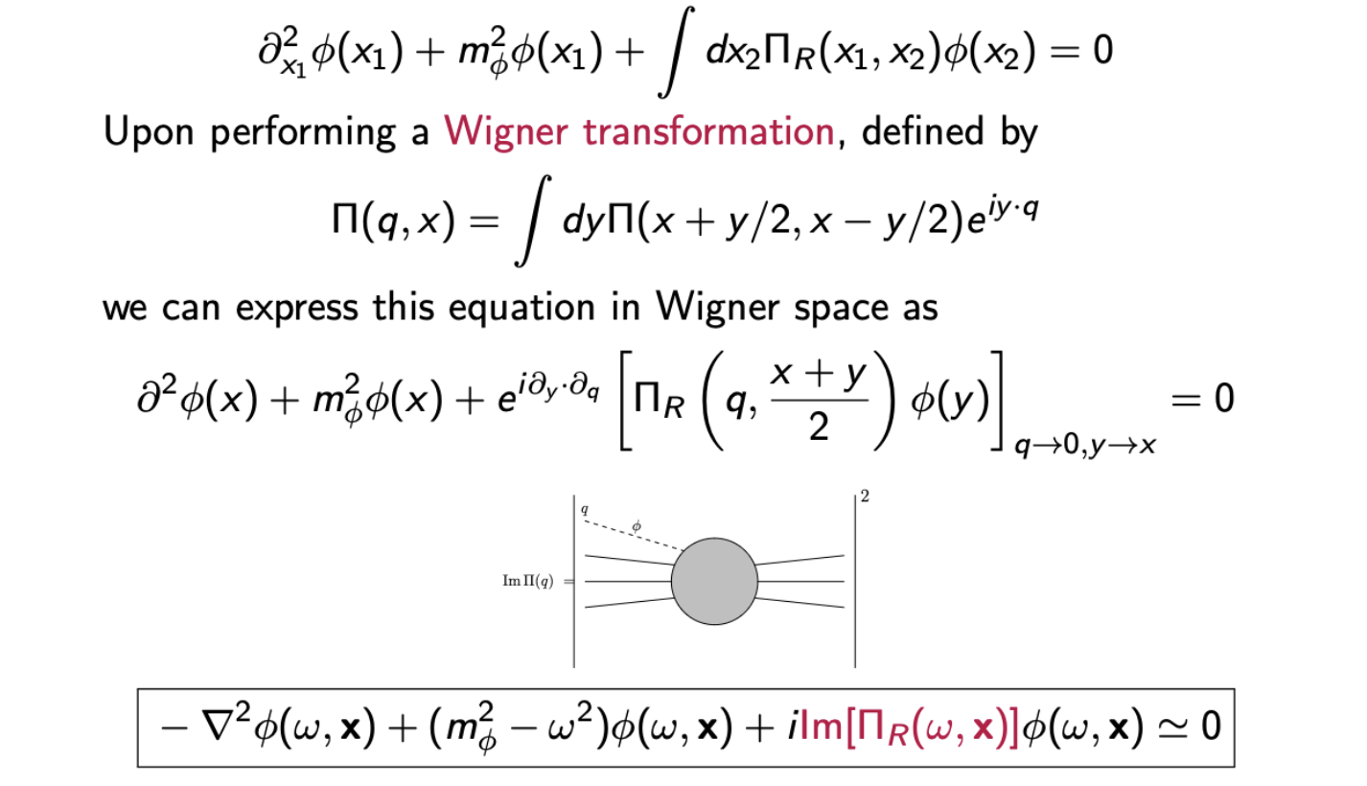
$$x=\frac{x_{1}+x_{2}}{2}$$
$$y=x_{1}−x_{2}$$

Slide 13
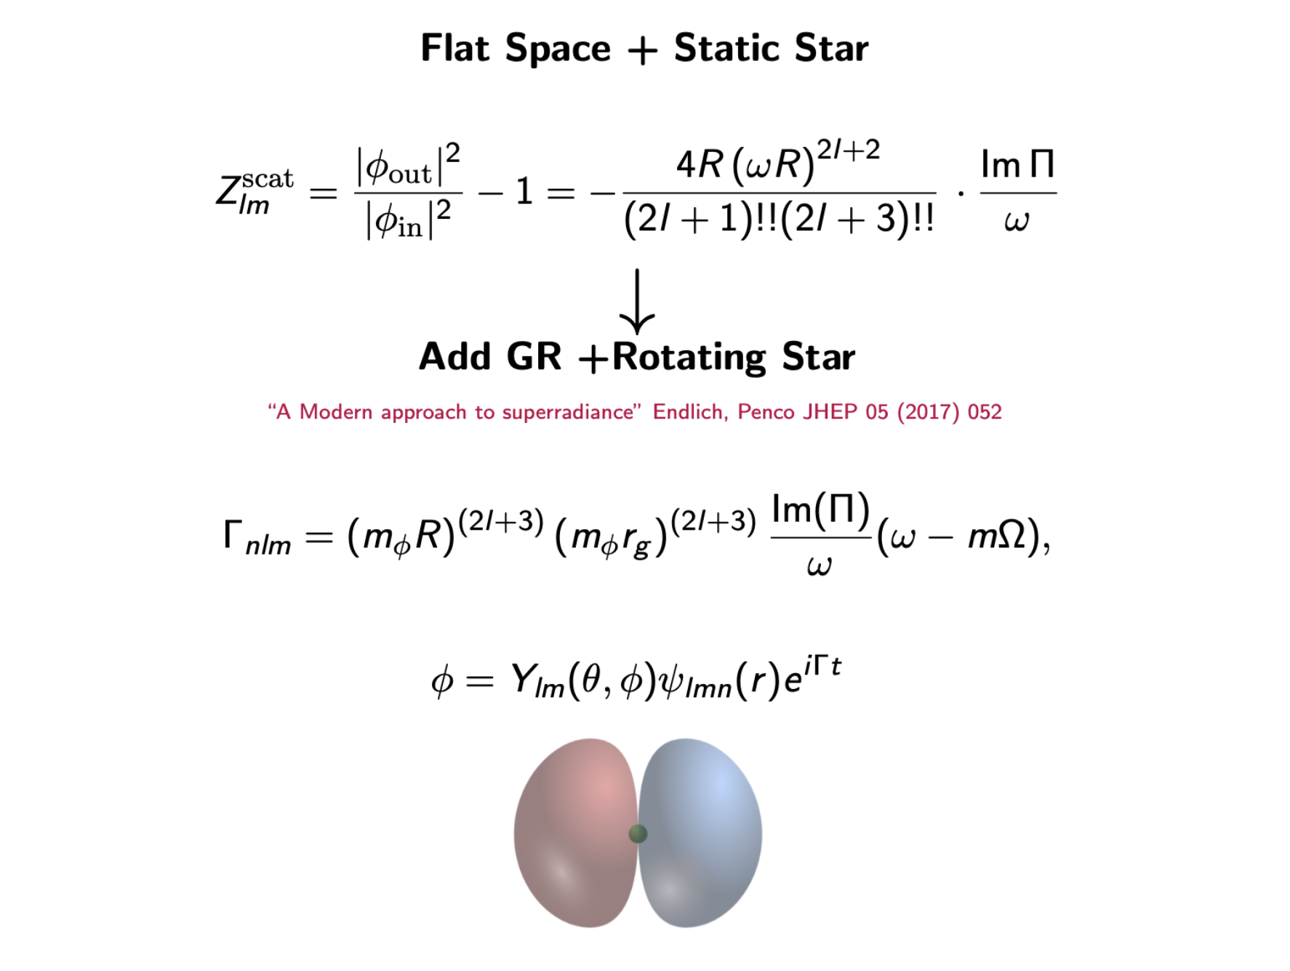

Slide 14
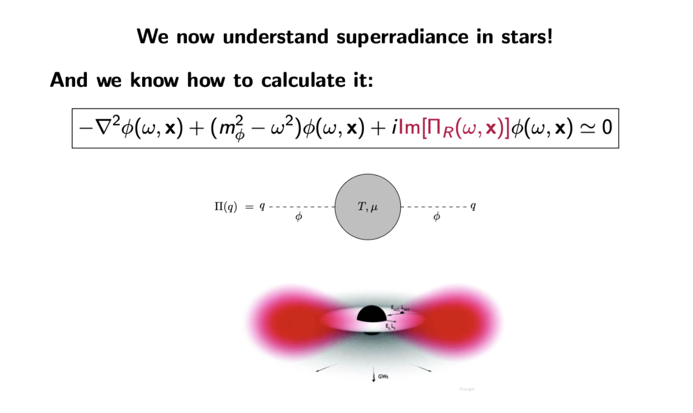

Slide 15
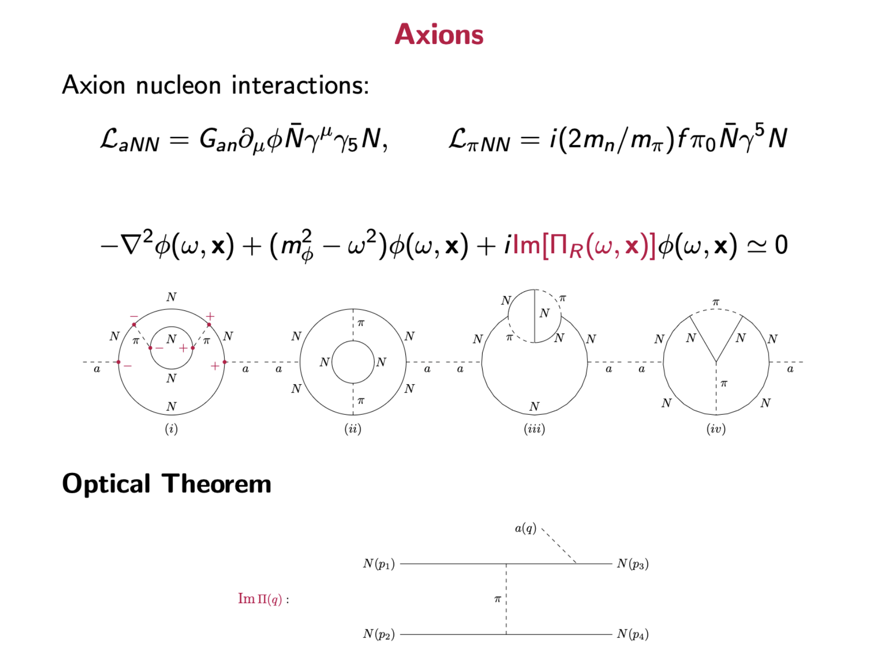

Slide 16
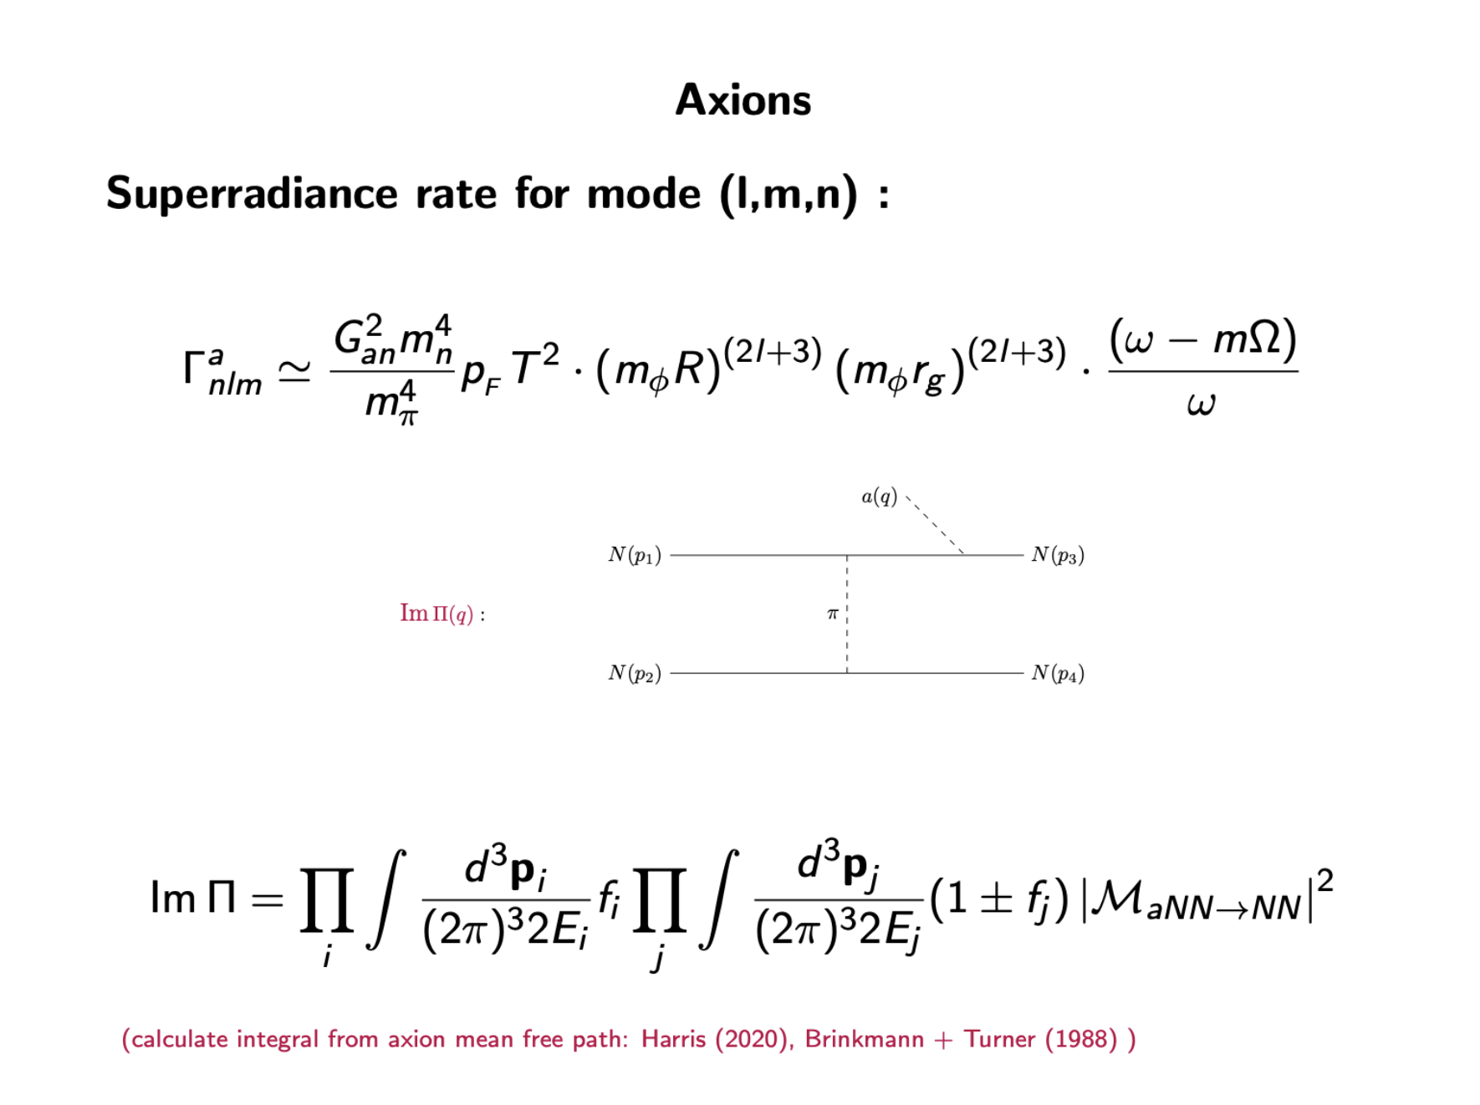

Slide 17
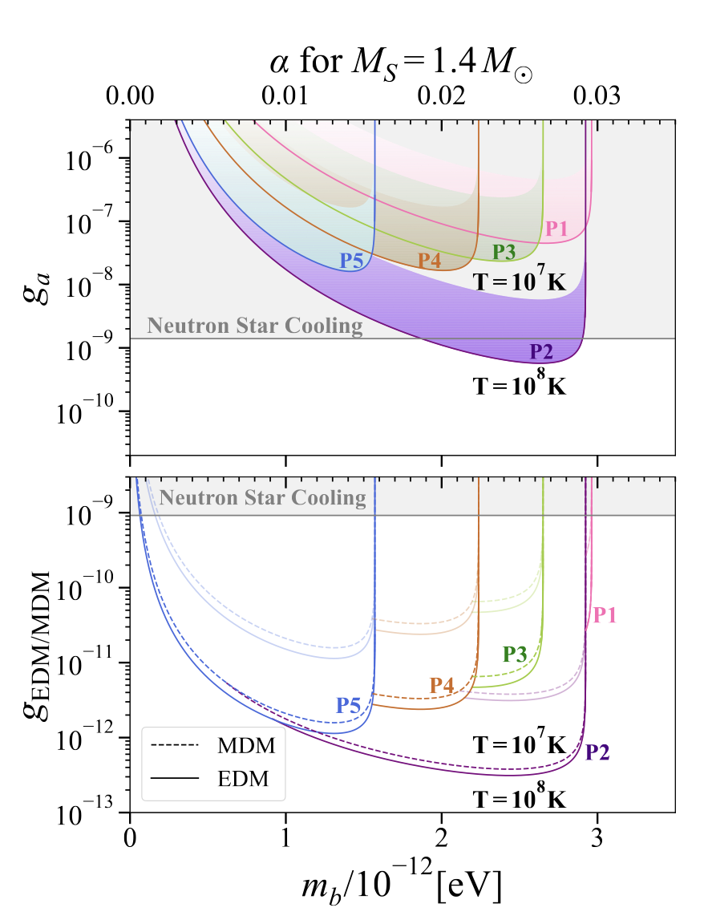
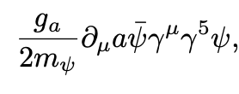
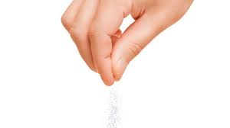
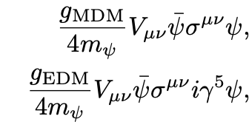
Superradiance Constraints on Other Interactions with Bosons Bai, Cardoso , Chen, Li, JM, Seong (to appear soon)
Preliminary
Preliminary

Slide 18
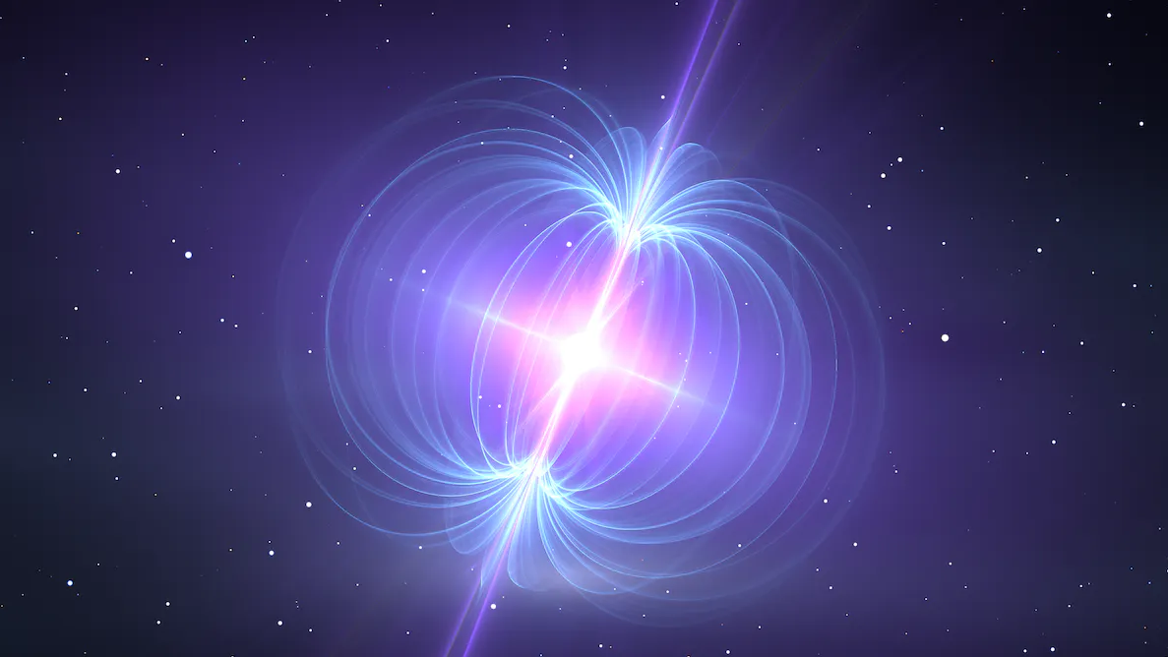
Axion DM Detection with Neutron Stars

Slide 19
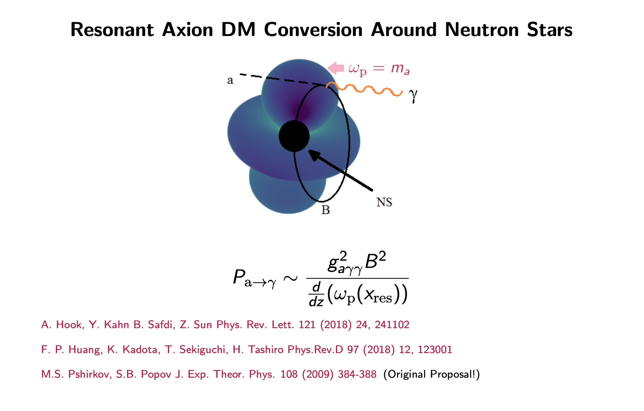
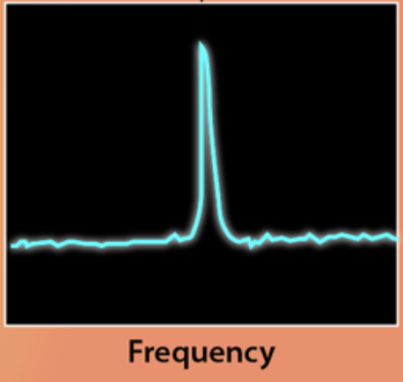
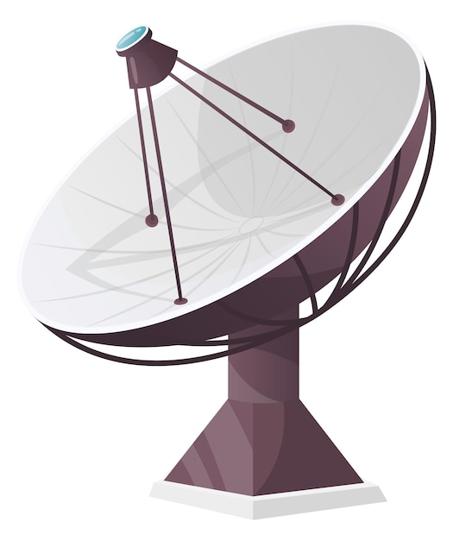
L $=−\frac{g_{aγγ}}{4} a F^{μν}{ \tilde{F }}_{μν}$
= $g_{aγγ}a E.B$
$P_{a→γ}∼{ g}_{aγγ}^{2}B^{2}L_{res}^{2}$ $L_{res}^{2}∼1/∇ω_{p}$
Early Proposals:

Slide 20
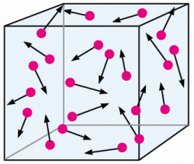
Kinetic Theory
$f_{γ}=f_{γ}$(k , x)
$∂_{t} f_{γ}+v_{γ}⋅∇_{x}{ f}_{γ}+F_{γ} . ∇_{k}f_{γ}=C_{a}$ $f_{a}$
$$a$$
$$γ$$
$$C_{a}∼{ g}_{aγγ}^{2} δ\left(E_{γ}^{2}−E_{a}^{2}\right){E_{γ}\left|ε_{γ}.B\right|}^{2}$$
$$B$$
Photons
[JM, Millington, Garbrecht, JCAP 12 (2023) 031]

Slide 21
Kinetic Theory
$f_{γ}=f_{γ}$(k , x)
$$\frac{dx_{γ}}{dt}=v_{g}, \frac{dk_{γ}}{dt}=F_{γ}=−∇_{x}E_{γ}\text{:}$$
$$C_{a}∼{ g}_{aγγ}^{2} δ\left(E_{γ}^{2}−E_{a}^{2}\right){E_{γ}\left|ε_{γ}.B\right|}^{2}$$
$$\frac{df_{γ}}{dt}=C_{a}f_{a}$$
Boltzmann Eq.
$$P_{a→γ}^{3D}=f_{γ}/f_{a}∼\frac{{ g}_{aγγ}^{2}{E_{γ}\left|B⋅ε_{γ}\right|}^{2}}{|{k ⋅ ∇}_{x}E_{γ}|}$$
[JM, Millington, Garbrecht, JCAP 12 (2023) 031]

Slide 22
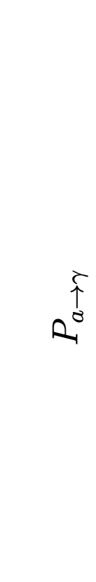
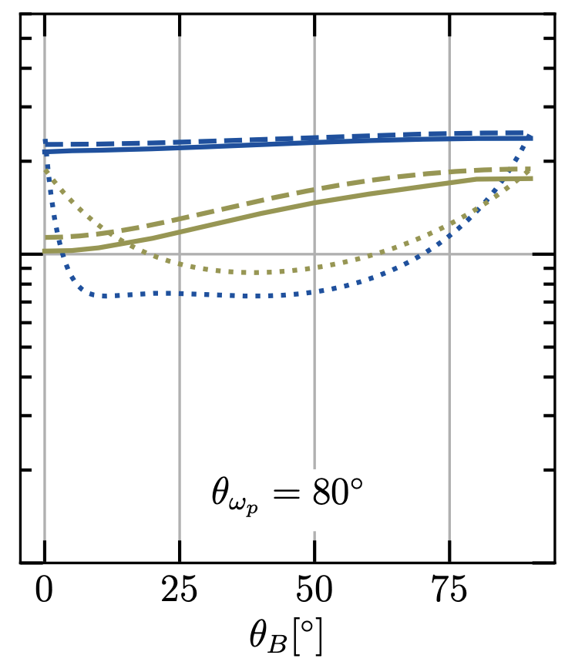
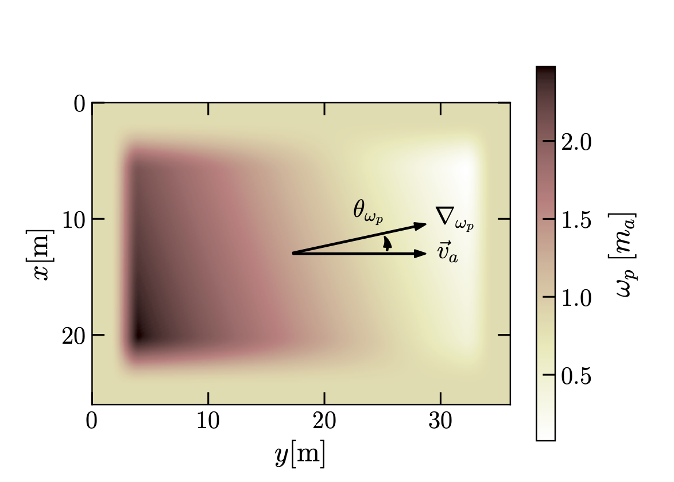
Comparison With Numerical Studies
Kinetic Theory (2023) = Classical (2024)
JM, Millington, Garbrecht
Numerical (2024)
Gines, Noordhuis, Weniger, Witte
(2021)
Millar, Baum, Lawson, Marsh JCAP 11 (2021) 013
(different colours = different axion velocities)

Slide 23
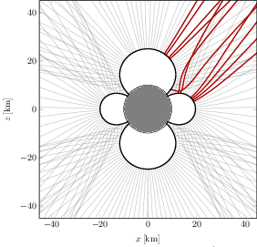

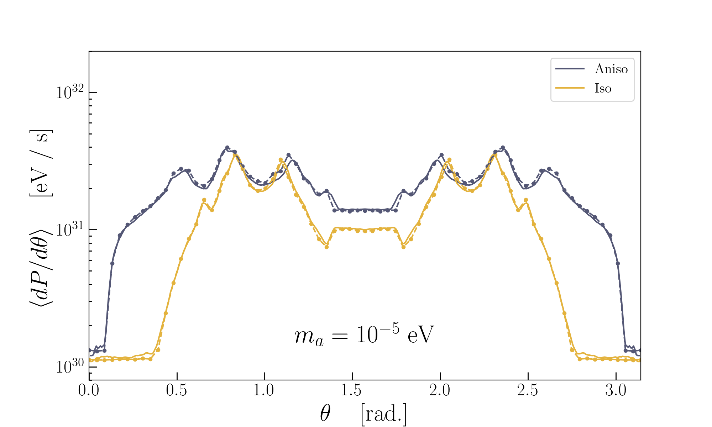
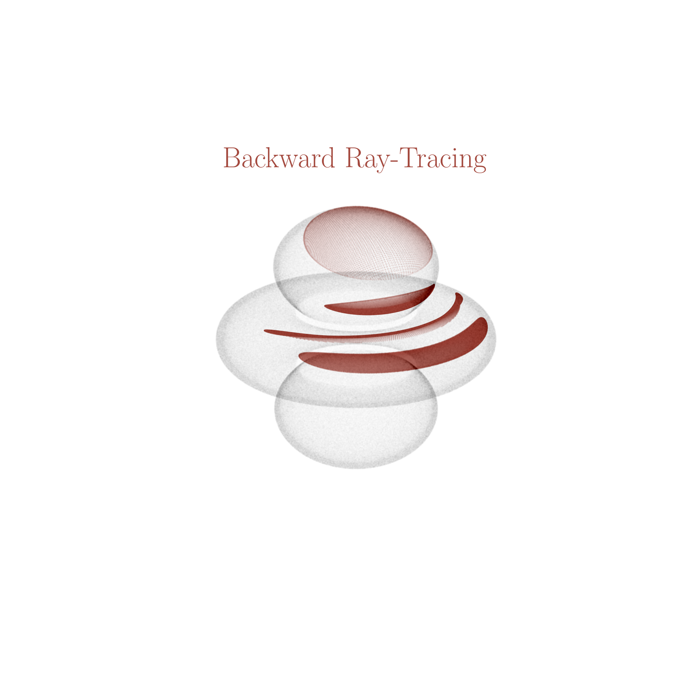

Progerss in Numerical Simulations
[JM, S. J. Witte, Phys. Rev. D 108 (2023) 10, 103021]
$$\frac{dx_{γ}}{dt}=v_{g}, \frac{dk_{γ}}{dt}=−∇_{x}E_{γ} \\ E_{γ}^{2}=k^{2}+ω_{p}^{2}+[k^{4}+ω_{p}^{4}+k^{2}ω_{p}^{2}(1 −2 {\left(\hat{k}.\hat{B}\right)}^{2}]$$
Curved Spacetime Effects
JM’s code
SW’s code
Anisotropic plasma effects
Emitted Power
Latest Expression for $P_{a→γ }^{3D}$
$$Ω$$
$$θ$$
[observing direction of star]

Slide 24
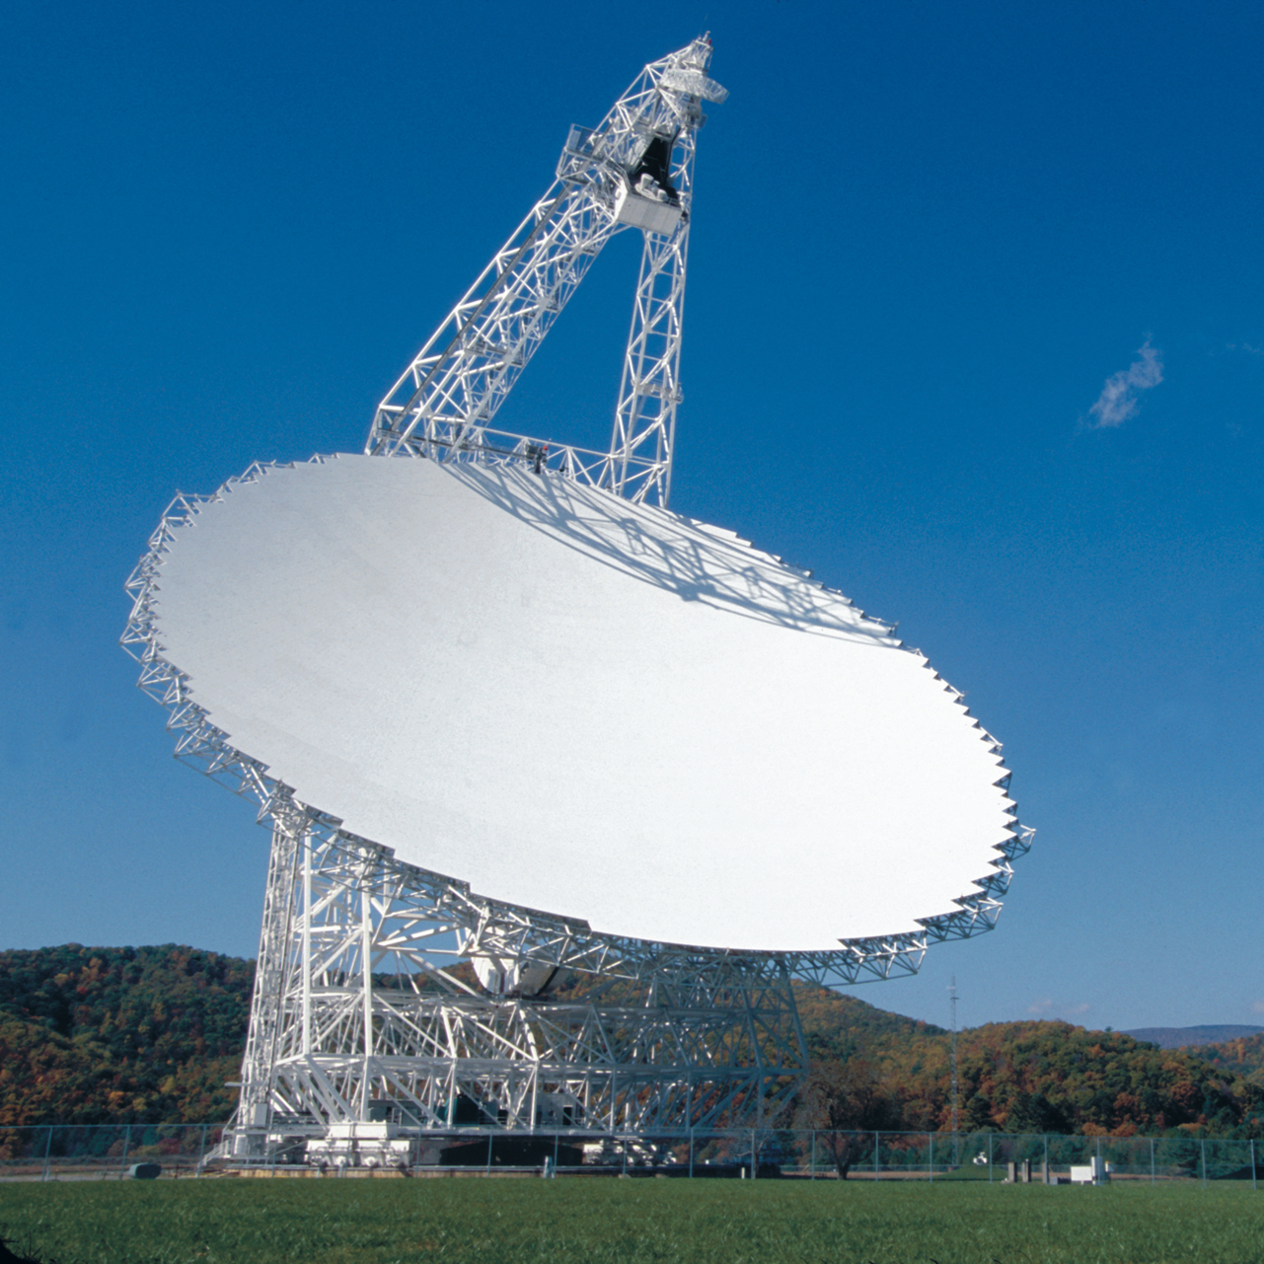
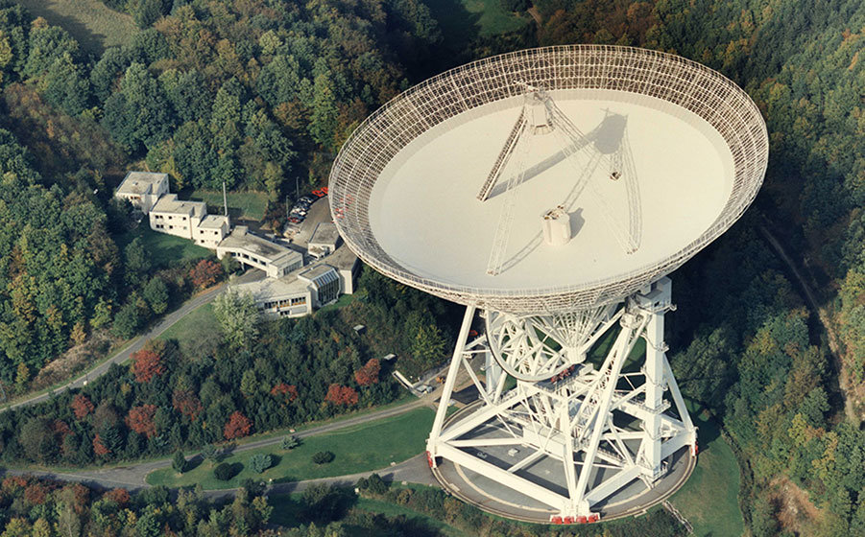
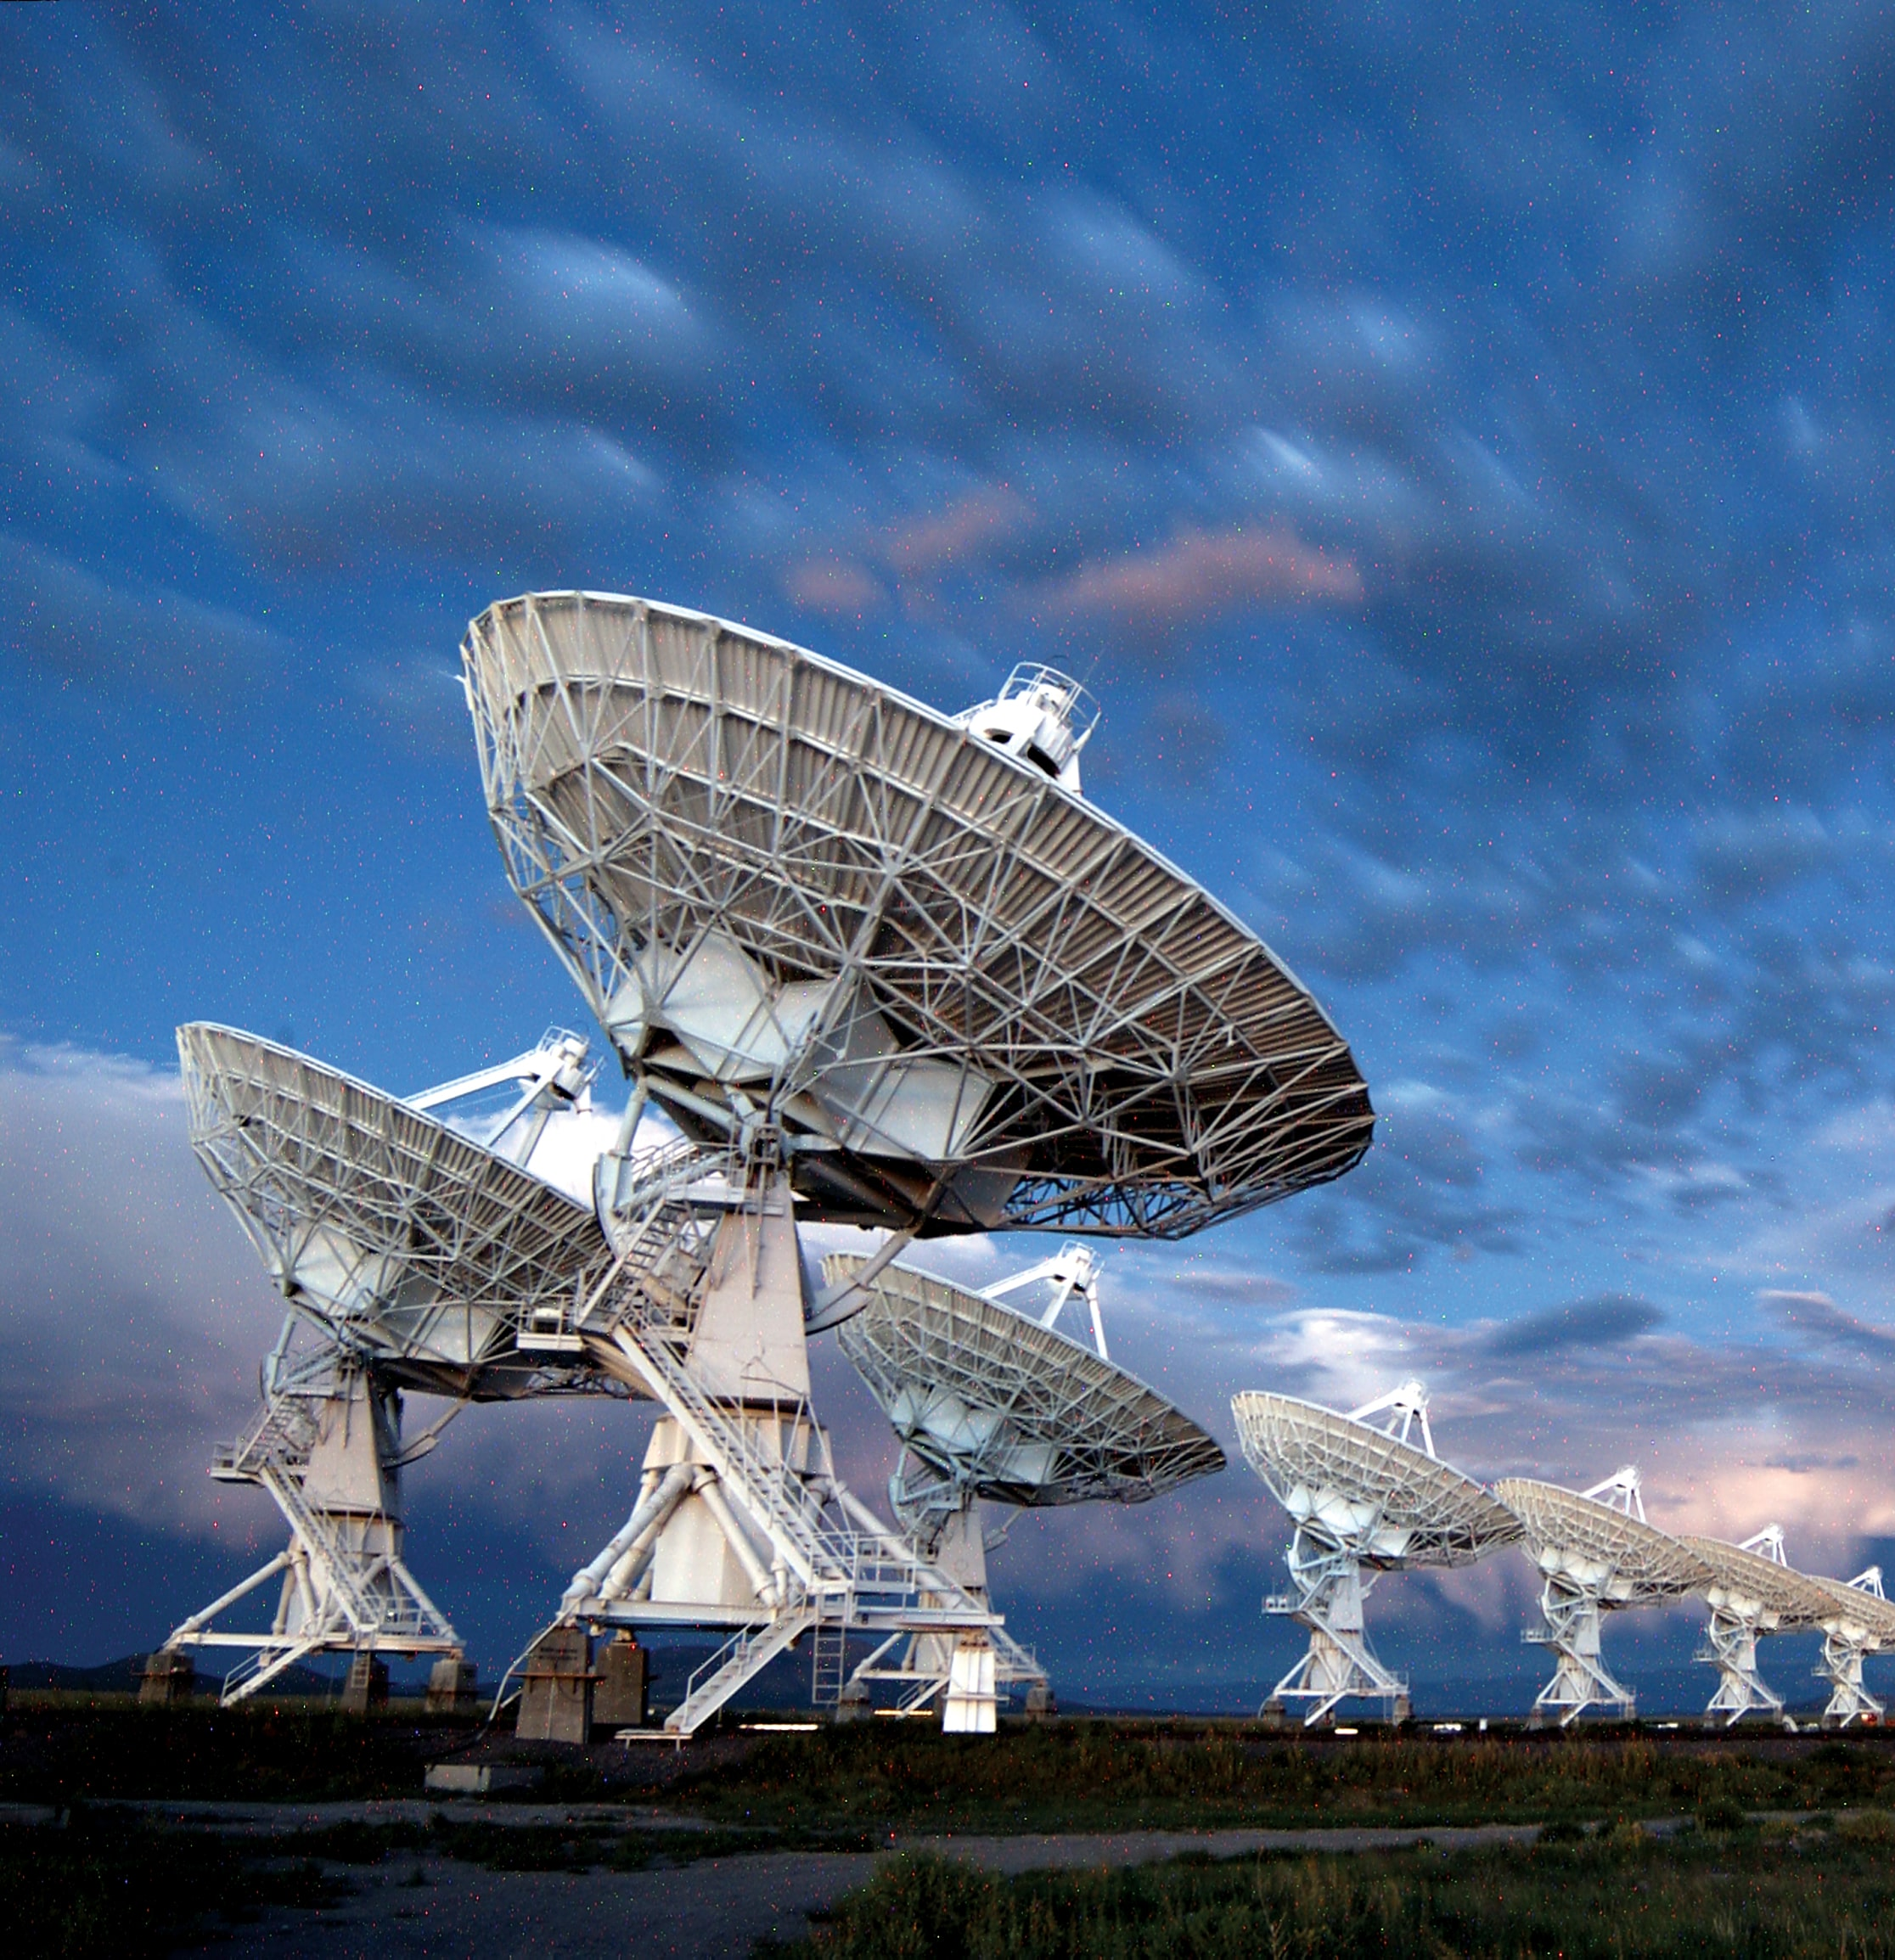
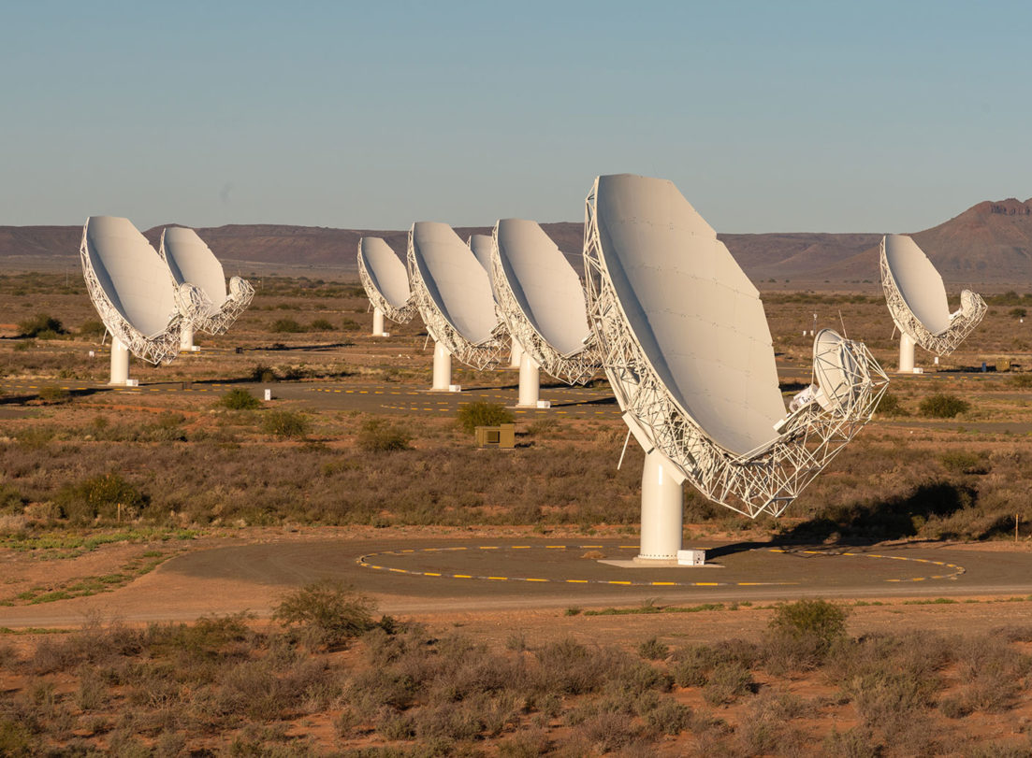
Observations: Axion Dark Matter
Stellar Populations
Foster et al, Phys. Rev. Lett. 129, 251102 (2022)
[GBT, Galactic Centre]
Foster et al Phys. Rev. Lett. 125 (2020) 17, 171301]
[GBT, Effelsberg, Galactic Centre + Isolated NSs]
Battye, Bhura, JM, Srinivasan JCAP 11 (2024) 029
Single Objects
Darling [Phys. Rev. Lett. 125 (2020) 12, 121103]
Battye, Darling, JM, Srinivasan
[Phys. Rev. D 105 (2022) 2, L021305] [Galactic Centre Magnetar, VLA, PSR J1745−2900]
Battye, Keith, JM, Srinivasan, Stappers, Weltevrede
[Phys. Rev. D 108 (2023) 6, 063001]
[MeerKAT, matched-filter/time-domain search PSR J2144-3933]
Green Bank Telescope (GBT) - USA
Effelsberg - Germany
Very Large Array (VLA) - USA
MeerKAT – S. Africa

Slide 25
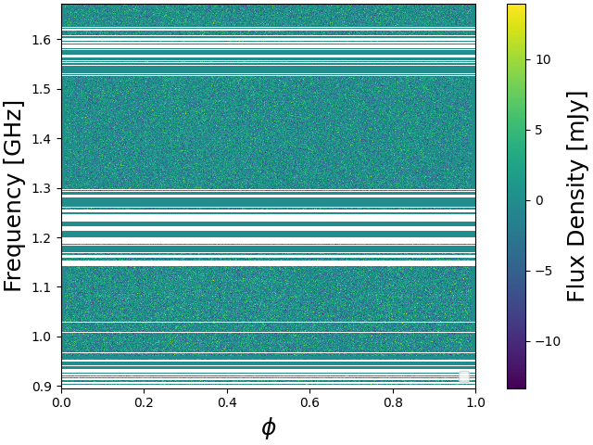
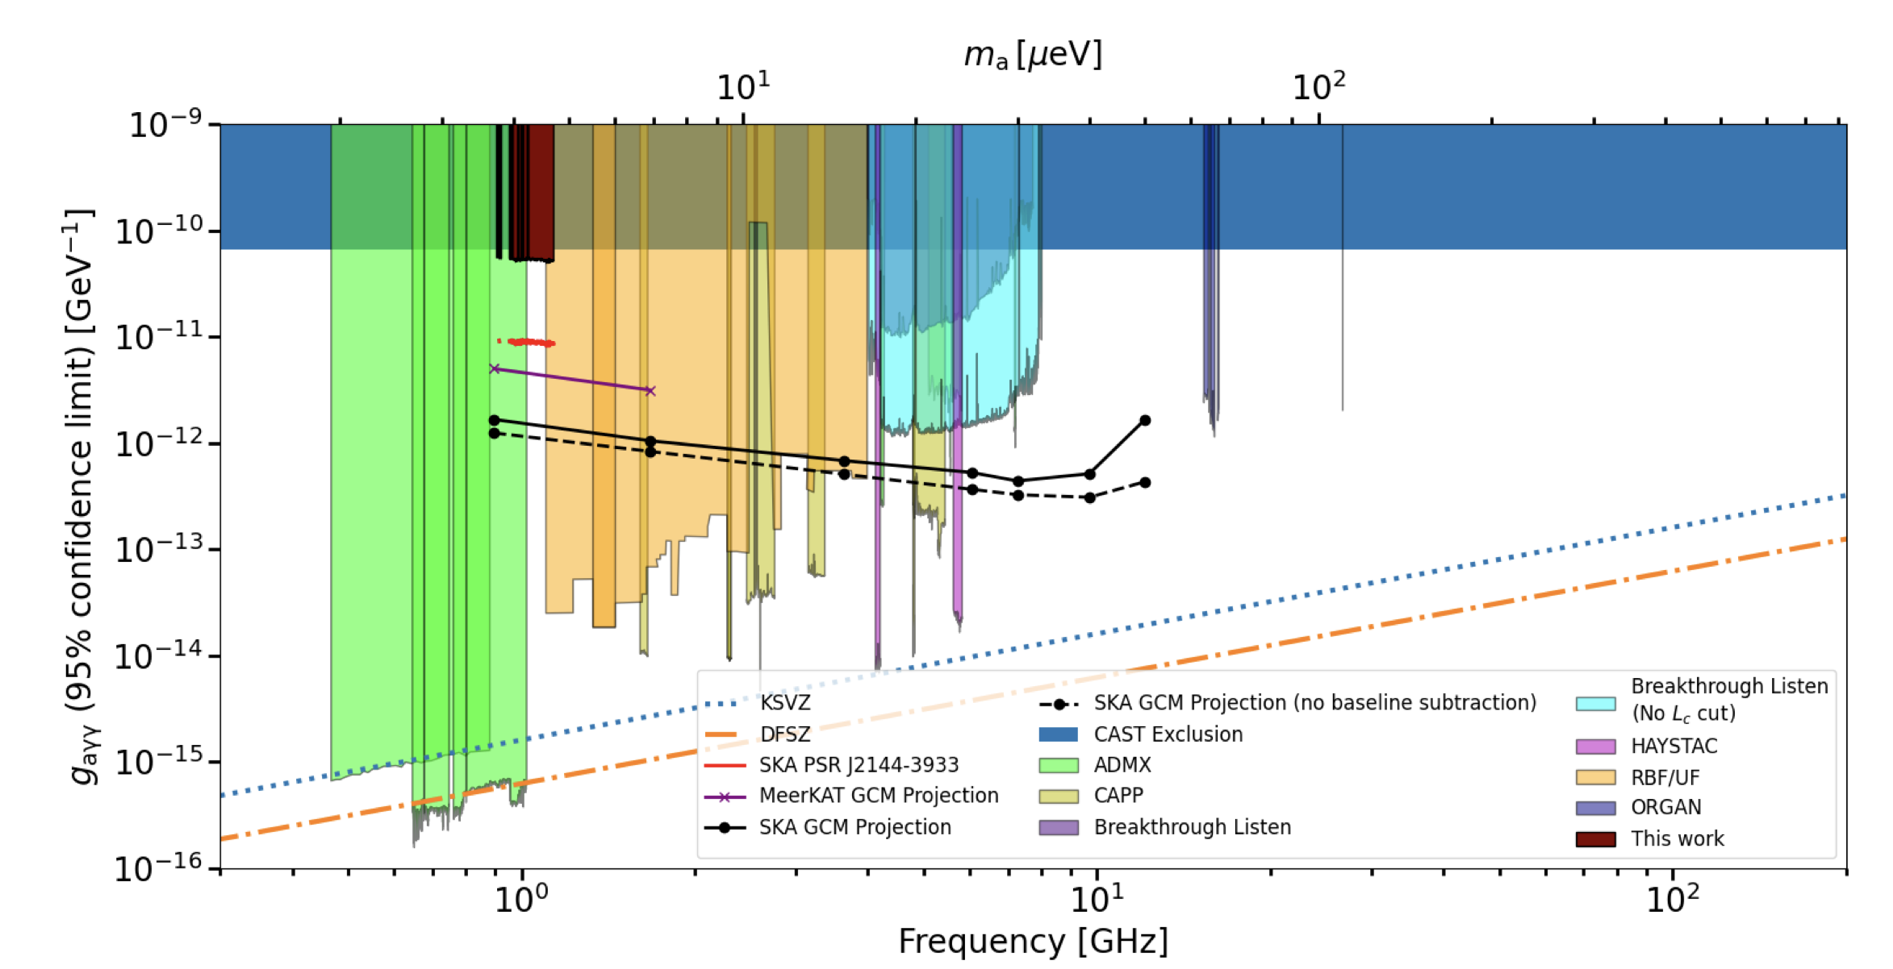
Time Domain Searches with MeerKAT
$$Ω$$
Battye, Keith, JM, Srinivasan, Stappers, Weltevrede
[Phys. Rev. D 108 (2023) 6, 063001]
$$θ$$
$$α$$
Time-Frequency Data
Time (pulse phase)
NS Populations
Foster et al, Phys. Rev. Lett. 129, 251102 (2022)

Slide 26
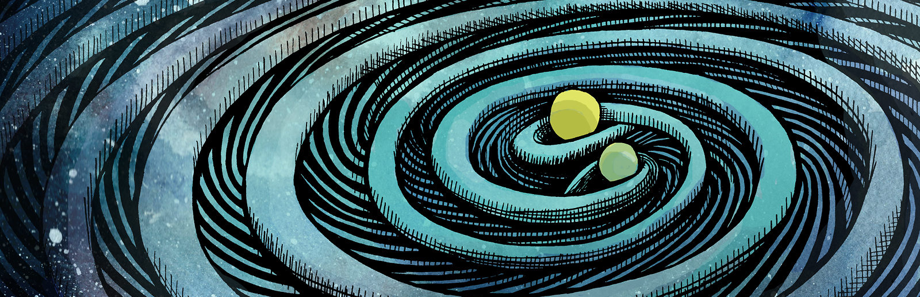
Astrophysical Probes of High Frequency Gravitational Waves
*work with Sebastian Ellis, Bjorn Garbrecht , Pete Millington

Slide 27
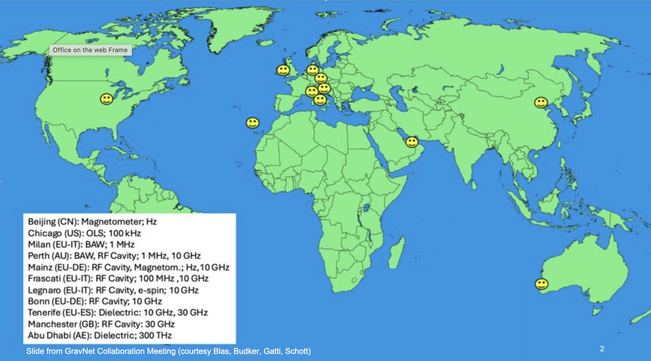
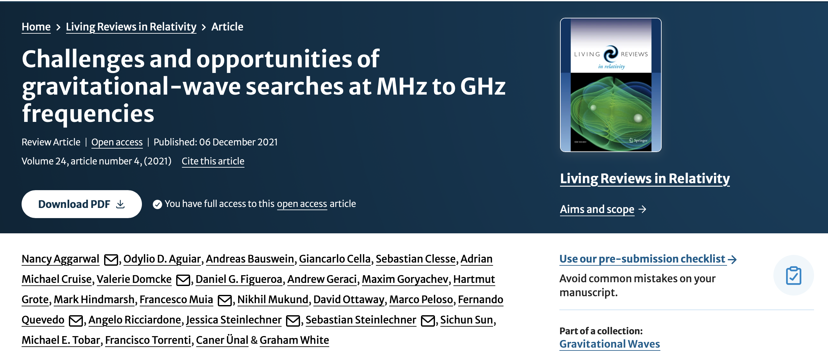
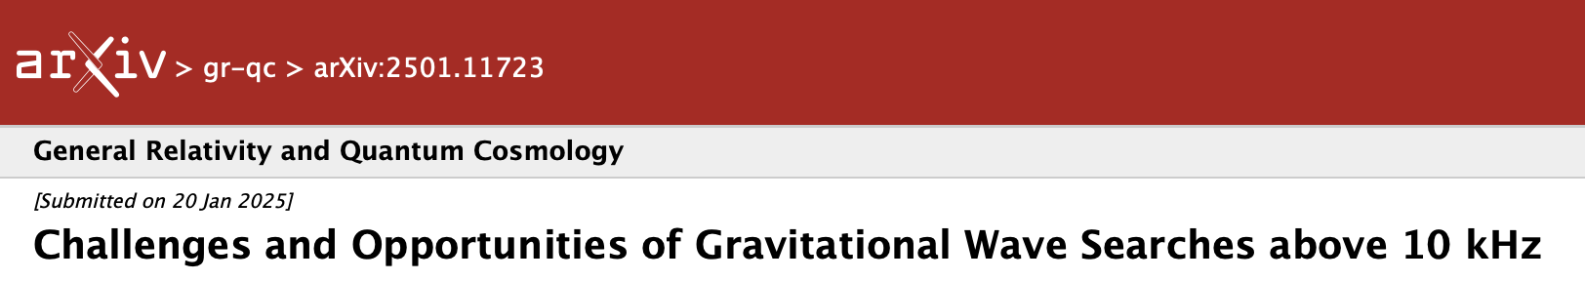
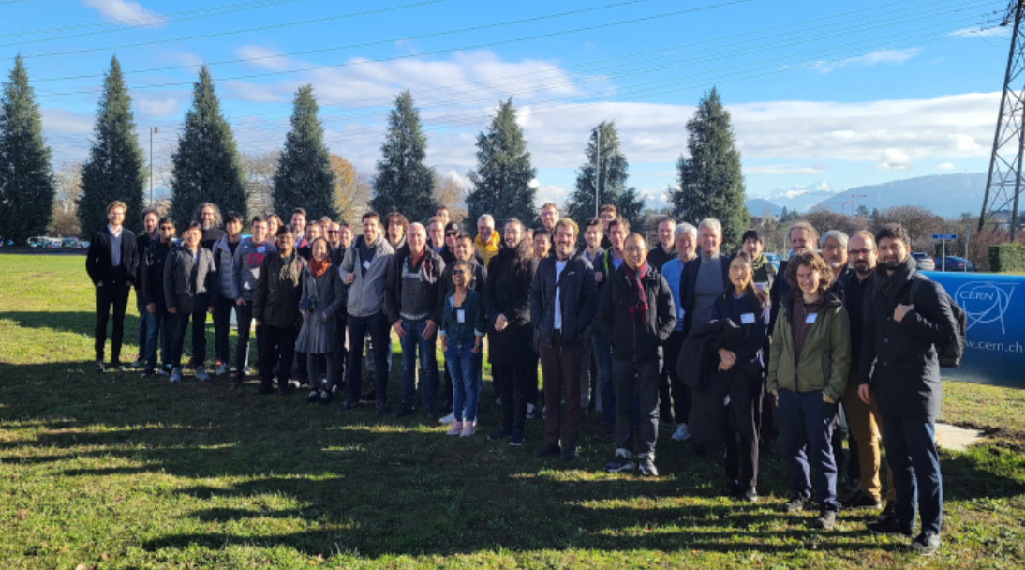
High-frequency gravitational waves
GravNet 2024 ERC Synergy Grant
2021 Living Review
(first community meeting Mainz June 25’)
2025 Update
Recent Workshop Dec 2023 @ CERN
Aggarwal, Aguiar, Bauswein, Blas, Cella, Clesse, Cruise, Domcke, Ellis, Figueroa, Franciolini, Garcia-Cely, Geraci, Goryachev, Grote, Hindmarsh, Ito, Kopp, Lee, Martineau, JM, Muia, Mukund, Ottaway, Peloso, Peters, Quevedo, Ricciardone, Ringwald, Sebastian Steinlechner, Jessica Steinlechner, Sun, Tamarit, Tobar, Torrenti, Ünal, White
Previous Workshops in 2019, 2021 (online), 2025 (Mainz)

Slide 28
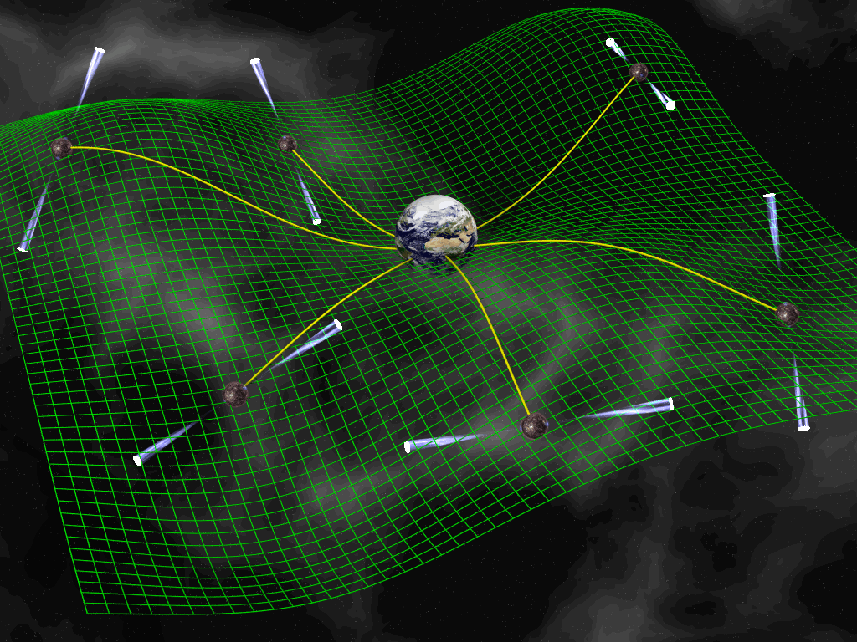
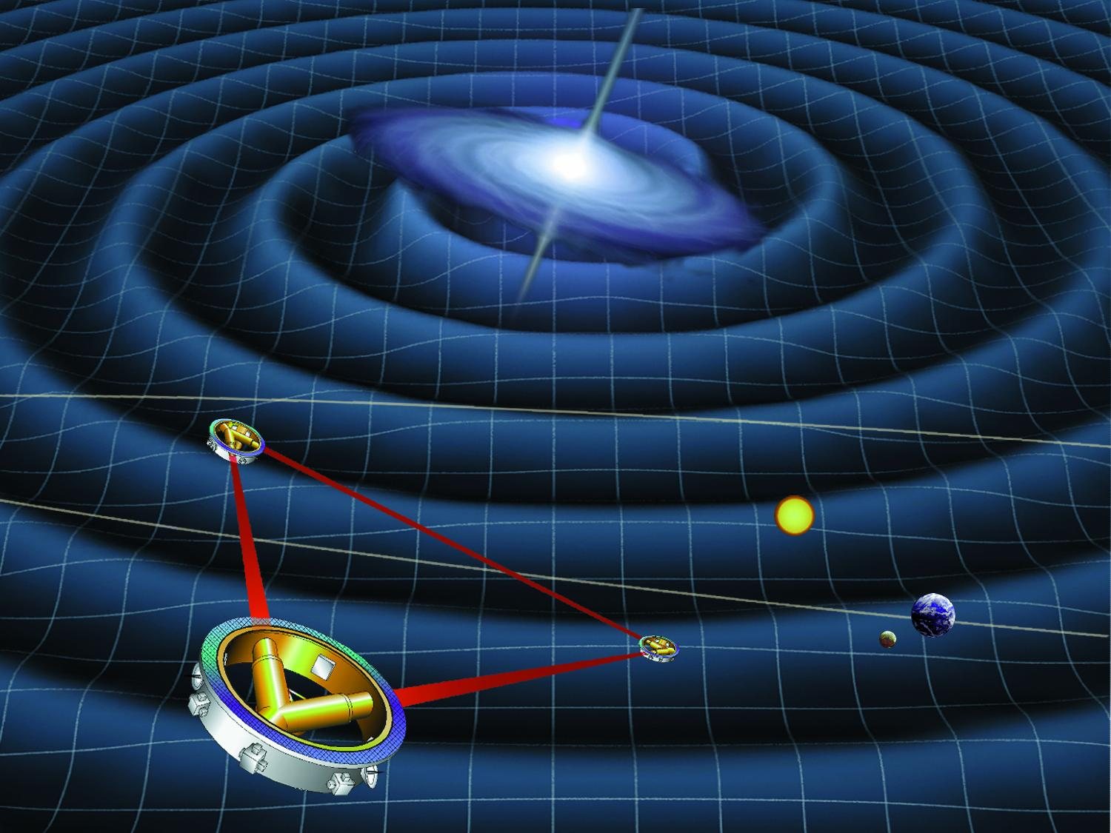
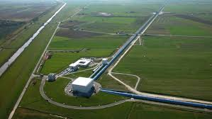
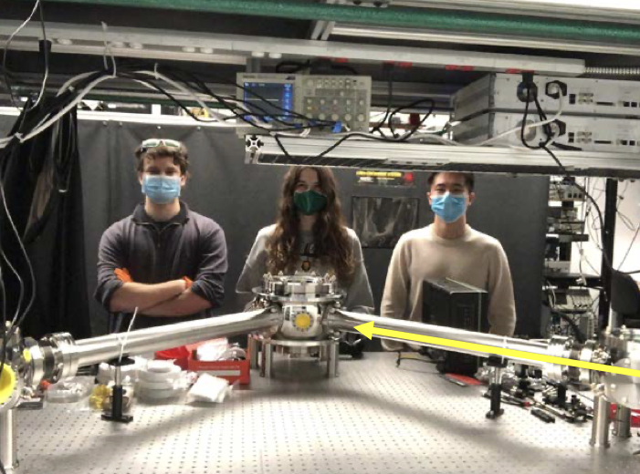
$${10}^{−9}Hz$$
$${10}^{−2}Hz$$
$$100 Hz$$
Ultra-High Frequency GWs
10 kpc$\sim {10}^{20}$m
${10}^{4}Hz$ and above
0.01 Au$\sim {10}^{9}$m
LISA
1$km \sim {10}^{3}$m
(tabletop + astrophysical!)

Slide 29
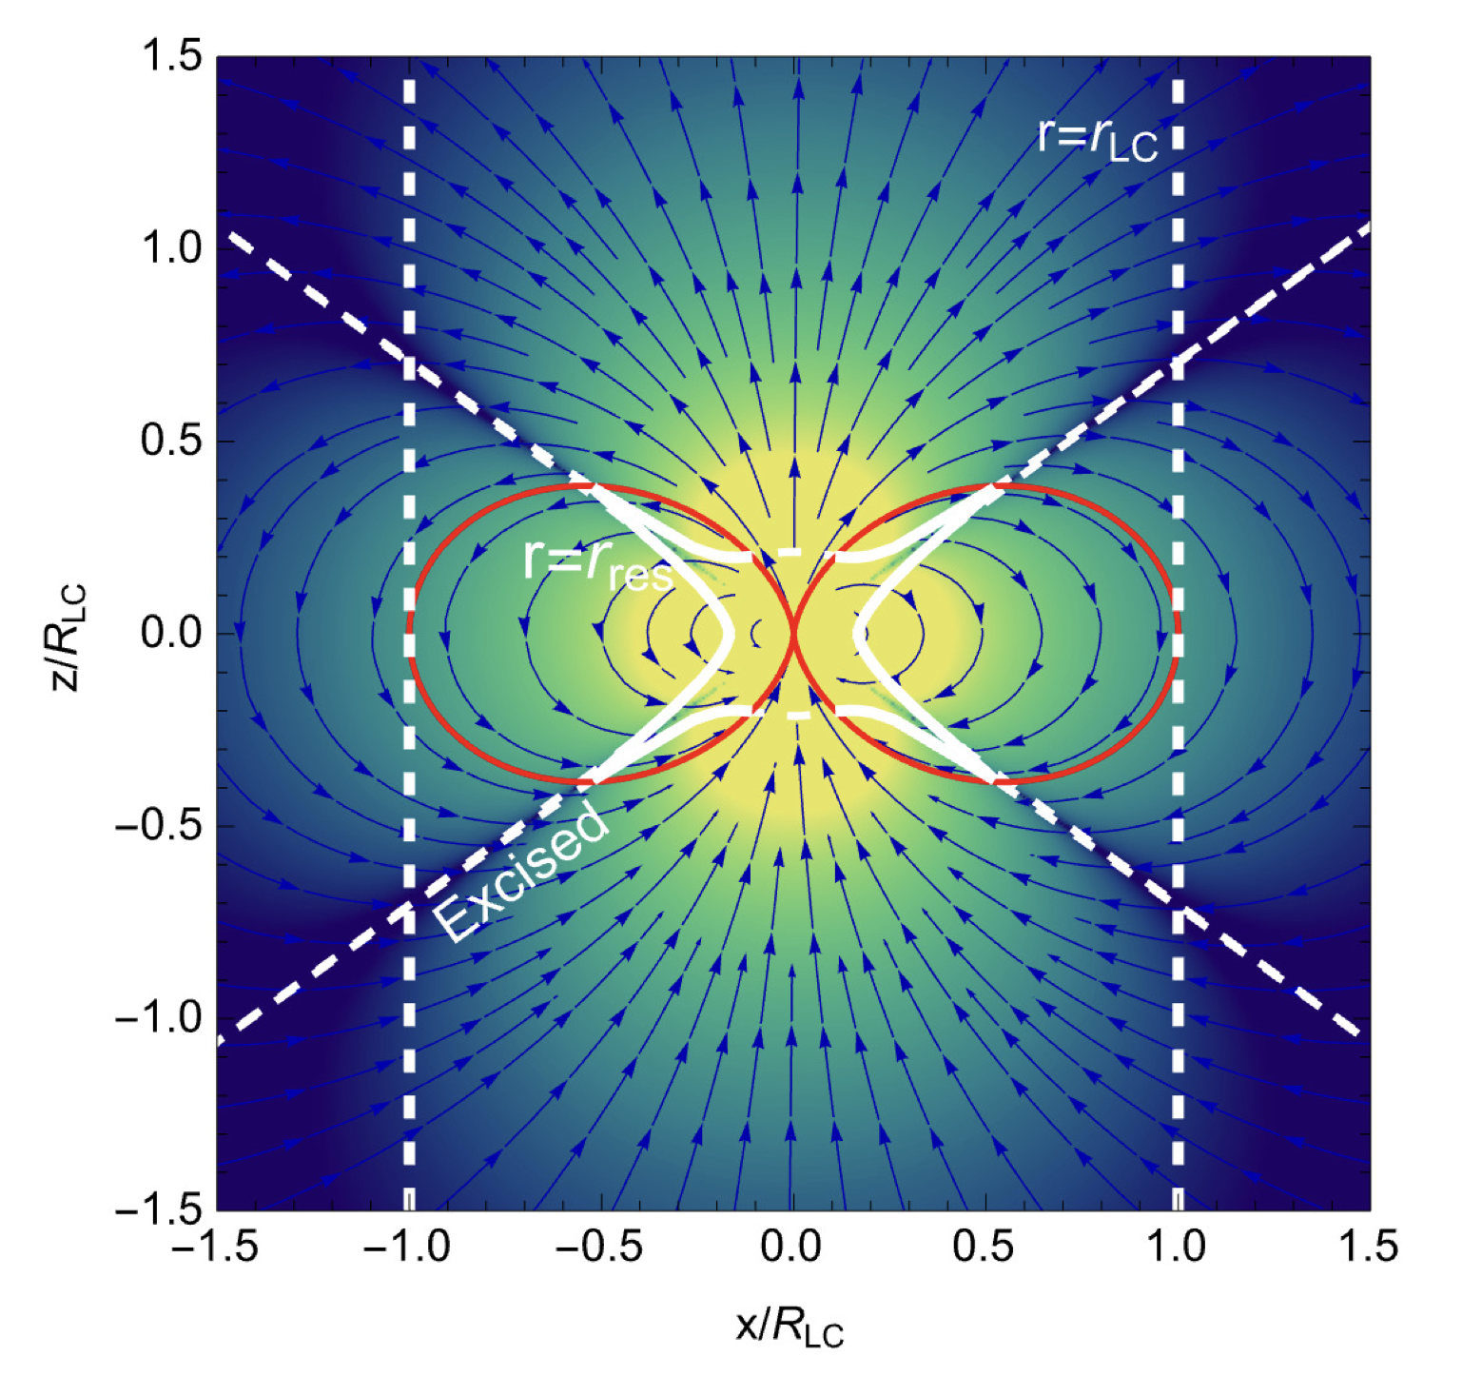
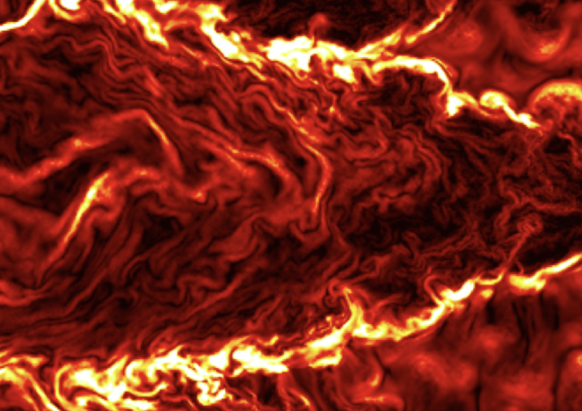
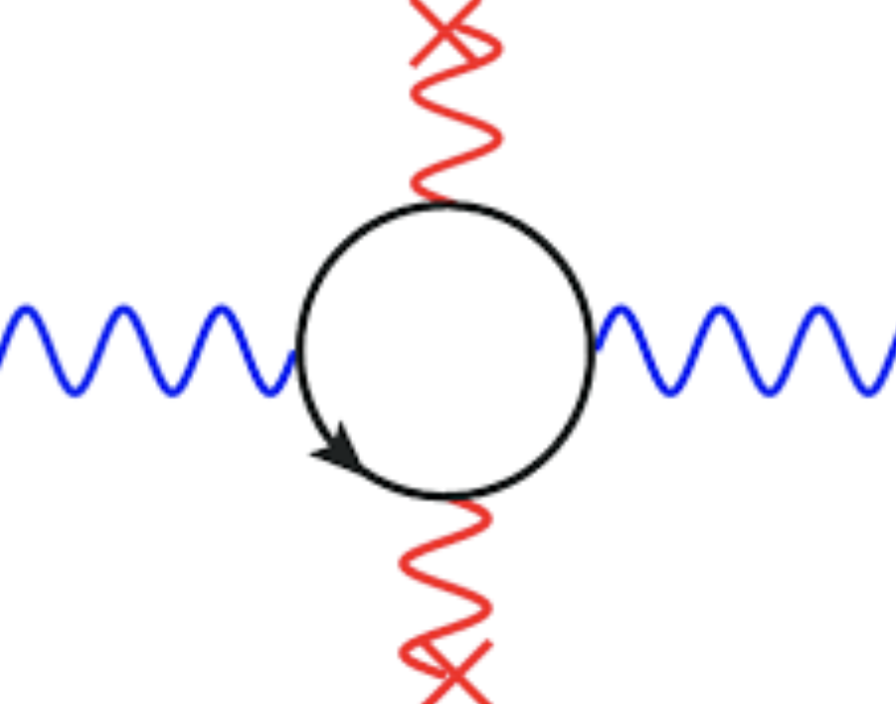

Astrophysical Constraints on High Frequency Gravitational Waves
JM, S. A. R. Ellis – PRD 110 (2024) 10, 103003
$$h_{μν}$$
$$γ$$
$$B_{NS}$$
$$n^{2}=1 −\frac{ω_{p}^{2}}{ω^{2}}+\frac{16 {α^{2}B}^{2}}{45 m_{e}^{4}}$$
$\frac{ω_{p}^{2}}{ω^{2}}=\frac{16 {α^{2}B}^{2}}{45 m_{e}^{4}}$
Plasma
Vacuum Birefringence
(Goldreich Julian Model 1969)

Slide 30




Thanks - Jeremy Hare, George Pavlov,
Bettina Posselt, Oleg Kargaltsev, Tea Temim and StevenChen for JWST data – (2024)
JM, S. A. R. Ellis – PRD 110 (2024) 10, 103003

Slide 31





JM, S. Ellis (2024)
Ito, Kohri, Nakayama (2024)
CMB
Domcke, Garcia-Cely 2021
Neutron Stars
Galactic
Dandoy, Bertolez-Martinez, Costa (2024)
Lella, Calore, Carenza, Mirizzi (2024)

Slide 32


19-23 Jan 2026
https://indico.global/event/15247/
Invited Speakers
Topics

Slide 33
Thank You

