Slide 1
Status of the LiteBIRD mission to explore cosmic inflation
2025/10/02 Ken EBISAWA (ISAS/JAXA) on behalf of the LiteBIRD collaboration
Notes:
Comments by Ken Ebisawa on 09/20/2025: Most of the slides are from the slide deck v1.8 at https://cloud.iac.es/index.php/s/DCosRPwH7Ld2TBa

Slide 2

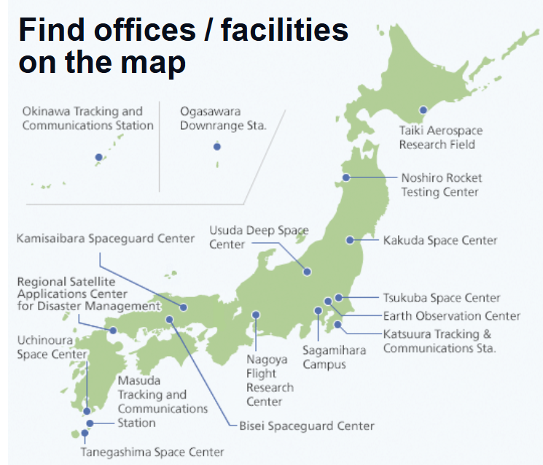

About ISAS/JAXA
Japan Aerospace eXploration Agency
ISAS is the only research laboratory in JAXA to carry out space science, which needs rockets, satellites or balloons.
There are ~200 engineers and scientists, who are affiliated with universities.
We plan, build and operate science satellites, and analyze/manage data.
Institute of Space and Astronautical Science

Slide 3
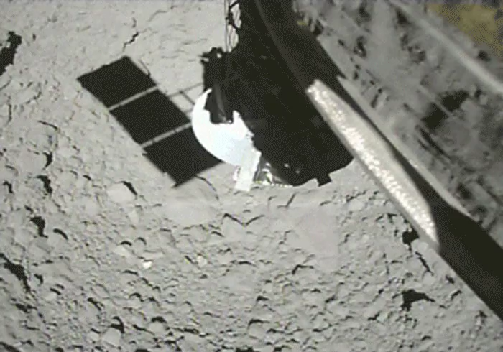
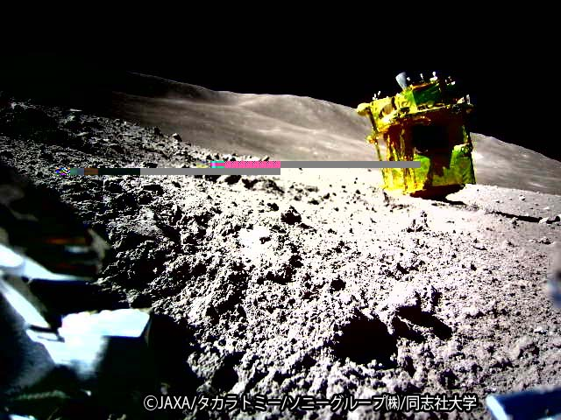
Recent large (medium) missions
Hayabusa2 (2014-)
Sample return from an asteroid.
SLIM (2023-2024)
Pin-pointing landing on Moon
XRISM (2023-)
X-ray Imaging and Spectroscopy Mission
>10 times higher spectral resolution than previous missions with the X-ray microcalorimeter in 2-10 keV
Hayabusa2 touch down on the asteroid Ryugu
https://www.hayabusa2.jaxa.jp/topics/20190726_TD2_images/
SLIM after the moon landing (taken by a robot camera)
https://www.hayabusa2.jaxa.jp/topics/20190726_TD2_images/

Slide 4
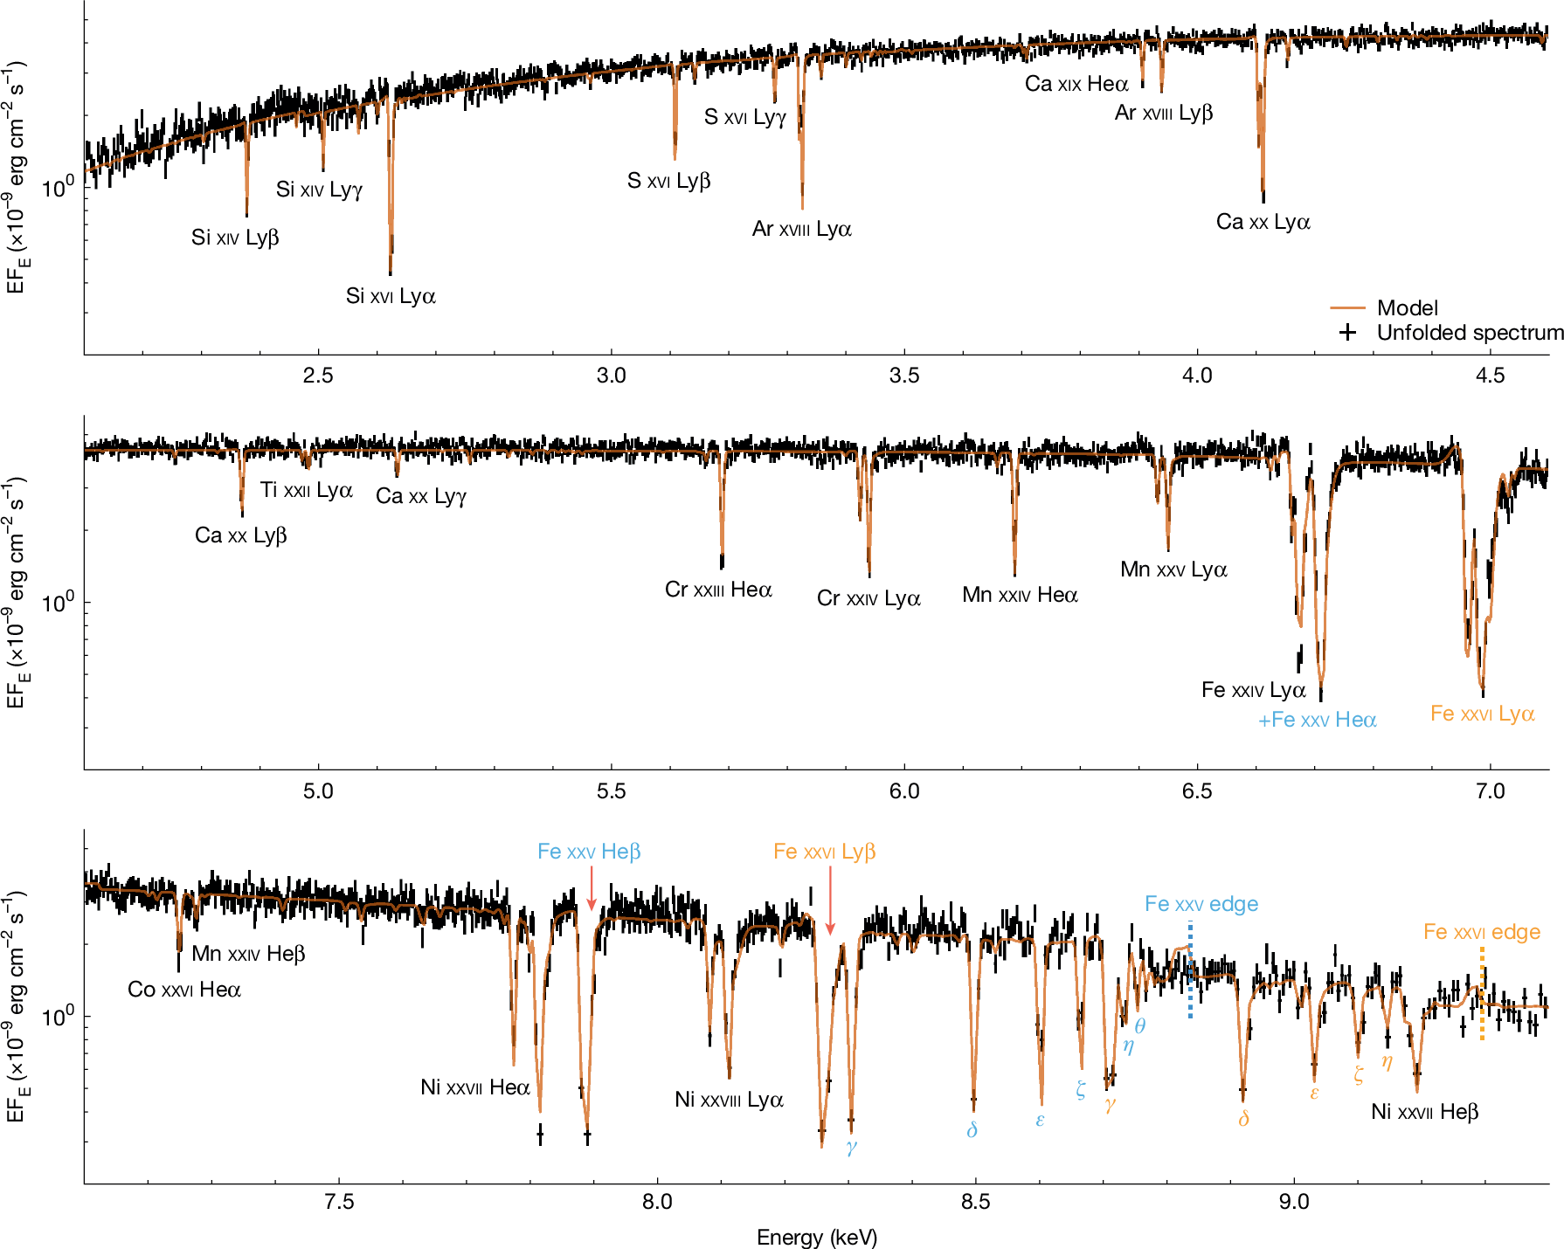
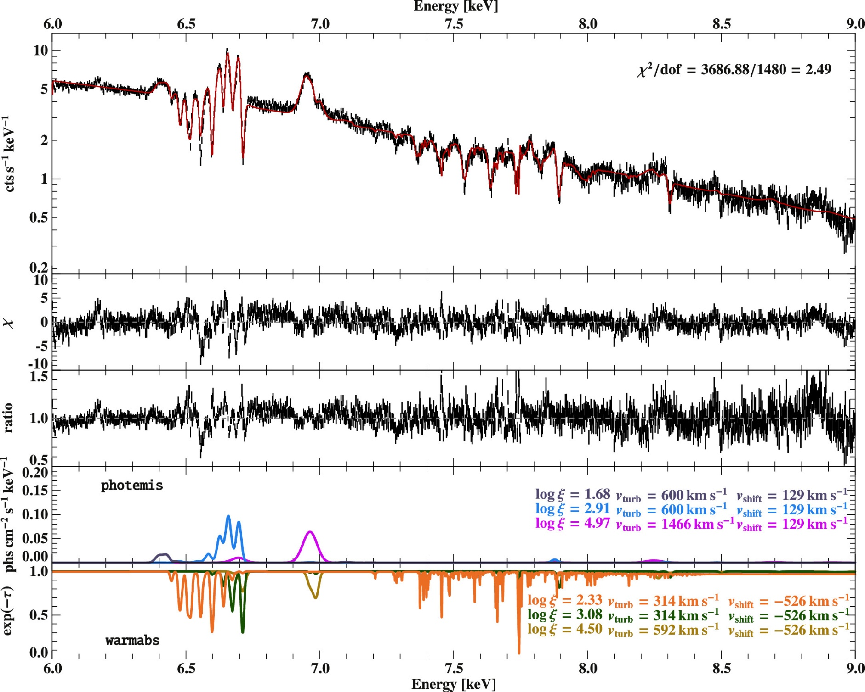
XRISM archive is now open. Observation time open to Guest Observers
Cyg X-3, black hole
or neutron star binary
ApJL 977 L34(2024)
GX13+1, low mass neutron star binary
Nature 646, 57–61 (2025).
Centaurus cluster
Nature 638, 365–369 (2025)

Slide 5
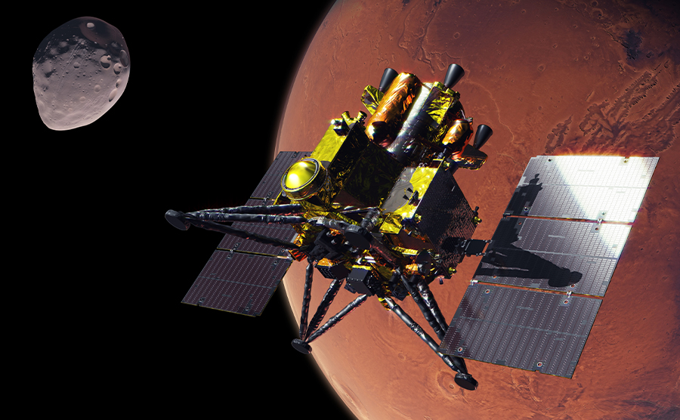
Future large (medium) missions
Martian Moons eXploration (MMX; FY 2026)
Sample return from Phobos
LiteBIRD (2030’s)

Slide 6

Content of the talk
LiteBIRD overview
Cosmic inflation and B-mode polarization
Mission goals
Space craft and instruments
Expected science outcomes
Summary

Slide 7
Content of the talk
LiteBIRD overview
Cosmic inflation and B-mode polarization
Mission goals
Space craft and instruments
Expected science outcomes
Summary
Notes:
15 frequency bands.
Emphasise that the final targeted sensitivity is around ~30 times better than Planck-HFI in polarization.
Official launch date 2032 Japanese fiscal year (JPY is from April to March), but we have removed this information from the slide.
CMB map: this is a B-mode map, resulting from a simulation produced by Yuji Chinone with tensor modes with r=0.01, lensing and with a Gaussian noise level of 10 muK·arcmin (this value is of the same order of what we might expect from the combination of white noise and foreground residuals), and convolved to a resolution of 5 deg in order to enhance the reionization bump.

Slide 8
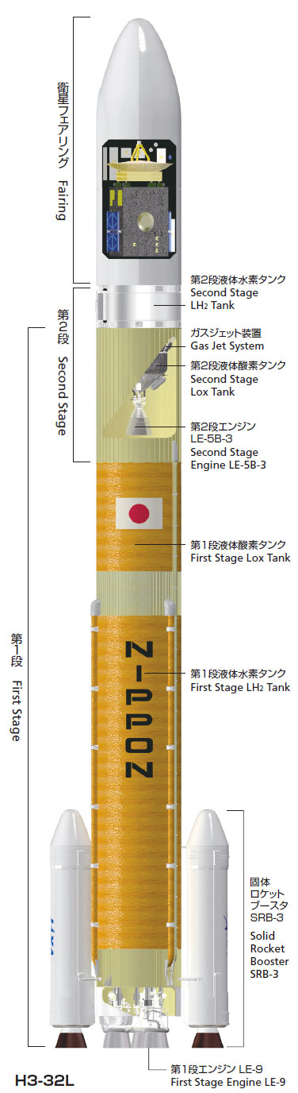
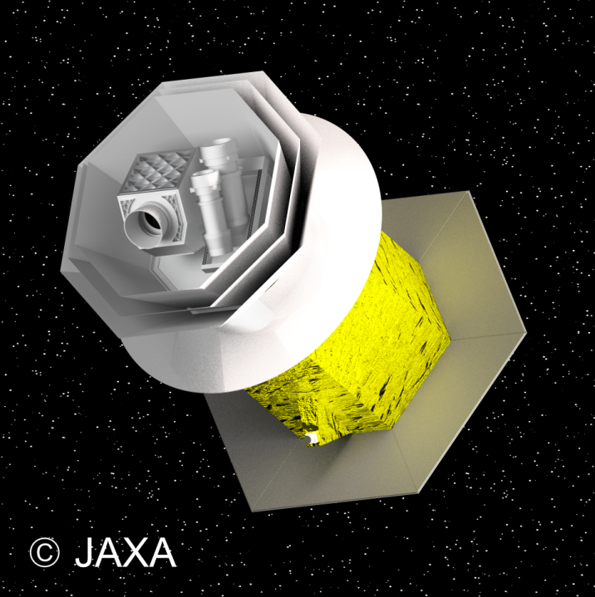
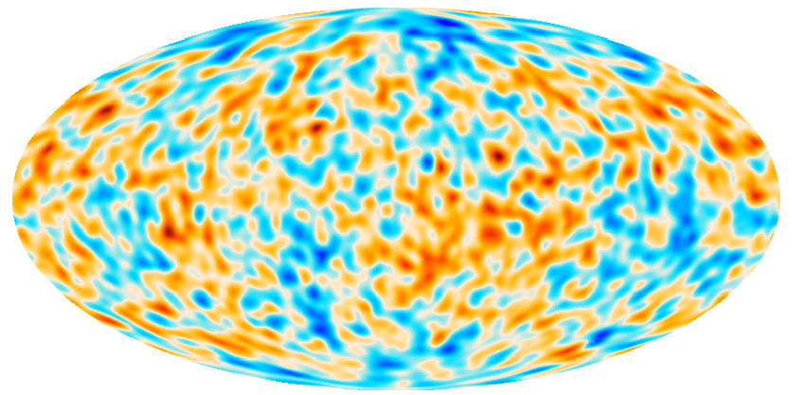


1. LiteBIRD overview
Lite (Light) spacecraft for the study of B-mode polarization and Inflation from Cosmic Microwave Background (CMB) radiation detection
JAXA’s L-class mission selected in May 2019 to be launched by JAXA’s H3 rocket
All-sky 3-year survey, from Sun-Earth Lagrangian point L2
Large frequency coverage (40–402 GHz, 15 bands) at 70–18 arcmin angular resolution for precision measurements of the CMB B-modes
Final combined sensitivity: 2.2 μK·arcmin
This Overview and other specifications are from 📖 "LiteBIRD collaboration PTEP 2023", which was the most complete reference at the time.
Notes:
15 frequency bands.
Emphasise that the final targeted sensitivity is around ~30 times better than Planck-HFI in polarization.
Official launch date 2032 Japanese fiscal year (JPY is from April to March), but we have removed this information from the slide.
CMB map: this is a B-mode map, resulting from a simulation produced by Yuji Chinone with tensor modes with r=0.01, lensing and with a Gaussian noise level of 10 muK·arcmin (this value is of the same order of what we might expect from the combination of white noise and foreground residuals), and convolved to a resolution of 5 deg in order to enhance the reionization bump.
Comments by Ken Ebisawa on 09/20/2025: This is taken from the slide deck v1.8 at https://cloud.iac.es/index.php/s/DCosRPwH7Ld2TBa with a minor modification on the reference and font color.

Slide 9
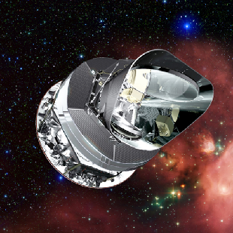
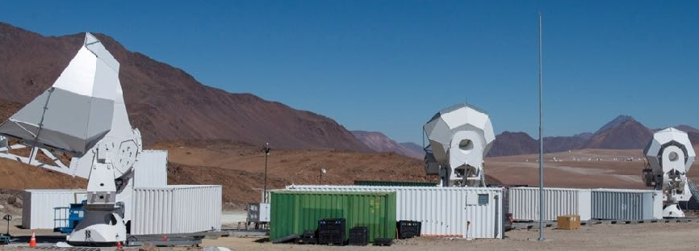
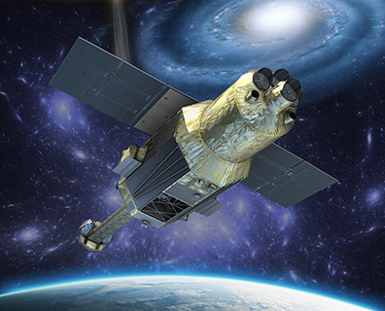
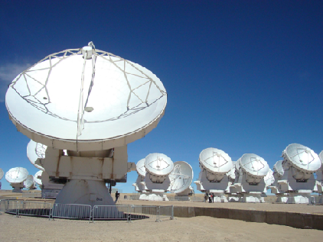
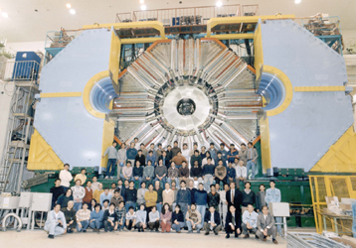



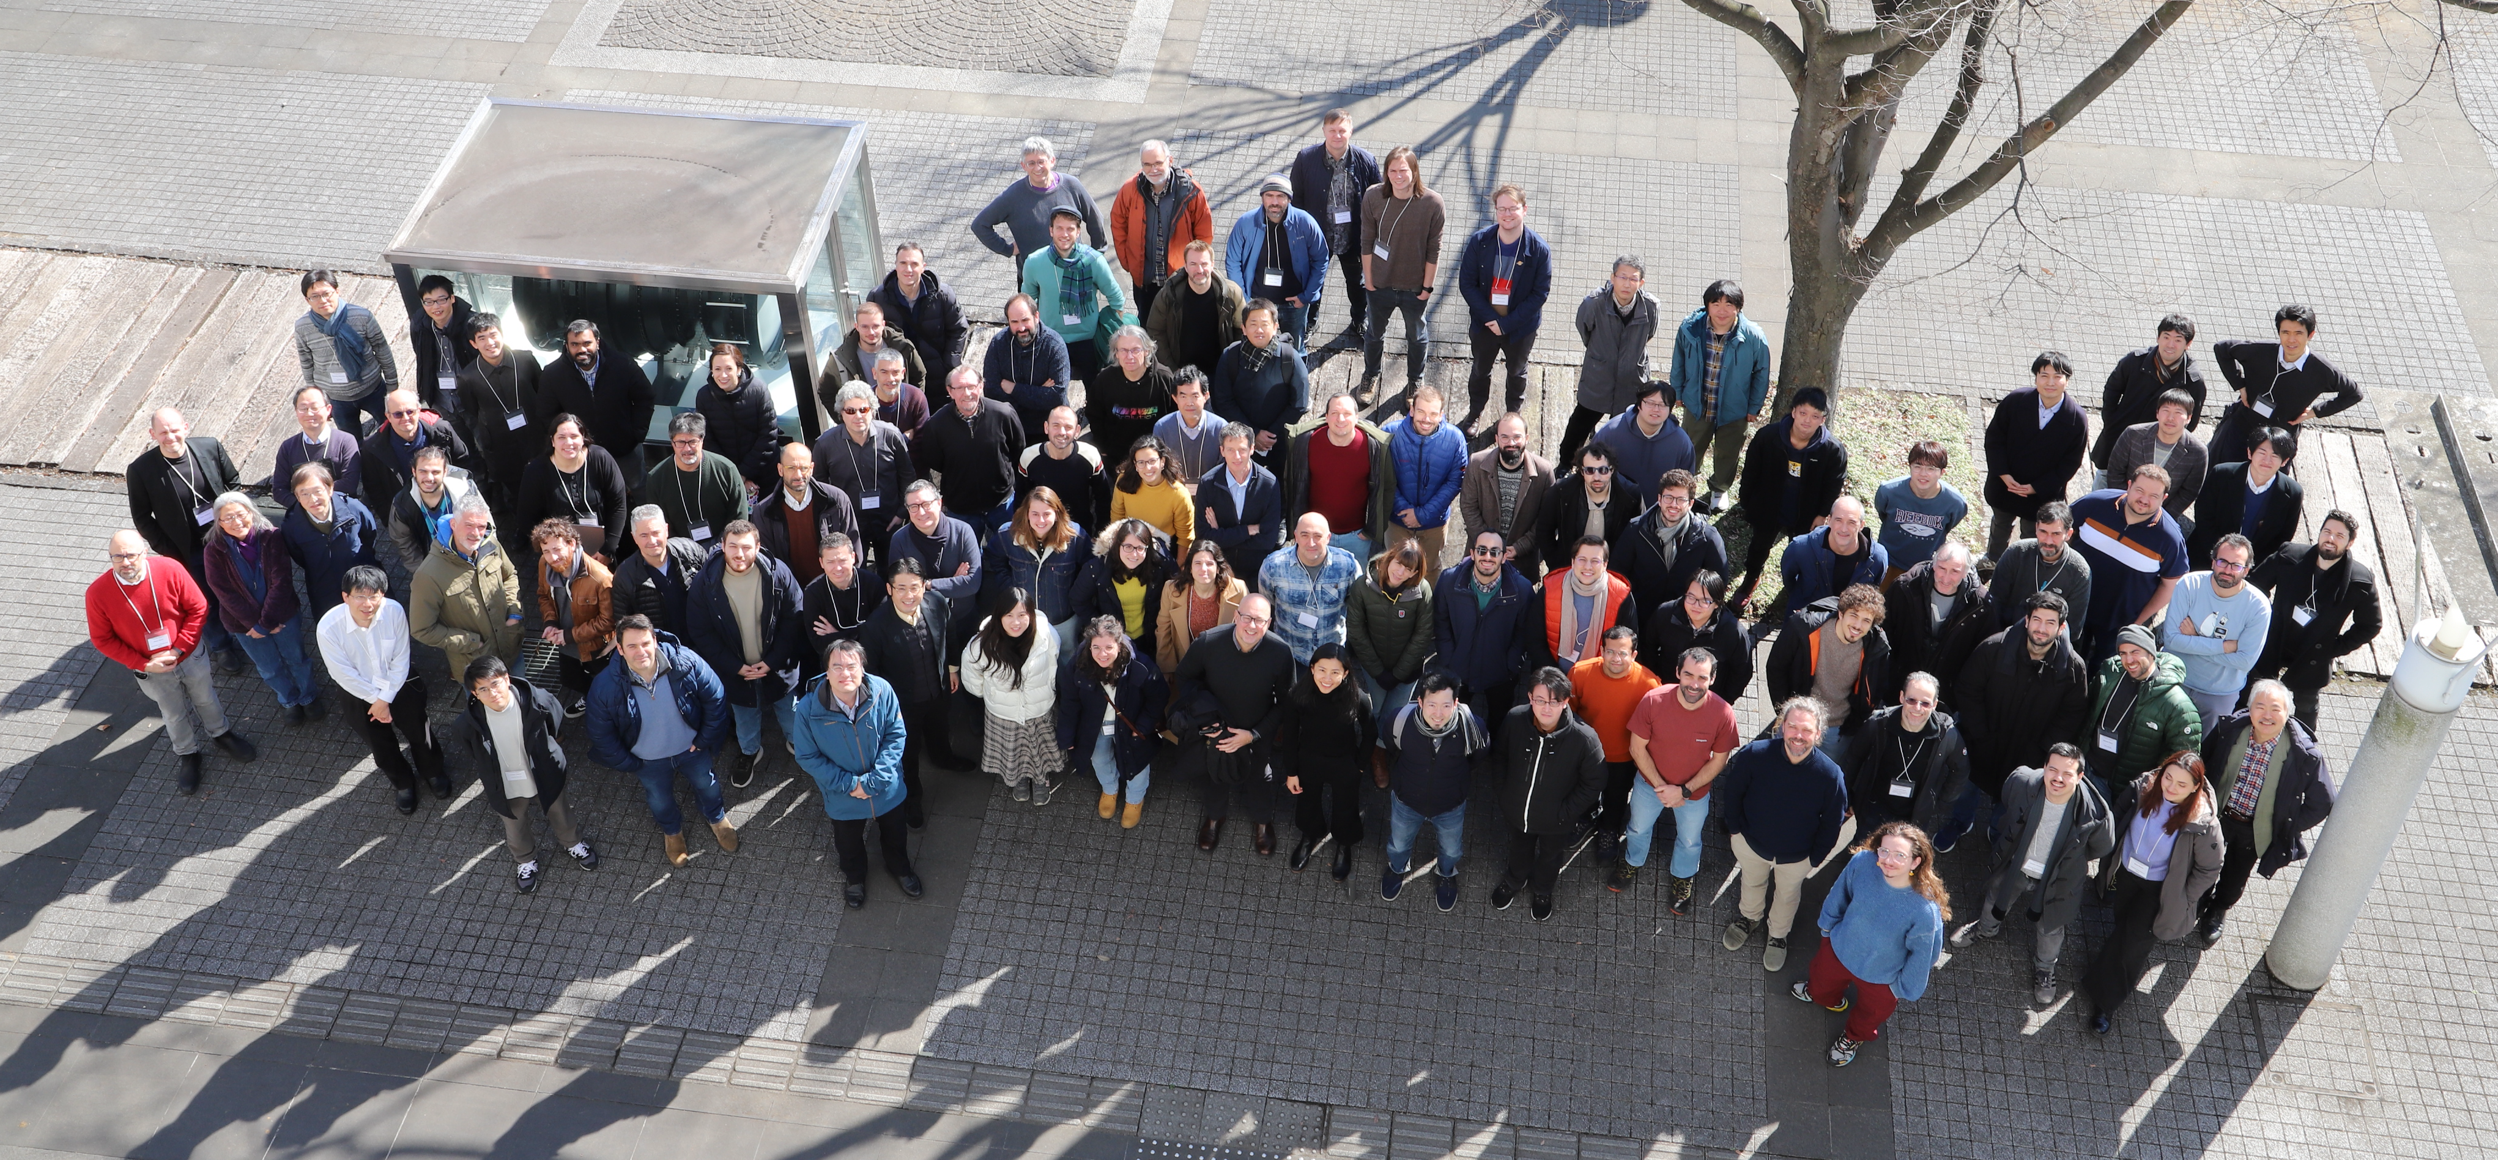










LiteBIRD Joint Study Group
Around 400 researchers from Japan, North America and Europe
Team experience in CMB experiments, X-ray satellites and other large projects (ALMA, HEP experiments, …)
LiteBIRD Global F2F meeting
Jan 20 - 24, 2025 at IPMU (Tokyo)
Notes:
The experiments in the top, from left to right, are: Planck, Simons Array (TBC), Hitomi (TBC), ALMA and Belle.
Comments by Ken Ebisawa on 09/20/2025: This is taken from the slide deck v1.8 at https://cloud.iac.es/index.php/s/DCosRPwH7Ld2TBa

Slide 10
Notes:
Comments by Ken Ebisawa on 09/20/2025: This is taken from the slide deck v1.8 at https://cloud.iac.es/index.php/s/DCosRPwH7Ld2TBa

Slide 11
Content of the talk
LiteBIRD overview
Cosmic inflation and B-mode polarization
Mission objectives
Space craft and instruments
Expected science outcomes
Summary

Slide 12
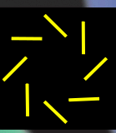
2. Cosmic inflation and B-mode polarization
Inflationary Cosmology
A hypothesis that the universe underwent rapid accelerated expansion before the hot Big Bang to explain the current flat and uniform universe.
Predicts primordial gravitational waves due to quantum fluctuations in space.
Primordial gravitational waves should have imprinted a swirling pattern (B-mode) onto the CMB polarization map.
Detecting this “fingerprint of inflation” is currently the only way to discover primordial gravitational waves.
The discovery of primordial B-modes in the CMB is a decisive evidence for the inflationary universe.
Today
Dark energy
CMB
B-mode
Big Bang
Inflation
time
Birth of the Universe
Frpm “Cosmology” ed. Sato and Futamase
Notes:
This is original

Slide 13
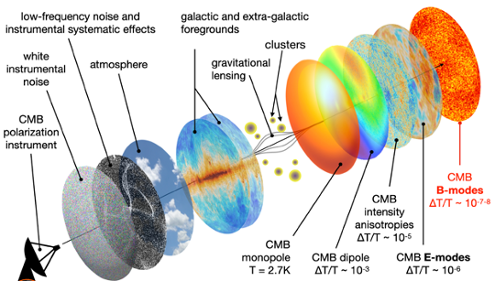
The challenge of B-modes detection
The B-mode signal is expected to have an amplitude at least 3 orders of magnitude below the CMB temperature anisotropies
LiteBIRD is targeting a sensitivity level in polarization ~30 times better than Planck
This extremely good statistical uncertainty must go in parallel with exquisite control of:
Instrument systematic uncertainties
Galactic foreground contamination
“Lensing B-mode signal” induced by gravitational lensing
Observer biases
Image credit: Josquin Errard
Notes:
The quotation of the first bullet point comes from this estimate: the maximum of the first peak of TT is around 6000 muK^2; the peak of the BB recombination bump for r=0.03 (around the current best upper limit) is around 3e-3 muK^2. The factor is then 2e6 in power and 1.4e3 in temperature.
The quotation in the second bullet point (factor 30 improvement over Planck) comes from what is said in the PTEP. Planck average polarization sensitivities are 4.5, 5.4, 4.6, 2.0, 1.2, 1.7 and 7.2 muK·deg for 30 to 353 GHz. This leads to a combined sensitivity of 0.83 muK·deg = 50 muK·arcmin, while LiteBIRD’s combined sensitivity is 2.2 muK·arcmin -> 50/2.2 = 22.7
Comments by Ken Ebisawa on 09/20/2025: This is taken from the slide deck v1.8 at https://cloud.iac.es/index.php/s/DCosRPwH7Ld2TBa

Slide 14
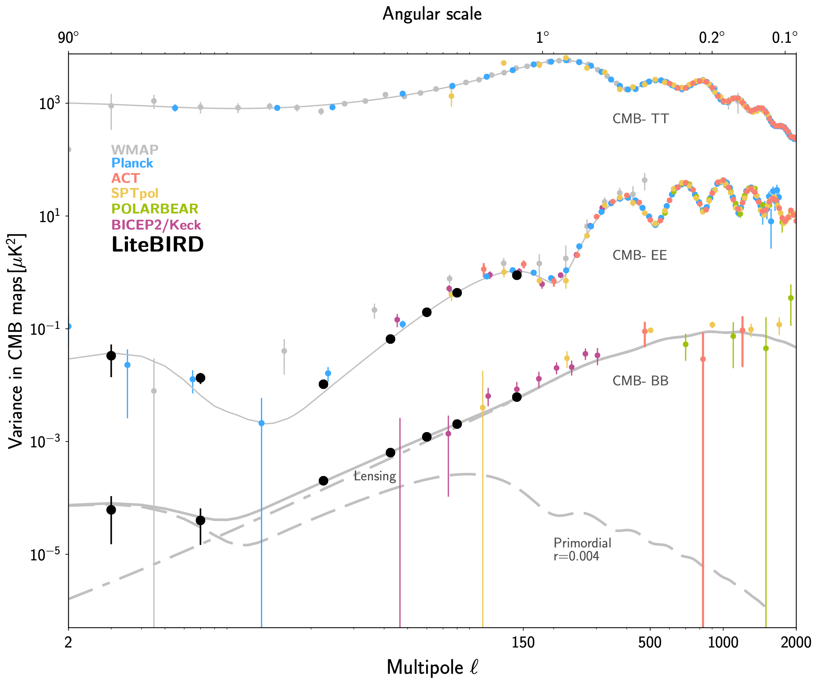




LiteBIRD main scientific objectives
Definitive search for the B-mode signal from cosmic inflation in the CMB polarization
Making a discovery or ruling out well-motivated inflationary models
Insight into the quantum nature of gravity
The inflationary (i.e. primordial) B-mode power is
proportional to the tensor-to-scalar ratio, r
Current best constraint: r < 0.032 (95% C.L.)
(📖 Tristram et al. 2022, combining BK18 and Planck PR4)
LiteBIRD will significantly improve the current sensitivity on r
The final goal is to achieve a total uncertainty of 𝛿r ≲ 0.001 for r=0
Planck
WMAP
ACT
SPTpol
POLARBEAR
BICEP2/Keck
LiteBIRD
Notes:
Emphasise that sigma_stat<6e-4 contains foreground and lensing residuals.
Comments by Ken Ebisawa on 09/20/2025: This is taken from the slide deck v1.8 at https://cloud.iac.es/index.php/s/DCosRPwH7Ld2TBa

Slide 15
Advantage of the observation from space:1
The primordial B-mode has peaks at two angular scales
Since the ratio of the two peaks depends on the model, observing both peaks is critically important.
Among these, the peak at the large angular scale (“the reionization peak”) cannot be detected from the ground because it requires the all-sky observations.
Planck
WMAP
ACT
SPTpol
POLARBEAR
BICEP2/Keck
LiteBIRD
Recombination peak
Reionization peak
Notes:
This is original

Slide 16
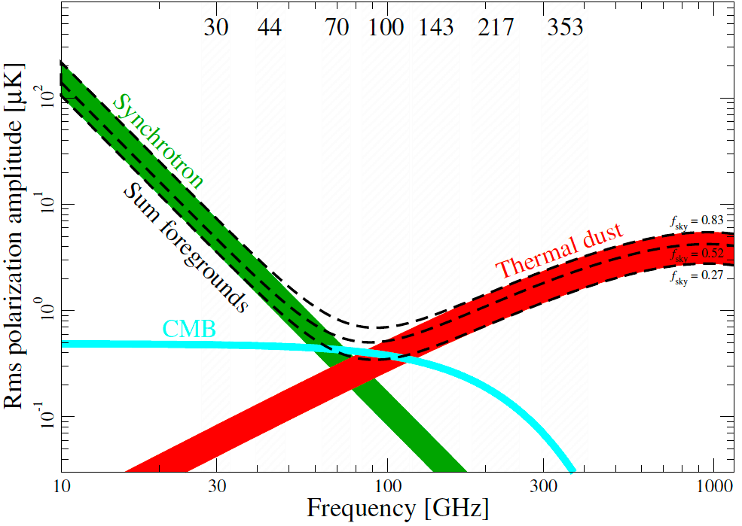
Advantage of the observation from space:2
Observations of the CMB require removal of the Milky Way foreground radiation (synchrotron radiation and dust emission).
LiteBIRD reliably eliminates this effect through wideband observations through 34 - 448 GHz.
Certain frequency bands are difficult to observe from ground due to significant atmospheric absorption .
Difficult to observe from ground
LiteBIRD coverage
Notes:
This is original

Slide 17
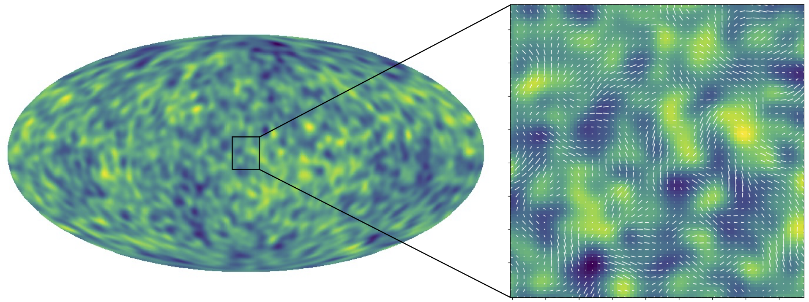
Expected B-mode pattern by LiteBIRD
Polarization pattern overlayed
LiteBIRD simulation of the B-mode assuming r=0.01
Simulation by Yuji Chinone
Spiral pattern (primordial B-mode) recognized!
Notes:
This is original

Slide 18
Content of the talk
LiteBIRD overview
Cosmic inflation and B-mode polarization
Mission objectives
Space craft and instruments
Expected science outcomes
Summary

Slide 19
3. Mission objectives
The first scientific objective
Verify representative inflationary cosmology models by measuring the amplitude of the primordial gravitational waves (“r”, the tensor to scalar ratio) using all-sky multi-frequency microwave polarization maps.
The second scientific objective
Using the all-sky, multi-frequency microwave polarization maps capable of achieving the first science objective, we will pioneer diverse scientific discoveries in the fields of cosmology, particle physics, and astrophysics.
Notes:
This is original, taken from KDP2 review material (original Japanese)

Slide 20
Content of the talk
LiteBIRD overview
Cosmic inflation and B-mode polarization
Mission objectives
Space craft and instruments
Expected science outcomes
Summary

Slide 21
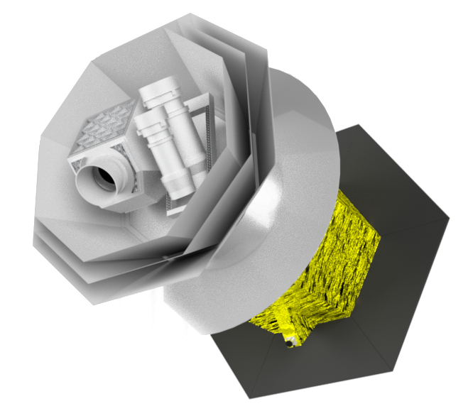
Space craft
PLM: Payload Module,
Carrying telescope and focal plane instruments (mainly developed by European Countries)
After launch, LiteBIRD will reach the Sun-Earth Lagrange Point L2, located approximately 1.5 million km from Earth, via a transfer orbit in about three months.
It will then conduct three years of all-sky observations in an orbit near L2 (a Lissajous orbit).
CMB
Nhit map for a
3-year survey
(Galactic projection)
SVM: SerVice Module (mainly developed by JAXA)
JAXA
H3-22L
Notes:
This is taken from the MDR material (2024 March), so the PLM still has LFT and MHFT

Slide 22
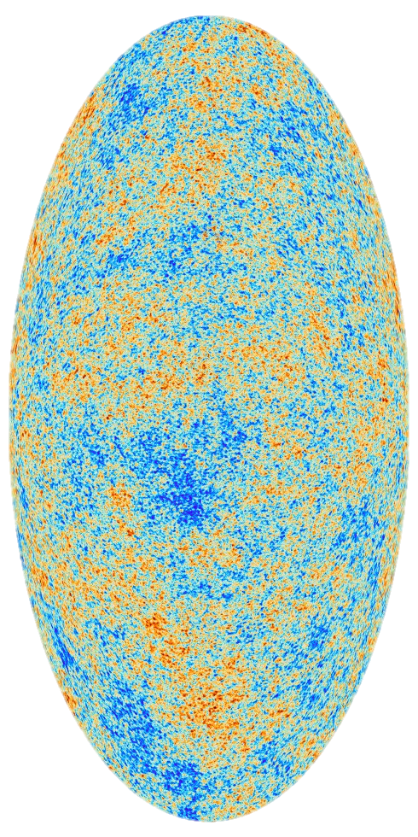
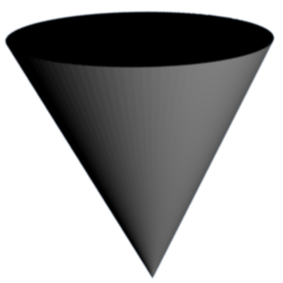

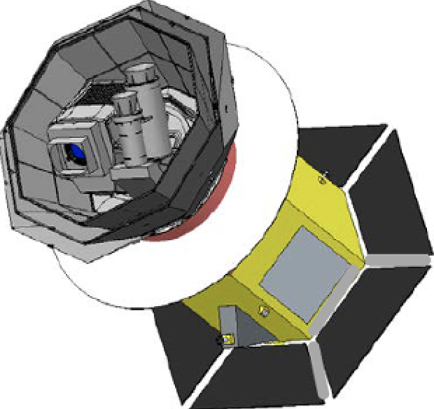
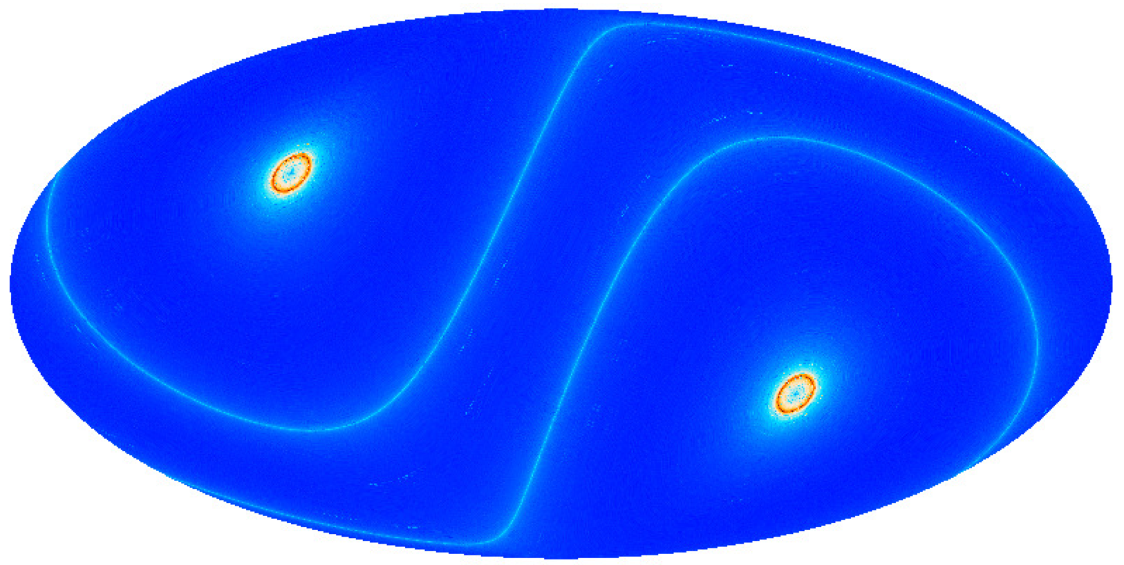
LiteBIRD scanning strategy
Boresight
Spin axis
(period 20 or 3.3 min.)
3-year survey, Sun-Earth L2 Lissajous orbit
Precession angle: 𝛼 = 37.5°
Spin angle: 𝛽 = 57.5°
𝛽
Sun
𝛼
CMB
FoV
Nhit map for a
3-year survey
(Galactic projection)
Precession (anti-Sun) axis
(precession period, ~3.2 h)
Notes:
Comments by Ken Ebisawa on 09/20/2025: This is taken from the slide deck v1.8 at https://cloud.iac.es/index.php/s/DCosRPwH7Ld2TBa

Slide 23
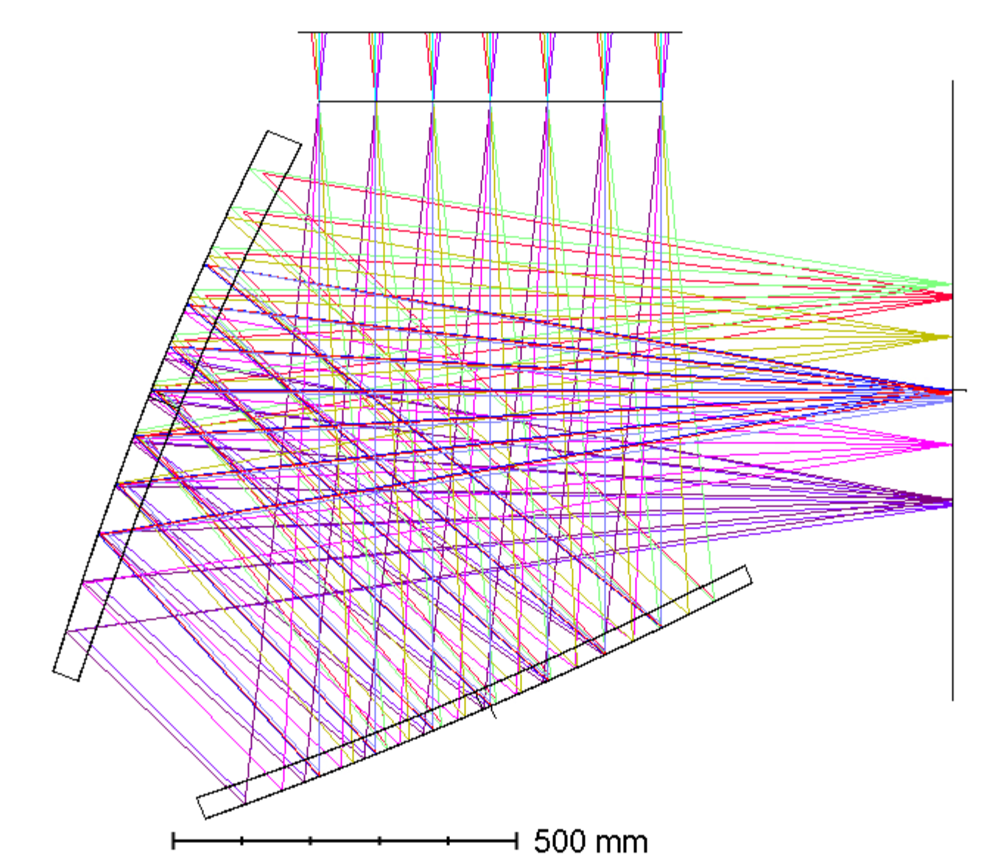
LiteBIRD reformation phase
LiteBIRD is under rescope studies to consolidate the mission's feasibility while keeping the same scientific objectives
Revisit the error budget
Simplify the mission configuration (one single telescope instead of three; try to use existing technologies as much as possible)
Simplify the cryogenic chain
The LiteBIRD collaboration will spend approximately one year (~ late 2025) on the studies of the reformation plan
Two different configuration options now being considered, both based on single Crossed-Dragone reflective telescope
Option 1 (no Half-Wave Plate) requires a faster spin rate to minimize 1/f noise
Option 2 is based on the possibility of using a wider-band HWP
Aperture 500 mm
40-570 GHz
No HWP
Spin rate 0.3 rpm
HWP
Option 1
Aperture 500 mm
40-402 GHz
Transmissive HWP
Spin rate 0.05 rpm
Option 2
Notes:
The wider-band HWP is based on 5 plates in Pancharatnam configuration. Each of these plates is made of 10 meta material mesh layers.
The design is responsibility of La Sapienza University (Giampaolo Pisano) and the fabrication is responsibility of Cardiff.
According to the latest simulations the efficiency of the HWP decreases below 100 GHz and above 400 GHz. Therefore the lowest-frequency channels will be affected, particularly the 40 and 50 GHz channels (the efficiency drops to ~50% at 50 GHz).
The aperture has increased from 400 mm (LFT), 300 mm (MFT) and 200 mm (HFT). This has the added benefit of improved science outcomes in some areas like e.g. SZ science, thanks to better angular resolution in the higher-frequency channels.
The reflective HWP of option 3 has some constraints and requires a smaller aperture and also smaller focal plane. This option has been removed in the current version.
Synergies with ground-based CMB observatories should be emphasised:
Can use larger-aperture telescopes providing better angular resolution, so their data can contribute to improve de-lensing of LiteBIRD’s data.
They can adopt cutting-edge challenging technologies to achieve the best possible performance, contrary to space missions that are forced to use well-established and reliable technologies. Technological exchange between ground-based and space missions is then very useful.
We should also emphasise science outcomes from the mission on various topics beyond B-modes.
Further information about the reformation plan:
KEK decided to relinquish their responsibility for the development of their original technological contribution (focal plane detectors).
As a result of the ISAS/JAXA KDP that was released on 26 September 2024:
The LiteBIRD collaboration will conduct an investigation of a reformation plan during around one year.
Then, ISAS/JAXA will judge the continuation on the project (late 2025).
On October 2024 the PI has changed to Tomotake Matsumura (Kavli IPMU, the University of Tokyo).
Primary purpose (triggered by KEK’s decision not to provide the focal-plane detector system) is to redefine the detector procurement plan in coordination with new partners.
After the JAXA KDP2 in September 2025 JAXA will decide on whether or not to approve its support to the mission will be maintained.
In the JAXA MDR in spring 2026 the collaboration must show that the mission is mature to enter the JAXA phase A (equivalent to ESA Phase B).
The principal science goal remains unchanged, i.e., to verify the inflationary Universe.
The sensitivity to the tensor-to-scalar ratio r will be maintained at a level where representative inflationary models, e.g. Starobinsky, can be tested.
Will revisit the error budget (statistical, foreground residuals, systematic effects, margin) keeping the science goals.
The statistical uncertainty on sigma_r will remain unchanged although the requirement on delta_r is subject to change.
LiteBIRD obtains 40-400 GHz millimeter wavelength all-sky maps. They will allow us to address important scientific topics other than the verification of the inflationary universe.
Most of this has been made public in the ISAS/JAXA webpage: https://www.isas.jaxa.jp/en/missions/spacecraft/future/litebird.html

Slide 24
Content of the talk
LiteBIRD overview
Cosmic inflation and B-mode polarization
Mission objectives
Space craft and instruments
Expected science outcomes
Summary

Slide 25
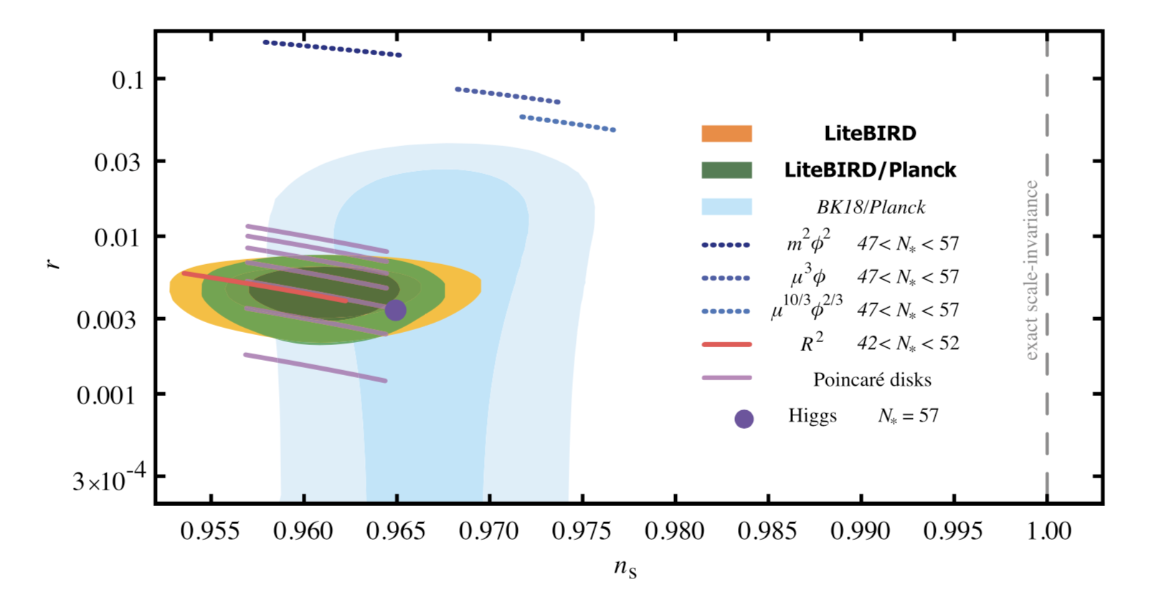
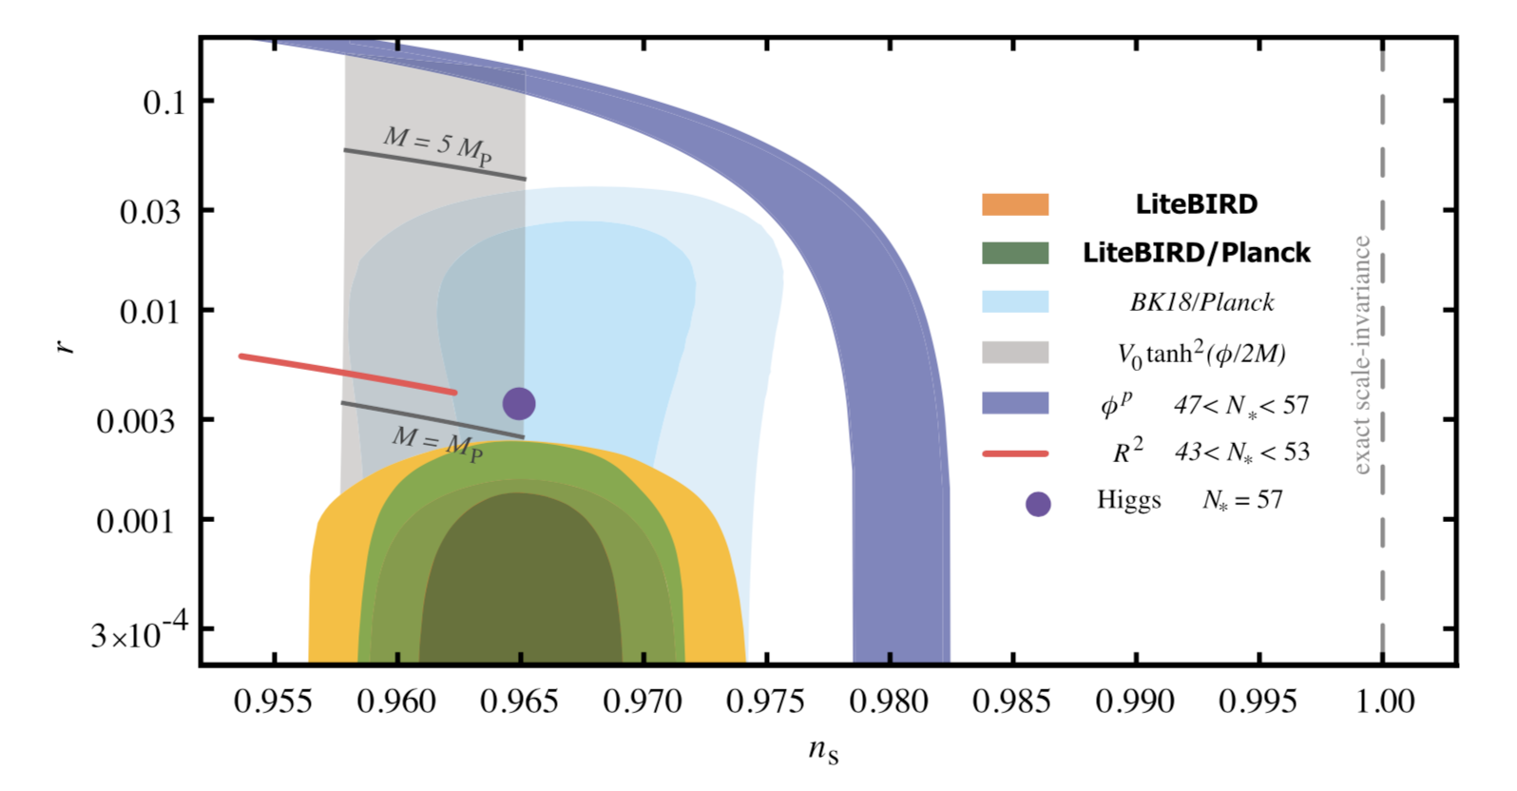
LiteBIRD constraints on inflation
Huge discovery impact (evidence for inflation, knowledge of its energy scale, and distance traveled by the inflaton…)
A detection of B-modes by LiteBIRD with r > 0.01 would imply an excursion of the inflation field that exceeds the Planck mass
Such a detection would constrain theories of quantum gravity such as superstring theories
An upper limit from LiteBIRD would disfavour the simplest inflationary models, with M > Mp
This includes the monomial models, α-attractors with a super-Planckian characteristic scale, including the Starobinsky model and models that invoke the Higgs field as the inflaton
Notes:
Explanation of the top figure (caption of Figure 2 in PTEP): LiteBIRD constraints on the tensor-to-scalar ratio r and the scalar spectral index ns assuming Starobinsky’s R2 model for inflation with N∗ = 51 (specifically the analytic prediction described in the text) as the fiducial model. The lighter and darker green regions show 68% and 95% confidence- level limits achievable with LiteBIRD and Planck. The lighter and darker orange regions (partly hidden behind the green regions) show 68% and 95% confidence-level limits achievable with LiteBIRD alone. The current limits are shown in light blue. The dotted blue lines show representative cases of the first class of models described in the text, monomial models. The red line and the dark purple dot show the predictions of the Starobinsky model (labeled as R2) and models that invoke the Higgs field as the inflaton, respectively. The light purple lines shows the prediction for Poincaré disk models.
Explanation of the bottom figure (caption of Figure 3 in PTEP): LiteBIRD constraints for a fiducial model with r = 0. The lighter and darker green regions show 68% and 95% confidence-level upper limits achievable with LiteBIRD and Planck. The lighter and darker orange regions (partly hidden behind the green regions) show 68% and 95% confidence-level upper limits achievable with LiteBIRD alone. The blue band shows the first class of models mentioned in the text, monomial models. The gray band shows a concrete representative second class of plateau models with p = 1, α-attractors. As discussed in the text, the second class of models depends on the characteristic scale of the potential M. The darker gray lines show α-attractors with M = M_p and M = 5M_p. In the absence of a detection, LiteBIRD will exclude the first class of models at high significance, and will exclude models in the second class with a super-Planckian characteristic scale, which includes the Starobinsky model and models that invoke the Higgs field as the inflaton, shown as the red line and the purple dot, respectively.
Comments by Ken Ebisawa on 09/20/2025: This is taken from the slide deck v1.8 at https://cloud.iac.es/index.php/s/DCosRPwH7Ld2TBa Same as for the rest of the expected science outcomes.

Slide 26
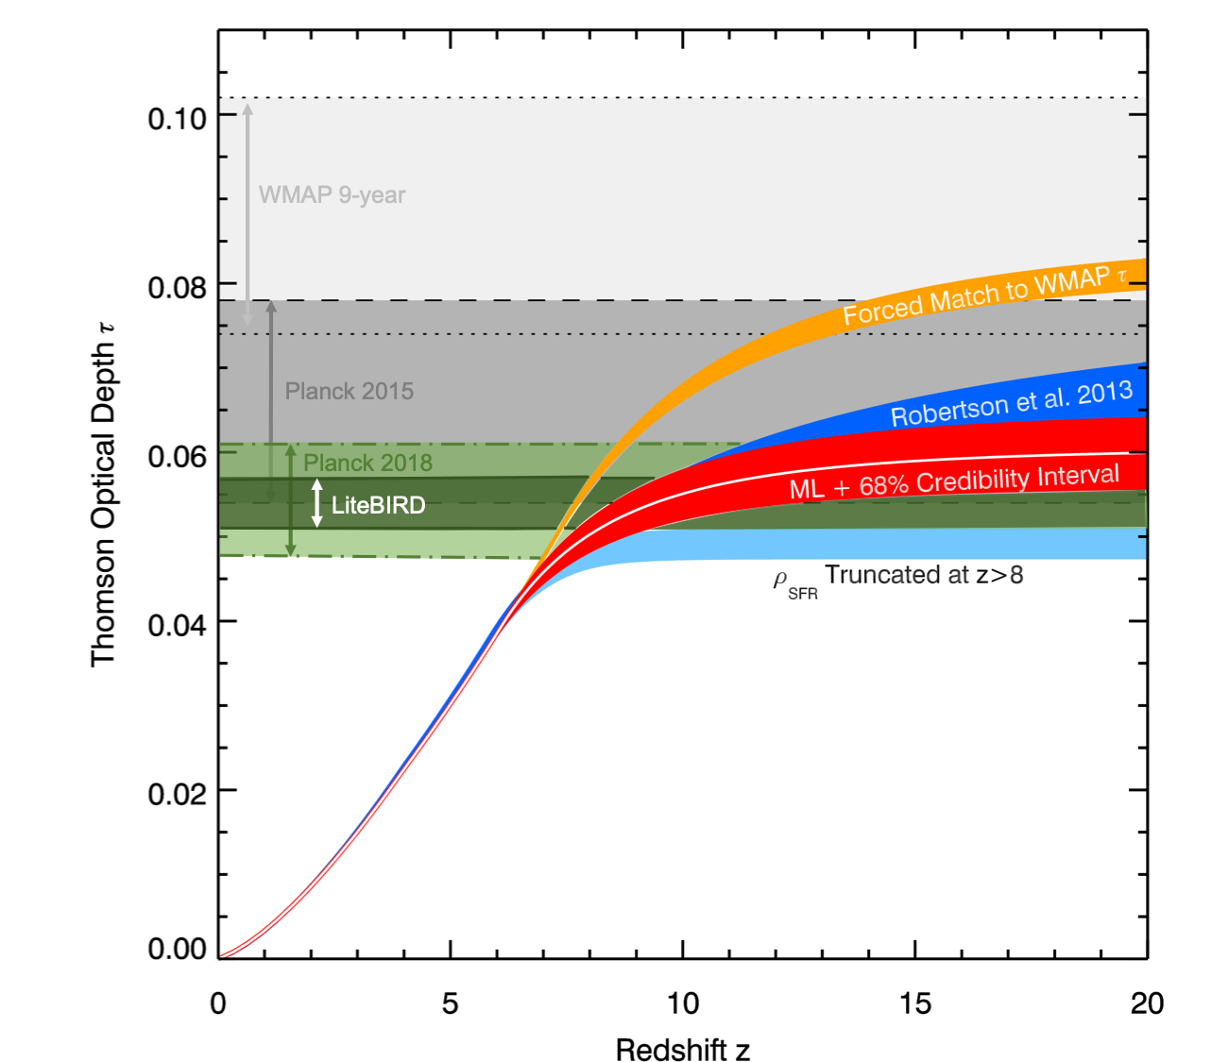
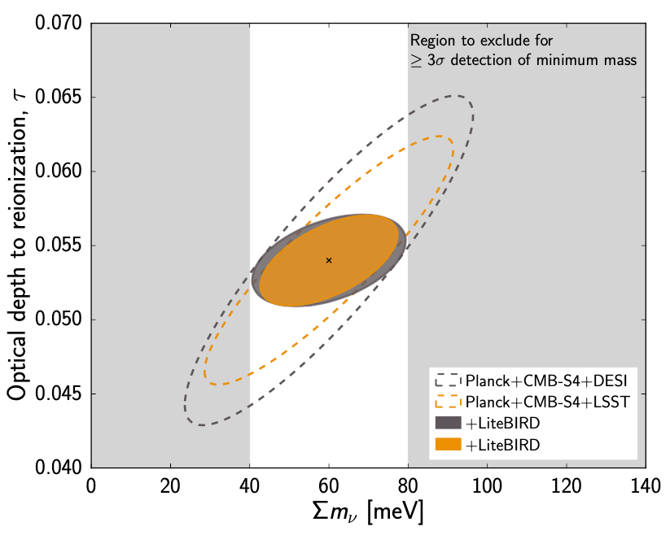
LiteBIRD other science outcomes
The mission specifications are driven by the required sensitivity on r
Meeting those sensitivity requirements would allow to address other important scientific topics, such as:
Characterize the B-mode power spectrum and search for source fields (e.g. scale-invariance, non-Gaussianity, parity violation, …)
Power spectrum features in polarization
Large-scale E-modes
Reionization (improve 𝜎(𝜏) by a factor of 3)
Neutrino mass (𝜎(∑m𝜈) = 12 meV)
Constraints on cosmic birefringence
Gravitational lensing
SZ effect (thermal, diffuse, relativistic corrections)
Anisotropic distortions of the CMB spectrum
Constraints on primordial magnetic fields
Elucidating anomalies
Physics of Galactic emission mechanisms
Catalogues of polarized point sources
_{📖 Adapted from Robertson +2015}
📖 LiteBIRD collaboration PTEP 2023
Notes:
Expected error in the reionization optical depth, on fsky=0.7, cosmic-variance limited measurements below l=10 (see figure 46 of PTEP): sigma(tau)=0.002. Previous best measurement from Planck-NPIPE is sigma(tau)=0.006 -> factor 3 improvement.
Assuming the previous cosmic-variance limited measurement of tau would lead to sigma(sum(m_nu)) = 12 meV. Assuming the minimum value of sum(n_nu) = 60 meV as allowed by flavour-oscillation experiments, would lead to a 5-sigma detection (see figure).
Note that S4 has now been cancelled. The sigma(sum(m_nu)) = 12 meV value results from a combination with DESI+S4, while the combination of DESI+SO, which is what now we should probably quote, leads to sigma(sum(m_nu)) = 18 meV (see next slide).

Slide 27
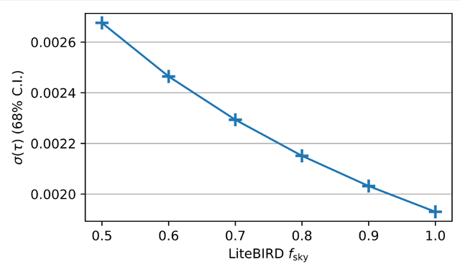
Optical depth, reionization and neutrino masses
LiteBIRD will provide a cosmic-variance limited measurement of the E-mode power spectrum on large scales (2 < ℓ < 200)
This will lead to improved constraints on:
Reionization
Signal-dominated measurement of the optical depth to reionization ⇒ 𝜎(𝜏) ≈ 0.002 ⇒ ×3 improvement w.r.t Planck
Only limited by the sky fraction after cleaning
Signal-dominated regime reached after 6 months, allowing 𝜎(𝜏) ≈ 0.003
Impact on reionization history currently under investigation
Neutrino masses
Combination with ground-based CMB and BAO data will allow σ(∑mν) ≈ 18 meV (SO+DESI) or σ(∑mν) ≈ 12 meV (S4+DESI)
Potentially rule out the inverted neutrino mass ordering
5𝜎 detection for ∑mν = 60 meV (minimum mass in normal ordering)
_{📖 LiteBIRD coll 2023}
Notes:
Expected error in the reionization optical depth, on fsky=0.7, cosmic-variance limited measurements below l=10 (see figure 46 of PTEP): sigma(tau)=0.002. Previous best measurement from Planck-NPIPE is sigma(tau)=0.006 -> factor 3 improvement. The estimate of sigma(tau)=0.002 is for a fiducial value of tau=0.054 and comes from Di Valentino et al. (2018) (CORE forecast paper)
It is worth mentioning that after one survey (6 months) we will already improve the Planck constraint significantly.
Delta(Z_reion) is the duration of reionization. The expected improvement wrt to Planck is of 35% (Paoletti et al. 2020), and is inferred from Hazra et al. (2018). This number is being revisited now, and that is why we are conservative and say “Impact on deionisation history currently under investigation”.
Top figure is Figure 49 from PTEP: 2D marginalized contour levels at 68% CL for τ and the sum of the neutrino masses as measured by future combinations of CMB and large-scale structure data, including, e.g., baryonic acoustic oscillation (BAO) from DESI or galaxy lensing and clustering from LSST, adapted from Calabrese et al. (2017). The contours are centered on the fiducial values τ = 0.054 and sum(m_nu) = 60 meV, as indicated by the cross. A cosmic-variance-limited measurement of τ is reached with LiteBIRD (i.e., σ(τ) = 0.002). This τ limit will enable a better neutrino mass measurement, reaching a 5 σ detection when combined with DESI or LSST.
The bottom figure shows the error on the optical depth for different sky fraction (or foreground cleaning efficiencies).
Note that S4 has now been cancelled. We should probably refer to the combination with SO+DESI only. This would imply modification of the top figure, so for the moment we are leaving also the combination with S4.

Slide 28
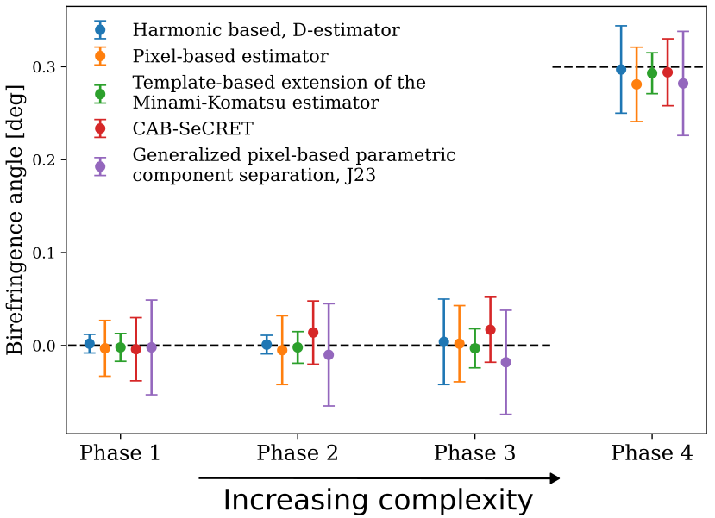
Constraints on cosmic birefringence
Dark matter or dark energy could be a parity-violating pseudo-scalar field that couples to electromagnetism and rotates the linear polarization of photons propagating through the Universe.
This effect, known as cosmic birefringence, induces non-zero TB and EB correlations and also a B-mode signal.
Recent measurements show tentative detections of rotations:
(0.34±0.09)° from the combined analysis of WMAP and Planck PR4 _{(📖 Eskilt & Komatsu 2022)}
(0.20±0.08)° from ACT DR6 _{(📖 Louis et al. 2025)}
which are potentially compatible with cosmic birefringence.
LiteBIRD has the potential to:
Reduce the error bar on isotropic birefringence, leading to a 5 to 13σ detection of a 0.3° angle depending on the method used to account for possible detector angle miscalibration and the EB signal from Galactic foregrounds _{(📖 de la Hoz et al. 2025)}
Distinguish between dark matter and dark energy by probing EB around the reionization peak (📖 Nakatsuka et al. 2022, 📖 Namikawa et al. 2025)
Produce a full-sky map of birefringence anisotropies to further test the nature and origin of the field.
📖 de la Hoz +2025
Notes:
CB modifies all CMB spectra except TT. In particular, CB creates a B-mode (that is zero in the absence of PWGs and lensing) and TB and EB (which are zero under parity conservation)
The archetypical field responsible for CB would be the axion.
The figure is from de la Hoz et al. (2025), and contains the recovered CB angle and error for five different pipelines (different colours) and for four different simulations setups or phases. The first three phases have input CB angle = 0 deg, while the fourth has input CB angle 0.3 deg. From phase 1 to phase 2, there is an increase in foreground complexity. From phase 2 to phase 3, miscalibration of detectors' polarization angles is added. From phase 3 to phase 4, non-null birefringence is added. A more detailed description of these 4 phases is given at the end of section 2 of de la Hoz et al. (2025) (https://arxiv.org/pdf/2503.22322)
The methods providing the maximum and the minimum significance are respectively: 1) the Minami-Komatsu estimator, (29.3+/-2.2)e-2 deg (13 sigma), green point, and 2) J23 (this is a modified version of FGBuster), (28.2+/-5.6)e-2 deg (5 sigma), purple point.

Slide 29
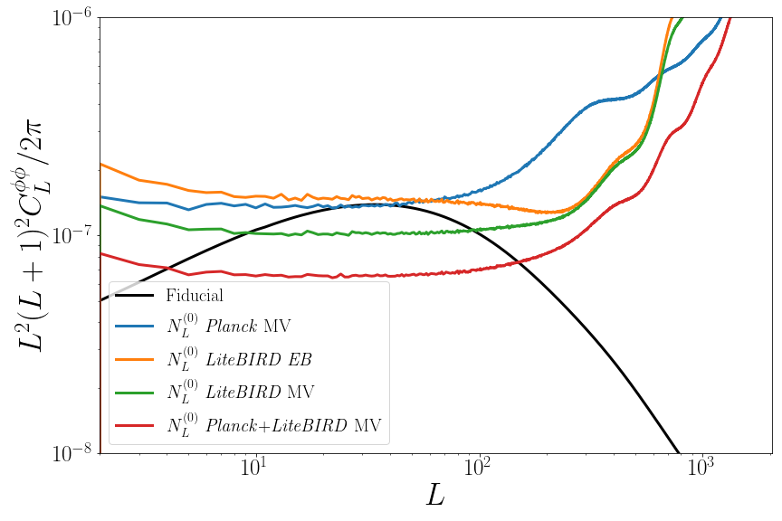
Weak gravitational lensing
CMB photons are deflected by large-scale structure through gravitational lensing, which introduces higher-order correlations in CMB anisotropies.
These higher-order correlations can be used to reconstruct the lensing deflections and map the integrated matter distribution along the line of sight, probing the growth of structure up to high redshifts.
LiteBIRD will provide a 49 to 58𝝈 detection of the lensing power spectrum over 80% of the sky, depending on the final complexity of polarized Galactic emission.
85% of the S/N of LiteBIRD’s lensing reconstruction will come from polarization.
The combination of Planck and LiteBIRD will provide the best full-sky lensing map in the 2030s with a 72 to 78σ detection over 80% of the sky, almost doubling Planck’s sensitivity.
These combinations will improve the constraint on S₈ by a factor 2 compared to Planck.
📖 Lonappan +2024, Ruiz-Granda +2025
Notes:
It is important to emphasise here that while LiteBIRD clearly adds the benefit of improved sensitivity and frequency coverage, which helps crucially in reducing foreground residuals, it is important to combine with Planck data in order to gain angular resolution.
The top figure is extracted from Figure 7 of Remazeilles et al. (2024), and shows the reconstruction of the Y-map in a given position using Planck-only or Planck+LiteBIRD: 12.5◦ × 12.5◦ gnomonic projection of the y-maps at optimal resolution centred at (l,b) = (120◦,−40◦): Input y-map at 10′ resolution (left), Planck y-map at 10′ resolution (centre) and LiteBIRD -Planck combined y-map at 10′ resolution (right). Most compact clusters cannot be resolved in the LiteBIRD y-map due to beam limits, while they are detected in the LiteBIRD-Planck combined y-map, with higher signal-to-noise compared to the Planck y-map. The message that must be conveyed from this figure is that LiteBIRD clearly helps in reducing the contamination wrt to Planck. However, Planck higher angular resolution is clearly needed for a better recovery of the SZ signal at angular scales of galaxy clusters. The figure in the post-PTEP paper shows an extra panel that has been omitted here with the LiteBIRD-only case that clearly shows the effect of poorer angular resolution. Note also that these figures have been obtained without including 1/f noise in the LiteBIRD simulation.
It is important to remind that this analysis is based on the previous configuration with 3 telescopes. In the new configuration the angular resolution will be better in the high frequency channels.
The bottom figure is top panel of Figure 8 of the PTEP and shows the impact of instrument plus Galactic noise residuals in the reconstruction of the SZ map in comparison with the input map. Here a combination of Planck+LiteBIRD has been considered. Comparison with the LiteBIRD-only case shown in the middle panel of figure 8 demonstrates that the Planck 545 and 857 GHz channels are critical to clean the dust, and then in the LiteBIRD-only case there are significant residuals from the dust that affect the SZ map on the largest angular scales. It must be noted also that no 1/f for LiteBIRD has been considered in this plot. However, Figure 10 demonstrates that Galactic residuals when Planck data is not included dominate over 1/f noise. The grey dotted line shows the noise in the public Planck SZ map (released in the PR2). Comparison with the dashed green curve shows the improvement expected from the addition of LiteBIRD data. The recovered noise power spectrum from the Planck-only simulation is perfectly consistent with he dotted grey curve, highlighting the reliability of the adopted simulation pipeline.

Slide 30
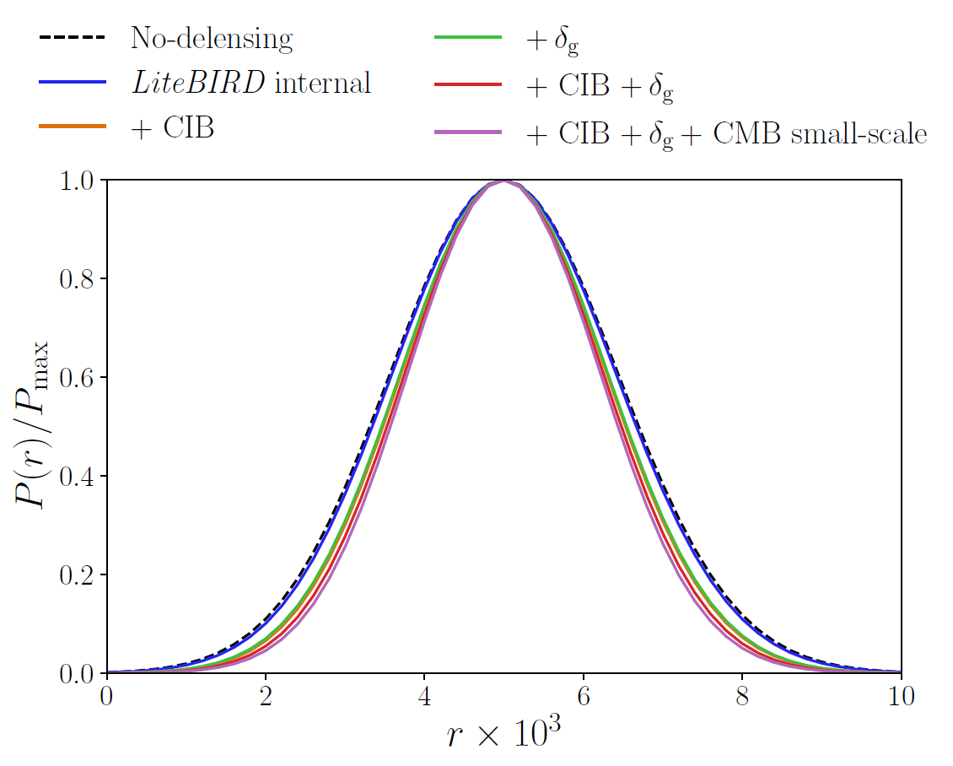
B-mode delensing
If the lensing potential is known, lensing deflections can be reverted to recover an undistorted view of the last scattering surface. This process is called delensing.
Constraints on r will tighten by about 5% when delensing using only LiteBIRD data (internal delensing).
Through the combination of different mass tracers, like the cosmic infrared background (CIB) or galaxy surveys such as Euclid and LSST (δg), and high-resolution CMB maps such as those from CMB-S4, we can achieve a more efficient delensing that tightens constraints on r by about 20%.
_{📖 Namikawa +2024}
Synergy between LiteBIRD and ground-based experiments to carry out a detailed study on how much:
LiteBIRD’s high- and low-frequency maps will improve foreground cleaning for ground-based experiments (SO, BICEP/Keck).
The small-scale information from ground-based experiments will improve B-mode delensing for LiteBIRD.
Notes:
It is important to emphasise here that while LiteBIRD clearly adds the benefit of improved sensitivity and frequency coverage, which helps crucially in reducing foreground residuals, it is important to combine with Planck data in order to gain angular resolution.
The top figure is extracted from Figure 7 of Remazeilles et al. (2024), and shows the reconstruction of the Y-map in a given position using Planck-only or Planck+LiteBIRD: 12.5◦ × 12.5◦ gnomonic projection of the y-maps at optimal resolution centred at (l,b) = (120◦,−40◦): Input y-map at 10′ resolution (left), Planck y-map at 10′ resolution (centre) and LiteBIRD -Planck combined y-map at 10′ resolution (right). Most compact clusters cannot be resolved in the LiteBIRD y-map due to beam limits, while they are detected in the LiteBIRD-Planck combined y-map, with higher signal-to-noise compared to the Planck y-map. The message that must be conveyed from this figure is that LiteBIRD clearly helps in reducing the contamination wrt to Planck. However, Planck higher angular resolution is clearly needed for a better recovery of the SZ signal at angular scales of galaxy clusters. The figure in the post-PTEP paper shows an extra panel that has been omitted here with the LiteBIRD-only case that clearly shows the effect of poorer angular resolution. Note also that these figures have been obtained without including 1/f noise in the LiteBIRD simulation.
It is important to remind that this analysis is based on the previous configuration with 3 telescopes. In the new configuration the angular resolution will be better in the high frequency channels.
The bottom figure is top panel of Figure 8 of the PTEP and shows the impact of instrument plus Galactic noise residuals in the reconstruction of the SZ map in comparison with the input map. Here a combination of Planck+LiteBIRD has been considered. Comparison with the LiteBIRD-only case shown in the middle panel of figure 8 demonstrates that the Planck 545 and 857 GHz channels are critical to clean the dust, and then in the LiteBIRD-only case there are significant residuals from the dust that affect the SZ map on the largest angular scales. It must be noted also that no 1/f for LiteBIRD has been considered in this plot. However, Figure 10 demonstrates that Galactic residuals when Planck data is not included dominate over 1/f noise. The grey dotted line shows the noise in the public Planck SZ map (released in the PR2). Comparison with the dashed green curve shows the improvement expected from the addition of LiteBIRD data. The recovered noise power spectrum from the Planck-only simulation is perfectly consistent with he dotted grey curve, highlighting the reliability of the adopted simulation pipeline.

Slide 31
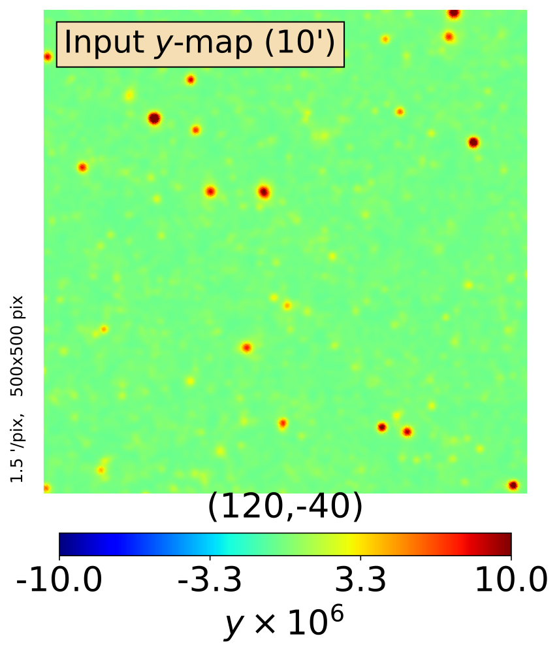
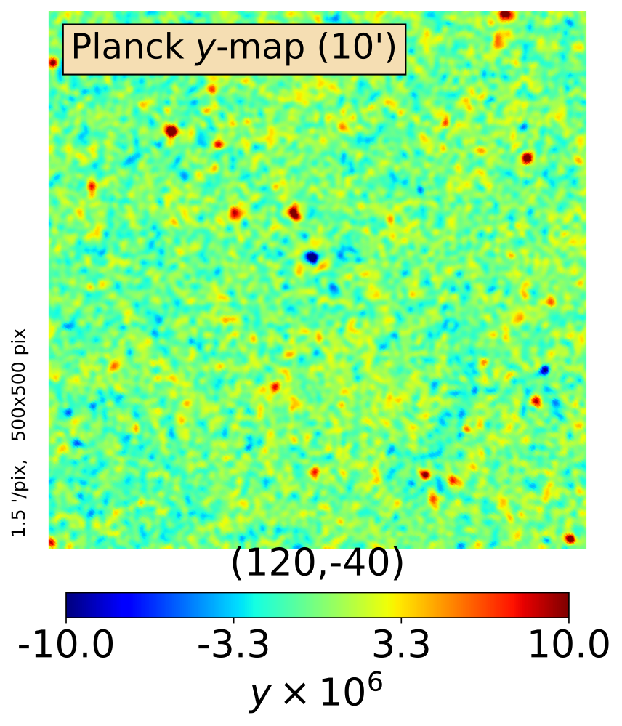
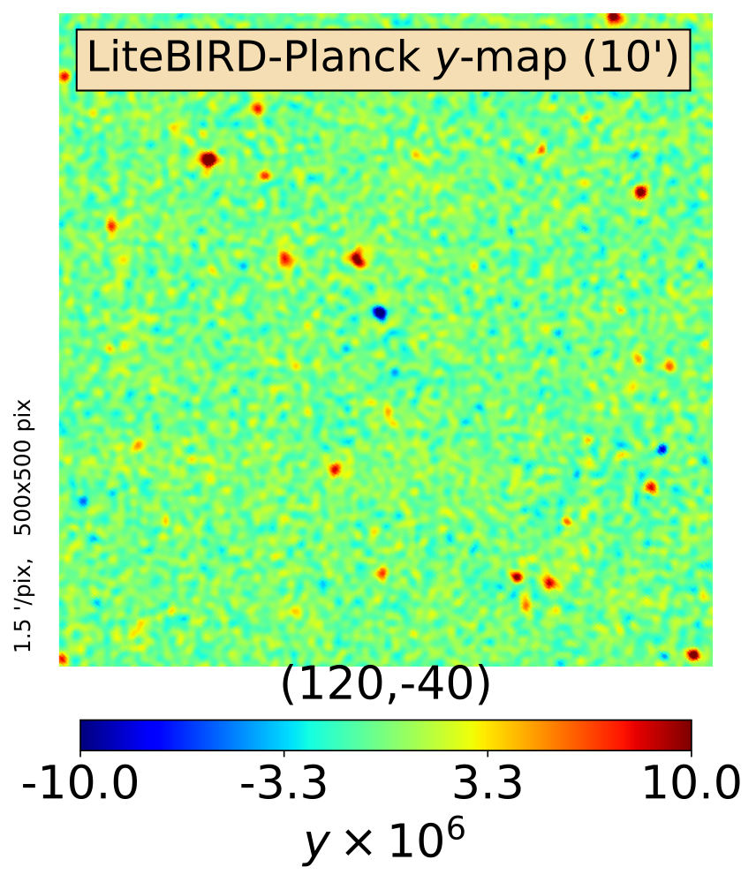
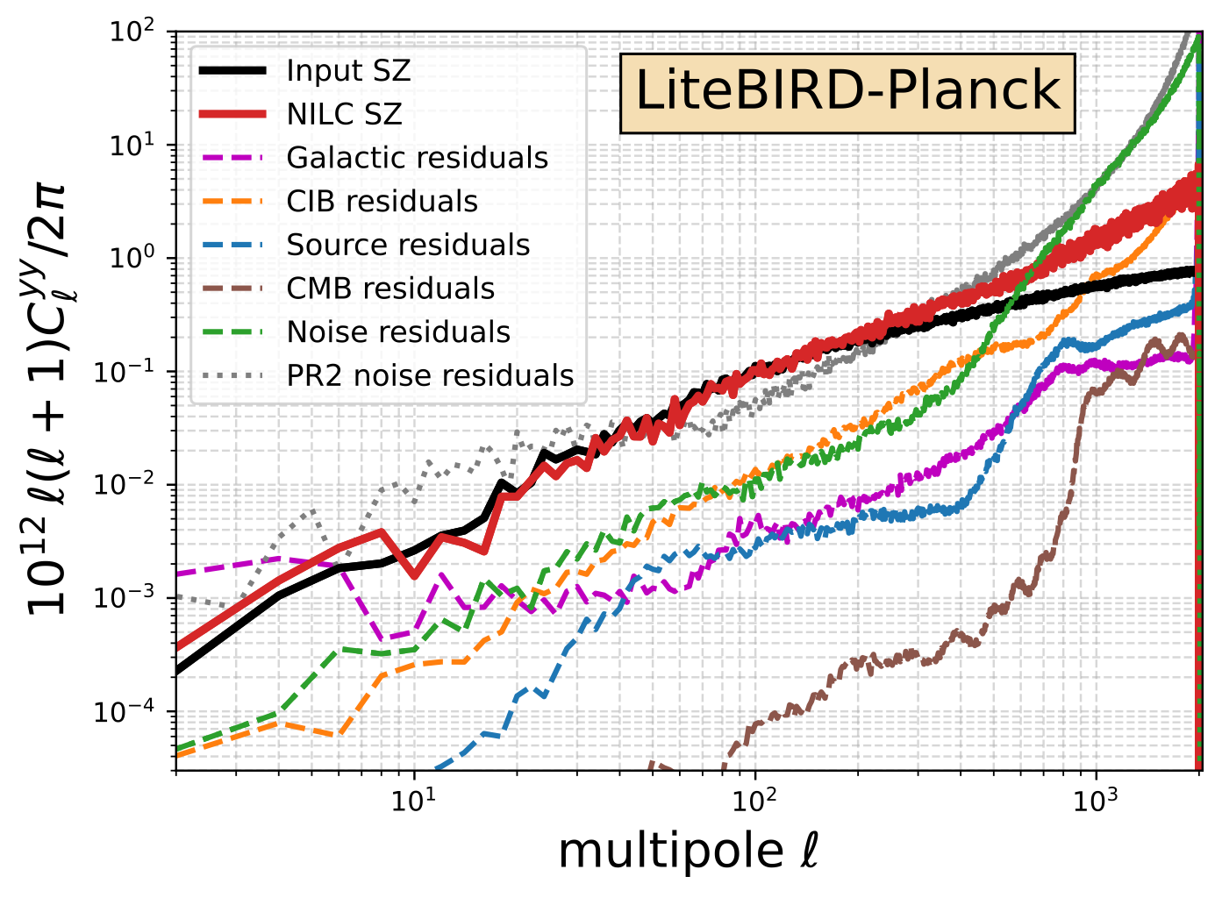
Mapping the hot gas in the Universe
The Sunyaev-Zel’dovich effect provides a mean to map the distribution of hot electrons in the Universe
Improved sensitivity and frequency coverage of LiteBIRD crucially contributes to improve these studies
Combination with Planck adds the benefit of angular resolution
LiteBIRD will improve ×10 the noise in the SZ map wrt Planck
This will allow to:
Produce a high-fidelity SZ map over the full-sky essentially free of contamination at ℓ < 200
Test theories of structure formation via hot-gas tomography from SZ × galaxy surveys correlations
Search form WHIM in filaments connecting clusters
Study an inhomogeneous reionization process via cross-correlations of SZ × CMB optical depth
Measure the mean gas Te via the relativistic SZ
Improve constraints on S8 = σ8(Ωm/0.3)^{0.5} by 15%
_{📖 Remazeilles+ JCAP 2024}
Notes:
It is important to emphasise here that while LiteBIRD clearly adds the benefit of improved sensitivity and frequency coverage, which helps crucially in reducing foreground residuals, it is important to combine with Planck data in order to gain angular resolution.
The top figure is extracted from Figure 7 of Remazeilles et al. (2024), and shows the reconstruction of the Y-map in a given position using Planck-only or Planck+LiteBIRD: 12.5◦ × 12.5◦ gnomonic projection of the y-maps at optimal resolution centred at (l,b) = (120◦,−40◦): Input y-map at 10′ resolution (left), Planck y-map at 10′ resolution (centre) and LiteBIRD -Planck combined y-map at 10′ resolution (right). Most compact clusters cannot be resolved in the LiteBIRD y-map due to beam limits, while they are detected in the LiteBIRD-Planck combined y-map, with higher signal-to-noise compared to the Planck y-map. The message that must be conveyed from this figure is that LiteBIRD clearly helps in reducing the contamination wrt to Planck. However, Planck higher angular resolution is clearly needed for a better recovery of the SZ signal at angular scales of galaxy clusters. The figure in the post-PTEP paper shows an extra panel that has been omitted here with the LiteBIRD-only case that clearly shows the effect of poorer angular resolution. Note also that these figures have been obtained without including 1/f noise in the LiteBIRD simulation.
It is important to remind that this analysis is based on the previous configuration with 3 telescopes. In the new configuration the angular resolution will be better in the high frequency channels.
The bottom figure is top panel of Figure 8 of the PTEP and shows the impact of instrument plus Galactic noise residuals in the reconstruction of the SZ map in comparison with the input map. Here a combination of Planck+LiteBIRD has been considered. Comparison with the LiteBIRD-only case shown in the middle panel of figure 8 demonstrates that the Planck 545 and 857 GHz channels are critical to clean the dust, and then in the LiteBIRD-only case there are significant residuals from the dust that affect the SZ map on the largest angular scales. It must be noted also that no 1/f for LiteBIRD has been considered in this plot. However, Figure 10 demonstrates that Galactic residuals when Planck data is not included dominate over 1/f noise. The grey dotted line shows the noise in the public Planck SZ map (released in the PR2). Comparison with the dashed green curve shows the improvement expected from the addition of LiteBIRD data. The recovered noise power spectrum from the Planck-only simulation is perfectly consistent with he dotted grey curve, highlighting the reliability of the adopted simulation pipeline.

Slide 32
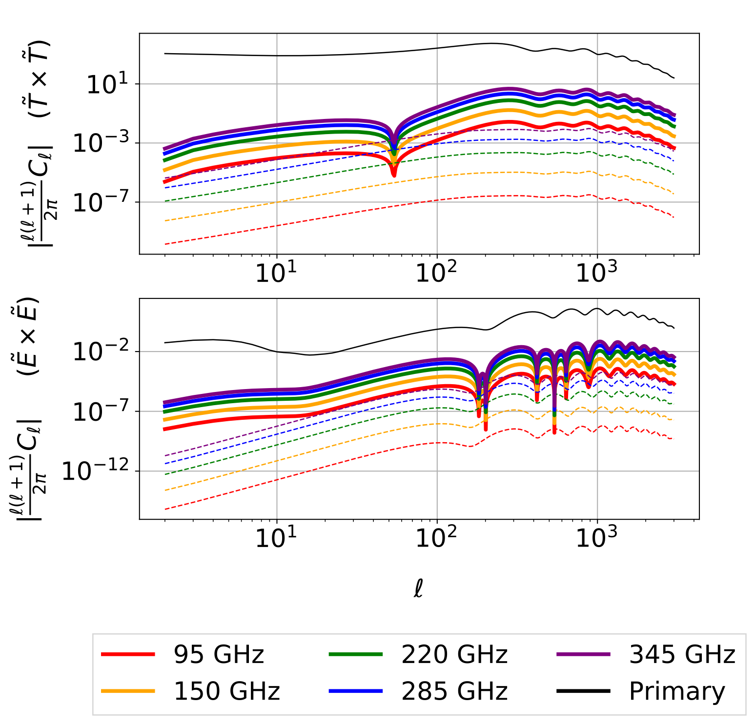
Anisotropic CMB spectral distortions
LiteBIRD will be sensitive to any spatially-varying CMB spectral distortion, beyond the SZ effect
Rayleigh scattering. LiteBIRD will have sensitivity to measure at 25-sigma (_{📖 Beringue et al. 2021}) the frequency-dependent CMB anisotropies due to Rayleigh scattering by HI at the LSS
Such a detection would allow to derive improved constraints on Neff and ∑mν
μ distortion. LiteBIRD can detect an anisotropic μ distortion induced by non-Gaussian fluctuations induced during inflation (Remazeilles, Raveni & Chluba 2022)
This would offer a power test of inflation at its onset
Axion decay. LiteBIRD can look for polarized spectral distortions produced by resonant conversion of axions into photons by the Galactic magnetic field (Mukherjee, Khati & Wandelt 2018)
_{📖 Dibert+ PhysRevD 2022}
Notes:
It is important to emphasise that LiteBIRD does not measure the CMB monopole and then it cannot measure the monopole component of spectral distortions, only the anisotropic spectral distortions.
It is important to note that the 25-sigma estimate for the detection of Rayleigh scattering in Beringue et al. (2021) that we quote in the PTEP does not consider foreground residuals. Once foreground residuals are included the S/N is expected to decrease significantly. A more careful forecast needed, and this is being pursued by a new group that is being formed inside the collaboration.
Figure: shows the TT (top) and EE (bottom) of the power spectra of Thomson-scattering CMB anisotropies (black), cross-correlation between Thomson and Rayleigh scattering in absolute value (solid coloured lines) and the auto power spectra of anisotropies induced by Rayleigh scattering (dotted coloured lines). Different frequencies are considered for the case of the Rayleigh scattering. The figure is from Dibert et al. (2022) and shows SPT-3G+ frequencies (the paper presents a forecast for SPT-3G+, CCAT-prime, SO and CMB-S4). It would be nice having an equivalent figure showing some combination of LiteBIRD frequencies or, even better, a Figure showing some forecast for LiteBIRD. In the PTEP paper there is no figure related with this study. There is a new project study group that is being formed in the collaboration to perform this forecast.

Slide 33
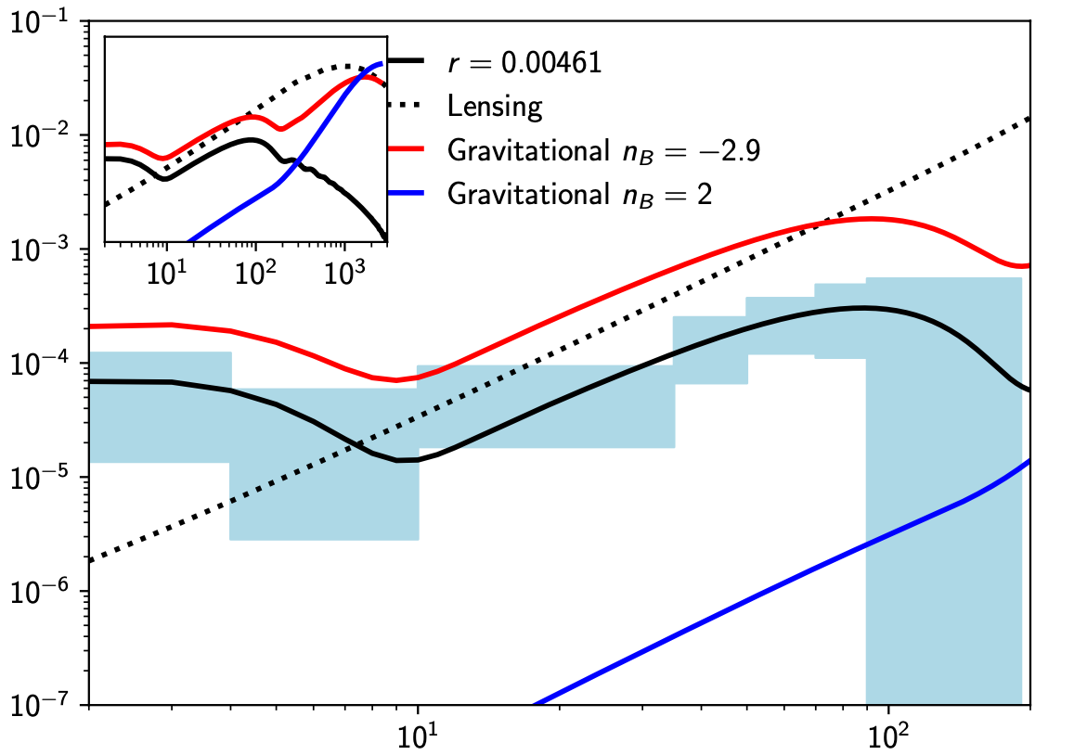

Constraints on primordial magnetic fields
Primordial magnetic fields (PMFs) affect the CMB via different effects:
Gravitational effects with magnetically-induced perturbations
Impact on the ionization history of the Universe due to their post-recombination dissipation
Induce a Faraday rotation of the CMB polarization
Non-Gaussianity induced in the CMB polarization anisotropies
LiteBIRD:
Is a sensitive probe to PMFs through all these effects, thanks mainly to its remarkable sensitivity in polarization
Will break the nG threshold improving current upper limits by a factor of ~ 3
Will be able to univocally identify the PMFs contribution to CMB by joining all these effects together
Will allow a detection of nG fields with high significance
_{📖 Paoletti+ JCAP 2024}
Upper limits on PMF amplitude for nB = -2.9
Gravitational effect | B1Mpc < 0.8 nG
Ionization history | √<B²> < 0.7 nG
Faraday rotation | B1Mpc < 3.2 nG
Non-Gaussianities | B1Mpc ≲ 1 nG
Notes:
n_B is the spectral index. Upper limits on B_1 Mpc are referred to the 95% CL, and are obtained from LiteBIRD data only (in some cases combination with Planck helps improving these constraints, as shown in the Paoletti et al. 2024).
The figure has been extracted from Figure1 of Paoletti et al. (2024). The comparison of the gravitational effect on B modes created by PMFs for nB = 2 in blue and nB = −2.9 in red, with the LiteBIRD error bars. In black solid and dotted lines, we show the primary CMB assuming a R2-like model of inflation and the lensing contribution, respectively. In the inset we show the same curves but including also the small scales which are not observed by LiteBIRD. The amplitudes of the PMF curves are chosen to match the current limits, B(1Mpc)= 2nG and 0.003nG for nB = −2.9 and 2, respectively

Slide 34
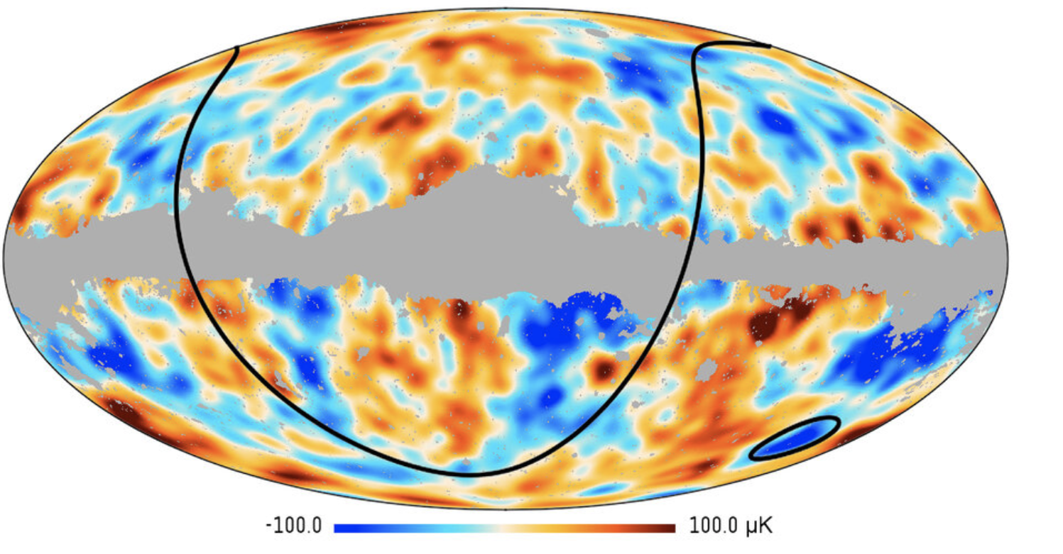
Confronting statistical anomalies with polarization
Various so-called anomalies have been found in WMAP and Planck temperature data that exert a mild tension against the ΛCDM cosmological model:
anomalously low temperature variance
a lack of power on large angular scales
a lack of correlation at large angular scales
a hemispherical asymmetry in power on the sky
the alignment of the quadrupole and octopole moments
parity asymmetry in the power associated with even/odd mode
an anomalous "Cold Spot" on a scale of ~ 10°
Credit ESA/Planck Collaboration
Given their modest statistical significance, these could simply be statistical flukes. However, they may also be hints of new physics beyond the standard model.
Polarized CMB anisotropies provide independent information on the fluctuations that source the temperature anisotropy and therefore a cross-check of the detected anomalies avoiding the look-elsewhere effect.
LiteBIRD E-mode polarization sky maps will allow further tests at close to the cosmic-variance level of sensitivity. The fluke hypothesis can be assessed using temperature ⨯ E-mode statistics. Anomalies seen directly in E modes will strongly challenge the ΛCDM model.
📖 Banday+ JCAP 2025
Notes:
It is important to emphasise that the main contribution LiteBIRD will bring on this area comes from the E-mode information, as commented in the last bullet point. The fluke hypothesis refers to the hypothesis that the observed anomalies are simply statistical excursions, caused by mildly unusual patterns in the temperature anisotropies arising in the standard cosmological model.
The figure is from an ESA Planck release. The two lines show the North-South asymmetry and the location of the Cold Spot.

Slide 35
Content of the talk
LiteBIRD overview
Cosmic inflation and B-mode polarization
Mission objectives
Space craft and instruments
Expected science outcomes
Summary

Slide 36
7. Summary
LiteBIRD is a major JAXA project planned for launch in 2030s in collaboration with international partners. European countries, in particular, play a key role in developing the telescope and its observational instruments.
LiteBIRD's primary objective is to observe B-mode polarization of the cosmic microwave background (CMB) to test inflationary cosmological models. To this end, LiteBIRD will acquire the most precise multi-band polarization maps during its three-year standard observation period.
Using these maps, LiteBIRD is expected to contribute not only to solving cosmological questions but also various astrophysical problems.
A reformation study is being conducted for LiteBIRD to propose a new design while keeping the same scientific goals.
Notes:
This is original.

Slide 37
Backup

Slide 38
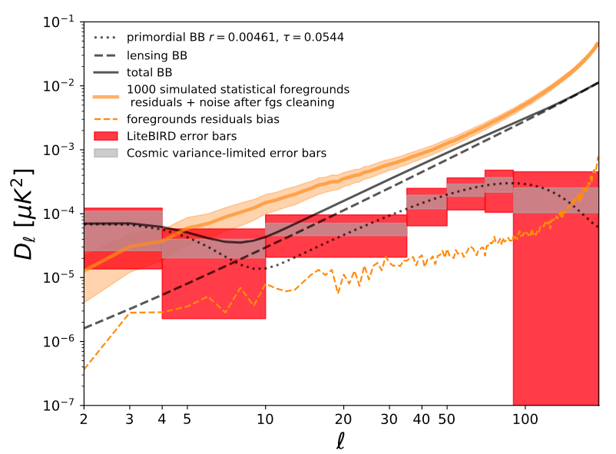
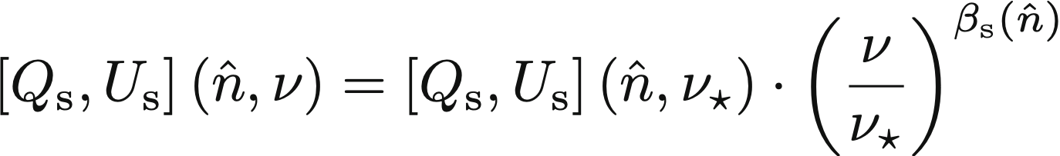
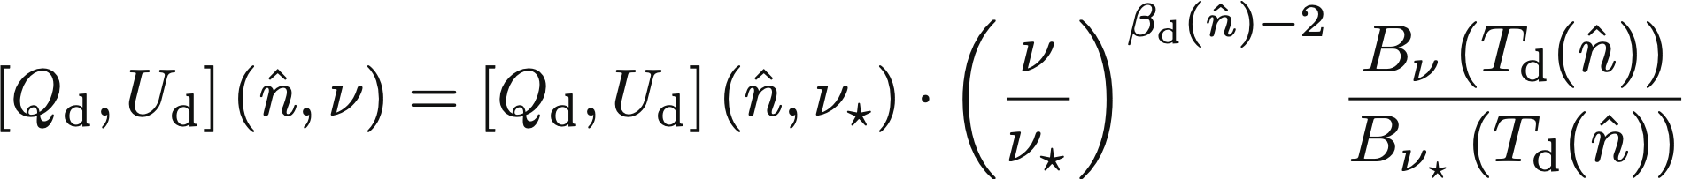
Foreground cleaning
Foreground modelling
Impact of foreground residuals
Synchrotron: power law with spatially-varying index
Dust: modified blackbody
7 parameters in each sky patch
Multi-Clustering interface with foregrounds data to account for spatial variability (📖 Puglisi et al. 2022, Carones et al. 2023)
Current baseline for fitting foregrounds: 12╳(Nside)² patches with Nside between 8 and 64, depending on the foreground parameter
Performance verification through FGBuster derived XForecast procedure
📖 LiteBIRD collaboration PTEP 2023
Notes:
The seven parameters that are fitted in each sky patch are all of them foreground parameters: Q_s, U_s, beta_s, Q_d, U_d, beta_d and T_d.
Multi-Clustering is a generalisation of Multi-Patch.
Beta_s, beta_d and T_d do vary spatially according to PySM d1s1 (beta_s = -2.993 +/- 0.046, beta_d = 1.534 +/- 0.028, T_d = 22.23 +/- 1.56 K).
Explanation of the figure: gray shows cosmic-variance error bars (containing both primordial for r=0.00461 and tau=0.0544 and lensing), and red shows total error bars including also foreground residuals. The solid orange curve represents the average total residuals (including foreground residuals after component separation). The dashed orange curve represents noiseless foreground-residuals.

Slide 39
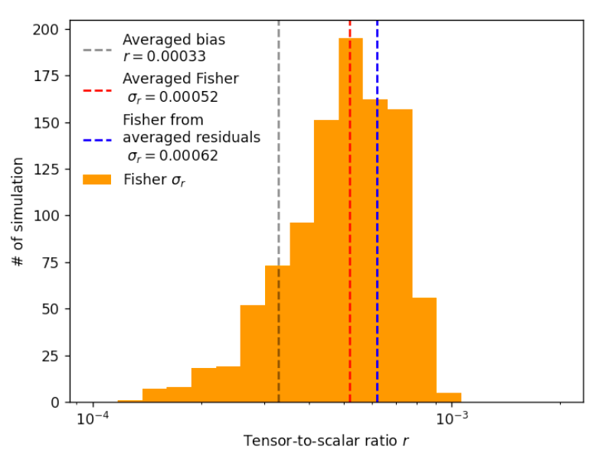
Foreground cleaning
“Multi-Clustering technique” (extension of xForecast)
Distribution of the recovered r in 1000 simulations with input r = 0, with and without foreground residuals
Bias from foreground (PySM d1s1) residuals is found to be small
Final value: r = (3.3 ± 6.2)×10⁻⁴
Notes:
The plot shows the bias on r when the input value is r=0 (vertical dashed black line) and the associated distribution of sigma_r from 1000 simulations with r=0 and foreground residuals (orange histogram). 1000 simulations are run, which include foregrounds given by the PySM s1d1 sky model, which are fixed in all simulations, and a realization of CMB+noise. A parametric component separation technique, FGBuster, is applied in each realization, and as a result a value of r and sigma_r is obtained in each simulation. The black dashed line shows the mean of r in the 1000 simulations (3.3e-4), and then this can be regarded as a bias. The orange histogram shows the distribution of sigma_r in the 1000 simulations, and the blue dashed line marks the mean of sigma_r (6.2e-4). The red dashed line shows the mean of a the Fisher approach (5.2e-4=, in which the likelihood is approximated by a Gaussian around its peak. These two approaches (direct sigma_r from the simulations and from the Fisher approach) agree to within 20%, but here we conservatively adopt the highest value, and quote a final value of (3.3 +/- 6.2)*1e-4.

Slide 40
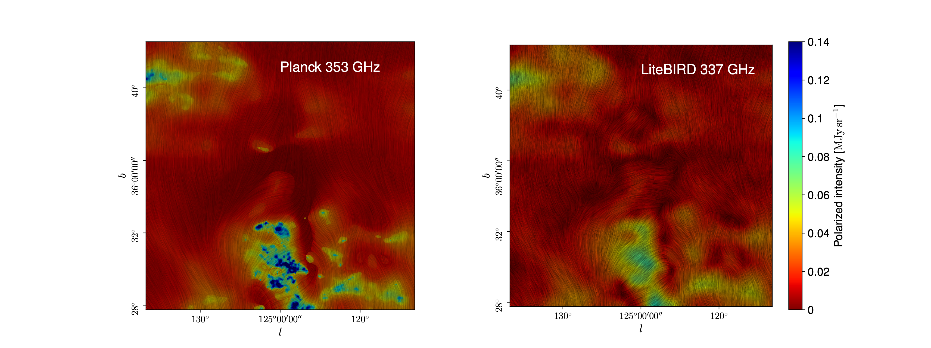
Galactic astrophysics
LiteBIRD will provide 15 high-sensitivity polarization full-sky maps from 40 to 402 GHz
Sensitivity improved by a factor of 5 at 40 GHz and 10 at 402, with respect to Planck
Gain in spectral resolution
Wealth of Galactic science possible:
Geometry of the Galactic magnetic field
Interstellar turbulence
Dust composition
Grain alignment
Cold clumps
Geometry of synchrotron-bright loops
SED of the synchrotron emission
Nature of AME and spectral variations...
… and many others!

Slide 41
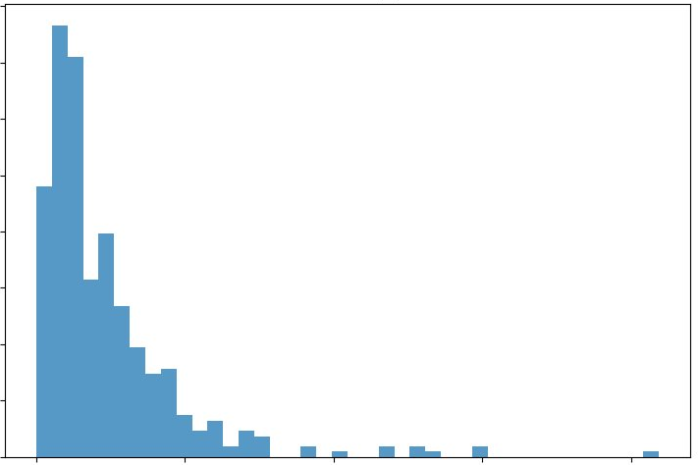
Polarized Compact Source Catalogues
Production of a unique multi-frequency all-sky catalogue of polarized compact sources significantly improving Planck catalogues​
Possibility to produce an Early (Launch+6 months) and a Full Mission catalogue​
Study the impact of resolved and unresolved polarized compact source contamination in CMB analyses​
Possible scientific outcomes from these source catalogues​
Probe magnetic field structures in radio and dusty galaxies​
Constrain AGN structure and properties through number counts​
Measure polarization properties of faint galaxy populations via stacking ​
Trace evolution of galactic-scale magnetic fields beyond the Milky Way​
Enable multi-wavelength studies of galaxy dust and magnetism through cross-survey correlations​
Constrain polarization properties of the cosmic infrared background​
0.40
0.30
3.5 detections above |b| > 10º
0.20
Normalized histogram
0.10
0
0
5
10
15
20
Polarization fraction (%)
Support to mission operations​
Monitor pointing accuracy and calibration with astrophysical sources​
Monitor flaring transient events to minimize impact on TOD and map-making algorithms​
Notes:
The plot shows the distribution of polarization fractions from the sources in the PTEP-based source catalogue @ 140 GHz (SNR>3.5). This plot has been produced by Diego Herranz and Marcos López-Caniego.

