Slide 1
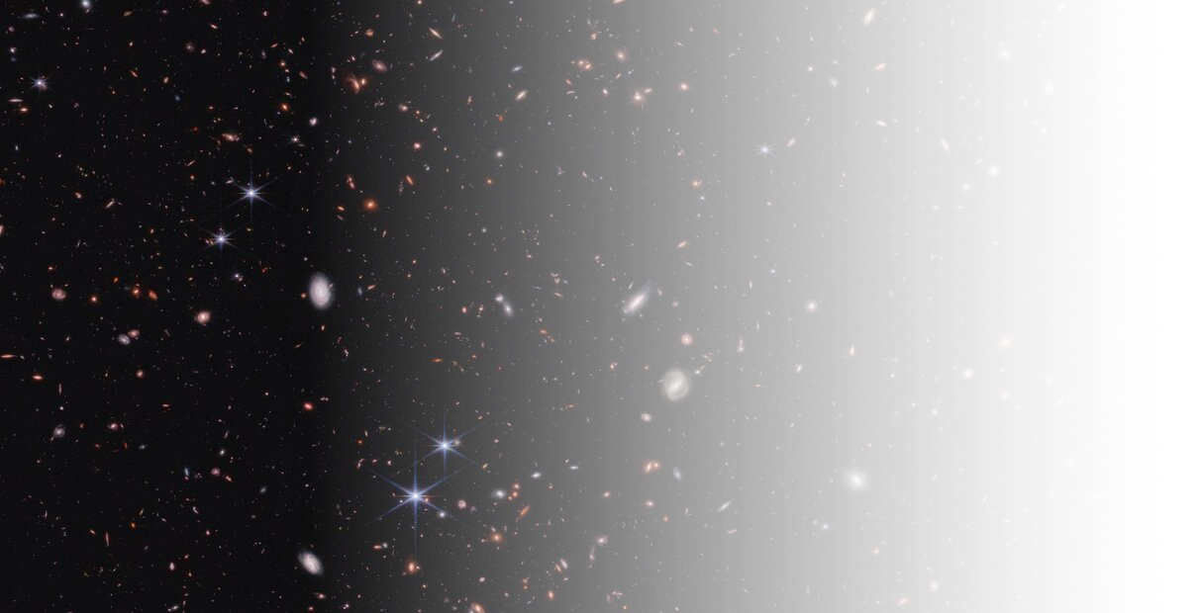


Black holes
Not-quite-primordial
Wenzer Qin
Simons Junior Fellow, New York University
Oct 3rd, 2025 | UNDARK Workshop, IAC

Slide 2
This talk In One slide…
Based on recent work: 2506.13858
With Neal Weiner (NYU), Soubhik Kumar (NYU/Tufts), and Priya Natarajan (Yale)
Takeaways:
Origins of supermassive black holes (SMBHs) still unknown
Modest enhancements in dark matter density fluctuations can seed SMBHs through direct collapse

Slide 3
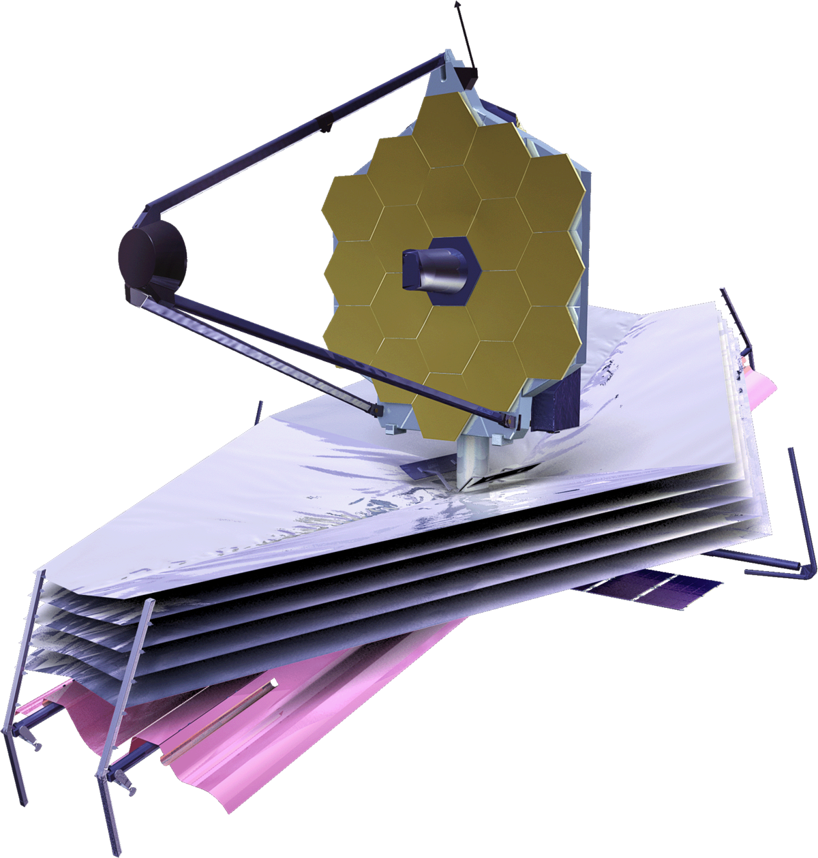
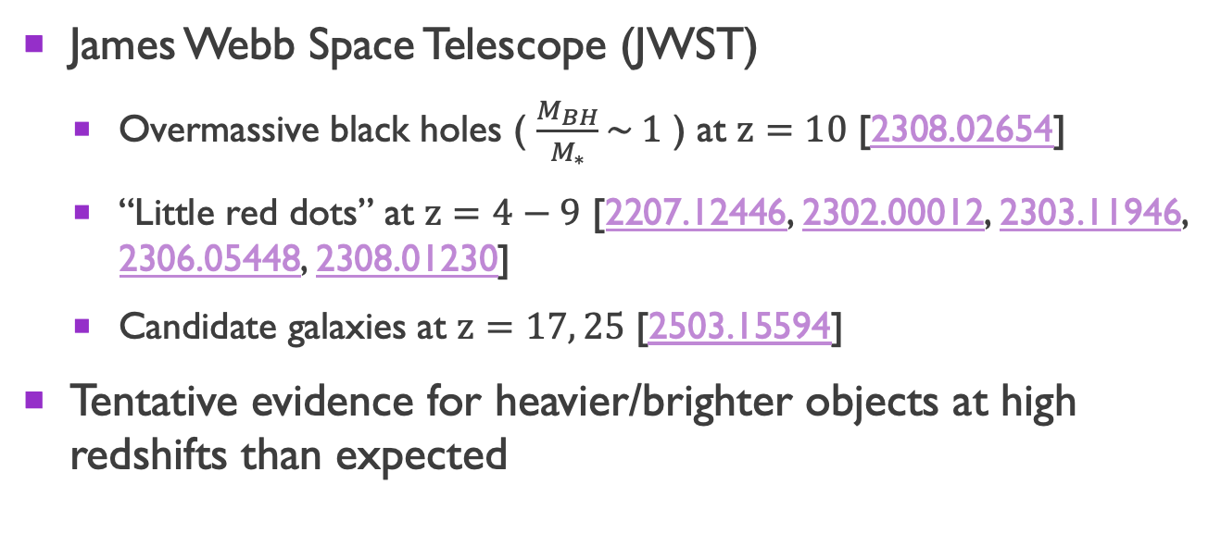
Motivations
James Webb Space Telescope (JWST)
Overmassive black holes ( $\frac{M_{BH}}{M_{∗}}\sim 1$ ) at $z=10$ [2308.02654]
“Little red dots” at $z=4−9$ [2207.12446, 2302.00012, 2303.11946, 2306.05448, 2308.01230]
Candidate galaxies at $z=17, 25$ [2503.15594]
Tentative evidence for heavier/brighter objects at high redshifts than expected

Slide 4
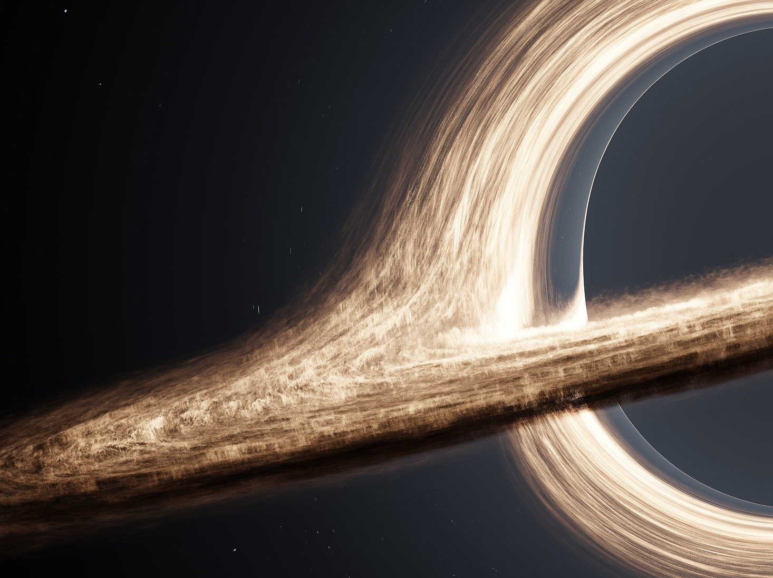
How do supermassive black holes (SMBHs) form?
Do JWST observations favor some mechanisms?
Are the observations consistent with standard physics?
If not, how can we explain them?

Slide 5
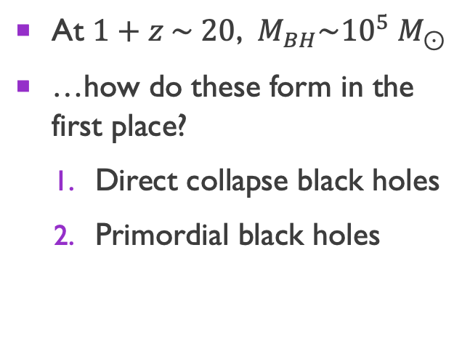
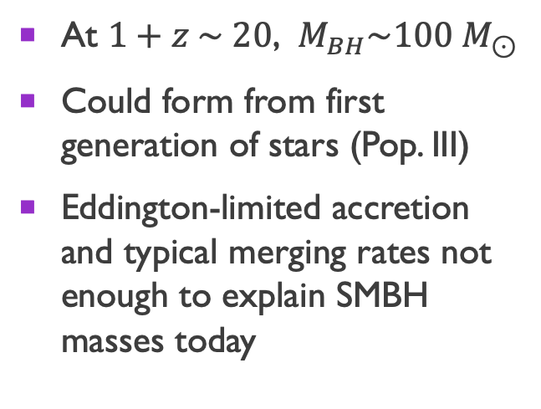
Hypotheses for smbh formation
Light seeds
Heavy seeds
At $1+z \sim 20$, $M_{BH}\sim 100 M_{⊙}$
Could form from first generation of stars (Pop. III)
Eddington-limited accretion and typical merging rates not enough to explain SMBH masses today
At $1+z \sim 20$, $M_{BH}\sim {10}^{5} M_{⊙}$
…how do these form in the first place?
Direct collapse black holes
Primordial black holes

Slide 6
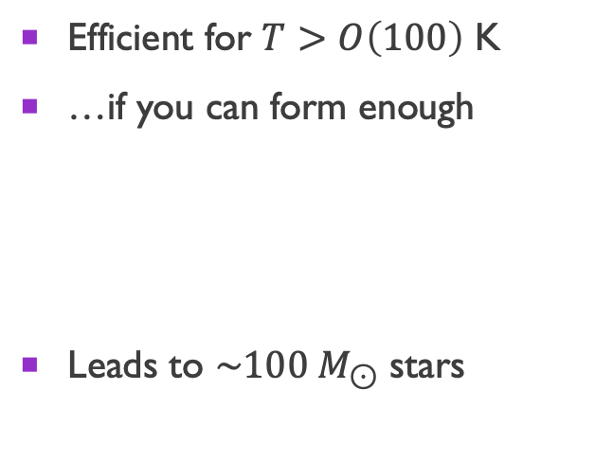
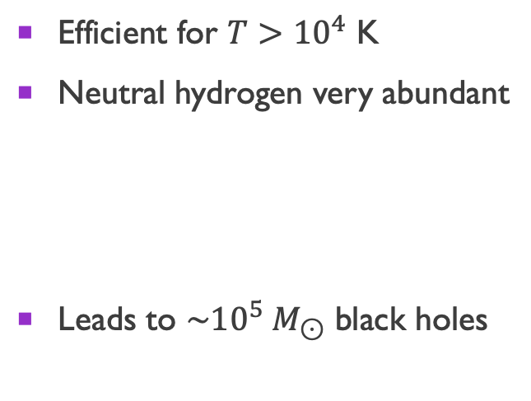
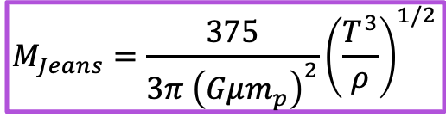
Direct collapse
Atomic hydrogen cooling
Molecular hydrogen cooling
Efficient for $T>{10}^{4}$ K
Neutral hydrogen very abundant
Leads to $\sim {10}^{5} M_{⊙}$ black holes
Efficient for $T>O\left(100\right)$ K
…if you can form enough
Leads to $\sim 100 M_{⊙}$ stars
$$M_{Jeans}=\frac{375}{3π {\left(Gμm_{p}\right)}^{2}}{\left(\frac{T^{3}}{ρ}\right)}^{1/2}$$
Suppression of molecular cooling can lead to formation of a heavy seed

Slide 7
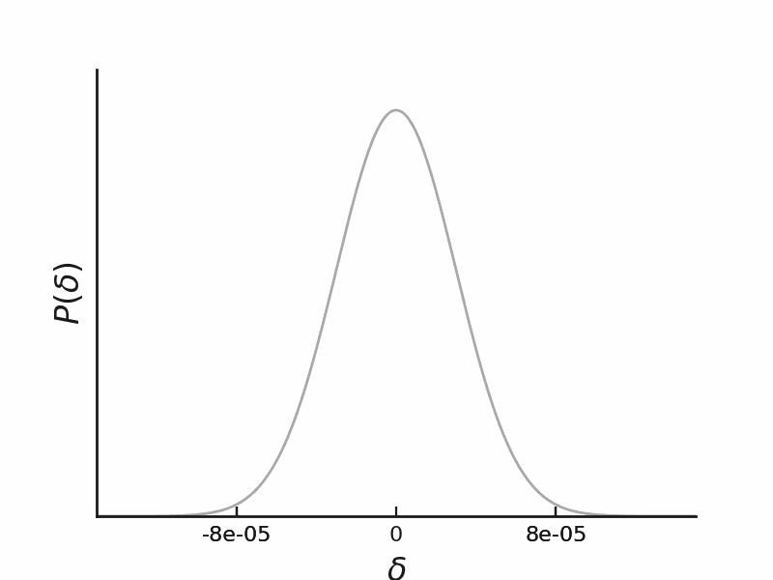

Primordial black holes
Require initial fluctuations of $δ \sim 0.3$

Slide 8
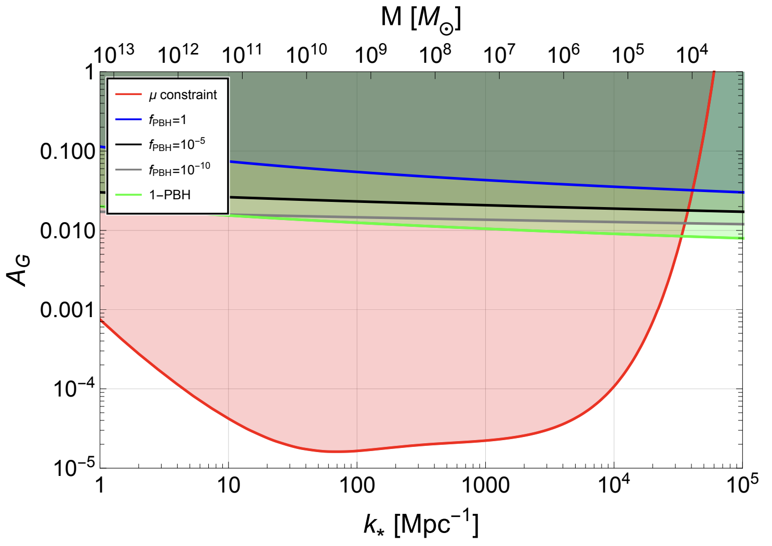

Primordial black holes
Require initial fluctuations of $δ \sim 0.3$
Ruled out by CMB spectral distortions from dissipation
Byrnes, Lesgourgues, & Sharma 2024

Slide 9
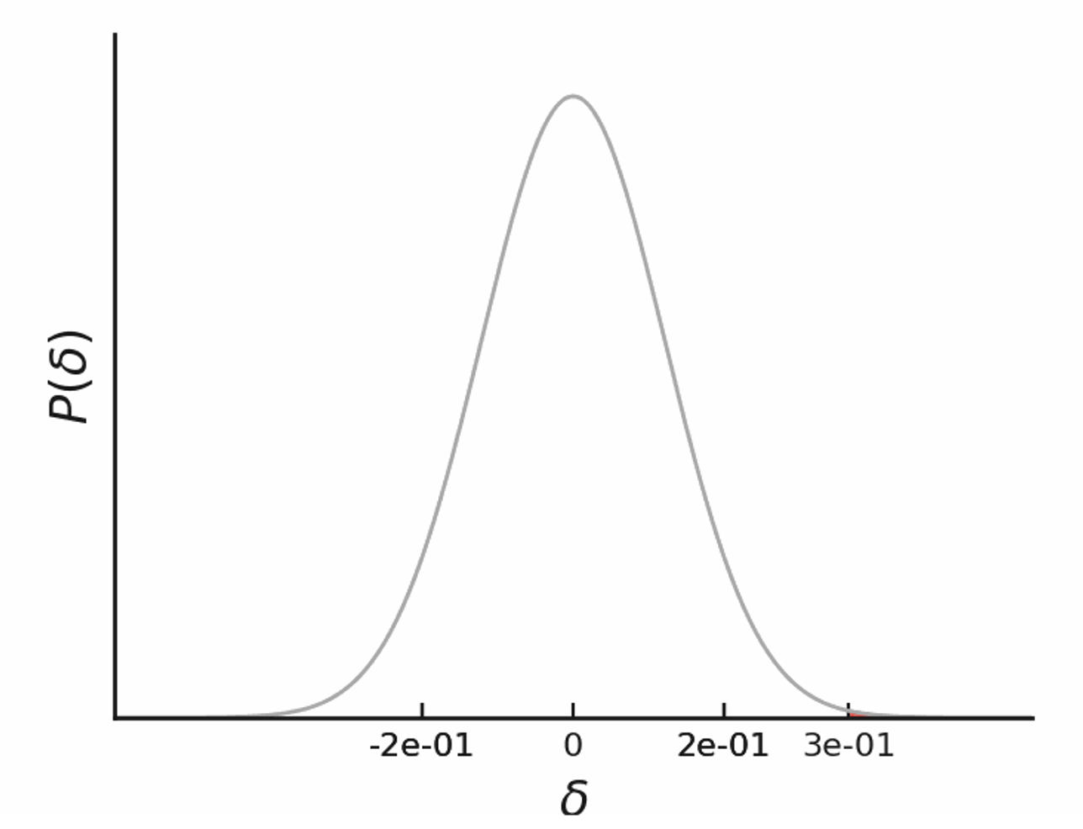
What about initial fluctuations of intermediate amplitude?
?

Slide 10
Evolution of density perturbations

Slide 11
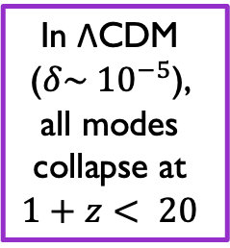
Evolution of density perturbations
In ΛCDM ($δ\sim {10}^{−5}$),
all modes
collapse at
$$1+z< 20$$

Slide 12
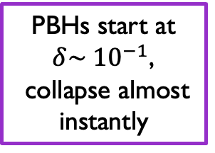
Evolution of density perturbations
PBHs start at $δ\sim {10}^{−1}$,
collapse almost instantly

Slide 13
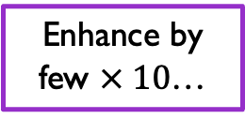
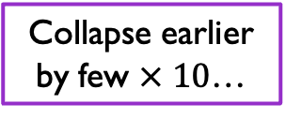
Evolution of density perturbations
Collapse earlier by few $× 10$…
Enhance by few $× 10$…

Slide 14
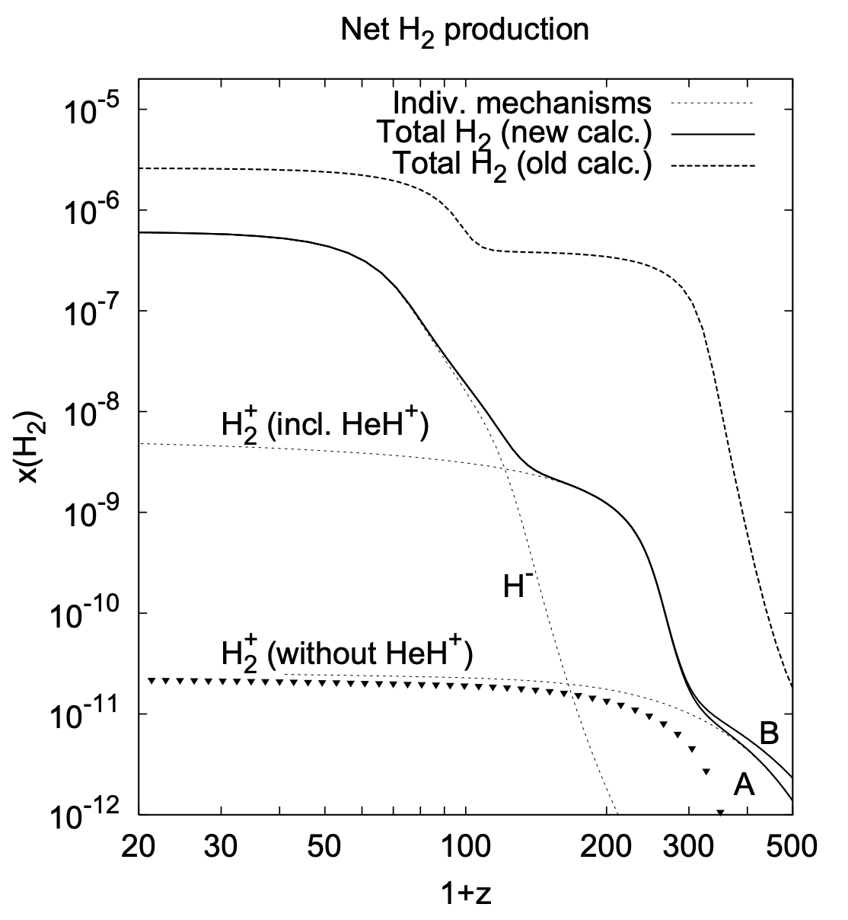
Molecular hydrogen suppressed at early times
Cosmic abundance
(Hirata & Padmanabhan 2006)

Slide 15

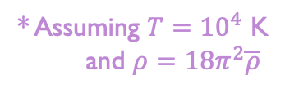
Abundance of molecular hydrogen
“Too much” cooling → cooling time shorter than free-fall time $τ_{H_{2}}=\frac{T}{{\dot{T}}_{H_{2}}}, τ_{ff} =\sqrt{\frac{3π}{32Gρ} }$
* Assuming $T={10}^{4}$ K and $ρ=18π^{2}\overline{ρ}$

Slide 16

Abundance of molecular hydrogen
Evolve $H_{2}$ abundance in top-hat halos virializing at different $z$
Earlier $z$ → CMB hotter, suppresses abundance of $H^{−}$ and $H_{2}$
Prior to $1+z∼200$, halos are unable to fragment/form stars

Slide 17
Molecular hydrogen suppressed at early times
Cosmic abundance
(Hirata & Padmanabhan 2006)
Estimated halo abundance
(our work)
direct collapse for free??
See also Hirano et al. 2015, Ito & Omukai 2024

Slide 18
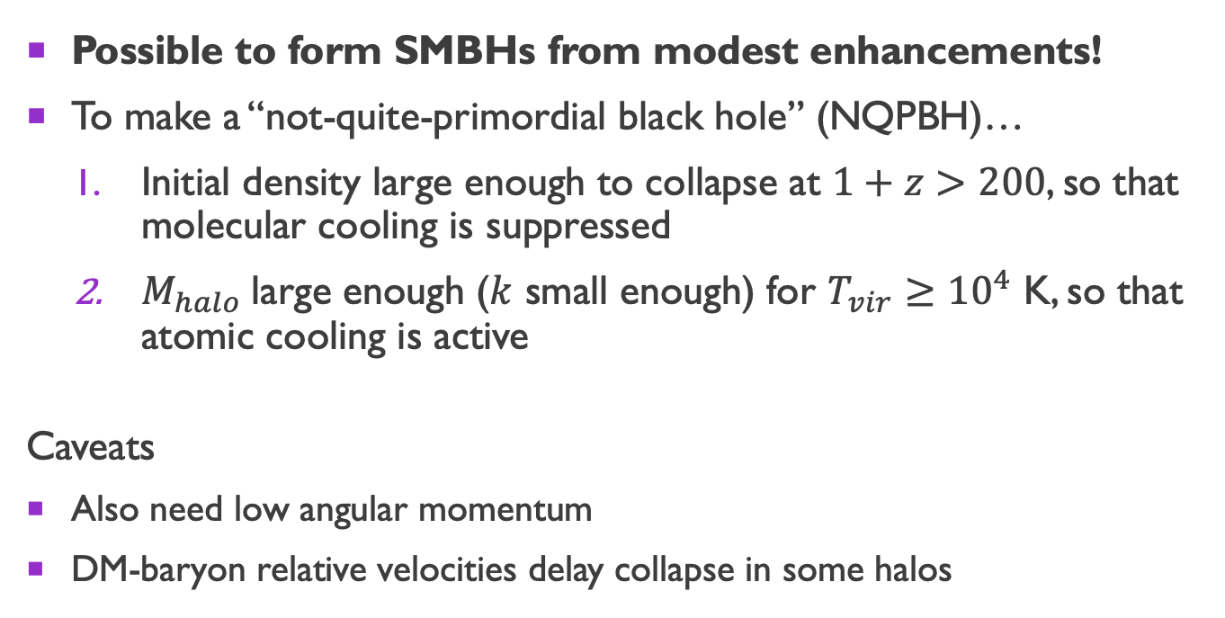
Putting everything together…
Possible to form SMBHs from modest enhancements!
To make a “not-quite-primordial black hole” (NQPBH)…
Initial density large enough to collapse at $1+z>200$, so that molecular cooling is suppressed
$M_{halo}$large enough ($k$ small enough) for $T_{vir}≥{10}^{4}$ K, so that atomic cooling is active
Caveats
Also need low angular momentum
DM-baryon relative velocities delay collapse in some halos

Slide 19
Overdensities and outcomes

Slide 20
CONSTRAINTS ON PRIMORDIAL CURVATURE

Slide 21
CONSTRAINTS ON PRIMORDIAL CURVATURE

Slide 22
CONSTRAINTS ON PRIMORDIAL CURVATURE

Slide 23

Can produce density of BHs inferred from JWST little red dots ($n=1.3 × {10}^{−5} {\text{M}\text{pc}}^{−3}$) with narrow peak (x310) and step-function enhancement (x180)

Slide 24
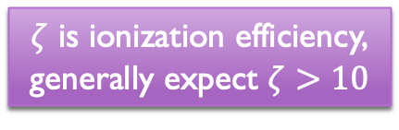
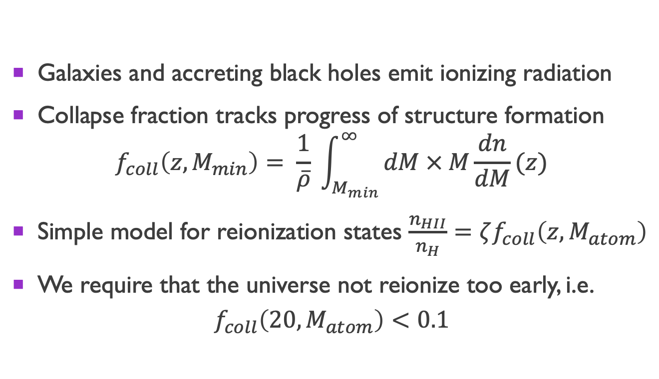
Early reionization
Galaxies and accreting black holes emit ionizing radiation
Collapse fraction tracks progress of structure formation $f_{coll}\left(z, M_{min}\right)= \frac{1}{\overline{ρ}} \int_{M_{min}}^{∞}{dM × M\frac{dn}{dM}(z)}$
Simple model for reionization states $\frac{n_{HII}}{n_{H}}=ζf_{coll}\left(z, M_{atom}\right)$
We require that the universe not reionize too early, i.e.
$$f_{coll}\left(20, M_{atom}\right)<0.1$$
$ζ$ is ionization efficiency,
generally expect $ζ>10$

Slide 25
Constraints on primordial fluctuations

Slide 26
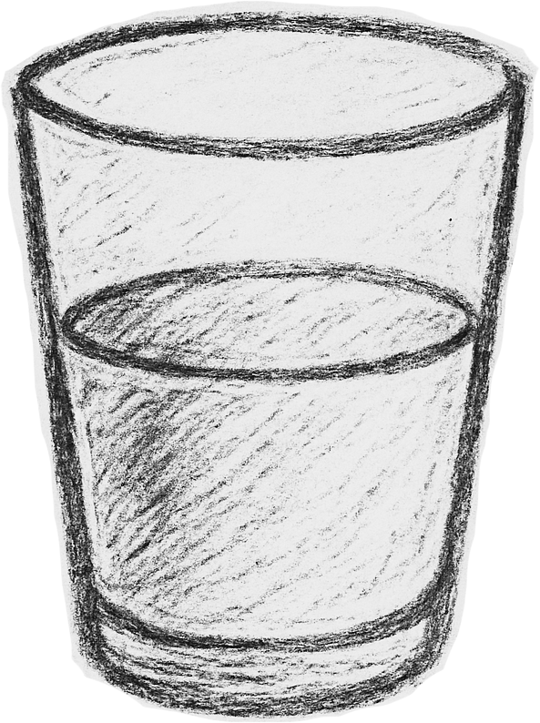
Implications for primordial black holes
Pessimist: So I can’t make PBHs without NQPBHs? :c
Optimist: I can make SMBHs with modest enhancements and less fine-tuning! :D

Slide 27
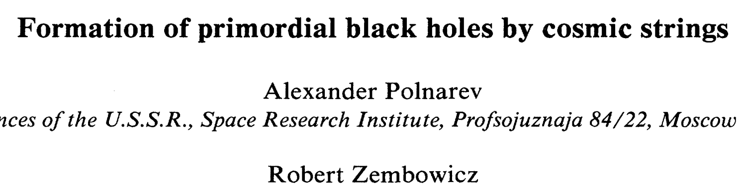
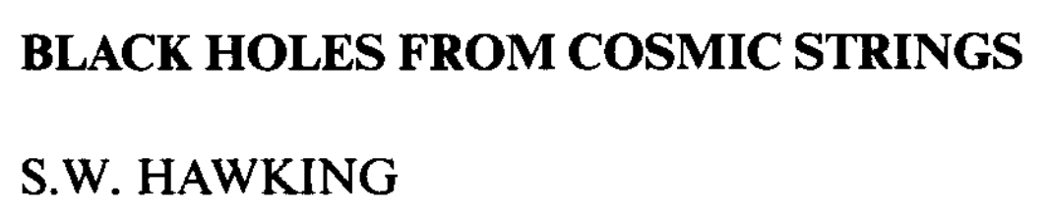
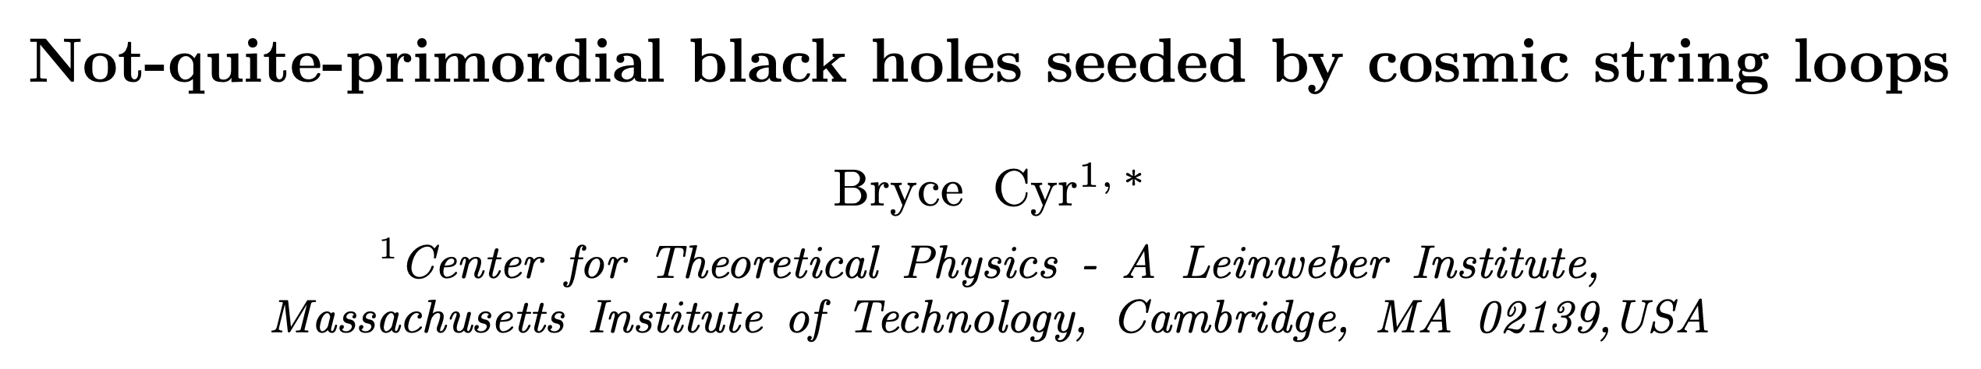
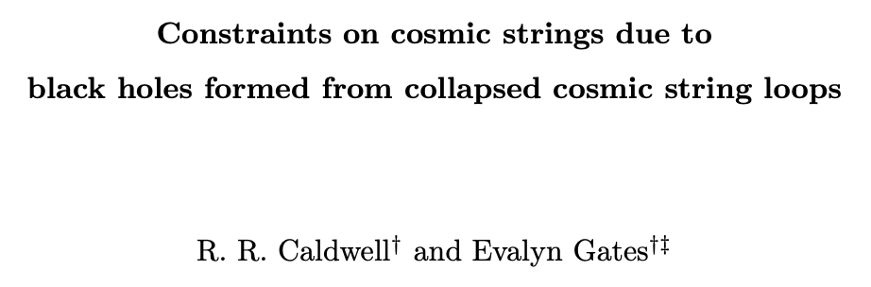
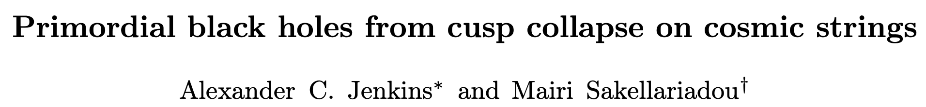
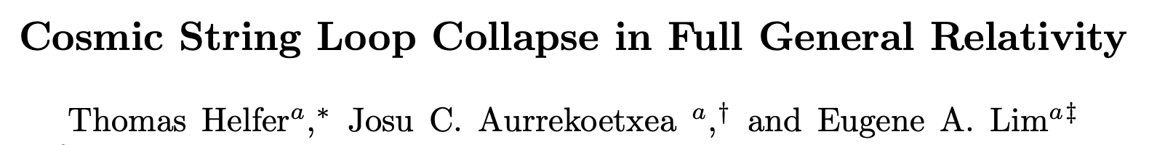
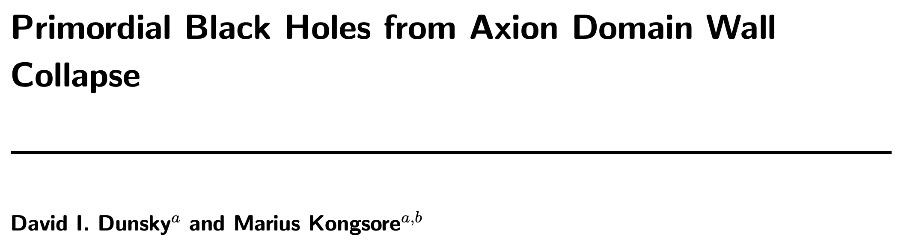
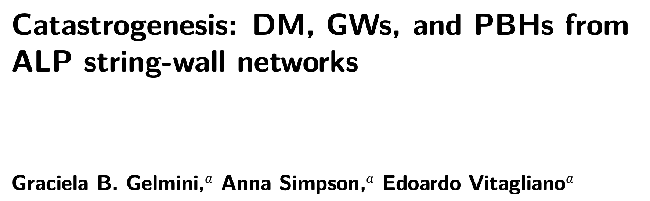
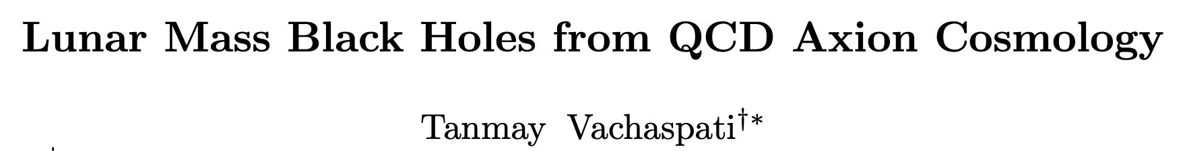
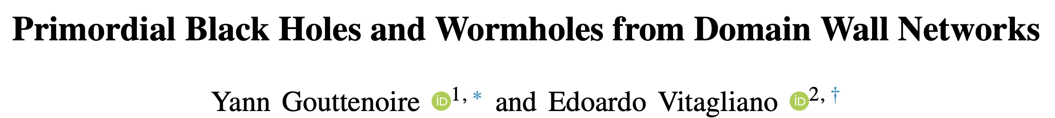
Examples of PBH → NQPBH Models
Cosmic string loops
Collapsing domain walls
Your favorite model???
Future work…

Slide 28
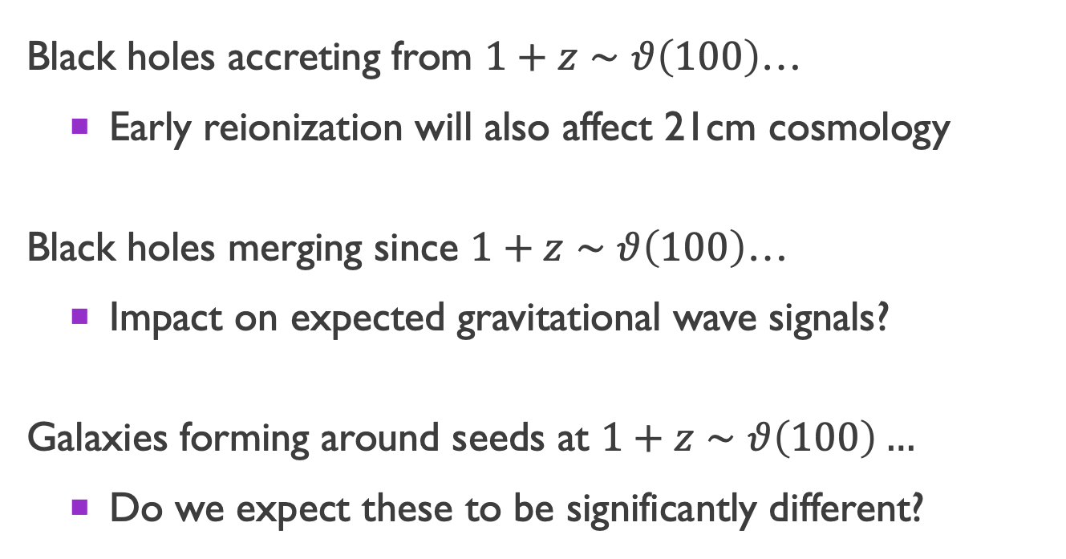
Observational implications
Black holes accreting from $1+z∼θ\left(100\right)$…
Early reionization will also affect 21cm cosmology
Black holes merging since $1+z∼θ\left(100\right)$…
Impact on expected gravitational wave signals?
Galaxies forming around seeds at $1+z∼θ\left(100\right)…$
Do we expect these to be significantly different?
Radio!

Slide 29
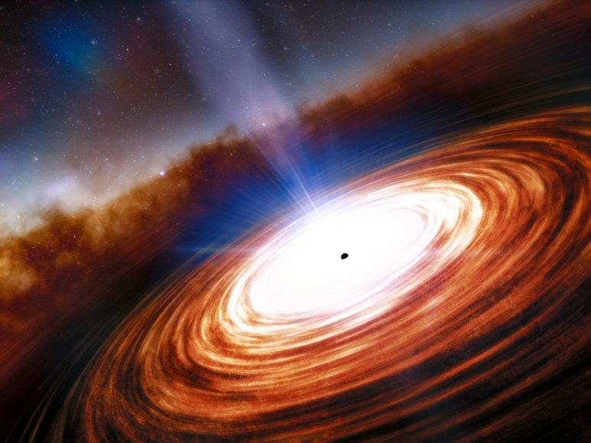
Conclusions
NQPBHs -- a new mechanism explaining origin of SMBHs that is less demanding than PBHs
Can set strong constraints on initial power
Future directions: What do NQPBHs look like today? How will they affect other observables?

Slide 30
Backup slides

Slide 31
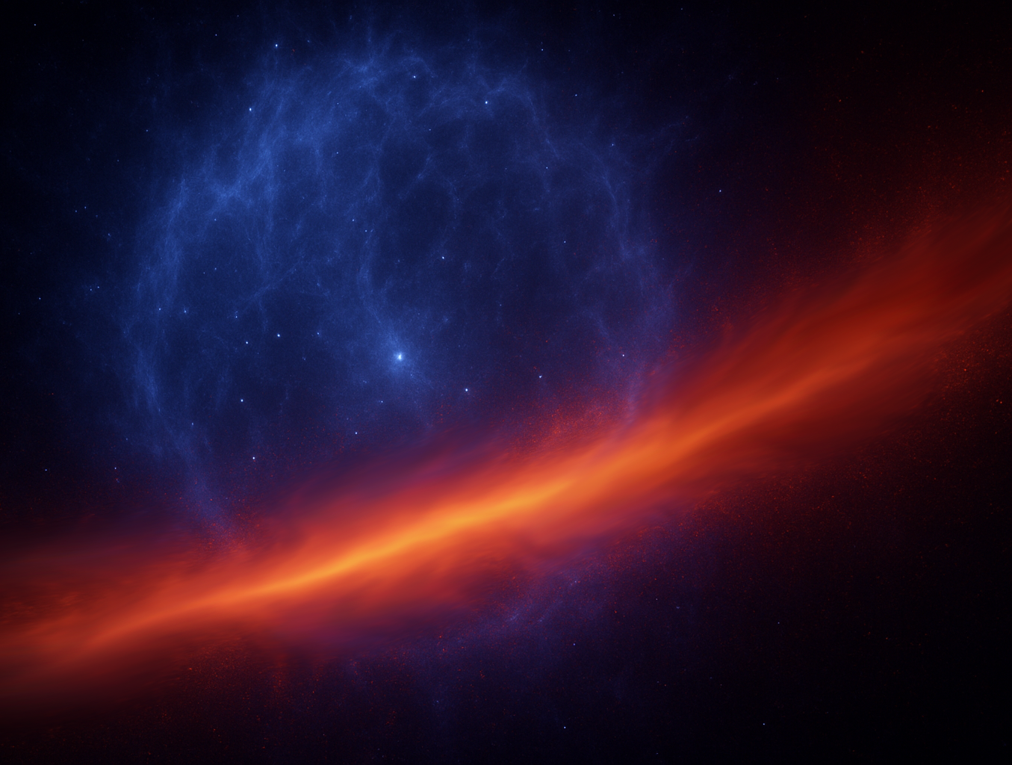

DM-baryon relative velocities
Tseliakhovich & Hirata 2010: After baryons decouple from photons, have a velocity relative to DM
When is this a problem for structure formation? Compare to gas sound speed
$$v_{\text{DM}\text{−}\text{b}}\left(z\right)=30 \text{km}\text{/}\text{s} × \frac{1+z}{1100}$$
$c_{s}=\sqrt{\frac{5T}{3μm_{p}}}≈11 \text{km}\text{/}\text{s}$ at $T={10}^{4}$K
$v_{\text{DM}\text{−}\text{b}}\left(z\right)<c_{s}$ for $1+z<400$

Slide 32

angular momentum considerations
Dimensionless spin parameter $λ=\frac{{J\left|E\right|}^{1/2}}{GM^{5/2}}$
Lodato & Natarajan 2006 find direct collapse occurs for $λ<0.02$
At $1+z=10$, spin distribution is lognormal with $\left\langle λ\right\rangle ∼0.04$ and $σ_{λ}∼0.55$
10% of halos meet criteria
Conservative b/c later halos have more spin

