Slide 1


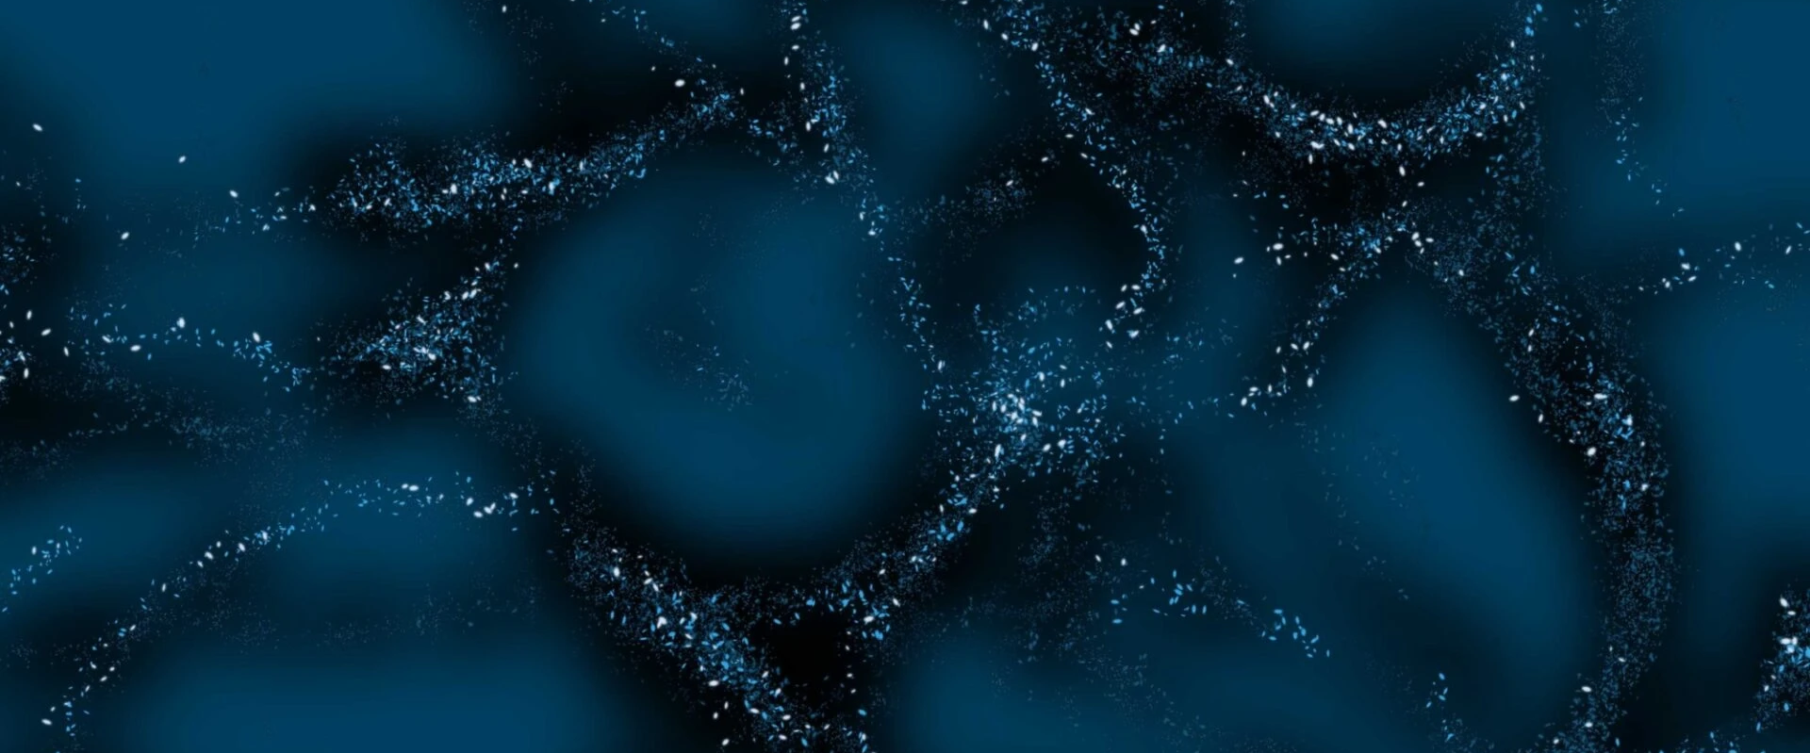

Dark Matter with ALMA
Image credit: V. RUBIN
Evanthia Hatziminaoglou (ALMA, AtLAST, AGN)
ESO / IAC
1st UNDARK Workshop, Tenerife, Spain 29 Sep – 3 Oct 2025

Slide 2
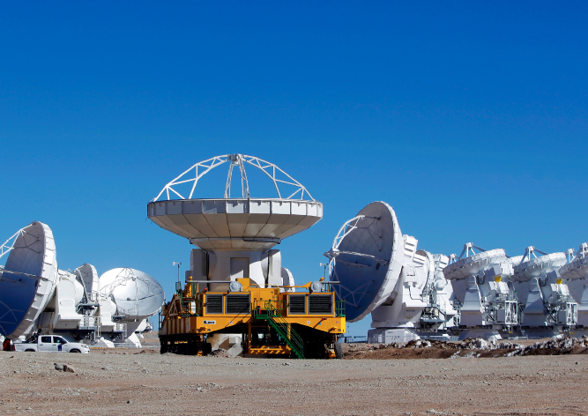
ALMA
The most powerful (sub)mm facility (interferometer) on earth;
66 antennas (54 12m; 12 7m); three arrays; 10 bands covering 35 – 950 GHz;
Baselines from 160m to 16km; 10 configurations, up to 0.005” spatial resolution at the highest frequencies and unprecedented sensitivities;
Spectral resolution up to 0.01km/s;
ALMA has revolutionized our understanding of planet formation, astrochemistry and the high (and cold) Universe.
IMAGE CREDIT: ALMA

Slide 3
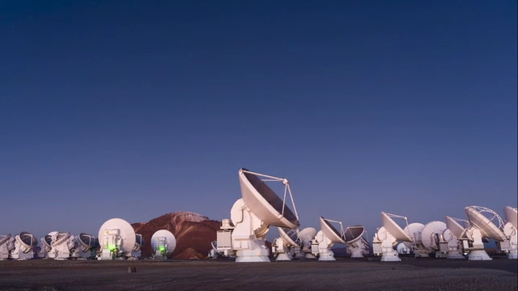
ALMA
The most powerful (sub)mm facility (interferometer) on earth;
66 antennas (54 12m; 12 7m); three arrays; 10 bands covering 35 – 950 GHz;
Baselines from 160m to 16km; 10 configurations, up to 0.005” spatial resolution at the highest frequencies and unprecedented sensitivities;
Spectral resolution up to 0.01km/s;
ALMA has revolutionized our understanding of planet formation, astrochemistry and the high (and cold) Universe.
“El baile de antenas”
Credit: Ravi Deepres and Luke Unsworth (ravideepres.com)
IMAGE CREDIT: ALMA

Slide 4
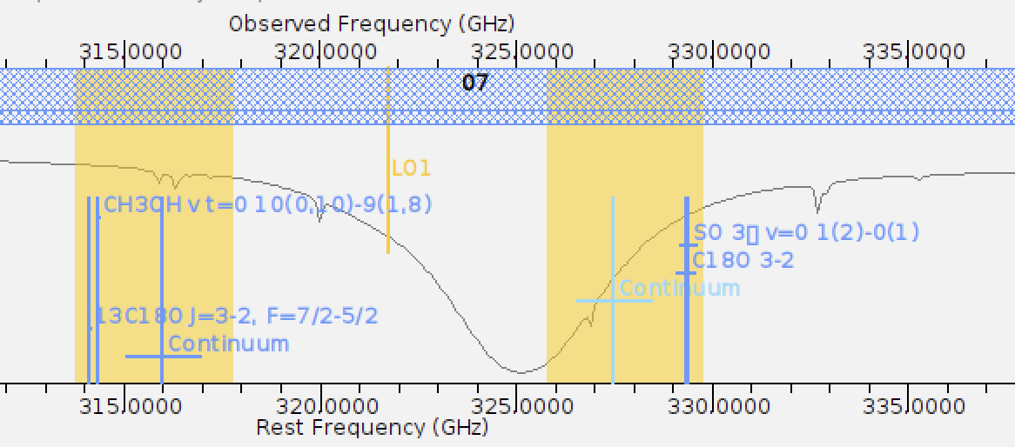
ALMA
The most powerful (sub)mm facility (interferometer) on earth;
66 antennas (54 12m; 12 7m); three arrays; 10 bands covering 35 – 950 GHz;
Baselines from 160m to 16km; 10 configurations, up to 0.005” spatial resolution at the highest frequencies and unprecedented sensitivities;
Spectral resolution up to 0.01km/s;
ALMA has revolutionized our understanding of planet formation, astrochemistry and the high (and cold) Universe.
IMAGE CREDIT: ALMA

Slide 5
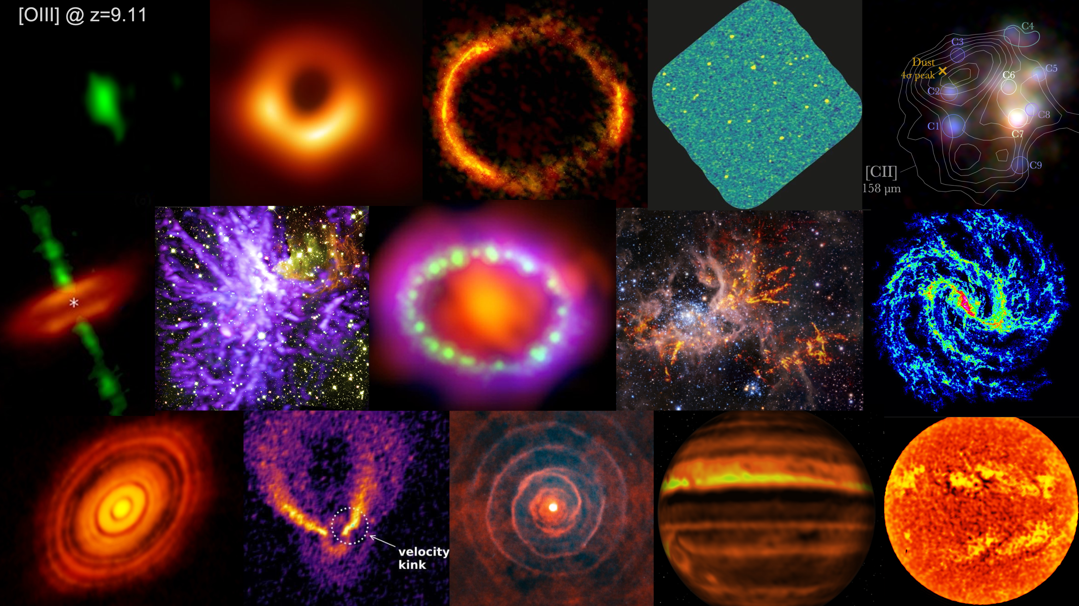
ALMA
The most powerful (sub)mm facility (interferometer) on earth;
66 antennas (54 12m; 12 7m); three arrays; 10 bands covering 35 – 950 GHz;
Baselines from 160m to 16km; 10 configurations, up to 0.005” spatial resolution at the highest frequencies and unprecedented sensitivities;
Spectral resolution up to 0.01km/s;
ALMA has revolutionized our understanding of planet formation, astrochemistry and the high (and cold) Universe.
“For the first time, ALMA has surpassed the 4,300-hour goal of observations acquired and delivered to the global scientific community. It has also achieved the stretch goal of 4,500 hours, first envisioned in the Forward Look of 2019.” S. Dougherty, ALMA director, on Cycle 11.
Credit: J. CarpENTER
IMAGE CREDIT: ALMA

Slide 6
Search for dark matter with ALMA
Gravitational lensing
Galaxy kinematics
Search for axion signatures
Image credit: V. RUBIN

Slide 7
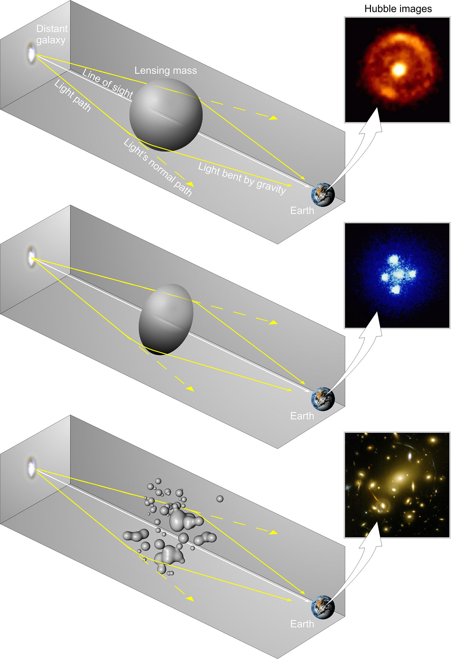
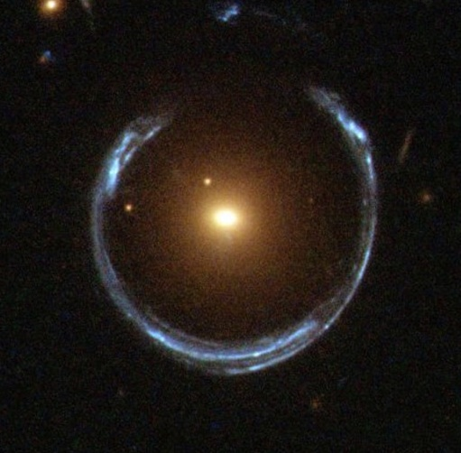
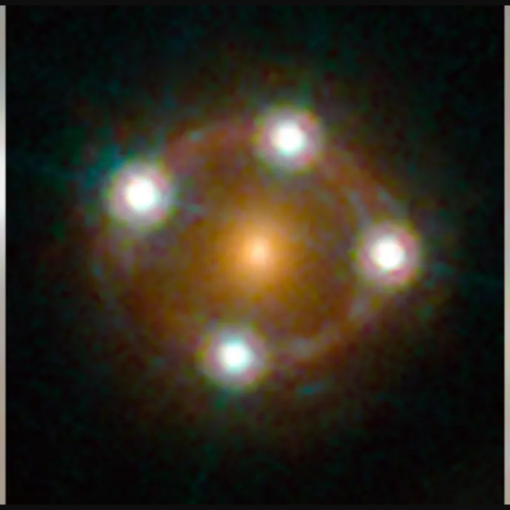
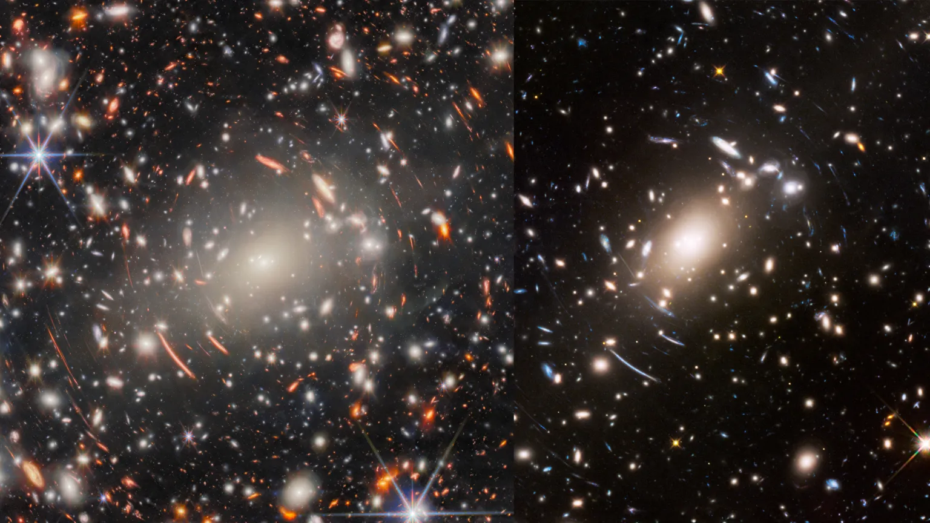
Gravitational Lensing
When a massive object (like a galaxy or galaxy cluster) lies between Earth and a more distant object, its gravity bends and magnifies the light from the background source.
This creates multiple, distorted, or magnified images, a phenomenon called gravitational lensing.
The exact positions, shapes, and brightness of these lensed images depend on the total mass distribution along the line of sight, including both visible matter and (invisible) dark matter.
Credit: ESA, Hubble & NASA
SOURCE: LIVESCIEnCE
Credit: ESA
Credit: ESA/Webb, NASA & CSA, H. Atek, M. Zamani (ESA/Webb)

Slide 8
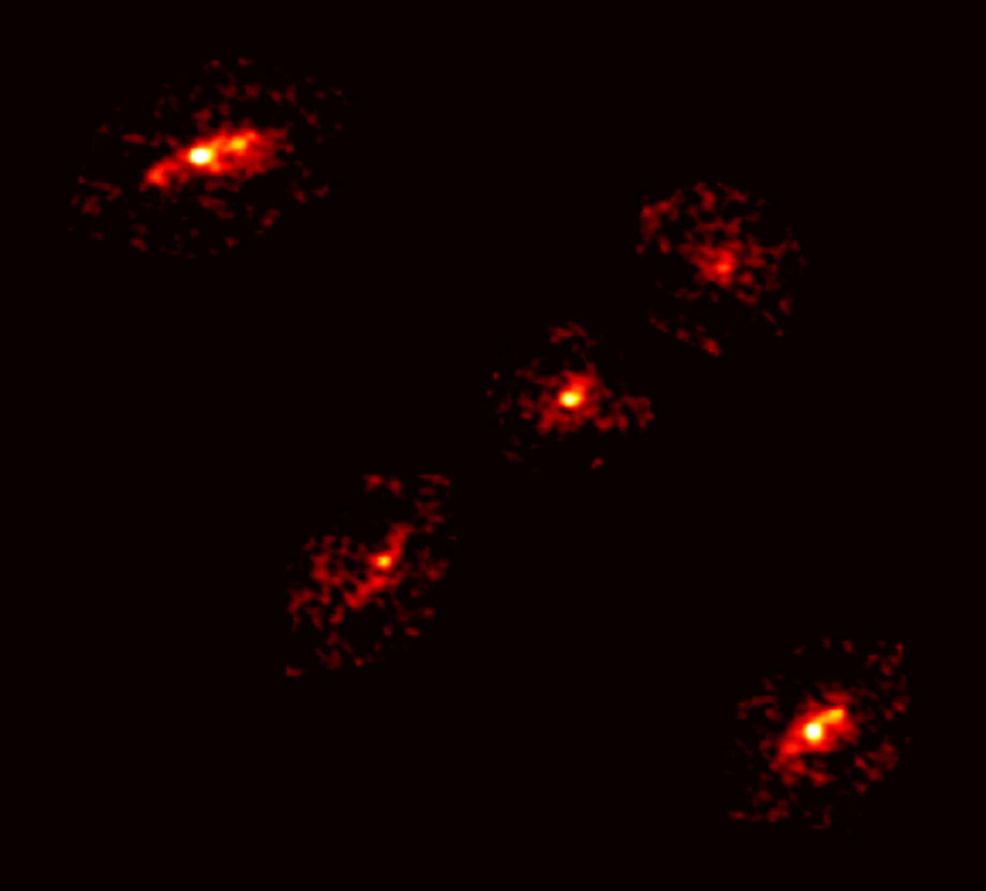
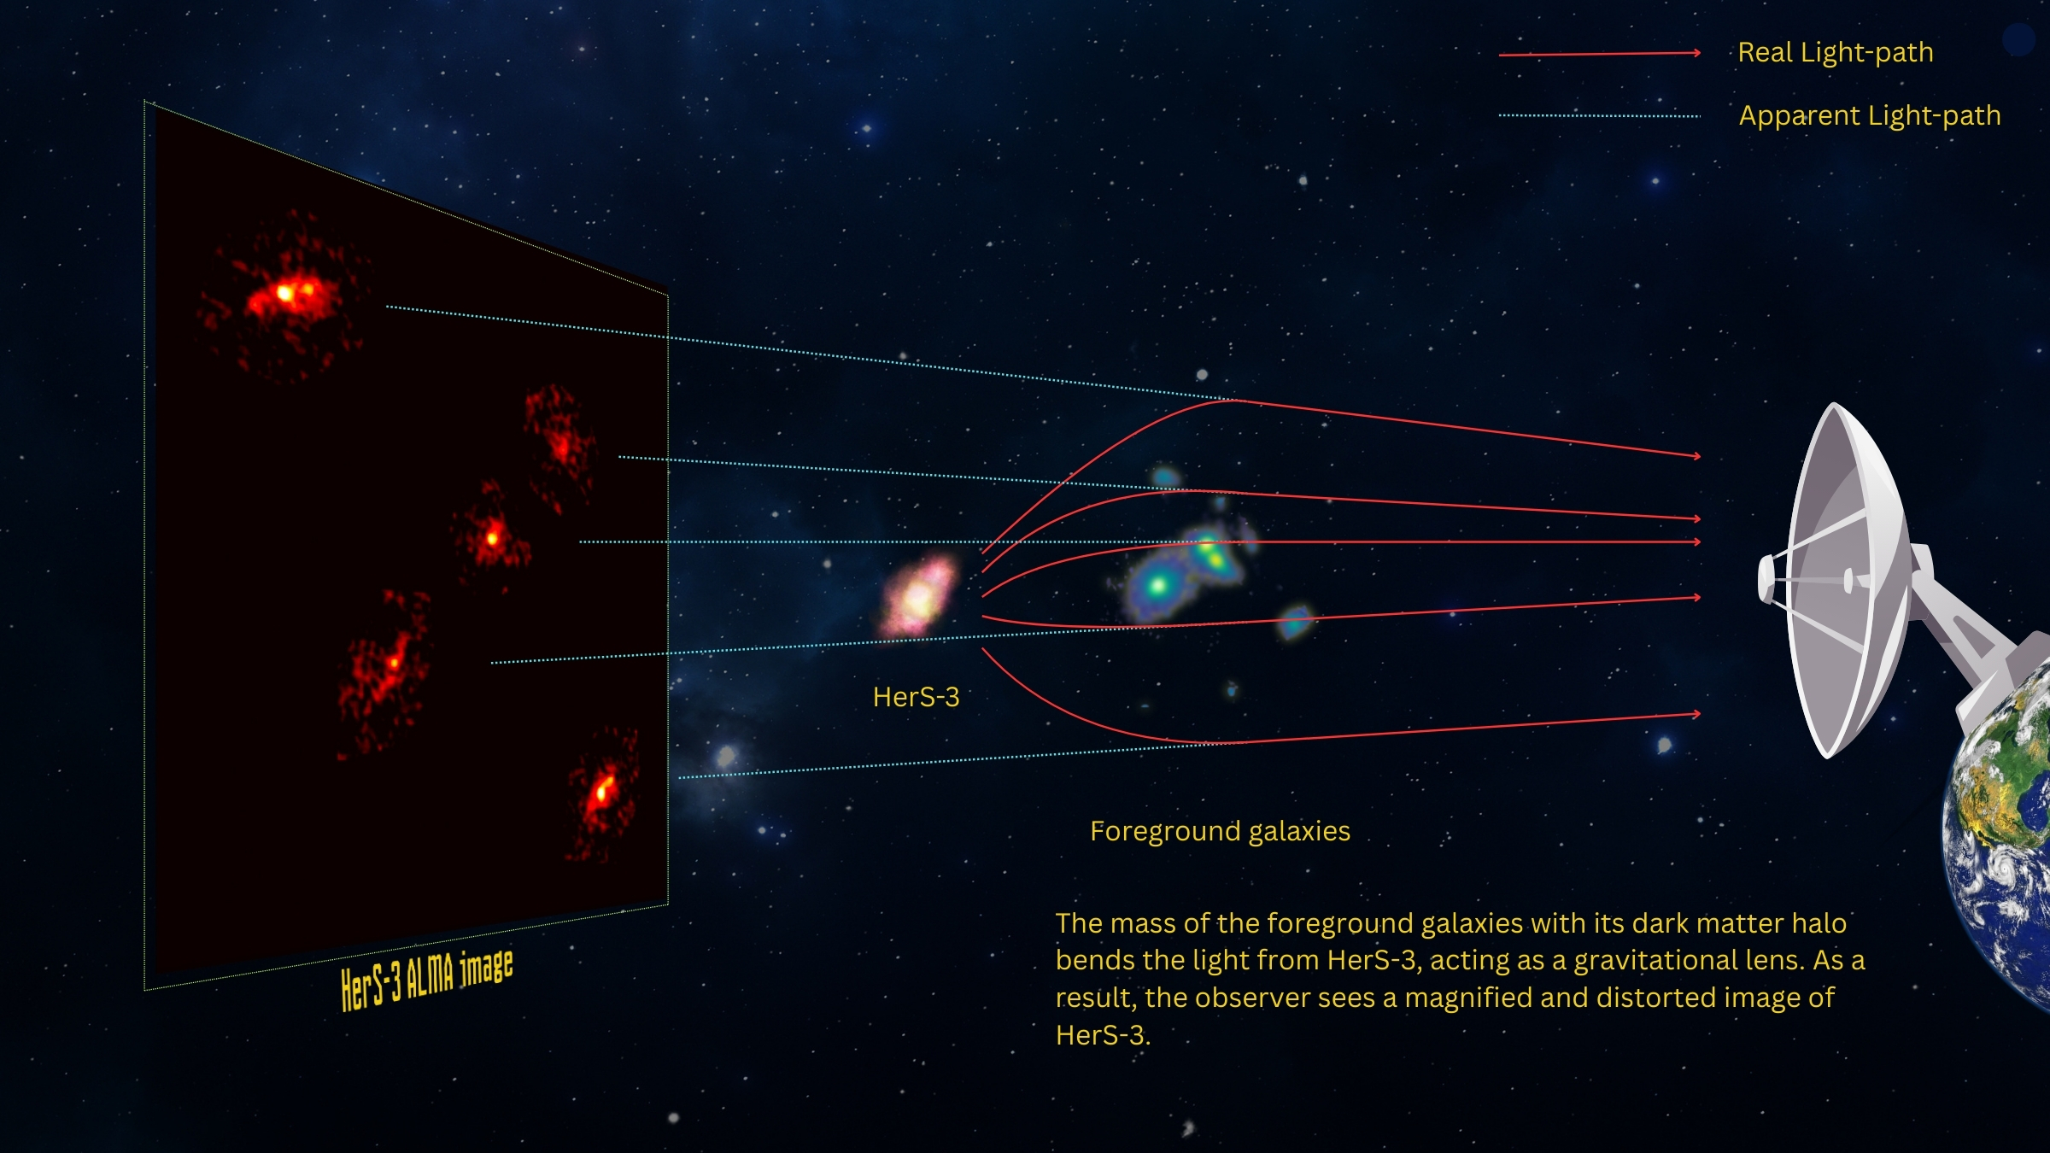
Observations towards a dusty star-forming galaxy at z=3.0607;
1 mm observations with NOEMA and ALMA confirm redshift of counterparts;
HST image reveals foreground lensing group of four with z_{phot} ∼ 1.0;
Lens models cannot reproduce HerS-3 unless a fifth, very massive counterpart is added (accounting for up to 90% of total mass).
Cox et al. 2025, ApJ, 991, 53
Cox et al. 2025, apJ, 991, 53
Credit: N. Lira, Cox et al. - ALMA (ESO/NAOJ/NRAO) / NOEMA
Notes:
HerS-3, a dusty star-forming galaxy at z_{spec} = 3.0607 (11.6 billion light years away), which is gravitationally amplified into an Einstein cross with a fifth image of the background galaxy seen at the center of the cross. Detailed 1 mm spectroscopy and imaging with NOEMA and ALMA resolve the individual images and show that each of the five images display a series of molecular lines that have similar central velocities, unambiguously confirming that they have identical redshifts. HST image reveals a foreground lensing group of four galaxies with a photometric redshift z_{phot} ∼ 1.0 (7.8 billion light years from Earth). Lens models that only include the four visible galaxies are unable to reproduce the properties of HerS-3. By adding a fifth massive component, lying southeast of the brightest galaxy of the group, the source reconstruction is able to match the peak emission, shape, and orientation for each of the five images. The fact that no galaxy is detected near that position indicates the presence of a massive dark matter halo in the lensing galaxy group, accounting for up to 90% of the total mass (baryonic and non-baryonic) of the system. Log halo mass estimated between 12.2 and 13.0 solar masses.

Slide 9
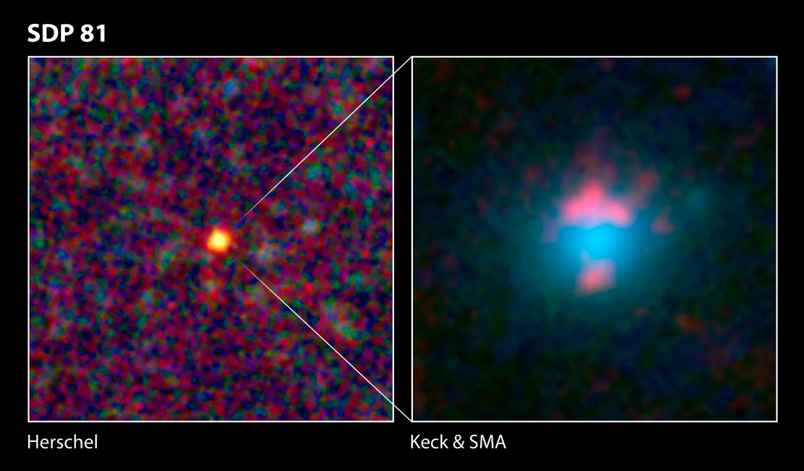
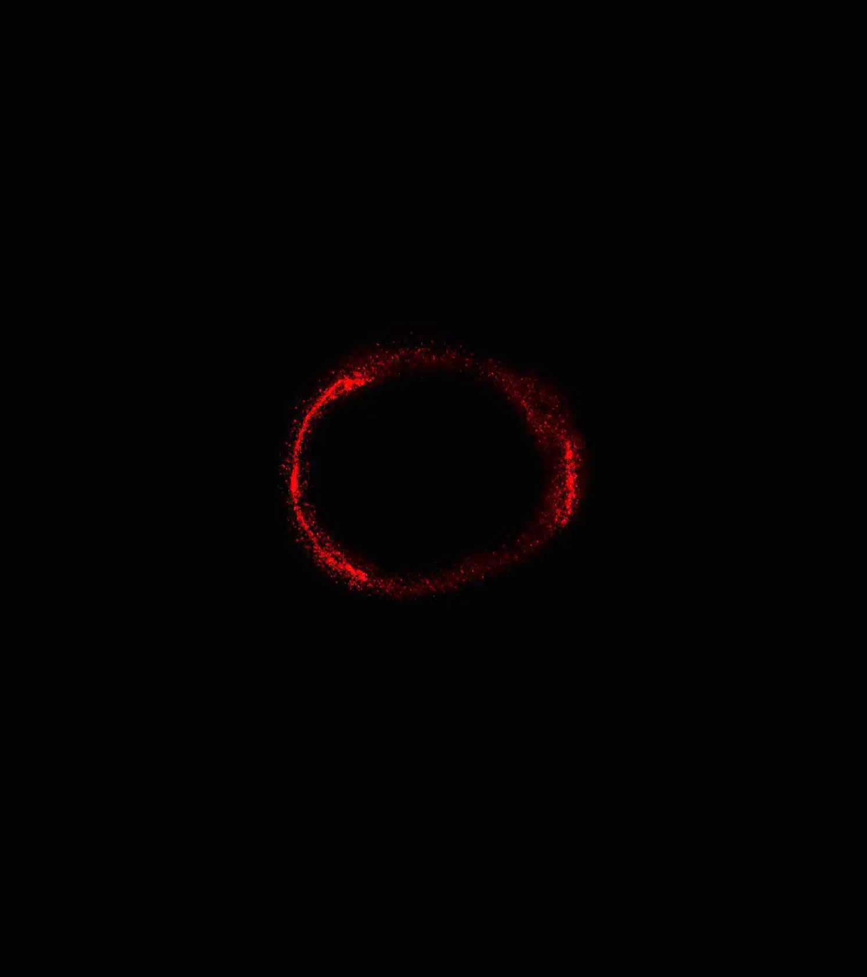
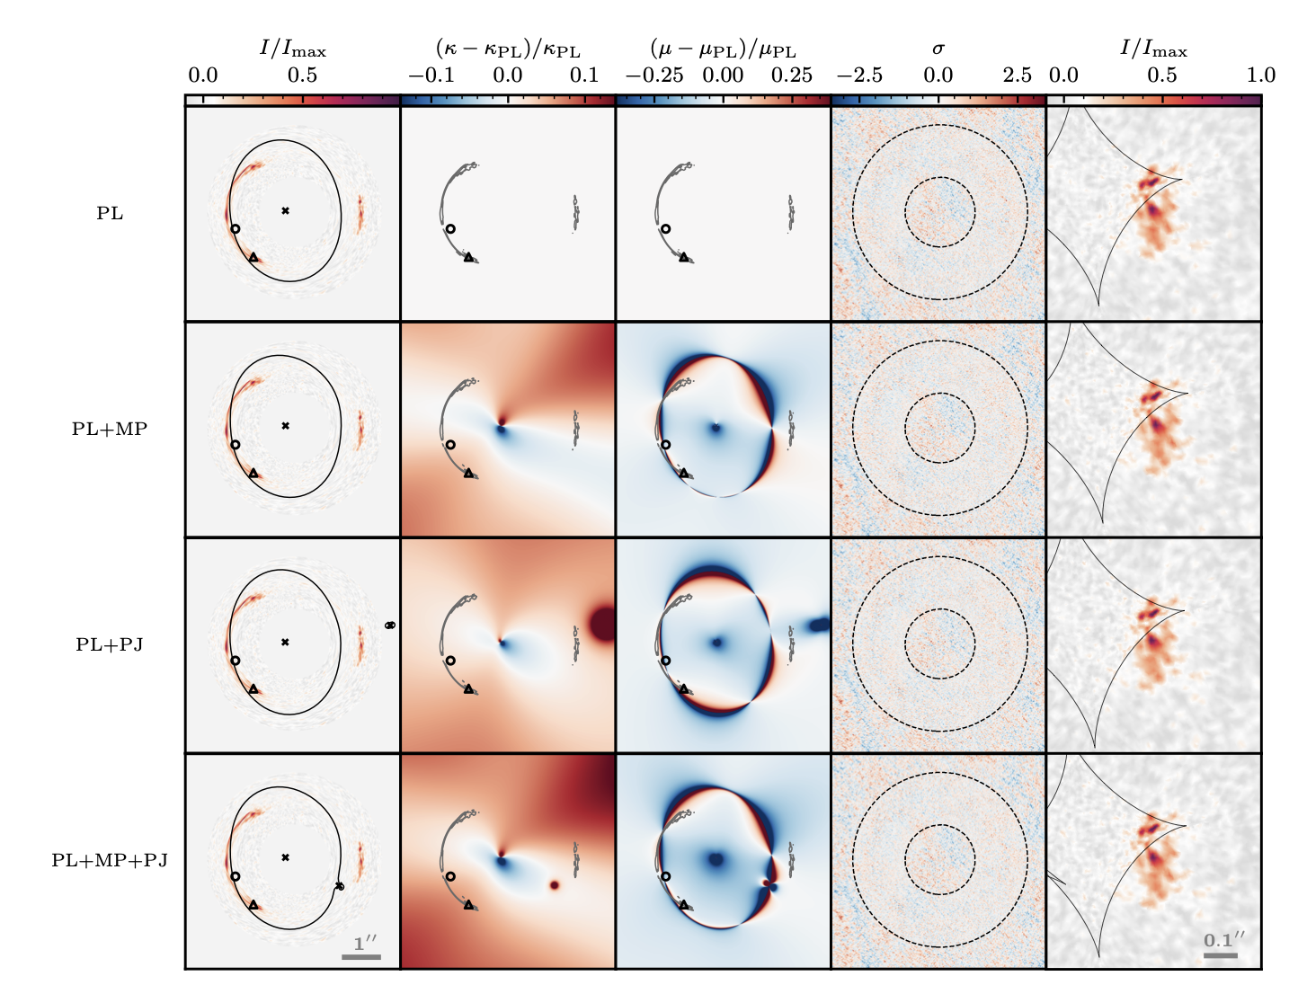
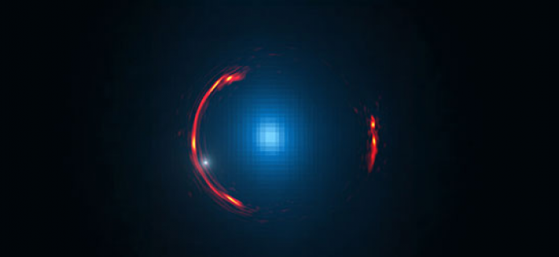
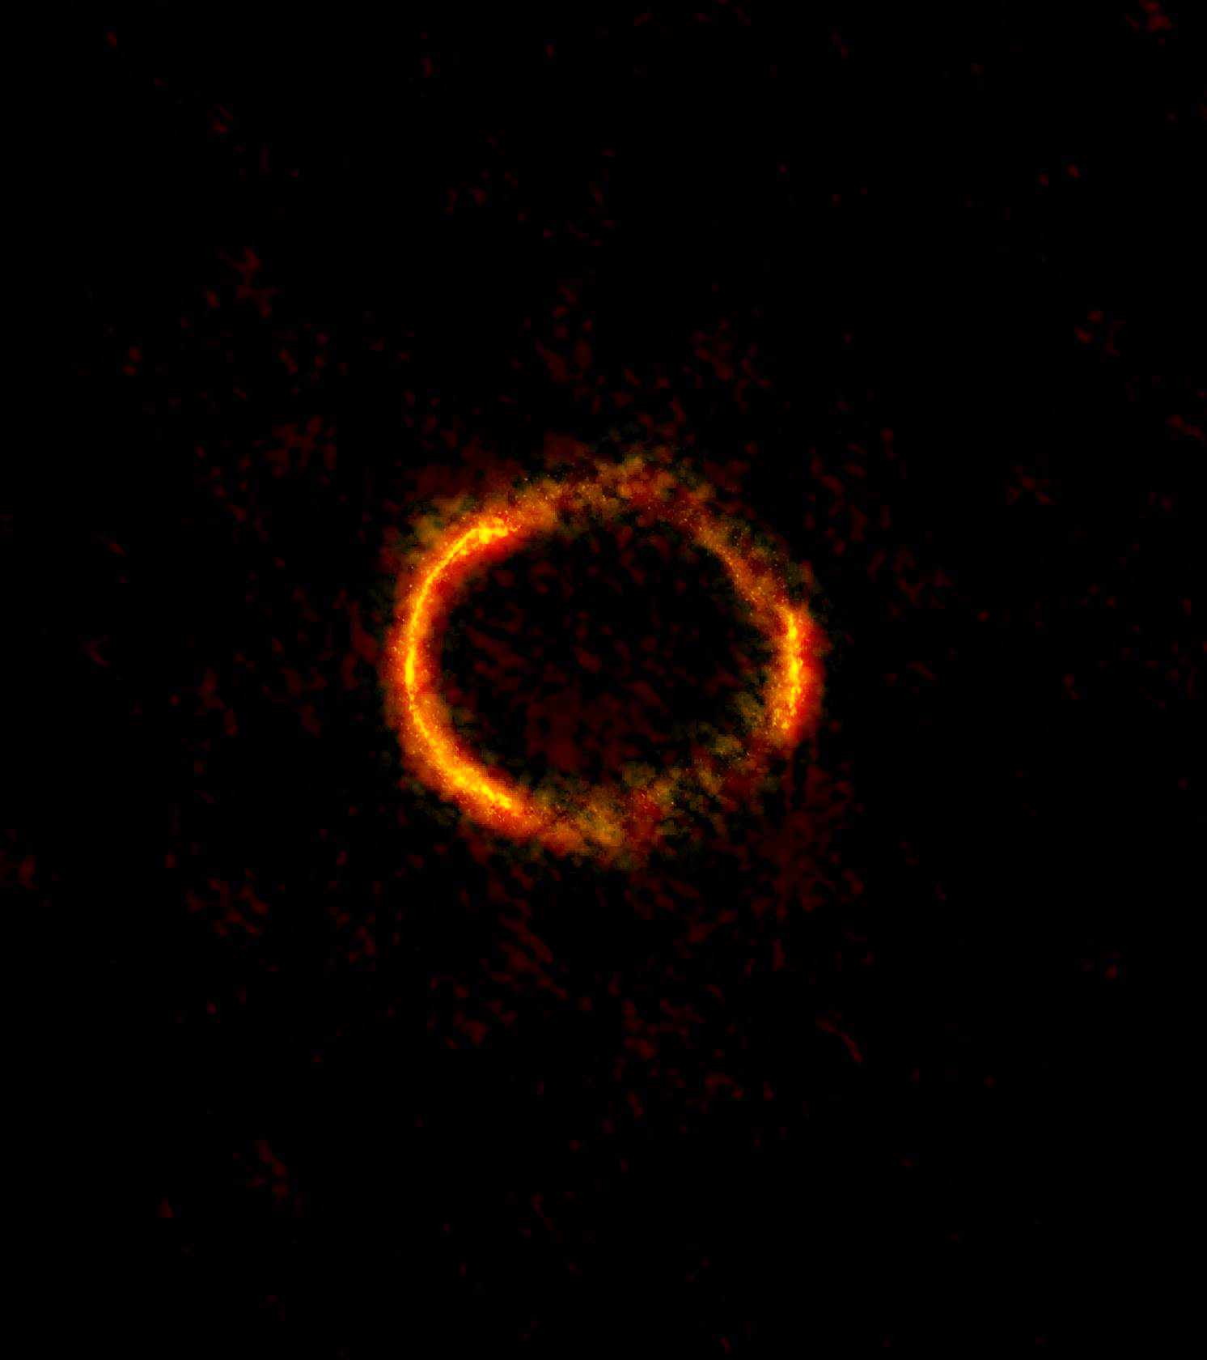
z = 3.042
Stacey et al. 2025, A&A, in press
Hezaveh et al. 2016, ApJ, 823, 37
Inoue et al. 2016, MNRAS, 457, 2936
Credit: Y. Hezaveh, Stanford Univ.; ALMA (NRAO/ESO/NAOJ); NASA/ESA Hubble Space Telescope
ALMA long baseline campaign 2014
Notes:
One of five such galaxies uncovered by Herschel.
Detailed analysis of the ALMA image uncovered signs of a hidden dwarf dark galaxy in the halo of the more nearby galaxy, with a sub-halo of ~10^9 solar masses.
According to theoretical predictions, most galaxies should be brimming with similar dwarf galaxies and other companion objects. Detecting them, however, has proven challenging. Even around our own Milky Way, astronomers can identify only 40 or so of the thousands of satellite objects that are predicted to be present.
The prevalence and properties of low-mass dark matter haloes serve as a crucial test for understanding the nature of dark matter, and may be constrained through the gravitational deflection of strongly lensed arcs.
Stacey et al. demonstrate that should such sub-halos be there, the ALMA data have sufficient quality to allow for their detection.

Slide 10
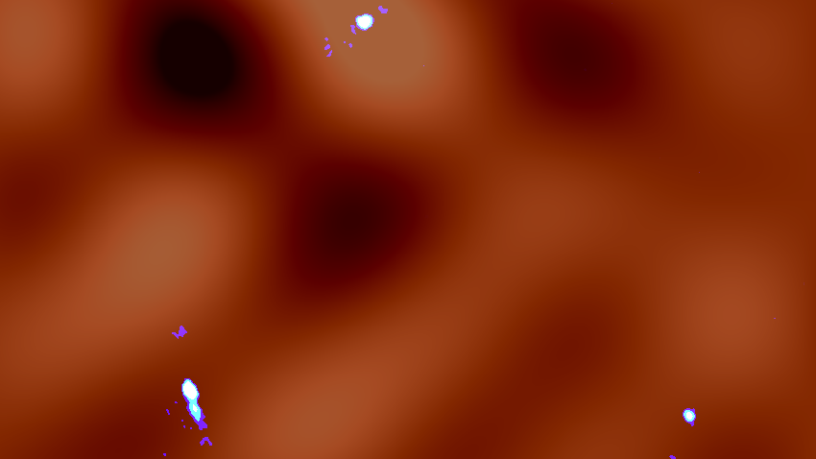
Observations towards quasar MG J0414+0534 (z=2.639) at 0.02’’–0.05’’;
Partially nonparametric lens models suggest the presence of a clump, a possible dusty dwarf galaxy, and some small clumps in the vicinity of other lensed quadruple images;
DM distribution fluctuations on scales smaller than that of massive galaxies (< 30000 light years).
Inoue et al. 2023, ApJ, 954, 197
Image credit: ALMA (ESO/NAOJ/NRAO), K.T. Inoue et al.

Slide 12
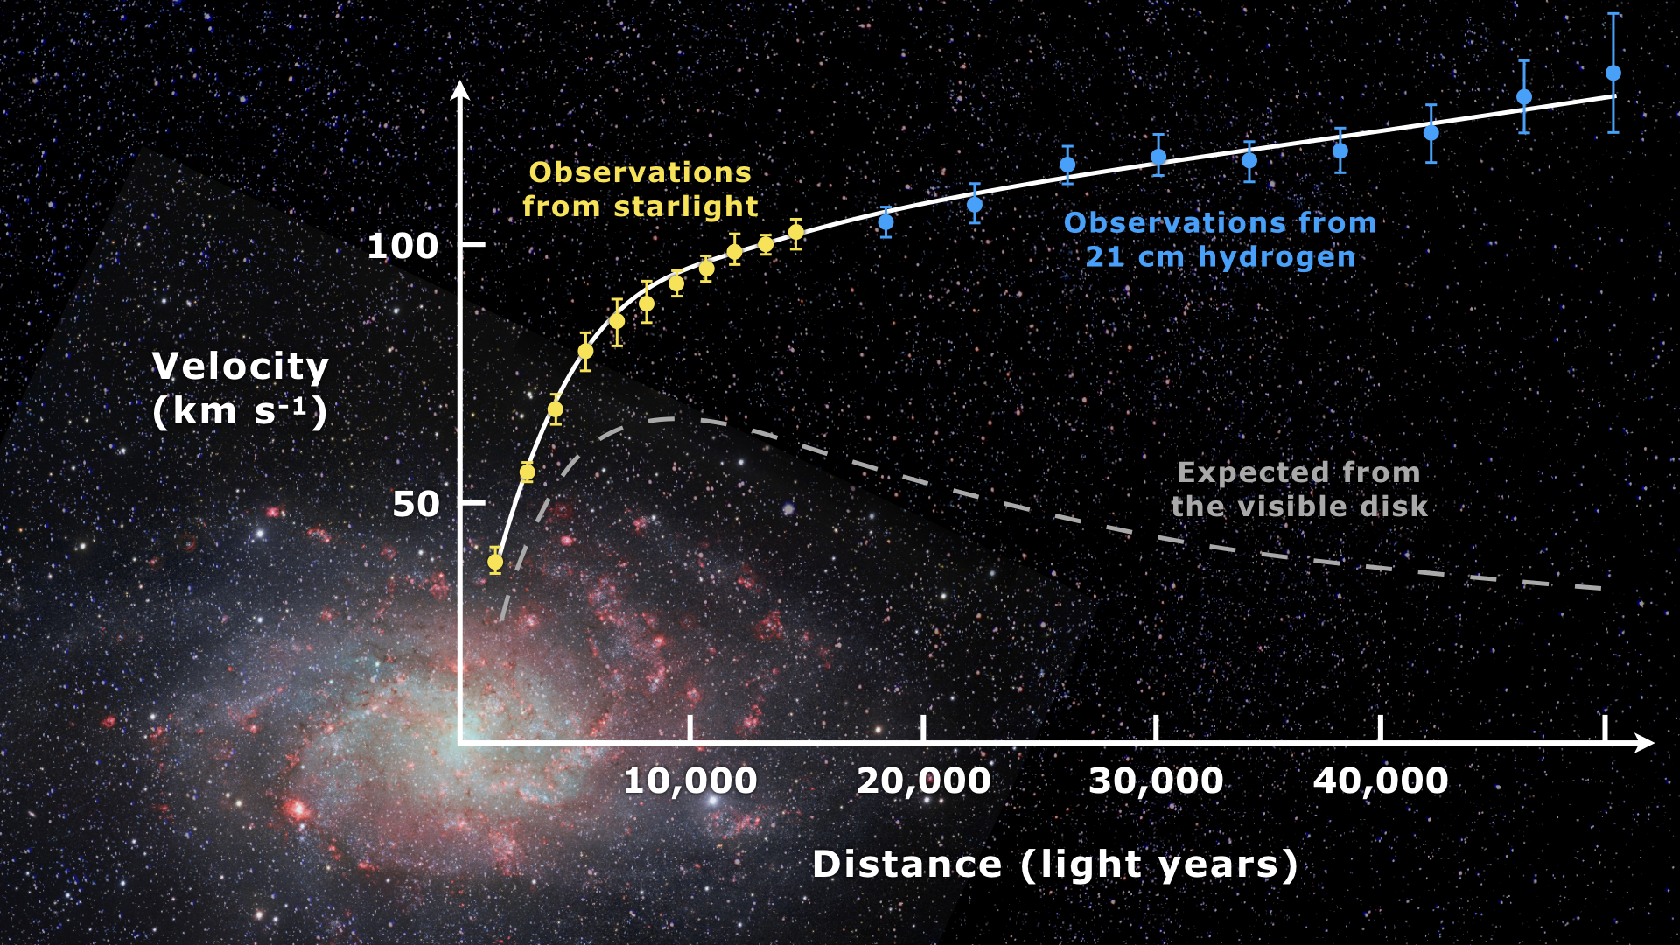
Galaxy kinematics
Historically the primary method for inferring the existence of dark matter;
Measures rotation curves of galaxies, i.e. orbital velocity of stars and gas as a function of distance from the center;
Velocities remain flat out to large distances, can only be explained by vast, invisible dark matter halo.
IMAGE SOURCE: WIKIPEDIA
Notes:
The axion is a long-postulated boson that emerges in the most natural solution to the so-called charge and parity problem in quantum chromodynamics.
The CP problem is a puzzle in physics querying why the strong nuclear force, described by Quantum Chromodynamics (QCD), does not violate CP-symmetry (laws of physics should remain the same if particles replaced by their antiparticles and spatial coordinates are reflected), even though its mathematical formulation suggests it should. Unlike other interactions where CP violation is understood, there's no inherent symmetry in QCD to explain why this term should be zero or extremely small.

Slide 13
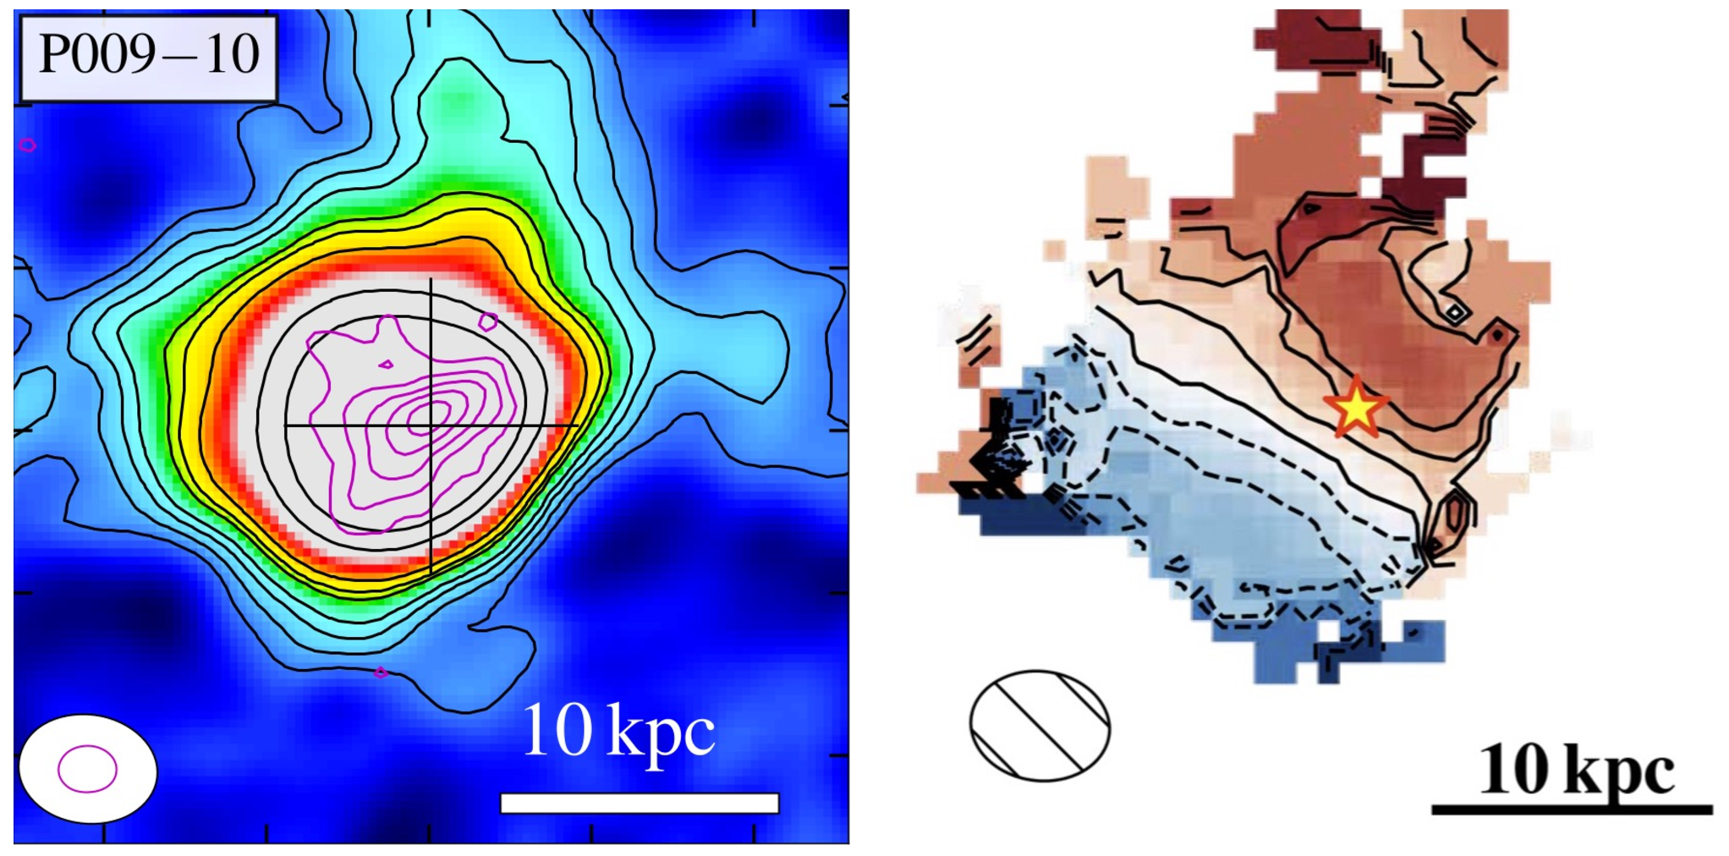
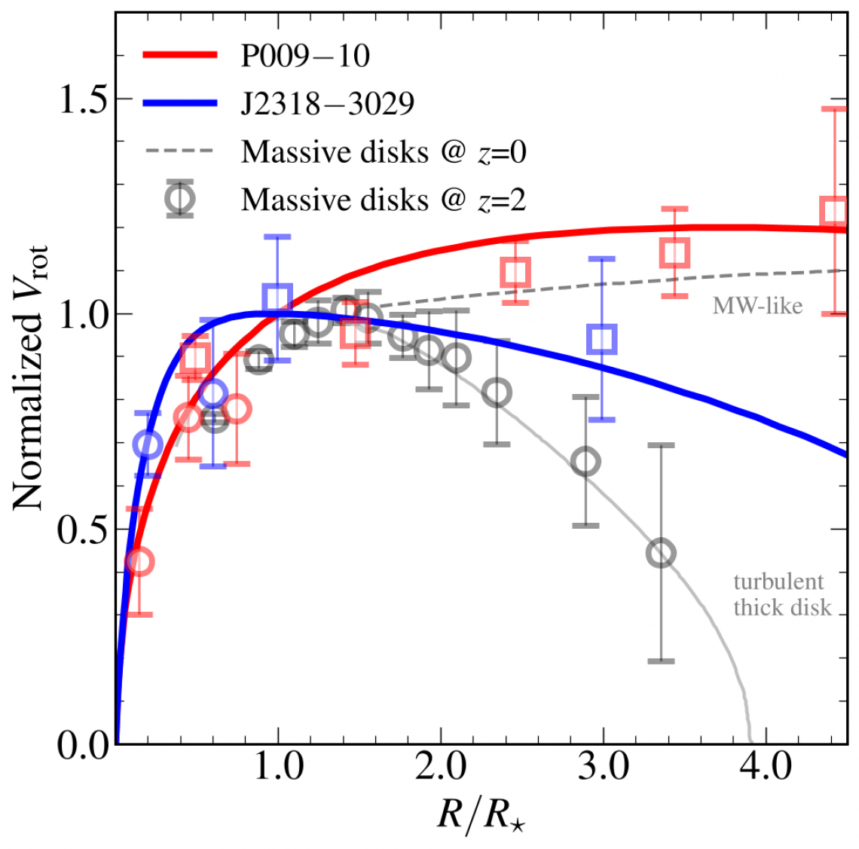
Study of the gas kinematics of two quasar hosts at z ≳ 6 traced by [C II] using ALMA Band 6 at ~0.1”-0.7” resolution;
Inferred circular velocities out to∼6-8 kpc scales, well beyond the likely stellar distribution;
Estimated DM halo masses of∼10^{12.5}−10^{12.8} M⊙, representative of the most massive halos at these redshifts.
Fei et al. 2025, ApJ, 980, 84

Slide 14
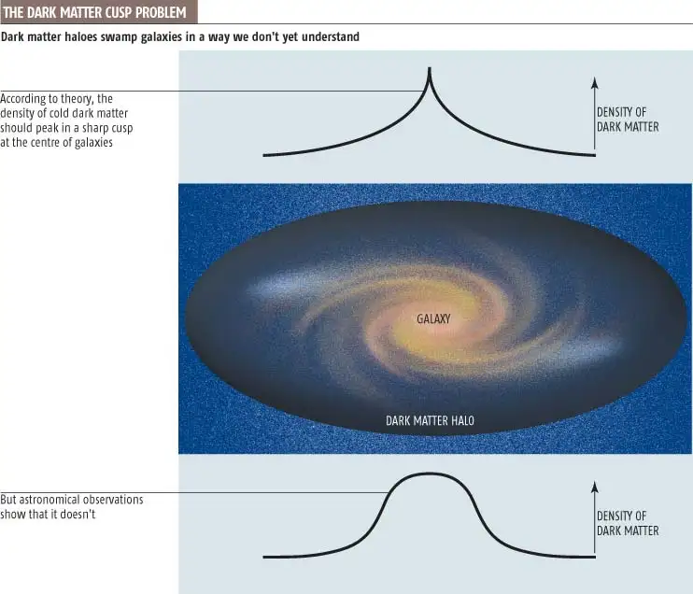
Cusp-core problem
In a NFW DM profile, the central slope of the dark matter density (β) is usually between 1 and 1.5;
Observations, particularly of dwarf galaxies, instead show nearly constant central density (β ≈ 0);
Cusp-core problem represents a challenge for CDM cosmology.

Slide 15
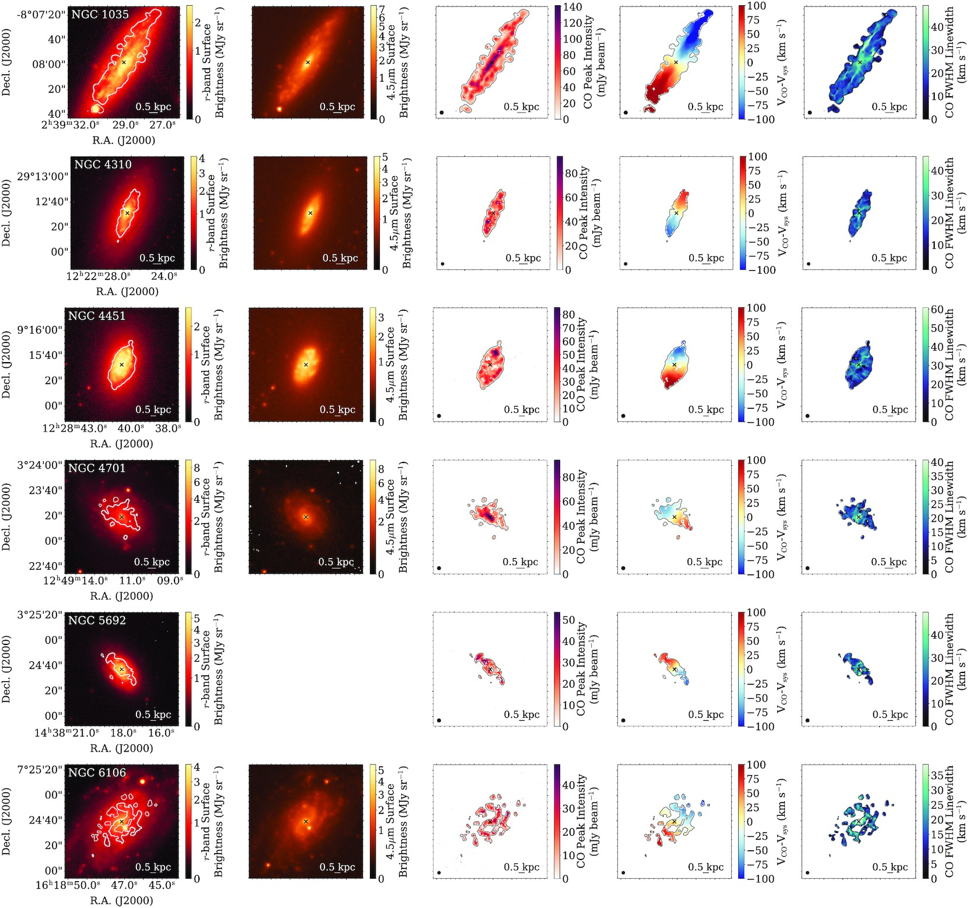
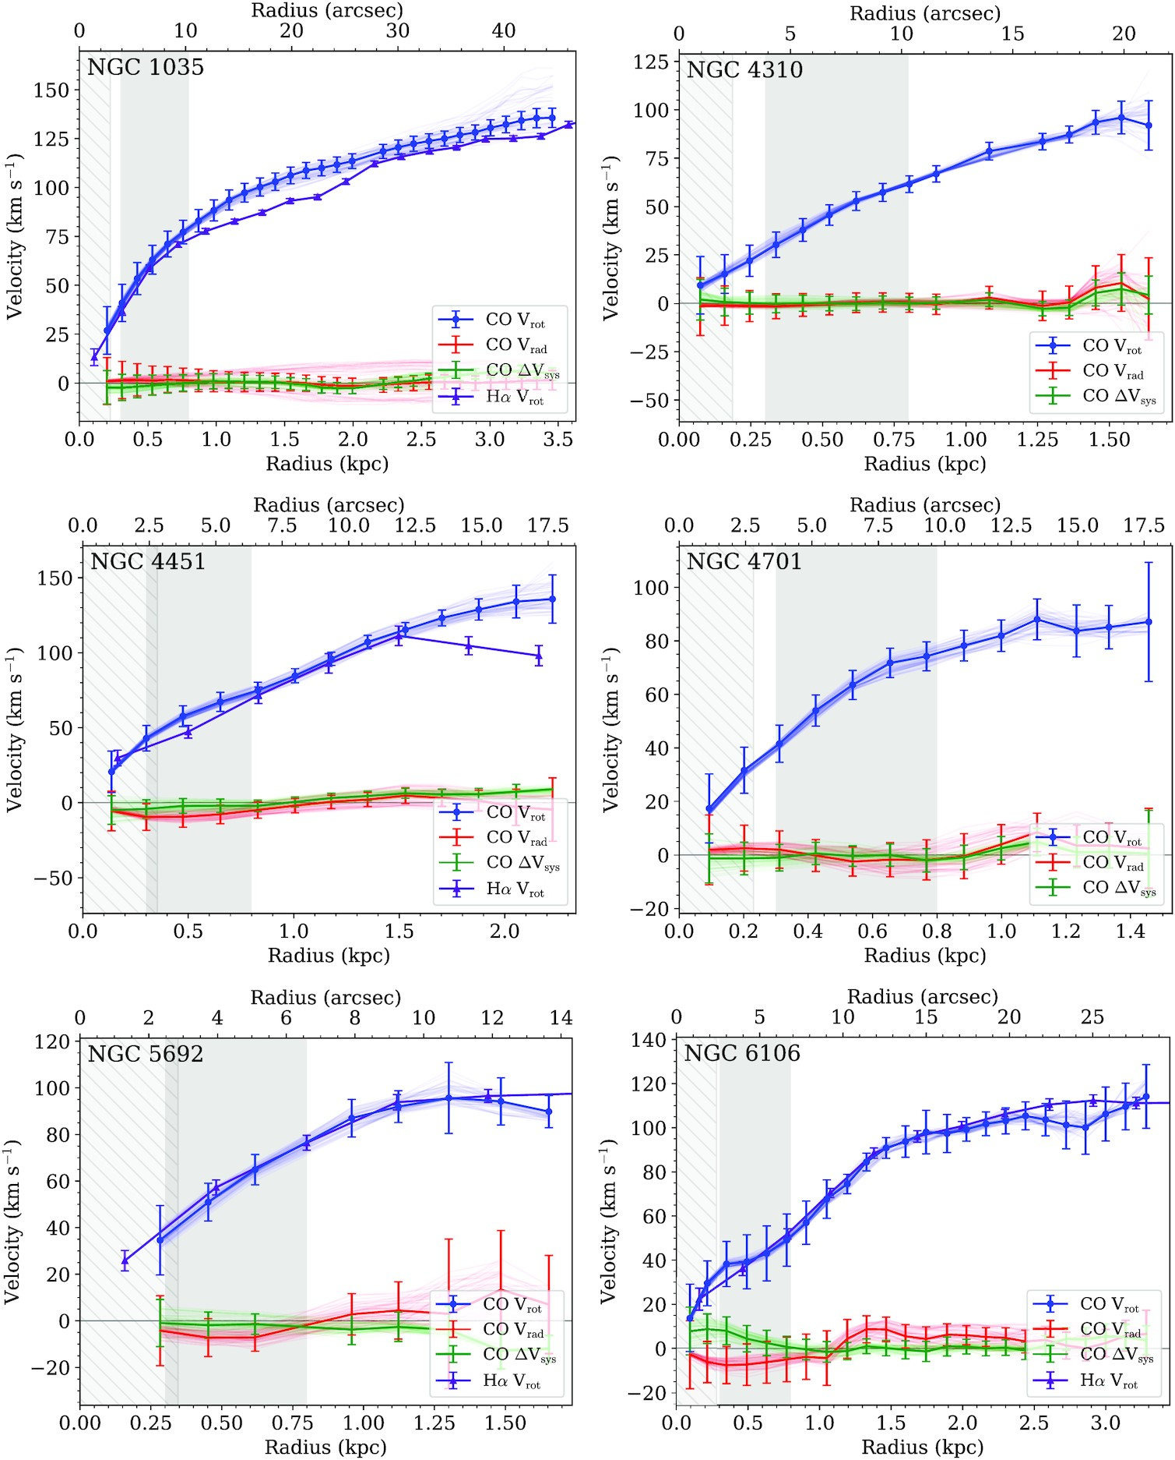
High resolution CO J=1-0 observations of six spiral dwarf galaxies to address the core-cusp problem;
β = 0.6 ± 0.1
The galaxies studied are on the high stellar mass end of dwarf galaxies and have cuspier profiles than lower mass dwarfs, in agreement with other observations.
Cooke et al. 2022, MNRAS, 512, 1012
Notes:
mismatch between observed and simulated dark matter density profiles in the central regions of galaxies, especially in low-mass and dwarf galaxies. Cosmological simulations based on the standard Cold Dark Matter (CDM) model predict that dark matter halos should have a "cuspy" profile, where the density increases steeply toward the center. However, actual astronomical observations (using rotation curves of galaxies) often reveal a much flatter, "core-like" density profile at the center instead of this steep rise.

Slide 17
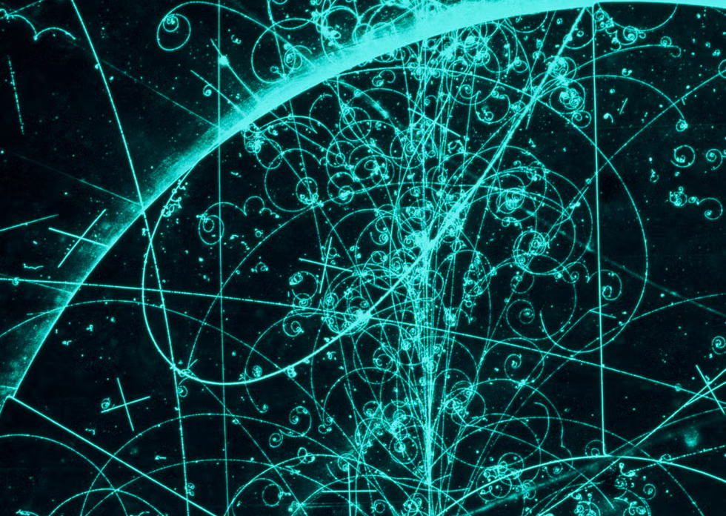
Axions
Hypothetical elementary particles (bosons), proposed to solve the strong CP problem in quantum chromodynamics;
Uncharged, very light and interact weakly with other particles, i.e. direct observation challenging;
Convert into photons within a magnetic field, that contributes a virtual photon;
They fit the properties required for a dark matter candidate: uncharged, low mass, and could have been produced in large numbers in the early universe, slow moving ➞ leading candidates for cold dark matter.
DE AGOSTINI PICTURE GALERY
Notes:
The axion is a long-postulated boson that emerges in the most natural solution to the so-called charge and parity problem in quantum chromodynamics.
The CP problem is a puzzle in physics querying why the strong nuclear force, described by Quantum Chromodynamics (QCD), does not violate CP-symmetry (laws of physics should remain the same if particles replaced by their antiparticles and spatial coordinates are reflected), even though its mathematical formulation suggests it should. Unlike other interactions where CP violation is understood, there's no inherent symmetry in QCD to explain why this term should be zero or extremely small.

Slide 18
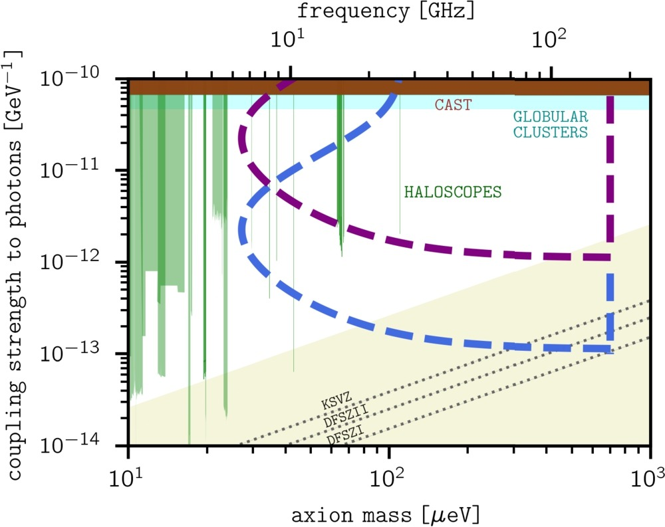
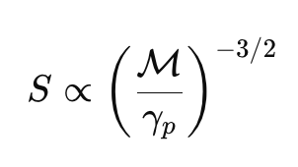

A new model
Predicts the emission originating from axion-to-photon conversion in the strongly magnetized ultra-relativistic plasma of neutron stars;
S : axion-induced flux
: pair multiplicity factor
ᵧ_{p} : plasma Laurenz factor
Acceleration and multiplicity of charges shift the axion-induced spectral feature with respect to previous expectations;
The frequency range of interest widens accordingly, and heavier dark matter axions may resonate in magnetospheric splits giving rise to detectable radio signals that could extend into the mm band.
Retuning radio astronomy for axion dark matter with neutron stars, J. De Miguel, 2025, Physics Letters, v862, 139328.
Notes:
Because charged particles accelerate along field lines and scatter into electron–positron pairs, producing a denser plasma, the resulting light signal from axions, arising at the plasma’s characteristic frequency by resonance, will show up at slightly different frequencies than originally thought.
This means that even heavier axions, which were thought to be harder to detect, might leave a detectable trace in the form of radio waves, potentially reaching into frequencies as high as the millimeter-wave band.

Slide 19
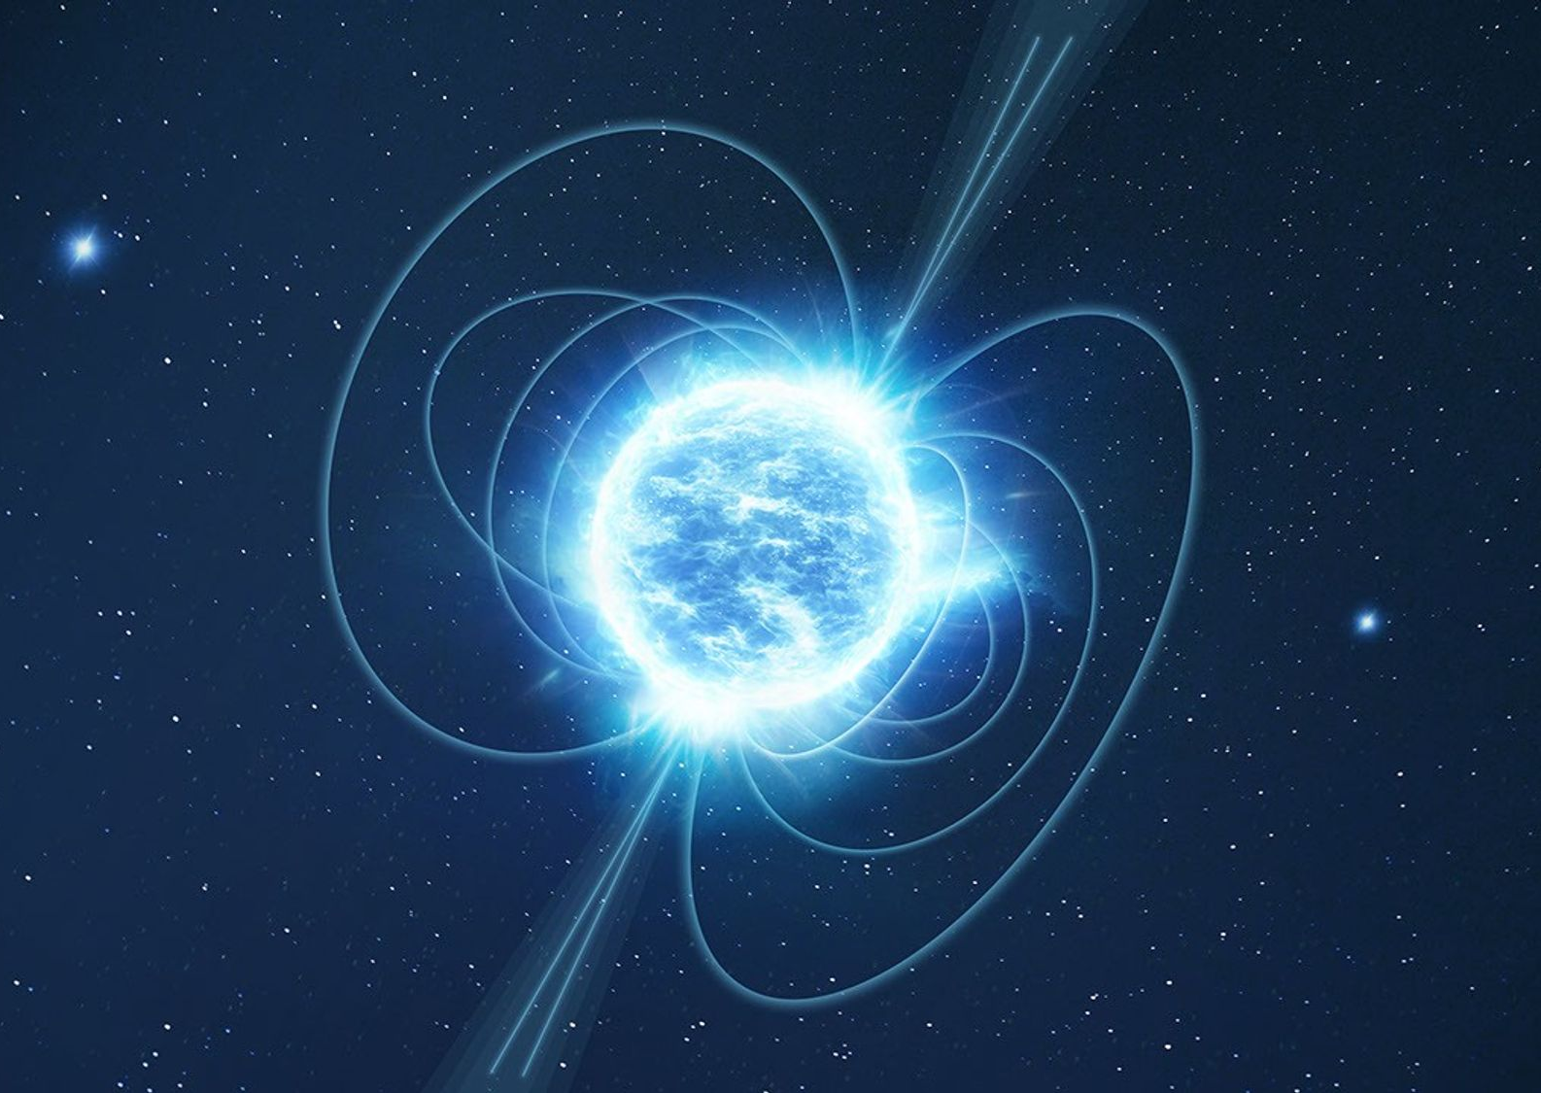
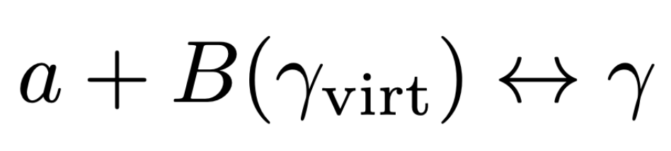
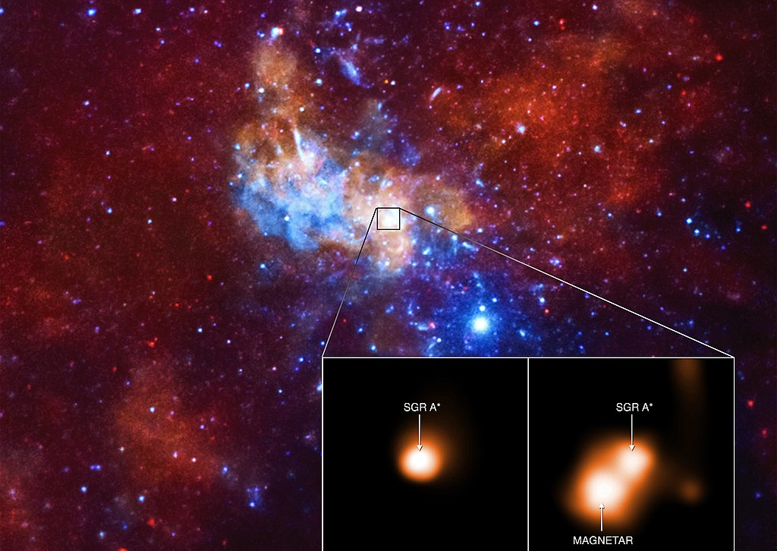
Magnetars
Neutron stars with extremely powerful magnetic fields (10¹³ – 10¹⁵ G);
Primakoff effect:
interaction between a photon and a strong electromagnetic field, resulting in the conversion of an axion into a photon ➞ detected using telescopes;
Experiments look for a distinct radio spectrum (a narrow spike) as a signature of this conversion.
SGR 1745-2900 an ideal candidate close to the galactic centre (2.4’’, 0.33lys), where the DM density is expected to be 6-9 orders of magnitude higher than at the Earth’s vicinity.
NASA/CXC/INAF/F.Coti Zelati et al.
SCIENCE.NASA.GOV

Slide 20
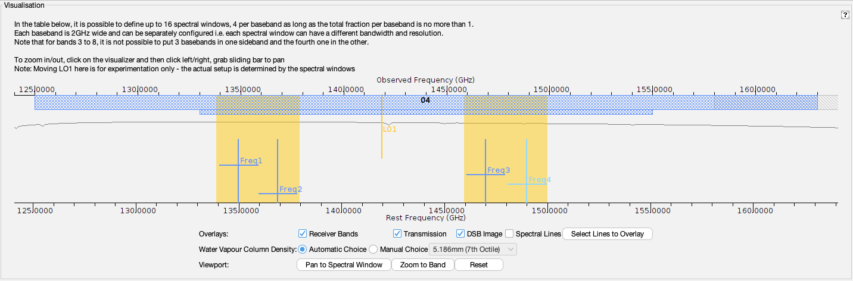
ALMA Setup
Project 2024.1.00310.S, PI J. De Miguel;
Line width set to 100km/s (expected); Covers 8 GHz (4+4), at a spectral resolution of ~16km/s (7.8 MHz), sensitivity of 0.01 mJy/beam (continuum);
7.1h on source; 0.75” spatial resolution (intermediate configurations, ~700m longest baselines);
Decided against spectral scan at the time.

Slide 21

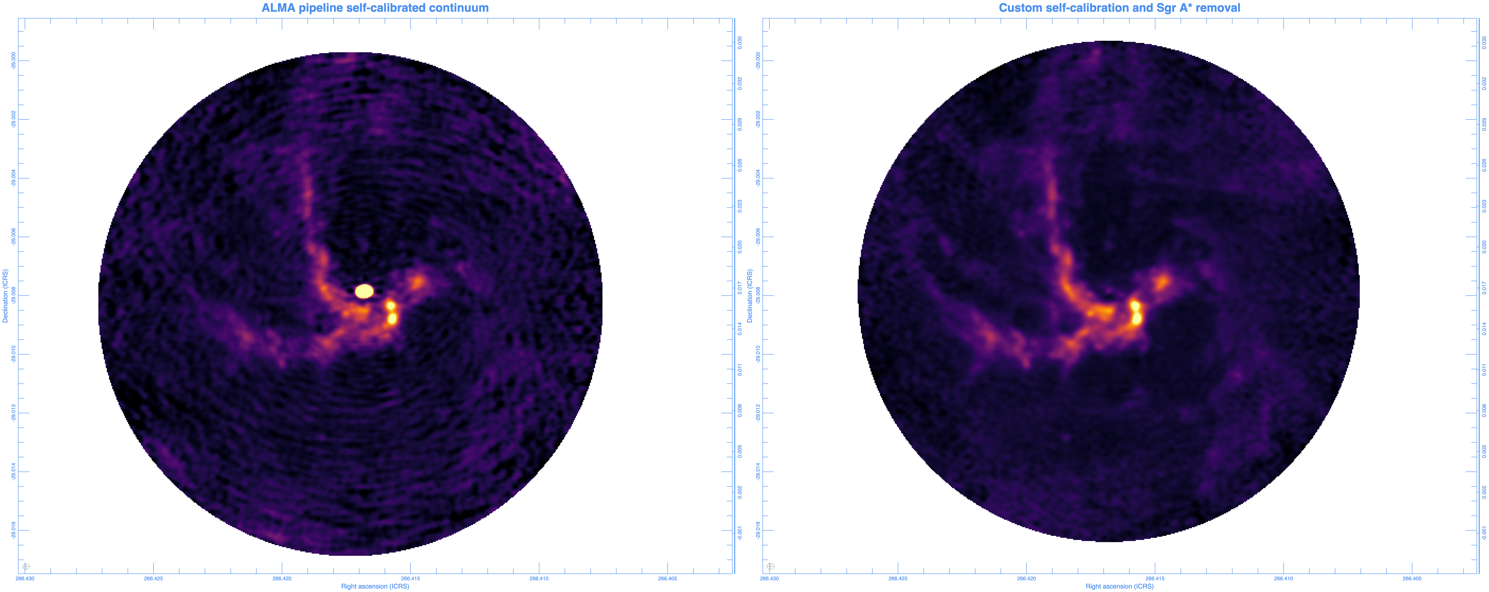
Project 2024.1.00310.S
Goals:
Look for axions signature (primary)
probe SGR 1745-2900 continuum emission to study the spectral and temporal evolution of the radio-mm emission of its outburst;
observe SgrA* with high angular resolution in band 4 for the first time, searching for a possible jet-like feature or flares;
search for diffuse emission in the region probing dust distribution.
DAN WALKER, UK ARC NODE

Slide 22
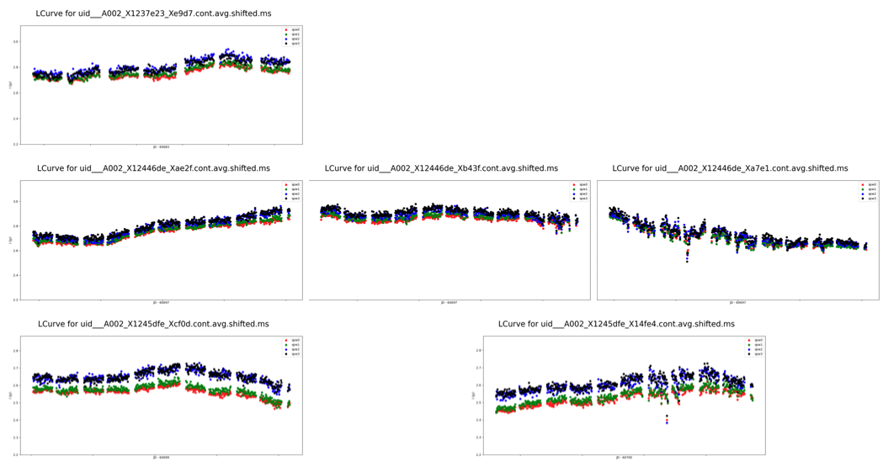
Project 2024.1.00310.S
Goals:
Look for axions signature (primary)
probe SGR 1745-2900 continuum emission to study the spectral and temporal evolution of the radio-mm emission of its outburst;
observe SgrA* with high angular resolution in band 4 for the first time, searching for a possible jet-like feature or flares;
search for diffuse emission in the region probing dust distribution.
DAN WALKER, UK ARC NODE

Slide 23
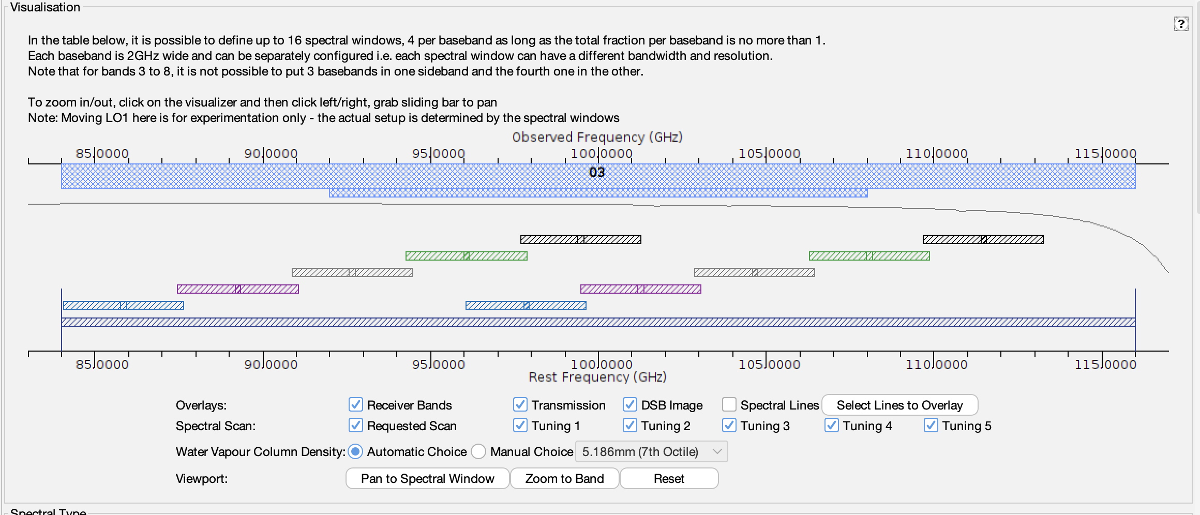
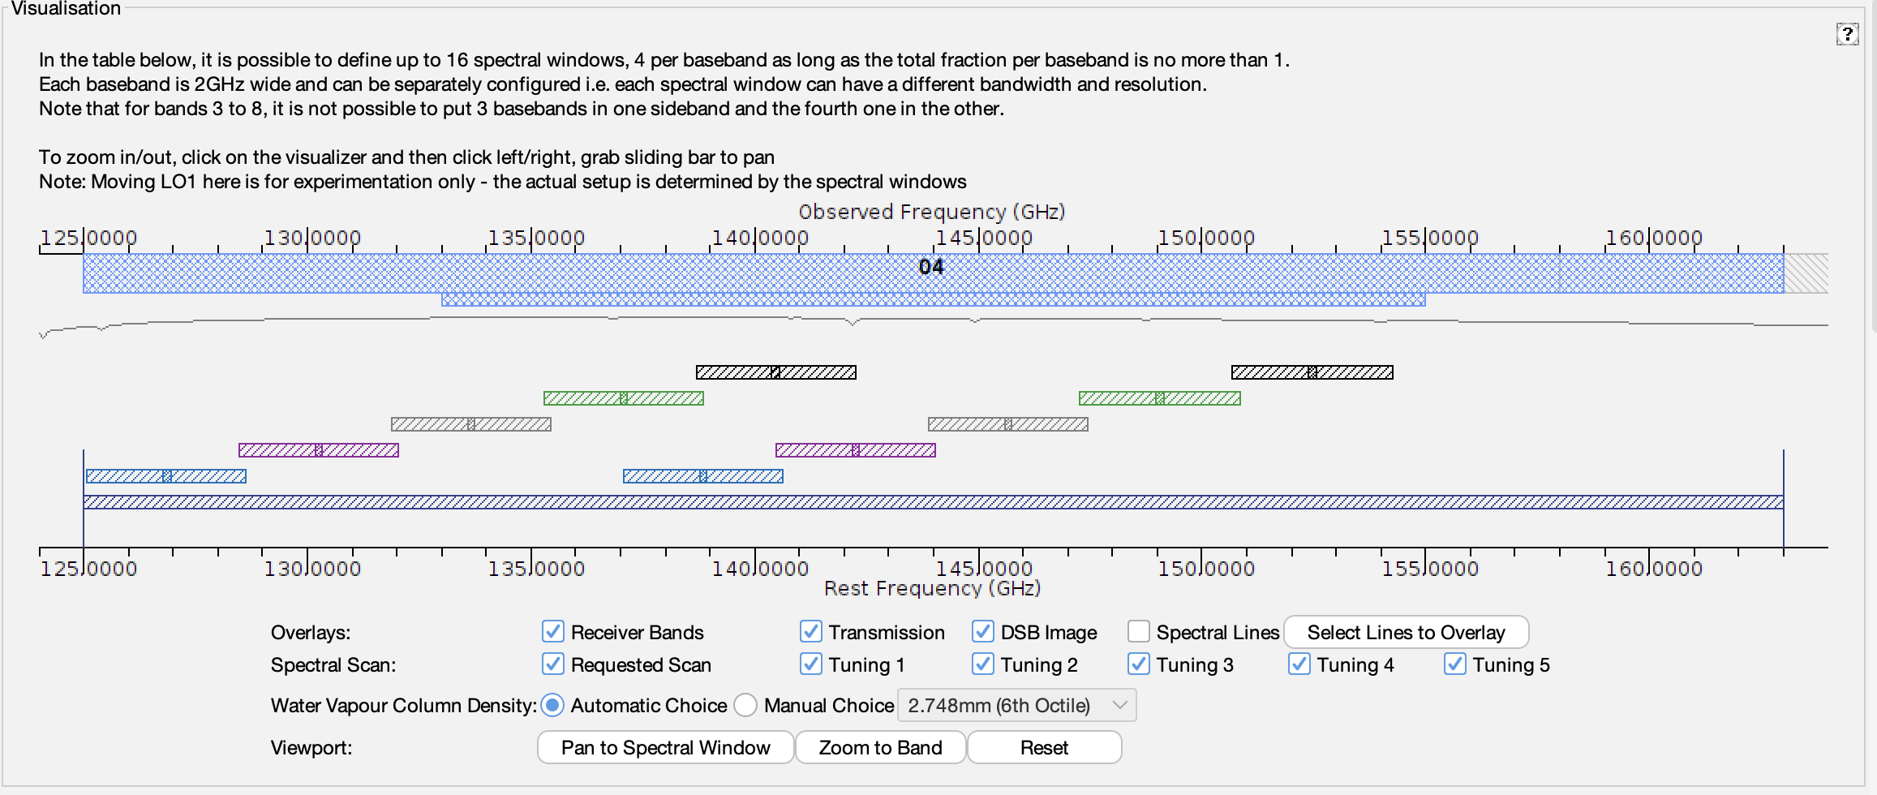
ALMA spectral scans
Cover wide spectral ranges
Set up as a single Science Goal but broken down into individual SBs
Project covering large parts of ALMA Bands 3 & 4

Slide 25
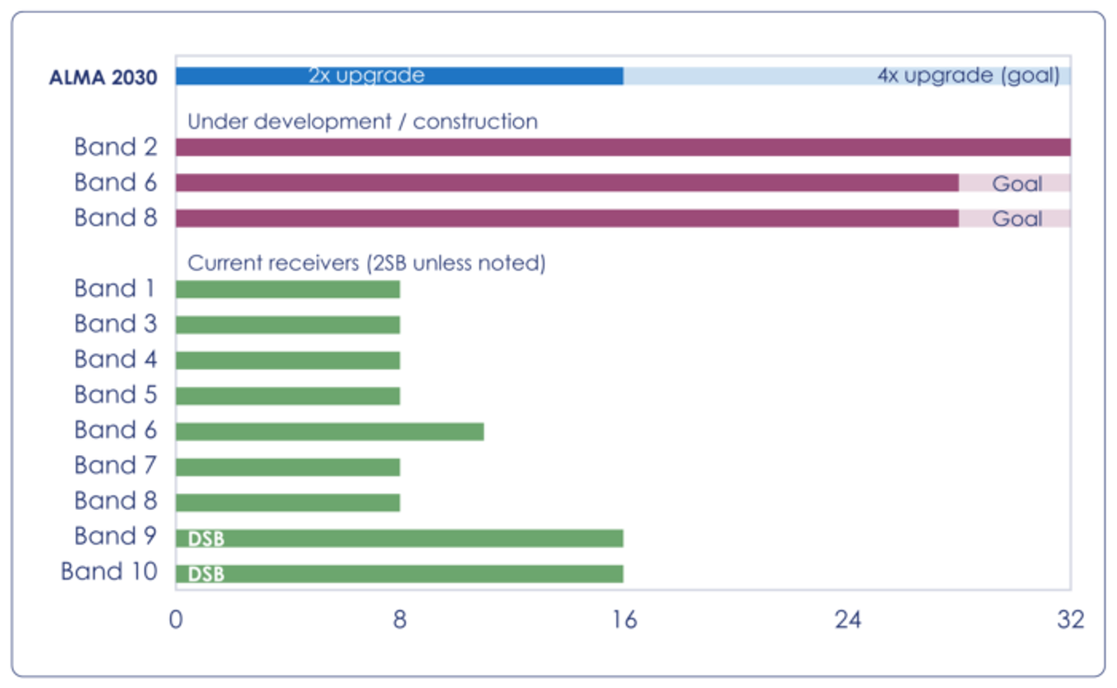
ALMA’s Wideband Sensitivity Upgrade
Instantaneous bandwidth
Correlated bandwidth
Observing speed
Increase of the available IF band width by a factor 2
Notes:
Aggregate instantaneous bandwidth of the ALMA receivers (per polarization). At minimum the WSU receiver upgrades will increase the aggregate IF bandwidth (summed across sidebands for 2SB receivers) to at least 16 GHz per polarization (blue bar), with a goal of 32 GHz per polarization (orange bar). The gray bars show the aggregate bandwidth (per polarization) of the current ALMA receivers (summed across sidebands for 2SB receivers). The red bars show the two ALMA wideband receivers already under development (Bands 2 and 6), where the dark red is the minimum bandwidth (24 GHz per polarization), and the light red shows the goal for these two projects.

Slide 26
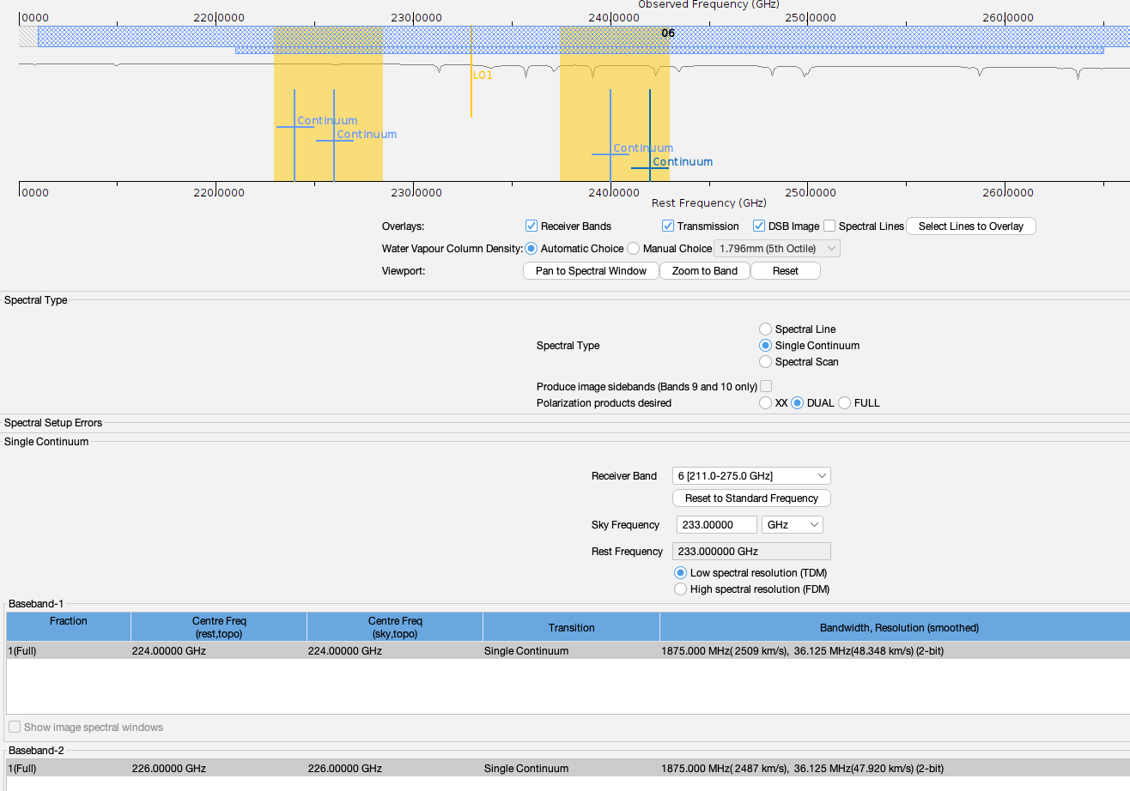
ALMA’s Wideband Sensitivity Upgrade
Instantaneous bandwidth
Correlated bandwidth
Observing speed
Notes:
Aggregate instantaneous bandwidth of the ALMA receivers (per polarization). At minimum the WSU receiver upgrades will increase the aggregate IF bandwidth (summed across sidebands for 2SB receivers) to at least 16 GHz per polarization (blue bar), with a goal of 32 GHz per polarization (orange bar). The gray bars show the aggregate bandwidth (per polarization) of the current ALMA receivers (summed across sidebands for 2SB receivers). The red bars show the two ALMA wideband receivers already under development (Bands 2 and 6), where the dark red is the minimum bandwidth (24 GHz per polarization), and the light red shows the goal for these two projects.

Slide 27
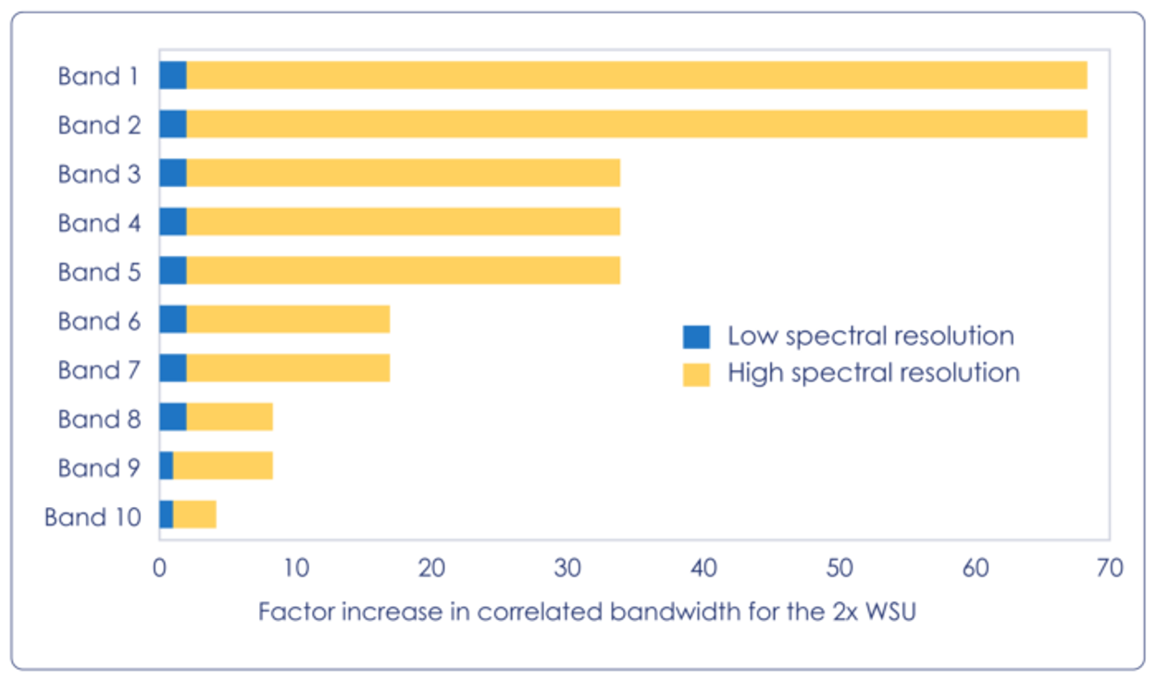
ALMA’s Wideband Sensitivity Upgrade
Instantaneous bandwidth
Correlated bandwidth
Observing speed
Increase of correlated bandwidth by factors 4 to 70
Current ALMA: need to choose narrow bandwidth for high spectral resolution
ALMA 2030: 0.1-0.2 km/s resolution across 16 GHz BW
Notes:
Factor by which the correlated bandwidth will increase with the 2× bandwidth WSU relative to the current system for each band, in two spectral resolution regimes: “Low Spectral Resolution” (blue), which is defined by the best spectral resolution that the BLC can achieve at full correlated bandwidth (7.5GHz per polarization), and “High Spectral Resolution” (orange), which is defined by the WSU goal of reaching 0.1–0.2 km s−1 in every ALMA band at the maximum correlated bandwidth (16GHz per polarization).

Slide 28
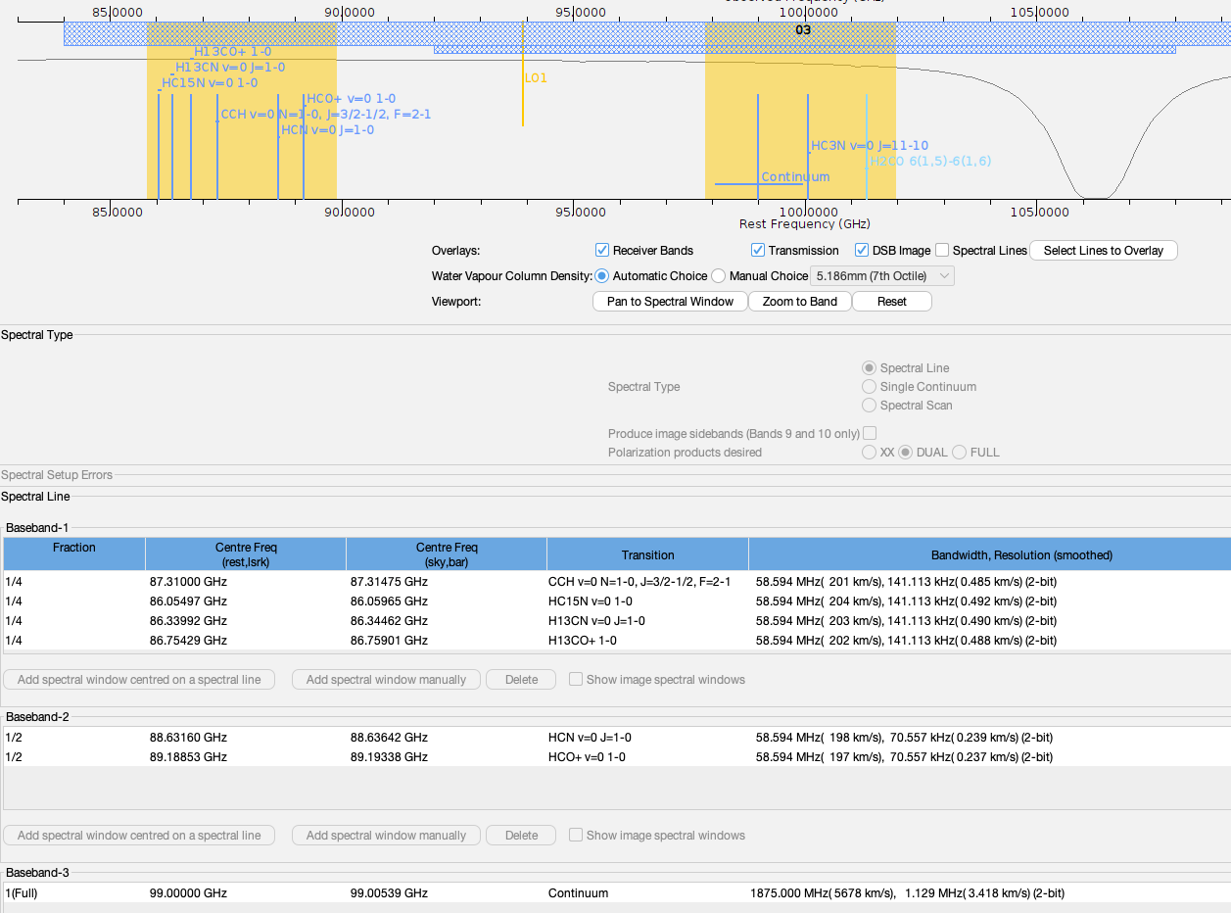
ALMA’s Wideband Sensitivity Upgrade
Instantaneous bandwidth
Correlated bandwidth
Observing speed
Notes:
Factor by which the correlated bandwidth will increase with the 2× bandwidth WSU relative to the current system for each band, in two spectral resolution regimes: “Low Spectral Resolution” (blue), which is defined by the best spectral resolution that the BLC can achieve at full correlated bandwidth (7.5GHz per polarization), and “High Spectral Resolution” (orange), which is defined by the WSU goal of reaching 0.1–0.2 km s−1 in every ALMA band at the maximum correlated bandwidth (16GHz per polarization).

Slide 29
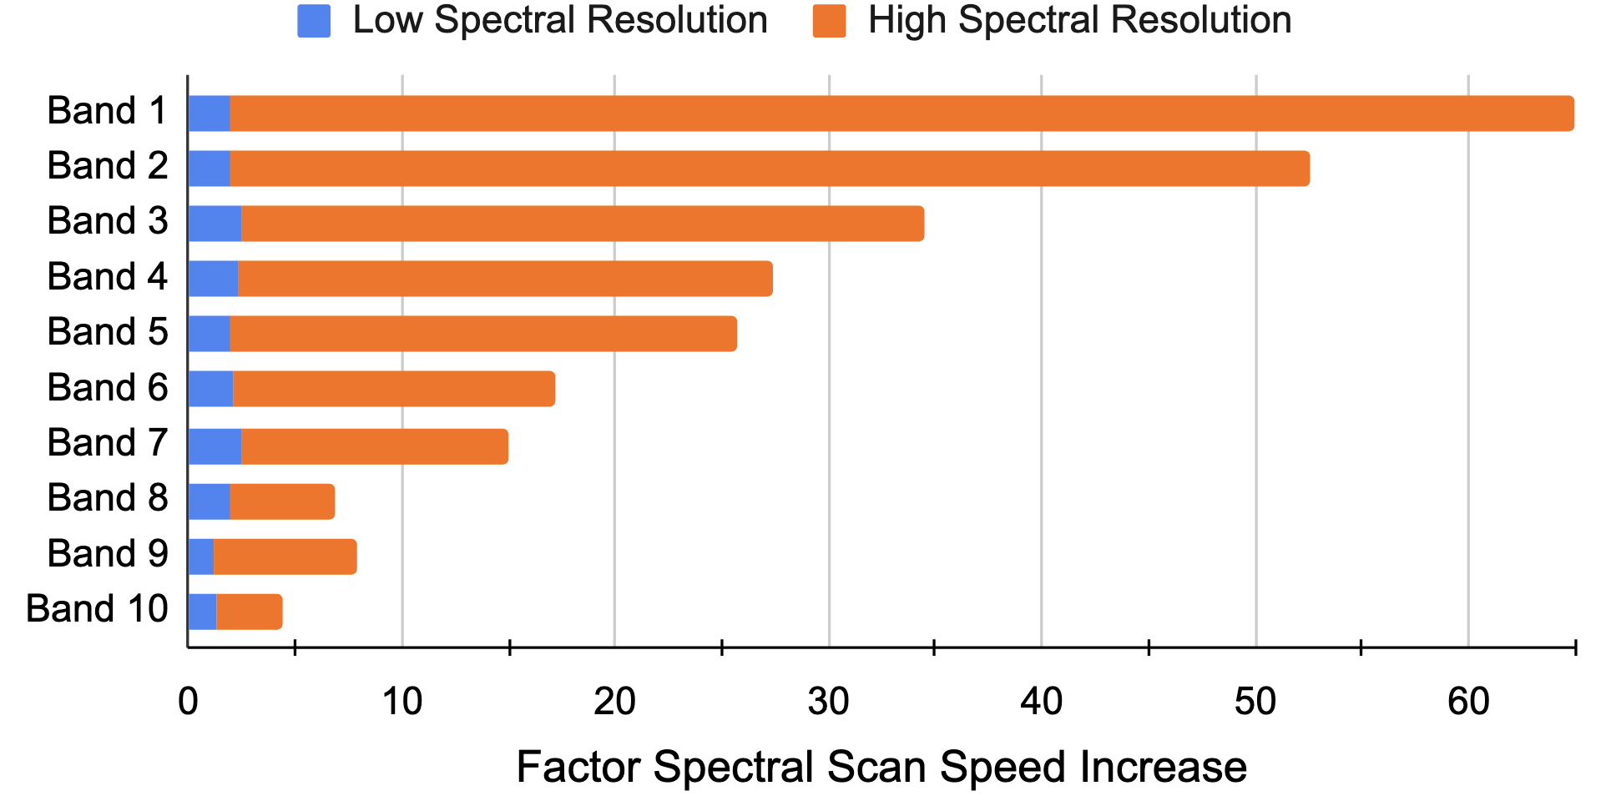
ALMA’s Wideband Sensitivity Upgrade
Instantaneous bandwidth
Correlated bandwidth
Observing speed
Increase in spectral scan speed
Continuum imaging speed increase by x3 for x2 correlated bandwidth
Spectral line imaging speed increase by ~ x2-x3
Spectral scan speed increase by x2-x54

Slide 30
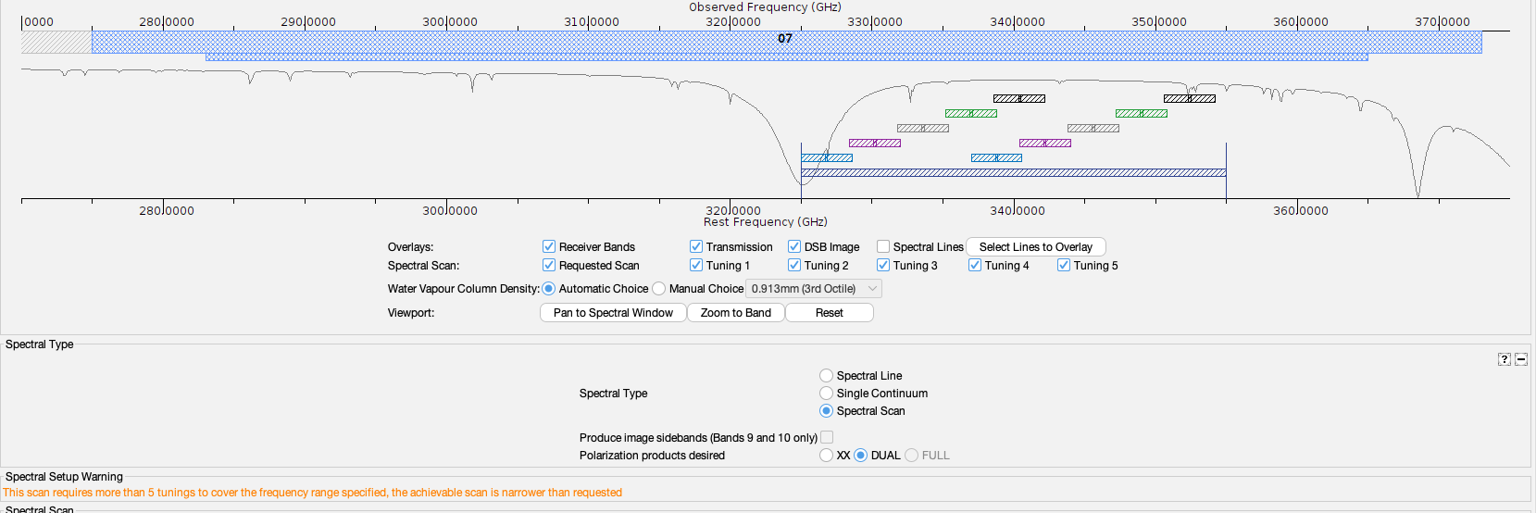
ALMA’s Wideband Sensitivity Upgrade
Instantaneous bandwidth
Correlated bandwidth
Observing speed
Increase in spectral scan speed

Slide 31
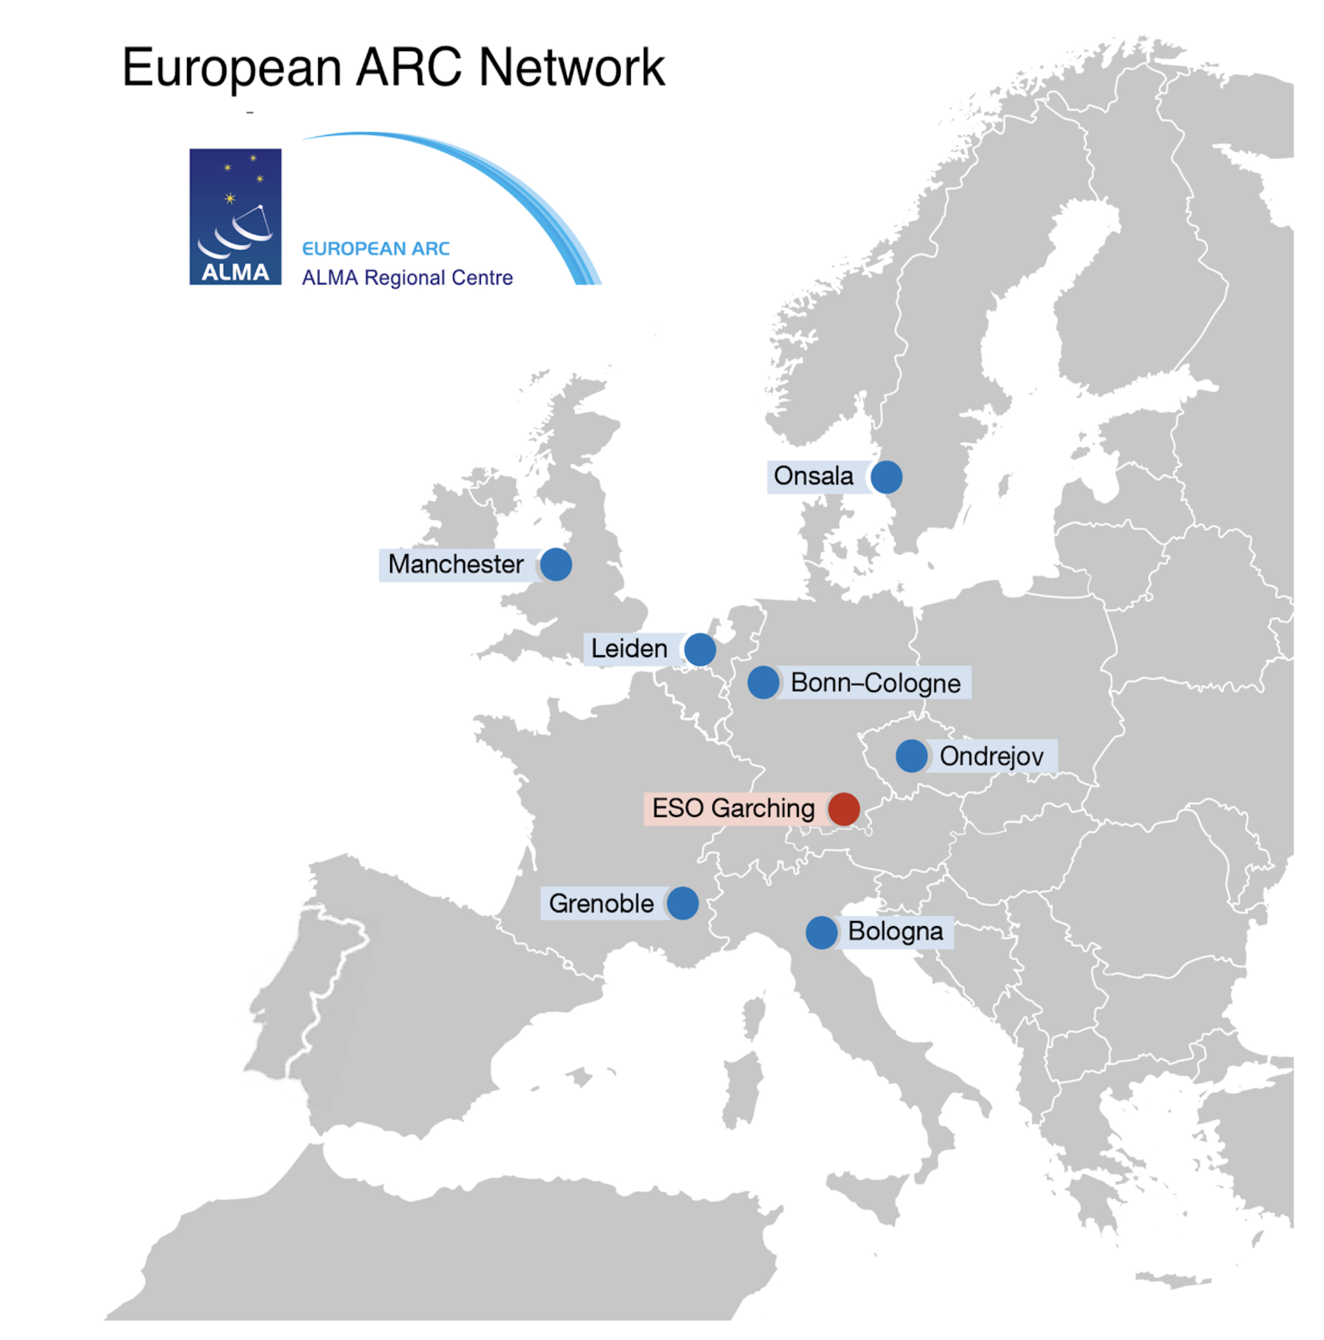
ALMA user support in Europe
Seven nodes + ESO, 50+ experts, there to support >4000 registered ALMA users with European affiliations
Face-to-face specialised support with:
Proposal preparation
Imaging
Archival Research
European funding
Community development:
Community days
Science and technical workshops
Online tutorials (e.g. I-TRAIN)
Videos
Presence in big science events and many more

Slide 33


Slide 34

Dark Matter with ALMA
Image credit: V. RUBIN
Thank you for your attention

