Slide 1
MET Correction in WZ Analysis using Coffea
Israr, Nick Manganelli
Coffea Users Meeting
12-05-2025

Slide 2
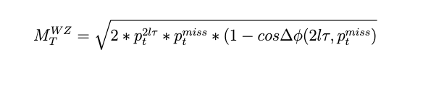
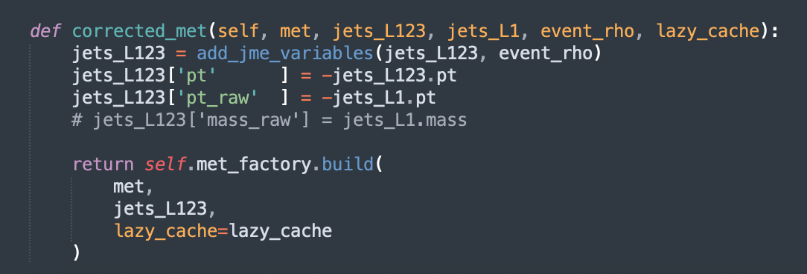
MET Correction
We are using the corrections made by Hong
https://github.com/scikit-hep/coffea/pull/1066
CorrectedMetFactory git : CorrectedMetFactory
With met_pT >30 GeV
self.met_factory = CorrectedMETFactory(jec_name_map)

Slide 3
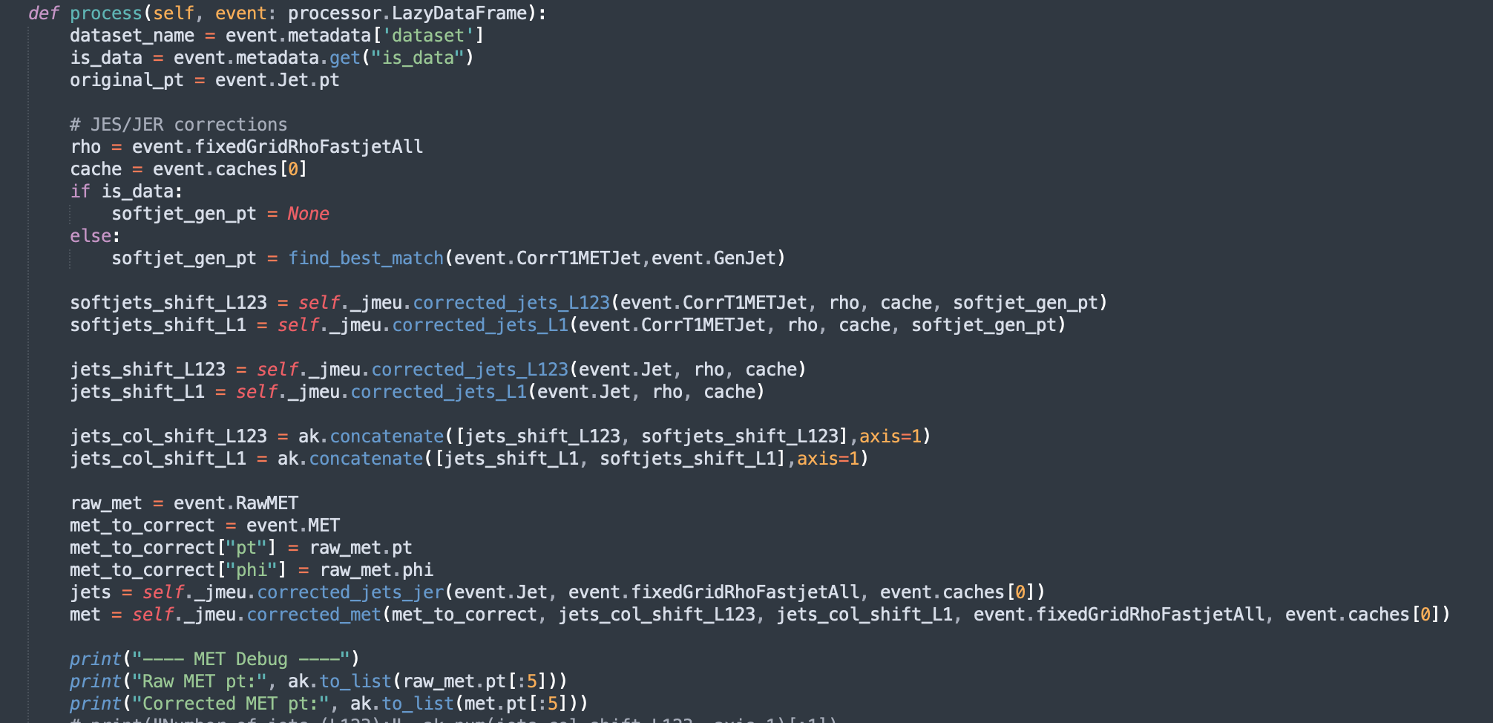
Jet-MET corrections applied in the analysis

Slide 4
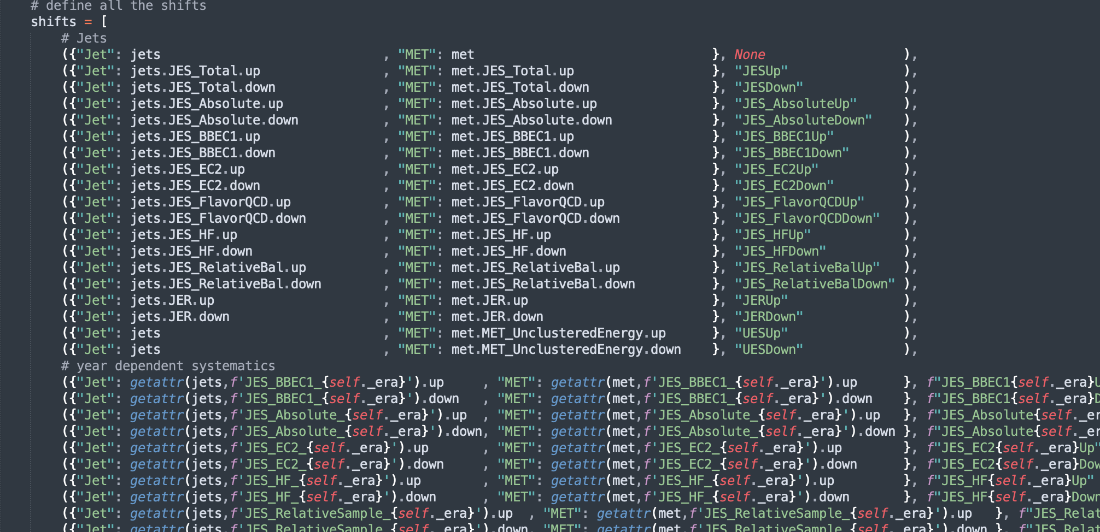
Jet-MET Uncertainties

Slide 5
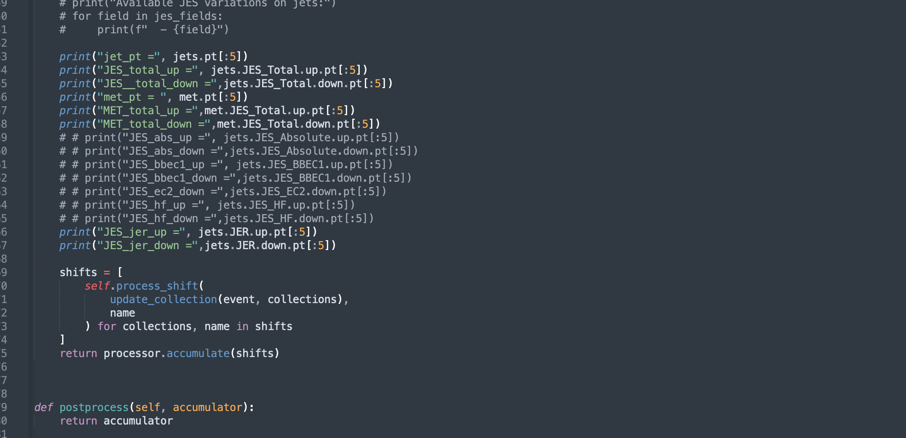
Values to print

Slide 6
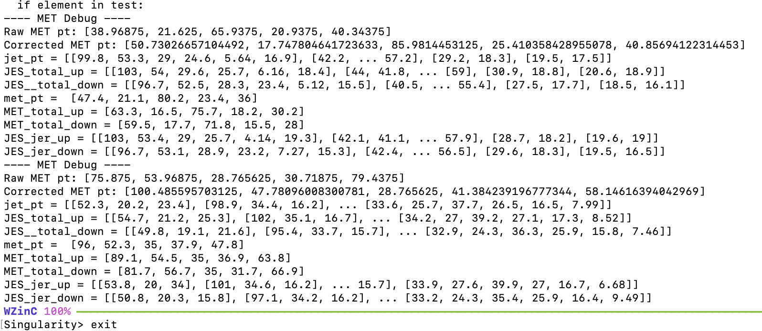
Printed Outcomes

Slide 7
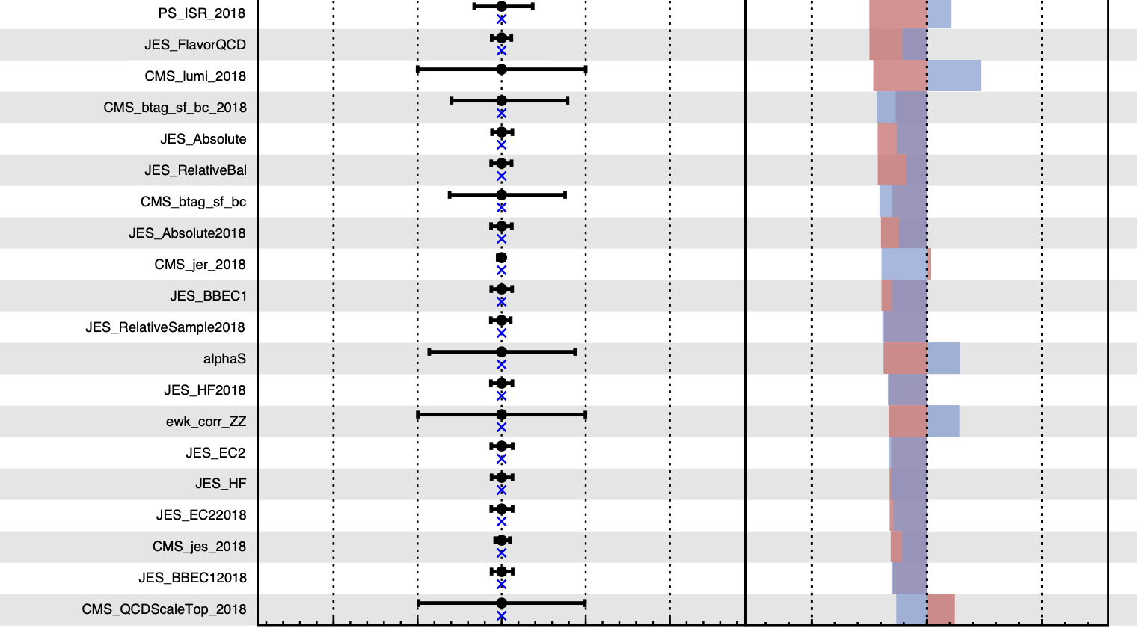
One-sided impacts due to the wrong MET correction

