Slide 1
Energy deposition in Q4/Q5 in IR6 for losses on TCSP/TCDQ
Anton Lechner (studies by V. Rizzoglio and J.B. Potoine)
09/05/2025

Slide 2
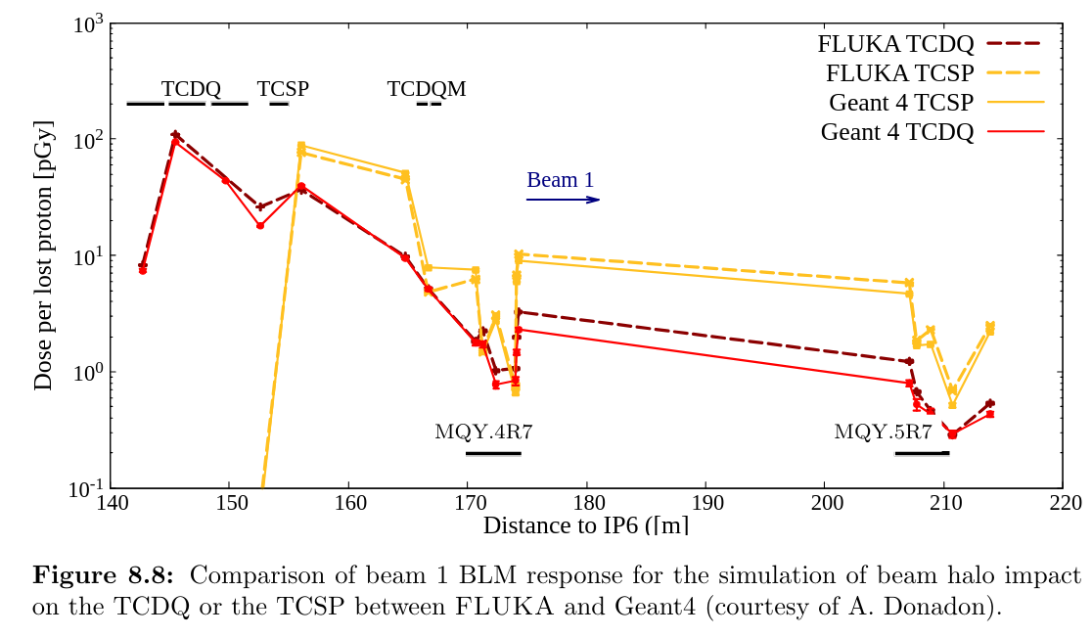
Simulated BLM response factors (7 TeV protons)
Q4/Q5 BLM signals for losses on the TCDQ / TCSP:
 | Impacts on the TCDQ | Impacts on the TCSP
BLMQI.04R6.B1E10_MQY | 2x10⁻¹² Gy/p | 6x10⁻¹² Gy/p
BLMQI.05R6.B1E10_MQY | 1x10⁻¹² Gy/p | 6x10⁻¹² Gy/p
Signals per proton on TCDQ or TCSP

Slide 3
Present Q4/Q5 BLM threshold settings
BLM name | Family name | Applied thresholds (MF=0.4) at EL28 (6.8 TeV)
 |  | RS08 | RS09-11 | RS12
BLMQI.04R6.B1E10_MQY | THRI.LS.P1_MQY_FT | 0.001753 Gy/s | 0.001718 Gy/s | 0.000687 Gy/s
BLMQI.05R6.B1E10_MQY | THRI.LS.P1_MQY_FT | 0.001753 Gy/s | 0.001718 Gy/s | 0.000687 Gy/s
BLM name | Family name | TCSP losses at Q4/Q5 dump threshold
 |  | RS08 | RS09-11 | RS12
BLMQI.04R6.B1E10_MQY | THRI.LS.P1_MQY_FT | 3x10⁸ p/s | 3x10⁸ p/s | 1x10⁸ p/s
BLMQI.05R6.B1E10_MQY | THRI.LS.P1_MQY_FT | 3x10⁸ p/s | 3x10⁸ p/s | 1x10⁸ p/s
BLM name | Family name | TCDQ losses at Q4/Q5 dump threshold
 |  | RS08 | RS09-11 | RS12
BLMQI.04R6.B1E10_MQY | THRI.LS.P1_MQY_FT | 9x10⁸ p/s | 9x10⁸ p/s | 3x10⁸ p/s
BLMQI.05R6.B1E10_MQY | THRI.LS.P1_MQY_FT | 2x10⁹ p/s | 2x10⁹ p/s | 7x10⁸ p/s

Slide 4
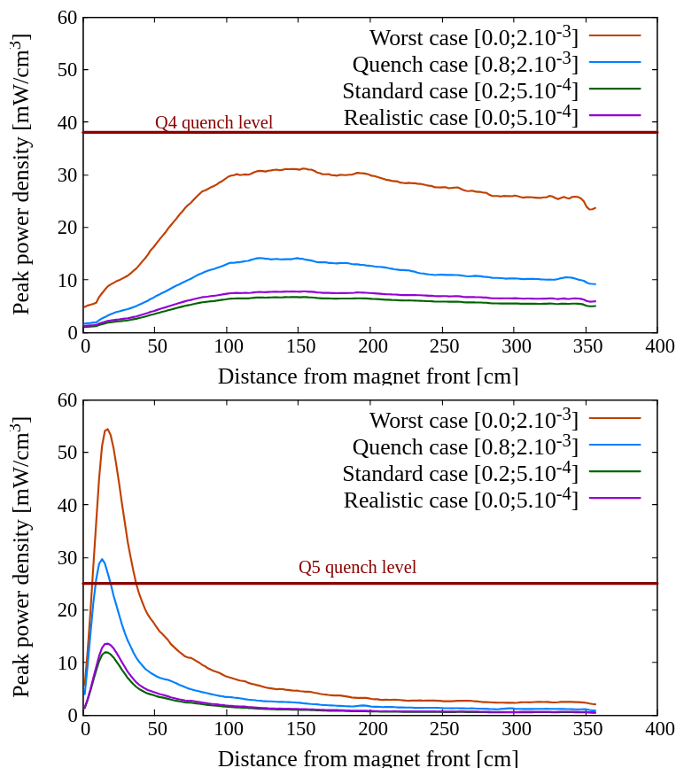
Simulated power density in Q4/Q5 coils
The Q4 has a mask (TCDQM), hence the power deposition per proton on TCDQ/TCSP is lower than in the Q5
 | Energy density in coils per proton
 | Impacts on TCDQ | Impacts on TCSP
Q4 | 0.6x10⁻⁸ mW/cm³ | 1.7x10⁻⁸ mW/cm³
Q5 | 1.3x10⁻⁸ mW/cm³ | 3.0x10⁻⁸ mW/cm³

Slide 5
Quench margin with present Q4/Q5 BLM thresholds
Both magnets are MQY type → quench level depends on actual current (expected to be around 30-40 mW/cm3 at 7 TeV)
BLM name | Losses on TCSP
 | RS08 | RS09-11 | RS12
Q4 | 5 mW/cm3 | 5 mW/cm3 | 2 mW/cm3
Q5 | 9 mW/cm3 | 9 mW/cm3 | 3 mW/cm3
BLM name | Losses on TCDQ
 | RS08 | RS09-11 | RS12
Q4 | 5 mW/cm3 | 5 mW/cm3 | 2 mW/cm3
Q5 | 17 mW/cm3 | 17 mW/cm3 | 7 mW/cm3

