Slide 2


Are you ready?
Take a seat, the session will start shortly…

Slide 3
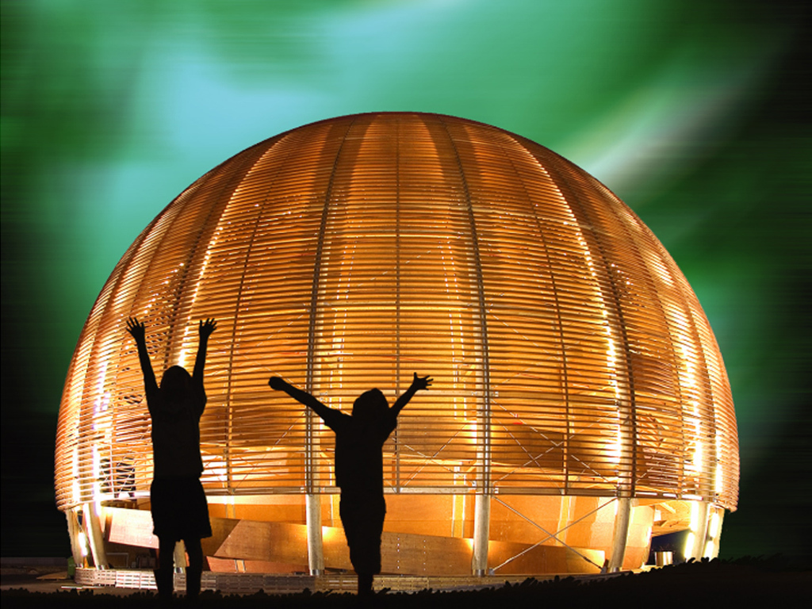
Welcome @ CERN
© CERN Photo
Notes:
1
WELCOME

Slide 4
Welcome Bienvenue
Amy Collins
HR Department
Learning & Development
Florence Licci-Ounnough
HR Department
Learning & Development

Slide 5
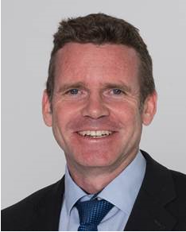
Bienvenue
Welcome
James PURVIS
Chef du département des ressources humaines
Head, Human Resources Department
Link to video
Notes:
1
**************
But first let me welcome James Purvis, our Head of HR department.
Lisette Van Den BOOGAARD, our HR Deputy Department Head, who will welcome you this morning.
James/Lisette the floor is yours.
Thank you James.

Slide 6
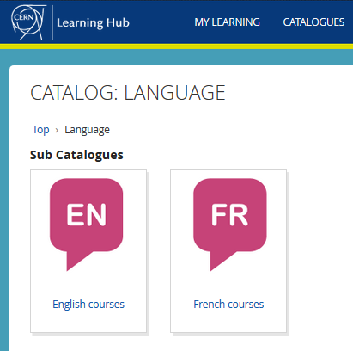


Logistics - language
Tandem
→ link
Find a partner
to practice speaking
each other’s language
Different levels, different formulas
classroom on site
virtual classroom (online)
blended (mix)
self-study with online platform
→ Learning Hub

Slide 7

Logistics - slides
Available at any time
Direct link: https://indico.cern.ch/category/10150/

Slide 8
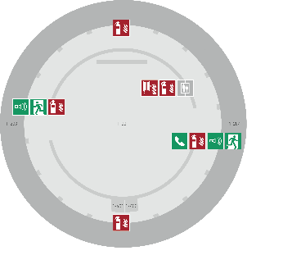
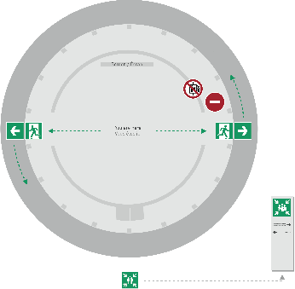
Emergency Procedure
When the alarm sounds
Lorsque le signal d’évacuation retentit
Evacuate immediately
Évacuez immédiatement
Don’t use the lift
N’utilisez pas l’ascenseur
Follow the signs
Suivez le balisage
Go to assembly point
Rendez-vous au point de rassemblement
74444
Escape routes
Voies d’évacuation
Fire hose
Lance d’incendie
Extinguisher
Extincteur
Assembly point
Point de rassemblement

Slide 9
Programme of the morning
08.50 Quiz – Part 1: CERN as an organisation
09.15 Group photo, coffee break and networking
09.55 Quiz – Part 2: Daily life at CERN
10.25 Meet colleagues from your department
Transfer to department
11.00 Welcome in your department

Slide 10
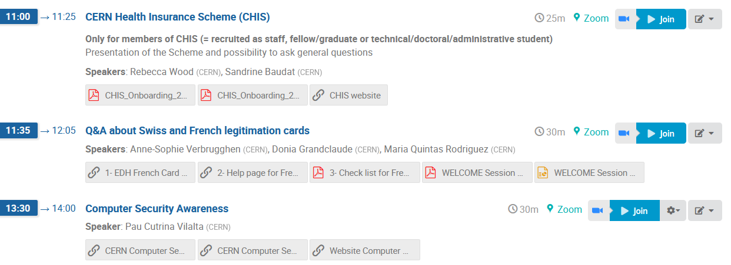


Also: Tuesday 3rd June

Slide 11

Ready to learn
more about CERN
with a quiz?

Slide 12

Quiz – voting clickers
Team work!
One clicker for 2 or 3 people
Get together!

Slide 13
How to answer
Question with only one correct answer
  Click on the number of your choice – blinks green
  Mistake? Just enter your new choice – blinks green
Question with several correct answers
  Click on the different numbers of your choice
  Blinks green on every entry
  Mistake? Reset response by pressing on button ’10’
  Blinks red. Now enter all your answers again

Slide 14

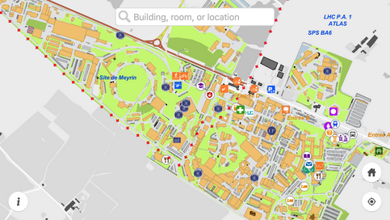
CERN Map

Slide 15
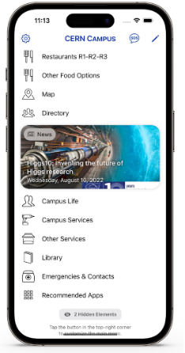
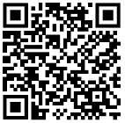
New
CERN Campus app
centralises all most important campus services in one place

Slide 16
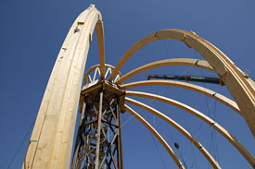
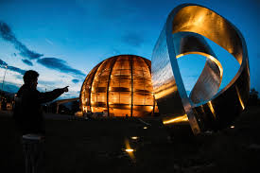
© CERN Photo
https://visit.cern/globe
© CERN Photo

Slide 17

CERN as an international organization
Quiz – part 1

Slide 18






CERN MoP
~17 550
Contractors
> 4 500
Employed MPE
~ 3 670
Associated MPA
~ 13 880
Staff
~ 2 670
Fellows/ Graduates
~ 1000
Users
~ 12 370
Associates
~ 990
Students
~ 520
Notes:
Sources: https://cds.cern.ch/record/2897705/files/CERN-HR-STAFF-STAT-2023.pdf (Table 1a) - Updated 23.04.25 (except contrators)

Slide 19
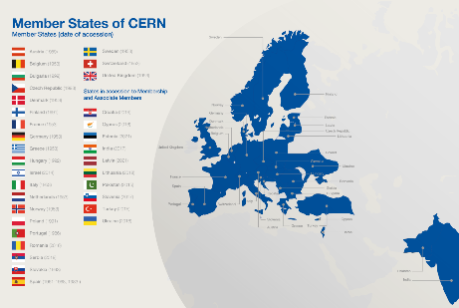
Revenues 2024
Member State contributions 87 %
Associate Member State contributions 2 %
Special contributions 3 %
(to HL-LHC, specific experiments, from EU)
Other 8 %
(e.g. knowledge transfer, donations, …)
Principle =
proportional to Gross National Income
→ equal effort for every country
Notes:
Sources :
- https://cds.cern.ch/record/2888205/files/English.pdf Total=1 408.6M, MS=1 221.9 (86.8%), AMS=33.5 (2.4%), spec. contr=18.5+9.1+14.2 (2.96%), Other - Updated 23.04.25
- https://cds.cern.ch/record/2790156 (map member states) dates back 2021!!

Slide 20
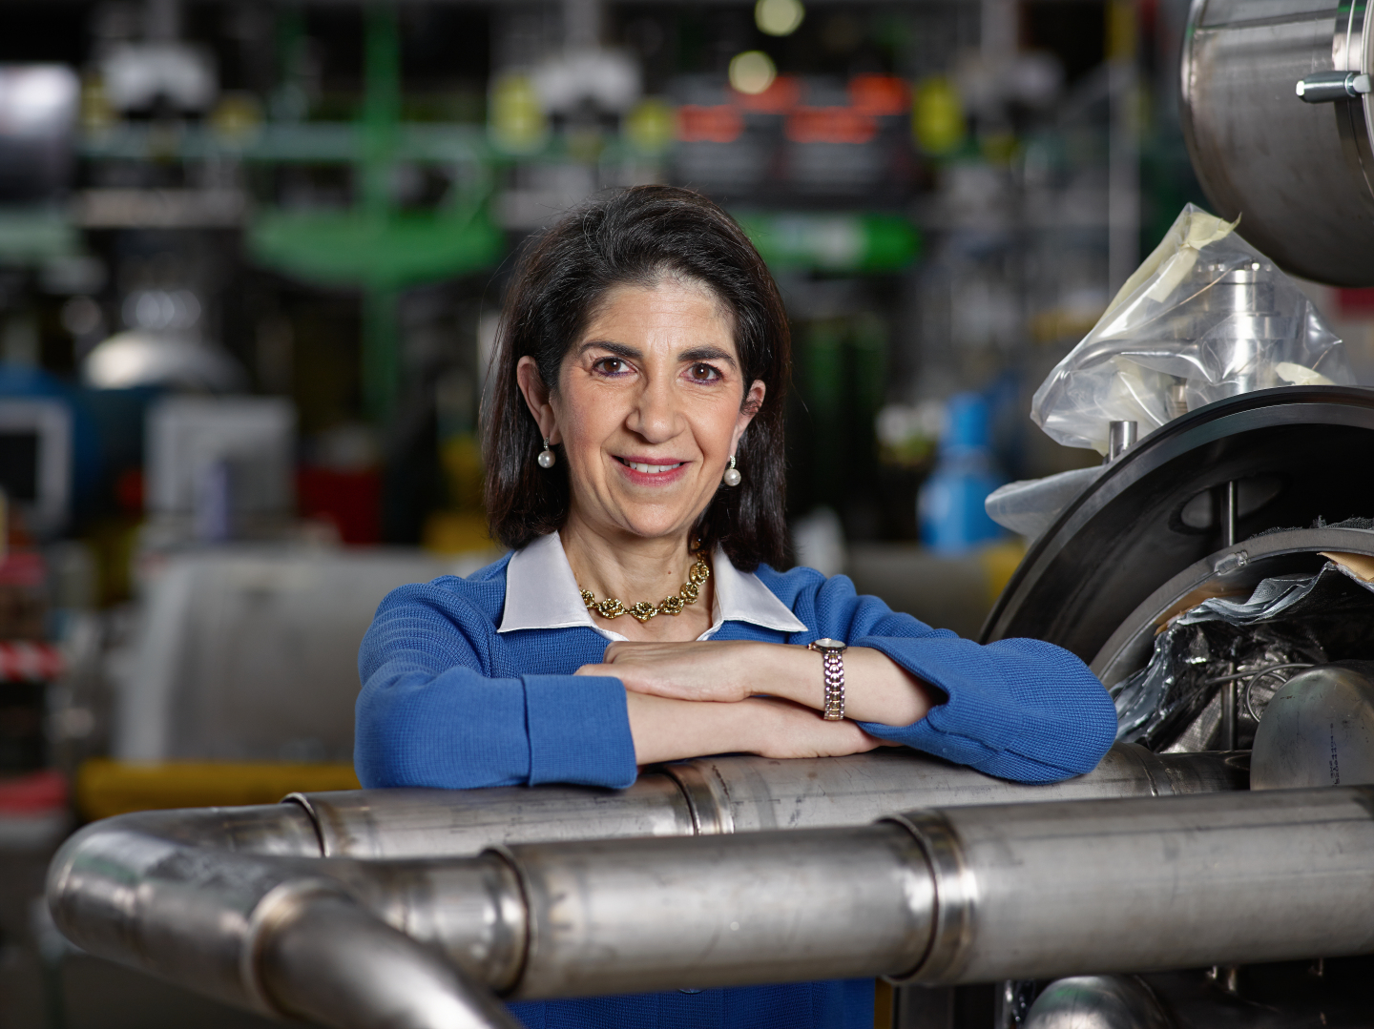
Link to biography
© CERN Photo, 2015
Notes:
https://www.forbes.com/profile/fabiola-gianotti/?list=power-women
https://press.cern/biographies/fabiola-gianotti-born-1960-Italian

Slide 21
Health, Safety & Environment
Director General
Internal Audit
Legal Service
Pension Fund
Accelerators & Technology
Beams
Technology
Finance & Human Resources
International Relations
Research & Computing
Engineering
Finance & Administrative Processes
Industry, Procurement & Knowledge Transfer
Human Resources
Site & Civil Engineering
Experimental Physics
Theory
Information Technology
AcceleratorSystems
Diplomatic & Stakeholder Relations
Education, Communication & Outreach
Science Gateway Operations
Sector
Department
Group

Slide 22
HSE
PF
DG
Benoit Delille
Doug Heron
Fabiola Gianotti
ATS
BE
TE
FHR
IR
RCS
EN
FAP
IPT
HR
SCE
EP
TH
IT
SY
Sector
Mike Lamont
Raphael Bello
Charlotte Warakaulle
Joachim Mnich
Rhodri Jones
Florian Sonneman
Manfred Krammer
Department
J. Miguel Jiménez
Christopher Hartley
Gian Giudice
Katy Foraz
James Purvis
Enrica Porcari
Brennan Goddard
Mar Capeans

Slide 23
Sector
Director
Department
Department Head
DAO
DPO
DSO
DTO
…
Group
Group
Group
Group Leader
Section
Section
Section
Section Leader

Slide 24
Working at CERN when Nobel prize
1992: Georges Charpak
1988: Carlo Rubbia & Simon van der Meer
1984: Jack Steinberger (with Lederman and Schwartz)
Working at CERN after Nobel prize
1952: Felix Bloch
1976: Sam Ting
Nobel prize thanks to discoveries at CERN
2013: Peter Higgs & Francois Englert

Slide 25
Welcome to HR-PXE colleagues
Opportunity to ask questions during coffee break
Collective induction session by type of contract
  Graduates (Origin, Quest, …)
  Tech & Admin students in the 2nd week
  Doctoral students
Individually contacted by HRA : Staff

Slide 26


Slide 27
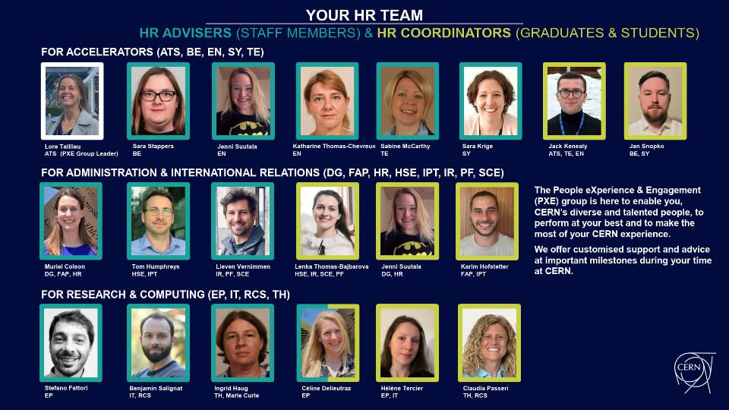

Slide 28
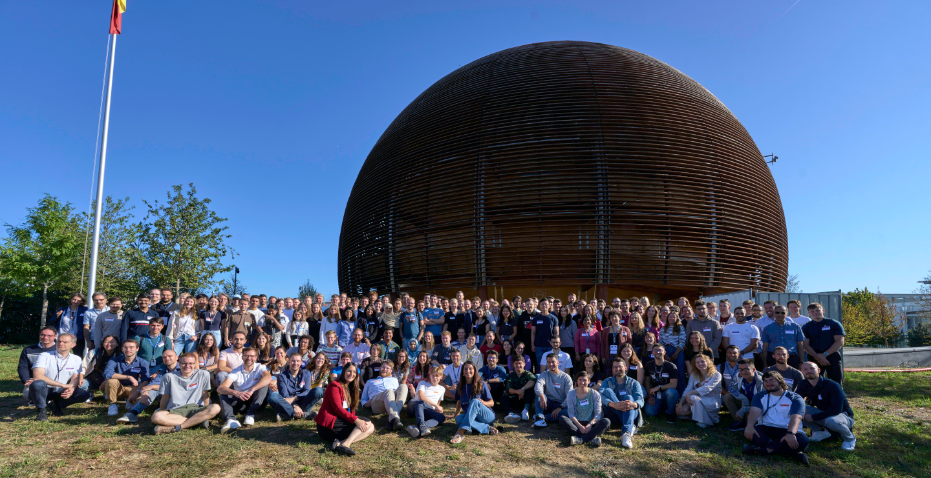
Time for a group photo!
© CERN Photo

Slide 29



30
MINUTES
BREAK TIME

Slide 30
Are you ready?
Take a seat, the session will start again shortly…

Slide 31
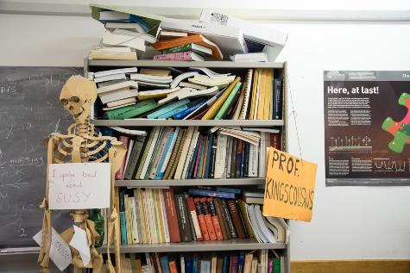
Daily life at CERN
Quiz part 2

Slide 32
CERN infrastructure covers…
625 ha of land
700+ buildings
30 km of roads
One site in France + one site in Switzerland
Several correct answers!
Notes:
2
************************

Slide 33
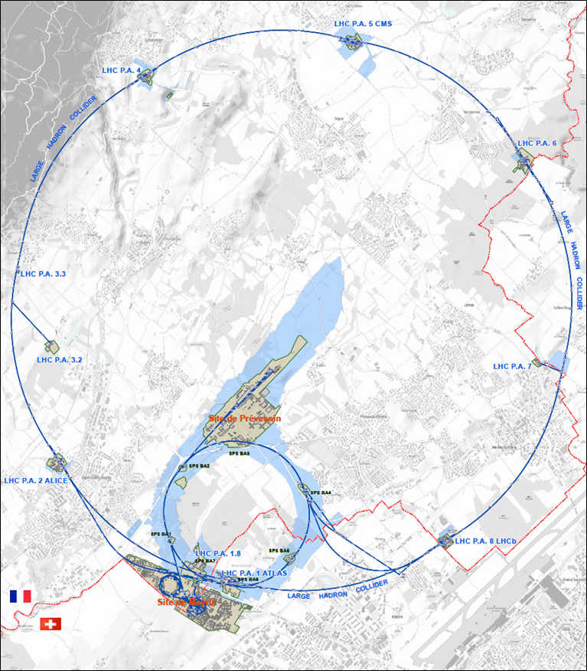




625 ha
515 ha
fenced : 220
110 ha
… 700+ buildings
accounting for
500.000 m²
5 900 parking spots
101 ha
green
spaces
30 km roads
Notes:
Source: https://indico.cern.ch/event/669690/contributions/2740056/attachments/1553507/2441980/Mobility_IoT.pptx

Slide 34
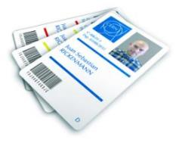
CERN access card
CERN access card
CERN Community Support Centre
Buidling 33 - Meyrin site,
7.00 am to 6.30 pm, Monday to Friday
vehicle registration
biometrics registration
https://sce-dep.web.cern.ch/security/access
Notes:
Your access card is available for collection at the CERN Community Support Centre (buidling 33- Meyrin site), in front of CERN tramway stop 18.
The service will be open from 7am. Due to the large number of people coming to CERN that day, please be aware that queues may be expected. You will be able to collect your access card after the Welcome session.

Slide 35




Gates | Days
Meyrin A | Mon-Fri | 24/24 |  | 7-20
Porte Jura Bldg 33 |  | 24/24
Meyrin B (Main entrance) |  | 24/24
Meyrin C | Mon-Fri | 24/24 |  | 7-20
Meyrin D (goods only) | Mon-Fri |  |  |  | 08-12 13-16
Meyrin E (Only Authorised Personnel and contractors. Rules of Use) | Mon-Fri | In: 7-9.30 Out: 16.30-20
Intersite tunnel (restrictions apply) | Mon-Fri |  |  | 7-18
Prévessin Main entrance |  | 24/24 |  |  | 08-12 13-16
Prévessin Route du Maroc |  | 24/24
Prévessin Moulin des Ponts |  | 24/24

Slide 36

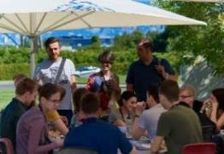
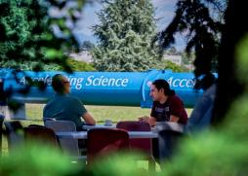
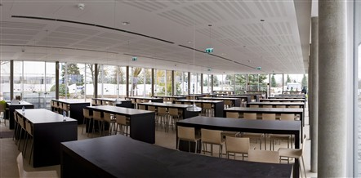
Restaurants
2 in Meyrin (R1 & R2)
1 in Prévessin (R3)
Cafeterias (snacks)
Building 13, 30, 40, 54, …
Click for more info
© CERN Photo

Slide 37
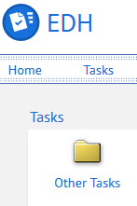
CERN Car
Requires
CERN driving authorisation:
Valid driving licence
OK Department Head
Private vehicle
Not requiring registration
  Bike, “trottinette”
Requiring registration
  Must be registered in member state or EU country
  “Tourist” cars only
  Not allowed:
  Scooter, moto, lorry, bus, …
Notes:
1
********************
How do you do this:
- via an EDH request you can ask for the CERN driving authorization.
With regards to the use of private vehicles for journeys on official duty (this includes duty travel, but also travel during working hours and travel to and from the Org Sites), you can find all details in one of our admin circulars (AC20).
In short are permitted for journeys on official duty:
a) private cars provided that they are registered in one of the Organization’s Member States or in a Member State of the European Union, and
b) private non-motorised or electric motor vehicles that do not require vehicle registration.
7. Consequently, all other categories of private vehicle, including motorbikes, scooters, mopeds and private utility motor vehicles are not permitted for journeys on official duty.
WHY – For insurance purposes.

Slide 38
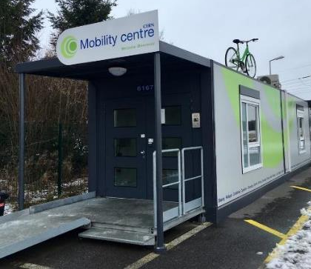
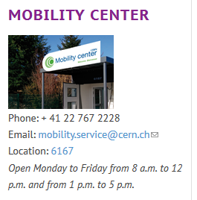
CERN Mobility Centre
Located next to Entrance A
Services offered
Bike rental
Car rental
Car sharing
Bike sharing
Shuttles
….
https://sce-dep.web.cern.ch/campus-life/mobility

Slide 39


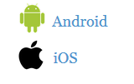
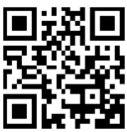
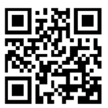
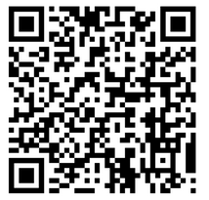
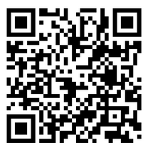
Mobility apps
Car sharing
glide.io
login with CERN SSO
Bike sharing
www.mobility-parc.net/
login with CERN SSO

Slide 40
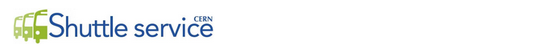
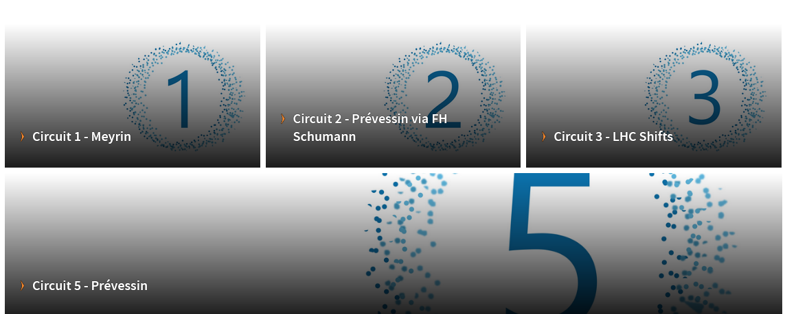
https://sce-dep.web.cern.ch/cern-shuttle-service
Notes:
2

Slide 41
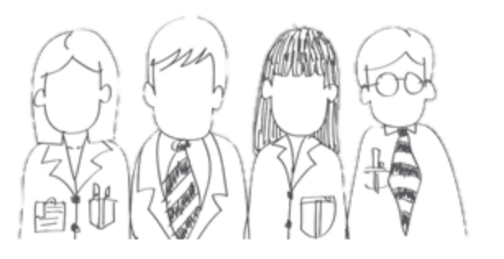

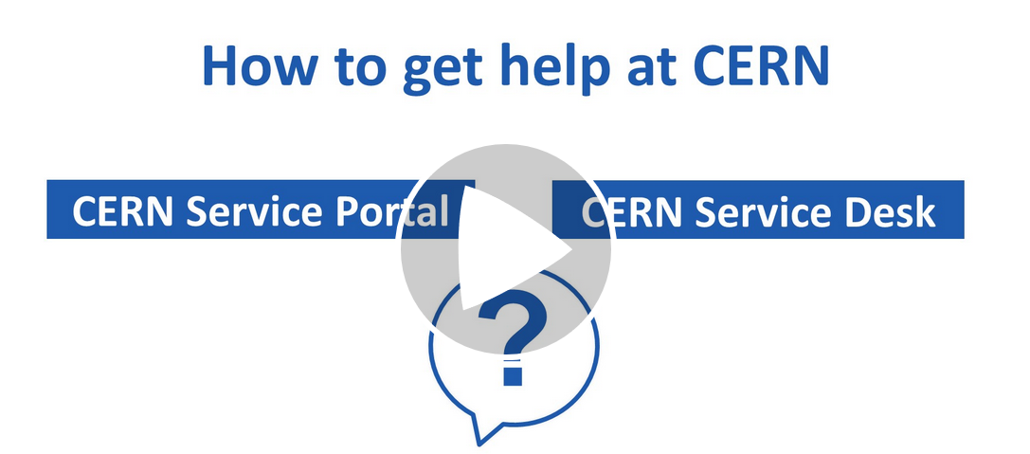




CERN Service Desk
Phone: +41 22 76 77777
Email: service-desk@cern.ch
Monday to Friday
from 7.30 to 18:30
(Geneva time)
CERN Service Portal
Services
Service overview in a glance
Online forms
Report an incident, submit a request
Knowledge articles
Find your answer!
Feedback
Your feedback matters!
https://cern.ch/service-portal

Slide 42
Accident on site – different cases
In all cases
In case of
Injury
Environmental hazard
Disruption traffic
3rd party involved
CERN Fire & Rescue 74444
(+ 41 22 767 44 44)
Inform your supervisor
+
Internal accident report (EDH)
+
European Union Car Accident form
Notes:
1
************************
The correct answer in all cases is to call your supervisor 4) and in some cases (3, the CERN Fire and rescue service, through the number 74444.
Why always your supervisor ?
Internal accident report :
- needs to be signed by your supervisor, so for that reason they must be informed immediately.
- also used to report near-misses -> can be used to avoid further accidents
In certain cases, the CERN Fire and rescue need to be called.
We recommend to add the full number in your mobile phone
+41 22 767 44 44, so you can also call them if you are not connected to the CERN telephone network.
And through the CERN campus app you also have the emergency contact details available at hand.
https://admin-eguide.web.cern.ch/node/352
2.2.1 Accident on the CERN site
In the event of injury, disruption to the flow of traffic or involvement of a third party:
The CERN Fire Brigade will go to the scene of the accident, take the appropriate measures required by the circumstances and draw up a call-out report.
The local Gendarmerie/Police will intervene only if so requested by CERN (Relations with the Host States Service or CERN Fire Brigade).
The driver(s) of the vehicle(s) (or, if not possible, the Fire Brigade) must complete a European car accident form (a blue form known as the "Constat européen d'accident automobile"), which must be signed by the parties involved. A copy of page 1 of the form must be sent to the Legal Service and to the CERN's Insurance Manager. If the injured party is a member of the personnel or a family member who is a member of the CERN Health Insurance Scheme, the procedure set out in paragraph 3 must also be followed.
In all other cases, and if the vehicle suffers material damage:
The member of the personnel must draw up a report to which he must attach, where possible, a statement by a witness (the European car accident form may be used). This report (or a copy of the European car accident form) must be sent to the CERN's Insurance Manager together with a statement by the Head of Department or his designated representative, certifying that the journey was made on official duty, or a copy of the official travel form if applicable.

Slide 43
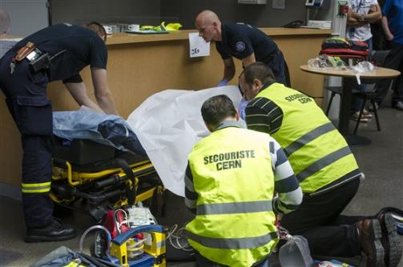
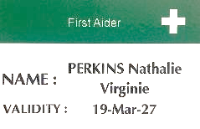
CERN Fire and Rescue Service
assisted by local First Aiders
Find out who are closest to
your office / usual workplaces
© CERN Photo

Slide 44
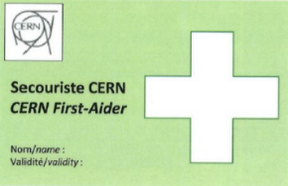
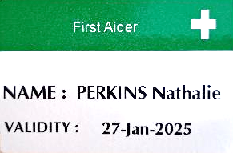
First Aider door sticker
Your safety contacts : http://safety.cern.ch/FirstAid.html

Slide 45
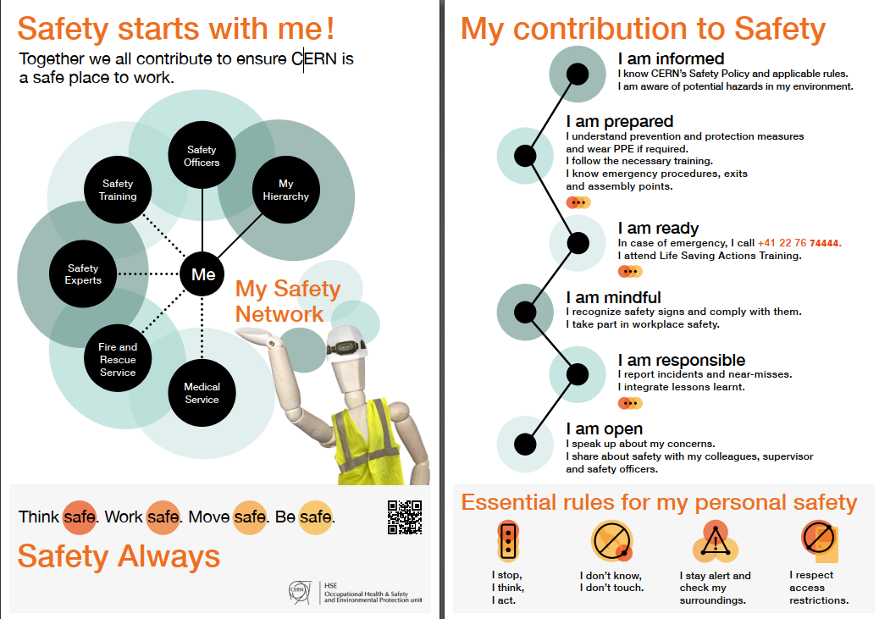
Click on the picture to download the flyer
Training for all: First Aid - Life-Saving Actions
Notes:
Training available for all personnel working at CERN: First Aid - Life-Saving Actions (1st responder)
https://lms.cern.ch/ekp/servlet/ekp?TX=FORMAT1&LOTYPE=R&CID=EKP000043535

Slide 46

or click on this slide
Notes:
2

Slide 47


Defends all personnel
on a collective and individual basis
Become a member here.
Network of people who work(ed) at CERN
Become a member here.

Slide 48
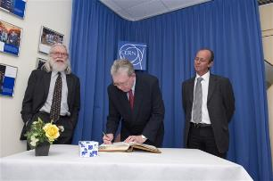
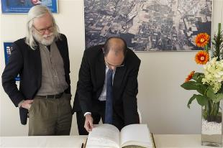
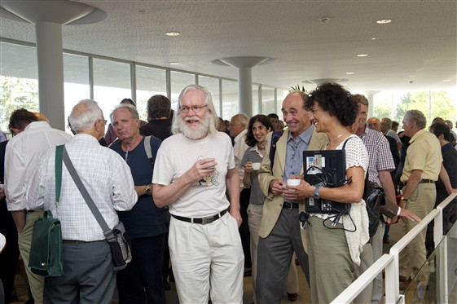
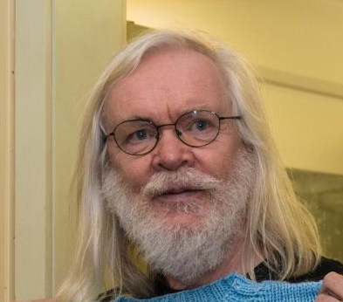
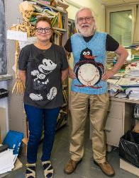
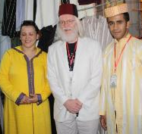
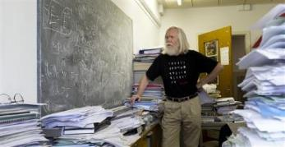
© CERN Photo
Notes:
This is Prof. John Ellis, a British theoretical physicist.
Employed by CERN, he once was the Department Head of the Theory department.

Slide 49

Code of Conduct
Link to Code of Conduct
Notes:
The Code of conduct was introduced in 2010 and it is a guide to help us, as CERN contributors, understanding how we should behave, how we should treat others and how we should expect to be treated.
It is structured around the Organization's five core values. We should all be familiar with this code and try to integrate it into our daily lives at CERN.
You will find a copy of this document on the tables when leaving the Globe.

Slide 50

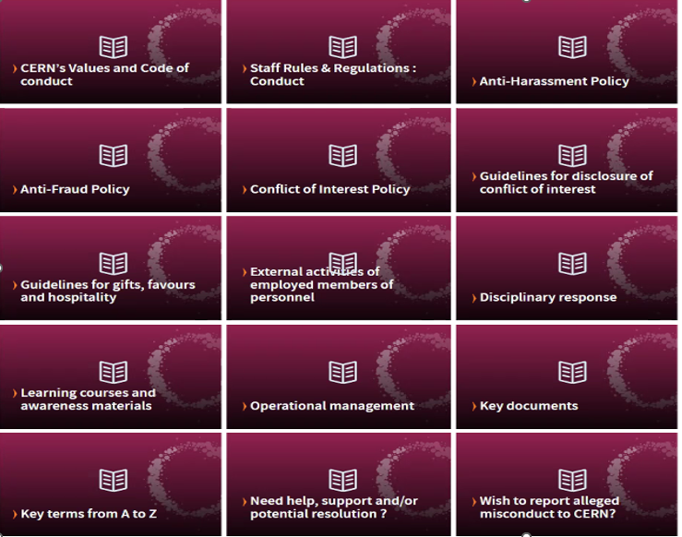
https://hr.web.cern.ch/ethics

Slide 51



CERN tools
Phone (audio only): CERNphone
  Mobile App (iOS and Android)
  Desktop client (Windows, macOS, Linux)
Videocalls and videoconferencing: cern.zoom
Messaging – Personal and public/private ”channels”
integration with Zoom
dedicated channel NEWCOMERS@CERN

Slide 52
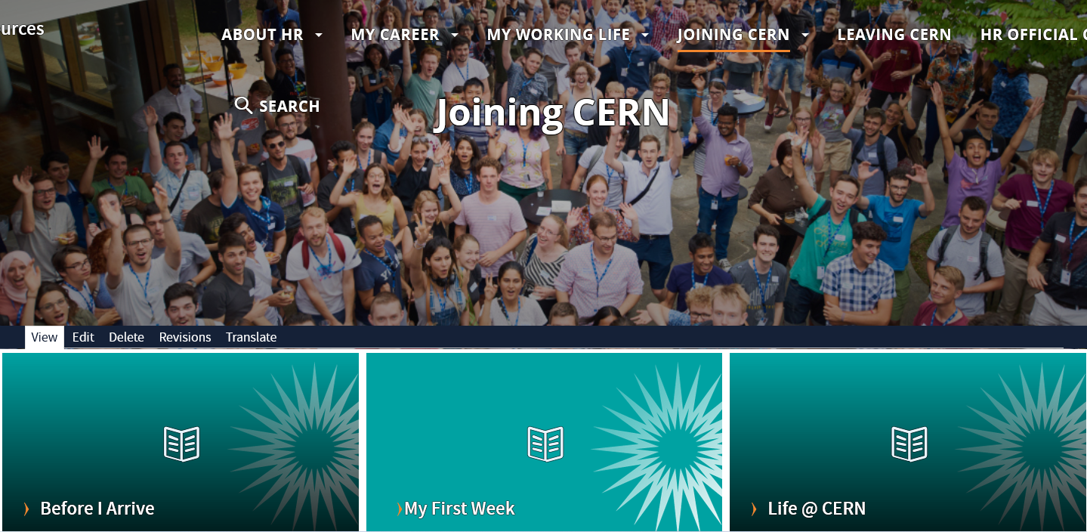
Newcomers website
https://hr.web.cern.ch/joining-cern

Slide 53



Many questions, answers are…
  Your departmental secretariat
  Your supervisor, your colleagues
  Specific question for personal situation?
  → Make appointment with the expert services
  Pension Fund, Health Insurance, Installation Service, Housing Service, Social Service, …
  HR Website > Welcome > my first week

Slide 54

Public meetings
Click for past and future events (agenda, slides, recordings)
Directorate
Highlights of Council Week and other recent news.
HR
Focus on one topic (eg. flexibility)
Staff Association
Latest information on priorities and current issues

Slide 55

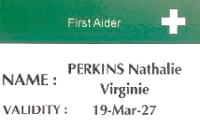
Important information to remember
Download the CERN Campus app on your phone
Enter the Fire and rescue service number in your phone
Find out who are the closest First Aiders to you
+ 41 22 76 74444

Slide 56
Onboarding continues with …
Welcome session in your department
Meet the experts (online – Zoom)
  CERN Health Insurance (CHIS) 3 June, 11.00 – 11.25
  Legitimation cards 3 June, 11.35 – 12.05
  Computer security 3 June, 13.30 – 14.00
More short sessions with experts (online – Zoom)
  Pension Fund* 22 September, 13.30 – 14.00
  Library and Open Science* 17 June, 13.30 – 14.00
Connecting the dots* 10 June, 13.30 – 18.00
Spouse welcome session* 30 September, 16:00 – 18:00
Collective induction session or Individual contact by HRA
Visit* of CERN installations – register via Indico
Part of
Welcome session
see Indico
* You will be invited
* You need to register

Slide 57
Before joining your Department

Slide 58
Meet your new colleagues !
Go to the flag of your Department/Unit.
Introduce yourself to your colleagues
Meet with your DAO
  in the Globe
  on Zoom
  in their office

Slide 59


Thanks !

Slide 60
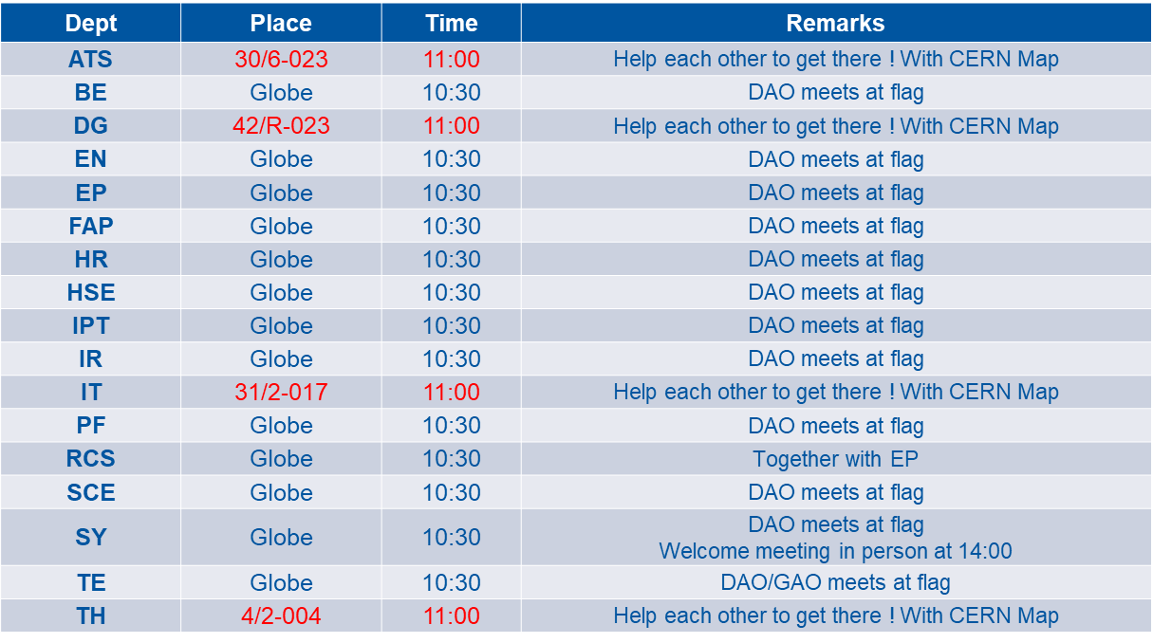
Meeting points

Slide 61

Notes:
All the best!

