Slide 1
Equipments for electrical tests in SM18
By S. Juberg and G. Pichon
15/05/2025

Slide 2
Summary
Test plan
High voltage tests
Capacitive discharge and AWT CD
Transfer function and AWT TF

Slide 3
Electrical tests in SM18
Test plan
    HV tests :
    At reception
    After installation on the test bench
    At cold before and after the powering tests ( repeated if thermal cycle )
    At 100 K during the final warmup
    At room temperature before departure
    Transfer functions and capacitive discharges: Once at warm and twice at cold.

Slide 4
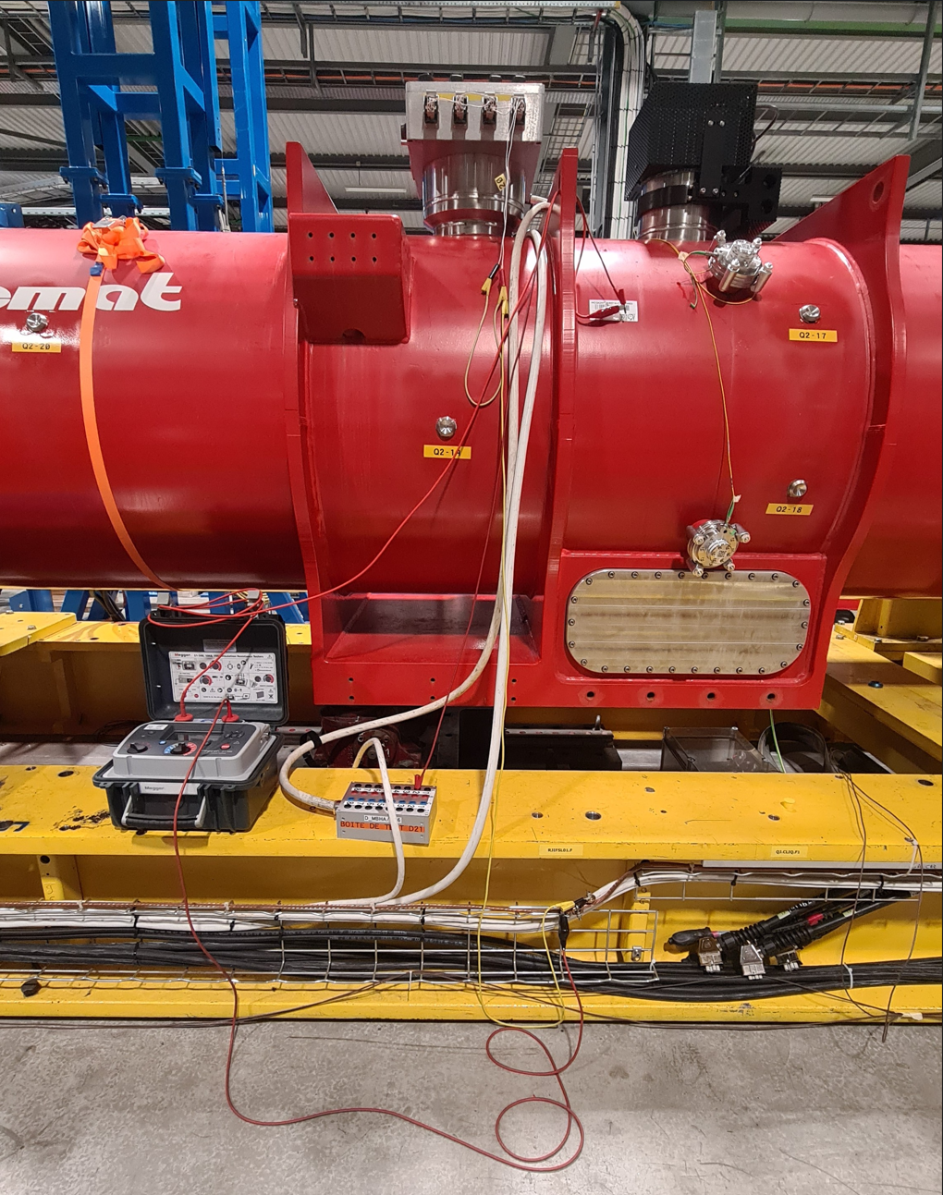
High voltage tests
Stand alone Megger S1-568 (or MIT-525)
    Positive terminal directly connected to the equipment to be tested (Busbars or vtaps).
    The other circuits connected to the ground:
    along the test bench
    On the cold mass
    IR(t) or SV

Slide 5
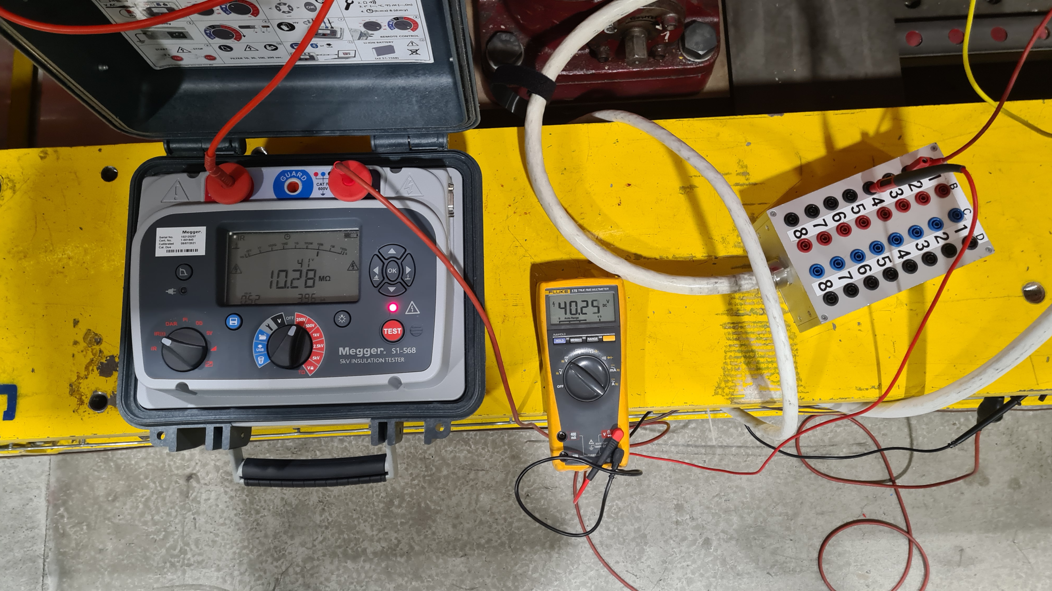
High voltage tests
Stand alone Megger S1-568 (or MIT-525)
Connection check
    Check if the circuits are properly connected:
    At the minimum voltage of the Megger (40 V)
    A multimeter is connected on the circuit and the ground
    => Voltage measured = Voltage Megger
    => Insulation resistance displayed = multimeter impedance

Slide 6
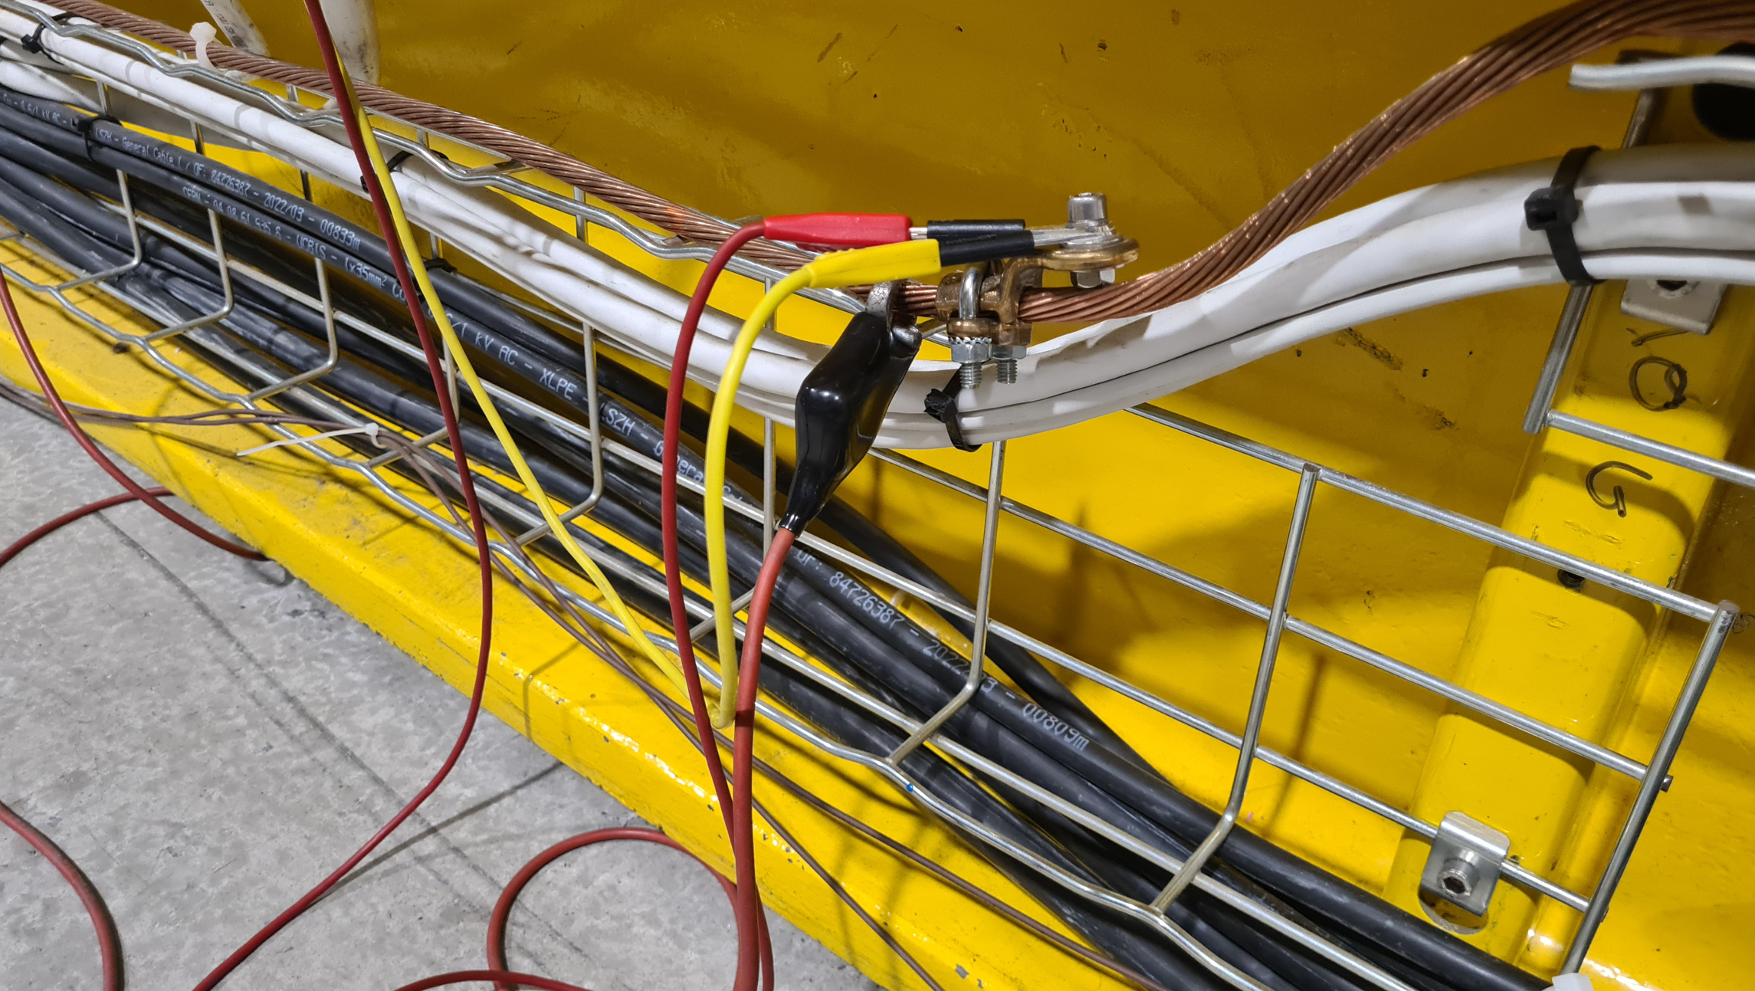
High voltage tests
Stand alone Megger S1-568 (or MIT-525)
Connection check
    Discharge after test :
    Internal load of the Megger
    all circuits grounded after each configuration

Slide 7
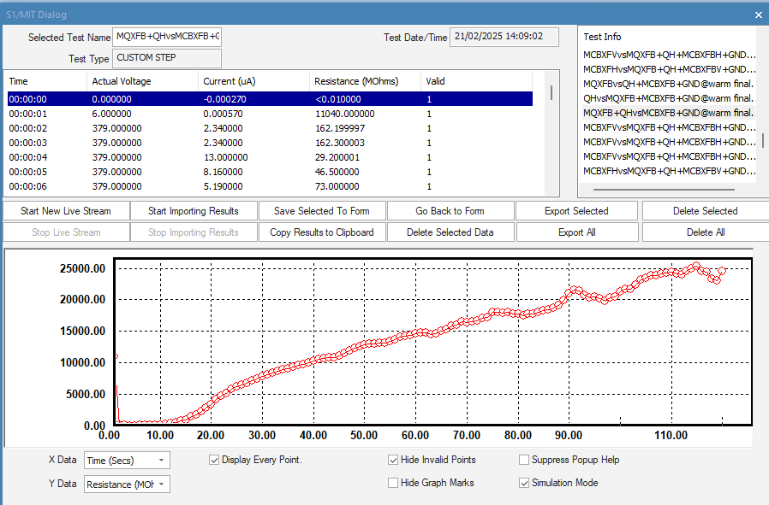
High voltage tests
Stand alone Megger S1-568 (or MIT-525)
PowerDB interface
    The data are recorded with a laptop through the application of the manufacturer (USB connection) : PowerDB
    One point per second
    Plot the graph in live

Slide 8
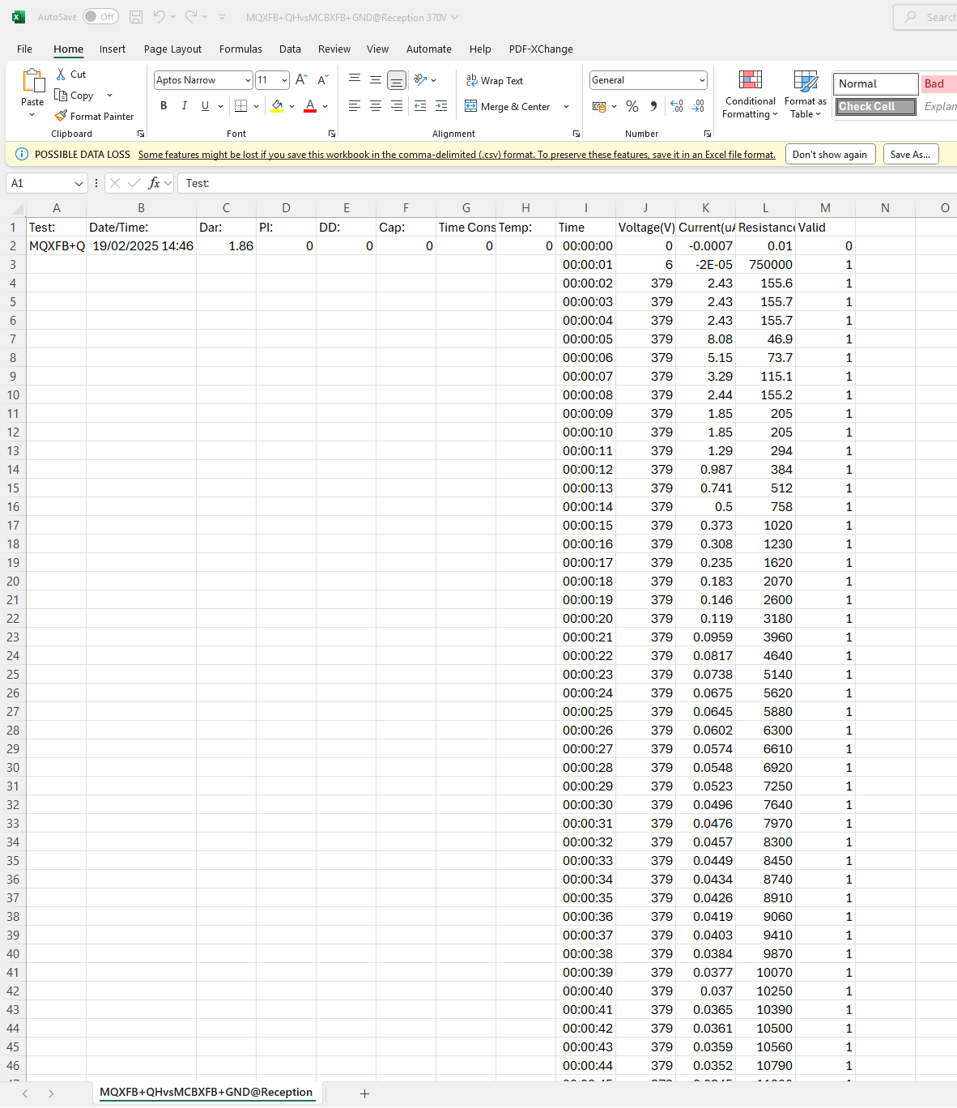
High voltage tests
Stand alone Megger S1-568 (or MIT-525)
Raw data
    The data are exported in a .csv file :
    One point per second
    Date
    Relative time
    Voltage measured
    Current
    Resistance

Slide 9
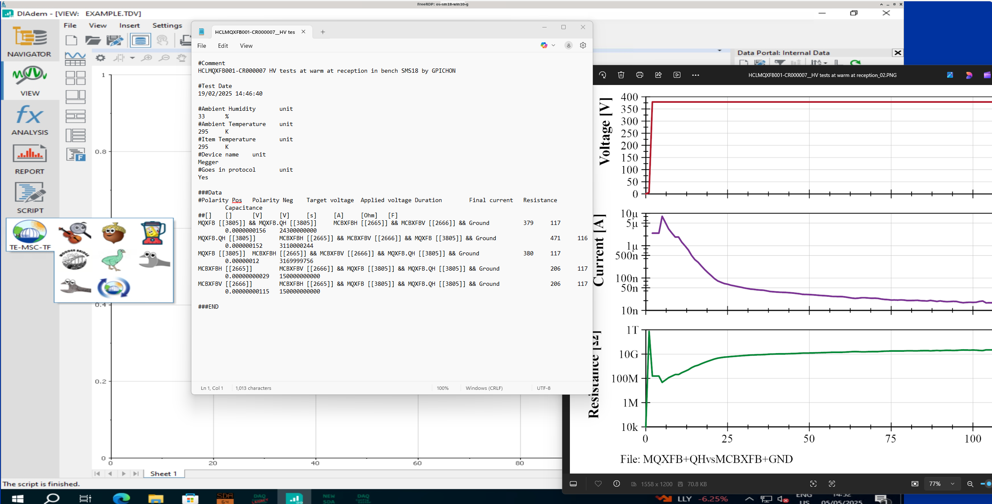
High voltage tests
Stand alone Megger S1-568 (MIT-525)
Post-processing
    Data conversion with EMU application in DIADEM
    ( National Instrument software ) :
    Generate :
    Plots in *.PNG files
    A text file to export to the data base Carpenter (QA)

Slide 10
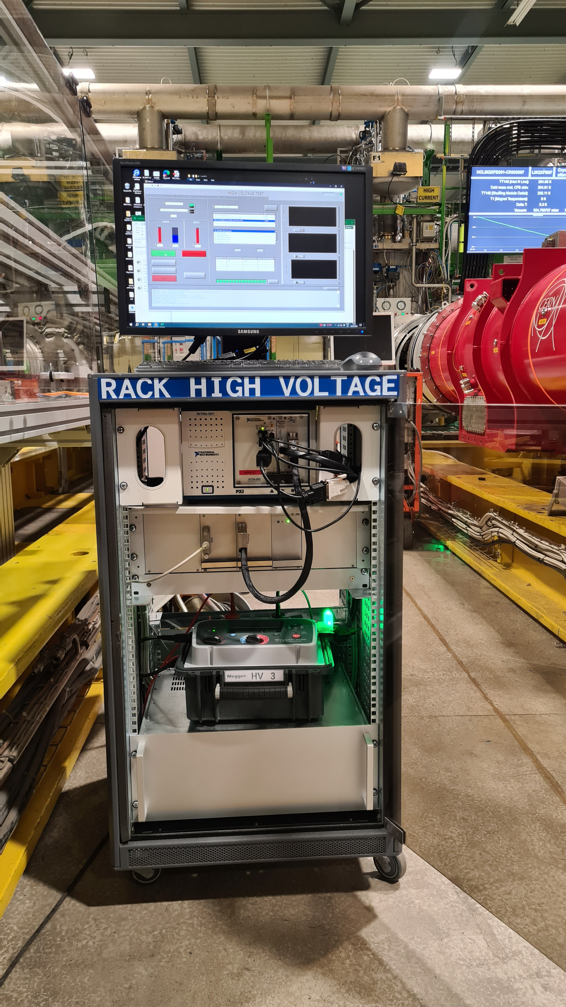
High voltage tests
High voltage rack
Composition :
  PXI National instrument :
  Remote control of the Megger
  Commutation of circuits
  Data acquisitions
  2. Electronic crate
  Interface between the PXI and the relay box
  3. Megger S1-568
  4. Relay box : 16 channels / 3 positions (HV+;HV-;Float)
1
2
3
4

Slide 11
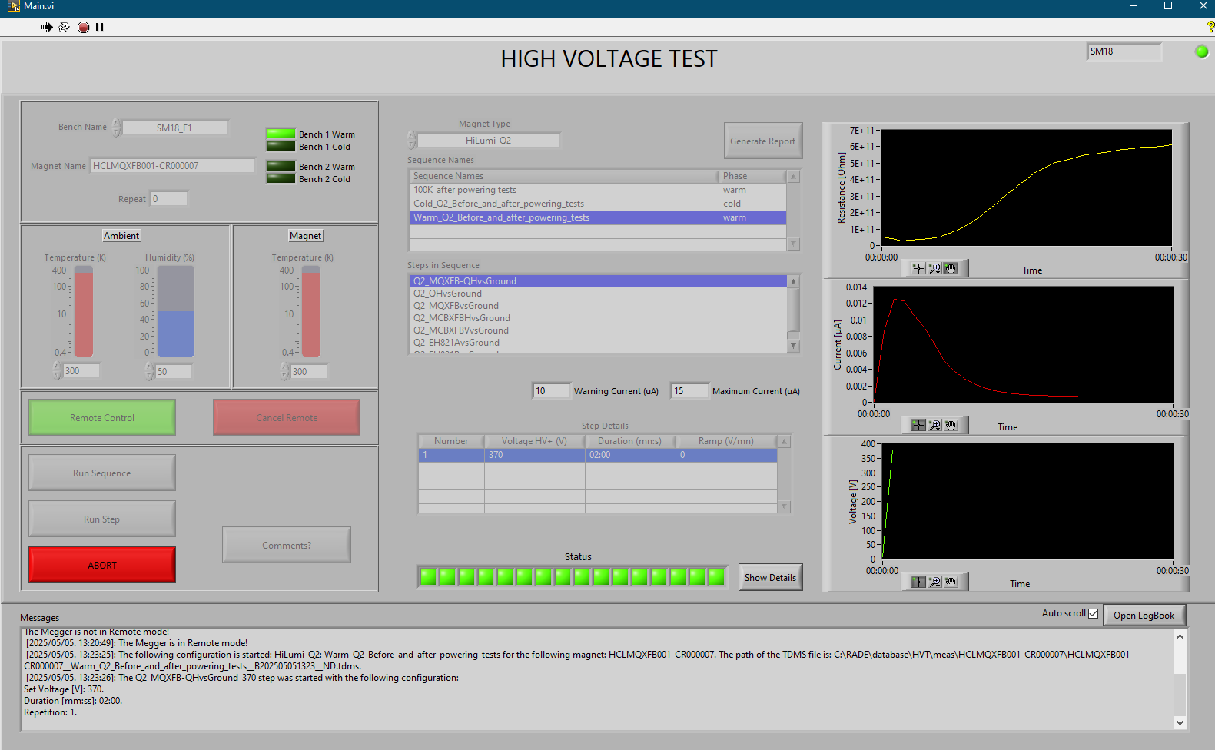
High voltage tests
High voltage rack
Labview interface
Automatization of the tests
Repeatability
Interlock with the PLC of the test bench
Cycle (ramp + plateau)
LabVIEW software programmation and support by BE-CEM

Slide 12
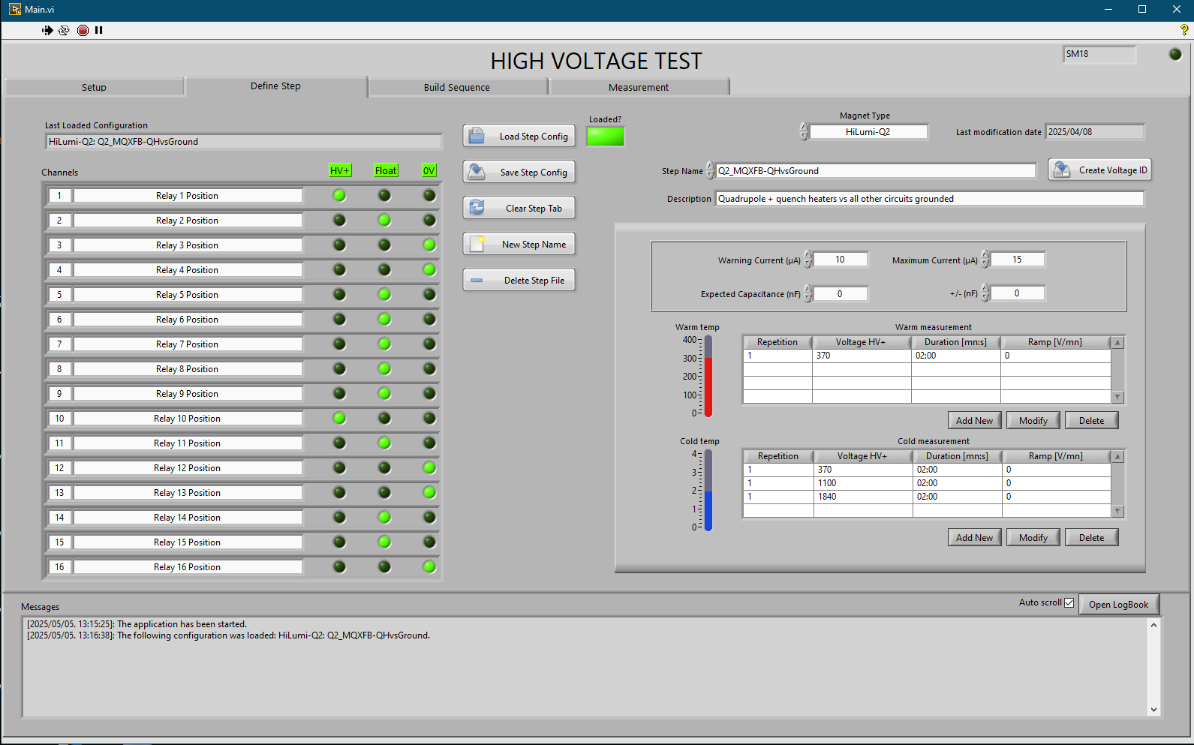
High voltage tests
High voltage rack
Labview interface
Configuration
Selection of the polarity for each output
Test voltage at cold or at warm
Maximum current allowed
Expected capacitance
Cycle : ramp + plateau

Slide 13
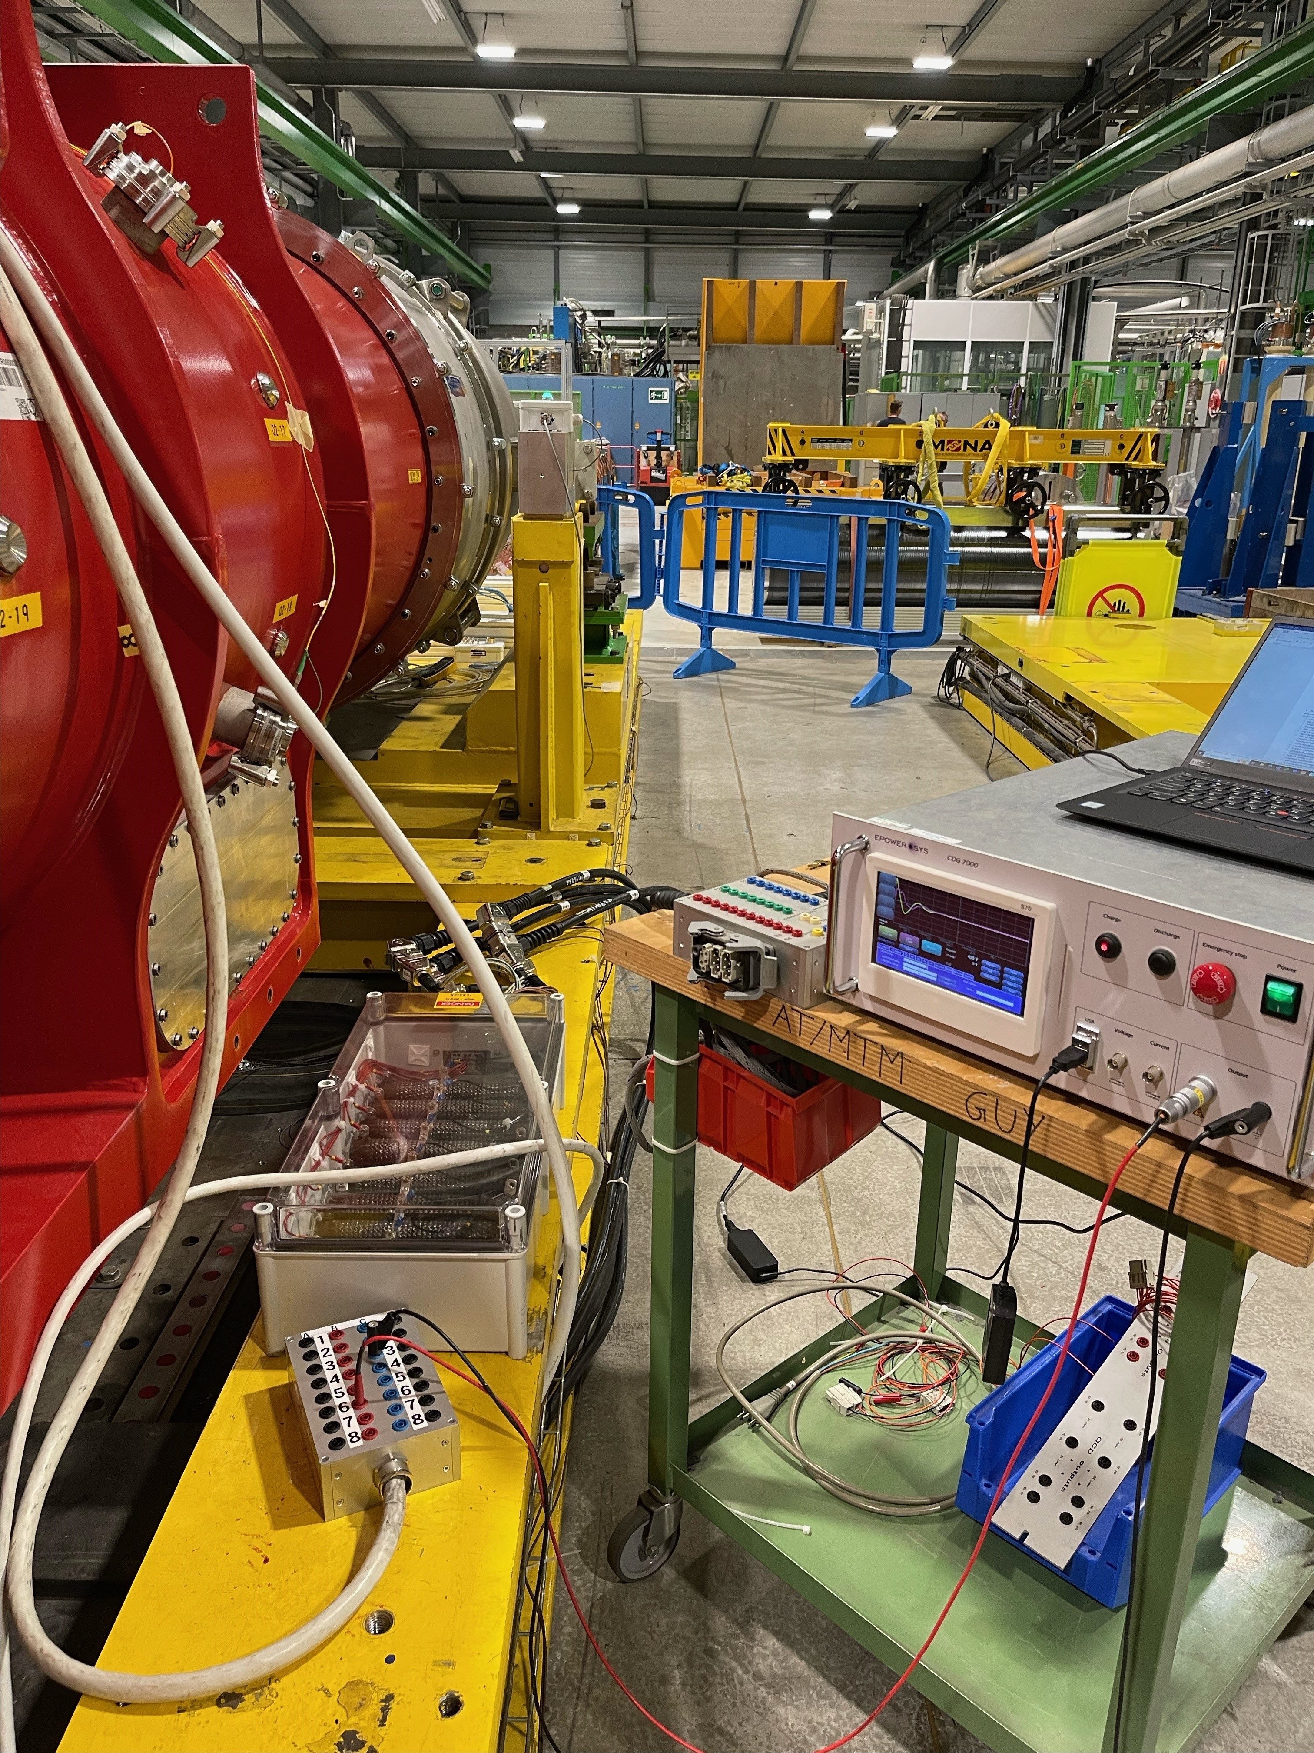
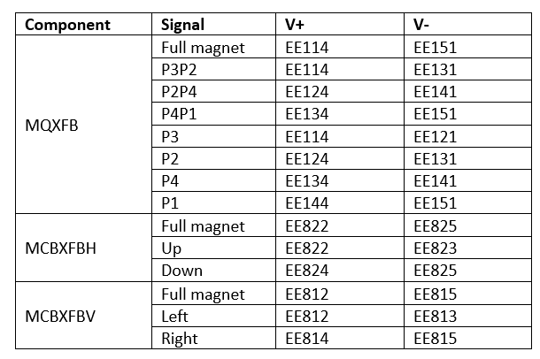
Capacitive discharge test
CDG-7000
CDG-7000 device
CDG-7000 with 7 kV max output voltage, 2 kA max output current and 49 J max pulse energy
Tests performed up to 600 V
Tester connected to the IFS boxes to discharge in full coil, coil pairs and individual coils
Manual setup, configuration and saving on USB stick
Prone to human errors during tests

Slide 14
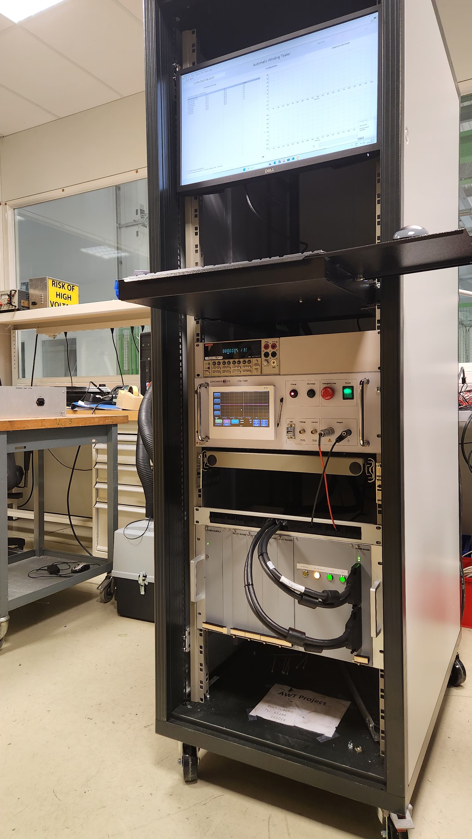
Capacitive discharge test
AWT – Automatic Winding Tester CD
Project initiated in 2024 to automate, save time and free operator to perform other tests
Thanks to AWT team: Unai Martinez Hernandez & Roberto Gabriel Dias Goncalves
Remote control of CDG 7000
Automatic configurations and saving process
Relays and driver board for individual relay control

Slide 15
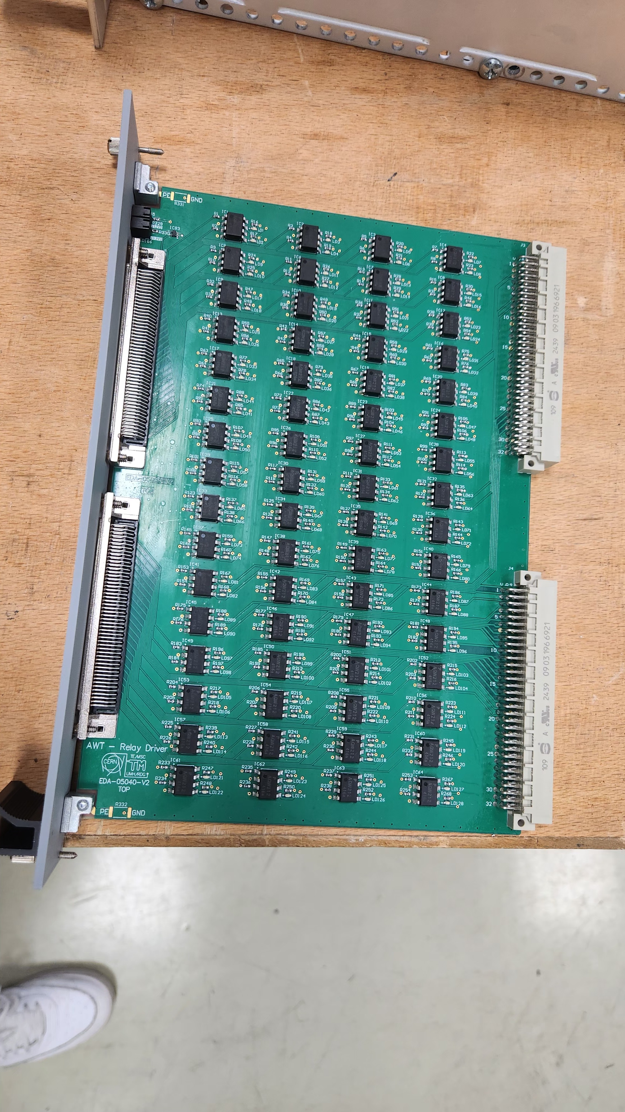
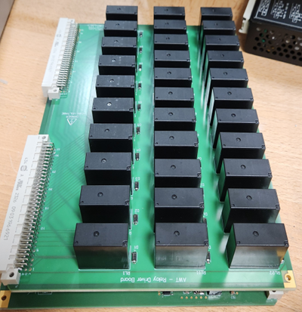
Capacitive discharge test
AWT – Automatic Winding Tester CD
Independent controlled relays by driver board
Modular relay chassis 1:128
Cable adaptors for each magnet type
NI I/O module, DAQmx, Modbus and LabVIEW environment
Multimeter

Slide 16
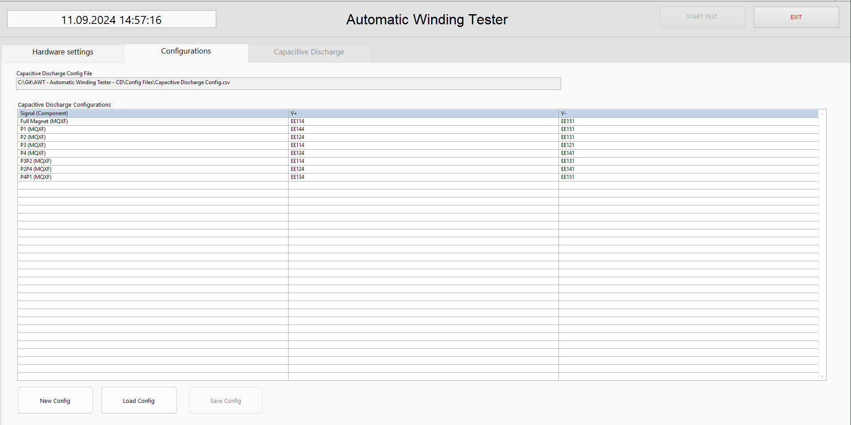
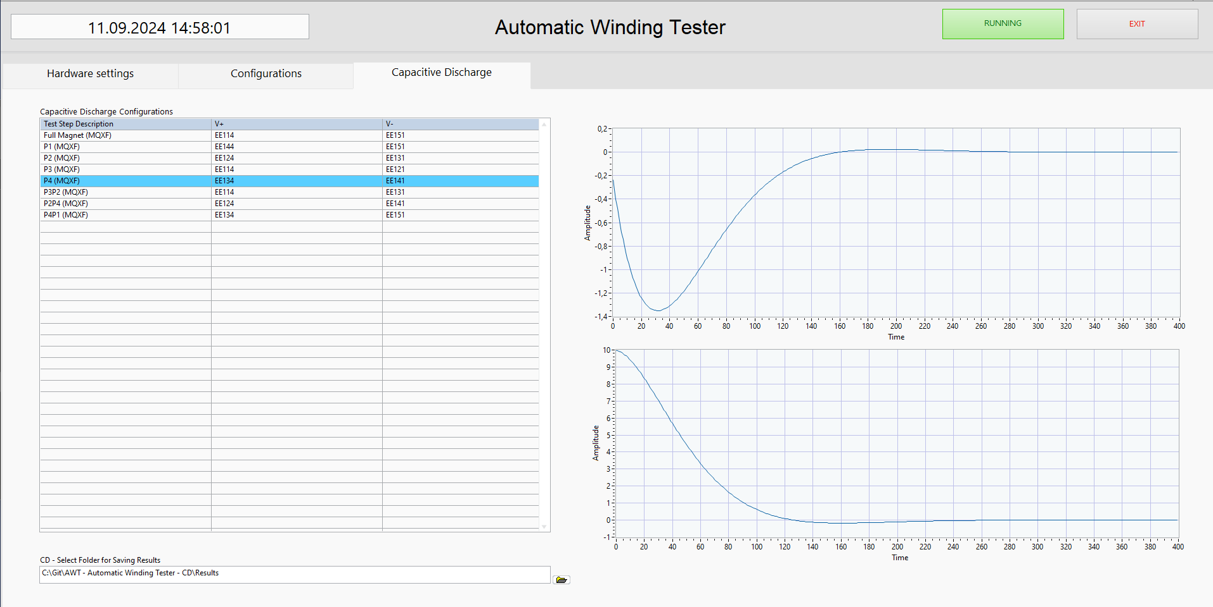
Capacitive discharge test
AWT – Automatic Winding Tester CD
Simple GUI for user
Easy setup, “Plug and play”
Outputs dataset in .txt and graphs in .png
NI I/O module, DAQmx, Modbus and LabVIEW environment

Slide 17
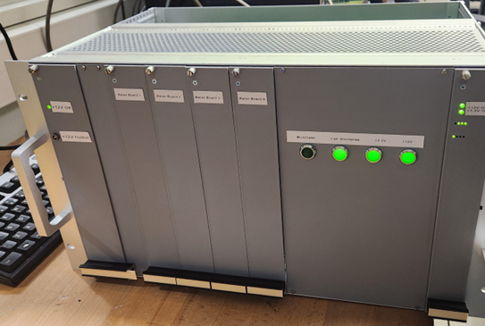
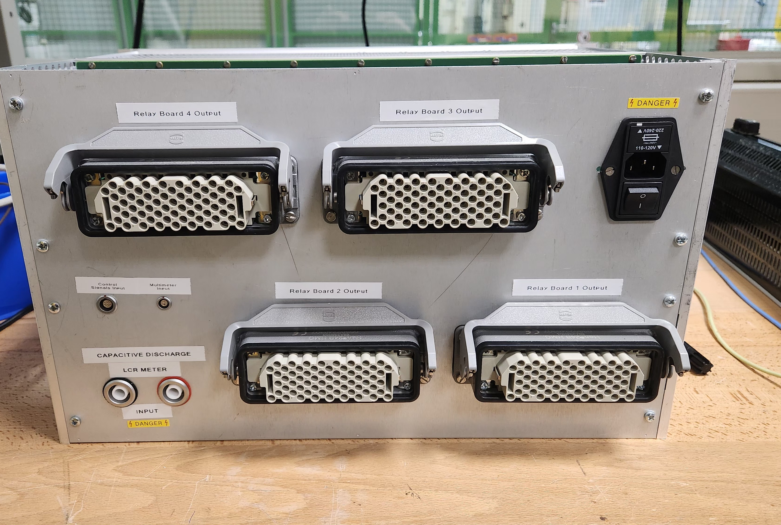
Capacitive discharge test
AWT – Automatic Winding Tester CD

Slide 18
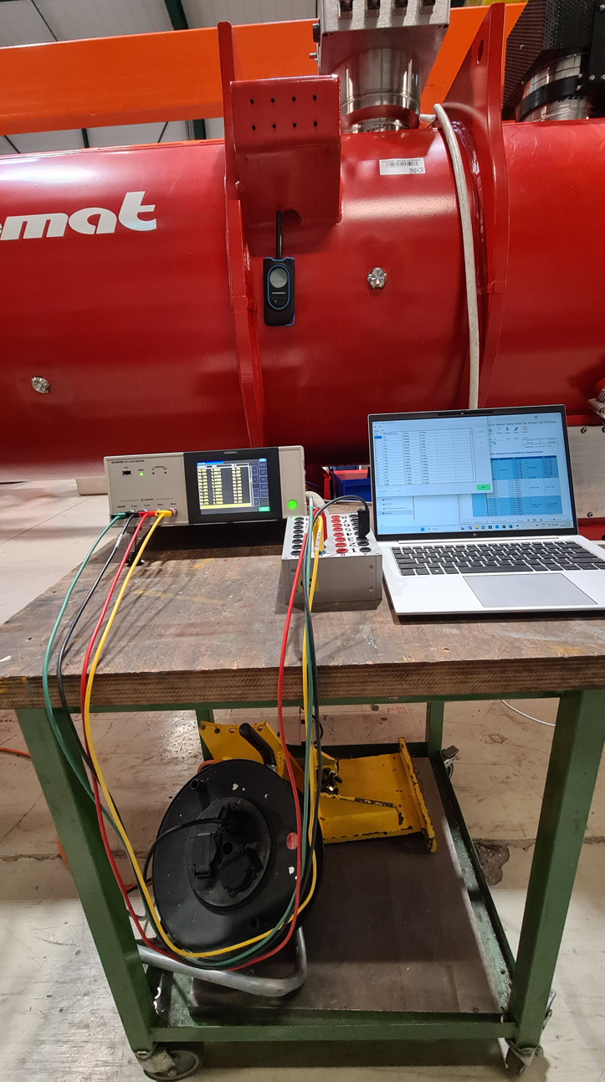
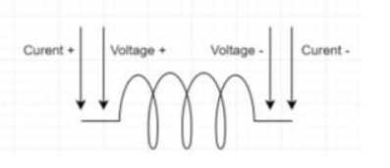
Transfer function
LCR meter : HIOKI IM3533-01
HIOKI connection
4-wires measurements
Manual setup, configuration and saving on laptop
Prone to human errors during tests
Connected through a test box
Prone to human errors during tests
Controlled with HIOKI software

Slide 19
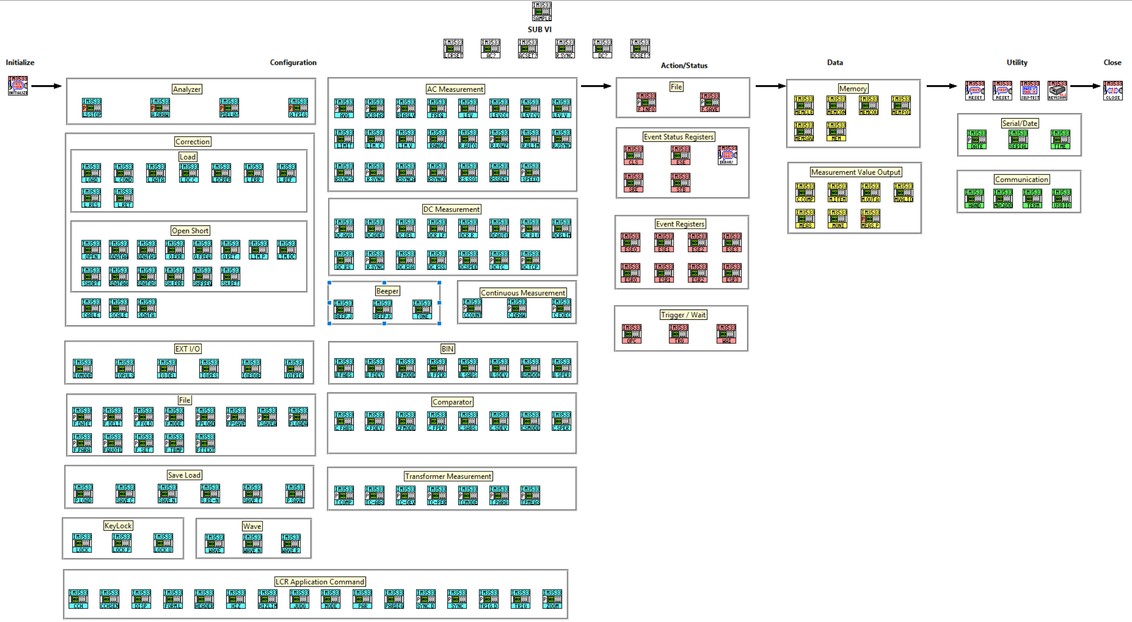
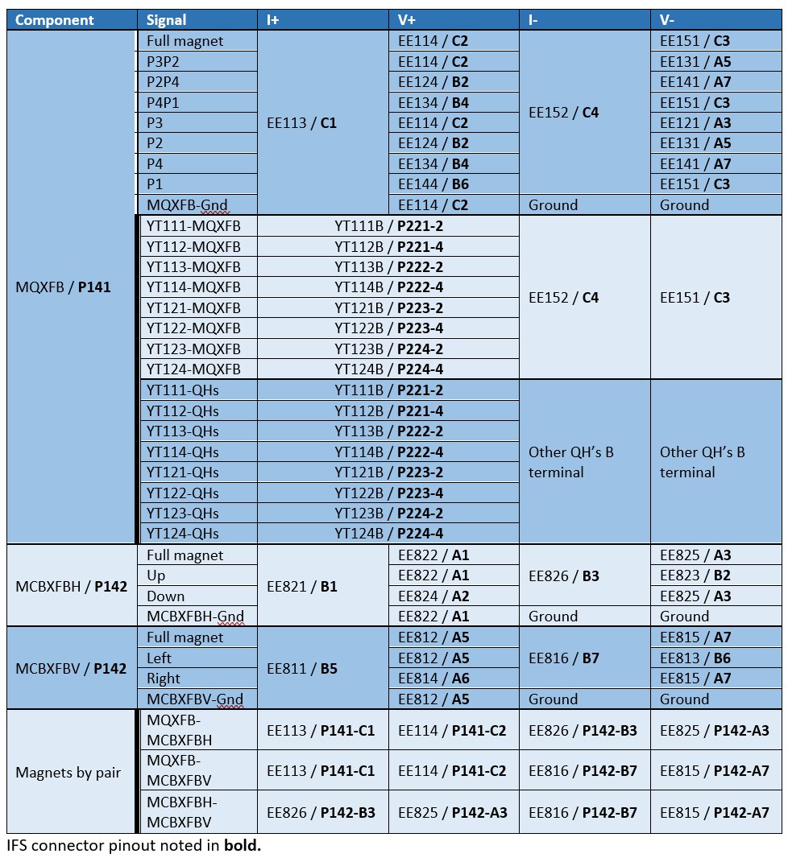
Transfer function
AWT TF
Same HW setup as AWT CD with double amount of relays
Premade drivers from manufacturer was not robust so new home-made drivers in progress
Same SW with almost similar setup as AWT CD
Connected through a test box
Controlled with HIOKI software

Slide 20
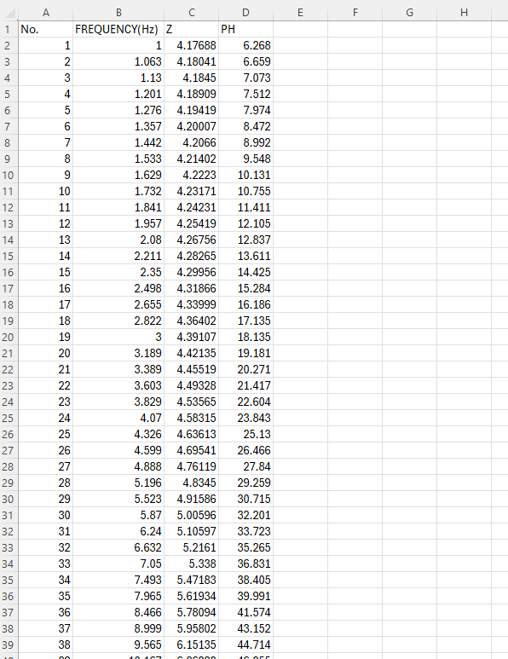
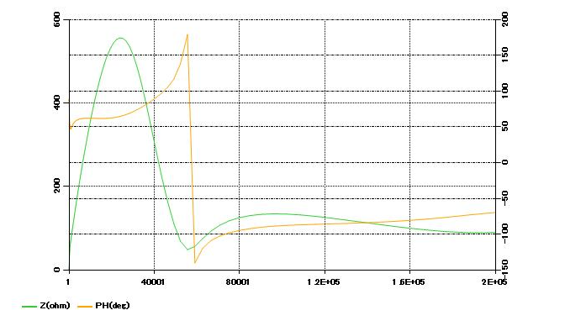
Transfer function
HIOKI IM3533-01 & AWT TF
HIOKI data
Data file HIOKI and AWT TF : .csv or .bpm
Frequency, impedance and phase

Slide 21
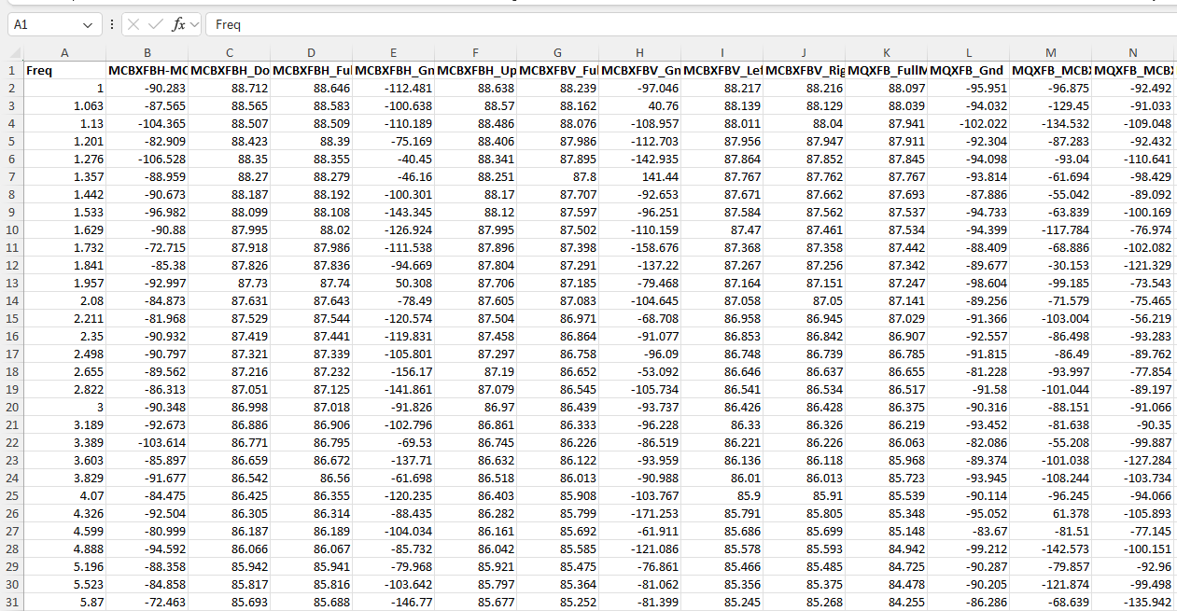
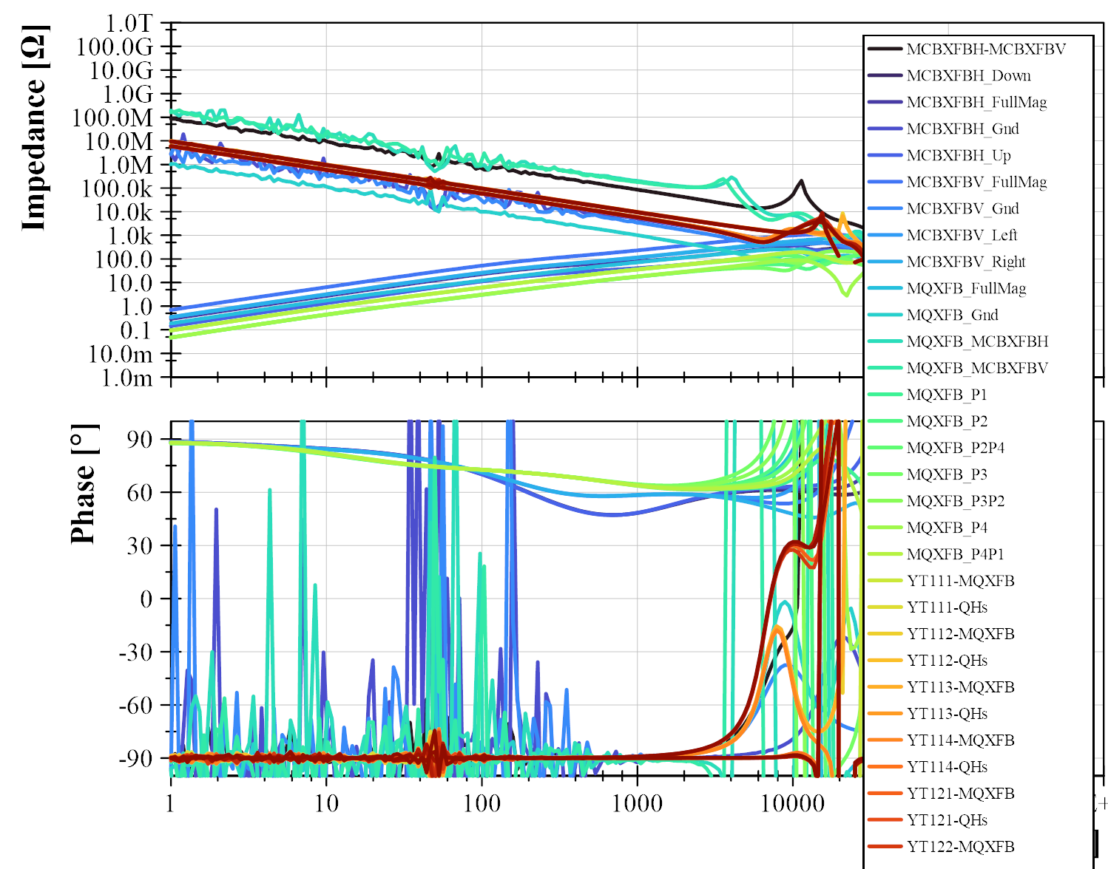
Transfer function
HIOKI IM3533-01 & AWT TF
Data compilation
EMU
Merges all the data files
Creates plots

