Slide 1
MSC Technical Forum #14
Electrical tests during HL-LHC magnet assembly
Ludovic Grand-Clément
Franck Evrard & Jérémy Pechiney
MSC Technical Forum #14 Electrical Test Techniques for Magnets Insulation Systems – 15/05/2025

Slide 2
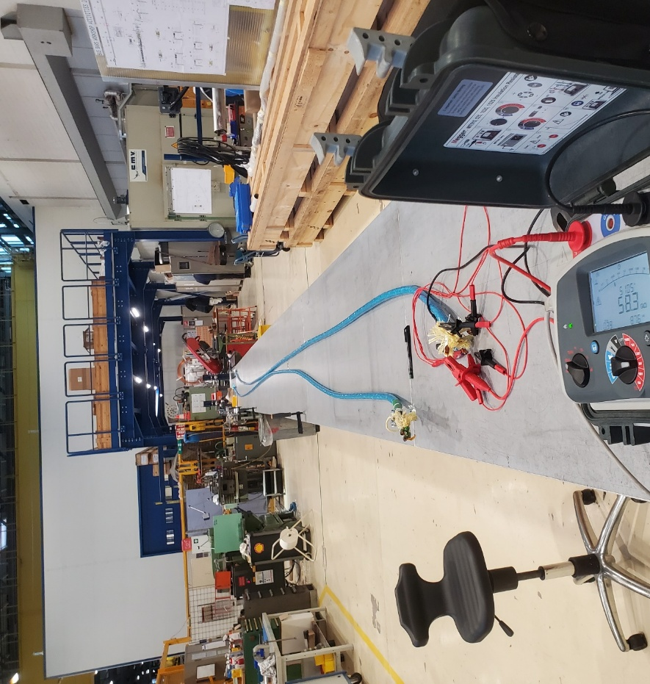
Summary
LMF support
Equipment
  Standard
  Rack auto
Test
Special test
  Water
  Polarity
  Fault localization
  Thermic camera
Data analysis

Slide 3
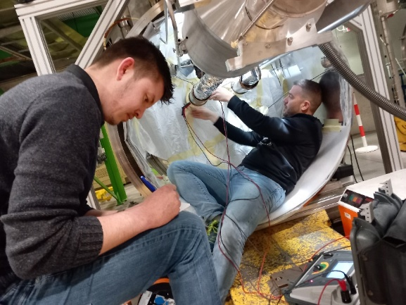
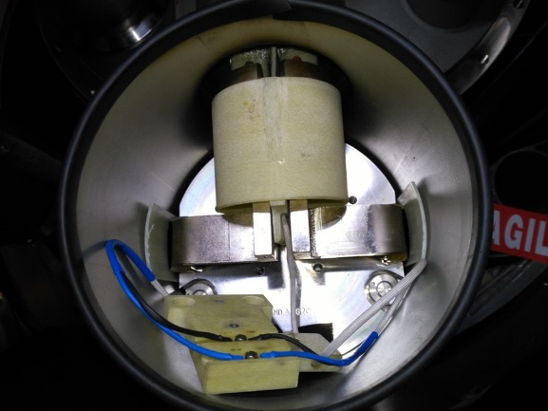
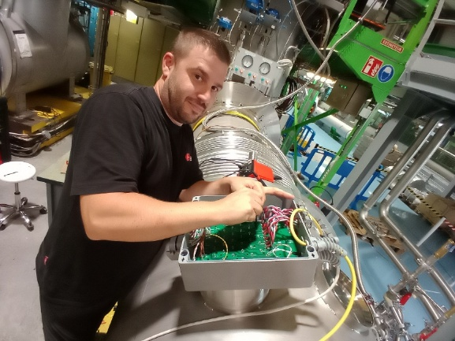
LMF support
180
  Cable to cold mass
SMI2
  Cryostat
    IFS instrumentation
    Current lead check (CP)
    Splice resistance measurement (DCM)
SMS18 - SM18
  Shuffling Module / DFB
  IFS box – cover flange exchange
  Information exchange
String
  Grounding
  Splice resistance measurement
  Vtaps checking
LS_
  Diode
    Exchange
    Connection consolidation
    Insulation upgrade
  Splice resistance measurement

Slide 4
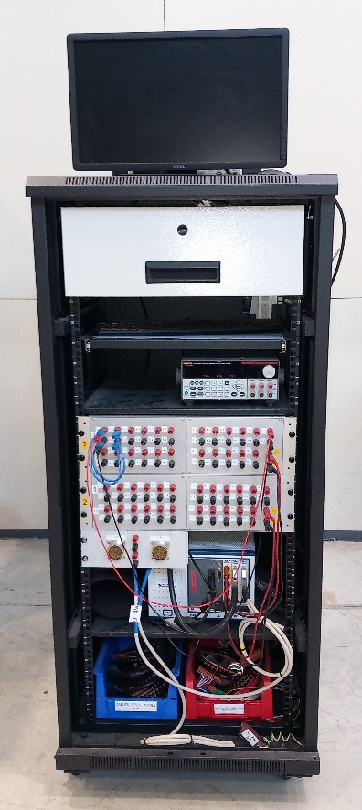
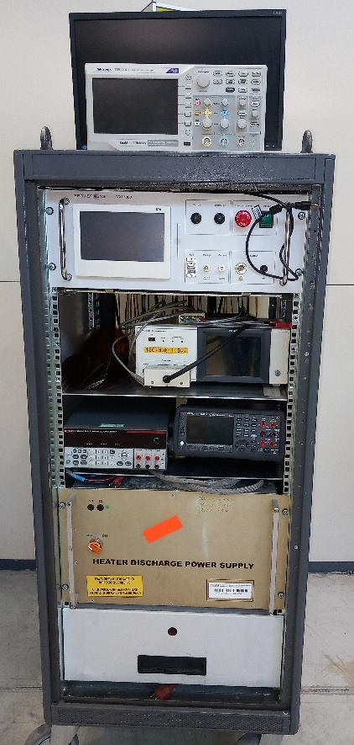
Equipment
Power supply
Multimetre (R, U, I)
LCR meter
  Hioki / Bode
Insulation tester
  Megger
  Chroma19057
Microohmmetre
  DLRo10
  DLRo600
Discharge
  CDG7000
  Effacec
Automatic rack
  R 2/4 wires
  HV (on going)

Slide 5
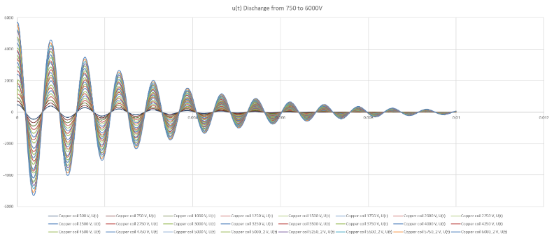
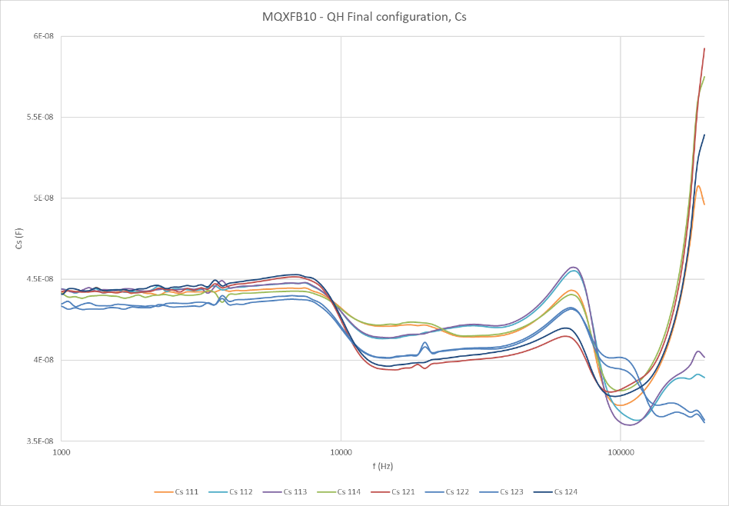
Test
R (2/4w), (dc) (μΩ)
L
C
Period
Tau
Insulation resistance
Leakage current

Slide 6
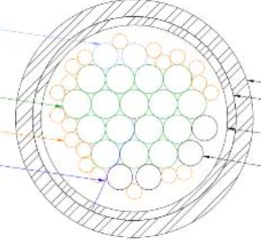
Special test 1.1
Water test
Before insertion into IFS tube insulation wires must be checked & validated.
Different cases have been studied, EDMS 2900678, the fault was detected:
  8 kV - Wires in capillary tube
  5,6 kV - Wires in Helium bag
  1 kV - Wires in water
Drying the wires at 60 ℃ for 3 hours removes any measurable trace of water in the insulation. EDMS 3010970 J. Osuna
The test has been added in all cold mass assembly by LMF, and approved by HL-MCF

Slide 7
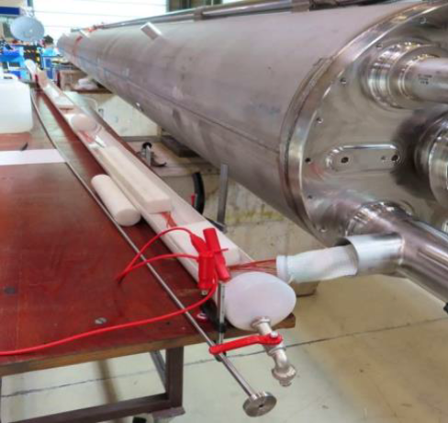
Special test 1.2
Water test
Wires end and all circuits connected to the cold mass
Wires immersed in tap water in half tube, except wires end
Conductor “mass braiding” in water along the ½ tube
“+” terminal on the water via mass braiding
“-” terminal on all other circuits
500 V, 30 s, R>1 GΩ
1 kV, 2 min, I < 10 µA
2 kV, 2 min, I < 10 µA
Dry the wires, 60 °C, 3 h

Slide 8
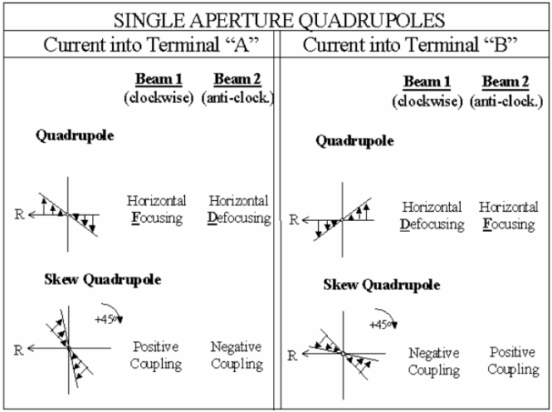
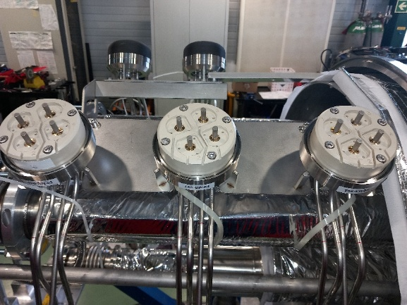
Special test 2
Polarity test
LHC Magnet Polarities
LHC-DC-ES-0001-30-20
During cold mass assembly, the Vtaps and leads labelling must be exact, some operations are delicate
  Leads & Vtaps extension
  Capillary tube insertion
  “Reception test”, Cern labelling instead of the company’s
  Magnet upside down or turned
A polarity check is performed
  Powering the magnet
  Magnet orientation to consider vs final orientation
  Check the magnetic field orientation with a compass

Slide 9
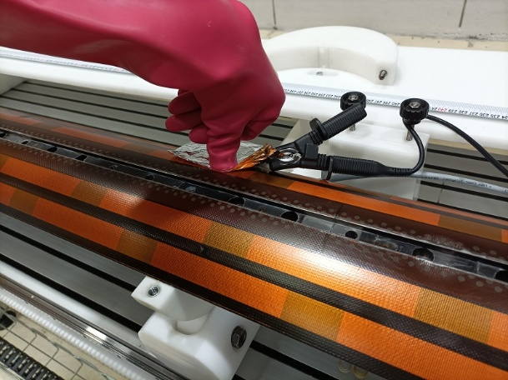
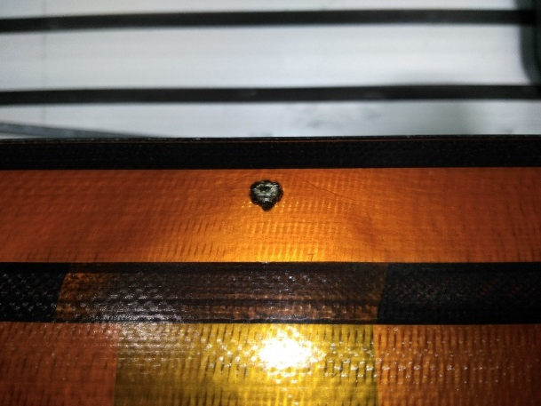
Special test 3
Fault localization
Short-circuit between 2 circuits :
  Voltage applied on the resistive circuit
  Voltage measured on the other circuit, same minus potential than the powering
Local pressure or positioning impacts the resistance between circuits
Destructive test by applying over voltage or high energy discharge
Compass in certain cases

Slide 10
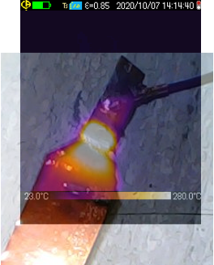
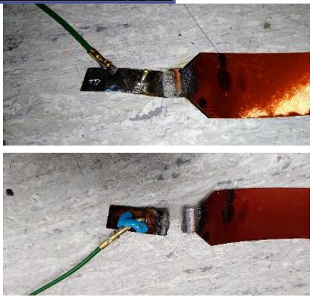
Special test 4
Thermic camera
Usually, used to find hot point in an electrical cabinet
Coupling with a DLRO600
  Weakness in a splice
  Qualification of Quench Heater connection

Slide 11
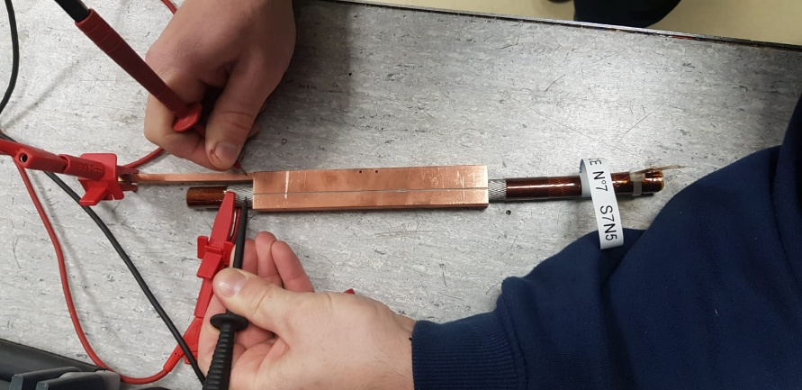
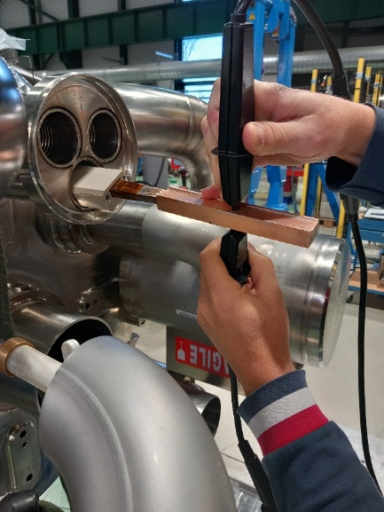
Special test 5
Splice qualification
Resistance measurement
Powering with 10 A
DLRO10
To qualify splice at RT
17 splice configurations qualified
Long side and transversal

Slide 12
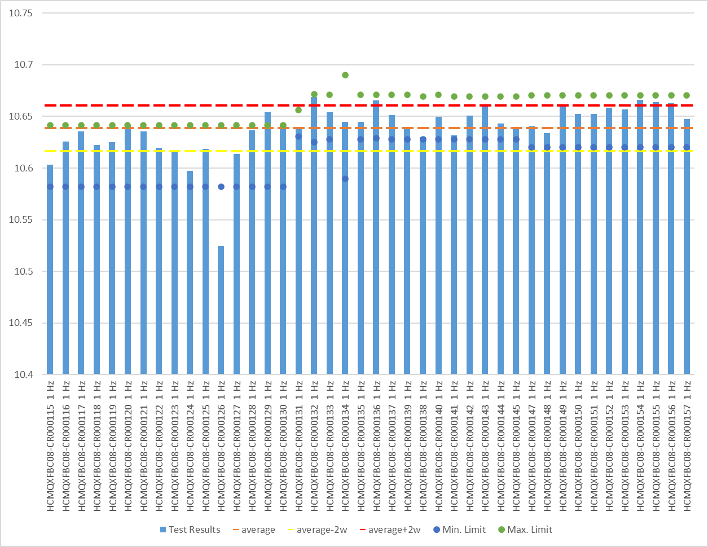
Data analysis
Excel « queries »
MQXFB coil
L after impregnation - 1 Hz
« Queries » used for each template
For each file, data are compiled in a « data » table
The « data » tables are compiled together, and processed in a new file
One sheet per kind of test (R, L, Discharge, etc.)
Statistical analysis, average, sigma, lowest & highest value
Limits can be calculated directly

Slide 13
Merci à tous !

