Slide 1
fcc-ee Collimation
Roderik Bruce
Space for additional logos
R. Bruce, with material from A. Abramov, K. Andre, G. Broggi, M. Hofer, M. Boscolo,
X. Buffat, D. Gibellieri, A. Lechner, G. Lerner, M. Migliorati, A. Perillo-Marcone,
S. Marin, S. Redaelli, K. Skoufaris, F. Van der Veken, C. Zannini

Slide 2
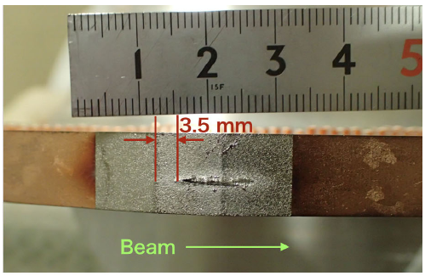
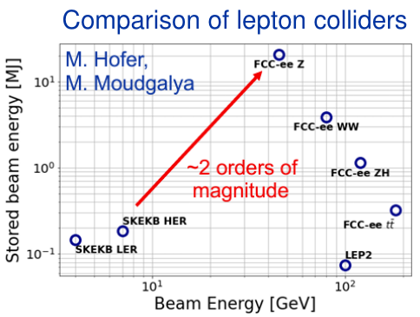
Why do we need collimation in the FCC-ee?
Unprecedented stored beam energy of up to 17.5 MJ (Z-mode)
  Comparable to LHC with Pb ions in 2023
  Factor ~100 higher than SuperKEKB, where damage to detector and collimators was observed
Without collimation in FCC-ee
  Risk of quenches or damage due to uncontrolled beam losses in regular operation and during accidents
  Risk of too high background at the experiments

Slide 3
Collimation system design considerations
  Collimation system should be the aperture bottleneck of the ring intercepting primary losses
  Collimation should
    Suppress experimental backgrounds to tolerable levels
    Suppress losses sufficiently so that any leakage out of the collimation system does not damage impacted machine components or quench superconducting elements for given “design beam losses“, nor should the collimators themselves be damaged
      New regime for lepton colliders, where collimation is typically needed only for backgrounds
  Total impedance of the collimators should stay within the allowed impedance budget, not significantly degrade beam lifetime, or in other ways jeopardize the beam quality and machine performance

Slide 4
Work needed for collimation design
System design
Layout and number of collimators
  Betatron, off-momentum, experimental insertions
Collimator settings
Materials, lengths
Iterate system design based on performance and optics evolution
Hardware design, controls, instrumentation (not ABP)
Beam loss scenarios
Define scenarios
Set up simulation models for each scenario
Study performance, compare with tolerances
Beam loss tolerances
Obtain inputs on tolerances (background, damage limits, quench limits)
Dedicated studies of beam impacts
  E.g. background study → synergy with MDI
Code development
Implement and missing physical effects relevant for collimation studies
Code benchmarks with existing machines
MDI
Optics
Impedance, collective effects
Halo, DA, NL dynamics

Slide 5
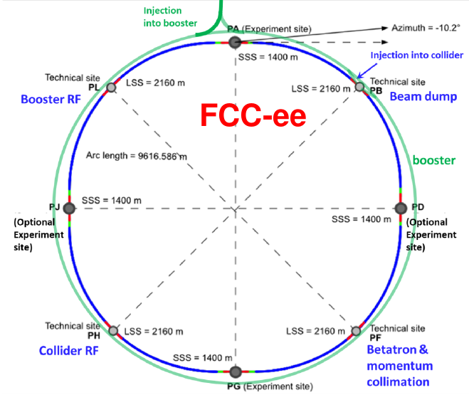
Present status: Collimation system design
Several iterations on system design carried out, probably more to come
Combined 2-stage betatron and momentum collimation in PF
  Primary ring aperture for slow losses far from experiments
  One primary collimator, two secondaries, for horizontal, vertical and
  off-momentum losses, one shower absorber each for hor. and ver.
Collimators in experimental IRs
  Synchrotron radiation collimators and masks for reduced backgrounds
  studied by MDI team
  Robust tertiary collimators - shower absorbers under study
In total, more than 100 collimators
In addition, local protection (extraction, injection etc) – not treated here (ABT, FLUKA…), possible physics debris collimators

Slide 6
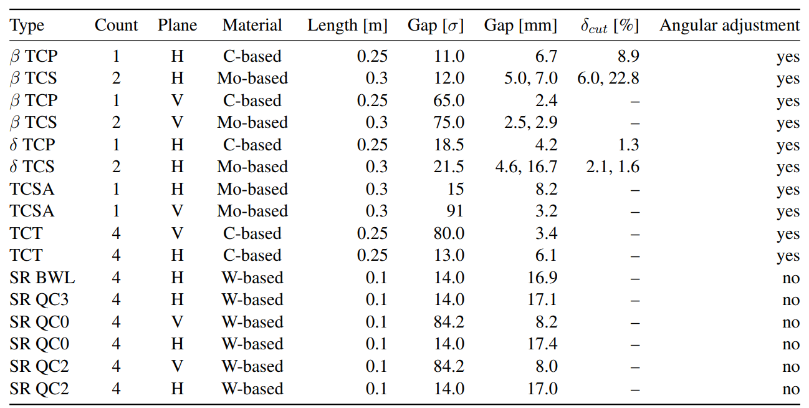
Summary of needed collimators
Collimators in present layout
  11 halo collimators per beam in PF
  8 tertiary collimators per beam (exp. IRs)
  6 SR collimators per beam in PA, PD, PG, PJ → 24 devices per beam
    8 fixed masks per beam in addition
Under study
  2 protection collimators per beam in PA, PD, PG, PJ → 8 devices/beam
  Protection absorbers for extraction and injection in PB (ABT, FLUKA…)
In total, O(100) devices needed
  More might be added in the future
estimated aperture: 14.6 sig (H), 82 sig (V)

Slide 7
Present status: beam loss scenarios studied (GHC, Z)
Unavoidable sources of beam losses in regular operation
  Beam-gas interactions
  Spent beam from collisions (beamstrahlung, Bhabha scattering)
  Losses during top-up injection (global leakage, not local protection)
  Touschek scattering (probably less important)
  Scattering on thermal photons
Irregular or accidental losses (global effects - local protection absorbers studied elsewhere)
  Generic 5-minute beam lifetime (could be caused by a number of processes)
  Instability after damper failure
  Injection failure
  Extraction failure
  Other failures: power supplies, RF, missing beam-beam, feedback ...
  (“crazy beam“ a la SuperKEKB, 80% lost in 2-3 turns – not fully understood/modelled – dust?, presently not designing to sustain this)
Radiation photons going towards the experiments, with MDI
1st iteration done
in tracking
Work in progress
not started
1st iteration done;
tracking + FLUKA
Background: w.i.p.
Work in progress
not started -
need inputs
1st iteration done

Slide 8
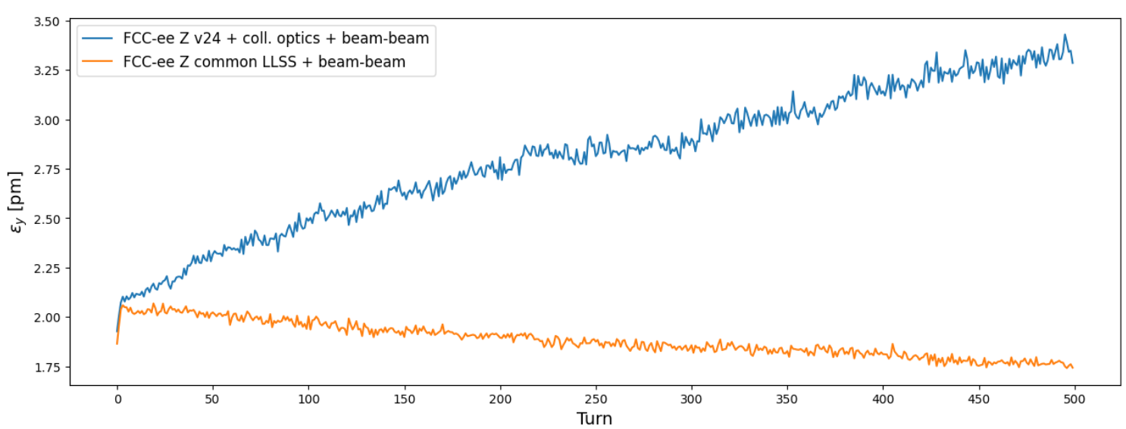
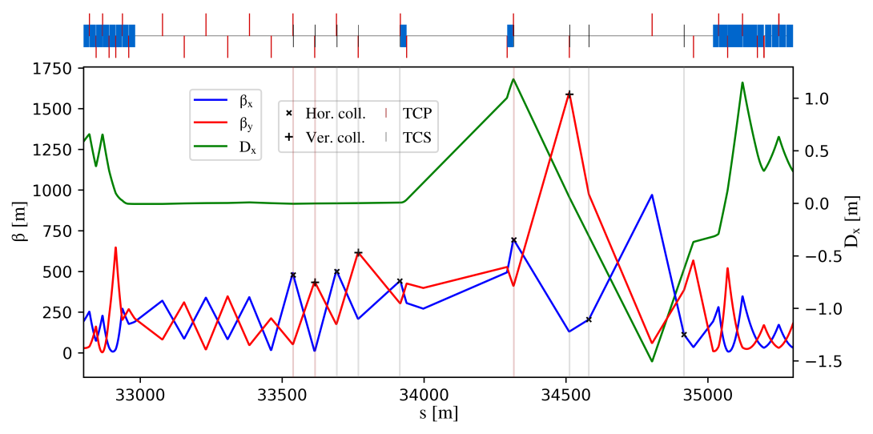
Collimation system in PF
  Optics developed initially for combined collimation insertion
    Betatron and off-momentum – several iterations
    Placement of collimators coupled to beam optics: phase advances, dispersion, β-functions affect impedance
  Problem found with strong vertical emittance blowup in the presence of beam-beam and collimation optics
  Mitigated with new common LSS optics
    Collaboration with optics team - K. Oide
    In latest optics V25, potential issues with small horizontal aperture in experimental IRs
    Impedance being assessed
G. Broggi

Slide 9
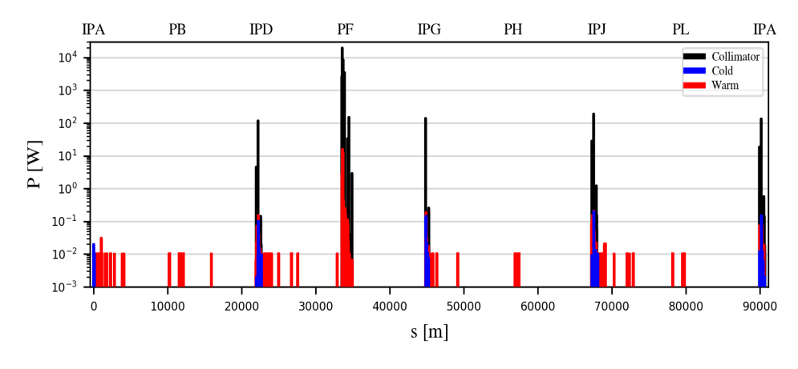
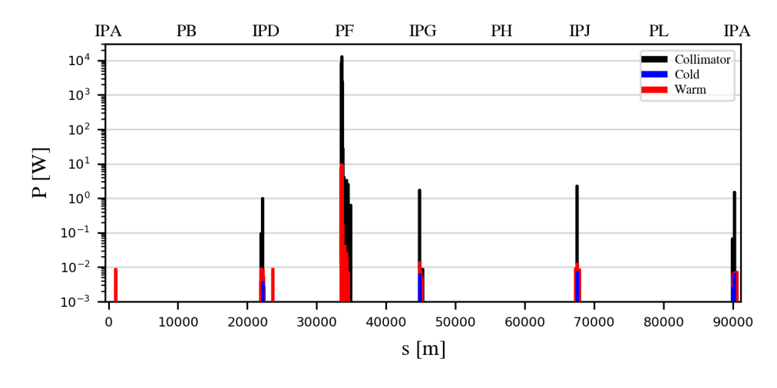
Collimation performance
“Generic halo” loss map
Simulation of “Generic halo”
  Simulation starting with impact on collimators - diffusion not simulated
  Normalized to 5-minute lifetime (58 kW beam loss power)
Achieved performance
  Loss suppression of factor 10² on TCTs, 10⁴-10⁵ on SR collimators, >10⁵ on other elements
  Aligning collimator tilt angle to beam envelope → Almost factor 100 performance increase
  Experimental backgrounds still to be studied
  Note: impact parameter scan typically gives worse cleaning the smaller the impact parameter
    Need to quantify realistic impact parameters – underway together with modelling of beam loss processes
No tilt
G. Broggi
Tilted collimators
G. Broggi

Slide 10
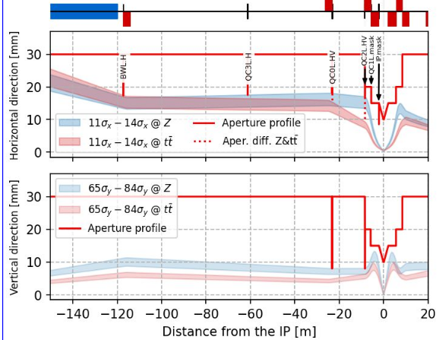
Experimental insertions
  Synchrotron radiation collimators studied within the machine-detector interface (MDI) working group
    Meant to intercept photons, not there for beam halo collimation
    Nevertheless, intercept also beam losses
      help the cleaning but also risk being damaged by high losses
  Robust tertiary collimators added for protection
    2 robust collimators (H+V) upstream of SR collimators per IR
    Task: Protect SR collimators and the rest of the insertion
  Additional studies
    SR collimators for reflected photons
    optimization of opening (and maybe placement) of SR collimators for latest optics
    Organization of work: who should continue studies?
See talk by K. Andre at FCC Physics Workshop 2025

Slide 11
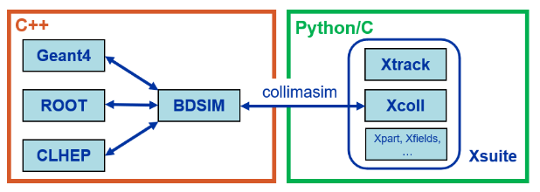
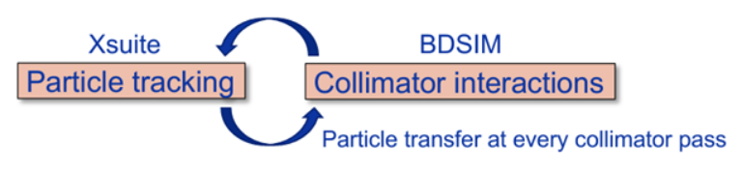
Code development
FCC-ee presents unique requirements for collimation simulations
  Multi-turn tracking in 90+ km beamline including electron/positron-matter interactions, synchrotron radiation and tapering, strong sextupoles, strong beam-beam effects, crab waist
  Specific beam loss mechanisms: Touschek, beam-gas, spent beam, dynamic failures
  No existing code had all required features
Xsuite + BDSIM (Geant4) coupling developed to include all relevant effects
  See A. Abramov, IPAC’22 paper, JINST paper)
  Benchmarked against other simulation codes and measured data from proton machines
  Xsuite-FLUKA coupling being set up (see F. Van der Veken, talk at ICAP’24)

Slide 12
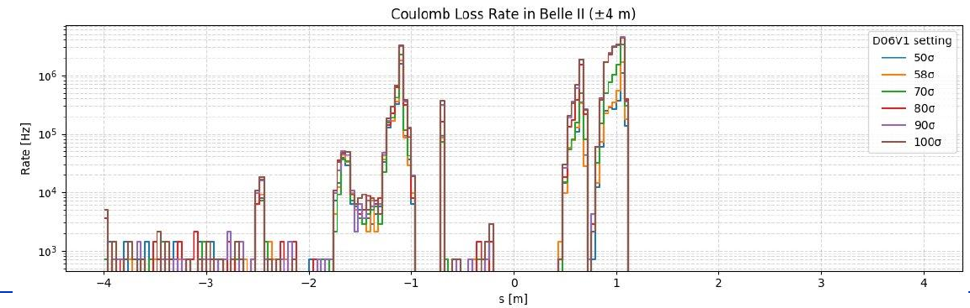
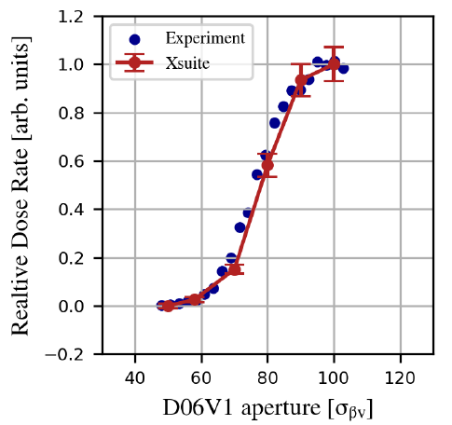
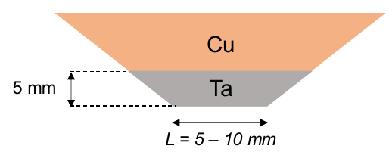
SuperKEKB benchmark
SuperKEKB is possibly the closest running machine to FCC-ee – perfect for benchmark
Simulation setup
  XSuite simulation of beam losses from Touschek and beam-gas for different collimator settings, including collimator-matter interaction
  Simulation of response of Belle-II diamond detector
  Comparison with measured Belle-II background vs collimator opening
Results
  Almost perfect agreement in relative
  Factor 3-4 discrepancy in absolute – still excellent result, considering the complexity of the simulation and the uncertainty on inputs (e.g. pressure profile and gas composition)
G. Broggi

Slide 13
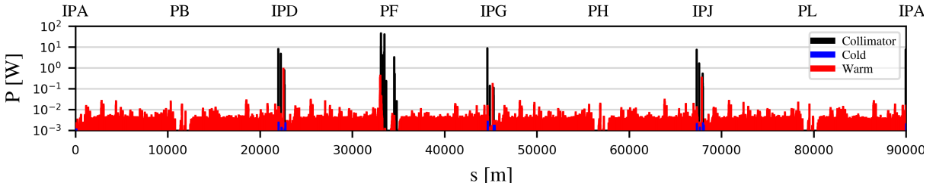
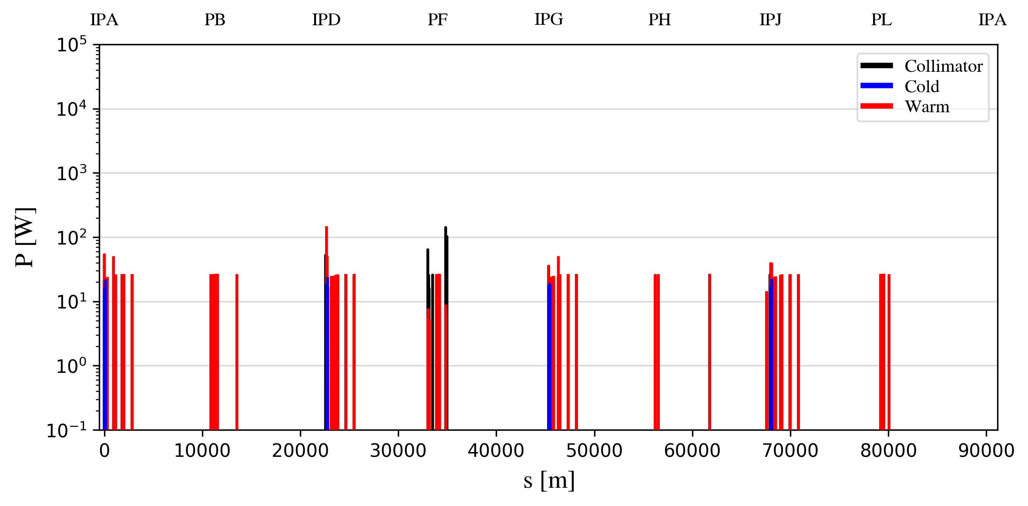
Beam-beam and beam-gas losses
Beam-gas loss map
Beam-gas losses
  Simulation of bremsstrahlung on residual gas, using pressure profile from vacuum group after 1h of conditioning
  Rather low beam loss power expected – not problematic
G. Broggi
Spent-beam losses
  First implementation of combined collimation and beam-beam simulation, including beam-beam kicks, beamstrahlung, radiative Bhabha
  Simulated lifetime of 14 minutes
  Affected particles mainly lost downstream of experiments – do we need physics debris collimators?
Spent beam loss map
G. Broggi

Slide 14
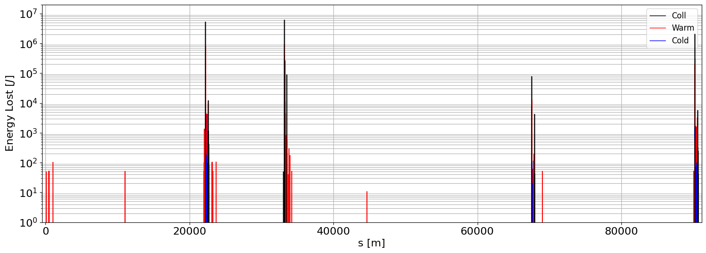
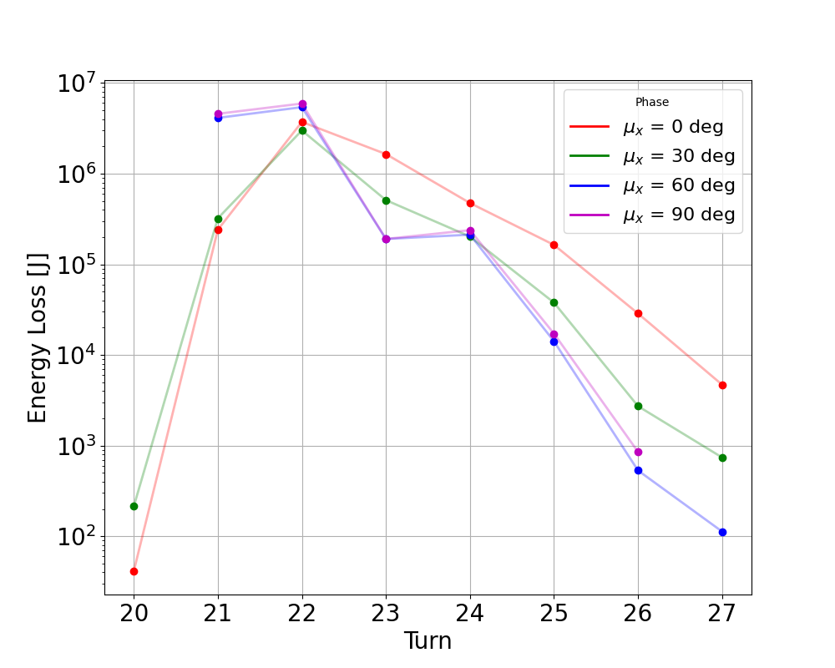
Losses from fast instability
Instability with a few turns risetime expected in case of damper failure
Studied beam loss distribution resulting from coherent oscillation at different phases
  Losses are so fast that we get primary losses on tertiary collimators
  Could have O(10 MJ) losses on primary collimators before beam is dumped – robustness is important!
Collimator robustness to be studied
High losses on tertiary collimators – impact on experiments to be studied
Mitigations: Design redundant damper system so this cannot happen?
G. Nigrelli

Slide 15
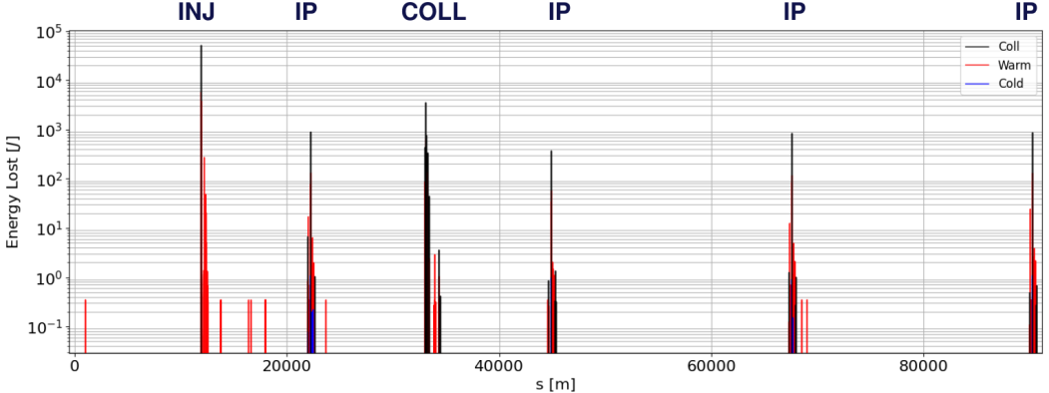
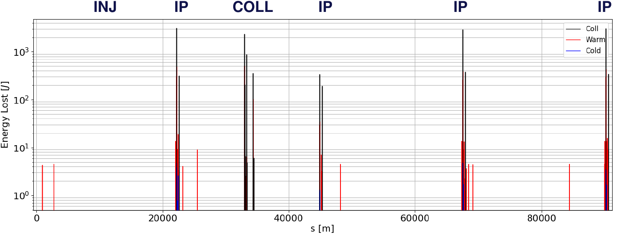
Injection losses
Halo losses from circulating beam
Simulations of losses from injected beam as well as losses on bumped circulating beam
High losses observed, but need detailed design of injection absorber
  For now, assumed same as primary collimator – conservative
  High losses observed on tertiary collimators
Background estimate ongoing
Losses from injected beam
G. Nigrelli

Slide 16
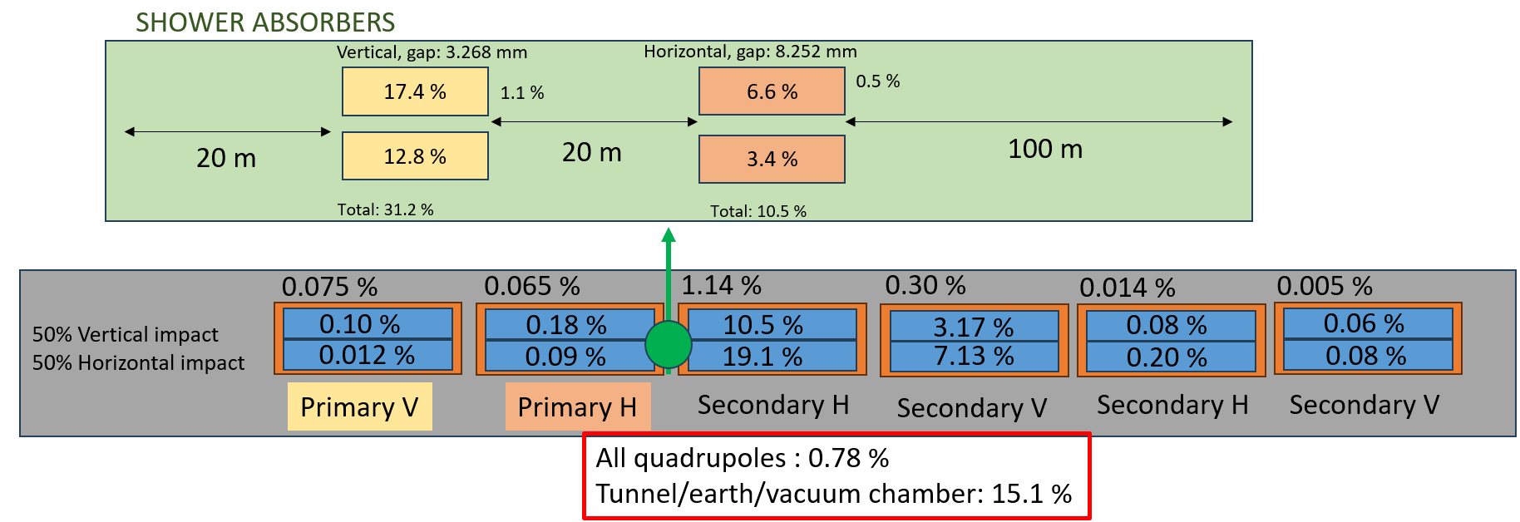
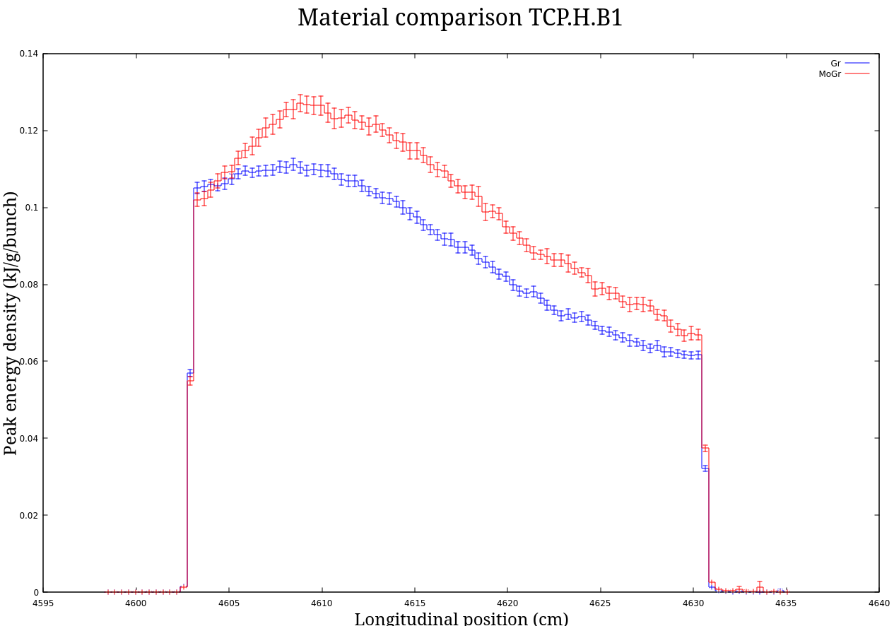
Energy deposition studies in PF
FLUKA model of PF set up
(FLUKA team)
2 shower absorbers added
to decrease energy deposited
in vacuum chamber, tunnel, earth
Peak energy density in primary collimator is challenging
  Graphite could withstand about 45 impacting bunches
    with nominal beam size
S. Marin et al.

Slide 17
Topics for future work (1)
In every new iteration of optics / layout – “continuous work”
  Introduce collimation layout, check constraints from collimation
    In present v25: need to solve issue of protection of small horizontal aperture. Impedance?
  Collimation optics coupled to emittance in non-trivial way
  Aperture validation and tolerances, collimation settings compatible with aperture
  For major changes, repeat key studies
  Upcoming (~September): collimation studies with LCC when lattice becomes available
  Challenge: rapid optics development
Repeat key studies for for all operation modes (ongoing) and for B2 when available
  Ongoing work to define collimation settings at each energy, trying to keep the same hardware
  For now, assumed same as primary collimator – conservative
  High losses observed on tertiary collimators

Slide 18
Topics for future work (2)
Set up studies for all remaining beam loss scenarios – on a good track
    Injection failure, extraction failure, sudden beam loss, thermal photons, other failures. MP?
    Impact distributions for realistic loss scenarios – cleaning worse at smaller impact parameters
    Estimate halo distribution and lifetime from natural beam evolution with collimation aperture
    Challenge: additional inputs and/or significant work needed for some scenarios, e.g. thermal photons
  Simulate key beam losses with machine errors and corrections – need inputs
    Need inputs: imperfect lattices after corrections for several seeds
    Devise tolerances on collimator imperfections (tilt angle, flatness, optics, orbit, …)
Dynamic/momentum aperture vs TCP setting
    TCP V outside DA → chaotic motion causes primary impacts in experimental insertions – tolerable?
    TCP V inside DA → impacts in PF, smaller spot size (bad for robustness), higher impedance
    Setting of off-momentum TCP vs MA – strong influence by higher order dispersion

Slide 19
Topics for future work (3)
Work out beam loss tolerances
  Simulate experimental backgrounds from different sources (with MDI, FLUKA team)
    need of re-distributing losses from tertiary collimators?
    Synchrotron radiation background
  Shower simulations of radiation, risk of damage on collimators in realistic impact scenarios - STI
  Obtain inputs on quench limits, energy deposition studies of doublets
Optimize materials: Impedance vs robustness: what is required on each?
  damage at O(45) bunches on graphite TCP, MoGr likely slightly less – good enough?
Energy deposition studies with FLUKA team
  Need shower absorbers after tertiary collimators?
Collimator hardware: Provide specifications for hardware design in STI

Slide 20
Topics for future work (4)
Code development
  Set up coupling to FLUKA, as alternative to BDSIM - ongoing
  Further benchmarks at SuperKEKB or other machines (DAFNE)?
    Potentially time-consuming, not easy with present resources
  Implement needed physics in XSuite (scattering on thermal photons? SR photons? Sudden beam loss element? …)
Collimation in the booster? (1% of stored beam energy)
  Presently no resources for this, but maybe also not needed
Timeline: Goal is to converge on all open points for TDR (2027 )

Slide 21
Resources and interfaces
Core workforce for ABP collimation and beam dynamics studies: G. Broggi (DOCT, paid 50% FCC, last year), G. Nigrelli (DOCT, Italian grant with 2/3 FCC contribution over 2 years)
  Staff: fraction of R. Bruce, F. Van der Veken and K. Skoufaris
  Trainees: D. Proniakova (EPFL), Liverpool trainee planned to start soon
  Would need another fellow – A. Abramov not replaced
SR collimators studied by MDI team, but closely linked to collimation
  K. Andre (CERN ABP contract finished), M. Boscolo
  Need clear strategy on how to continue synchrotron radiation studies
Energy deposition studies in FLUKA team: S. Marin (fellow), supervised by A. Lechner
Background studies –within MDI, but closely linked to collimation (tolerances)
  FLUKA studies, based on inputs from ABP tracking: A. Frasca in FLUKA team (DOCT, last year), G. Nigrelli (ABP, but partly working with FLUKA team)
  Detector studies: External collaborators: A. Ciarma, M. Boscolo, (possibly G. Nigrelli)
Close collaboration with optics team, ABP impedance and collective effects team, XSuite development team, machine protection, hardware design team in SY/STI, instrumentation SY/BI

Slide 22
Backup

Slide 23
What about collimation in the booster?
Stored beam energy in the booster is only 1% of that in the main FCC-ee ring
  Machine protection is less critical, but not uncritical
No worries about experimental backgrounds in the booster
A priori, don't expect that we need extensive halo collimation in the booster, but to be studied
  Still likely need protection absorbers and transfer line collimators – impacts on these collimators needs careful study, but this is outside of the scope of halo collimation studies
Collimation system not yet studied for the booster
  Limited resources focused on main ring
  Booster design has changed significantly several times

