Slide 1
IQNs, PINNs, and more alphabet soup

Slide 2
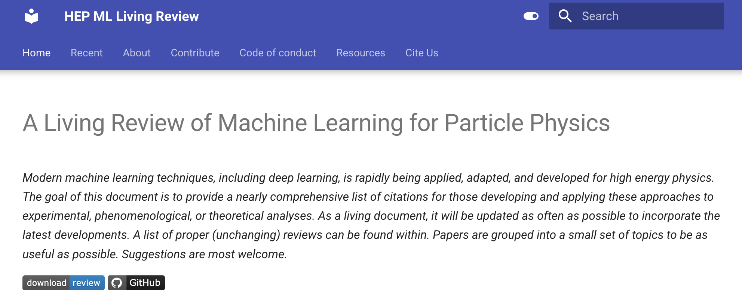
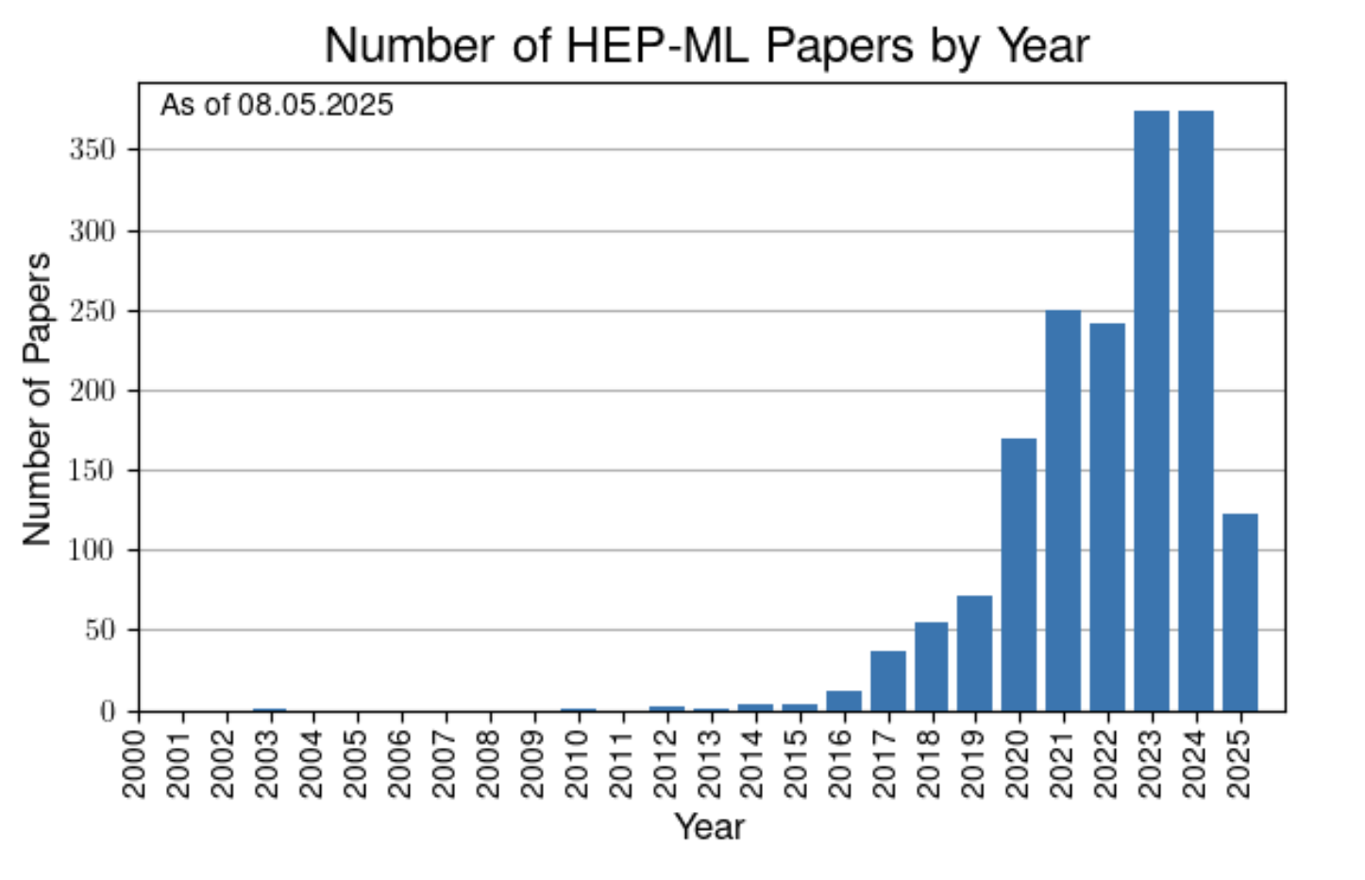

Slide 3
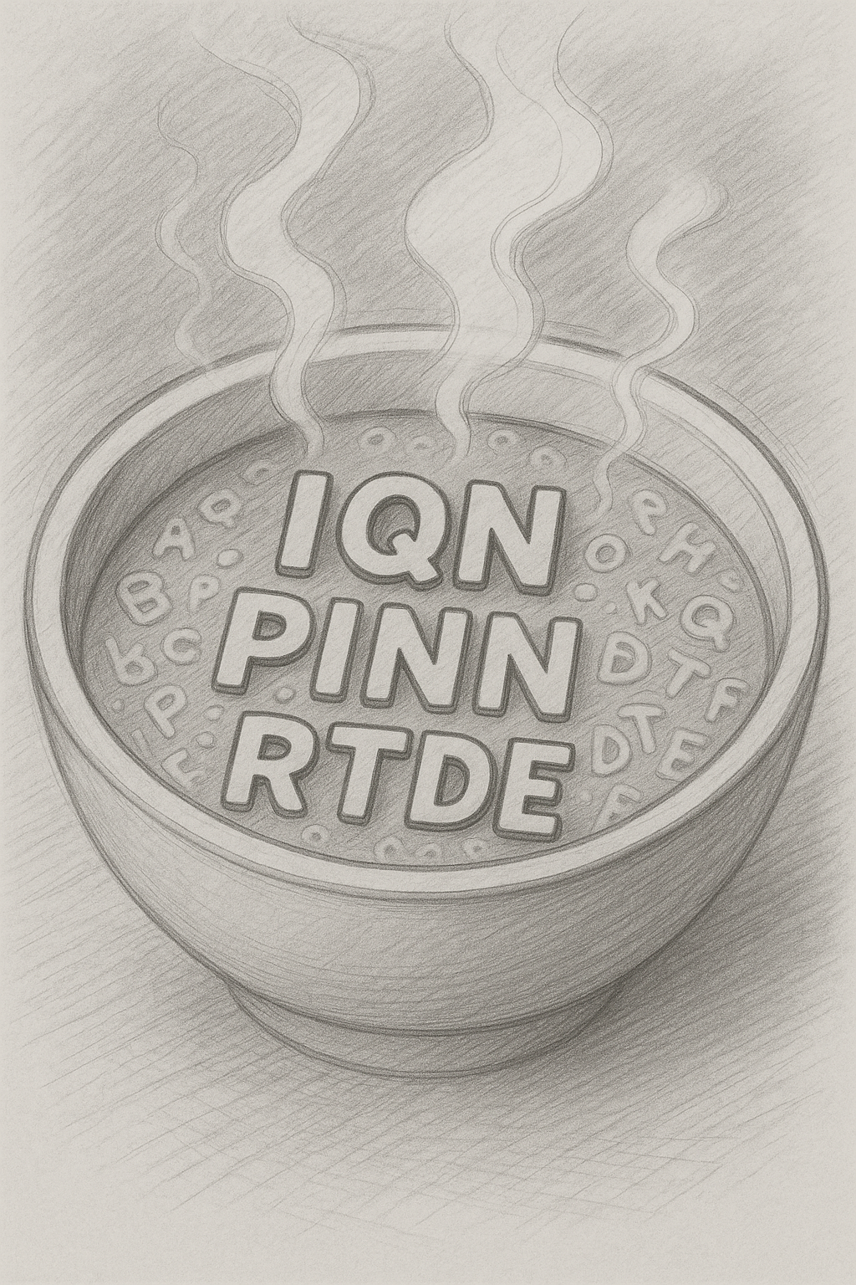

Slide 4
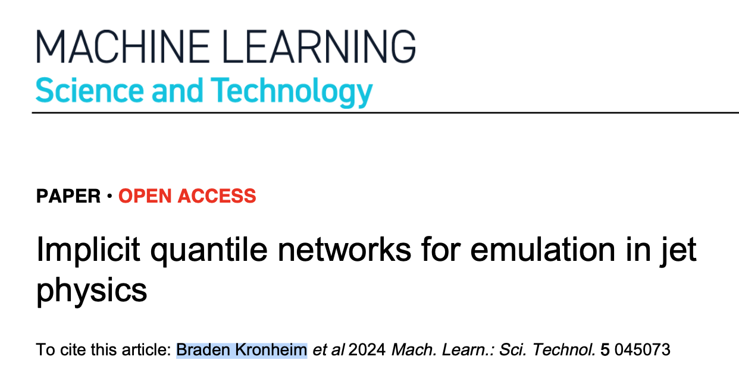
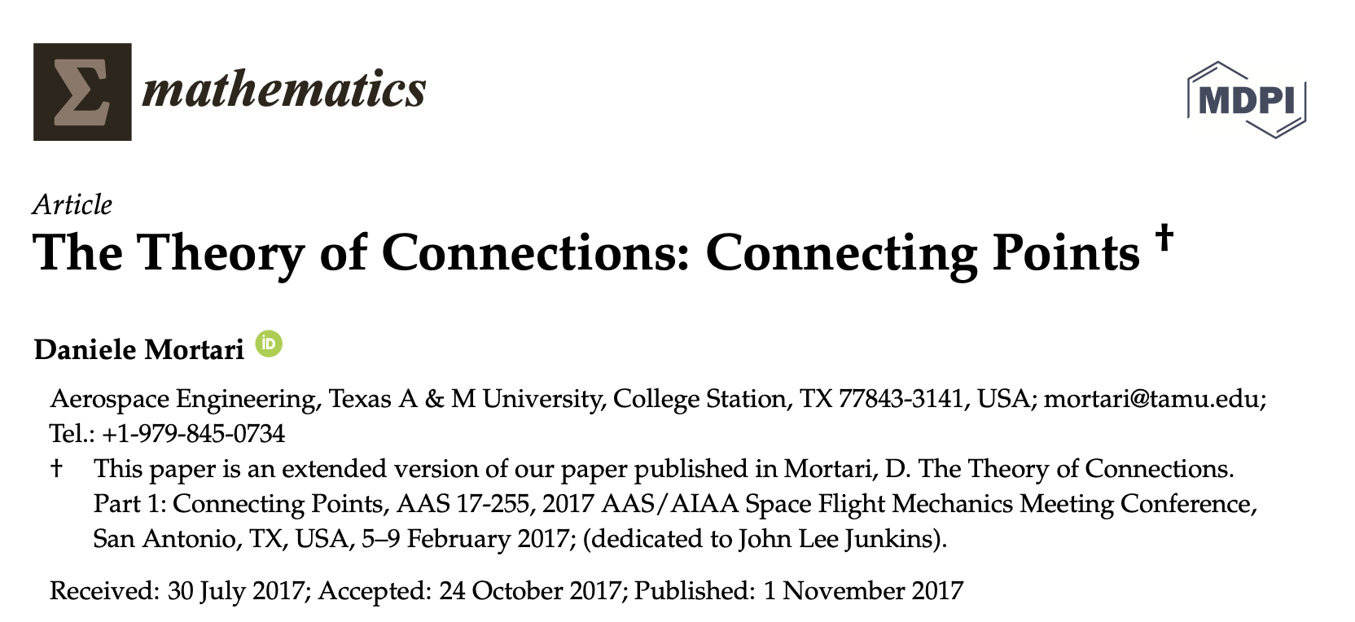
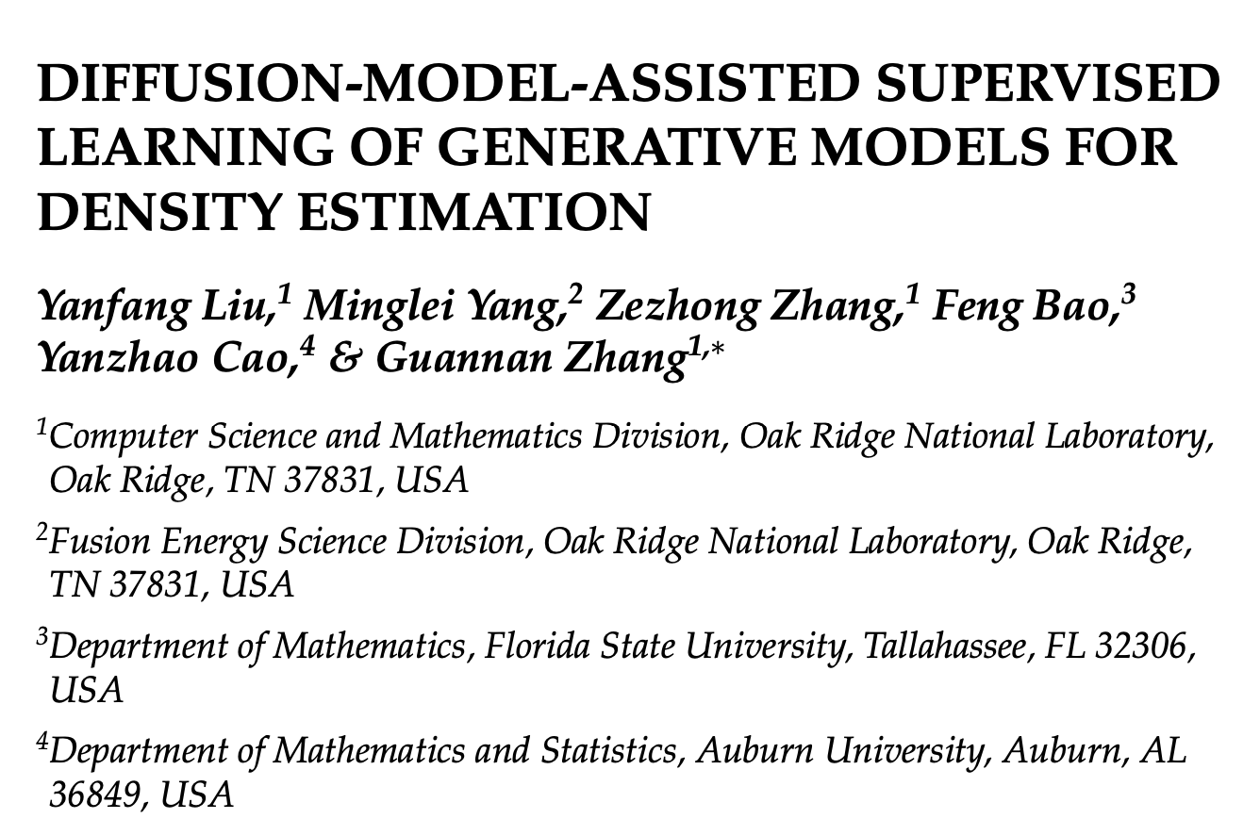
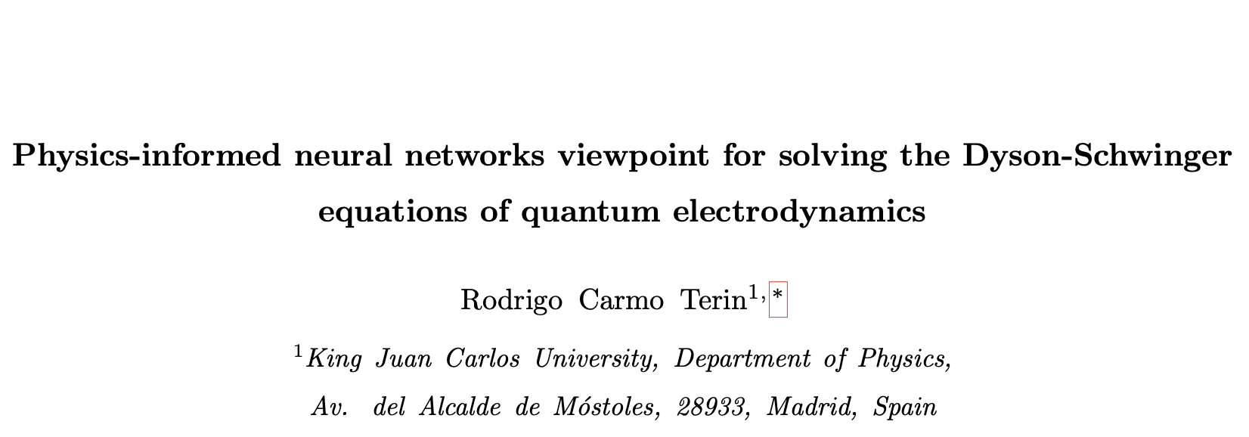
Alphabet Soup
IQN
PINN
RTDE

Slide 6
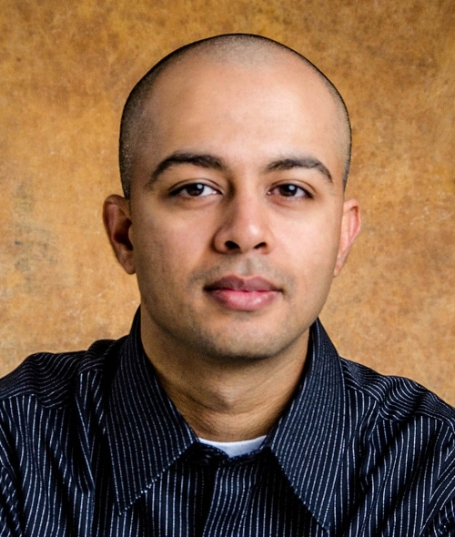

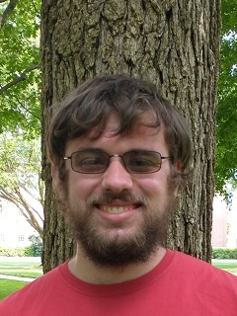
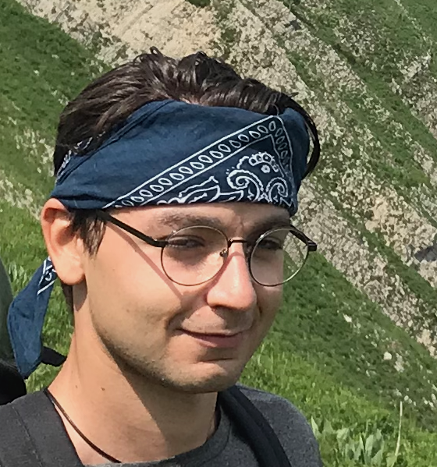
Implicit Quantile Networks
Prof. Raghuram Ramanujan
Davidson College
Prof. Michelle Kuchera
Davidson College
Braden Kronheim
University of Maryland
Ali Al Kadhim
Florida State University

Slide 7
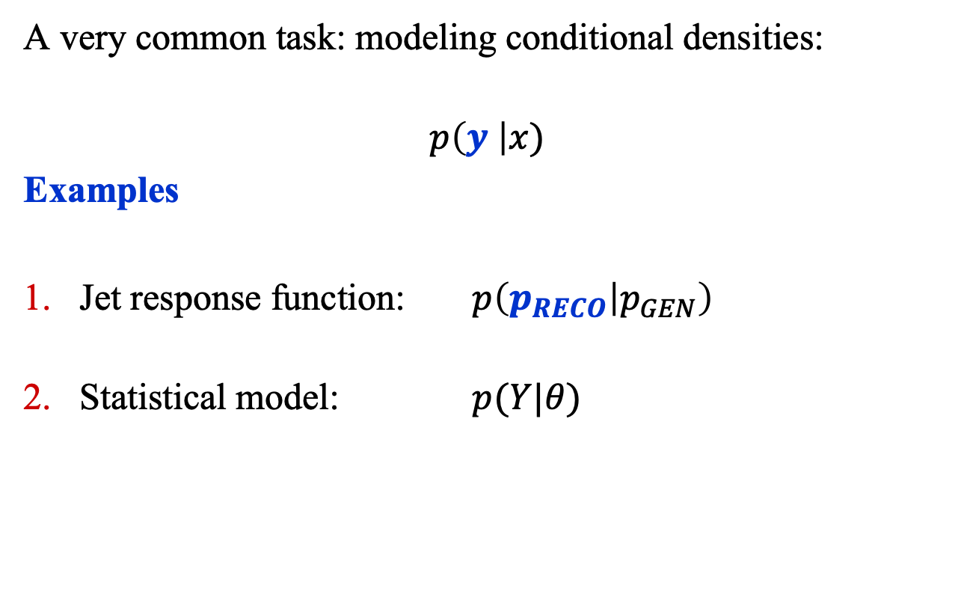
Implicit Quantile Networks
A very common task: modeling conditional densities:
$$p\left(y \right|x)$$
Examples
Jet response function: $p\left(p_{RECO} | p_{GEN}\right)$
Statistical model: $p(Y|θ)$

Slide 8
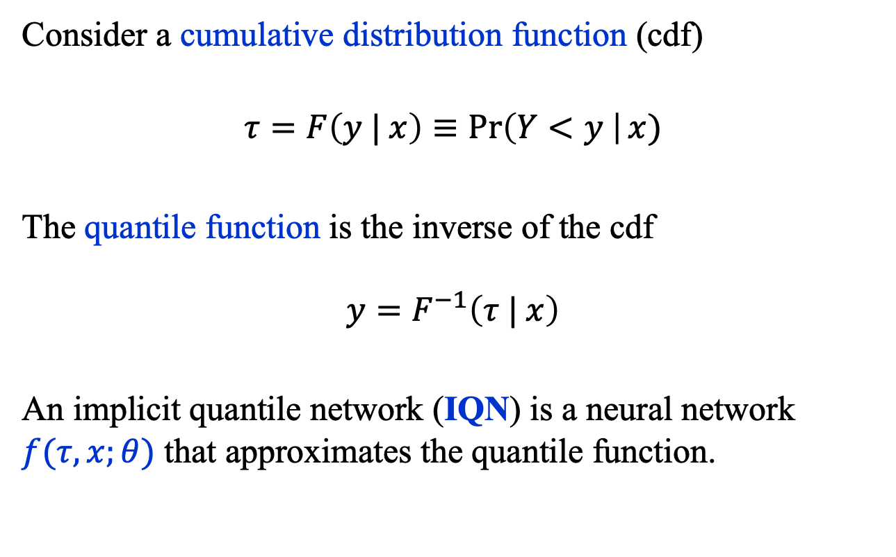
Implicit Quantile Networks
Consider a cumulative distribution function (cdf)
$$τ=F\left(y | x\right)≡\operatorname{Pr}\left(Y<y \right|x)$$
The quantile function is the inverse of the cdf
$$y=F^{−1}\left(τ | x\right)$$
An implicit quantile network (IQN) is a neural network $f(τ, x;θ)$ that approximates the quantile function.

Slide 9
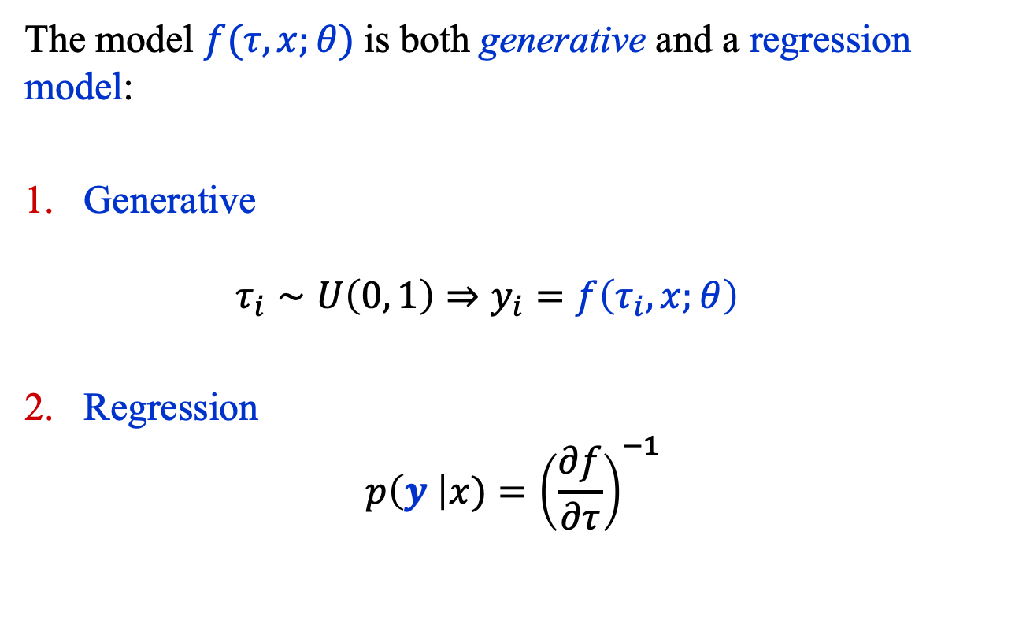
Implicit Quantile Networks
The model $f(τ, x;θ)$is both generative and a regression model:
Generative
  $$τ_{i}∼U\left(0, 1\right)⇒y_{i}=f\left(τ_{i}, x;θ\right)$$
Regression
$$p\left(y \right|x)={\left(\frac{∂f}{∂τ}\right)}^{−1}$$

Slide 10
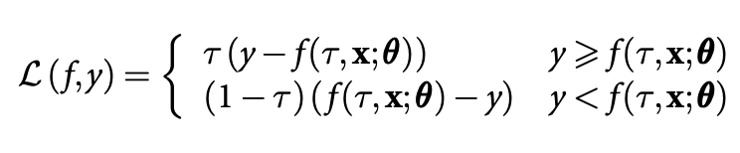

Implicit Quantile Networks
Given data $D={\left\{\left({y_{i}, τ}_{i}, x_{i}\right)\right\}}_{i=1}^{n}$, any model with sufficient capacity that is trained using the quantile loss
will approximate the quantile function $y=F^{−1}\left(τ | x\right)$.

Slide 11
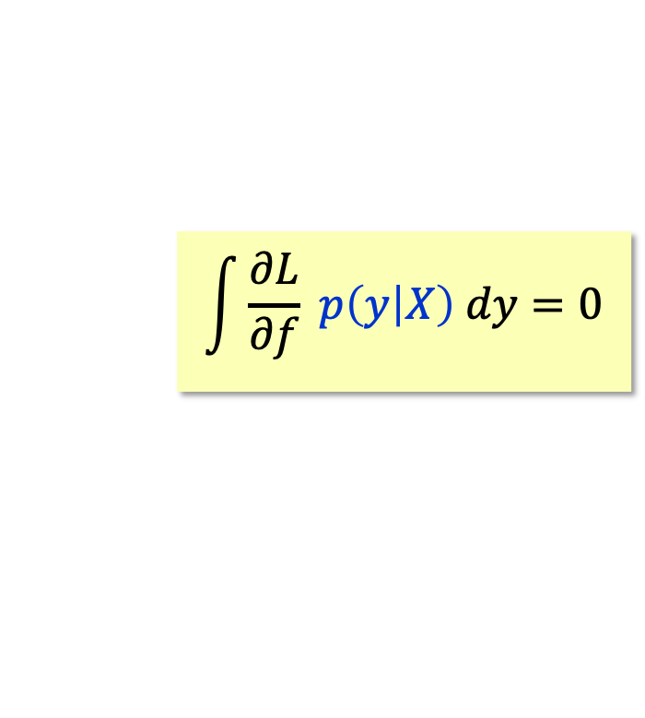
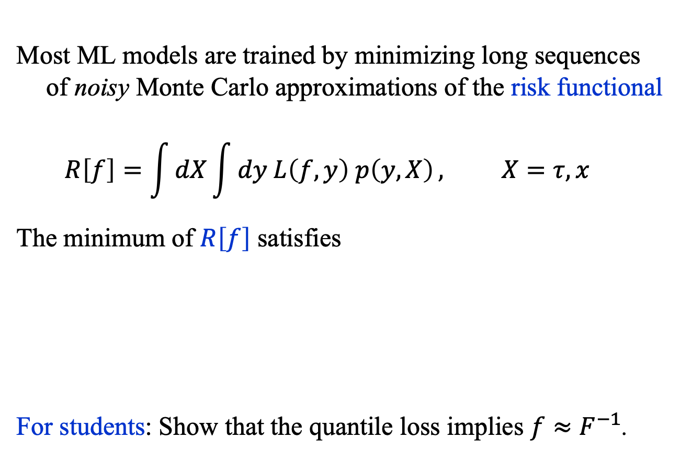
An Aside: Risk Minimization
Most ML models are trained by minimizing long sequences of noisy Monte Carlo approximations of the risk functional
$$R\left[f\right]=\int{dX}\int{dy L\left(f, y\right) p\left(y, X\right)}, X=τ, x$$
The minimum of $R\left[f\right]$ satisfies
For students: Show that the quantile loss implies $f≈F^{−1}$.
$$\int{\frac{∂L}{∂f} p\left(y | X\right) dy=0}$$

Slide 12
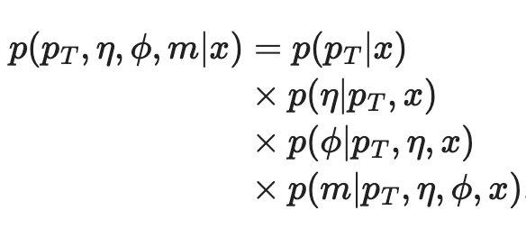
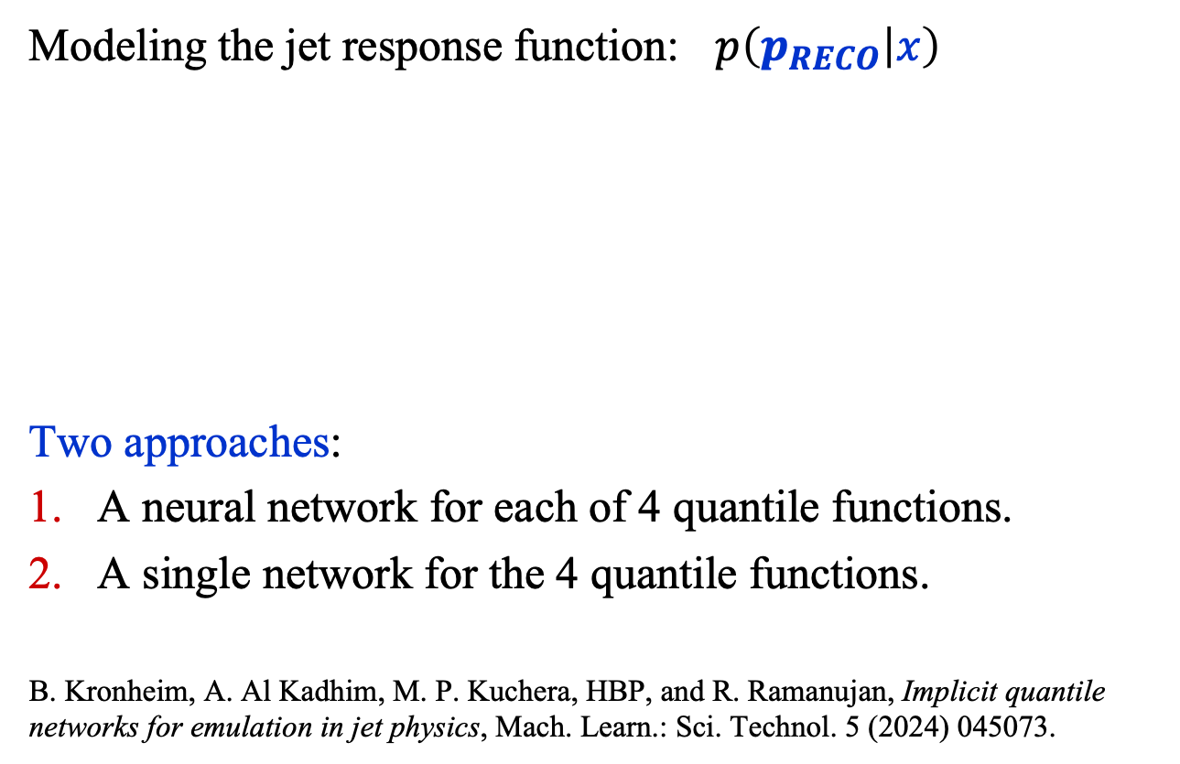
Implicit Quantile Networks
Modeling the jet response function: $p\left(p_{RECO} | x\right)$
Two approaches:
A neural network for each of 4 quantile functions.
A single network for the 4 quantile functions.
B. Kronheim, A. Al Kadhim, M. P. Kuchera, HBP, and R. Ramanujan, Implicit quantile networks for emulation in jet physics, Mach. Learn.: Sci. Technol. 5 (2024) 045073.

Slide 13
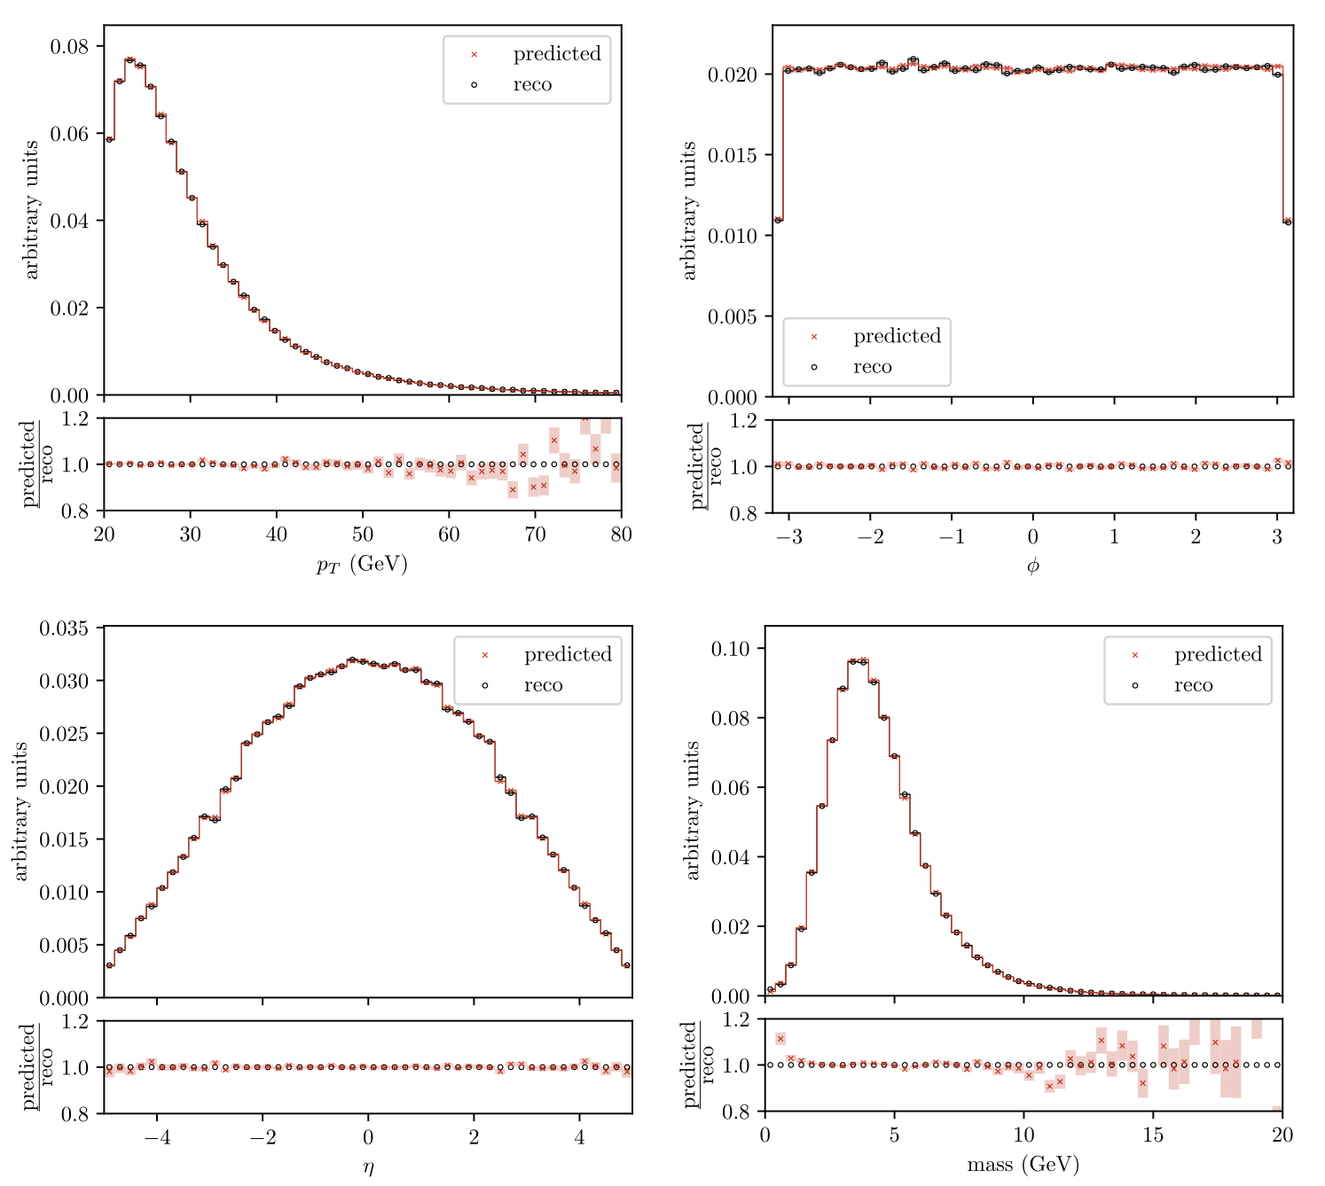
Implicit Quantile Networks
B. Kronheim, A. Al Kadhim, M. P. Kuchera, HBP, and R. Ramanujan, Implicit quantile networks for emulation in jet physics, Mach. Learn.: Sci. Technol. 5 (2024) 045073.

Slide 15
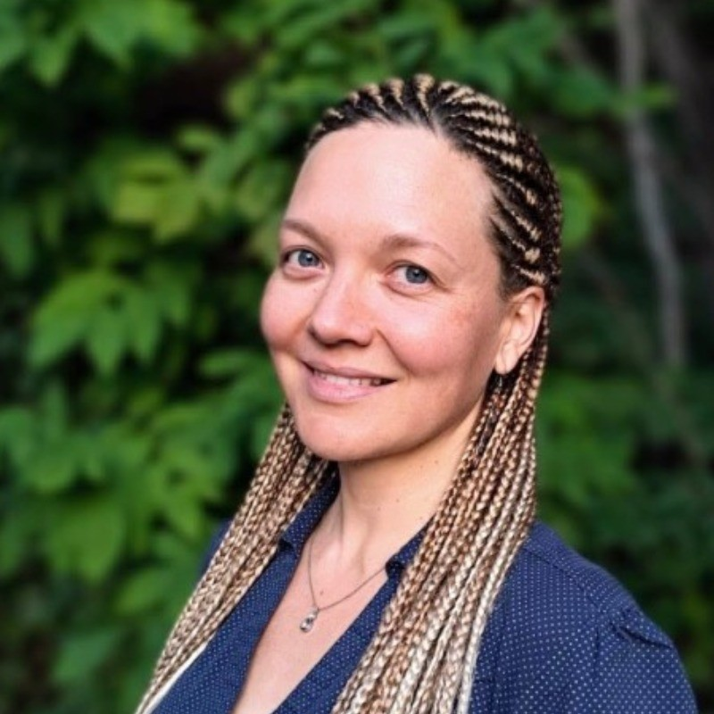
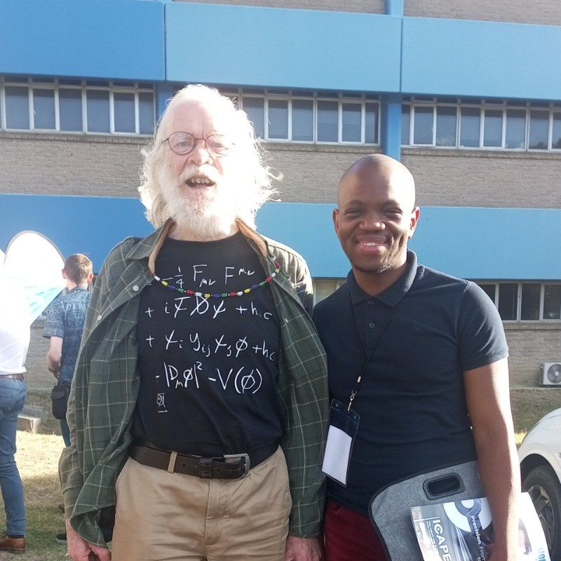
Physics Informed Neural Networks
Dr. Claire David
Academic Director AIMS
Cape Town, South Africa
Tlotlo Oepeng
former AIMS student
from Botswana

Slide 16
Physics Informed Neural Networks
A way to solve equations using the computational tools developed for ML.
B. Moseley, see, for example, https://www.youtube.com/watch?v=IDIv92Z6Qvc.
S. Cuomo et al., Scientific Machine Learning through Physics-Informed Neural Networks: Where we are and What's next, https://doi.org/10.48550/arXiv.2201.05624.
Aditi S. Krishnapriyan, Amir Gholami, Shandian Zhe, Robert M. Kirby, Michael W. Mahoney, Characterizing possible failure modes in physics-informed neural networks, NIPS'21: Proceedings of the 35th International Conference on Neural Information Processing Systems; https://arxiv.org/abs/2109.01050.
D. Mortari, The Theory of Connections: Connecting Points, Mathematics, vol. 5, no. 57, 2017.
Raissi, M., Perdikaris, P., Karniadakis, G.E., Physics-informed neural networks: A deep learning frame-work for solving forward and inverse problems involving nonlinear partial differential equations. J. Comput. Phys. 378, 686–707 (2019).
Cuomo, S et al. Journal of Scientific Computing (2022) 92:88 https://doi.org/10.1007/s10915-022-01939-z

Slide 17
Physics Informed Neural Networks
Advantages of the PINNs
Mesh-free solutions.
Scales well with the dimensionality of the space.
Can condition on initial/boundary conditions.
Disadvantages of PINNs
Much slower than traditional numerical methods for a single set of initial/boundary conditions.
Convergence is sensitive to the details of the average loss.

Slide 18
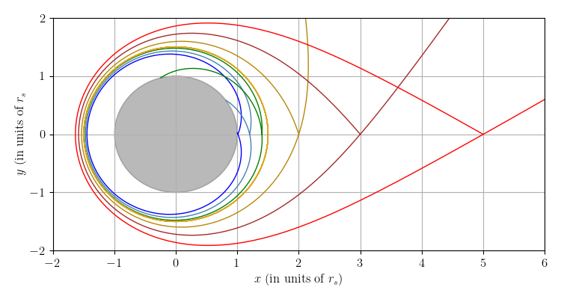
Physics Informed Neural Networks
Problem statement
Can we model an infinite set of photon orbits in a Schwarzschild spacetime using a single neural network?

Slide 19
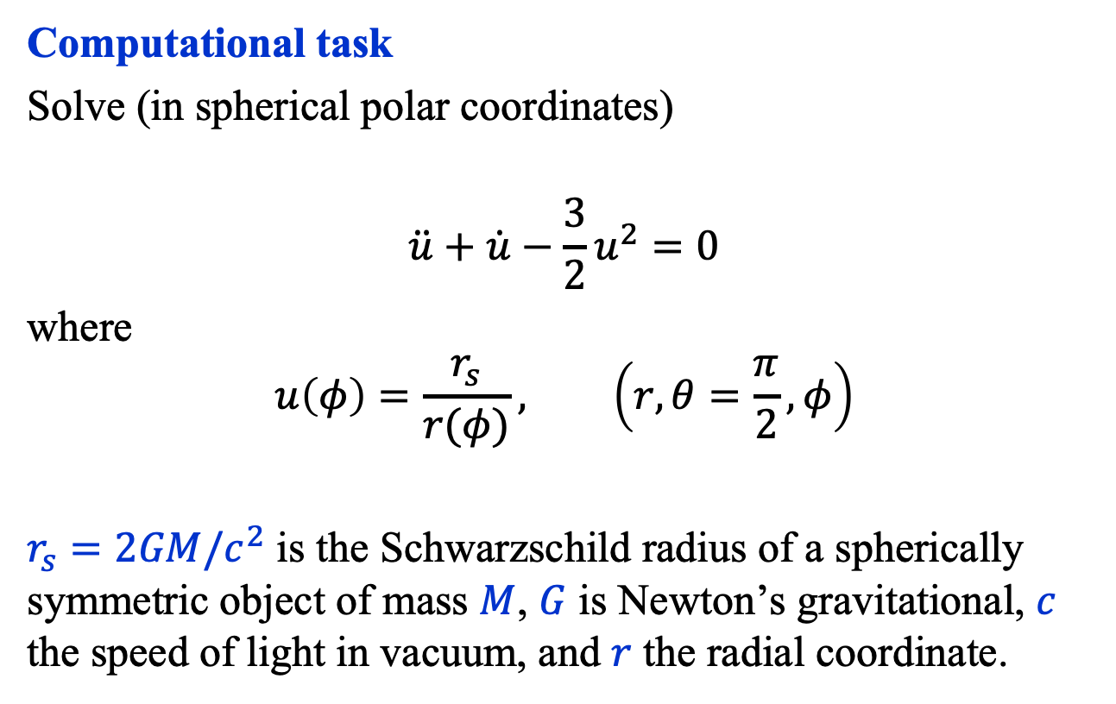
Physics Informed Neural Networks
Computational task
Solve (in spherical polar coordinates)
$$\ddot{u}+\dot{u}−\frac{3}{2}u^{2}=0$$
where
$$u\left(φ\right)=\frac{r_{s}}{r(φ)}, \left(r, θ=\frac{π}{2},φ\right)$$
$r_{s}=2GM/c^{2}$ is the Schwarzschild radius of a spherically symmetric object of mass $M$, $G$ is Newton’s gravitational, $c$ the speed of light in vacuum, and $r$ the radial coordinate.

Slide 20
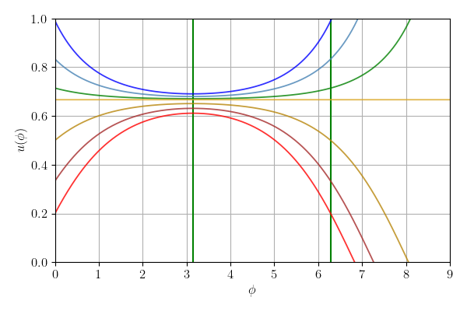
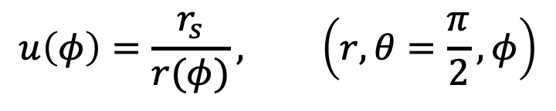
Physics Informed Neural Networks
$$u\left(φ\right)=\frac{r_{s}}{r(φ)}, \left(r, θ=\frac{π}{2},φ\right)$$

Slide 21
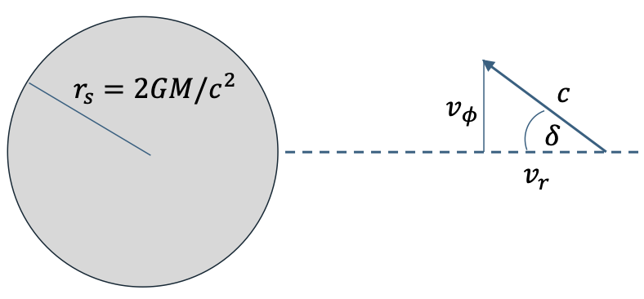

Physics Informed Neural Networks
Initial conditions
$$\left(r(0),δ\right)⇒\left(u\left(0\right), \dot{u}\left(0\right)\right)≡\left(u_{0}, v_{0}\right)$$
Solution ansatz (see Theory of Connections)
$$u\left(φ, u_{0}, v_{0}\right)={ u}_{0}+f_{θ}\left({φ, u}_{0},v_{0}\right)−f_{θ}\left({0, u}_{0},v_{0}\right)+φ\left[v_{0}−{\dot{f}}_{θ}(0, u_{0}, v_{0})\right]$$

Slide 22
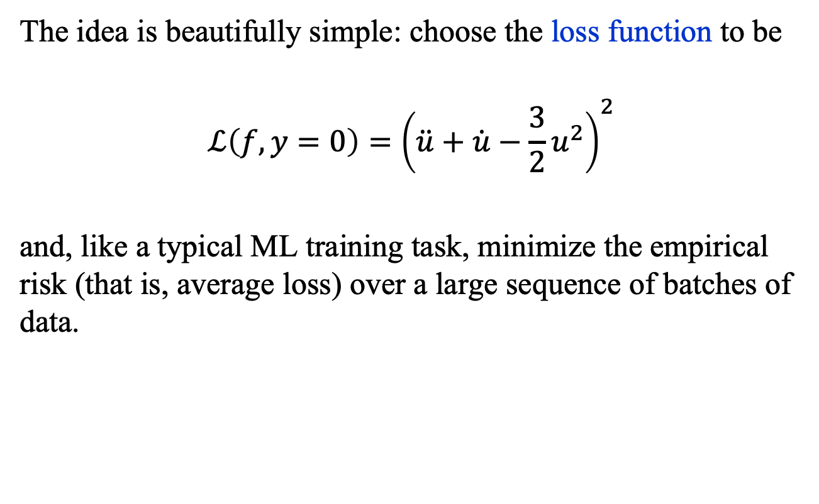
PINNs: Basic Idea
The idea is beautifully simple: choose the loss function to be
$$ℒ\left(f, y=0\right)={\left(\ddot{u}+\dot{u}−\frac{3}{2}u^{2}\right)}^{2}$$
and, like a typical ML training task, minimize the empirical risk (that is, average loss) over a large sequence of batches of data.

Slide 23
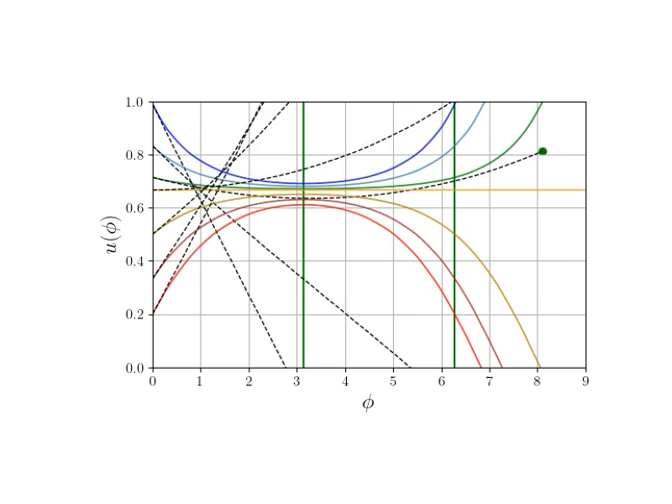
Physics Informed Neural Networks

Slide 25
Reverse Time Diffusion Equations
Mapping an easily sampled n-dimensional density to a difficult to sample n-dimensional density is a a very important task.
Typically, one maps from a diagonal n-dimensional Gaussian (zero mean, unit variance).
This problem has been solved in many ways, including with normalizing flows, IQN, and diffusion models.

Slide 26
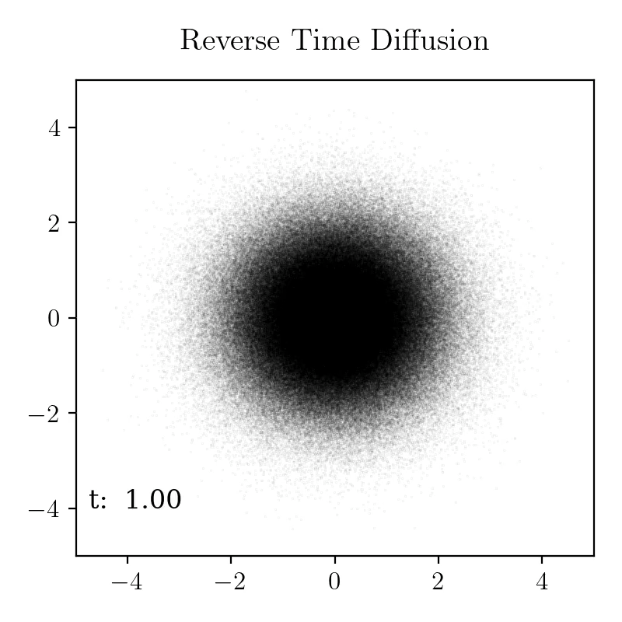
Reverse Time Diffusion Equations

Slide 27
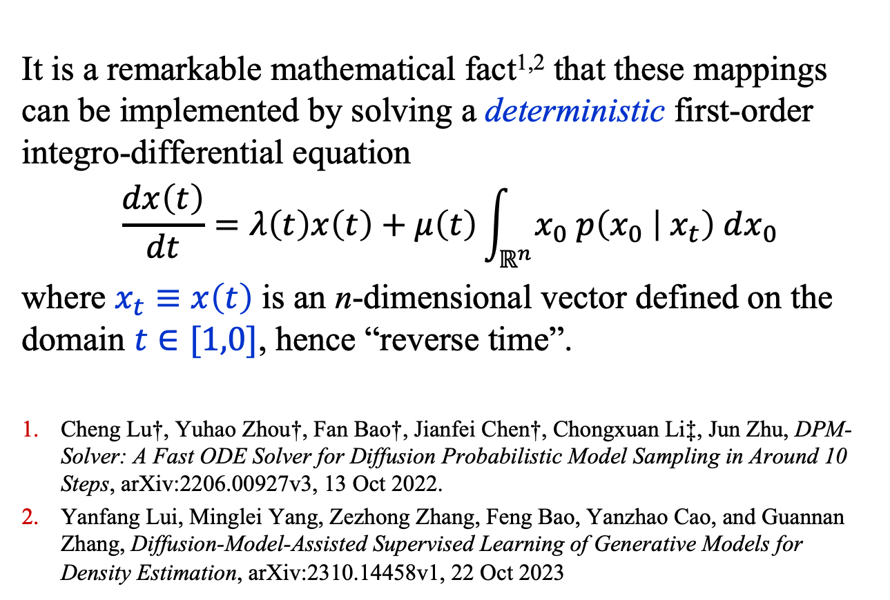
Reverse Time Diffusion Equations
It is a remarkable mathematical fact^{1,2} that these mappings can be implemented by solving a deterministic first-order integro-differential equation
$$\frac{dx\left(t\right)}{dt}=λ\left(t\right)x\left(t\right)+μ\left(t\right)\int_{ℝ^{n}}{x_{0} p\left(x_{0} | { x}_{t}\right) dx_{0}}$$
where $x_{t}≡x\left(t\right)$ is an n-dimensional vector defined on the domain $t∈[1,0]$, hence “reverse time”.
Cheng Lu†, Yuhao Zhou†, Fan Bao†, Jianfei Chen†, Chongxuan Li‡, Jun Zhu, DPM-Solver: A Fast ODE Solver for Diffusion Probabilistic Model Sampling in Around 10 Steps, arXiv:2206.00927v3, 13 Oct 2022.
Yanfang Lui, Minglei Yang, Zezhong Zhang, Feng Bao, Yanzhao Cao, and Guannan Zhang, Diffusion-Model-Assisted Supervised Learning of Generative Models for Density Estimation, arXiv:2310.14458v1, 22 Oct 2023

Slide 28
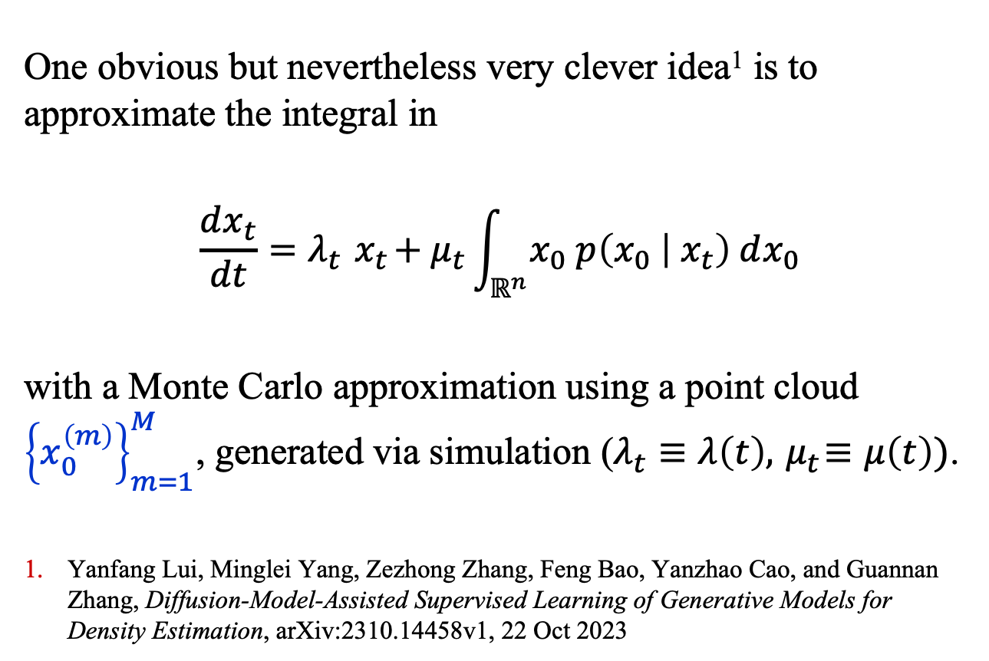
Reverse Time Diffusion Equations
One obvious but nevertheless very clever idea¹ is to approximate the integral in
$$\frac{dx_{t}}{dt}=λ_{t}{ x}_{t}+μ_{t}\int_{ℝ^{n}}{x_{0} p\left(x_{0} | { x}_{t}\right) dx_{0}}$$
with a Monte Carlo approximation using a point cloud ${\left\{x_{0}^{\left(m\right)}\right\}}_{m=1}^{M}$, generated via simulation ($λ_{t}≡λ\left(t\right),{ μ}_{t}≡μ\left(t\right))$.
Yanfang Lui, Minglei Yang, Zezhong Zhang, Feng Bao, Yanzhao Cao, and Guannan Zhang, Diffusion-Model-Assisted Supervised Learning of Generative Models for Density Estimation, arXiv:2310.14458v1, 22 Oct 2023

Slide 29

Reverse Time Diffusion Equations
Some details
At $t=1$, $x_{t}∼N_{2}(0, 1)$
Point cloud size: $M=5×{10}^{4}$
Points mapped: $5×{10}^{5}$
$μ_{t}=− λ=t^{−1}$
Method: finite-difference solver
Mapping rate: 285 points/s
using PyTorch on an
NVIDIA GeForce RTX
4090

Slide 30
Summary
Generative modeling, whether it be sampling from a high-dimensional probability density or generating solutions from differential equations, is a very important task on which an enormous amount of sophisticated work has been done.
We have considered three, relatively simple generative models, IQNs, PINNs, and RTDEs, from the rapidly diversifying menu of Alphabet Soup.

