Slide 1


ET-PP (WPX)
2nd review meeting (RP2)
Project: 101079696 — ET-PP — HORIZON-INFRA-2021-DEV-02
Horizon Europe: Coordination
and Support Actions
15/05/2025
Grant agreement: Nº 101079696

Slide 2

Introduction WP2
Current composition
Lead Nikhef, INFN, STFC
Nikhef team: Miriam Roelofs, Hans Chang
INFN team: Monique Bossi, Federico Ferrini
STFC team: Laura Woodward, Jamie Parkin
Invitation to: ETO directorate (Fernando Ferroni), secretary BGR (Jerome Pourbaix)
15/05/2025
Project: 101079696 — ET-PP, 2nd review meeting

Slide 3
Objective WP2: to support the ET concept
Interaction with the BGR:
building an understanding of potential future legal models (ERIC, IGO or hybrid as a domestic company with an international flavour),
identifying the key elements with an impact on the governance options,
gathering good practices and lessons learned from current international science projects (CERN, CTAO, SKAO, ESRF, ESS, EGO)
to inform the rules/statutes for the preferred final legal form of ET (Del.2.3. WP2)
to inform the roadmap for establishment of the legal entity (Del.2.4. WP2)
Interaction with the ET-Coordinators/Directorate
With regard to organisational aspects
Exchange with other ET PP workpackages:
Input for governance requirements
WP3, WP7, WP5: e.g. balanced return on investment, procurement, beneficial tax regime, financial model
15/05/2025
Project: 101079696 — ET-PP, 2nd review meeting

Slide 4
ET working assumptions
Previously known assumptions
E.g. According to ESFRI application is ET a single site observatory with a Headquarter and datacenter. However, multiple site configurations are being discussed within the ET organisation and ET Collaboration.
Parallel developments in the ET project of the future ET organisation: instrument-design, procurement model, financial model, HR model
Later on: possible revision or adjustement of assumptions
This might have an impact on the preferred legal model preferred → Legal Structure follows function
15/05/2025
Project: 101079696 — ET-PP, 2nd review meeting

Slide 5
WP 2: Deliverables
2.1. Report providing options for a legal entity (October 2023)
2.2. Minutes of meetings with involved Ministries (BGR) and EC (October 2023)
Revised Del 2.1. Study and analysis on governance: Intermediate paper (March 2024)
  Responding to suggestions of EC review
2.3. Legal documents and content for statutes (Q3 2025)
2.4. Roadmap to establish the legal entity (Q3 2026)
---------------------------------------------------------------------------------------------------------------------------------------
2.3. Legal documents and content for statutes (Q3 2025), request for amendment
  Considerations for request:
  preliminary state of discussion in BGR → consensus on a preferred legal framework not before Q2 25
  experience from other large scale research infrastructures with regard to the lenght of negotiation process
Possible option discussed in October 2024 (Midterm review):
Extension until M47; with the note that a request for a content change may be needed in the future, depending on how discussions progress in terms of the geometry, site selection and legal framework.
15/05/2025
Project: 101079696 — ET-PP, 2nd review meeting

Slide 6
WP 2: Critical risks, deviations from Annex I, contingency plans
Deliverables (2024-2026)
2.3. Legal documents and content for statutes (Q3 2025)
2.4. Roadmap to establish the legal entity (Q3 2026)
Risks
Extension of decision making timelines with an impact on the governance:
      Instrument-design, procurement model, site selection, funding model
WP2 depends on the input from BGR (ET decision making body), if the input for the long term and/or intermediate entity is not timely exchanged:
- WP2 is unable to deliver the legal documents ( Del.2.3.) within the ETPP project timeline
- WP2 is unable to deliver a Roadmap to establish the final legal entity (Del.2.4.) with a certain level of accuracy
Risk Mitigation
Increased interaction with BGR, direct link to BGR secretary, invitation to WP2 meeting
Initiation of (in-person) workshops to facilitate informative discussions: BGR experts, ETO, ETPP
Interaction with the other ETPP workpackages (WP3,WP7) to define relevant aspects (e.g. financial model and procurement strategy)
Request to BGR to nominate legal experts
15/05/2025
Project: 101079696 — ET-PP, 2nd review meeting

Slide 7
WP 2: Contribution from each partner
% PMs used =
Project: 101079696 — ET-PP, 2nd review meeting
15/05/2025

Slide 8
WP 2: update activities 2024
Every 2-4 weeks: WP2 meetings with Nikhef, INFN and STFC
Three action lines: (chronological order…)
Interaction with the BGR
BGR-6, 8 March 2024, online, update progress WP2
BGR-7: 4 October 2024, Cascina, governance workshop
WP2 Discussionpaper BGR-7, including outcome of WP7
Interaction with the ETO directorate
WP2 developed a draft MoU to establish a joint ETO fund for the ET project and installation of an ETO Funders group
Undersignment December 2024: Nikhef, INFN, Belspo, FWO (Nikhef host agency)
Collaboration with ETPP workpackages
WP2-WP3 joint session ETPP Annual (18 June Barcelona): development of financial and legal model
WP2-WP3 joint workshop (15 Nov Warsaw): development of sustainable financial model and relation with legal framework, e.g. HR, Procurement, In Kind contribution (keynote speakers from other RI’s: ESS, Xfel, ERIC Forum, ELI, SKAO, CTAO)
https://indico.ego-gw.it/event/764/page/96-et-pp-wp2wp3-joint-workshop
WP7: preliminary results as input for discussion paper
15/05/2025
Project: 101079696 — ET-PP, 2nd review meeting

Slide 9
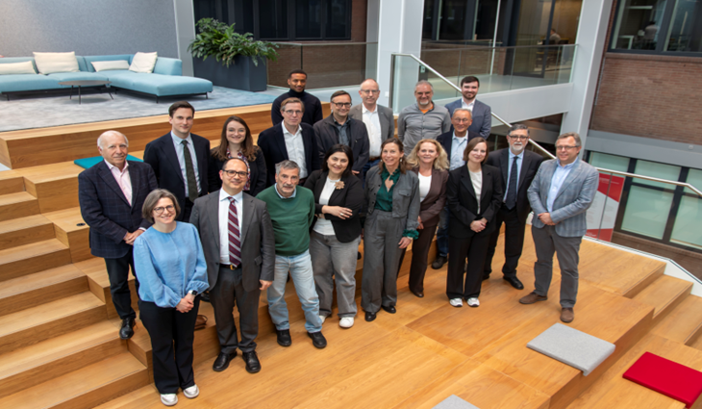
WP 2: update activities 2025
In-person preparatory WP2 workshop, 9-10 April 2025
For BGR members and BGR experts
“Weigthing key-elements with an impact on the governance options”
  To gain a deeper understanding, from all perspectives
    To understand the needs of the ET project and ETO organisation
    Explore the aspects of the topics with an impact on governance options
    Discuss the various experiences and advices of participants
Participants
  BGR members and BGR experts *
    (12) Belgium, Italy, Netherlands, United Kingdom, Germany
  * Poland, France and Spain not able to join in person
  ETPP WP2, WP3 and WP7 (6)
  ETO (4)
Next steps:
With the outcomes of this workshop WP2 will deliver a discussion starter for BGR-10 on 3-4 June Maastricht:
Compile matrix with pro’s and con’s for the key-elements in each of the 3 legal frameworks as input for a decision on a preferred legal framework
15/05/2025
Project: 101079696 — ET-PP, 2nd review meeting

Slide 10

WP 2: some take aways 9-10 April 2025
Willingness to build the bridge → “defining both sites of the riverbank”: funding timelines and ETO project timeline
BGR will work towards a consensus on a preferred legal entity: flexibility
HR scheme: competitive salaries with industry first phase focus on technicians and engineers
Fair return*: apply a fair return principle to attract Founding Members
IKC: one central procurement office is recommended
Multi site configuration: one central organisation is recommended
Intermedediate legal entity: dedicated entity for preparation ET project with defined purpose and scope to prepare for final legal entity and construction
Coordination by ETO: clear line of authority ETO and ETC
  IKC
  *boundary condition: consensus on preferred final legal entity, clarity on geometry and configuration
15/05/2025
Project: 101079696 — ET-PP, 2nd review meeting

Slide 11
WP 2: next steps 2025-2026
Governance development
Continue exchange and interaction with BGR
Q2: Governance session with BGR-10, 3-4 June, Maastricht
- Conclusive paper with pro’s and con’s as a discussion starter for weighting process by BGR towards consensus on preferred legal entity
Q3-Q4: Follow-up BGR-10
Interaction with BGR-experts to (speed up process and) receive advice on:
  to further detail principles of the preferred final legal entity
  to further explore the need of an intermediate legal entity
  to develop statutes and legal documents
  Q4 2025-Q2 2026
  External legal advice to finalise legal documents (Del. 2.3.) and detail Roadmap (Del. 2.4.)
Support ETO directorate on legal and organizational aspects
  Strenghtening governance of ETO fundersgroup
Exchange with ETPP workpackages
15/05/2025
Project: 101079696 — ET-PP, 2nd review meeting

Slide 12
ET-PP (WPX)
2nd review meeting (RP2)
Project: 101079696 — ET-PP — HORIZON-INFRA-2021-DEV-02
Horizon Europe: Coordination
and Support Actions
15/05/2025
Grant agreement: Nº 101079696

