Slide 1


ET-PP (WP6.2)
2nd review meeting (RP2)
Project: 101079696 — ET-PP — HORIZON-INFRA-2021-DEV-02
Horizon Europe:
Coordination and Support Actions
15/05/2025
Grant agreement: Nº 101079696

Slide 2

WP 6.2: Introduction and objectives (1)
Preparatory Phase for the Einstein Telescope Gravitational Wave Observatory
2nd review meeting (RP2) — 15.05.2024
The ET vacuum pipes are metallic tubes through which laser beams propagate in an ultrahigh vacuum (UHV) between the input and end mirrors of the interferometers.
The objectives of WP6.2 (ET-beampipe) are to:
        Design and test technical solutions that meet the ET requirements in a cost-effective manner.
        Manufacture, assemble, and test a pilot sector.
        Produce the technical design report, including cost estimates.
The team includes CERN staff members contributing the equivalent of 2 FTEs, along with two CERN graduates. An engineer from the University of Antwerp joined the team in 2024. We are contractually linked to INFN, Nikhef, and IFAE, and maintain open collaboration with LAPP-CNRS (Annecy, FR) and parallel initiatives such as MacBeth (NL) and BeamPipes4ET (DE, BE, NL).
We report to the Engineering Department of the ET Organisation (ETO).
The WP6.2 is led by Ana Teresa Perez Fontenla and Paolo Chiggiato.
Project: 101079696 — ET-PP, 2nd review meeting

Slide 3
WP 6.2: Introduction and objectives (2)
Preparatory Phase for the Einstein Telescope Gravitational Wave Observatory
2nd review meeting (RP2) — 15.05.2024
CERN-NSF
Letter of Intent for collaboration in CE beamtube experiment (CEBEX)
Presentation to CERN management for approval of technical collaboration
Framework collaboration
agreement
CERN-INFN-NIKHEF
Addendum on
CERN contribution to ET beampipes
IFAE joins the collaboration agreement
Amendment signed by CERN, INFN, NIKHEF and IFAE
Extended TDR
ET-PP
End of addendum and its amendment
CERN-NSF
Letter of Intent
3rd workshop at LIGO Hanford
4th workshop at CERN
2019
2020
2021
2022
2023
2024
2025
2026
2027
ET-PP INFRA-DEV Kick-off Meeting
Preliminary TDR
[ET-PP] including peer review
1st workshop at
LIGO Livingston
Review of the pilot sector design
Final TDR, including integration and fabrication drawings
ET-ISB kick-off
Effective start of the technical activities
Start construction of the ET beampipe pilot sector
Pilot sector operational
2nd workshop at CERN
Test of different technical solutions with the pilot sector
Project: 101079696 — ET-PP, 2nd review meeting

Slide 4
WP 6.2: Tasks
Preparatory Phase for the Einstein Telescope Gravitational Wave Observatory
2nd review meeting (RP2) — 15.05.2024
Our main task is the progressive preparation of the Technical Design Reports (TDRs), moving toward their final version by incorporating results from the pilot sector and parallel studies (e.g., corrosion, integration, and interfaces with experimental areas).
The TDRs will be revised and adapted to reflect:
New infrastructure inputs
Technical results from the pilot sector
Recommendations from peer reviews
In Q4 2025, we plan to organise two peer reviews focusing on:
Support systems, once the vacuum pipe envelope and tunnel geometry are defined
Pipe assembly, alignment, and leak detection within the tunnel
Project: 101079696 — ET-PP, 2nd review meeting

Slide 5
WP 6.2: Critical risks, deviations from Annex I, contingency plans (1)
Preparatory Phase for the Einstein Telescope Gravitational Wave Observatory
2nd review meeting (RP2) — 15.05.2024
Critical risks that were highlighted at the previous review:
Delay in manufacturing and installing the pilot sector
This delay might come from challenges in the procurement process and delays in receiving components from the industry.
Availability of personnel
    The success of the WP heavily relies on CERN personnel operating on a best-effort basis. Any shifts in CERN’s priorities could result in personnel being reassigned to different tasks, potentially impeding progress in ET-related activities.
    3. Technical issues
    The proposed manufacturing procedure and material for the beampipe are unusual for UHV applications. Incompatibility could appear necessitating a significant alteration in the work plan and the supply chain.
All happened in the last six months!
Project: 101079696 — ET-PP, 2nd review meeting

Slide 6
WP 6.2: Critical risks, deviations from Annex I, contingency plans (2)
Preparatory Phase for the Einstein Telescope Gravitational Wave Observatory
2nd review meeting (RP2) — 15.05.2024
Delay in manufacturing and installing the pilot sector
A two-month delay occurred in finalizing the manufacturing specifications and selecting the purchasing strategy.
A similar delay affected the fabrication of the vacuum tube elements, due to interactions between CERN and the supplier to qualify the welding approach.
The vacuum tube elements were delivered two weeks ago.
These elements now require modifications in CERN’s main workshop to add the optical baffle frames.
This risk also remains active for any future modifications to the pilot sector.
Project: 101079696 — ET-PP, 2nd review meeting

Slide 7
WP 6.2: Critical risks, deviations from Annex I, contingency plans (3)
Preparatory Phase for the Einstein Telescope Gravitational Wave Observatory
2nd review meeting (RP2) — 15.05.2024
Availability of personnel
As the start of the LHC Long Shutdown 3 approaches, the availability of CERN internal services requires careful planning and flexibility.
Welding and manufacturing of the pilot sector extremities were delayed by three months due to scheduling conflicts with new LHC equipment.
Once the first version of the pilot sector is installed, we expect greater flexibility in the schedule to absorb potential fabrication delays.
A partial mitigation involves anticipating and submitting ‘job requests’ as early as possible.
Project: 101079696 — ET-PP, 2nd review meeting

Slide 8
WP 6.2: Critical risks, deviations from Annex I, contingency plans (4)
Preparatory Phase for the Einstein Telescope Gravitational Wave Observatory
2nd review meeting (RP2) — 15.05.2024
    3. Technical issues
    We encountered a problem with a mock-up system used for joining tests: the assembly sleeve was misaligned, and the welding robot developed a water leak during the final phase of the welding process. Notably, all of this occurred in a cleanroom environment.
    We also faced challenges with meeting concentricity tolerances — a reminder of real-world complexities.
    These issues led us to redesign the assembly methods.
    Such technical challenges are valuable at this stage of the work package, as we still have time to address them and update the TDR accordingly.
Project: 101079696 — ET-PP, 2nd review meeting

Slide 9
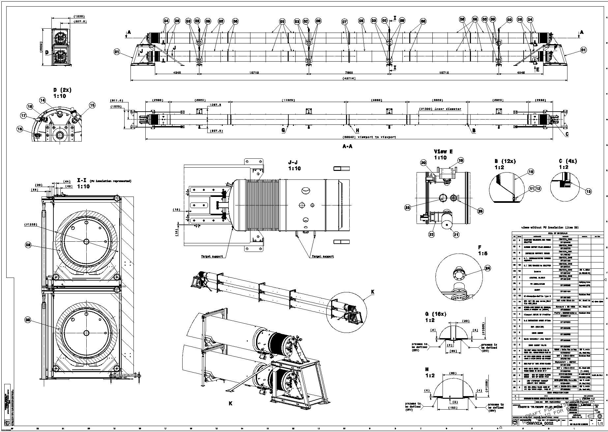
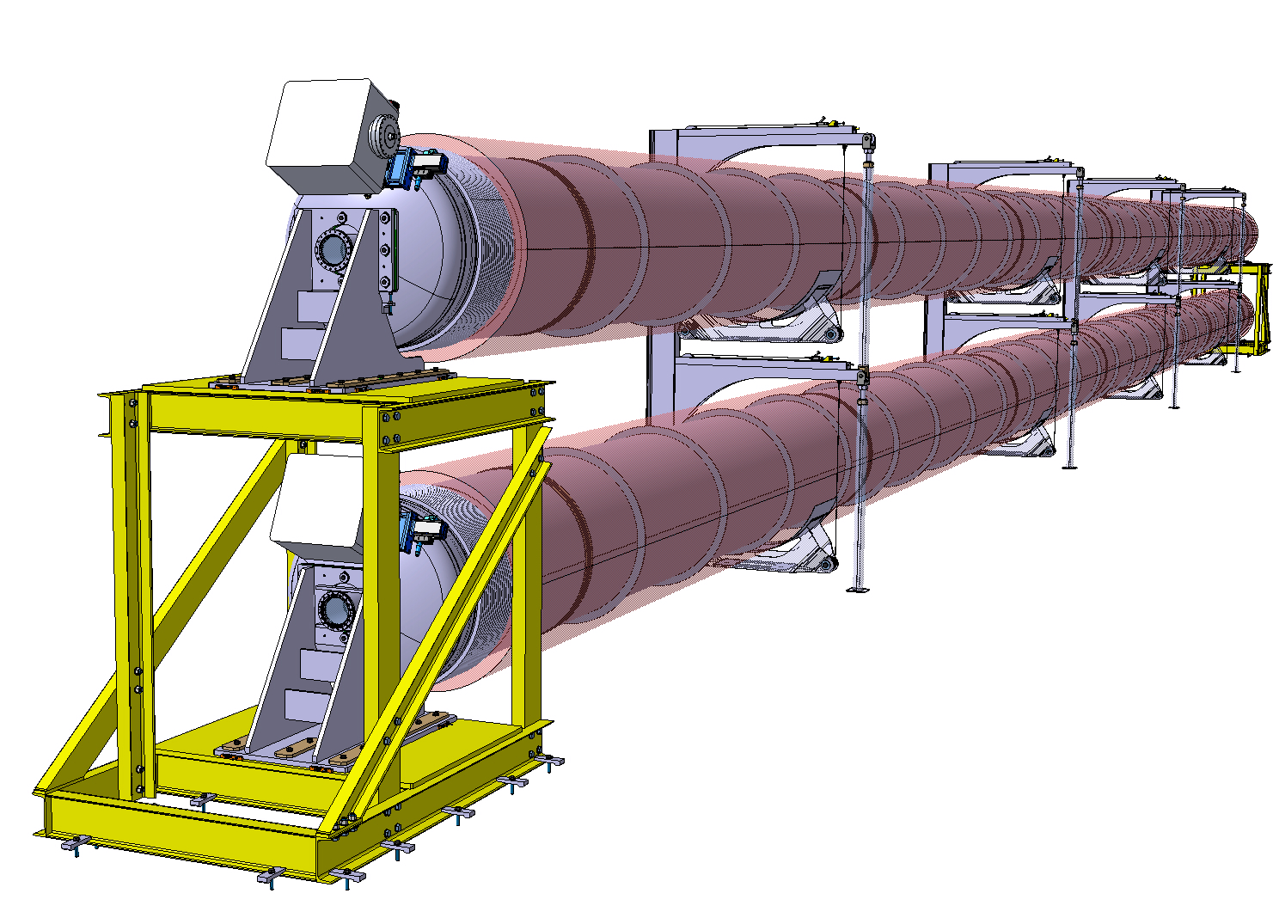
WP 6.2: Deliverables and milestones (1)
Preparatory Phase for the Einstein Telescope Gravitational Wave Observatory
2nd review meeting (RP2) — 15.05.2024
Pilot sector: from conceptual design to installation
Technical design
Conceptual design
Project: 101079696 — ET-PP, 2nd review meeting

Slide 10
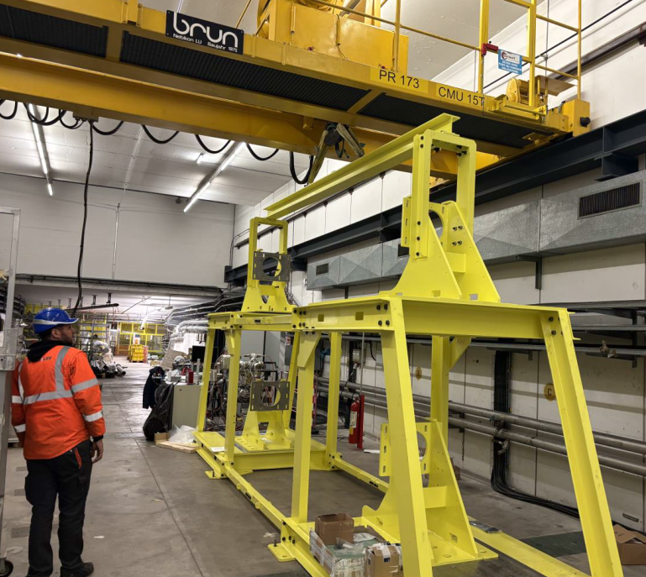
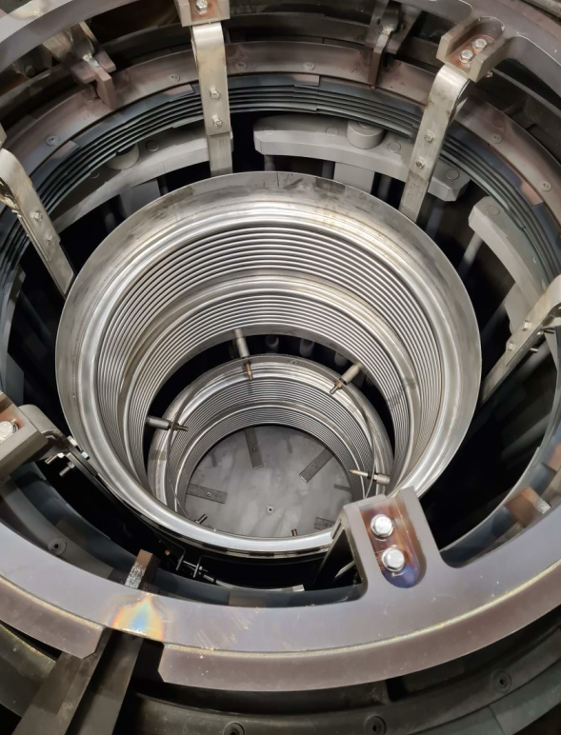
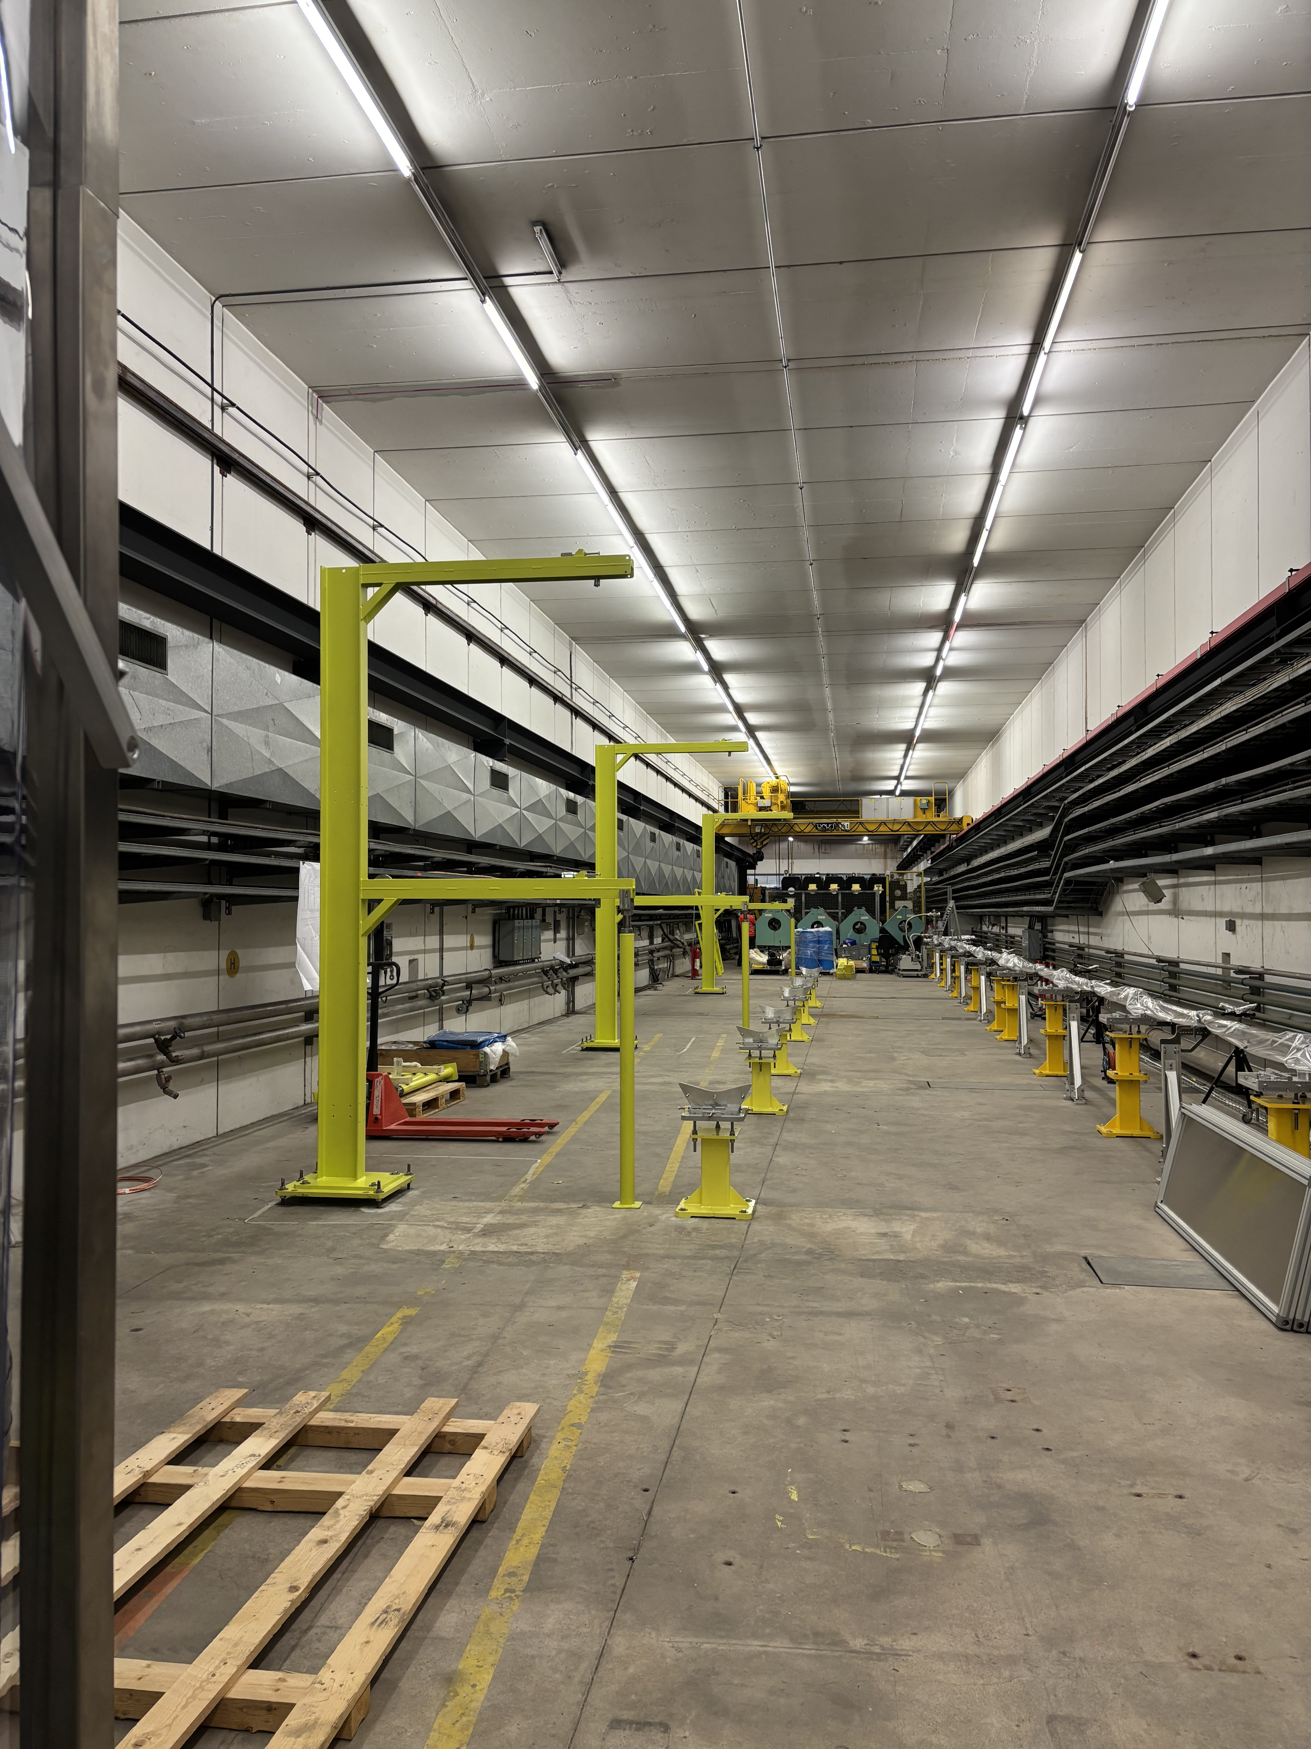
WP 6.2: Deliverables and milestones (2)
Preparatory Phase for the Einstein Telescope Gravitational Wave Observatory
2nd review meeting (RP2) — 15.05.2024
Pilot sector: from conceptual design to installation
Fabrication and installation
Test of support installation and
alignment in TT4
Installation of the extremity support in TT4
Compensation bellows in the CERN’s vacuum firing furnace
Project: 101079696 — ET-PP, 2nd review meeting

Slide 11
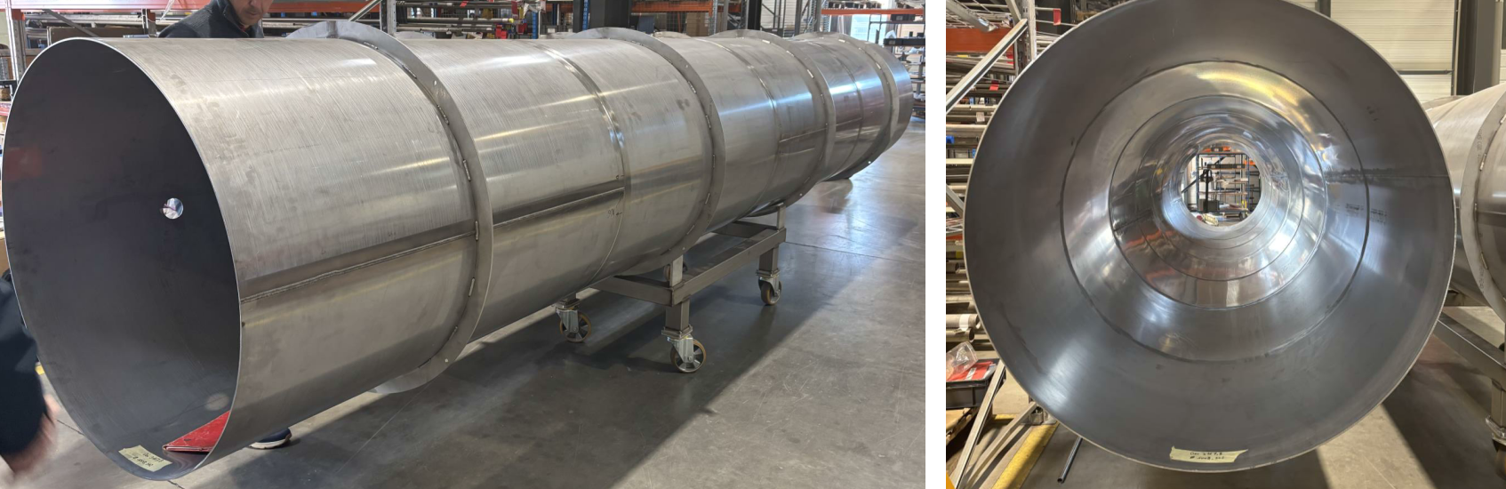
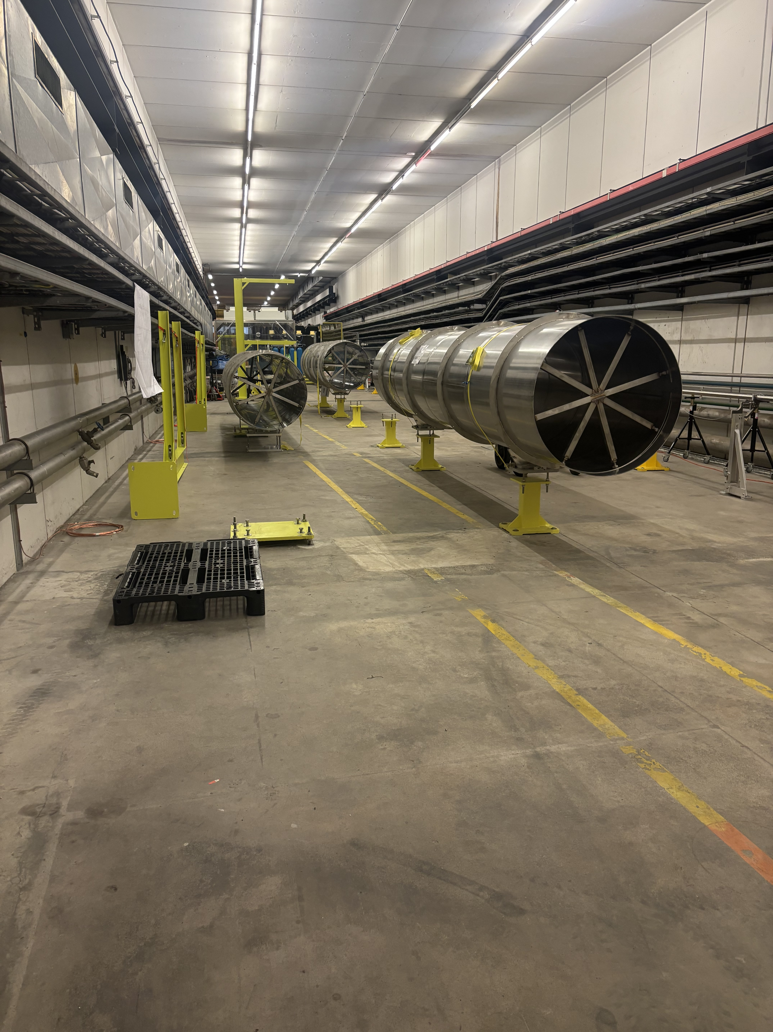
WP 6.2: Deliverables and milestones (3)
Preparatory Phase for the Einstein Telescope Gravitational Wave Observatory
2nd review meeting (RP2) — 15.05.2024
Pilot sector: from conceptual design to installation.
Fabrication and installation
Vacuum tube elements (first phase) at the supplier production plant
The detailed installation and measurement plan was prepared in January and is updated monthly based on input from the fabrication teams.
Currently, the measurements are organized into three main steps:
    Dust generation during tube junction assembly.
    Performance evaluation of pumps and instrumentation.
    Performance evaluation of a 36-metre-long pipe (scheduled to begin in August).
Vacuum tube elements (first phase) in TT4 at CERN waiting for optical baffle ring welding.
Project: 101079696 — ET-PP, 2nd review meeting

Slide 12
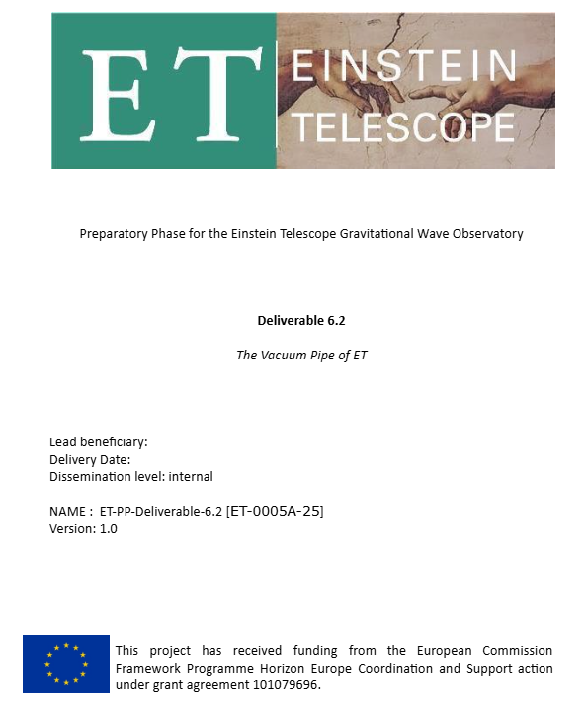
WP 6.2: Deliverables and milestones (4)
Preparatory Phase for the Einstein Telescope Gravitational Wave Observatory
2nd review meeting (RP2) — 15.05.2024
The Pre-TDR was issued in January following a peer review.
The review defined the focus areas for our current development activities:
Corrosion studies: Further investigations under realistic conditions relevant to the proposed sites.
Support system: A dedicated review will be organised before the next TDR version.
Corrugated pipe design: In collaboration with Dutch and U.S. initiatives.
Gate valve integration: Joint development with PSI and VAT to design alternative valve solutions.
Dust management: Closer collaboration with the team in Padua is anticipated.
Thermal insulation: In partnership with PIEP (University of Minho, Braga, PT).
Leak detection strategy: A review will be held prior to the next TDR version.
Project: 101079696 — ET-PP, 2nd review meeting

Slide 13
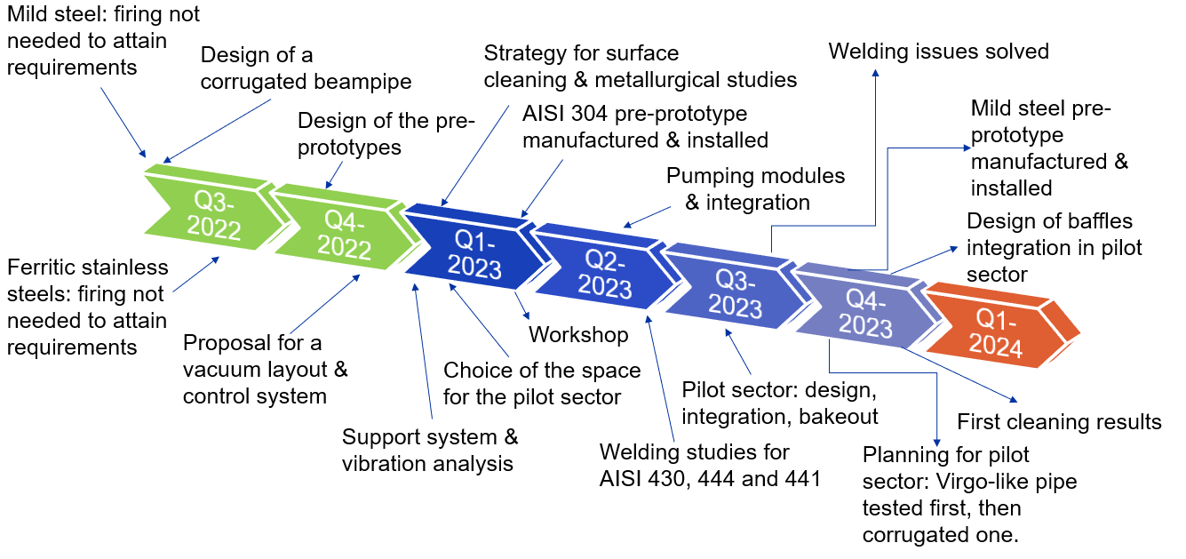
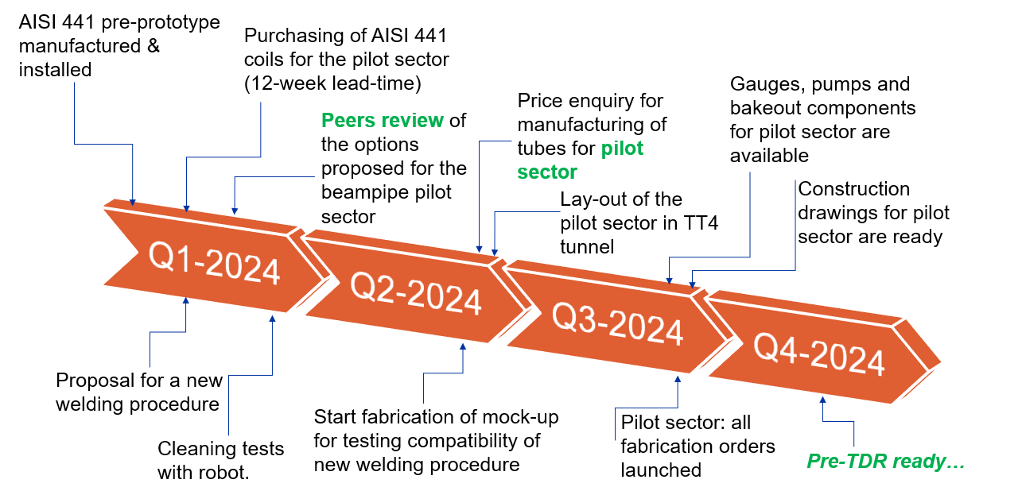
WP 6.2: Deliverables and milestones (5)
Preparatory Phase for the Einstein Telescope Gravitational Wave Observatory
2nd review meeting (RP2) — 15.05.2024
Technical results and achievement presented at the October’s review:
Project: 101079696 — ET-PP, 2nd review meeting

Slide 14
WP 6.2: Deliverables and milestones (6)
Preparatory Phase for the Einstein Telescope Gravitational Wave Observatory
2nd review meeting (RP2) — 15.05.2024
Expected technical results and achievement in 2025:
Pre-TDR
Outgassing rate of small valves finished
Assembly by sleeves tested with the mock-up.
Start of background measurements
Start of tests with the 36-m pipe
Firing of the bellows
Background system ready
Start of purchasing procedure for alternative tubes (pilot sector v. 2)
Q1-2025
Q2-2025
Q3-2025
Q4-2025
Support installation in TT4
Vacuum tube elements delivered at CERN.
Proposal of alternative supports and joining methods
Assessment of welds made by the tube supplier
Beginning of vacuum tube finishing
Extended-TDR ready
Project: 101079696 — ET-PP, 2nd review meeting

Slide 15
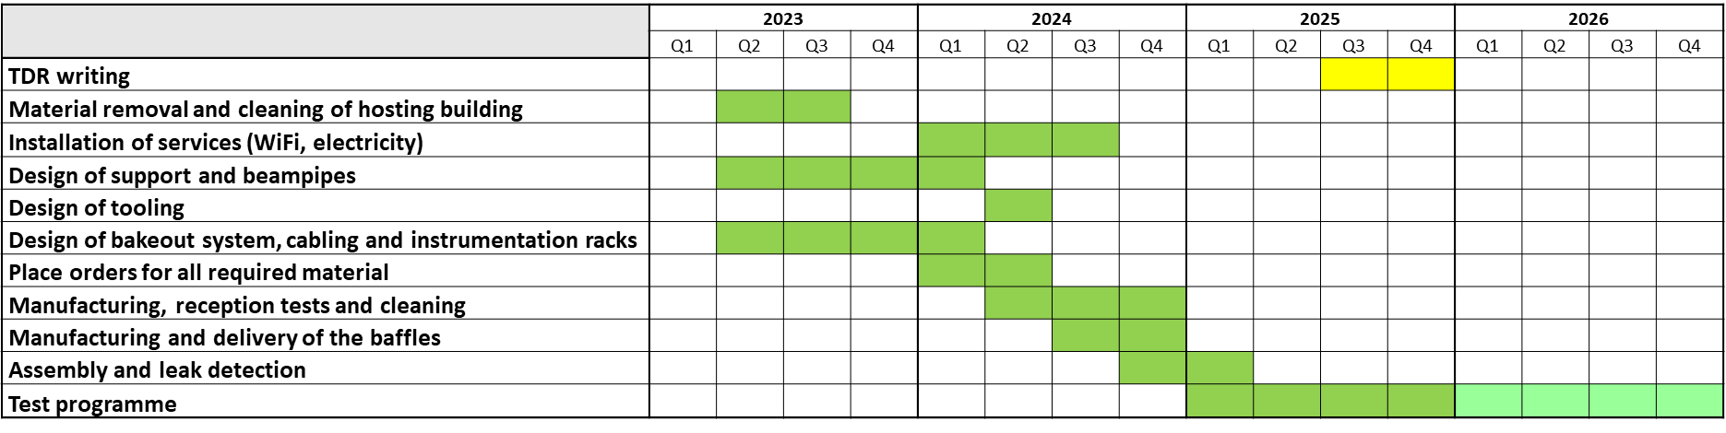
WP 6.2: Deliverables and milestones (5)
Preparatory Phase for the Einstein Telescope Gravitational Wave Observatory
2nd review meeting (RP2) — 15.05.2024
Updated master plan that includes the new addendum of our collaboration with NIKHEF, INFN and IFAE:
 | 2025 |  |  |  | 2026 |  |  |  | 2027
 | Q1 | Q2 | Q3 | Q4 | Q1 | Q2 | Q3 | Q4 | Q1 | Q2 | Q3 | Q4
Manufacturing and installation of pilot sector
Measurement with pilot sector (phase 1)
Extended-TDR
Purchasing of material for phase 2
Measurement with pilot sector (phase 2)
Purchasing of material for phase 3
Measurement with pilot sector (phase 3)
Technical documents for ET-beampipe market survey
Final TDR
We are experiencing a six-month delay compared to the previous master plan.
The first measurements with the pilot sector were initially planned for Q1 2025 but are now expected to begin in August.
Despite this delay, we aim to deliver the Extended TDR by the end of Q1 2026.
Previous master plan:
Project: 101079696 — ET-PP, 2nd review meeting

Slide 16
WP 6.2: Outlook and perspectives
Preparatory Phase for the Einstein Telescope Gravitational Wave Observatory
2nd review meeting (RP2) — 15.05.2024
We have entered a new phase in our involvement with the ET project. Moving from the conceptual design stage, we are now in the fabrication and installation phase.
This execution phase is encountering typical challenges related to purchasing, personnel availability, and technical issues.
These challenges provide us with opportunities to optimize the design and tolerances, refine installation procedures, and continue with parallel studies (e.g., corrosion, supports, and assembly).
As a result, the advanced TDR may be delivered a quarter later than originally planned.
Project: 101079696 — ET-PP, 2nd review meeting

Slide 17
ET-PP (WP6.2)
2nd review meeting (RP2)
Project: 101079696 — ET-PP — HORIZON-INFRA-2021-DEV-02
Horizon Europe:
Coordination and Support Actions
15/05/2025
Grant agreement: Nº 101079696

