Slide 1
Gamma Factory Updates
May 13th
Shelby Cavanaugh

Slide 2
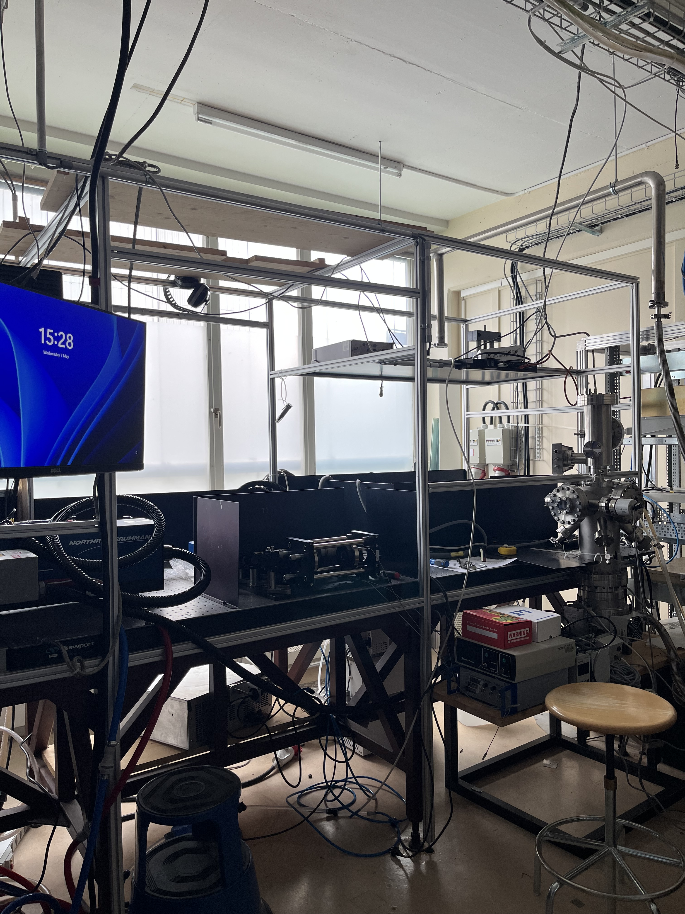
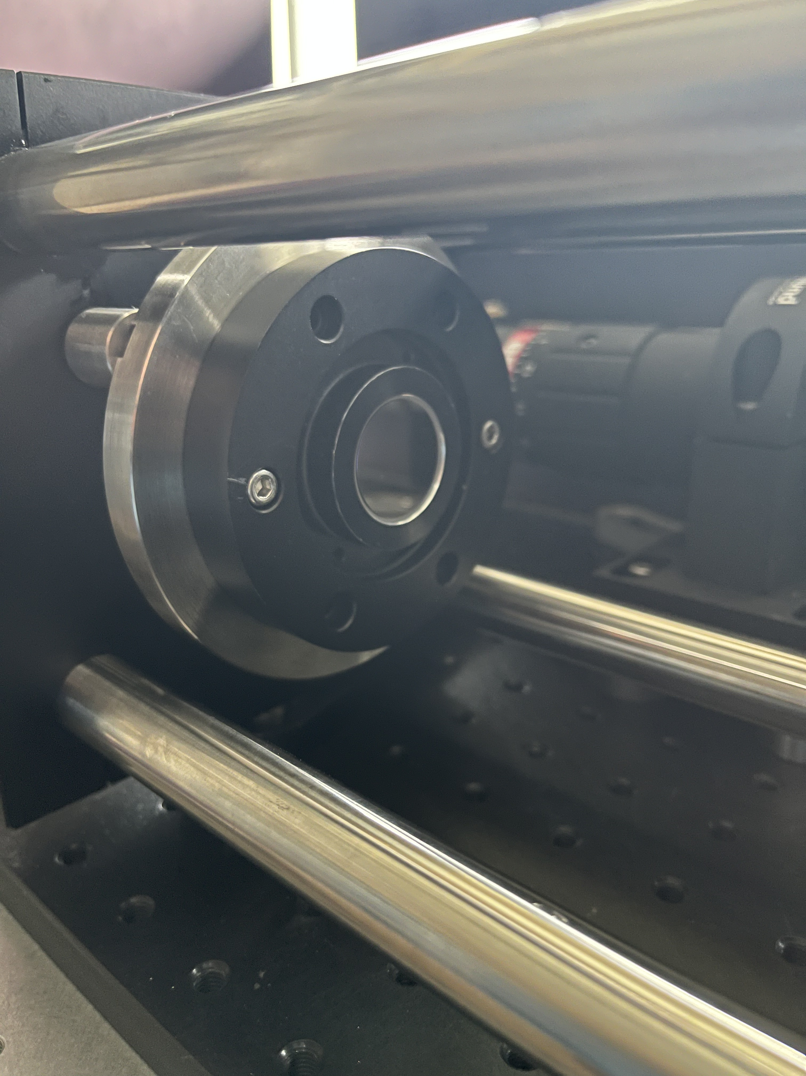
Updates
New mirrors arrived
Did some calculations and reading in the down time
Moved all my stuff to LARIS on Monday
Getting familiar with Raspberry Pi
  Going to integrate into my set up for piezo control and recording data
Set up the new lab
  Replaced the Mirrors
Lots of alignment work

Slide 3
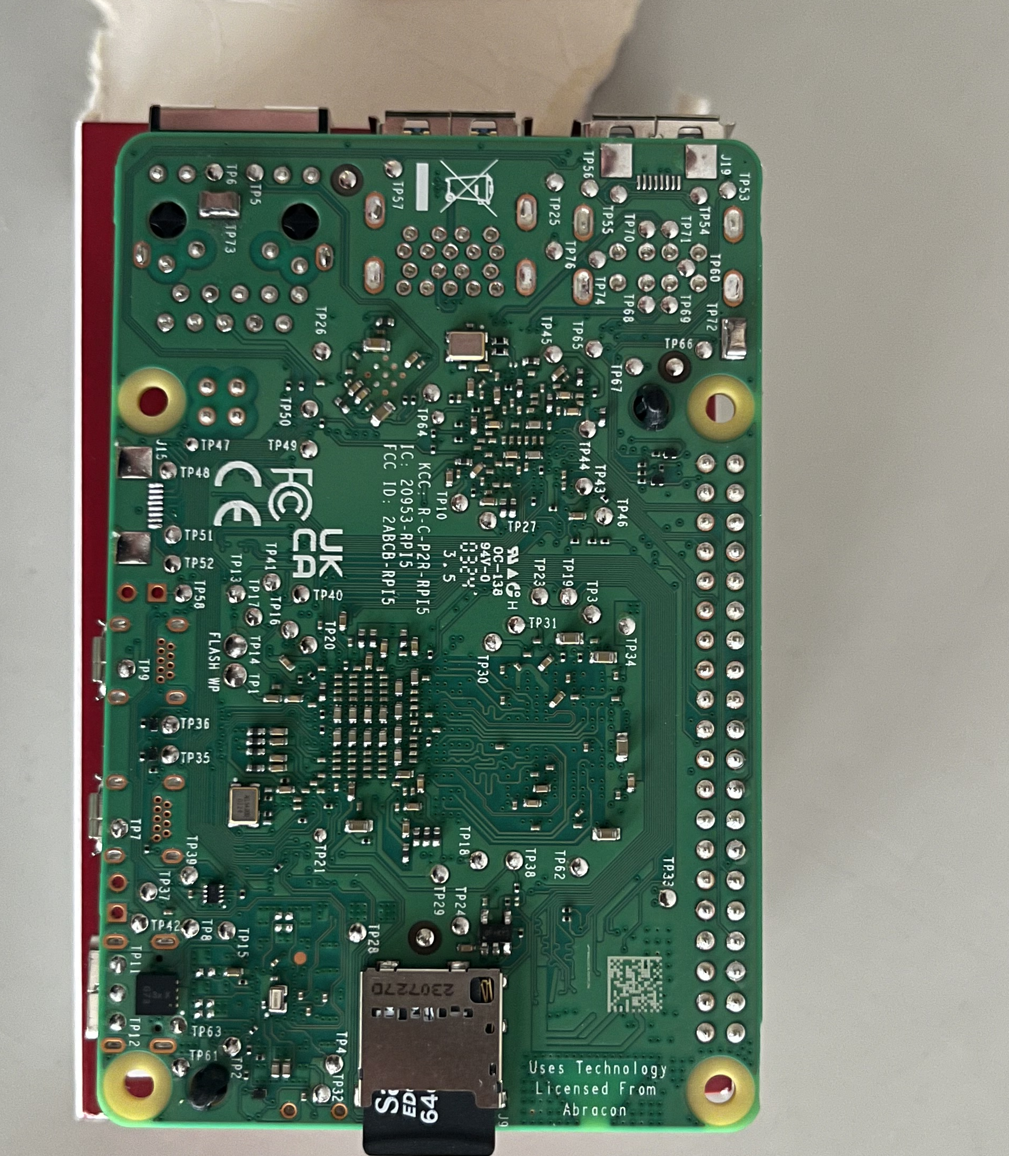
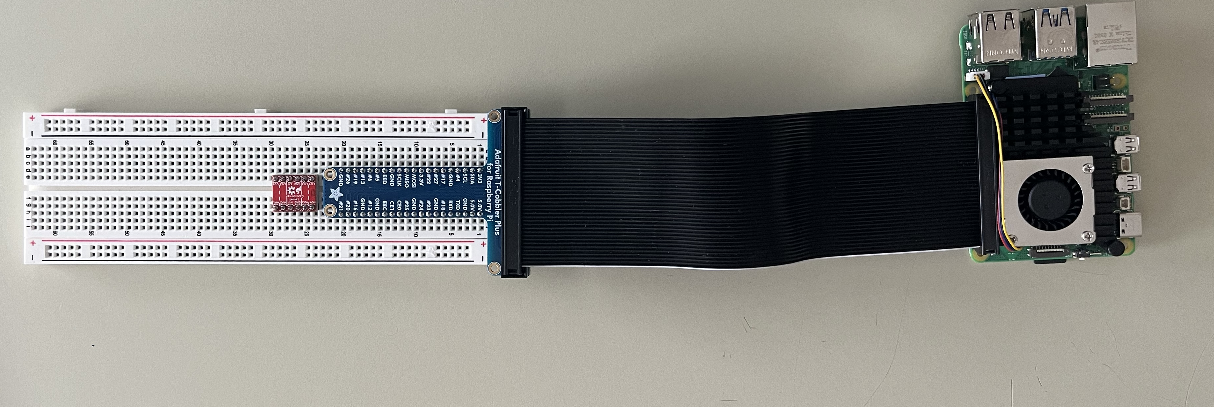
Raspberry Pi
Given enough time allows
Going to use to control the Piezos
  Possibly also attach the output of the photodiode
    Would remove the need for the oscilloscope
This would automate everything to one location and make it easier to quickly adjust and take measurements
  Not the most important focus as of right now
  Can do the same things with an oscilloscope and direct BNC connection to a signal generator
GPIO → DAC (MCP4725)
  Creates precise voltage levels or dynamic analog wave forms
  VCC to 5V
  GND to GND
  I2C Communication
    SDA to SDA (data)
    SCL to SCL (clock)
    Output to Op-amp(+)
      R1 to GND
      R2 to Output to BNC
        BNC is the input of the Piezo Amplifier
        Op-amp optionally used to scale the DAC 0-5V to the piezo controller voltage range so 0-10V
Photodiode Connection
  Photodiode current output to Transimpedance amplifier
    Converts current to voltage
  TIA to ADC

Slide 4
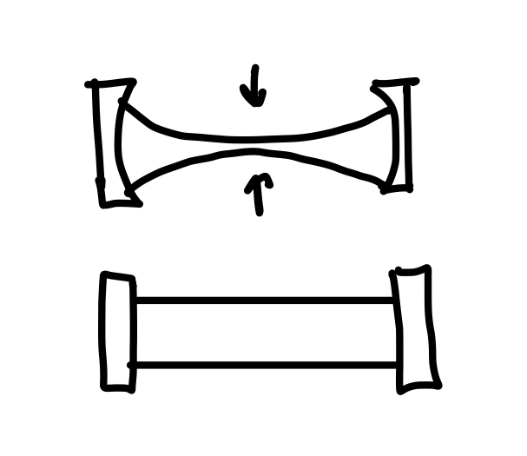
Alignment
Current major issue
  More difficult than it should be indicating something is going wrong
  Possibly something not being compensated for
Addressing the issues with alignment
    Spot size
      Issue may be caused from the increasing divergence of flat mirrors
      Flat mirrors give a large spot size (w0) but allow for scanning
      Can mean that our expanded beam might not meet requirements for saturation making it harder to align
      We want to reduce beam divergence by increasing beam diameter
Calculate round trips needed for close to equal transmission out of cavity
  Easy indication that the cavity is in resonance
  Meaning the cavity has hit saturation and can’t transmit more power than was input

Slide 5
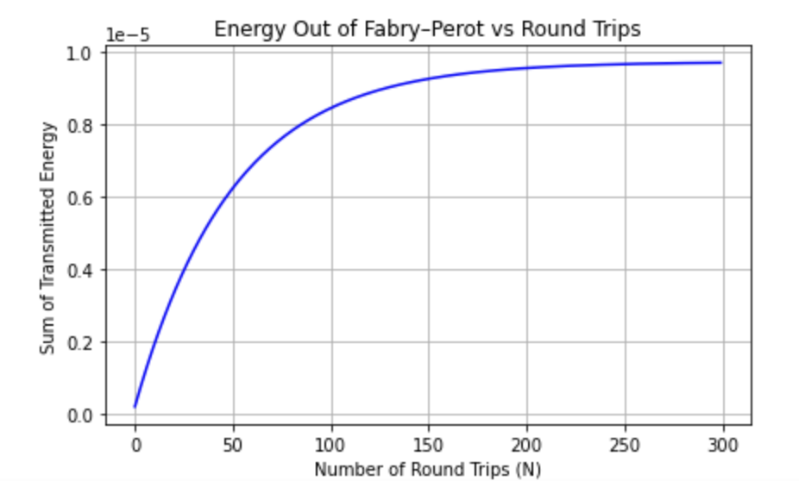

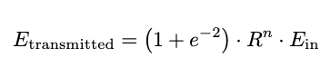

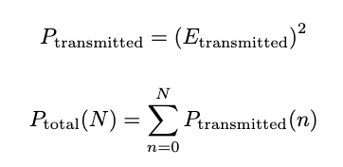
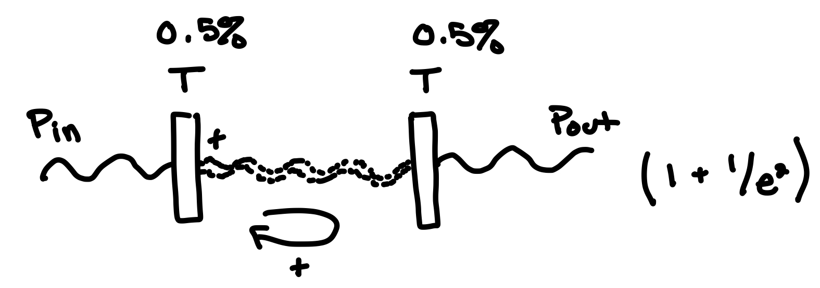
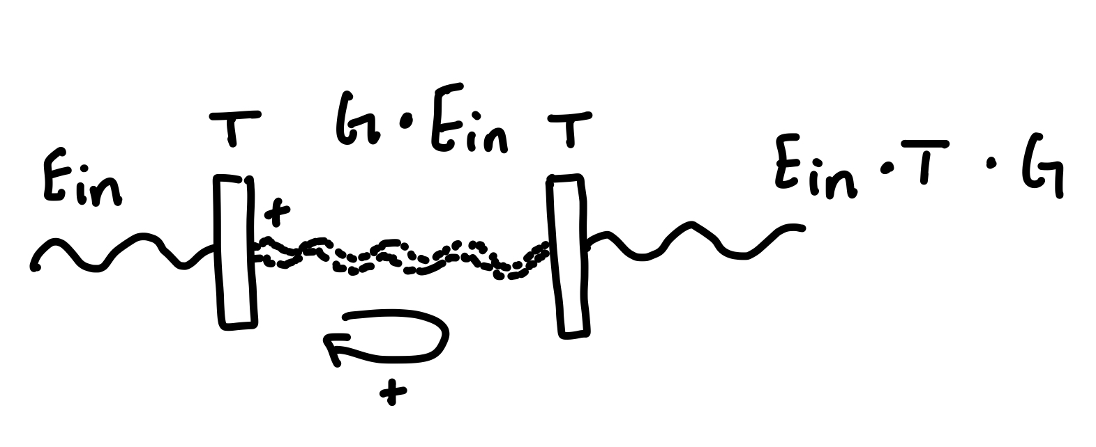
Calculations
First need to find the number of round trips needed to reach the maximized transmission.
P = 1.5x10^-3 W
Each round trip adds in phase to the small transmitted wave of the first mirror. When the wave hits the second mirror a small amount is also transmitted through. Saturation is reached with this amount out cannot be any larger due to the amount of power in.

Slide 6
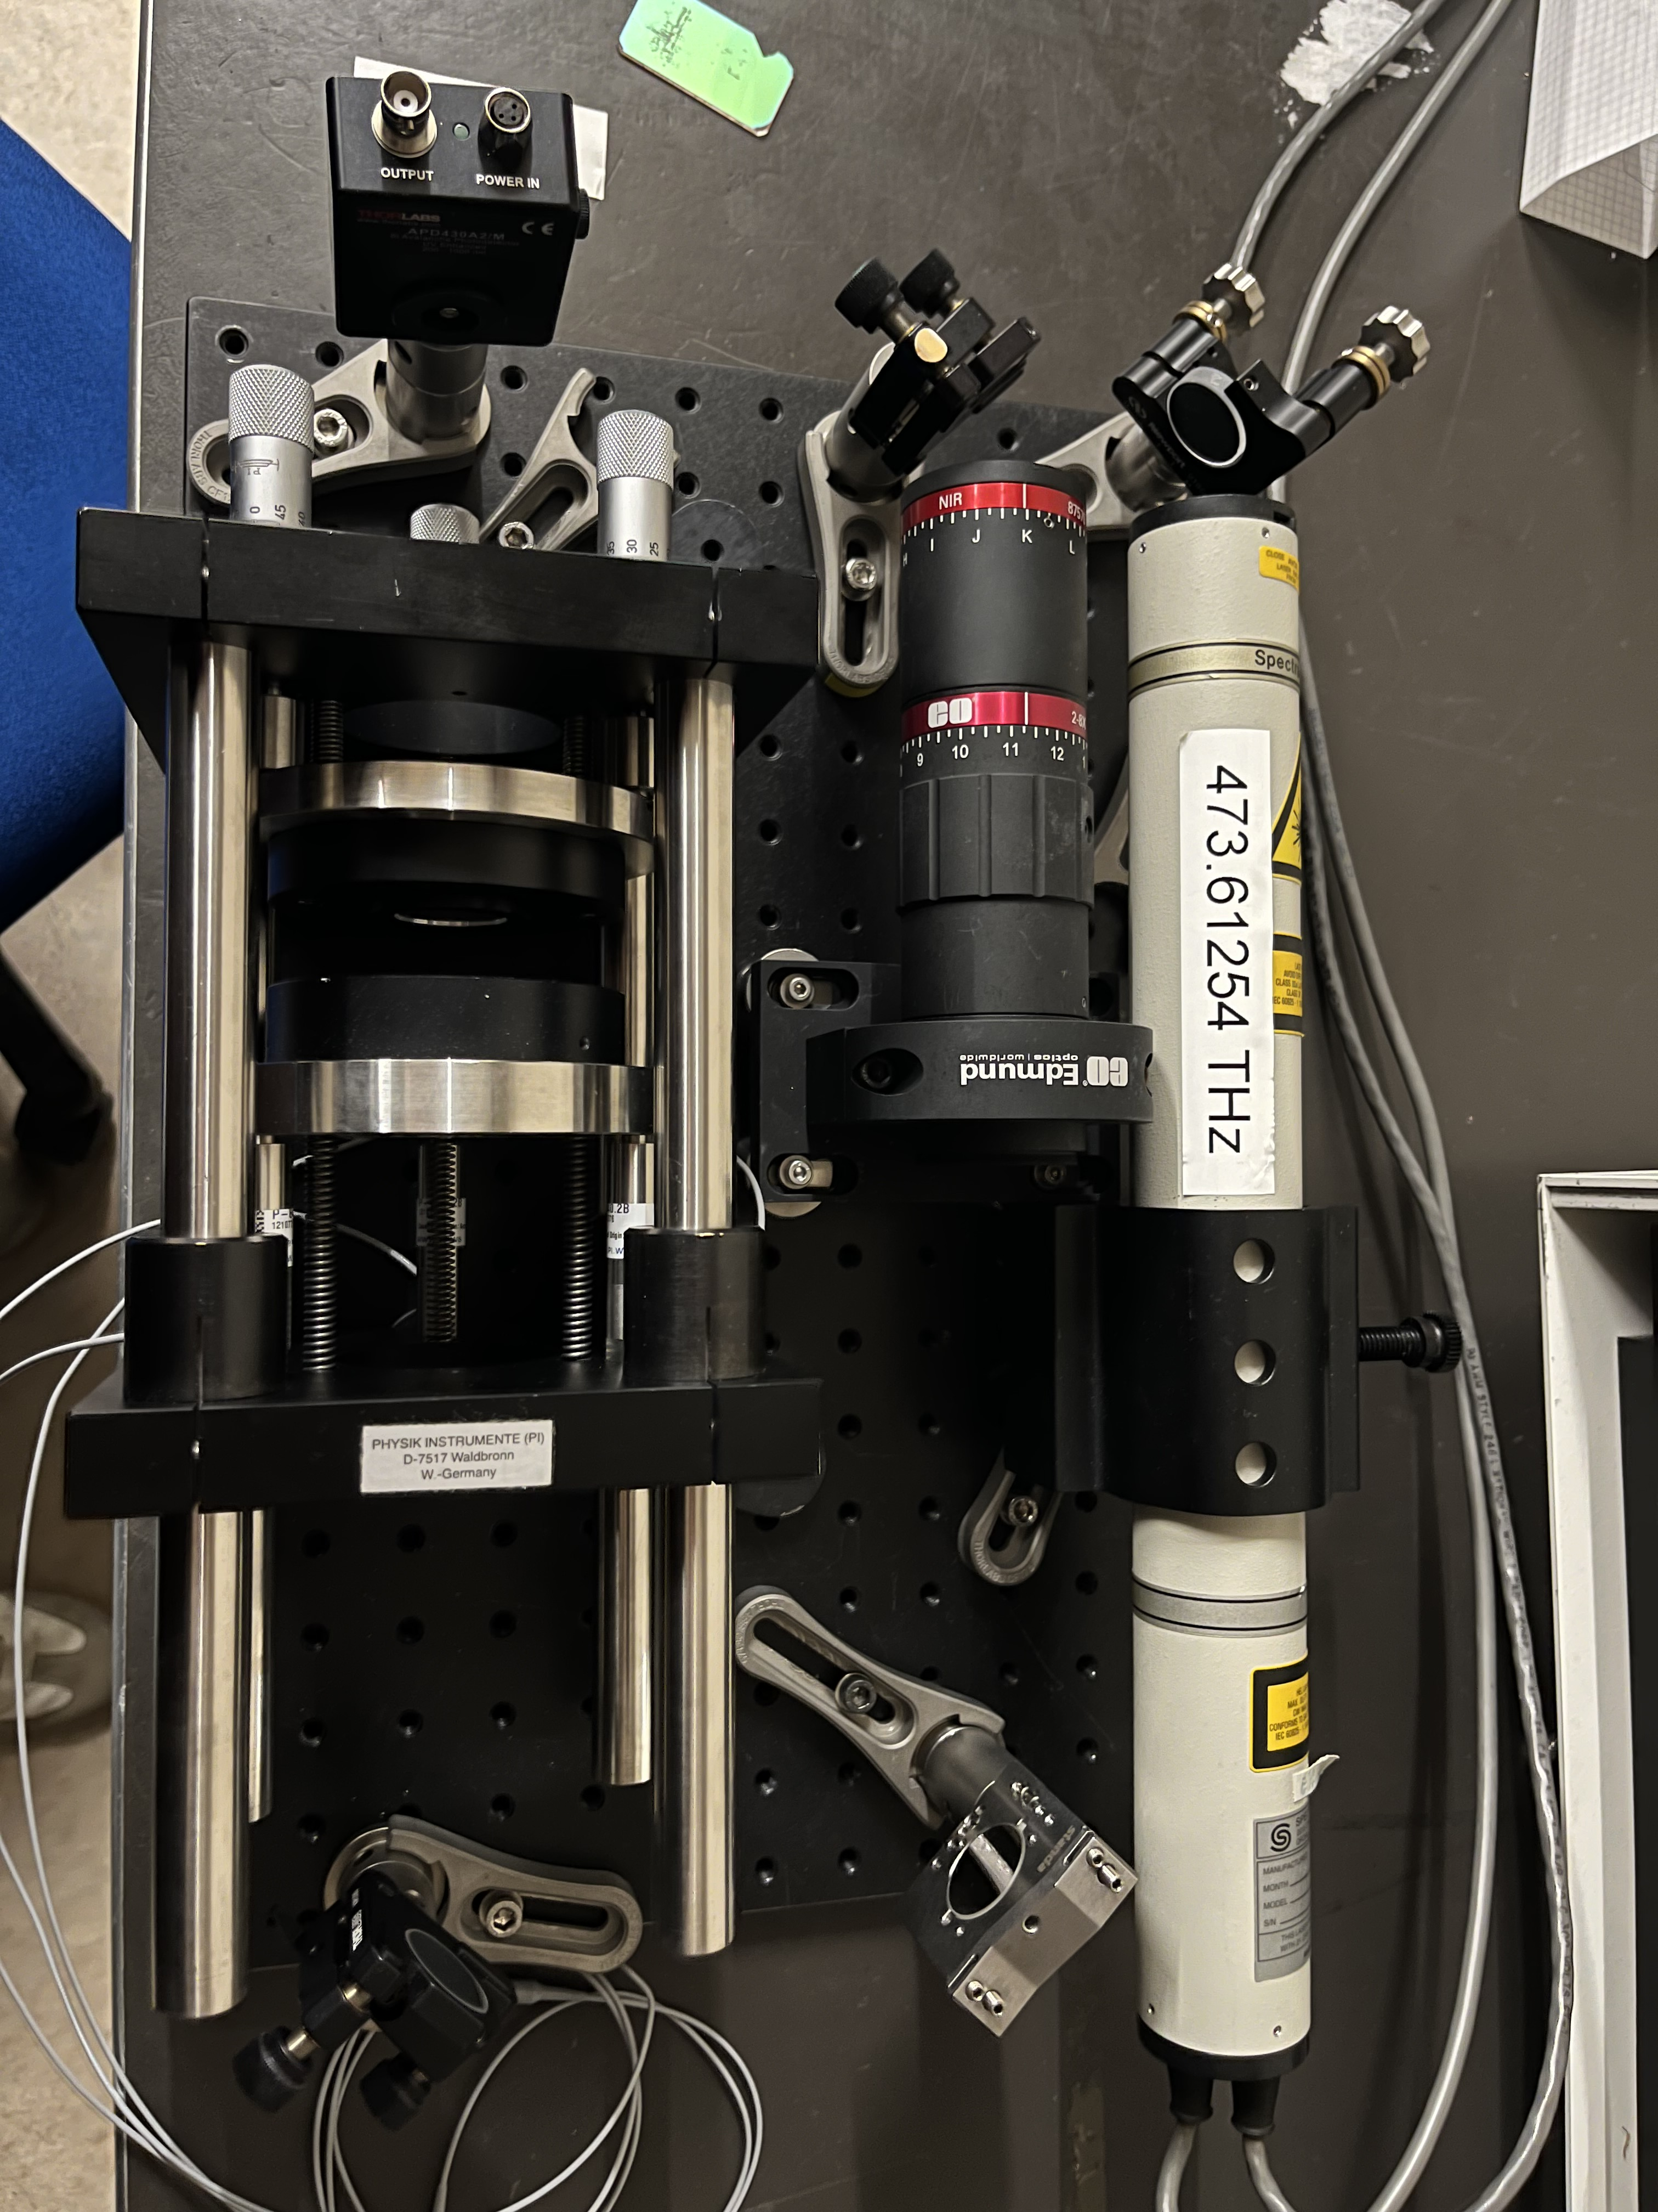


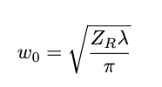
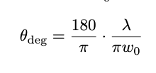
Beam Waist
Use this N and with the length of the cavity to find the beam waist.
 | L = 0.3 N = 200 | L = 0.075 N = 200
Rayleigh Range (ZR) | = 120m | = 30m
Beam Waist (w0) | = 4.92mm | = 2.46mm
Divergence angle | = .000041 | = .000082
As length of the cavity decreases your FSR increases
→ The longer the cavity the more precise your FSR is (LIGO)
→ The shorter you go the worse resolution you have but the easier it will be to align

Slide 7
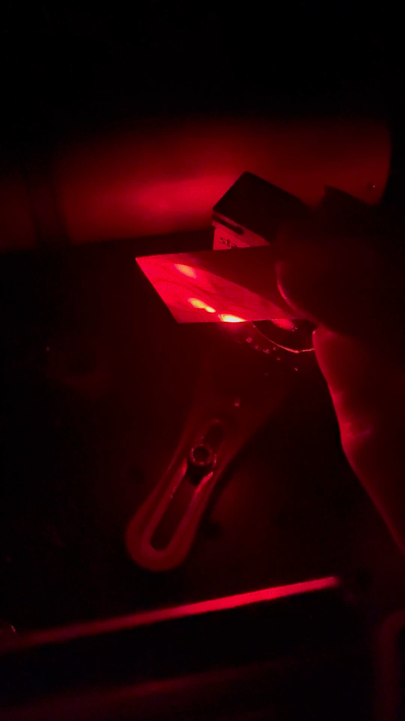
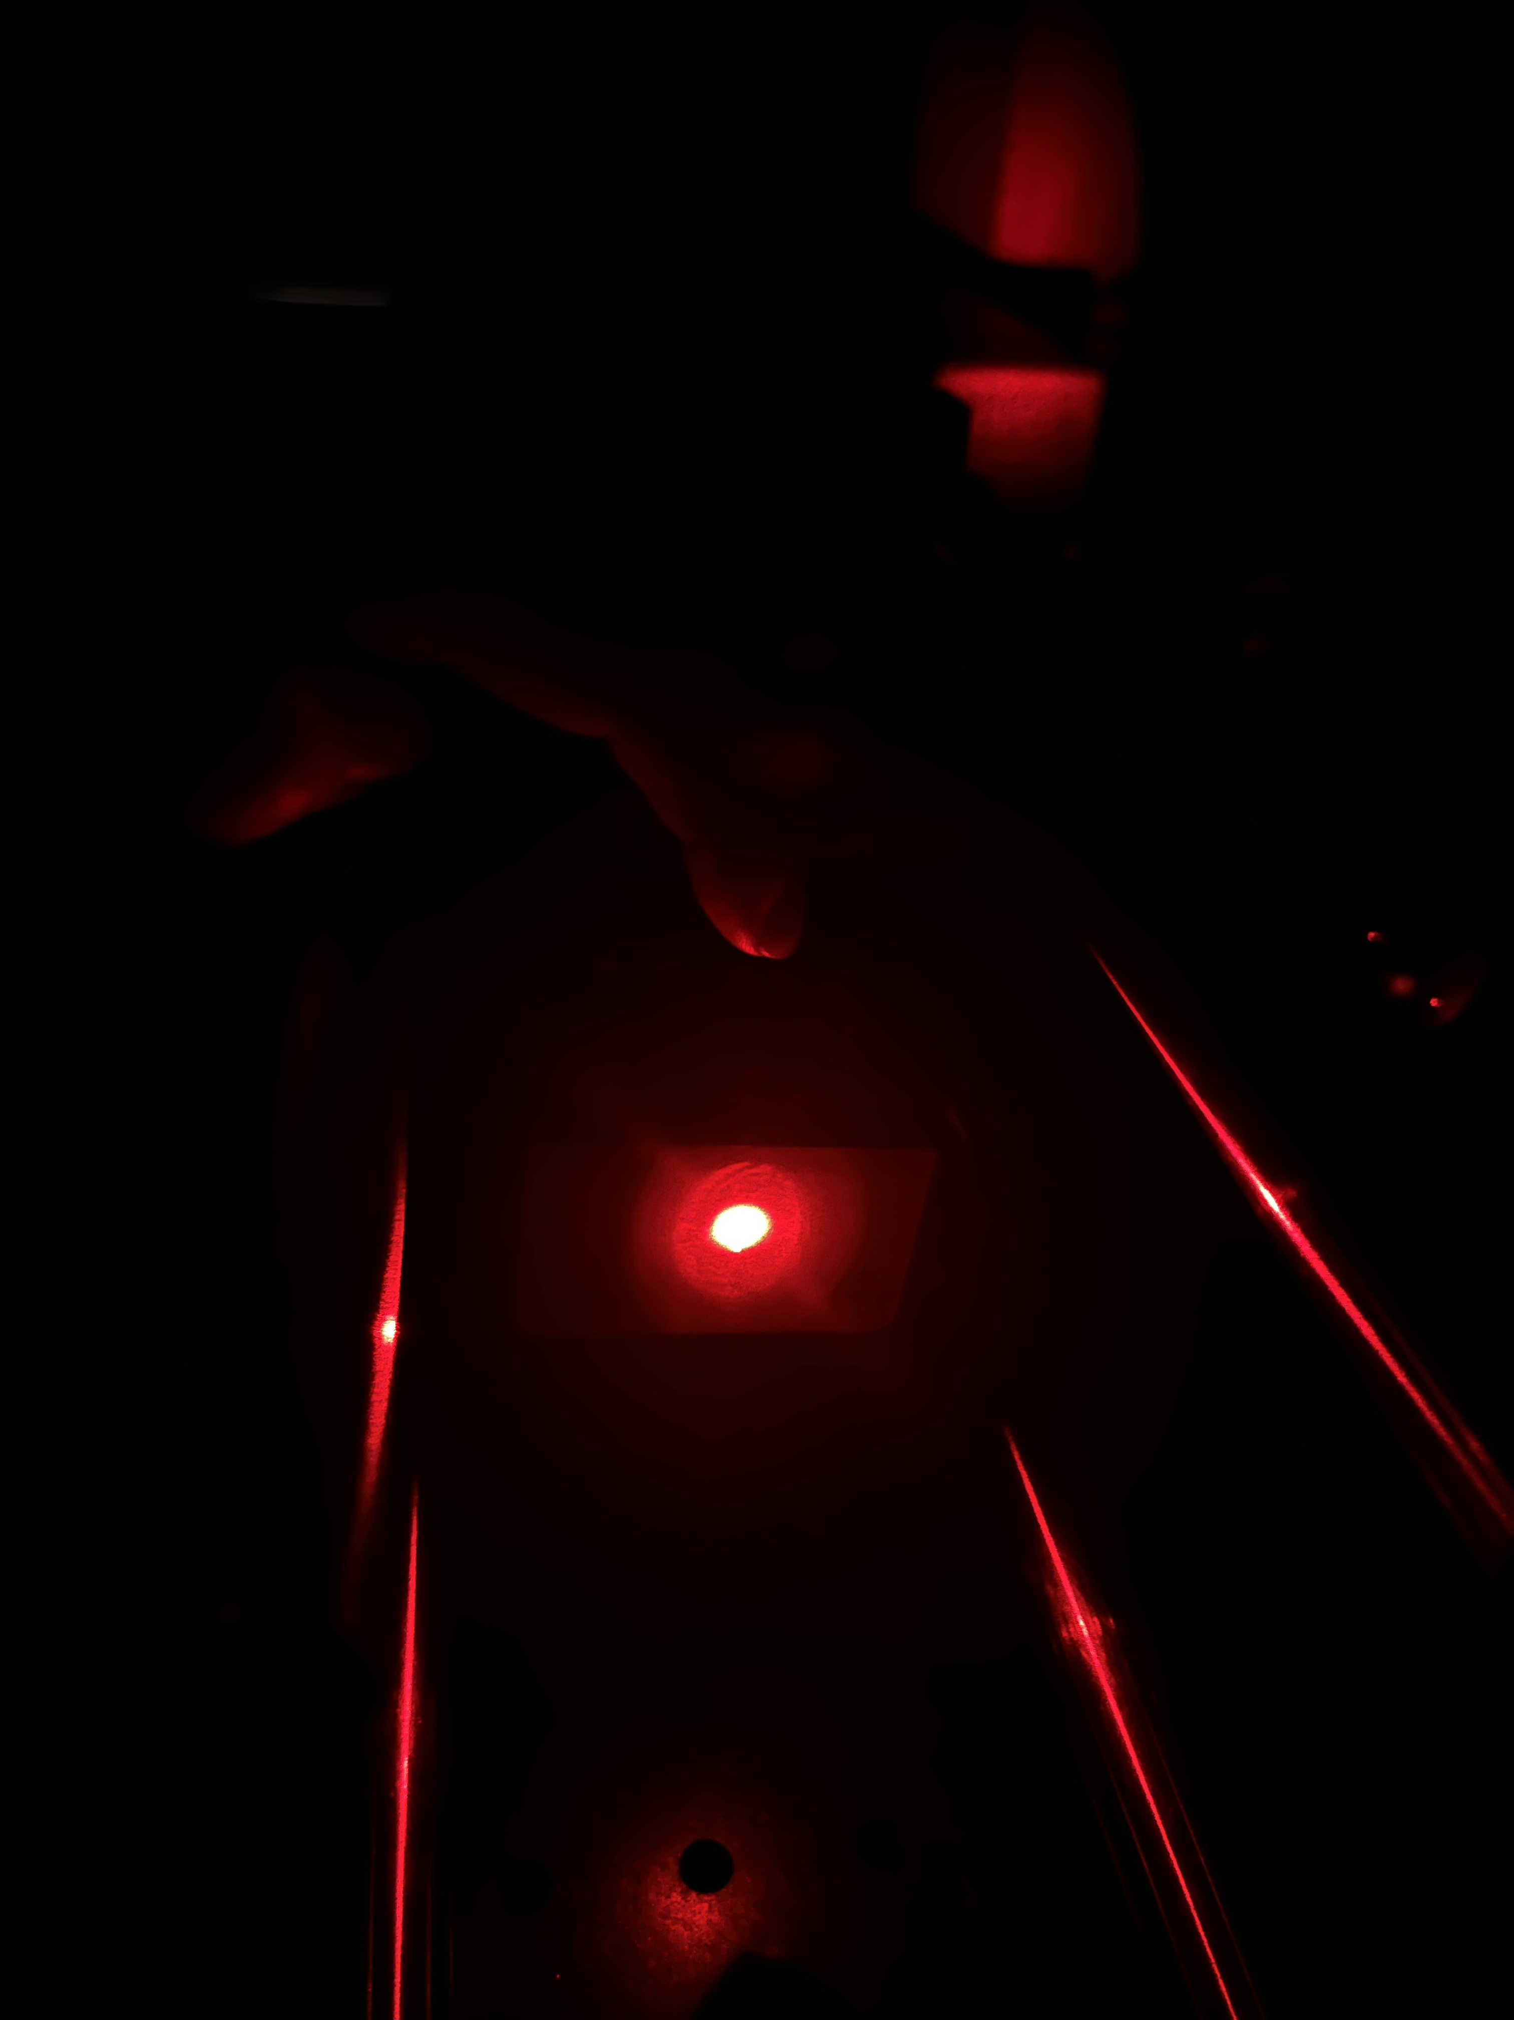
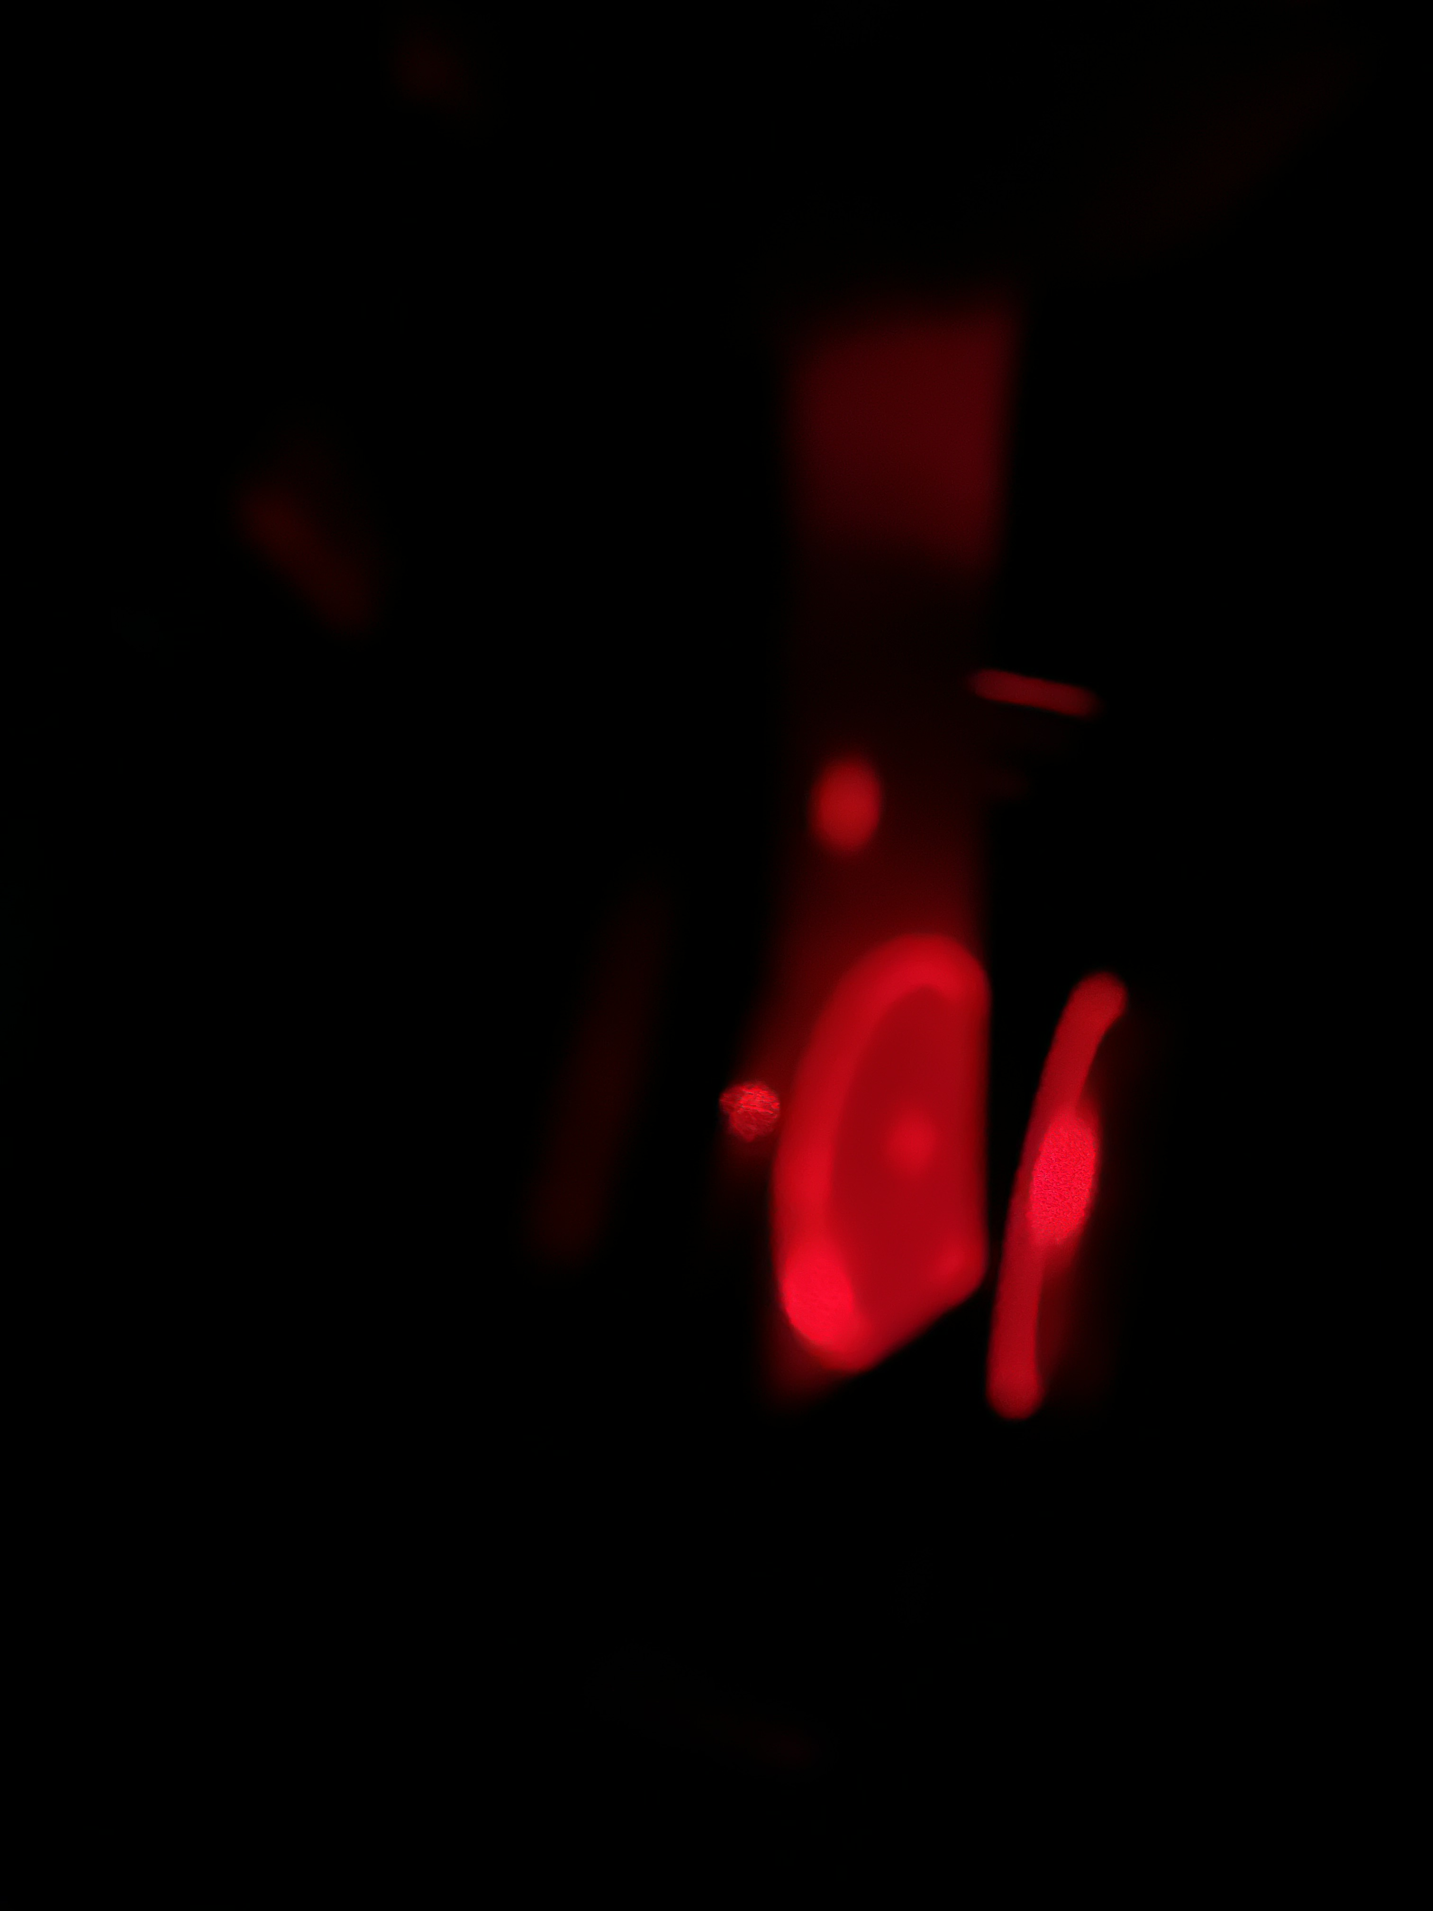
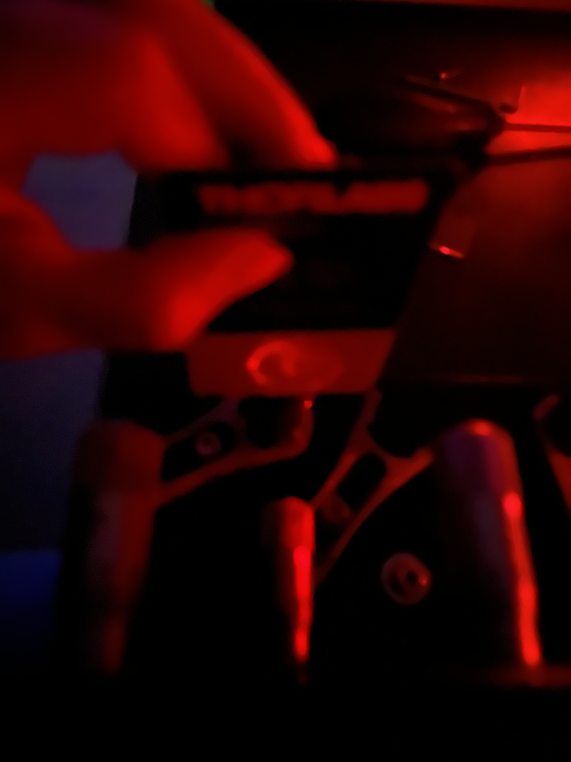
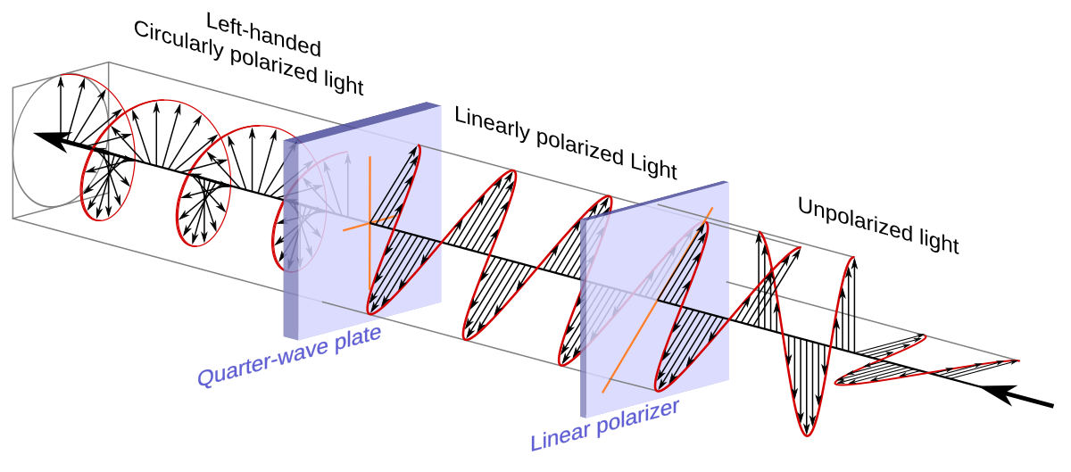
Didn’t fix the issue
Sadly, solution did not work and could still barley see any transmission
Current state is trying to figure out what else could be wrong
  Ideas are limited
  Possibly messing with the laser
    Giving me issues with its frequency lock / stabilization
  Going to try stopping the back reflection from going back to the laser.

