Slide 1

Progress Update #6
Payton Harvill
13.05.2025

Slide 2
Reminder From Last Time:
Coding Improvements:
  Had the goal of implementing a monte carlo method to propagate errors
  Remove the AOM signal to improve calculation
Magnesium Systematics: Photon Recoil
  The new systematic measurements conducted: Changing the amount of helium buffer gas, change the number of ions in each bunch by changing the loading time of ions to the trap, changing the laser power to see how the centroid changes

Slide 3
Improving the Uncertainty Calculation:
I was able to successfully implement the monte carlo method as well as do the subtraction of the AOM signals
  I’ve had to omit a lot of sweeps due to the AOM signal removal so the plots look bad, still need to check for accuracy but the output is promising.. Haven’t perfected it yet
I revisited an idea I had from a couple weeks ago: autocorrelation function
  Essentially, it slides the original signal against itself by a certain perturbation and measures how well it matches at these different time lags, with peaks appearing at integer multiples of the true period.
  Not sure if it works yet.

Slide 4
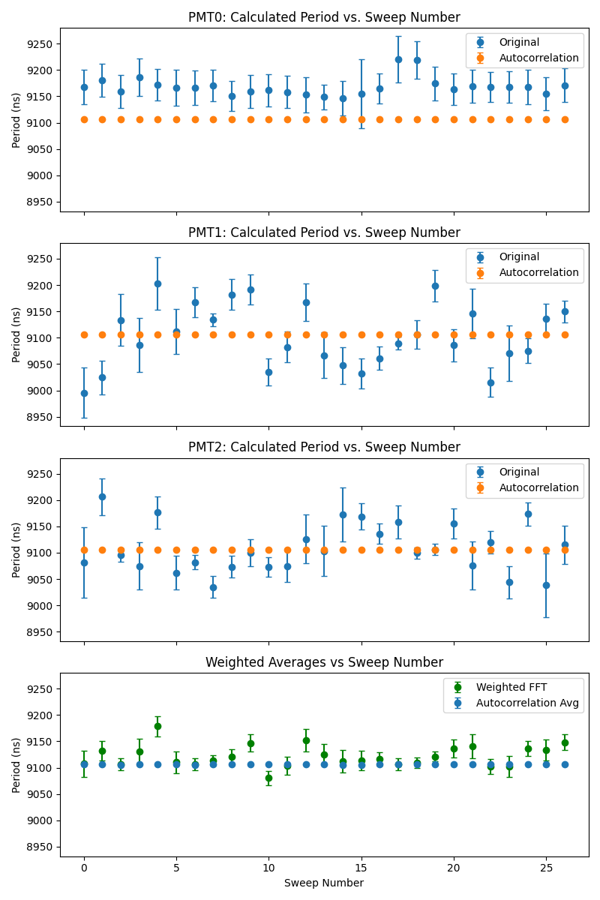
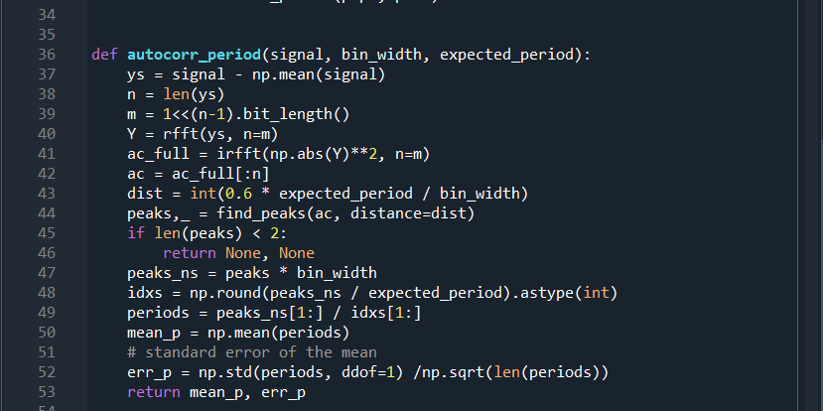
Produced plots from the autocorrelation function WITHOUT background sub:
Seems as though it is much more consistent
I hope this is good?
Example output:
PMT2sweep18:
Fft: 9099.57±10.83
Auto:9105.84±0.095736

Slide 5
Lab work…
We are helping with another experiment’s beamtime (COLLAPS), so I haven’t done much lab work in the past two weeks
This experience is preparing me for what I will be doing later on in the summer
Additionally, we are still working on getting all the necessary parts to do an equipment upgrade for cadmium.
Still working on characterizing all of the results from the magnesium systematics. It is just anthony and I so there is a lot of work to be done.

Slide 6
The end.

