Slide 1


Performance Evaluation of TOF-PET Readout Electronics: Progress & Contributions #6
Cesar Cardona*
Boston University | Group: EP-CMX-DD
Mentors: Carsten Lowis✲ , Giulia Terragni※
* sciences@bu.edu | ✲ carsten.lowis@cern.ch | ※ giulia.terragni@cern.ch
Cesar Cardona
May 13, 2025

Slide 2
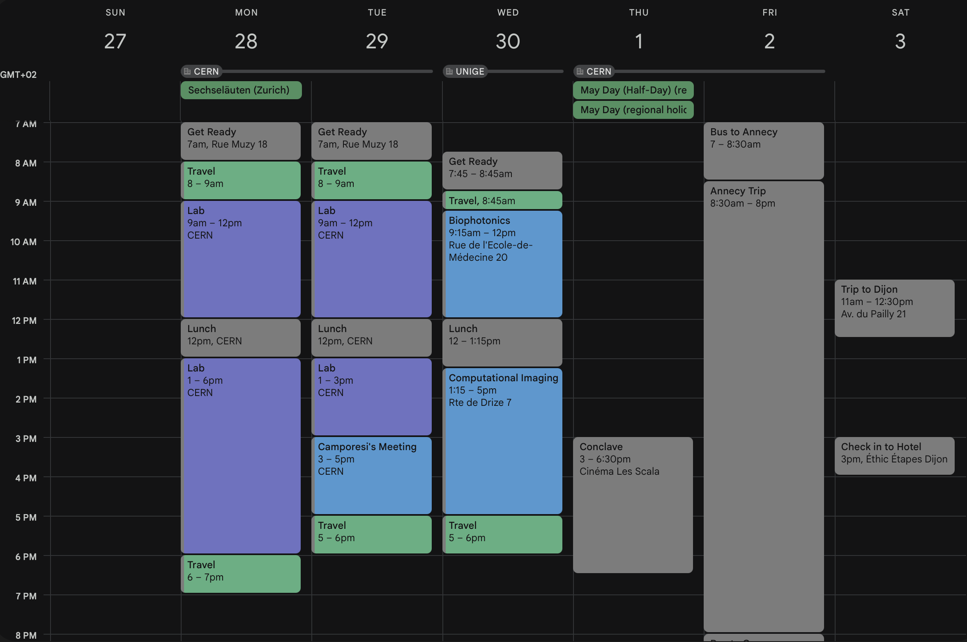
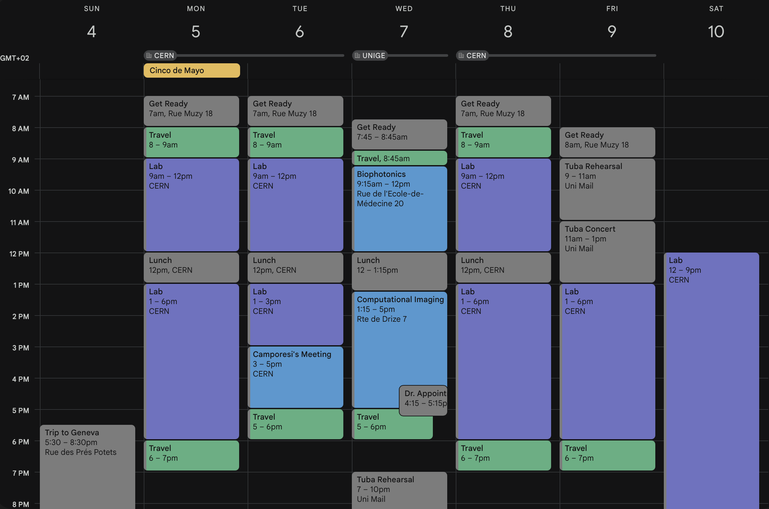
April 27 – May 10
Cesar Cardona
May 13, 2025

Slide 3
CTR Board Fix
Cesar Cardona
May 13, 2025

Slide 4
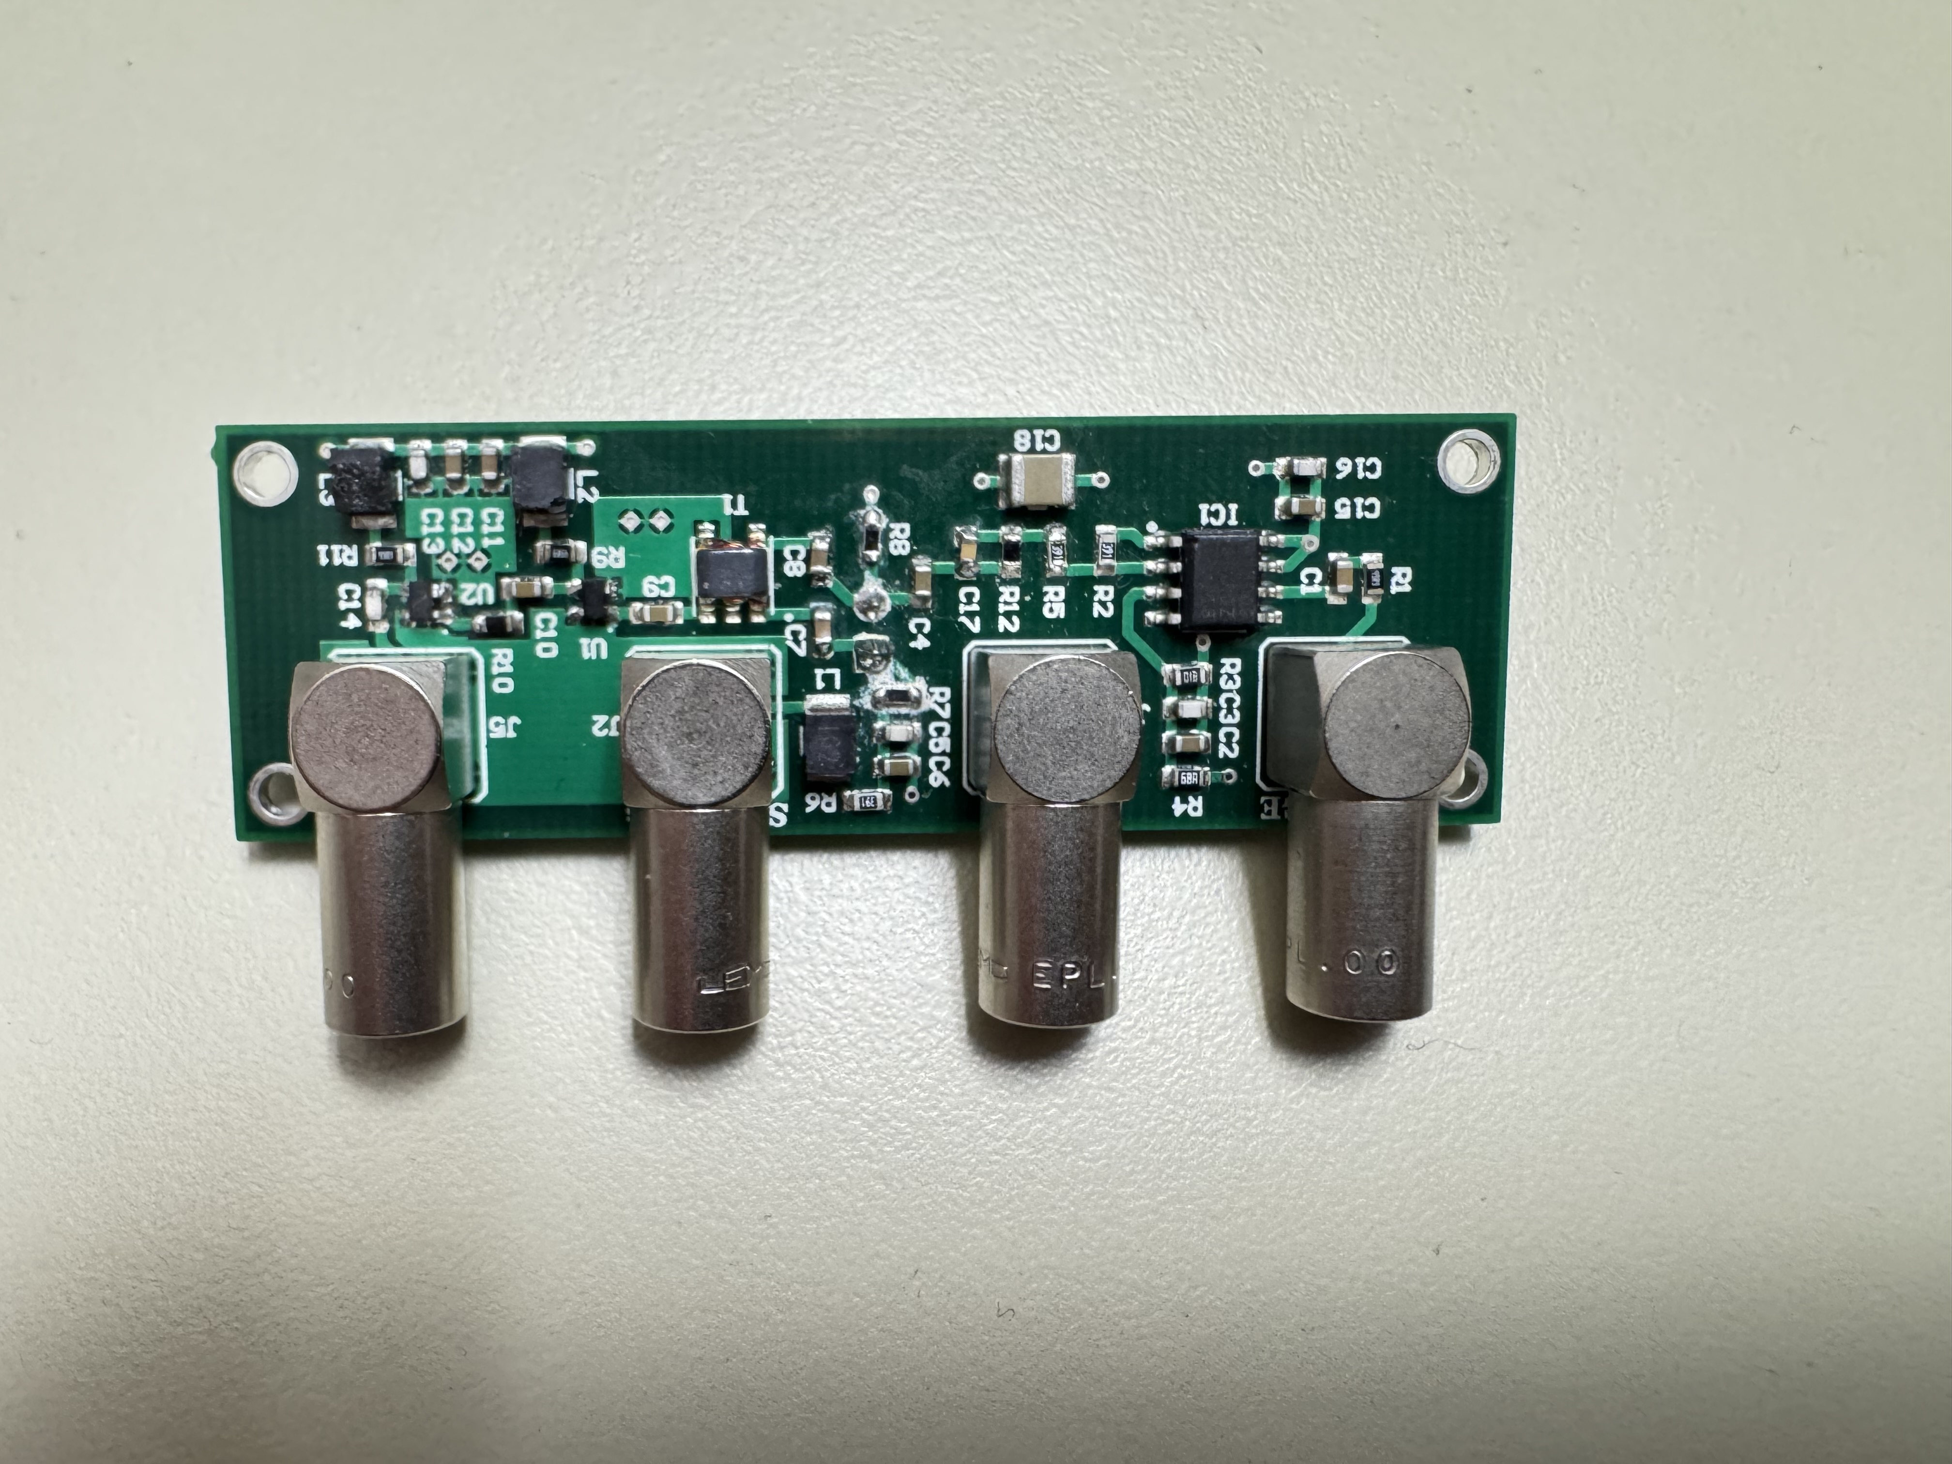
Initial Board Failures and Diagnostic Approach
• Out of 5 TOF-PET readout boards, only one was fully functional by May 9.
• Boards began failing progressively — symptoms first appeared in the timing branch.
• I developed a systematic, multi-step diagnostic method to identify, classify, and repair faulty boards.
Example of a TOF-PET readout board.
Cesar Cardona
May 13, 2025

Slide 5
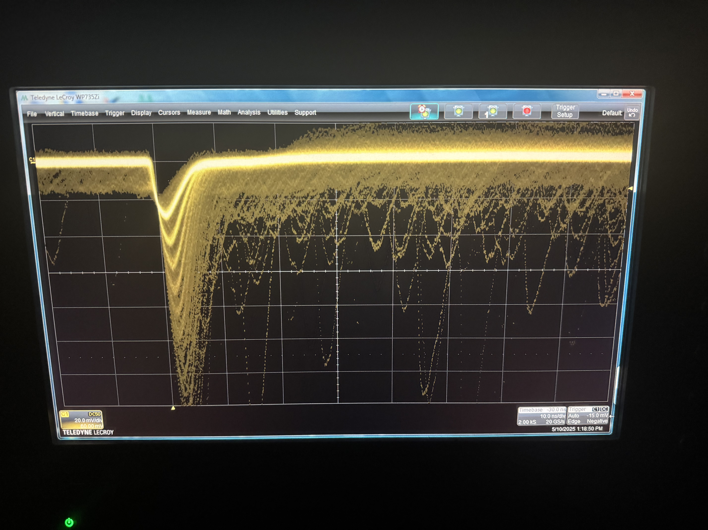
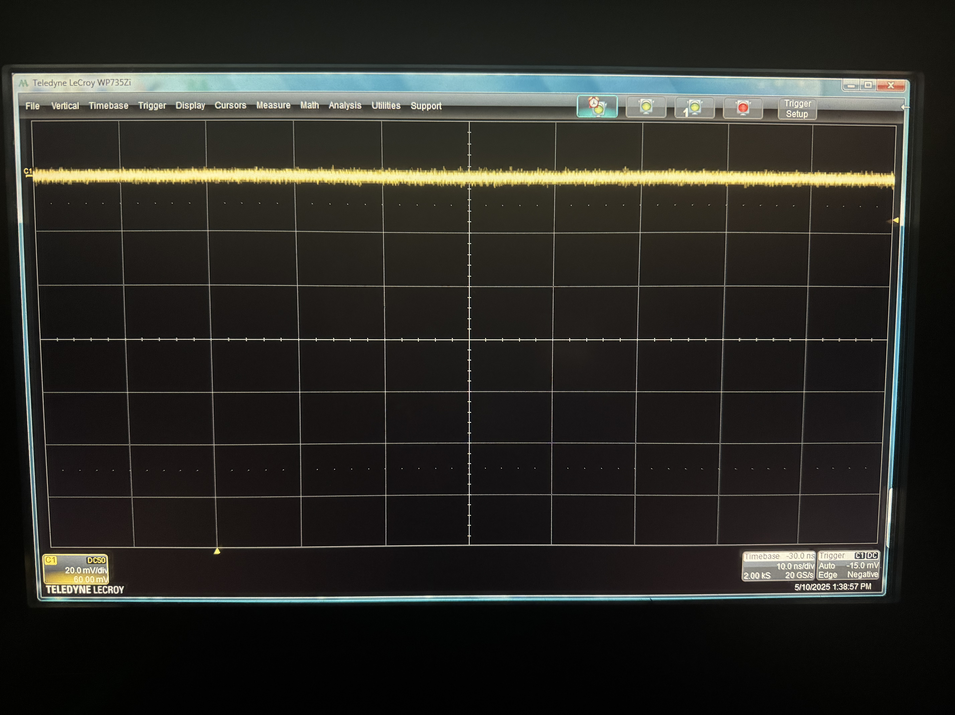
Timing Branch: Good vs. Broken
• The first sign of board failure was a missing timing signal.
• I compared a known-good board (Board-01) with the four failing boards.
• Oscilloscope traces clearly distinguished functional timing behavior from flat/noisy output.
Board-01: Normal Timing Response
Board-05: Broken Board No signal
10 ns
20 mV
10 ns
20 mV
Cesar Cardona
May 13, 2025

Slide 6
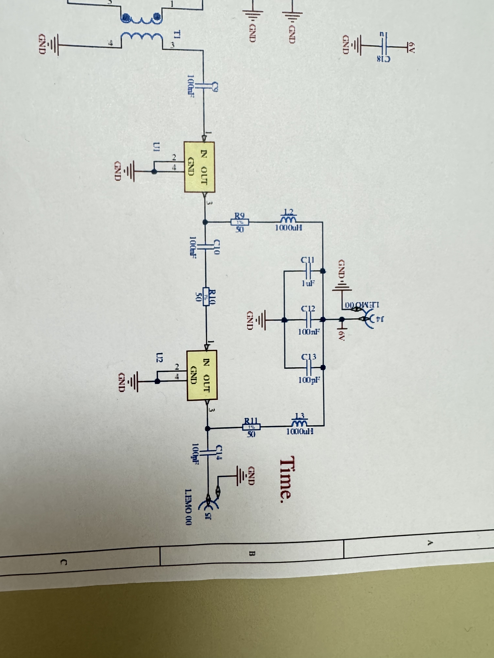
First Test: Resistance Across Timing Capacitors
• The first diagnostic step was suggested by Thomas Meyer: measure the resistance across capacitors C11, C12, and C13.
• This quick test allowed me to isolate suspect boards immediately.
Board | Resistance
Board-01 (Good Board) | 481 Ω
Board-02 | 377 Ω
Board-03 | 76 Ω
Board-04 | 84 Ω
Board-05 | 383 Ω
Cesar Cardona
May 13, 2025

Slide 7
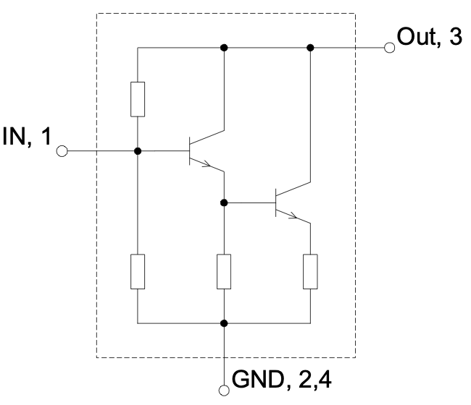
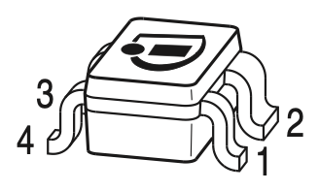
Amplifier Pin Checks: Board-01 Reference
• I figured out I could use pin-to-pin resistance to diagnose amplifier damage.
• This gave a reliable fingerprint of a functioning BGA616 amplifier.
• Board-01 served as the reference for all others.
U1 Board-01
Pin-to-pin Check | Resistance
1-2 (IN to GND) | 445 Ω
1-3 (IN to OUT) | 478 Ω
1-4 (IN to GND) | 445 Ω
2-3 (GND to OUT) | 502 Ω
2-4 (GND to GND) | 0 Ω
3-4 (OUT to GND) | 502 Ω
BGA616 Silicon Germanium Broadband MMIC Amplifier
Cesar Cardona
May 13, 2025

Slide 8
Amplifier Pin Checks: Board-05
• Damaged amplifiers typically showed 0 Ω across multiple pin pairs.
• Board-05 had a shorted U1, matching this pattern. However, all other broken boards also had unusual readings in U1.
U1 Board-05
Pin-to-pin Check | Resistance
1-2 (IN to GND) | 0 Ω
1-3 (IN to OUT) | 383 Ω
1-4 (IN to GND) | 0 Ω
2-3 (GND to OUT) | 383 Ω
2-4 (GND to GND) | 0 Ω
3-4 (OUT to GND) | 383 Ω
BGA616 Silicon Germanium Broadband MMIC Amplifier
Cesar Cardona
May 13, 2025

Slide 9
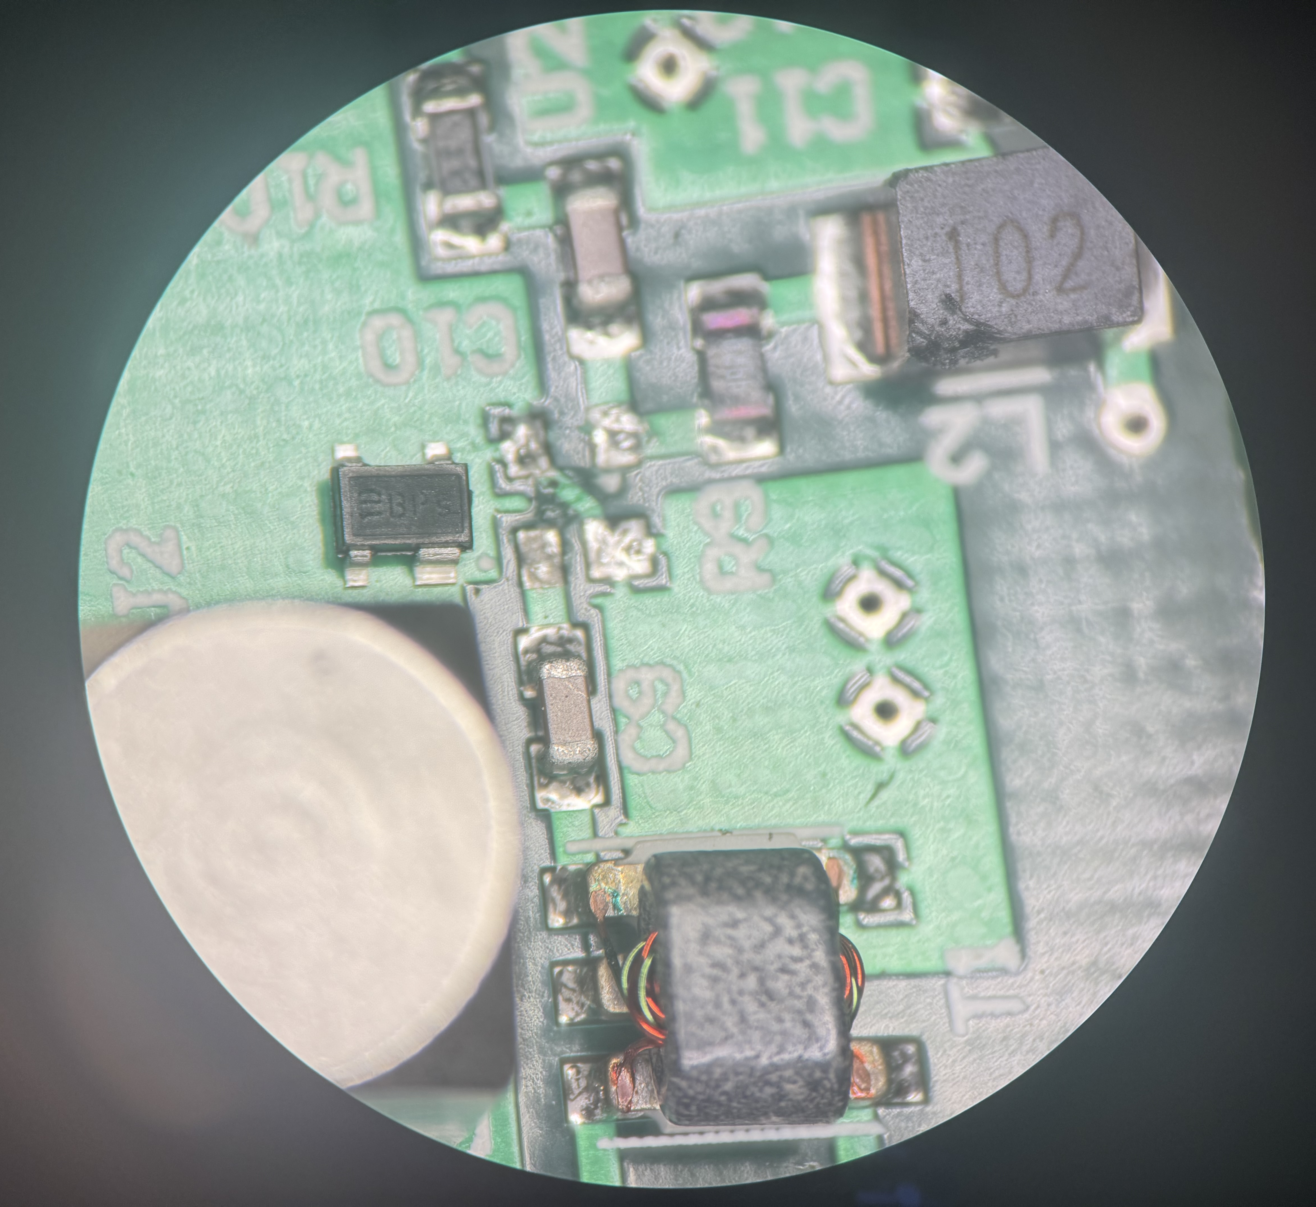
Replacing Amplifiers
• All four broken boards showed abnormally low resistance across the U1 amplifier pins.
• I replaced each U1 amplifier using a precision soldering pen and a microscope.
• This process required careful alignment, solder wick cleanup, and steady reflow soldering of all 4 pins.
1 mm
Cesar Cardona
May 13, 2025

Slide 10
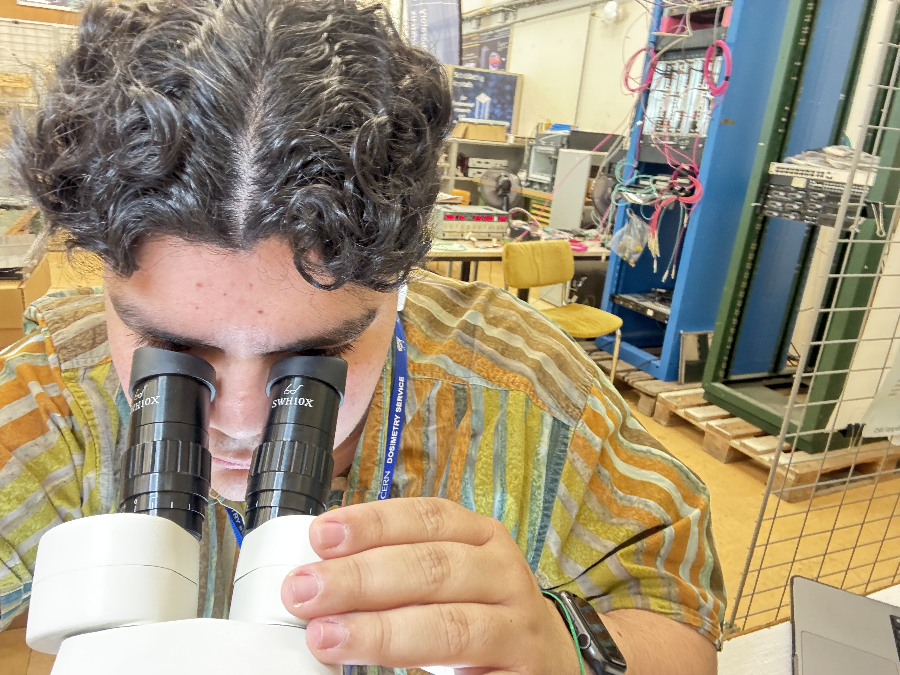
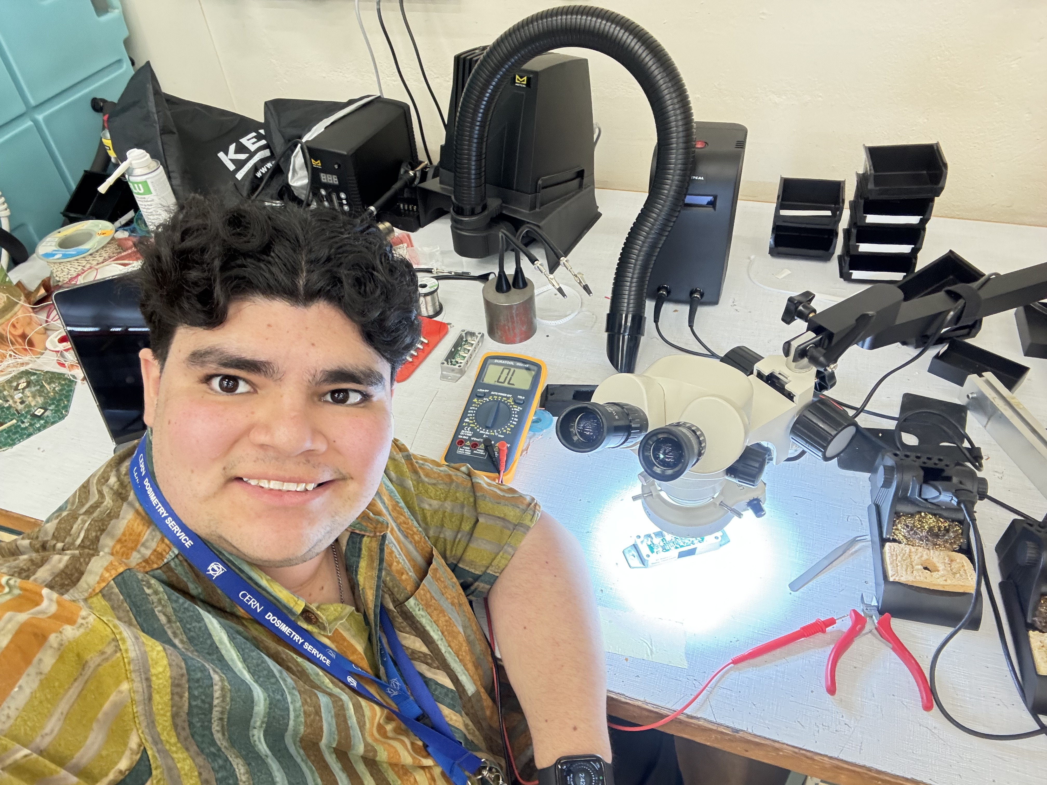
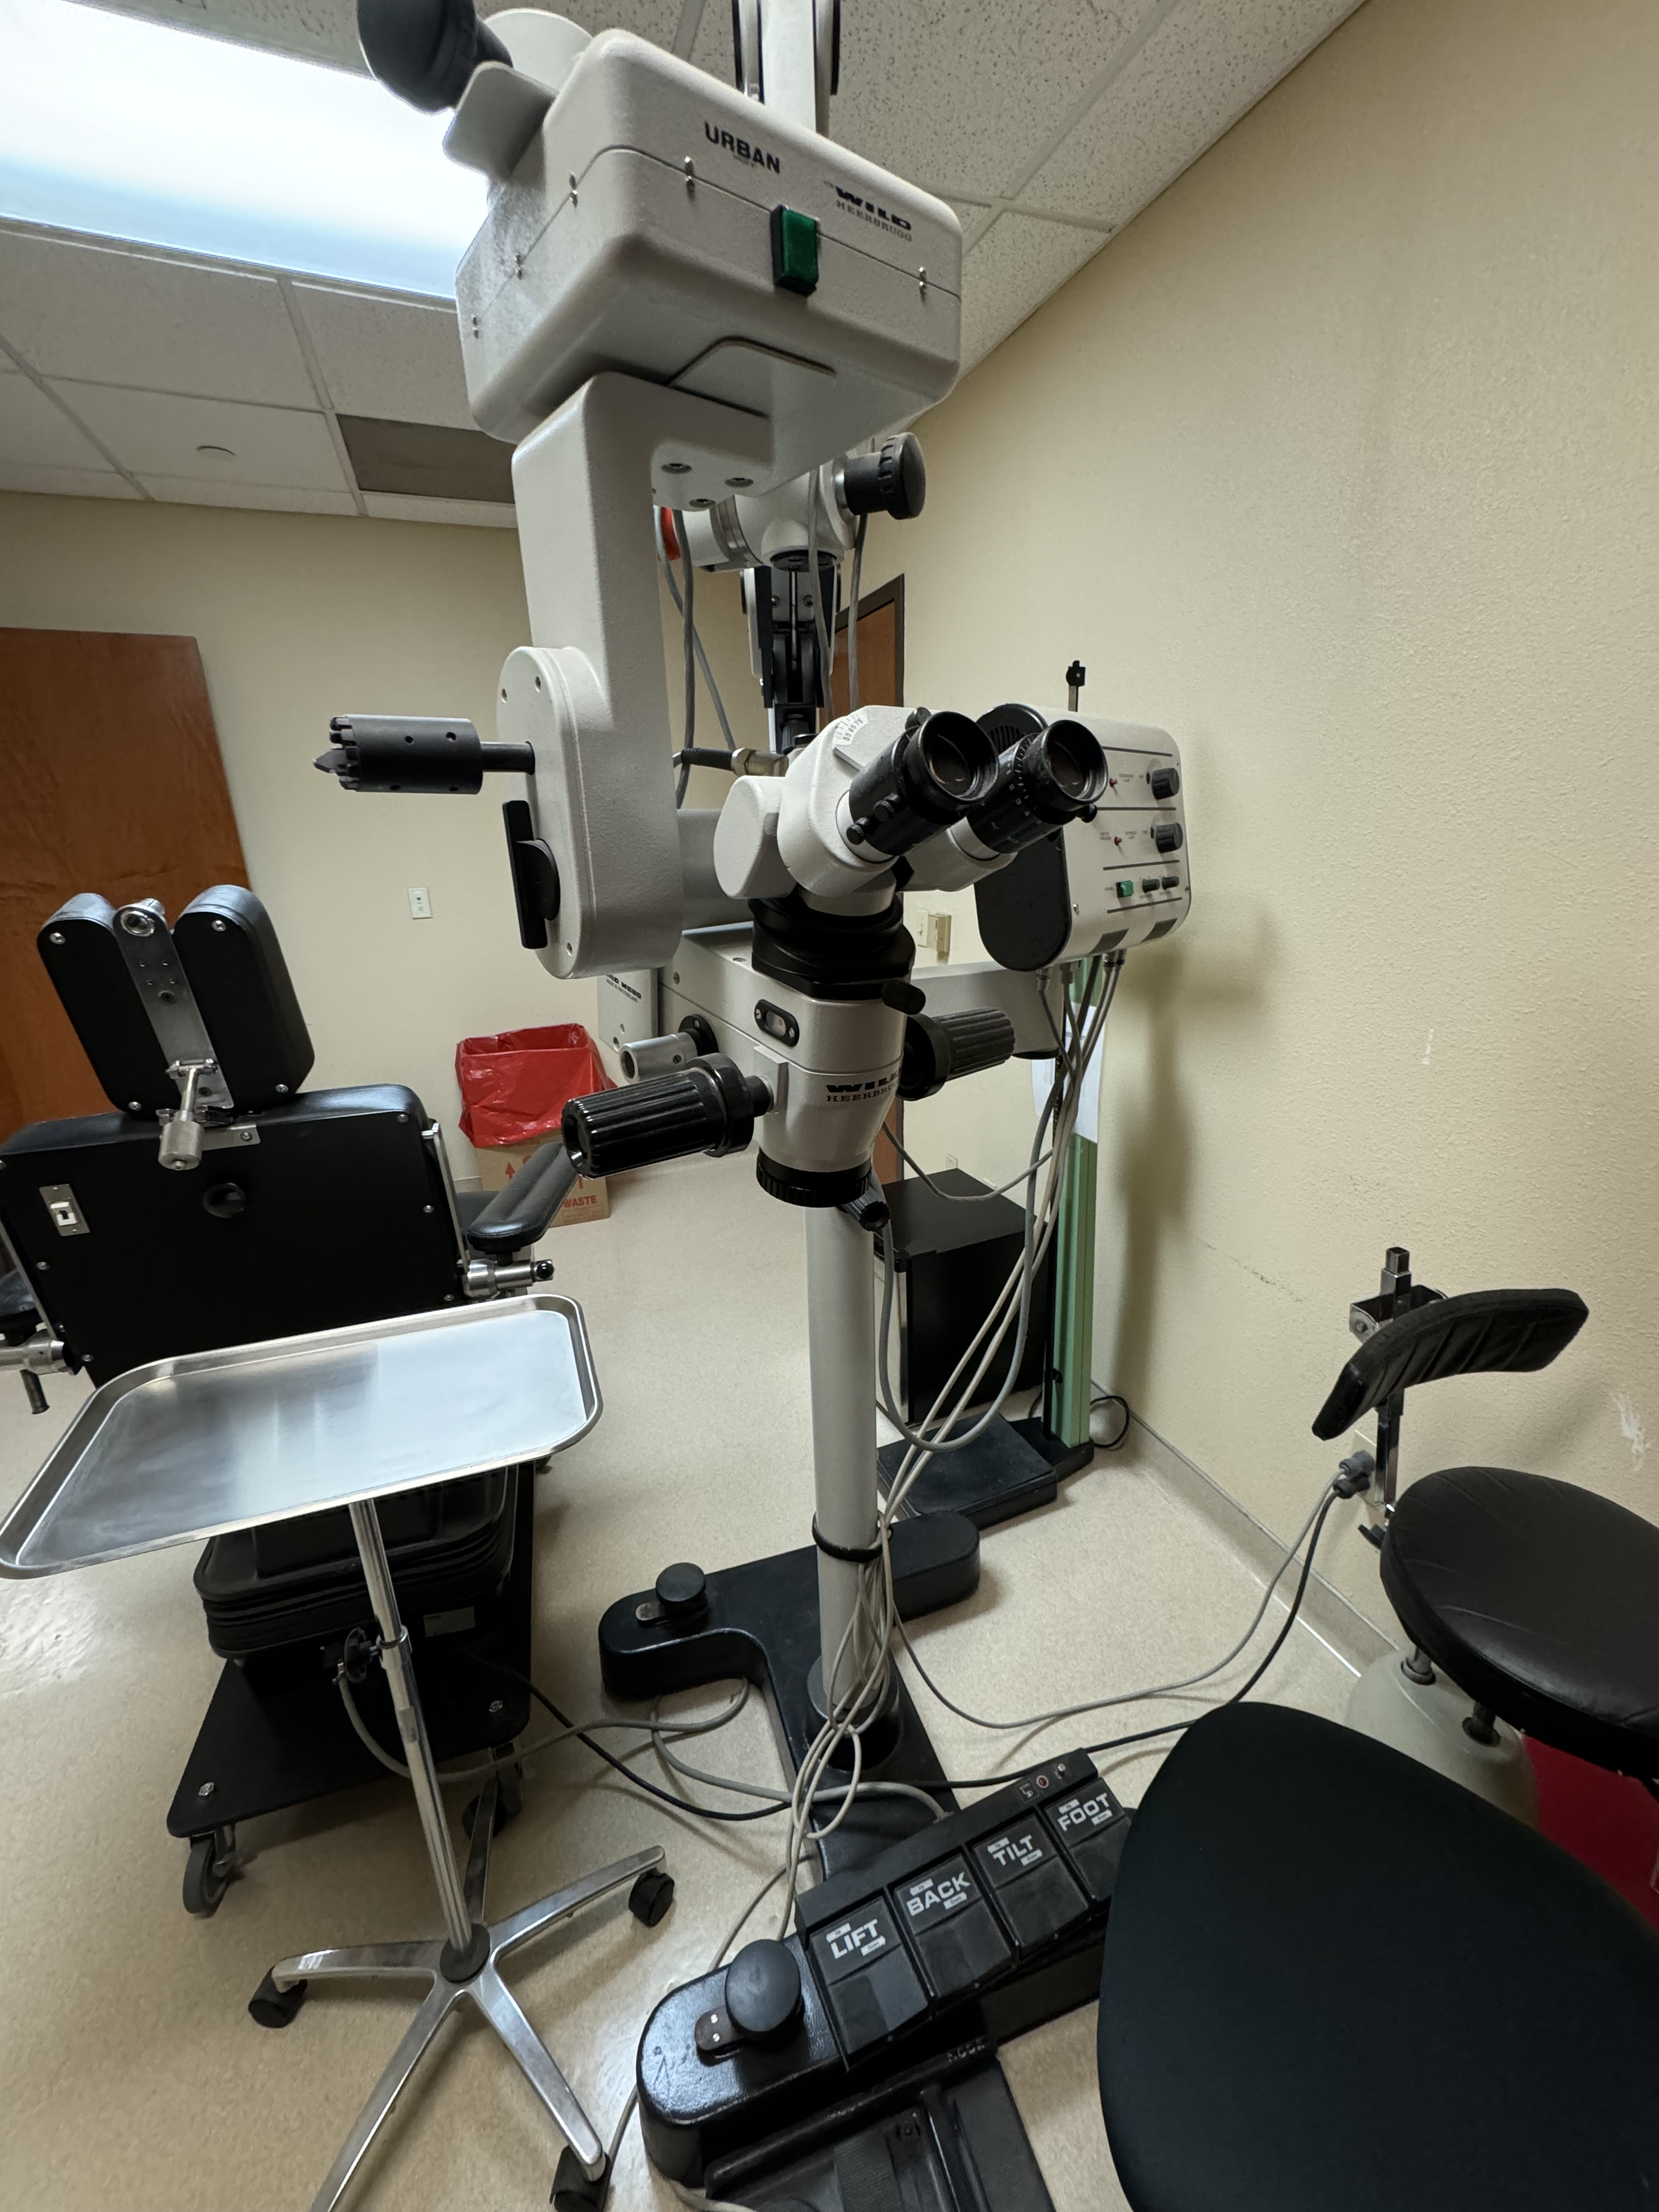
Hands On Repair at the Soldering Station
Here are some Photos. It took me back to assisting in Ophthalmic Surgeries.
Cesar Cardona
May 13, 2025

Slide 11
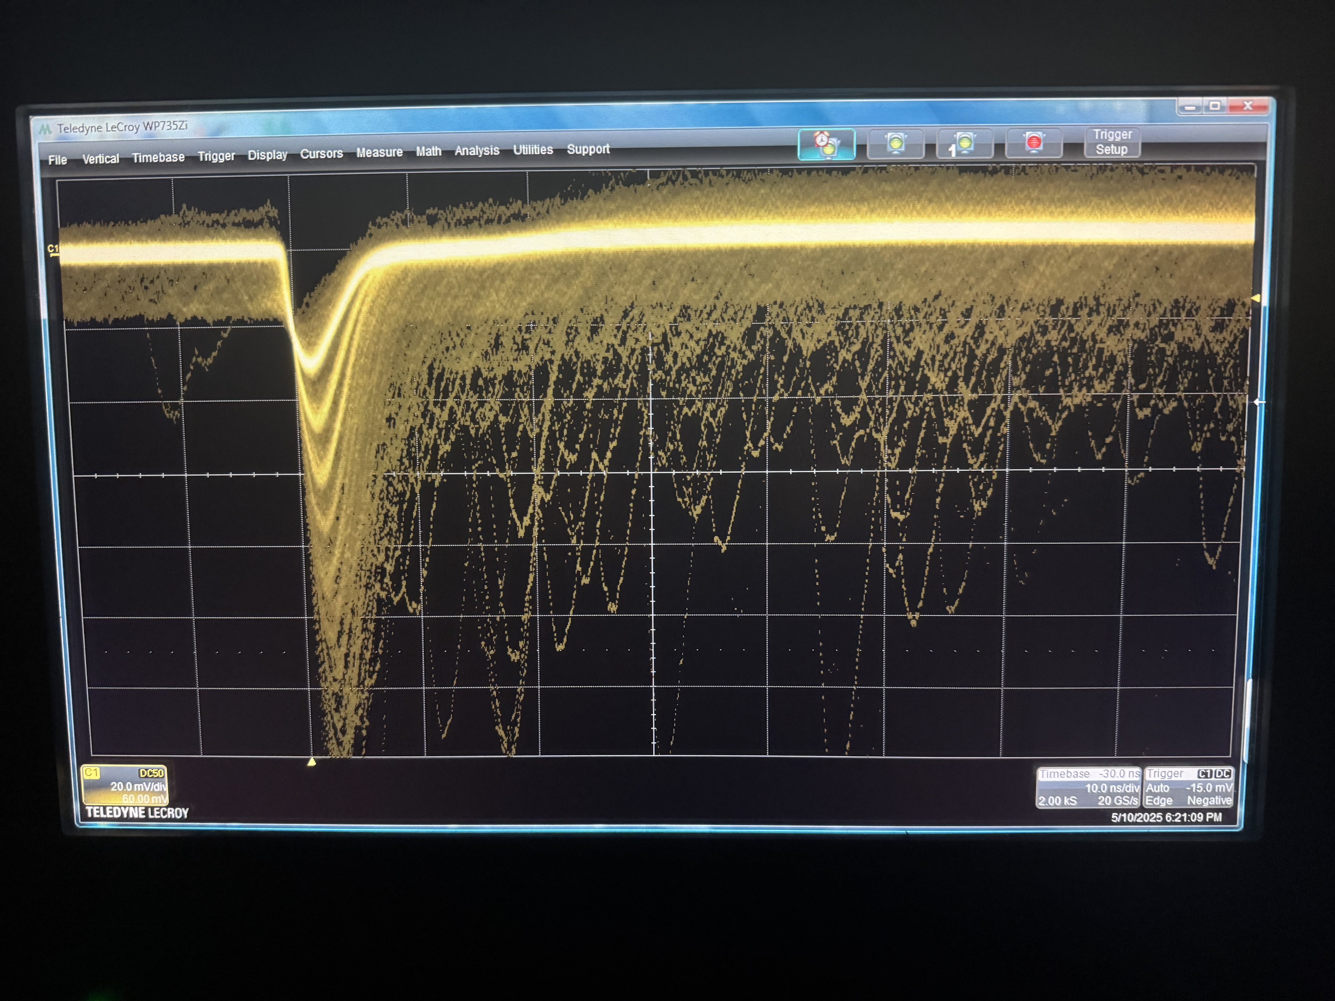
All Timing Branches Fixed
• With U1 replaced on Boards 02, 04, and 05, timing signals were fully restored.
• Board-03 required U2 replacement instead — it also recovered its timing branch (But more on this board later).
• All four repaired boards now match the signal profile of Board-01.
10 ns
20 mV
Cesar Cardona
May 13, 2025

Slide 12
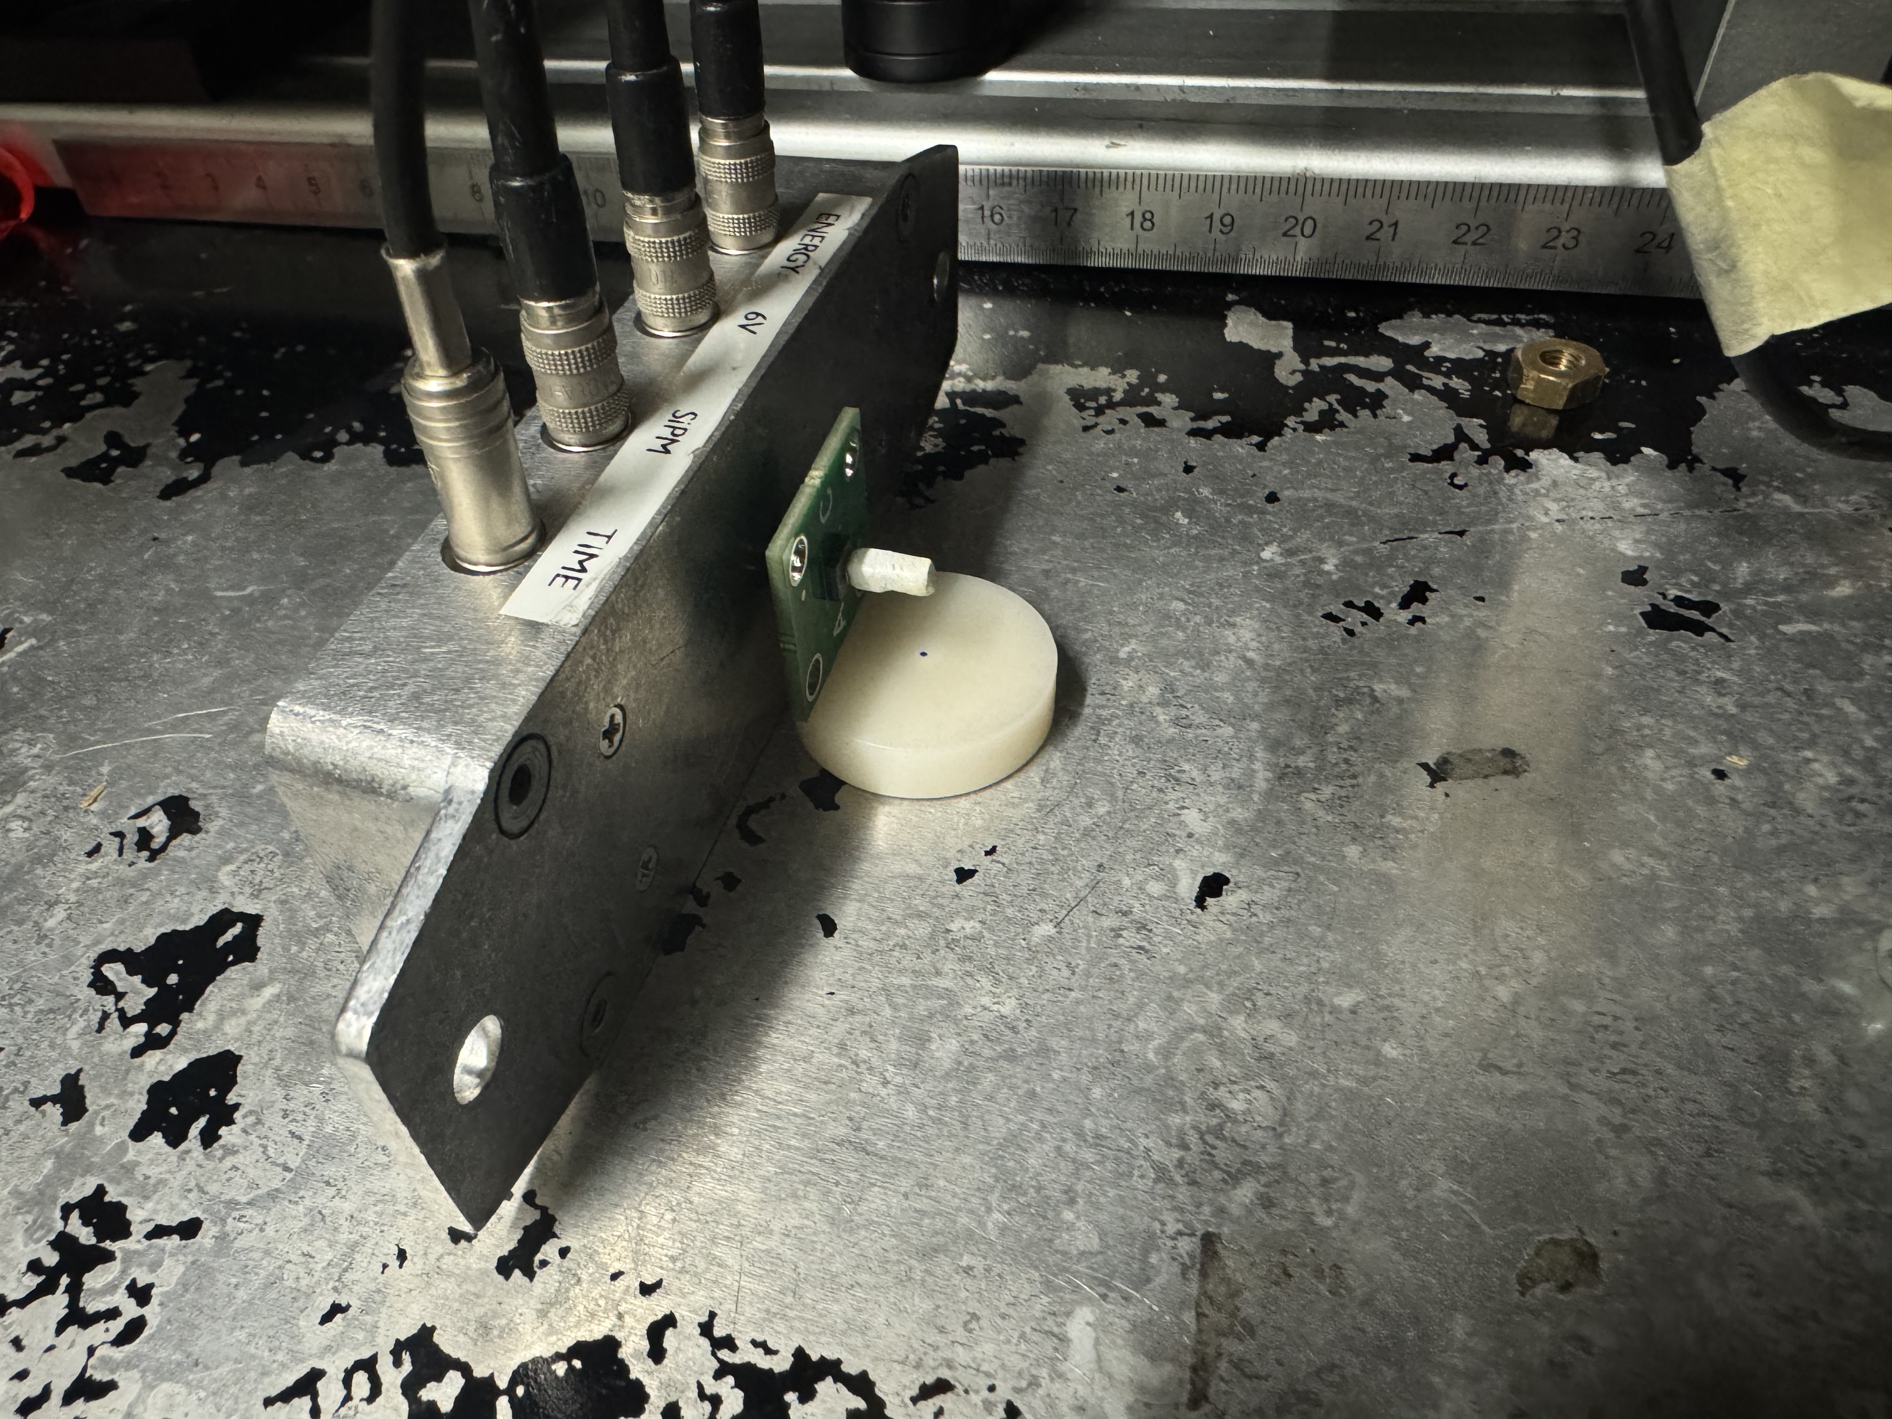
Energy Branch Diagnostics
• After restoring all timing branches, I proceeded to test the energy output on each board.
• The energy branch is typically more stable, but timing was prioritized first because it showed clearer signs of failure and was needed for CTR tests.
• Here’s the test setup I used, with the SiPM coupled to a crystal and a Sodium-22 source positioned nearby. Very scientific.
Sodium-22 Source
Cesar Cardona
May 13, 2025

Slide 13
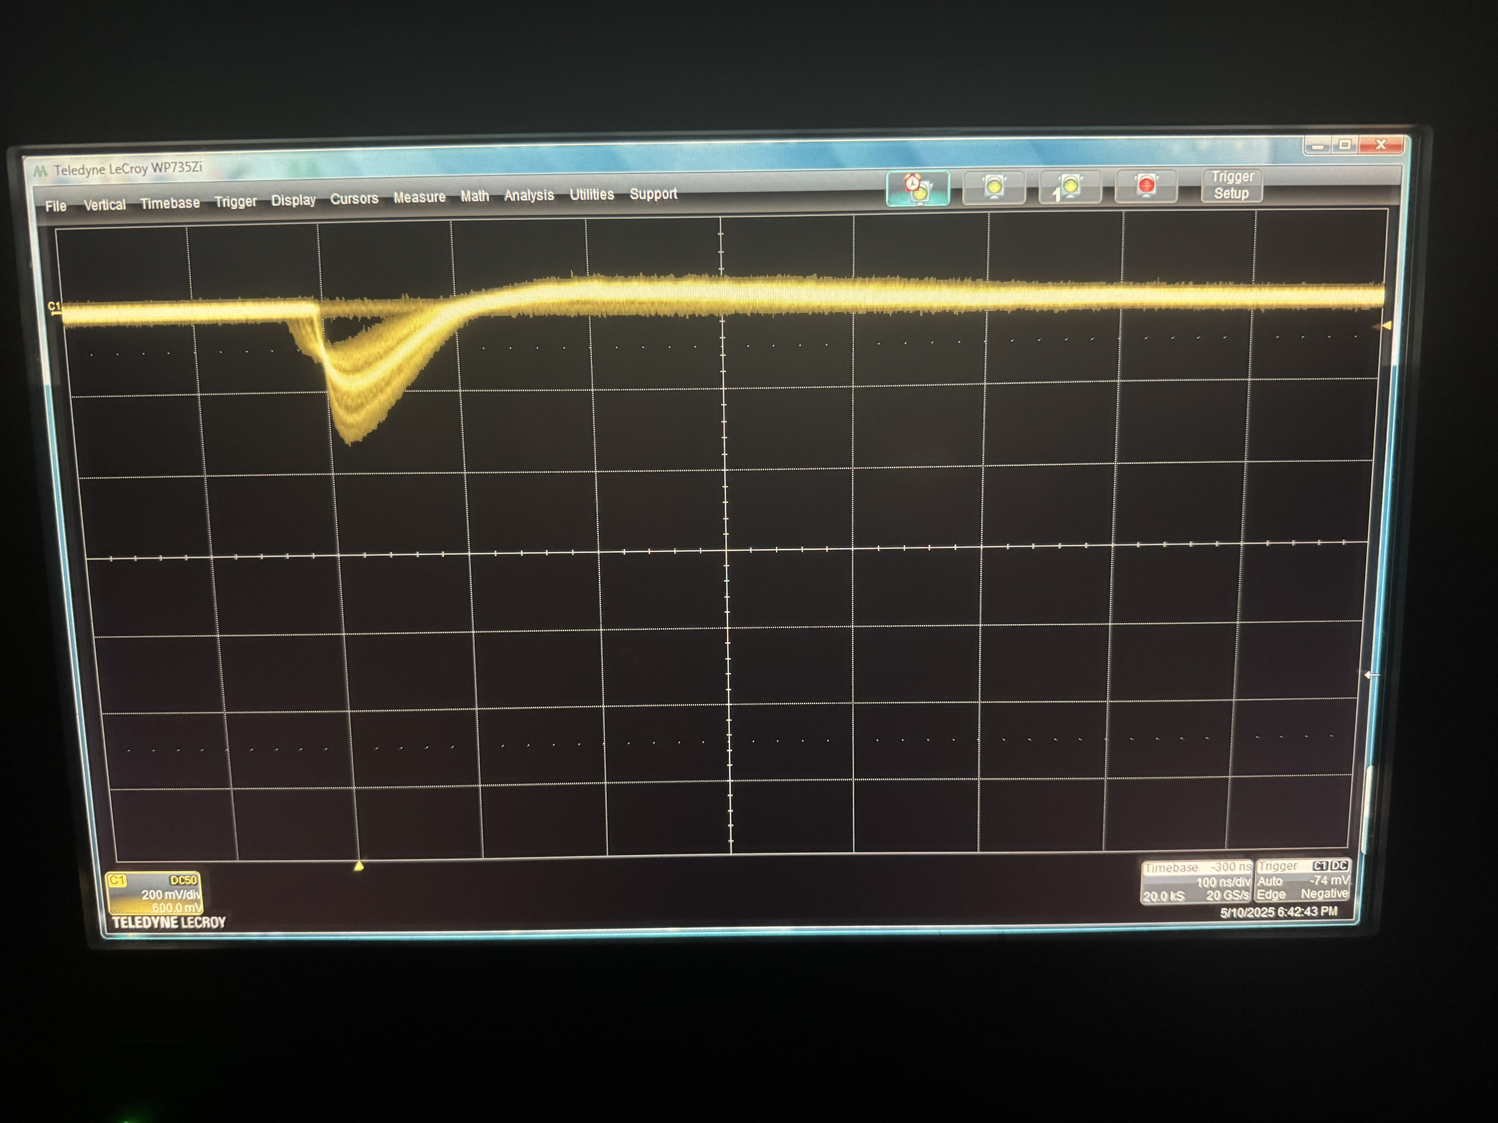
Energy Signal: Restored Boards
• All four repaired boards showed energy signals that matched the reference profile from Board-01.
• This confirmed that both amplifier channels (U1 and U2) were operational and that the energy pathway was unaffected post-repair.
Except…
100 ns
200 mV
Typical Energy Signal (Repaired Board)
Cesar Cardona
May 13, 2025

Slide 14
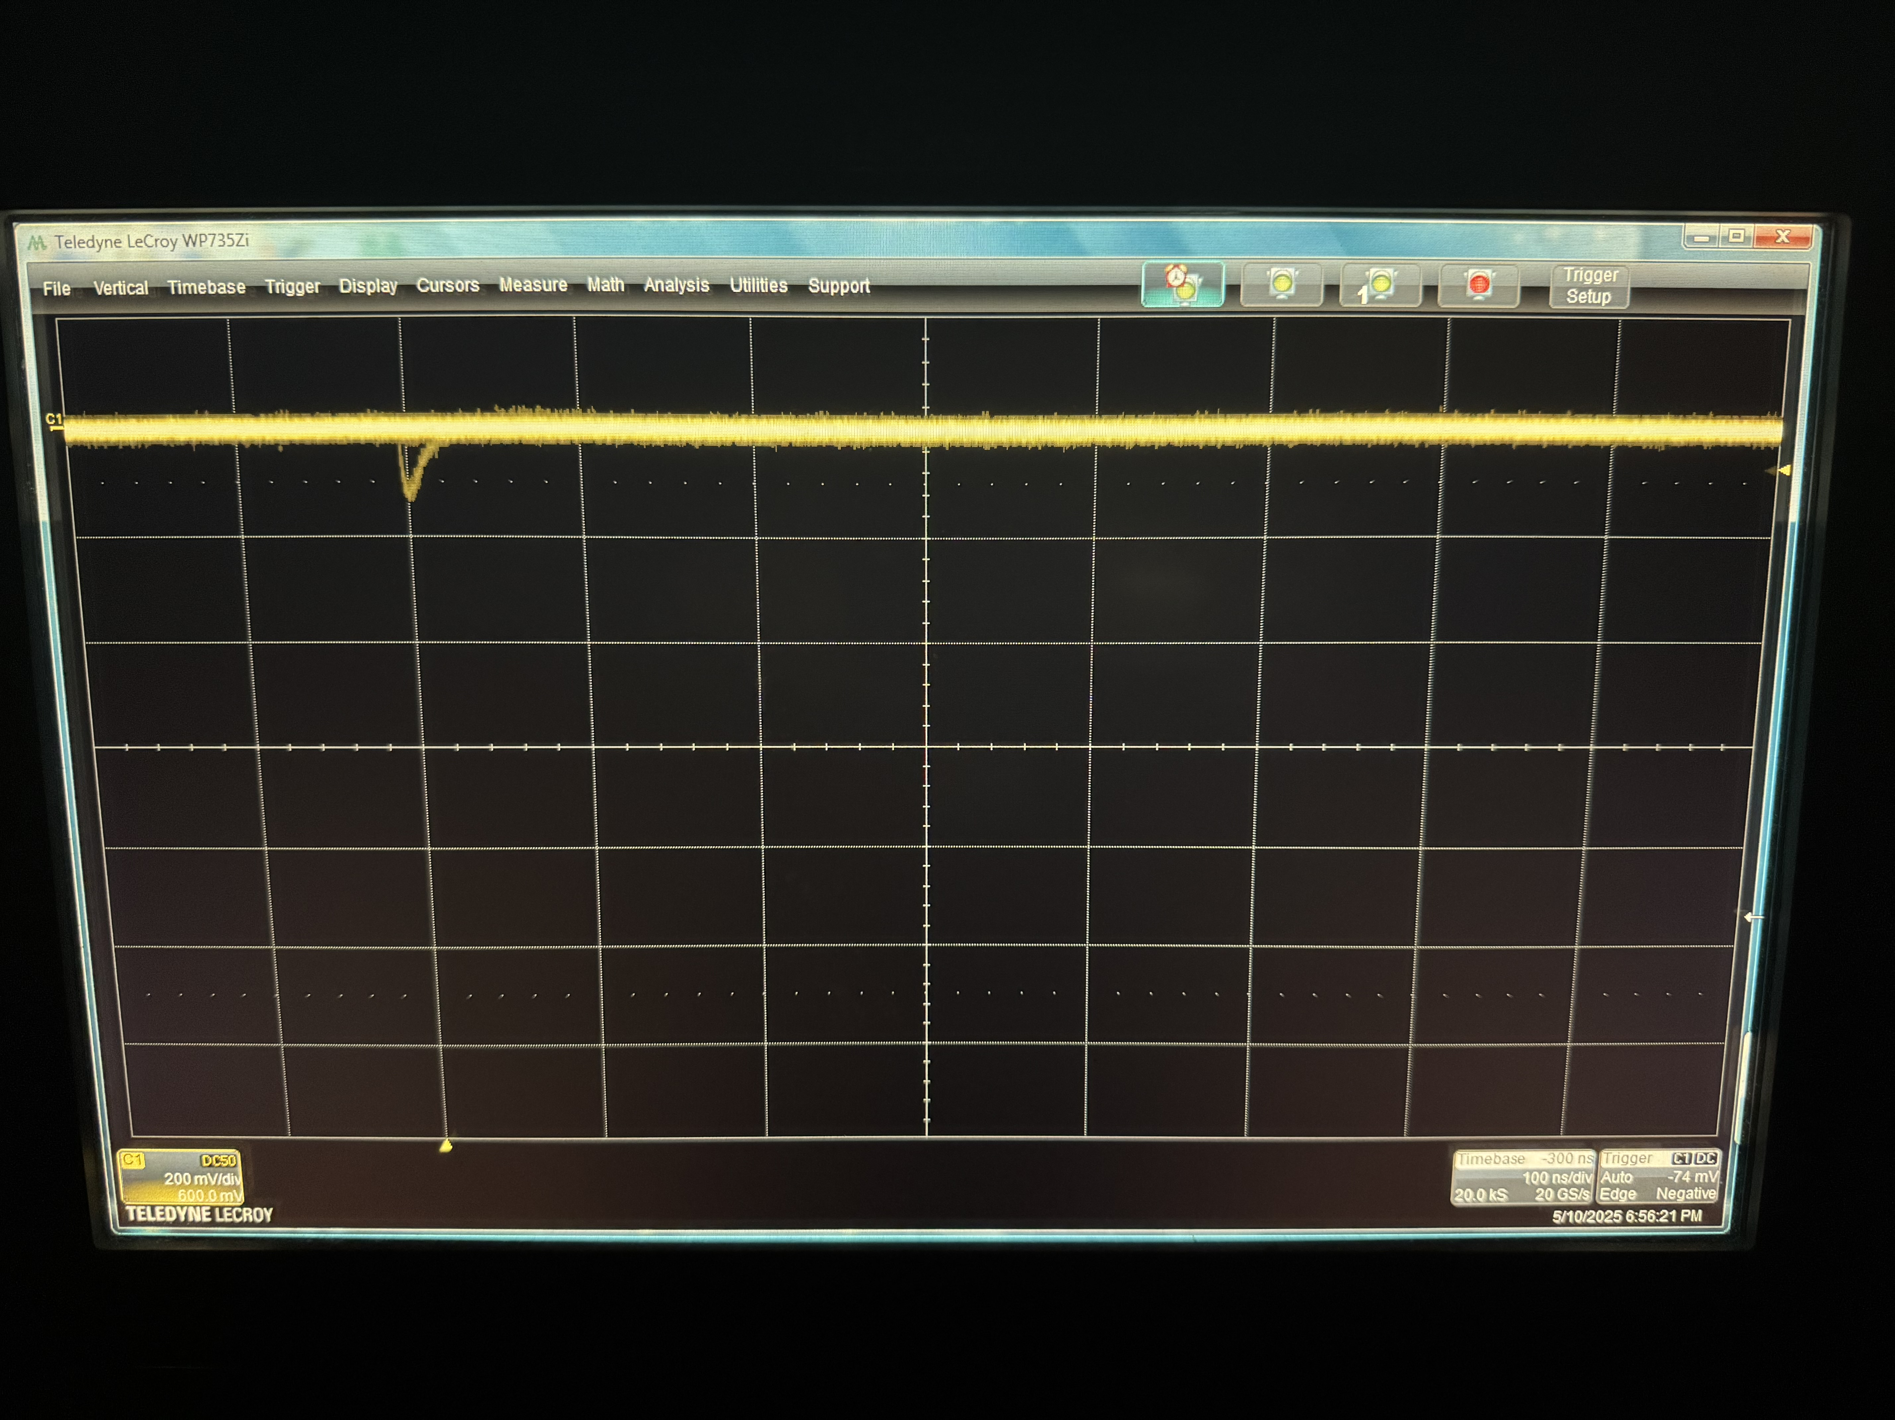
Energy Branch Failure: Board-03
• Board-03’s energy branch was the only one that didn’t recover — the waveform showed no clear pulses.
• Timing branch was previously fixed by replacing U2, but energy remains unresponsive.
• My working theory is that either the SiPM is not properly soldered, or the inductor (L3) is damaged.
• I ran out of time to explore further, but I plan to test both hypotheses in the coming weeks.
100 ns
200 mV
Board-03 Energy Output (Unfixed)
Cesar Cardona
May 13, 2025

Slide 15
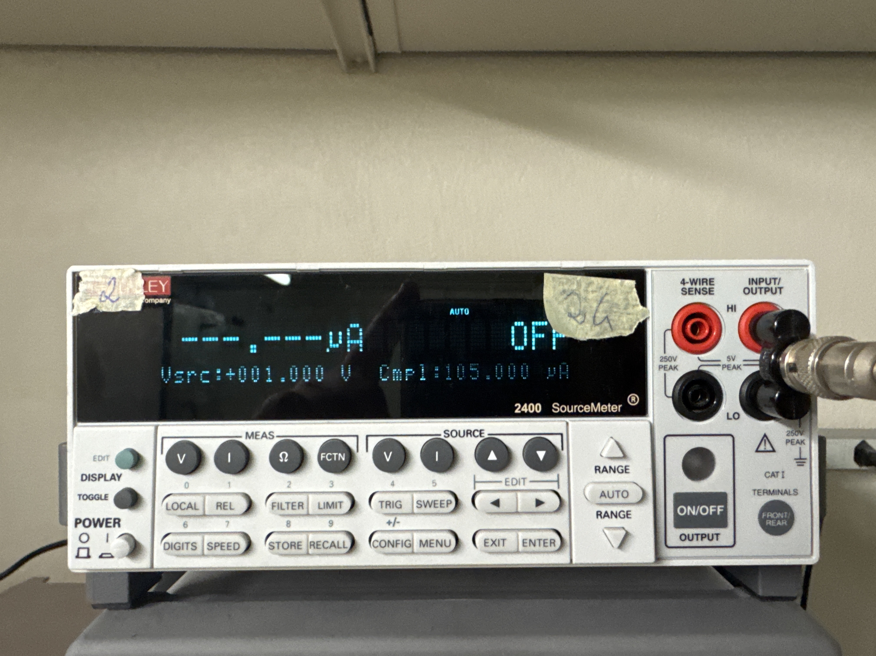
Investigating the Root Cause
• After restoring most boards, I began searching for the underlying cause of the failures.
• I suspected the bias voltage supply might be unstable.
• I tested both supplies with an oscilloscope and captured strange behaviors in one unit — shown on the next slides.
Cesar Cardona
May 13, 2025

Slide 16
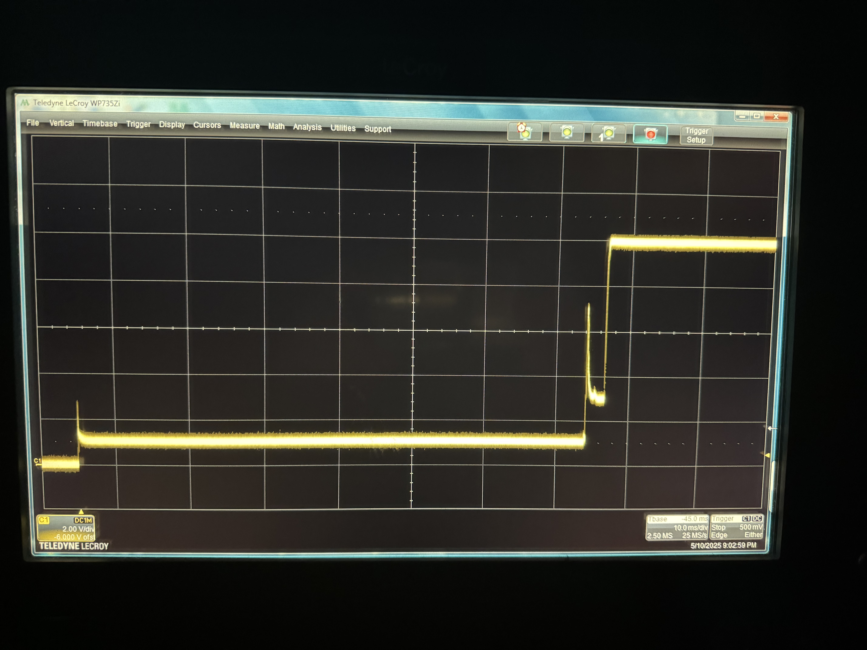
Problem #1: Voltage Ramp Instability
• When ramping from 0 V to 10 V, the supply did not transition smoothly.
• The scope showed oscillations and sharp intermediate transients before settling.
• This kind of instability can create momentary overcurrent or signal injection, damaging sensitive components like U1.
10 ms
2 V
0 to 10 V ramp – unstable behavior.
Cesar Cardona
May 13, 2025

Slide 17
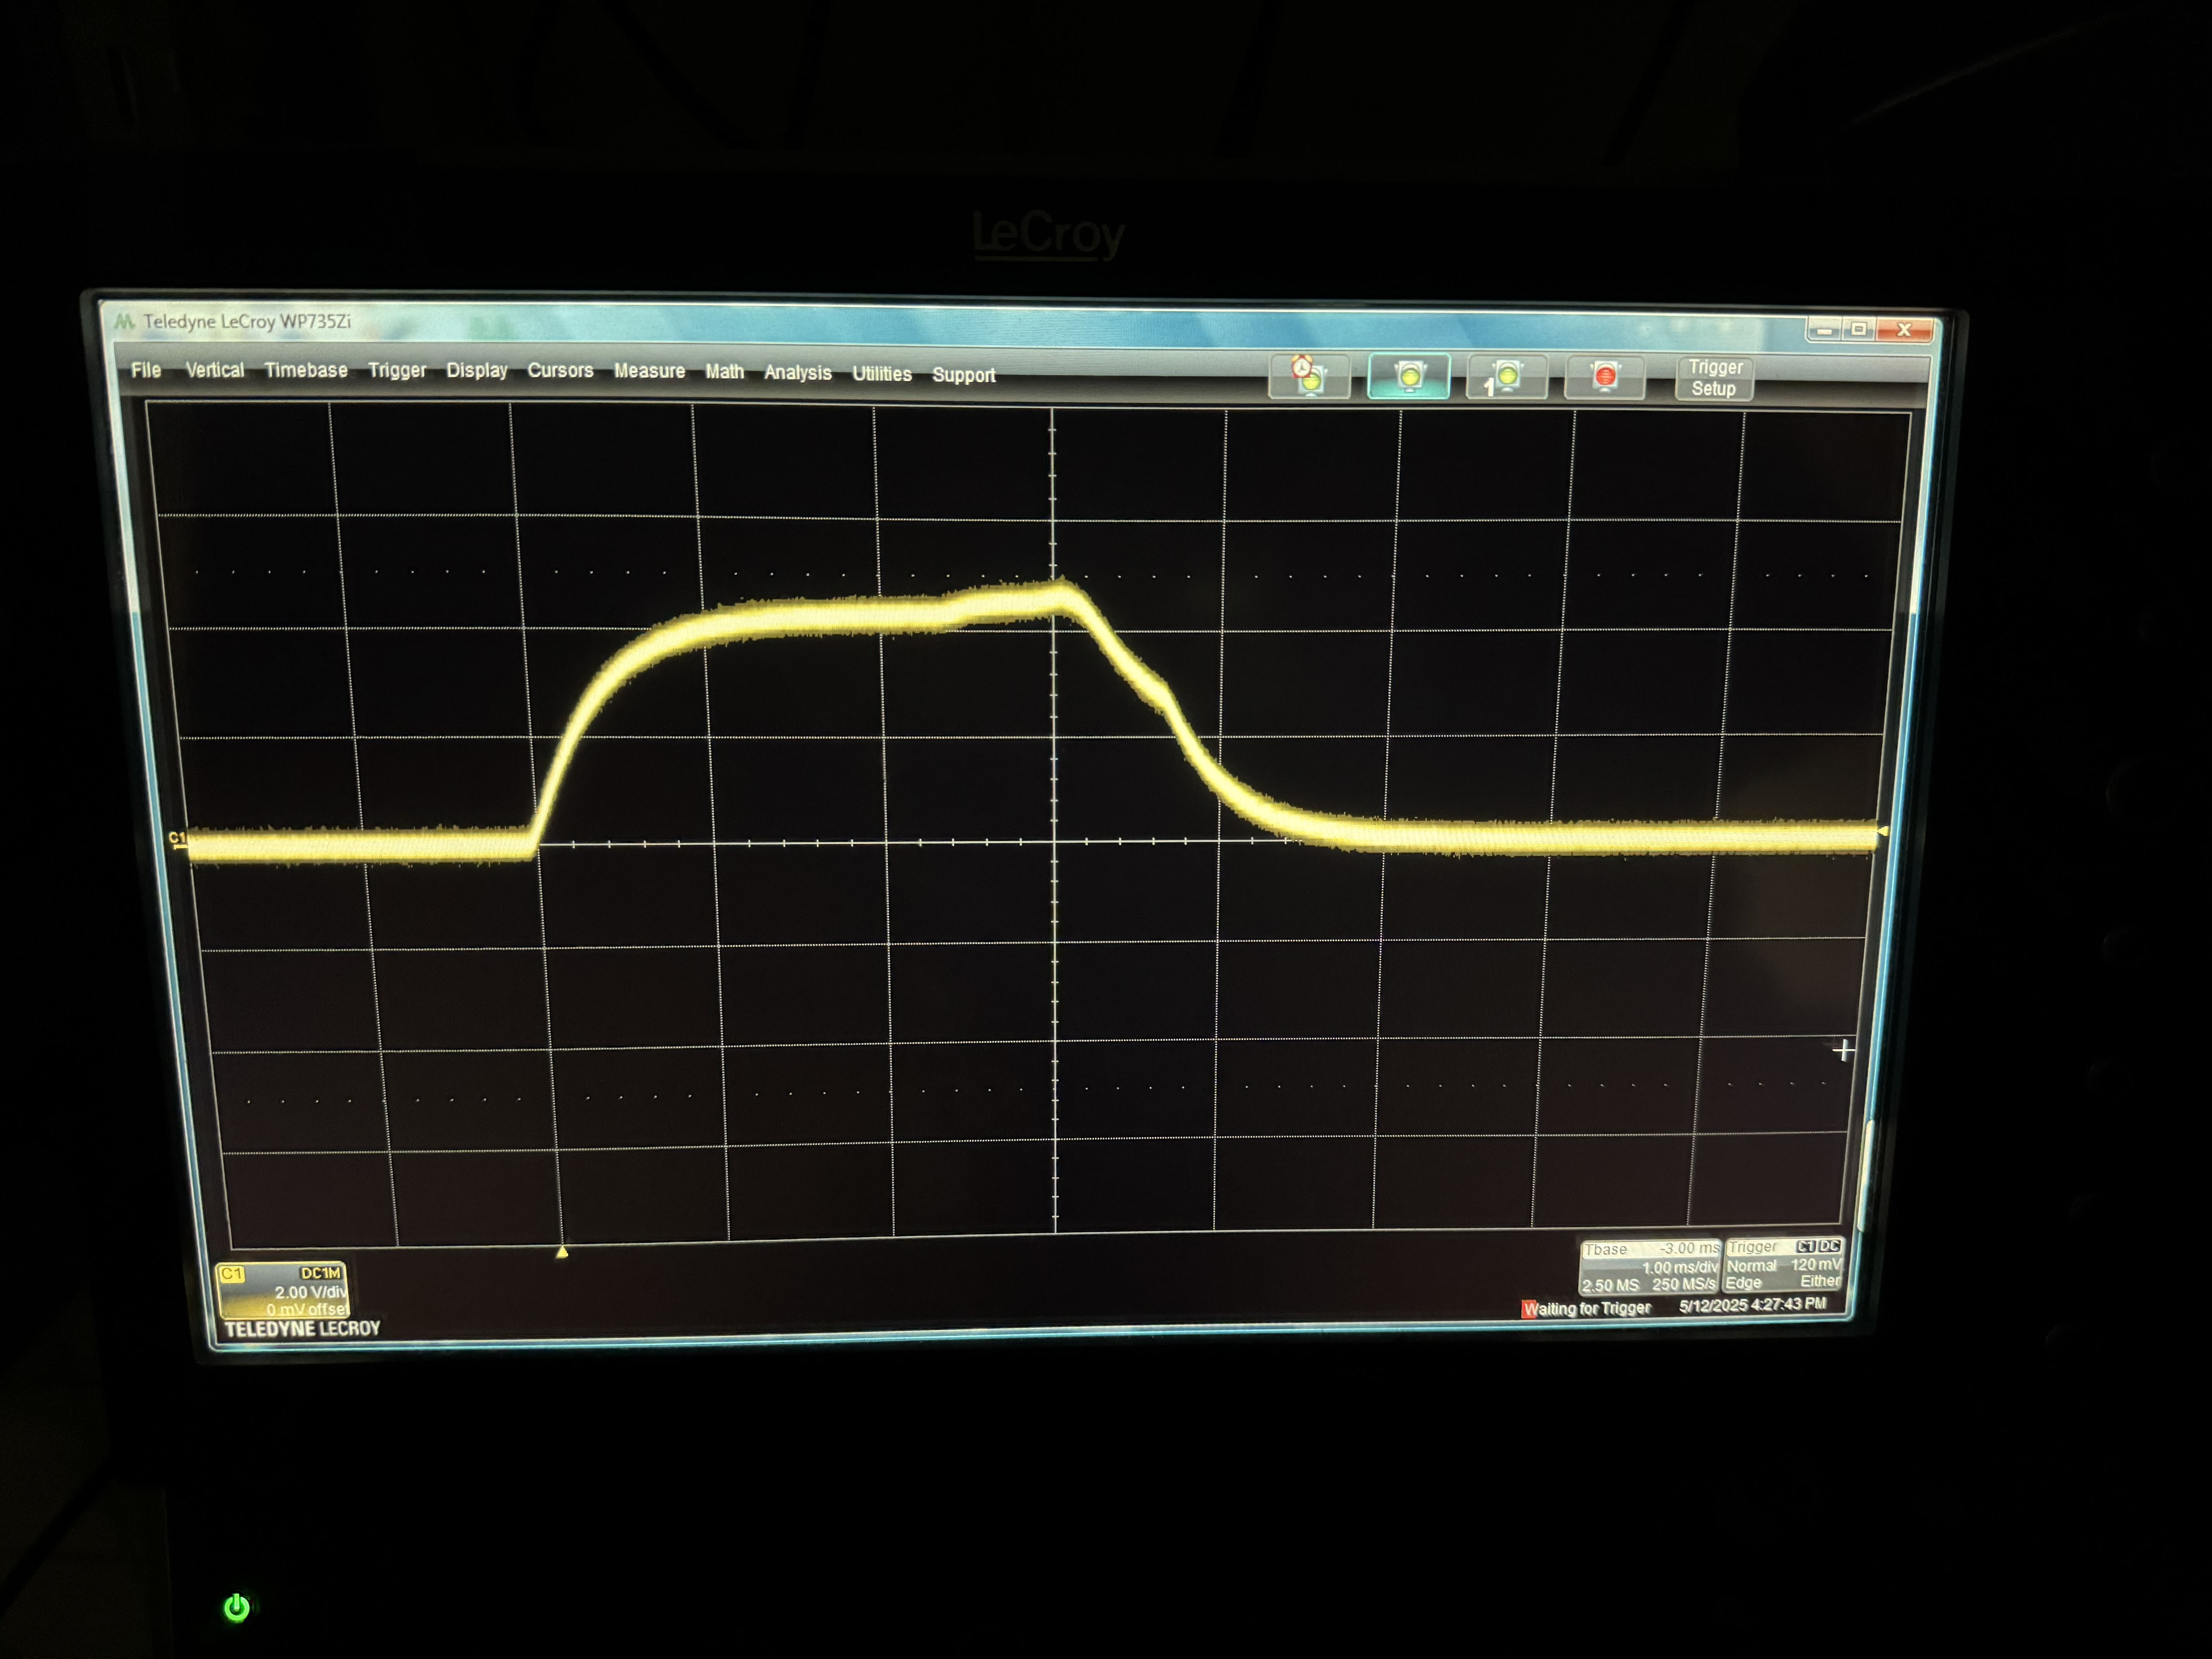
Problem #2: Voltage Spikes at Power-On
• Turning the power supply ON from the physical switch with 0 V setpoint did not yield 0 V output.
• The voltage unexpectedly jumped upward before settling back — an unsafe startup transient.
• This could easily inject a voltage into downstream components even when “OFF” conditions are expected.
1 ms
2 V
Power-On Jump with 0 V Setpoint.
Cesar Cardona
May 13, 2025

Slide 18
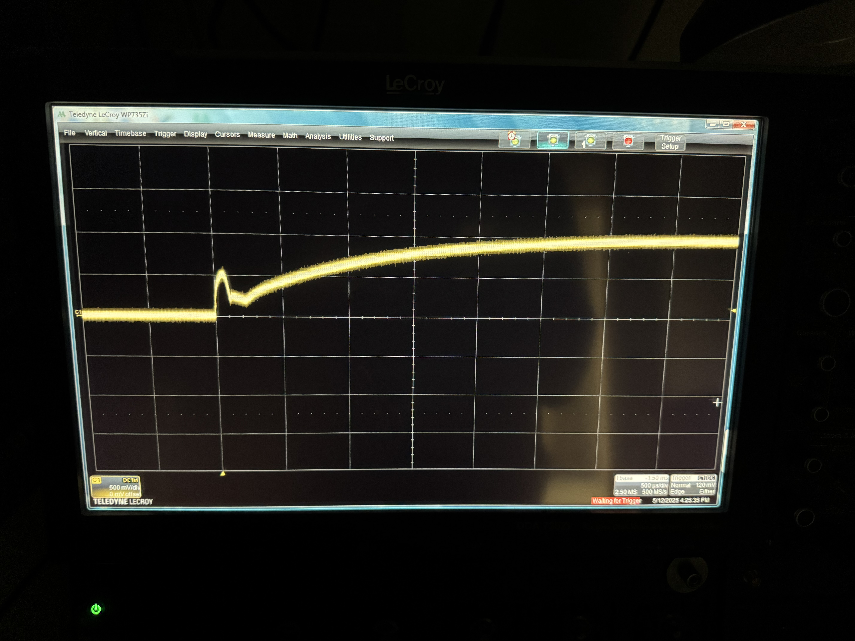
Problem #3: Fast Voltage Toggling Bubble
• When toggling quickly between +1 V and -1 V, the scope shows a transient “bubble.”
• While small in amplitude, this change is extremely fast — and all damaged boards had U1 near the HV entry path.
• My working theory: fast transients near the transformer (balun) couple into the U1 amp, stressing it despite filtering.
• Further tests would be needed to confirm this.
500 µs
500 mV
+1 V to -1 V Toggle – Transient Bubble.
Cesar Cardona
May 13, 2025

Slide 19
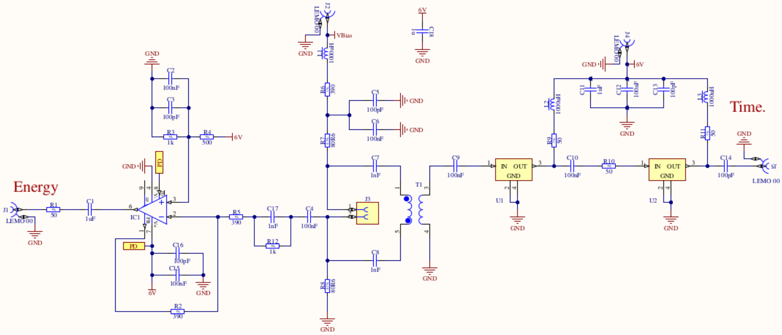
System Level Schematic
Cesar Cardona
May 13, 2025

Slide 20
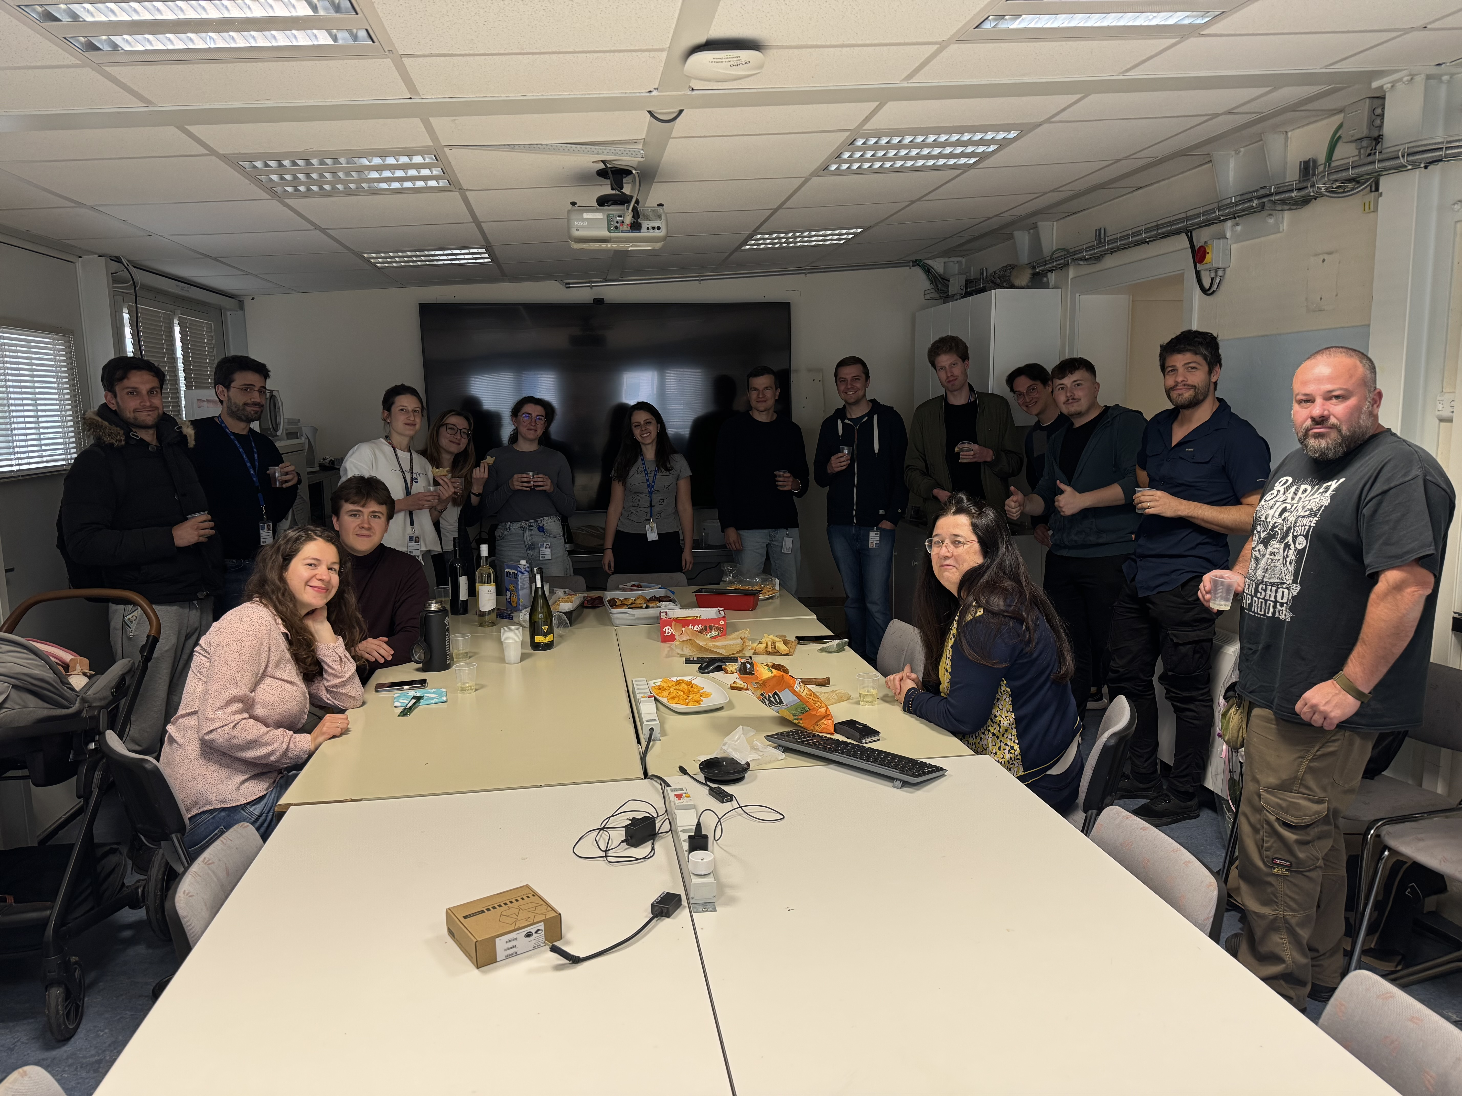
Questions?
Cesar Cardona
May 13, 2025

