Slide 1



Weekly Updates
Pedro Baculima – 13/05/2025
1

Slide 2
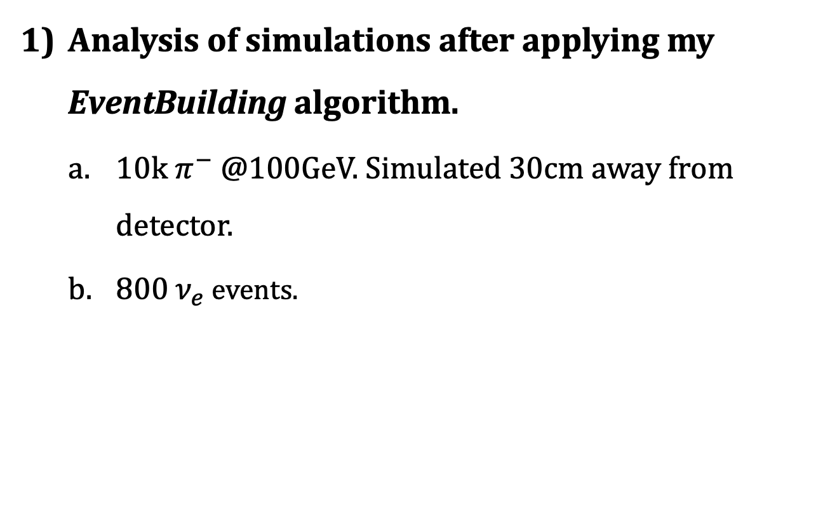
Overview
Analysis of simulations after applying my EventBuilding algorithm.
  10k $π^{−}$ @100GeV. Simulated 30cm away from detector.
  800 $ν_{e}$ events.
Pedro Baculima – 13/05/2025
2

Slide 3
Common tests
We focused on the study of the following for both the Mu Filter and Scifi Points:
Comparison of the energy loss within the first 25ns and the total energy loss per events, their difference, and ratio.
For events where the ratio was greater than 0.3, we studied them separately.
Pedro Baculima – 13/05/2025
3

Slide 4
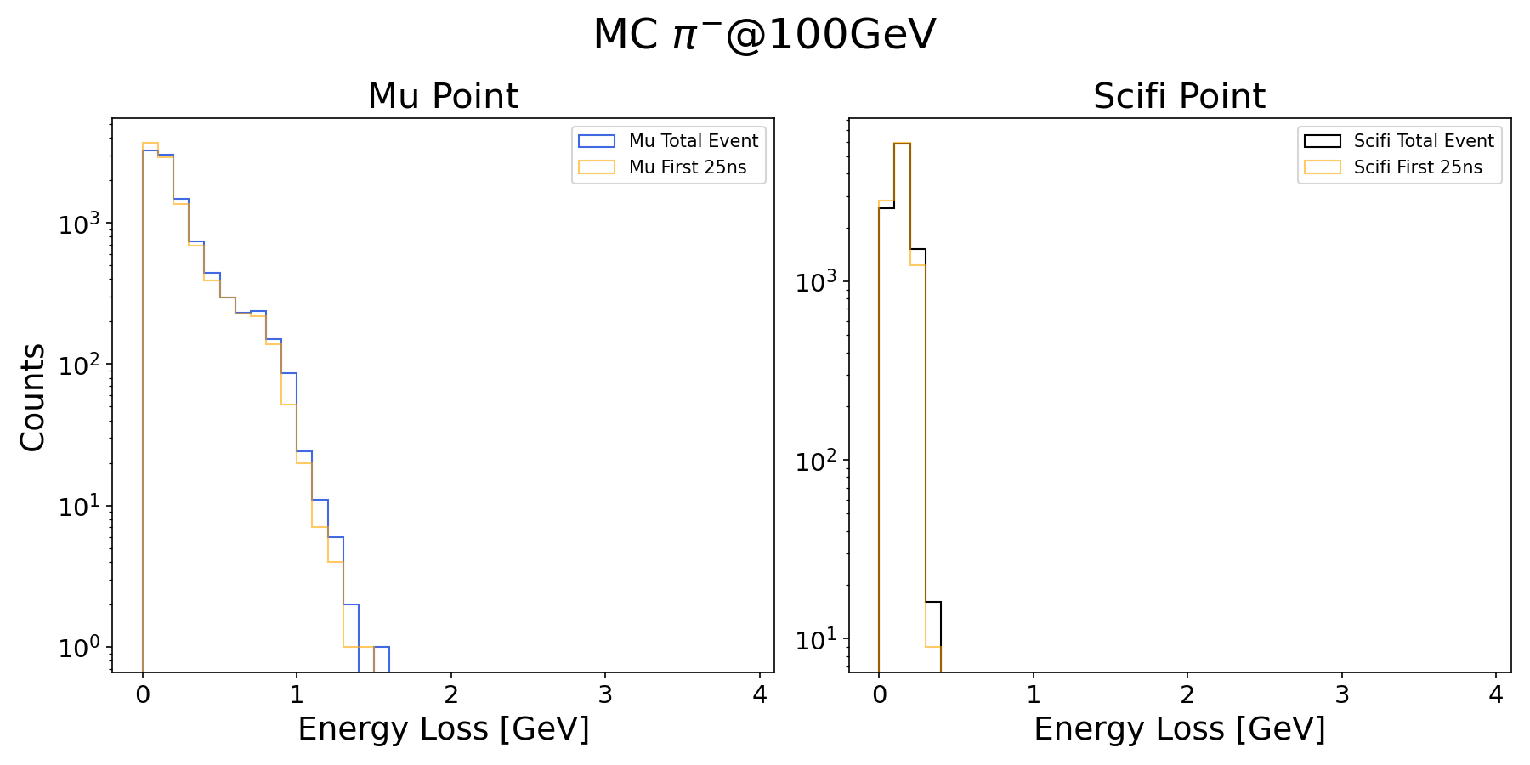

$π^{−}$ @100GeV, 30cm away
Pedro Baculima – 13/05/2025
4

Slide 5
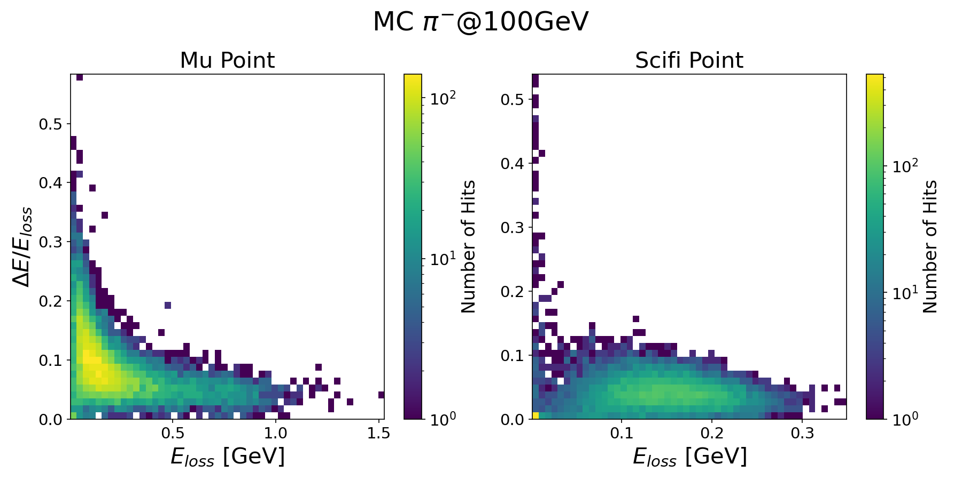
$π^{−}$ @100GeV, 30cm away
Pedro Baculima – 13/05/2025
5

Slide 6
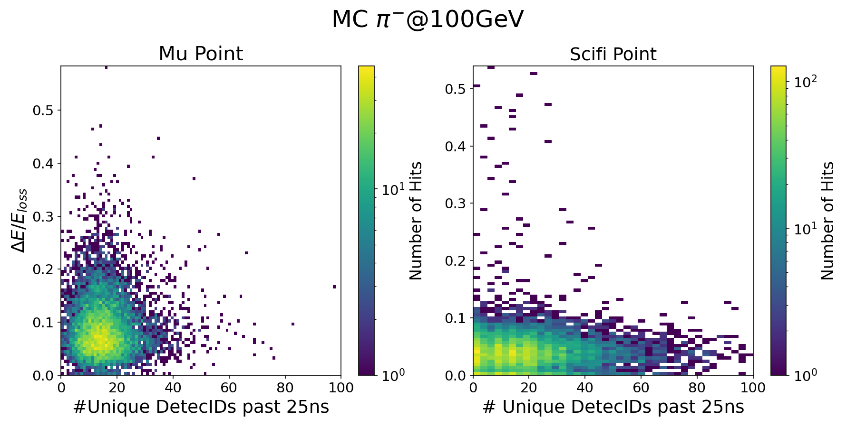
$π^{−}$ @100GeV, 30cm away
Pedro Baculima – 13/05/2025
6

Slide 7
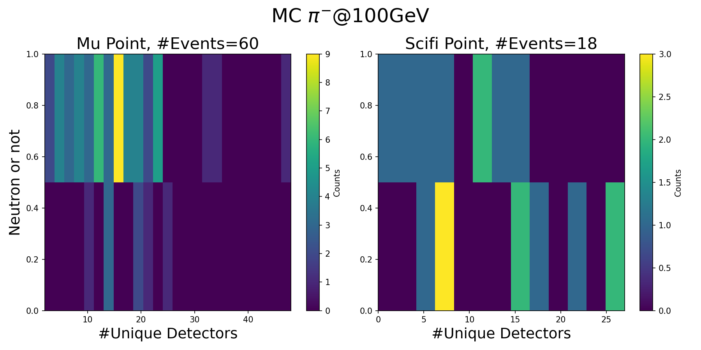
$π^{−}$ @100GeV, 30cm away
Pedro Baculima – 13/05/2025
7

Slide 8
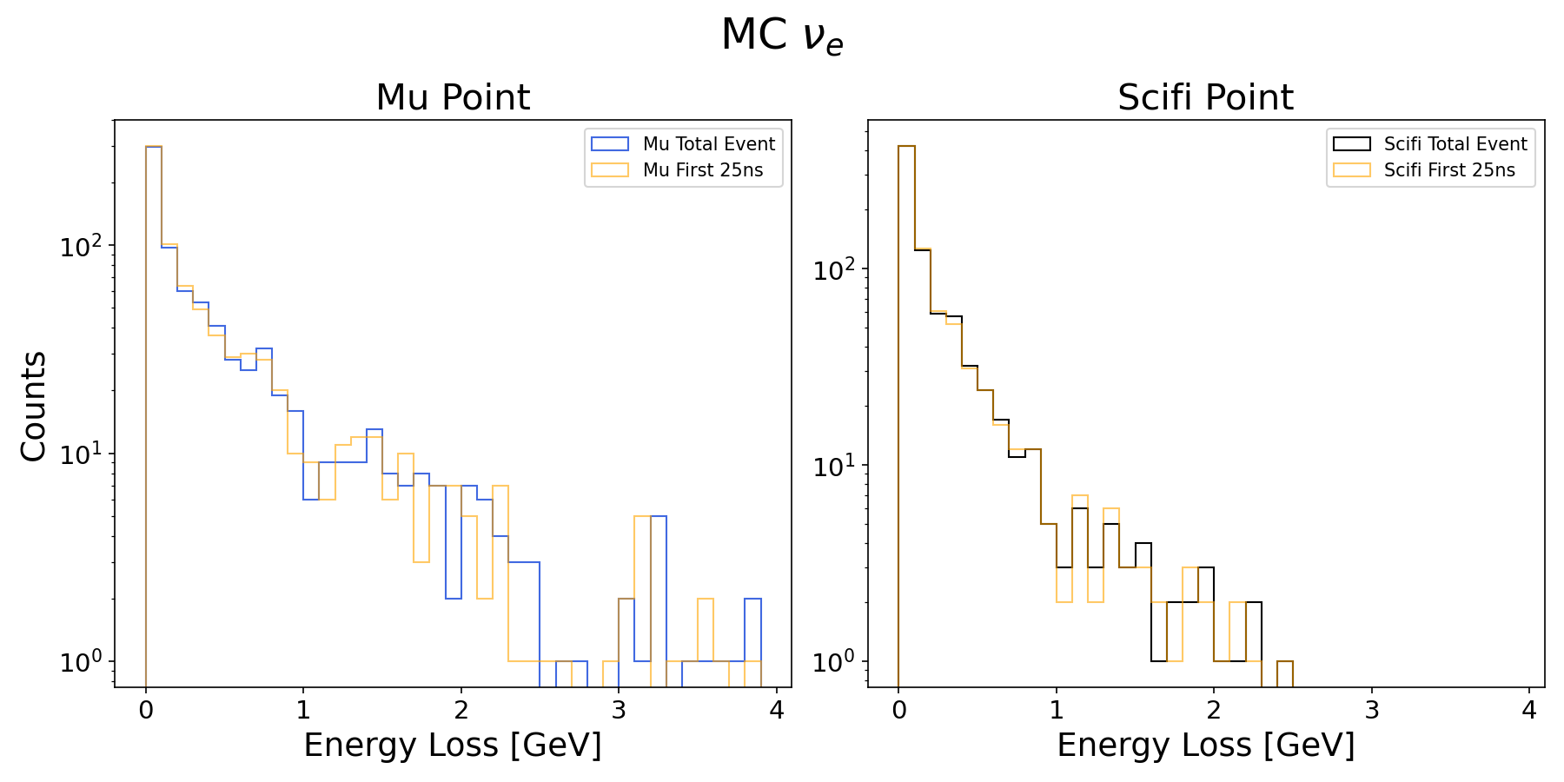

$800 ν_{e}$ events
Pedro Baculima – 13/05/2025
8

Slide 9
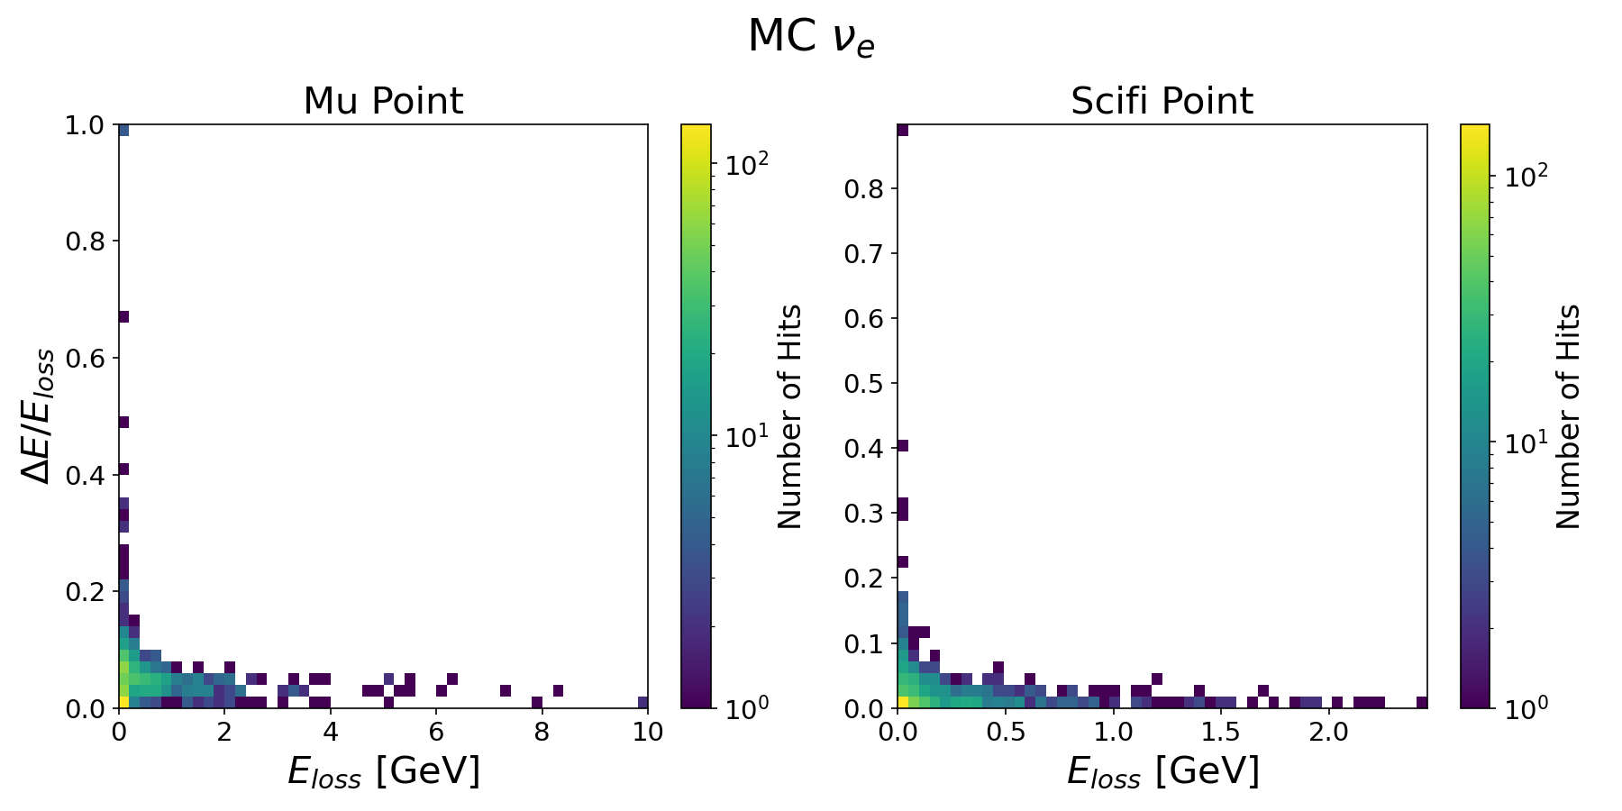
$800 ν_{e}$ events
Pedro Baculima – 13/05/2025
9

Slide 10
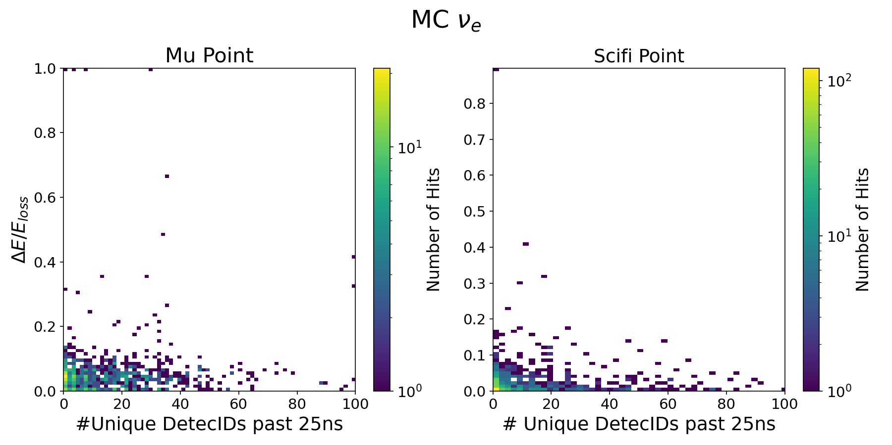
$800 ν_{e}$ events
Pedro Baculima – 13/05/2025
10

Slide 11
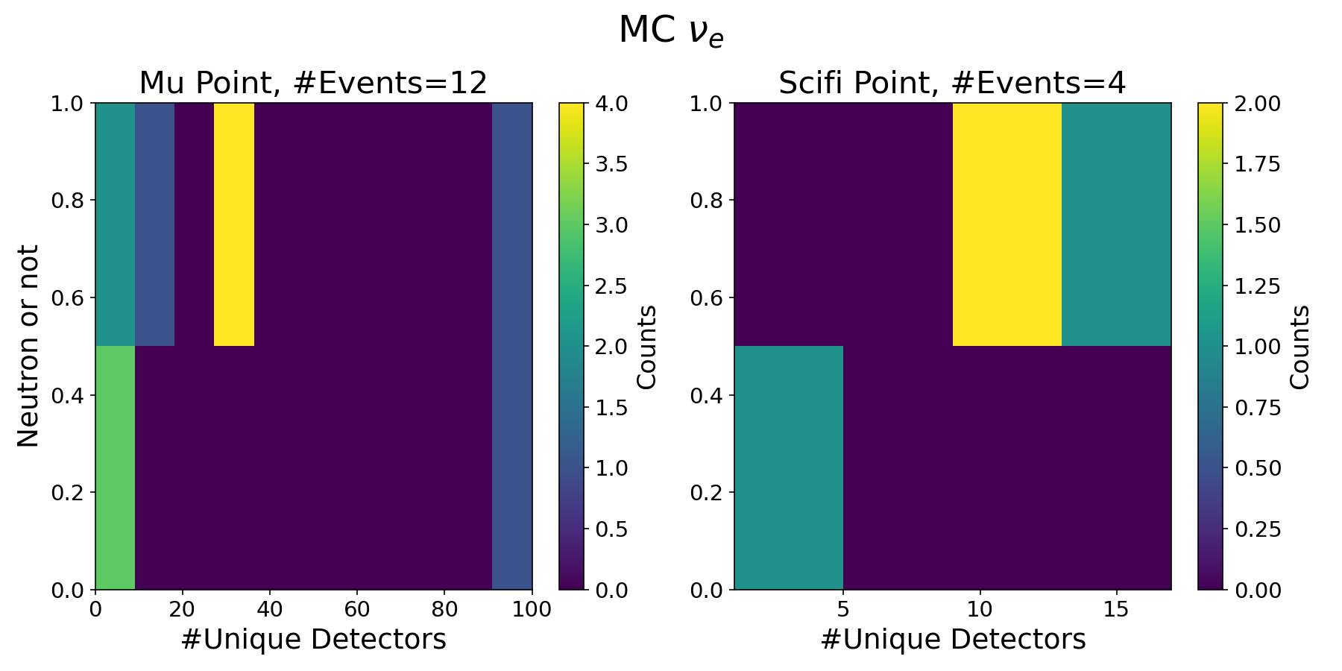
$800 ν_{e}$ events
Pedro Baculima – 13/05/2025
11

Slide 12
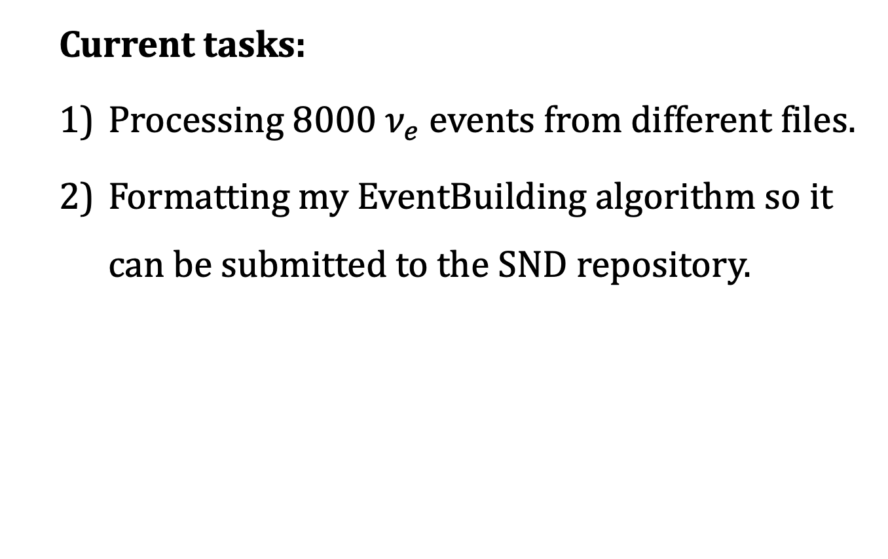
Other Updates
  Current tasks:
  Processing 8000 $ν_{e}$ events from different files.
  Formatting my EventBuilding algorithm so it can be submitted to the SND repository.
Pedro Baculima – 13/05/2025
12

Slide 13
Thank you!
Pedro Baculima – 13/05/2025
13

