Slide 1


BTL Progress Update @ CMS
5.13.2025
Zhihao Cheng

Slide 2
TIF Assembly Update
We set up the dry air tube yesterday for the test; removed tray #1 out of the 2nd coldbox
We discussed the possibility of grounding using copper inside the box to the aluminum supporter, then outside connected to the supporter, in the consideration between electrical conductivity & thermal conductivity
We found that the black tape used to seal the coldbox is “permeable,” that dry air can leak through it noticeably
The coldbox might be slightly “damaged” that dry air outflow was found at various spots; sealed with more black tape (humidity goes down afterwards)

Slide 3
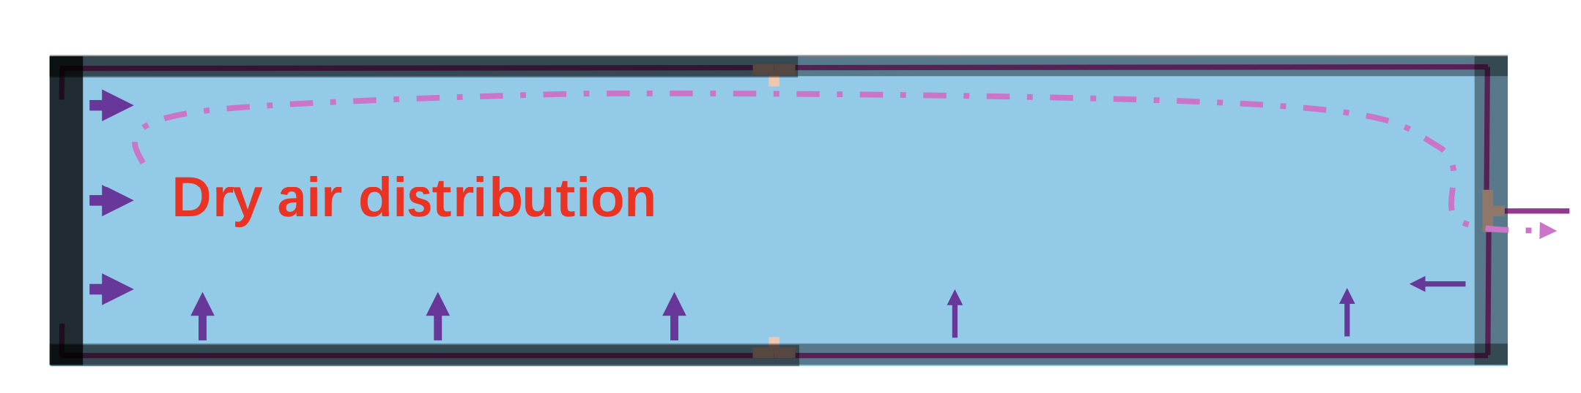
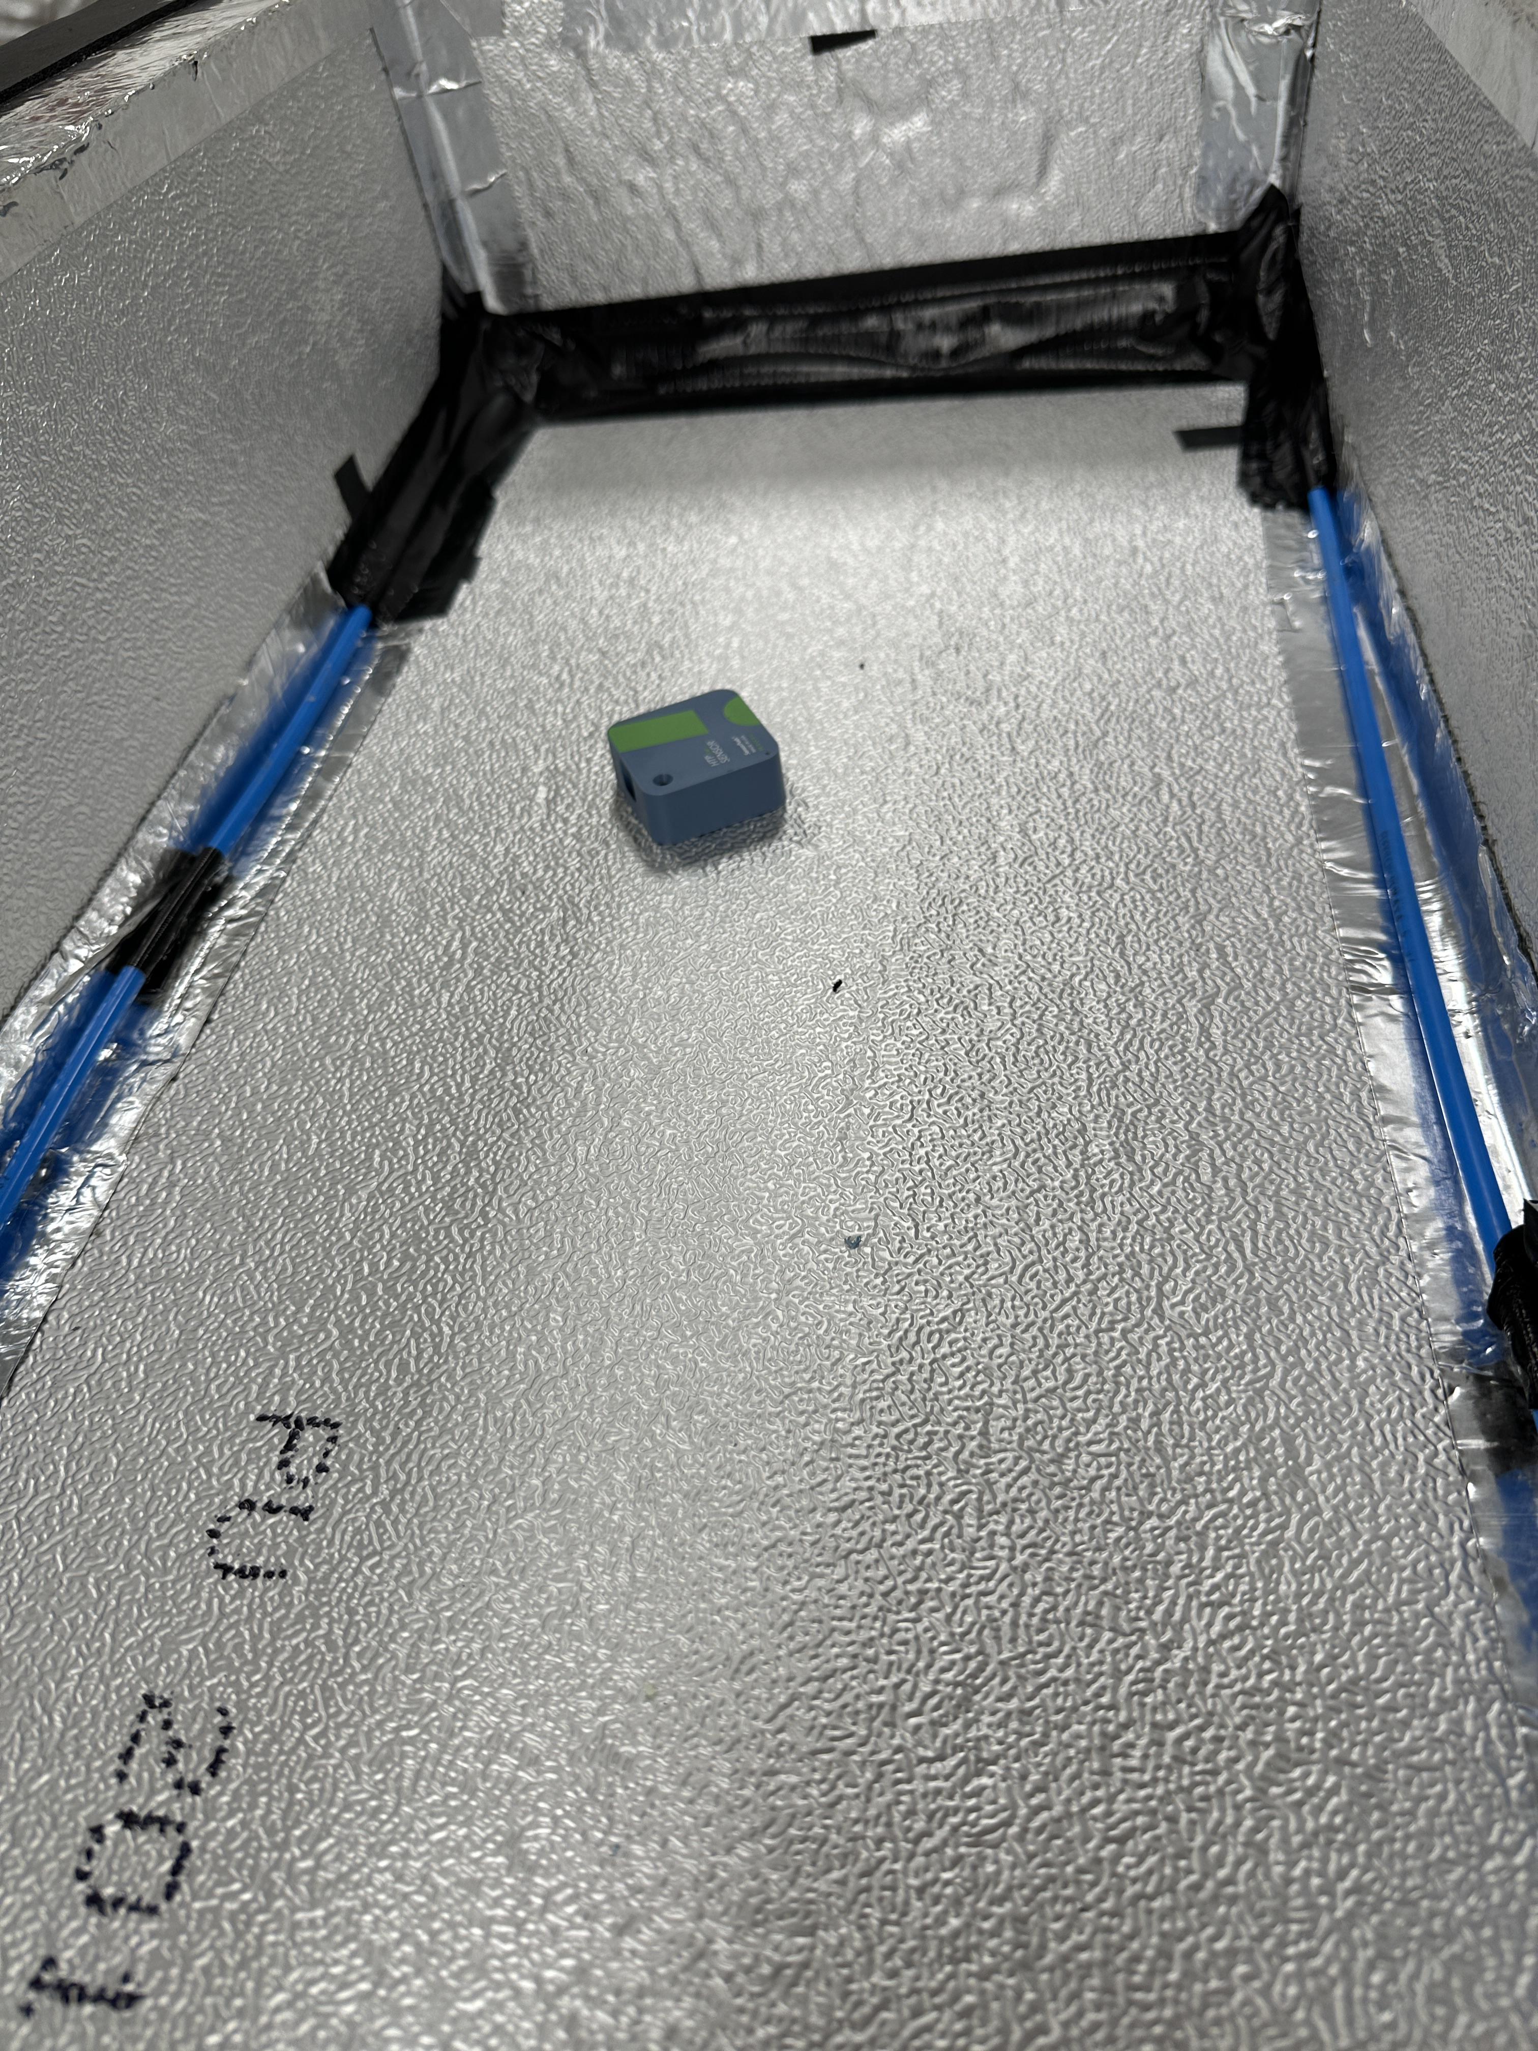
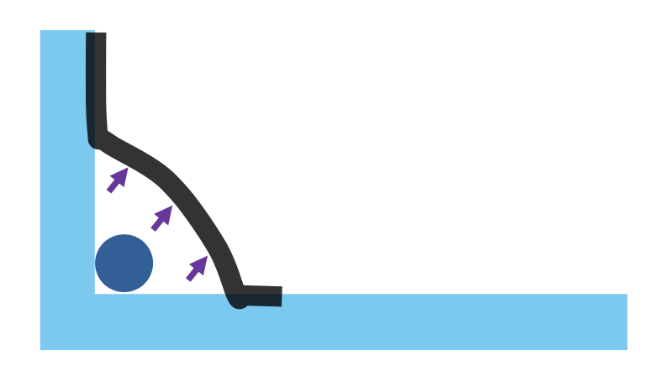

Slide 4
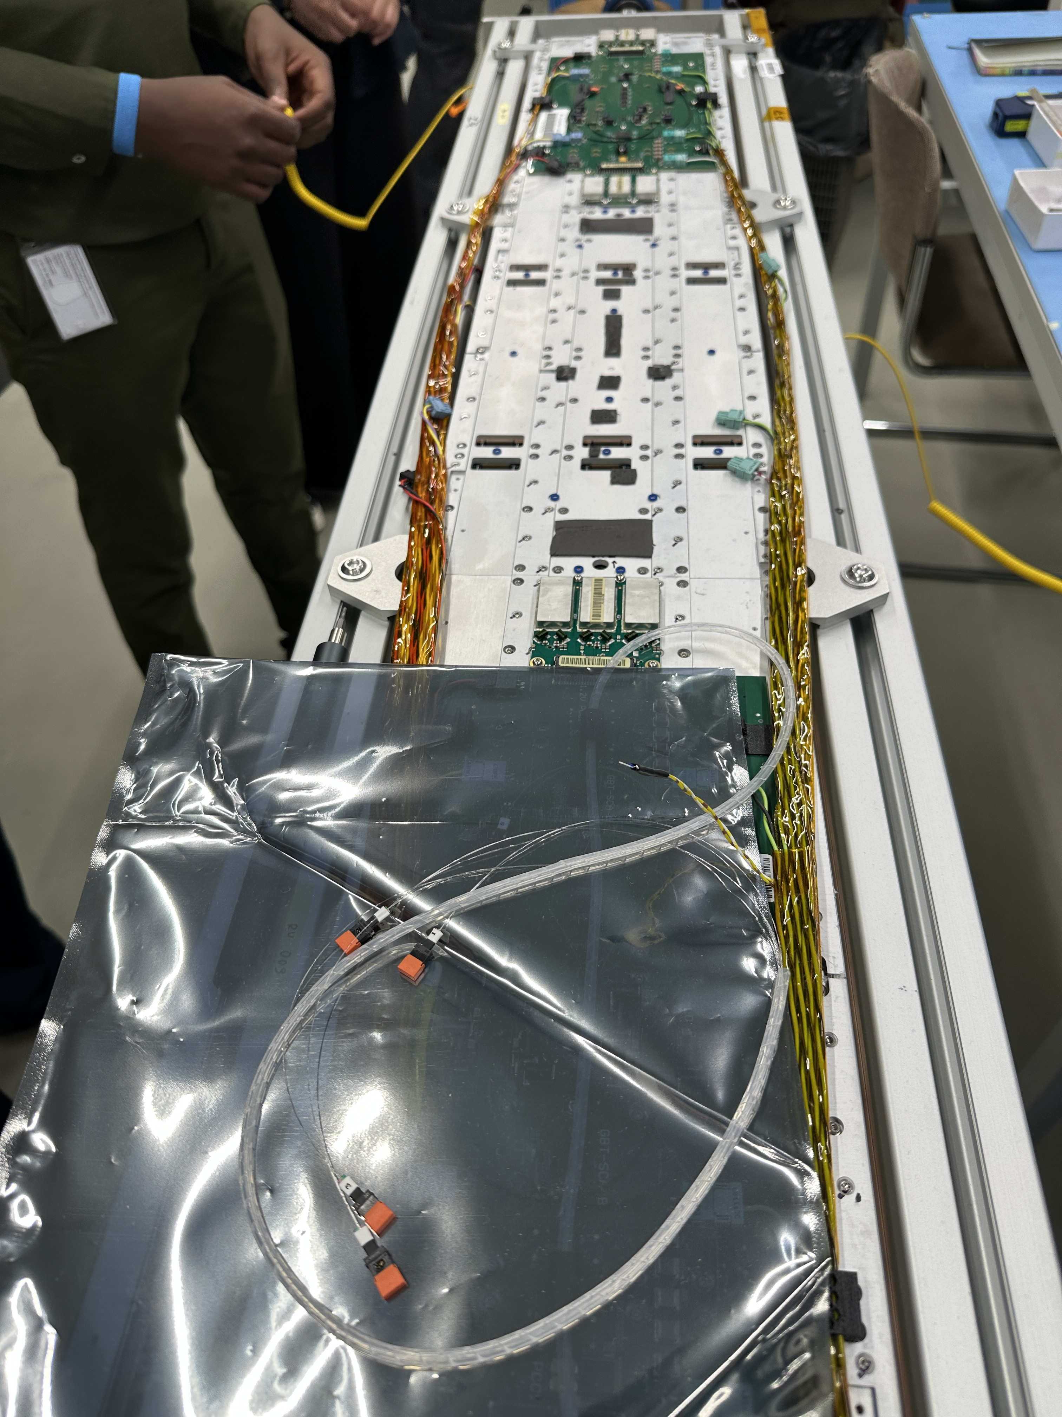
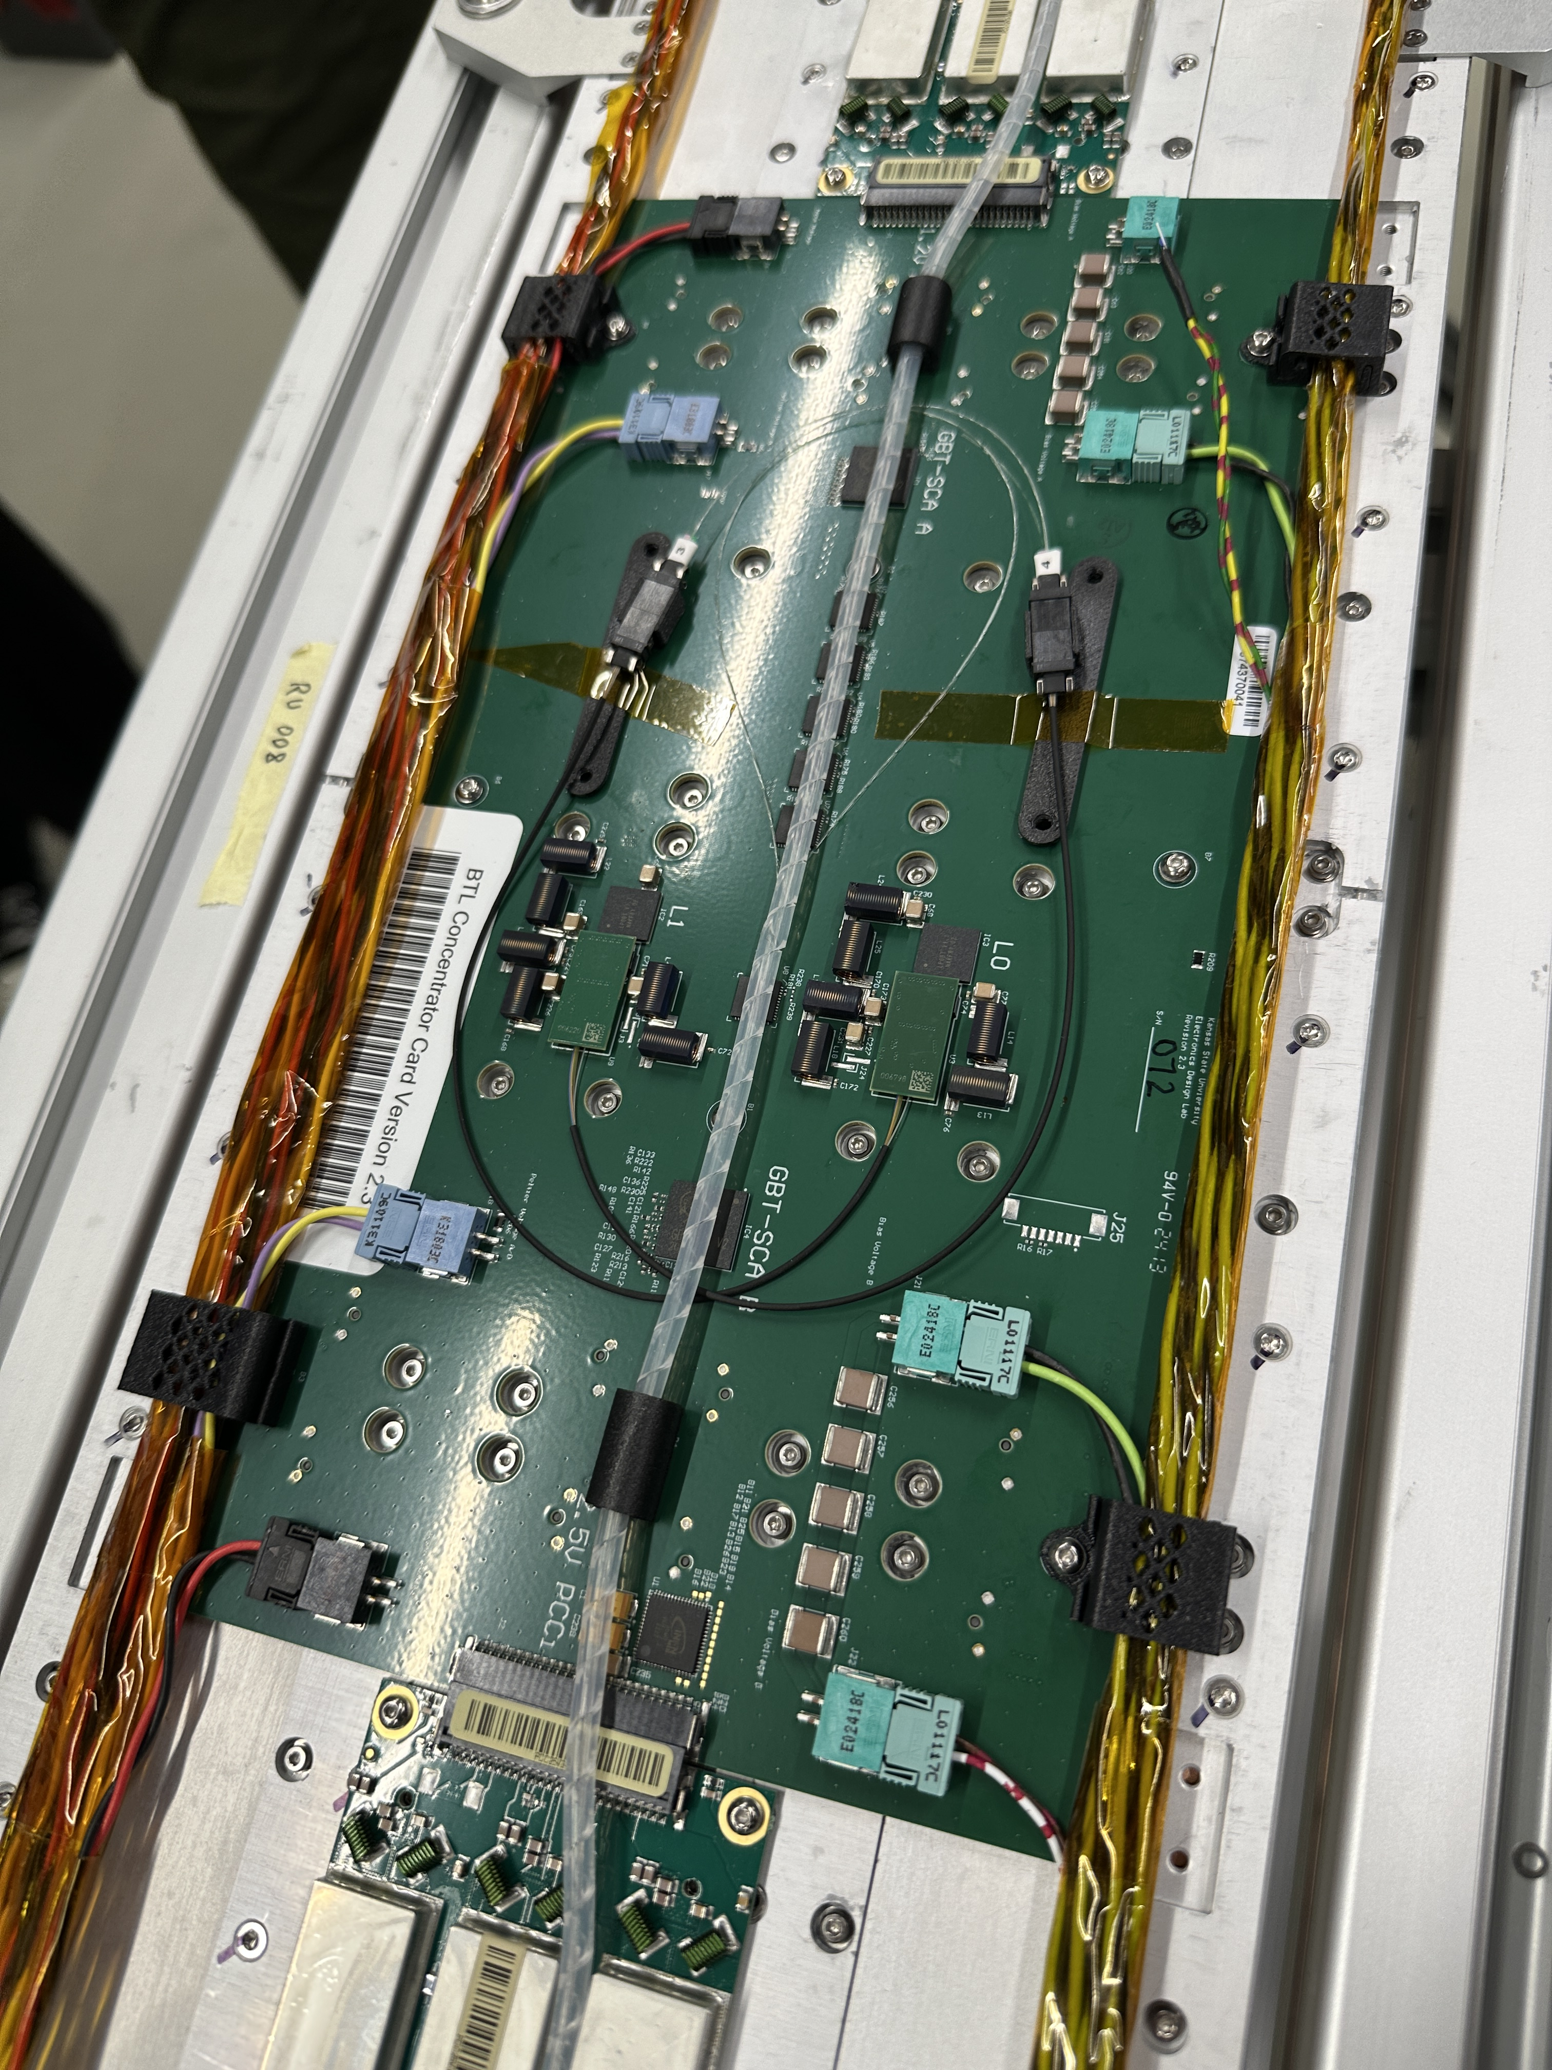

Tray Assembly Update
The concentrator card on our BTL tray #2 RU1 replaced due to unknown instability issue on GBT-SCAs; installed CC 072
Replacement works as expected; blue washers & thermal pasting stay where they are; replace 1 blue washer with metal for grounding
TECNet resistance recorded ~17$Ω$
Doing full testing on the new CC and retest on RU0

Slide 5
Testing Procedure
Initializing Z1.1 Serenity card causes problem; we thought the system kernel was the, but the problem wasn’t solved, until 2 days later it “disappeared”
Regular testing procedure:
Finished the testing procedure 1-4; 5 failed due to a bug on RU1
6 and 7 needs to be thoroughly tested in TIF; currently ongoing: optical connection between BTL lab and TIF
Powering connection with tray power supply distribution board (TPSDB): expected ~0.51 A with 1 RU on
Change RU1 structure file so that it points to the correct RU
DM Position test using BoardID; quick SiPM bias
TP time resolution test
Discriminator & IV scan
TEC test
LYSO Energy Spectra

Slide 6
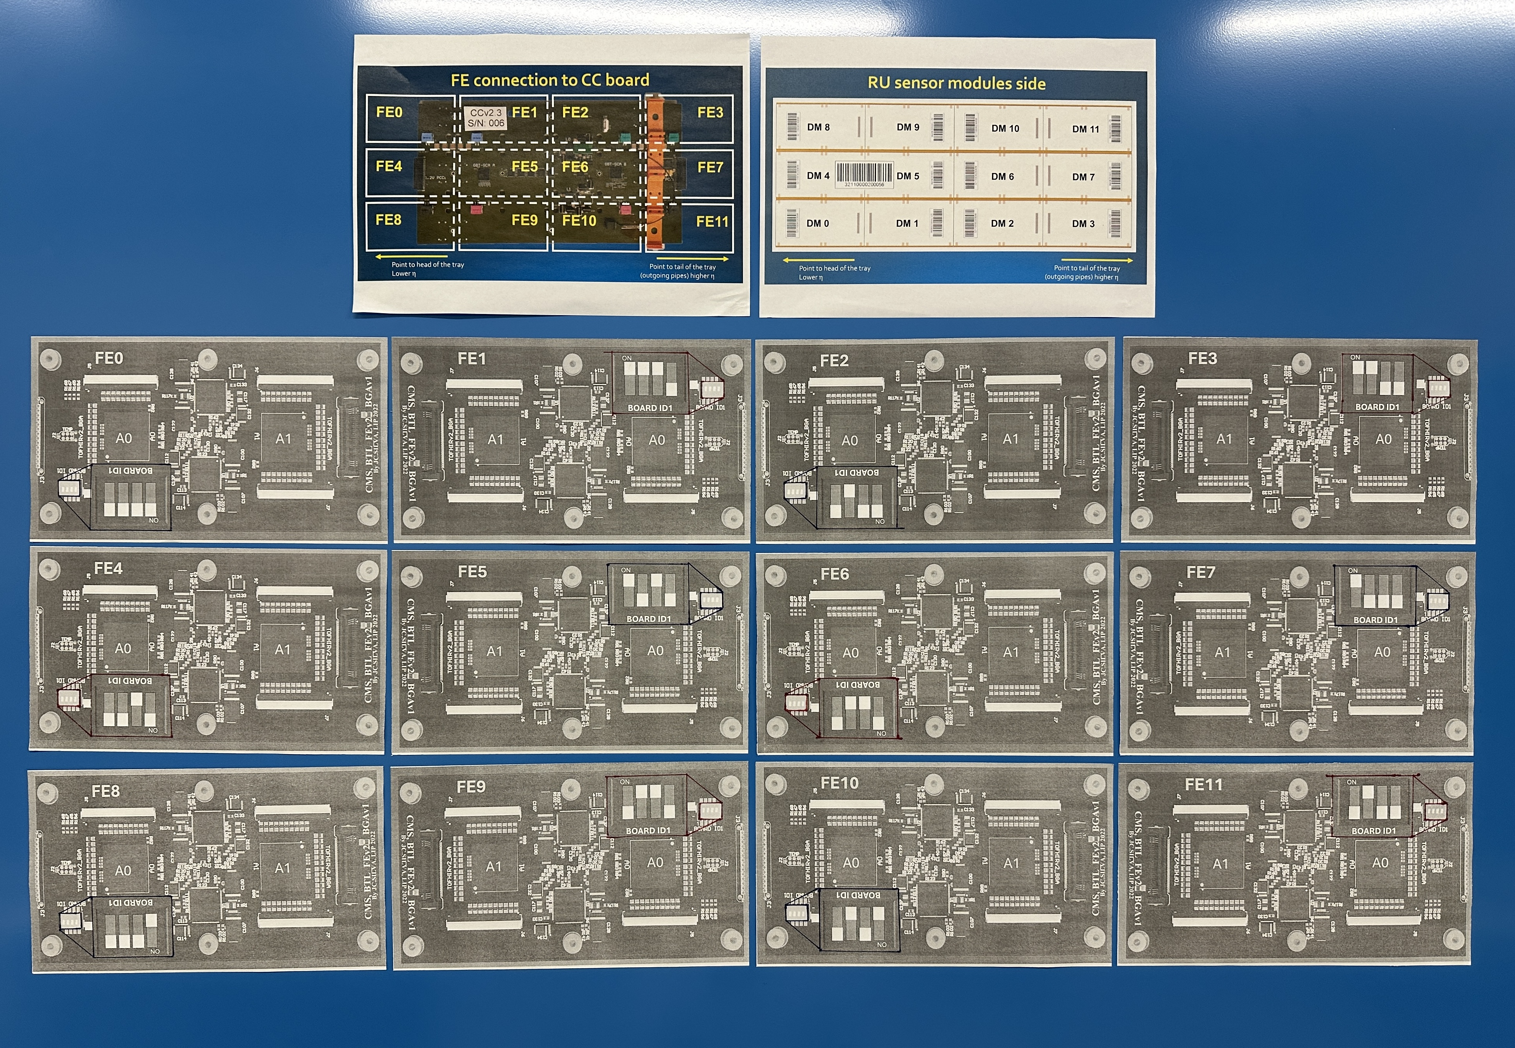
DM Position Test & SiPM Quick Bias
Each DM on the CC has a switch that points to a certain BoardID
During the test we run 12 individual runs to acquire the response of each DM
SiPM Bias expect temperature readings ~35C after 1min with room lights on
With high voltages on, leaving SiPMs under room lights too long could fry the electronics

Slide 7
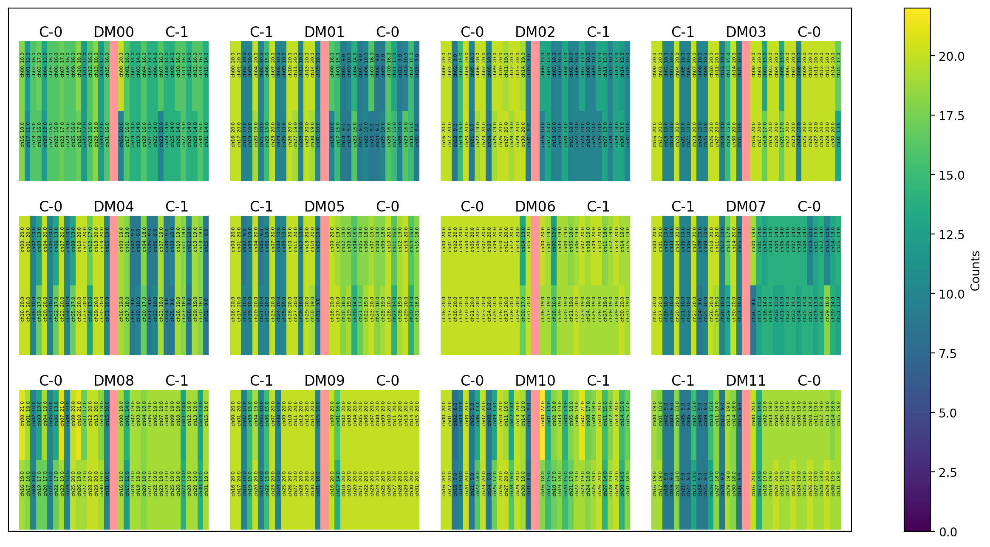
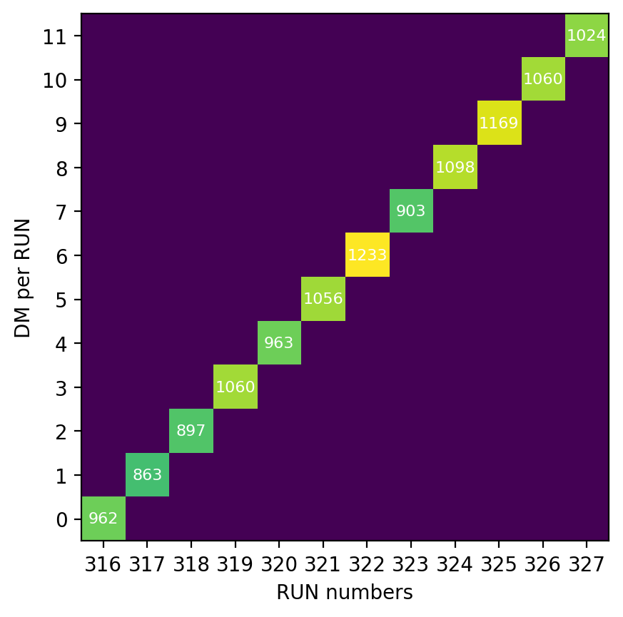
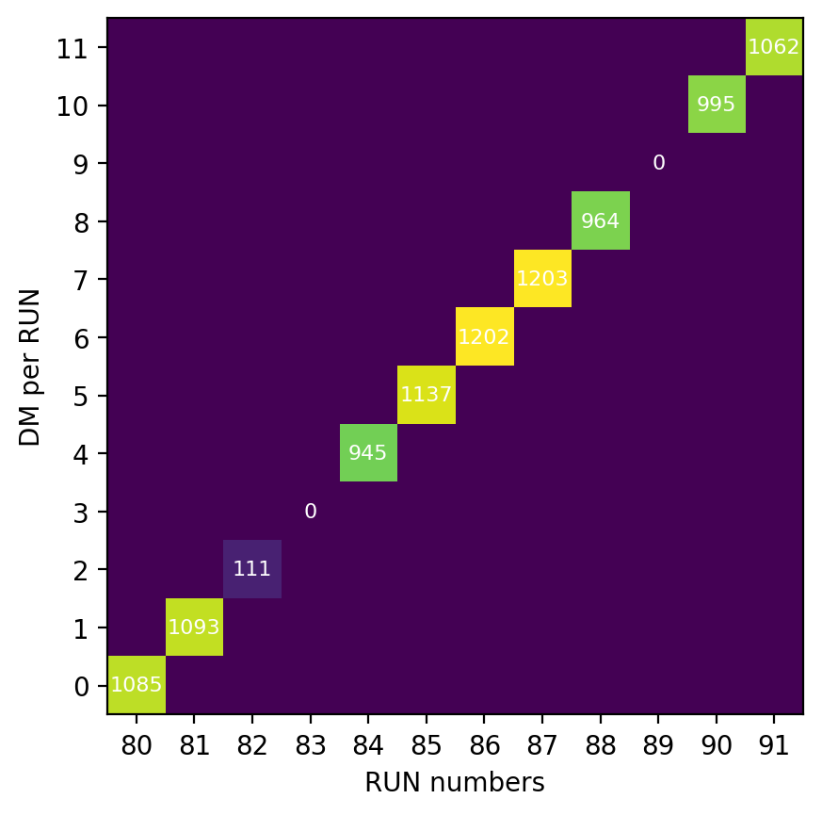
GOOD!
NOT GOOD!

Slide 8
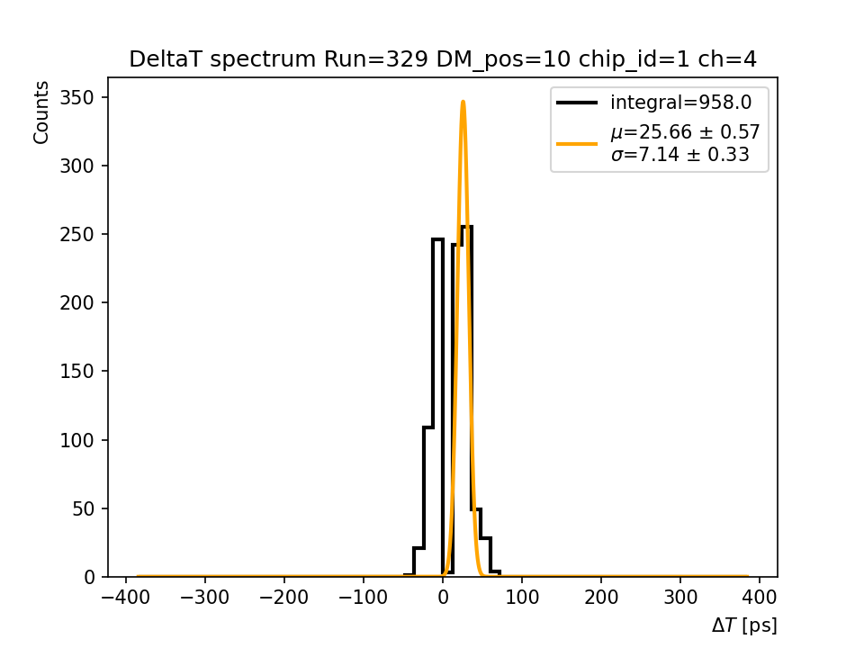
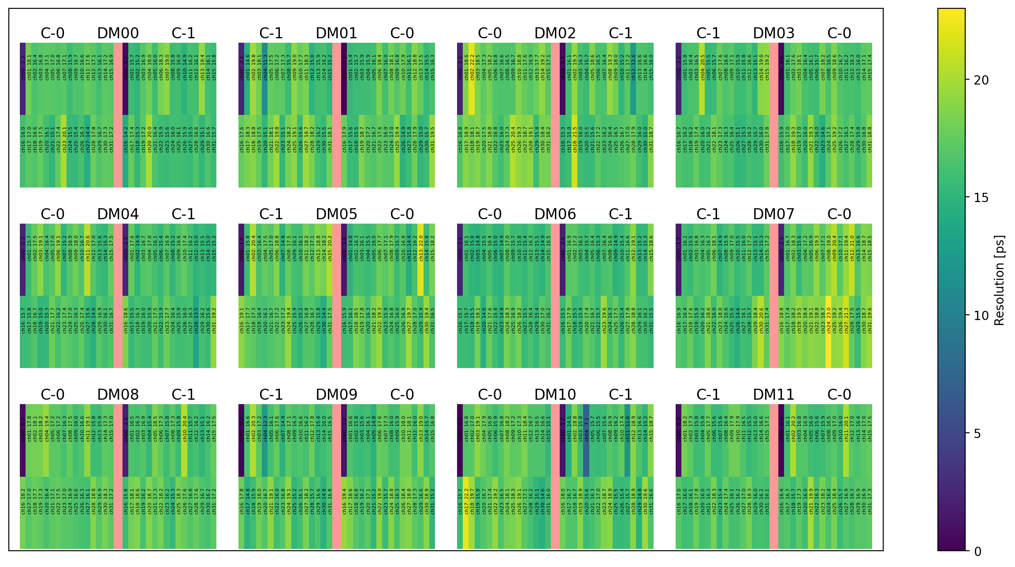
Time resolution Test
New CC works as expected
In special cases where there is a bimodal distribution, the reason could be how TOFHIRs clock the timestamps
Resolution of ~17ps is how fast electronics respond between the TP is sent and TOFHIR “measures its arrival” and converts into readable data

