Slide 1
Measurements with AC-LGAD at JSI
Bojan Hiti (JSI Ljubljana)
DRD3
16 May 2025

Slide 2
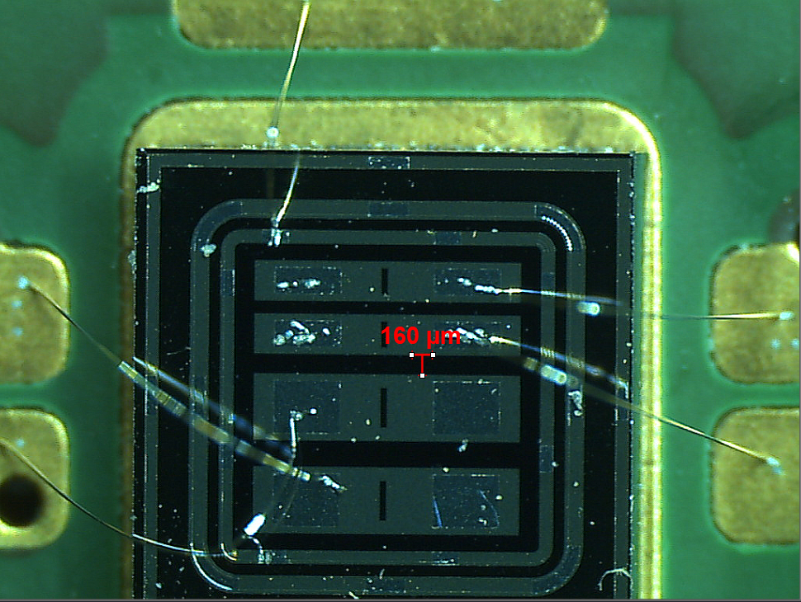
Samples and readout
Bias ring (GND)
-HV back plane
4 channel AC-LGAD investigated with IR Top-TCT
  IHEP V3 W11Q4-1
Mounted on 4-channel Chubut2 Front End Board (40 dB)
Read out with DRS4 digitizer
  700 MHz, 5 GS/s
First signals observed last week
Ch1
Ch3
Ch2
Ch4

Slide 3
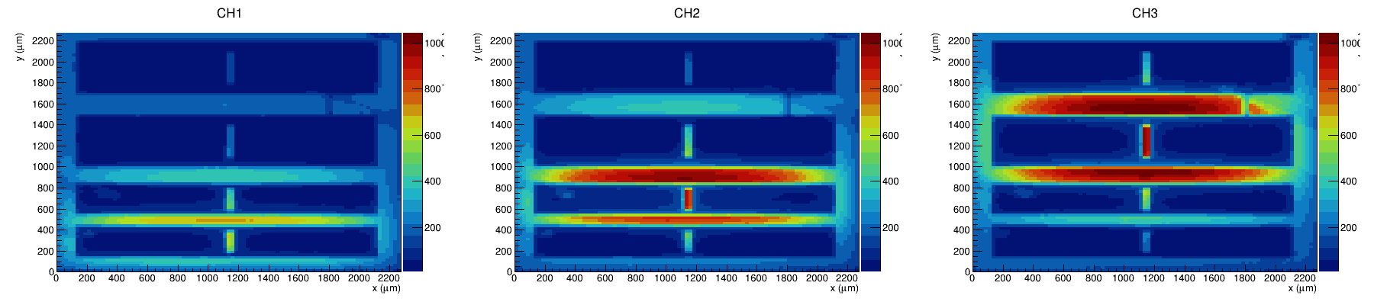
First measurements with AC-LGAD (standard TCT)

Slide 4
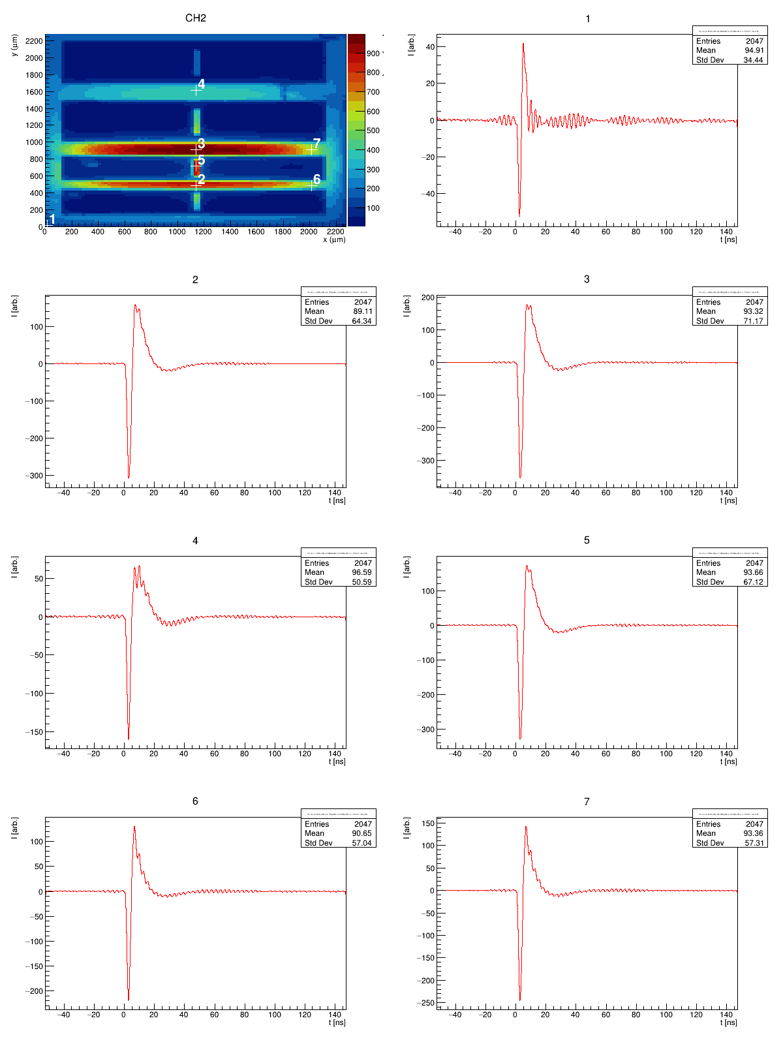
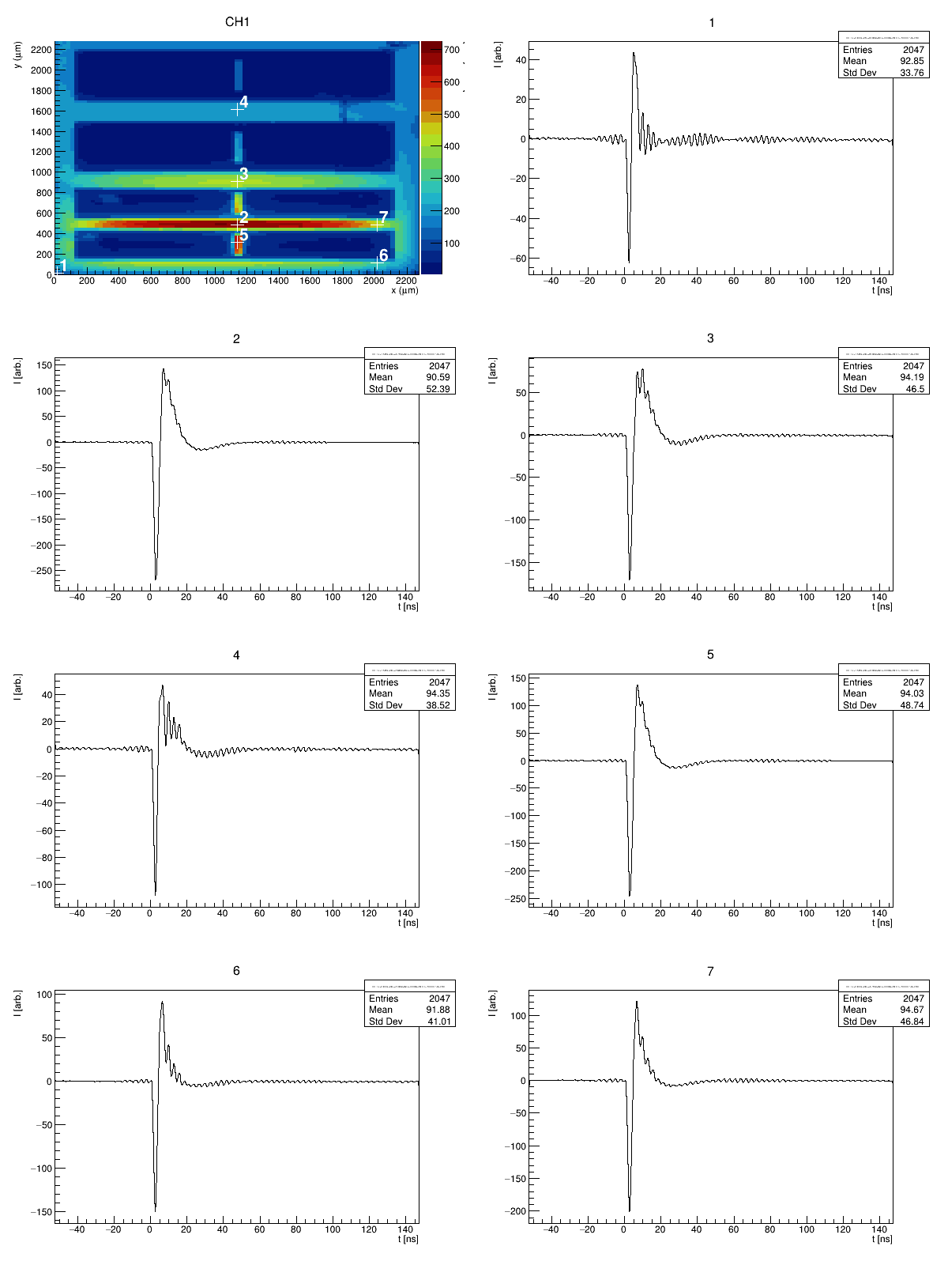

Slide 5
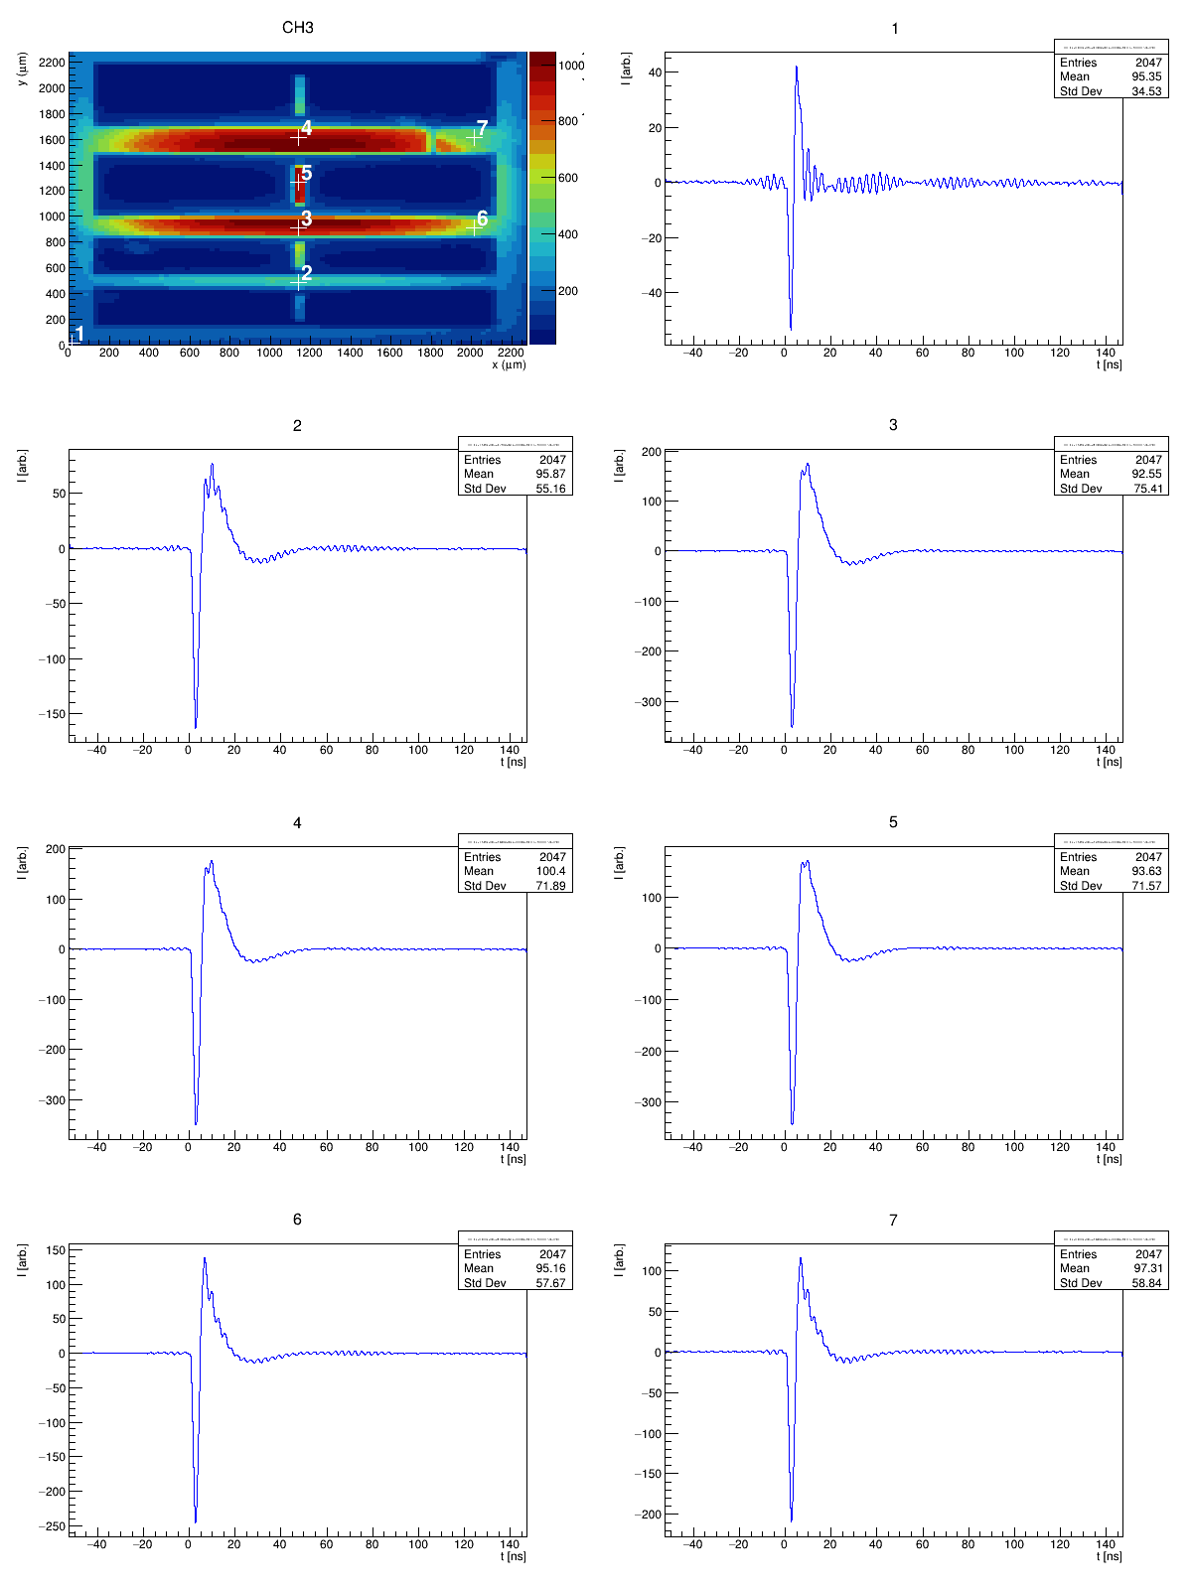

Slide 6
Future plans
Plan to study AC-LGAD performance in terms of hit rate:
  What is effect on signal shape by two simultaneous hits spatially ‘close’ together
  What is recovery time needed to observe no pile up effects?
Developing a new laser based test method
  Laser allows precise control of hit position/energy/time of hit
Measurement strategy:
  Inject two laser signals:
    Hit 1 (normal hit) comes first and is stationary
    Hit 2 (probe hit) is injected in different positions
    Hit 2 can be delayed by a few ns w.r.t. to Hit 1
  Read out the waveform containing both signals
Hit 1
Normal hit
Hit 2
Probe hit

Slide 7
Double Beam TCT (DB-TCT)
Double Beam TCT – Two signal injections obtained by splitting an original laser beam into two beams and physically separating two beams
Laser source
1064 nm
300 ps
Beam 1
beam splitter
Beam 2 positioning stage
Beam 2
  Fine alignment of both beams necessary
    Common focus and known point of entry
  Beams refract (favorably) on silicon surface
    Angle between beams in silicon about 10°
  Beam 2 can be moved independently of beam 1
  Delay by extending beam 2 fiber length (steps of 5 ns)
DRS 4
Sample
(not to scale)
Beam size in focus 10 µm

Slide 8
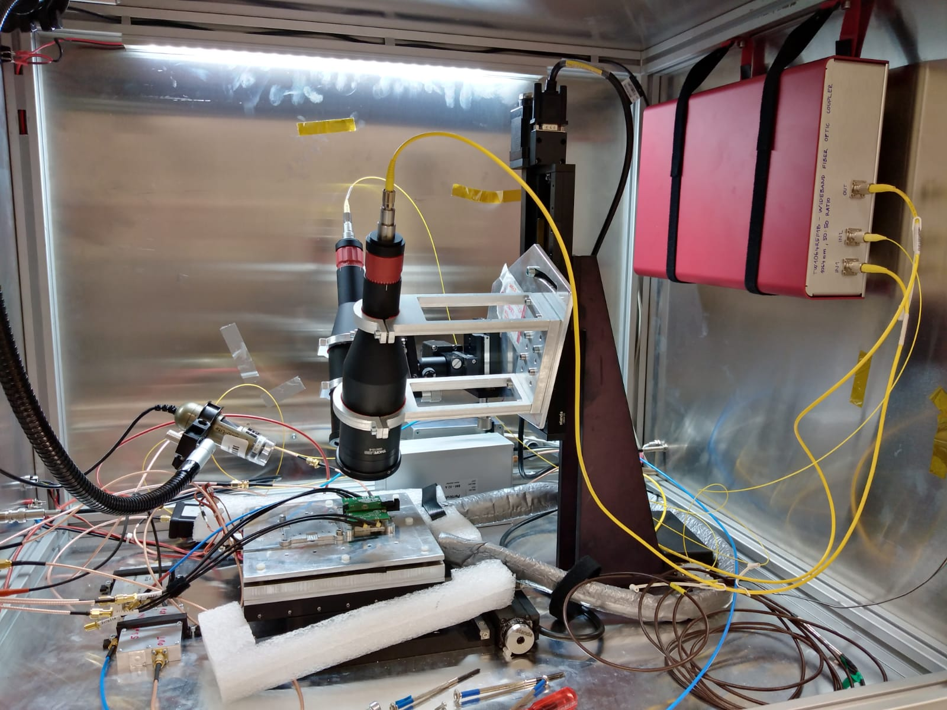
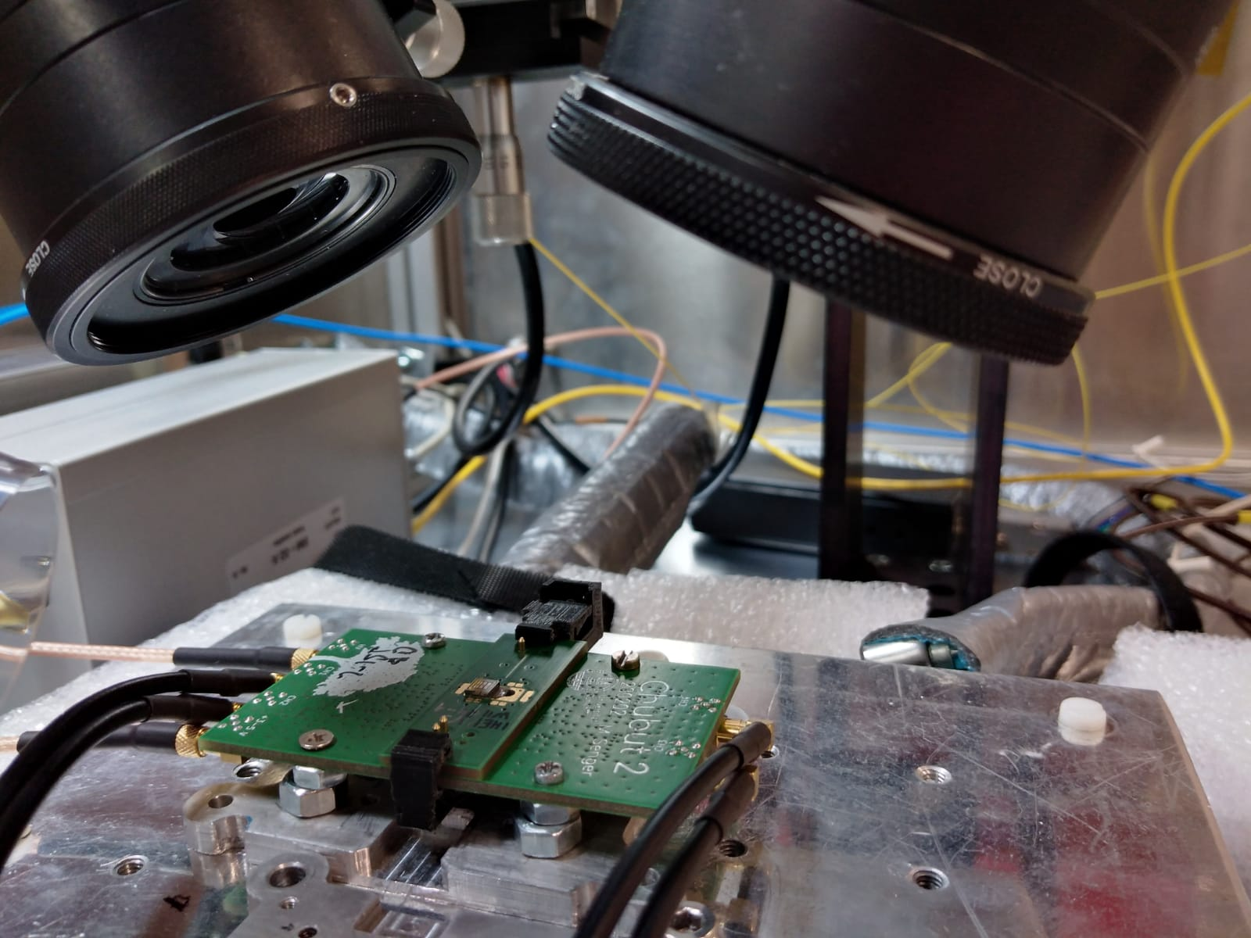
DB-TCT setup
Beam splitter
Beam 2
Beam 1
Chubut 2
Motherboard
Chubut 2
Daughterboard
with sample

Slide 9
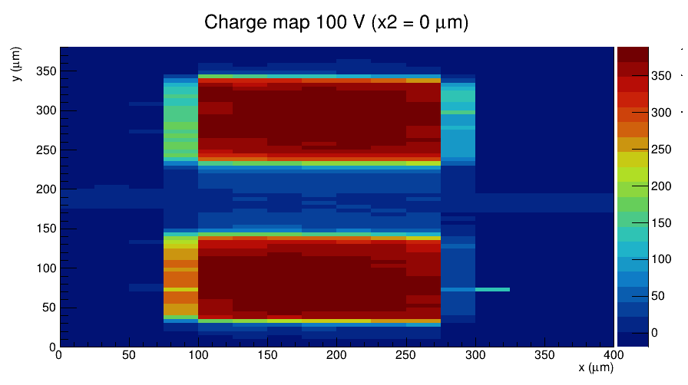
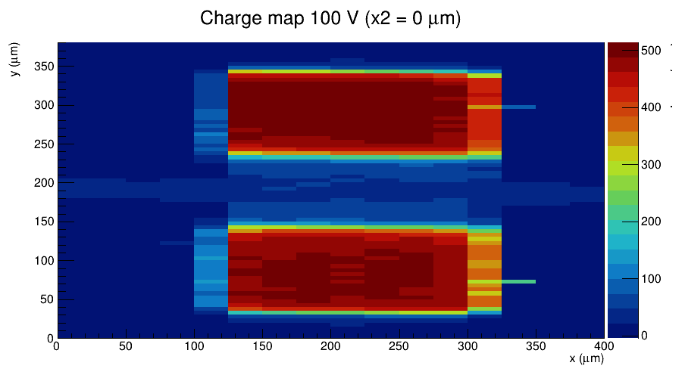
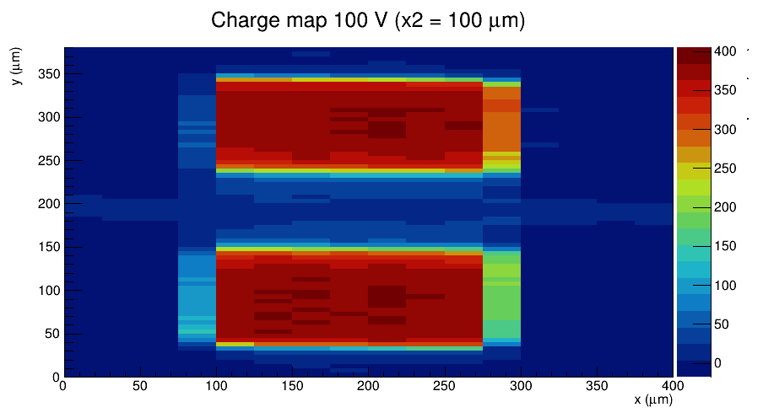
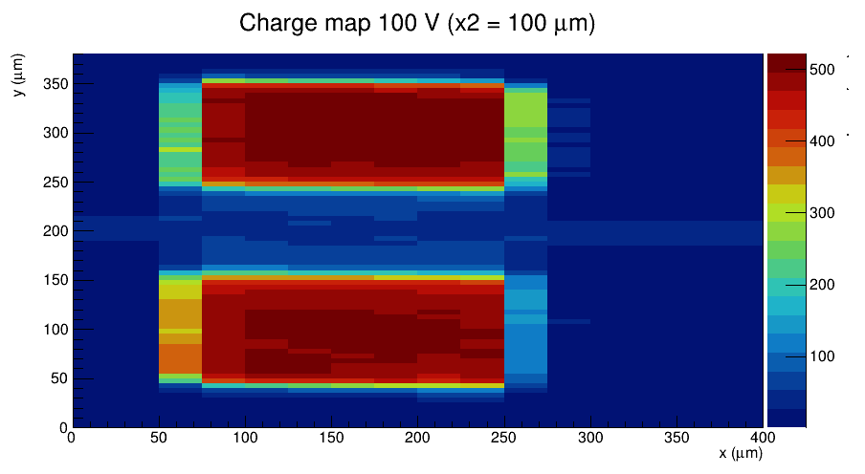
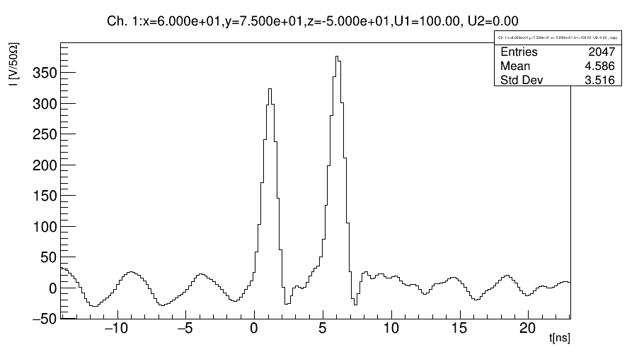
DB-TCT first results (with ATLAS HGTD LGAD)
Beam 1
Beam 2
5 ns delay
XY scan
Beam 1 stays at rest
Beam 2 moves
both beams well aligned w.r.t. each other

