Slide 1


AC-LGAD readout electronics based on FPGA
K. Hu
on behalf of the NEX group in SDU

Slide 2
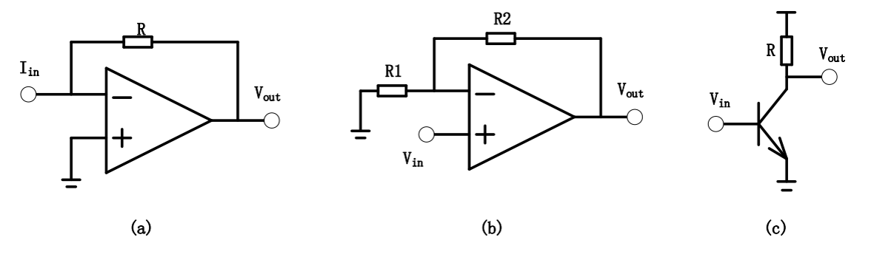
Front-End Readout electronics
Transimpedance Amplifier (TIA): Vout=Iin* R;
Voltage Amplifier (VA): Vout = (1+R2/R1)Vin;
Wideband Radio-Frequency Amplifier (RF): fixed gain.

Slide 3
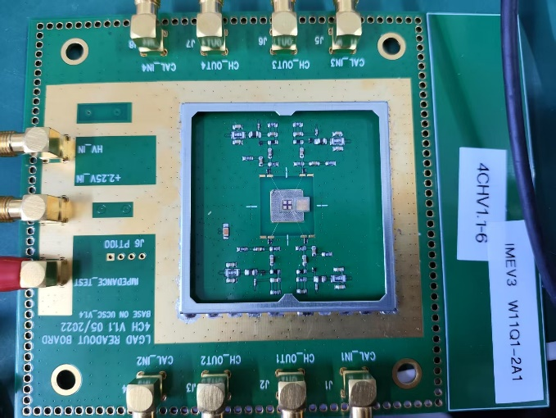
Readout electronics
LGAD detector & adapter board
LGAD front-end electronics (FEE)
PC

Slide 4
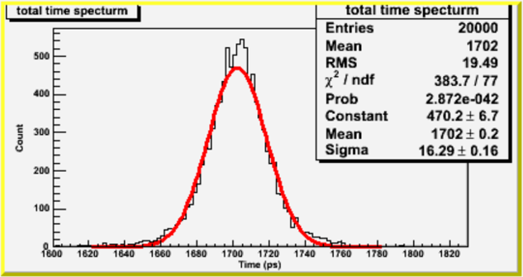
FEE Verification
~11 ps
2-ch test system to validate the time resolution measurement:
1. RF: ADL5545->6 GHz with integrated bias control circuit;
2. Ultrafast comparator: ADCMP572 with differential output;
3.Time-to-Digital Converter (TDC): KCU116 Dev-> Tapped delay time technology in the FPGA.
Currently, ~6 ps resolution can be achieved.

Slide 5
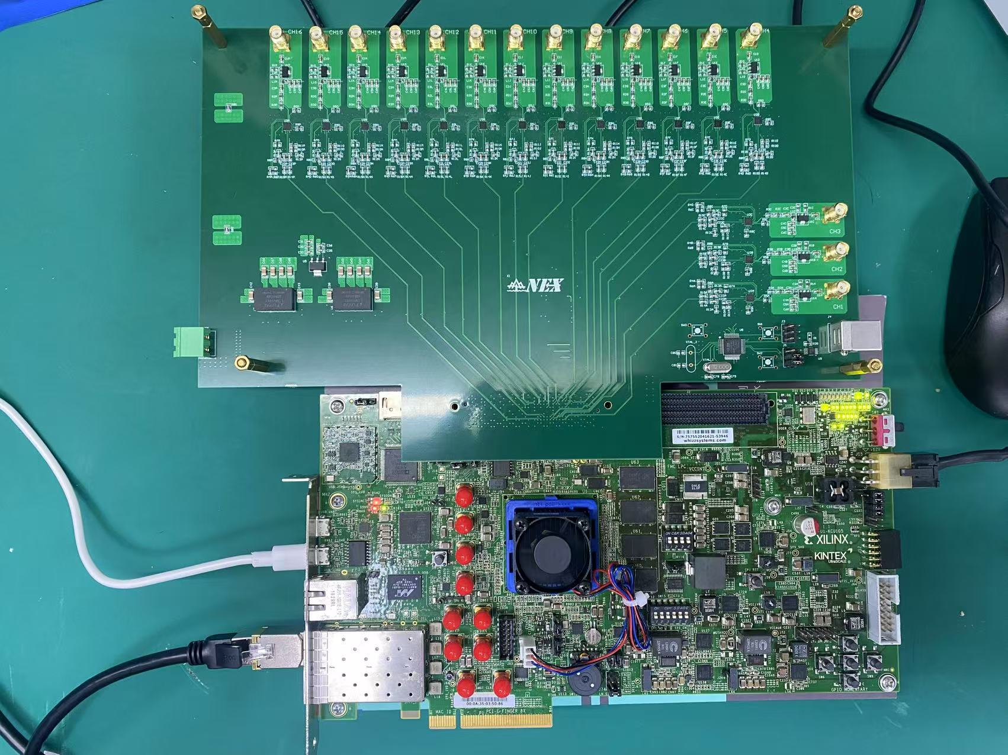
16-ch electronics prototype
16-ch front-end board
KCU116 dev
16-ch front-end board :
1. RF: ADL5545->6 GHz with integrated bias control circuit
2. Comparator: ADCMP572 with differential output;
KCU116 dev : TOT & TOA measurement
Thanks for your listening!

Slide 6
backup

Slide 7
backup
  FPGA-TDC
  1.Coase time：16-bit counter；
  2.Fine time：Time delay line is implemented CARRY8 primitive。

