Slide 1



FoCal status upate
Nicola Minafra, on behalf of FoCal
June 17th 2025

Slide 2
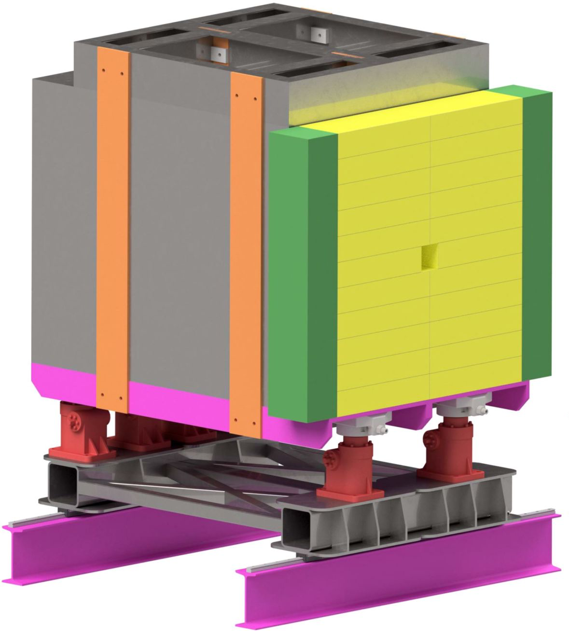
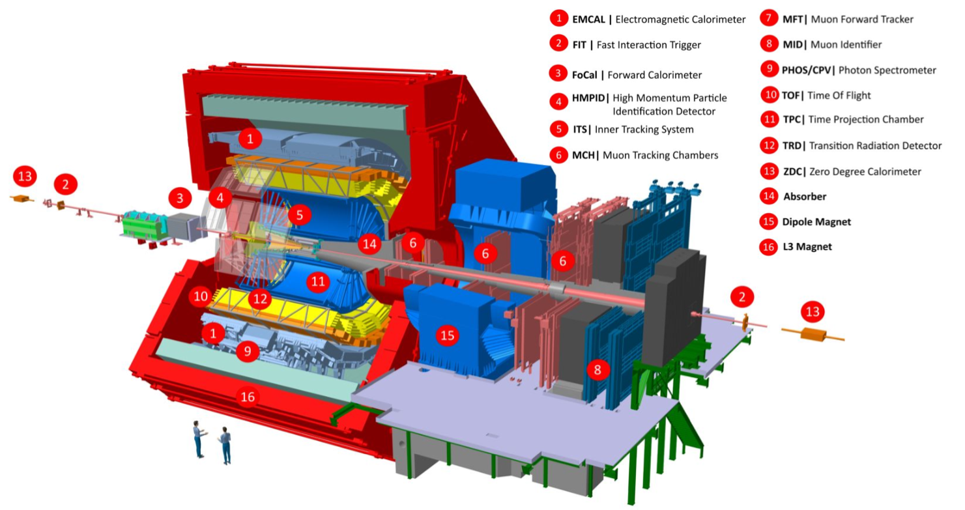
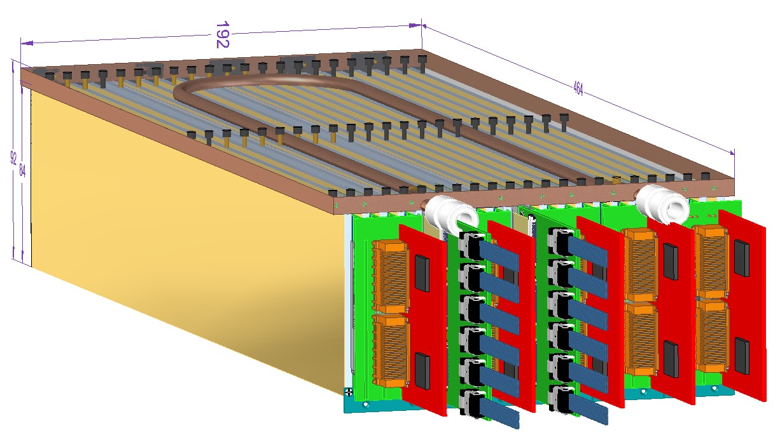
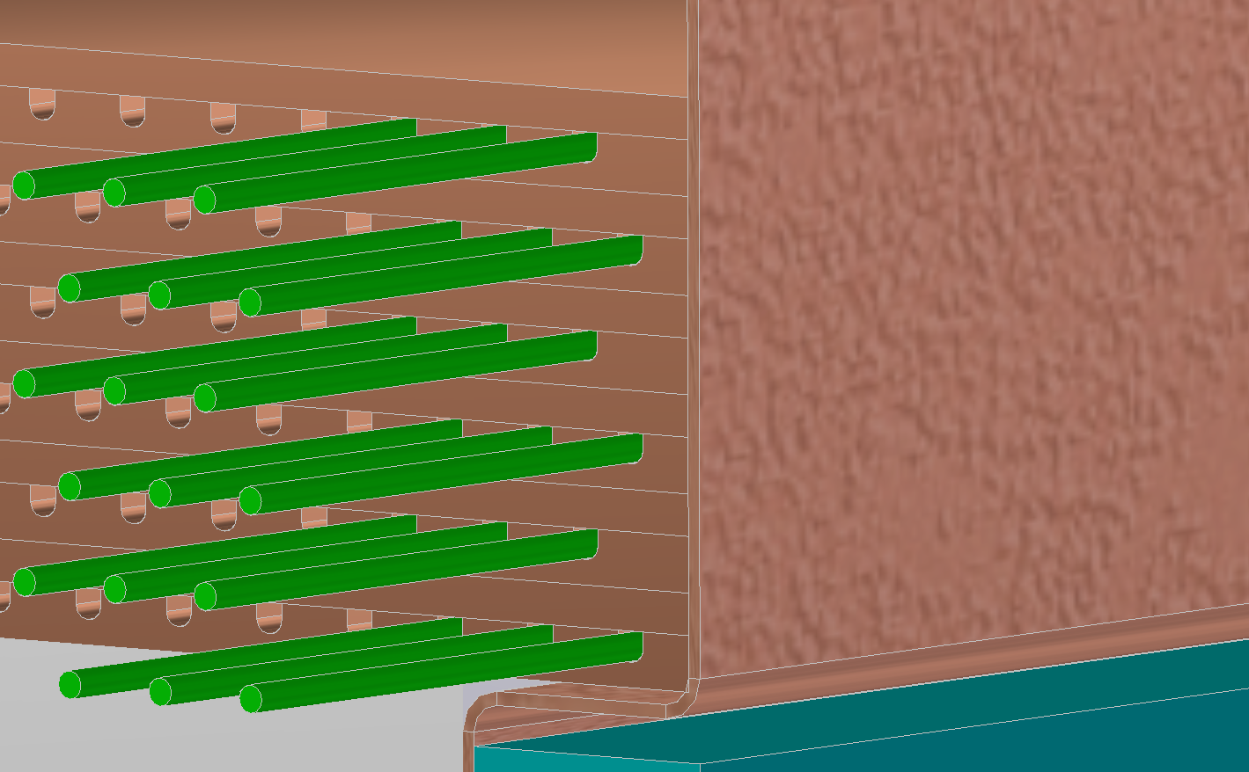
FoCal: Forward Calorimeter for ALICE detector for Run 4 of the LHC
FoCal-H Transversally segmented spaghetti calorimeter
Tot thickness ~ 6 𝝀had
FoCal-E
20 Layers (LG + HG Si detectors + W absorbers). Tot ( ~ 20 X₀)

Slide 3
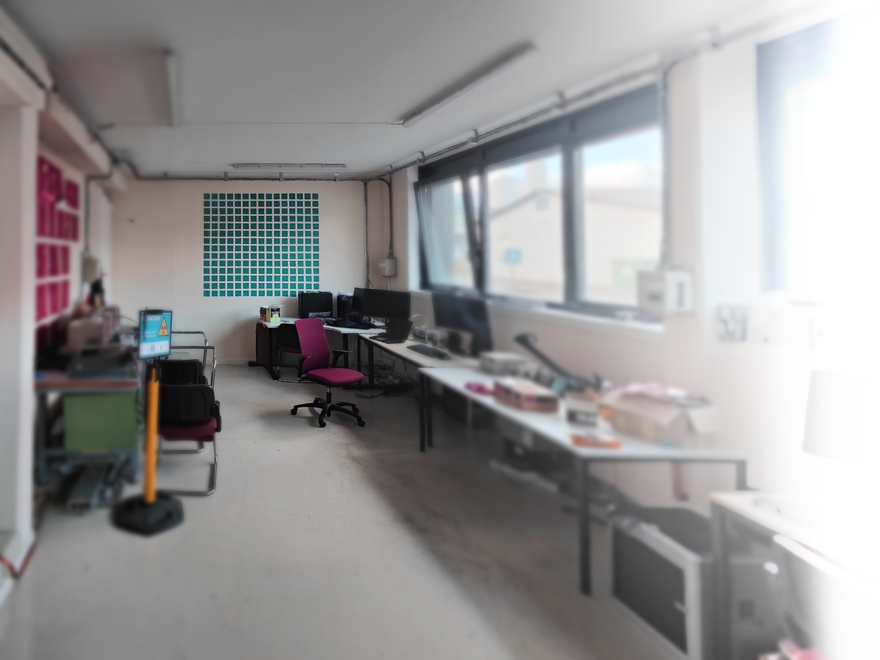
Outline
General Updates
Updates from Pixels
Updates from Pads
Updated from HCAL
Possible descoping options

Slide 4
FoCal Important milestones for 2025 (in evolution)
May 27th 2024: Cooling System EDR (postponed to May 27th)
April 30th IB
May 27th: HCAL EDR (Martin Aleksa as external expert)
June 10th: HCAL Mechanical EDR (+ FoCal Services)
June 2025: PAD Assembly Workshop in Japan, to decide on detailed procedures and locations
July 2-9: IRRAD
August 13-20: PS Test Beam
September 10-17: SPS Test Beam
September 2025: Focal E Assembly Workshop
September 2025: Focal Readout EDR
<September 2025: Tungsten Plates EDR
October 8-15: SPS Test Beam
October 15-30 2025: Cooling System PRR
December 2025: Platform and Positioning system PRR
June 2026: FOCAL PRR (no further change to the HW)

Slide 5
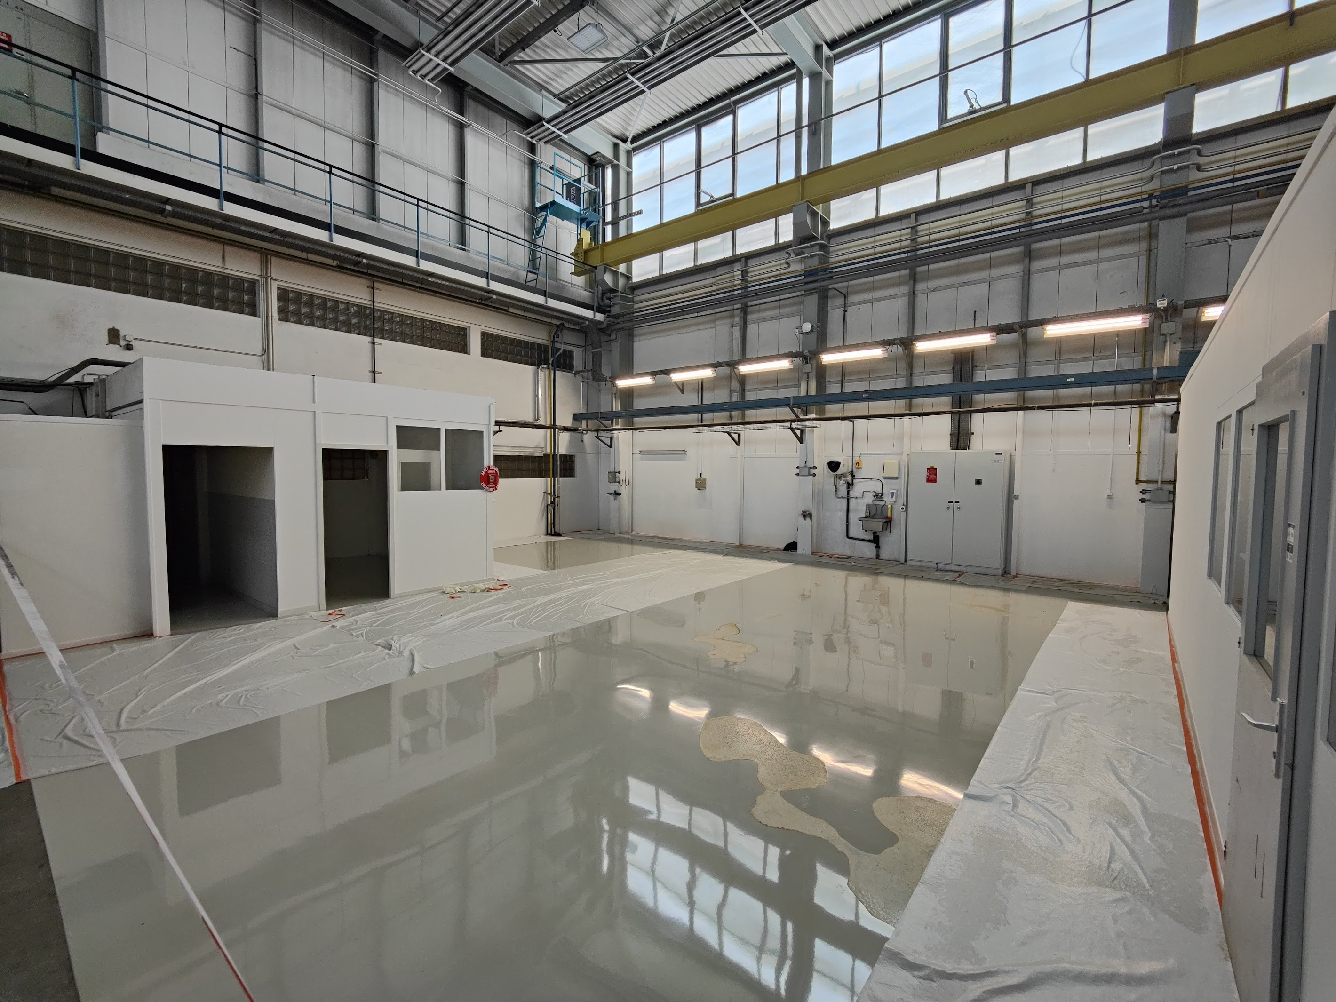
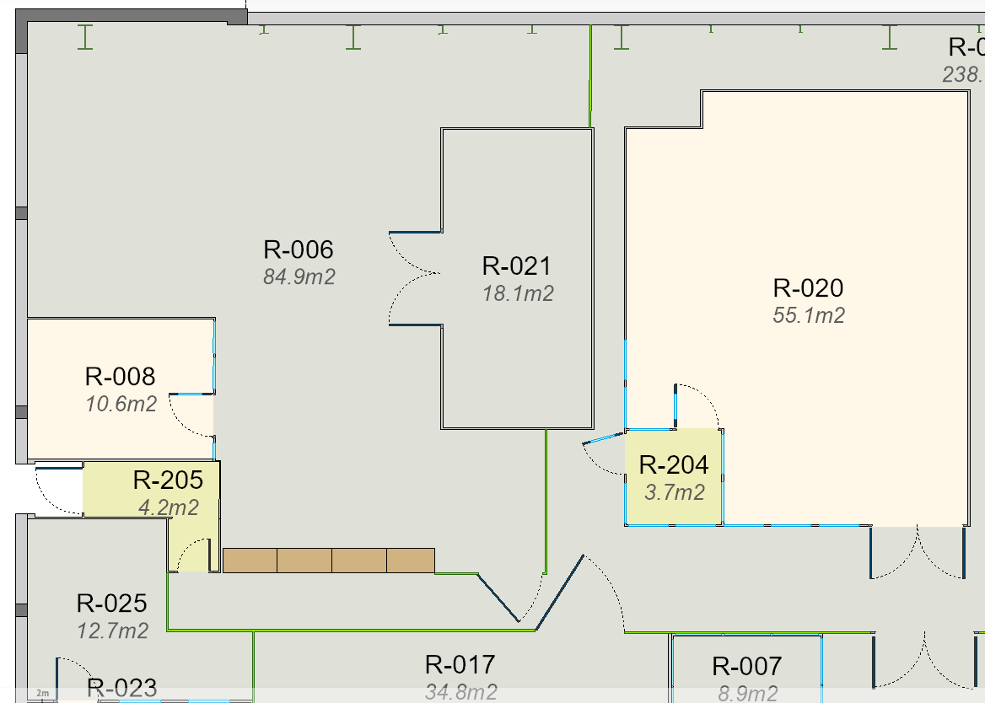
New FoCal lab under refurbishing
Thanks to A. Tauro

Slide 6
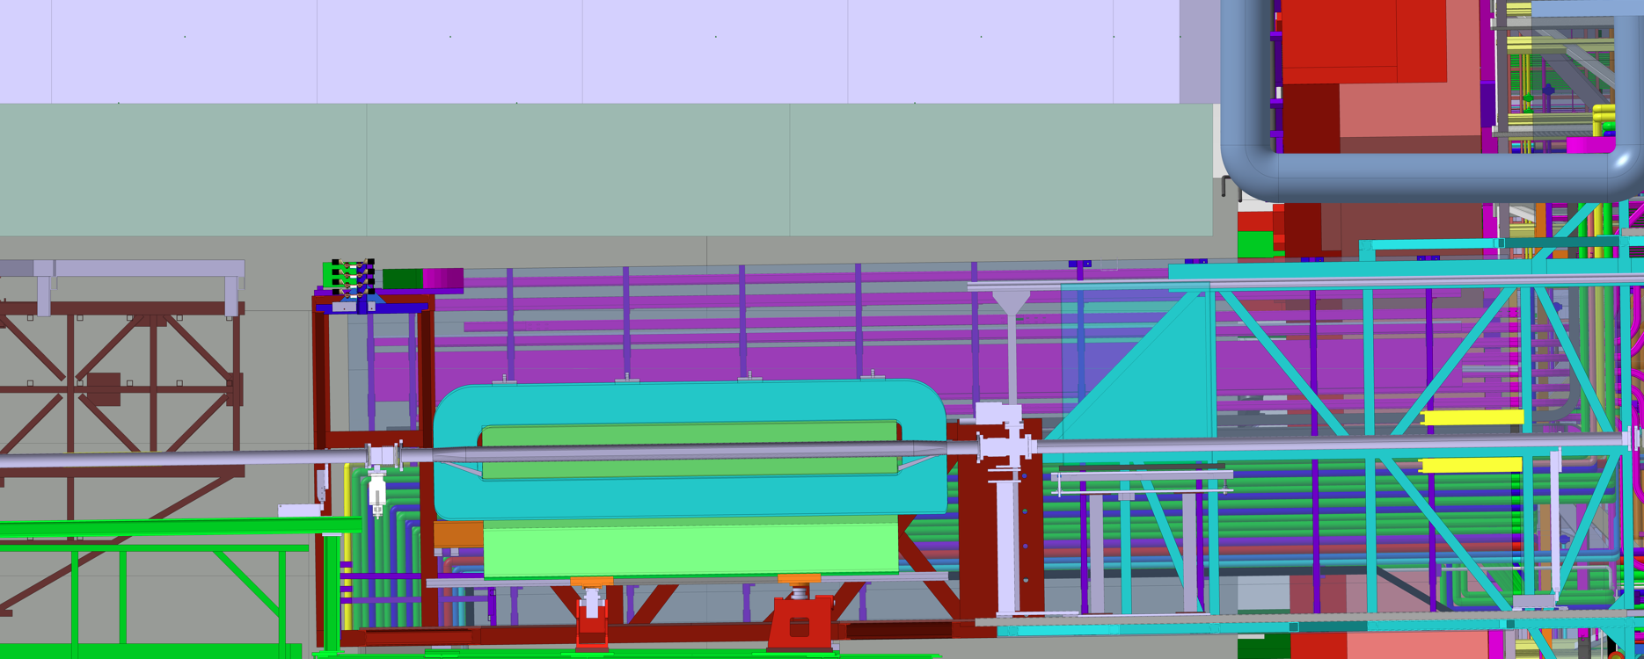
Magnetic field measurements on the mini-frame
Thanks to A. Tauro, K. Barth
M. Czarnynoga
ALICE magnet
RUs <300 mT
V ~10 mT H ~10mT L ~ 100 mT
HCAL Back
V ~10 mT H ~10mT L ~ 40 mT
ECAL Side
V ~ 35 mT H ~ 150 mT L ~ 150 mT
Compensator magnet
Max in the region
V ~ 50 mT H ~10mT L ~ 50 mT

Slide 7
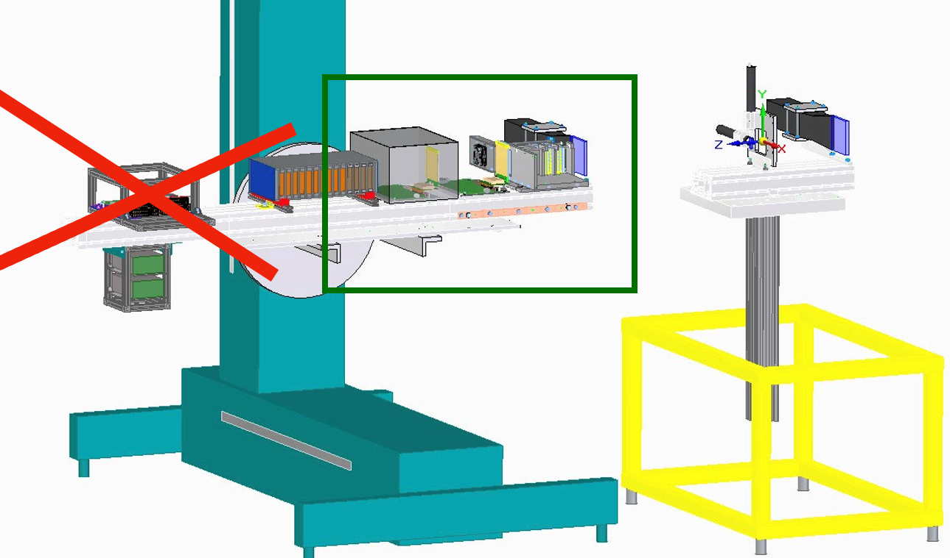
FOCAL Test Beams in 2025
T. Isidori, M. Rauch
PS (T0):
week 33 (August 13 - 20)
SPS (H2):
week 37 (Sep 10 - 17)
week 41 (Oct 8 - 15)
Beam configuration:
~15 GeV Hadrons
Up to ~10GeV electrons
Up to ~ 10^5 particles/spill
Test goals:
FoCal-H
Test of new readout chain (VDLB+ -> CRU)
FoCal-E
Test of effects of trigger latency on ALPIDE efficiency
Test of 15 strings pixels
Test of new pads production?

Slide 8
FOCAL Test Beams in 2025
T. Isidori, M. Rauch
PS (T0):
week 33 (August 13 - 20)
SPS (H2):
week 37 (Sep 10 - 17)
week 41 (Oct 8 - 15)
Beam configuration:
Up to 350 GeV Hadrons
Up to 250 GeV electrons (85 - 98% purity)
Up to ~ 10^4 particles/spill (for high purity)
Test goals:
FoCal-H
Test of new readout chain (VDLB+ -> CRU)
Test of new detector module
FoCal-E
Test of p-type Indian sensor
Contingency runs for pixels
Test of new pads pcb and readout ?

Slide 9
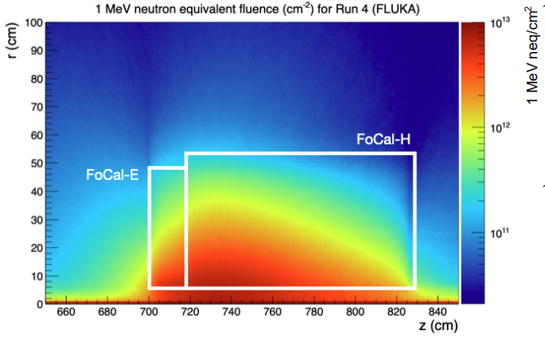
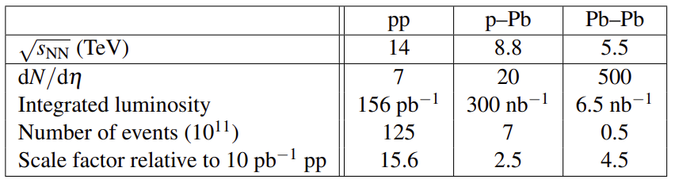
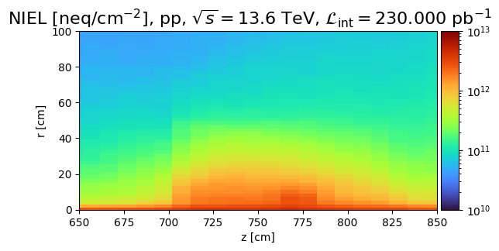
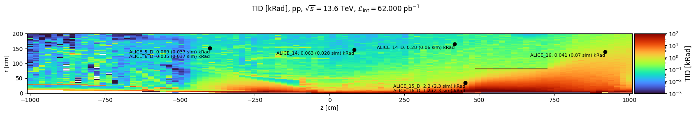
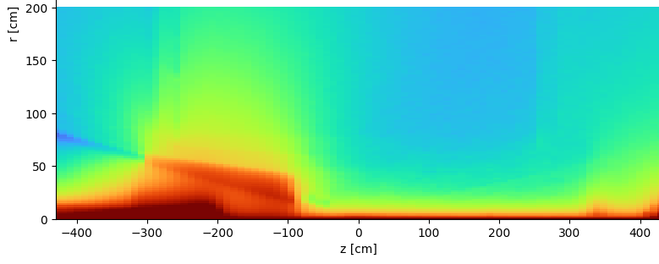
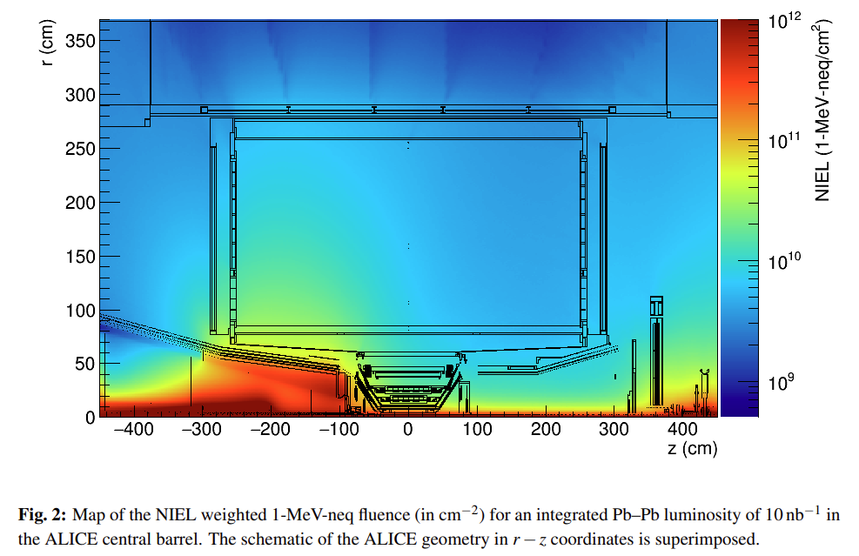
Fluka simulations using O2
TDR
$$NIEL ≈7 {10}^{13} neq / {cm}^{2}$$
$$TID ≈3.5 Mrad$$
Equivalent pp luminosity of 230 pb⁻¹
Including a safety factor of 10
Correctly reproduce TDR
Correctly reproduce previous works (A. Alici et al)
Correctly reproduce RADMON (2024)

Slide 10
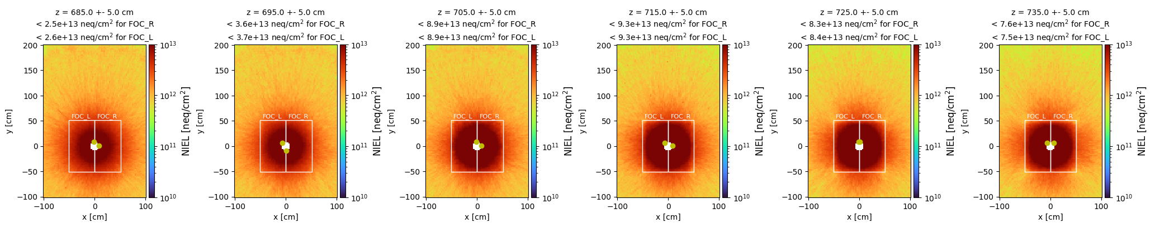
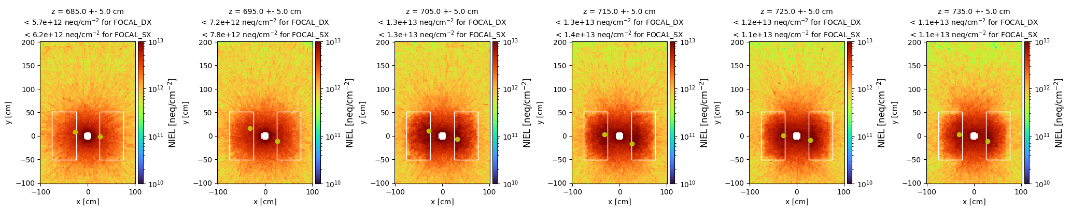
Open FoCal for pp operations
Equivalent pp luminosity of 230 pb⁻¹

Slide 11
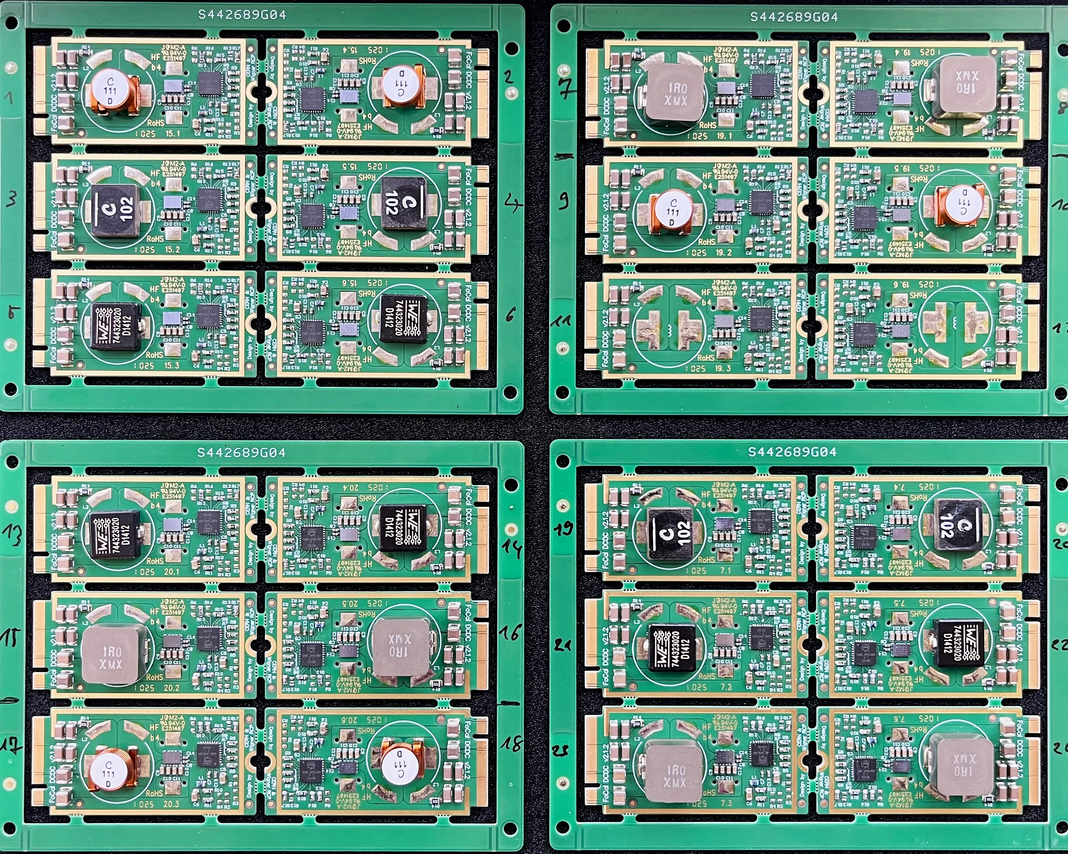
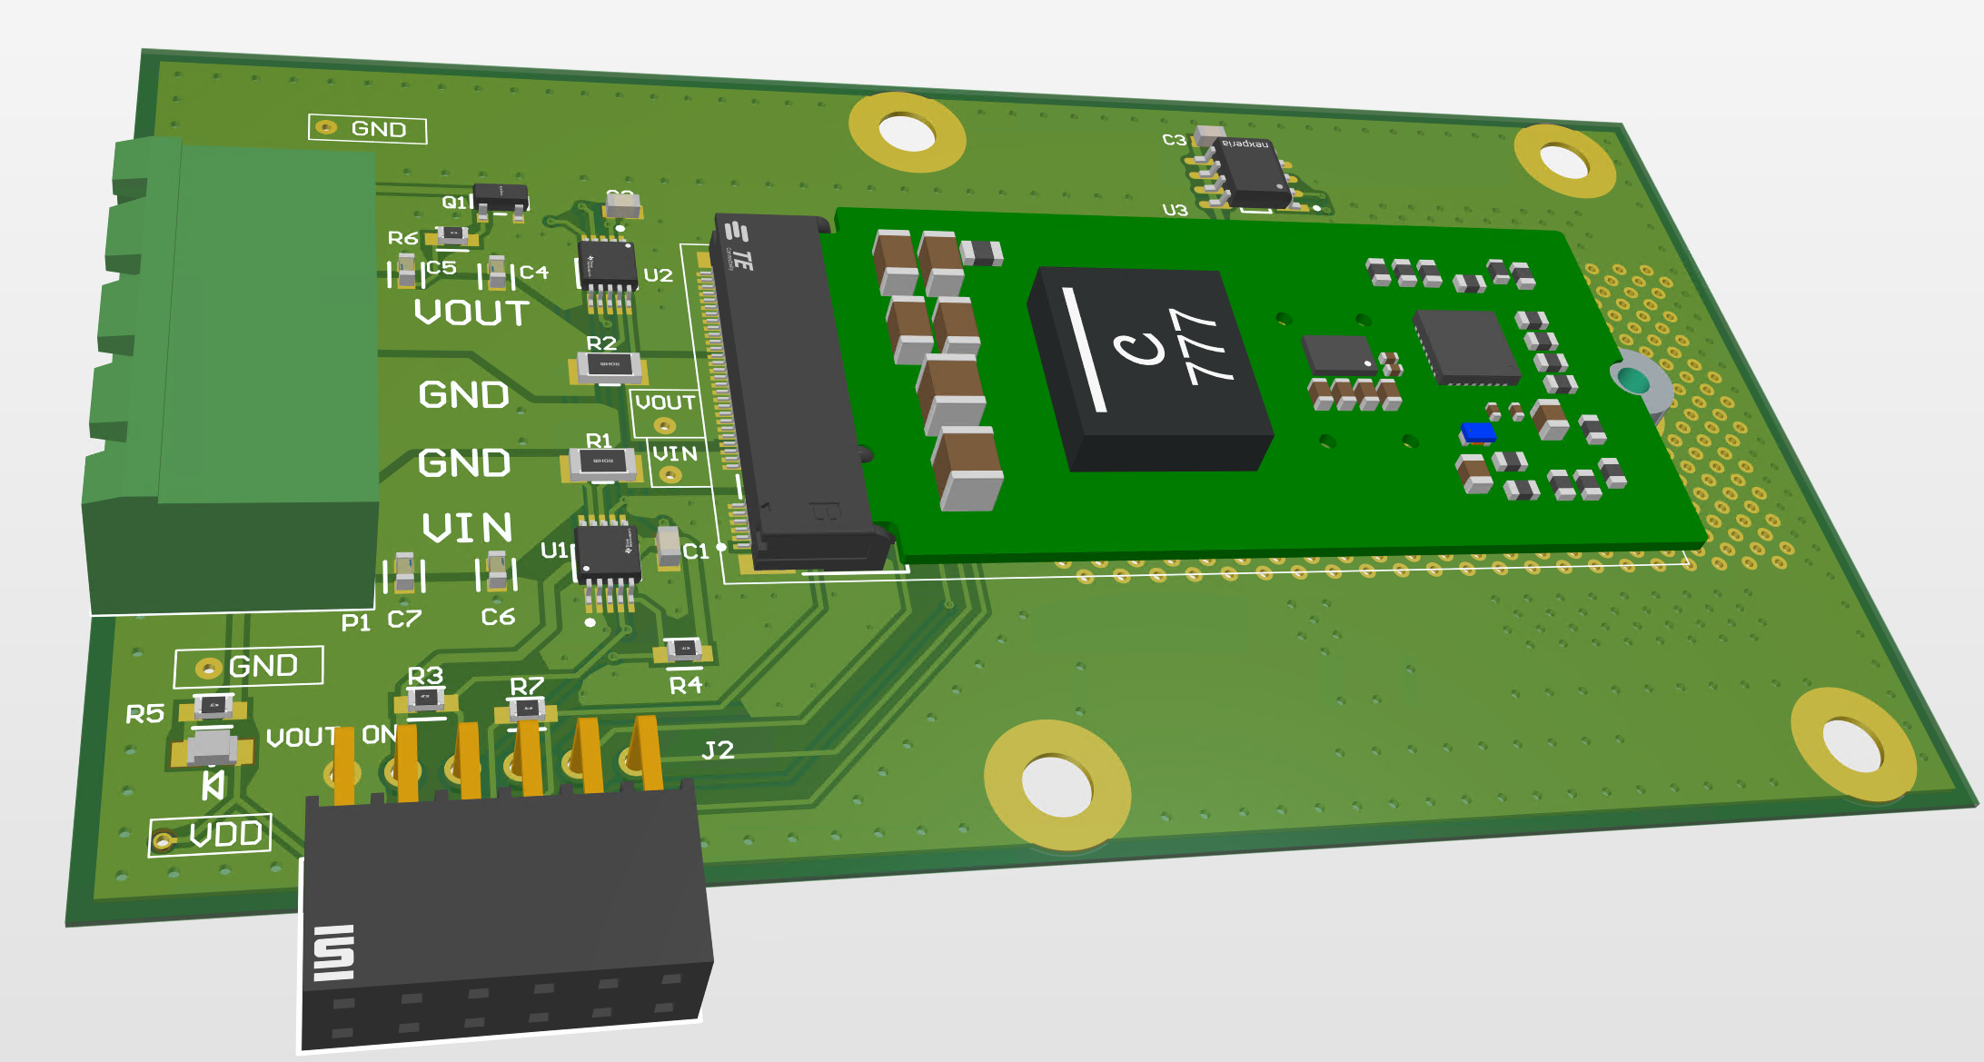
First FOCAL bPOL48 Production
T. Kiss
Several VOUT:
5V for Pixel Power Board
2.75V for Pixel Transition Cards
1.52V for Pad Front-end
2.5V for Pads Data Concentrator Board
Several inductors:
0.2, 0.22 and 1 uH Ferrite core
0.111 uH Air core
Test boards produced

Slide 12
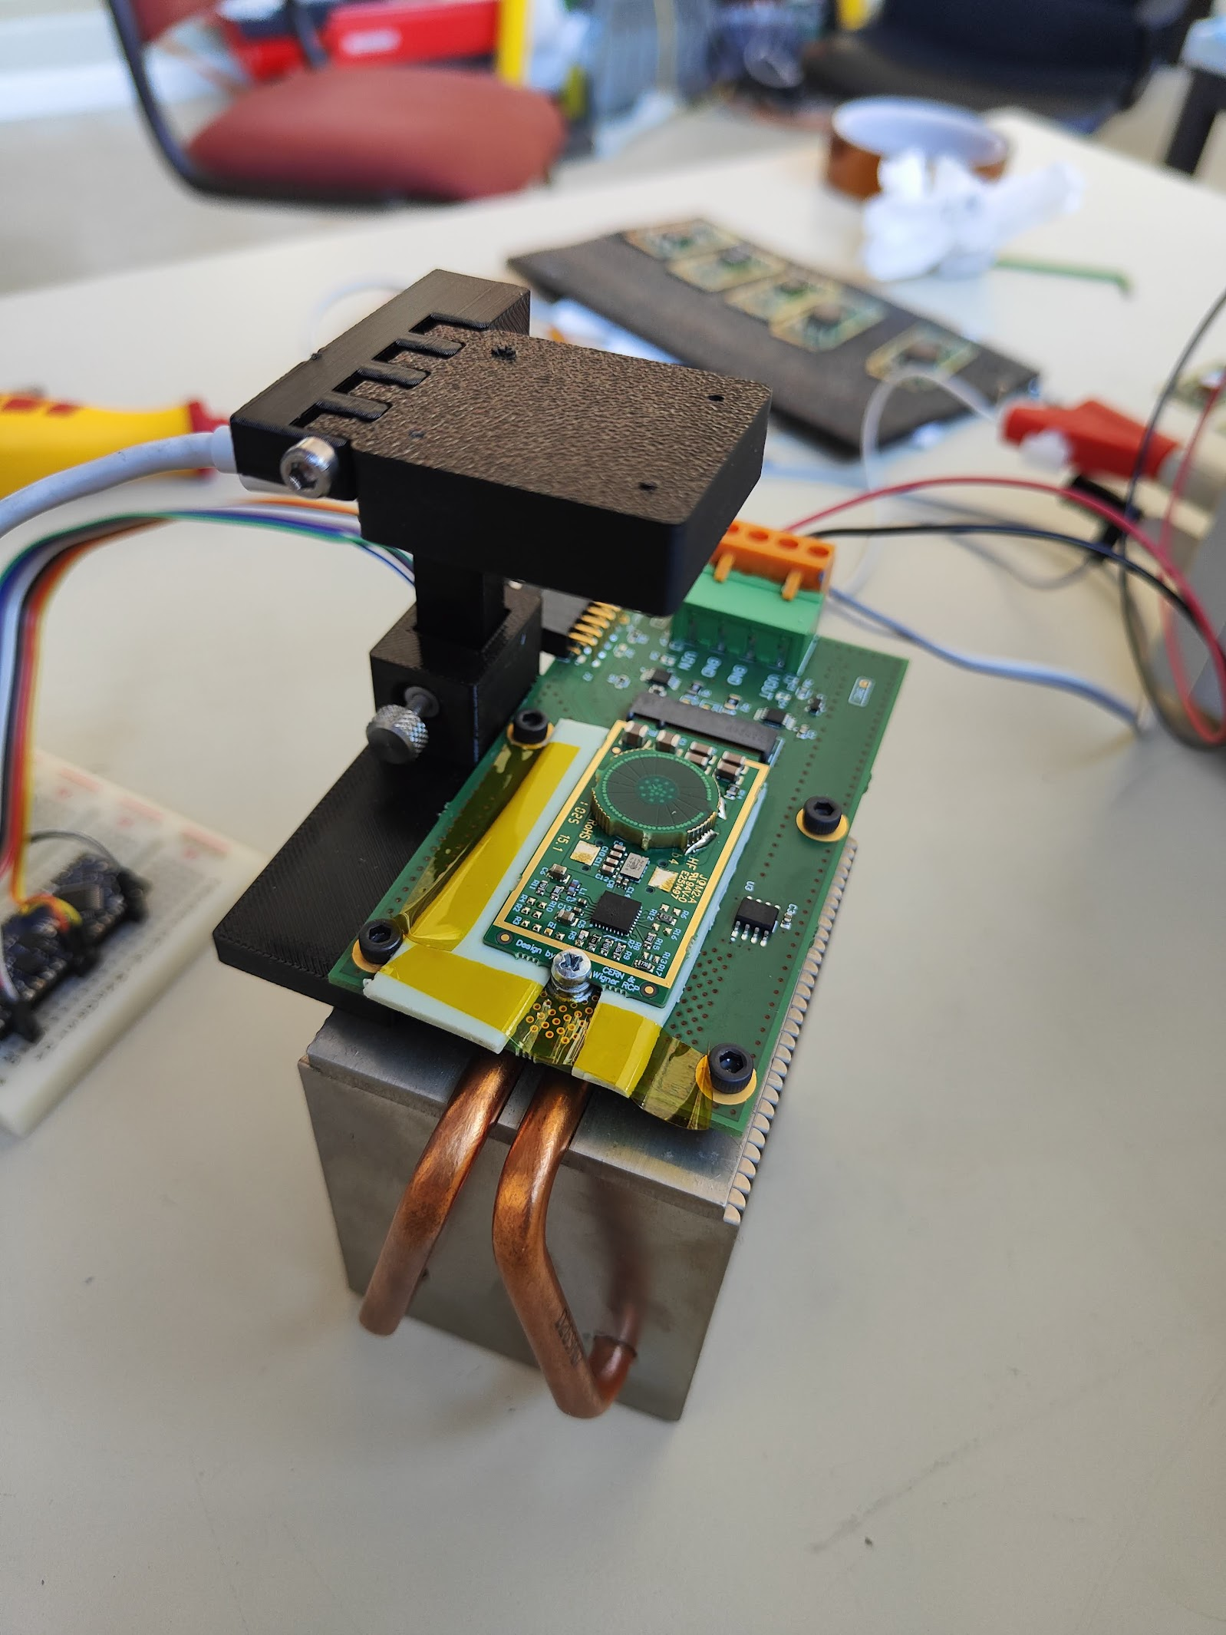
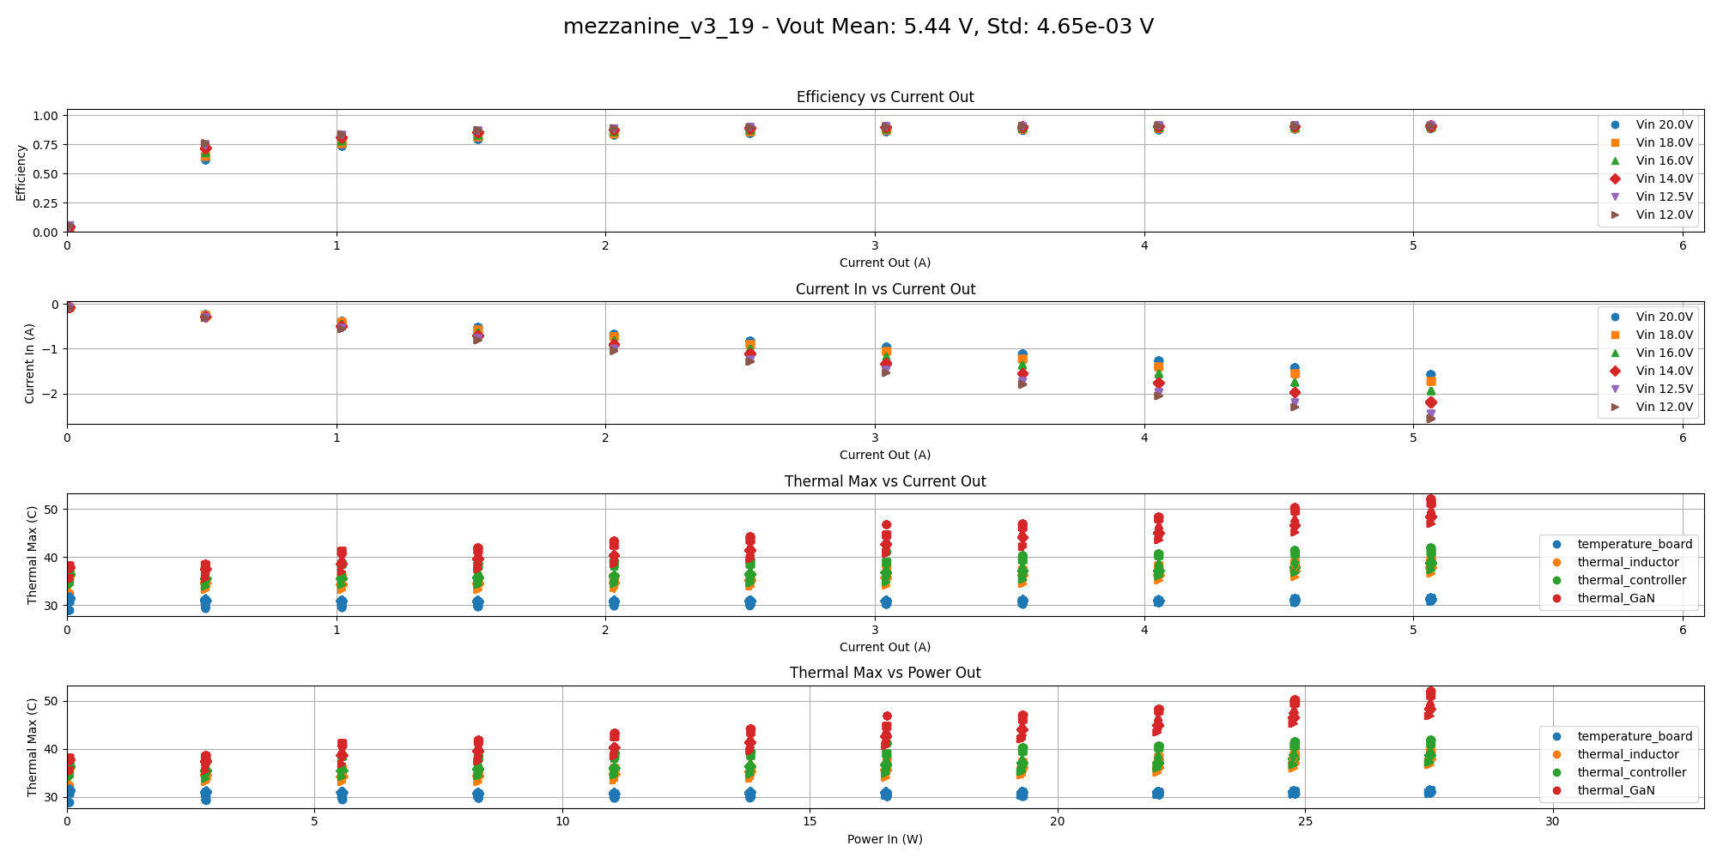
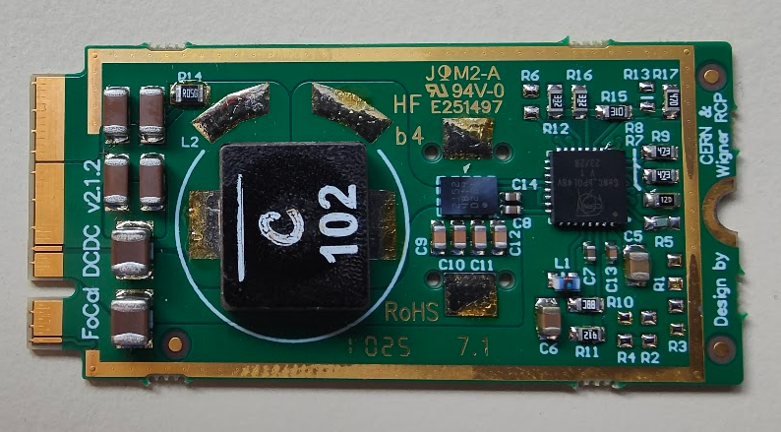
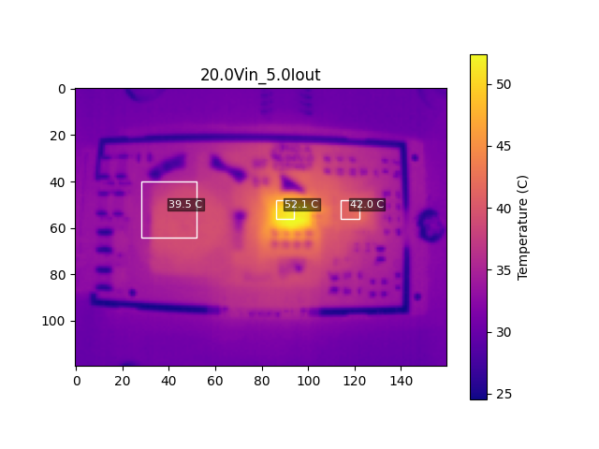
DCDC testing platform

Slide 13
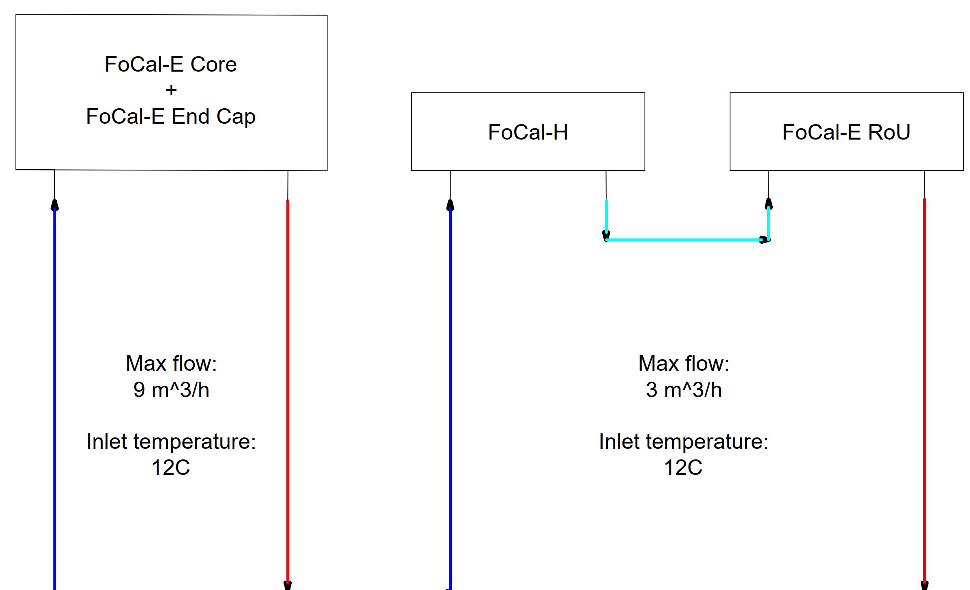
FoCal Cooling System
Suggested during the EDR
FoCal cooling system
FoCal-E cooling system
FoCal-H cooling system
FoCal-E active volume cooling system
FoCal-E external electronics cooling system
FoCal-H electronics cooling system
FoCal-H SiPMs cooling system
FoCal-E pixel Readout crates cooling system
Per side: FoCal-I, FoCal-O

Slide 14

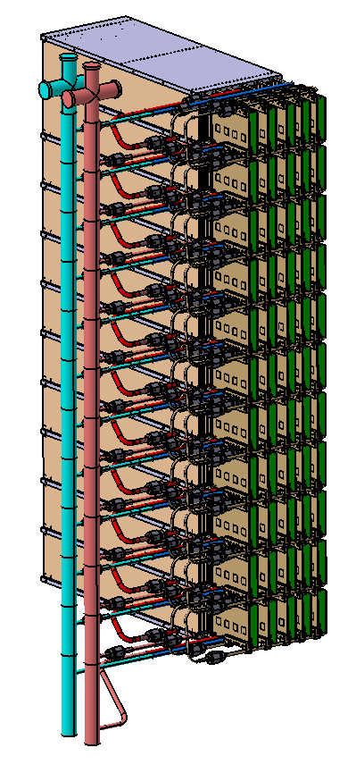
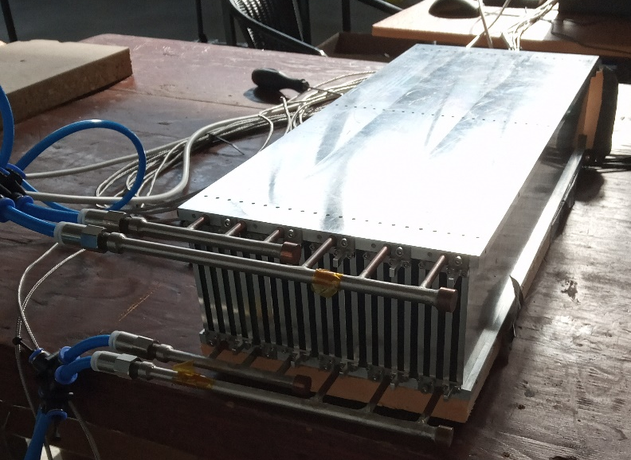
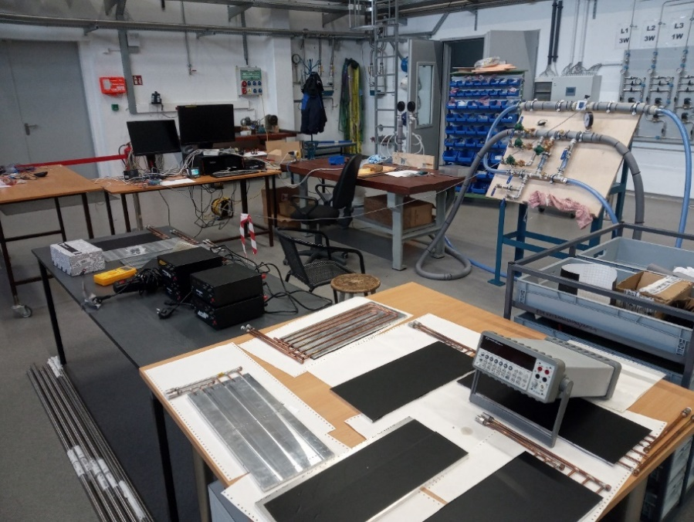
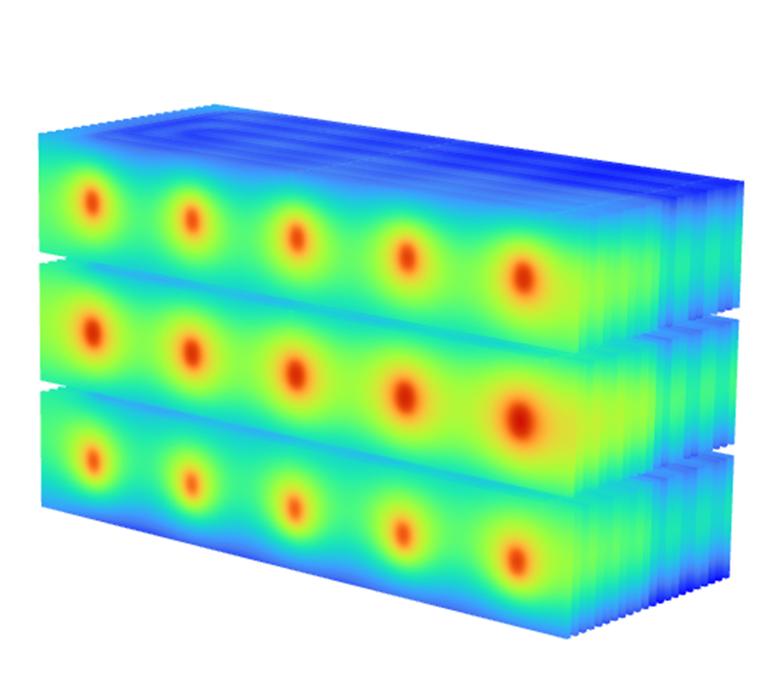
FoCal-E cooling system
Prototype of module with heat exchangers on top and bottom
Lab @IFJ to measure:
IN/OUT temperature for each HEX
Pressure drop for each HEX
IN/OUT Temperature input (manifold)
Presure drop (manifold)
Flow
Experimental measurements compatible with ANSYS simulations
Supply
line
Return line

Slide 15
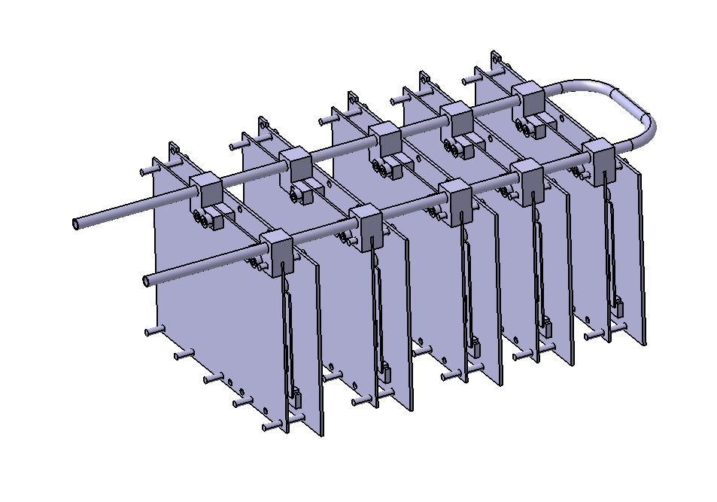
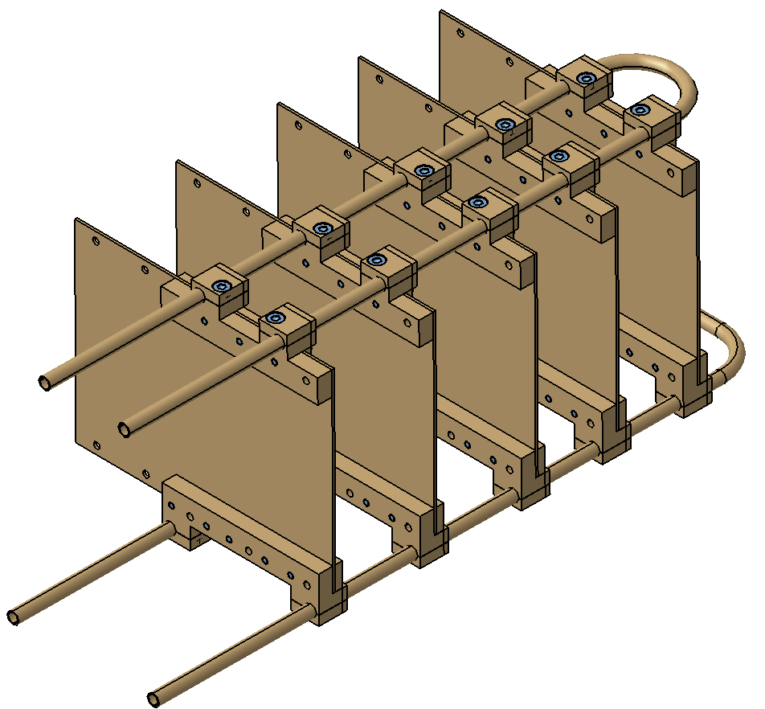
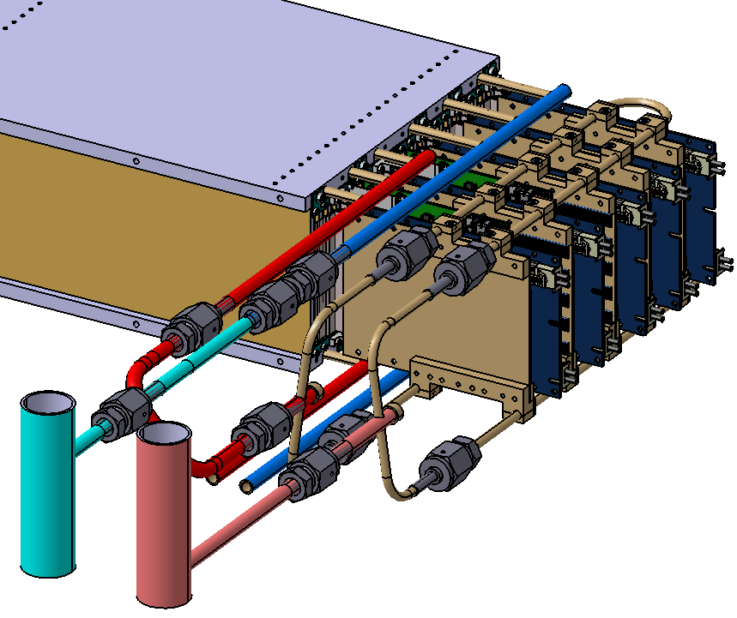
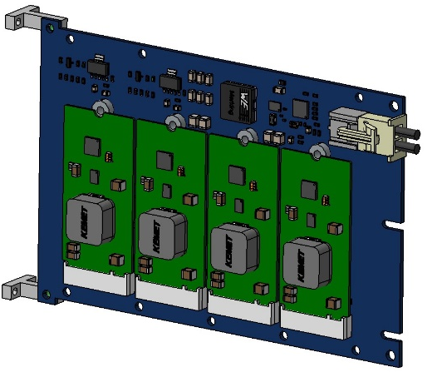
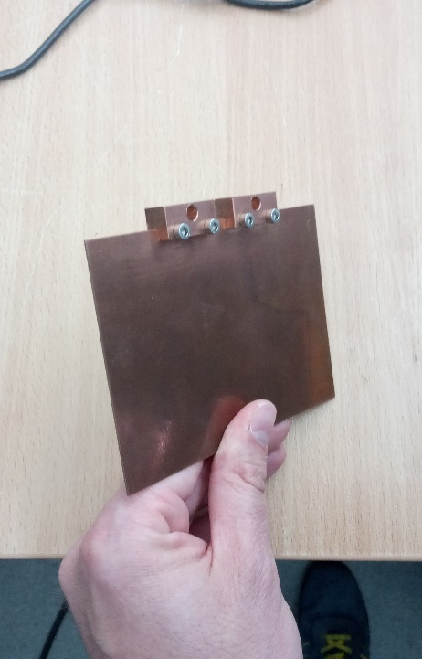
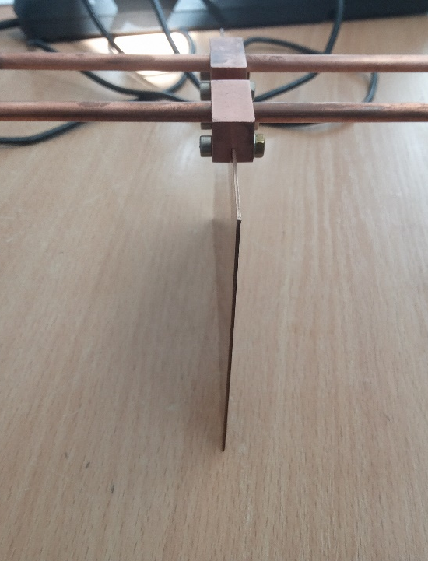
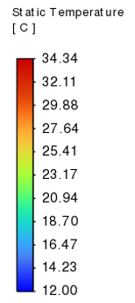
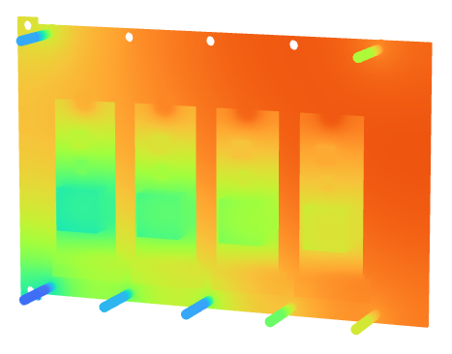
FoCal-E Electronics Cooling
Finalized component placement on the electronics Considering best cooling strategy: single or double loop

Slide 16
Outline
General Updates
Updates from Pixels
Updates from Pads
Updated from HCAL
Possible descoping options

Slide 17
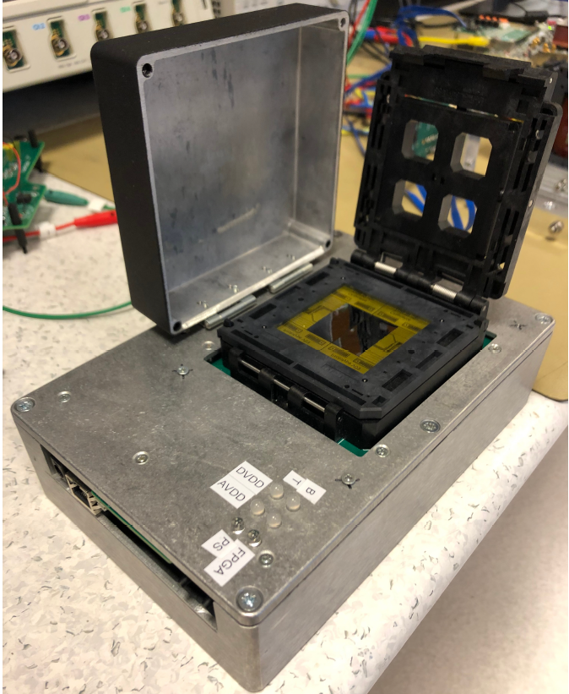
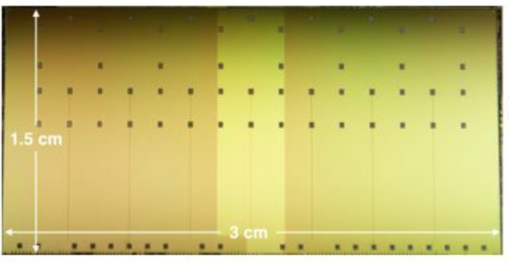
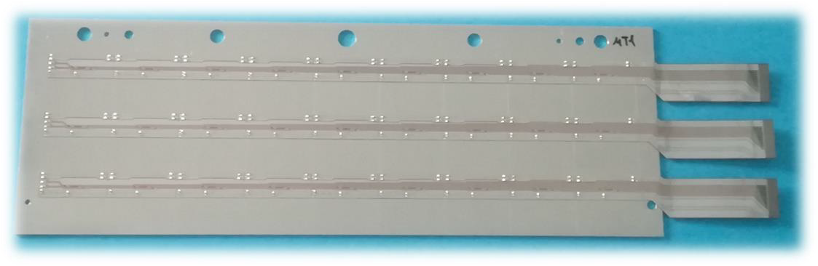
Pixel strings assembly
I. Tymchuk, T. Van Den Brink
Tested with PTB (pCT Test Board)
ALPIDEs (checked on ITS db)
Chipcable
ALPIDE + Chipcable + Frame
Mounted on Al Carrier and tested for connectivity
Visual inspection and electrical QA tests on all components
Components for strings
SMD components
Ni/SnBi coat

Slide 18
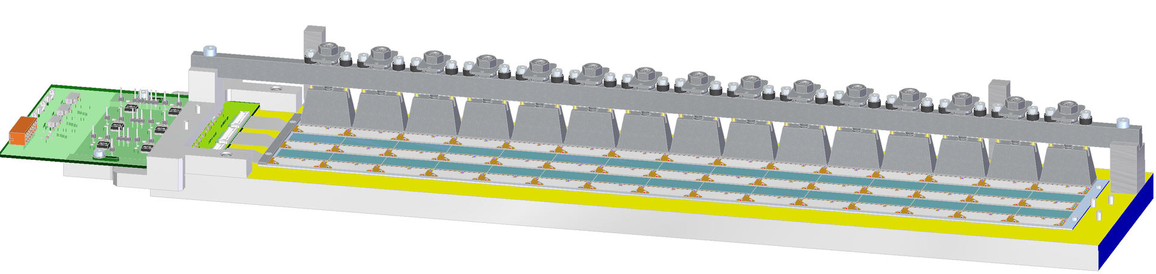
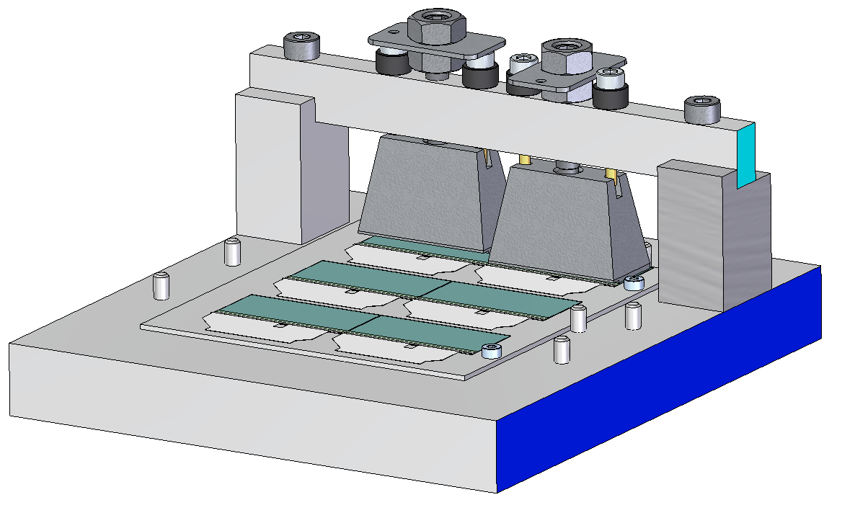
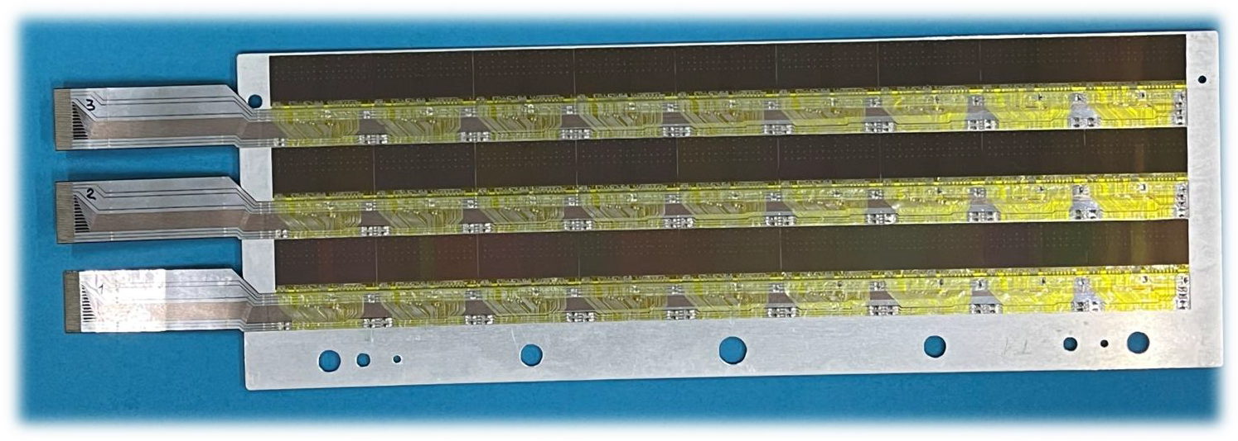
Pixel strings assembly
I. Tymchuk, T. Van Den Brink
Possible critical point: ALPIDE top surface exposed

Slide 19
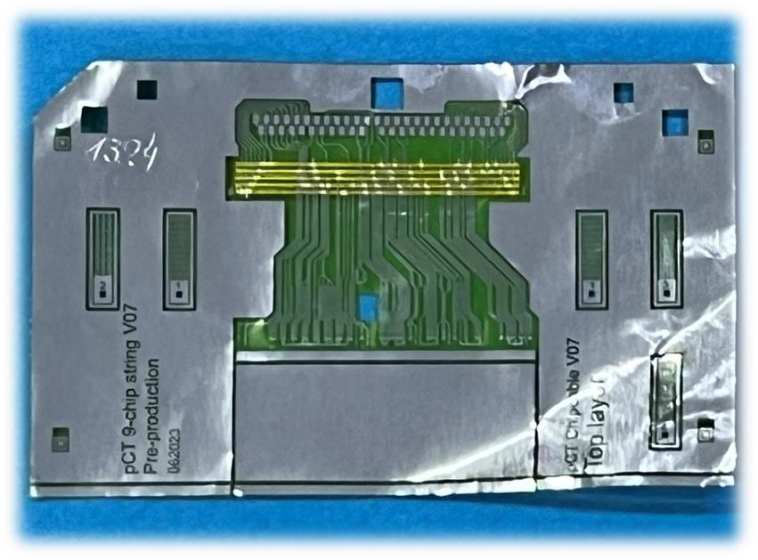
Pixel strings assembly: improvement after pCT first run
10 um soft polyamide + 14 um Al
First design: cover removed after assembly
Improved design: cover grounded and kept
Strings are tested at every step: early detection of failure points

Slide 20
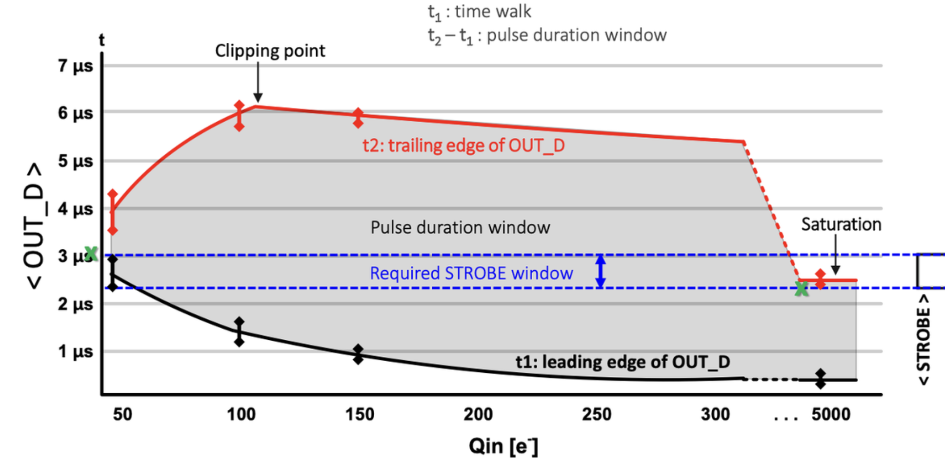
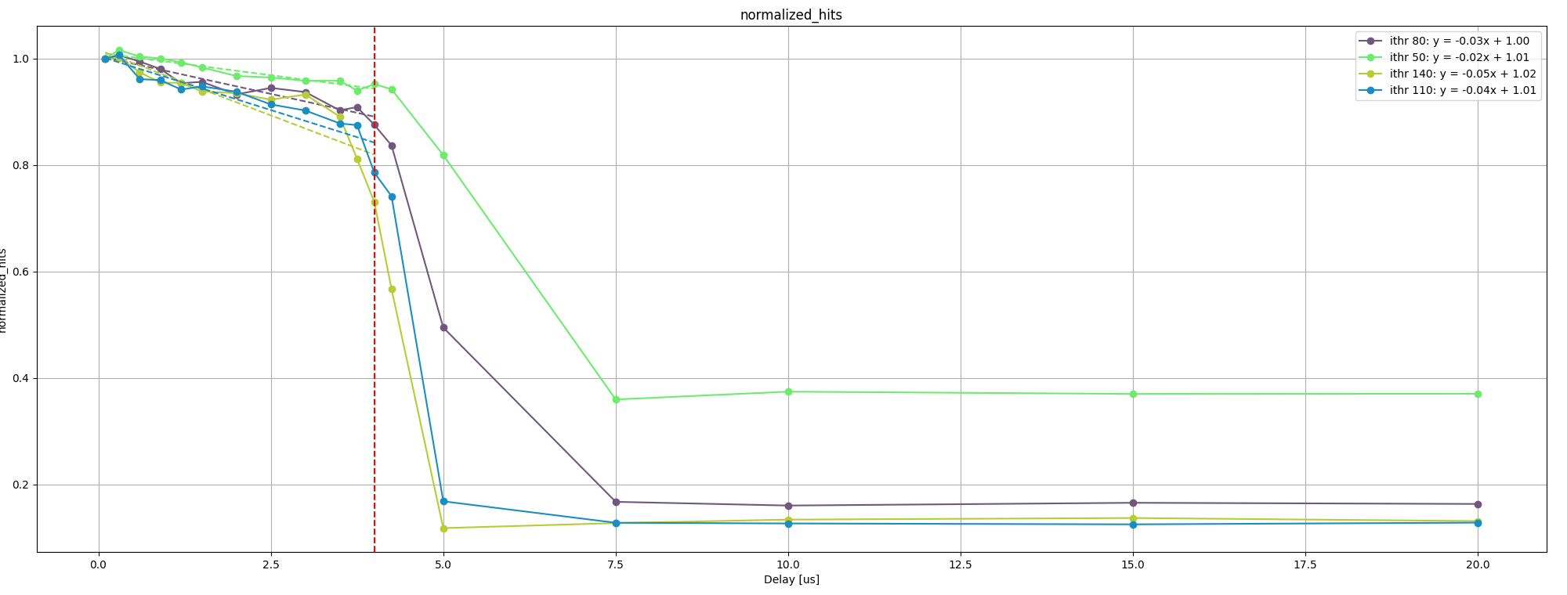
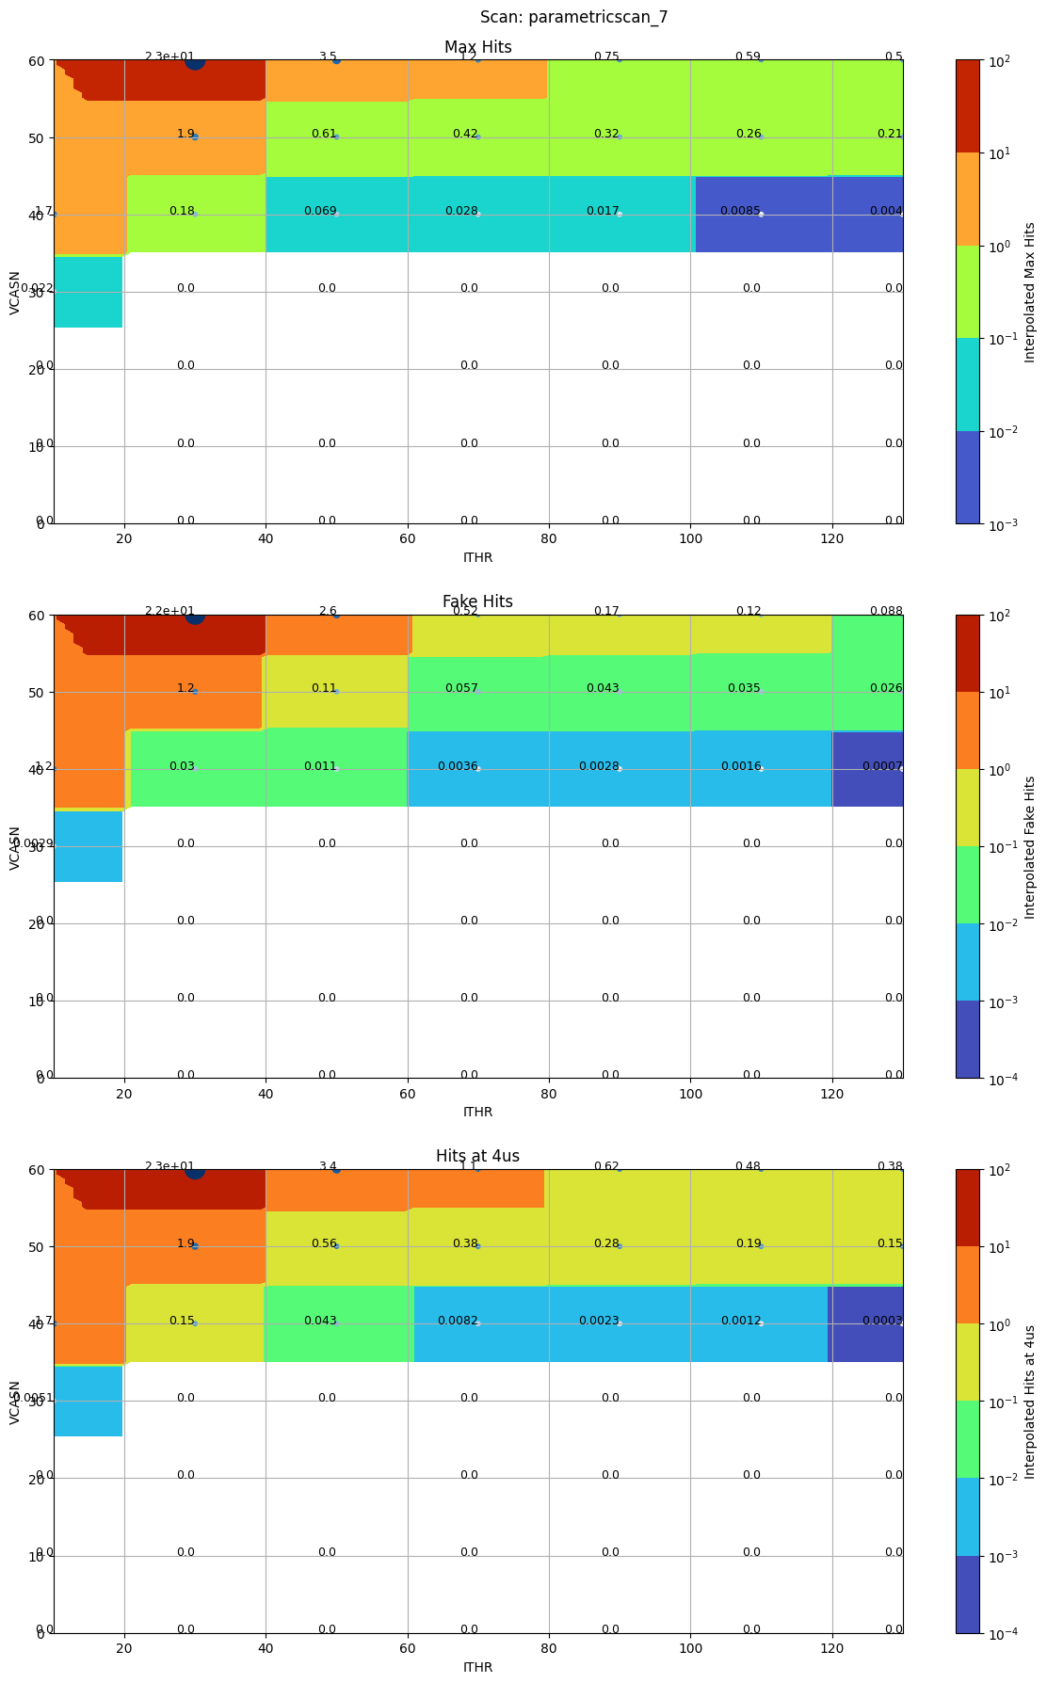
ALPIDE efficiency dependency on trigger latency
A. Kaiser, F. Reidt
Sr90
ALPIDE
DAQ Board
PMT
Trigger Delay
Known “feature”: shorter ToT for large charges
After ~4 us efficiency drops quickly
Feature dependent on parameters: parameter scans under study
Linear decrease of efficiency even at low latencies
Trigger too late: fake hits

Slide 21
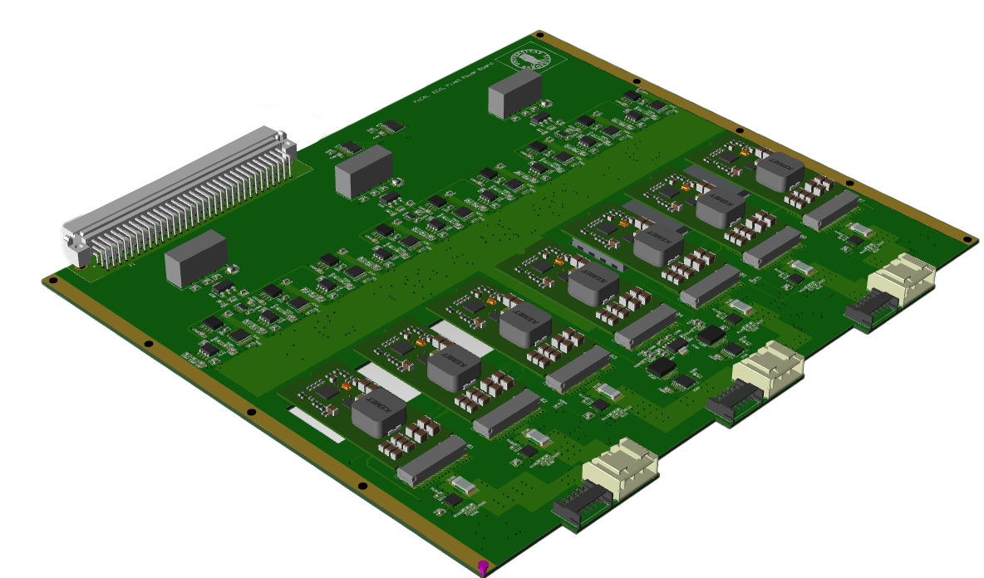
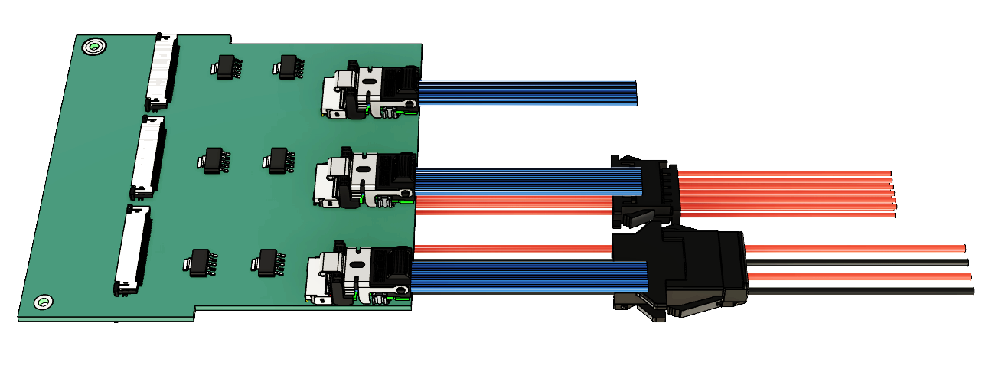
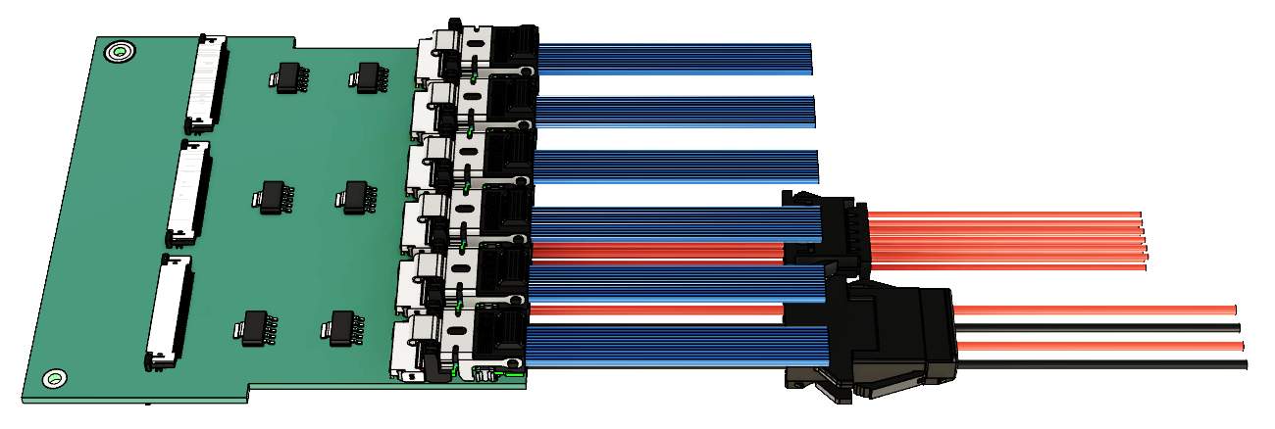
Pixel Power Boards and Transition Cards
B. H. Qureshi, Bergen Group
~4m
Transition Cards
ALPIDE String
1.9V
LDO
AVDD
…
LDO
1.9V
DVDD
-6V
PWELL
ALPIDE String
EN
bPOL48 mezzanine: designed by CERN EP-ESE modified by FoCal
Outer Barrel
Backplane: connection with RU
Ground
Power
I2C
Layout completed:
Under Internal Review!
IB/OB
https://gitlab.cern.ch/alice-focal-readout/focale-pixels/documentation/ https://alice-focal.docs.cern.ch/

Slide 22
Outline
General Updates
Updates from Pixels
Updates from Pads
Updated from HCAL
Possible descoping options

Slide 23
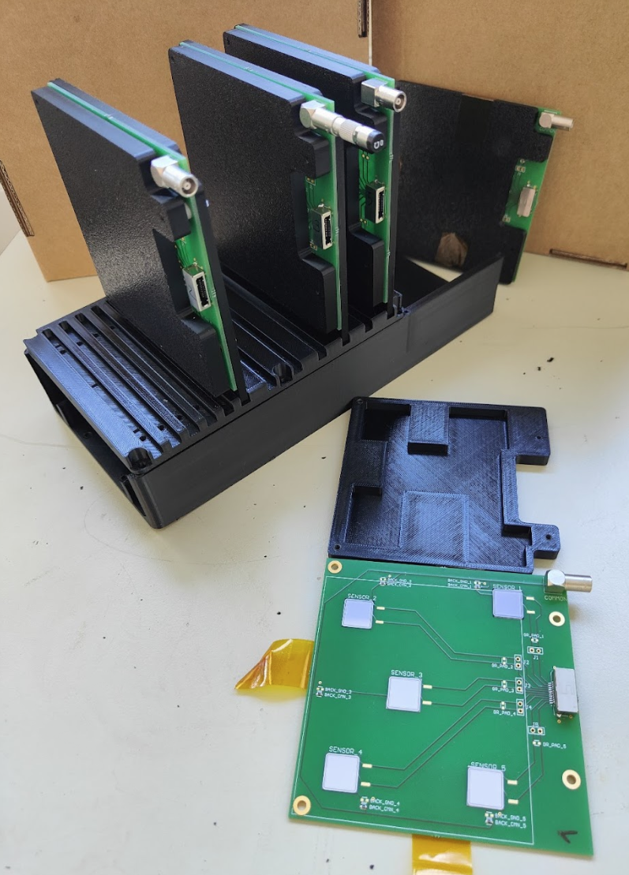




Irradiation campaign 2025 @IRRAD
Full sensors from HPK, SCL and BEL characterized before (IV/CV) and after irradiation IV/CV/MIP).
Some sensors (>2) irradiated at $7 {10}^{13} neq / {cm}^{2}$
Full sensors irradiated in spots:
Control
$\sim {10}^{11} neq / {cm}^{2}$
$\sim {10}^{12} neq / {cm}^{2}$
$\sim 7 {10}^{13} neq / {cm}^{2}$
$\sim {7 10}^{14} neq / {cm}^{2}$
1x1 cm² from SCL and BEL ready!
waiting for HPK:
IV/CV before and after irradiation in progress
IV monitoring during irradiation

Slide 24


New front-end board
First front-end designed by Grenoble, second by ORNL New version designed @VECC:
HGCROC v3
1 independent PCB per sensor
Connected with flex: very low mechanical constraints
Thin PCB: more flexible, easier to produce, better for wire bonding
HV on back side: almost no insulation needed on the PCB
LDOs purchased from CMS HGCAL (half already in the lab)
This board is based on HGCROC v3B
v3D expected this summer
v3E (final?) end of the year
HGCROCv3 boards designed by the Japanese team are planned for beginning of 2025
Setup working with 24” (~61 cm) FFC >> 45 cm expect max length
New version designed @VECC, Kolkata Review in progress with CMS (M. Noy)
@Tsukuba

Slide 25
Outline
General Updates
Updates from Pixels
Updates from Pads
Updated from HCAL
Possible descoping options

Slide 26





Grooved Copper Sheets instead of Capillary Tubes
Solved production problems:
High cost of milling -> custom technique
Stress in the copper sheets -> rolling after machining
Damage to the copper during machining -> correct thickness of the sheets
Custom pitch possible!

Slide 27



Increased pitch of the scintillating fibers: from 2.5 mm to 4 mm
Higher pitch is cheaper and with better resolution🤔

Slide 28

Energy resolution vs scintillating fiber pitch
Not too strong dependence on the pitch

Slide 29
Outline
General Updates
Updates from Pixels
Updates from Pads
Updated from HCAL
Possible descoping options

Slide 30








Possible descoping scenarios
I. Arsene, H. Hassan
Scenario 0:
3888* ALPIDEs 1944 pads
Scenario 1:
3168 ALPIDEs 1584 pads
Scenario 2:
3096 ALPIDEs 1548 pads
Removing the 2 top layers we keep the possibility of adding them in a second moment
(not excluding the possibility of doing it during a technical stop)
Removing the 2 outermost columns (1 pad, 3x6 ALPIDEs) we simplify the design considerably: more space for electronics and cooling, shorter strings
Scenario 1a (asymmetric):
3168 ALPIDEs 1584 pads
Same as Scenario 1 but better relative acceptance (?)
*: the actual number of chips needed (hence cost) is approximately 2x to account for yield and testing

Slide 31



Luminosity “descoping”
I. Arsene, H. Hassan
Delivered luminosity expectations for Run 4:
p-Pb: 300 nb⁻¹
pp ref: 3pb⁻¹
pp @14 TeV: 600 pb⁻¹
The pT range where stat errors become larger than the systematic errors:
P-Pb: ~50 GeV/c (rapidity dependent)
pp reference: ~40 GeV/c
pp at 14 TeV: most likely no statistical limitations for cross-section measurement with <<100 pb^-1
Do we really need all 600 pb⁻¹?
Movable platform
Lower radiation requirements: we can optimize exposure for pp, pPb, PbPb
No loss in acceptancy for scenario 2, but in statistics
More complex mechanical design:
~1mm of uncertainty in x corresponds to ~2% of uncertainty on p_{T}

Slide 32


Luminosity “descoping”
I. Arsene, H. Hassan
Statistical uncertainty expectations
Isolated photons
Differential probes requiring correlations of isolated photons with other probes will require more luminosity
Photon-π₀ correlation measurements indicate rather small stat uncertainties for 10 and 100 pb⁻¹ samples when using photon triggers up to 15-25 GeV/c
If required by radiation constraints, the running for pp @ 14 TeV can be reduced
More studies are needed for other, rarer, observables

Slide 33
PAD Workshop: What to discuss?
Review of present status
(re)evaluation of responsibilities and milestones
(re)evaluation of logistic of assembly
Definition of technical details of assembly procedure: glue, insulation, QA, testing of the prototypes

Slide 34
FoCal status upate
Nicola Minafra, on behalf of FoCal
Jan 23rd 2025

Slide 35

PADS: the HGCROC readout chip
Tunable pre-amplifier
40 MHz 10bits SAR-ADC
Time-of-Arrival: LSB 25 ps, 10 bits
Time-over-Threshold: LSB 50ps, 12 bits
DV_{DD}, AV_{DD}: 1.2 V (<1A)
Data: 2 x 1.280 Mbps (CLPS)
Trigger: 4 x 1.280 Mbps (CLPS)
https://iopscience.iop.org/article/10.1088/1748-0221/17/03/C03015

