Slide 1
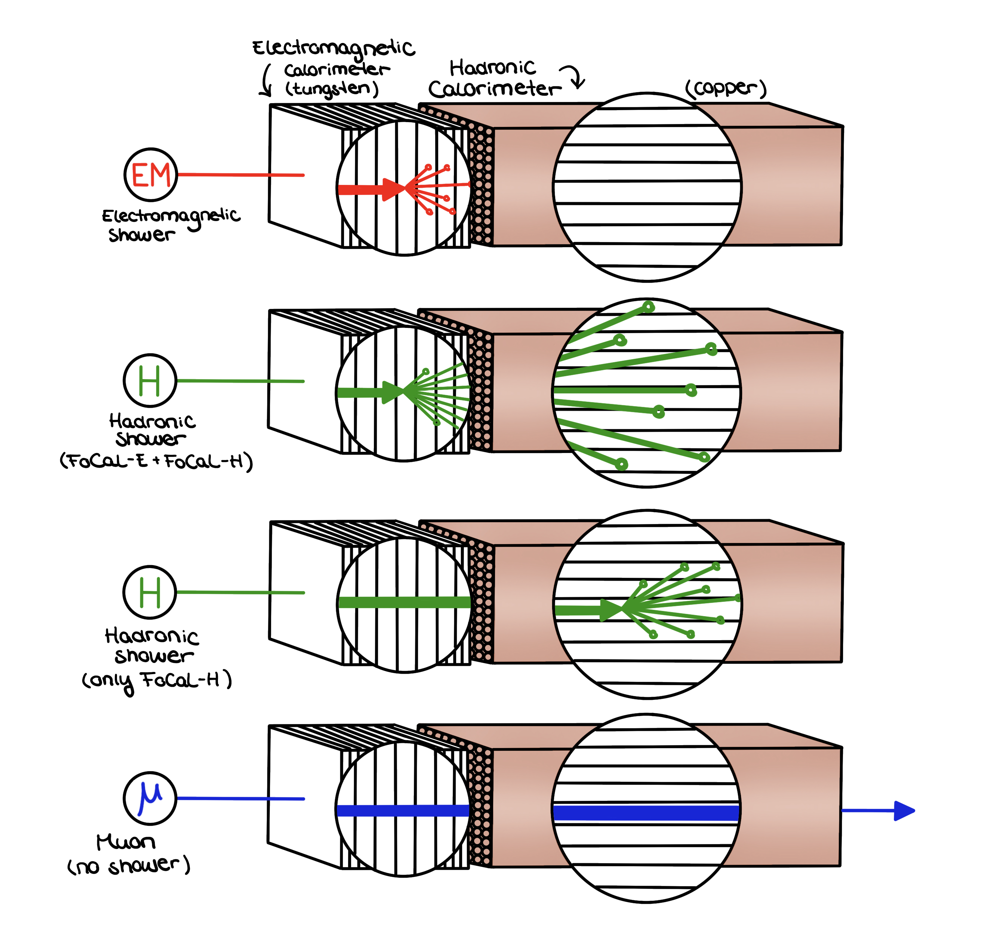
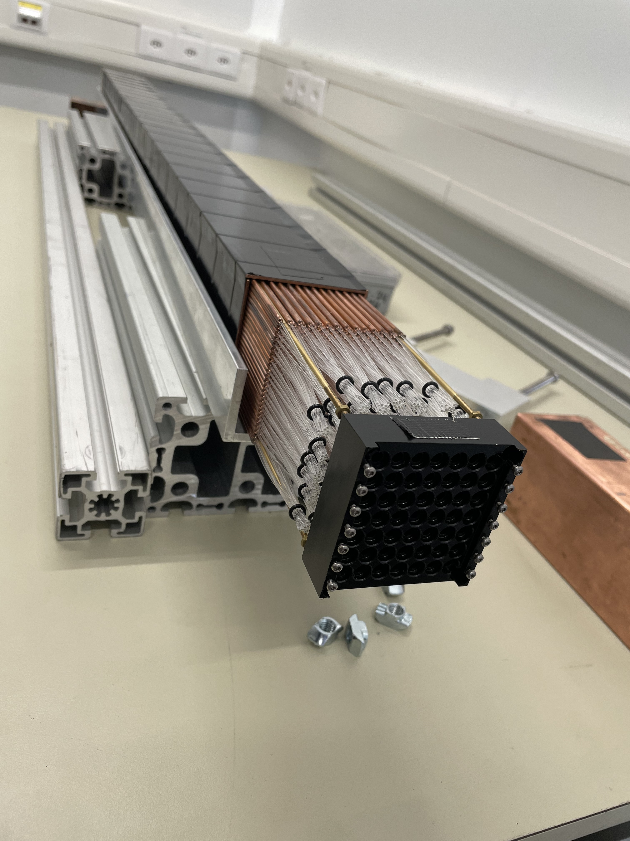
FoCal-H:
Status & Open Questions
I.G. Bearden
NBI
27 May 2025

Slide 2
Status: June 2025
We will build Prototype 3 this summer.
Beam testing September/October.
Cost reductions (compared to TDR) likely.
Readout electronics (next talk by Shihai Jia) proceeding nicely.
Mechanical design progressing well (thanks to Maciej and Rafal)
Several key decisions need to be made in late 2025, early 2026.
Unlikely to be the bottleneck in getting FoCal in the cavern in July 2028.

Slide 3
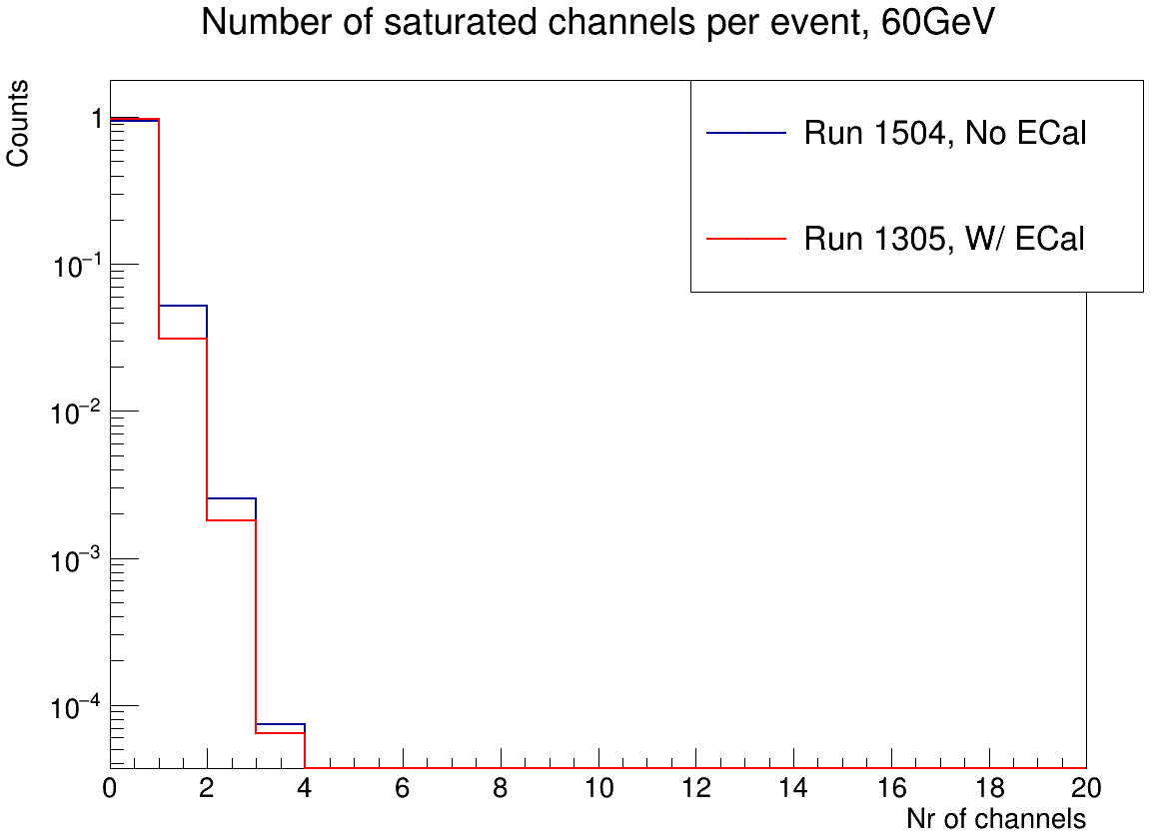
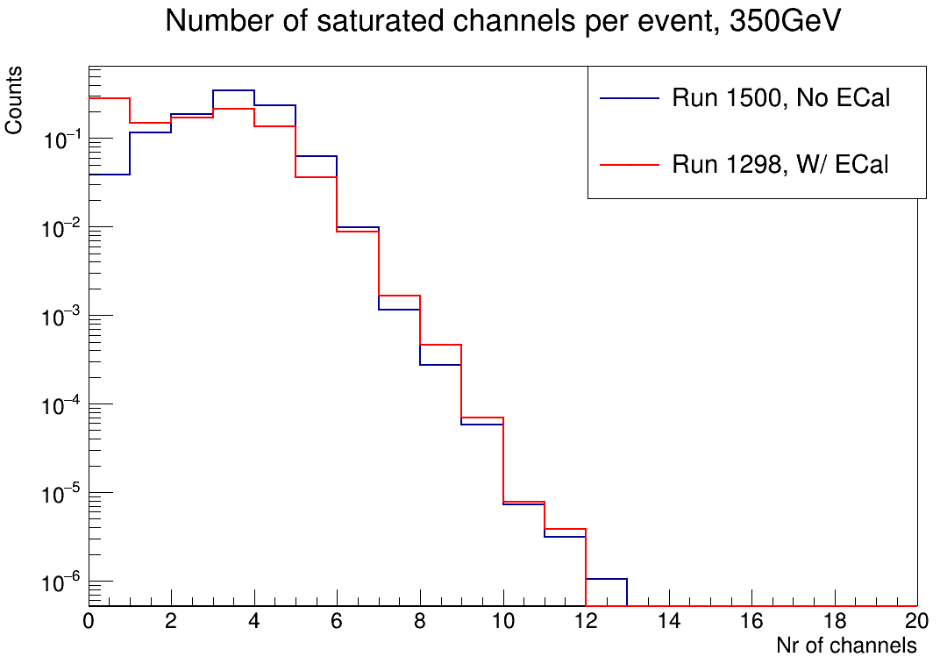
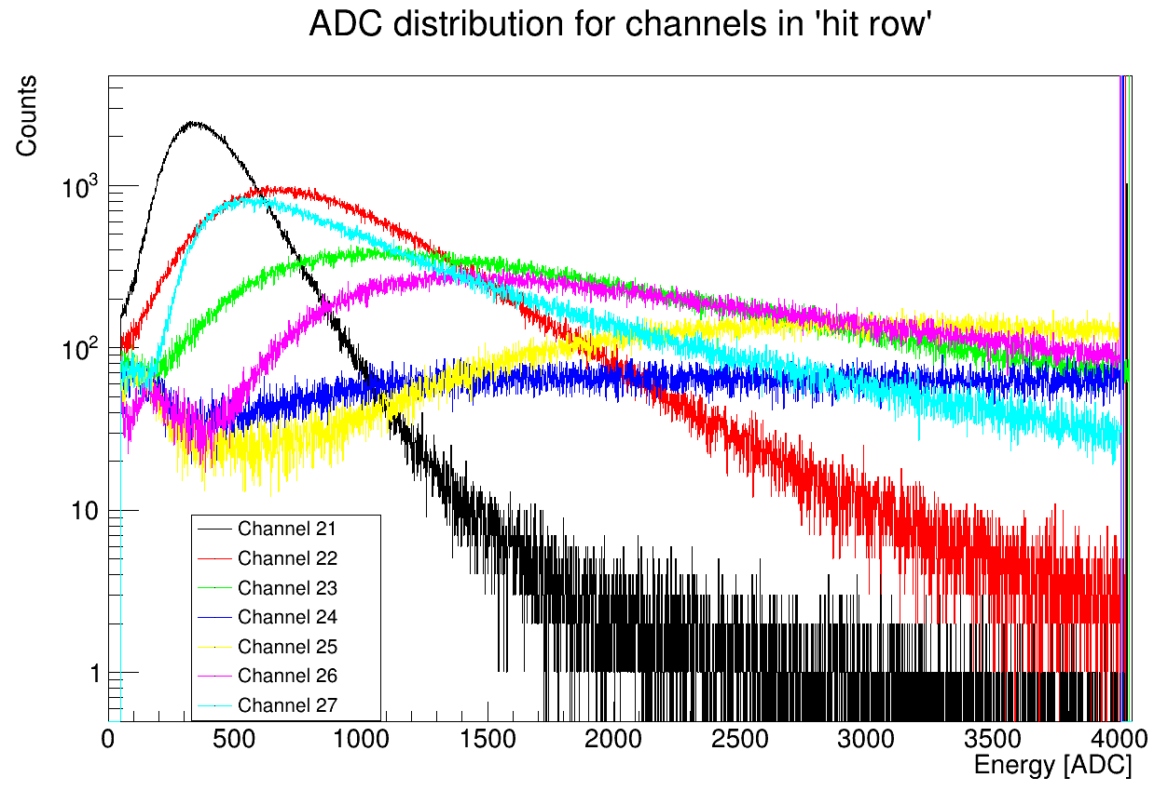
Prototypes I & II: 2.5mm Cap. Tubes
Design taken from E895 (grooved Pb plates with scintillating fiber)
“validated” with early MC studies (not the same as we’ve used with Proto 2)
Drawbacks: expensive due to fiber cost (≈175km fiber costs ≈525k€)
Saturation of electronics is severe, even with few (≈14) fibers/SiPM.
NB: in principle, can be taken care of by ToT

Slide 4
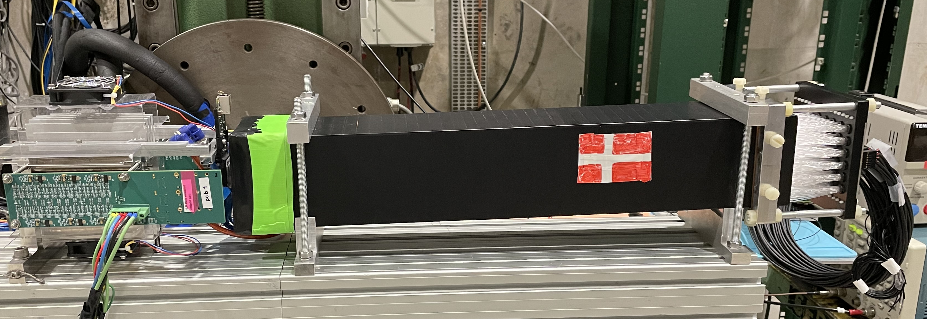
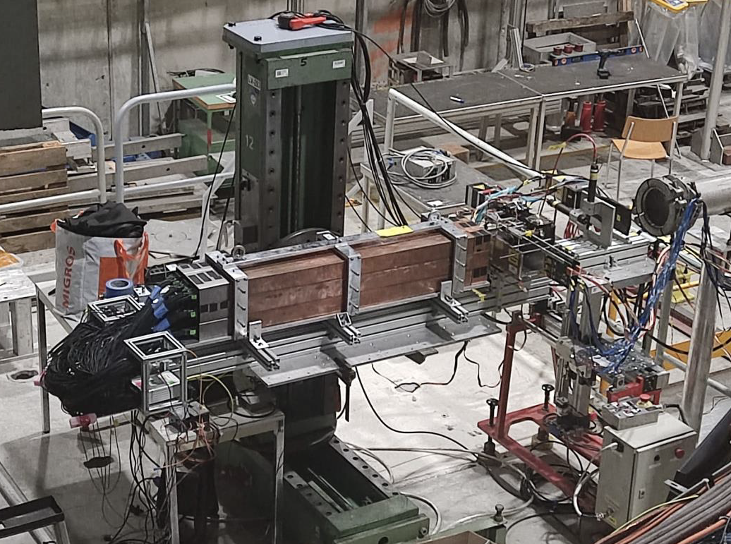
Prototype 1:
9.5x9.5x50cm³
Capillary tubes: 2.5OD 1.2ID
BCF10 Scint fiber
30 fibers/SiPM
Prototype 2:
9 modules.
Inner module 7x7 SiPM array
Outer module 5x5 SiPM array
Each 6.5x6.5 cm2 module comprised 668 Cu 110 cm capillary tubes.
Tube: OD 2.5mm,1.1mm ID.
Each tube has a 1mm BC412 fiber.
Readout for Prototype 2: CAEN DT5202

Slide 5
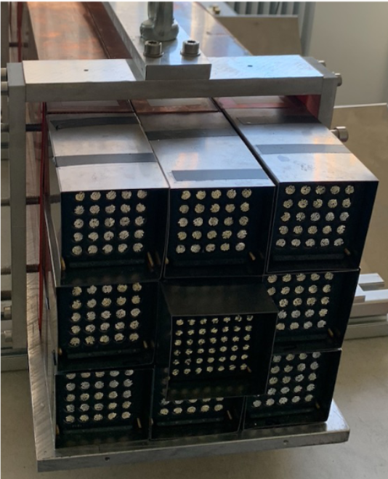
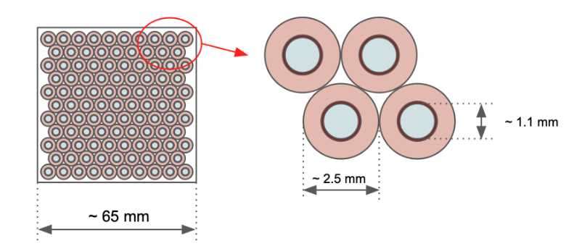
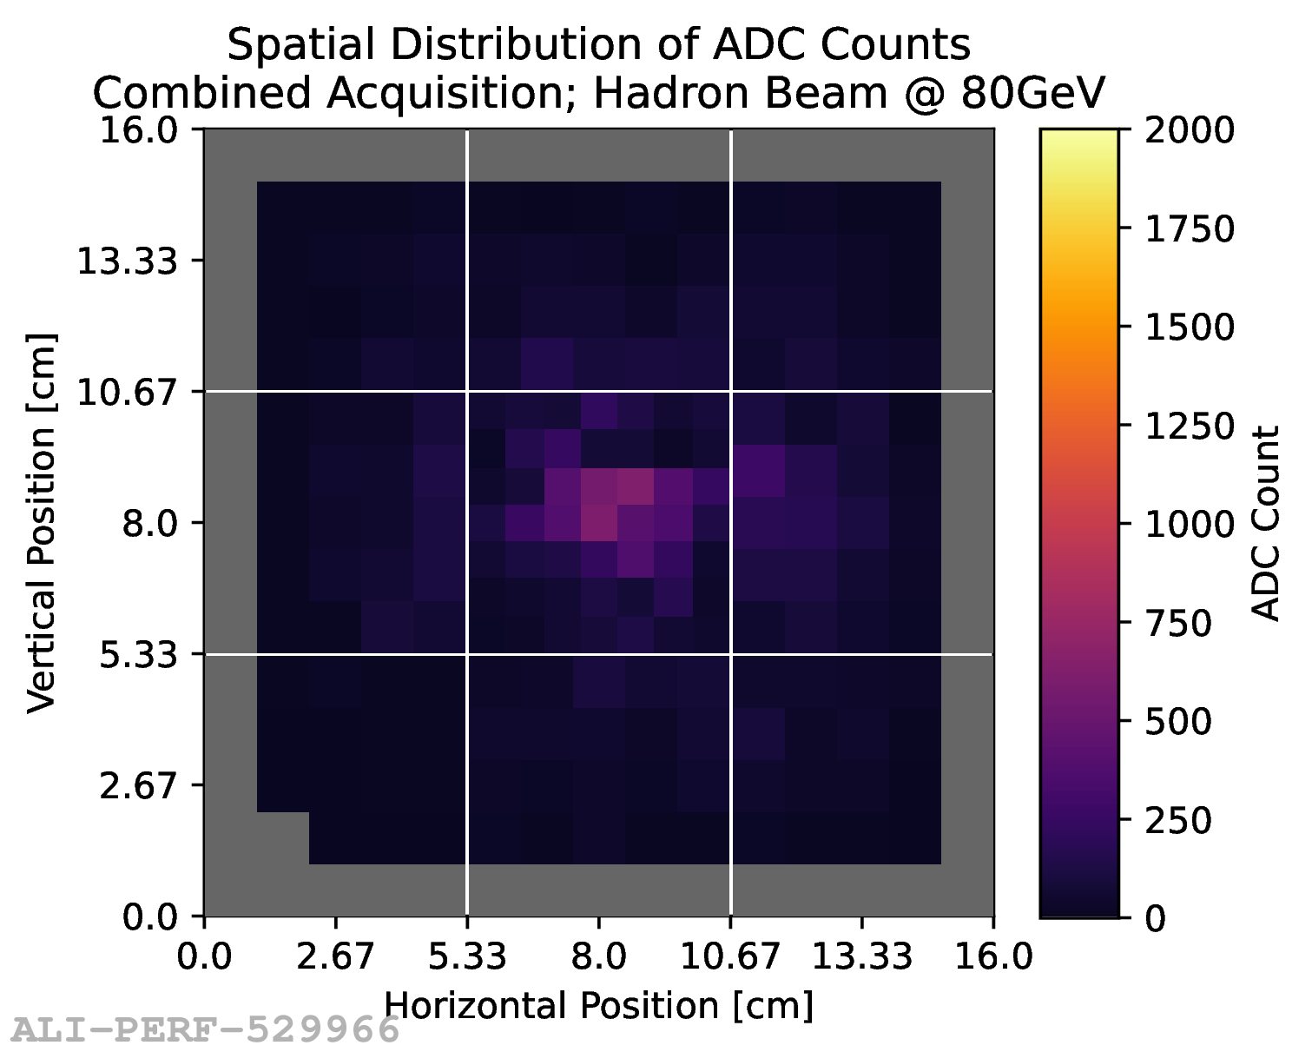
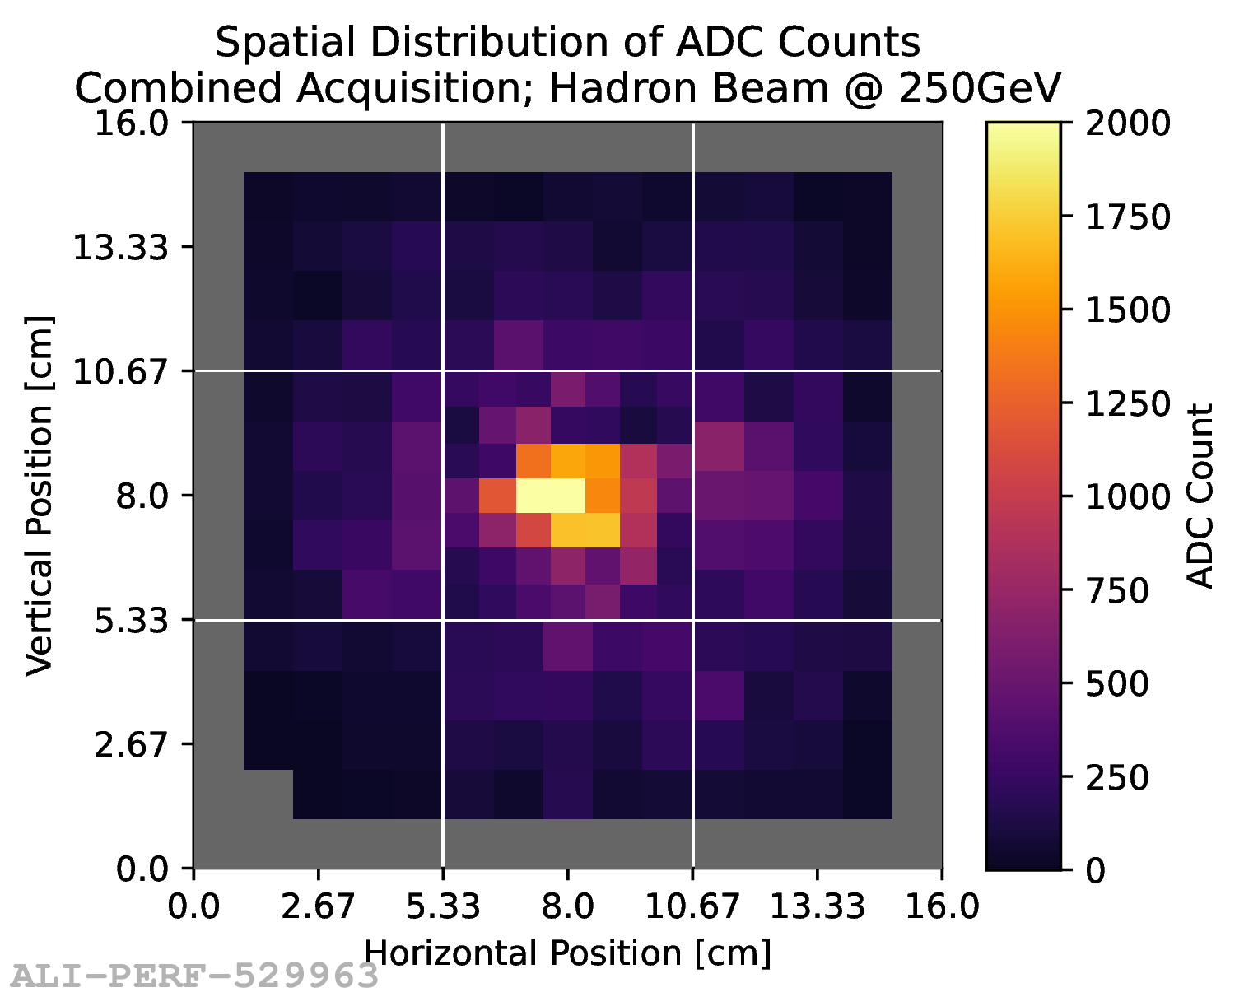
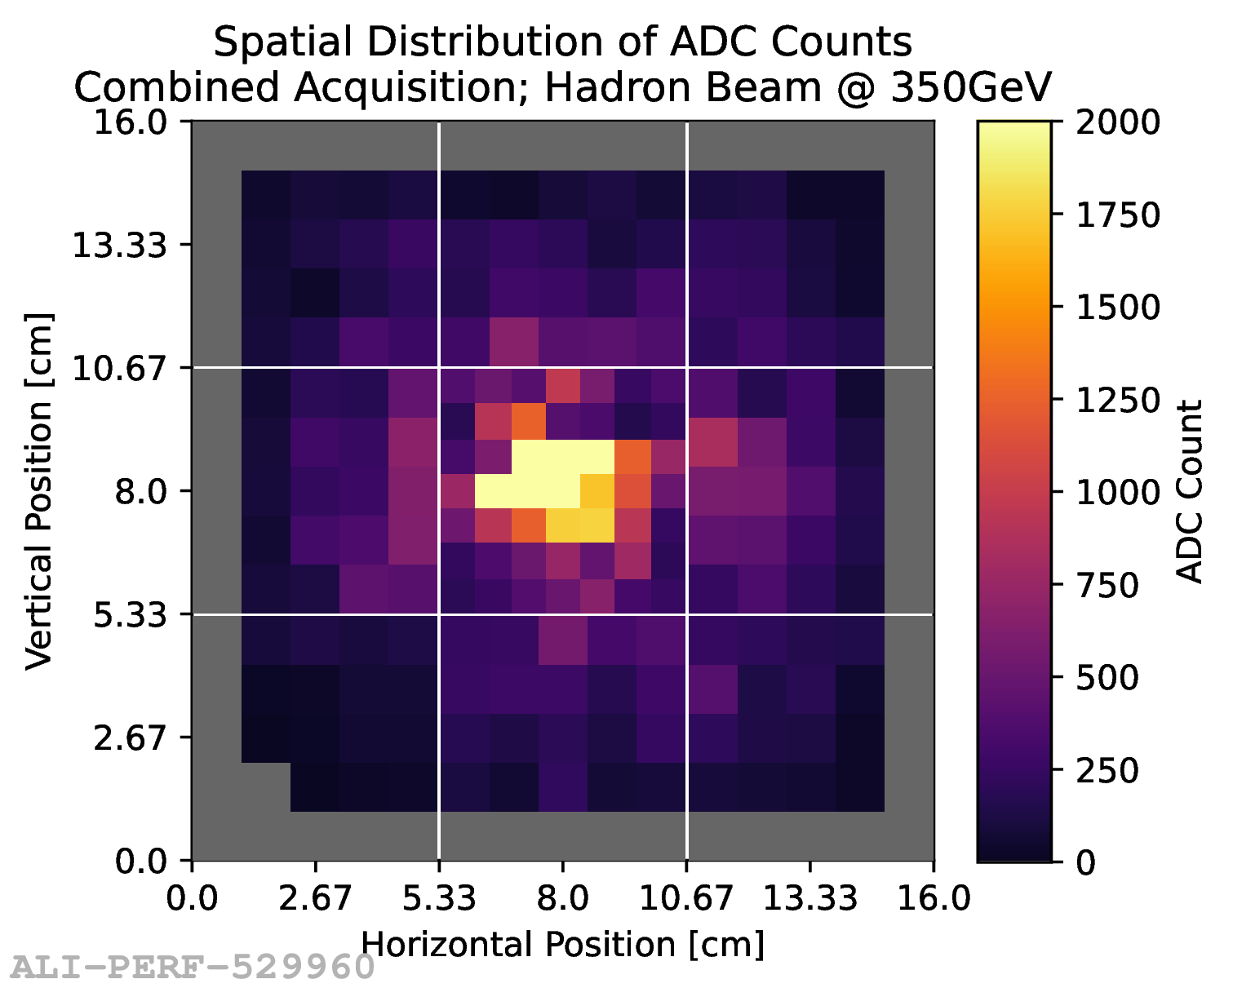
FoCal-H
Prototype 2 built summer 2022
9 full length modules at 6.5 cm x 6.5 cm x 110 cm
Copper tubes filled with BCF12 scintillating fibers
Fibres grouped to bundles of SiPMs
  49 readout bundles in central modules
  25 readout bundles for each outer module
Readout with CAEN DT5202 boards
Overall weight > 300 kg

Slide 6
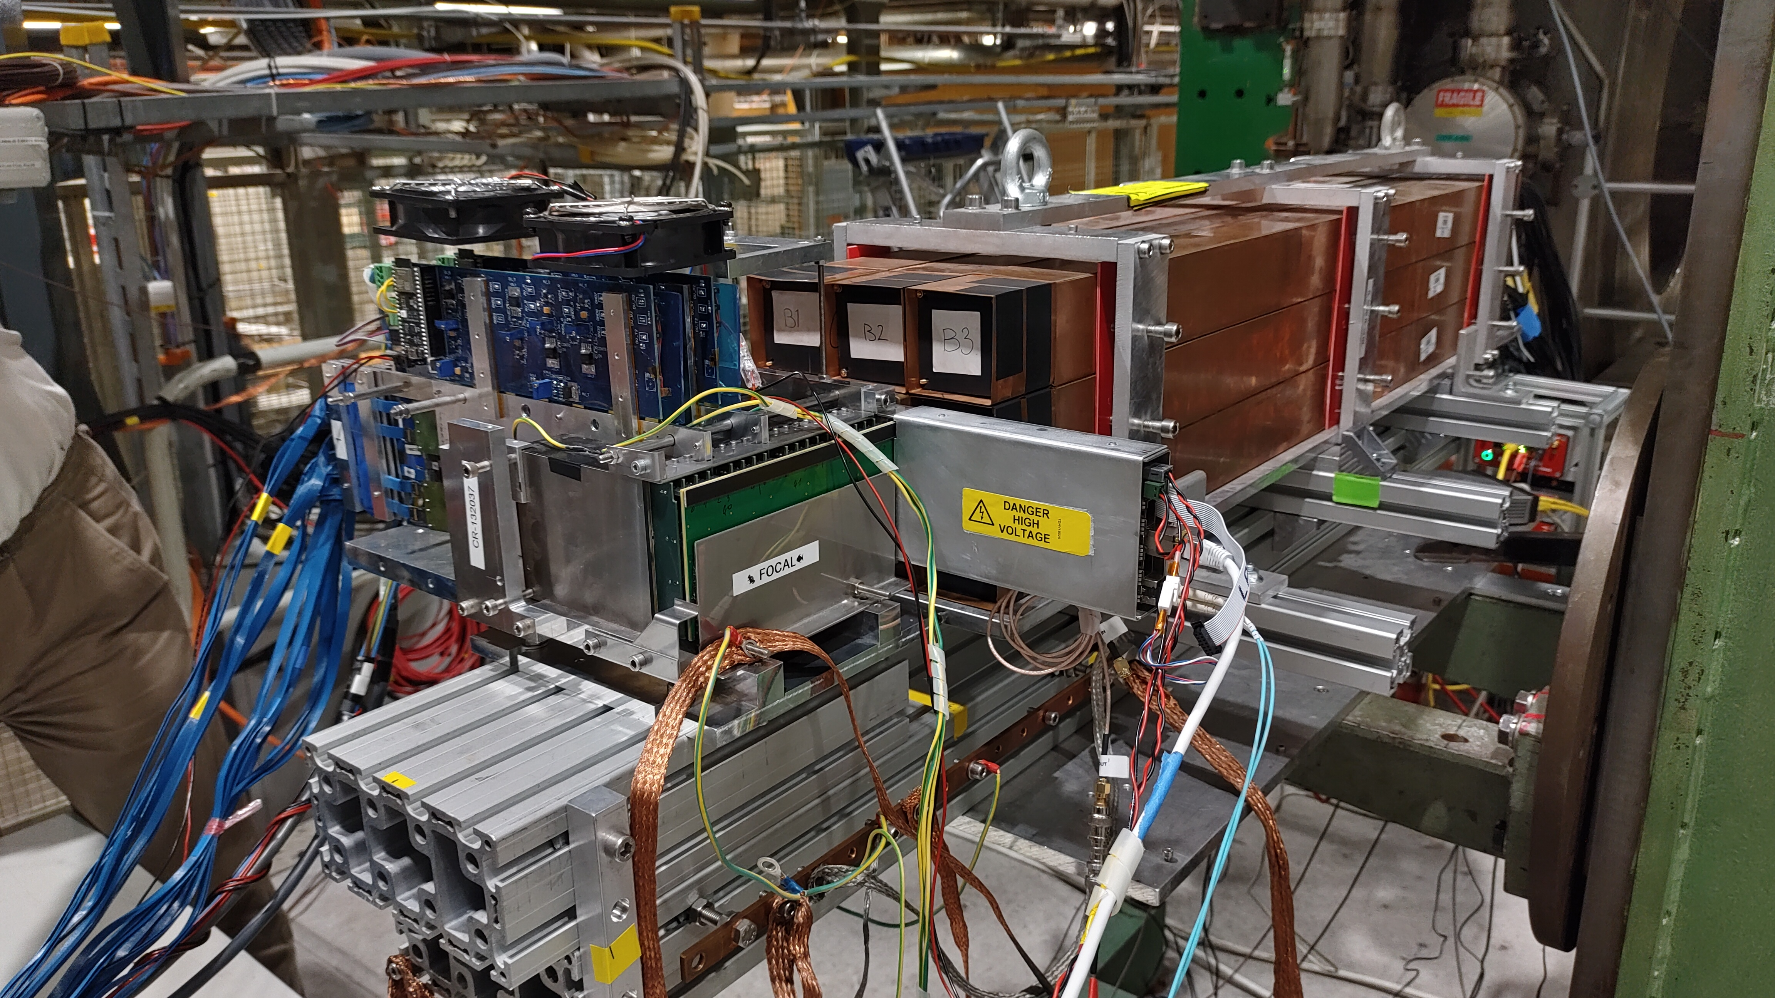
ALICE FoCal prototype installed at CERN SPS H2
CERN SPS H2 (17th to 24th May 2023)
FoCal-H
9 Cu-scintillating fiber blocks
Block size ~ 6.5 x 6.5 cm²
Length ~110 cm
FoCal-H
FoCal-E pixel
FoCal-E Pads
18 layers of silicon pad sensors of 9 x 8 cm²
Pad size 1 cm²
Readout with HGCROC v2
FoCal-E Pads
FoCal-E Pixel
2 ALPIDE pixel layers
Monolithic active pixel sensors with pixel size of ~30 x 30 µm²
24th May 2023

Slide 7
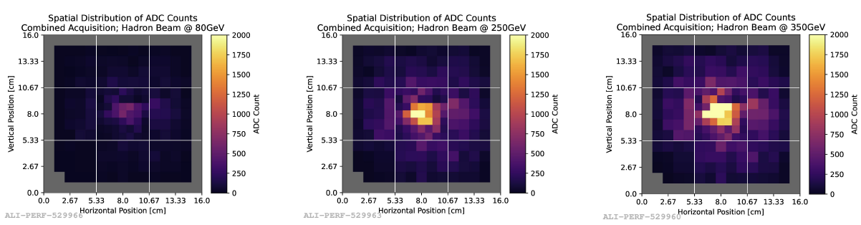
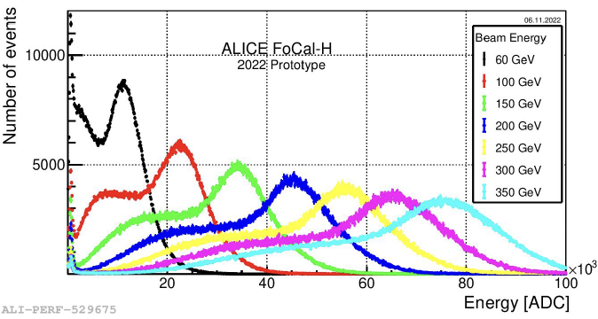
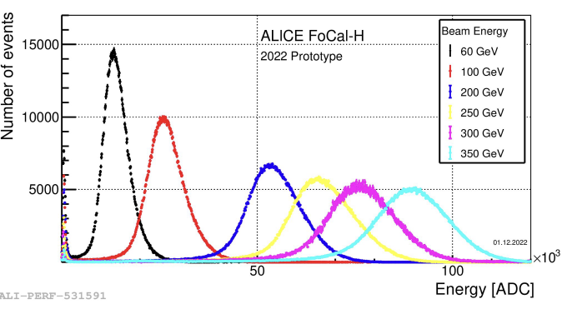
FoCal-H Prototype 2, November 2022
FoCal-E in front
FoCal-H only

Slide 8
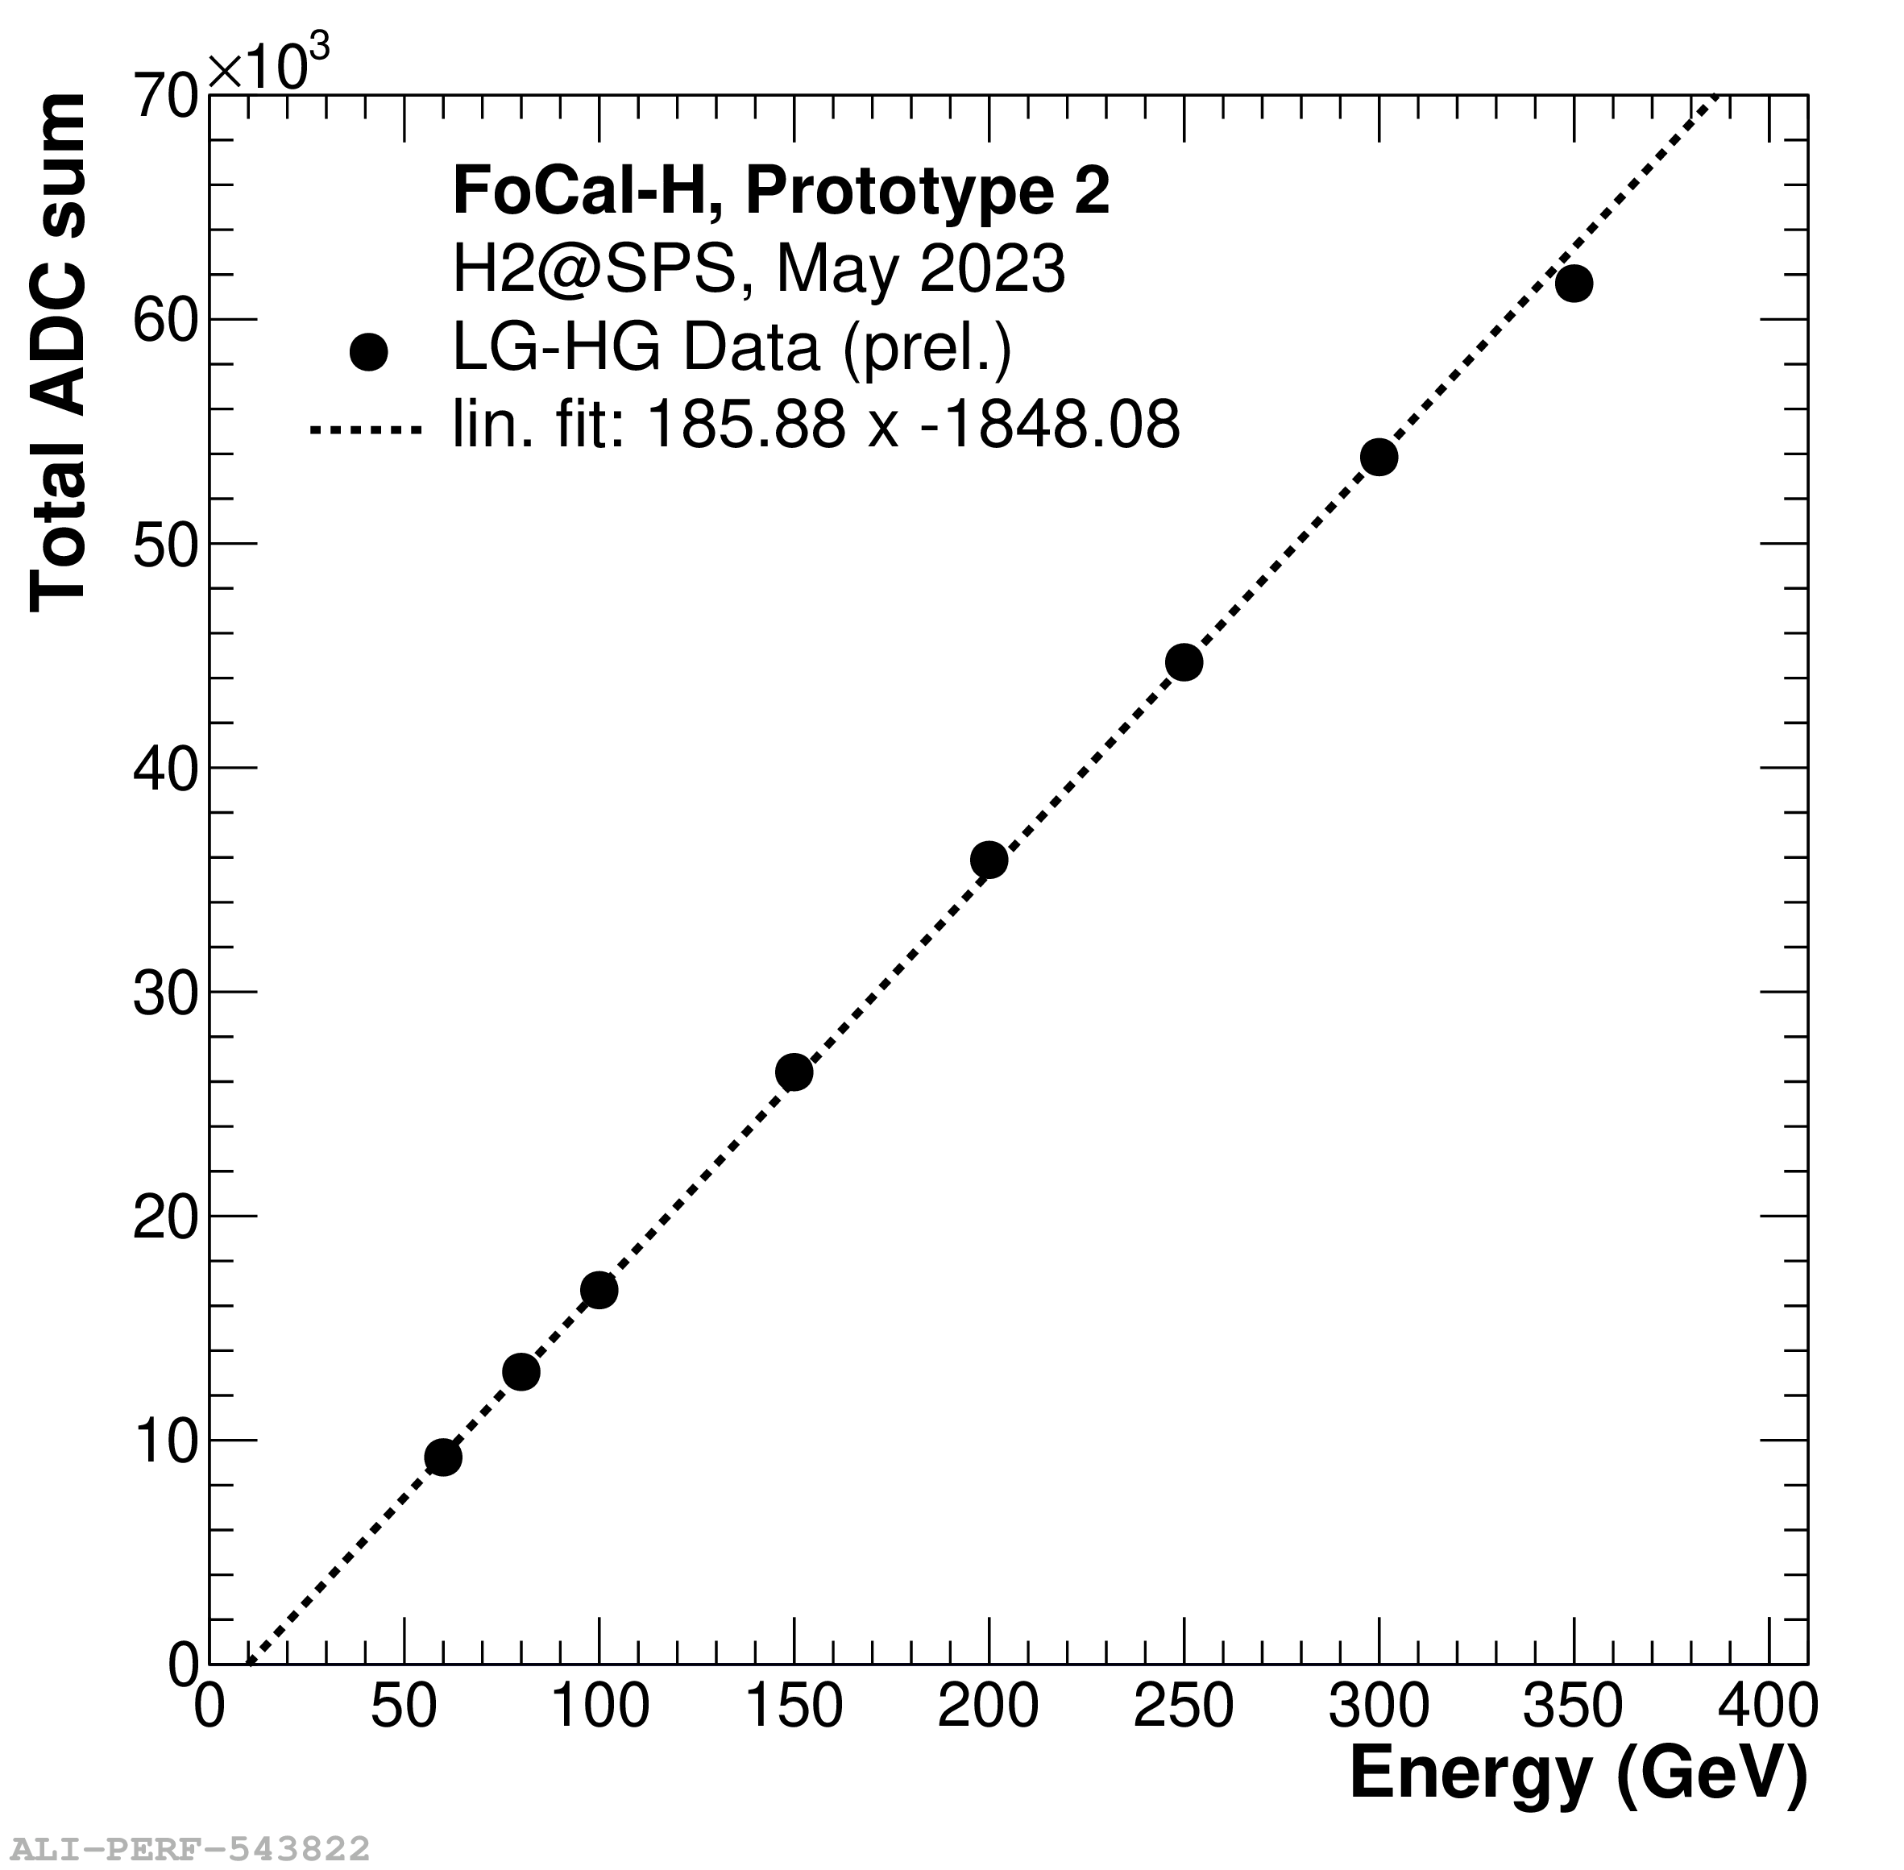
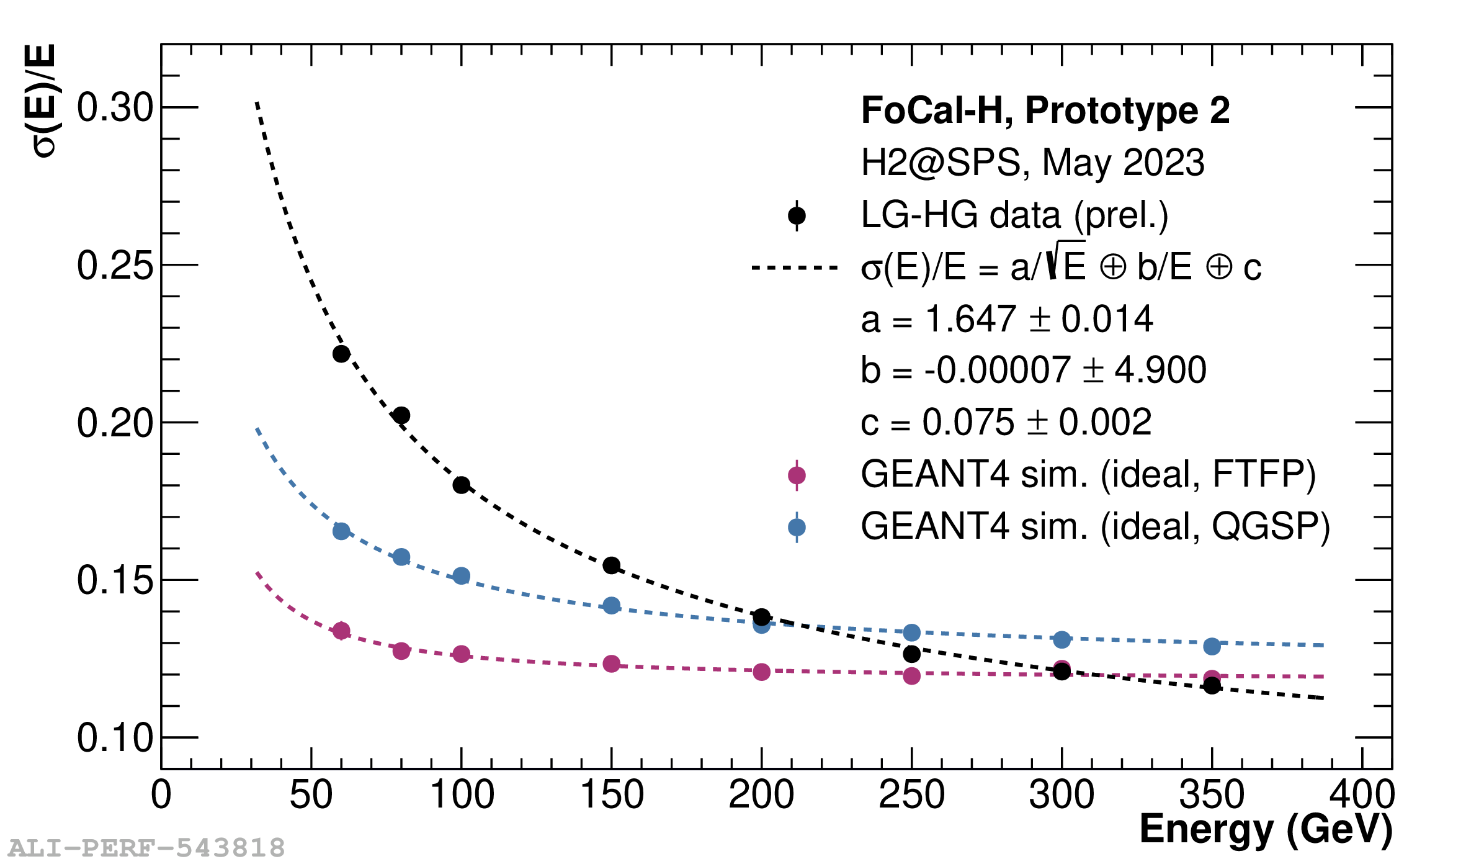
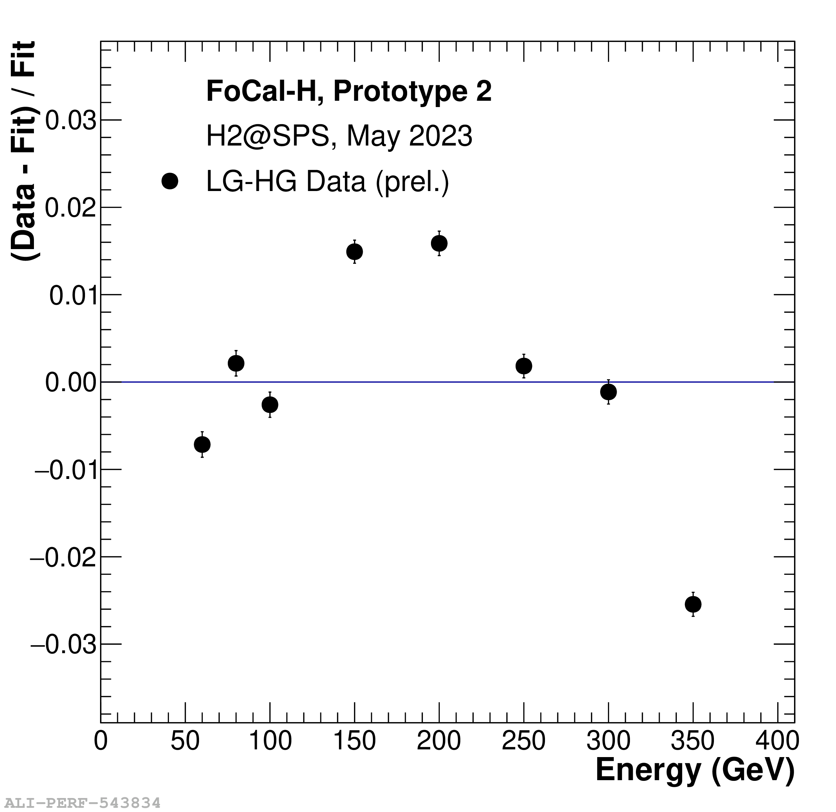
FoCal-H Prototype 2 Performance
JINST 19 P07006 2024
DOI 10.1088/1748-0221/19/07/P07006

Slide 9
Question 1:
What analyses should be done with existing FoCal-H Proto2 data?
ML studies: what can we conclude from the Prototype 2 data?
”clustering” algorithms, synthetic multi-particle data…

Slide 10
So far, we base everything on Σ(ADC)
FoCal-E in front
FoCal-H only

Slide 11
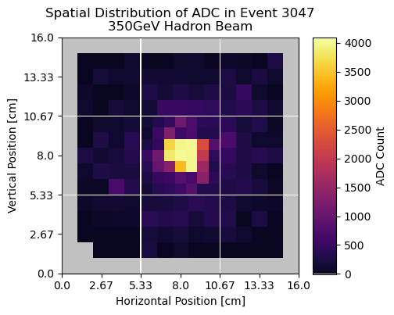
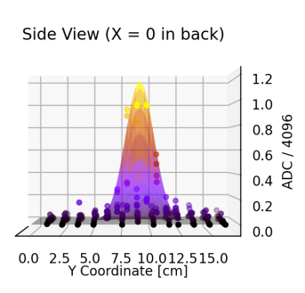
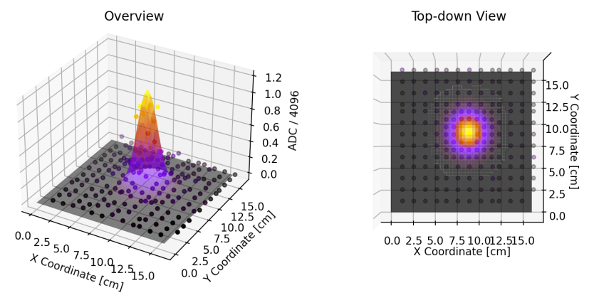
2D: Fit Gaussian to each event…

Slide 12
Σ(ADC)
OK as long as we have only one particle, but what do we do with “real” data?
Ian P. & Bjartur have looked into this. This summer there are a couple of summer students in Jyvaskyla also looking ito it.
ML? Clustering algorithms? Mixture?

Slide 13
Question 2:
How do we extract ”hits” from our data?
In principle, we can get the answers from Proto2 data:
ML studies: what can we conclude from the Prototype 2 data?
”clustering” algorithms, synthetic multi-particle data…

Slide 14
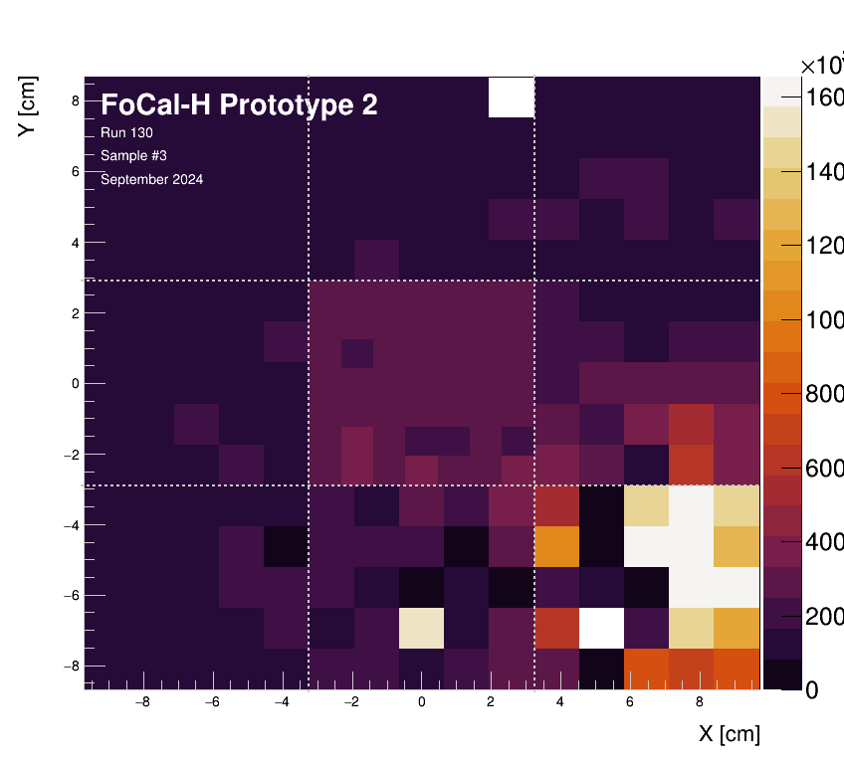
Good news: no longer using CAEN DT5202
SPS test beam 4-11 Sept. 2024
H2GCROCv3+KCU105
Final readout chain: Oct. 2025
FoCal-H prototype 2 response (ADC only) for pions.
Still working on combining ADC and ToT.
Position scan (100k events/run)

Slide 15
H2GCROC ADC+ToT
Do we know how to combine them properly?
What settings (current conveyor, etc) should be used?
How do we calibrate?
How stable is calibration?

Slide 16
Question 3:
What needs to be done so that we can use
ADC+ToT in September SPS data?
Lab tests using NBI Laser in FIT lab.
How many photons to ”saturate” SiPM?
Comparison of N_photon & H2GCROC.

Slide 17
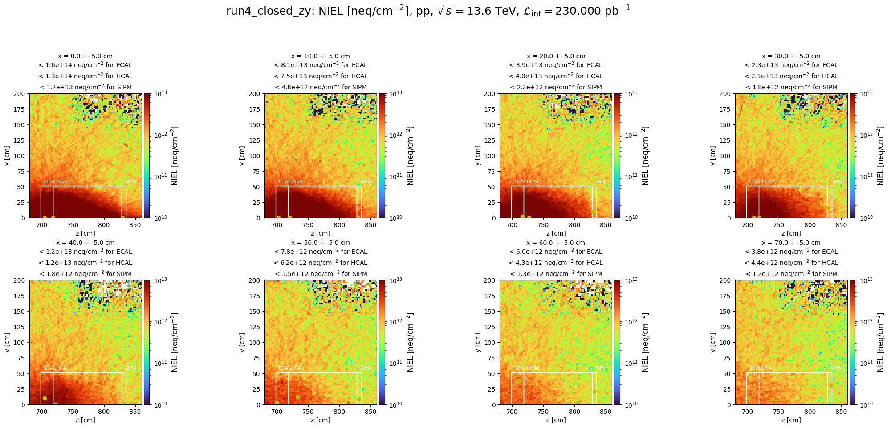
Challenges: radiation dose
1
3
2
4
1
3
4
2

Slide 18
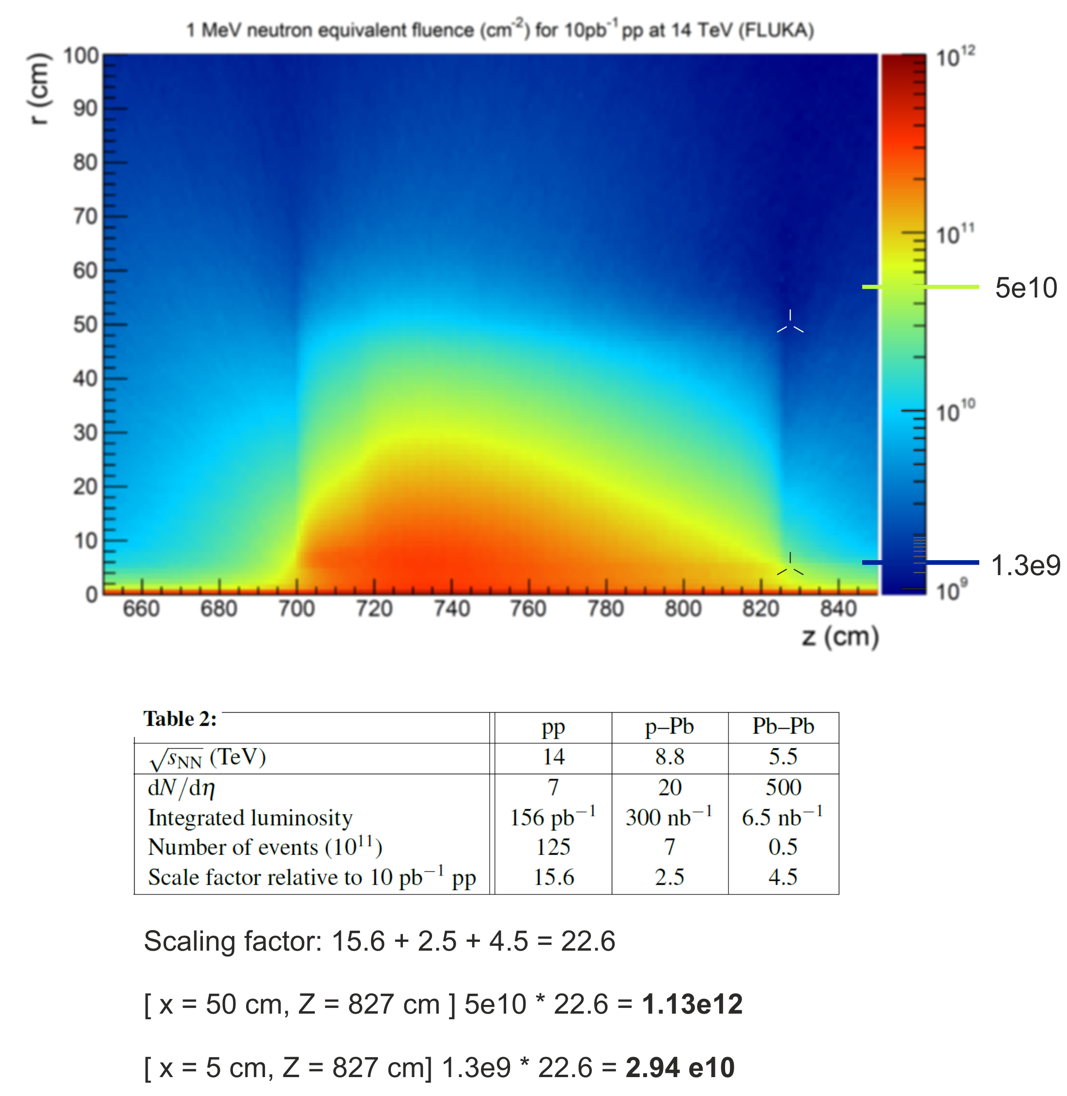
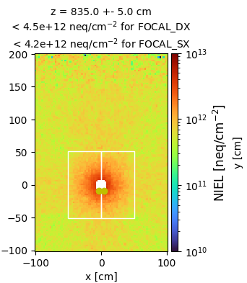
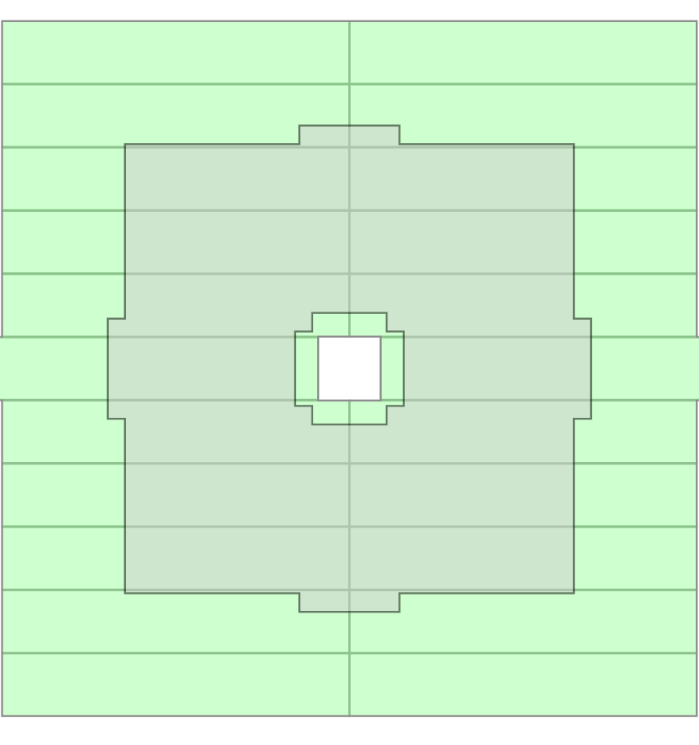
FoCal-H: SiPM Radiation Tolerance Tests
Hadron fluence well over 1e12 n_{eqv}/cm² expected for the innermost FoCal-H SiPMs.
1
Simulation results:
Scaling to other colliding systems from the TDR:
3
1
3
r = 5 cm
r = 50 cm

Slide 19
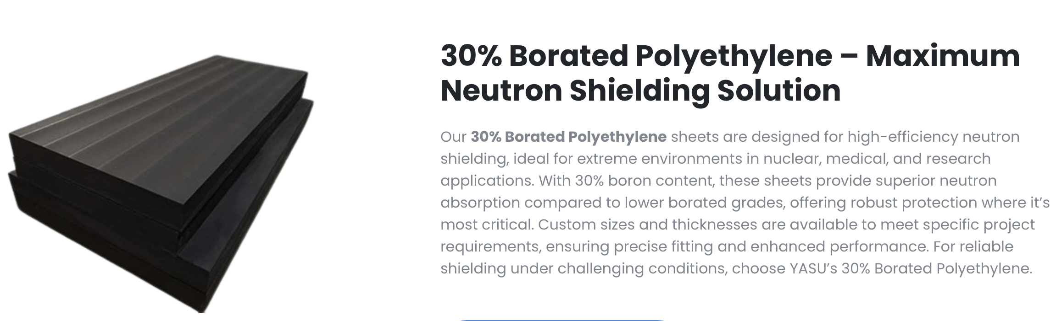
Idea arising during EDR…
Use shielding to minimise neutrons. Perhaps Borated Polyethylene and Cd foil can provide appreciable shielding?
This needs to be simulated and perhaps considered for the FoCal-H “cooling box”.

Slide 20
Question 4:
What do we need to do to decide whether
(and how much) shielding helps*?
*allows SiPMs to survive** through one LHC-year
** assuming, as we do, that annealing SiPMs during YETS will be sufficient

Slide 21
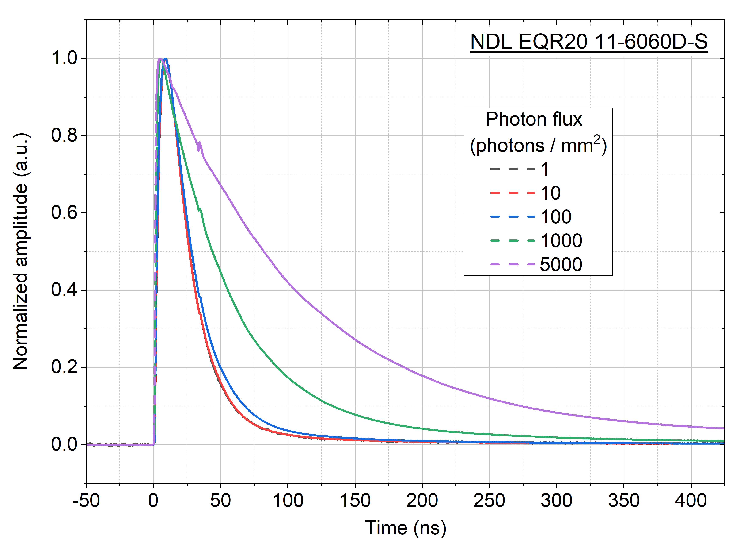
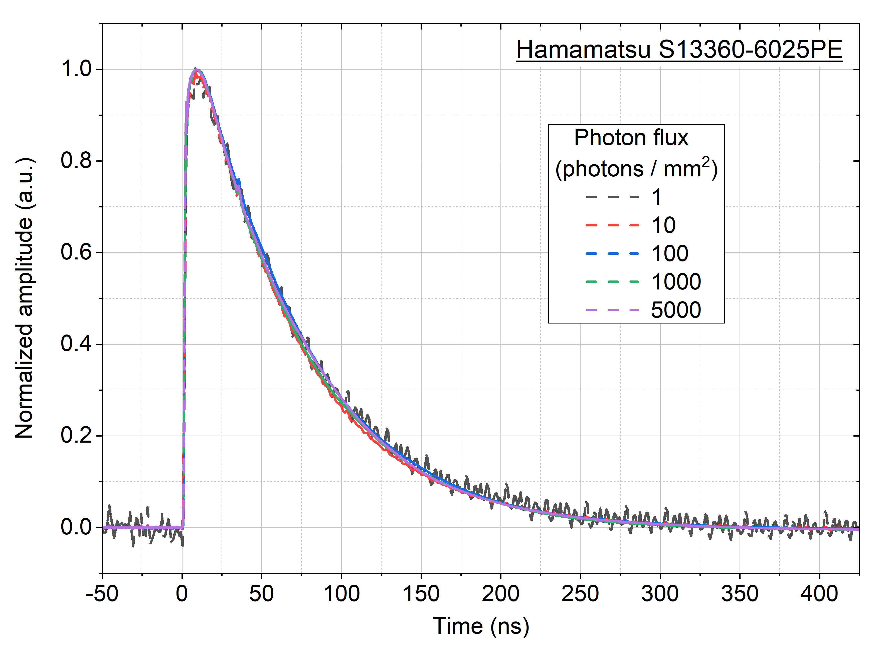
SiPM candidates: NDL and Hamamatsu
Extensive SiPM characterization outside beam was finished in June:
NDL features
Faster recovery
Much larger PDE
Higher gain
Incomparably better SPE resolution
DCR similar to Hamamatsu
Rate capability similar to Hamamatsu
Much higher inter-pixel cross-talks
Strong pulse shape distortion at high load
NDL, while excellent for small numbers of photons, not the best for our application.

Slide 22
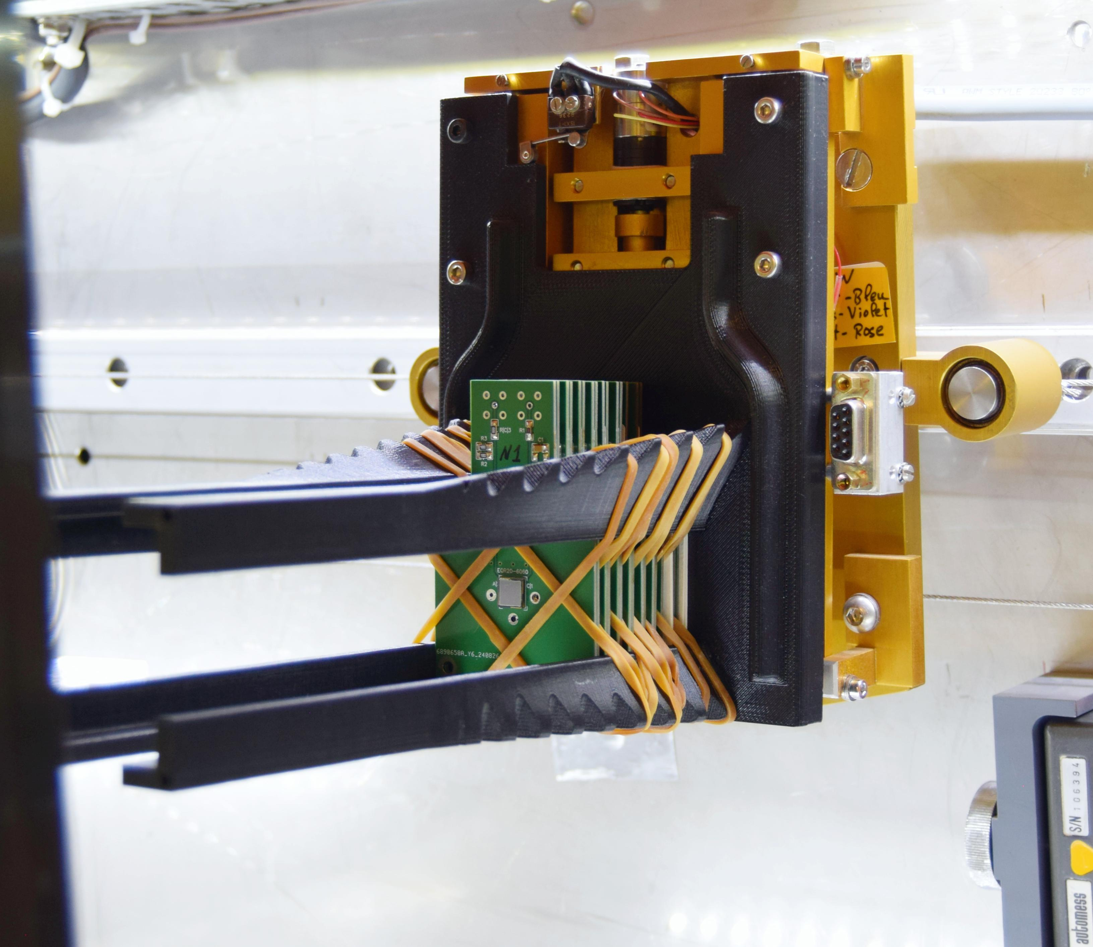
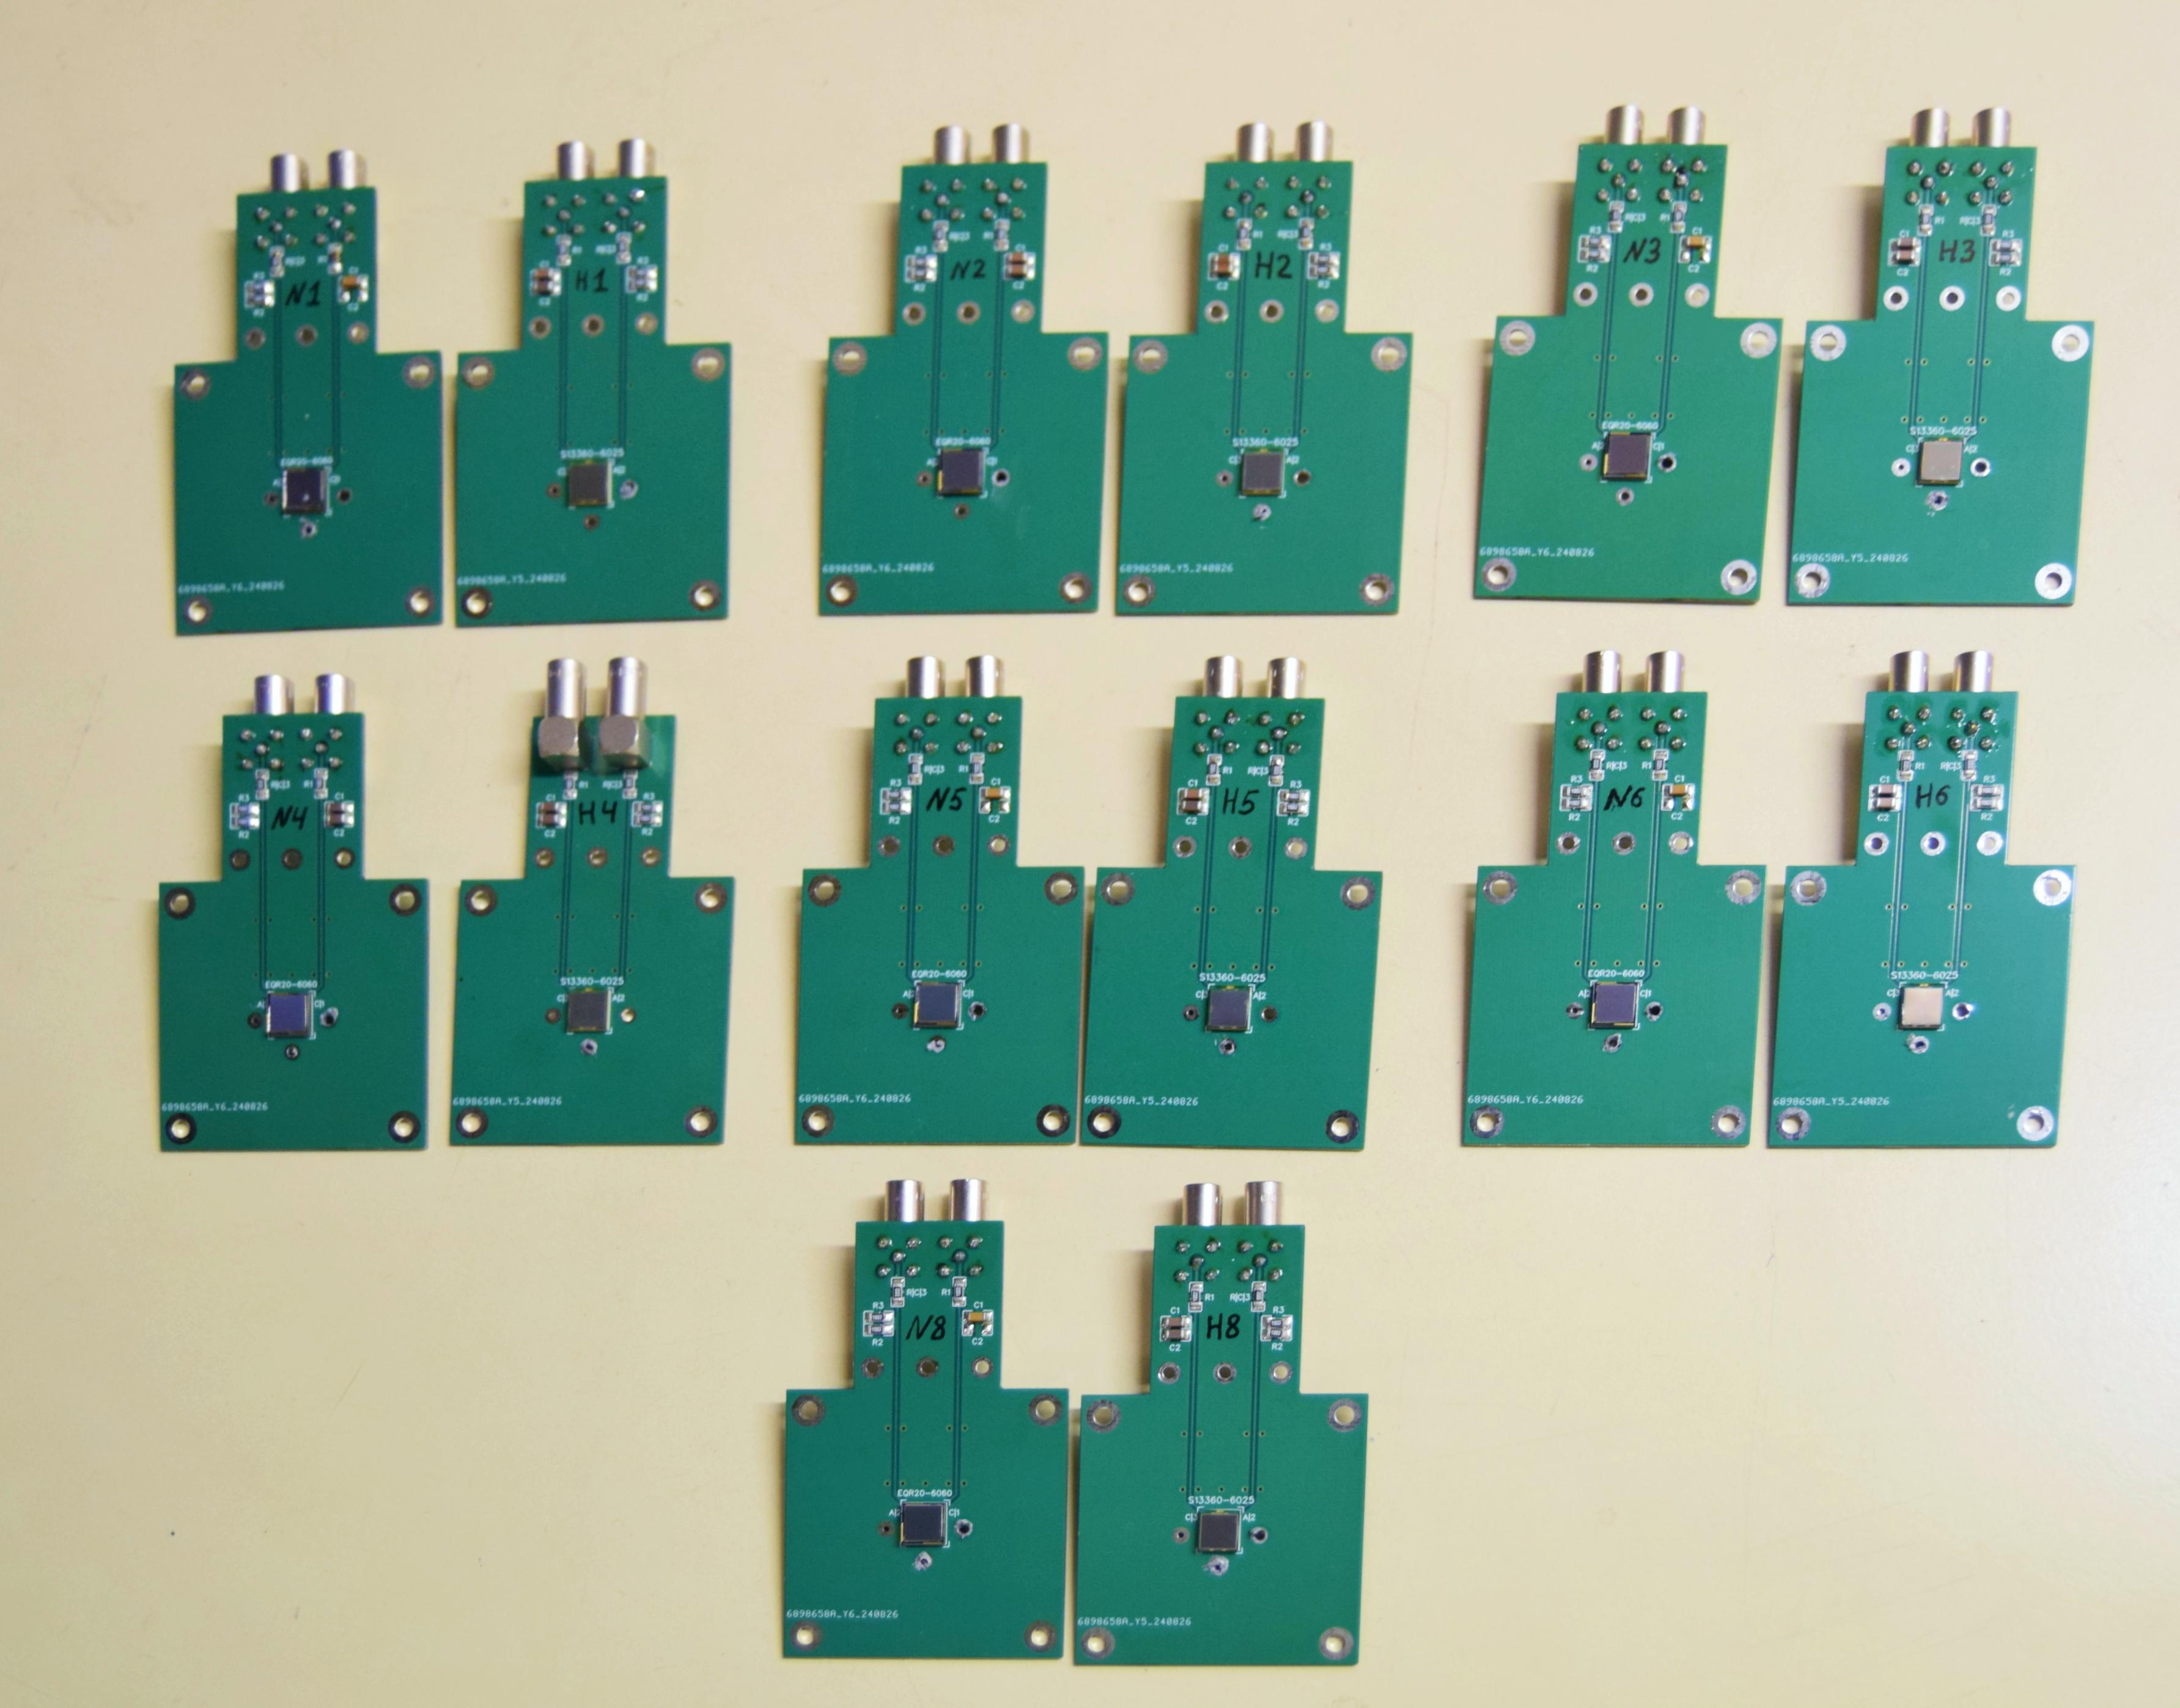
SiPM irradiation
While the dedicated irradiation campaign is being prepared outside CERN, PS IRRAD beam was used for a brief rad. tolerance test for seven pairs of NDL and HPK samples:
27 GeV/c protons, ~1.2e10 p/spill;
~2h start-to-finish.

Slide 23
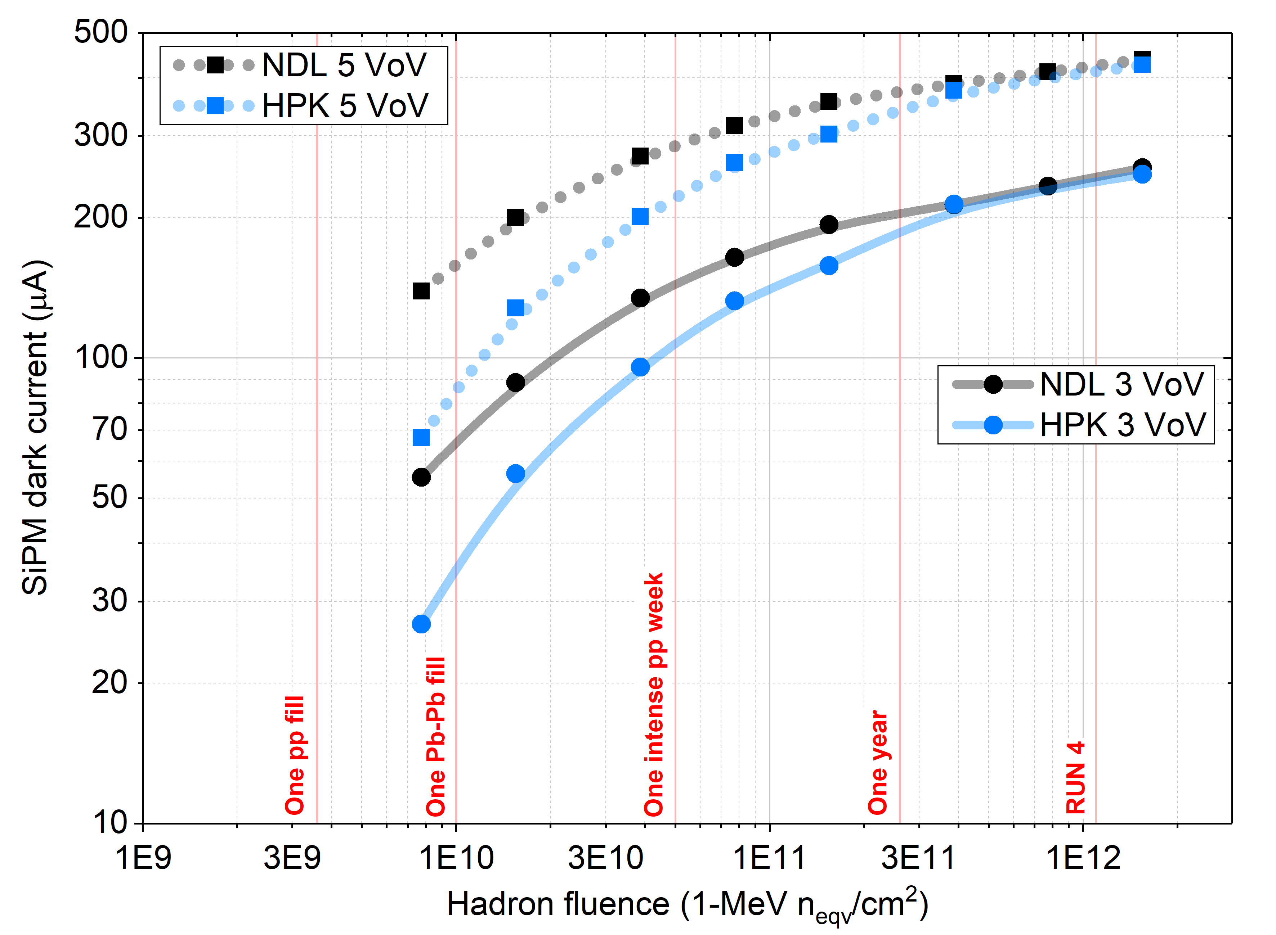
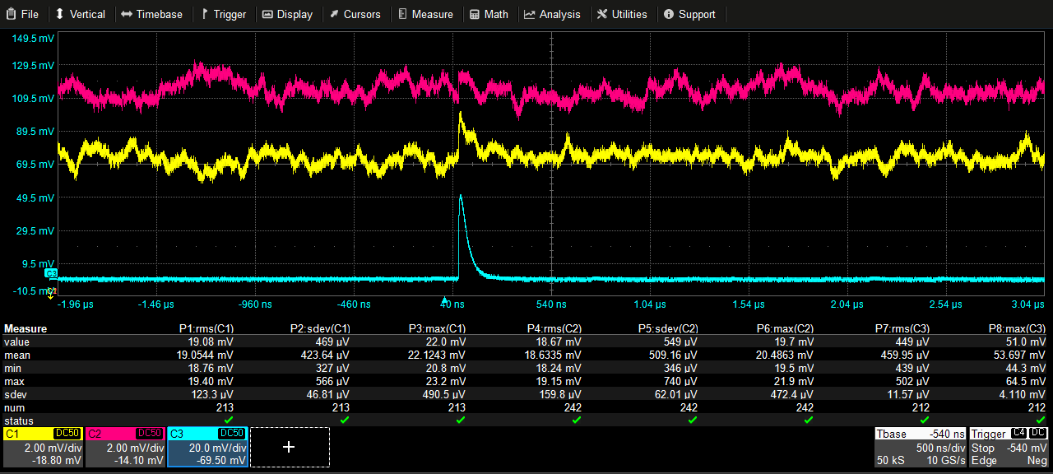
A few summary slides for the LHCC:
SiPMs: Before & After ≈1 LHC year at inner position
Same pulse seen by NDL and HPK irradiated to a yearly fluence
~1 mV pulses on top of the 19 mV baseline shift
±0.5 sdev!
430 photons seen by a healthy NDL

Slide 24
Question 5:
What do we need to do to ”validate” 3x3 SiPMs?
Are we saturated (i.e. too many photons)?
Are we rate limited (insufficient recovery time)?
Cf: question 3

Slide 25
Implications:
SiPMs cannot tolerate the dose at small R (from beam) betweenYETS annealings
Cure: cool (≈-30C) or move R>30.
Chilled water is ≈14C.
Need to move “inner” SiPMs outward.
Investigate smaller SiPMs

Slide 26
Question 6:
What are our success criteria regarding cooling?

Slide 27
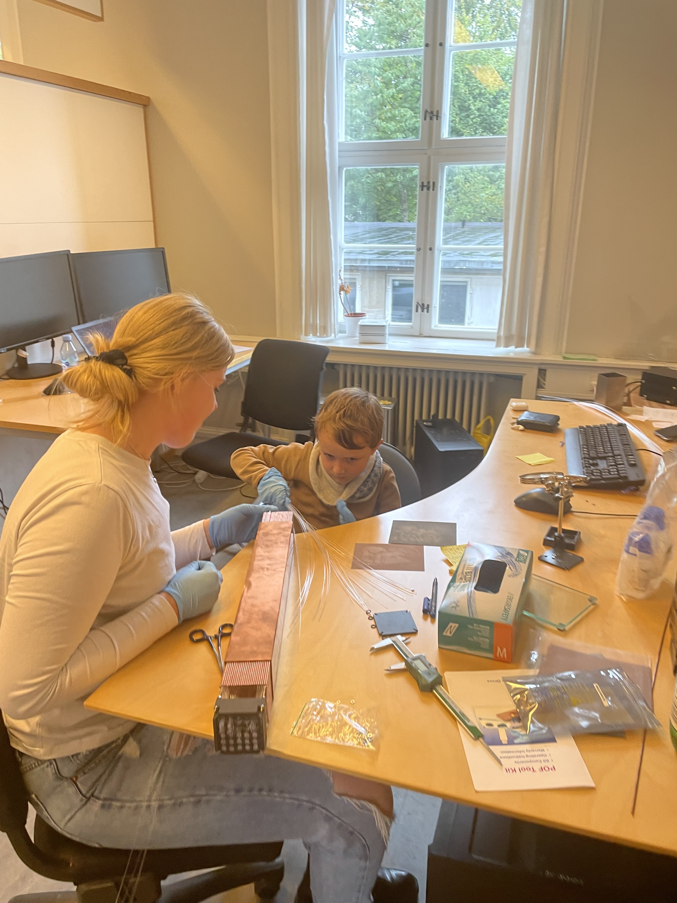
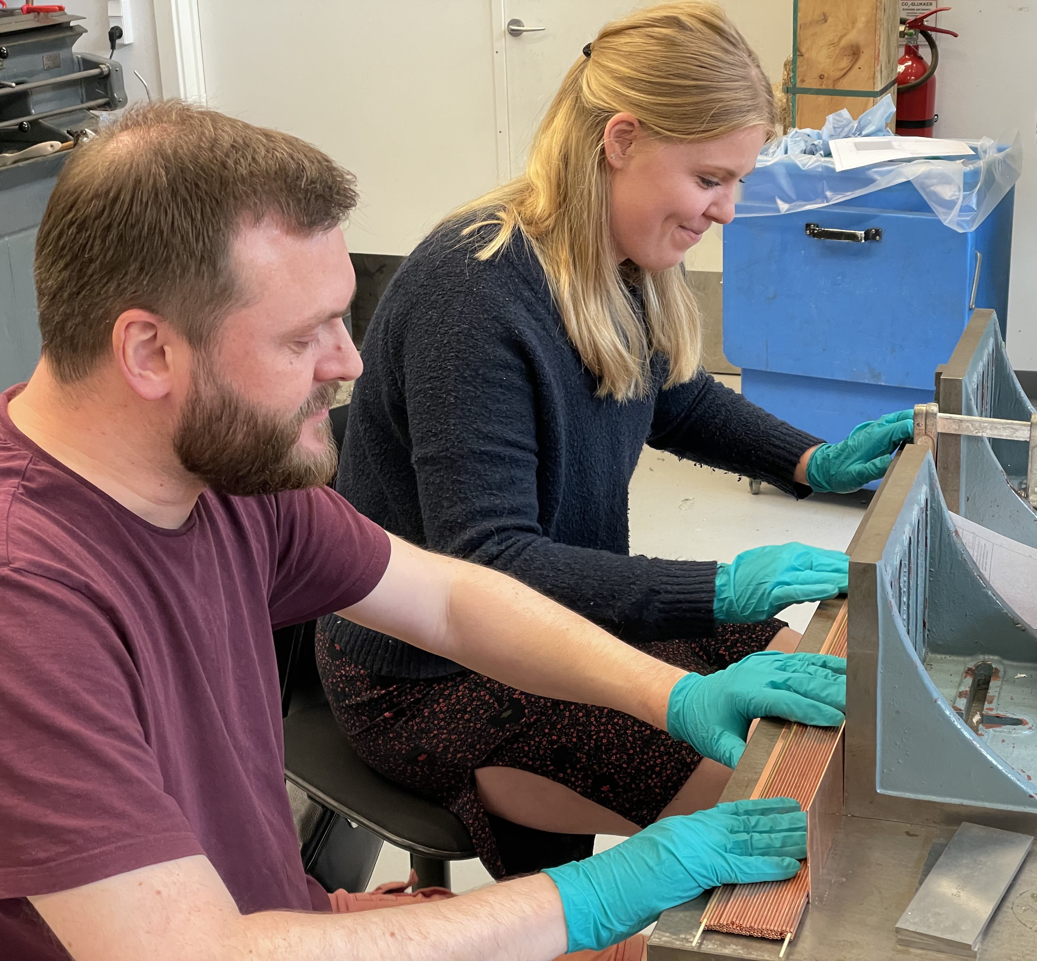
Production:
Prototype 2: (6.5 x 6.5 cm² modules)
The first 3 modules:
The average construction time is 3 days for mechanical assembly, 1.5 days for fiber insertion and bundling, and ≈ 1 module/week.
Last 3 modules: ≈2 modules/week.
Note: this was a rather artisanal production

Slide 28
Potential solution:
Copper sheets with machined grooves (details in Prototype 3 section)
Reduce time for inserting fibers.
Reduce assembly time.
We will learn how much this summer when we build prototype 3.
See slides 50-53

Slide 29
Question 7:
What are our success criteria regarding sheets?

Slide 30
Outline
FoCal
FoCal-H
Prototypes
Challenges
Costing
Prototype 3
Final (?) Design
Schedule

Slide 31
What pitch should we use, based on performance?
Cost considerations pushed us to reconsider, but we want to do physics.
Considerations:
  Resolution
  Expected saturation
  Visible energy
  e/h ratio vs. E (how well compensated is FoCal-H?)
  Linearity
  Other parameters?
Simulations done by Ian Pascal, based on GEANT 4
  Same as used previously by Laura, consistent with simulations in our published results (for 2.5mm CT)

Slide 32
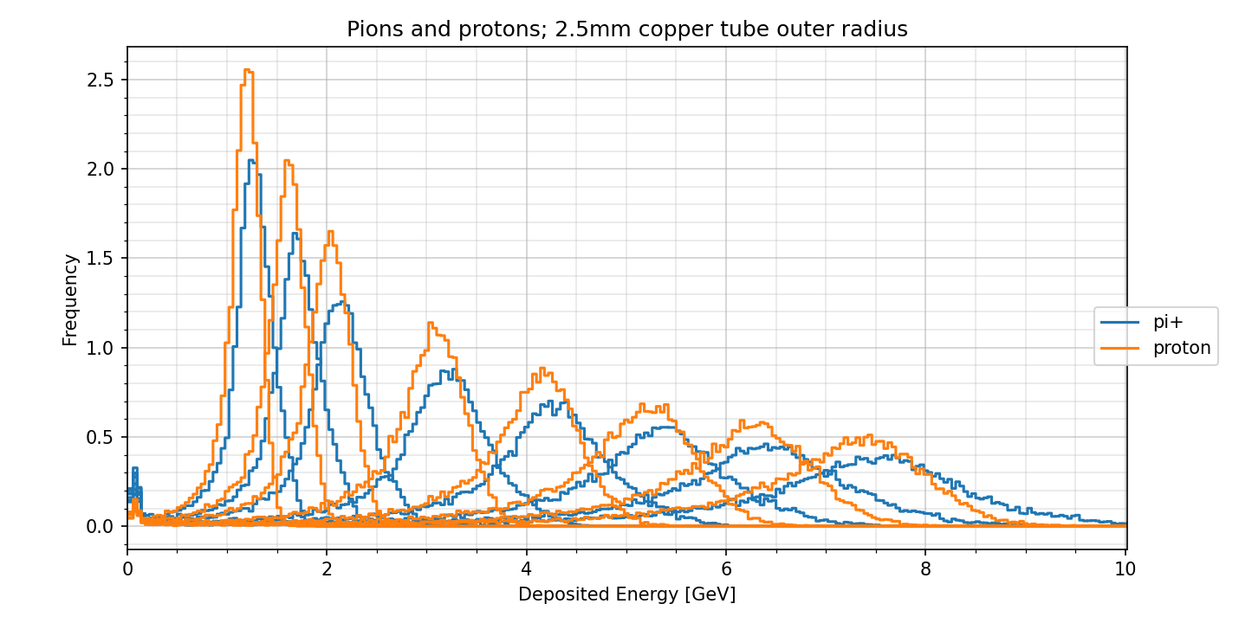
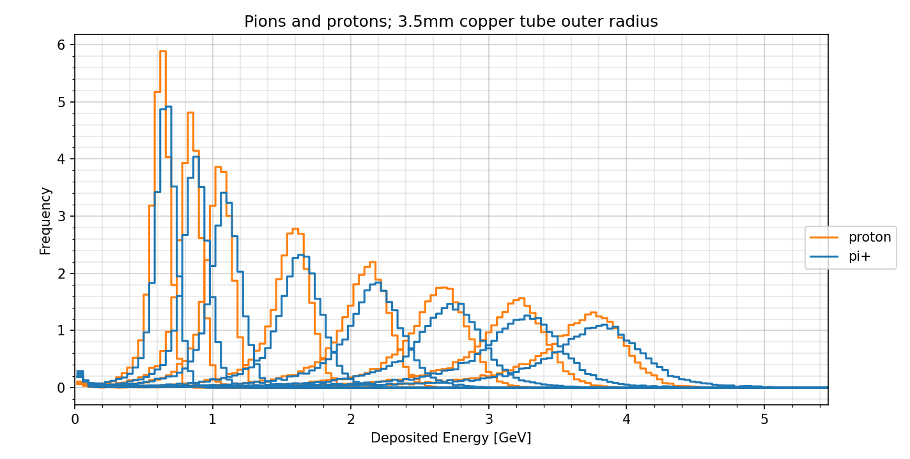
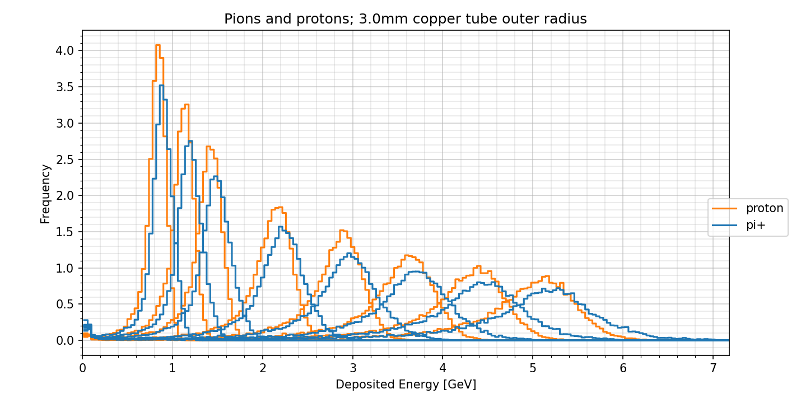
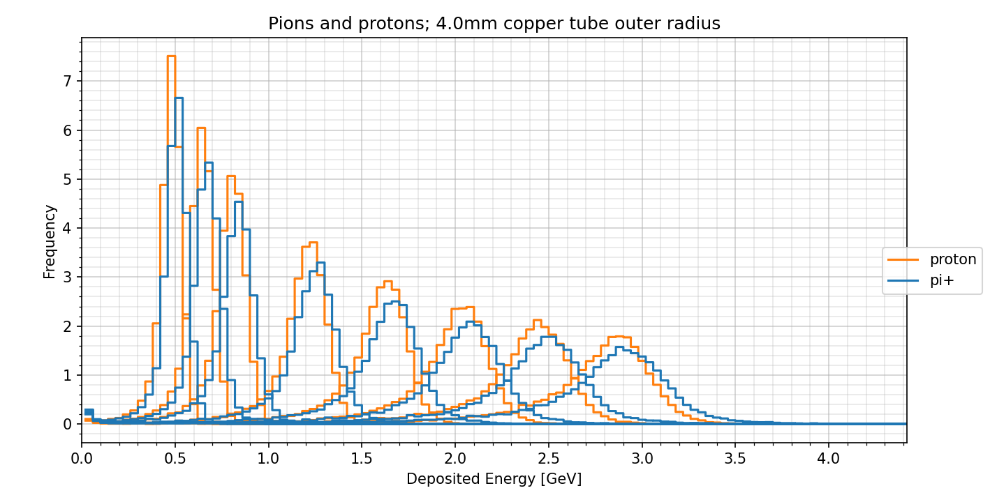
Visible energy (pi & p 60-350GeV)
NB: note variation in energy scale!

Slide 33
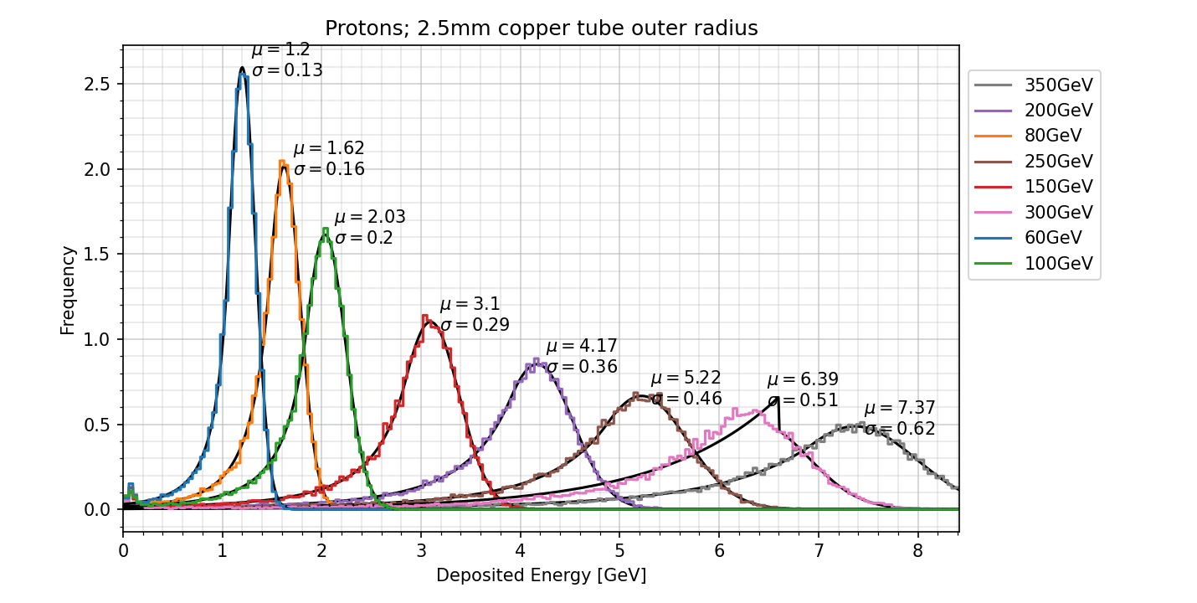
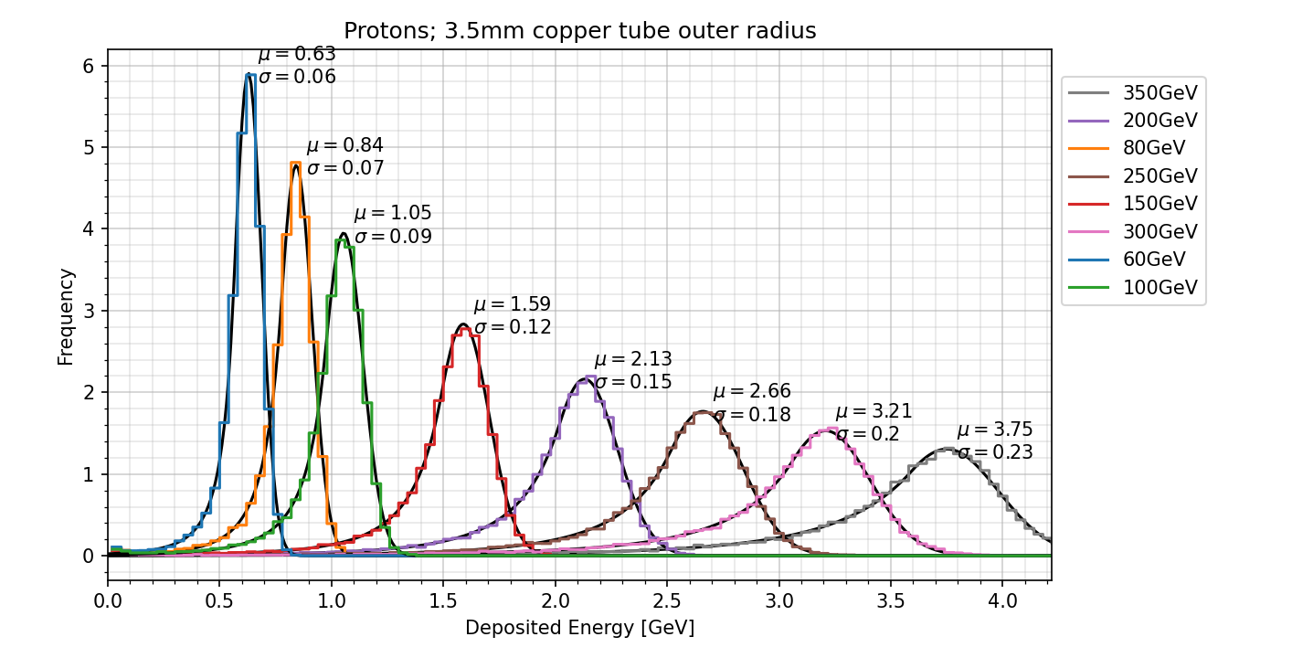
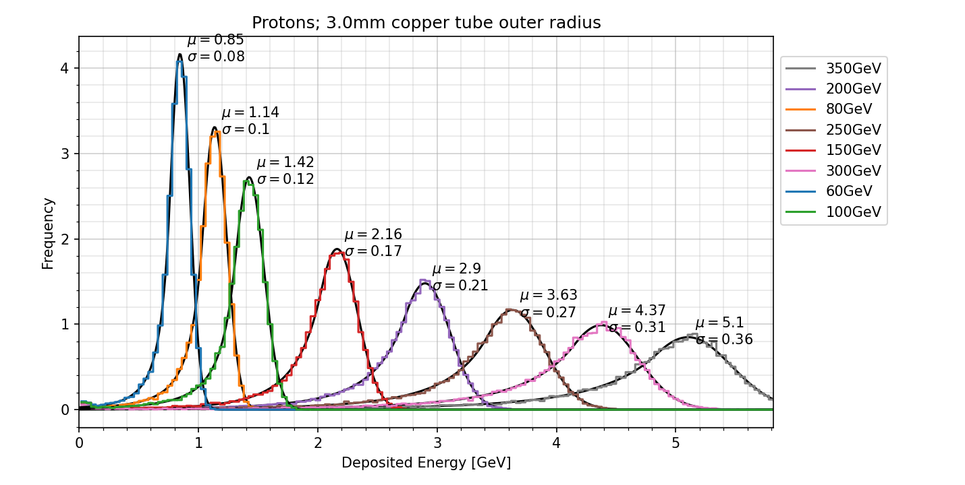
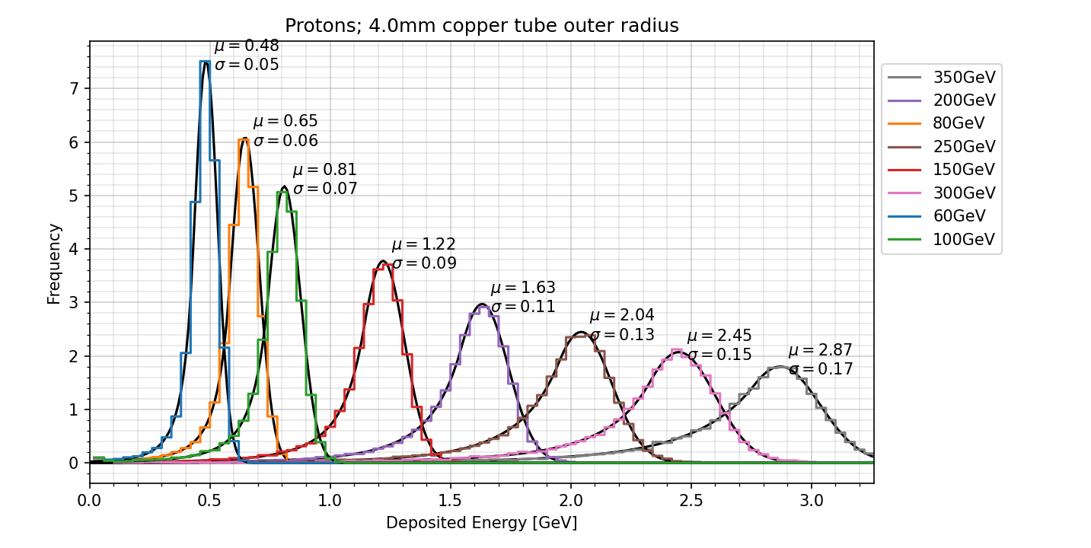
Visible energy (protons 60-350GeV)
2.1%
1.1%
μ/E(350)
1.5%
0.8%
NB: note variation in energy scale!

Slide 34
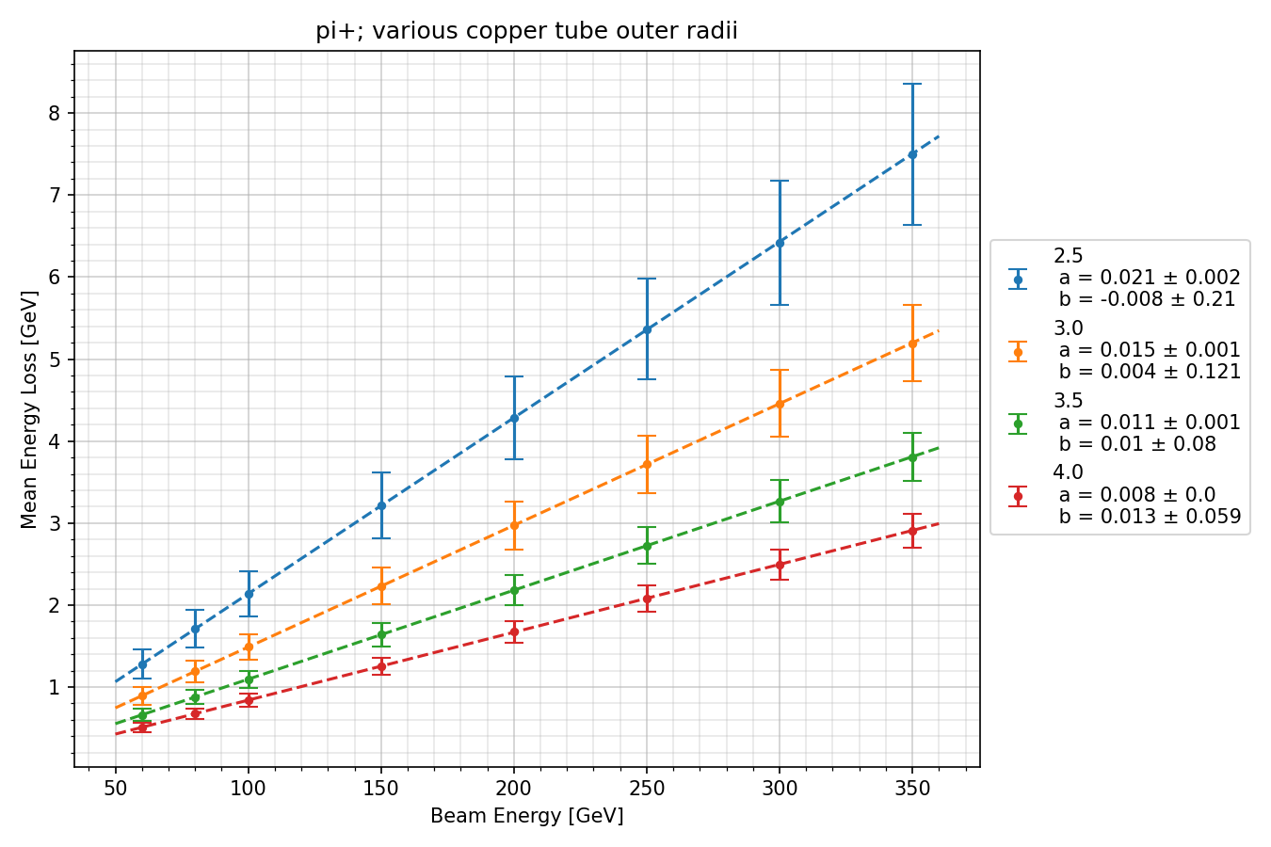
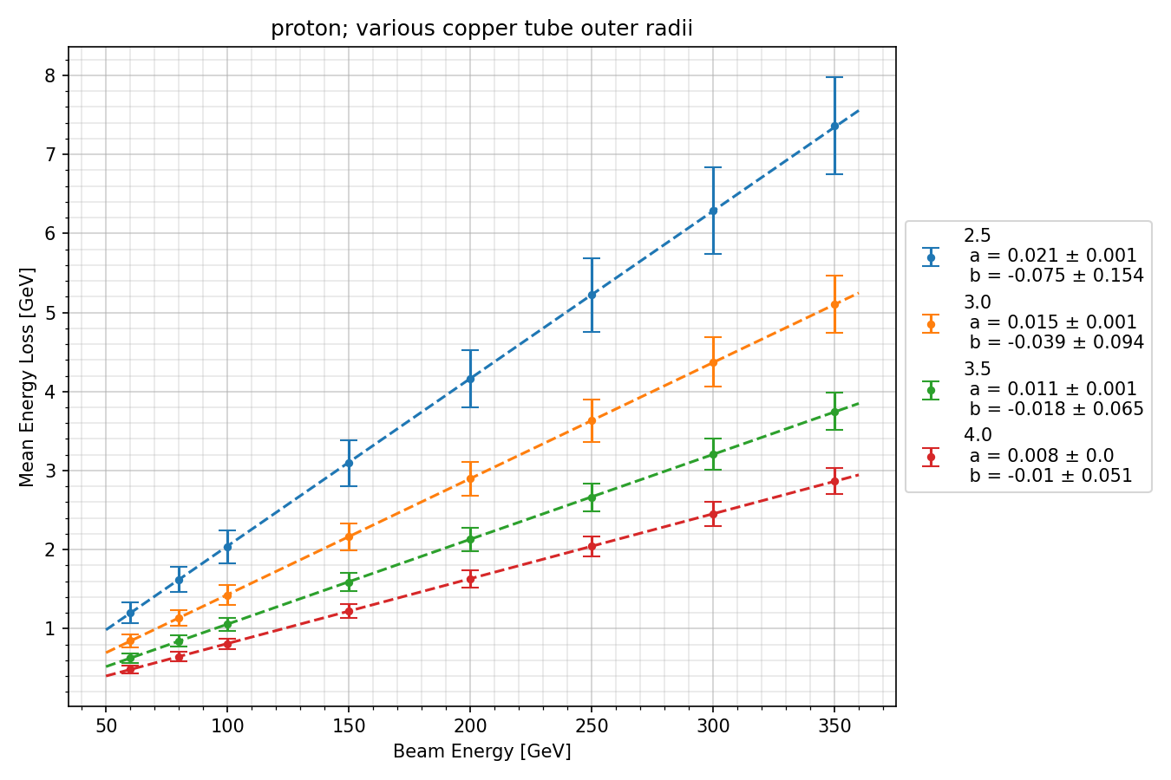
Linearity (only looking at ΔE in scint!)

Slide 35
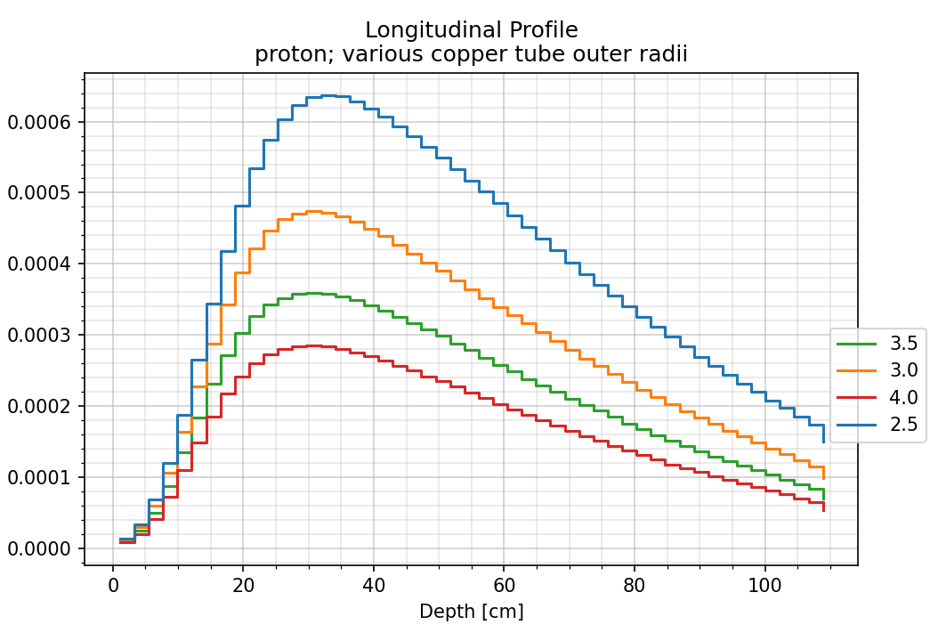
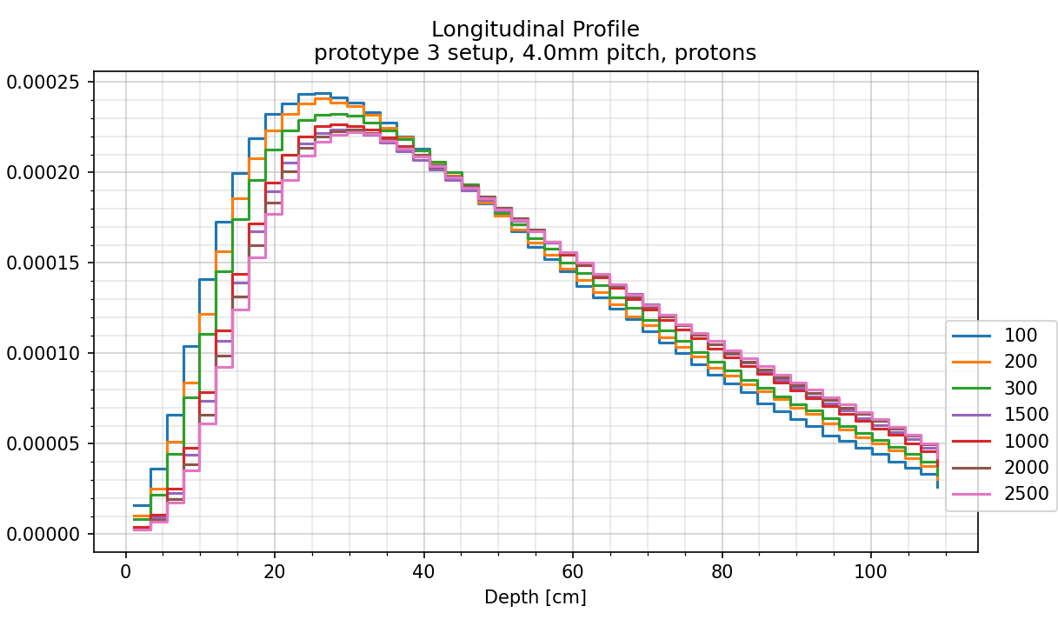
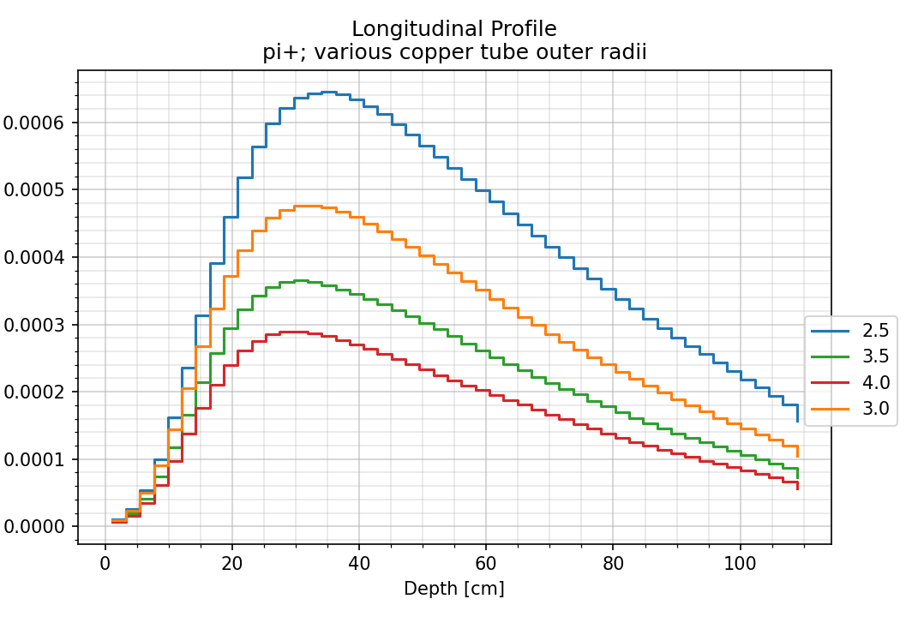
Longitudinal Energy Deposit

Slide 36
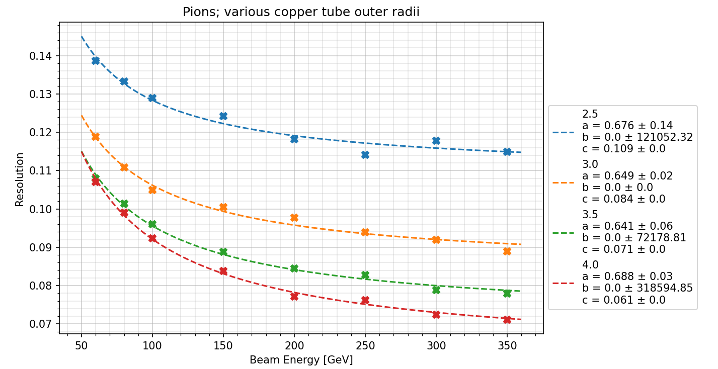

Resolution (only looking at ΔE in scint!)
40%
20%
NB: different ranges in resolution. Worse for π (e/h??)

Slide 37

Resolution vs. pitch:

Slide 38


Compensation (by proxy)
Argument: if compensation were poor, resolution would deteriorate with E and pi/p would not be flat.

Slide 39


Resolution:

Slide 40

Expected e/h compensation
With 4mm spacing, unit cell is:
Sim
1mm
1.1mm
Real
13.58
MCAbs/Scint =
1.57
13.9
4mm
RealAbs/Scint =
1.57
Proto2
Proto3
FoCal-H (MC)
Sampling fraction
NB: Fe lower Z and less dense than Cu
FoCal-H
Abs/scint
Calorimetry for Collider Physics, an Introduction p. 152

Slide 41





Copper sheets from
Electris
Payment for Proto3 sheets should be made by KU this week.

Slide 42

Prototype 3 (status in April):
Cu delivery in early August (to be confirmed by Electris)
Waiting for prices from Luxium and China for scintillating fibers.
Photosensors: waiting for prices from Hamamatsu.
Question: should we continue with 6x6 mm SiPM?
  Unclear these can be used in final FoCal due to radiation environment
  Smaller SiPMs?
  PMTs?
Assembly at CERN after delivery of Cu, scintillating fiber
  Hope for ≈end of August, but may be too optimistic.
beam

Slide 43
Prototype 3 (update):
Cu delivery in early August (to be confirmed by Electris)
Waiting for prices from Luxium and China for scintillating fibers.
Photosensors: waiting for prices from Hamamatsu.
Question: should we continue with 6x6 mm SiPM?
  Unclear whether these can be used in FoCal due to the radiation environment
  Smaller SiPMs?
  PMTs?
Assembly at CERN after delivery of Cu, scintillating fiber
  Hope for ≈end of August, but may be too optimistic.
≈$2.50/m
Hamamatsu S14160 (10 micron)
N _{order} | 6x6 | 3x3 | 1x1
450 | 19,51 | 8,34 | 5,98
5000 | 13,58 | 5,81 | 4,17
beam
Cost of Proto3:
SiPM 8.8kCHF
Fiber: $25k≈21kCHF
Copper: ≈23k€ (21.50kCHF)
51.3kCHF
Assuming P3 is good,
Total cost ≈513kCHF

Slide 44
Prototype 3 (update):
1000 cm2
10000 m scintillating fiber
1.2 cm2 optical towers: 694 (3x3 fibers/tower)
1.6 cm2 optical towers: 391 (4x4 fibers/tower)
Costs:
  Copper: 22kCHF
  Scintillating fiber: 30kCHF (Luxium) 20kCHF (Chinese)
  SiPM: 5.8kCHF (3x3); 7.7kCHF (6x6)
  Cooling?
  SiPM boards?
  Construction?
  n shielding?
  Insulation?
Hamamatsu S14160 (10 micron)
N _{order} | 6x6 | 3x3 | 1x1
450 | 19,51 | 8,34 | 5,98
5000 | 13,58 | 5,81 | 4,17
beam

Slide 45
Question 8
3x3 or 6x6 SiPMs?

Slide 46
Question 9
Luxium vs. China?

Slide 47


Outline
Machined Cu sheets
FoCal
FoCal-H
Prototypes
Challenges
Costing
Prototype 3
Final (?) Design
Schedule
Prototype 3

Slide 48



Simulation: 4mm pitch, 16 fibers/SiPM
Design:
Mean number of hits/ SiPM/event
Mean Energy/ SiPM/event
GEANT detector
Based on 100k minimum bias p+p Pythia

Slide 49





Simulation: 4mm pitch, 16 fibers/SiPM
Mean number of hits/ SiPM/event
Mean Energy/ SiPM/event
Based on 1k minimum bias Pb+Pb events
MeV

Slide 50
Question 10:
What is a hit* in simulations? (see also Q2,Q3)
*I assume that 5keV is much too low a “threshold” energy. Am I wrong?

Slide 51
Question 11:
Should we “descope” FoCal-H?

Slide 52
Questions 12…N:
What have I not asked?
Mechanics: ask not only whether it “works” in simulation but also whether it can be done in reality?

Slide 53
Goal summer 2025*:
We are able to answer these questions and we know what other question are still open!
*deadline: Tuesday 9. September

Slide 54
Decisions for 2025
Granularity: how many fibers per “optical tower”?
  16 fibers/ot, cell size 2.6 cm² ≈ 3820 channels
  9 fibers/ot, cell size 1.44 cm² ≈ 6900 channels
Photosensors
  6x6 SiPMs have severe DCR limitations
  3x3 may perform better
  SiPMs must be cooled to survive 1 beam-year
  If cooling and/or smaller SiPM insufficient, PMTs?

Slide 55
Outline
FoCal
FoCal-H
Prototypes
Challenges
Costing
Prototype 3
Final (?) Design
Schedule

Slide 56


Slide 57
To Do:
Choose photosensors (deadline end 2025)
  Radiation environment
  Smaller SiPMs? PMTs?
Choose final scintillating fiber (deadline end 2025)
Mechanical design
  Performance of sheets (know by ≈1.November)
  Price of sheets vs capillary tubes (including assembly)
  Optimal pitch
FoCal-H grant ends 12.2026, procurement before then.

