Slide 1
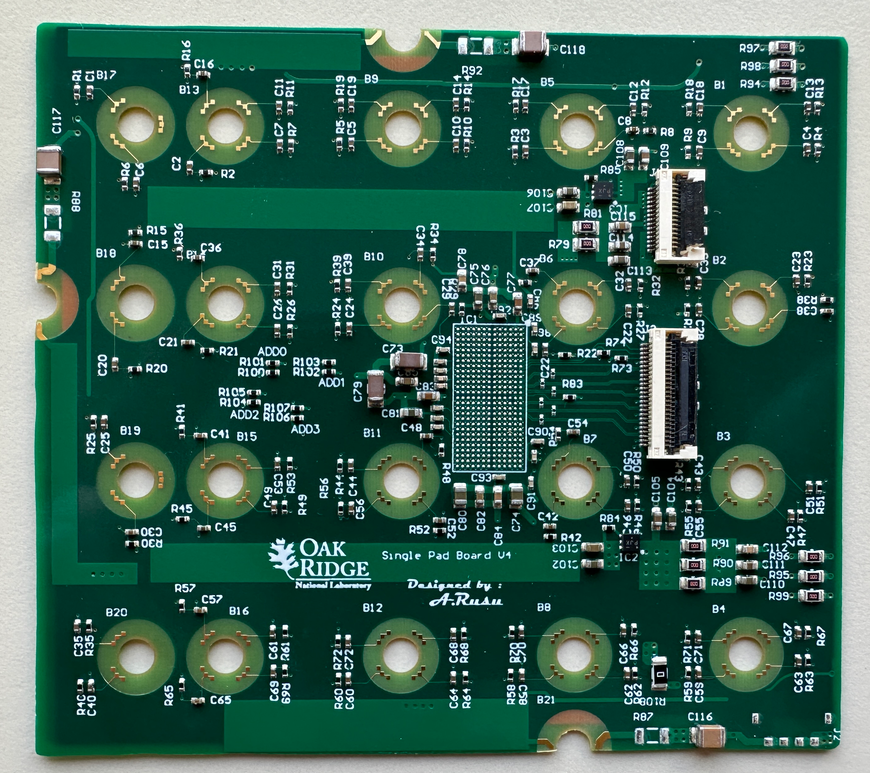
Pads Read-out / Data Concentrator Board (DCB) – Overview
5x
Pad-Board Con
ECON-D
lpGBT
Each Data Concentrator Board handles 4 layers of FEE (Pad Boards)
4 layers (pad rows) of FEE
5 HGCROC front-end ASICs /row, 20 in total
DCBs provide:
Trigger, Data, and Control communication between FEE and the ALICE system via lpGBT links
Power and high voltage distribution* to FEE
FEE hardware monitoring and control with the required granularity
Each Data Concentrator Board has 2 lpGBT links (1 bidirectional link per two layers)
Each link handles 2 pad layers (10 HGCROCs) (fast control, slow control, data taking)
Data of each layer is compressed with an ECON-D ASIC
Aggregated data transmitted to Common Read-out Units (CRUs)
* HV distribution is not implemented in the prototype version!
bPOL48
VTRX+
5x
Pad-Board Con
ECON-D
bPOL48
5x
Pad-Board Con
ECON-D
lpGBT
bPOL48
VTRX+
5x
Pad-Board Con
ECON-D
V_{IN}
bPOL48
not all details are shown

Slide 2
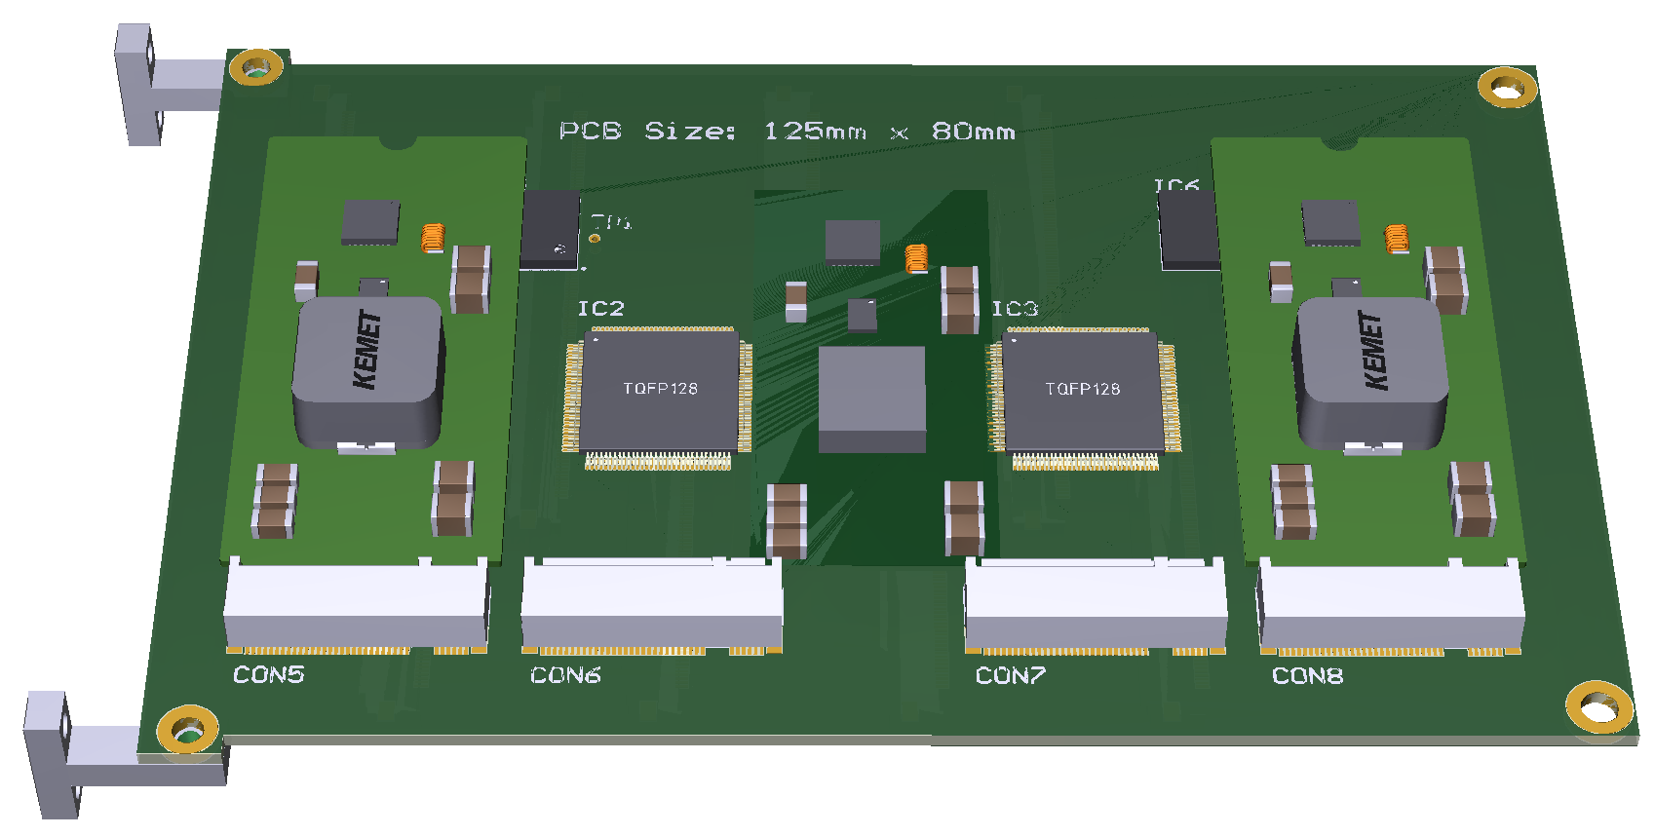
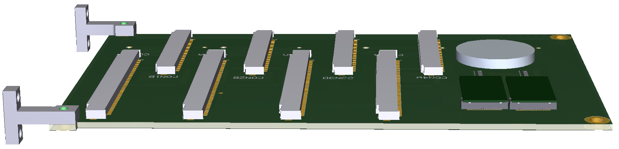
Pads Read-out / Data Concentrator Board (DCB) – Overview
Each Data Concentrator Board handles 4 layers of FEE (Pad Boards) (Power and HV distribution, hardware monitoring and slow control)
Data and control: the Data Concentrator Cards are connected to the Pad Boards by flex printed circuit cables (FPC)
LV distribution
Each DCB has a single input voltage from the PSU farm
Each Pad Board layer shall be supplied with 2x 1.5V (V_{A} and V_{D}) from the DCB by dedicated rad hard bPOL DC/DC mezzanine modules
Power dissipation
The power dissipation of the DCBs is close to 20 W /each
110 DCBs dissiapte ~2 kW in total → proper cooling is needed without the heating of the environment
Challanging PCB design: very dense physical environment and complex requirements
First prototypes to be produced by Q3 2025

Slide 3
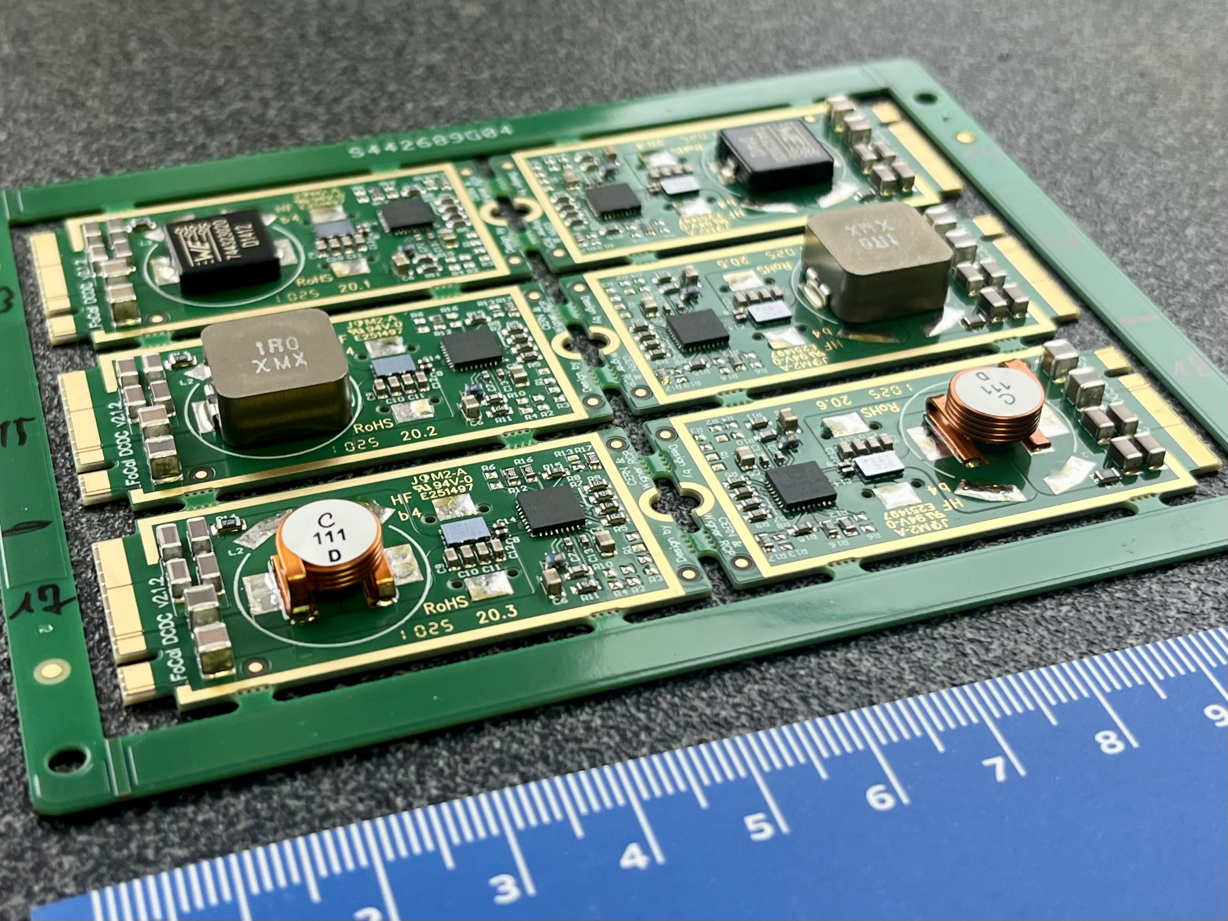
FoCAL DCDC Converter Prototypes - Production Status
24 pcs of the FoCalDCDC v2.1 have been produced
Test Platform at CERN built and tested
2 minor issues on the test platform have been fixed (See Nicola’s presentation)
All kinds of the modules have already been tried
Issues fixed:
Slightly different internal refernce voltage: → output voltage settings had to be adjusted – done.
The commercial air-core inductor is not OK in our case (L is too low) → they had to be replaced with a new CERN-developed one.
Detailed characterization to be done in the summer
→ Inductors and cooling have to be decided!
Documentation updated
https://cernbox.cern.ch/s/mRk0oYRDKzGnfDW

Slide 4
FoCAL DCDC Converter Prototypes - Production Status
Several inductor options – ferrite core and air core ones

Slide 5
FoCAL Data Concentrator Board - Design Status
Board design is close to the completion
All signal and control nets are routed - done
some differential signals are inverted to ease the routing (supported by both ECON-D and lpGBT)
this has to be followed up in the configuration settings of these ASICs!
Most signal trace length equalizations (e.g. fast control and command lines) - done
Trigger Data Output signals have been routed to edge connector - done
The ‚big inductor’ has to be choosen for the 5th (on-board integrated) DC/DC converter
Exact placement of power input connector and VTRX+ optical modules has to be decided
When every open question is closed,
then some final steps has to be done, and production file set can be generated.
After that:
Negotiation with possible manufacturers can be started (needs the production file sets)
In the meantime:
The design review process can be started (to be defined...)

Slide 6
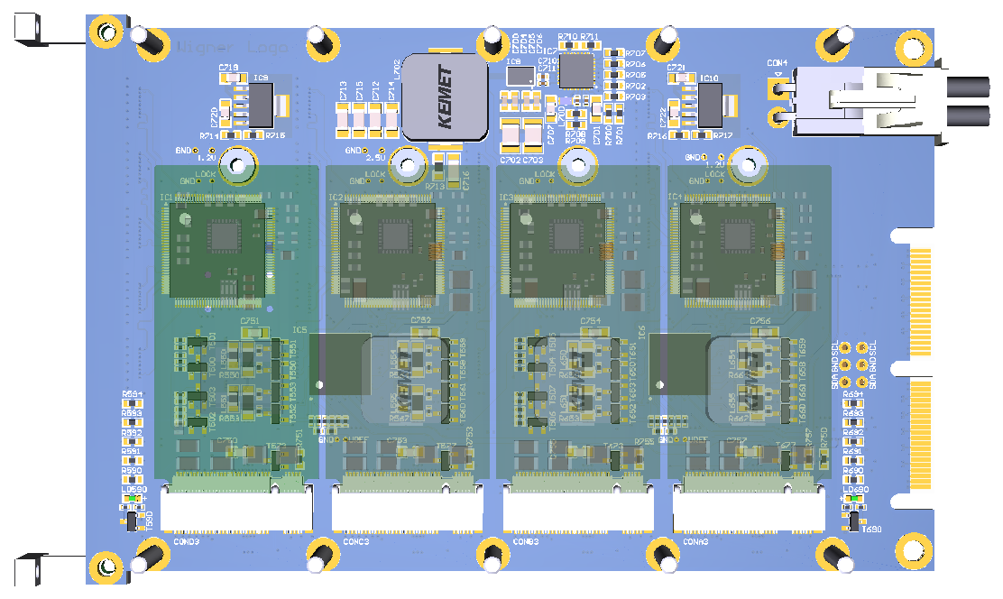
Data Concentrator Board (DCB) – Top View

Slide 7
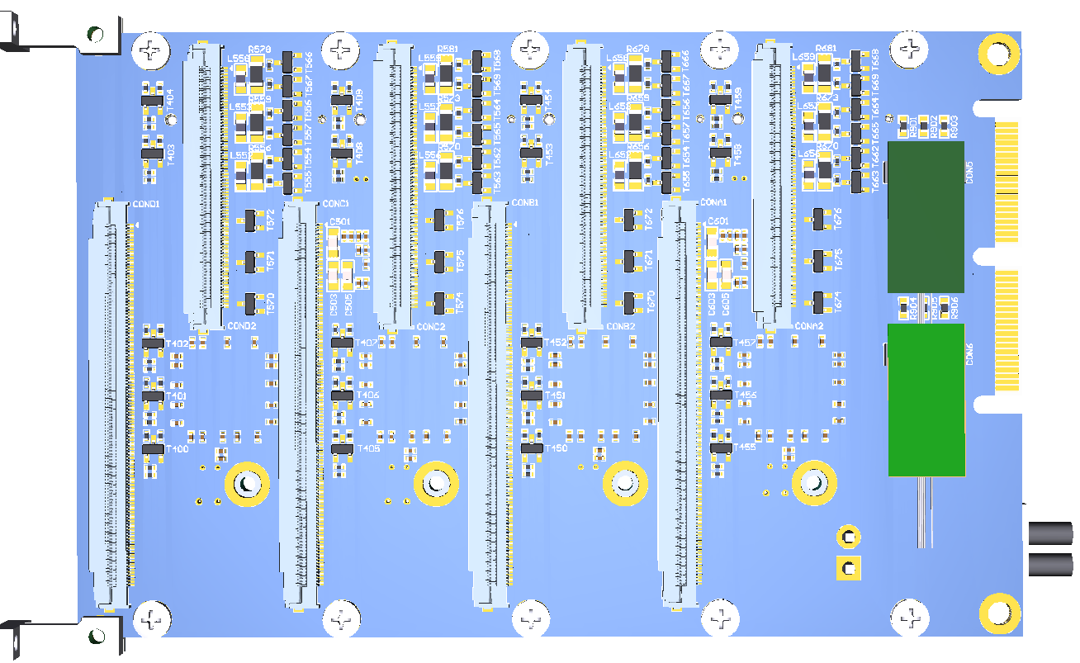
Data Concentrator Board (DCB) – Bottom View

Slide 8

Data Concentrator Board (DCB) – Open Questions

Slide 9
Data Concentrator Board (DCB) – Open Questions

Slide 10
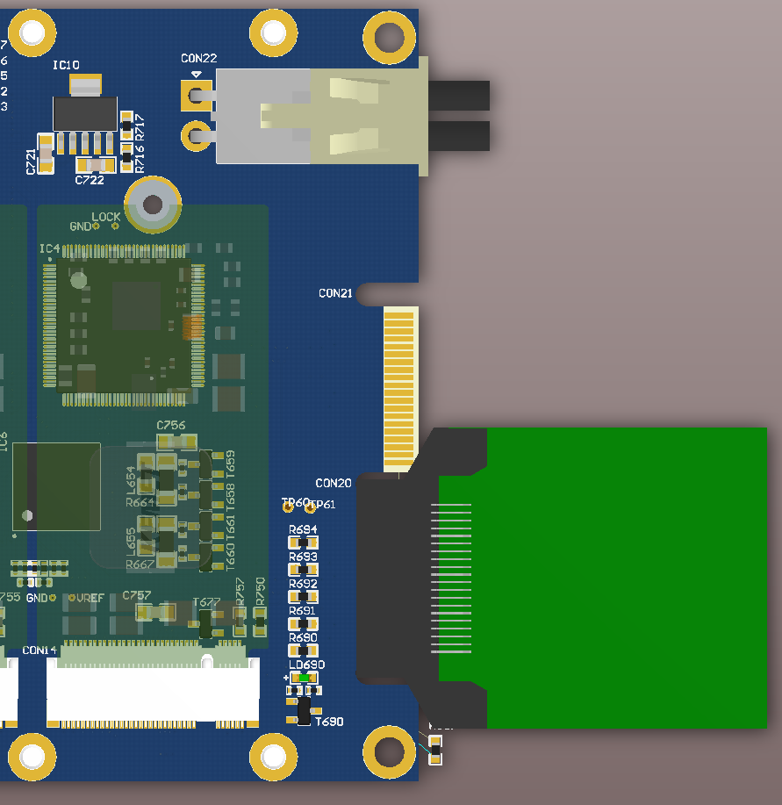
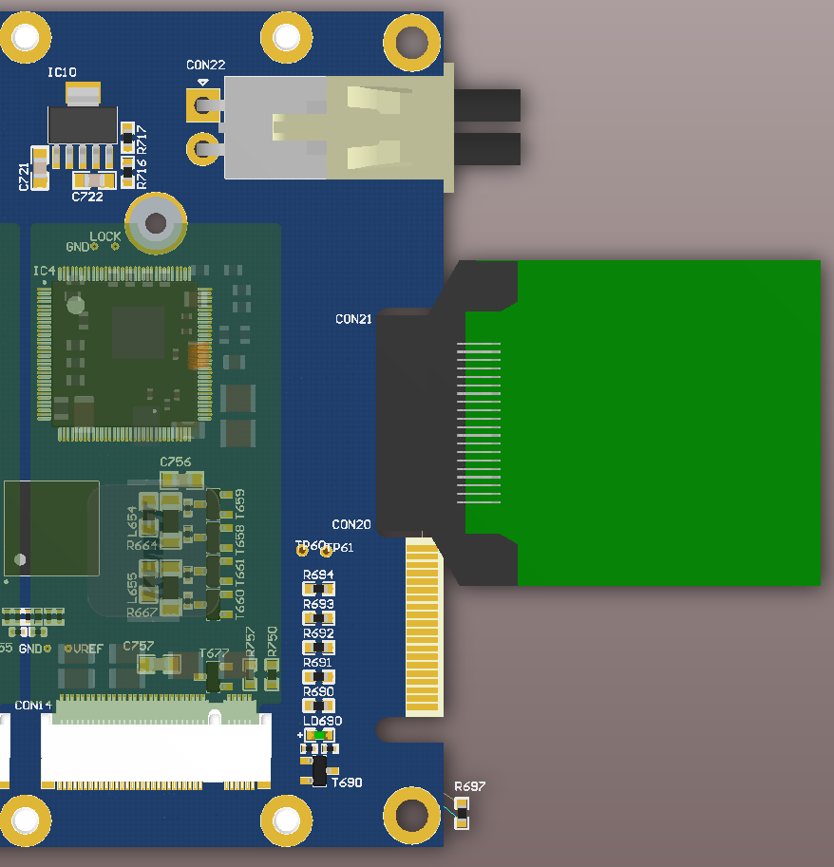
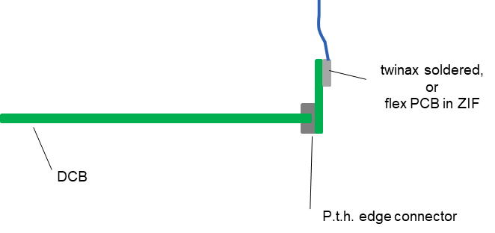
FoCAL Data Concentrator Board – Trigger Data Outputs
Possible (?) solution:
(side view)
Only one of the two is used at a time
There is only an additional 13 mm available after the board!

Slide 11
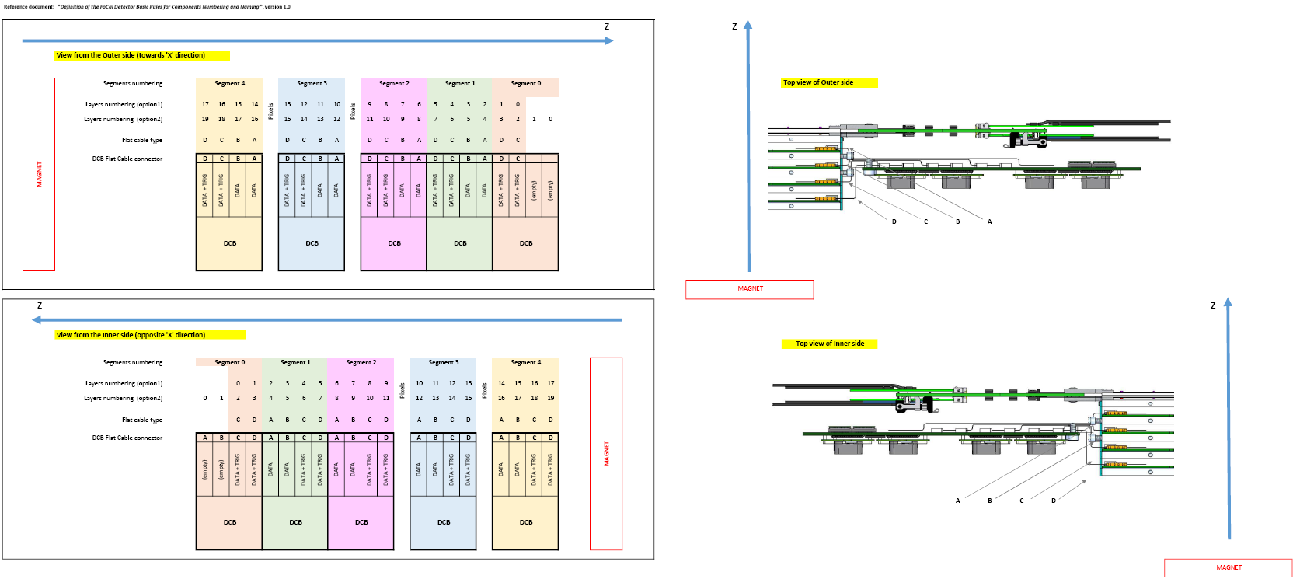
Data Concentrator Board (DCB) – Open Questions

Slide 13
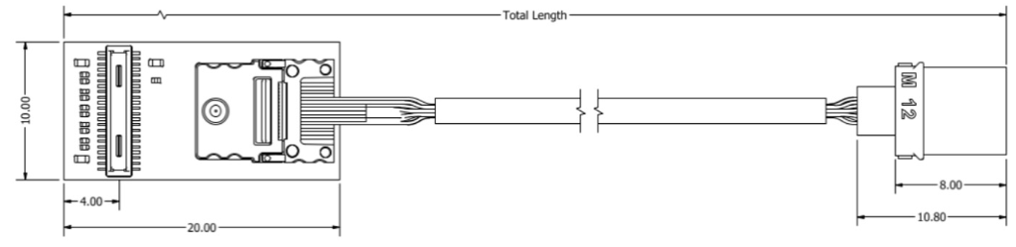
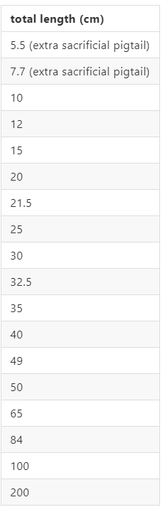
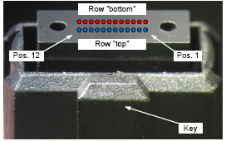
FoCAL Data Concentrator Board – VTRX+ Optical Connection
MT: the ferrule only!
VTRX+
Pigtail fibers are very fragile, esp. at the VTRX+ end, no mechanical starin allowed, no pull is possible
5 fibers (1 RX and 4 TX) but we use only 1 RX and 1 TX
Length choices are restricted (See possible lengthes on the right...)
ALICE - centralized production is starting soon
We have to define the lengthes in a few weeks (July the max.)
Better to keep short and (on-board) and have an adapter as soon as possible

Slide 14
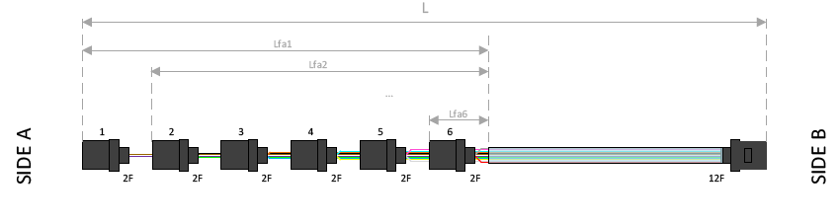
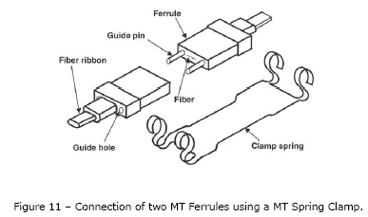
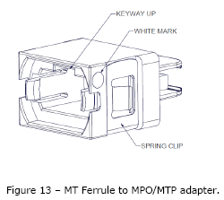
VTRX+ pigtails with MT ferrule only
We can fan-in the optical links of a multiple VTRX+ modules (MT ferrules) into a common cable
Only a single 24-lane optical cable (or 2x 12-lane ones) could go out from each ECAL module through an MT to MPO adapter
However, we have to fit somehow these bulky optical assmeblies in between the Data Concentrator Boards!
- min. bending radiues: 15 mm (!)
- length tolerance: -0 / +2cm (!)
1

Slide 15
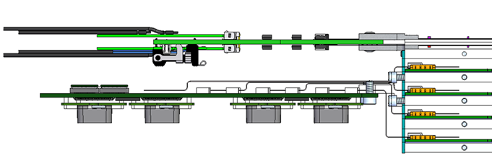
VTRX+ pigtails with MT ferrule only
Bulky and fragile passive optical assemblies somewhere here...

Slide 16
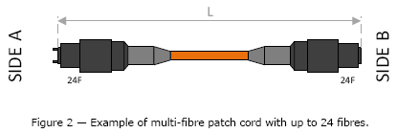
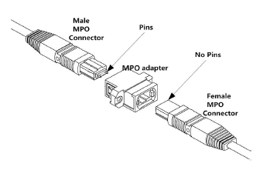
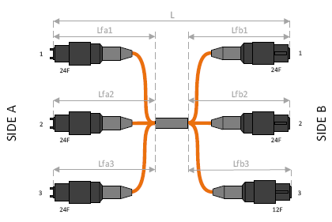
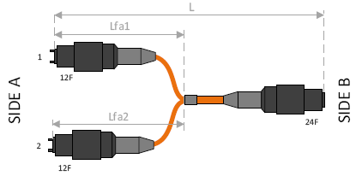
And, if we are out, there comes the MPO (MTP) World...
Patch cables
MPO adapters
Fan-in, fan-out
TX/RX Shuffling...

