Slide 1





Key Steps for IMCC
D. Schulte
On behalf of the International Muon Collider Collaboration
ICB, IMCC Annual Meeting, May, 2025
Funded by the European Union (EU). Views and opinions expressed are however those of the author(s) only and do not necessarily reflect those of the EU or European Research Executive Agency (REA). Neither the EU nor the REA can be held responsible for them.

Slide 2
ESPPU
Collaboration produced ESPPU input
Ten-page report
Answers to specific questions
Back-up document
  Assessment of collider status
  R&D Plan
  Important US contributions
  Final polishing is ongoing, you Urgently sign up to support
Many thanks to all
Who did the work
Who wrote the text
Who edited the text
Core editors Federico, Chris, Taylor
Need to continue the work

Slide 3
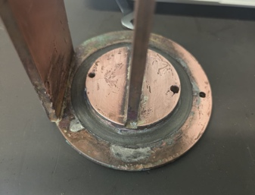
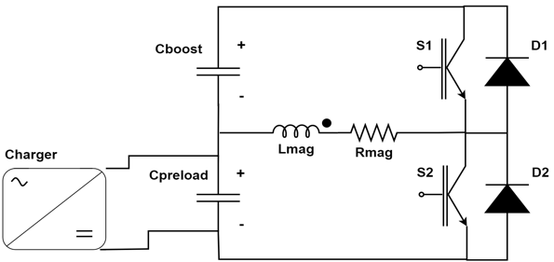
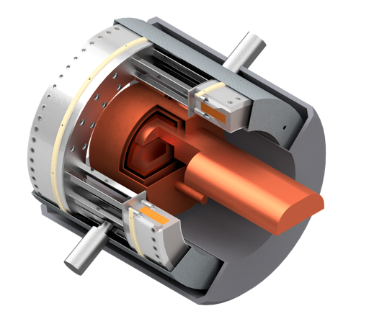
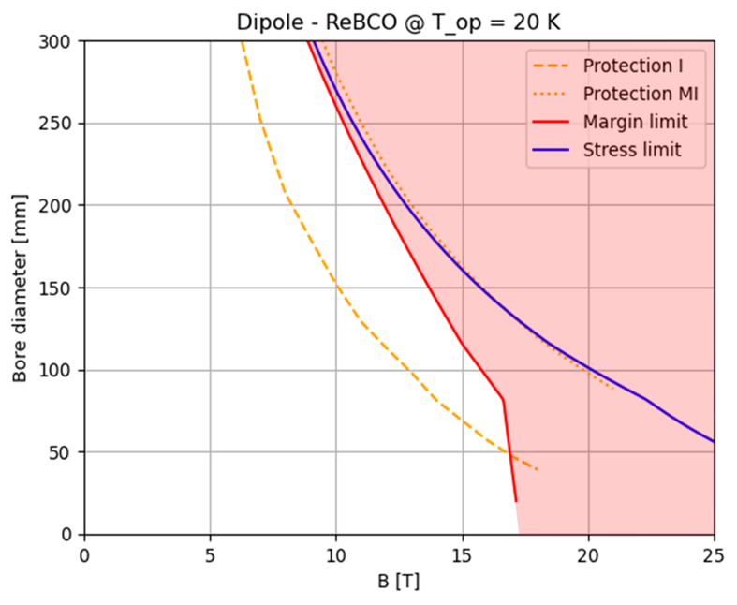
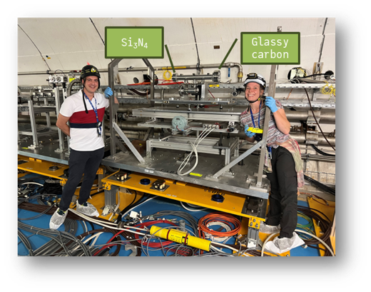
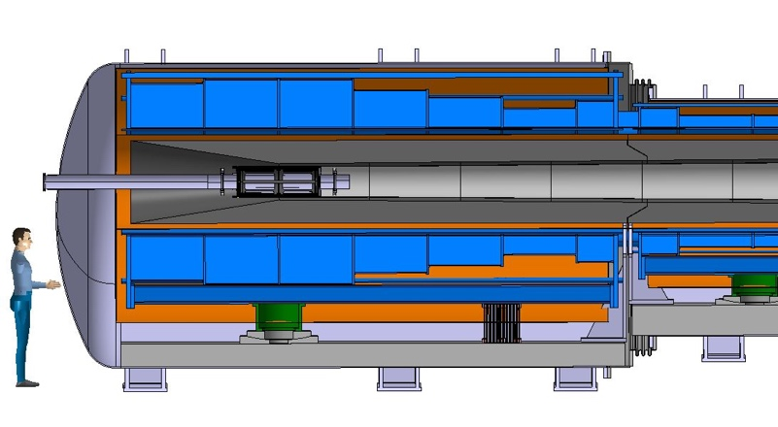
R&D Progress
Design of many collider areas has progressed
Lattice design
  Proton accumulator and compressor ring
  Much better muon cooling performance
  RCS lattice designs
  Collective effects
  …
Technologies
  Realistic magnet performance targets, conceptual designs
  High-efficiency power converter design
  RF cavities for muon cooling
  Muon cooling module conceptual design
  Cooling absorbers
  Target design
  ….
Detectors and MDI
Demonstrator scope and design
Will be covered later today and during the week
REBCO, 20 K
See Tao, Chris, and Massimo

Slide 4
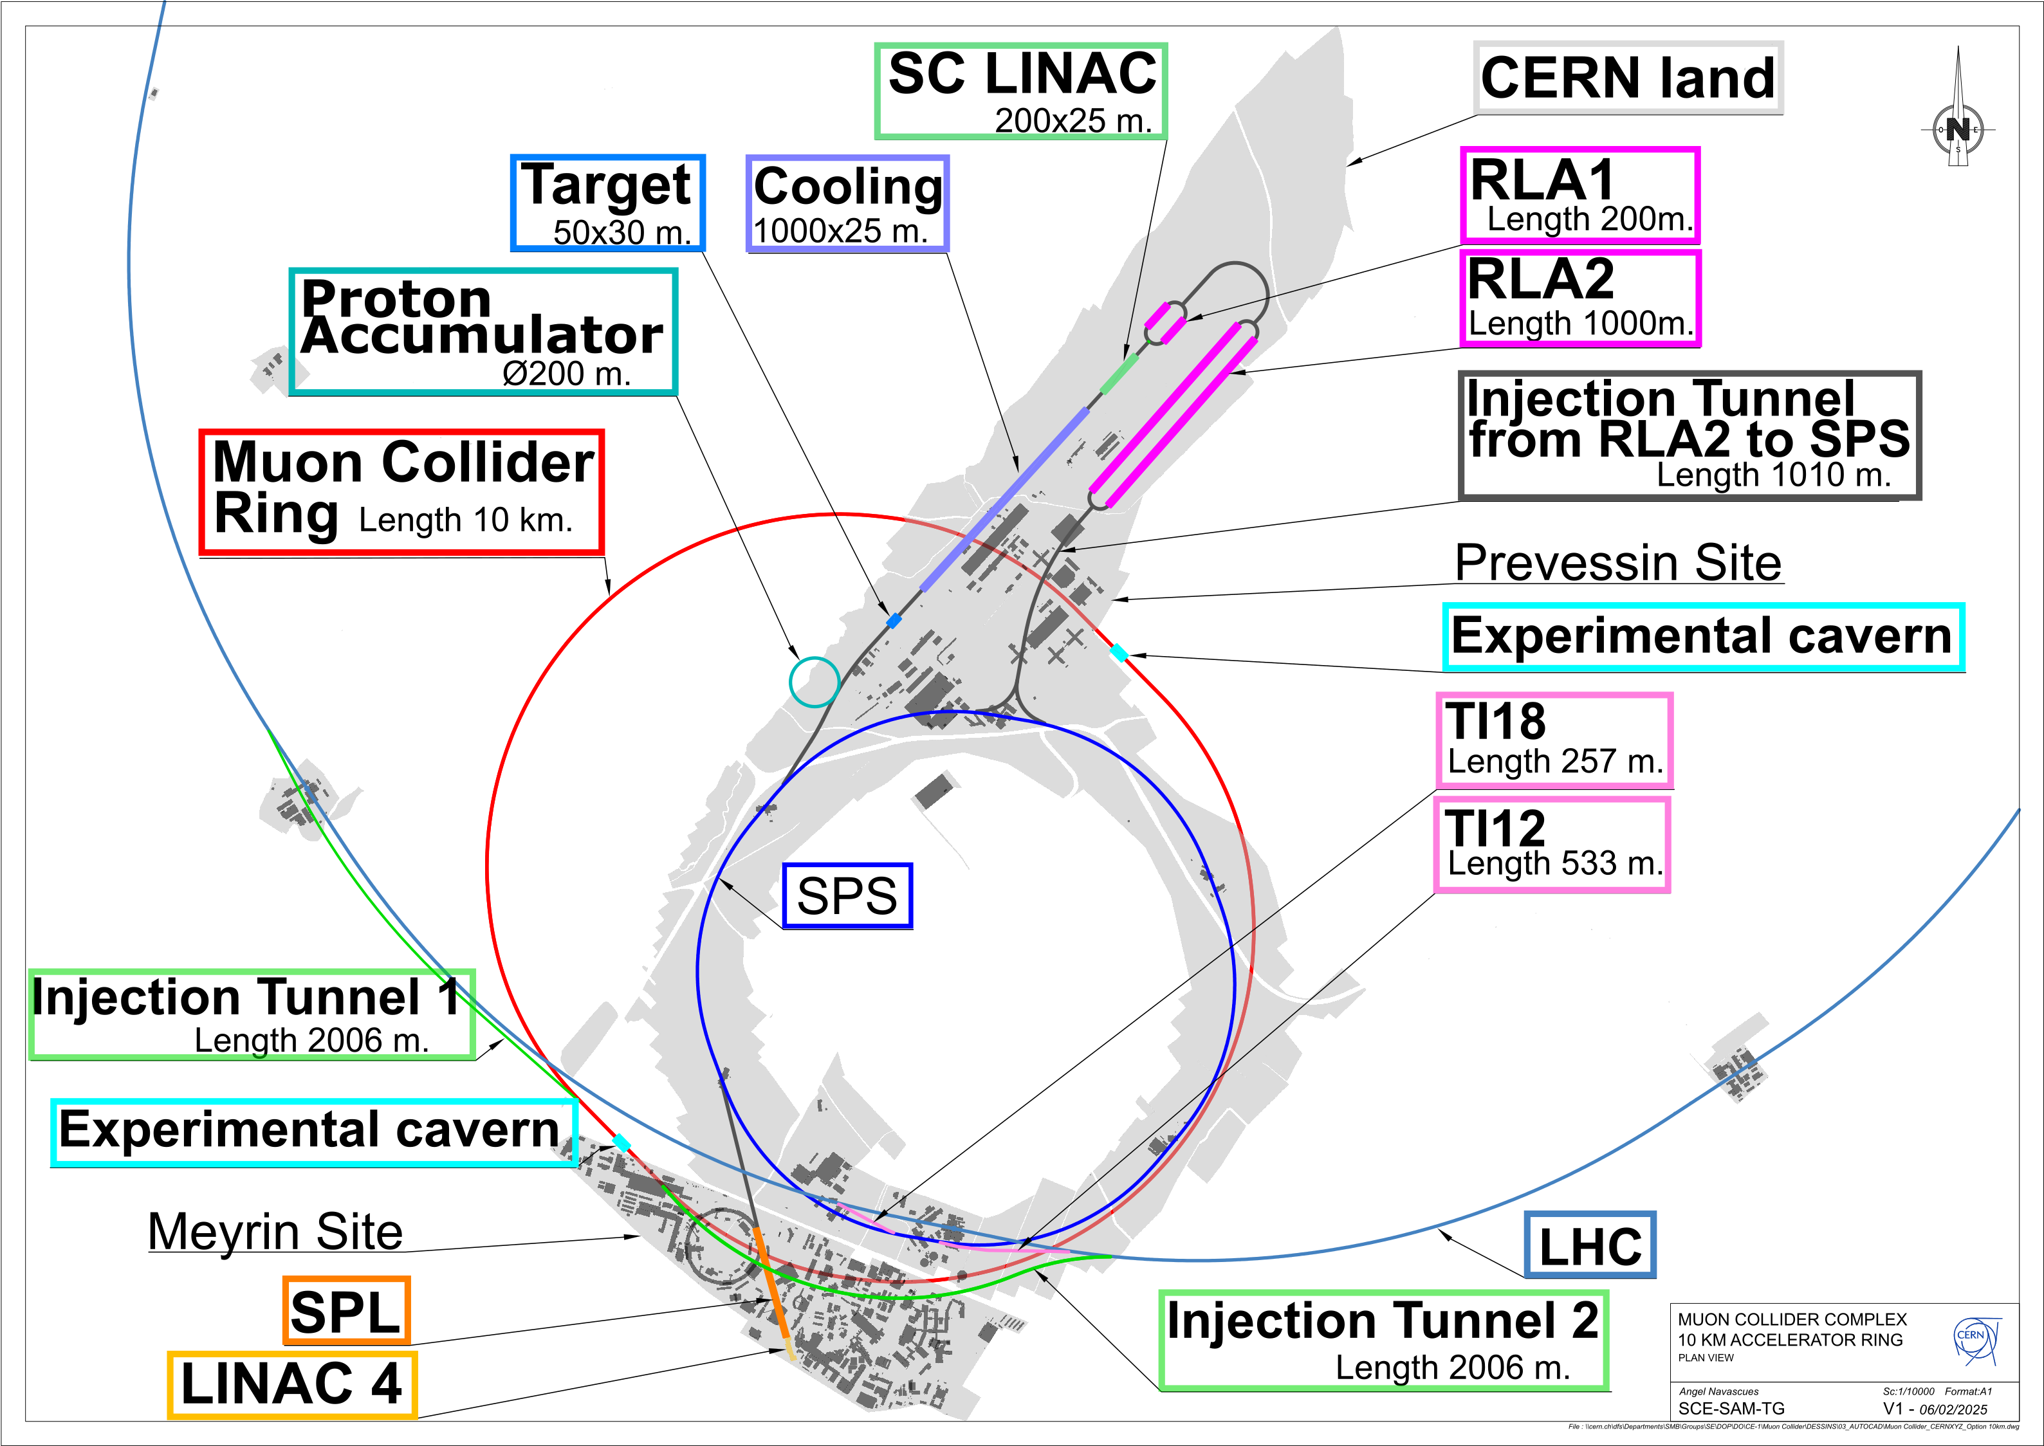
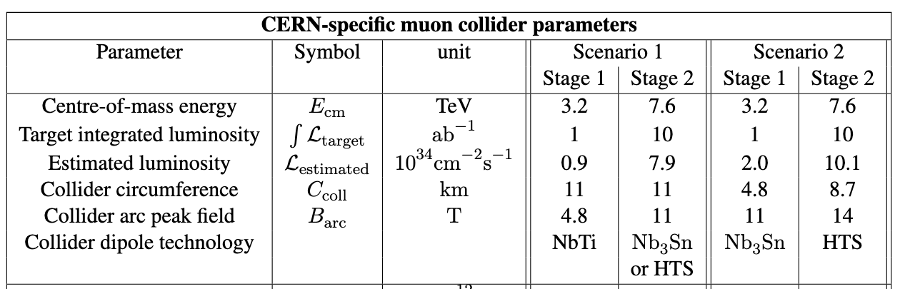
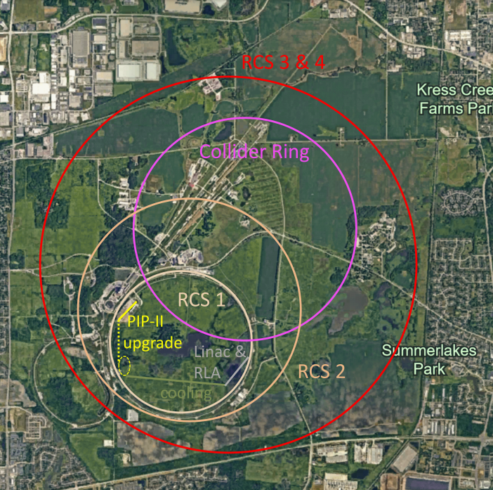
Site Specific Designs
Started studies for concrete site at CERN and Fermilab
At CERN re-use SPS and LHC and construct facility on CERN land
Neutrino flux appears solvable
Adjusted parameters (3.2 and 7.6 TeV)
Stage with one tunnel or two different tunnels
  Use of different technologies

Slide 5
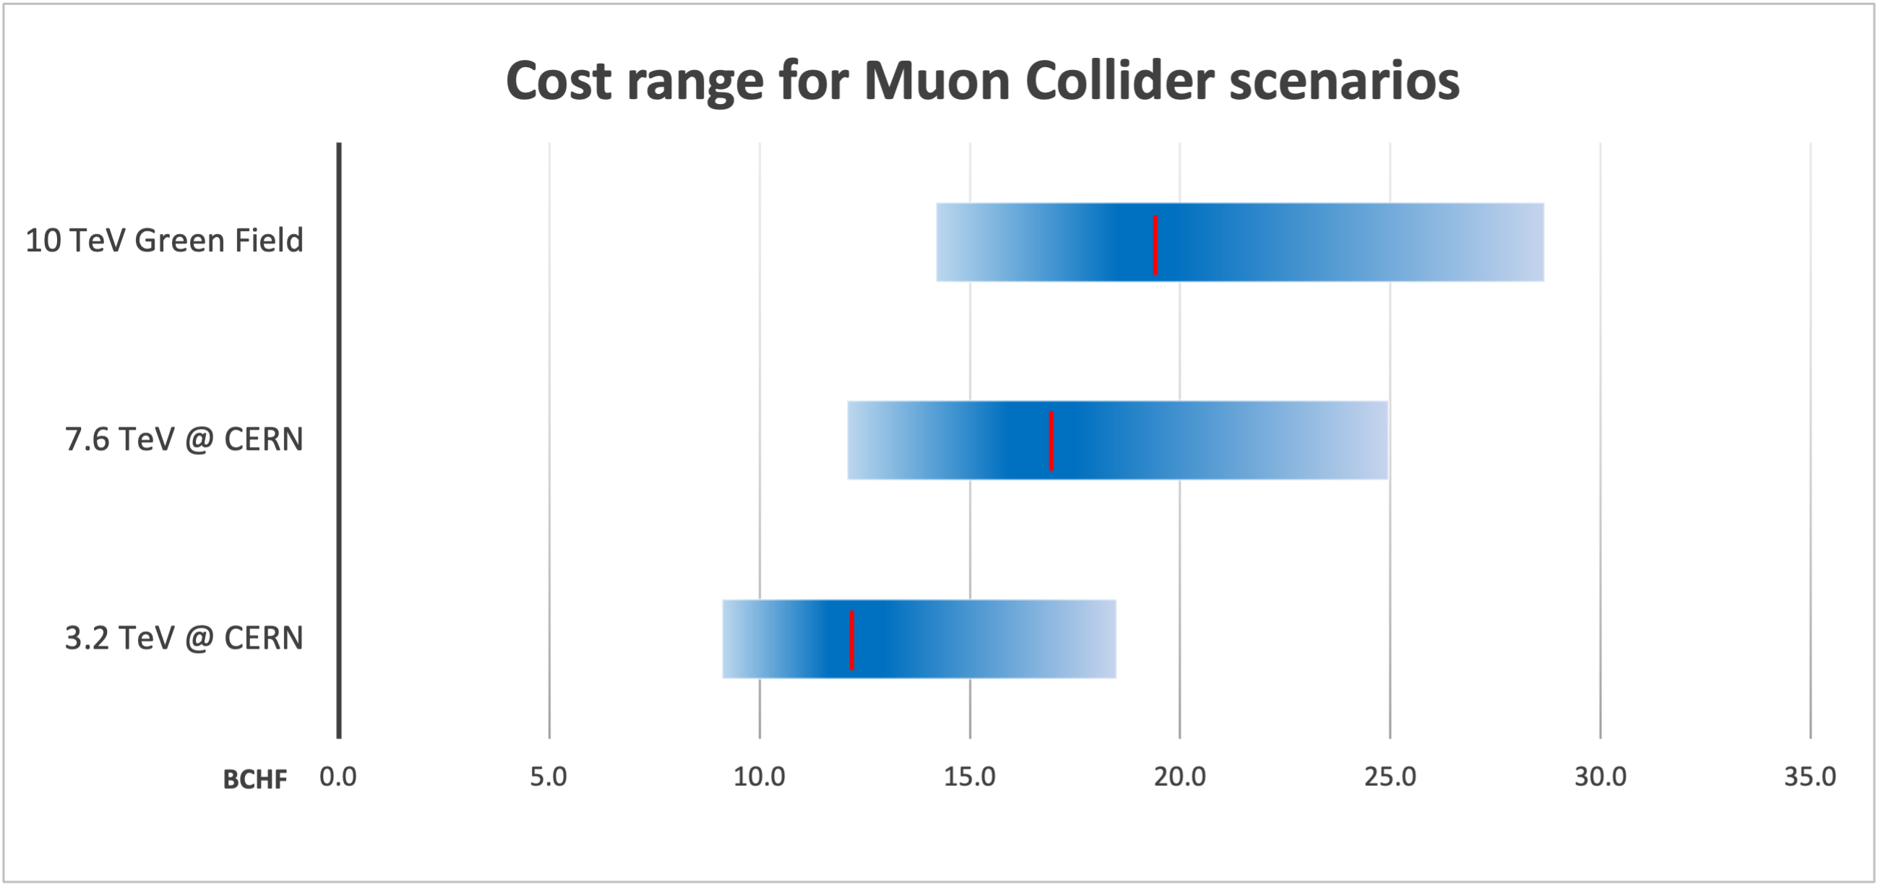
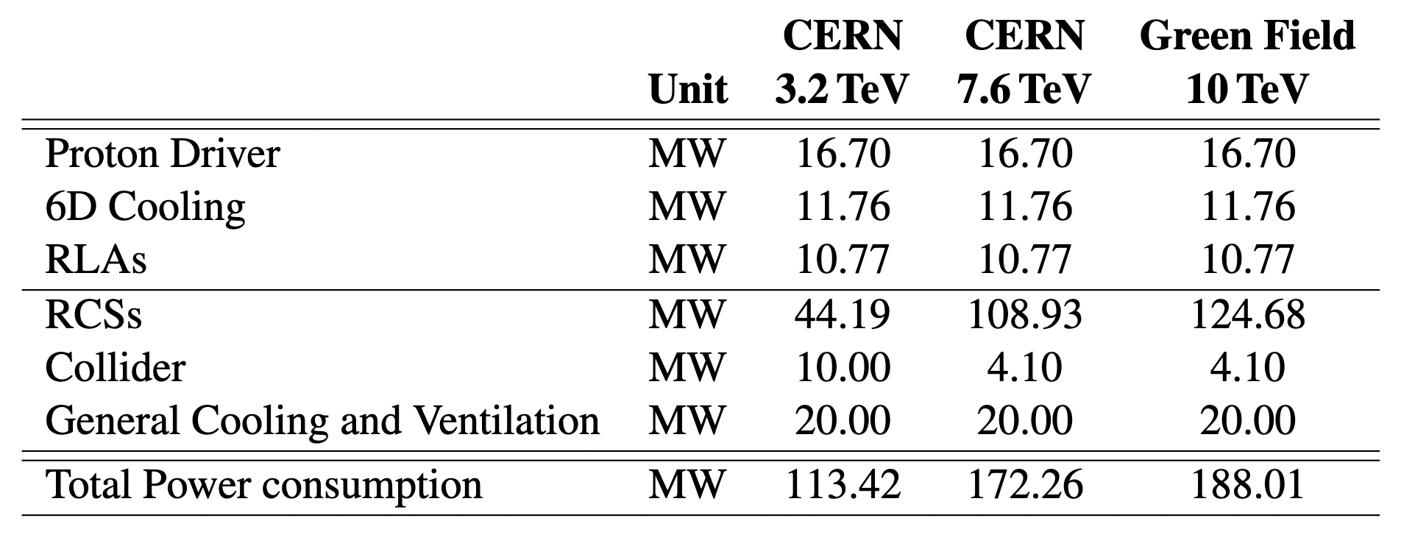
Cost and Power Consumption
Determined the cost scale for the collider
Different sources of uncertainty
No design for all systems
  Error bar in both directions
Technologies (e.g. HTS cost development)
  Error bar in both directions
Design has not been optimised for cost
  Error bar only to lower cost
Estimated power consumption of the collider
Some sources of uncertainty exist
Several MW for cooling of losses in RCS cavities required
This is a great basis for future developments and optimisation

Slide 6
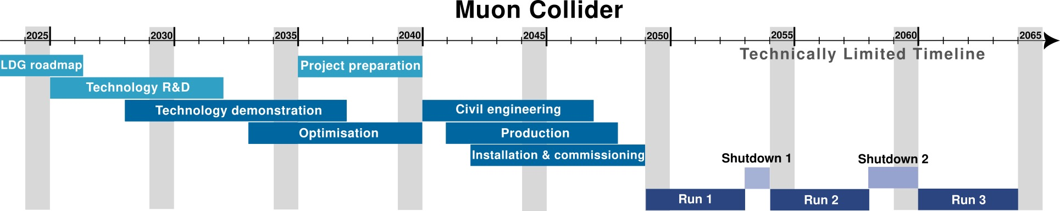
Timeline and R&D Programme
Goal is to be able to commit to a muon collider in 2036 to enable collider by 2050
Considering the timeline drivers:
  Magnet technologies: this excludes high-field HTS dipoles
  Muon cooling technologies
  Start-to-end design
  Detector optimization
Ramping up of programme to rapidly gain confidence and balance risk vs R&D cost

Slide 7
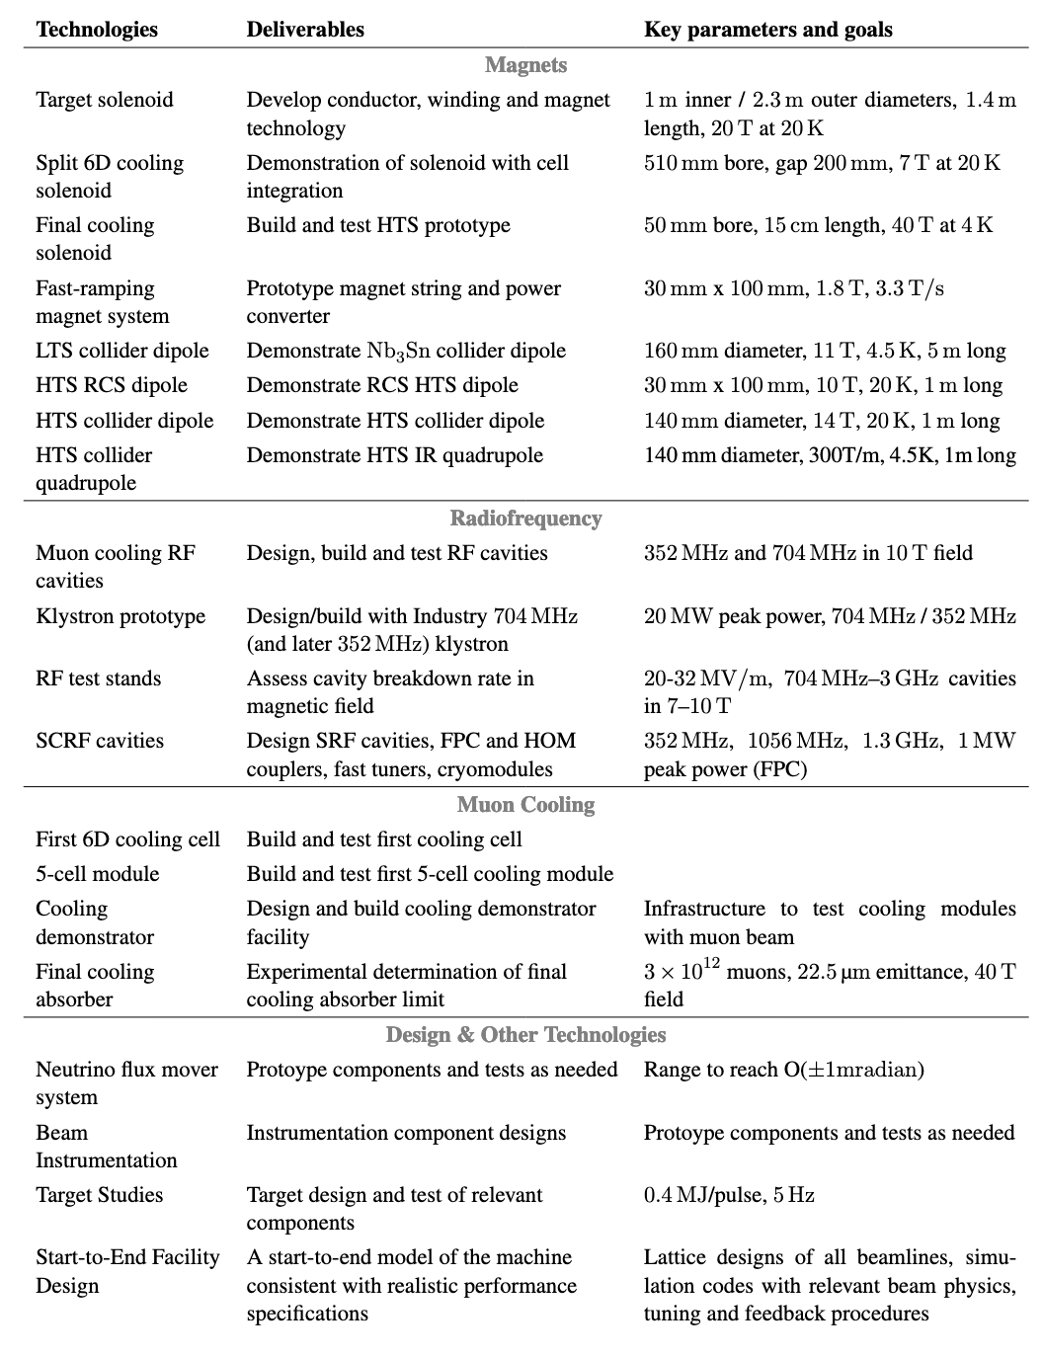
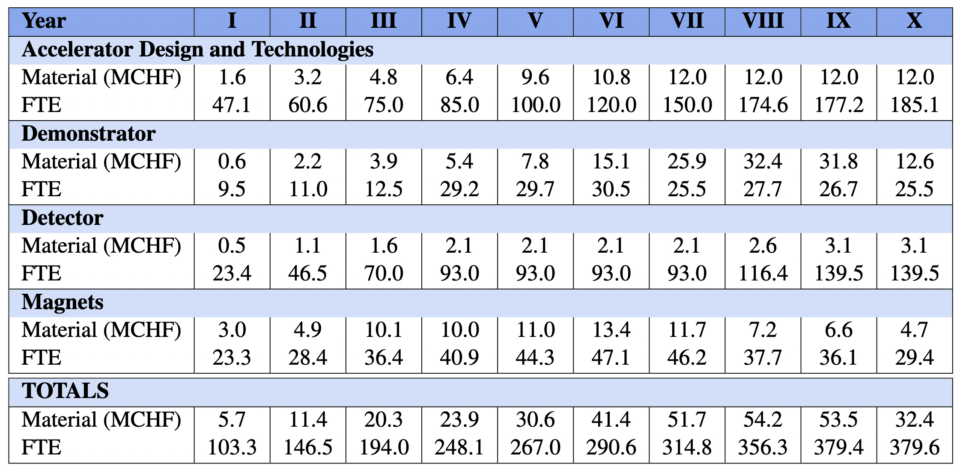
R&D Deliverables and Resources

Slide 8
Note: LDG
Reviewed the progress and the proposed R&D plan
Good progress noted, estimated that 75% of Roadmap goals have been achieved
Reviewers: Norbert Holtkamp (chair), Mei Bai, Frederick Bordry, Nuria Catalan-Lasheras, Barbara Dalena, Massimo Ferrario, Andreas Jankowiak,
Robert Rimmer, Herman ten Kate, Peter Williams
Recommendations:
Develop a Start-to-End Performance Simulator: Create a comprehensive simulation framework to assess the robustness of key parameters, including luminosity, cost, and energy consumption. This tool should enable performance optimization, sensitivity analysis, and risk mitigation across the entire collider complex.
Define and fund a High-Field HTS and RF Development Strategy: Establish a clear roadmap for the development of the high-field HTS magnet and the RF systems, including well-defined specifications and performance targets. Securing dedicated funding is essential to advance these critical technologies.
Conduct an Independent Review of Scope, Schedule, and Costs: An urgent, independent evaluation is needed to assess the overall scope, timeline, and budget of the Muon Collider R&D program for the period 2026-2036. This review will be crucial to ensure that funding requests for this R&D phase are well-justified and aligned with project objectives.
Mike Seidel (LDG chair) wants to improve the effectiveness of LDG
Plans to prepare an updated LDG Roadmap during the ESPPU process (early 2026)

Slide 9
R&D Plan Implementation
The IAC will review the R&D plan
Started today Wednesday
We need to refine the plan
Scope
Define intermediate deliverables and clarify staging
Estimates and plans exist for the key cost driver
  Magnets
  Muon cooling technology
  Detector
Some parts need improvements to be fully defined
Arbitration of resource estimates required in some places
IAC regular members:
Ursula Bassler (IN2P3, interim Chair)
Mauro Mezzetto (INFN)
Hongwei Zhao (Inst. of Modern Physics, IMP)
Akira Yamamoto (KEK)
Maurizio Vretenar (CERN)
Stewart Boogert (Cockcroft)
Sarah Demers (Yale)
Giorgio Apollinari (FNAL)
Experts for this review
Waiting for all confirmations
Need to secure resources
Promising developments
See R&D session this morning
Future sessions mid-June, exact date being defined

Slide 10
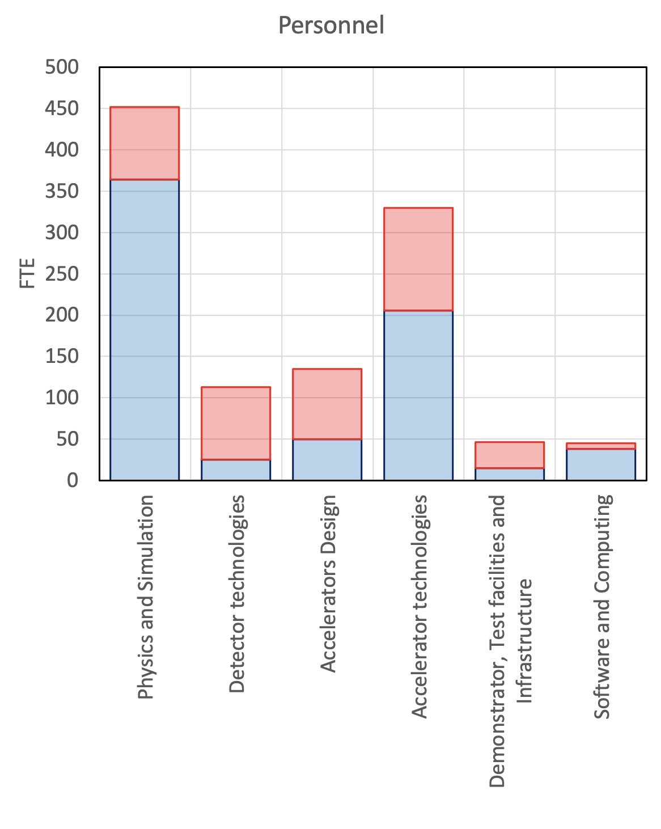
IMCC Resources
Total accelerator resources:
Used until end 2024: 169 FTEy
Available 2025+26: 90 – 130 FTEy (secured - prospect)
Corresponds to minimal programme
Need to secure the resources to continue and increase activity
Prepare Global Muon Collider R&D Roadmap before ESPPU concludes
  Then feed into Updated LDG R&D Roadmap and other funding options
Will initiate Working group with technical representation from partners to prepare (as for MuCol)
Detector resources less clear
Will need to iterate on data quality
Be careful not to overstate

Slide 11




Example Prospective Resources
Already successful
MuCol, IFAST, MUSIC, …
Fermilab site study
Grants for US detector work
DoE grant for RF test stand at SLAC
…
EU co-funding request via IFAST2
Power converter (PSI, CERN and Infineon)
FFAG (UKRI and ESS)
Modulator for klystron (INFN and Scandinova)
Mover system (CERN and ?)
LDG might
Integrate final cooling solenoid in the HFM programme
Strengthen the HFM programme contribution to magnet protection studies
Explore RF panel contributions
Collaboration on target solenoid
with fusion magnet technology
F4P
EUROFusion
ENI
Gauss Fusion
Other grant requests
E.g. one for MUSIC calorimetry
Physics case for intermediate facilities
Could leverage extra funding
Other sources to try
Increased contributions from partners
More grants
…
Will try to collect this centrally

Slide 12
Conclusion
Making great progress
  Thanks to all the hard and dedicated work
Need to push on
  Performing R&D
  Securing resources, with support from strategy processes
    Prepare new global R&D Roadmap
    Technical preparation by experts then resources from the partners, similar to MuCol preparation
  Engaging early career experts
  Contributing to dealing with challenges that society is facing
I think all that contributed can be a little proud of what we achieved
Received many supportive mails and comments

Slide 13
Reserve

Slide 14
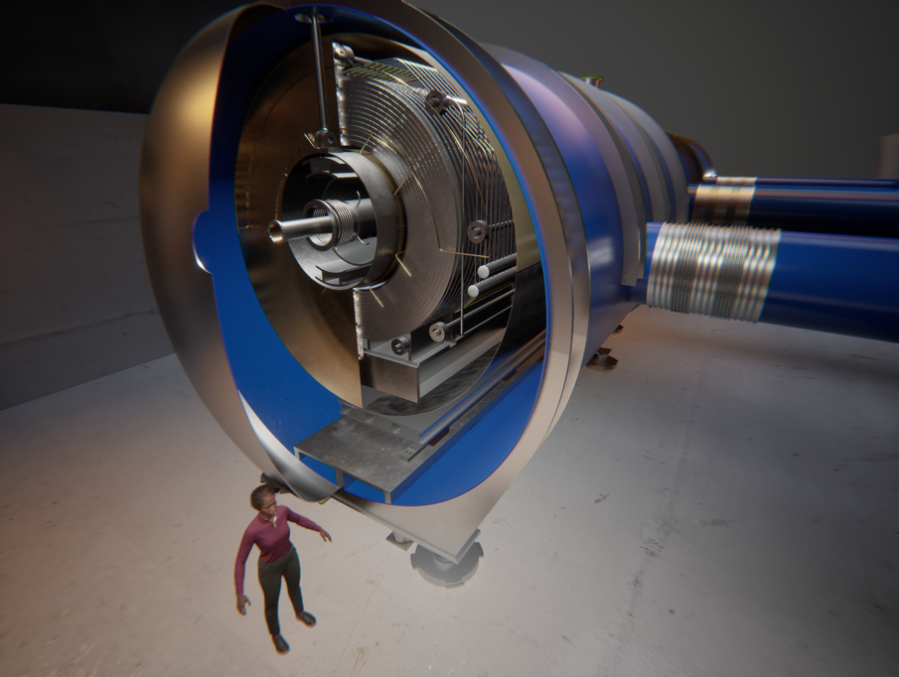
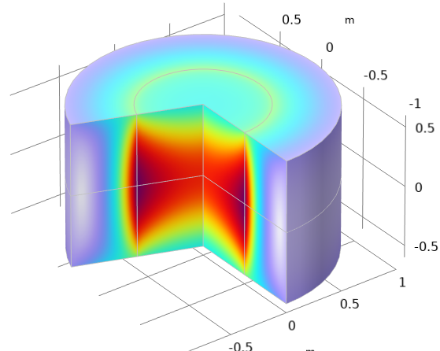
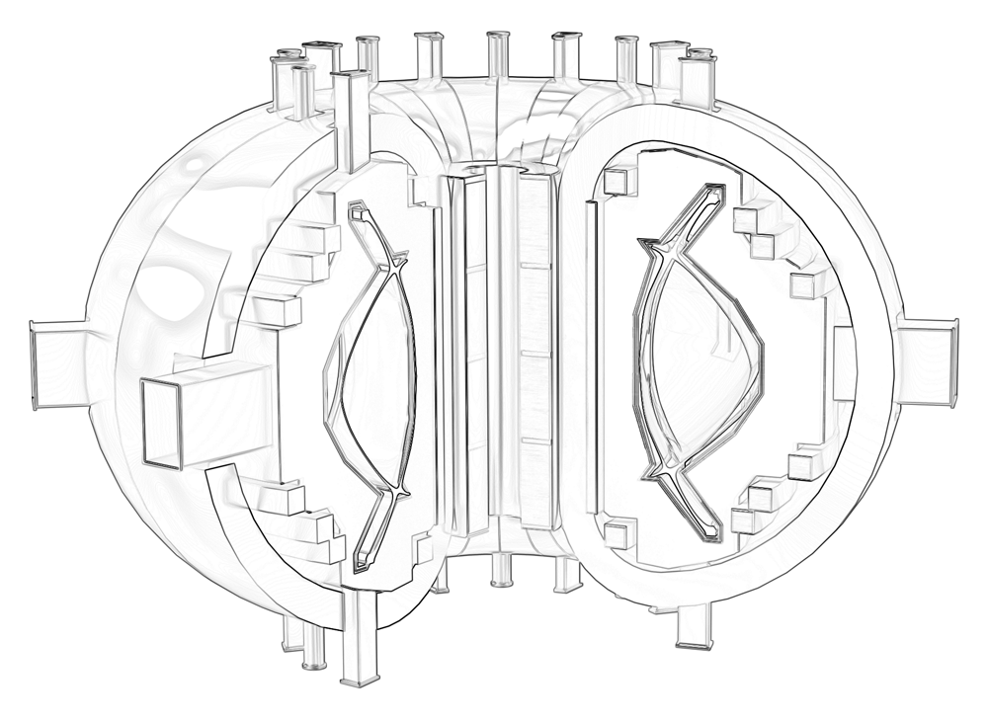
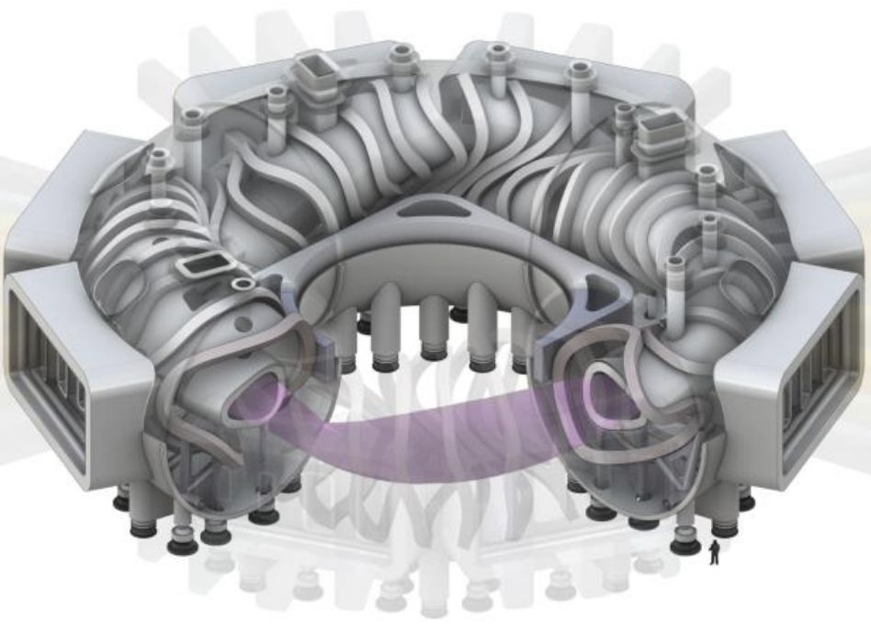
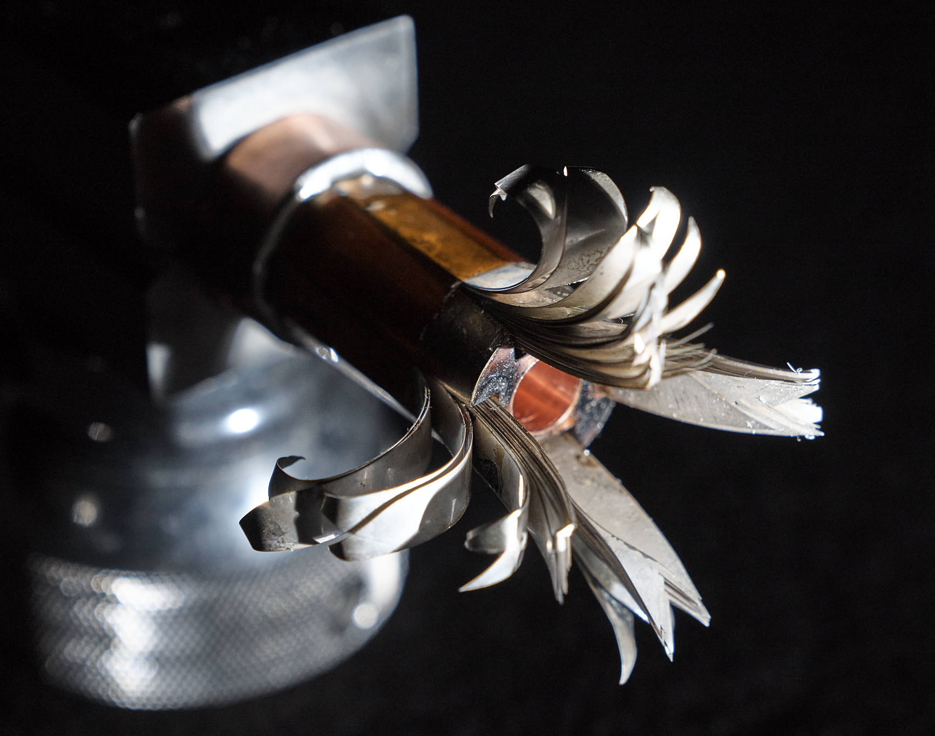
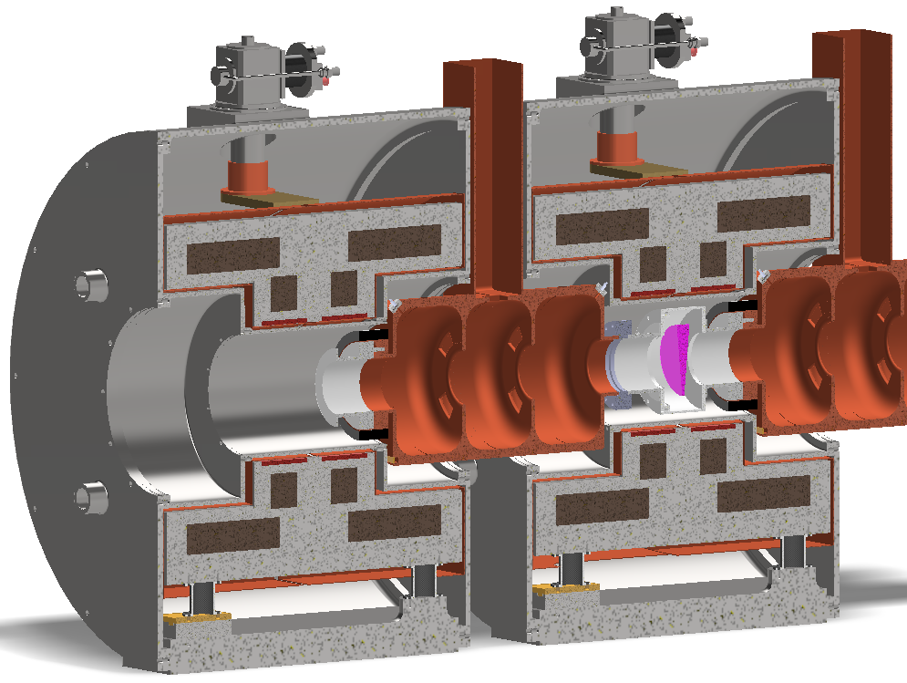
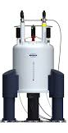
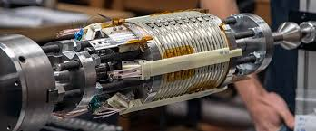
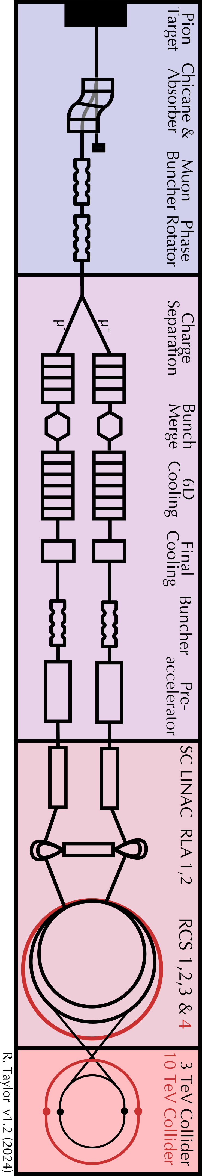


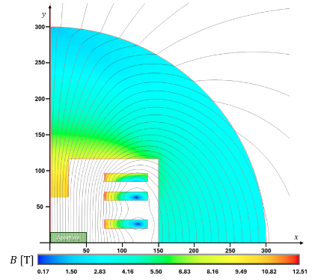
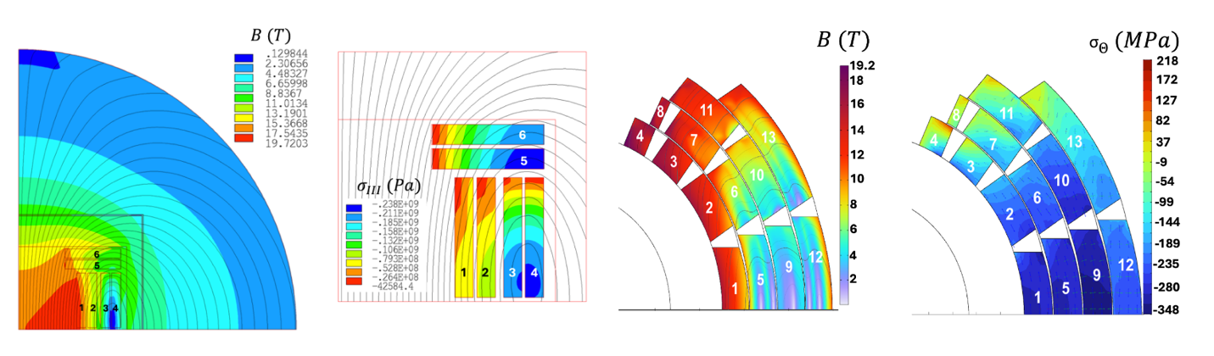
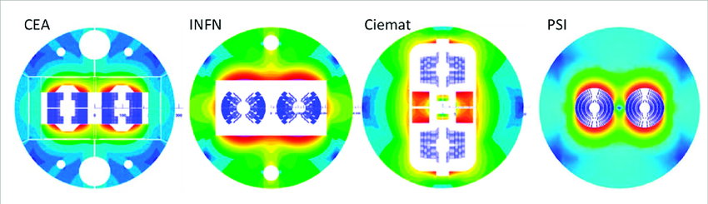

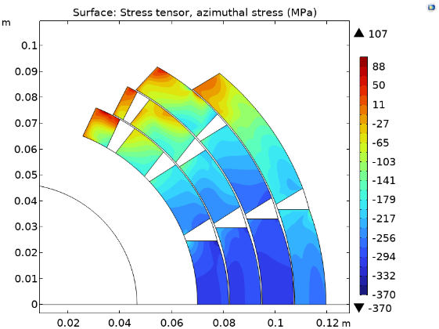
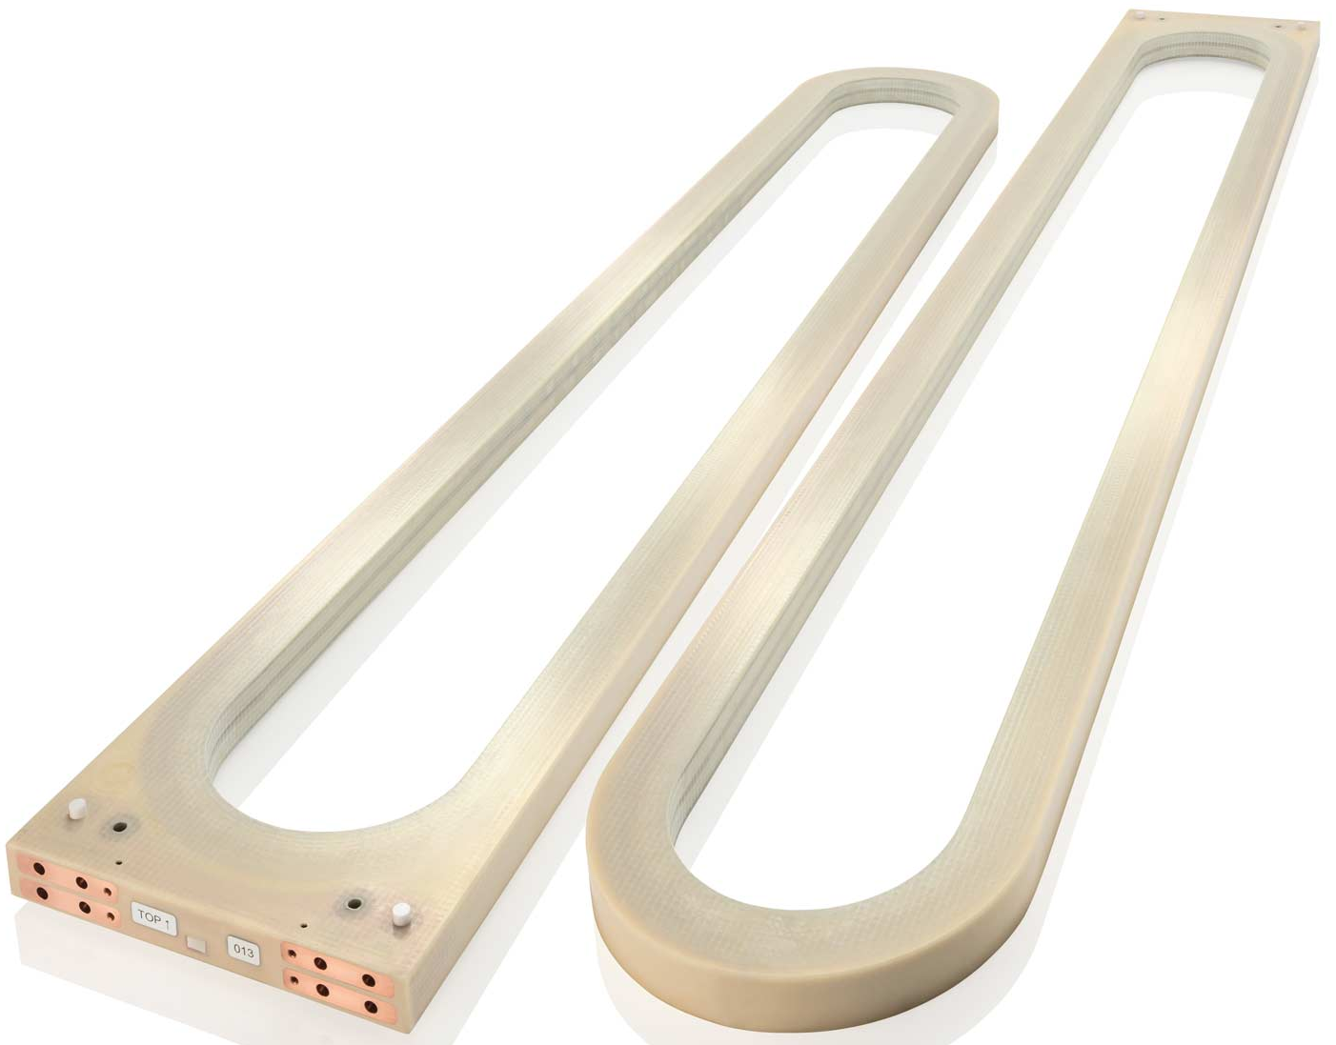

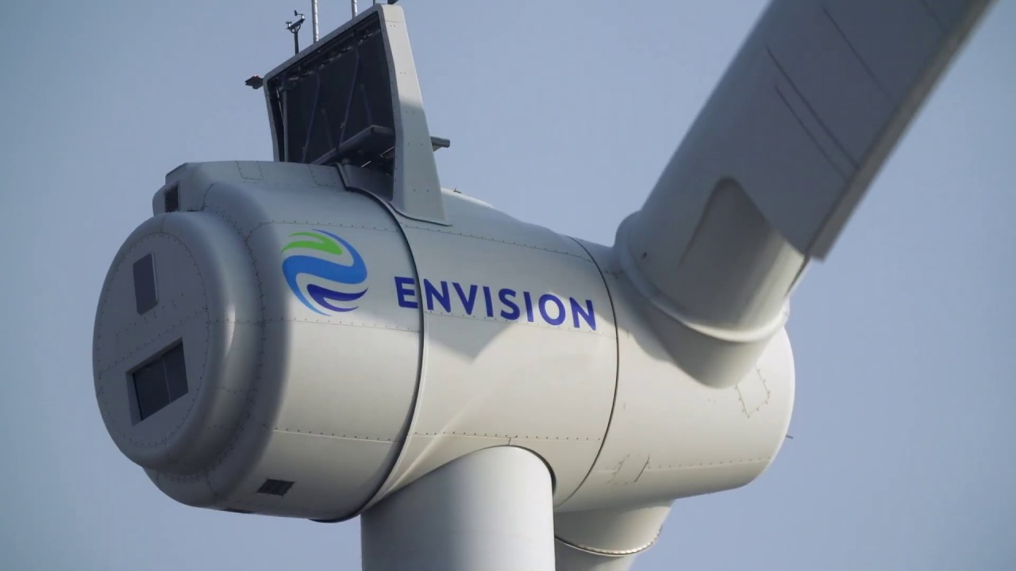
F4E
EUROFusion
Gauss Fusion
ENI
Target and capture solenoid
Magnetically confined fusion
Muon beam cooling solenoids
LNCMI
NHMFL
UHF science, NMR and MRI
Accelerator and collider magnets
HEP and power applications
HFM
FCC-hh

Slide 15

Muon Collider Roadmap CTEs
Protons produce pions which decay into muons which are captured
Short, intense proton bunch
Ionisation cooling of muon in matter
Acceleration to collision energy
Collision
- Proton driver
bunch compression
- Graphite target
- Target solenoid
- Muon cooling design
- 6D cooling solenoids
- 6D cooling RF cavities
- Final cooling solenoids
- Pulsed magnets and
power converters
- RCS RF system
Identified and prioritized with community
Other areas need now also to be addressed
(some work started)
- Collider ring dipoles
- Final focus quadrupoles
2
D. Schulte Muon Collider, LDG Review, February 2025
3

Slide 16
Tentative Accelerator Design Resources
Area | Tasks | FTE
Proton complex | Accumulator ring; combiner ring; target delivery system | 2.6
Target | Spent beam and losses; higher-power alternative | 1.3
Front end | Capture efficiency | 1.3
Cooling | System design optimisation; capture efficiency, tolerances | 3.9
Final cooling | System design optimization; tolerances | 2.6
Bunch merge | Lattice design | 1.3
Linacs | Lattice design | 1.3
Transfer lines | Injection/extraction in rings and transfer lines | 1.3
RCS | Lattice design; neutrino flux mitigation; loss mitigation, tolerances, operational cons.; eddy currents | 3.9
Collider ring | Neutrino flux mitigation/tolerances; optimisation of energy acceptance; magnet field imperfections | 3.9
MDI | Continued support to detectors | 1.3
Start-to-end studies | Code development; collection and simulation of lattices; system specification optimization; version control | 3.9
Collective effects | All “conventional” collective effects along the complex | 2.6
Longitudinal dynamics | All along the complex; rings; linacs/cooling | 2.6
Losses | RCS cavities and cold magnets; all along complex | 3.9
Neutrino flux mitigation | Neutrino flux studies along the whole complex | 1.3
Absorber collective effects | Model the collective effects on the absorber and back on the beam | 2.6
Demonstrator | Modelling of demonstrator specific designs | 3.9
Sum |  | 45.5

Slide 17
R&D Plan Fundamentals
The current R&D is based on the prioritised LDG Accelerator R&D Roadmap
Goal: Assess whether investment into R&D is justified
Design of systems containing largest risk for overall performance
Design of the Critical Technology Elements (CTE)
Strong interplay exists between CTE and system design
Use state-of-the-art components where-ever possible
Proposed R&D programme
Goal: Assess whether muon collider is feasible
Ramp-up of resources to balance risk and investment
  E.g. RF test stand -> cooling cell power test -> demonstrator to test one module -> several modules
Further improve systems and expand study to all systems (start-to-end)
  Use state-of-the-art components where possible and profit from R&D elsewhere
Address the CTEs experimentally
Innovative nature of muon collider
Requires to carefully prioritise the R&D
Motivates early career scientists and engineers
Results in important synergy with societal applications, e.g. collaborations with ENI and Infineon

Slide 18
Muon Collider CTEs and R&D Plan
- Proton driver
bunch compression
- Graphite target
- Target solenoid
- Muon cooling design
- 6D cooling solenoids
- 6D cooling RF cavities
- Final cooling solenoids
- Pulsed magnets and
power converters
- RCS RF system
R&D programme key ingredients:
Start-to-end design and optimization
Magnet technologies
RF technologies
Cooling technology
- Collider ring dipoles
- Final focus quadrupoles
- Mover system
Demonstrator
Detector R&D and optimization
Other technologies
2
D. Schulte Muon Collider, LDG Review, February 2025
3

Slide 19
R&D Plan Resources

Slide 20
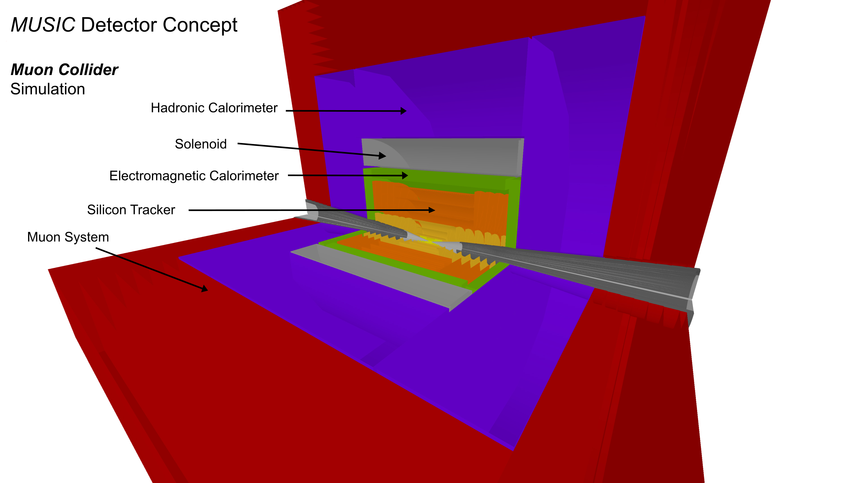
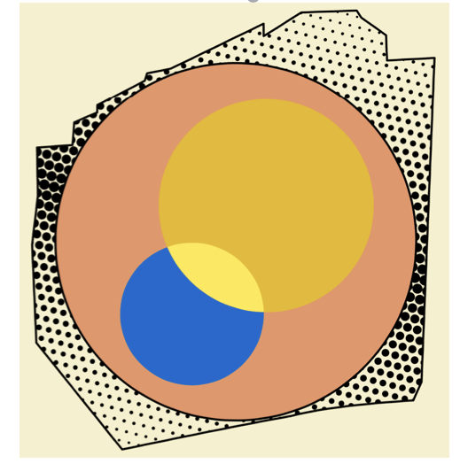
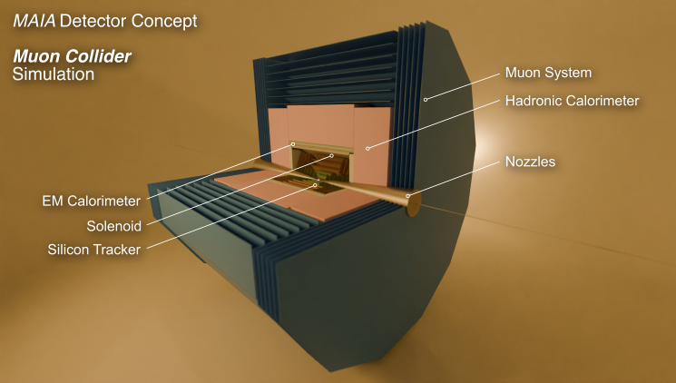
Collaboration
Collaboration is growing
US had their inauguration meeting O(300) participants in person
Now have two detector studies, MUSIC and MAIA
Strong interest from Early Career Scientists
Increasing contributions from experts that are not yet formal members of the collaboration
e.g. for the R&D plan
Publication and Speaker Committee is seeing an increasing number of publications also from partners that are not yet formally in the collaboration
Accommodating rules are effective

Slide 21
IMCC Partners
IEIO | CERN
FR | CEA-IRFU
 | CNRS-LNCMI
 | Ecoles des Mines St-Etienne
DE | DESY
 | Technical University of Darmstadt
 | University of Rostock
 | KIT
UK | RAL
 | UK Research and Innovation
 | University of Lancaster
 | University of Southampton
 | University of Strathclyde
 | University of Sussex
 | Imperial College London
 | Royal Holloway
 | University of Huddersfield
 | University of Oxford
 | University of Warwick
 | University of Durham
 | University of Birmingham
 | University of Cambridge
NL | University of Twente
IT | INFN
 | INFN, Univ., Polit. Torino
 | INFN, LASA, Univ. Milano
 | INFN, Univ. Padova
 | INFN, Univ. Pavia
 | INFN, Univ. Bologna
 | INFN Trieste
 | INFN, Univ. Bari
 | INFN, Univ. Roma 1
 | ENEA
 | INFN Frascati
 | INFN, Univ. Ferrara
 | INFN, Univ. Roma 3
 | INFN Legnaro
 | INFN, Univ. Milano Bicocca
 | INFN Genova
 | INFN Laboratori del Sud
 | INFN Napoli
Mal | Univ. of Malta
EST | Tartu University
PT | LIP
SE | ESS
 | University of Uppsala
FI | Tampere University
 | HIP, University of Helsinki
LAT | Riga Technical University
CH | PSI
 | University of Geneva
 | EPFL
 | HEIA-FR
BE | Univ. Louvain
AU | HEPHY
 | TU Wien
ES | I3M
 | IFIC/CSIC
 | ICMAB
China | Sun Yat-sen University
 | IHEP
 | Peking University
 | Inst. Of Mod. Physics, CAS
 | University of CAS
KO | Kyungpook National University
 | Yonsei University
 | Seoul National University
India | CHEP
Ty
CA | Université Laval
US | Iowa State University
 | University of Iowa
 | Wisconsin-Madison
 | University of Pittsburgh
 | Old Dominion
 | Chicago University
 | Florida State University
 | RICE University
 | Tennessee University
 | MIT Plasma science center
 | Pittsburgh PAC
 | Yale
 | Princeton
 | Stony Brook
 | Stanford/SLAC
 | …
DoE labs | FNAL
 | LBNL
 | JLAB
 | BNL
Brazil | CNPEM
21
Signed MoC (58), requested MoC, contributor

