Slide 1
Geometrical Measurements
HCQQXF_SB014-CR000003/ MQXFB06
Patrick Bestmann
MAB meeting 02/06/2025

Slide 2
Q2B HCQQXF_SB014-CR000003
Coldmass measurements @ CERN B180
Mechanical fiducialisation SMI2 23.01.2025

Slide 3
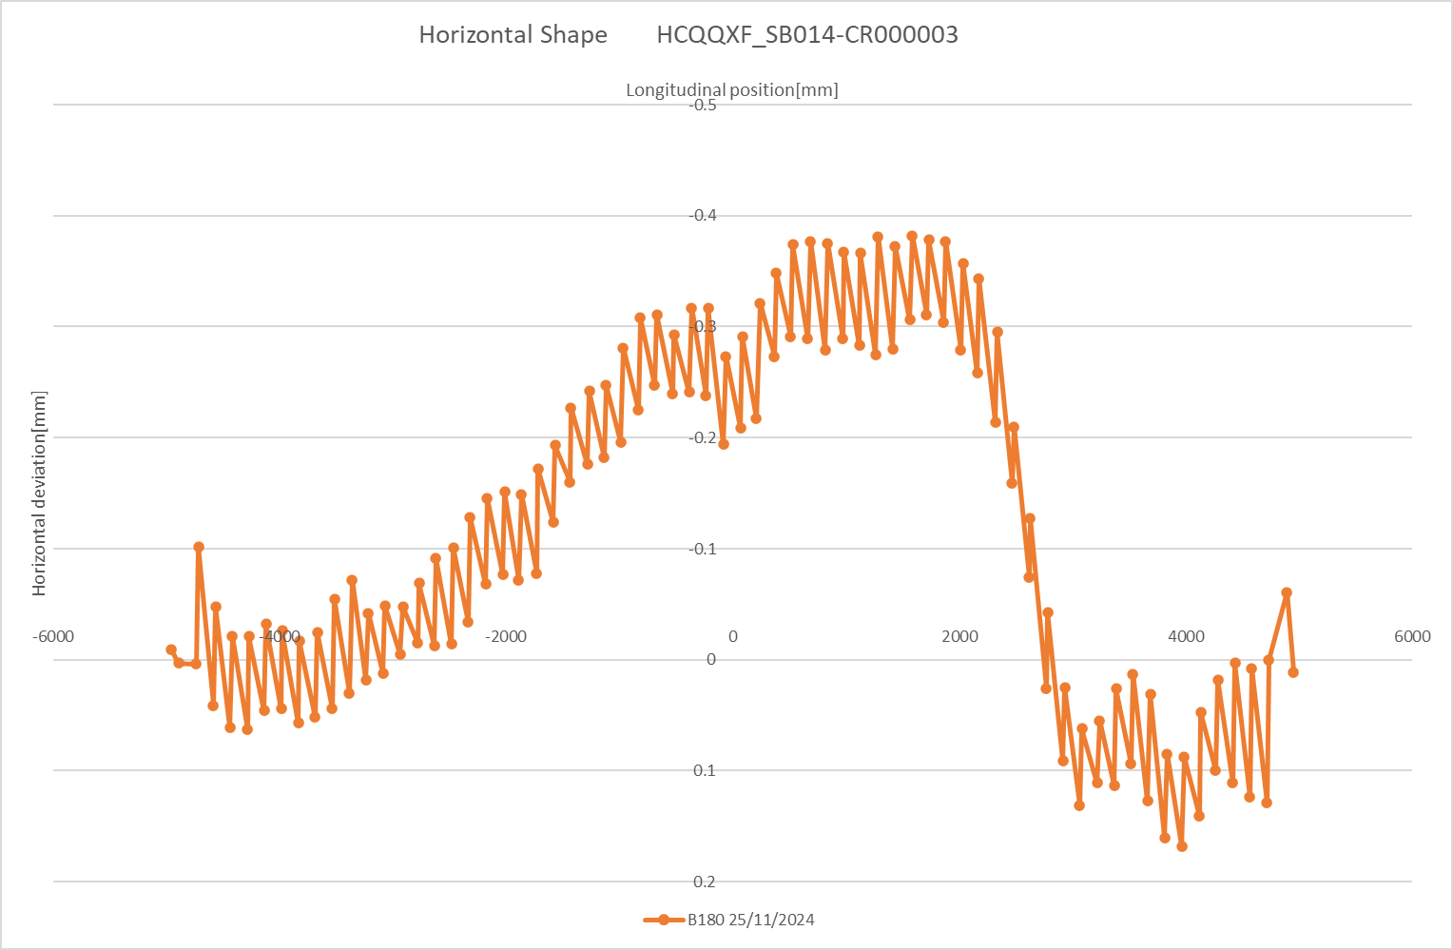
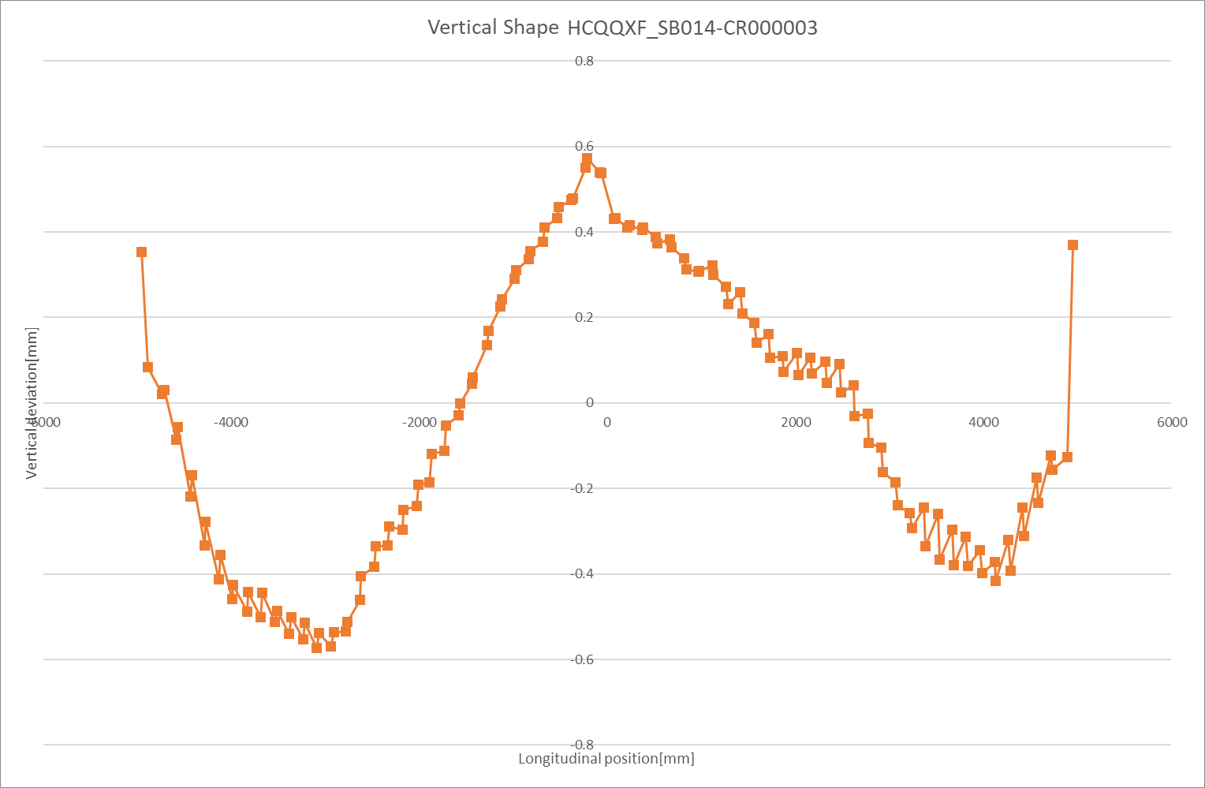
Q2B HCQQXF_SB014-CR000003
Coldmass measurements @ B180
Horizontal Shape
Vertical Shape
CS/IP-side
NC/NIP-side
CS/IP-side
NC/NIP-side

Slide 4
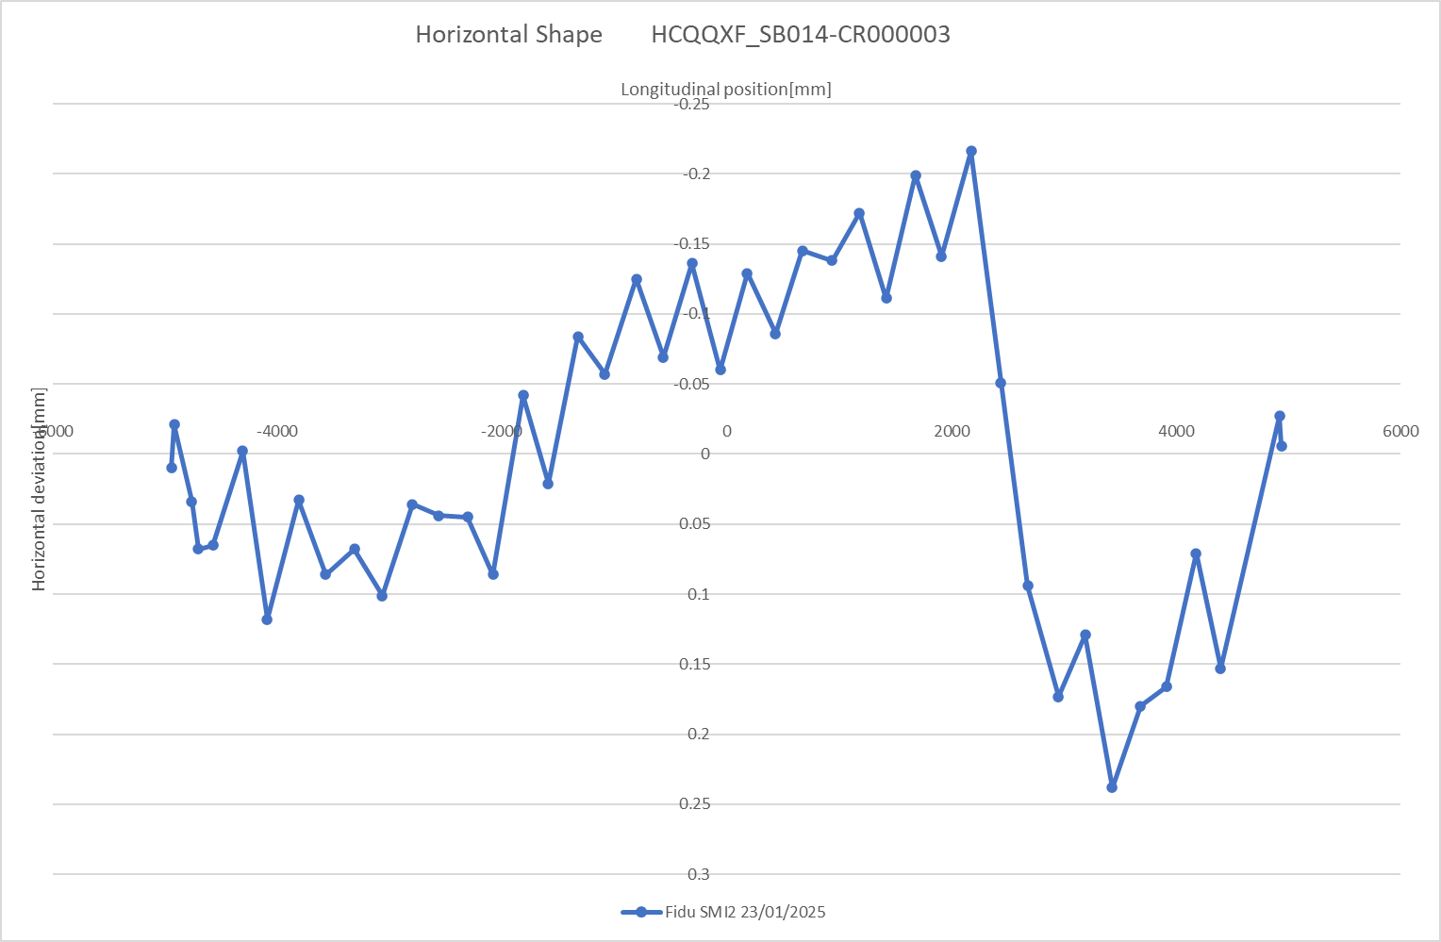
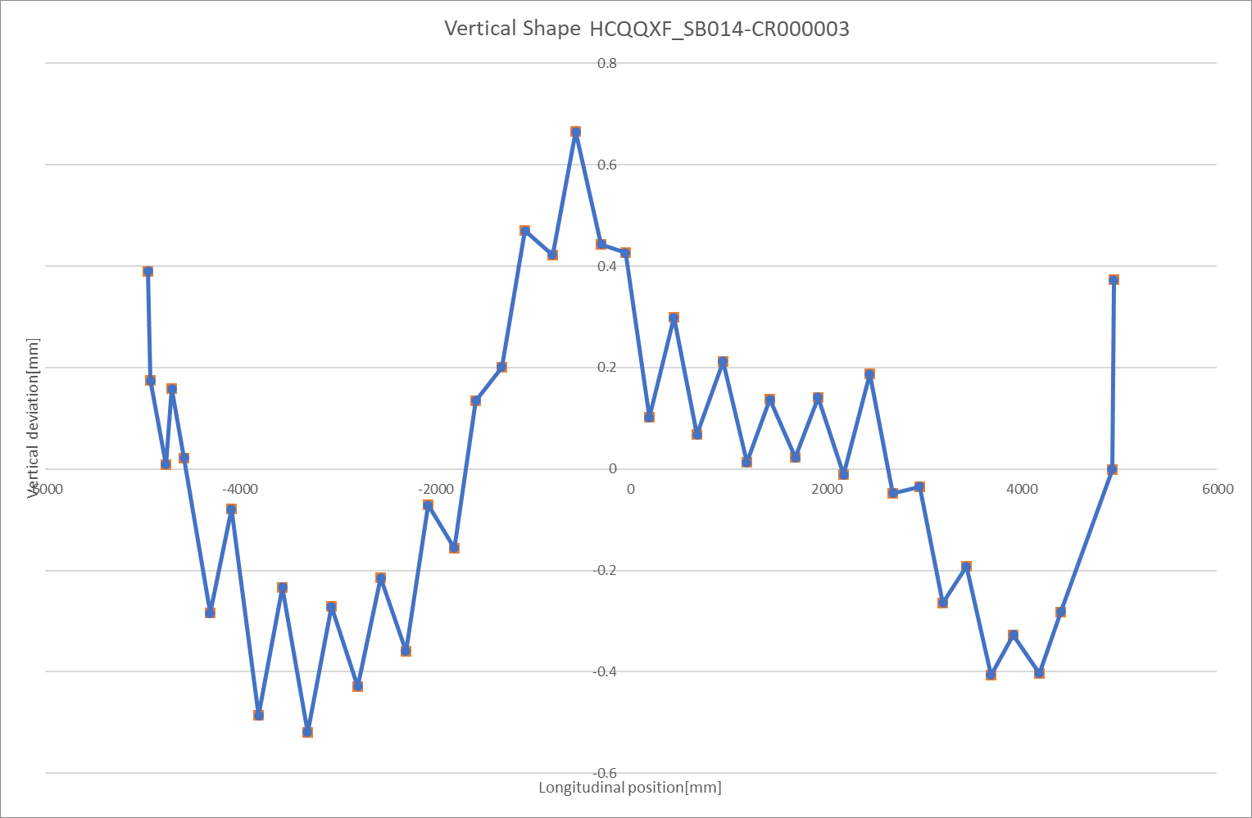
Q2B HCQQXF_SB014-CR000003
Fiducialisation before ColdTest @ CERN
Horizontal Shape
Vertical Shape
CS/IP-side
NC/NIP-side
CS/IP-side
NC/NIP-side

Slide 5
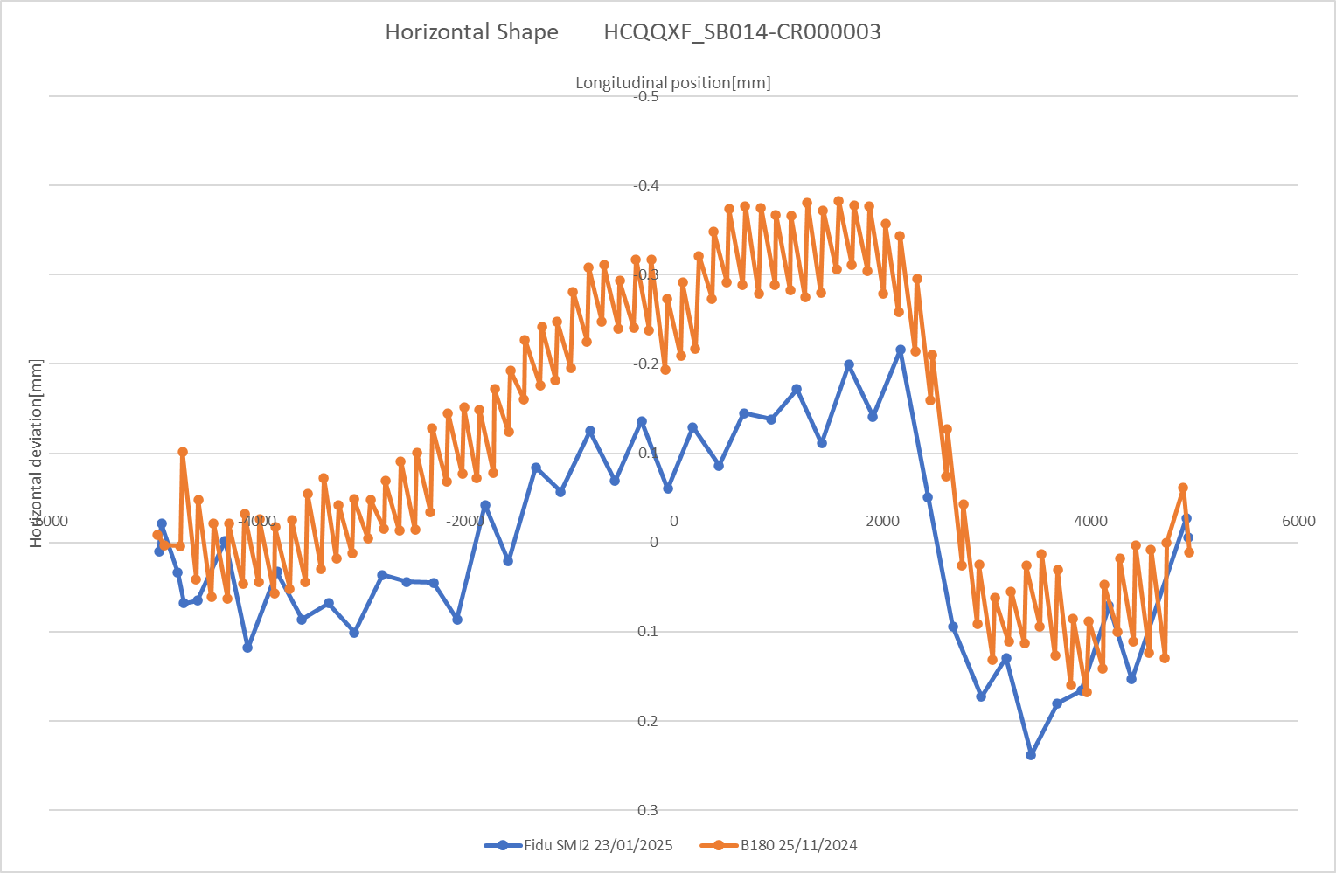
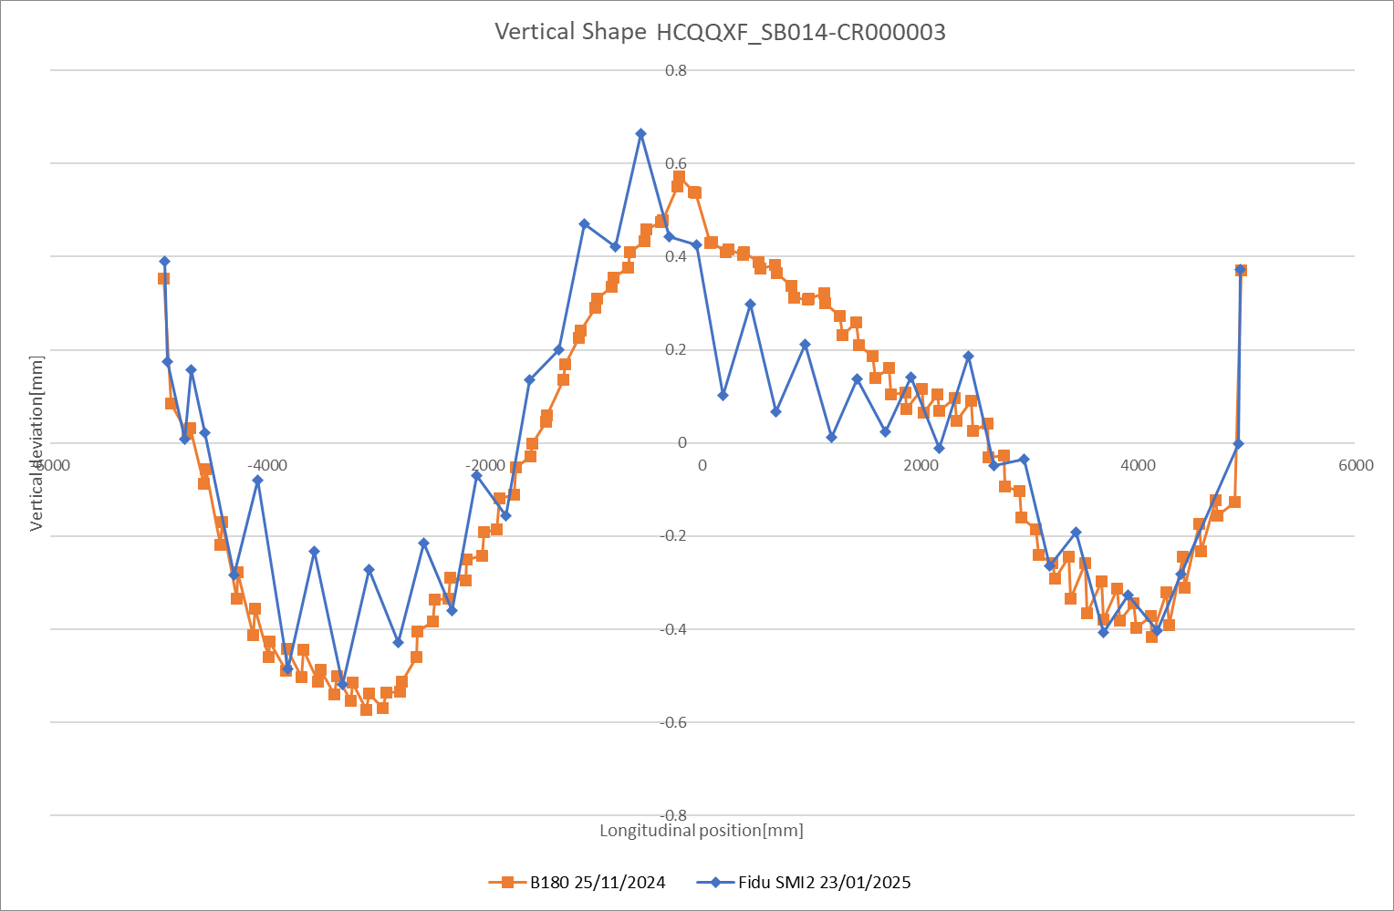
Q2B HCQQXF_SB014-CR000003
Fiducialisation after ColdTest @ CERN
Horizontal Shape
Vertical Shape
CS/IP-side
NC/NIP-side
CS/IP-side
NC/NIP-side

Slide 6
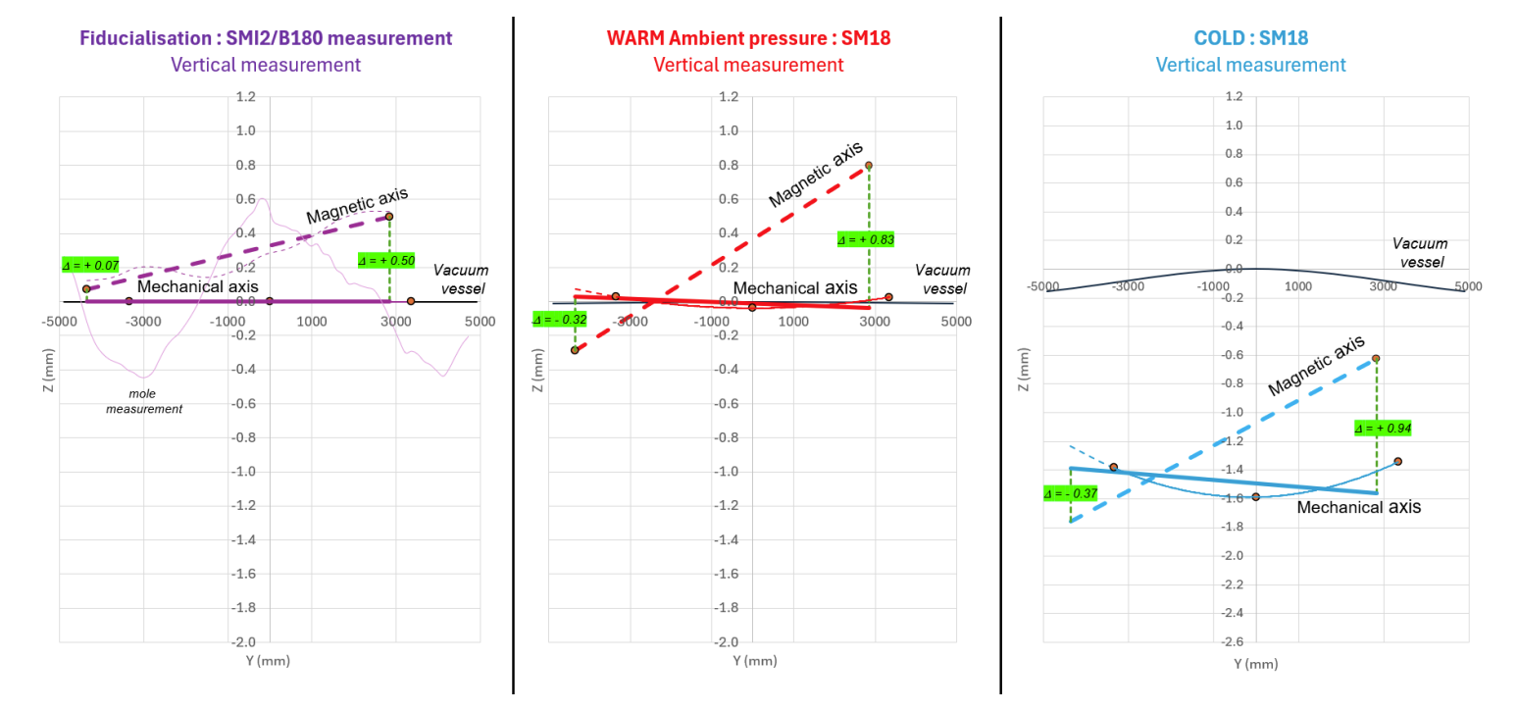
Q2B HCQQXF_SB014-CR000003
Test_Report___LMQXFB07_v1.0.pdf
J. Calmels, V. Rude

Slide 7
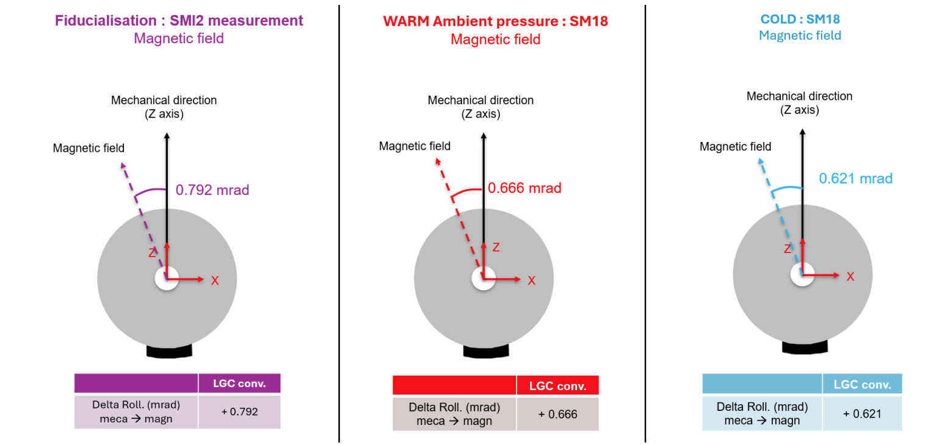
Q2B HCQQXF_SB014-CR000003
Test_Report___LMQXFB07_v1.0.pdf
J. Calmels, V. Rude

Slide 8
General Feedback Q2B HCQQXF_SB014-CR000003
Coldbore shape from 180 and first fiducialisation differ in radial and vertical
Significant vertical shift of axis between SMI2 and SM18 (0.3mm)
Movements of magnetic axis in SM18 coherent with FSI
Magnet in Phase 2 assembly, new fiducialisation planned in SMI2

