Slide 1
Field quality of HCQQXF_SB014-CR000003 (Q2)
- Cold mass LMQXFB07
- Quadrupole MQXFB06
- Corrector MCBXFB03
Test report EDMS 3293800
ID card EDMS 3304474
L. Fiscarelli
MAB meeting 02/06/2025

Slide 2
Available test results
MCBXFB
Measurements (3x) at warm
  Inner coils, inner and outer coils, full assembly with yoke
Test in vertical at 1.9 K
MQXFB
Measurements (3x) at warm
  Coil pack, after centering, after loading
Cold mass (rotating coil)
Final measurement at warm of the cold mass
Cryo-assembly (stretched wire)
Test in horizontal at 1.9 K of the cryo-assembly
Measurement in horizontal at warm of the cryo-assembly
Test at warm (rotating coil) - Pending

Slide 3
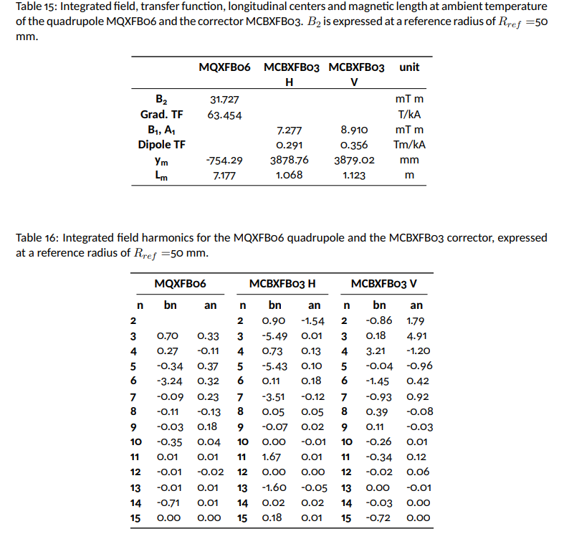
Field quality from measurement at warm

Slide 4
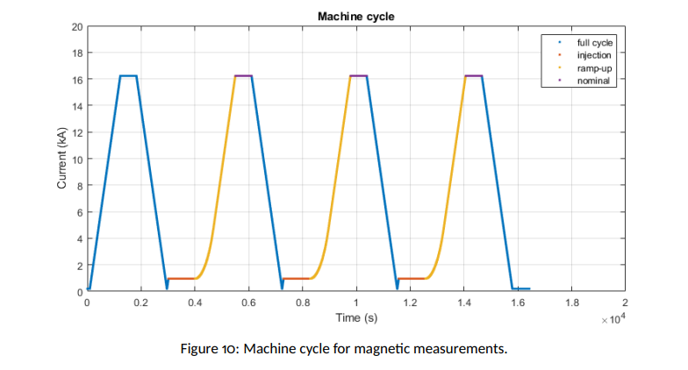
Field quality from measurements at 1.9 K

Slide 5
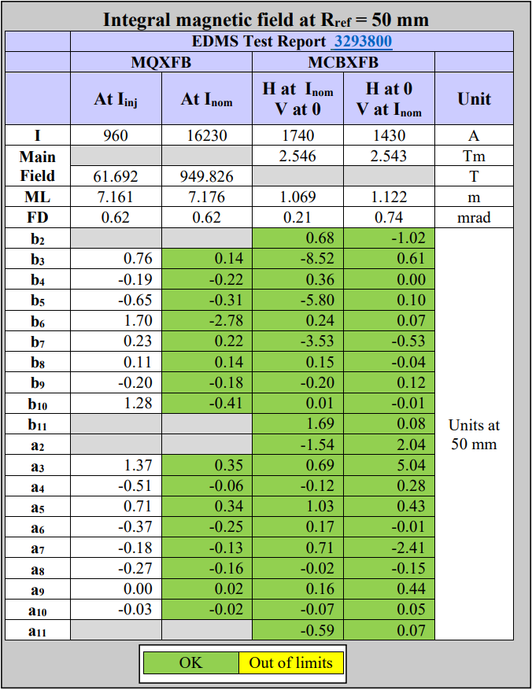
Field quality from measurements at 1.9 K

Slide 6
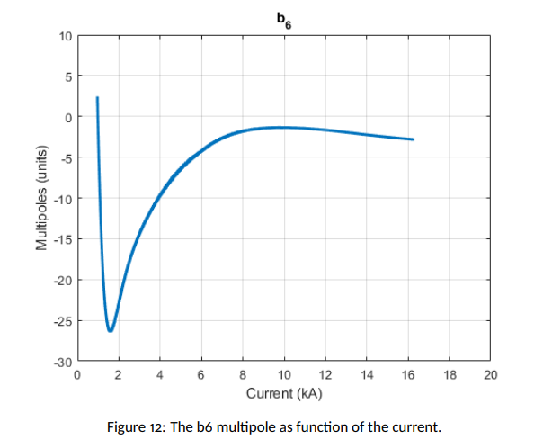
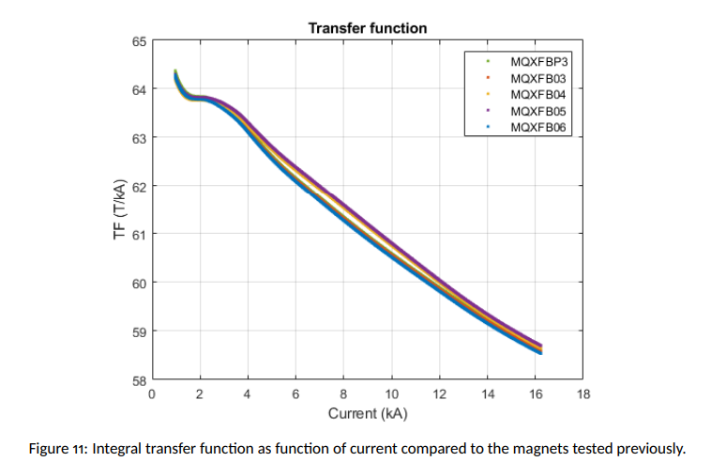
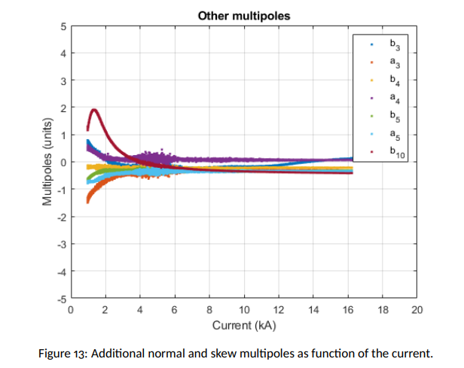
Field quality from measurements at 1.9 K

Slide 7
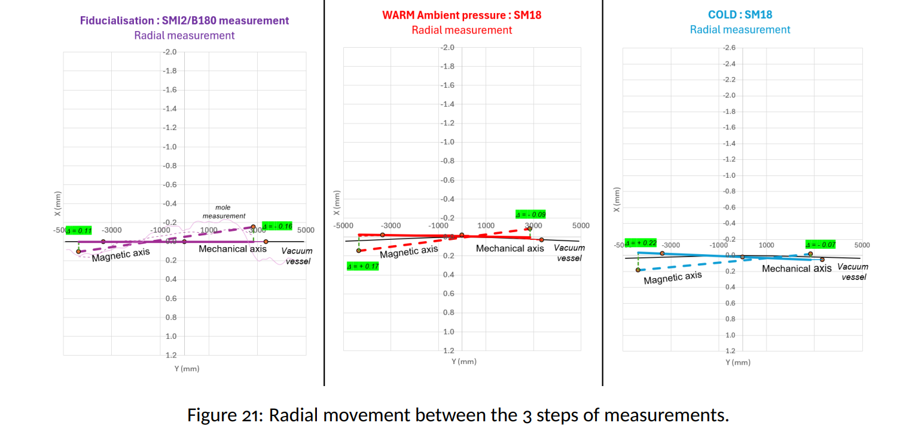
Magnetic axis - Radial

Slide 8
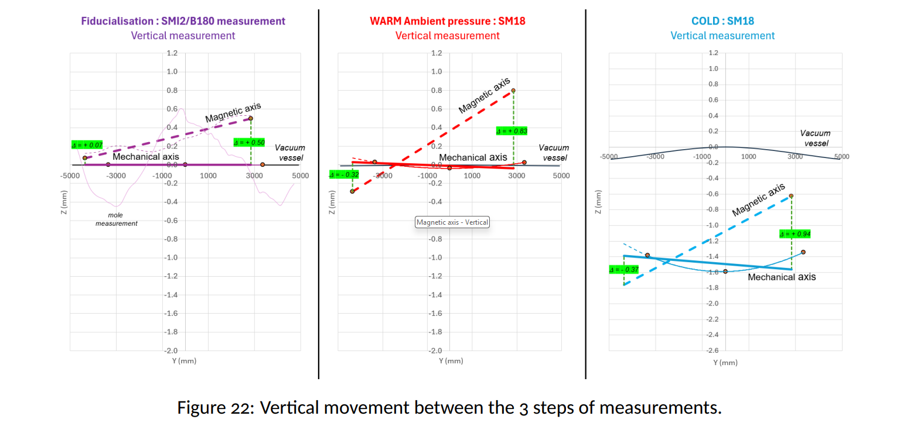
Magnetic axis - Vertical

Slide 9
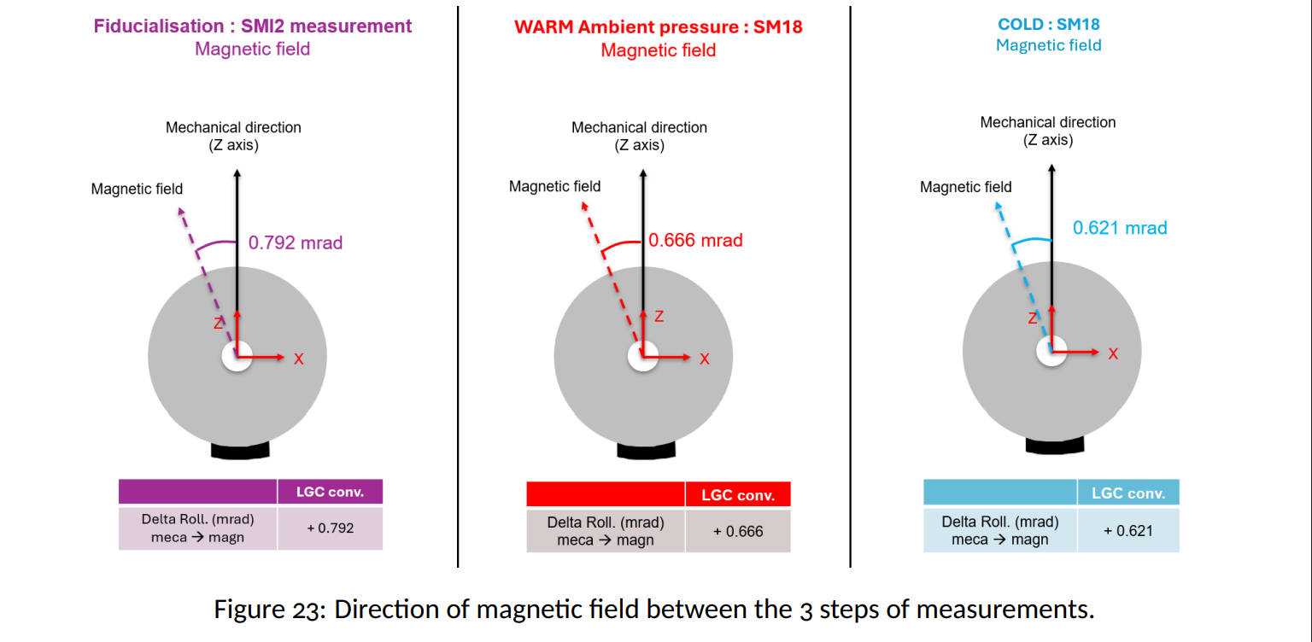
Field direction

