Slide 1
Experiment preparation

Slide 2
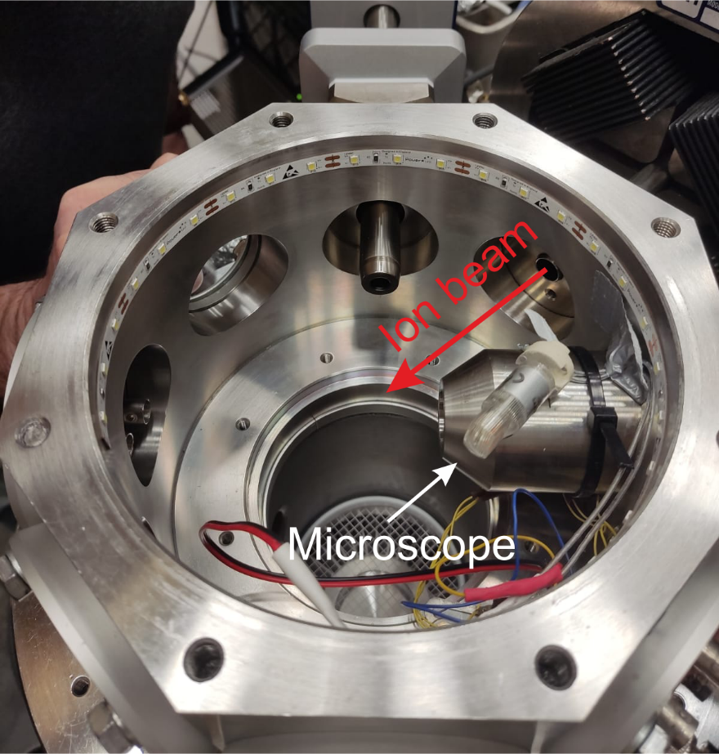
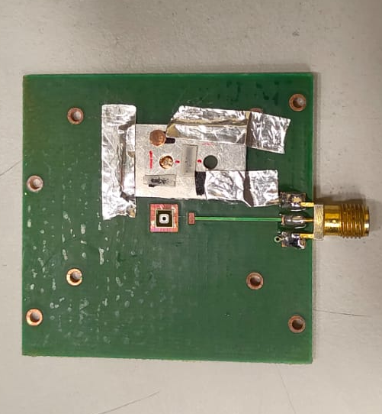
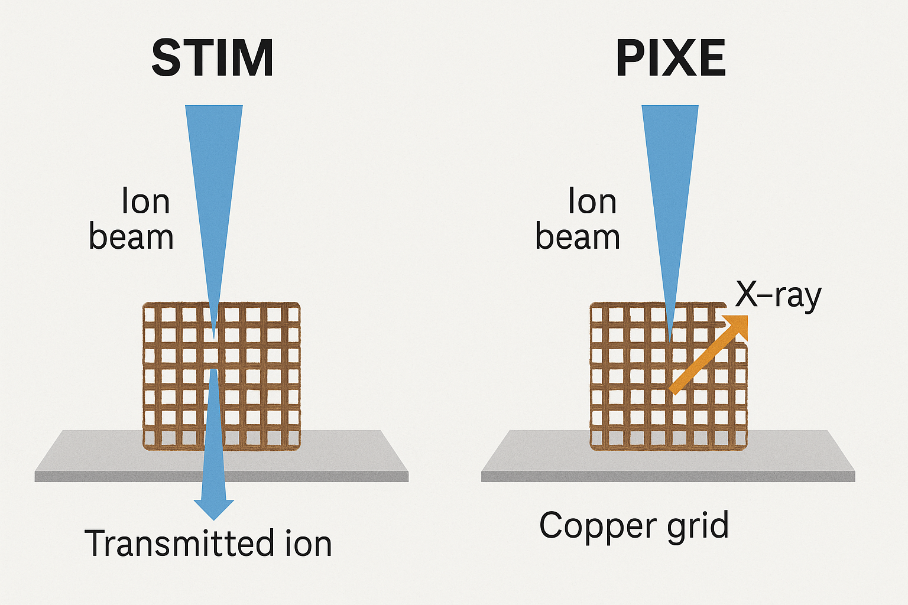
Hole on the PCB
Hole on PCB to do STIM (low count rate)
-PIXE (high count rate) (No accurate beam size prior to closing of the micrometric slits).
-STIM (low count rate)[ Accurate beam size but requires a hole in the PCB for the beam to reach the STIM detector].
PIXE
PCBs
STIM detector
STIM

Slide 3
Hole on the PCB
Hole on PCB to do STIM (low count rate)

Slide 4
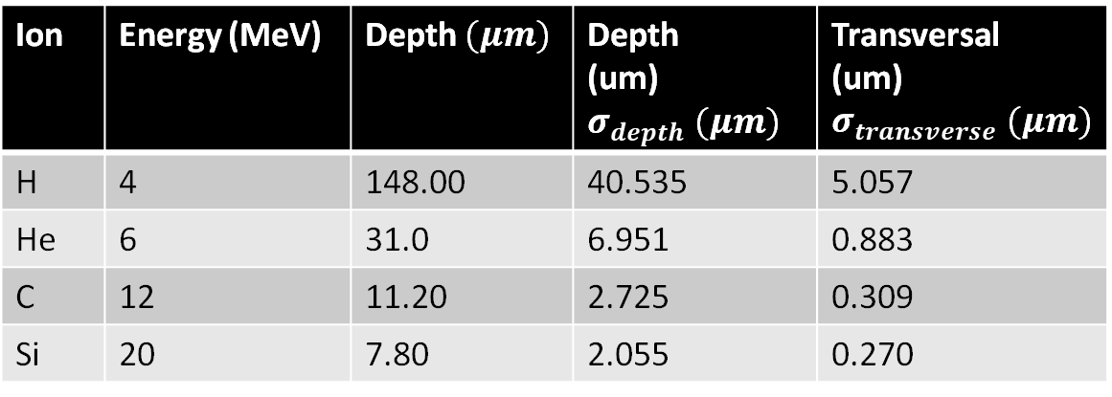
Straggling in depth and transversal
Ion | Energy (MeV) | Depth $(μm)$ | Depth (um)$σ_{depth} (μm)$ | Transversal (um)$σ_{transverse} (μm)$
H | 4 | 148.00 | 40.535 | 5.057
He | 6 | 31.0 | 6.951 | 0.883
C | 12 | 11.20 | 2.725 | 0.309
Si | 20 | 7.80 | 2.055 | 0.270

Slide 5
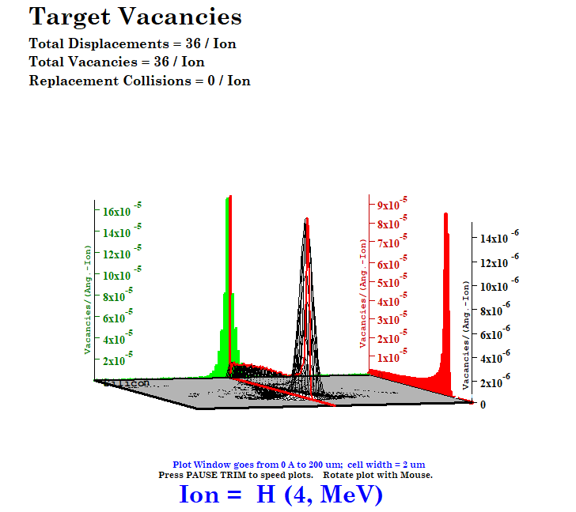
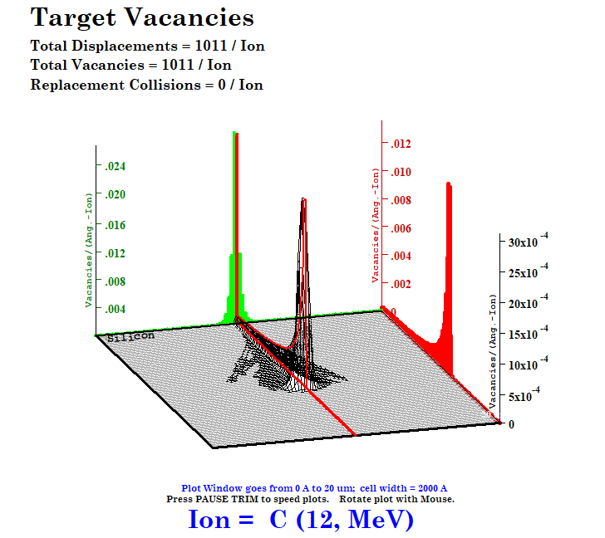
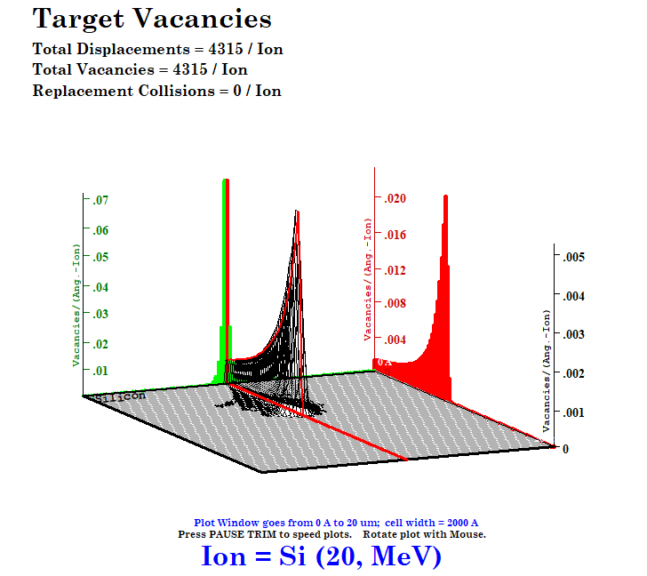
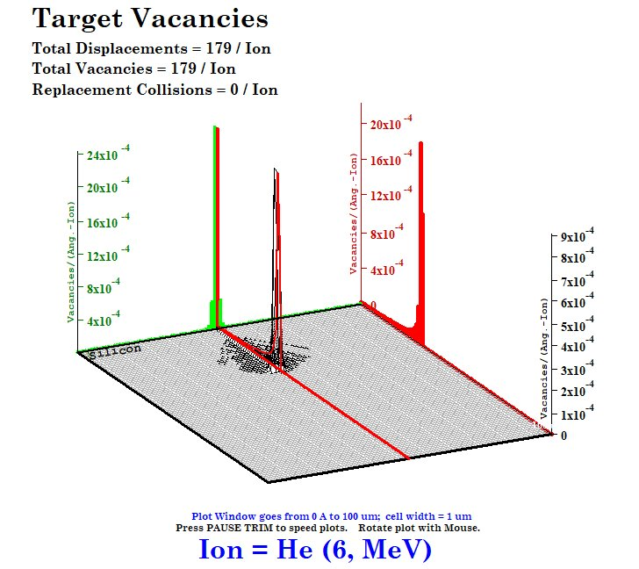
Vacancies simulations (9999 ions)

