Slide 1
SM18 vertical test bench planning
2025.05.13

Slide 2
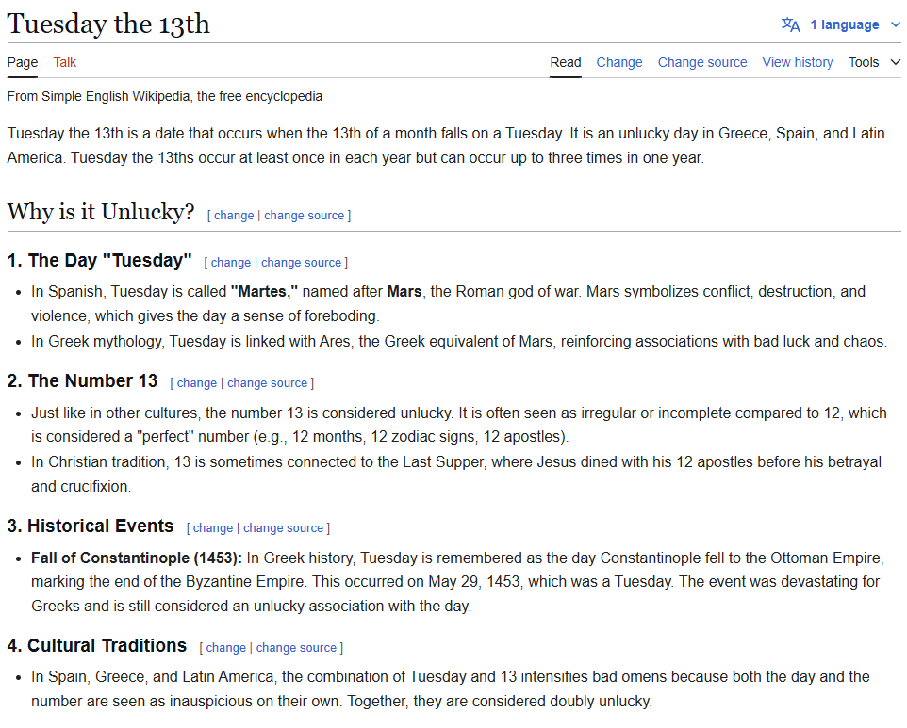
As I was preparing these slides yesterday (Monday) I found that today is not an unlucky day here, only in Greece, Spain and Latin America
Other similar unlucky days:
Friday 13 – popular thanks to the movie
Friday 17 in Italy – I didn’t know about this one either
https://simple.wikipedia.org/wiki/Tuesday_the_13th
https://en.wikipedia.org/wiki/Friday_the_13th#Tuesday_the_13th_in_Hispanic_and_Greek_culture

Slide 3
Back to the monthly discussion

Slide 4
Update since last meeting
Cluster D | HFM | Siegtal | Long | Diode
MCBXFB07 – finished | MQXFS8b – finished | SMC108-eCLIQ – finished | Sushi – finished | DR_FFC01_06 – finished
MCBRD06 – finished | MQXFS4f – ongoing CD2 | SMC109-eCLIQ – finished | MSCB 399, 386 – finished | IT-diode 1 – finished
MCBRD05 – finished |  | HO session 5 – finished | MSCB 396, 385 – finished | IT-diode 2 – finished
MCBXFA02 – finished |  | PSI SubSMCC 2 – prep | MQ #1 – prep | IT-diode 3 – prep CD2
MCBRD07 – ongoing CD2
 | Fusillo | HO session 6 | MQ x2 (3 next year) | IT-diode 4
MCBRD08 | RMM1e | PSI SMACC | LMF Splices x2 | IT-diode 5
MCBXFB08 | RMM2 | CEA R2D2 |  | DR-FFC01-xx ?
MCBRD11 | HD3 | CHIC – probably 2026 |  | HTS three coils (x2?)
MCBRD09 | MBHSP107 with Beam Scr | SMC 106 |  | CEA HTS racetrack
MCBXFB09 | Ciemat ISAAC | SMC 108 |  | HTS common coil
MCBRD10 | MQXFS4g… | SMC 110
 | MQXFS9 | FalconD LMK1
In red: new since last meeting
In gray: foreseen later this year

Slide 5
Planning last few weeks before summer
Focus on cryogenics
June 1
July 1
 | Week 20 | Week 21 | Week 22* | Week 23 | Week 24* | Week 25 | Week 26 | Week 27
Long | MQ |  | MQ |  |  |  | LMF splice | LMF splice
HFM | MQXFS4f | Fusillo | Fusillo
CTV | Diode IT | Diode IT |  | HTS 3 coils |  | HTS 3 coils
Siegtal | PSI SubSMCC2 |  |  | PSI SubSMCC2 |  | HO ses6 |  | HO ses6
Cluster D | MCBRD07 |  |  |  | MCBXFB08 | MCBXFB08
Works in the
Cluster G structure
Low cryogenic availability
Shutdown starts
Fusillo test may be delayed one week depending on cryogenic capacity
All tests could be delayed depending also on HB tests (Q2, D2, D1)
1.9 K capacity will be very limited
*: Short weeks (Pentecost, Ascension)
Preparation
Stand-by
Test

Slide 6
Planning last few weeks before summer
Focus on 20 kA PC
June 1
July 1
 | Week 20 | Week 21 | Week 22* | Week 23 | Week 24* | Week 25 | Week 26 | Week 27
Long | MQ |  | MQ |  |  |  | LMF splice | LMF splice
HFM | MQXFS4f
CTV | Diode IT | Diode IT |  | HTS 3 coils |  | HTS 3 coils
Siegtal | PSI SubSMCC2 |  |  | PSI SubSMCC2
Cluster D
Works in the
Cluster G structure
Low cryogenic availability
Shutdown starts
20 kA PC is practically fully booked until summer
Small delays or extra tests in one magnet will impact all the following ones
*: Short weeks (Pentecost, Ascension)
Preparation
Stand-by
Test

Slide 7
Magnets from SMT
Fusillo: in SM18, to be installed after MQXFS4f.
  Test plan ready (EDMS 3292867). Note: no 20 kA PC conflict with other tests.
The following magnets might arrive before summer, but I don’t think we can test them until September:
RMM1e with fishbone and prototype flat QA – June
SMC 108 with eCLIQ – End of May
MQXFS4g with different pre-load – June
Magnets for after summer this year:
RMM2 with second version flat QA – October
MQXFS9 with RRP coils + ESC
SMC 106 and 110

Slide 8
Magnets from HSD
DR_FFC01
  DR_FFC01_08: test cancelled due to problems when integrating into the mechanical structure
  DR_FFC01_xx: test delayed after the three coils in a frame
Three coils in a frame (SeR_FFC01_01? *): next week
  With Carlo’s MM, NbTi leads
Second Three coils in a frame (SeR_FFC01_02? *): after the next DR_FFC01
HTS leads after summer – can be done earlier (TBD with Christian)
Common Coil configuration (3 and 3): around September
  20 mm apertures
CPCL: lower priority, probably after September
*: DR_FFC is Double Racetrack, Faraday Factory Conductor, so
SeR_FFC could be Sextuple Racetrack, Faraday Factory Conductor

Slide 9
Magnets from LMF / WP3
MCBRD07 (virgin): to be finished this week
MCBXFB08: June 2-6 – top priority
  It should arrive before June 9 to have a good chance of test before summer
Available right after summer:
MCBXFA3, MCBXFB09 (September)
MCBRD08, MCBRD11, MCBRD09 (September)
MCBRD10: November
Two boards with splices: ?
EESD2 (phase 3): end of the year
MgB2 bending test
It would be best for us to test several of the same time in a sequence.
From this planning we could do the 2 MCBXF (+1 before summer) and then 4 MCBRDs

Slide 10
Magnets from collaborations
PSI – SubSMCC2 (with ESC) – in SM18, test plan ready (EDMS 3295170)
PSI – SMACC: ?
PSI – HTS racetracks: ?
CIEMAT – ISAAC: December
CIEMAT – Poseidon ?
LBNL – HD3: arrival June 2025
  It could be interesting to have a multipole QA for this
CEA – HTS EuCARD2 ?
CEA – R2D2: arrival October 2025
CEA – MI long racetrack HTS: ?
I took the delivery date of magnets without a “?” from the weekly report week 19.

Slide 11
Other CERN tests
FCC hh HTS beam screen
  Sergio Calatroni does not have news as of 12.05
  Probably in SP107
  Probably September
  Magnetic measurements device arrived and in calibration/assembly
    Rotating coil for dipoles, 18 mm diameter, <1 m length
    Also used for PSI SubSMCC and HSD’s common coil

