Slide 1

Modification to baseline of FRAS GYPOS Racks (BE-GM) position in UR15/UR55
(Racks renaming to be revised by EN-EL)
Stephane Maridor, Miguel Navarro Baeza
HL-LHC WP15 Integration
19/05/2025
INDICO

Slide 2
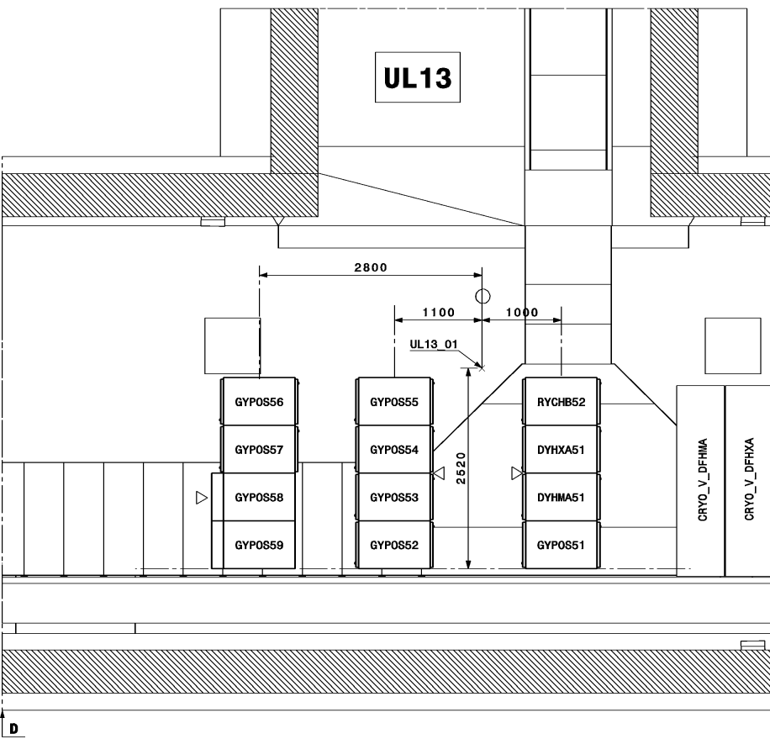
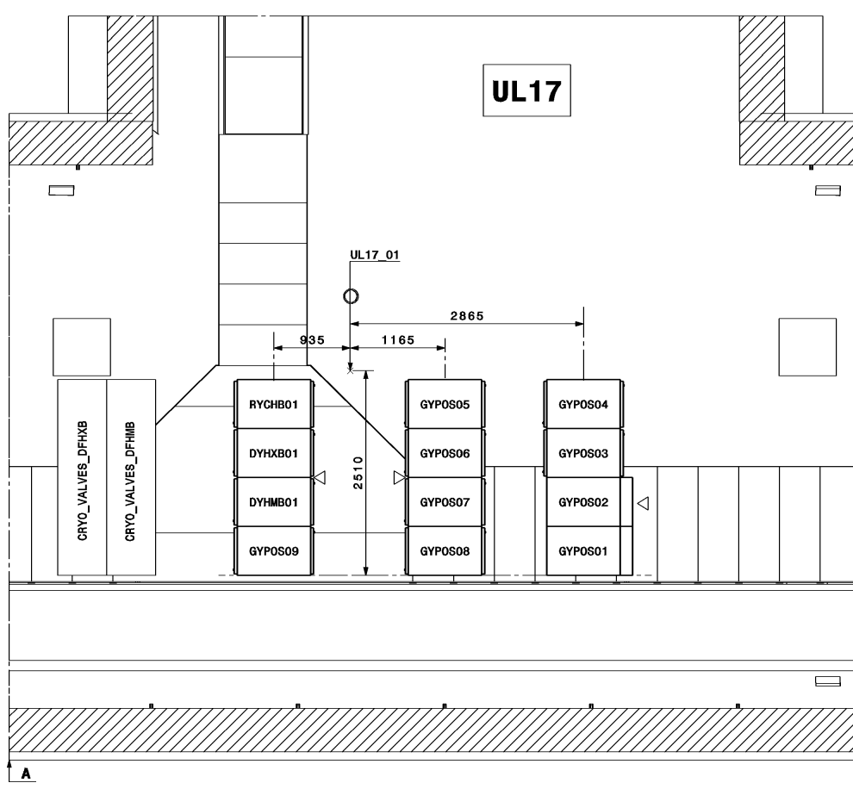
Approved Baseline 2024 GYPOS – UR15
GYPOS
GYPOS
FRAS
FRAS
UR15 Left
UR15 Right
LHCEY__1091
LHCEY__1090

Slide 3
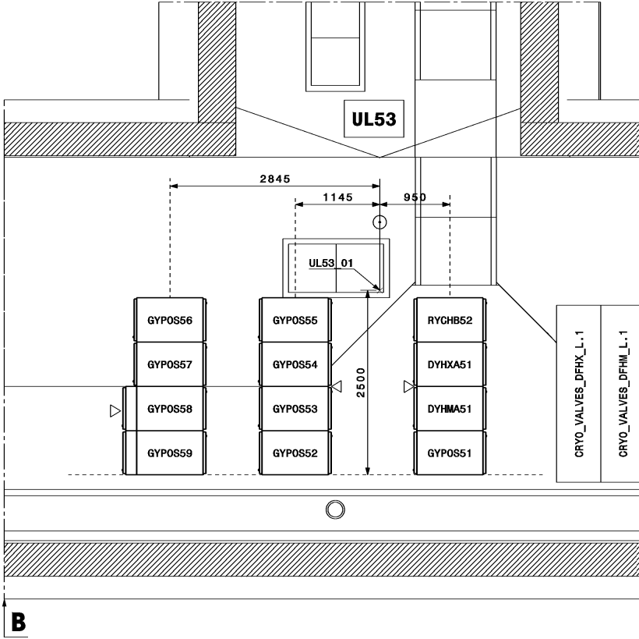
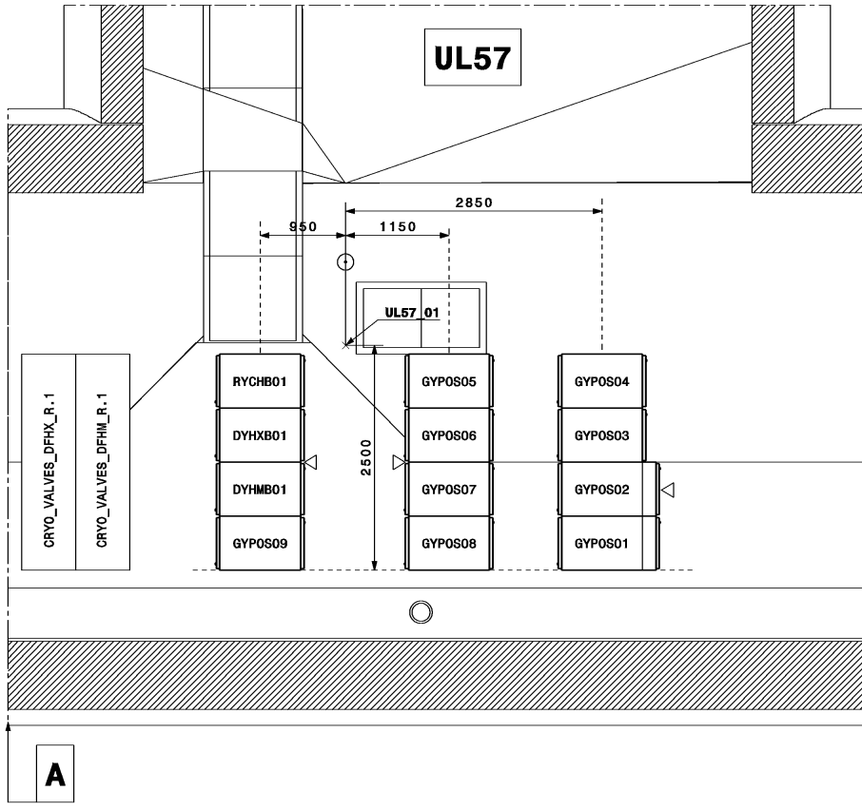
Approved Baseline 2024 GYPOS – UR55
GYPOS
GYPOS
FRAS
FRAS
UR55 Left
UR55 Right
LHCEY__5093
LHCEY__5092

Slide 4
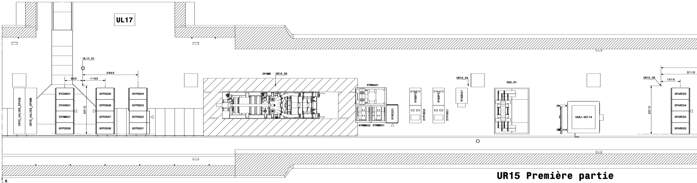
New Baseline Proposal GYPOS – URx5 Right
~30m displacement away from IPx

Slide 5
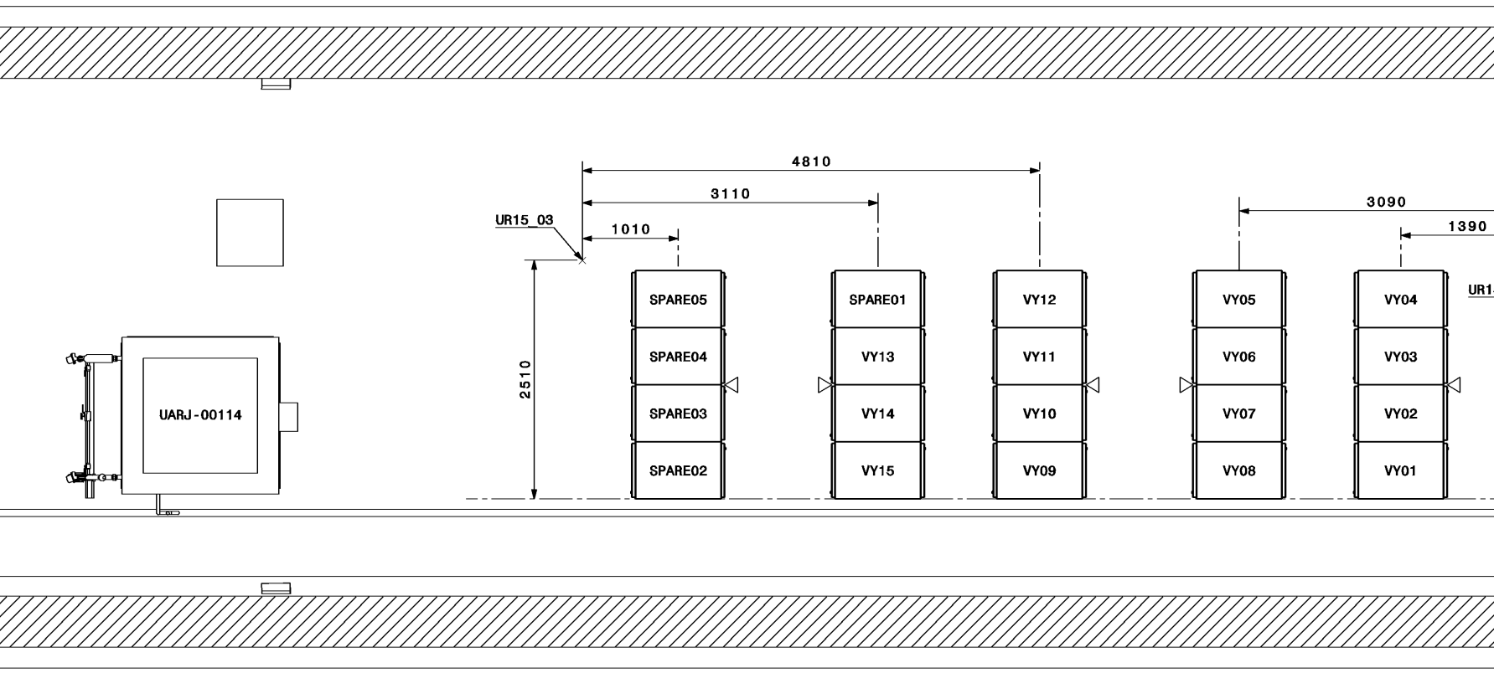

New Baseline Proposal GYPOS – URx5 Right
GYPOS 01/02 installable after QXL and before SC Link
SPARE03
SPARE02
GYPOS02
GYPOS01

Slide 6
New Baseline Proposal GYPOS – URx5 Right
Installable after SC Link
SPARE05
SPARE04

Slide 7
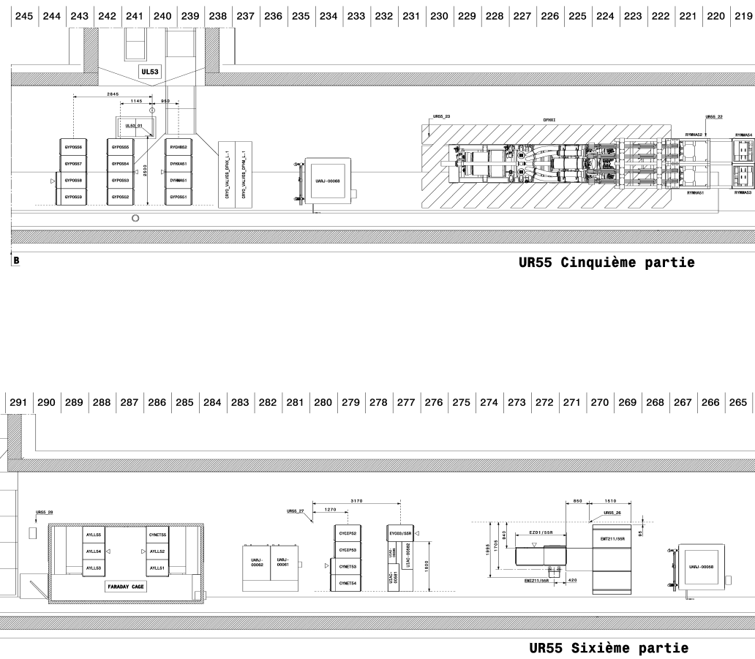
New Baseline Proposal GYPOS – URx5 Left
~40m displacement away from IPx

Slide 8
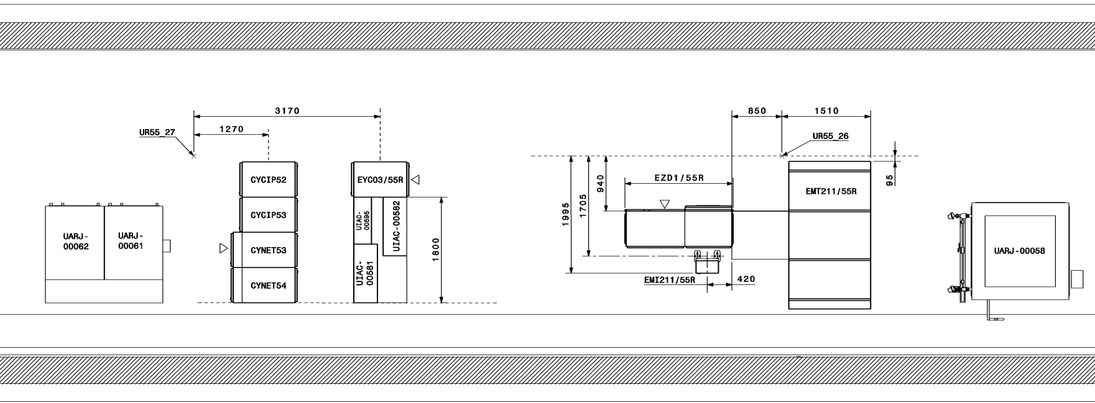
New Baseline Proposal GYPOS – URx5 Left
New row of racks
(space available due to EZD1 cabinet being shortened)
Installable before QXL
GYPOS58
GYPOS59

Slide 9
New Baseline Proposal GYPOS – URx5 Left
Installable after SC Link
SPARE04
SPARE05

