Slide 1
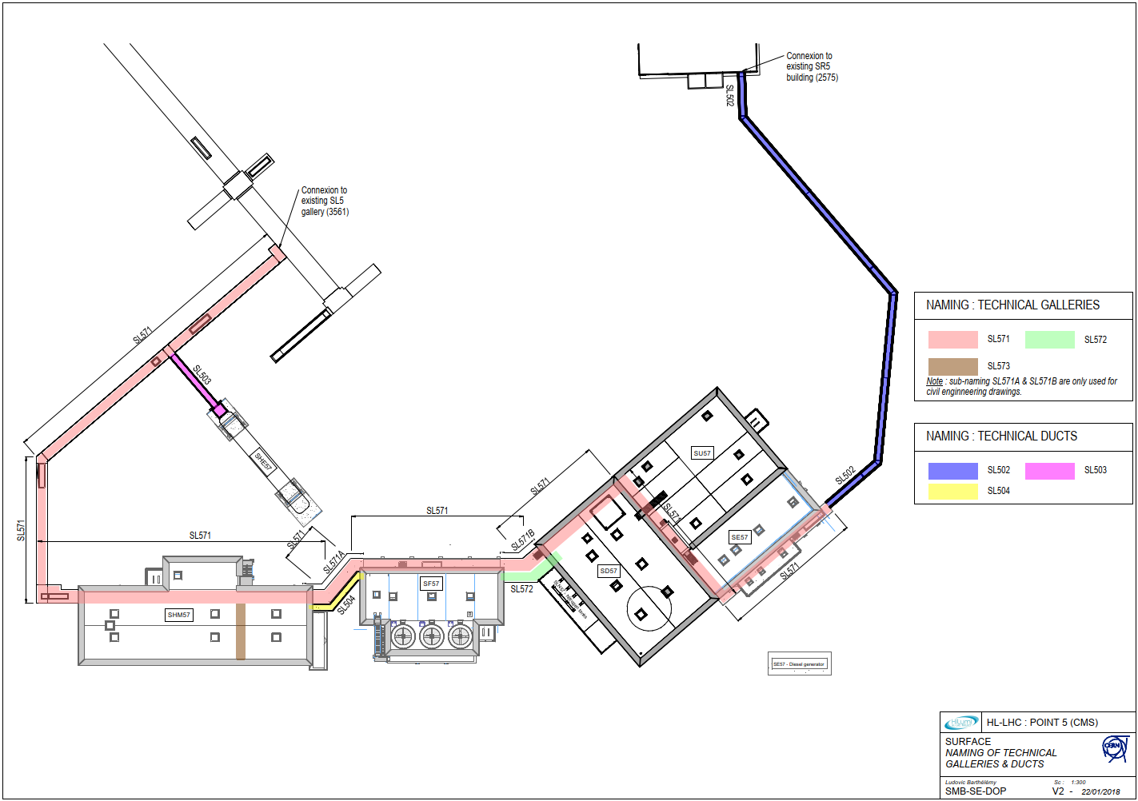
SL57
SF57_1
SU57
SHM57_1
SHM57_2
SF57_2
Fire resistant doors in SL57 Technical galleries

