Slide 1

HL-LHC LSS5 Integration Approval Phase I
Francesca Paola Nicoletti
16.05.2025

Slide 2
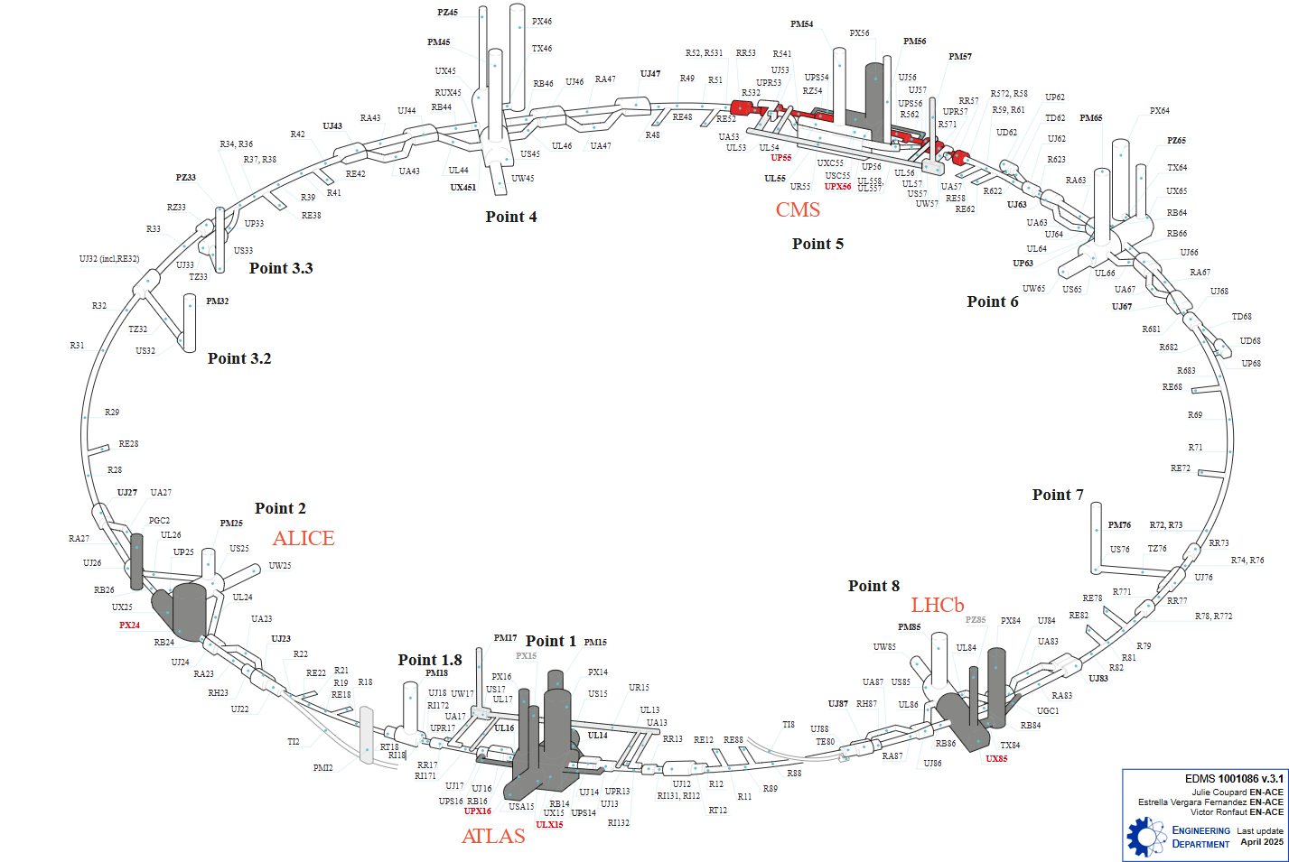
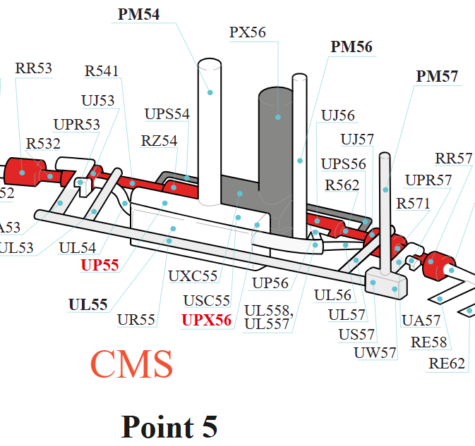
Introduction
LSS5 area overview
5L
5R

Slide 3
Introduction
Context:
  delays in the 3D detailed modelling of the new cryogenic distribution lines (QXL) at P1 and P5 for HL-LHC
  finalization of the rest of the integration
Objective: Approve HL-LHC LSS5 integration Phase I
Phased approach adopted due to delays in detailed 3D models of the QXL
Approval is conditional on resolution of pending points listed in the report (EDMS 3301467)

Slide 4
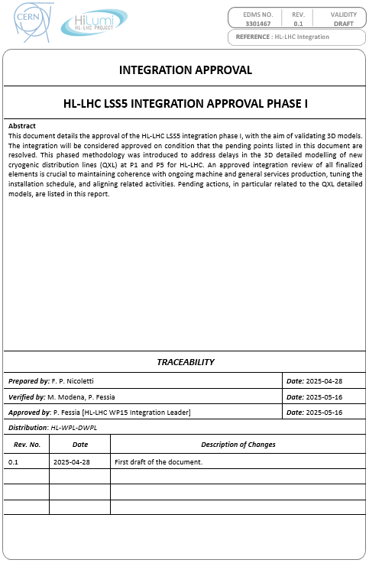
Report structure
HL-LHC LSS5 INTEGRATION APPROVAL PHASE I
EDMS 3301467
INTRODUCTION OF THE APPROVAL PROCESS
HL-LHC LSS5 INTEGRATION 3D MODELS
OPEN POINTS

Slide 5
Approval Process
Approval of the integration in the
  HL-LHC WP15 Monday Integration of Tunnel Services Meetings
  HL-LHC Friday Integration meeting
Review and incorporation of comments in the report
→ Deadline for comments: 22.05.2025
Release of the document through EDMS official approval process, with distribution to HL WP Leaders and Deputies
Approval of the integration by the ICL committee
Release of the integration 3D model with the tag “Preliminary”

Slide 6
3D Models
HL-LHC LSS5 integration 3D models are categorized into two main groups:
  Machine only divided by halfcell
  Gallery + Services + Machine divided by gallery
For definition of the halfcells refer to the 2D Layout Drawings:
  LSSR5 Machine HL-LHC 1507 LS3
  LSS5L Machine HL-LHC 1507 LS3
For definition of the galleries refer to the LSS5 area overview.
This separation method is the CERN standard for integration. It facilitates working with large 3D models in CATIA.
ST numbers for HL-LHC LSS5 integration are listed in the report and on the dedicated page in WP15’s SharePoint.

Slide 7
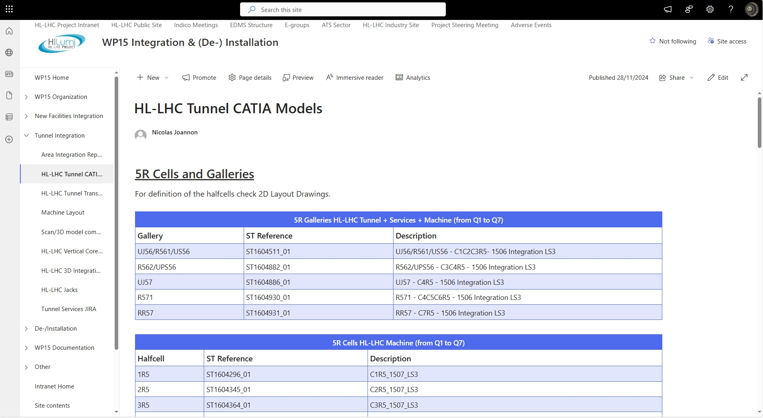
3D models list overview

Slide 8
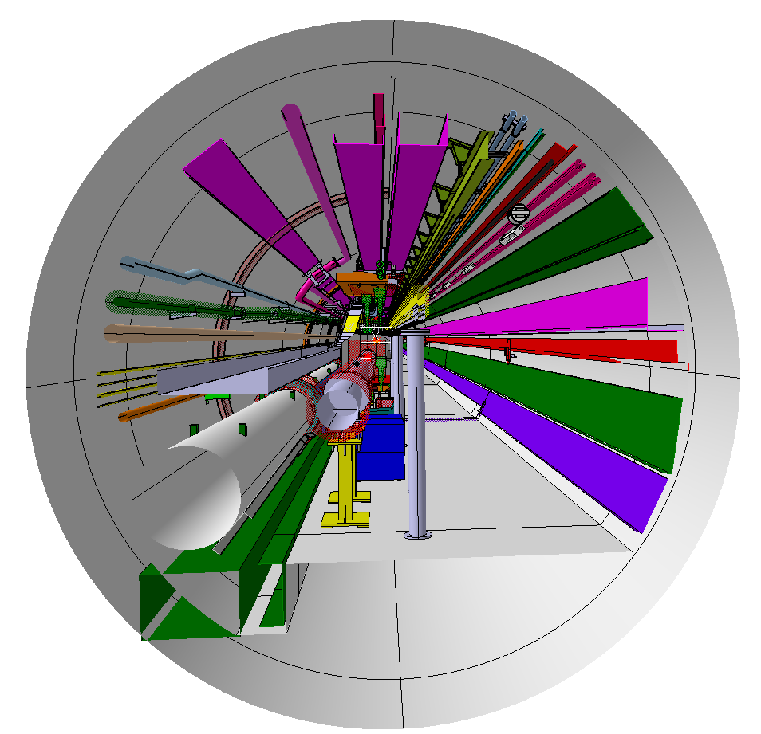
3D models captures overview

Slide 9
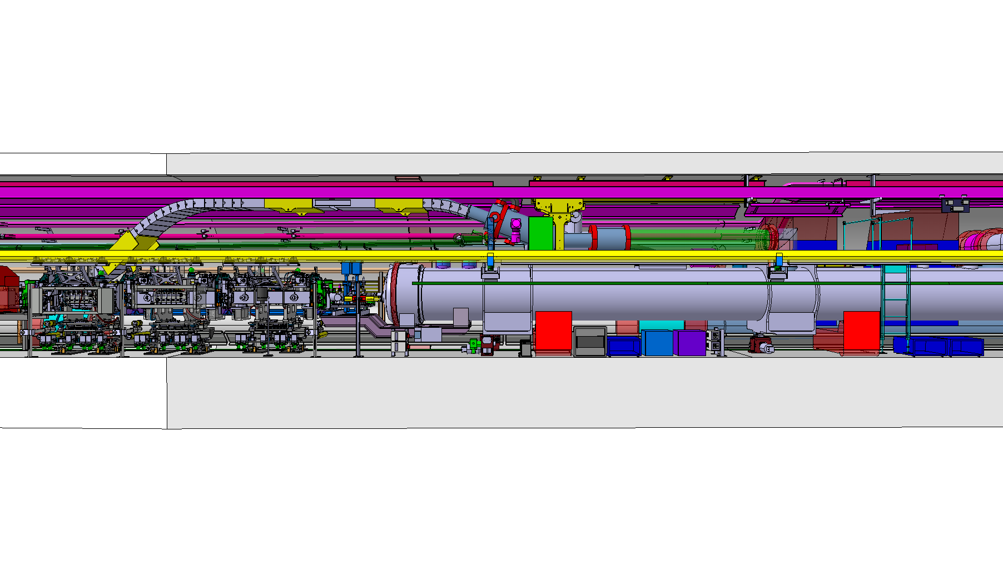
3D models captures overview

Slide 10
Open points
The integration open points are listed in the report.
The integration will be considered approved on condition that the pending points are resolved.
The open items status is tracked via the following Agile Kanban board in CERN Jira: HLINTS board.
The structure and operation of this tool are explained on a dedicated page in WP15's SharePoint.

Slide 11
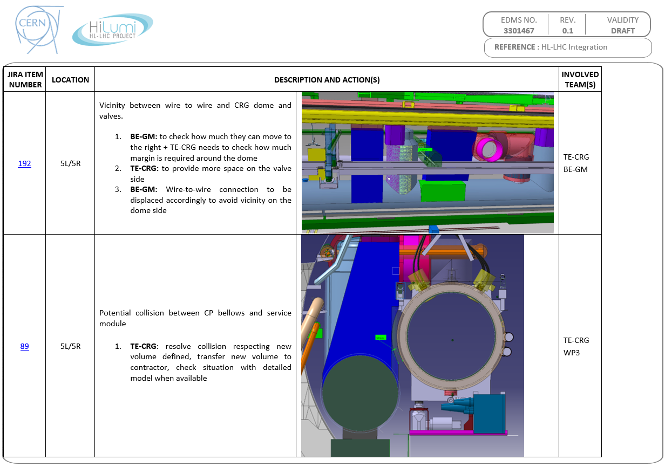
Open points list overview

Slide 12
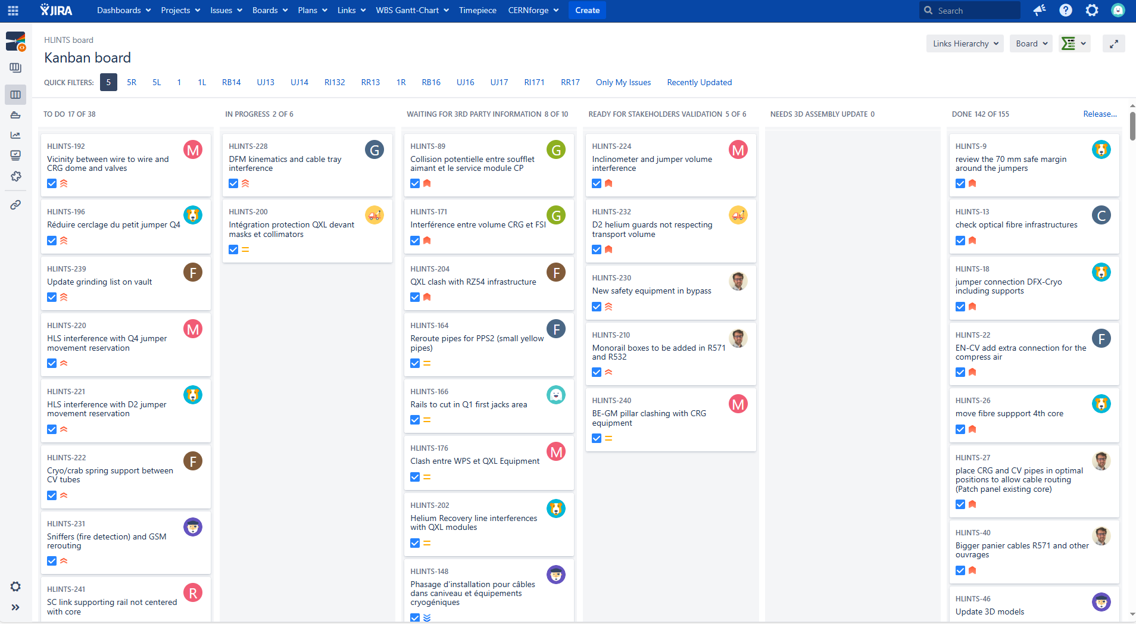
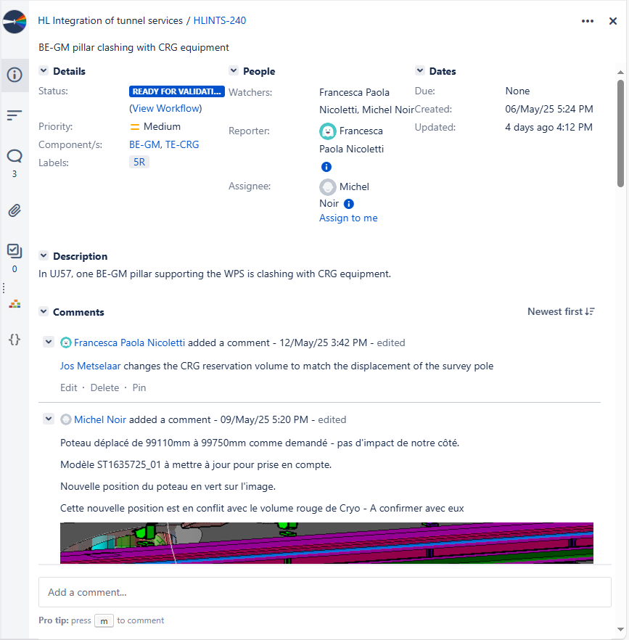
Kanban board overview

Slide 13
Summary & Takeaways
Report “HL-LHC LSS5 INTEGRATION APPROVAL PHASE I”: EDMS 3301467
Deadline for comments: 22.05.2025

Slide 14
Thank you for your work !
Credits: Paolo Fessia, Michele Modena, Stephane Maridor, Nicolas Joannon
and all contributors involved in this work !

