Slide 1
View on recent results of ATLAS and CMS
Paris Sphicas
CERN & University of Athens
Amsterdam Particle Physics Symposium
Nov 30, 2011
Prelude – reasons for this talk
  (High) expectations from the LHC
A quick tour of pp collisions at 7 TeV
  Strong interaction physics (jets, QCD); Electroweak signals (W/Z production & properties); The top quark (still there)
Searching for New Physics
  Closing in on the Higgs; evidence for new physics!
  Where is SUSY? Searches for exotica
So what next? More data (lumi?); higher energy?
Summary

Slide 2
Summary of the talk (I)
At 95% CL:
  APPS participants are aware of the fact that the LHC has had a spectacular year, breaking luminosity records and all expectations
  Most people are aware of the incredibly successful operation of ATLAS and CMS
  Standard model (SM) of particle physics reigns supreme in pp collisions at 7 TeV
  The mass of the SM Higgs boson is not in the ranges M_{H}<114 or M_{H}>141 GeV
  R_{P}-conserv: gluinos, 1st/2nd-gen squarks, not lighter than ~0.5TeV
  There exist no new resonances with mass <~2 TeV
  There are no spectacular signatures from objects of mass ~few TeV decaying “democratically” to lots of jets, MET, leptons....
  Most of the information in this talk is already well known
  Standard model of human behavior reigns supreme in pp collisions at 7 TeV (some level of worry has set in; still in control)

Slide 3
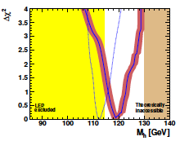
Summary of the talk (II)
At 100% CL, all the reasons for building the LHC are still there, intact:
  The WW cross section regulator is still missing. (S)he must be there before we explore fully the 1 TeV.
    Old name: “LHC no-lose theorem”; new name: “not finding the Higgs is a major discovery”
  Any (reasonable) M_{H} unnatural; Higgs needs its own regulator
    Old name: SUSY; New name: SUSY; its main prediction is (so far) vindicated ☺
    Old CW: SUSY around the corner; New CW: she’s in the third generation (stop, sbottom)
  Other stuff:
    Extra-dimension physics, new gauge
    bosons, leptoquarks, fourth fermion
    Generation, quark substructure…
    Still huge space of unexplored physics
The best has yet to come – read on.
Mastercode

Slide 4
What was (and still is) expected from the LHC?
The question: why where the
“expectations from the LHC” so, so very high?

Slide 5
What (new elements) the LHC experiments bring in
All that has been developed and learned up to “now” is “in” CMS and ATLAS
  With the exception of track and vertex triggering [UPGRADES!]
  The precision of all devices and their coverage represents major steps forward with respect to the previous generation
There are two major new elements brought in:
  Tough: rad-hardness; can withstand huge luminosities
  Quick: can process 100 kHz of Lvl-1, can store 500-1000 Hz
Both summarized in “extreme selectivity”

Slide 6
30 years (1980-2010) spent in looking for the
“completion or the breakdown of the Standard Model”
One machine that-was-not-to-be (SSC)
One machine-that-was-to-be (LHC)
And in between, we were told to “excite the public”
(and excite we did: outreach information is up by two orders of magnitude)
Conventional Wisdom (pre-LHC startup):
“Turn on the LHC and find Higgs & SUSY”

Slide 7
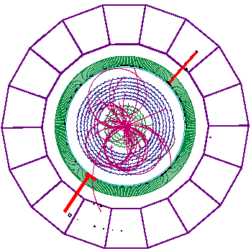
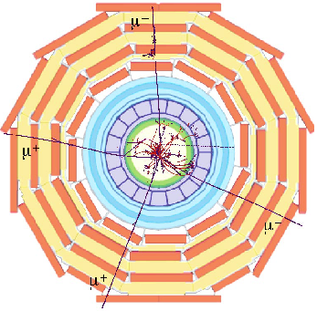
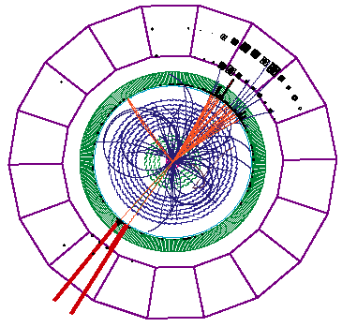
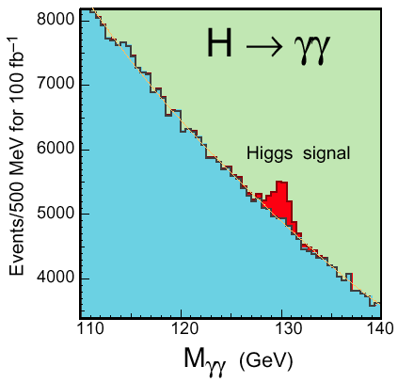
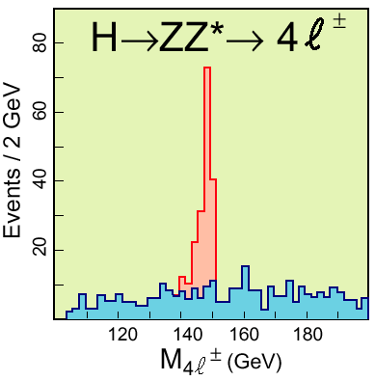
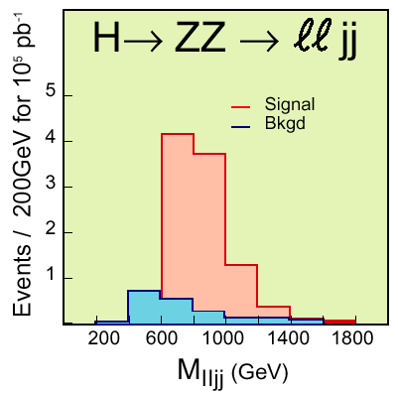
“Turn on the LHC and find Higgs & SUSY”
ATLAS and CMS were designed to do this; they were (are) “guaranteed” to find the Higgs – . ; “easily”.
Transparency from 1997

Slide 8
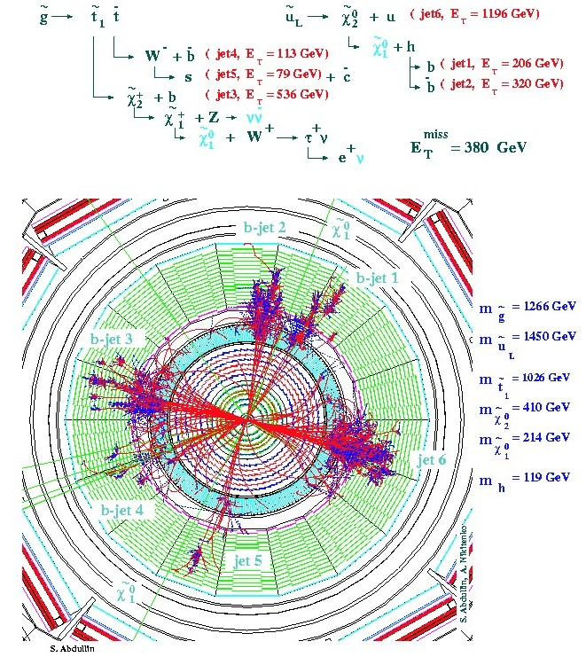
“Turn on the LHC and find Higgs & SUSY”
ATLAS and CMS were designed to do this; they were “guaranteed” to find the Higgs – period; right away
  In fact: SUSY is strongly produced, so will be observed first
    For the “impatient”: join SUSY physics group
Many hard Jets
Large missing energy
  2 LSPs
  Many neutrinos
Many leptons
In a word Spectacular!
Text & simu from 1999

Slide 9
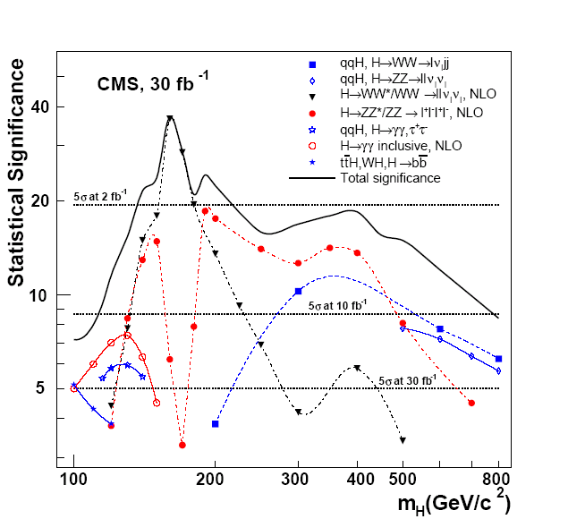
“Turn on the LHC and find Higgs & SUSY”
ATLAS and CMS were designed to do this; they were “guaranteed” to find the Higgs – period; right away
  In fact: SUSY is strongly produced, so will be observed first
    For the “impatient”: join SUSY physics group
    For the “patient” ones: join the Higgs group
The LHC can probe the entire set of “allowed” Higgs mass values;
  in most cases a few months at 10³³cm⁻²s⁻¹ are adequate for a 5σ observation
Text & simu from 2006

Slide 10
Turn on the LHC and find Higgs & SUSY
ATLAS and CMS were designed to do this; they were “guaranteed” to find the Higgs – period; right away
  In fact: SUSY is strongly produced, so will be observed first
    For the “impatient”: join SUSY physics group
    For the “patient” ones: join the Higgs group
  For all others:
    For those who like smaller analyses: join the Exotica group
    For those who like finding something:
      QCD, EWK, B physics, …

Slide 11
Surprise #1

Slide 12
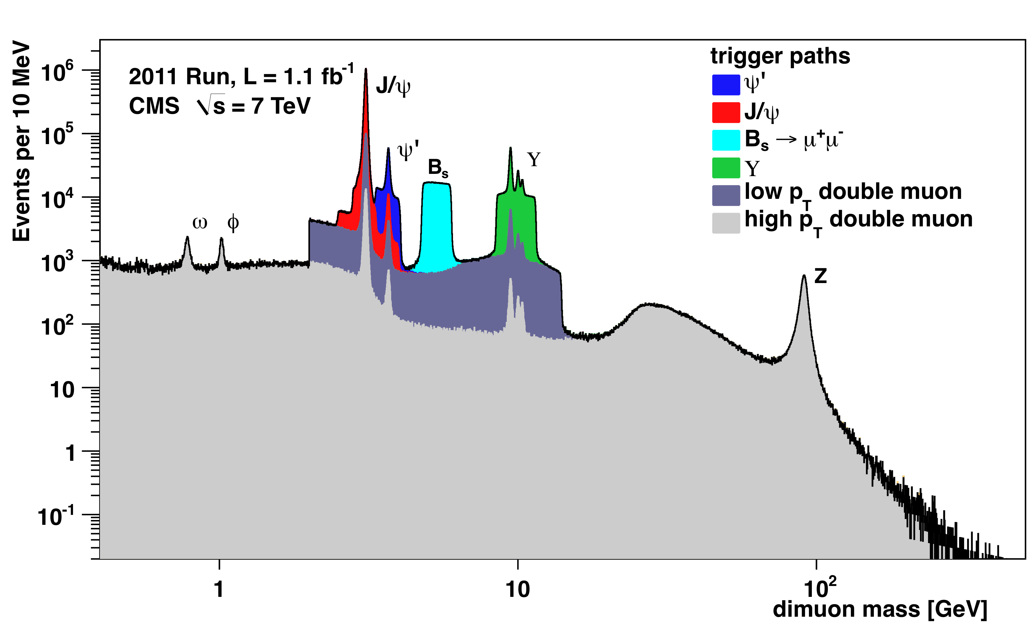
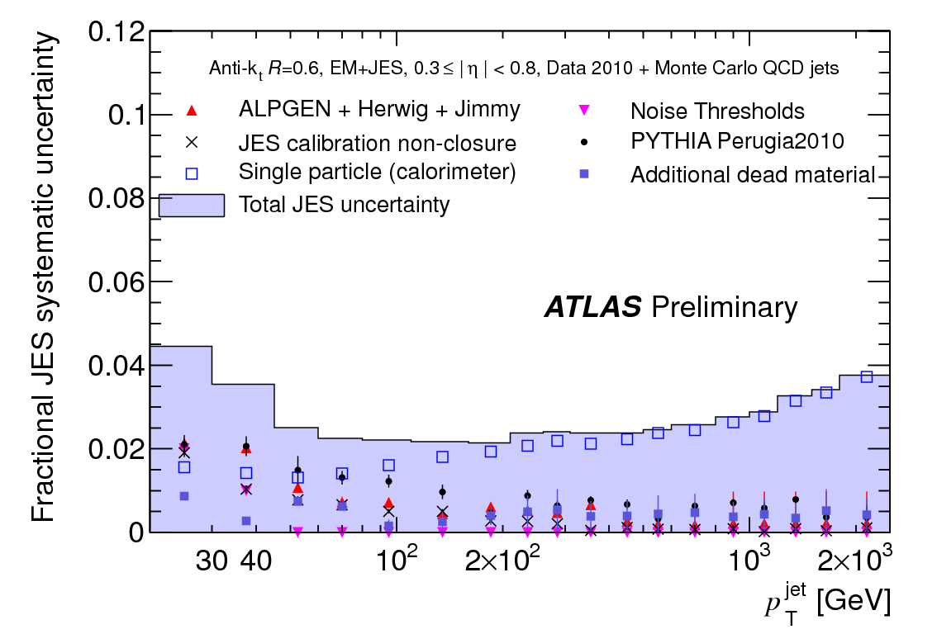
Really fast turn-on: detector performance
The startup of the experiments was the biggest discontinuity with the past: it was fast and efficient.
3 %
Standard Candles
2011 pileup → higher prel. JES error for E_{T}<100 GeV jets ( ±2-5% for |η|<2.1 )

Slide 13
So what followed?
The LHC Tour de Force

Slide 14
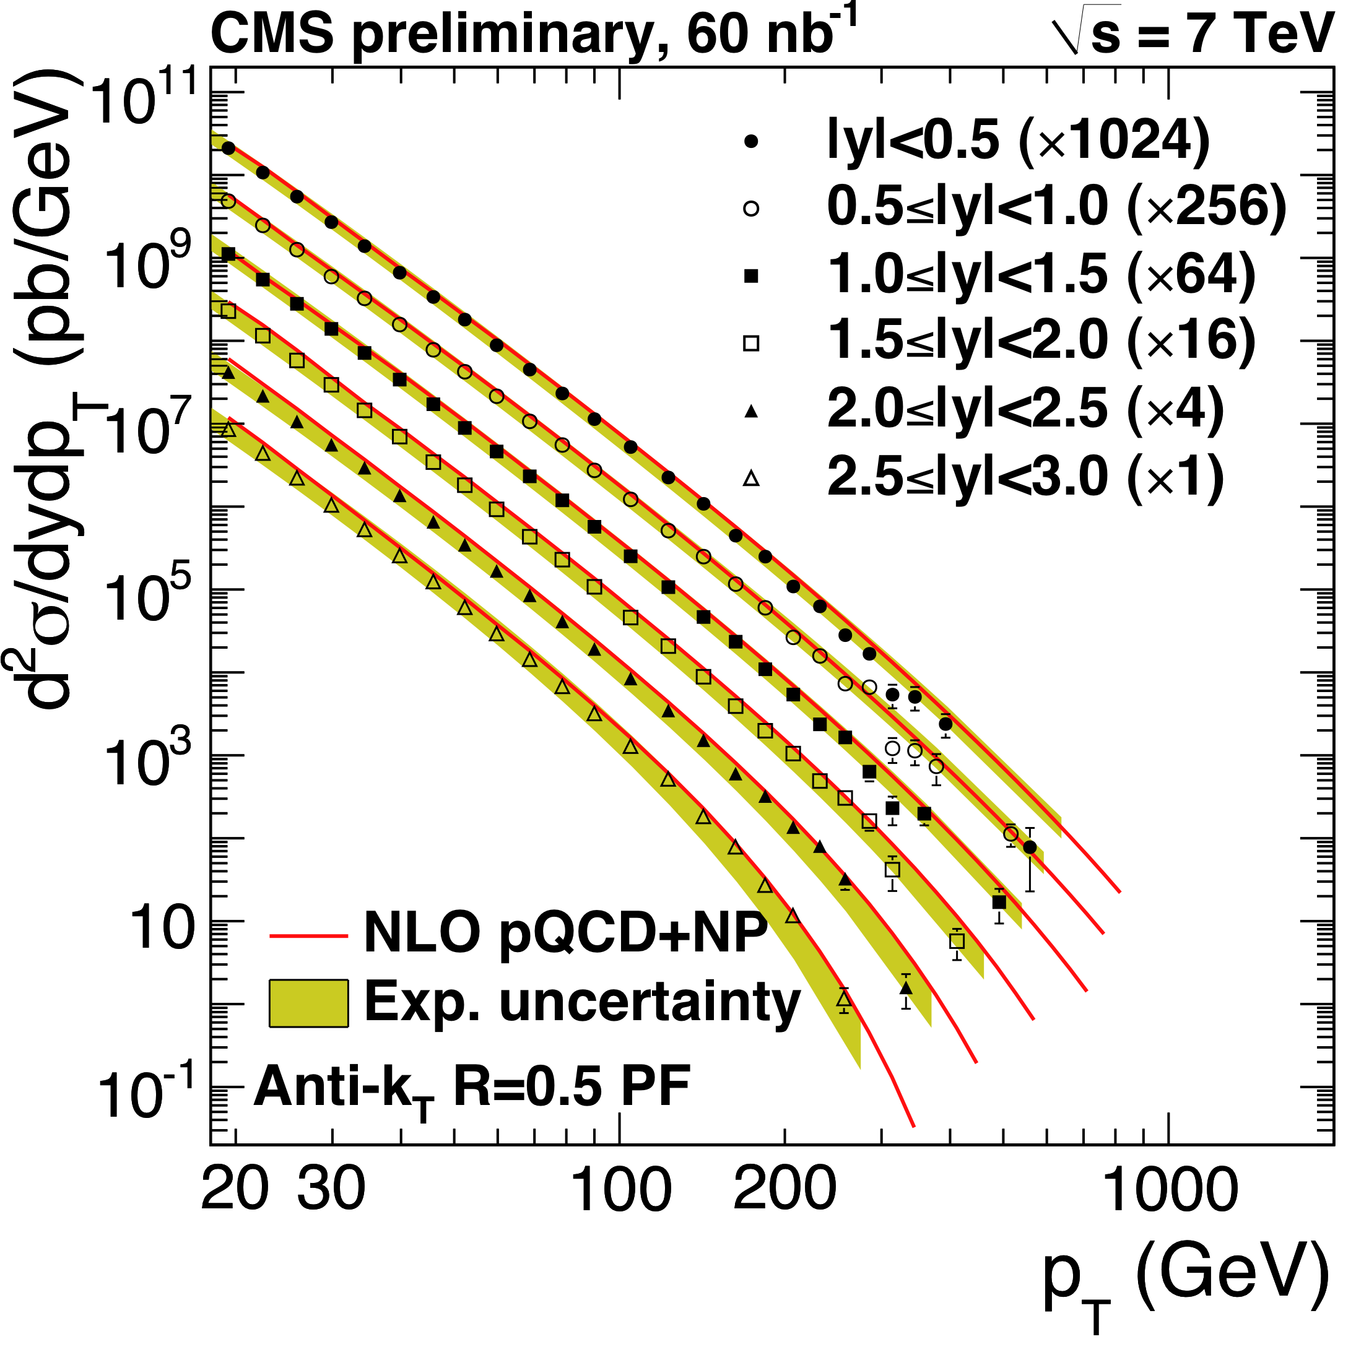
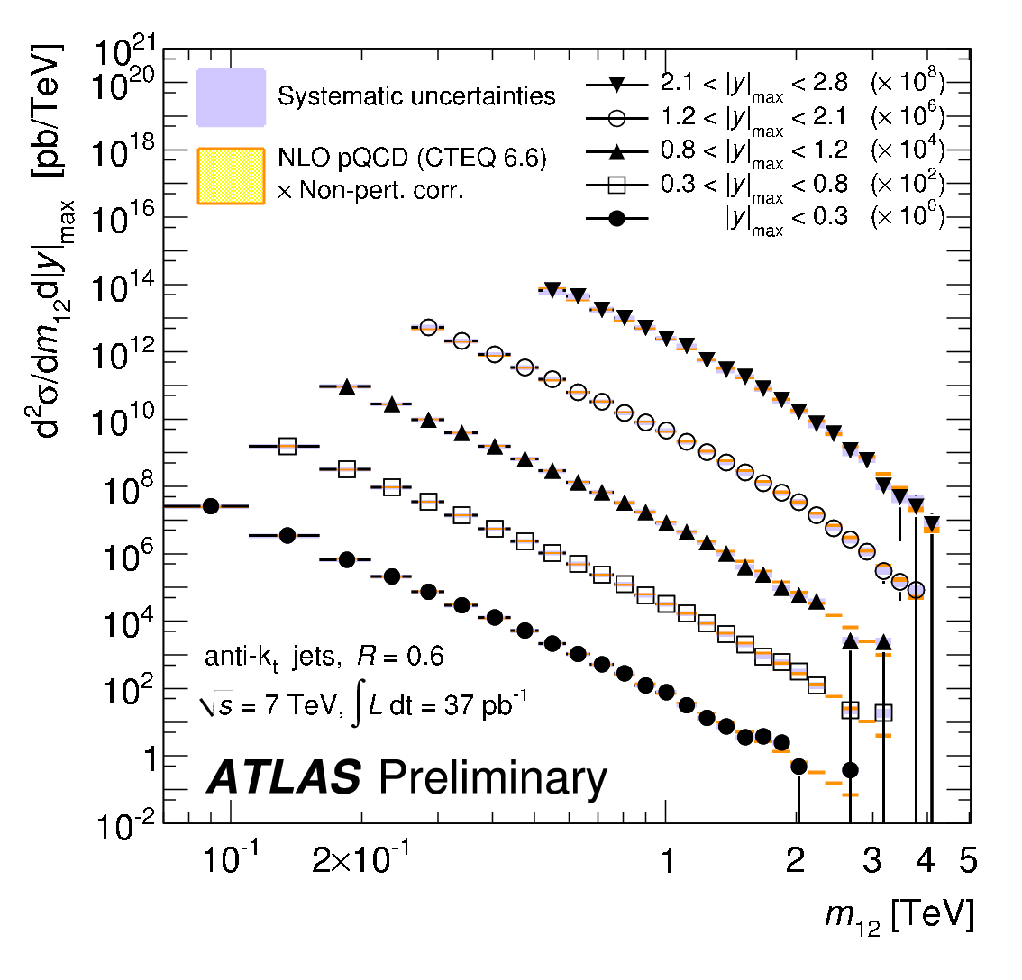
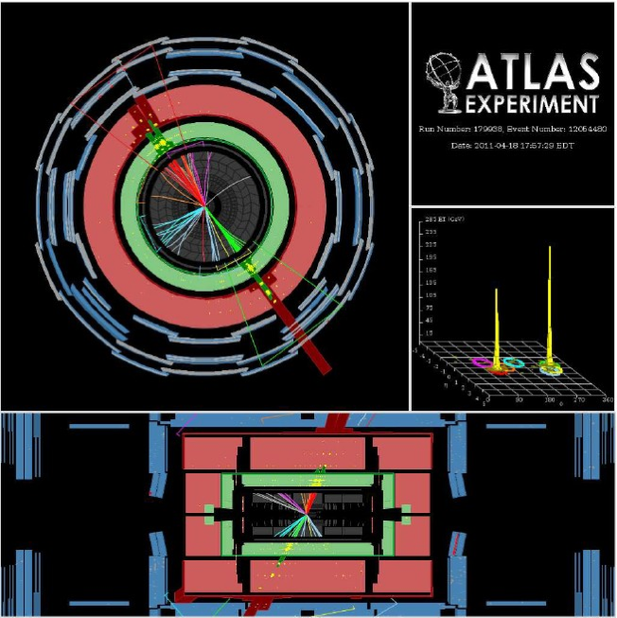
Jets
  M_{jj} = 4.04 TeV
  P_{T}¹ = 1850 GeV, η= 0.32
  P_{T}² =1840 GeV, η=-0.53
To probe the hard scatter:
  The hard scatter: jet P_{T} and η, dijet correlations, dijet mass,…
Excellent agreement with QCD

Slide 15
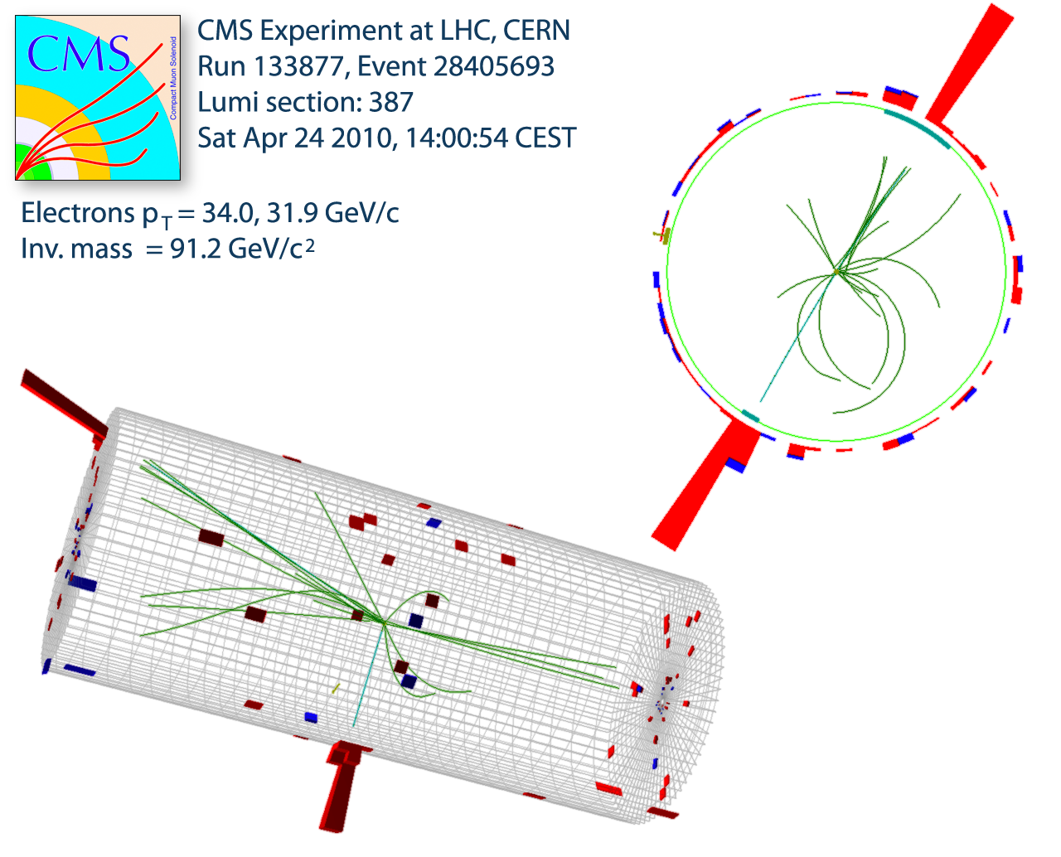
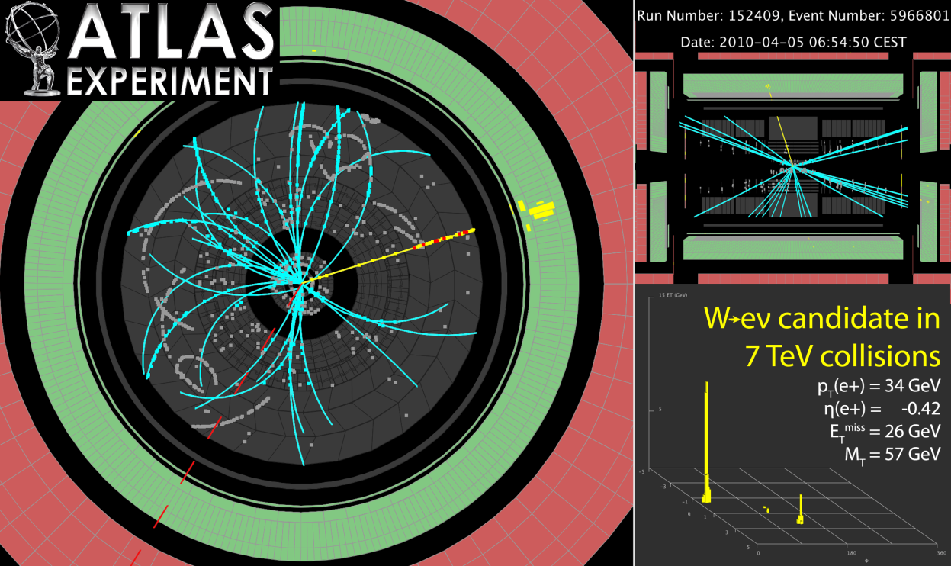
W/Z at 7 TeV: (still) clean & beautiful
Z → electron + positron
W → electron + neutrino

Slide 16
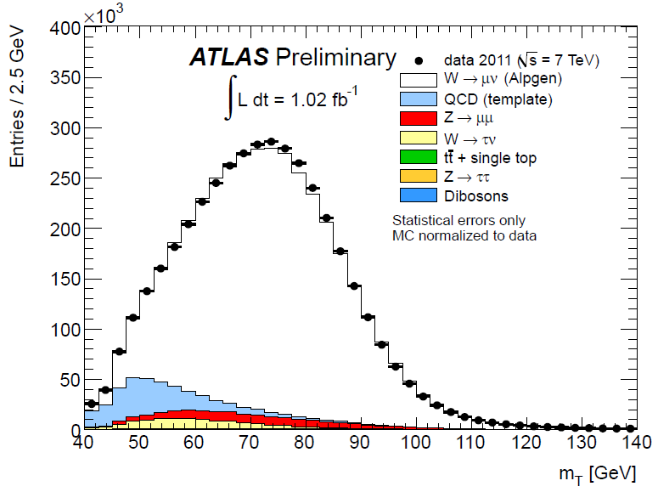
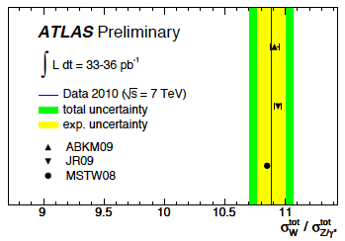
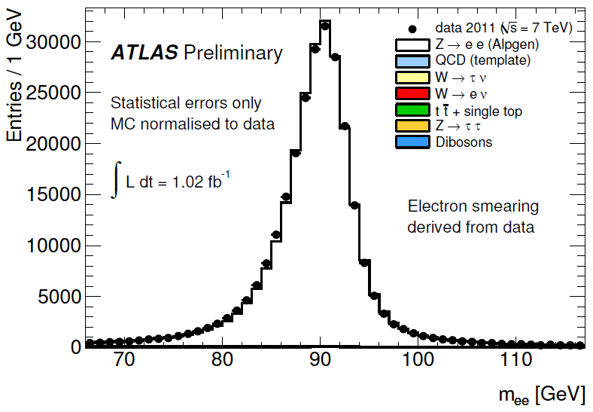
W/Z production (+LHC-specific obs)
Excellent agreement between data and simulation
Good agreement with NNLO+PDF theory predictions
Move to “new environment”:
  σ(W⁺)≠σ(W–) (~1.4)
  W polarization
W→μν
~4.3 M W→μν
Z→ee
264k Z→ee

Slide 17
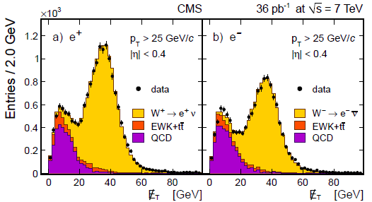
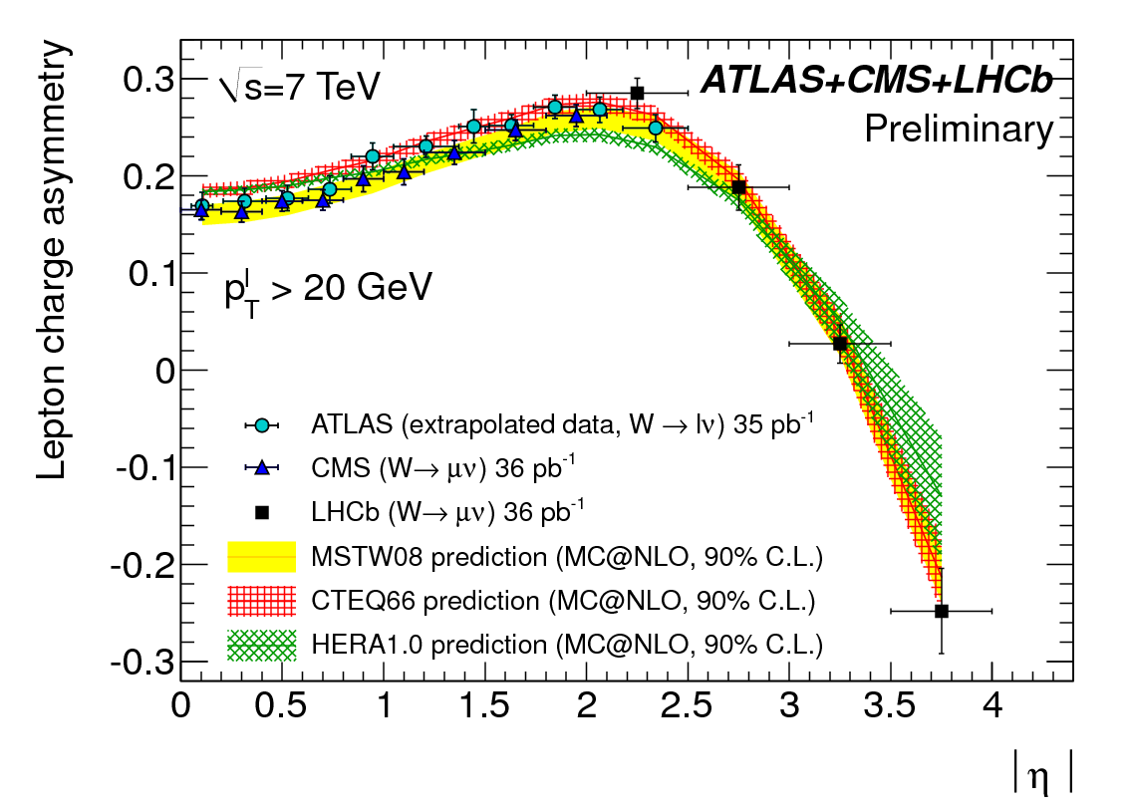
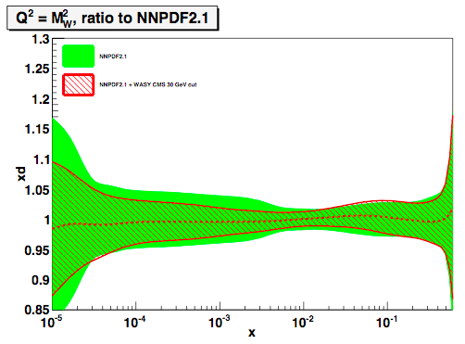
W production: charge asymmetry
Split samples in η; fit W⁺, W–.
In 10^{–3} < x < 10^{–2}:
measurement already improves d,u,q-bar PDFs by >40%
ATLAS-CONF-2011-129
LHCb-CONF-2011-039
CMS-EWK-10-006 (aXiv:1103.3407)

Slide 18
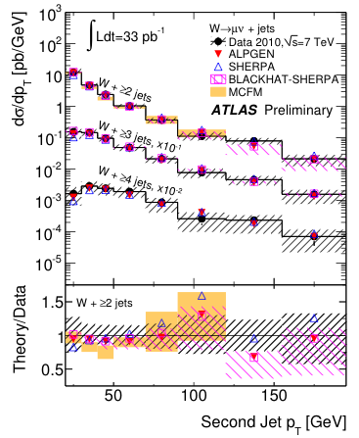
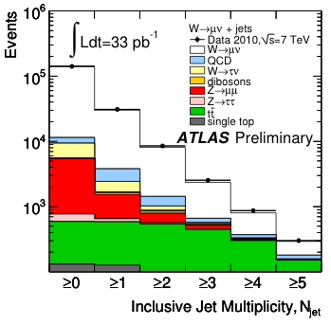
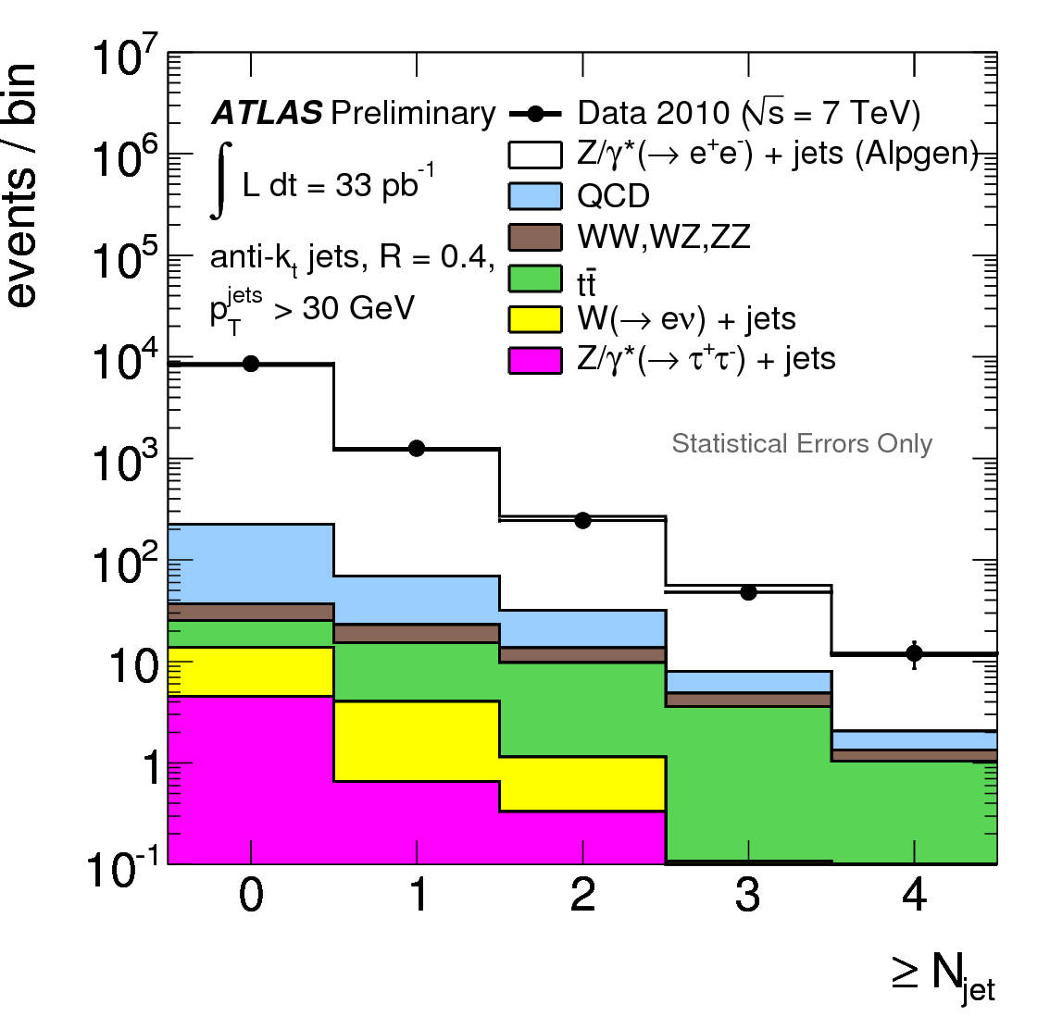
W/Z + jets
Background for top and new physics; especially at high p_{T}(W/Z); each jet “costs” ~α_{s}
Jet multiplicity and p_{T} distributions
  Good description by state-of-the art QCD NLO calculations and LO multi-parton generators
W+jets
Z+jets

Slide 19
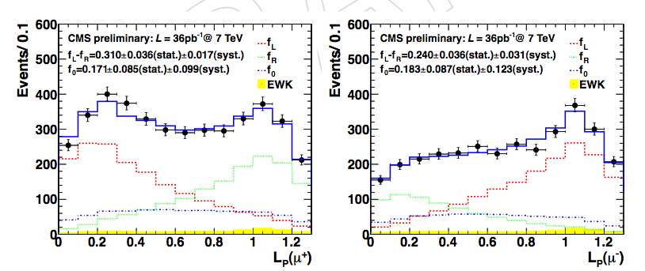
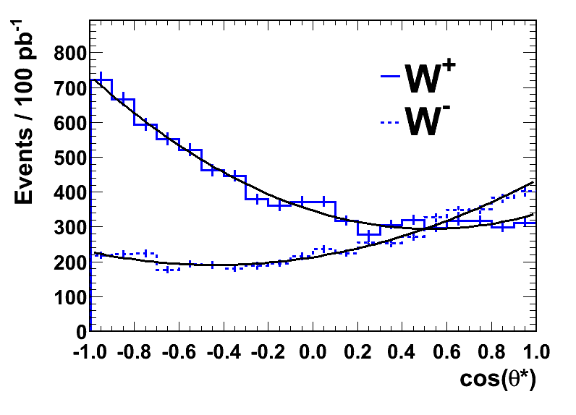
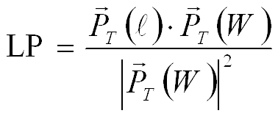
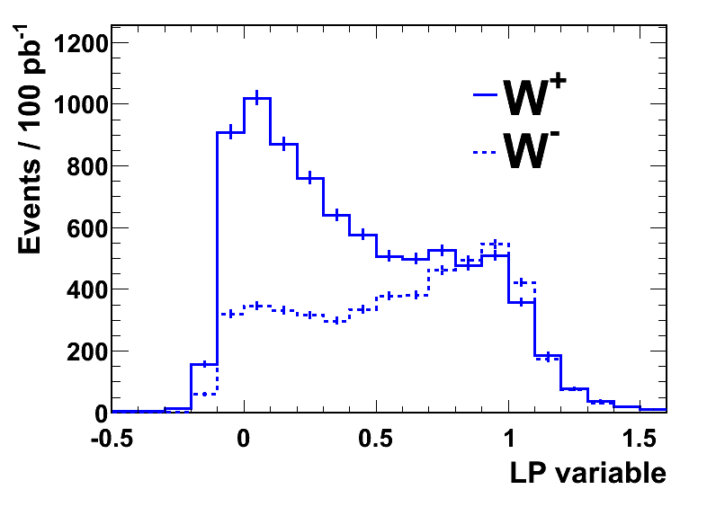
LHC-specific: W polarisation in pp
Production of high P_{T} (>50 GeV) W bosons:
  Valence quark – gluon (q_{v}-g) dominates. Strong polarisation effects in transverse plane at LHC expected.
  Initial states and CP counterparts not present in equal amounts at pp collider in contrast to pp-bar (Tevatron)
  ➔ W’s produced in pp are mainly left-handed.
CMS z-dir
W⁺
W–
 | Combined Result
(f_{L}-f_{R})– | 0.226 ± 0.031 (stat) ± 0.050 (syst)
(f₀)– | 0.162 ± 0.078 (stat) ± 0.136 (syst)
(f_{L}-f_{R})⁺ | 0.300 ± 0.031 (stat) ± 0.034 (syst)
(f₀)⁺ | 0.192 ± 0.075 (stat) ± 0.089 (syst)
helicity
helicity
Preferred W spin directions
W+1jet dominant production mechanism at LHC (not a Feynman diagram)
However: cannot measure cosθ* (missing neutrino)
HiggsHunting Workshop
19
July 28-30, 2011
Notes:
19

Slide 20
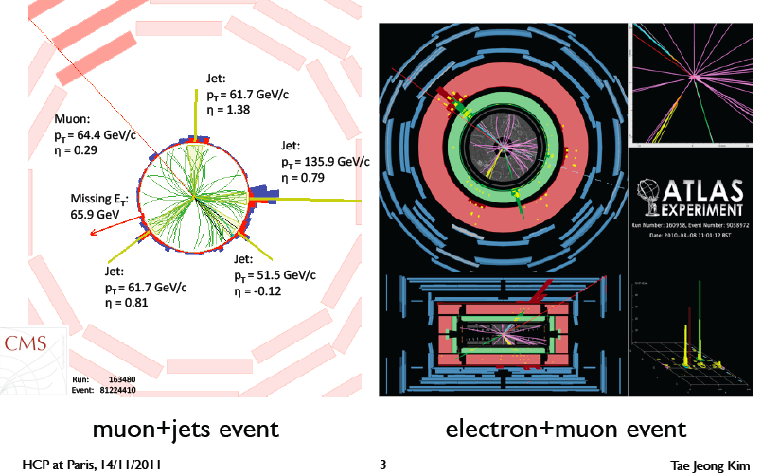
The most complex SM signal: the top

Slide 21
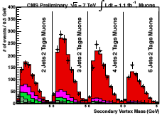
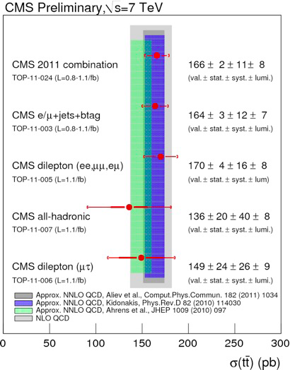
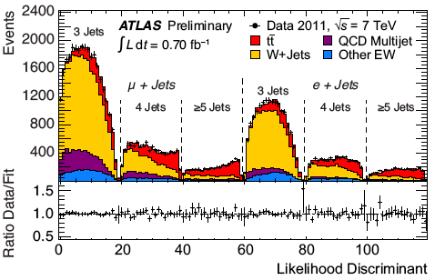
Top physics @ 7 TeV

Slide 22
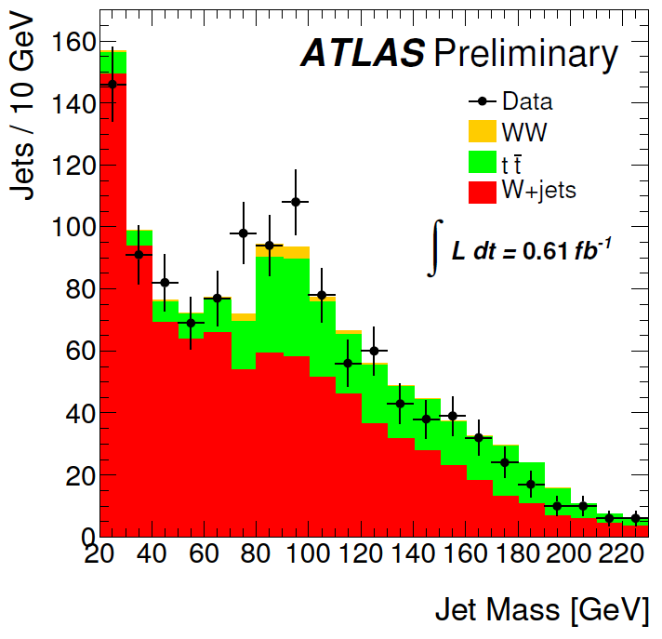
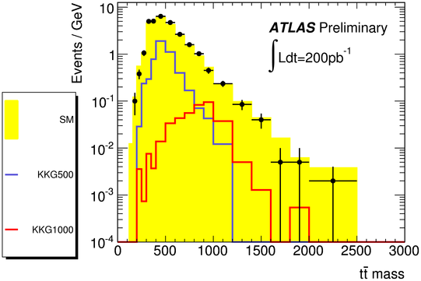
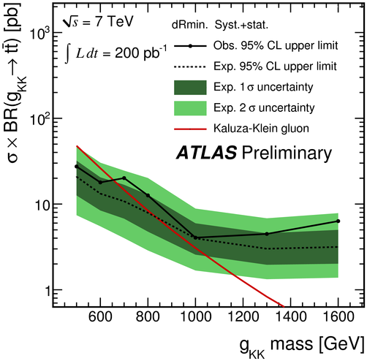
The biggest new tool: jet substructure
Reconstruct semileptonic tt events; look in m(t-tbar) distribution for possible resonances
Events with W→ℓν with p_{T}(W)>200 GeV
Mass distribution of split & filtered subjets with p_{T}>180 GeV
Evident hadronic W peak from boosted tt
Promising for the future
Next stop: High-P_{T} VH!

Slide 23
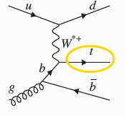
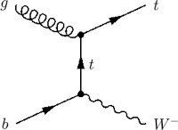
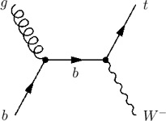
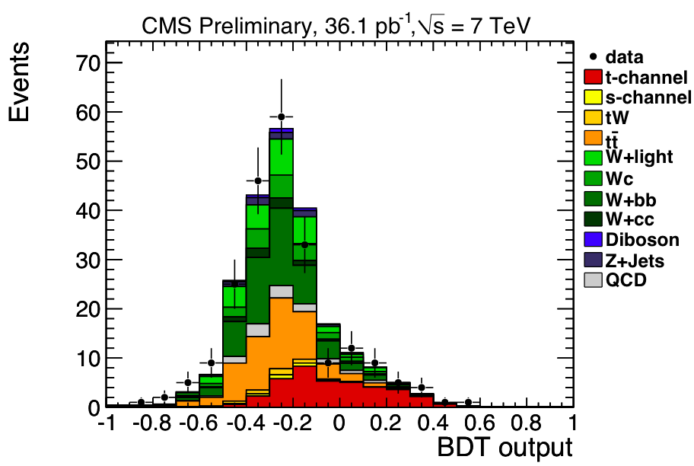
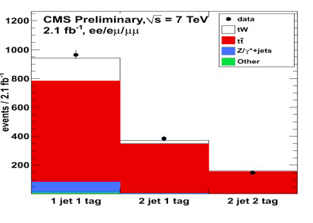
Small, tricky signals as well
Single-top production
t channel: 63 pb
Wt channel: 10 pb

Slide 24
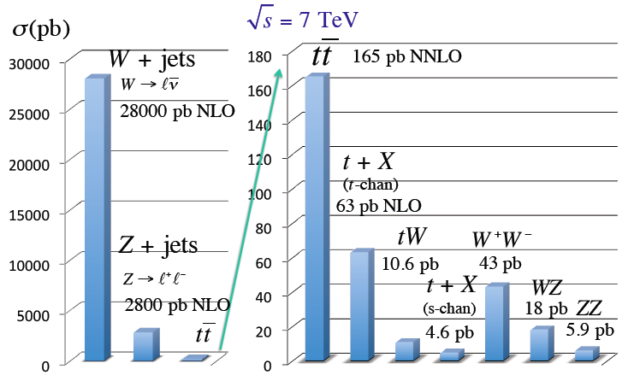
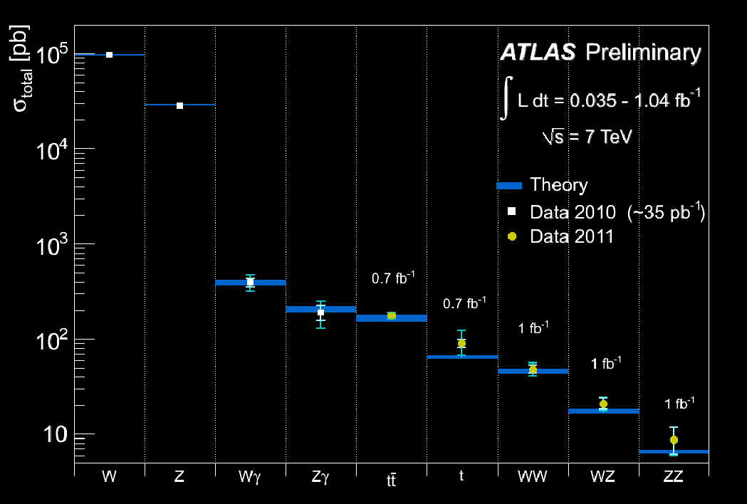
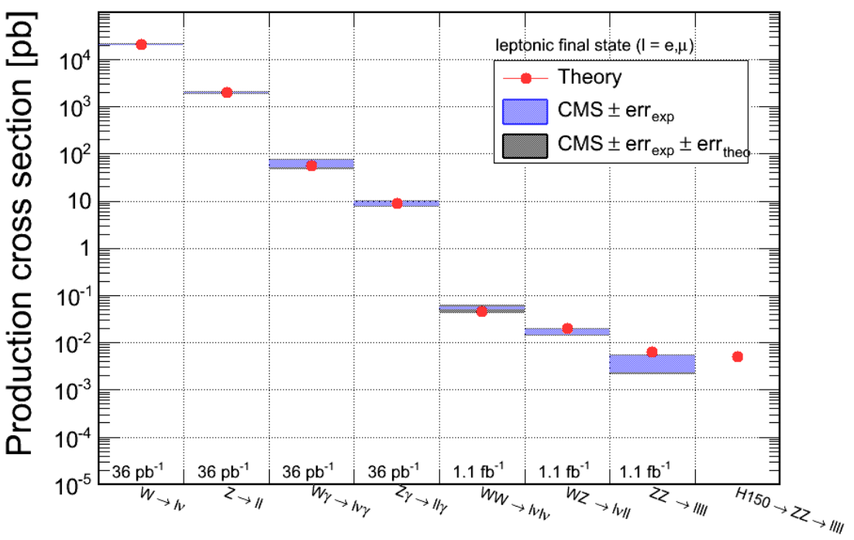
Standard model in pp collisions @ 7 TeV
V. Sharma
LP 2011
ATLAS @
EPS 2011
CMS @
EPS 2011

Slide 25
Closing in on the Higgs

Slide 26
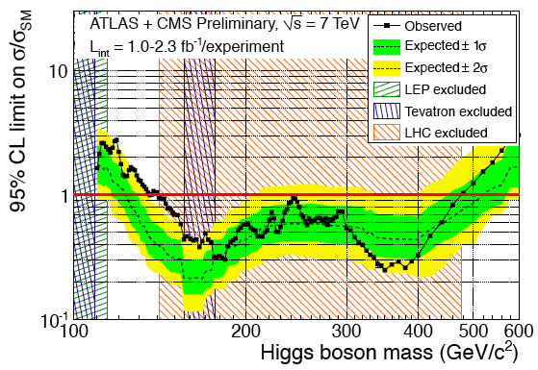
A big hint that new physics is “there”
HCP 2011: combination of ATLAS + CMS
  At 95% CL: Higgs not in 141-476 GeV
  At 90% CL: Higgs not above 132 GeV (!)

Slide 27
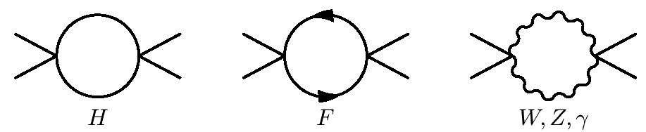

Scale of New Physics = F(M_{H})
V(φ)
Q²→∞, λ →∞!
φ
+
≠
V(φ)
φ

Slide 28
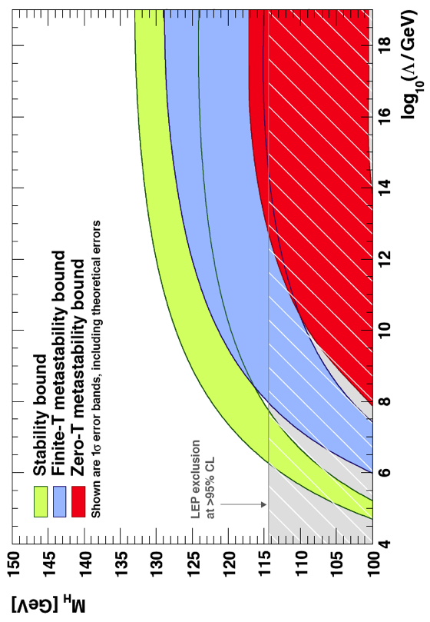
Zooming in: some good news
At 90% CL: there Is new physics at a scale below the GUT scale ☺
10¹⁸
10¹⁶
10¹⁴
10¹²
10¹⁰
10⁸
10⁶
10⁴
Excluded at 95% CL
Excluded at 90% CL
allowed region
100 110 120 130 140 150
M_{H} (GeV)

Slide 29
Where is the new physics?
Searches for signs of exotic New Physics

Slide 30
Many (many) possibilities
Compositeness; new contact interaction(s)
Exotica:
  Leptoquarks
  New gauge bosons (W’, Z’) – or resonances
  Fourth generation (b’)
  TeV-scale gravity: Black Holes; mono-jets; mono-photons; UED
    Universal Extra dimensions (diphotons)
Supersymmetry
  Squarks and gluinos
    Decays into jets and MET plus 0, 1 or 2 leptons
    Decays into photons (GMSB)
SUSY-based exotica
  Long-lived particles
The totally unexpected

Slide 31
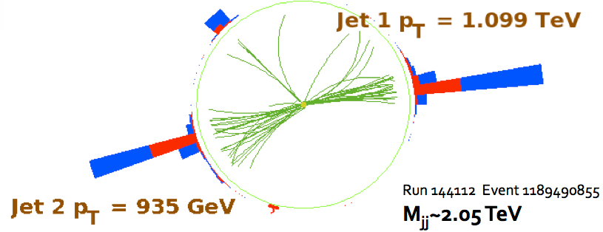
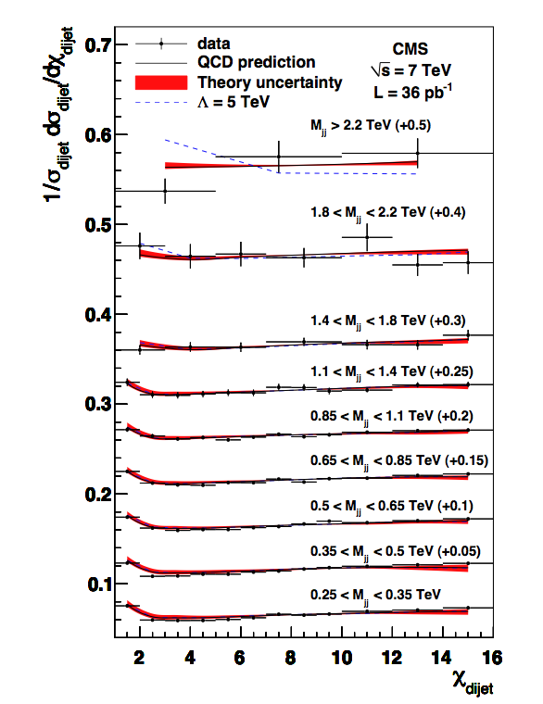
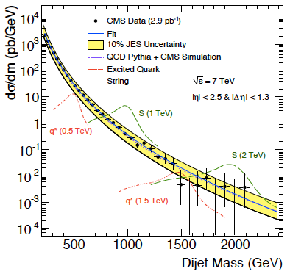
Searches…
36pb⁻¹
Scale of contact interaction Λ>5.6 TeV (95% CL)

Slide 32



(Null) search for W′
2011 update:
1.03 fb⁻¹
Combined (SSM) limit:
M(W’)>2.20 TeV obs
M(W’)>2.27 TeV exp
2011 update:
1.13 fb⁻¹

Slide 33





(Null) search for BHs
arXiv:1012.3375
Expect lots of activity in the event, so
  Use S_{T} = Sum E_{T} of all objects (including ME_{T}) with E_{T}>50 GeV.
    Great against pileup (in the future as well)
Key for search: S_{T}-invariance of final state multiplicity
  A posteriori wisdom: FSR/ISR collinear do not affect S_{T} a lot
Use N=2 shape (with uncertainties) to fit higher multiplicities – where signal more prominent
A candidate event with 10 jets and S_{T} = 1.3 TeV
M_{BH}> 3.5-4.5 TeV
(semi-classical
approximation)
No excess, so set limits on minimum M_{BH}

Slide 34
Supersymmetry

Slide 35




Supersymmetry: TO“E” at the Weak Scale
spin
For a small price increase (one principle plus an unknown SB mechanism → 500% increase in number of parameters), achieves quite a lot:
  No fine-tuning (large radiative corrections cancel)
  If Lightest SUSY Particle stable: offers “natural” dark-matter
  Equality of Strong, Weak and EM couplings at ~10¹⁶ GeV
Despite conventional wisdom, SUSY is actually quite predictive: it specifies spins & couplings of superpartners
  Unfortunately, it tells us nothing about the masses
    For this depends on the SUSY breaking mechanism
  End result: large space of signatures, dependent on models
Huge number of theoretical models
  MSSM-124. Hard work to study particular scenario. Reduce complexity: use model of dynamical SYSY breaking
    mSUGRA (gravity-mediated)
    GMSB (gauge-mediated)
    AMSB (anomaly-mediated; studied in less detail)
boson
fermion
+
= 0
λ²
λ
λ
gauge boson
gaugino
= 0
+
g²
g
g

Slide 36
SUSY search with ME_{T}: summary of 2010
No signs yet. But all analysis methods in place; now need more data (2011!)
Corner around which SUSY would lie
Transp from
March 2011

Slide 37
Surprise #2

Slide 38


In brief: SUSY moving further out
Simplified model: two squark (q) generations, m(χ₁⁰)~0
m_{g}>800 GeV m_{q}>850 GeV
Equal mass case: m_{g}=m_{q}>1.075 TeV
MSUGRA/CMSSM:
tanβ=10, A₀=0, μ>0
Equal mass case:
m_{q}=m_{g} > 980 GeV
2010→2011
2010→2011

Slide 39

Constrained MSSM
Corner around which SUSY used to lie

Slide 40
Then again…
A bit of a self-fulfilling prophecy; early searches were guided by combination of “probability of success” and “obeying the rules”:
  Go after high cross section processes (i.e. accessible at low luminosity ~10-50 pb⁻¹)
  Do not rely on a perfectly working detector: seek robust signatures with good experimental control of “things”
  Do not rely on Monte Carlo; “thou shall use the data” (well, ok, and some Monte Carlo)
  Beat the competition: go after the simplest signatures
We have followed these four guidelines extremely well
  (another reason to rejoice – when we set to do stnhg, we do)
  (another reason to think that there is much, much more)

Slide 41


What the LHC has done to/for the CMSSM
With 1fb⁻¹ of data the amount of naturalness need has diminished to “unnaturally” small values [?!?!]
  CMSSM being cornered. Not excluded [yet] but looking unlikely [e.g. “high fine-tuning price of the LHC” hep.ph/1101.2195]
But: (a) effect of g-2 ?! (b) SUSY >> CMSSM
68% CL
95% CL
….. pre-LHC
___ LHC@1fb⁻¹
without
g-2
CMSSM
NUHM1
MasterCode Project (Oliver Buchmüller et al)

Slide 42

SUSY is far from excluded (let alone dead)
Simple models (e.g. universal soft masses) being squeezed
Numerous other scenarii still very much unprobed [thus very unconstrained]. Two examples:
  Large flavor splitting: very heavy squarks [1st, 2nd gen], light 3rd gen (plus gluino at ~1-1.5 TeV)
  Low ME_{T}: not only within R_{p}-violation; small mass splittings (would be equally lethal to ME_{T} signature)
    Could even have all sparticles with mass < ~0.5 TeV…
Cohen et al (96)
Barbieri et al (07)

Slide 43




SUSY: we will always have the stop
Only the stop (+sb) need be light [e.g. Barbieri @ HCP 2011]
Some incredible signatures…

Slide 44


Recently: use of simplified models
CMSSM
What we see:
much simpler…
Simplified Model Spectrum (SMS)
with 3 particles, 2 decay modes

Slide 45




Simplified Model Spectra
Started with squark and gluino pair-production topologies
Limits are “best of N” searches (usually not a combination)
Black lines are QCD-like cross sections
Theoretical uncertainties like ISR simulation important (under study)
Theoretical uncertainties not included
Caution: usage of SMs is the sole responsibility of the user. SUSY and all its incarnations bear no obligation for any and all hasty conclusions (from SMS’s).
M(gluino)>0.4-0.5 TeV

Slide 46

SUSY: what we do not know
Agnostic approach: consider all possible mass hierarchies: there are 9! = 362880 of them
  ME_{T}: 4x8! (161,280) cases, LSP=weakly-interacting, neutral particle; phenomenology depends crucially on mass hierarchy
  CHAMPs: 8! (40,320) cases, LSP=e_{R} (charged, color-neutral); signature: CHAMP (independently of hierarchy)
  R-hadrons: 4x8! (161,280) cases, LSP=colored object; again, independent of hierarchy
arXiv:1008.2483: “How to look for supersymmetry under the lamppost at the LHC”; P.Konar, K.Matchev, M.Park, G.Sarangi

Slide 47
Heavy Stable Charged Particles
Both in SUSY and other SM extensions:
  SUSY (split SUSY: M(gluino)<<M(squark) → long lifetime; GMSB models: stau NLSP, decaying via gravitational coupling only…)
  Other: hidden valleys; GUTs; …
Two types of signatures: MIP & strongly-interacting
MIP: HSCP passes through tracker & muon chambers
R-hadrons traversing material can flip Q or become neutral
dE/dx: Massive, charged particles traversing detector: highly ionizing tracks (tracker, possibly muon dets)
(Out-of-time) Jet: particles stopping in the detector and decaying – possibly out-of-time with the collisions

Slide 48




Heavily ionizing tracks
Mass estimate from approximate Bethe-Bloch:
  K and C determined from proton data
    Mass resolution: 12% at 300 GeV
Cut on I_{AS} (MIP compatibility) & p_{T} (I_{AS}, p_{T}: uncorrelated)
  Bkg
K=2.58 MeV c²/cm
C=2.56 MeV/cm
600

Slide 49







Stopped gluinos
Slow (β < 0.4) long-lived gluinos hadronize into and then stop in the dense material of the CMS detector
  Their number builds up with luminosity:
They then decay μs, s or day(s) later. Their decay:
Spectacular jets in the absence of beam

Slide 50


A dizzying array of (null) searches

Slide 51
SES (Simplified Exp/ntalist’s Summary)
Effective Theories work extremely well
  They can explain things very, very well: Newton’s Law for the solar system, the point proton for the atom, the standard model for physics at ~10-100 GeV ☺
[As is well known] most important characteristic of Effective Theories: they explain things within a range of energy scales – no pretense of explaining “everything”
  Perhaps our notion of SUSY should give up on solving all three problems (naturalness, grand unification, dark matter) in one shot
    Two out of three would not be a bad scoring average! [Even one!]
  How about resurrecting R_{P}-violating SUSY and leaving dark matter to axions? Or… ? Beyond the loss of “minimality” – would nature [still] be well described [?]
    Free dictionary: “The verb minimize … undergone … extension of meaning. In its strict sense it means "to reduce to the smallest possible level," but quite often the context requires us to interpret what the smallest possible level might be.”

Slide 52
Some near-term prospects

Slide 53

LHC running in 2012: 8 TeV [?]
Enhances physics reach in two ways:
  Higher cross sections for new physics over full mass range
  More integrated luminosity
    @ 8 TeV: 10-16 fb⁻¹ expected (25/50 ns bunch-crossing)
Higgs: pp → H, H→ WW, ZZ & γγ
mainly gg: Factor ~1.2
SUSY: 3rd Gen Mass ~ 0.5 TeV
qq and gg: Factor ~1.5
SUSY: Squarks/Gluino M~1.5TeV
qq,gg,qg: Factor ~4.0
Z’ : Mass ~ 3.0 TeV
qq: Factor ~3.5
SUSY
squarks/Gluino
~1.5 TeV
or
Z’
~3.0 TeV
SUSY
3rd Gen
~500 GeV
Higgs
~ 100 GeV

Slide 54

CMS+ATLAS Projections
Old transp: March 2011
2xCMS≈ATLAS+CMS | Limit @ 95% CL | 3σ sensitivity | 5σ sensitivity
1 fb⁻¹ | 120 - 530 | 135 - 475 | 152 - 175
2 fb⁻¹ | 114 - 585 | 120 - 545 | 140 - 200
5 fb⁻¹ | 114 - 600 | 114 - 600 | 128 - 482
10 fb⁻¹ | 114 - 600 | 114 - 600 | 117 - 535

Slide 55
Summary

Slide 56
Summary
LHC and experiments’ run at 7 TeV truly impressive
  By now the detectors are fully functioning scientific instruments: physics-producing engines
With ~40pb⁻¹ the LHC has observed all particles of the standard model (indirectly, even neutrinos)
  Solid basis for understanding the “background” to searches at higher mass and transverse energy scales
With 1 fb⁻¹ we entered the true Higgs discovery era. With 5 fb⁻¹: discovery [no matter what]
  “SUSY” explorable over very large area with 1fb⁻¹; possible new resonances. Very large reach for other new physics.
  But nobody said it would be easy. May soon have to start looking hard for the more complicated scenarios.
  Perhaps unification should start in the physics [search] groups
Thankfully, there is also always the anthropic principle.
  Anthropically, history repeats itself → we will find the unexpected!
The journey has only just started!

