Slide 1
Statistical aspects of Higgs analyses
W. Verkerke
(NIKHEF)

Slide 2
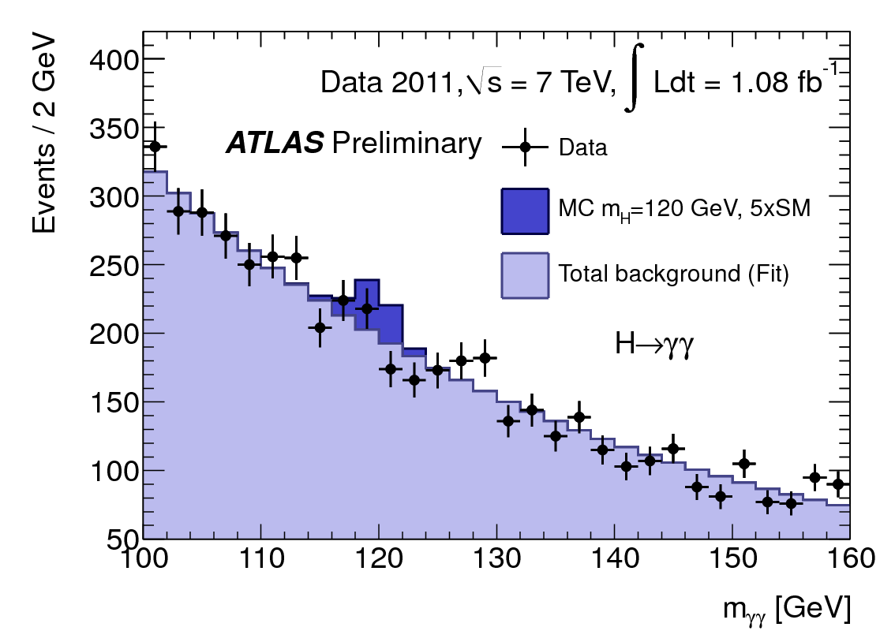
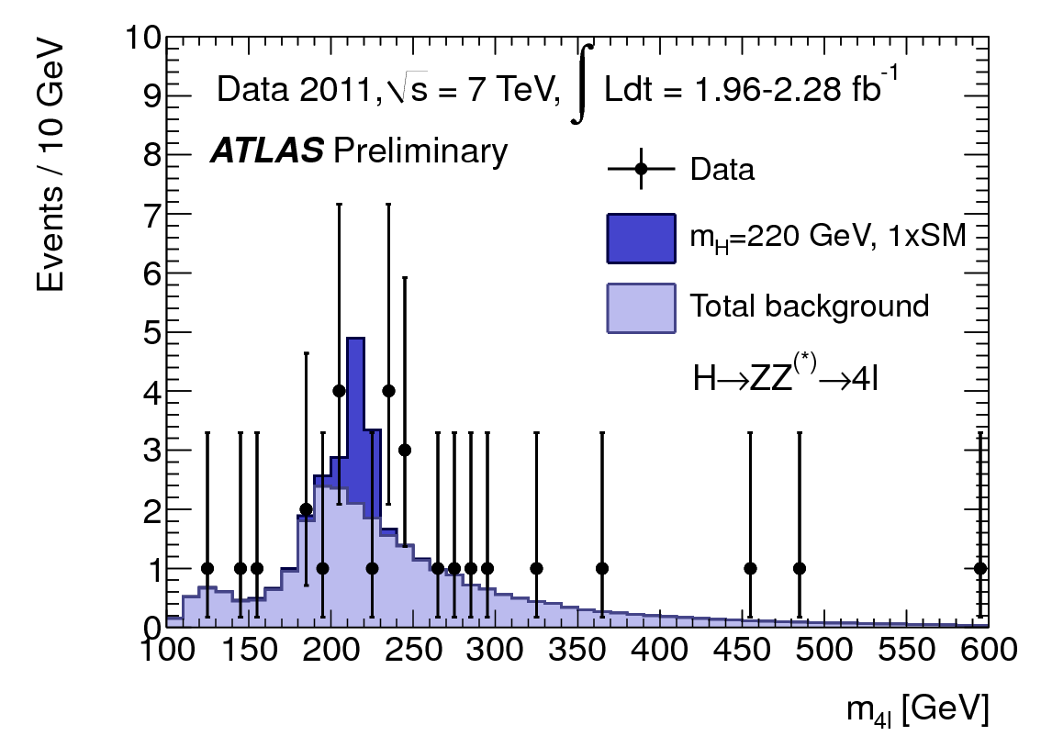
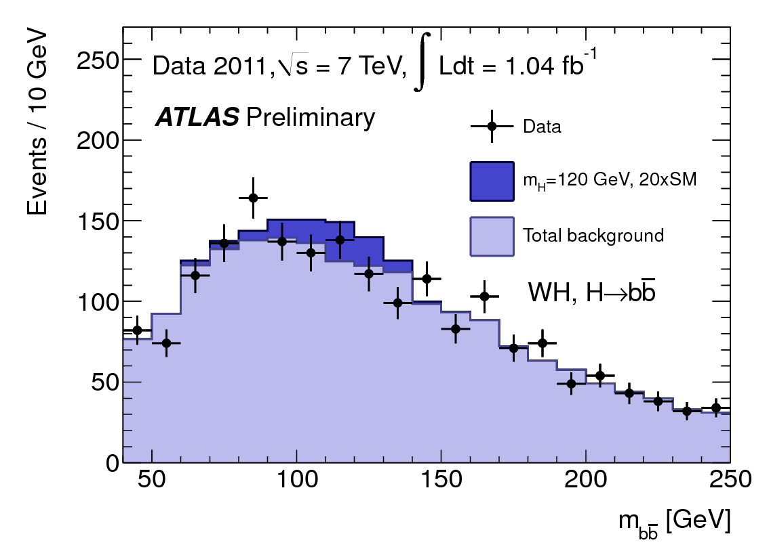
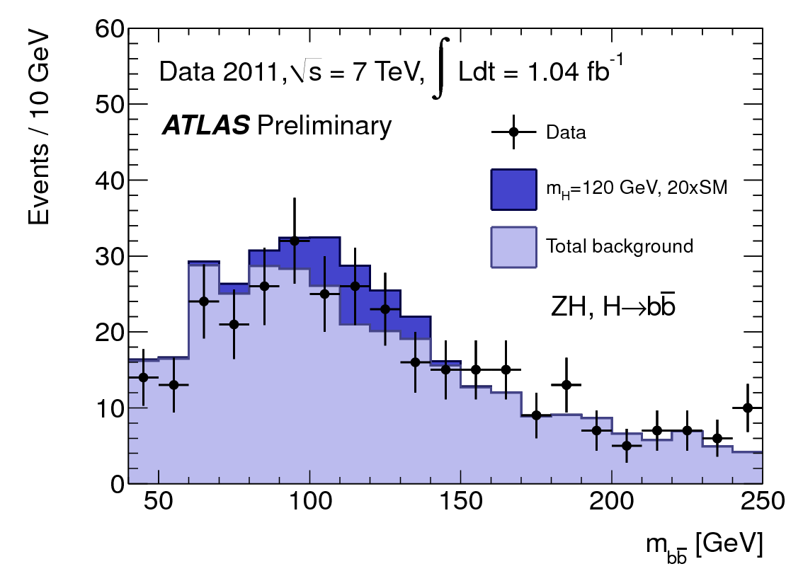
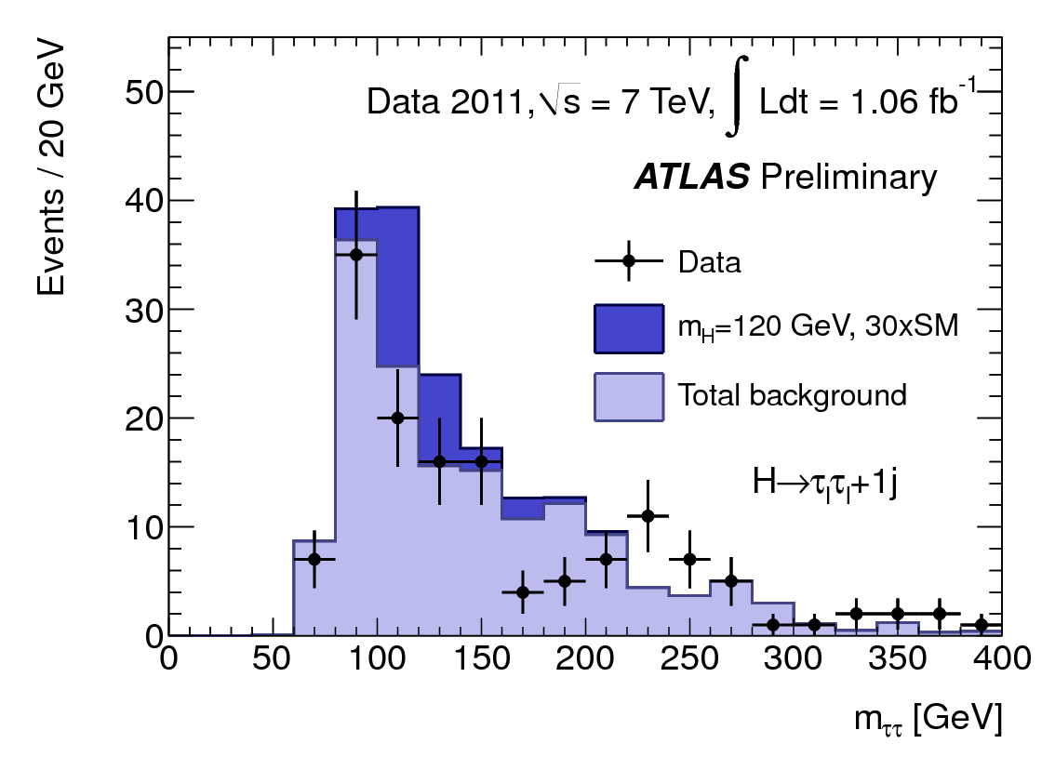
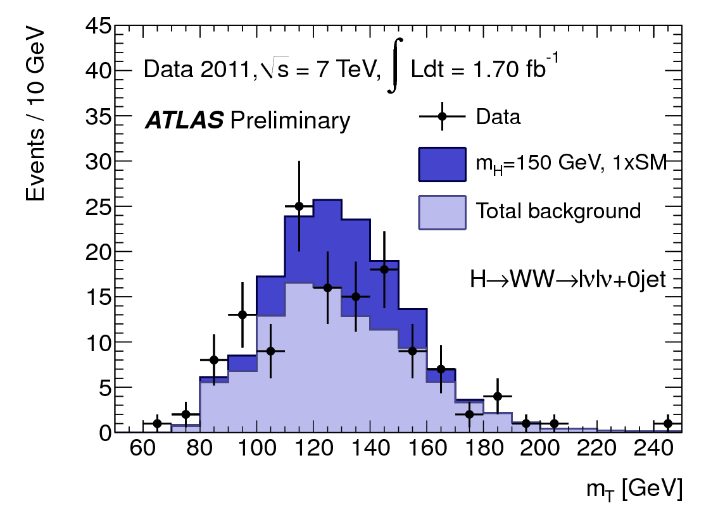
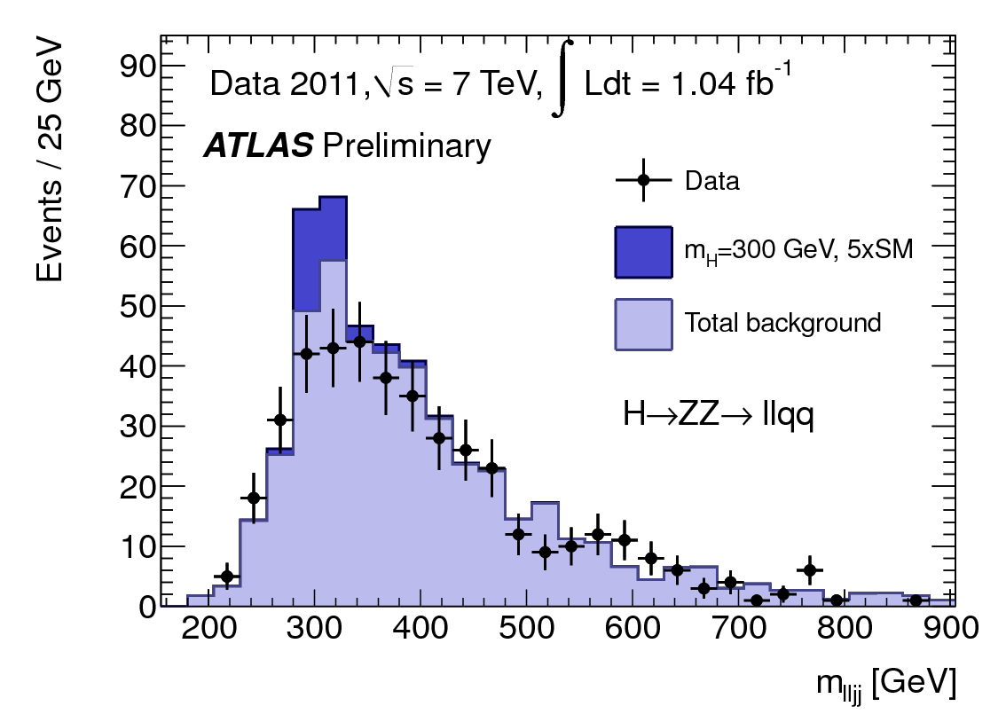
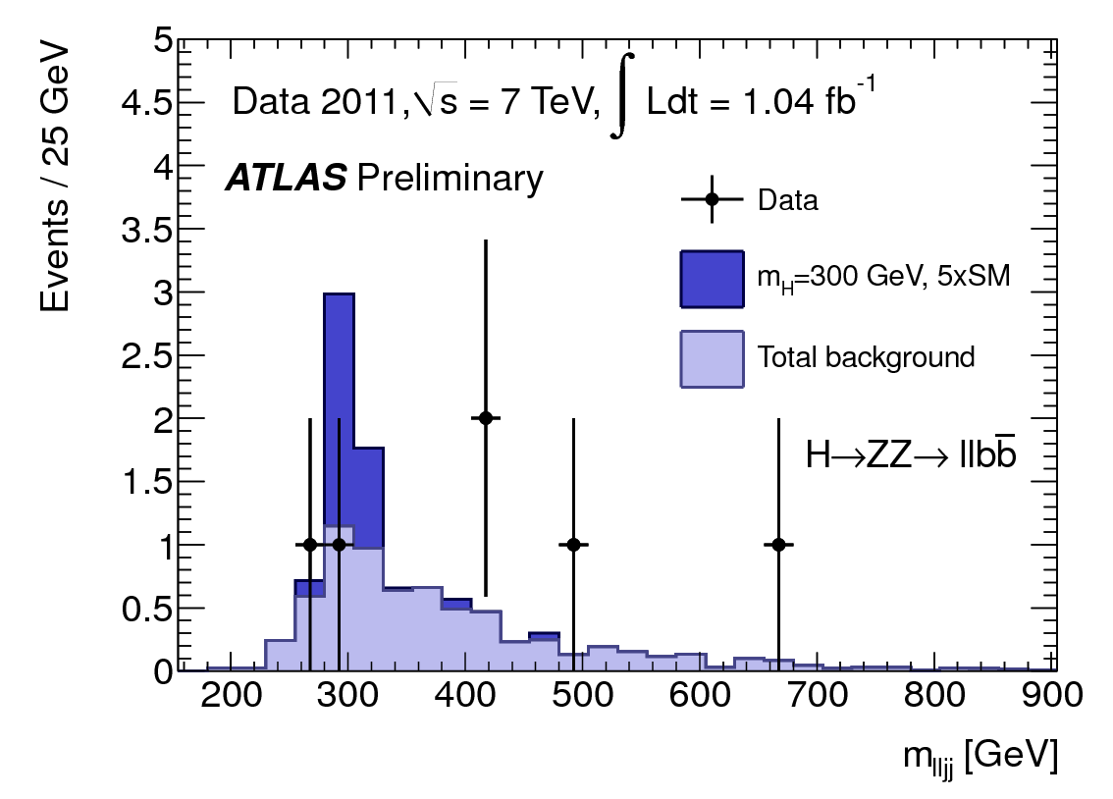
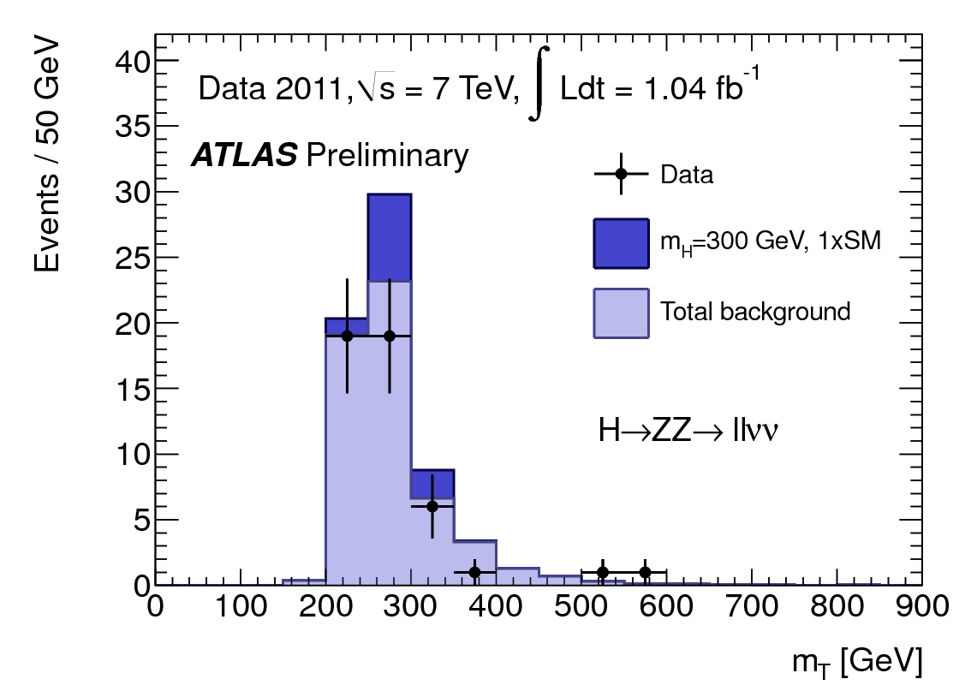
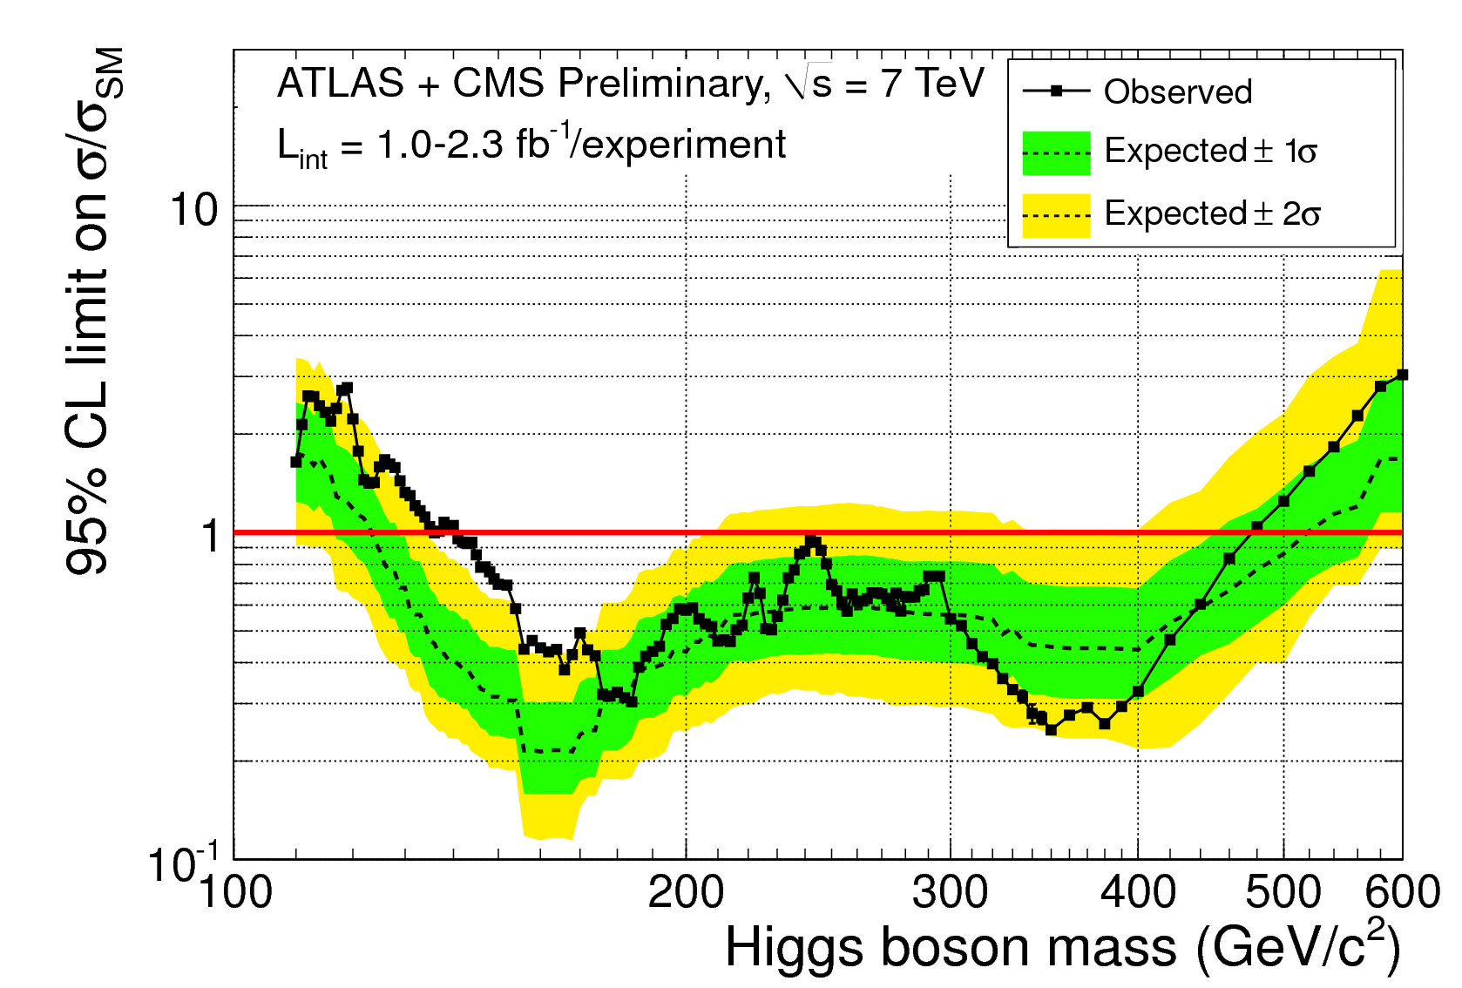
Introduction
Enormous effort to search for Higgs signature in many decay channels
Results → many plots with signal,
background expectations, each with
(systematic) uncertainties, and data
Q: How do you conclude from
this that you’ve seen the Higgs
(or not)?
  Want answer of type:
  ‘We can exclude that the Higgs
  exist at 95% CL”, or “Probability
  that background only caused observed
  excess is 3·10⁻⁷
Here a short guide through how
this is (typically) done

Slide 3
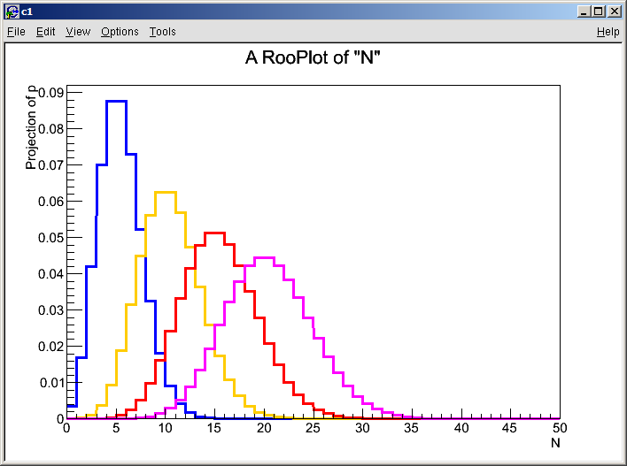
Quantifying discovery and exclusion – Frequentist approach
Consider the simplest case – a counting experiment
  Observable: N (the event count)
  Model F(N|s): Poisson(N|s+b) with b=5 known exactly
Predicted distributions of N for various values of s
s=0
s=5
s=10
s=15

Slide 4
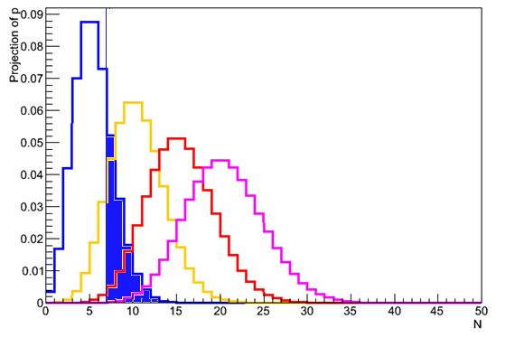
Frequentist p-values – excess over expected bkg
Now make a measurement N=N_{obs} (example N_{obs}=7)
Can now define p-value(s), e.g. for bkg hypothesis
  Fraction of future measurements with N=Nobs (or larger) if s=0
s=0
s=5
s=10
s=15

Slide 5
Frequentist p-values - excess over expected bkg
p-values of background hypothesis is used to quantify ‘discovery’ = excess of events over background expectation
Another example: N_{obs}=15 for same model, what is p_{b}?
  Result customarily re-expressed as odds of a
  Gaussian fluctuation with equal p-value (3.5 sigma for above case)
  NB: N_{obs}=22 gives p_{b} < 2.810-7 (‘5 sigma’)
s=0
s=5
s=10
s=15

Slide 6
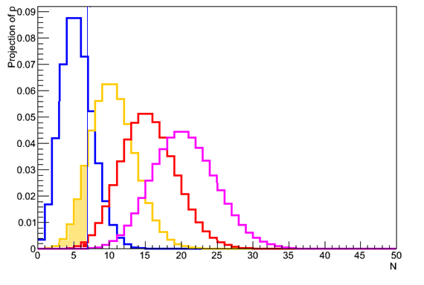
Upper limits (one-sided confidence intervals)
Can also defined p-values for hypothesis with signal: p_{s+b}
  Note convention: integration range in p_{s+b} is flipped
Convention: express result as value of s for which p(s+b)=5% → “s>6.8 is excluded at 95% C.L.”
p(s=15) = 0.00025
p(s=10) = 0.007
p(s=5) = 0.13
p(s=6.8) = 0.05

Slide 7
Modified frequentist upper limits
Need to be careful about interpretation p(s+b) in terms of inference on signal only
  Since p(s+b) quantifies consistency of signal plus background
  Problem most apparent when observed data
  has downward stat. fluctations w.r.t background expectation
Example: N_{obs} =2
Modified approach to protect
against such inference on s
  Instead of requiring p(s+b)=5%,
  require
→ p_{s+b}(s=0) = 0.04
s≥0 excluded at >95% C.L. ?!
s=0
s=5
s=10
s=15
for N=2 exclude s>3.4 at 95% C.L.s, for large N effect on limit is small as p_{b}→0

Slide 8
p-values and limits on non-trivial analysis
Typical Higgs search result is not a simple number counting experiment, but looks like this:
Any type of result can be converted into a single number by constructing a ‘test statistic’
  A test statistic compresses all signal-to-background
  discrimination power in a single number
  Most powerful discriminators
  are Likelihood Ratios
  (Neyman Pearson)
- Result is a distribution,
not a single number
- Models for signal and background
have intrinsic uncertainties

Slide 9
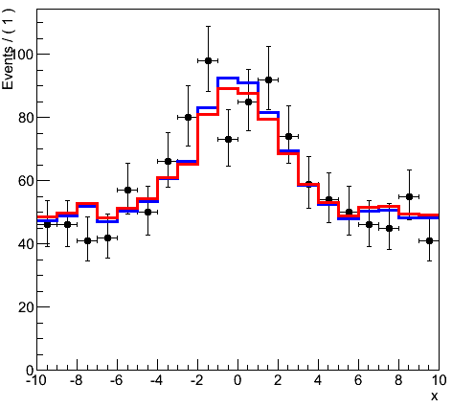
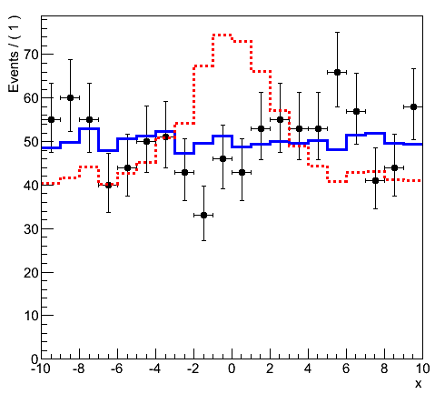
The likelihood ratio test statistic
Definition: μ = signal strength / signal strength(SM)
  Choose e.g likelihood with nominal signal strength in numerator (μ=1)
Illustration on model with no shape uncertainties
‘likelihood assuming nominal signal strength’
^
μ is best fit
value of μ
‘likelihood of best fit’
On signal-like data q1 is small
On background-like data q1 is large

Slide 10
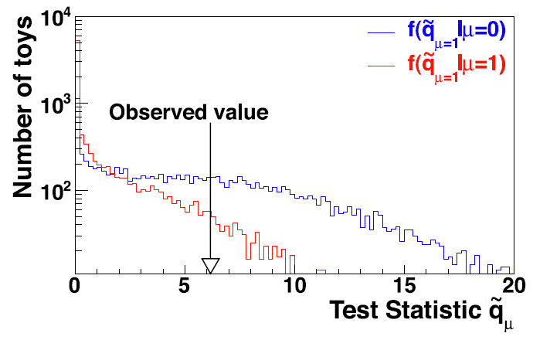
Distributions of test statistics
Value of q₁ on data is now the ‘measurement’
Distribution of q₁ not calculable
→ But can obtain distribution from pseudo-experiments
    Generate a large number of pseudo-experiments with a given value of mu,
    calculate q for each, plot distribution
From q_{obs} and these distributions, can then set limits
similar to what was shown for Poisson counting example
Note analogy
to Poisson
counting example
q₁ for experiments
with background only
q₁ for
experiments
with signal

Slide 11
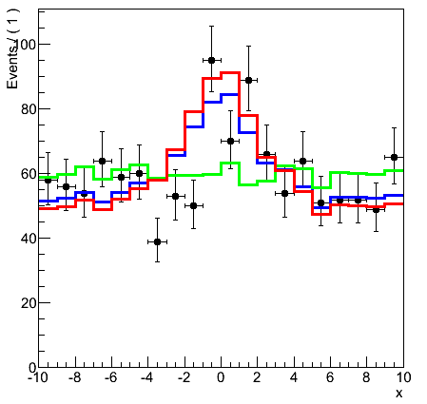
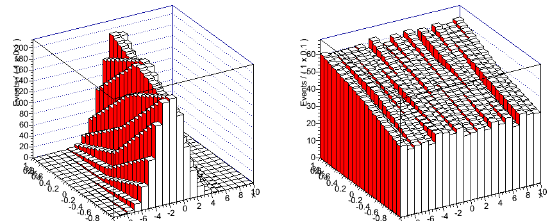
Incorporating systematic uncertainties
What happens if models have uncertainties
  Introduction of additional model parameters θ that describe effect of uncertainties
Jet Energy Scale,
QCD scale,
luminosity,
...
θ₁
θ₂
x
x

Slide 12
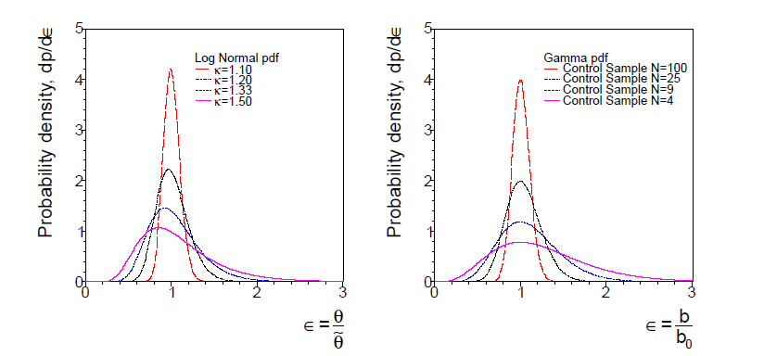
Incorporating systematic uncertainties
Likelihood includes
auxiliary measurement terms that constrains the nuisance parameters θ
(shape is flat, log-normal, gamma, or Gaussian)
θ₁
θ₂
x
x

Slide 13
Dealing with nuisance parameters in the test statistic
Uncertainty quantified by nuisance parameters are incorporated in test statistic using a profile likelihood ratio
Interpretation of observed value of
qμ in terms of p-value again based
on expected distribution obtained
from pseudo-experiments
‘likelihood of best fit for a
given fixed value of μ’
‘likelihood of best fit’
(with a constraint )

Slide 14
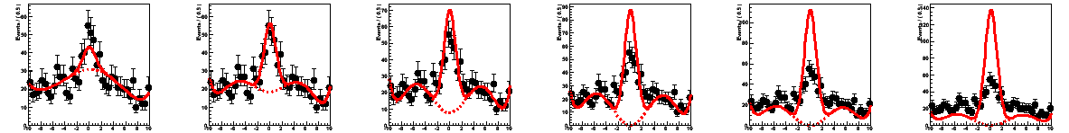
Dealing with nuisance parameters in the test statistic
Uncertainty quantified by nuisance parameters are incorporated using a profile likelihood ratio test statistic
Interpretation of observed value of
qμ in terms of p-value again based
on expected distribution obtained
from pseudo-experiments
μ=0.35
μ=1.0
μ=1.8
μ=2.6
‘likelihood of best fit for a
given fixed value of μ’
‘likelihood of best fit’
(with a constraint )

Slide 15
Putting it all together for one Higgs channel
Result from data D(x)
PDF F(x|m_{H},μ,θ) that models
the data for a given true Higgs
mass hypothesis
Construct test statistic
Obtain expected distributions
of q_{μ} for various μ
  Determine ‘discovery’ p-value
  and signal exclusion limit
Repeat for each assumed m_{H..}

Slide 16
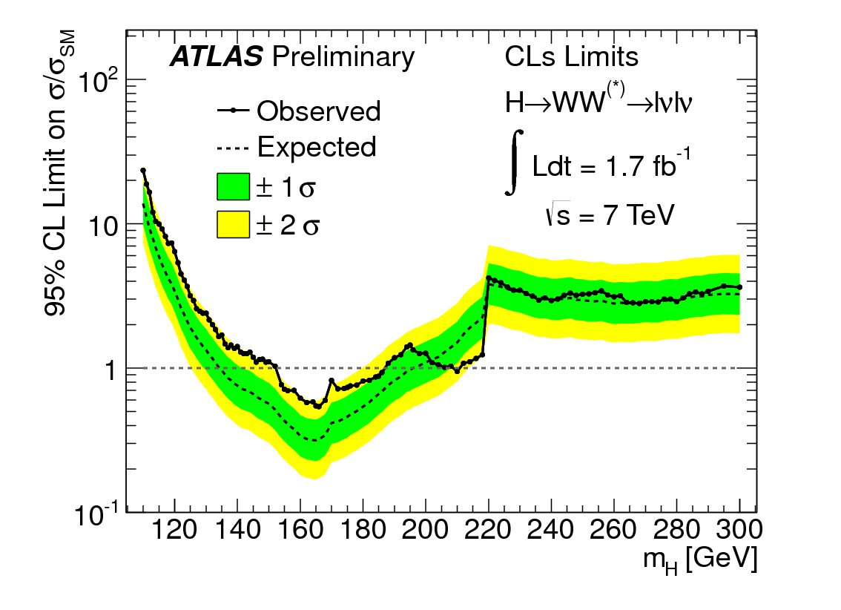
Example – 95% Exclusion limit vs m_{H} for H→WW
Example point: ≈3 x SM H→WW cross-section excluded at m_{H}=125 GeV
Expected exclusion limit
for background-only hypothesis
Example point: ≈0.5 x SM H→WW cross-section excluded at m_{H}=165 GeV
Higgs with 1.0x SM cross-section excluded at 95% CL for m_{H} in range [150,~187]

Slide 17
Combining Higgs channels (and experiments)
Procedure: define joint likelihood
Correlations between θ_{WW},θ_{γγ} etc and between θ_{ATLAS},θ_{CMS} requires careful consideration!
The construction profile likelihood ratio test statistic from joint likelihood and proceed as usual

Slide 18
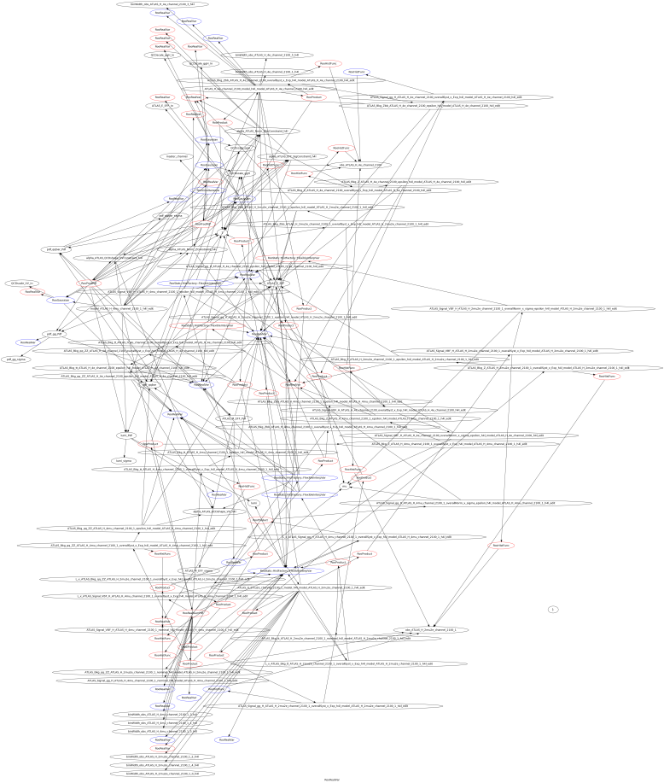
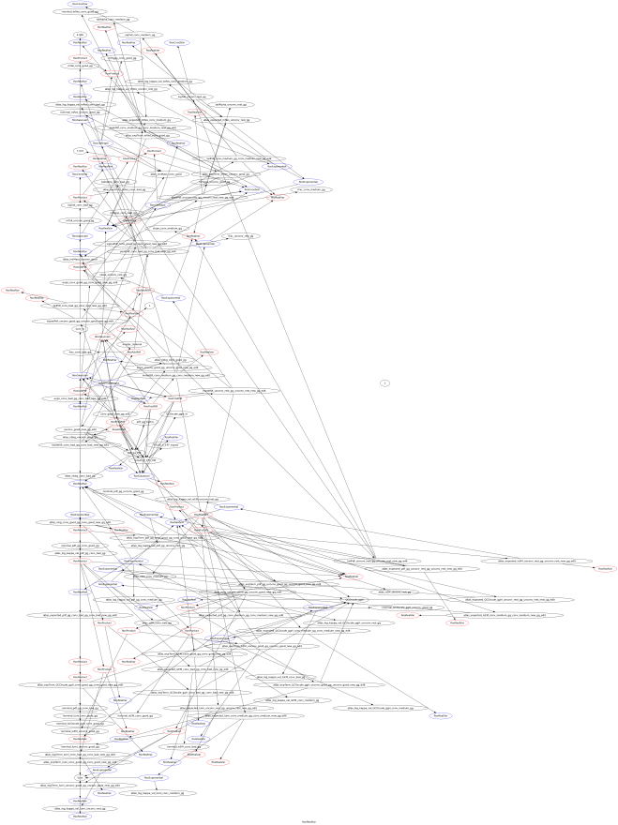
A word on the machinery
Common tools (RooFit/RooStats - all available in ROOT) have been developed in past 2/3 years to facilitate these combinations
  Analytical description of likelihood of each component stored and delivered in a uniform language (‘RooFit workspaces’)
  Construction of joint likelihood technically straightforward
‘llll/110.root’
‘gg/110.root’

Slide 19
Example – joint ATLAS/CMS Higgs exclusion limit

Slide 20
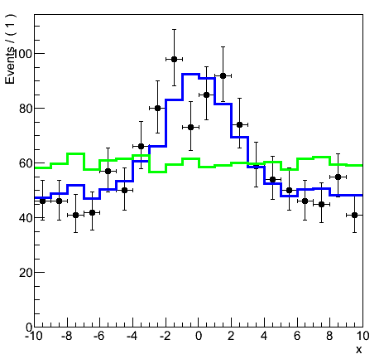
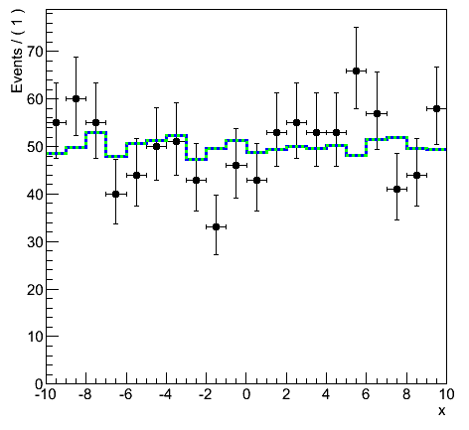
Switching from ‘exclusion’ to ‘discovery’ formulation
‘exclusion’
‘discovery’
‘likelihood assuming μ signal strength’
‘likelihood assuming background only’
‘likelihood of best fit’
‘likelihood of best fit’
simulated
data with
signal+bkg
simulated
data with
bkg only

Slide 21
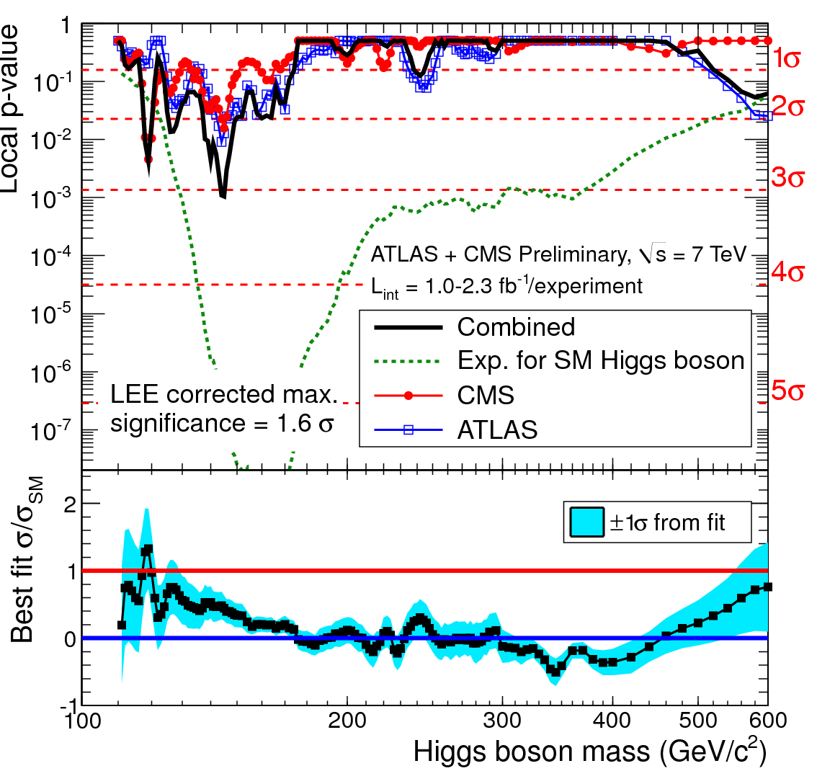
Comb: p-value of background-only hypothesis (‘discovery’)
Expected p-value for background
hypothesis of a data sample
containing SM Higgs boson
Note that ‘peak’ around 160 GeV reflects increased
experimental sensitivity not SM prediction of Higgs mass

Slide 22
Comb: p-value of background-only hypothesis (‘discovery’)
Example point: at m_{H}≈150 GeV probability
to obtain observed event count (or larger)
here from background only is ~0.0015% (~3σ)
But need to be careful with local p-values
Search is executed for a wide m_{H} mass range.
Odds to find a local p-value of e.g.
1% anywhere in mass range
(the ‘global p-value’) is larger than 1%
Can a estimate trial factor (global p/local p)
and obtain estimate of global significance
by using trial factor as correction

Slide 23
Conclusions
We are early awaiting more data!

