Slide 1
P42 Halo Measurement
Fabian Metzger, Laurie Nevay, Florian Stummer, Dipanwita Banerjee, Johannes Bernhard
15.05.2025

Slide 2
How to Measure the Halo?
Of course, there are more BLMs along P42!
x
XCHV.043.396
Horizontal direction
BLM.043.458
BLM.043.794
s
BLM.043.043
BLM.043.401

Slide 3
How to Measure the Halo?
We used the BLMs along the beamline to measure the halo
  We cannot directly reconstruct the beam and halo from it, but we have a good reference to compare to for simulations
A priori, the shape of the beam and halo are unknown
  Therefore, we performed two separate scans during which we moved only one jaw of the collimator → Potential asymmetries can be visible (or the collimator could be misaligned too)
  For each setting we acquired five spills to make an average and get a statistical uncertainty
We measured the nominal beam loss with fully open collimators
  For this we took 100 spills → Resulted in an rms of about 2%
All analysed signals are normalised to the T4 BSI, meaning it will be beam loss per proton on T4

Slide 4
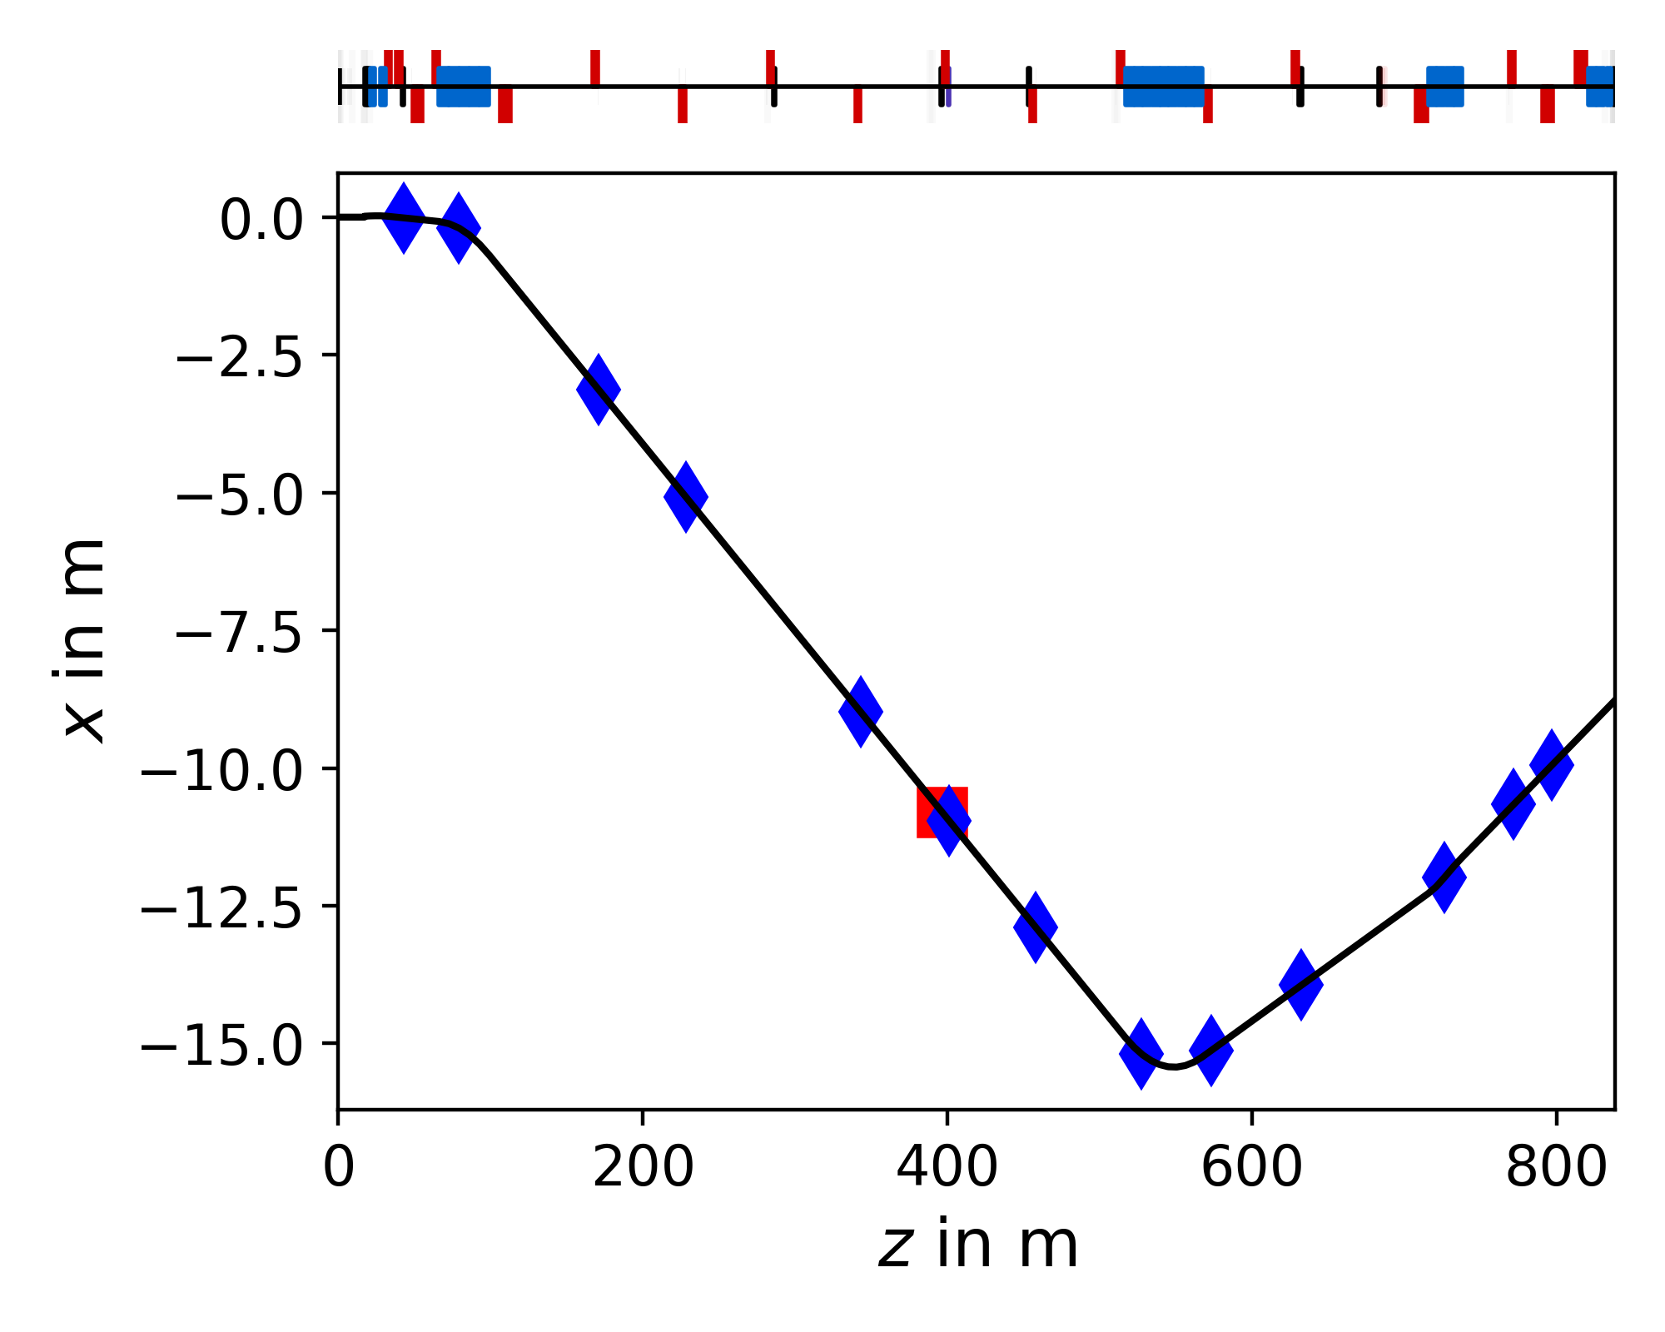
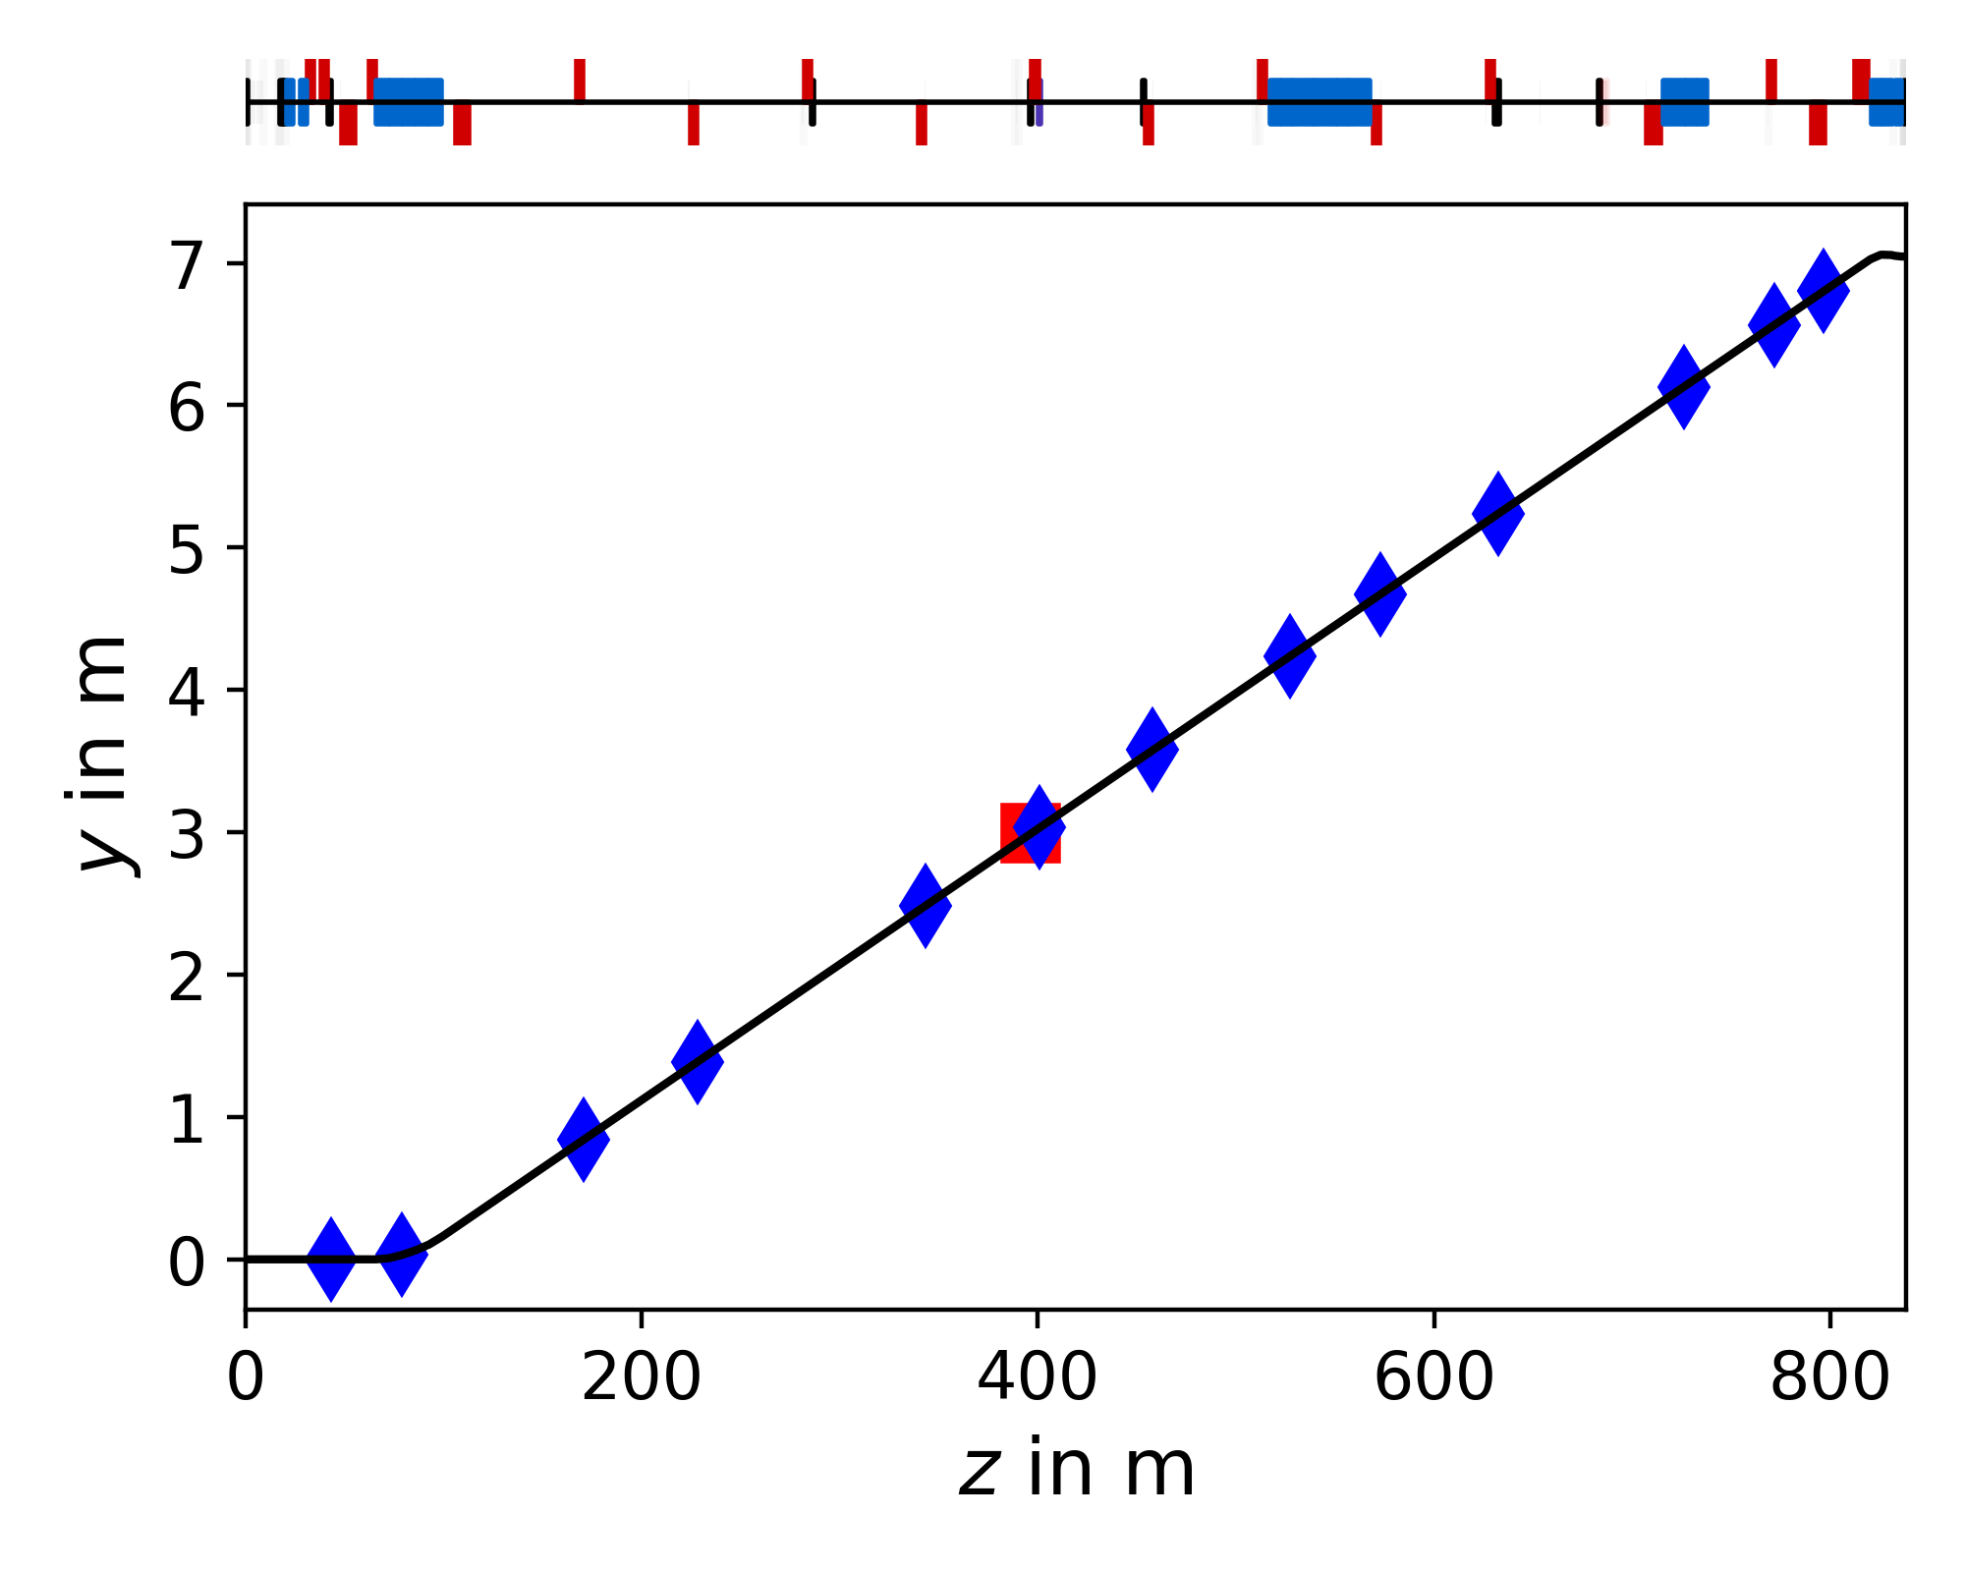
Where Do We Have BLMs in P42?
XCHV.043.396
BLMs

Slide 5
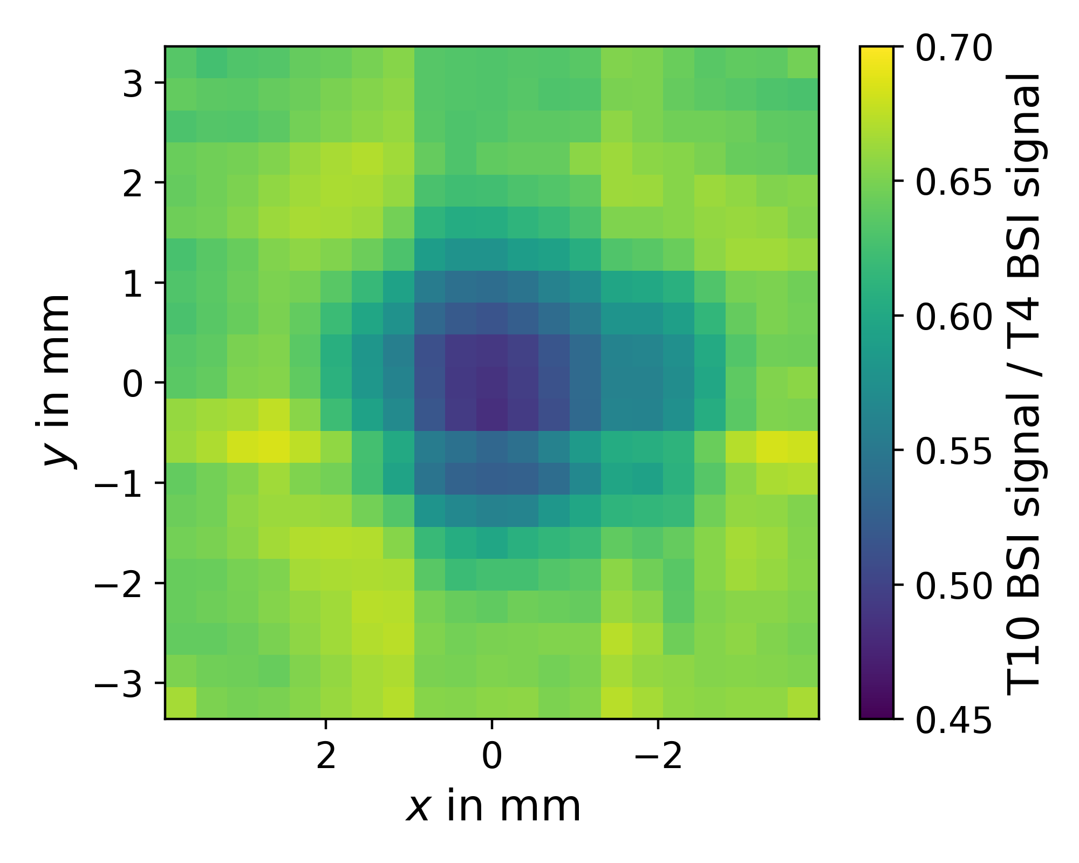
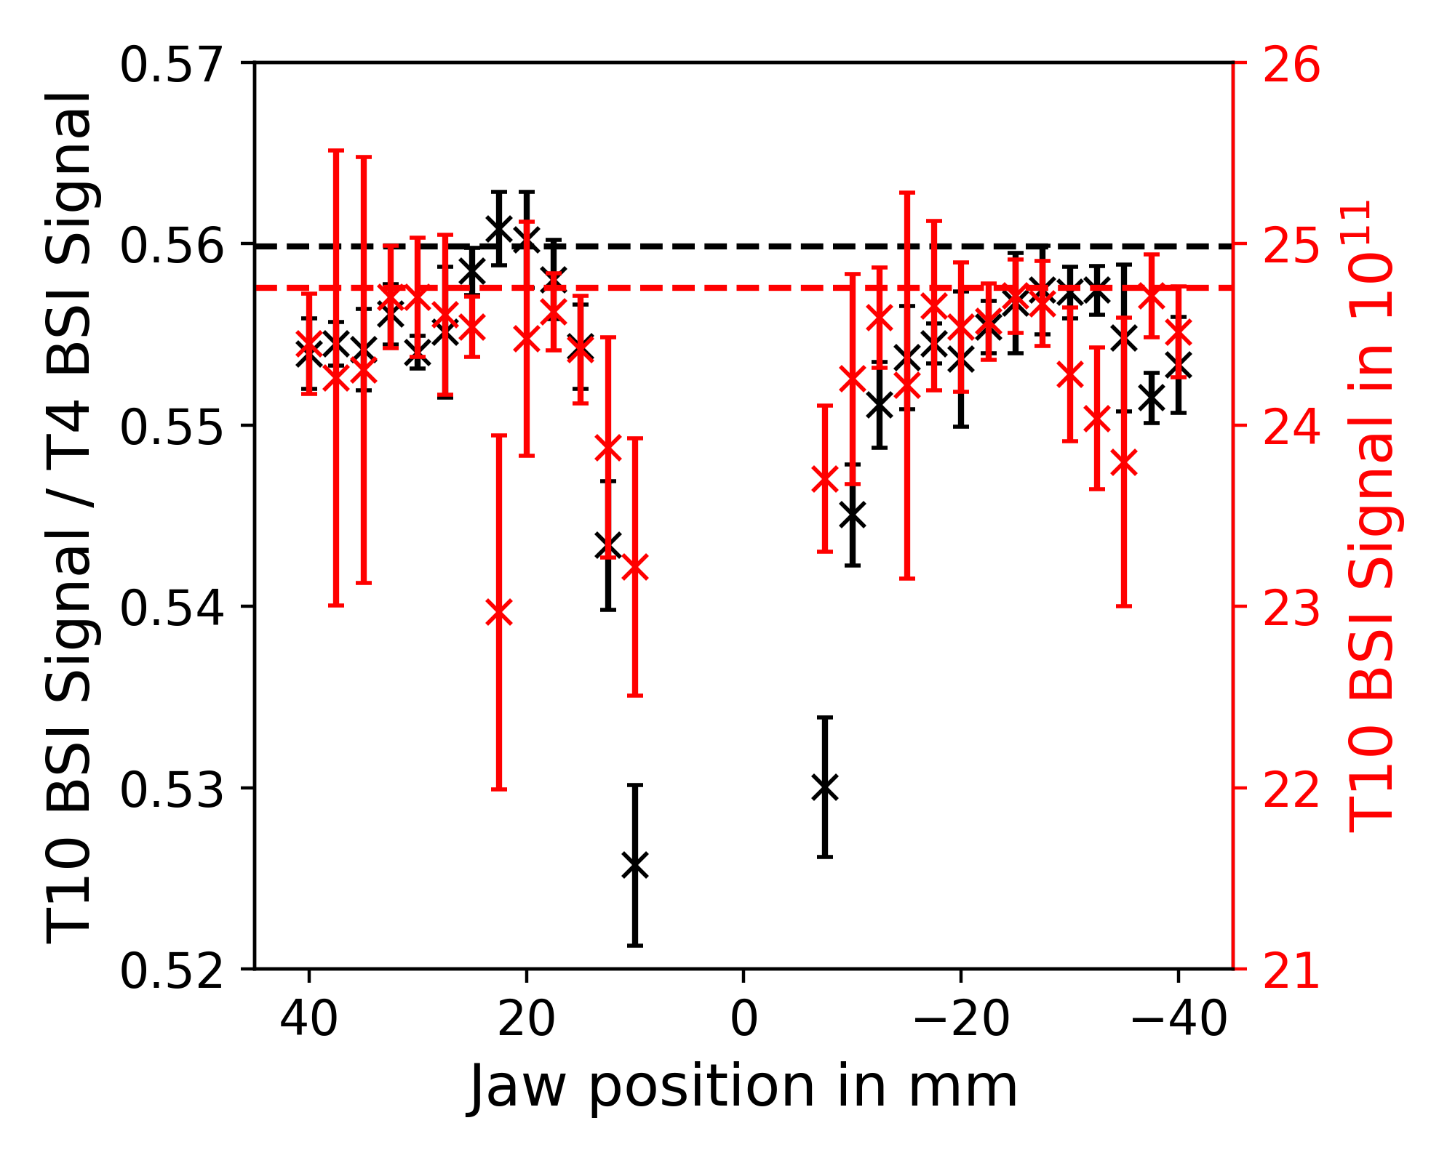
Intensity at T10
Dashed lines correspond to average over 100 spills taken with fully opened collimator
Intensity on T10 stable down to ±15mm
BSI foil degradation folded in here but should be neglibile as beam spot on foil was stable

Slide 6
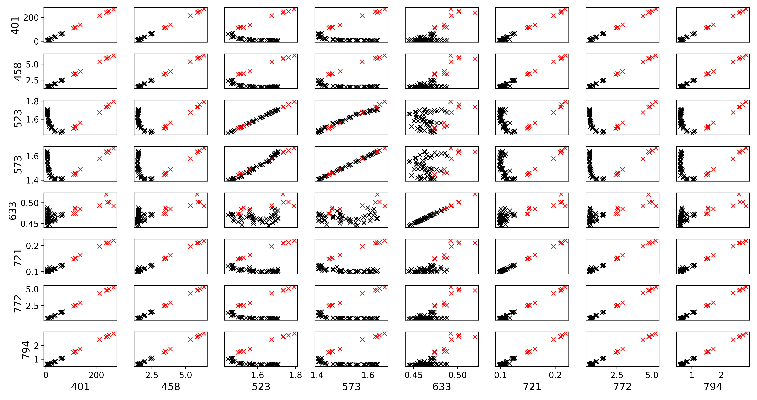
BLM Correlations for Left Jaw Scan
<15mm
≥15mm
Signals in 10⁻¹³ Gy per primary

Slide 7
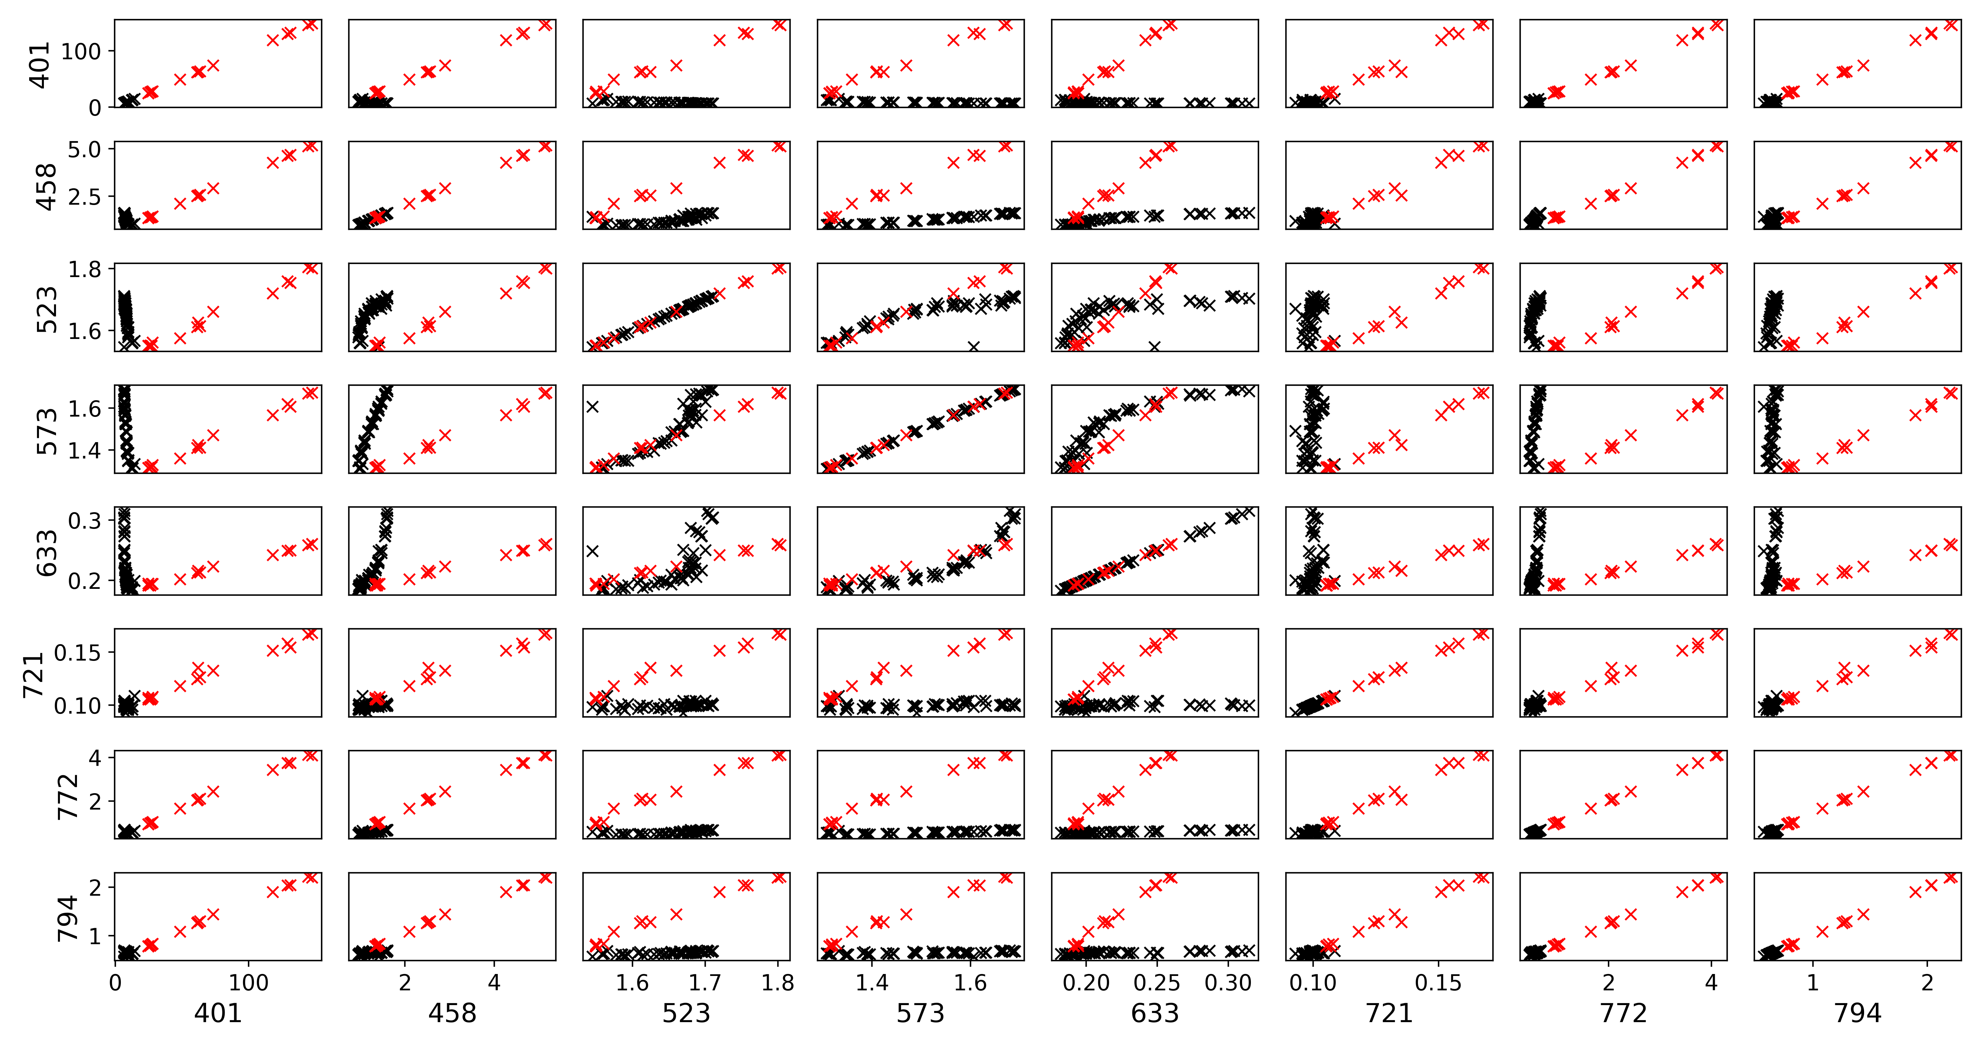
BLM Correlations for Right Jaw Scan
>-15mm
≤-15mm
Signals in 10⁻¹³ Gy per primary

Slide 8
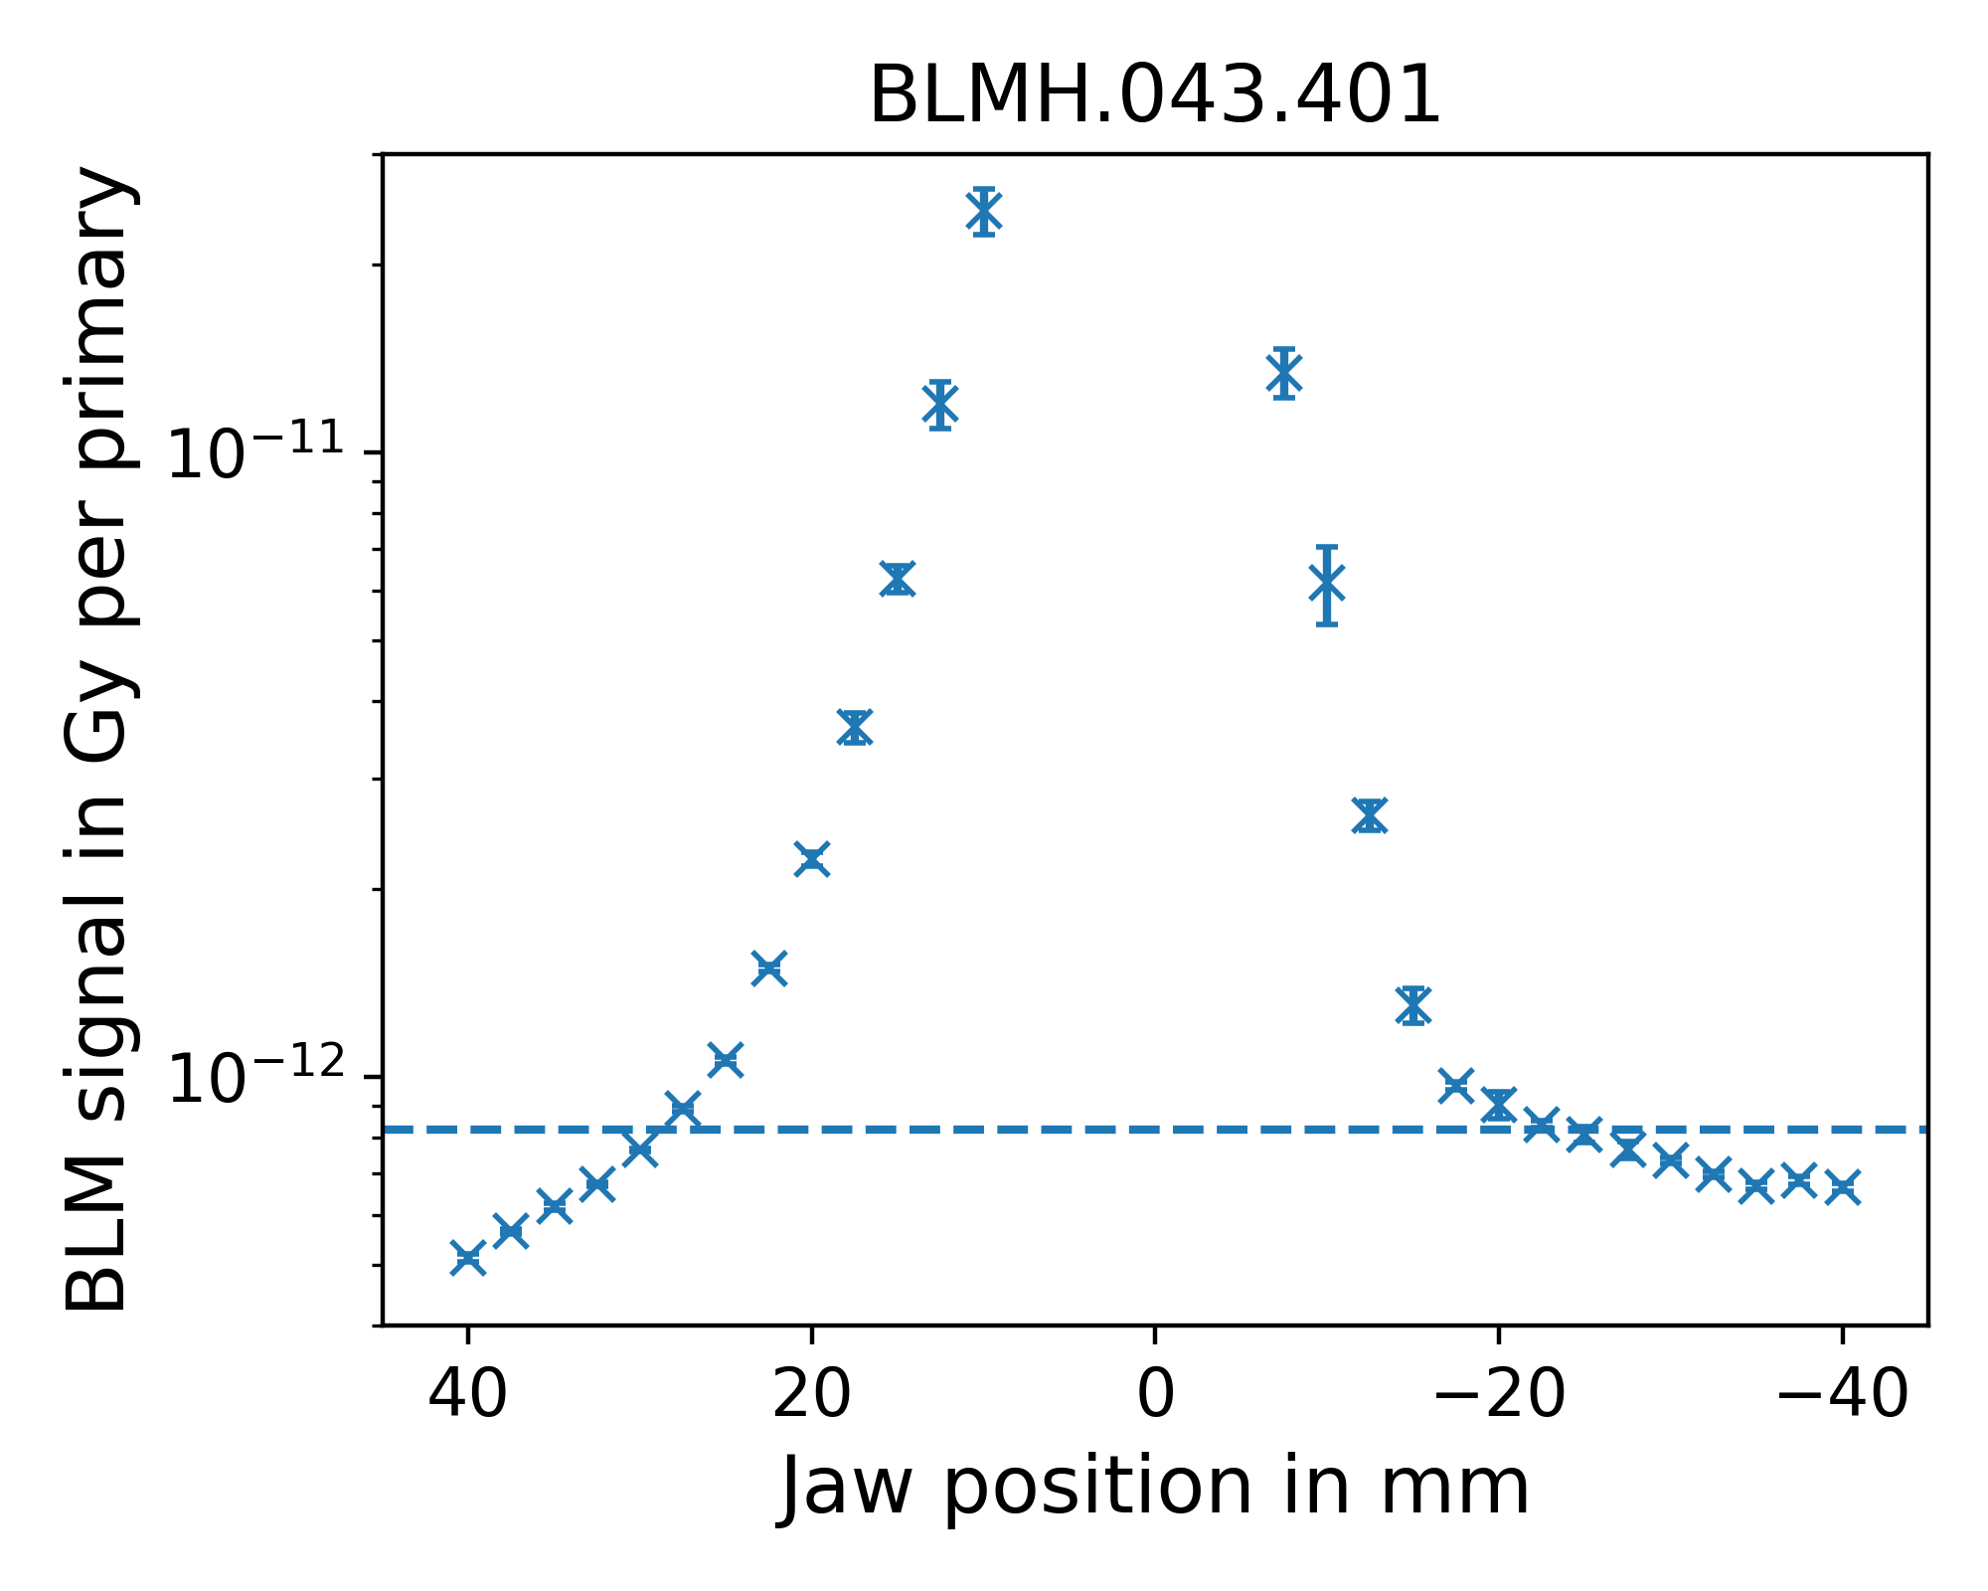
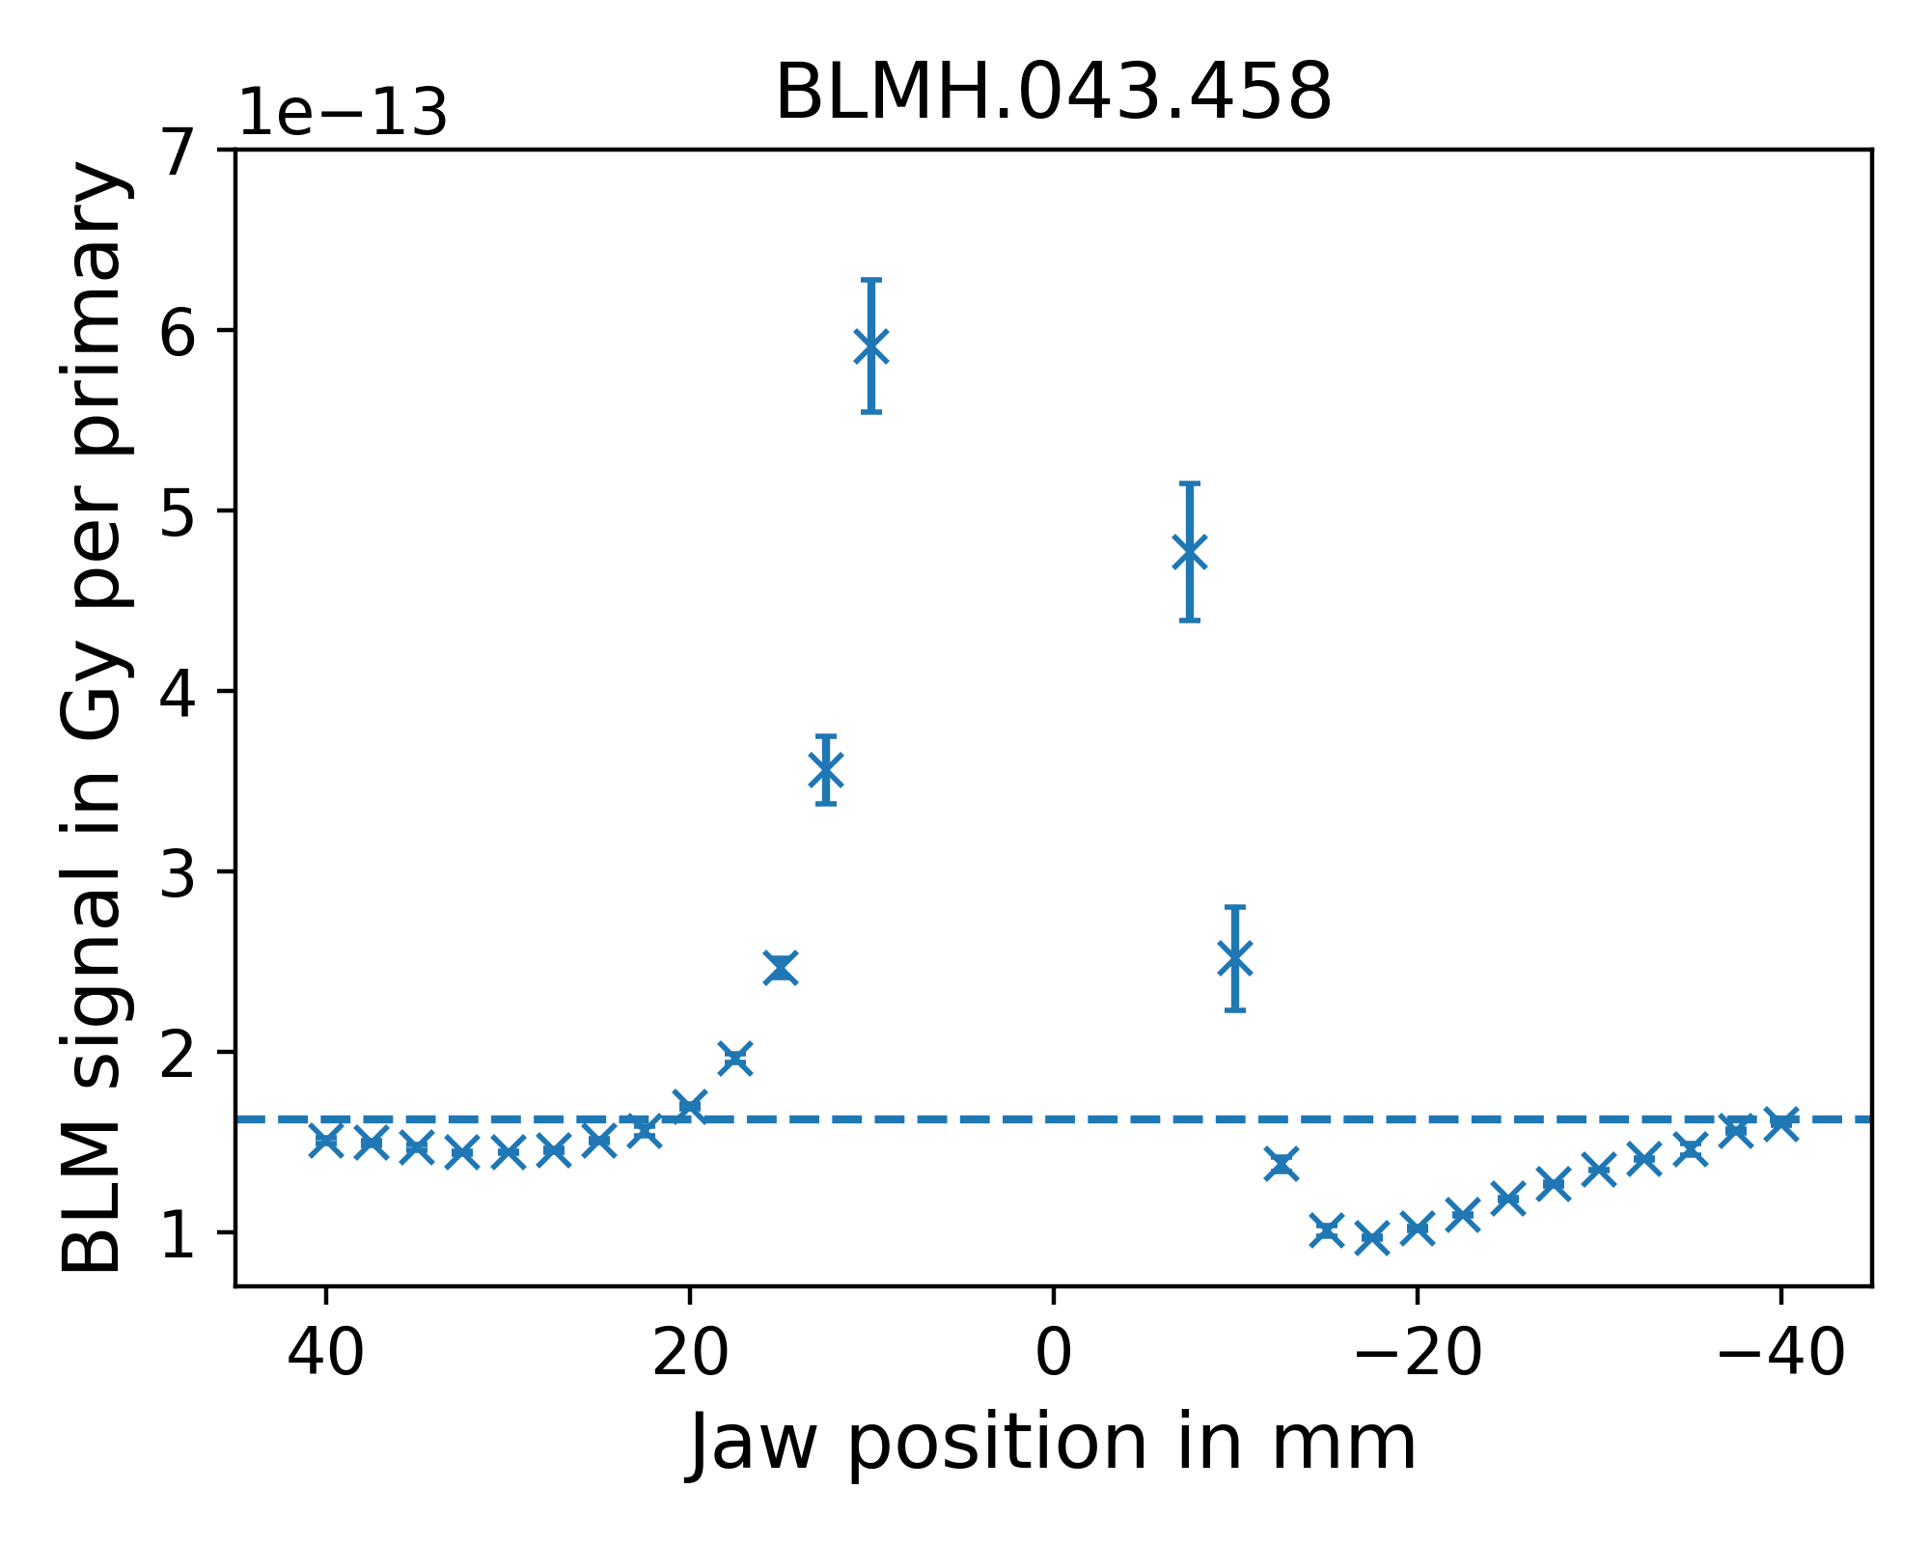
Individual BLM Signals

Slide 9
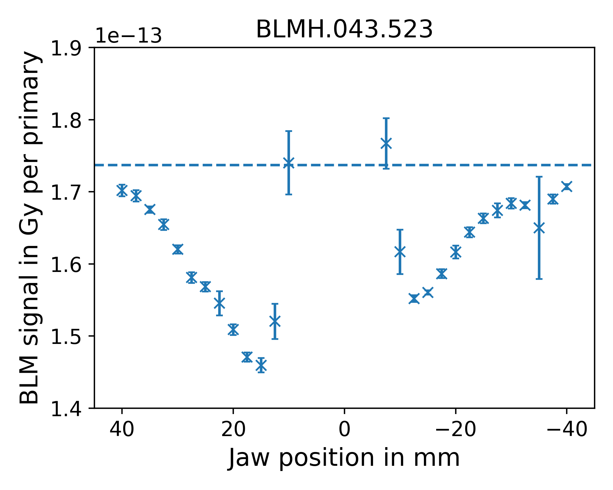
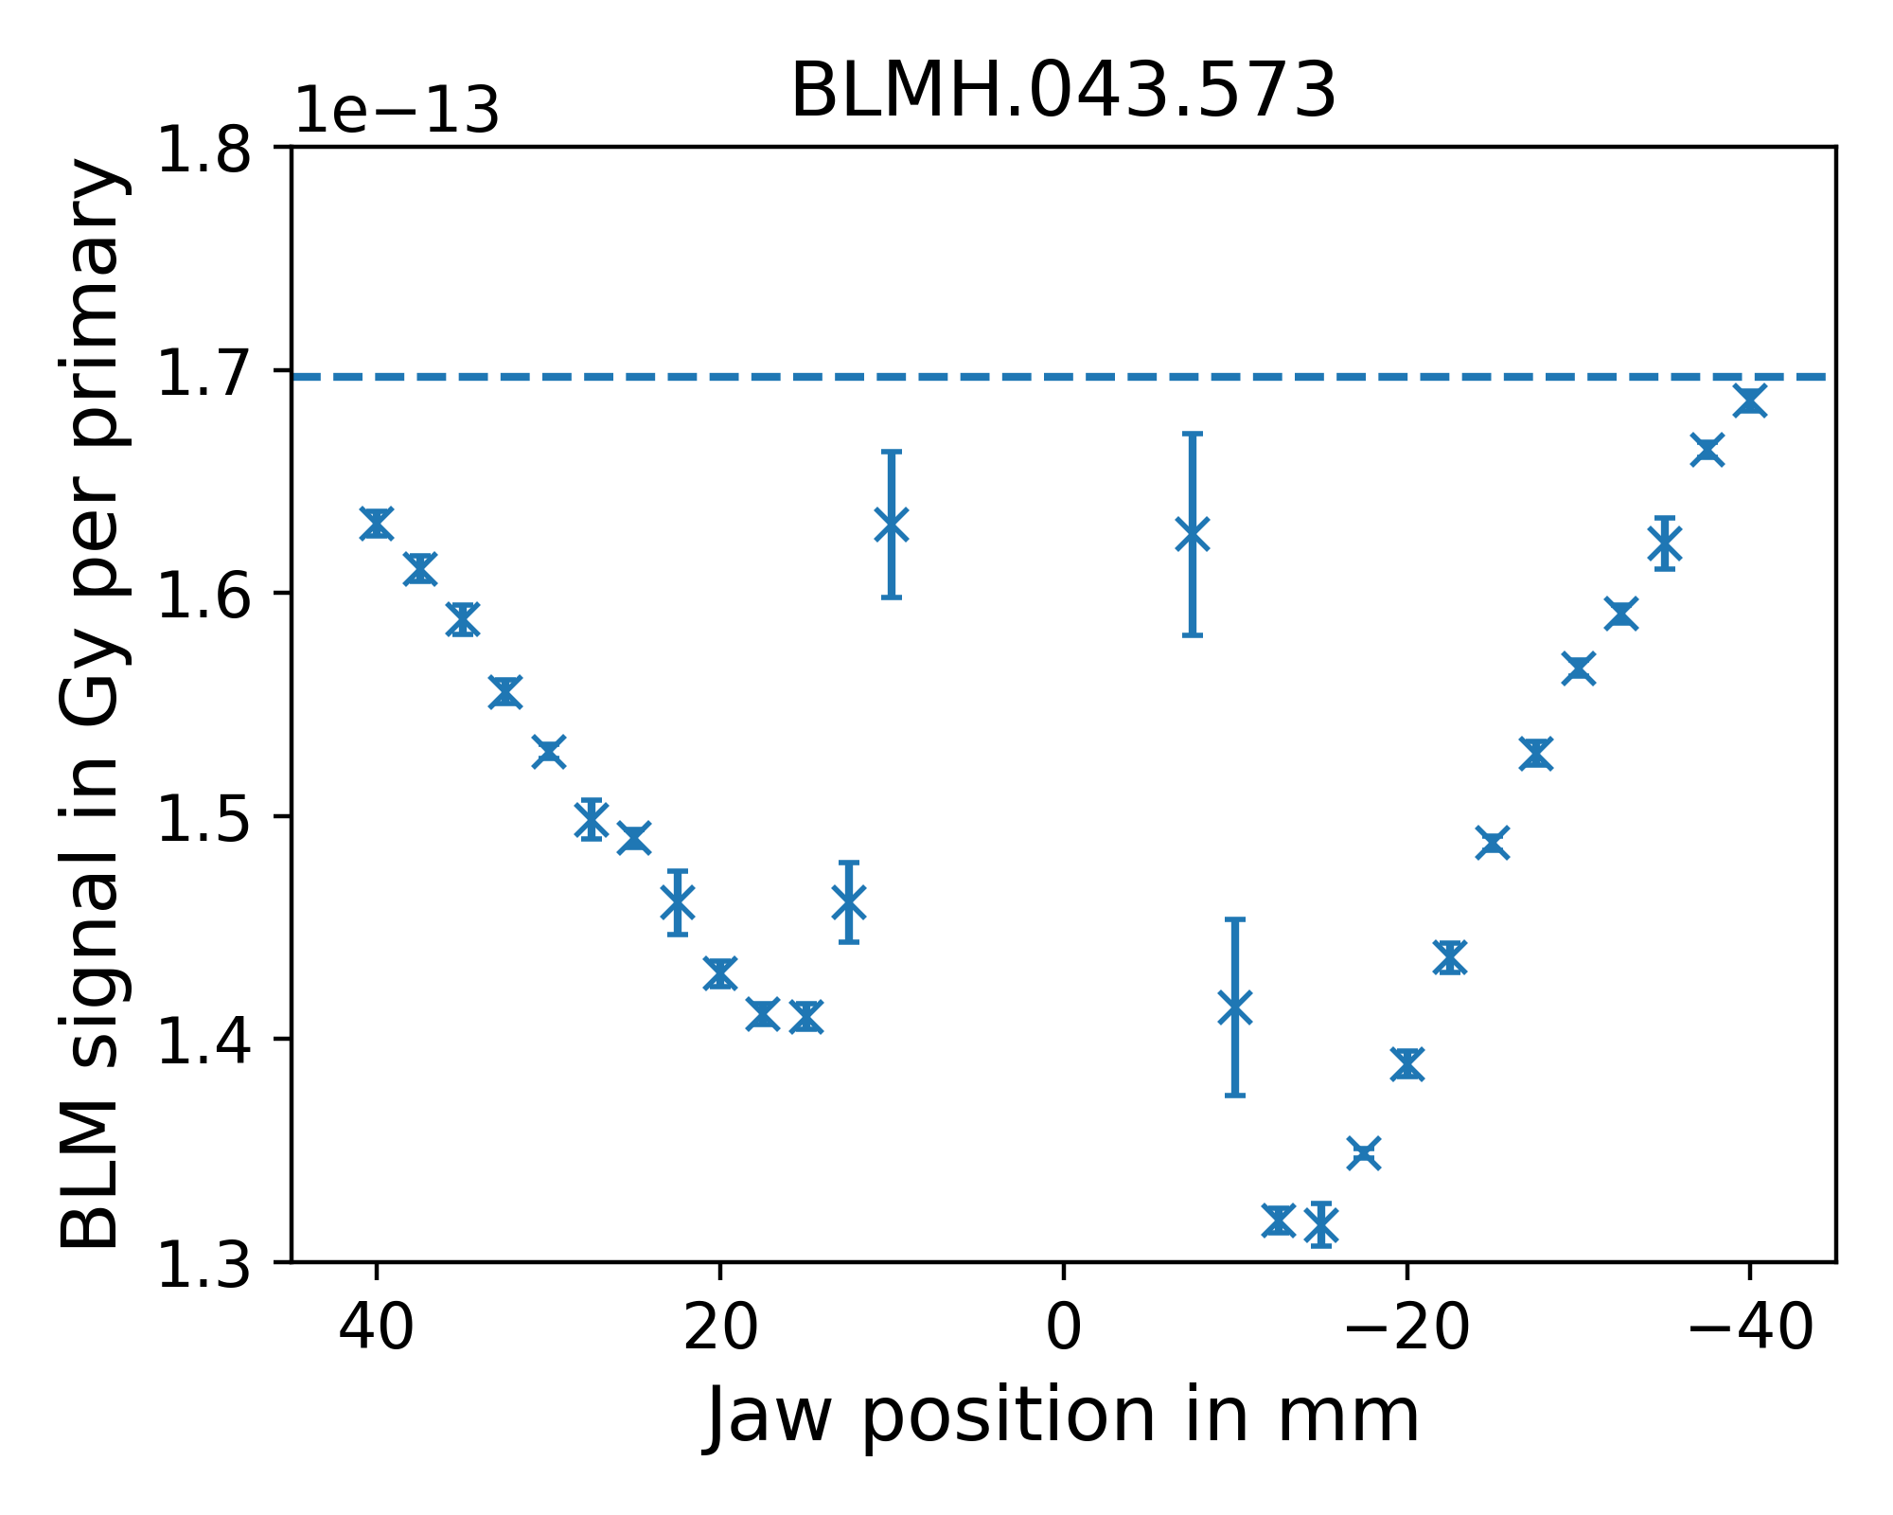
Individual BLM Signals

Slide 10
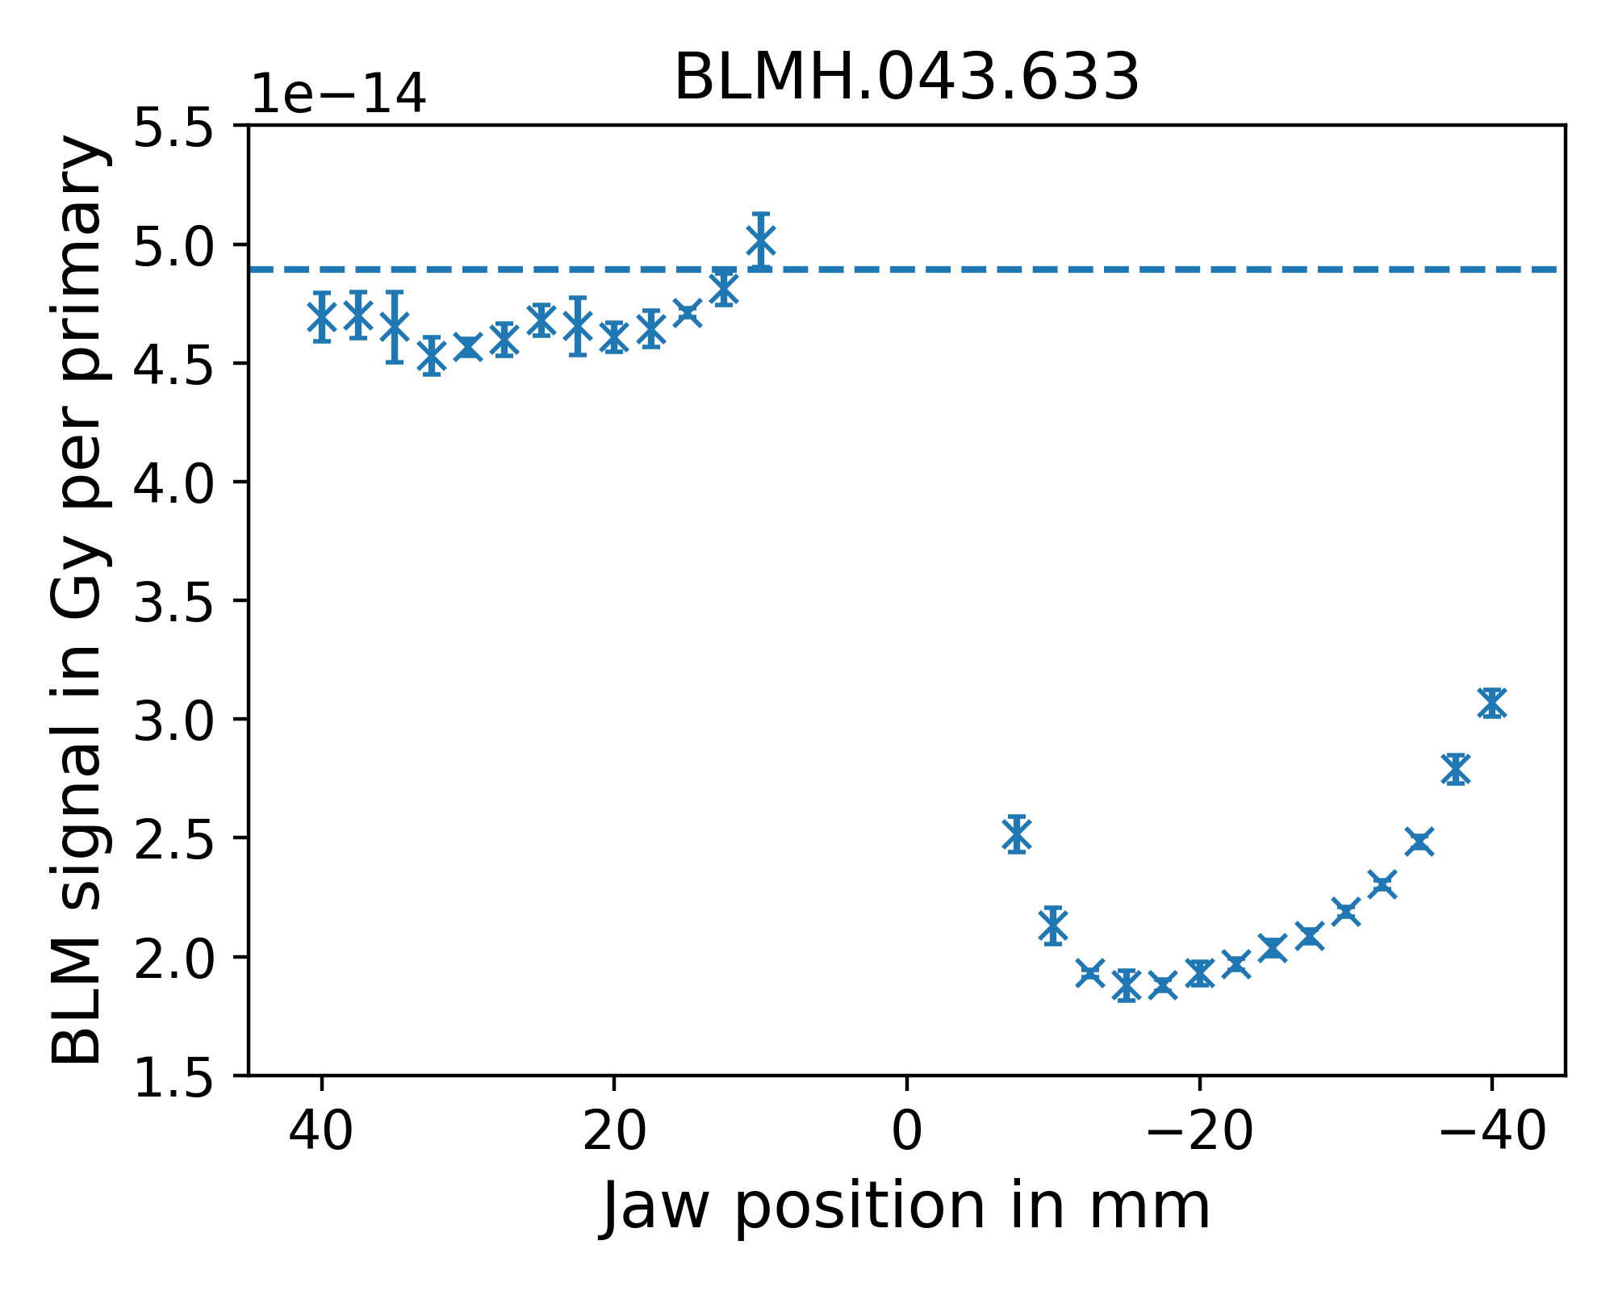
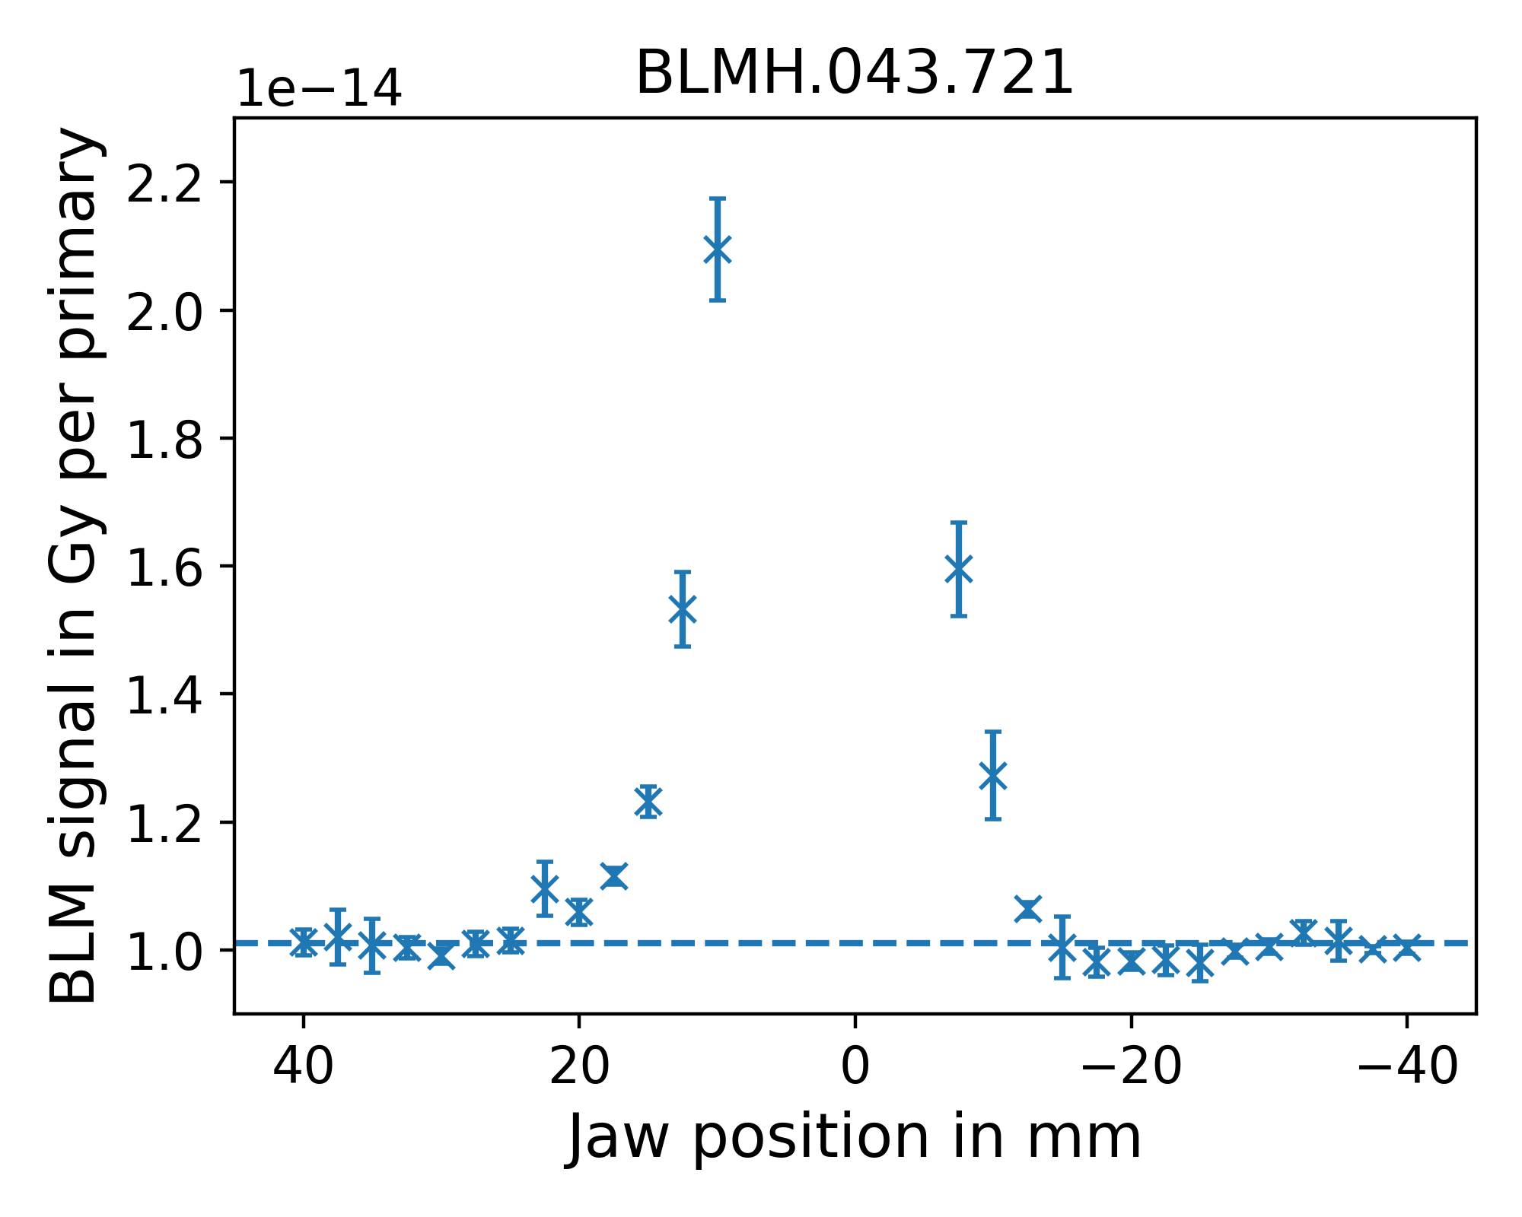
Individual BLM Signals

Slide 11
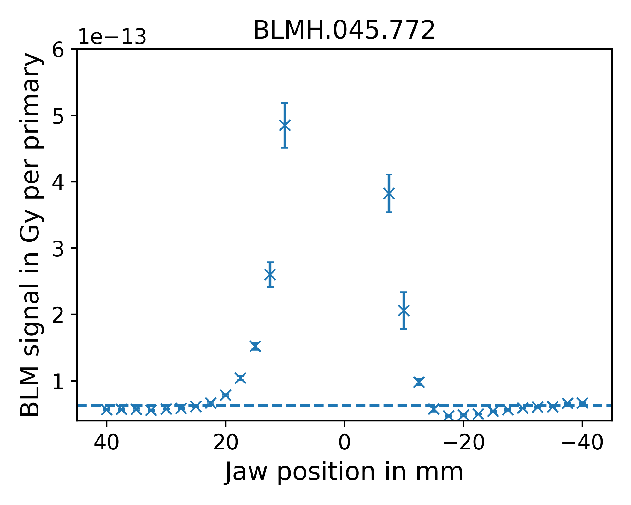
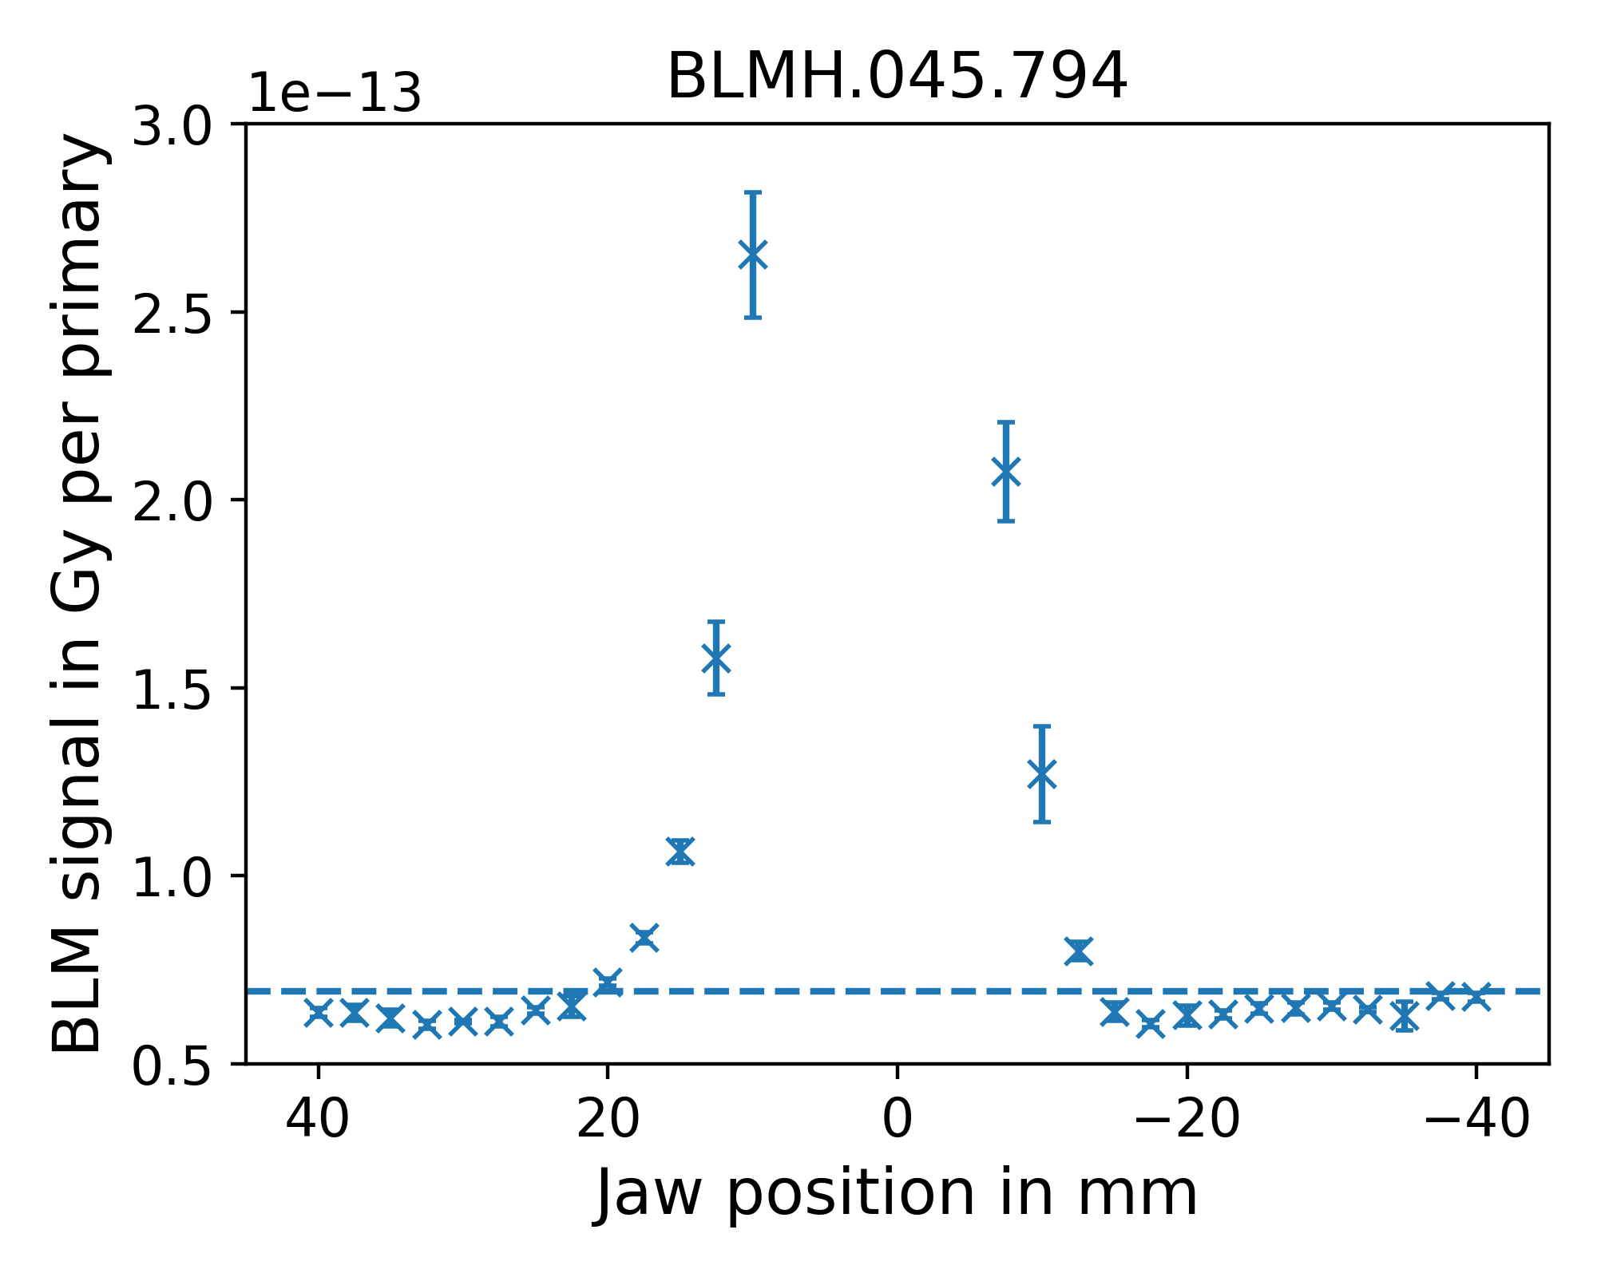
Individual BLM Signals

Slide 12
Conclusions
We get a clear picture that there is a halo travelling along with the beam
All signals are non-symmetric and non-gaussian
With these, we have a good set of measurements to benchmark simulations of P42
Reconstructing the shapes of the respective contributions is difficult as geometric effects are folded in
We can repeat this kind of measurements with the other collimators in the horizontal and vertical directions
We triggered a radiation alarm in the upstream zone of EHN2 when we went down to ±10mm and when we dumped only around 3 units → The location of the future P42 dump is not much upstream!

