Slide 1
Computational Accelerator Physics (CAP)
section meeting
Giovanni Iadarola
20 Jun 2024

Slide 2
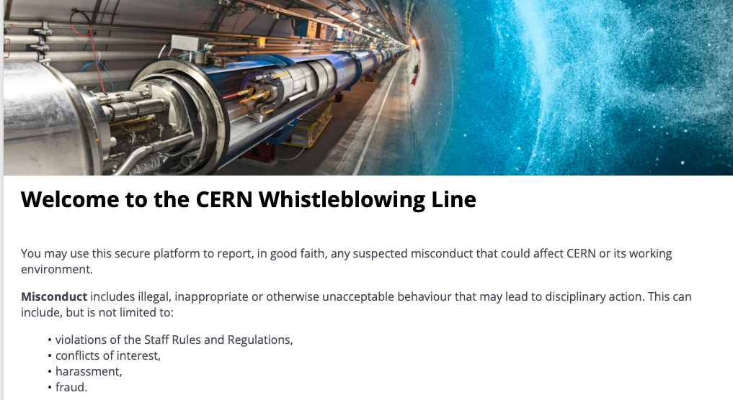
Information
Recently the CERN whistleblower line has been made active
  An official announcement will be published in the next Bulletin (Monday 23/06)
https://cern.integrityline.io/

Slide 3
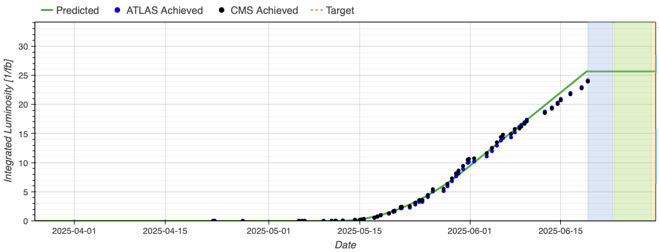
Information - LHC

Slide 4
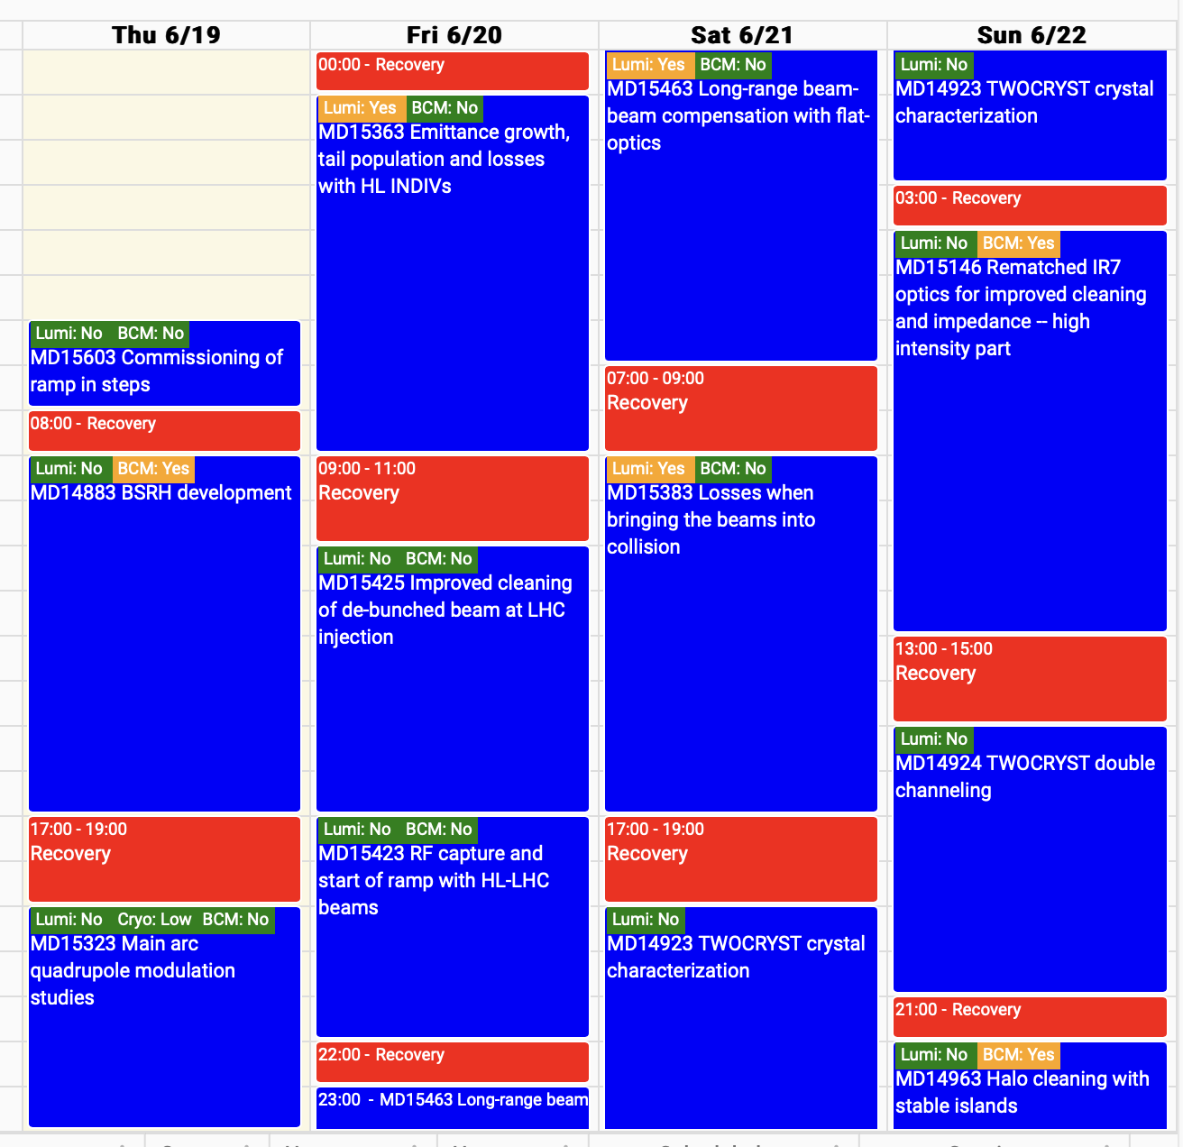
Information - LHC

