Slide 1


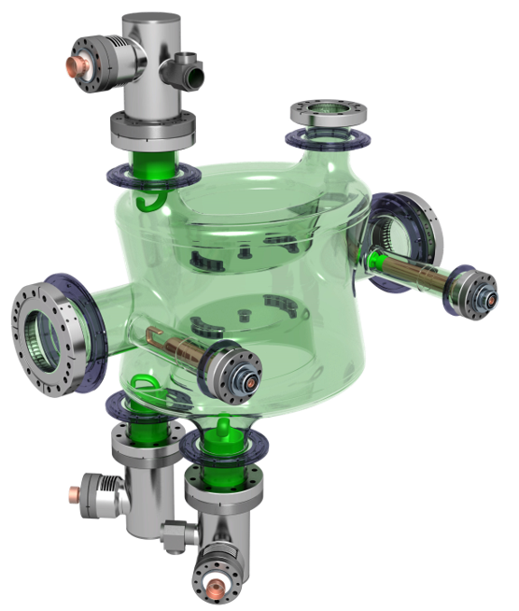


2025 Cold Test Results
& Impedance
Measurements
On behalf of WP4

Slide 2
Testing in 2025:
Bare Cavities:
Dressed Cavities:
RI DQW4
CERN DQW1 DC - HOM1 ONLY
CERN RFD3
CERN DQW1 DC - HOM1 & HOM3
RI DQW3
CERN DQW1 DC - HOM1 & HOM2
RI DQW8
CERN DQW1 DC - ALL HOM

Slide 3
Bare Cavity Tests:

Slide 4

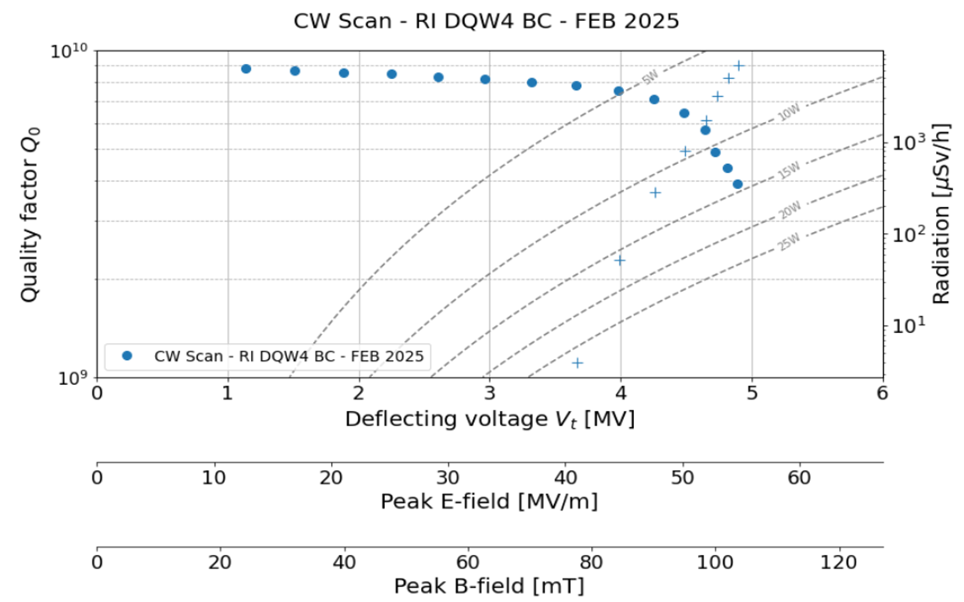
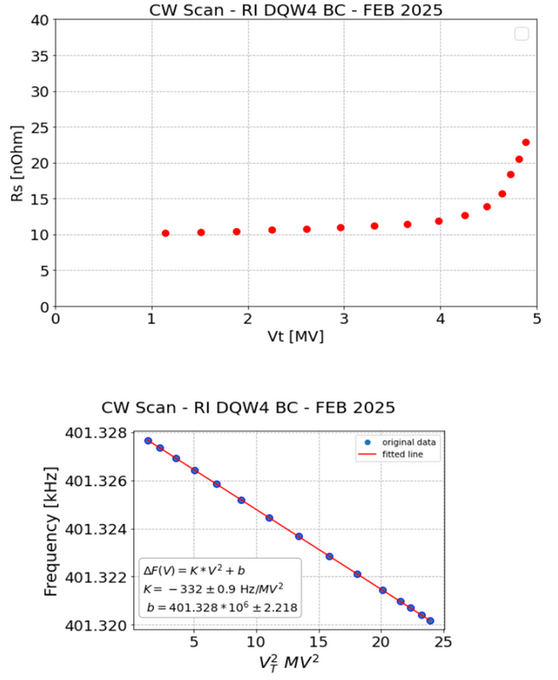
Bare Cavity - RI DQW4
Notes:
How to speak about this slide??
Maybe introduce the plots one at a time?
Add radiation onto this plot!

Slide 5

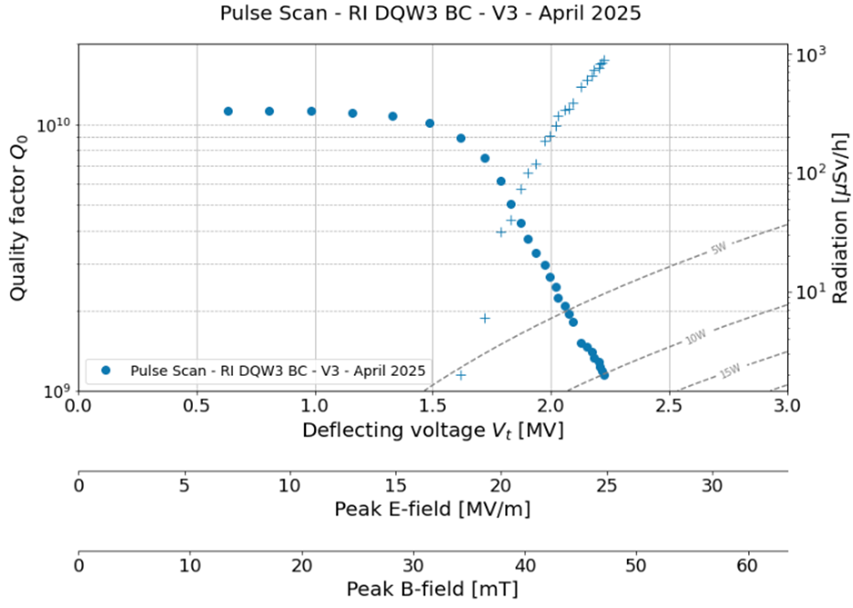
Bare Cavity - RI DQW3
BCP
Notes:
How to speak about this slide??
Maybe introduce the plots one at a time?
Add radiation onto this plot!

Slide 6
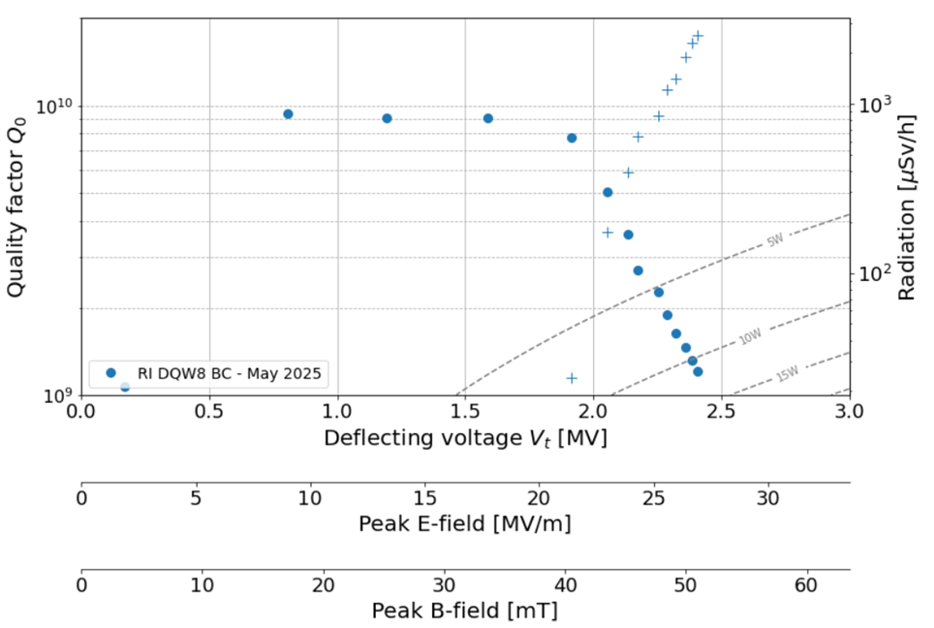
Bare Cavity - RI DQW8
BCP
Notes:
How to speak about this slide??
Maybe introduce the plots one at a time?
Add radiation onto this plot!

Slide 7
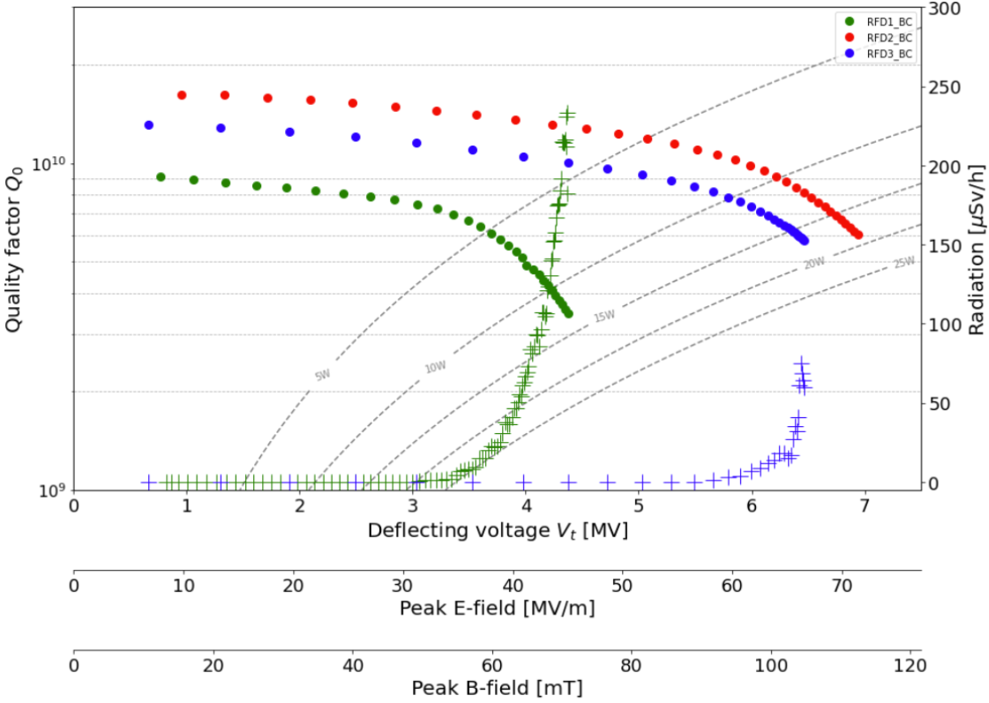
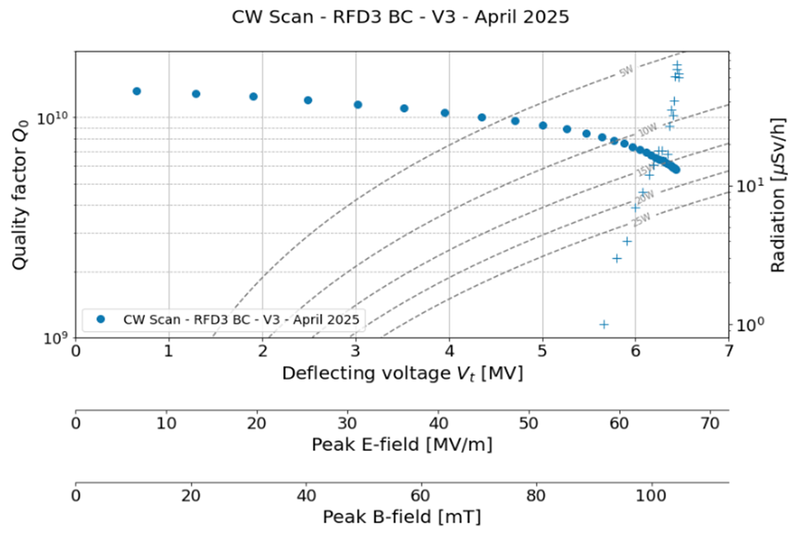
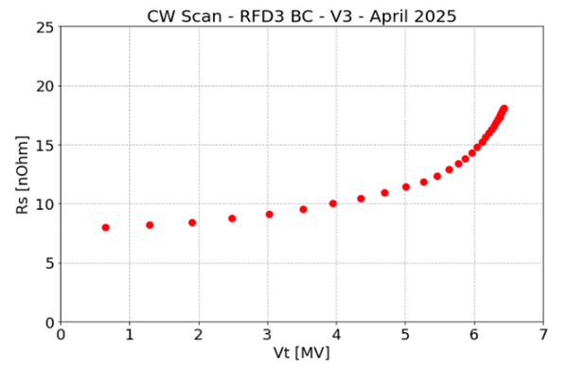
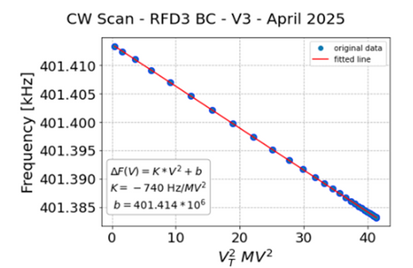
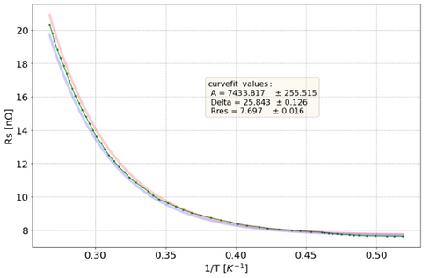
Bare Cavity - CERN RFD3
Notes:
How to speak about this slide??
Maybe introduce the plots one at a time?
Add radiation onto this plot!

Slide 8
Dressed Cavity Tests:

Slide 9
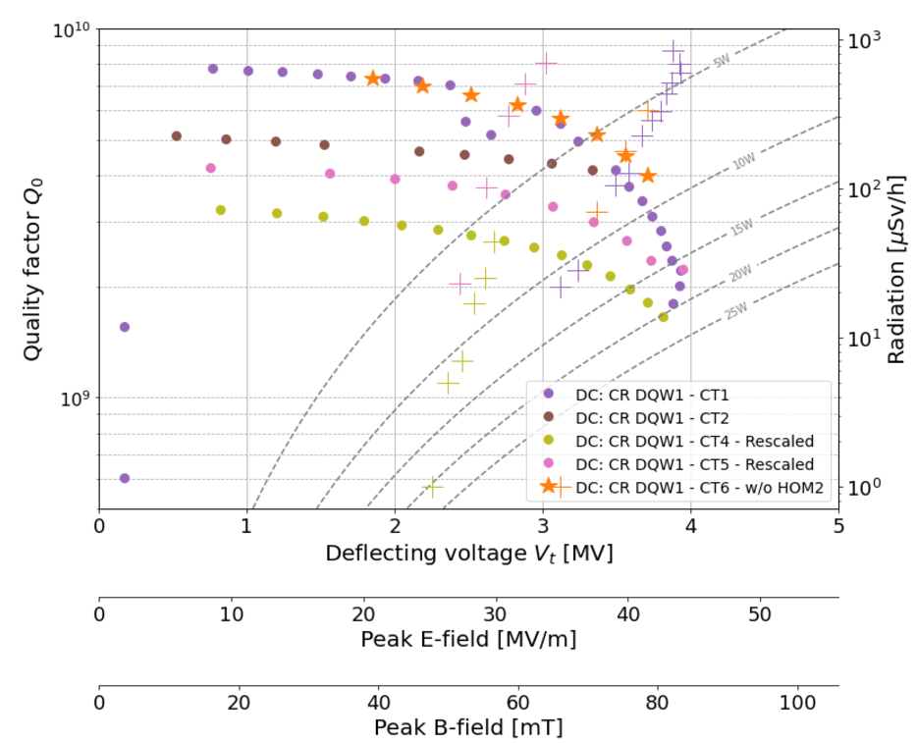
May 2023
CR DQW1 Dressed
CERN DQW1 - Recap...
Oct 2023
CR DQW1 Dressed
Mar 2024
CR DQW1 Dressed
Jun 2024
CR DQW1 Dressed
Aug 2024
CR DQW1 Jacketed
Sep 2024
CR DQW1 Dressed
Nov 2024
CR DQW1 Dressed w/o HOM2
Dec 2024
CR DQW1 Dressed w FA/HFHOM
Jan 2025
CR DQW1 Dressed w HOM1
Feb 2025
CR DQW1 Dressed w HOM1 & HOM3
March 2025
CR DQW1 Dressed w HOM1 & HOM2
May 2025
CR DQW1 Dressed
Notes:
How to speak about this slide??
Maybe introduce the plots one at a time?
Add radiation onto this plot!

Slide 10
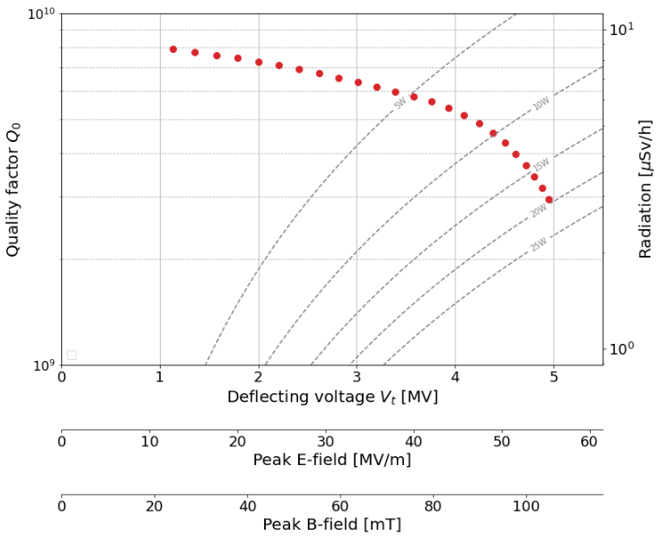
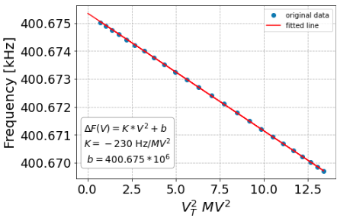
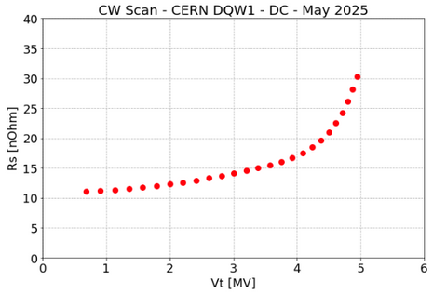
  All couplers installed
  No detectable field emission
CERN DQW1 - April 2025
Notes:
How to speak about this slide??
Maybe introduce the plots one at a time?
Add radiation onto this plot!

Slide 11
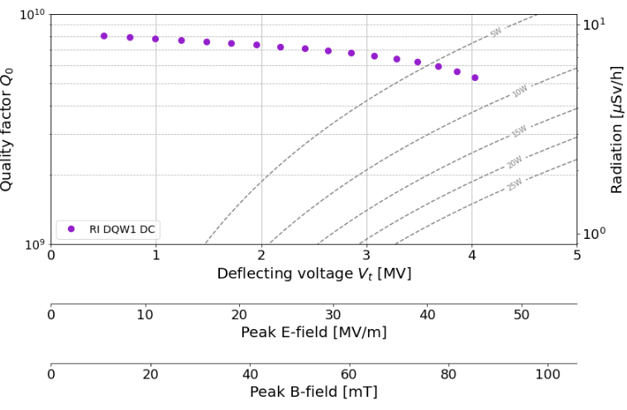
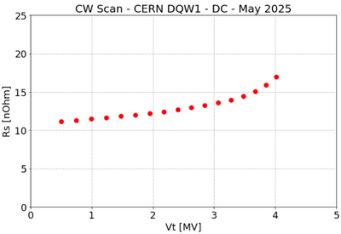
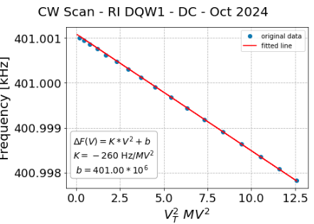
RI DQW1 - October 2024
After Additional Light BCP
Notes:
How to speak about this slide??
Maybe introduce the plots one at a time?
Add radiation onto this plot!

Slide 12
Dressed Cavity Tests:
Impedance Measurements at 2K

Slide 13
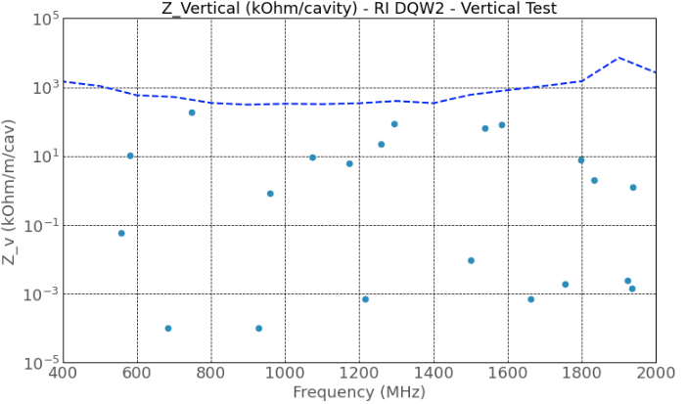
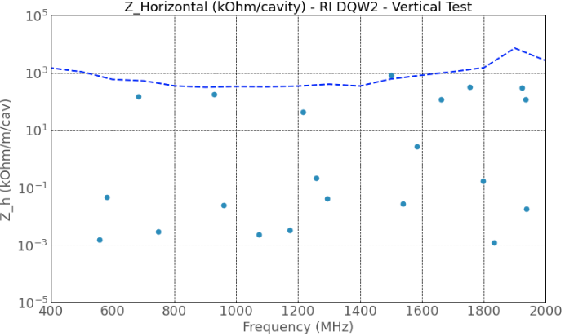
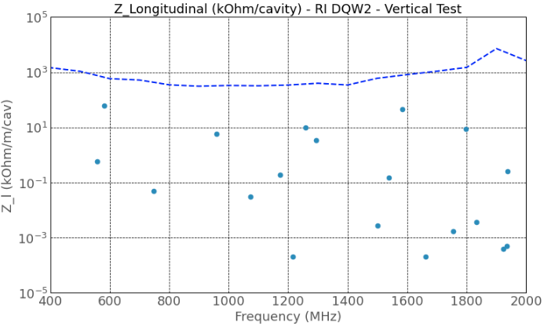

Impedance Measurements
  Example shown is RI DQW2

Slide 14
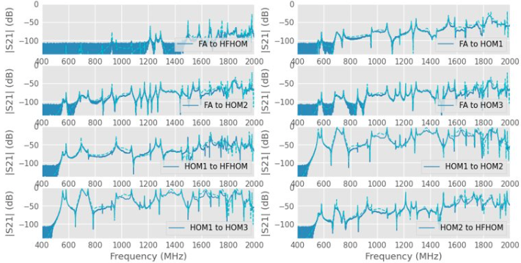

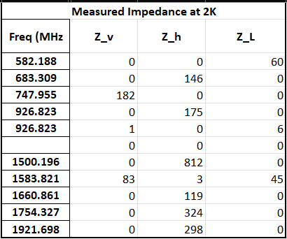
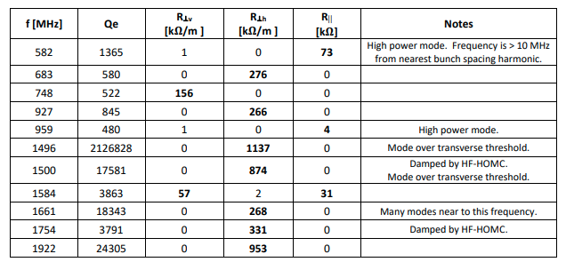
Impedance Measurements
  Taken at 2K during dressed cold test
  HOM Annex: EDMS 2488213
Final Impedances:
  RI2: EDMS 3299825
  CERN2: EDMS 3299823

Slide 15
Thankyou!

