Slide 1
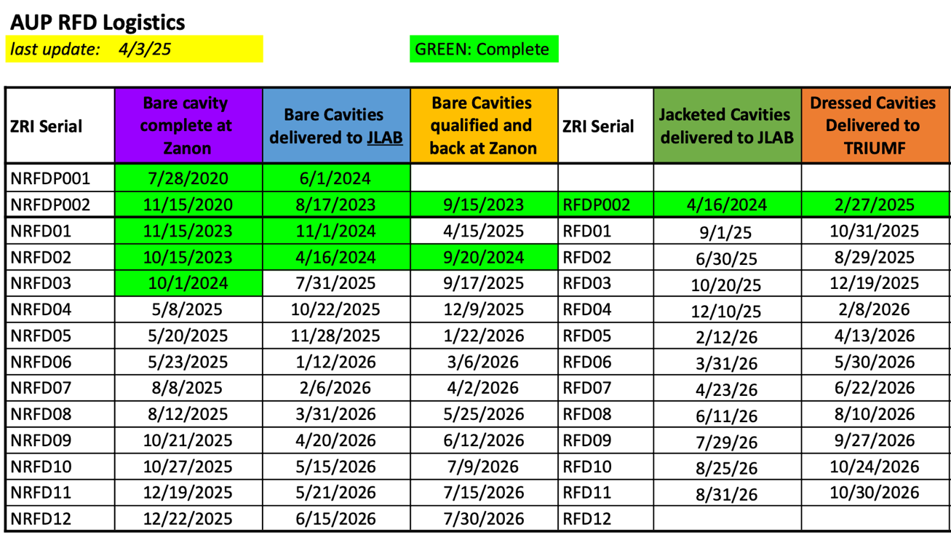

Logistic Dates and Deliveries to TRIUMF
Contractual
Contractual

Slide 2
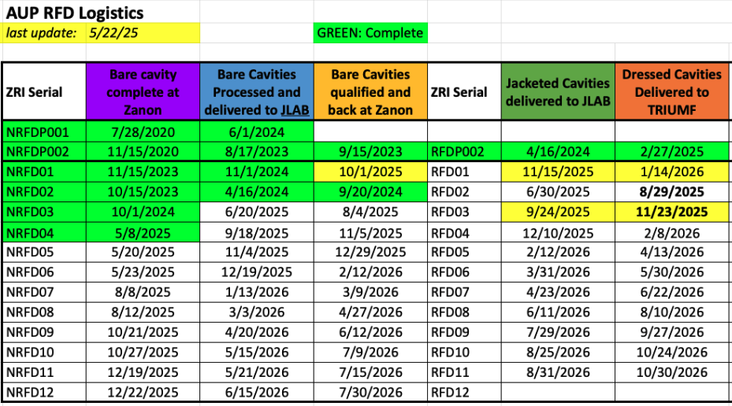
Logistic Dates and Deliveries to TRIUMF

