Slide 1

Status of European Compact Light Sources: perspective for a CLS in Morocco Bridging to South-Europe
Luca Serafini , INFN-Milano, luca.serafini@mi.infn.it
Compact Light Sources are multiple bridges linking the classical world of radiation sources (synchrotron light sources, free electron lasers) to the quantum world of Compton: they also bridge the world of high energy physics with radiation sources
Because CLS are boosted mini-colliders (electron beams vs. photon beams) devoted to generate secondary beams instead of particle physics events: and they uniquely exploit the quantum nature of light to provide users with advanced photon beams
CLS are also extreme examples of compact research infra-structures that can be hosted in University Campus with modest investments (in the range 10-20 M$), opening the way to fundamental research and high social-impact applications

Slide 2
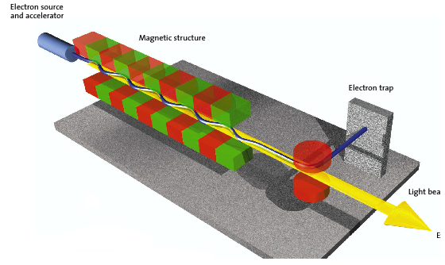
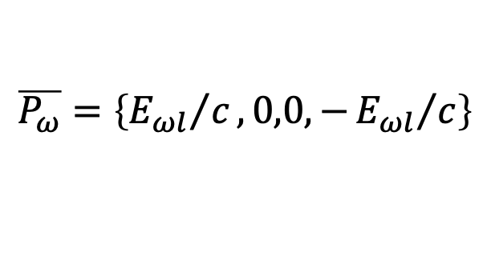
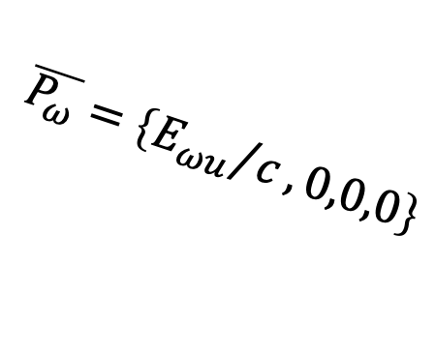
Status of European Compact Light Sources: perspective for a CLS in Morocco Bridging to South-Europe
Synchrotron Light Sources/Free Electron Lasers (C.E.M. world)
vs.
Inverse Compton Scattering CLS (QED world)
3 km
cm und. period λ_{u}
1-25 GeV
electrons
100 M$ - 1 G$
virtual photons
$$\overline{P_{ω}}=\left\{{E_{ωu}}/c,0,0,0\right\}$$
100-0.5 Å
X-ray photons
E_{ω u} = hc/λ_{u}
20-150 MeV electrons
1 μm laser λ
20-350 keV
X-ray photons
10 M$ - 20 M$
20 m
real photons
$$\overline{P_{ω}}=\left\{{E_{ωl}}/c,0,0,−{E_{ωl}}/c\right\}$$

Slide 3
Compact, high-brilliance X-ray sources based on Inverse Compton scattering, an option for the development of small, cost effective, advanced campus-based research infrastructures, tailored as test facilities or user facitlies
In Synchrotron Light Sources and Free Electron Lasers the electron beam scatters off virtual photons, represented by magnetostatic fields of dipoles, undulators, wigglers E_{X} = 2γ² hc/λ_{und}
Compact Light Sources are based on electron beams scattering off real photons carried by a laser pulse E_{X} = 4γ² hc/λ_{laser}
Radiating same photon energy E_{X} requires much larger γ in synchrotron light sources (in the range of thousands, i.e. GeV) : size and costs are much larger
However brilliances are larger than ICS’s if photon energies considered are smaller than 100-150 keV, because beam currents in synchrotrons are 200-400 mA, while in ICS ranges from micro-A to a few mA. Nevertheless, above 200 keV ICS are out-performing synchrotron based light sources because critical frequencies, even with multi-GeV beams, do not overcome 150 keV .

Slide 4
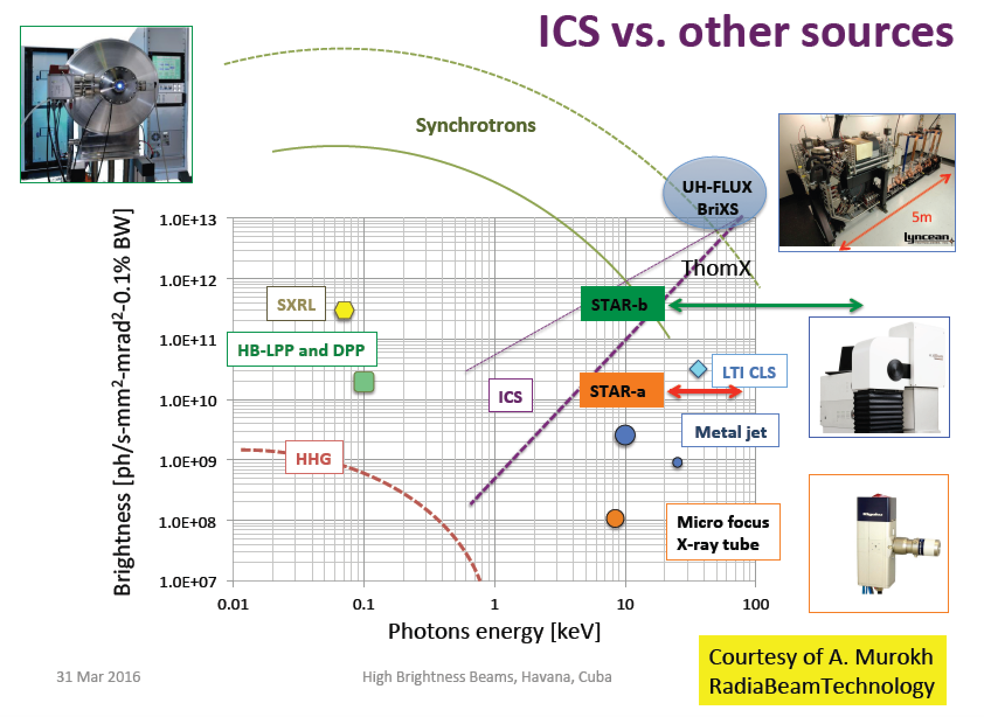

Rivaling with Synchr. Light Sources for energies above 50 keV
$$B_{av}=\frac{N_{ph}f}{ε_{x}^{2}\frac{ΔE_{X}}{E_{X}}}$$

Slide 5
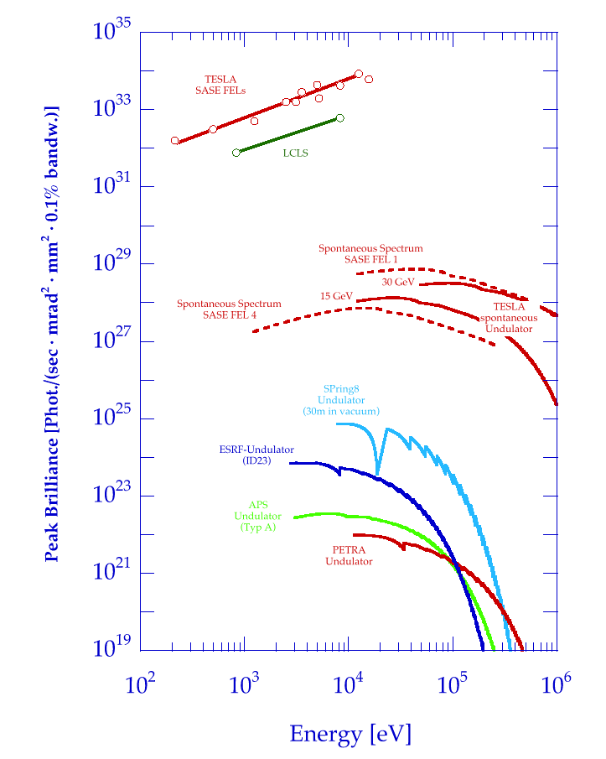
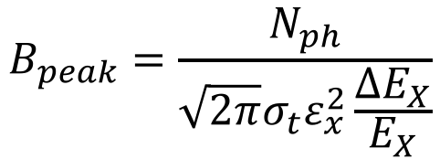
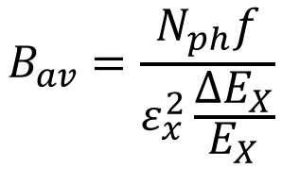
Brilliance of Lasers and X-ray sources
ELI
12.4
1.24
0.124
λ (nm)
BELLA
FLASH
$$B_{peak}=\frac{N_{ph}}{{\sqrt{2π}σ_{t}ε}_{x}^{2}\frac{ΔE_{X}}{E_{X}}}$$
Thomson/Compton Sources
$$B_{av}=\frac{N_{ph}f}{ε_{x}^{2}\frac{ΔE_{X}}{E_{X}}}$$

Slide 6
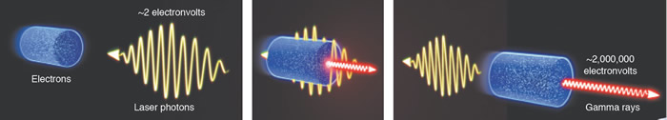
I.C.S. : Inverse Compton Scattering
Inverse Compton Scattering: why Inverse?
(direct) Compton Scattering is performed by an energetic photon (X-rays) interacting with an atomic electron (eV)
Inverse Compton Scattering is performed by an energetic electron (MeV-GeV) onto a visible (eV) photon (“inverse” refers to the reaction kinematics, not the dynamics)

Slide 7
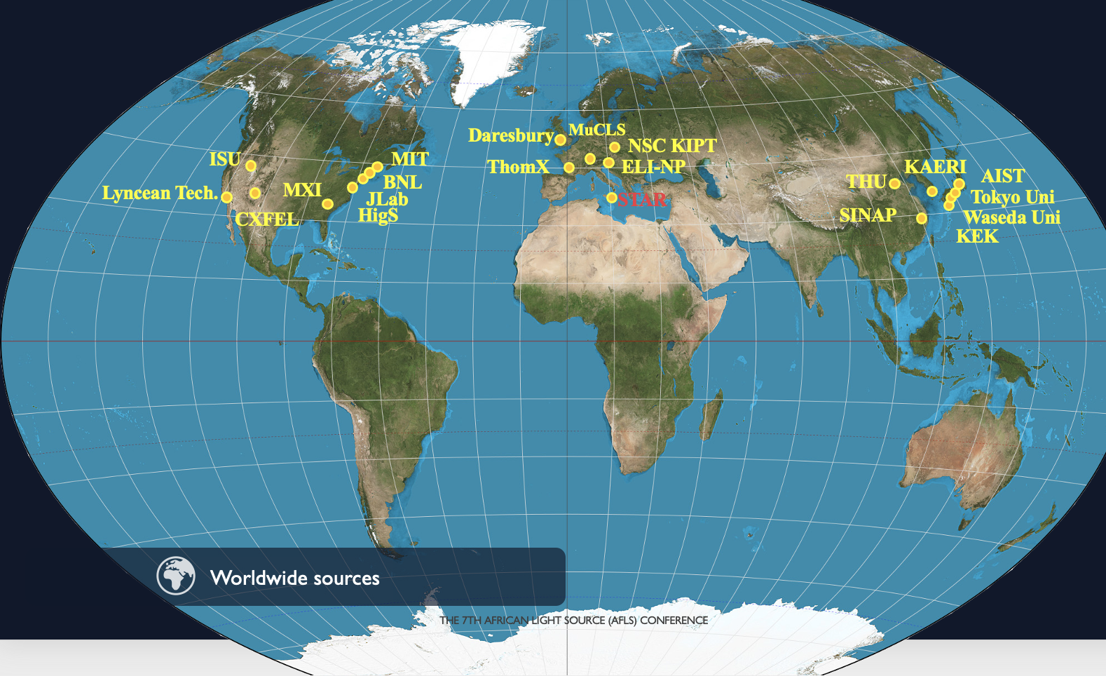
ICS are the most effective “photon accelerators” (boost twice than FELs)
“4γ² boost effect”

Slide 8
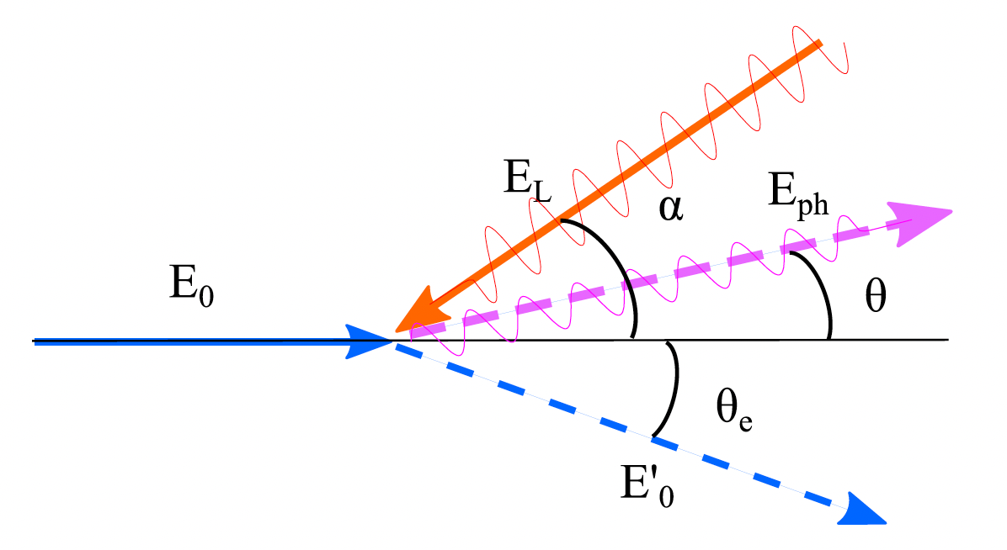
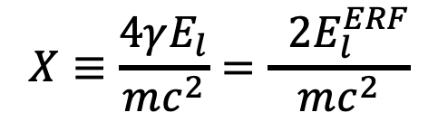

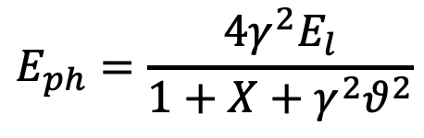
The γ²θ² issue/disease
All radiation originated by a Lorentz Boost associated to relativistic emitting particles (electrons, heavy ions) is intrinsically poli-chromatic because of γθ correlation (energy boost of scattered photons depends on scattering angle, at θ=1/γ photon energy is 50% of max photon energy at θ =0 ) of single electron spectrum (on top of inhomogeneous effects)
True for all kinds of Undulatory and Collisional radiation (bremsstrahlung, wiggler/betatron, synchrotron, RRS, ICS), while resonant or amplified radiation (undulators, FELs), that are diffraction limited thanks to their beam quality, are not (or only partially) affected
$$E_{ph}=\frac{4γ^{2}E_{l}}{1+X+γ^{2}θ^{2}}$$
$$E_{0}=γmc^{2}$$
quantum
nature of
light
$$X≡\frac{4γE_{l}}{mc^{2}}=\frac{ 2E_{l}^{ERF}}{mc^{2}}$$

Slide 9
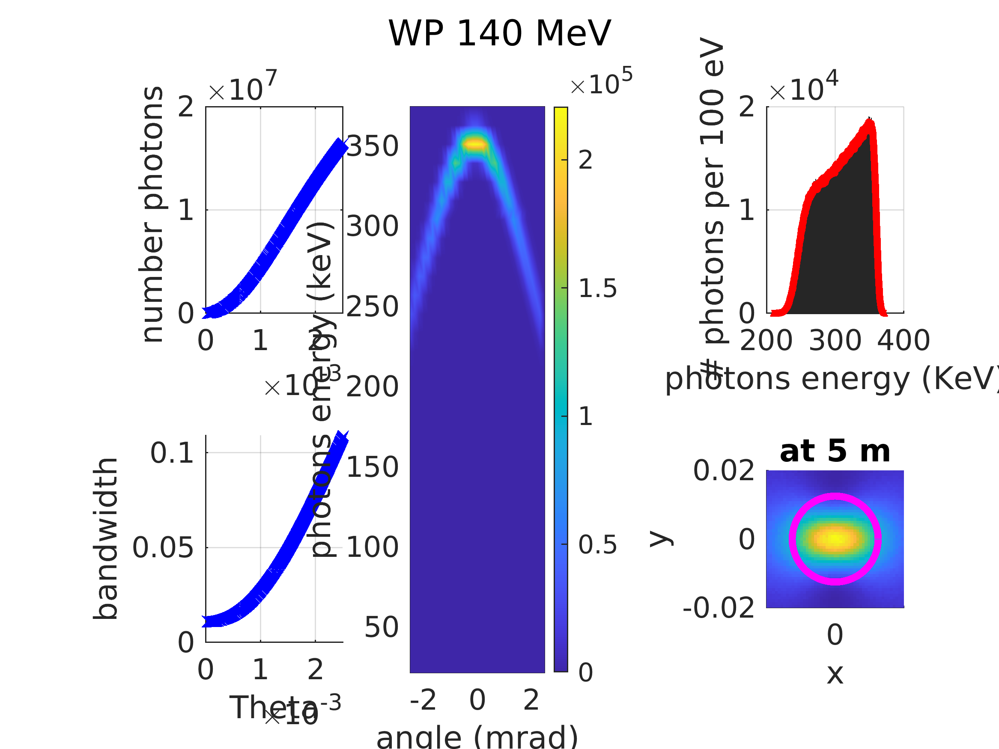
Courtesy I. Drebot

Slide 10
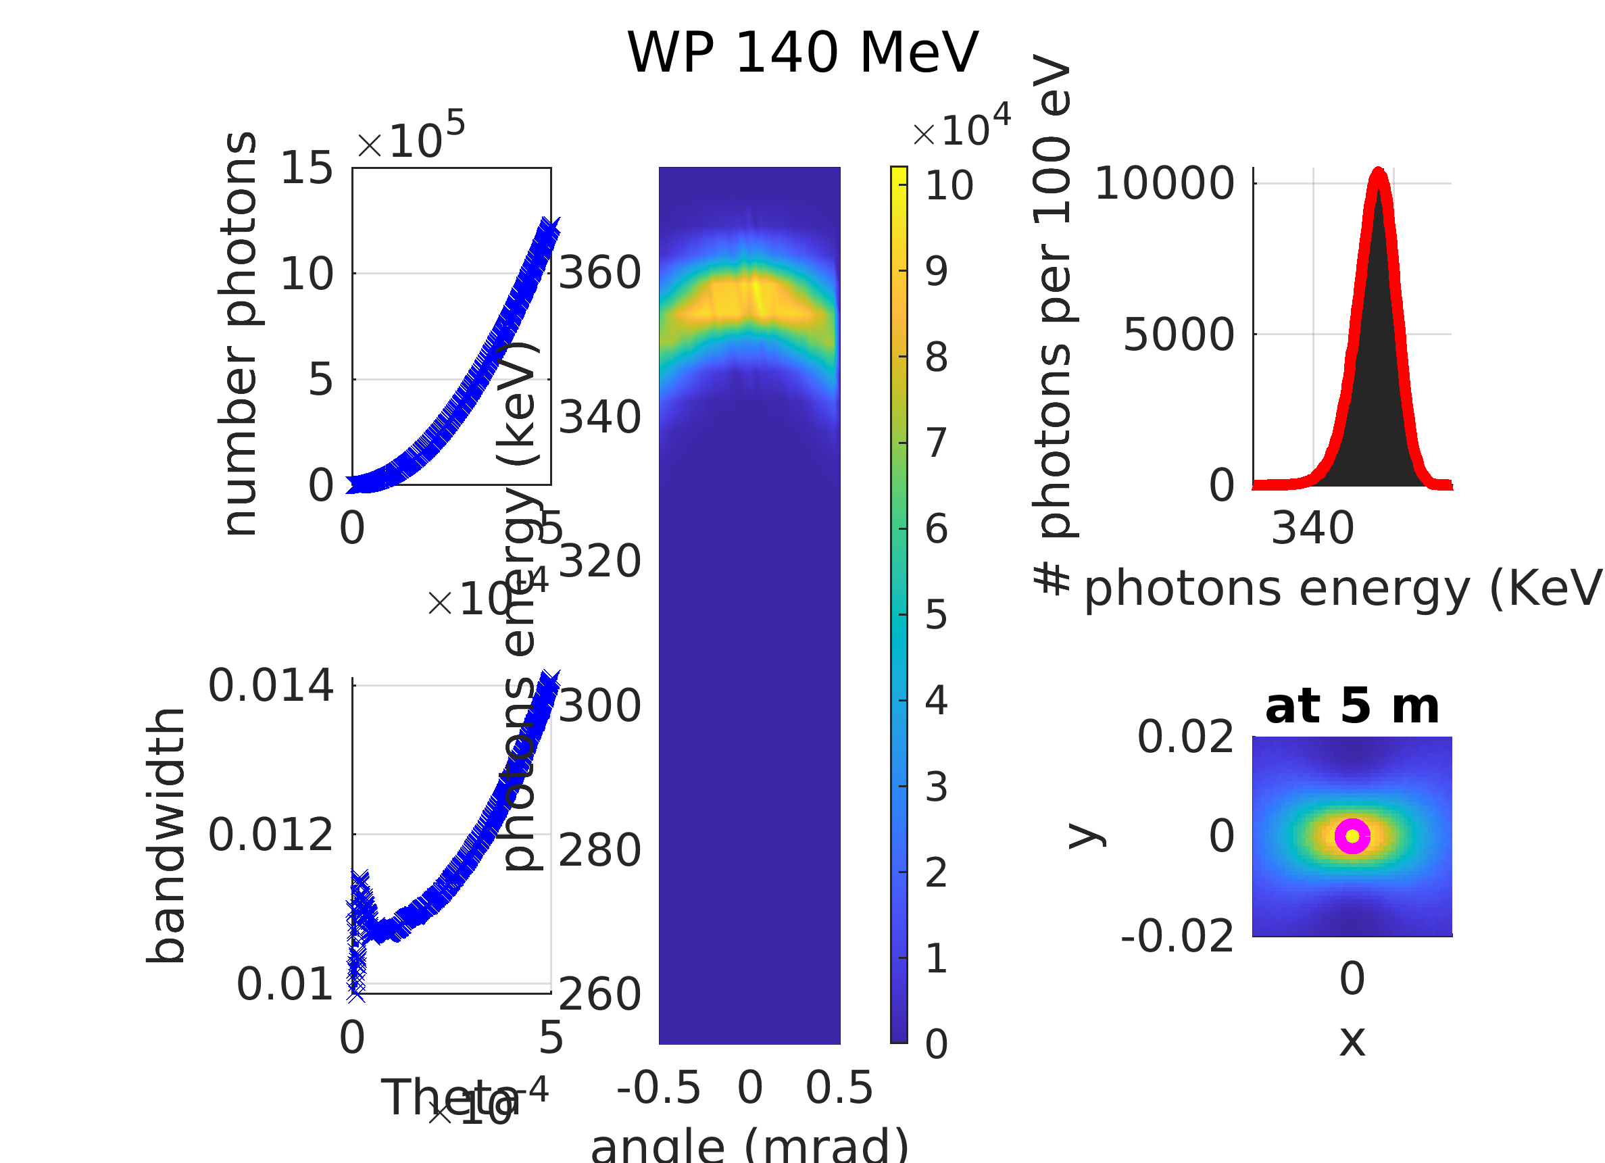
psec and sub-psec radiation pulses – large, round field of view
full and variable polarization (shot-to-shot)
Courtesy I. Drebot

Slide 11
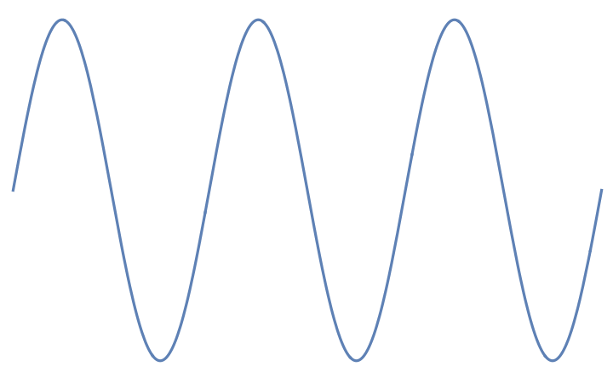
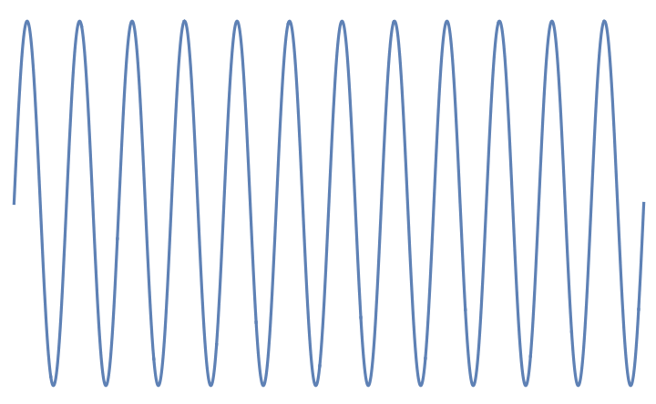
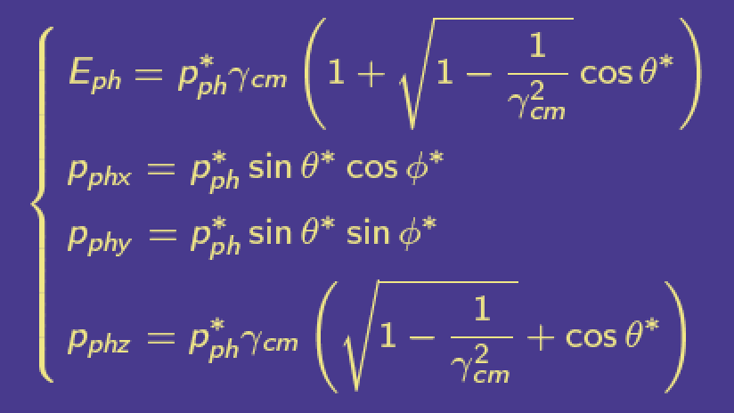
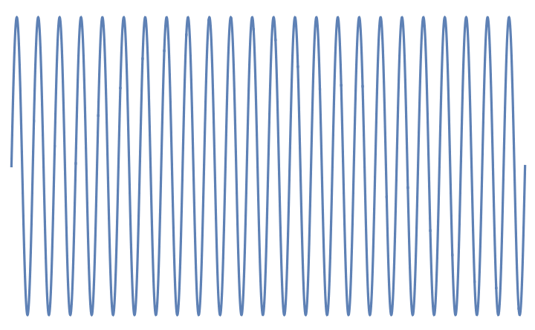


incident electron
E_{e} = γmc²
incident photon E_{ph}
Lab Reference Frame
Kinematics of
Inverse Compton Scattering
a Cartoon
Lorentz transformation (γ_{cm} = γ)
incident photon E*_{ph} = 2γ E_{ph}
Electron rest frame
E*_{e} = mc²
scattered photon at
θ=1/γ E’_{ph} =E’₀ /2
if E*_{ph} << mc² the photon is scattered
back elastically with same energy E*_{ph}
(zero recoil, Thomson limit)
scattered photon at θ
E’_{ph} =E’₀ (1-γ ²θ²)
Lab Reference Frame
after Scattering
θ=1/γ
θ
scattered electron
E’_{e} = γmc² + E_{ph} – E’_{ph}
energy of scattered photon at θ=0 E’₀ = 2γ E*_{ph} = 4γ² E_{ph}

Slide 12
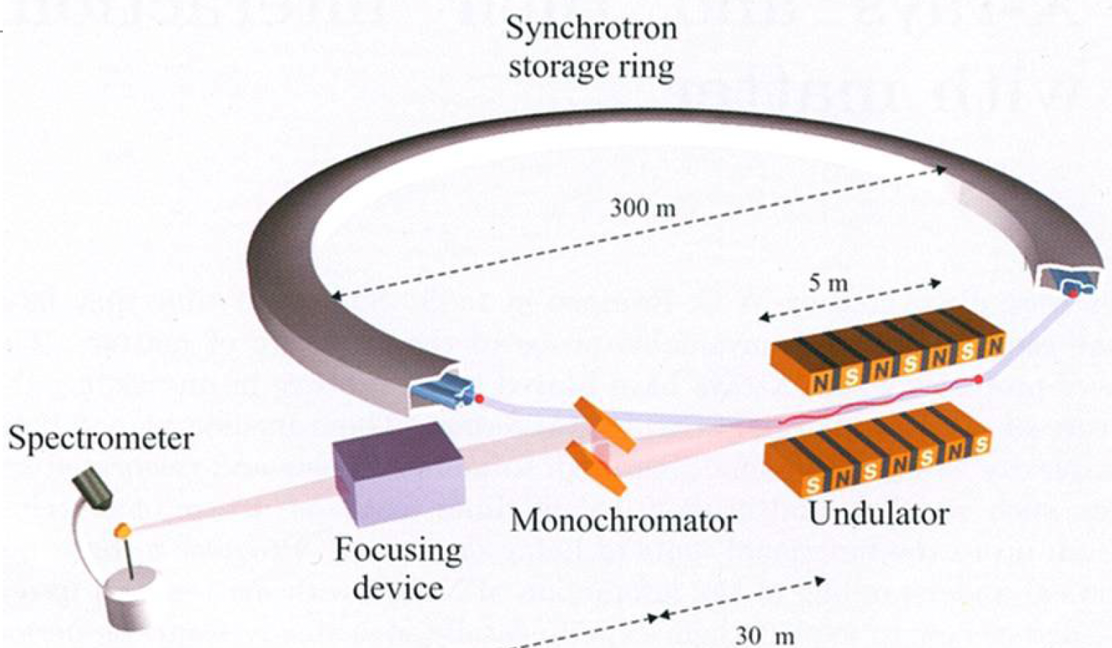
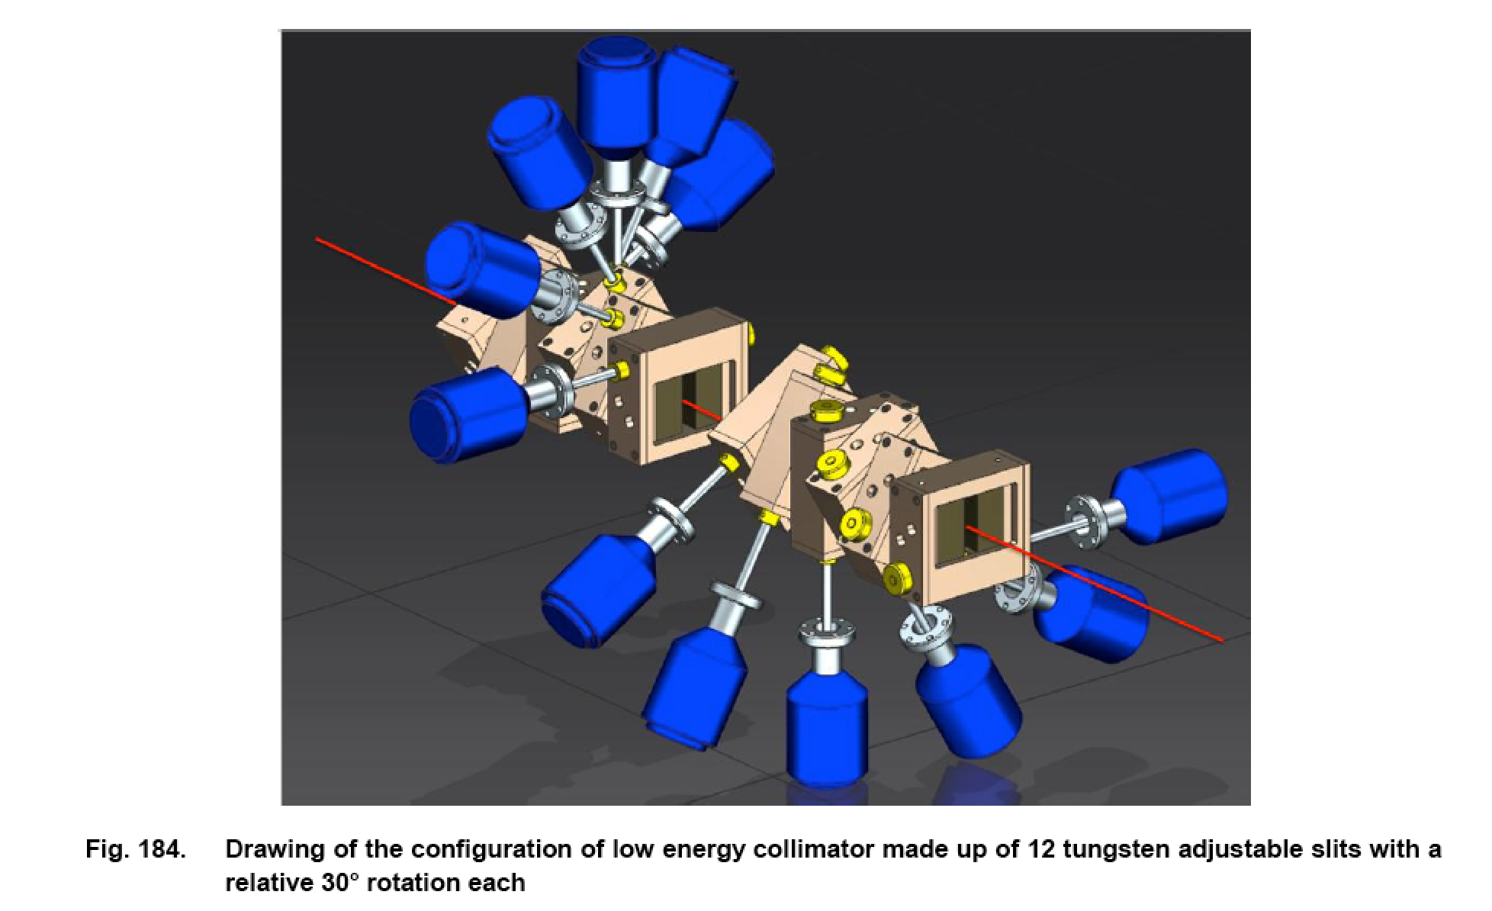
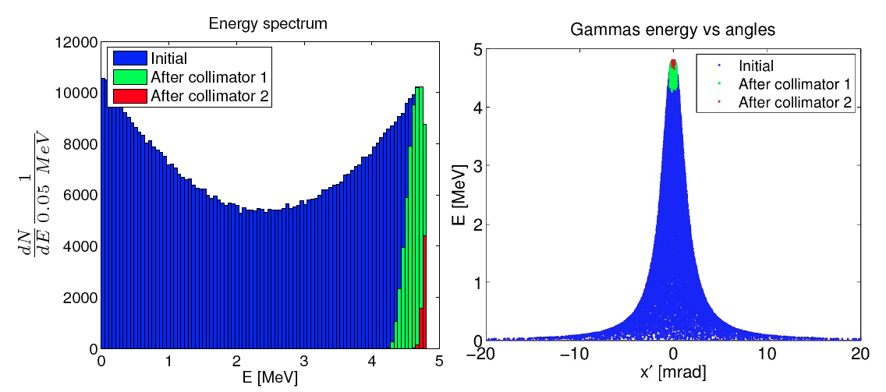
Poli-chromaticity implies using mono-chromators of different kinds (bragg-reflectors, collimators) to select a narrow bandwidth line from a broad-band spectrum
ELI-NP-GBS γ –beam
collimator (2-19 MeV)
X-ray monochromator

Slide 13
ICS Sources: three paradigma
Linac based (low flux, easy operation)
(full access to beam particles and phase space)
b) Storage ring based (large flux, challenging)
(no access to beam particles, limited access to phase space)
c) Energy Recovery Linac based (very large flux, very challenging)
(no access to beam particles, full access to phase space)
Linac based ICS are easily extandable to MeV gamma rays
towards nuclear physics oriented research and applications
Linac based ICS are also compatible to laser-plasma driven acceleration modules

Slide 14
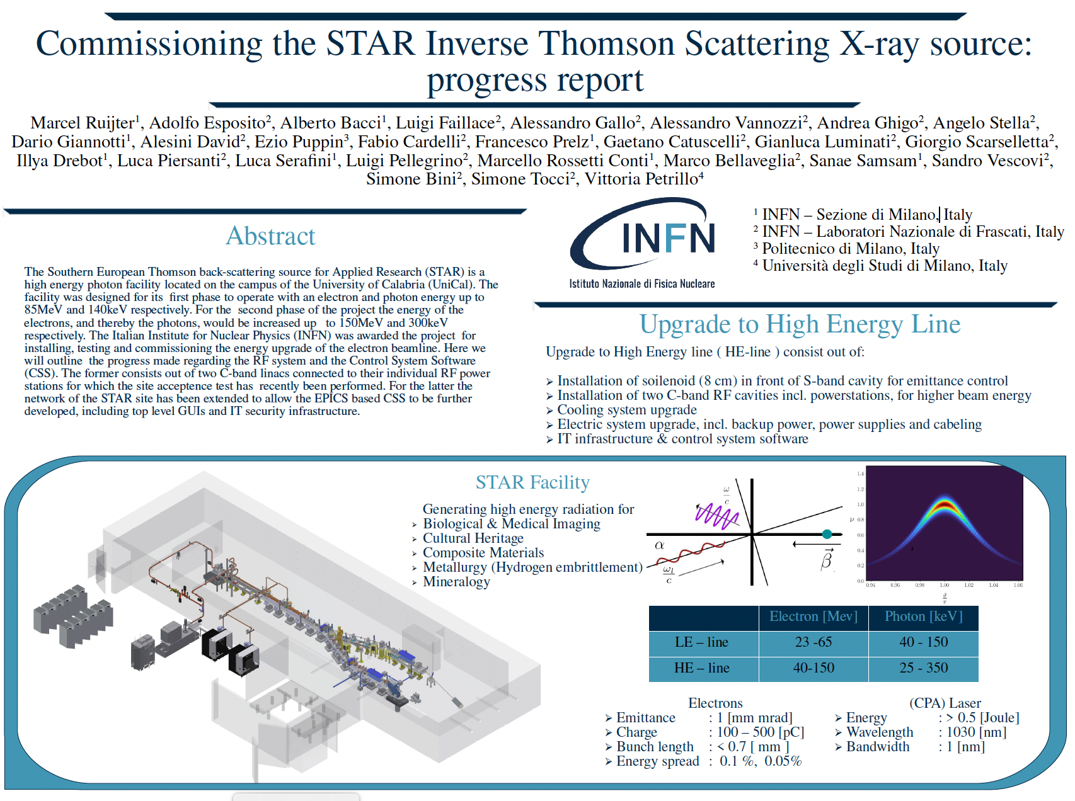
Built inside Università della Calabria campus, South Italy, with EU funds for the development of research infra-structures in EU regions of convergence
Cost of STAR ICS = 18.5 M€ with 2 beam-lines and 2 hutches

Slide 15

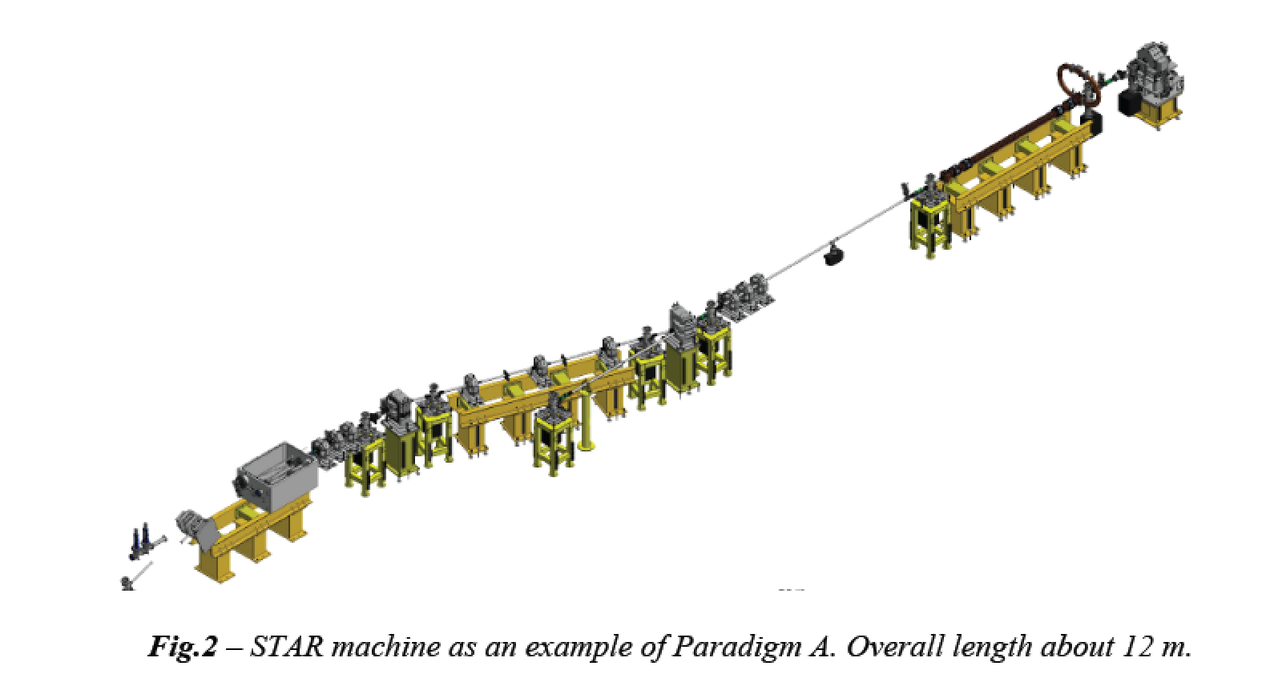
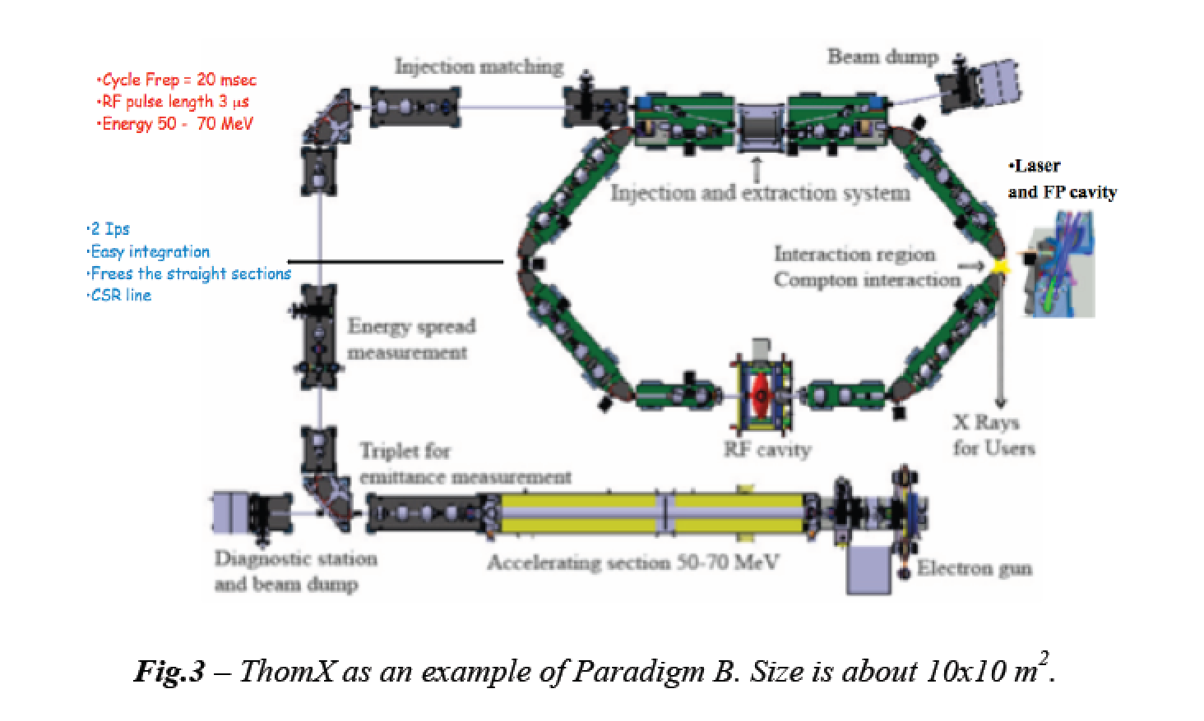
highly asymmetric compact*
electron-photon colliders
*10 m, 10 M$
MeV/GeV’s electrons
eV’s photons – more challenging and difficult to operate

Slide 16
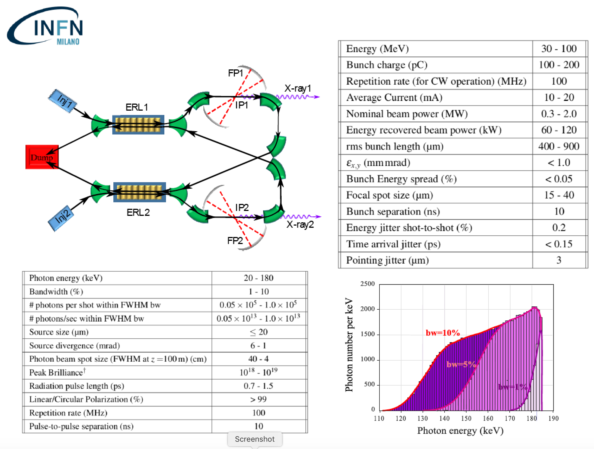
BriXS: an example of high sustainability. High power 2 MW beam delivered to user with only 200 kW power consumption/dissipation with outstanding beam quality (larger than storage rings, same current)

Slide 17
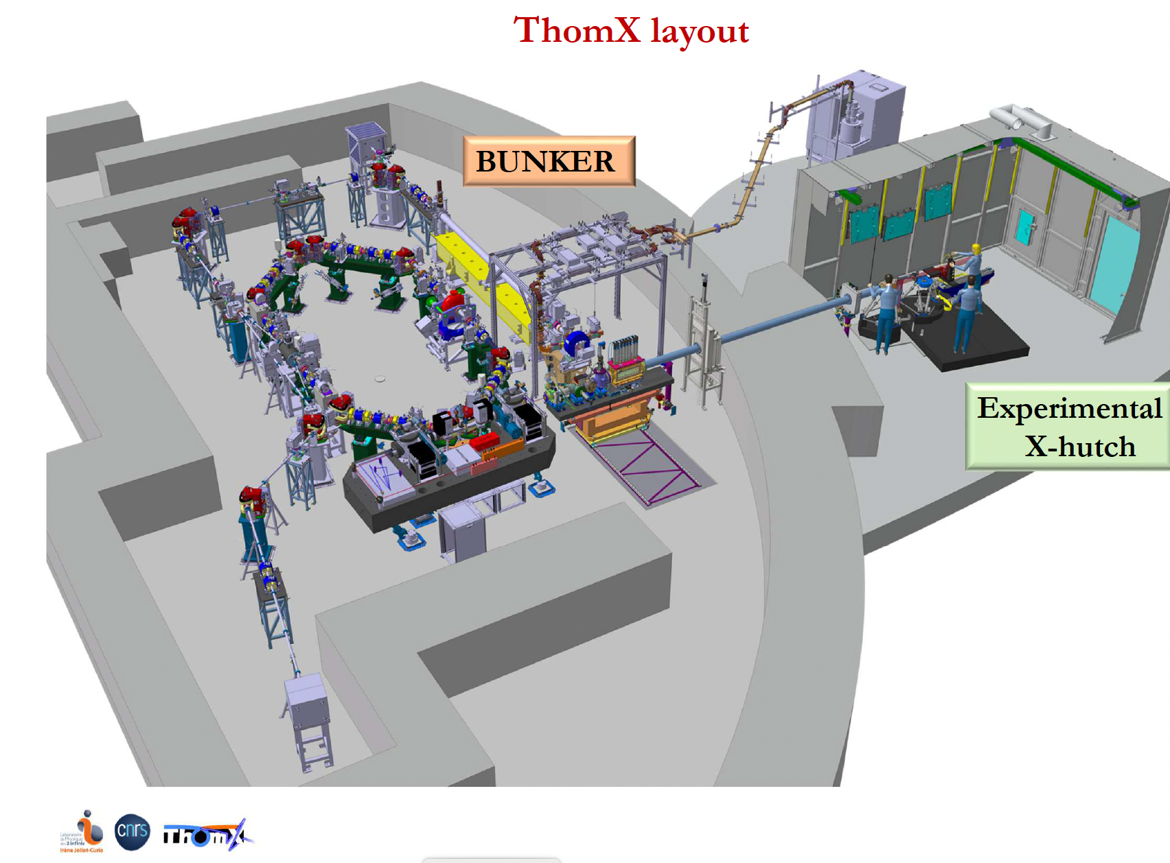
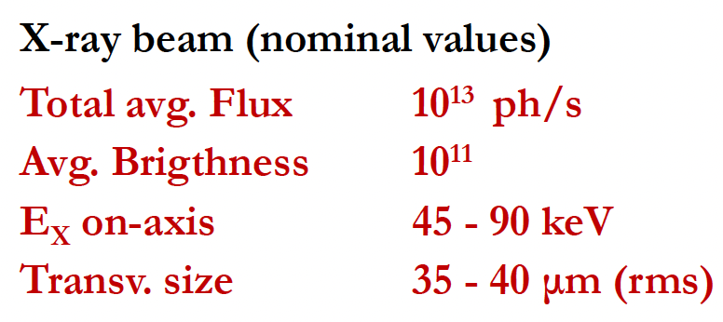
ThomX, Orsay-LAL, Paris

Slide 18
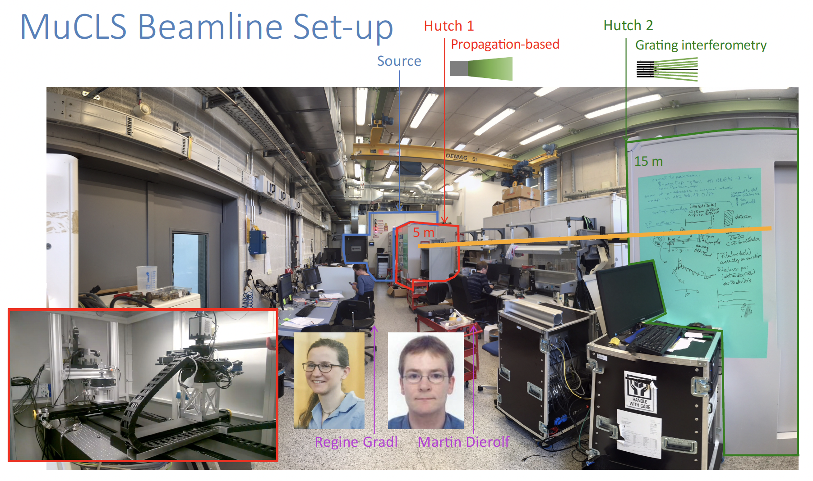
MuCLS: a Compact Light Source (ICS) in Germany (Munich)

Slide 19
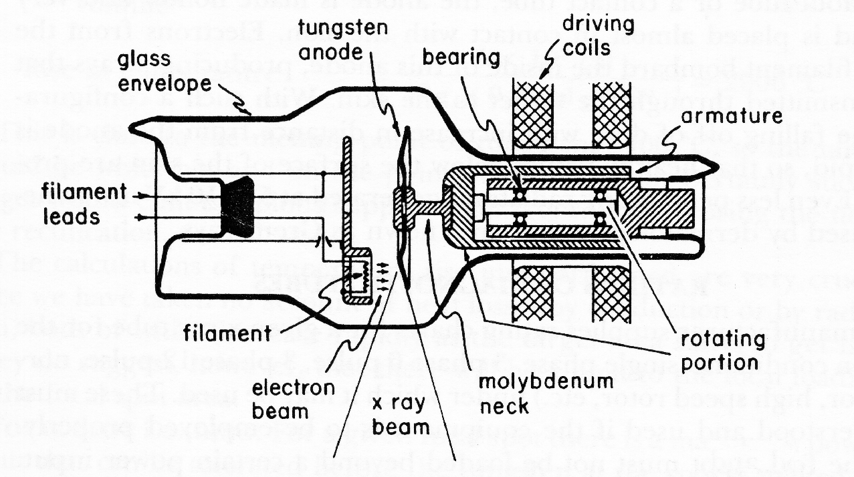
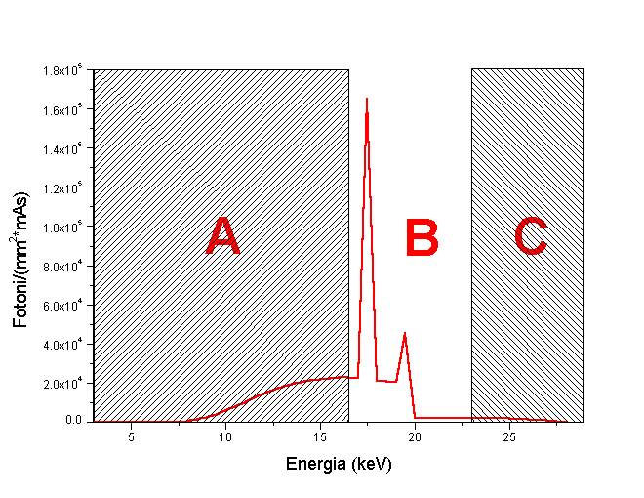
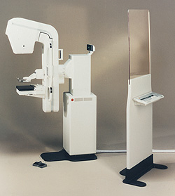
Great example of Radio-logical imaging applied to mass screening over population: mammography
Conventional X-ray tube for mammography
Spatial resolution ~100 μm
High Flux ~10⁷ γ/(mm²s) equivalent to ~5.10¹¹ γ/s over 20x20 cm² area.
Absent in
Thomson
Source
X-ray
spectrum!
65 cm
Low energy photons in the spectrum are absorbed by tissue, delivering radiation dose without bringing informations to detector. Risk of inducing secondary tumors increases without increasing the benefit of detecting early tumors

Slide 20
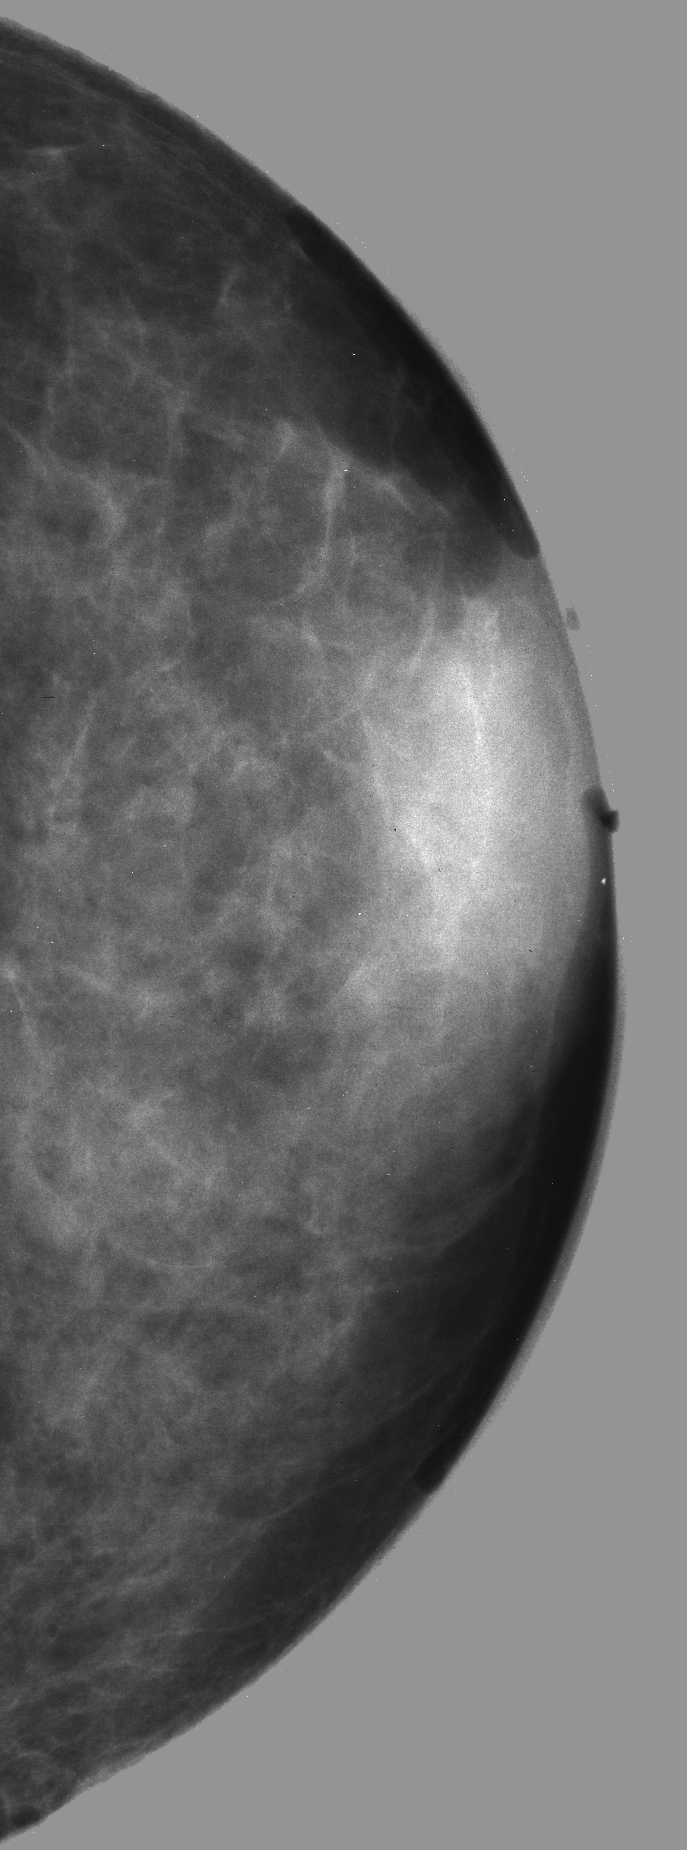
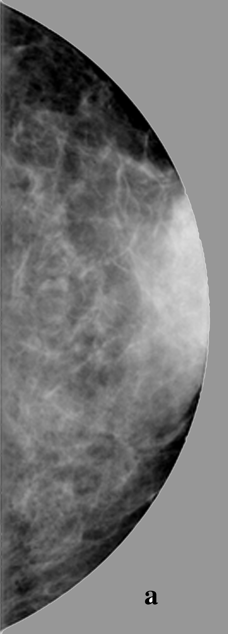

Mammography with Mono-chromatic X-rays at 20 keV has been proven
far superior in Signal-to-Noise-Ratio w.r.t. conventional mammographic tubes,
with a considerably lower radiation dose to the tissue
a) SR digital image
Energy 17 keV
Scan step 100 mm
MGD 1 mGy
Conventional
X-ray tube 26 kVp
MGD 1 mGy
b) SR digital image
Energy 20 keV
Scan step 100 mm
MGD 0.33 mGy
3 cm thick in vitro human breast tissue
8th African School of Physics - Marrakech (MO) - July 2024

Slide 21
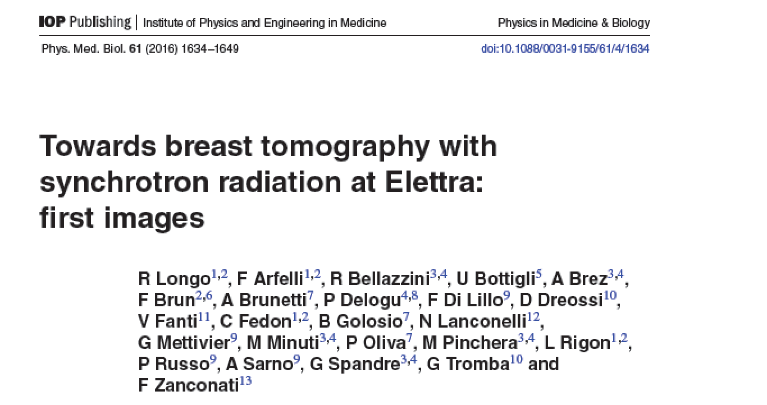
Compact Thomson X-ray Sources could be located inside hospitals to diagnose
and treat patients directly at the hospital site (unlike Synchrotrons…)
8th African School of Physics - Marrakech (MO) - July 2024

Slide 22
ICS Sources: typical fields of research
3D MICRO-TOMOGRAPHY with/without phase contrast
medical, cultural heritage, paleontological fields, material studies
b) Nuclear photonics with Nuclear Resonance Fluoresence
remote detection of nuclear materials
c) Dual energy imaging (Linac based ICS)
advanced radio-graphy with contrast imaging
d) Spectroscopy (ERL based ICS – large fluxes)

Slide 23
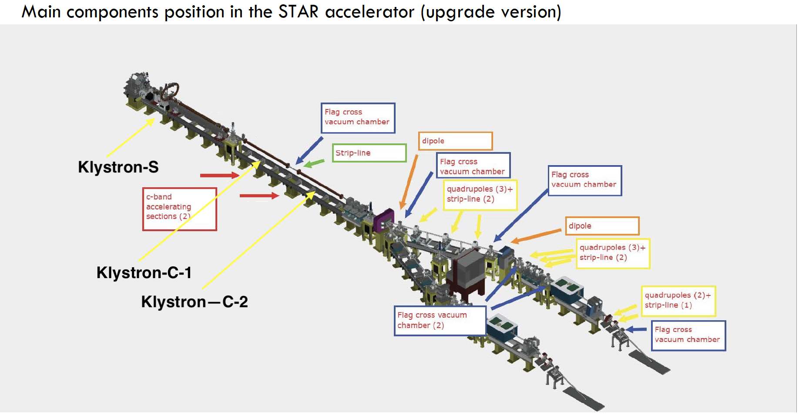
20-130 keV
100-350 keV

Slide 24

STAR X-ray beamlines
foreseen applications
with mono-chromatic
hard X-ray (350 keV)
3D micro-tomography

Slide 25
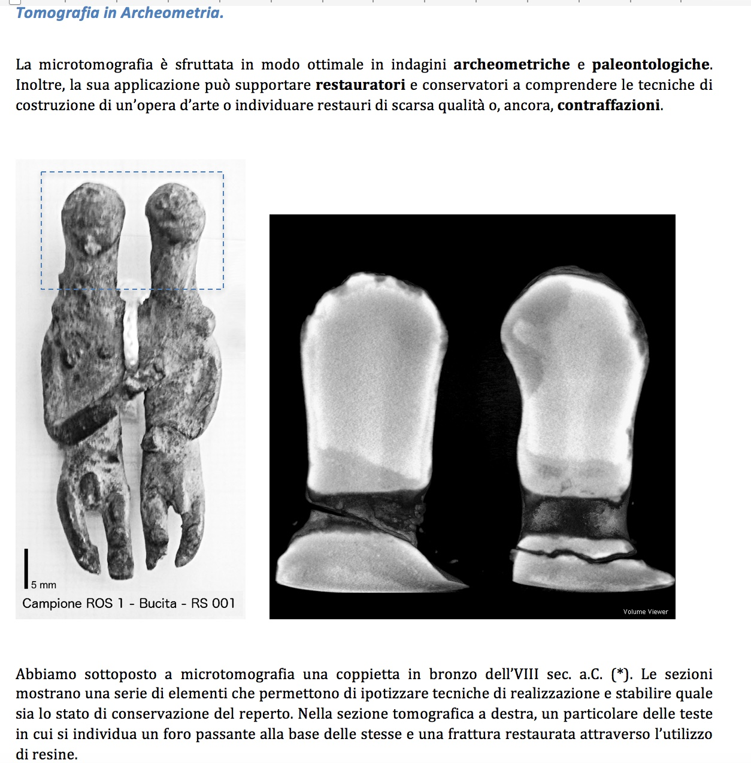
Courtesy R. Agostino

Slide 26

Photonuclear Reactions with γ-rays
Increasing the energy of ICS electron beam up to
300-400 MeV with plasma boosting stages (see Andrea Mostacci)
γ
What happens?
8th African School of Physics - Marrakech (MO) - July 2024

Slide 27
Courtesy C. Barty - LLNL

Slide 28
Photonuclear Reactions
Separation
threshold
~ 8 MeV
Absorption
γ
γ´
γ´
β
^{A´}Y
β
gs
^{A}X
Nuclear Resonance Fluorescence (NRF)
Photoactivation
Photodisintegration
(-activation)
8th African School of Physics - Marrakech (MO) - July 2024

Slide 29
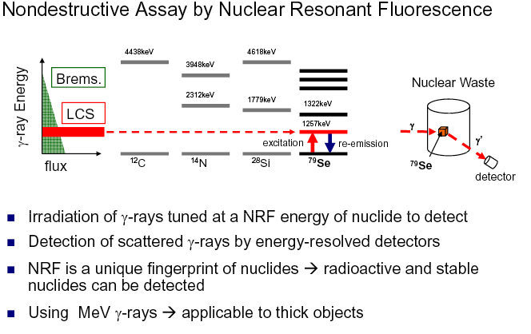
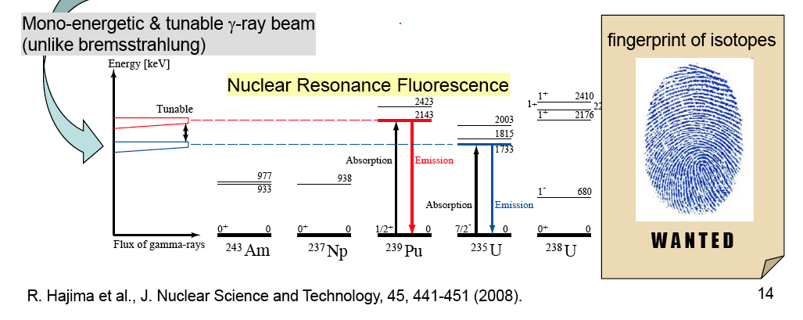

Slide 30
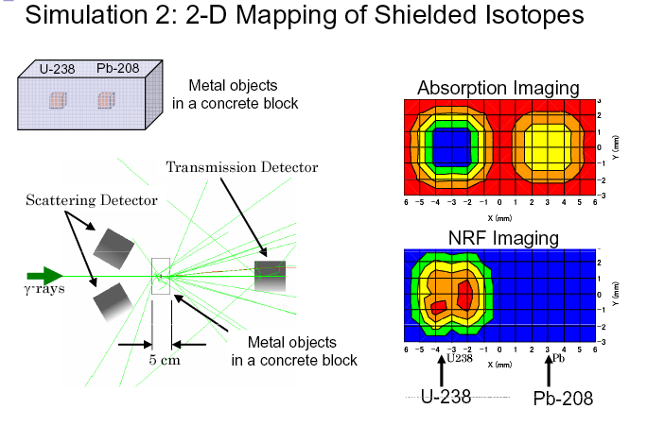
8th African School of Physics - Marrakech (MO) - July 2024

Slide 31
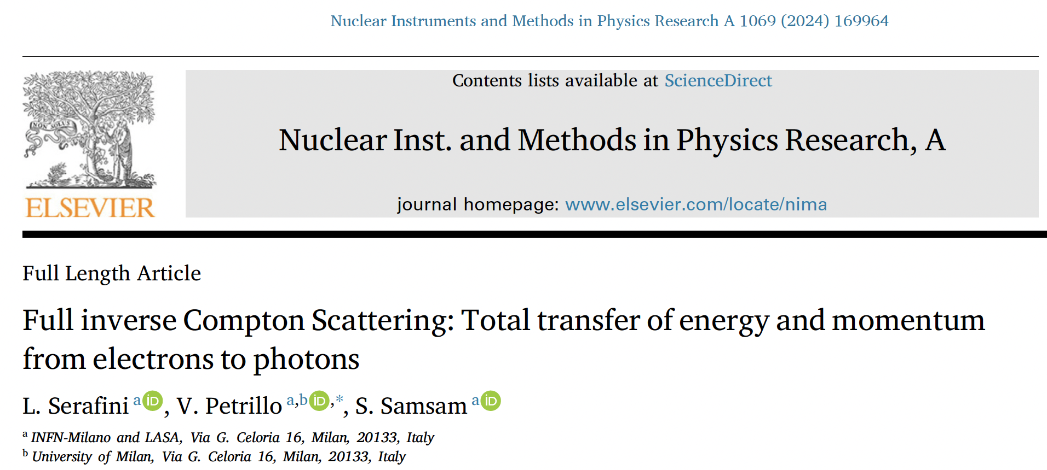
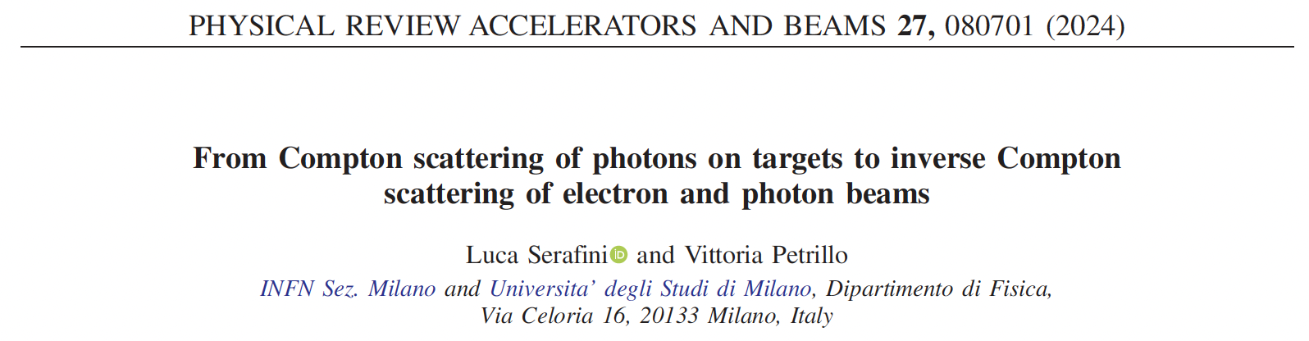
Last but not least:
with ICS (Linac-based) we can do also fundamental research in
QED, plasma physics, astro-physics and quantum gravity
Full Inverse Compton Scattering
the way an electron emits photons of energy larger than its own

Slide 32
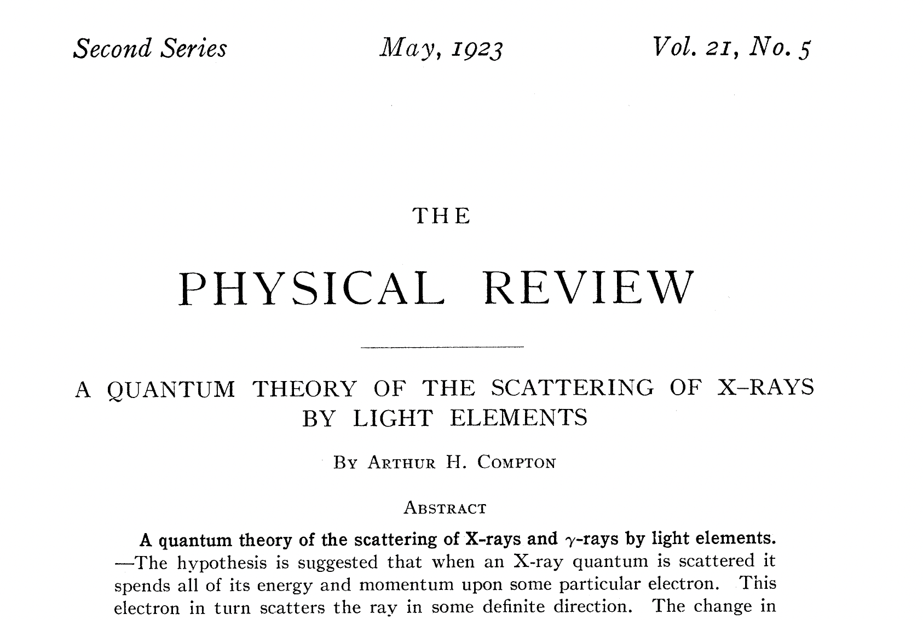
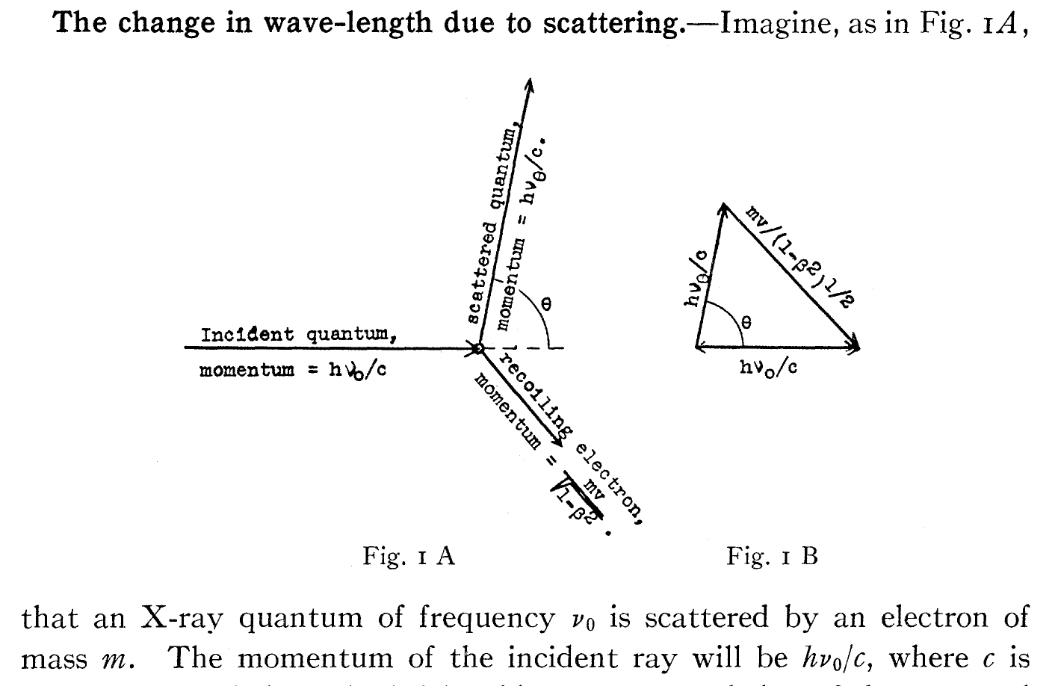

Slide 33
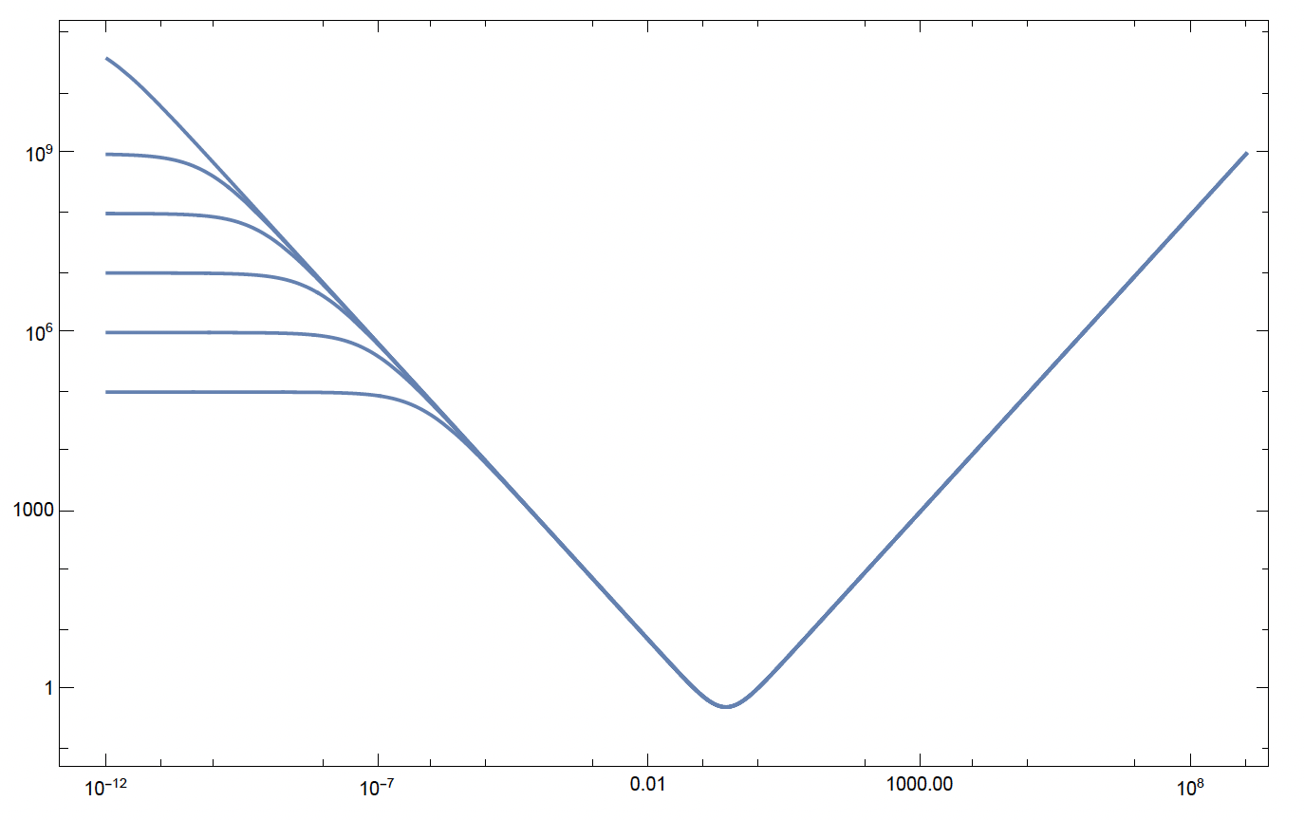
Follin, Primakoff, etc
100 PeV
1 PeV
0.5mc² = 255.5 keV colliding photons will
stop relativistic electrons of any energy E_{e} !
100 TeV
10 TeV
1 TeV
100 GeV
FICS
E’_{e}
E’_{e} (MeV)
e⁻ at rest E’_{e}=mc²
C.M.B.R.
E_{ph} (MeV)
E_{ph}=1 meV
E_{ph}=1 eV
E_{ph} =0.5mc²
E_{ph}=1 μeV
our study

Slide 34
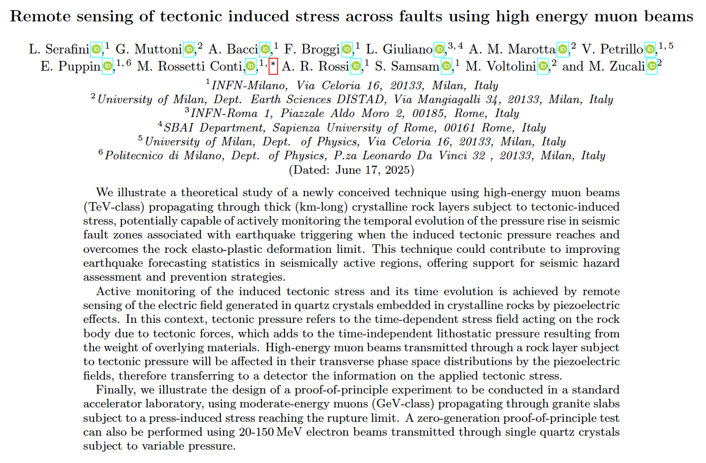
Last but not least - B:
with ICS (Linac-based) we can do also applied research in
Earthquake prediction preparatory tests

Slide 35
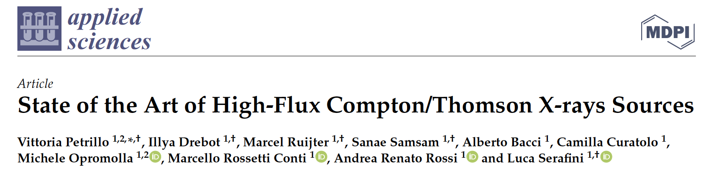
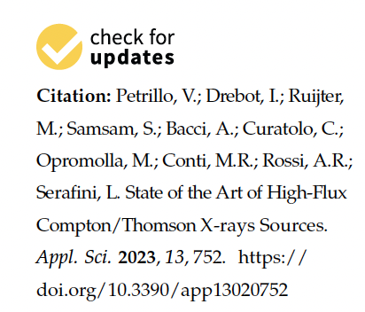
Grazie per l’attenzione
Thank you for your attention
more details in:
and references therein

Slide 37
BACKUP SLIDES

Slide 38

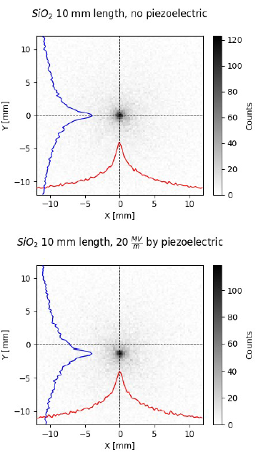
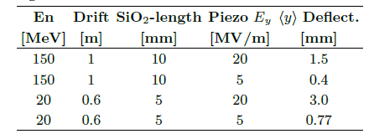

20 & 150 MeV e⁻ beam @ screen
38
The beam shows a significant visible shift on the target!
Considering other value as in the following Tab:
No pressure
Shifts are amplified at lower energy and reduced with lower field.
60 kpart @ 150 MeV
First investigation of nonlinear effects near fracture points
Zero prior literature
highly innovative research
Let’s do it asap
Active pressure
@20 MeV beam deceleration is less the 10%.

Slide 39


1 - Energy loss
39
More mechanisms play a role in the muon energy loss :
Ionization.
Radiation losses:
  Bremsstrahlung.
  Pair production.
  Photonuclear excitation.
Muons in SiO₂
MuAEGIS considers the average muon energy loss $\frac{dE}{dz}$
given by the sum of these effect.
Reference case:
500 GeV muon beam propagates ~700 m in SiO₂ rock.
Rock and quartz approximated as pure SiO₂.

Slide 40



2 - MCS
40
Multiple Coulomb Scattering (MCS) is the main transverse effect causing stochastic deflection by an angle ϑ.
Molière theory: for relativistic particles, angle ϑ follows a normal distribution with σ = 𝜃₀ .
$$θ_{0}=\frac{13.6}{cp}\sqrt{\frac{L}{L_{0}}}\left[1+0.038 \ln\left(\frac{L}{L_{0}}\right)\right]$$
ϑ
The radiation length for SiO₂ is L₀ = 12.3 cm
The particle momentum p is updated step by step considering $\frac{dE}{dz}$.
L

Slide 41


3 - PRW
41
Piezoelectric Random Walk (PRW): second effect on beam
transverse plane.
$$∆\vec{p}=\frac{q\vec{E_{p}}L_{c}}{c}$$
- - - - -
E_{p}
E_{p} = 20 MV/m for P = 400 MPa (= 4 kbar)
L_{c} up to few cm
+ + + + +
Crystals and E_{p} are randomly oriented over 4π.
    Transverse momentum evolves as 2D random walk
Notes:
spiegare il random walk

Slide 42




2D random walk
42
PRW and MCS affect transverse momentum like a 2D random walk.
Each momentum step has a random direction.
Each particle follows a unique transverse path, but the bunch evolves with averaged, ordered behavior:
$$\sqrt{\left\langle p_{r}^{2}\right\rangle }=\sqrt{N}\left\langle l_{i}\right\rangle$$
N: number of steps
l_{i}: step length ($∆p_{r,i}$)
Visual example:
20,000 muons through 1 km of ground
Periodic layers: 1 cm rock / 1 cm quartz
(20 tracks shown)

Slide 43


Reference case
43
We simulate ${10}^{6}$ muons into 600 m of ground -- Periodic layers: 1 cm rock / 2 cm quartz
Notes:
Errore! Emittanzza e sigma sono riferiti ad x, controlla!

Slide 44

Great benchmark
44
Same case simulated with FLUKA for comparison. Additional effects observed, but overall good agreement.
FLUKA – envelope
MuAEGIS: 2.243 m (+2%)

Slide 45


Quality is not mandatory
45
What happens with a higher emittance (10x) beam?

Slide 46


We can see the build-up
46
We simulated beam envelope enhancement (∆) under varying quartz pressures observing non-linear evolution.
$$Δ=\frac{σ_{TOT,r}}{σ_{MCS,r}}−1$$

Slide 47

How to see the effect
47
Effect observed by comparing muon distribution on detector plane with ideal case (no pressure/quartz).

Slide 48
My conclusion and advice
Dream big, start small, keep going far…
but don’t forget that a project is a dream with a deadline

Slide 49


Slide 50

CLS grid around Diamond (UK)

Slide 51

Light sources started being developed in the ’50s and went
through several generations (1st → 4th with FELs and MBA)

Slide 52
ICS started being developed in the late ’90s only after the technology of high brightness photo-injectors became mature (same as FELs):
they keep following new advanced accelerator development,
including laser-plasma wake acceleration

Slide 53

Courtesy L. Rivkin

Slide 56


Full Inverse Compton Scattering: amazing power
of 255.5 keV photons to stop ANY colliding electron
100 PeV
0.5mc² = 255.5 keV colliding photons will
stop relativistic electrons of any energy E_{e} !
1 PeV
100 TeV
10 TeV
1 TeV
100 GeV
FCC-ee
EupraXia
E’_{e}
$$E_{ph}$$
$${E′}_{ph}$$
E’_{e} (MeV)
$$E_{e}$$
$${E′}_{e}$$
the most extreme acceleration
achieved in the universe ??
e⁻ at rest E’_{e}=mc²
C.M.B.R.
E_{ph} (MeV)
E_{ph}=1 meV
E_{ph}=1 eV
E_{ph} =0.5mc²
E_{ph}=1 μeV
*hadronic threshold (E_{cm} < 600 MeV) with 255.5 keV photons ≈ 360 GeV

Slide 57
Follin, Primakoff, etc
100 PeV
1 PeV
0.5mc² = 255.5 keV colliding photons will
stop relativistic electrons of any energy E_{e} !
100 TeV
10 TeV
1 TeV
100 GeV
FICS
E’_{e}
E’_{e} (MeV)
e⁻ at rest E’_{e}=mc²
C.M.B.R.
E_{ph} (MeV)
E_{ph}=1 meV
E_{ph}=1 eV
E_{ph} =0.5mc²
E_{ph}=1 μeV
our study

Slide 58

$$E_{e}$$
$${E′}_{ph}$$
in vacuum electron-photon collision
E’_{e} (MeV)
$${E′}_{e}$$
$$E_{ph}$$
5 GeV
f_{FICS} = 1 !!
FICS – Full Inverse
Compton Scattering
1 GeV
200 MeV
E_{e} = 50 MeV
$$E_{ph−FICS}^{′}=T_{e}+\frac{{mc}^{2}}{2}$$
E’_{e} =511 keV , T’_{e}=0
E_{ph} (MeV)
E_{ph} = 1 eV
E_{ph} = 1 keV
E_{ph} =0.5mc²

Slide 59

FICS Relay in the cosmo - a possible mechanism to
propagate very high energy electrons in the universe
FICS
Direct
Compton
FICS, etc, etc

Slide 60


E’_{ph} - energy of scattered photon at θ
red shift at θ≠0
θ
scattered electron
E’_{e} = γmc² + E_{ph} – E’_{ph}
All I.C.S. X/γ ray Sources work at X<1 and A » 1
STAR (350 keV) X_{STAR} < 2.6.10⁻³ A_{STAR} > 10⁴
ELI-NP (20 MeV) X_{ELI-NP} < 0.026 A_{ELI-NP} > 2.4.10⁵
X = recoil parameter – twice the energy of the photon seen
by the electron in its own reference frame normalized to mc²

Slide 62
where is the Continental Divide
between
Compton Scattering
and
Inverse Compton Scattering?
when the electron becomes
a projectile (as in ICS)
instead of
a target (as in Compton)?
Does it depend only on electron energy?
No, it depends only on asymmetry in colliding momenta

Slide 63








$${E′}_{ph}$$
$$E_{e}$$
$$E_{ph}$$
$${E′}_{e}$$
I.C.S. low recoil X<<1
${E′}_{ph−max} = 4γ2$ $E_{ph}$
$${E′}_{ph−max} = \left(1−\frac{1}{X}\right)E_{e}$$
I.C.S. large recoil X>>1
$${E′}_{ph} =E_{ph}\left(1+\frac{2A}{\left(1+β\right)γ^{2}}\right)$$
S.C.S. (A=0) or
quasi-SCS (A<<1)
$${E′}_{e} ={E_{e}−E}_{ph}\frac{2A}{\left(1+β\right)γ^{2}}$$

Slide 64

γ -ray in-vacuum mono-chromatization, SCS at large Recoil
20% rms spread
Incoming e- beam 10⁻⁴ rms spread
Electron
Cooling of
photons!!
2.10⁻⁴
rms spread
no energy-
angular
correlation
10⁻¹ spread
e- beam
is heated
C. Curatolo - Whizard

Slide 65

Spread of incidence angle
(resembles emittance)
cooling of
photons still
effective
as well as
heating of
electrons

Slide 66






Schematic recap of X/γ Radiation Sources
(keV, MeV, GeV…)
Spontaneous undulatory radiation (synchrotron, wiggler, betatron, channeling, bremsstrahlung)
Resonant/amplified undulatory radiation (undulator, FEL)
$$E_{X}=f\left(γ^{2}θ^{2}\right)$$
courtesy B. Paroli, M. Potenza
courtesy L. Rivkin
$$E_{X}≠f\left(γ^{2}θ^{2}\right)$$

Slide 67



Collisional radiation
(Relativistic Rayleigh Scattering aka Gamma Factory, Inverse Compton Scattering, Large Recoil ICS, Symmetric Compton Scattering)
Gamma Factory
deep recoil I.C.S.
I.C.S.
EXMP
low recoil
I.C.S. - STAR

Slide 68
To transform to the Lab ref. system we need to compute
Then apply a Lorentz transformation

Slide 69





Deep Recoil I.C.S. helps attenuating the γ²θ² problem through slowing down of Lorentz boost γ_{cm}<<γ
7 GeV e⁻ beam
laser
UV FEL
X FEL
$$Ψ=\frac{γθ}{\sqrt{1+X}}$$
$$\overline{P}=\frac{\sqrt{2}ε_{n}}{σ_{x}\sqrt{1+X}}$$
X=0.13
X=13.
X=1300.
$$γ_{cm}=\frac{γ}{\sqrt{1+X}}$$
R. Hajima and M. Fujiwara, Narrow-band GeV photons
generated from an x-ray free-electron laser oscillator, Phys.
Rev. Accel. Beams 19, 020702 (2016). XFELO Project

Slide 70












An invariant view at Compton effect - 1
(any inertial ref. frame)
Phys. Rev. AB (2018)
21, 030701
$$X=\frac{4γℏω}{mc^{2}}$$
Arthur Compton,
Nobel Prize 1927
A<0
$$γ≫1 ; γ^{2}≫\frac{X}{4}$$
A<0
A=0
photon looses energy
electron looses energy
$$β=0$$
S.C.S.
I.C.S.
$$β γ^{2}=\frac{X}{4}$$
$$E_{ω′}=\frac{4γ^{2}E_{ω}}{1+X+γ^{2}θ^{2}}$$
$$E_{ω′}={βE}_{e}=βγmc^{2}$$
$$λ′≠∞$$
$$E_{ω′}≠f\left(γ^{2}θ^{2}\right)$$
$$\lim_{X→∞}{E_{ω′}}=E_{e}$$
isolated e⁻ cannot absorb a photon

Slide 71












An invariant view at Compton effect - 2
(any inertial ref. frame)
$$X=\frac{4γℏω}{mc^{2}}$$
A<0
A=0
A<0
photon looses energy
electron looses energy
$$\overset{⃑}{p_{e}}=−\overset{⃑}{p_{ω}}$$
Direct Compton
S.C.S.
I.C.S.
$$β=0 ; γ=1$$
$$X=4β γ^{2}$$
$$E_{ω′}=\frac{4γ^{2}E_{ω}}{1+X+γ^{2}θ^{2}}$$
$$ν′=\frac{ν}{1+\frac{X_{DC}}{4}\left(1+\cos{θ}\right)}$$
$$E_{ω}=p_{e}c=βγmc^{2}$$
$E_{ω′}=E_{ω}$ $∀θ$
$$γ →∞$$
$$X→∞$$
$$E_{ω′}→E_{e}$$
$$E_{e′}→mc^{2}$$
$X_{DC}=\frac{4ℏω}{mc^{2}}$ $=\frac{4λ_{C}}{λ}$
$$E_{e′}=E_{e}= γmc^{2} ∀θ$$
$$γ_{cm}=1$$
CM ref. frame = Lab ref. frame

Slide 72


E’_{ph}
(keV)
ICS
1 eV – O(100) MeV

Slide 73
Symmetric Compton Scattering suppresses the γ²θ² correlation
Photons are scattered at same energy at any angle
Lorentz Boost is damped
Radiation emission is intrinsically mono-chromatic
Poli-chromaticity of incident photon beam is transferred to the scattered electron beam and viceversa (photon cooling, electron heating)

Slide 74
















A look at 4-vectors (head-on collision)
Inverse Compton
Symmetric Compton
$E_{ω}≪γmc^{2 }; γ≫$1
$$E_{ω}=p_{e}c=βγmc^{2}$$
$$\overline{P_{e}}=\left\{γmc,0,0,βγmc\right\}$$
$$\overline{P_{e}}=\left\{γmc,0,0,βγmc\right\}$$
$$\overline{P_{ω}}=\left\{{E_{ω}}/c,0,0,−{E_{ω}}/c\right\}$$
$$\overline{P_{ω}}=\left\{βγmc,0,0,−βγmc\right\}$$
$$\overline{P_{tot}}≅\left\{γmc+\frac{E_{ω}}{c},0,0,βγmc−\frac{E_{ω}}{c}\right\}$$
$$\overline{P_{tot}}=\left\{\left(1+β\right)γmc,0,0,0\right\}$$
$$E_{cm}≡c\sqrt{\overline{P_{tot}}⊗\overline{P_{tot}}}$$
$$E_{cm}=mc^{2 }\sqrt{1+\frac{\left(1+β\right)X}{2}}≈$$
$$≈mc^{2 }\sqrt{1+{4γE_{ω}}/{mc^{2 }}}$$
collider
fixed target
$$γ_{cm}≡\frac{E_{lab}}{E_{cm}}$$
$$E_{cm}=\left(1+β\right)γmc^{2 }$$
$$γ_{cm}≅γ/{\sqrt{1+X}}$$
$${; γ}_{cm}$$
1
$$γ_{cm}=1$$
$$γ→∞$$

Slide 75


S.C.S. Spectra at different Recoils

Slide 76

Turning a radio-active Cobalt-60 fixed energy
gamma-ray source into a tunable sorce of gamma-rays

Slide 77


2 spectral lines merged into a single tunable line

Slide 78

S.C.S. – incident photon energy vs.
incident electron kinetic energy
E_{ph} (keV)
T_{e} (MeV)

Slide 80

Inverse Compton Sources rivaling/overcoming
Synchrotron Light Sources at photon energies above 80-100 keV
ELI-NP-GBS
STAR
I.C.S.

Slide 81
Inverse Compton Sources, Overview, Theory, Main Technological Challenges – Photonic Colliders
New Generation of X/γ ray beams via electron-photon beam collisions for advanced applications in medicine/biology-material science/cultural heritage/national security and fundamental research in nuclear physics and high energy physics (e-γ, γ-γ colliders, pol. e⁺ beams, hadron. physics, etc)
Inverse Compton Sources (ICS) are e⁻/photon colliders aimed at producing secondary beams of photons
Several Test-Facilities world-wide: after a decade of machine test&development we are entering the era of User Facilities in X-ray imaging and γ-ray Nuclear Physics and Photonics

Slide 82
Challenges of electron-(optical)photon colliders as X/γ beam Sources using Compton back-scattering
Need of high peak brightness/high average current electron beams (cmp. FEL’s drivers) fsec-class synchronized and μm-μrad-scale aligned to high peak/average power laser beams
Main goal for Nuclear Physics and Nuclear Photonics: Spectral Densities > 10⁴ N_{ph}/(s.eV) photon energy range 1-20 MeV, bandwidths 10⁻³ class
Main goal for Medical Applications with X-rays: tunability in the 20-120 keV range, good mono-chromaticity (1-10 %), high flux (10¹¹ min., 10¹² for radio-imaging, 10¹³ for radio-therapy)

Slide 83
Main goal for MeV-class γ − γ and TeV γ - nucleon colliders: Peak Brilliance > 10²¹ N_{ph}/(s.mm^{2.}mrad^{2.}0.1%) 10⁹<N_{ph}<10¹³ Source spot size μm-scale (low diffraction, few μrad) Tunability, Mono-chromaticity, Polarization (H,V,C)
Photon-Photon scattering (+ Breit-Wheeler: pair creation in vacuum) is becoming feasible with this new generation γ-beams: a γ-γ low energy collider

Slide 84


3rd-4th Generation Light Sources
Synchrotron light sources: < 50 keV, > 50 ps (100 m, 300 M$)
X-ray FEL (LCLS): energy ≤25 (50?) keV, 1-100 fs (1 km, 1 G$)
New approach: inverse Compton scattering (ICS) 20-200 keV , sub-ps, (10 m , 10 M$) – sometimes called Laser Synchrotron since a laser pulse substitutes the magnetic undulators

Slide 85

Photon / Particle Beams: diffraction, envelope, matching, co-propagation.
Example: TEM₀₀ Gaussian Laser mode (circ. pol. M²=1 diffr. limited)

Slide 86
LASER
PARTICLE BEAM

Slide 87

with
electron recoil
without
electron recoil

Slide 88

Large Recoil in ICS damps the effect of large bandwidth incident photon beams onto the bandwidth of scattered photons
equivalent to FELs Kim-Pellegrini crit. on 3D inhomogeneous effects on photon bandwidth
beam
en. spread
diffraction
collimation
angle
incident
photons
en. spread
beam
emittance
non
linearity

Slide 89



Large Recoil in MPP damps the normalized emittance of the secondary generated muon beam
muon beam norm. emittance
cmp. MAP norm. emitt. 2.5.10⁴ nm.rad
after ionization cooling

Slide 90

MuCLS

Slide 91


Slide 92


