Slide 1



Corso di Laurea Magistrale in Fisica
Tesi di Laurea Magistrale
POLARISED VECTOR BOSON SCATTERING AT THE LARGE HADRON COLLIDER
Studente: Giulia Gianoli
Relatore: Pietro Govoni
Correlatori: Raffaele Gerosa,
Giulia Lavizzari
1/21

Slide 2

01
Info preliminari
Overview
02
Risultati ottenuti
Giulia Gianoli – Meeting Tesi Magistrale - 21/05/25
2/21

Slide 3
01 INFORMAZIONI PRELIMINARI
Giulia Gianoli – Meeting Tesi Magistrale - 21/05/25
3/21

Slide 4
01
DATASET UTILIZZATO
MONTECARLO
SSWW, WZ (EWK e QCD) : https://github.com/GuillelmoGomezCeballos/MitAnalysisRunIII/blob/37000904a9a83000c7770e3eb4ca9d6f67f0f5d0/rdf/macros/utilsAna.py#L782 (782-785)
SSWW POLARIZZATI (TT,TL,LL) : https://github.com/GuillelmoGomezCeballos/MitAnalysisRunIII/blob/37000904a9a83000c7770e3eb4ca9d6f67f0f5d0/rdf/macros/utilsAna.py#L756 (756-758)
W+ N JETS (N = 1, 2, 3 ,4 )
/WtoLNu-4Jets_NJ_TuneCP5_13p6TeV_madgraphMLM-pythia8/Run3Summer22EENanoAODv12-130X_mcRun3_2022_realistic_postEE_v6-v2/NANOAODSIM (N = 1, 2, 3 ,4 )
TTBAR (SEMILEPTONICO) https://github.com/GuillelmoGomezCeballos/MitAnalysisRunIII/blob/37000904a9a83000c7770e3eb4ca9d6f67f0f5d0/rdf/macros/utilsAna.py#L715 (715)
Simulati con madgraph (powheg per ttbar), Run3-Summer22EE, formato file NanoAODv12
Giulia Gianoli – Meeting Tesi Magistrale - 21/05/25
4/21

Slide 5
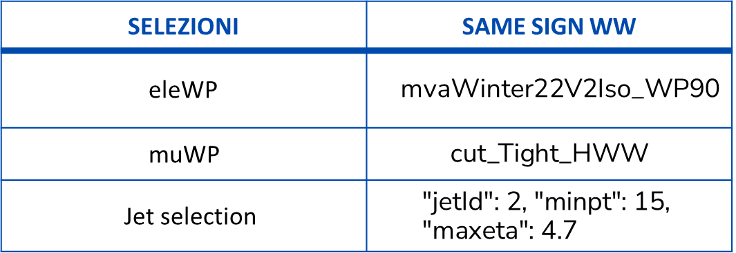
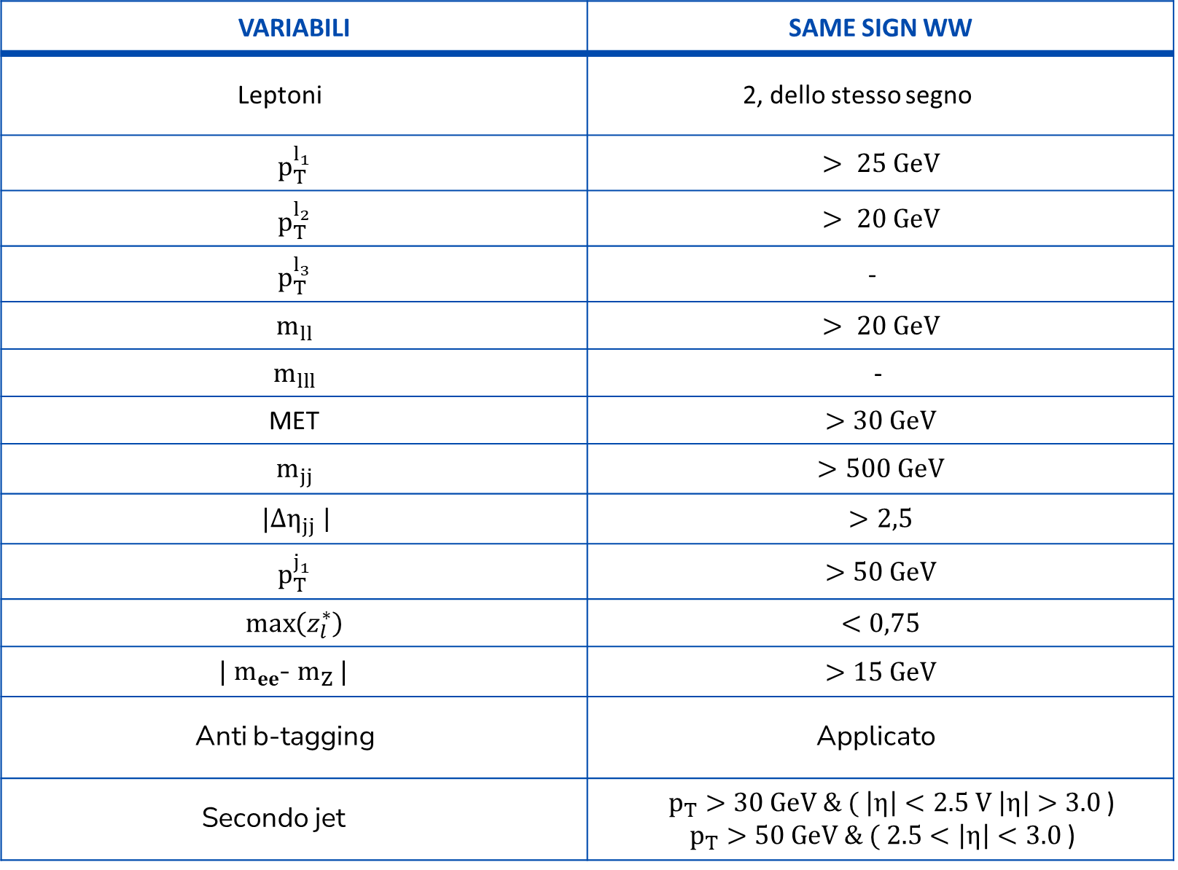
01
PRESELEZIONI APPLICATE
VARIABILI | SAME SIGN WW
Leptoni | 2, dello stesso segno
$$p_{T}^{l_{1}}$$ | $$> 25 GeV$$
$$p_{T}^{l_{2}}$$ | $$> 20 GeV$$
$$p_{T}^{l_{3}}$$ | -
$$m_{ll}$$ | $$> 20 GeV$$
$$m_{lll}$$ | -
MET | $$>30 GeV$$
$$m_{jj}$$ | $$>500 GeV$$
$|{Δη}_{jj}$| | $$>2,5$$
$$p_{T}^{j_{1}}$$ | $$>50 GeV$$
$$\max\left(z_{l}^{∗}\right)$$ | $$<0,75$$
$|$ $m_{ee}$- $m_{Z} |$ | $$>15 GeV$$
Anti b-tagging | Applicato
Secondo jet | $p_{T}>30 GeV \& ( \left|η\right|<2.5 V \left|η\right|>3.0$) $p_{T}>50 GeV \& ( 2.5<\left|η\right|<3.0$)
SELEZIONI | SAME SIGN WW
eleWP | mvaWinter22V2Iso_WP90
muWP | $$\text{cut}\text{_}\text{Tight}\text{_}\text{HWW}$$
Jet selection | $$\text{"}\text{jetId}\text{": 2, "}\text{minpt}\text{": 15, "}\text{maxeta}\text{": 4.7}$$
Giulia Gianoli – Meeting Tesi Magistrale - 21/05/25
5/21

Slide 6
02 RISULTATI OTTENUTI
Giulia Gianoli – Meeting Tesi Magistrale - 21/05/25
6/21

Slide 7
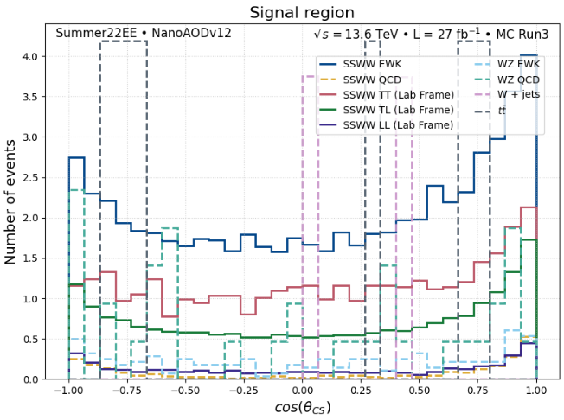
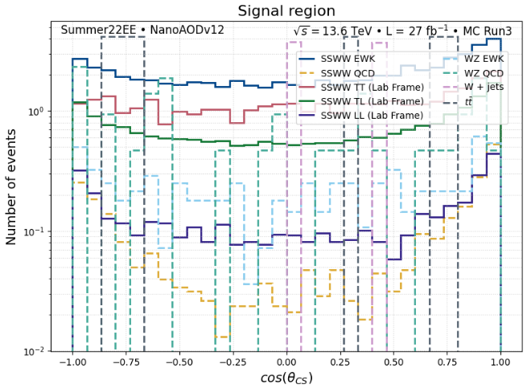
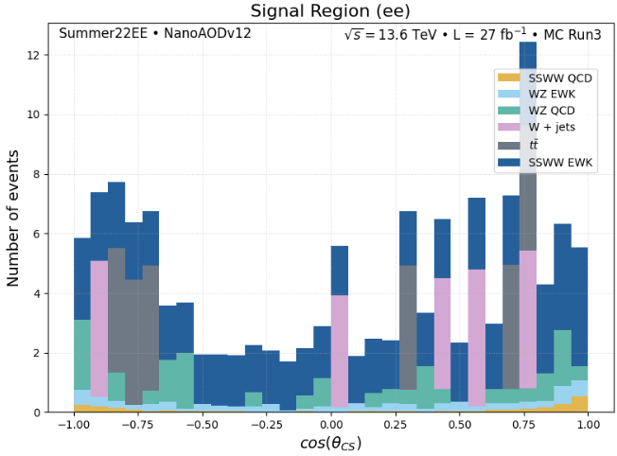
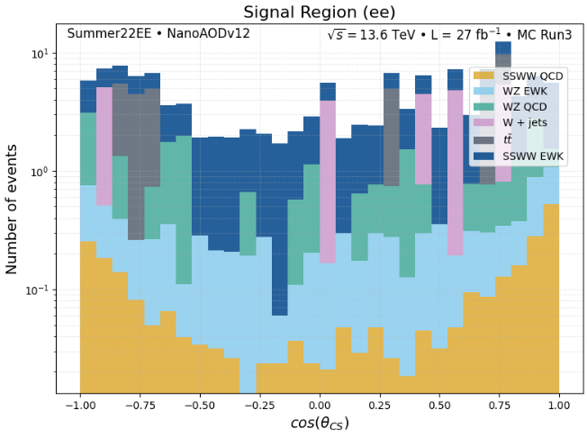
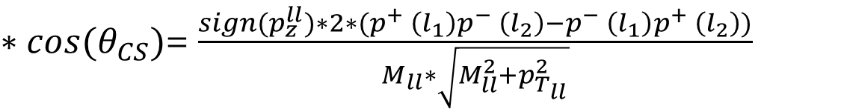
$∗cos(θ_{CS})$= $\frac{sign{(p}_{z}^{ll})∗2∗(p^{+} \left(l_{1}\right)p^{−} \left(l_{2}\right)−p^{−} \left(l_{1}\right)p^{+} \left(l_{2}\right))}{M_{ll}∗\sqrt{M_{ll}^{2}+p_{T_{ll}}^{2}}}$
02
$$cos(θ_{CS})$$
Giulia Gianoli – Meeting Tesi Magistrale - 21/05/25
7/21

Slide 8
02
Efficienze tagli b-tag
DATASET | MEDIUM | LOOSE | DIFF
SSWW EWK | 0.952 | 0.785 | 0.167
SSWW QCD | 0.918 | 0.681 | 0.237
SSWW TT | 0.951 | 0.787 | 0.165
SSWW TL | 0.957 | 0.798 | 0.159
SSWW LL | 0.963 | 0.816 | 0.148
WZ EWK | 0.633 | 0.506 | 0.127
WZ QCD | 0.920 | 0.716 | 0.204
W 3JET | 0.925 | 0.698 | 0.226
W 4JET | 0.860 | 0.605 | 0.256
TTBAR | 0.408 | 0.257 | 0.151
Giulia Gianoli – Meeting Tesi Magistrale - 21/05/25
8/21

Slide 9
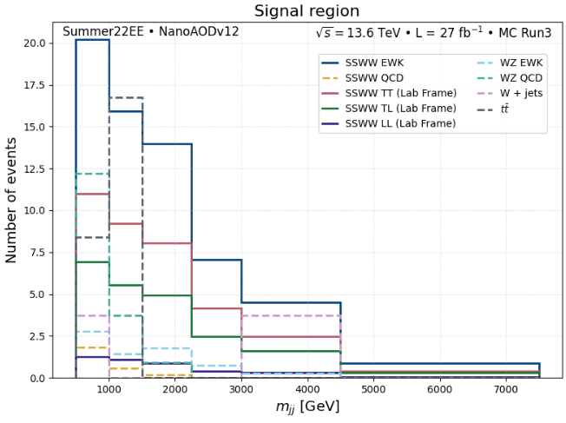
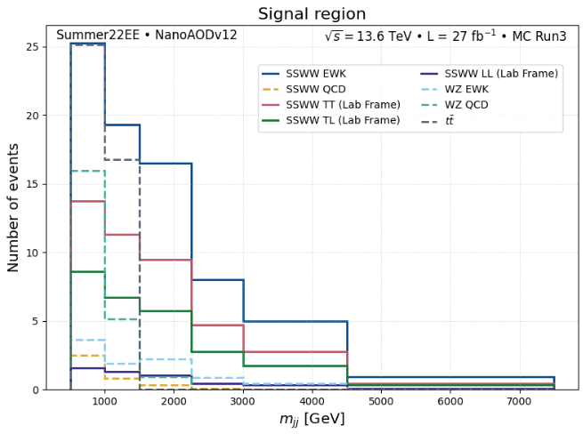
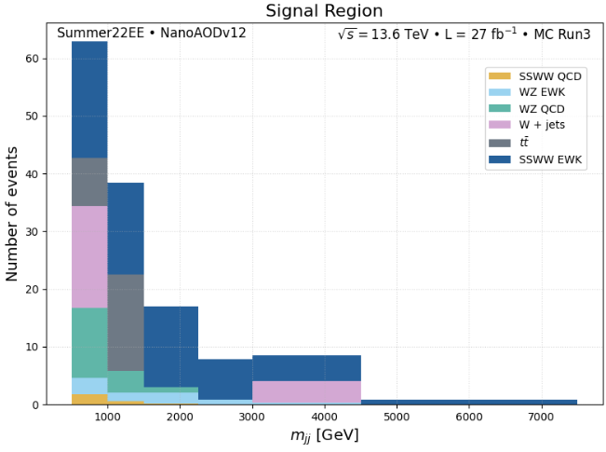
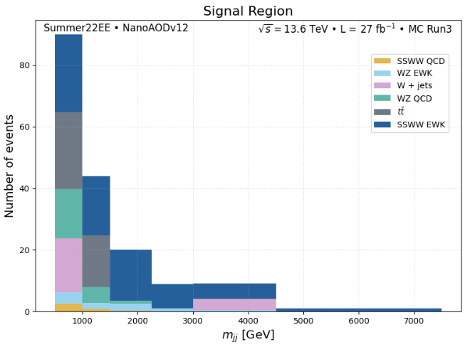
02
$$m_{jj}$$
Btag: Loose
Btag: medium
Giulia Gianoli – Meeting Tesi Magistrale - 13/05/25
9/21

Slide 10
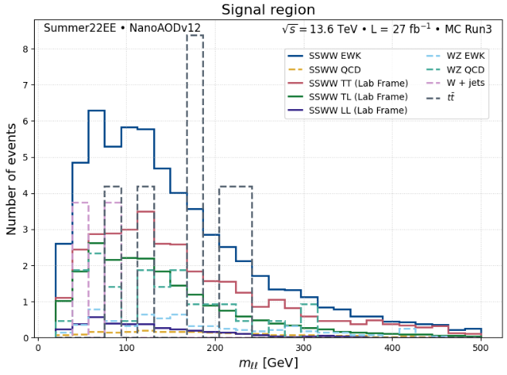
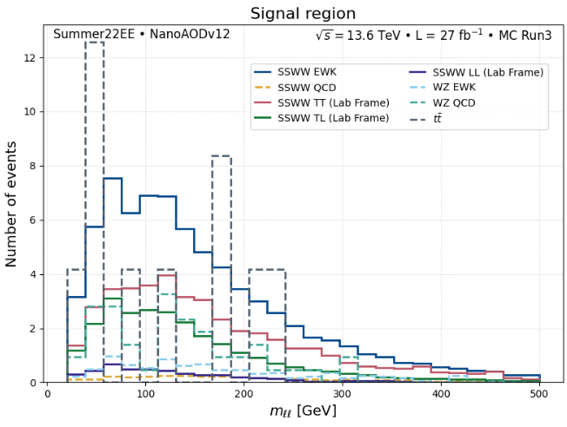
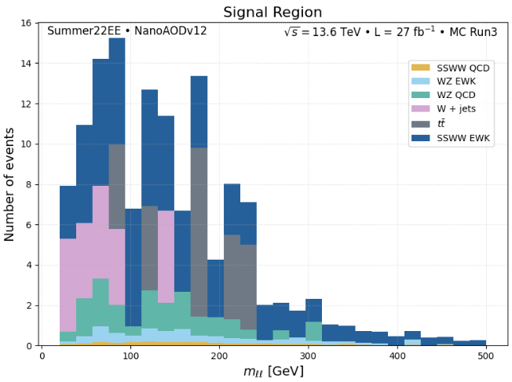
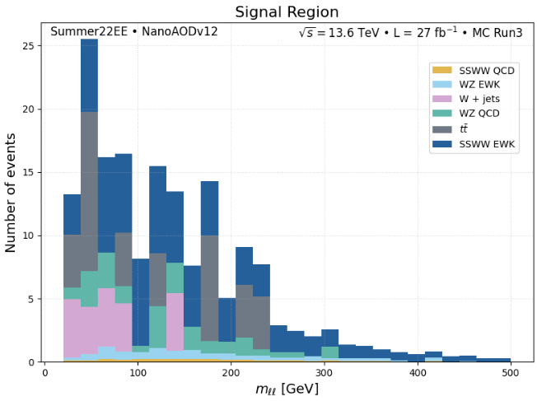
02
$$m_{ll}$$
Btag: Loose
Btag: medium
Giulia Gianoli – Meeting Tesi Magistrale - 13/05/25
10/21

Slide 11
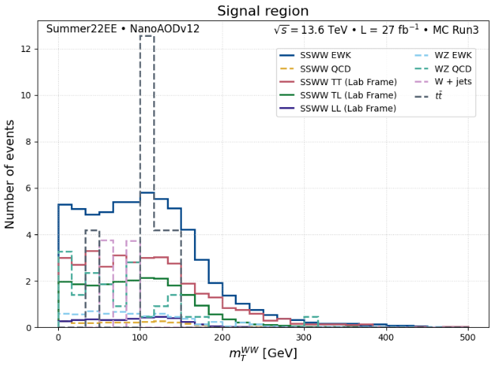
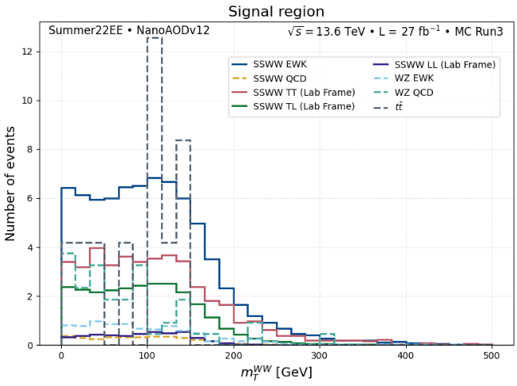
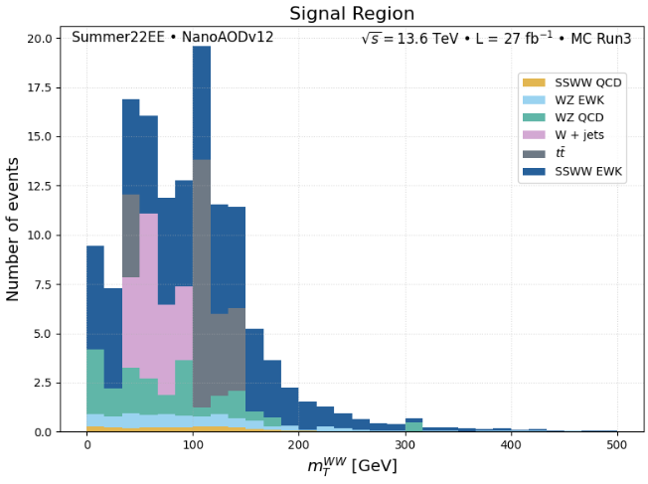
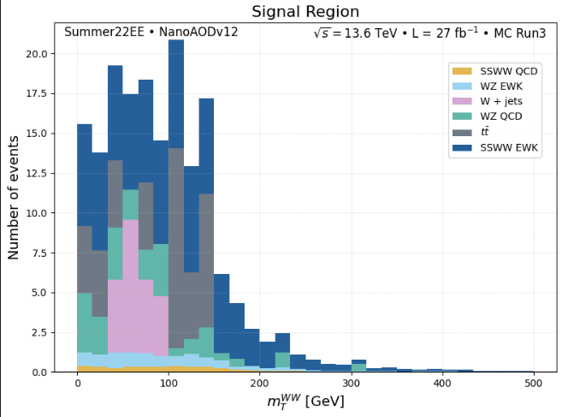
02
$$m_{T}(WW)$$
Btag: Loose
Btag: medium
Giulia Gianoli – Meeting Tesi Magistrale - 13/05/25
11/21

Slide 12
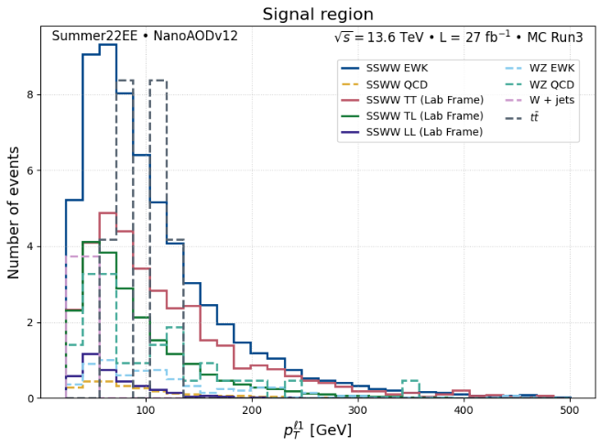
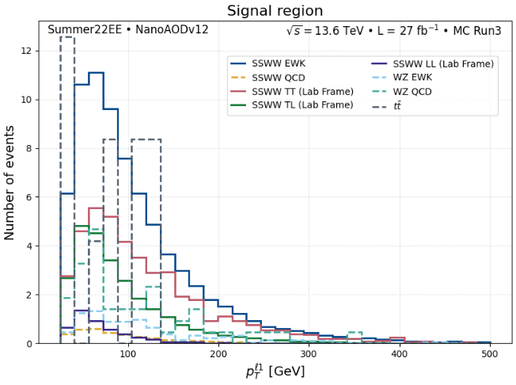
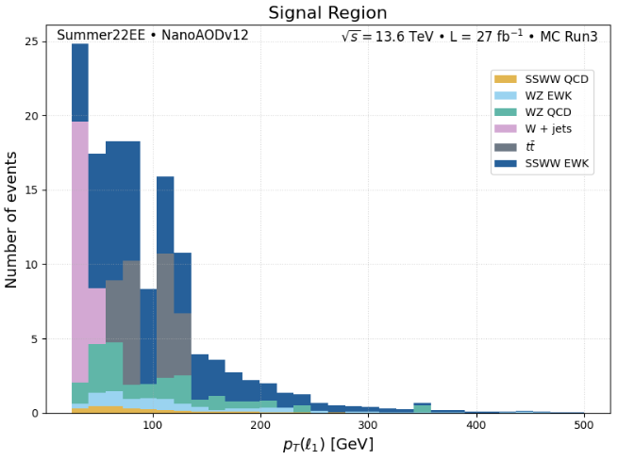
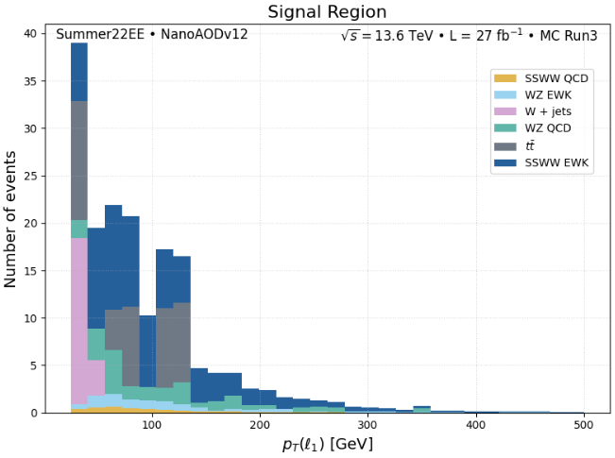
02
$$p_{T}{(l}_{1})$$
Btag: Loose
Btag: medium
Giulia Gianoli – Meeting Tesi Magistrale - 13/05/25
12/21

Slide 13
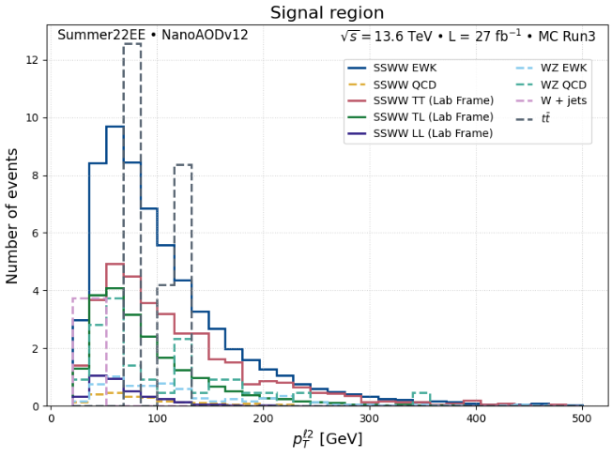
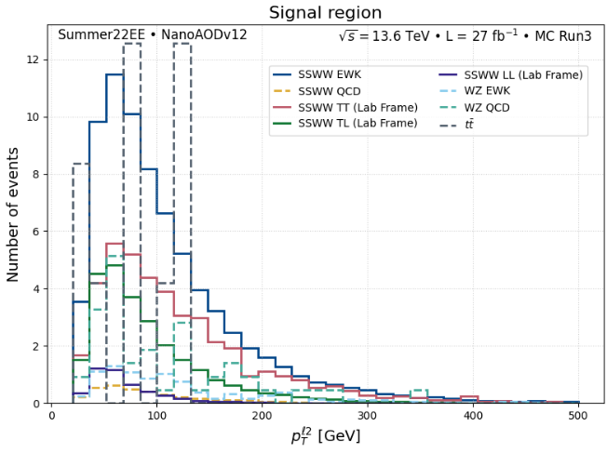
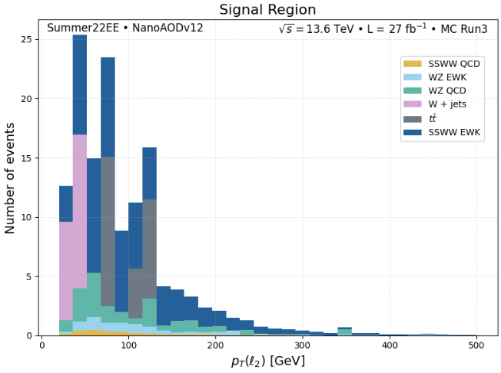
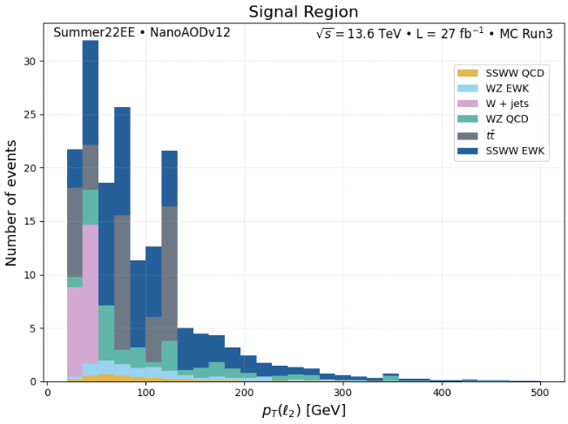
02
$$p_{T}{(l}_{2})$$
Btag: Loose
Btag: medium
Giulia Gianoli – Meeting Tesi Magistrale - 13/05/25
13/21

Slide 14
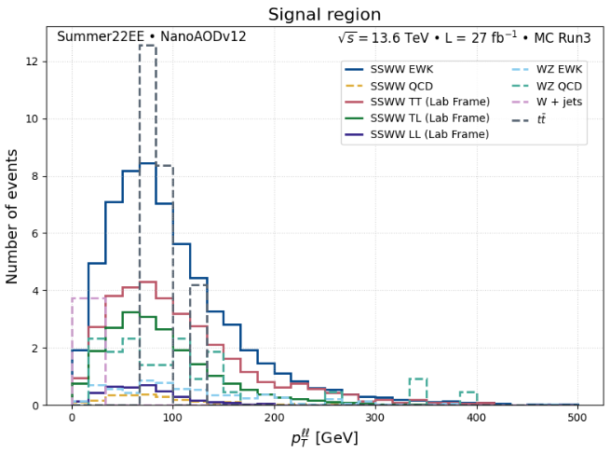
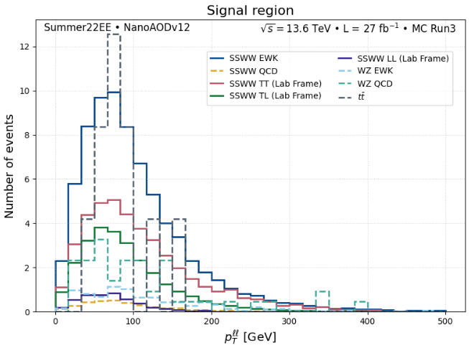
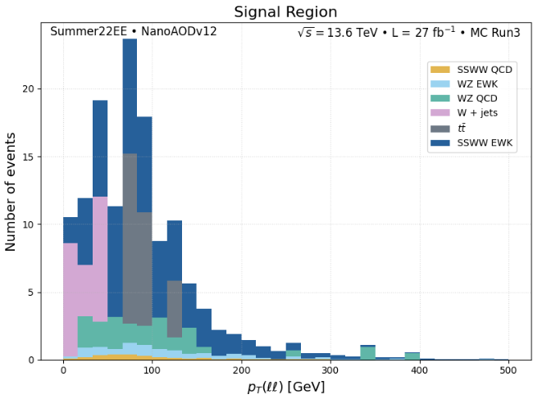
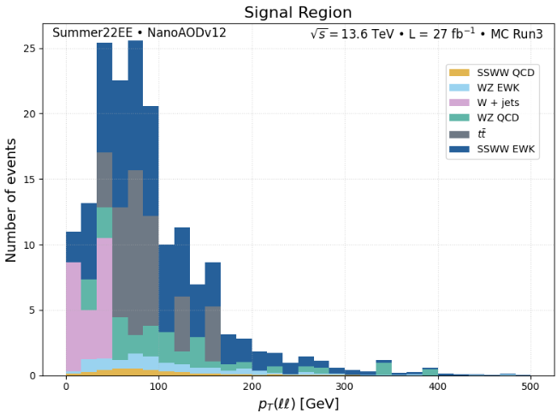
02
$$p_{T}(ll)$$
Btag: Loose
Btag: medium
Giulia Gianoli – Meeting Tesi Magistrale - 13/05/25
14/21

Slide 15
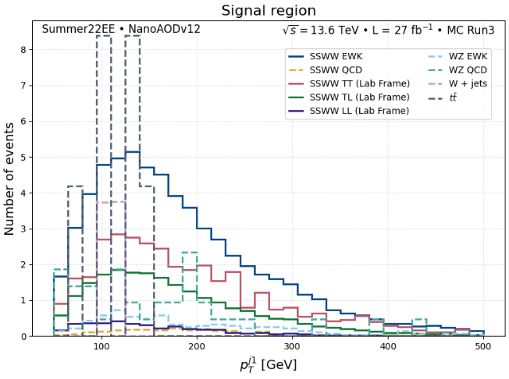
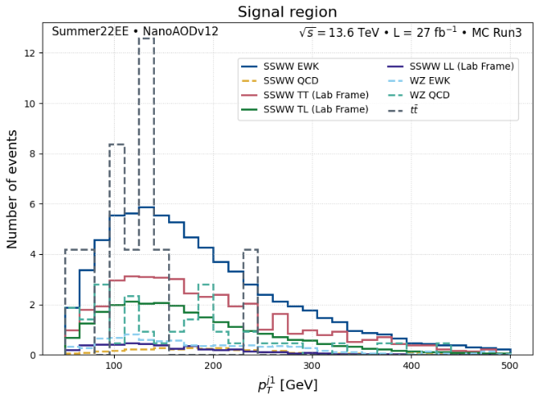
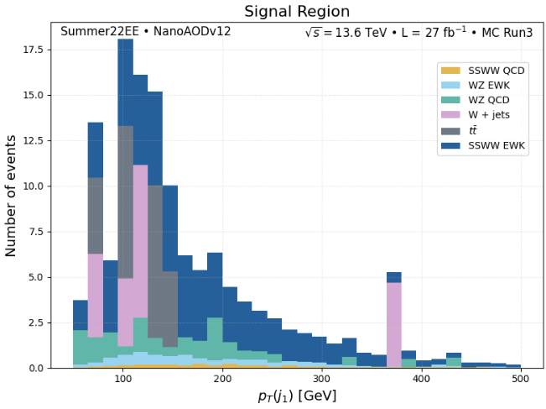
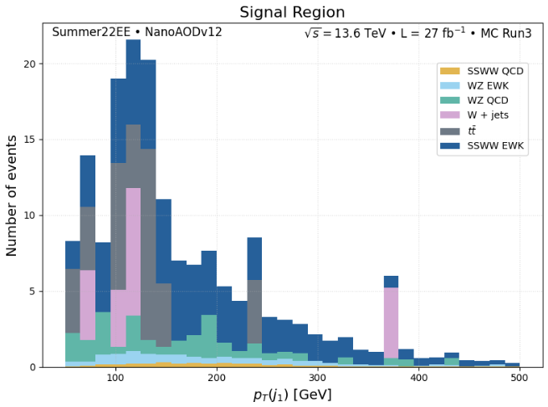
02
$$p_{T}{(j}_{1})$$
Btag: Loose
Btag: medium
Giulia Gianoli – Meeting Tesi Magistrale - 13/05/25
15/21

Slide 16
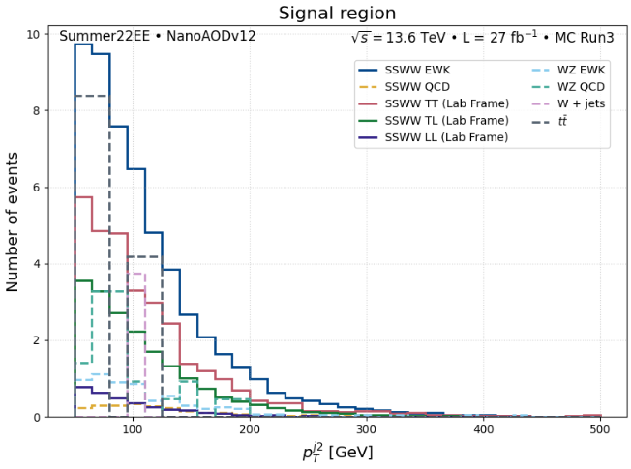
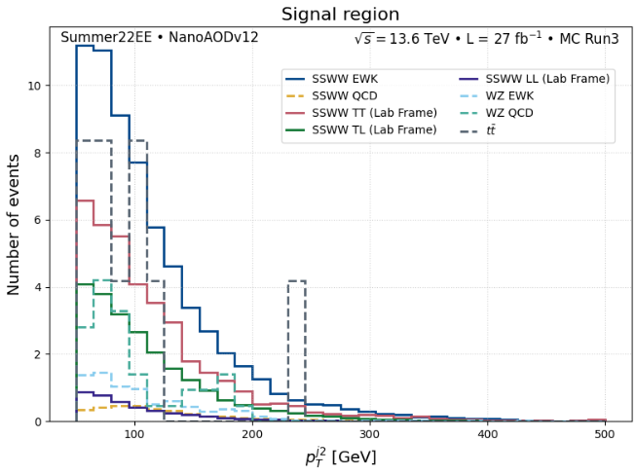
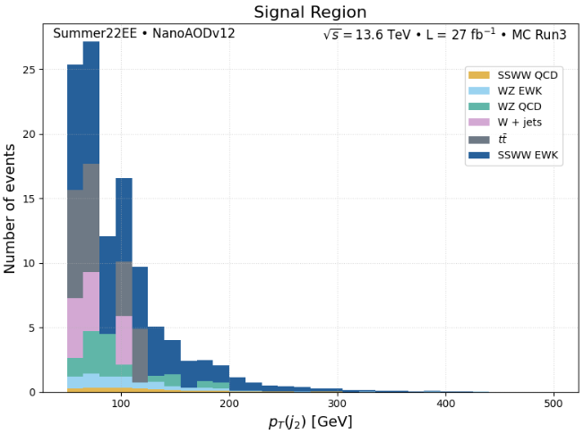
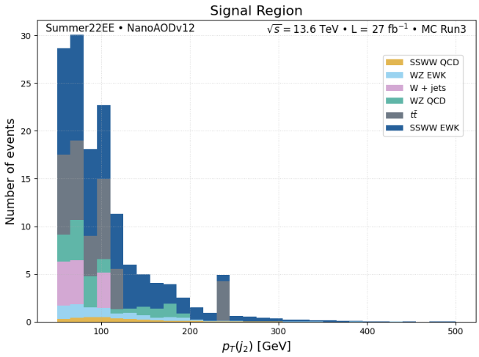
02
$$p_{T}{(j}_{2})$$
Btag: Loose
Btag: medium
Giulia Gianoli – Meeting Tesi Magistrale - 13/05/25
16/21

Slide 17
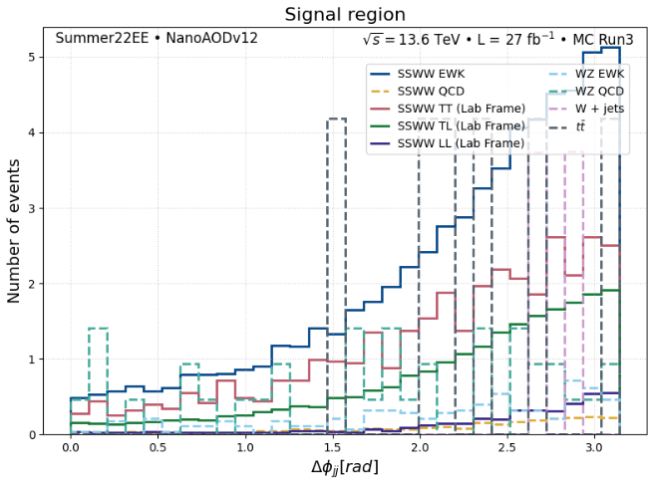
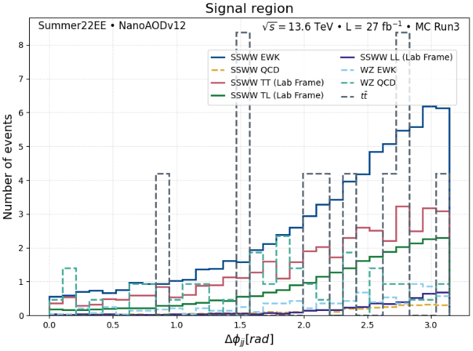
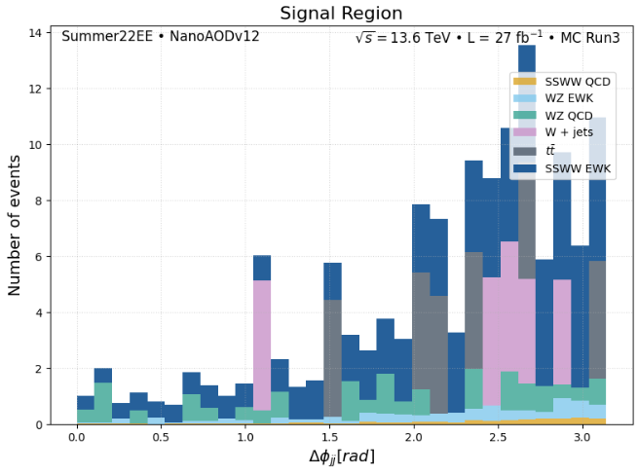
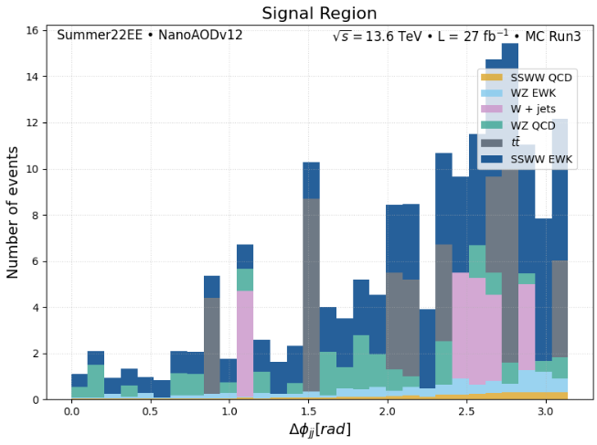
02
$$Δφ_{jj}$$
Btag: Loose
Btag: medium
Giulia Gianoli – Meeting Tesi Magistrale - 13/05/25
17/21

Slide 18
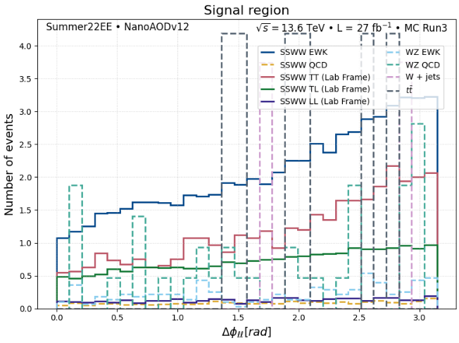
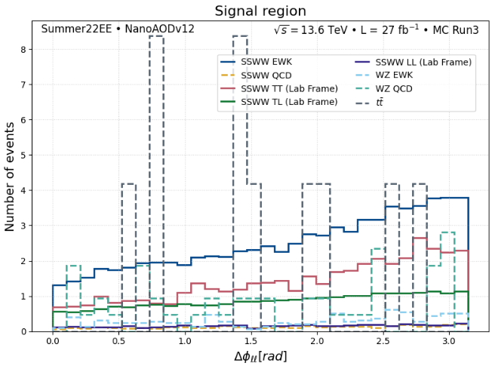
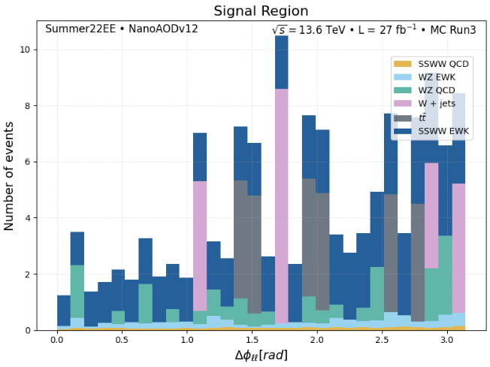
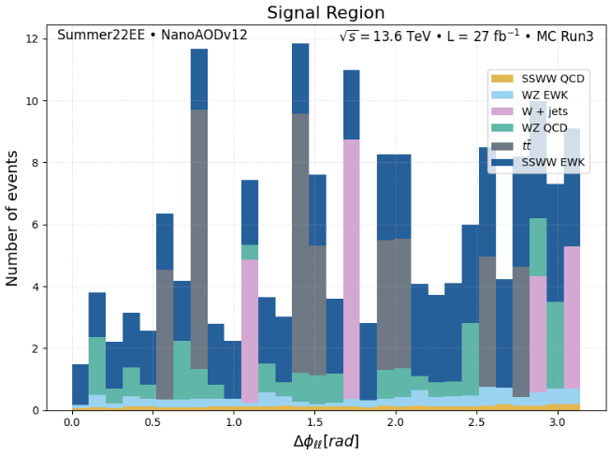
02
$$Δφ_{ll}$$
Btag: Loose
Btag: medium
Giulia Gianoli – Meeting Tesi Magistrale - 13/05/25
18/21

Slide 19
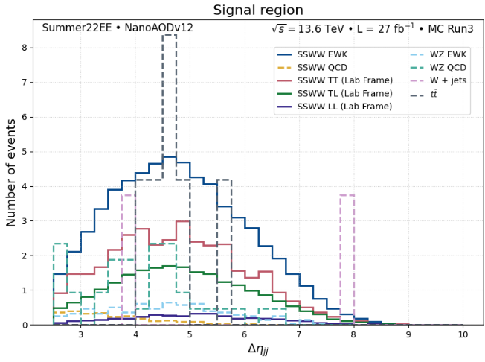
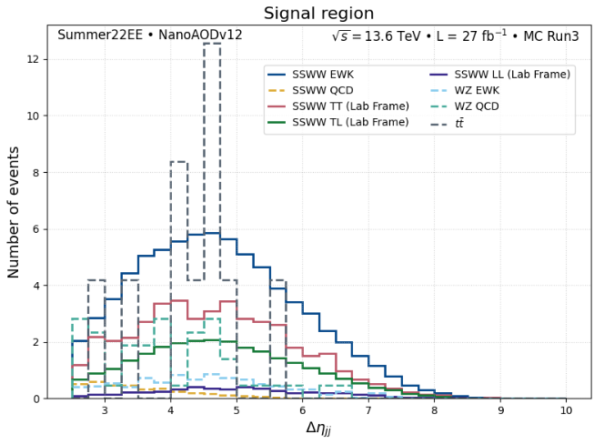
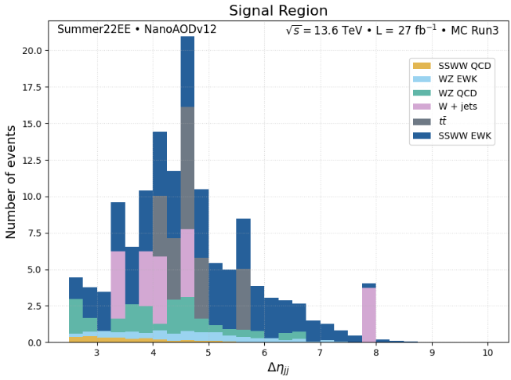

02
$$Δη_{jj}$$
Btag: Loose
Btag: medium
Giulia Gianoli – Meeting Tesi Magistrale - 13/05/25
19/21

Slide 20





02
${∗R}_{p_{T}}$= $\frac{p_{T}\left(l_{1}\right)∗p_{T}(l_{2})}{p_{T}\left(j_{1}\right)∗p_{T}(j_{2})}$
$$R_{p_{T}}$$
Btag: Loose
Btag: medium
Giulia Gianoli – Meeting Tesi Magistrale - 13/05/25
20/21

Slide 21


$∗cos(θ_{CS})$= $\frac{sign{(p}_{z}^{ll})∗2∗(p^{+} \left(l_{1}\right)p^{−} \left(l_{2}\right)−p^{−} \left(l_{1}\right)p^{+} \left(l_{2}\right))}{M_{ll}∗\sqrt{M_{ll}^{2}+p_{T_{ll}}^{2}}}$
02
$$cos(θ_{CS})$$
Btag: Loose
Btag: medium
Giulia Gianoli – Meeting Tesi Magistrale - 21/05/25
21/21

