Slide 1

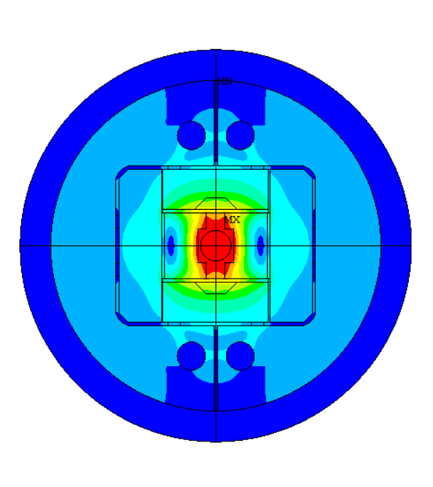
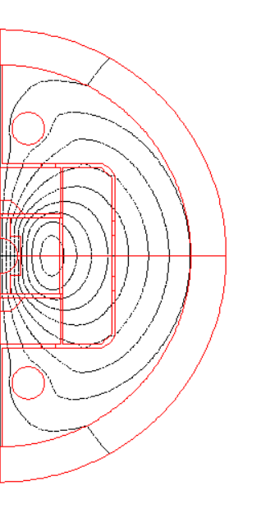
HFM WP3.3
Status and next steps
Attendees:
J. Ferradas Troitino, S. Izquierdo Bermudez, E. Todesco, J.C. Perez, A. Haziot,
N. Lusa & S. Luzieux.
Offline:
A. Milanese (conflict with FCC-week 2025).
TE-MSC-LMF Meeting room
20th May 2025
Slides:
J. Ferradas Troitino, S. Izquierdo Bermudez, N. Lusa, N. Bourcey, S. Triquet, S. Luzieux, N. Peray, M. Canale, J. Axensalva, J.C. Perez

Slide 2
Outline
Introduction
Design overview
Step by step look:
  Cable
  Coil winding & related infrastructure
  Reaction heat treatment
  Impregnation
  Coilpack assembly
  Magnet assembly
  Other aspects
Where are we?
Next steps

Slide 3

Naming
M-BOND
Medium length – BlOck Nb₃Sn Dipole

Slide 4
Outline
Introduction
Design overview
Step by step look:
  Cable
  Coil winding & related infrastructure
  Reaction heat treatment
  Impregnation
  Coilpack assembly
  Magnet assembly
  Other aspects
Where are we?
Next steps

Slide 5
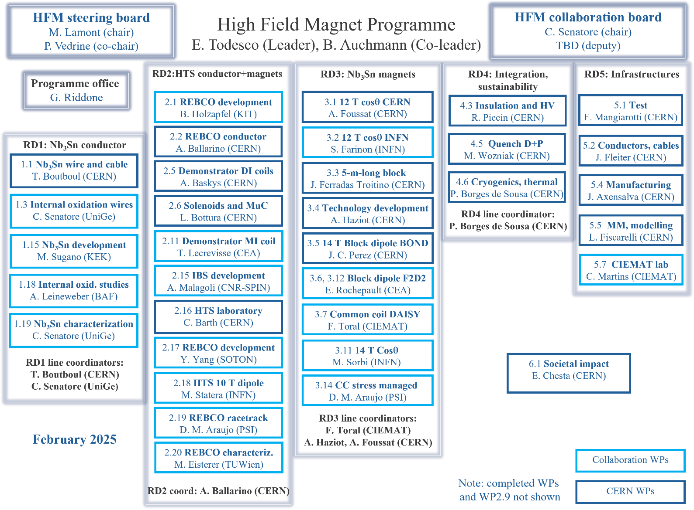
Introduction and objectives
Joint effort spanning across different work-packages
BOND and M-BOND as one entity, with practically the same team involved.

Slide 6
Introduction and objectives
Intro
What is M-BOND and why we want it already in the early-development stage?
Proposal for a first scaling in length for the HFM block-type coil → a ~ 5-m long magnet (single aperture) that can be vertically tested at CERN.
We believe that there are some aspects (regarding coil and magnet manufacturing) that most of the times cannot be fully anticipated based only on short model coils.
HL-LHC experience has shown us that the scaling in length is not trivial.
We try to account for long coil/magnet features as soon as possible!
1
Main goals for the 5 m long magnet:
Focus on coil production
  Understand coil fabrication features where length is a critical aspect.
  Prove the feasibility of the chosen manufacturing strategy for medium-size block-type coils
  Be as close as reasonably possible to the 14 T BOND coil. We are not worried about field quality, neither targeting a specific field/aperture. Rather than that we try to have a similar Bp/B0 ratio.
Goals

Slide 7
Introduction and objectives
Thinking further, the objectives could be enlarged and used to tackle in parallel / or in a later stage other interesting aspects for next generation accelerator magnets (medium and long size).
2
Some identified ideas:
Coil finishing
Magnet loading
Cold-mass
METRASCAN or any scanning-type geometrical measurements for the coils. I.e.- faster and without physical contact with the coil (possible free state measurements).
On-site machining of coil rails in a dedicated bench.
“Revised” bladder design.
With rods, instrument the bullet pushers to better understand the evolution of the force equilibrium.
Develop an alternative for the tie rods + endplate system for medium and long magnets.
Study the idea of pre-loading the magnet with the pre-assembled yoke-shell modules in cold-mass configuration
  (i.e.- Stainless Steel vessel already welded around, which is geometrically favourable)

Slide 8
Outline
Introduction
Design overview
Step by step look:
  Cable
  Coil winding & related infrastructure
  Reaction heat treatment
  Impregnation
  Coilpack assembly
  Magnet assembly
  Other aspects
Where are we?
Next steps

Slide 9
All information, including model and results, in EDMS (CERN-0000269372) and Indico:
https://edms.cern.ch/project/CERN-0000269372
https://indico.cern.ch/category/19504/

Slide 10
Cable choice
Slide from conceptual design meeting
https://indico.cern.ch/event/1511768/
BOND cable: 40 strands x 1.1 mm (50 mm aperture by “slightly opening up” both layers and coils)
The proposal here is to use MQXF strand (available) to manufacture a rectangular cable, 40 strands x 0.85 mm:
  MQXF strand is smaller in diameter and it has more copper
  MQXF rectangular cable would be ~ 5 mm smaller cable in width
From one MQXFB conductor unit length -> 2 block coils
Conductor parameters |  | 5-m long block | BOND
Strand diameter | (mm) | 0.85 | 1.10
Layout |  | RRP 108/127 | RRP 162/169
Effective filament diameter | (µm) | 55 | 64
Cu/NonCu ratio |  | 1.2 | 0.9
No. of strands in cable |  | 40 | 40
Bare cable thickness | (mm) | 1.525 | 1.98
Bare cable width | (mm) | 18.150 | 23.045
Bare cable thickness (reacted - 4.5%) | (mm) | 1.594 | 2.06
Bare cable width (reacted - 1.2%) | (mm) | 18.363 | 23.275
Insulation thickness | (mm) | 0.15 | 0.15
Insulated cable width (reacted) | (mm) | 18.663 | 23.575
Insulated cable thickness (reacted) | (mm) | 1.894 | 2.36
Astrand | (mm²) | 0.567 | 0.950
Asc | (mm²) | 0.258 | 0.500
Acu | (mm²) | 0.310 | 0.450
Goal: optimize the use of MQXF UL (750 m). Ideally, an integer multiple of MQXF UL
 |  | MQXFB | BOND | Options for 5 m
lm | m | 7.2 | 1.08 | 4.74 | 4.74 | 4.74
UL | m | 750 | 136 | 750 | 375 | 250
Lcoil | m | 7.48 | 1.31 | 5 | 5 | 5
Nturns |  | 50 | 52 | 76 | 38 | 25
Nturns*2*lm |  | 720 | 112 | 720 | 360 | 239
1.05*Nturns*2*Lcoil |  | 785 | 143 | 798 | 399 | 266
1 coil / UL
3 coil / UL
2 coil / UL

Slide 11
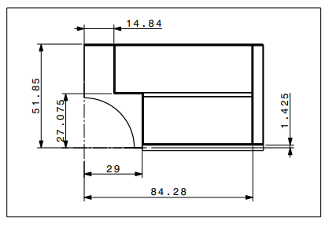
Coil options (2D)
Slide from conceptual design meeting
https://indico.cern.ch/event/1511768/
Keep external envelope
14 T - BOND
Scale to a smaller aperture

Slide 12
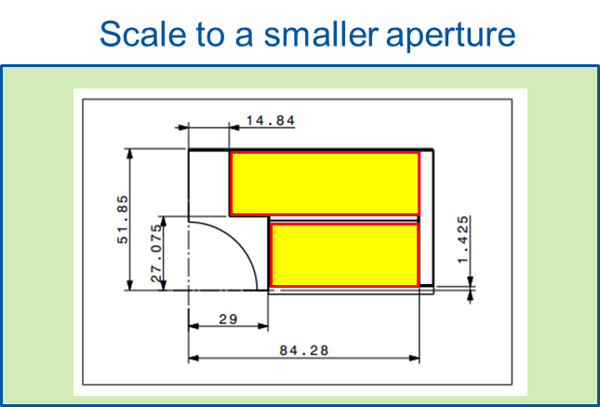
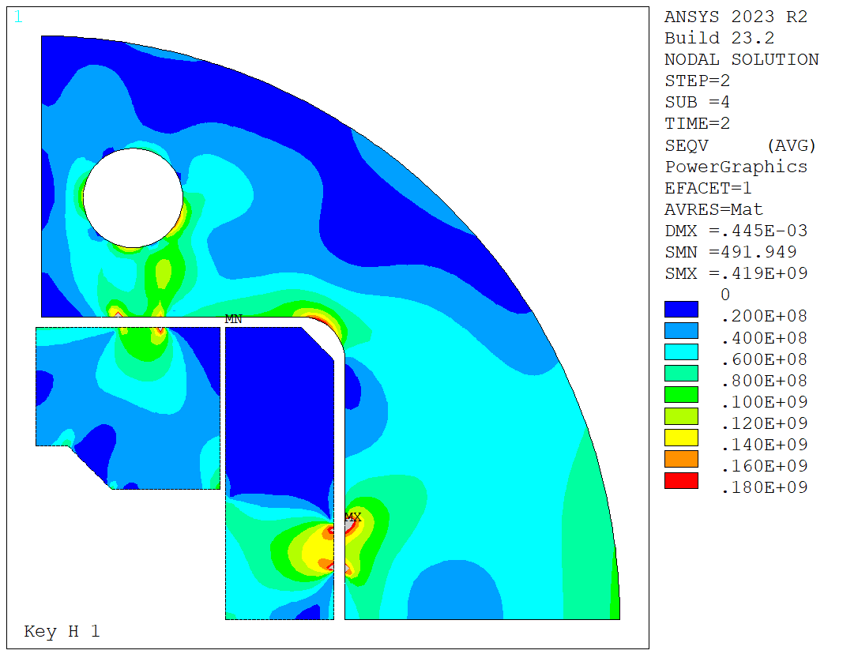
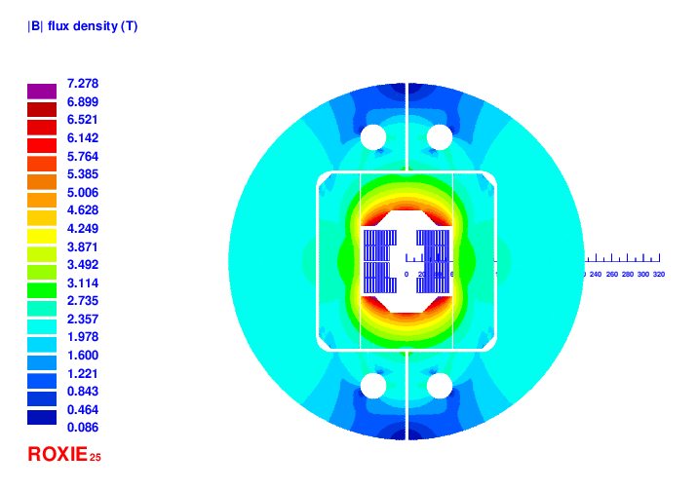
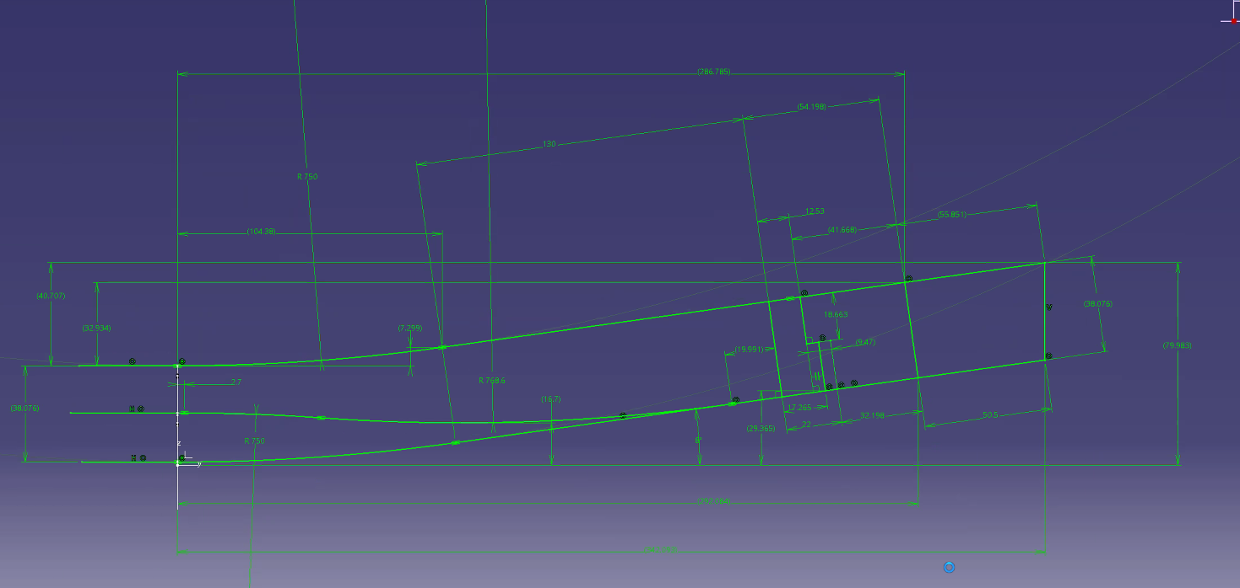
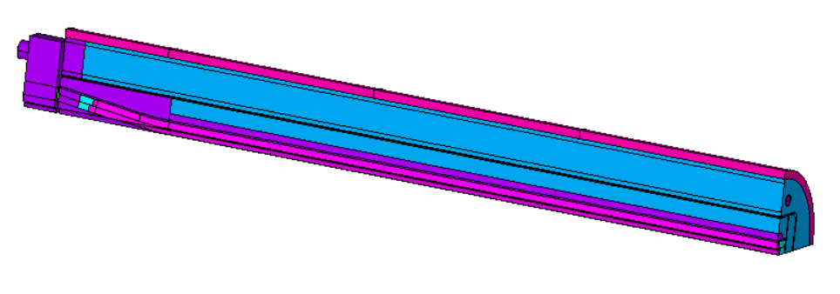
Design flowchart
Initial design choices
2D coil design
Coil end design
3D coil design
Structure design
Flat MQXF Rutherford cable
From 1 MQXFB UL, manufacture 2 block coils
We scale to a smaller aperture
Stay as reasonably as possible to BOND!
We check what we can get with our constraints
FQ is not a driving target, rather than that we try to target a similar Bp/B0 ratio. Iron optimized.
We set the coil end parameters following the same logic than for BOND. Note that both cables are 20x2 strands, similar aspect ratio
We propose as well some winding tests to better define these dimensions (see later).
Having the ends defined and the length of cable available, we fix the length of the straight section.
We check that this coil length is compatible with the test station (see later).
The structure dimensions are set in such a way that we can pre-load our magnet up to “B_{nom.} + 1.5 T” and we could withstand the forces from short-sample current.
Dimensions also compatible with the existing welding cradles at B.180 (see later).

Slide 13
M-BOND
Name |  | M-BOND | BOND 14T Single ap.
Coil design
Insulated cable surface (one aperture) | (mm²) | 5514 | 11572
Equivalent coil width | (mm) | 36.7 | 53.4
Coil efficiency | (T mm / A) | 0.00074 | 0.00073
N. layers | (adim) | 2 | 2
N. turns/pole | (adim) | 39 | 52
Cable length/pole | (m) | 350 | 136
Operational parameters
Current (Inom) | (kA) | 15.620 | 20.005
Peak Field | (T) | 12.79 | 14.85
Bp/B0 |  | 1.066 | 1.061
Short sample current @ 1.9 K | (kA) | 19.49 | 24.20
Short sample current @ 4.5 K | (kA) | 17.37 | 21.60
Short sample field @ 1.9 K, Bp | (T) | 15.48 | 17.55
Short sample field @ 4.5 K, Bp | (T) | 14.02 | 15.93
j overall⁷ | (A/mm²) | 442 | 360
j strand | (A/mm²) | 688 | 526
j superconductor | (A/mm²) | 1514 | 1000
Loadline fraction @1.9 K | (%) | 80.2 | 82.7
Loadline fraction @4.5 K | (%) | 89.9 | 92.6
Stored energy/m | (MJ/m) | 0.382 | 1.031
Inductance/m | (mH/m) | 2.77 | 4.72
Stored energy | (MJ) | 1.64 | 1.35
Name |  | M-BOND | BOND 14T Single ap.
Aperture | (mm) | 35 | 50
Field | (T) | 12.00 | 14.00
Field integral | (T m) | 51.58 | 15.10
Magnetic length | (m) | 4.30 | 1.08
Coil length | (m) | 4.584 | 1.31
Number of apertures | (adim) | 1 | 1
Distance between apertures | (mm) | - | -
Yoke outer diameter | (mm) | 500 | 540
Al-cylinder outer diameter | (mm) | 550 | 640
Cable data
Material |  | Nb₃Sn | Nb₃Sn
Process |  | RRP | RRP
No. strands | (adim) | 40 | 40
Strand diameter | (mm) | 0.850 | 1.100
Cu/NonCu | (adim) | 1.2 | 0.9
RRR | (adim) | 150 | 150
Bare cable thickness (Reacted) | (mm) | 1.59 | 2.06
Bare cable width (Reacted) | (mm) | 18.363 | 23.275
Insulation thick radial (5 Mpa) | (mm) | 0.150 | 0.150
Insulated cable surface | (mm²) | 35.35 | 55.64
Filling factor | (adim) | 0.292 | 0.360
Mechanics
Forces x | (MN/m) | 3.309 | 5.937
Forces y | (MN/m) | -1.351 | -2.680
Force z | (MN) | 0.382 | 0.958
Fx/2*Wcable | (MPa) | 89 | 126

Slide 14
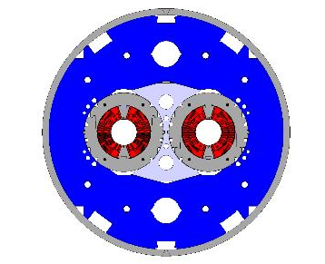
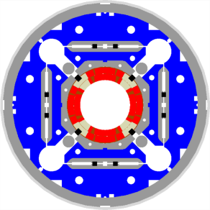
The 12 T challenge – current density
LHC MB
NbTi, B_{p} = 8.6 T
w_{eq} = 27 mm
J_{strand} = 475/616 A/mm²
HL-LHC MBH 11 T
Nb₃Sn, B_{p} = 11.7 T
w_{eq} = 28 mm
J_{strand} = 770 A/mm²
HL-LHC MQXF
Nb₃Sn, B_{p} = 11.3 T
w_{eq} = 36 mm
J_{strand} = 715 A/mm²
Slide from Susana (Feedback of HL-LHC Magnets to HFM)
https://indico.cern.ch/event/1471305

Slide 15
The 12 T challenge – e.m. forces
≈ 2 times more force/stress than in the LHC-MB dipoles, in a brittle conductor
LHC MB
NbTi, B_{p} = 8.6 T
F_{x} = 3.4 MN/m
σ_{θ,em} = 50-60 MPa
F_{z} = 265 kN
HL-LHC MBH 11 T
Nb₃Sn, B_{p} = 11.7 T
F_{x} = 7.2 MN/m
σ_{θ,em} = 100-110 MPa
F_{z} = 450 kN
HL-LHC MQXF
Nb₃Sn, B_{p} = 11.3 T
F_{x} = 6.8 MN/m
σ_{θ,em} = 100-110 MPa
F_{z} = 1200 kN
Slide from Susana (Feedback of HL-LHC Magnets to HFM)
https://indico.cern.ch/event/1471305
Lmag (11 T) = 5.3 m
F_{x} per half magnet; F_{z} per aperture

Slide 16
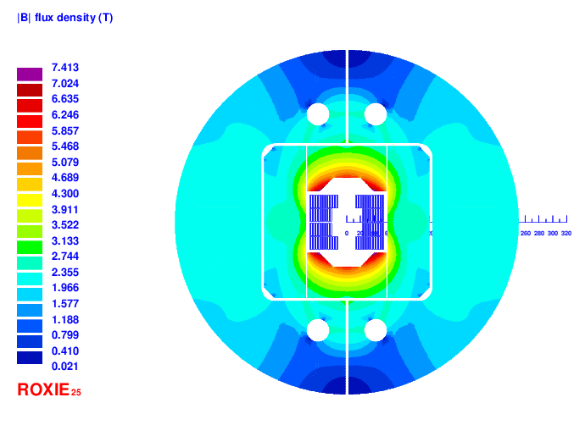
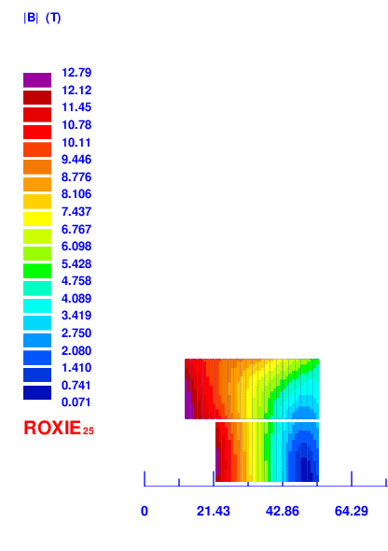
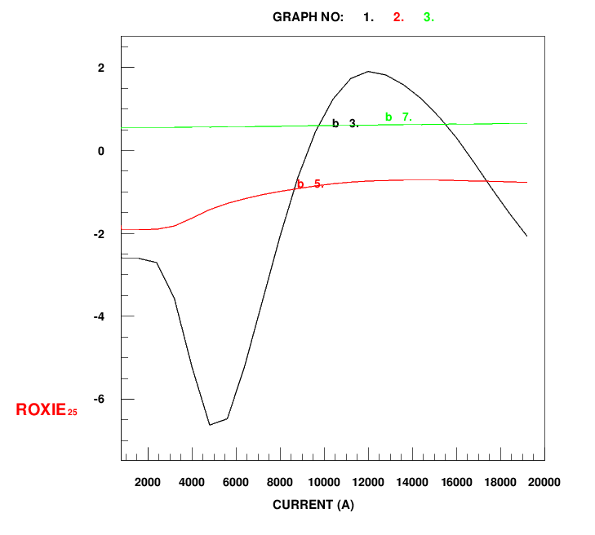
2D design - magnetic

Slide 17
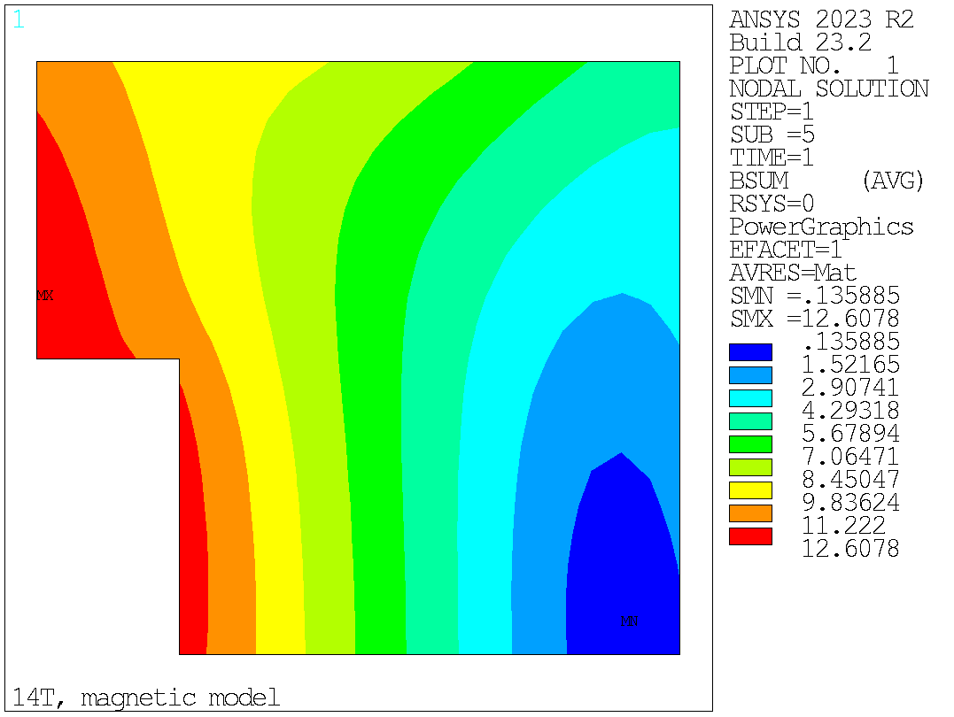
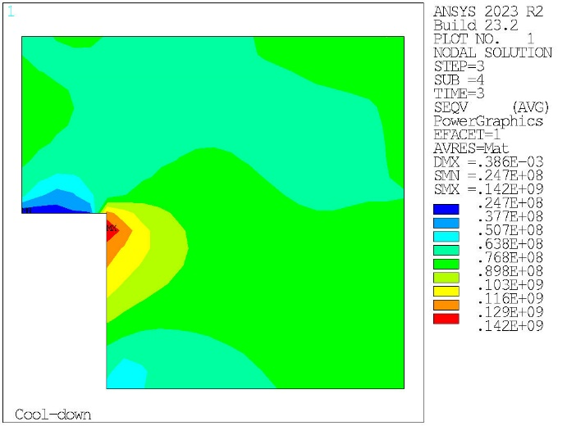
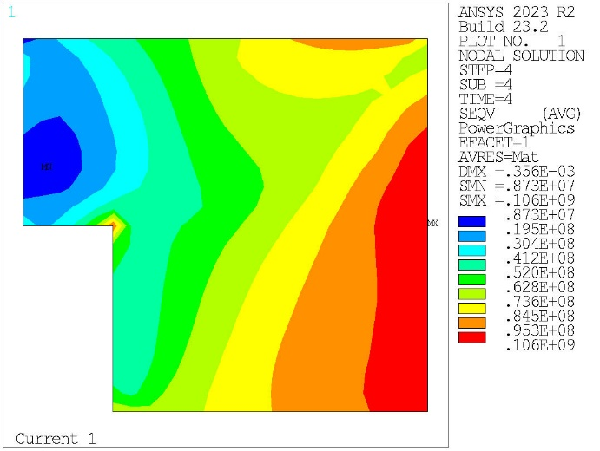
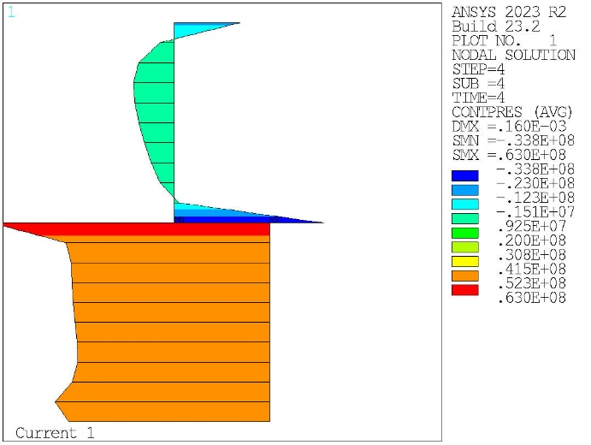
2D design – mech.
B_{ap.} = 12 T
Plots here summarize the main figures of merit.
Structural components comply with material limits.
Structure limit corresponds to a full coil pre-load for short sample current (see EDMS).
Seqv, at 1.9 K
Seqv at B_{ap.} = 12 T
Pole contact pressure at B_{ap.} = 12 T

Slide 18
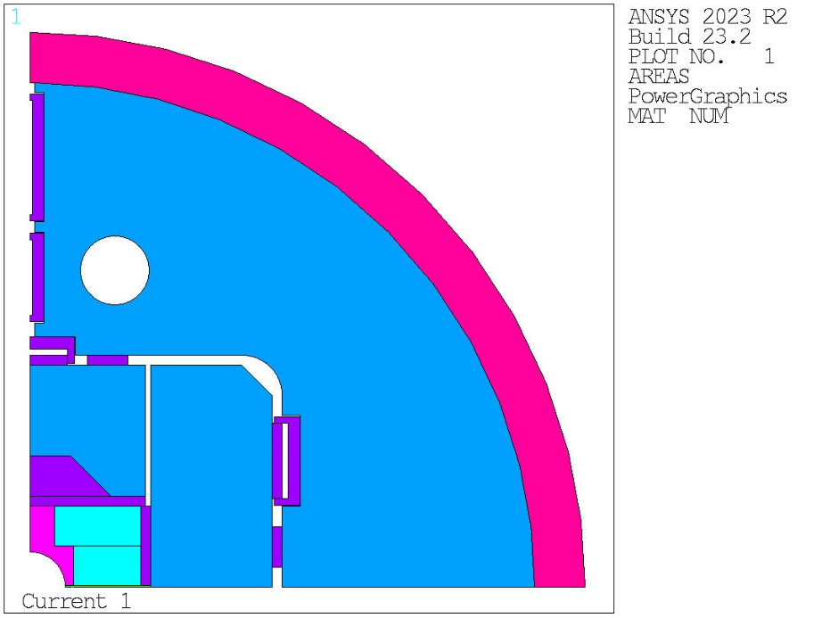
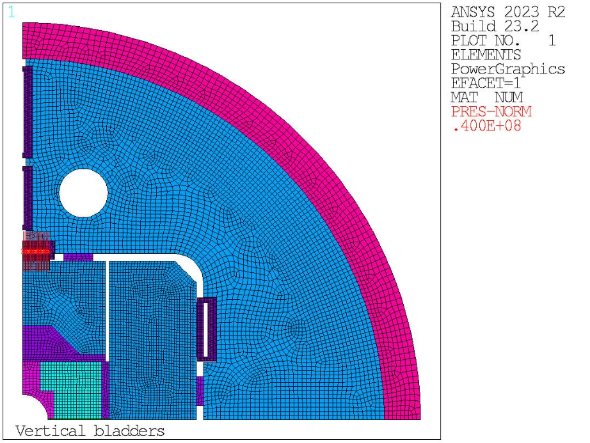
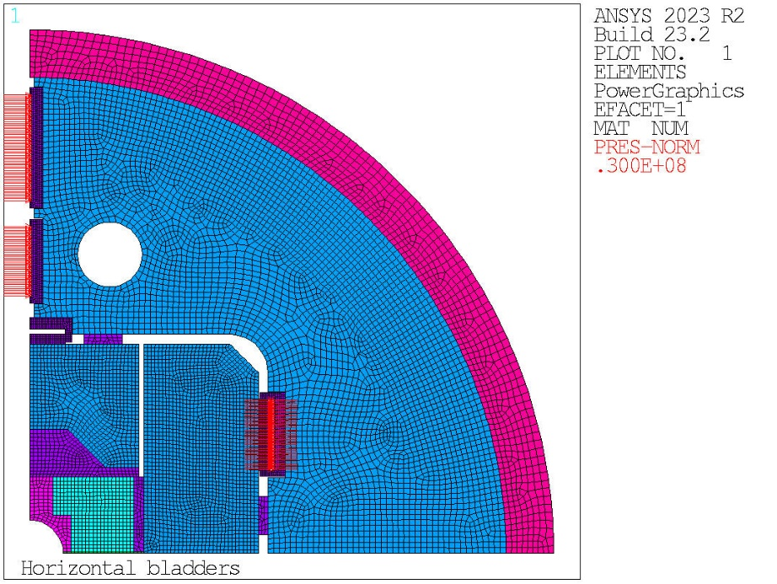
2D design – mech.
Models also account for detailed geometry (see later our proposal for bladders).

Slide 19
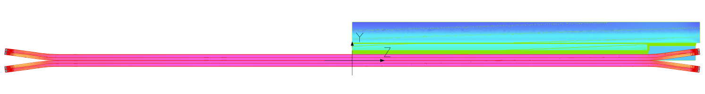
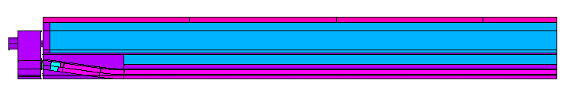
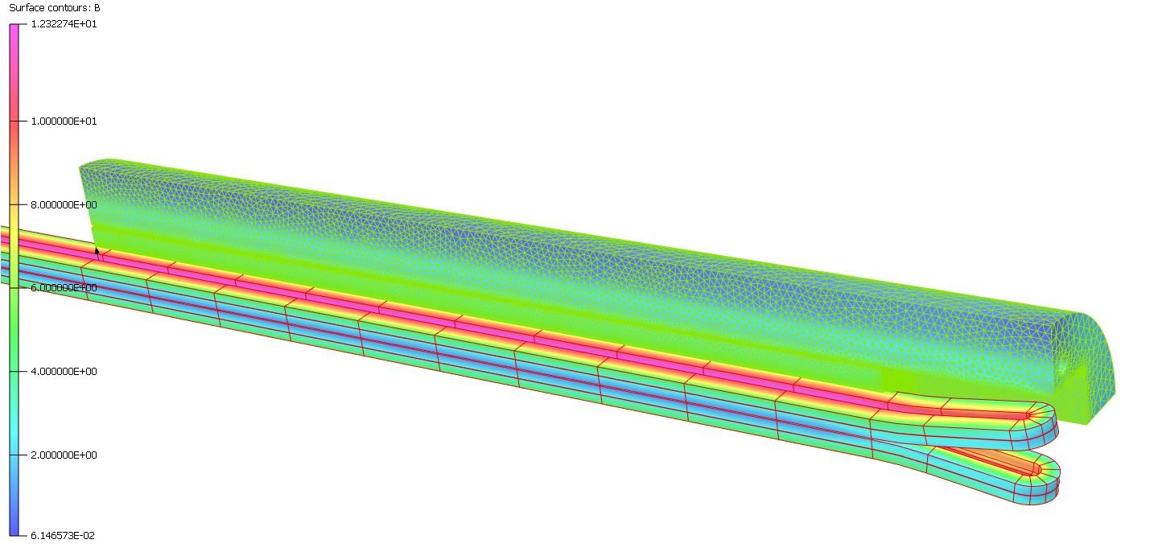
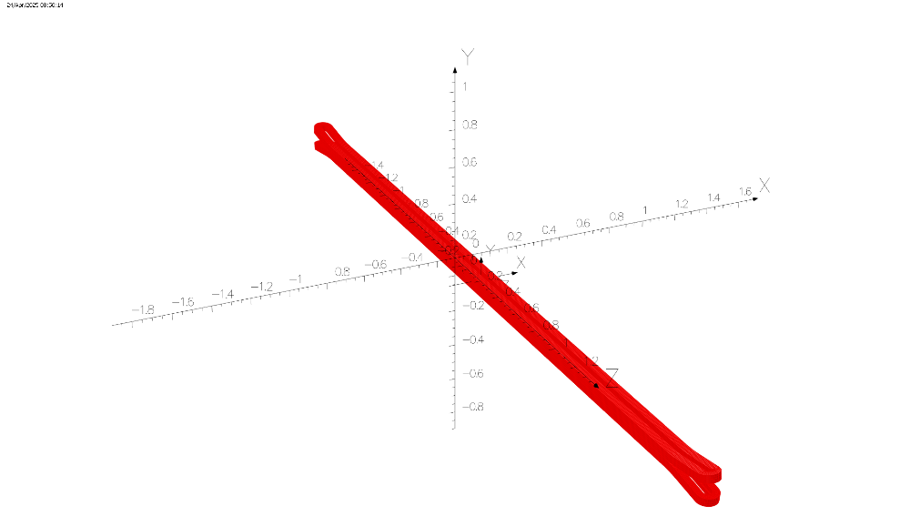
3D design - magnetic
Head type I (50 mm soft to hard-way, ~ ½ twist pitch)
L_{head} with endshoe (preliminary) | mm | 377
L_{straight} | mm | 1915
L_{coil} | mm | 4584
Cable length per magnet (1 ap.) | m | 700
End Iron pad | mm | 1915
End iron yoke (equals end of coil) | mm | 2242
L_{mag} | m | 4.30
Delta L_{coil}-L_{mag} | mm | 284

Slide 20
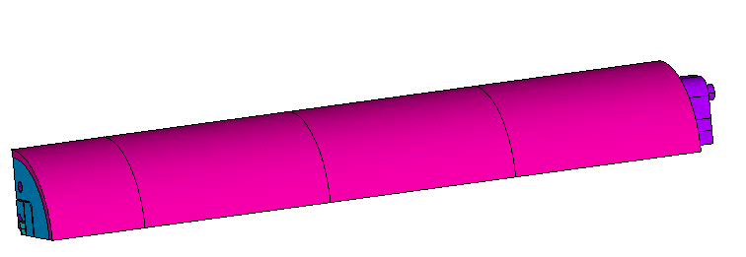
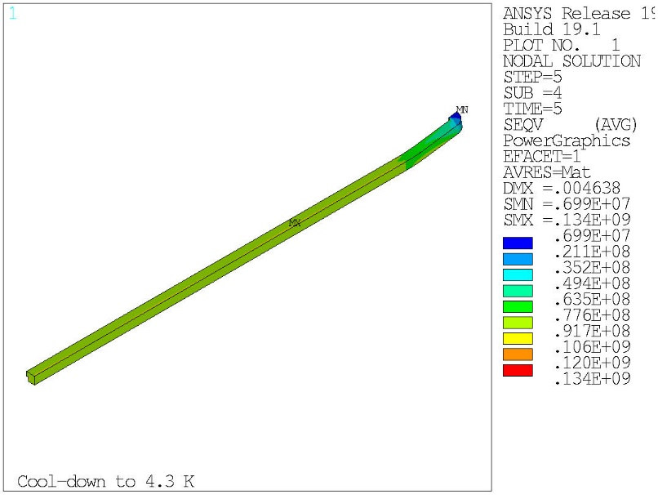
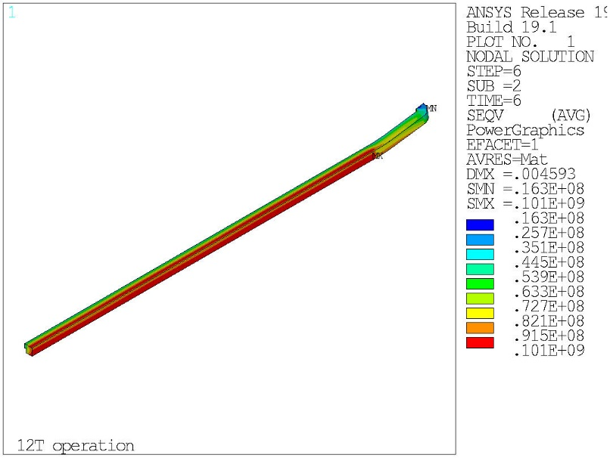
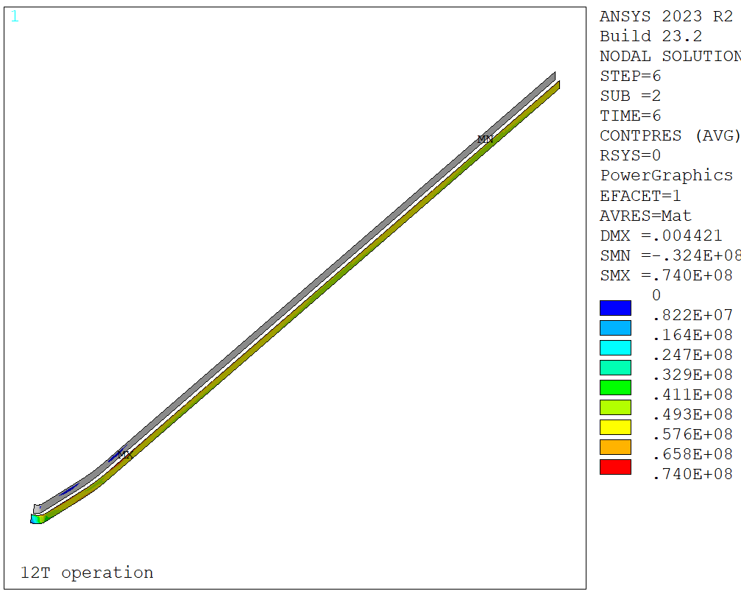
3D design – mech.
Shell azimuthal stress at 0⁰
Full length shell modules in the ends
Consistent results with 2D in the straight section
Very difficult to pre-load the upper layer, also in the ends
Seqv, at 1.9 K
Seqv at B_{ap.} = 12 T
Pole contact pressure at B_{ap.} = 12 T

Slide 21
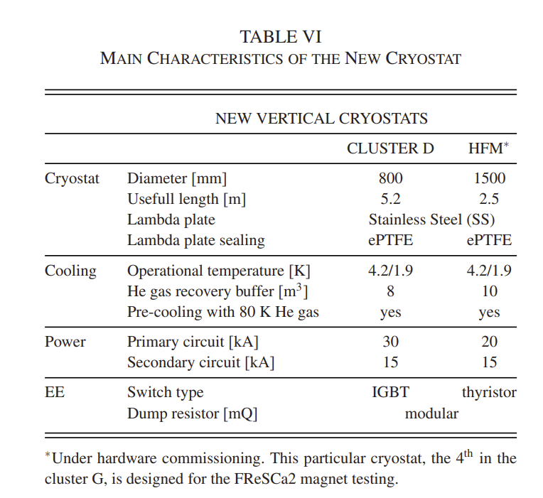
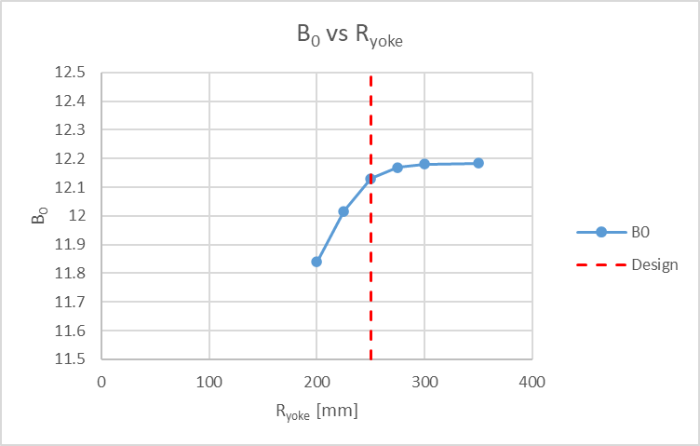
Magnet features - summary
Length
Outer diameter
Measurements and instrumentation
Aperture radius is small for the magnetic measurement shafts based on rotating coils, but we could still map the field in the aperture with PCBs or similar.
Quench antenna development will be very interesting for the characterization of the coil/magnet performance!
Discussions on-going with TE-MSC-MMM on these subjects.
As mentioned, we will add mechanical instrumentation in the end pushers (bullets).
MQML is the longest magnet tested up to date in Cluster D
MQML magnet length equals 5 m
Conceptual yoke-shell length = 4.55 m
~ 0.5 m for the endplates, connection box & leads (feasible based on MQXFB, see Annex.)
Magnet outer radius chosen to be compatible with the existing welding cradles at B.180
(Main dipole, OD = 550mm)

Slide 22
Magnetic length vs. physical length (coil ends)
Both BOND and M-BOND conceptual designs account for symmetric ends (without spacers). It was deemed simpler (design) and mechanically favorable.
*The difference in between both ends is the presence of leads and Layer Jump (LJ, located on the coil end). The latter sets special constraints in the geometry of the head, which makes it longer when compared to a possible end without LJ. This is not optimal and impacts filling factor. How much? See below a comparison with MQXF.
So far, we investigated two possible symmetric coil ends:
50 mm ramp (length between the exit of the hard-way in the layer jump and the beginning of the easy-way)
  ~ ½ of twist pitch, like MQXF case
20 mm ramp (idem)
  Like BOND
Head type I (50 mm soft to hard-way, ~ ½ twist pitch)
L_{head} with endshoe (preliminary) | mm | 377
L_{straight} | mm | 1915
L_{coil} | mm | 4584
Cable length per magnet (1 ap.) | m | 700
End Iron pad | mm | 1915
End iron yoke (equals end of coil) | mm | 2242
L_{mag} | m | 4.30
Delta L_{coil}-L_{mag} | mm | 284
Head type II (20 mm soft to hard-way)
L_{head} with endshoe (preliminary) | mm | 342
L_{straight} | mm | 1915
L_{coil} | mm | 4514
Cable length per magnet (1 ap.) | m | 689
End Iron pad | mm | 1915
End iron yoke (equals end of coil) | mm | 2207
L_{mag} | m | 4.24
Delta L_{coil}-L_{mag} | mm | 274
MQXF
L_{coil} | mm | 7500
L_{mag} | m | 7.2
Delta L_{coil}-L_{mag} | mm | 300
Note that for the block-type coil, the iron yoke extends over the full length of the coil. Iron pads stop at the end of the straight section. This is possible due to the natural decay of the field in the flared region.
*We are taking a closer look at the geometrical (coil) and iron effect.

Slide 23
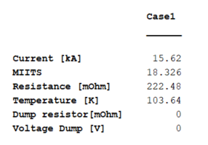
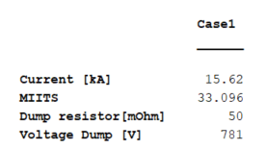
Protection
All conductors quenched t=0
Only dump resistor
Name |  | M-BOND | Bond_14T Single
Protection
Strand energy density | (J/cm³) | 107.9 | 130.4
Overall energy density | (J/cm³) | 69.3 | 89.1
j copper | (A/mm²) | 1262 | 1111
Temperature margin @ 1.9 K | (K) | 4.15 | 3.99
Time margin (300 K) | (ms) | 61.48 | 74.00
Emargin | (mJ/cm³) | 13.24
MIITS (300 K) | (MAAS) | 33.33
Voltage to ground | (V) |  | 120.00
*This temperature accounts for field decay.
Please use the T vs MIITS curve instead below
Zero time margin at I_{nom} for the case with only dump resistor (transient losses neglected)
Time margin for T_{Hot} = 300 K is 61.5 ms

Slide 24
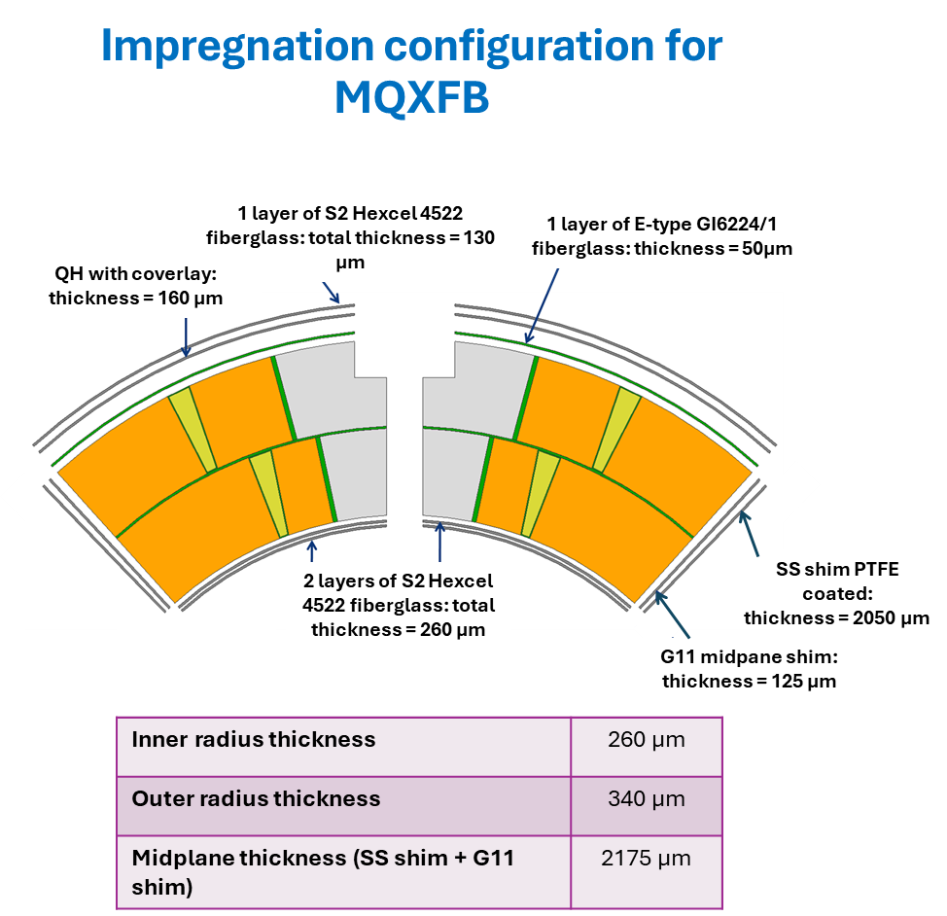
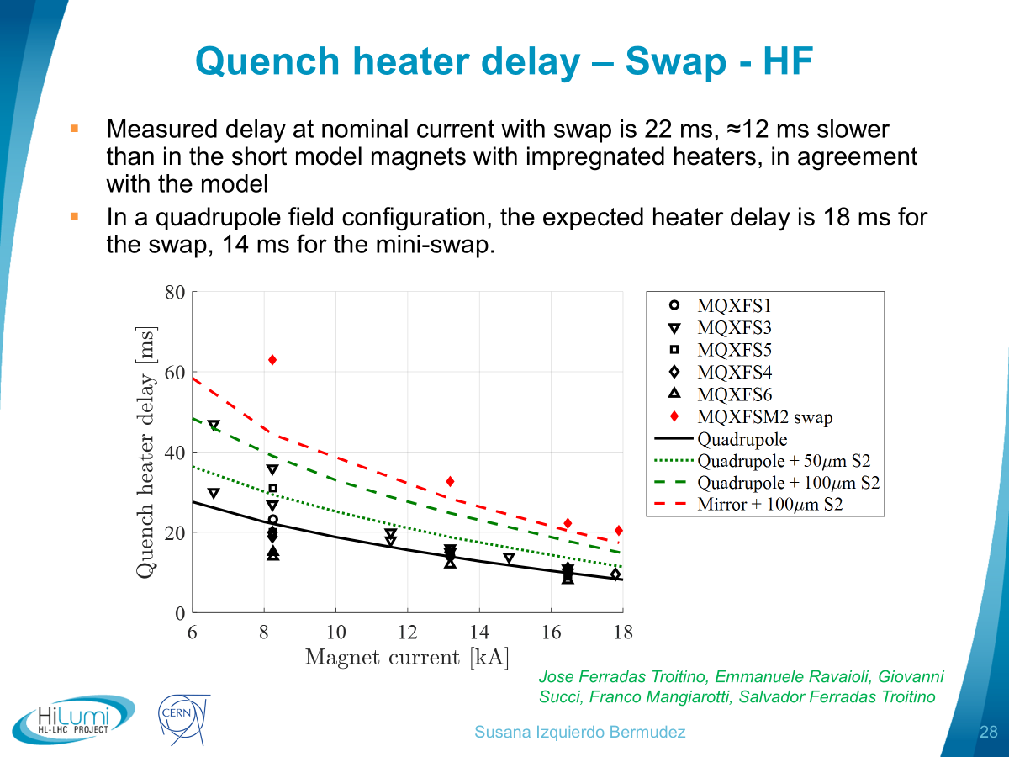
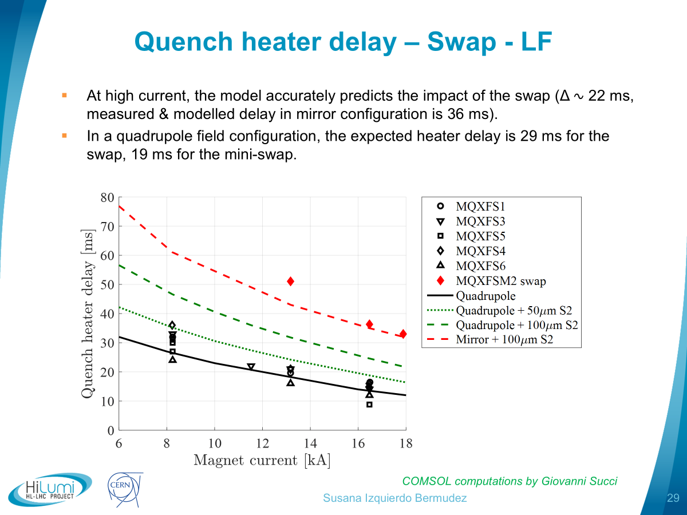
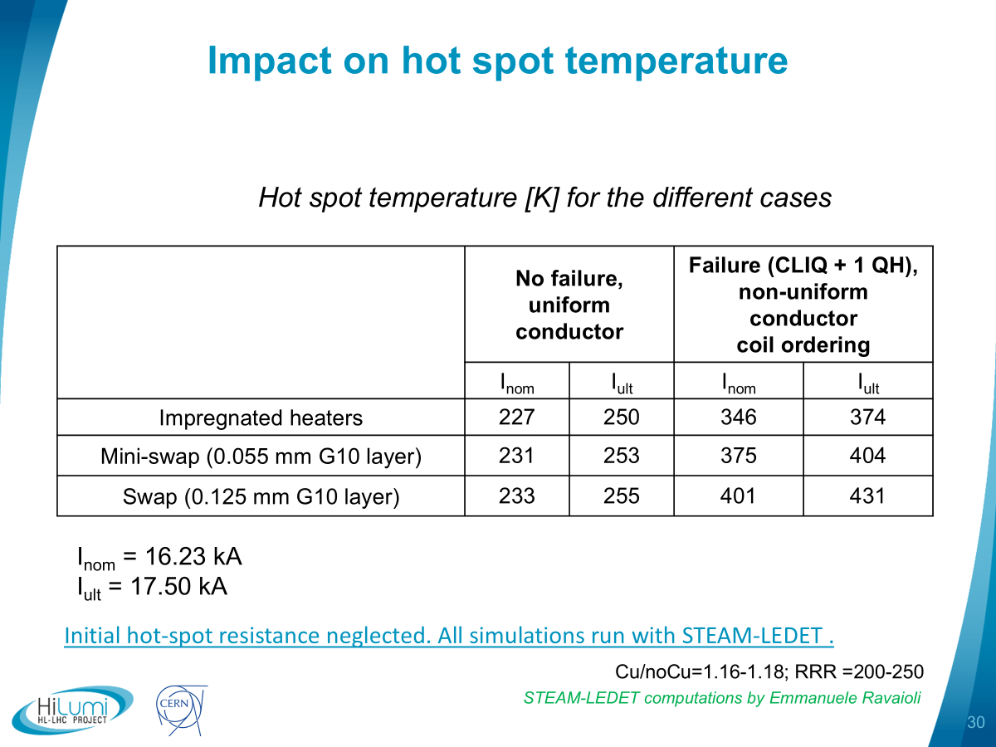
Protection
BOND protection relies on novel systems like ESC or E-CLIQ (and CLIQ).
Being a 1 m. length magnet, the dump guarantees protection even if the novel systems may be less efficient than initially expected.
For M-BOND, since the energy extraction does not guarantee protection, quench heaters are the fallback in case the novel systems do not satisfy the requirements.
The coil cross section design accounts for the required space to accommodate quench heaters.
In this case, our clear choice is to use external quench heaters (non-impregnated with the coil) and to profit from all lessons learnt up to now.
https://indico.cern.ch/event/1077589/
Optimized (large) distance from the heater strip to the polyimide edge
Polyimide coverlay added to the heater to increase its robustness
Fresh glass layer after RHT in between heater and coil (mini-swap in MQXF)
  Impact on delays and hot-spot temperature. But our case is easier!
(…)

Slide 25
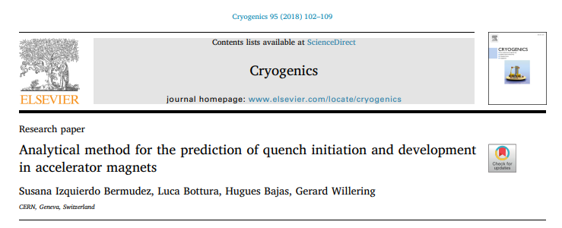
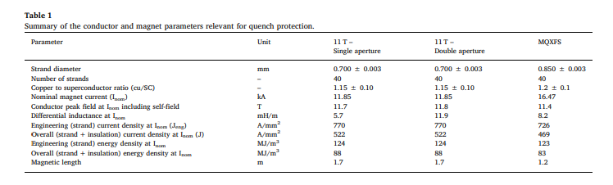
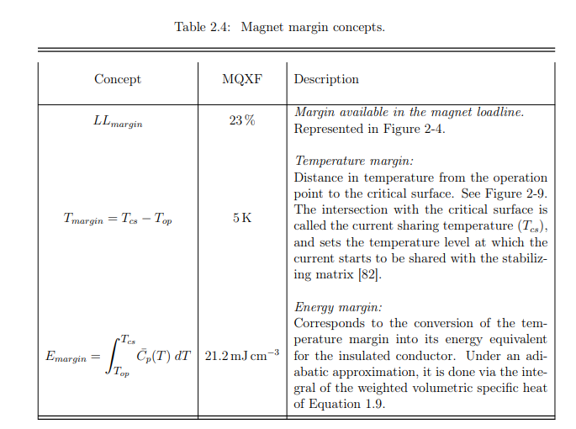
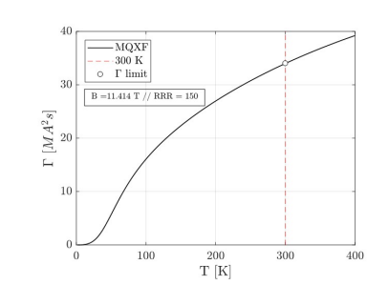
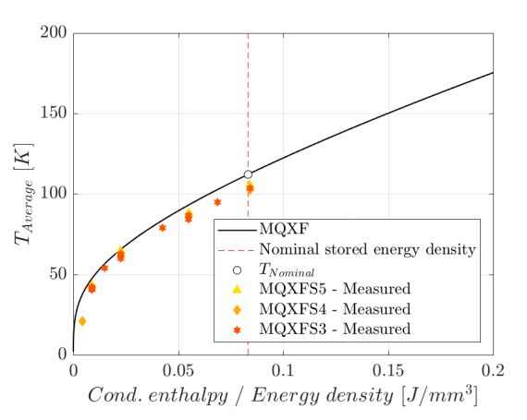
Very quick preliminary look on protection
Slide from conceptual design meeting
https://indico.cern.ch/event/1511768/
MQXF
T_{margin} = 5 K
E_{margin} = 21.2 mJ/cm³
Overall E_{density} = 0.0832 J/mm³ E_{stored} = 1.2 MJ/m

Slide 26
The 12 T challenge – protection
T_{hot} ≈ 100 K higher than in the LHC-MB dipoles, half the time margin
LHC MB
NbTi, B_{p} = 8.6 T
J_{overall}(I_{nom}) = 356/442 A/mm²
J_{cu}(I_{nom}) = 763/932 A/mm²
e_{m} (I_{nom}) = 71 J/cm³
HL-LHC MBH 11 T
Nb₃Sn, B_{p} = 11.7 T
J_{overall}(I_{nom}) = 522 A/mm²
J_{cu}(I_{nom})= 1440 A/mm²
e_{m} (I_{nom})= 124 J/cm³
HL-LHC MQXF
Nb₃Sn, B_{p} = 11.3 T
J_{overall}(I_{nom})= 462 A/mm²
J_{cu}(I_{nom}) = 1311 A/mm²
e_{m} (I_{nom})= 120 J/cm³
Slide from Susana (Feedback of HL-LHC Magnets to HFM)
https://indico.cern.ch/event/1471305

Slide 27
Outline
Introduction
Design overview
Step by step look:
    Cable
    Coil winding & related infrastructure
    Reaction heat treatment
    Impregnation
    Coilpack assembly
    Magnet assembly
    Other aspects
Where are we?
Next steps

Slide 28

Cable
M-BOND Conductor
Conductor parameters |  | M-BOND | BOND
Strand diameter | (mm) | 0.85 | 1.10
Layout |  | RRP 108/127 | RRP 162/169
Effective filament diameter | (µm) | 55 | 64
Jc at 4.2 K and 15 T , no self-field | (A/mm^2) | > 1280 | 1200
Cu/NonCu ratio |  | 1.2 | 0.9
No. of strands in cable |  | 40 | 40
Bare cable thickness | (mm) | 1.525 | 1.98
Bare cable width | (mm) | 18.150 | 23.045
Bare cable thickness (reacted - 4.5%) | (mm) | 1.594 | 2.06
Bare cable width (reacted - 1.2%) | (mm) | 18.363 | 23.275
Insulation thickness | (mm) | 0.15 | 0.15
Insulated cable width (reacted) | (mm) | 18.663 | 23.575
Insulated cable thickness (reacted) | (mm) | 1.894 | 2.36
Astrand | (mm²) | 0.567 | 0.950
Asc | (mm²) | 0.258 | 0.500
Acu | (mm²) | 0.310 | 0.450
Check | (mm²) | 0.567 | 0.950
ON-GOING:
Asked TE-MSC-SCD for 800 m of Cu-cable (1 Cu coil + 400 m for tests). It is already in their planning.
Nb₃Sn cable unit lengths will be discussed in October 2025 (HL-LHC & HFM agreement)
We also have 200 m of Nb₃Sn RMC-QXF cable available in 927. Note that each BOND mock-up uses 15 m. We could use some of this cable for our tests.

Slide 29
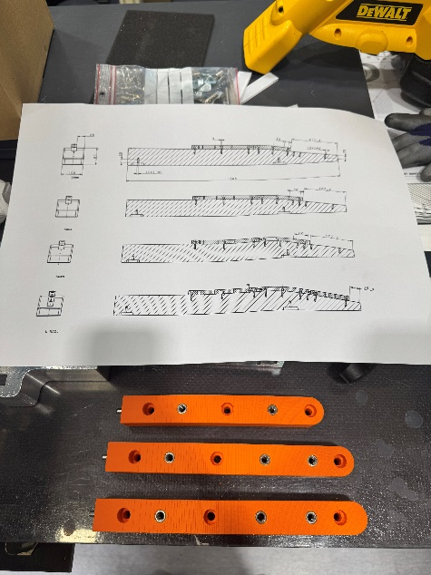
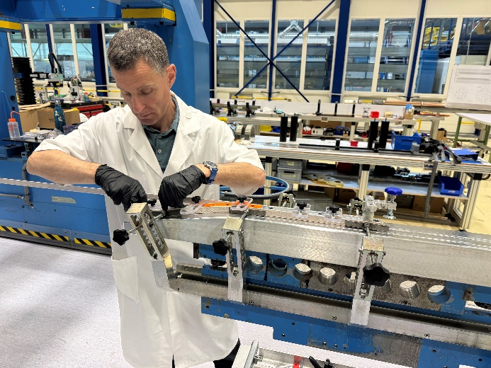
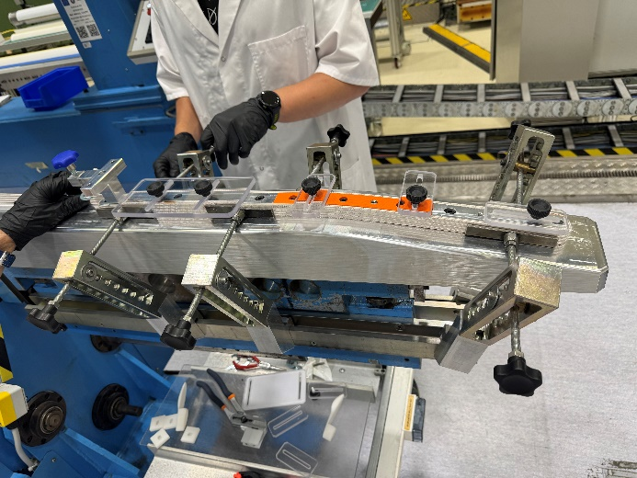
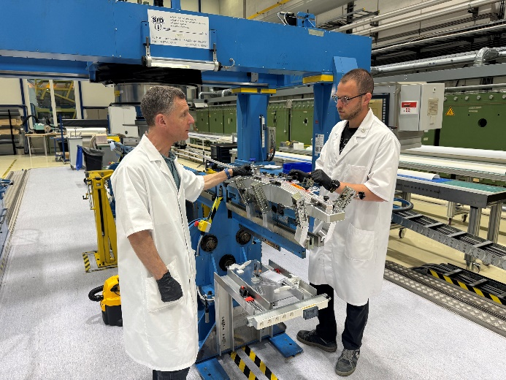
Coil winding & related infrastructure
M-BOND coils will be wound in the JEUMONT machine (recuperated from industry, up to 14 m coil & NUM controls)
The machine is today operational as long as the mandrel tilt (lateral) is blocked
We can wind the coils without any additional axis for the flared end (very gentle flaring).
  Preliminary test campaign proved it (using MQXFB leftovers). No showstopper found so-far.
    First tests with a 3D printed mandrel and pole. New aluminium mandrel machined to increase rigidity.
  Winding tests ongoing to study different ramps in the head and the layer jump geometry.
Order launched with SIEMENS for the upgrade of the control system
  Coming for the pre-study on week 26 (end of June)
Infrastructure is a part of HFM WP 5.4
J. Axensalva et al.

Slide 30
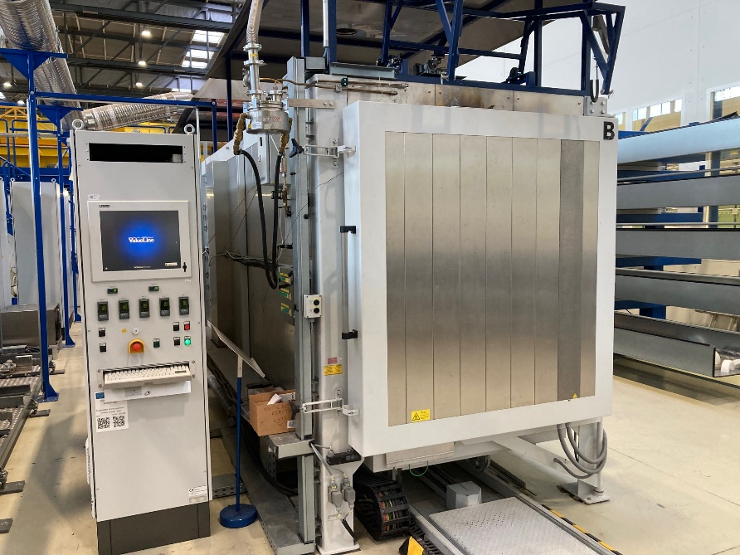
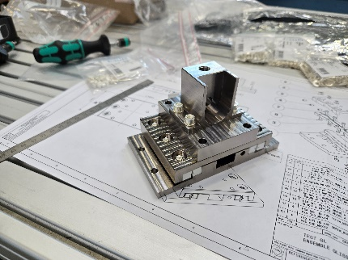
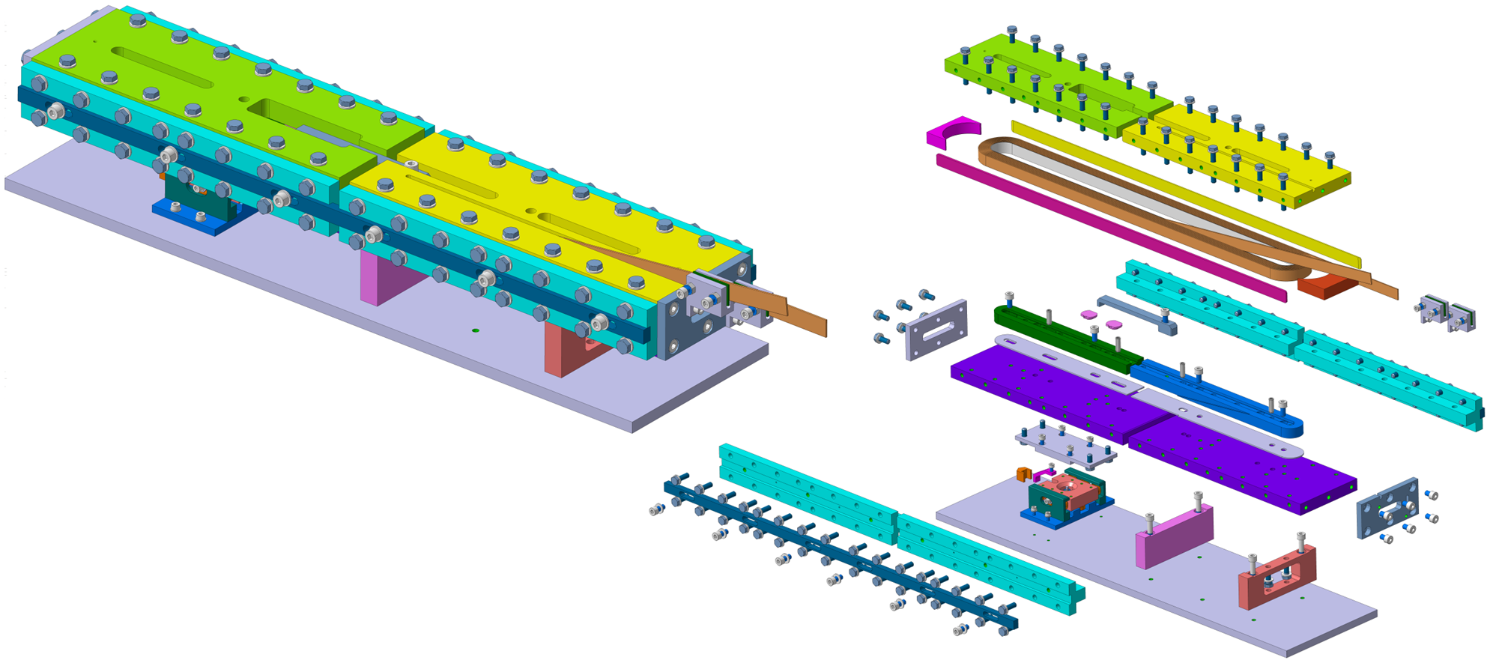
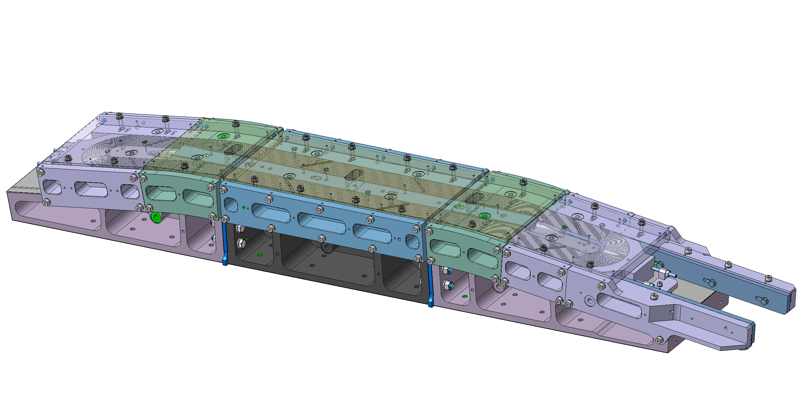

Coil reaction heat treatment
Coil reaction heat treatment will use the existing infrastructure from 11 T coils.
Carbolite Gero Furnace
6 m furnace for 11T
Routinely used up to 665°C, designed up to ~ 900°C
Fully operational today
The working principle of the reaction tooling is the same as BOND, with a sliding system that allows both ends to accommodate the differential thermal expansion during RHT.
Full test campaign on-going to characterize the system (including racetracks and DIC measurements)
https://indico.cern.ch/event/1531179/
https://indico.cern.ch/event/1545599/
Courtesy of Benjamin Pellet
Courtesy of N. Peray

Slide 31

Coil impregnation
Coil impregnation will use the CERN-made Vacuum Pressure Impregnation & Polymerization System
Up to 10 m impregnation mould
WinCC controls
Fully operational (trivially) today
Design of the impregnation tooling still under discussion. Today we have some doubts for BOND on how to match the coil geometry after RHT (with potential coil length changes) which also apply for M-BOND.
Decision on the tooling will be made in the following weeks.

Slide 32
Coilpack assembly
For coil finishing and coilpack assembly:
We are investigating the possibility of performing the coil geometrical measurements by scanning.
  Possible solutions: METRASCAN, LEICA scanner
  Advantages: Faster, no physical contact with the coil
Coil and coilpack insulation is also not trivial. Ground insulation needs to be folded in different directions simultaneously (flared ends):
  Possible solutions: Warm Kapton forming, staggered design of the different layers, to be studied.
As for BOND, we would like to machine the lateral coil rails to ensure a flat and well-controlled surface for pre-load application:
  Possible solutions: Machining bench in B.180 hall

Slide 33




Magnet assembly
M-BOND mechanical structure will be composed of different yoke-shell modules (all same length, no end modules like MQXF). Yoke and pads will use thin/thick iron laminations.
Note that in BOND we plan to re-machine the yoke inner surface after its sub-assembly. For M-BOND this is not the case.
We propose to use a system of encapsulated bladders, acting as the equivalent of “local masters”. This idea has been also implemented in BOND.
  Full length bladders for M-BOND
  Advantages: In principle, robust and easy to insert (we allow a gap in the order of 1 mm)
  A second passive bladder could be included in the sandwich, just to be gently inflated after the loading is finished (remaining on its elastic range). The idea is to use it to “flatten” back the active bladder and improve extraction.
    Test campaign will be launched soon to prove the concept.

Slide 34
Other aspects
COOLING:
  There is not much space for He-cooling compared to other magnets. This needs to be worked out as well in the framework of BOND (as we did for MQXF).
HANDLING:
  The magnet is dense and full of iron. We need to turn it vertically and the weight might be high. Everything is kept by the keys with the large force and friction.
    The weight of an iron cylinder with the same yoke OR is 7700 kg. Force equals ~ 76 kN
    The total radial force provided by the shell is 44400 kN at room temperature.
      Using µ=0.2, this equals 8880 kN
      Using µ=0.05, this equals 2200 kN
      This is orders of magnitude larger than the weight.
    We need, still, to handle the shear that appears during handling. We can check what it is done in MQXFA in terms of tooling.

Slide 35
Outline
Introduction
Design overview
Step by step look:
    Cable
    Coil winding & related infrastructure
    Reaction heat treatment
    Impregnation
    Coilpack assembly
    Magnet assembly
    Other aspects
Where are we?
Next steps

Slide 36
Where are we?
Preliminary 2D and 3D conceptual design done. Some inputs being finalized based on BOND.
First winding tests have proven the capability of winding this type of coils in our winding machine
Infrastructure preparation/upgrade is ongoing
  Winding machine (Jerome and Seb)
Asked SCD for 800 m of Cu-cable (1 Cu coil + 400 m for tests)
  Nb₃Sn cable unit lengths will be discussed in October 2025 (HL-LHC & HFM agreement)

Slide 37
Where are we?
 |  | SINGLE APERTURE
 |  | 2025 |  |  |  |  |  |  |  |  |  |  |  |  |  |  |  |  |  |  |  |  |  |  |  | 2026 |  |  |  |  |  |  |  |  |  |  |  |  |  |  |  |  |  |  |  |  |  |  |  | 2027
Category | Sub-category | Jan |  | Feb |  | Mar |  | Apr |  | May |  | Jun |  | Jul |  | Aug |  | Sep |  | Oct |  | Nov |  | Dec |  | Jan |  | Feb |  | Mar |  | Apr |  | May |  | Jun |  | Jul |  | Aug |  | Sep |  | Oct |  | Nov |  | Dec |  | Jan |  | Feb |  | Mar |  | Apr |  | May |  | Jun |  | Jul |  | Aug |  | Sep |  | Oct |  | Nov |  | Dec
2D / 3D Conceptual design and focus on BOND
Infrastructure B.180
Coil design | 3D CAD
 | Drawings
 | Manufacturing
 | Reception at CERN
Winding & Reaction tooling | 3D CAD
 | Drawings
 | Manufacturing
 | Reception at CERN
Impregnation tooling | 3D CAD
 | Drawings
 | Manufacturing
 | Reception at CERN
Magnet structure | 3D CAD
 | Drawings
 | Manufacturing
 | Reception at CERN
Assembly tooling / infrastructure | 3D CAD
 | Drawings
 | Manufacturing
 | Reception at CERN
Conductor | Copper run |  |  |  |  |  |  |  |  | ?
 | Copper insulation |  |  |  |  |  |  |  |  |  |  |  |  |  |  | CGP closed
 | Insulated copper delivery
 | Nb₃Sn run |  |  |  |  |  |  |  |  |  |  |  |  |  |  |  |  |  |  | ?
 | Nb₃Sn insulation
 | Insulated Nb₃Sn delivery
Trial / copper coil | Winding
 | Reaction
 | Impregnation
 | Finishing
Nb3Sn Coil 1 | Winding
 | Reaction
 | Impregnation
 | Finishing
Start emgineering design as soon as everything is clearly established for BOND – Scale-up in length with MQXF conductor (Job EN-MME).
Contacted SCD section for rectangular MQXF cable
Cu-cable first (RMC-QXF)
Ideally, first reacted BOND Nb₃Sn falling not far from these dates.
Components manufacturing times seem extremely challenging. To be updated based on BOND experience.
Engineering design activity for M-BOND after summer.

Slide 38
Outline
Introduction
Design overview
Step by step look:
    Cable
    Coil winding & related infrastructure
    Reaction heat treatment
    Impregnation
    Coilpack assembly
    Magnet assembly
    Other aspects
Where are we?
Next steps

Slide 39
Next steps
The priority today is to complete the missing milestones for finalizing BOND’s engineering design:
  Coil and winding tooling drawings well advanced. Tests ongoing for the detailed layer jump geometry and the handling of the insulation around the pole. This should answer our main doubt on the geometry of the winding pole (monolithic or in two layers).
  Reaction heat treatment tooling well advanced as well. Coupling with the sliding system to be designed, we are pending the final decision on which system to use.
    Recall tests ongoing, including racetrack mock-up and DIC
  Impregnation tooling under discussion. Doubts on how to deal with the geometry matching between the coil and vertical pad during impregnation and magnet assembly.
    The Test Facility Dipole (TFD) uses an adjustable impregnation mold and a smart shim for final assembly.
  Mechanical structure, detailed analysis ongoing:
    The new detailed geometry with the encapsulated bladders is being analyzed, to verify that all design criteria is fulfilled (as in the conceptual model).
    The 3D design of the endplate is also being performed.

Slide 40
Next steps
Based on BOND, we would like to proceed with the engineering design of M-BOND:
  Coil and winding tooling
  Reaction heat treatment tooling
  Impregnation tooling under discussion
  Mechanical structure
  Assembly tooling and related infrastructure
In parallel, we will continue working on the development aspects mentioned at the beginning of the talk.
Our first milestone (objective) is to start the engineering design of M-BOND after summer!

Slide 42


Slide 43
Cable unit length
For MQXFB, our Unit Length (UL) equals 760 m. This is the minimum required for winding, after removing 10-stacks, etc
  10-stacks we need: 20cm x 10 = 2 m / 2 m x 3 samples = 6 m
  After winding, usually we get remaining:
    10 m for the IL
    18 m for the OL
It is important to have enough length remaining in the spool to be able to correctly maintain tension.
For the 5-m long-block
  We produce one unit length (of MQXFB length) and we remove the 10-stacks. This should give us a minimum of 750-760 m.
  For 2 coils, this gives ~375 m per coil
    Removing 10 m for IL extra (remaining in the spool)
    Removing 15 m for OL extra (remaining in the spool)
    This gives 350 m per coil
    One magnet, 700 m (This would be the value in ROXIE 3D)

Slide 44

Constraints on test station
Useful length for Cluster D = 5.2 m (this is the useful length available below the lambda plate)
This means that the magnet (as shipped from B.180) should be shorter to account for the integration in the cryostat, i.e. leads, etc
On top of this, we should be able to turn the magnet in the building without interfering with the ground.
We contacted Franco and Patrick Viret to check the integration in CLUSTER D.
Today the coil is 4524 mm. This is fixed by the conductor length to accommodate 2 coils per MQXFB UL.
Full structure with endplates = 4524 mm + 250 mm (next slides) = 4774 mm

Slide 45



MQXFB example

Slide 46




MQXFB example

Slide 47


MQXFB example
From pictures (prev. slides):
Extra L = 100 + 150 = 250 mm
From drawing:
7750-7521 ~ 230 mm

Slide 48

Slide from Ariel

