Slide 1
CERN and its Scientific Information Service - an introduction
Alexander Kohls
04 June 2025

Slide 2
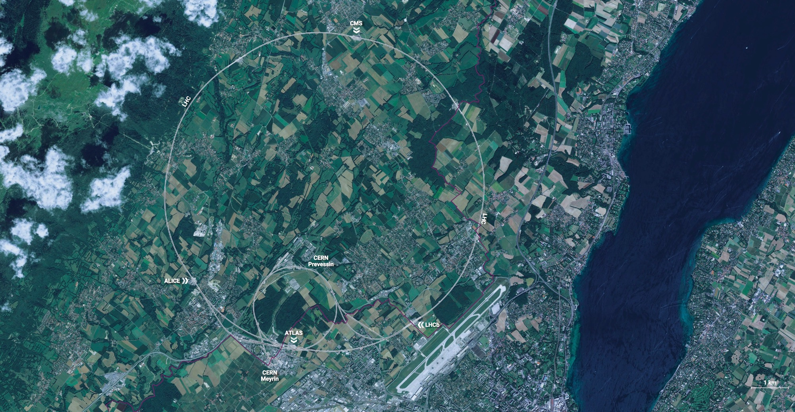
CERN - the world’s biggest laboratory for particle physics.
International Organization
established in 1954 -
“Science for Peace”.
Immunity of jurisdiction
and execution.
Notes:
This slide addresses two questions:
“Where are we?”
Use the map to indicate the location of CERN, headquartered in Geneva, straddling the Franco-Swiss border
“What is CERN?”
CERN is one of the world’s leading laboratories for particle physics
CERN’s vision (long-term goal) is to understand the fundamental particles and laws of the Universe (This is the Vision statement that features in CERN’s communication strategy)
Thus, CERN is first and foremost a research laboratory

Slide 3
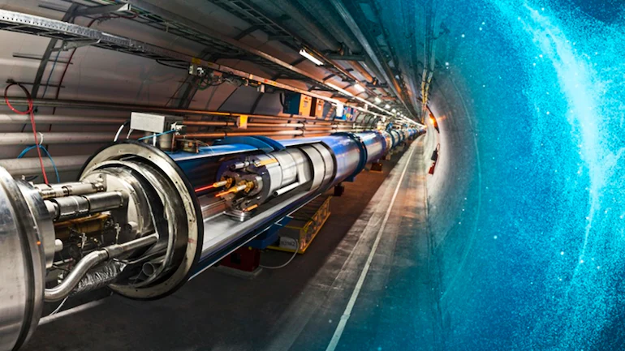
  CERN’s Mission
  Perform world-class research in fundamental
  physics
  Provide a unique range of particle accelerator
  facilities that enable research at the forefront of human knowledge, in an environmentally responsible and sustainable way.
  Unite people from all over the world to push the frontiers of science and technology for the benefit of all.
  Train new generations of physicists, engineers and technicians, and engage all citizens in research and in the values of science.

Slide 4

In 1954 CERN started with 12 Member States
Today CERN has 24 Member States and is still growing
Geographical & cultural diversity
110 nationalities,
from 77 countries
24 Member States
2 Associate Member States in the pre-stage to membership
9 Associate Member States
~ 2’675 Staff members
~ 2‘000 contractors’ employees
~ 13‘000 physicists /users
Yearly budget ~ 1‘300 MCHF
Notes:
The speaker can highlight CERN’s second mission as stated when it was established: to foster peaceful collaborations between nations that had recently been at war.
This slide will have information on the country of the visiting delegation:
Location on the world map
Date of accession (if Member State or Associate Member State)
For information:
Member States – Austria, Belgium, Bulgaria, Czech Republic, Denmark, Finland, France, Germany, Greece, Hungary, Israel, Italy, Netherlands, Norway, Poland, Portugal, Romania, Slovak Republic, Spain, Sweden, Switzerland, United Kingdom
Associate Member States in the pre-stage to membership – Cyprus, Serbia, Slovenia
Associate Member States – India, Lithuania, Pakistan, Turkey, Ukraine
Observers – USA, Russia, Japan, (EU, JINR, UNESCO)

Slide 5
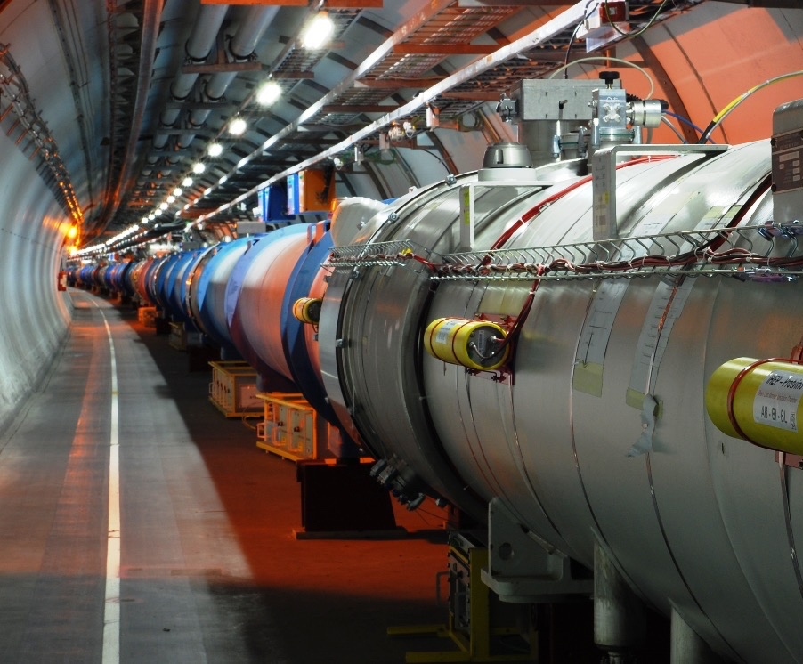
CERN‘s flagship:
The Large Hadron Collider
  Ca. 100m underground
  27 km circumference
  Coldest known place in the universe
  (Magnets cooled down to -271°C)
  Hottest place in the solar system
  (Collision temperature 100‘000x hotter than the sun)
  1 billion+ particle collisions per second
  Detectors collect 1PB/sec of data
Alexander Kohls | SIS Intro

Slide 6
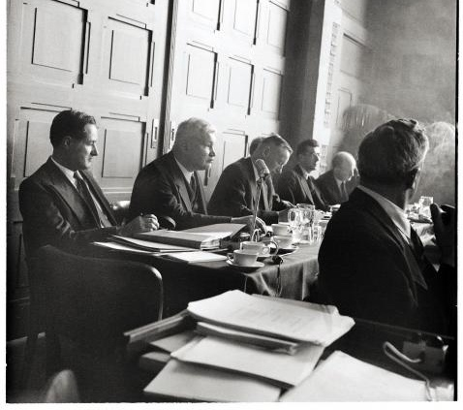

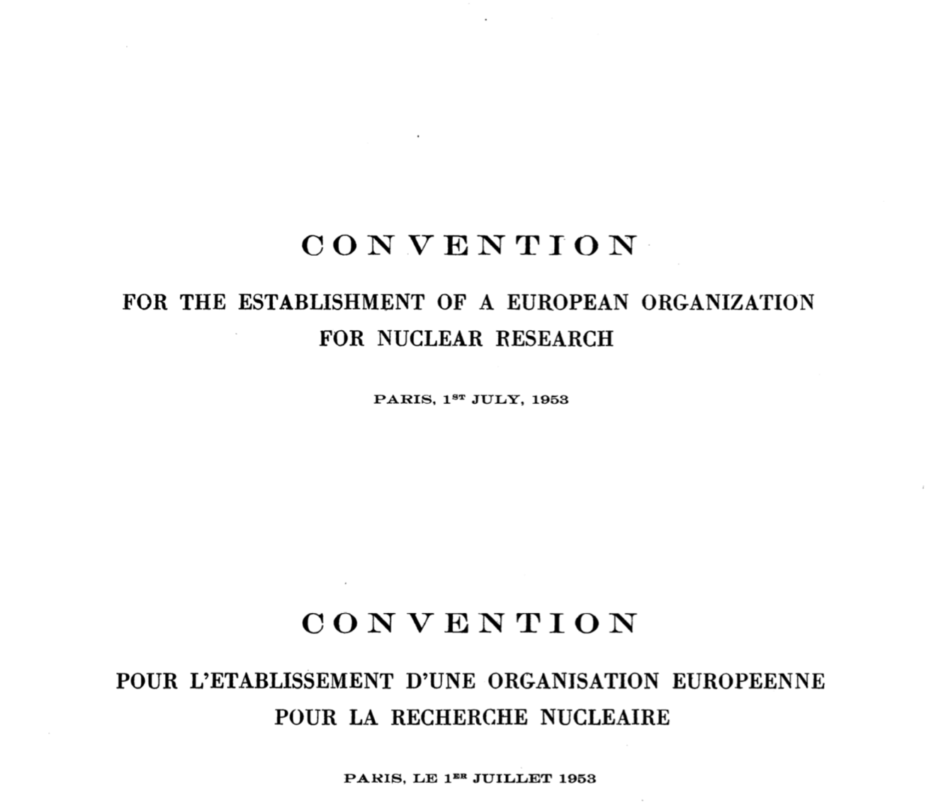
CERN was built for openness of information.

Slide 7
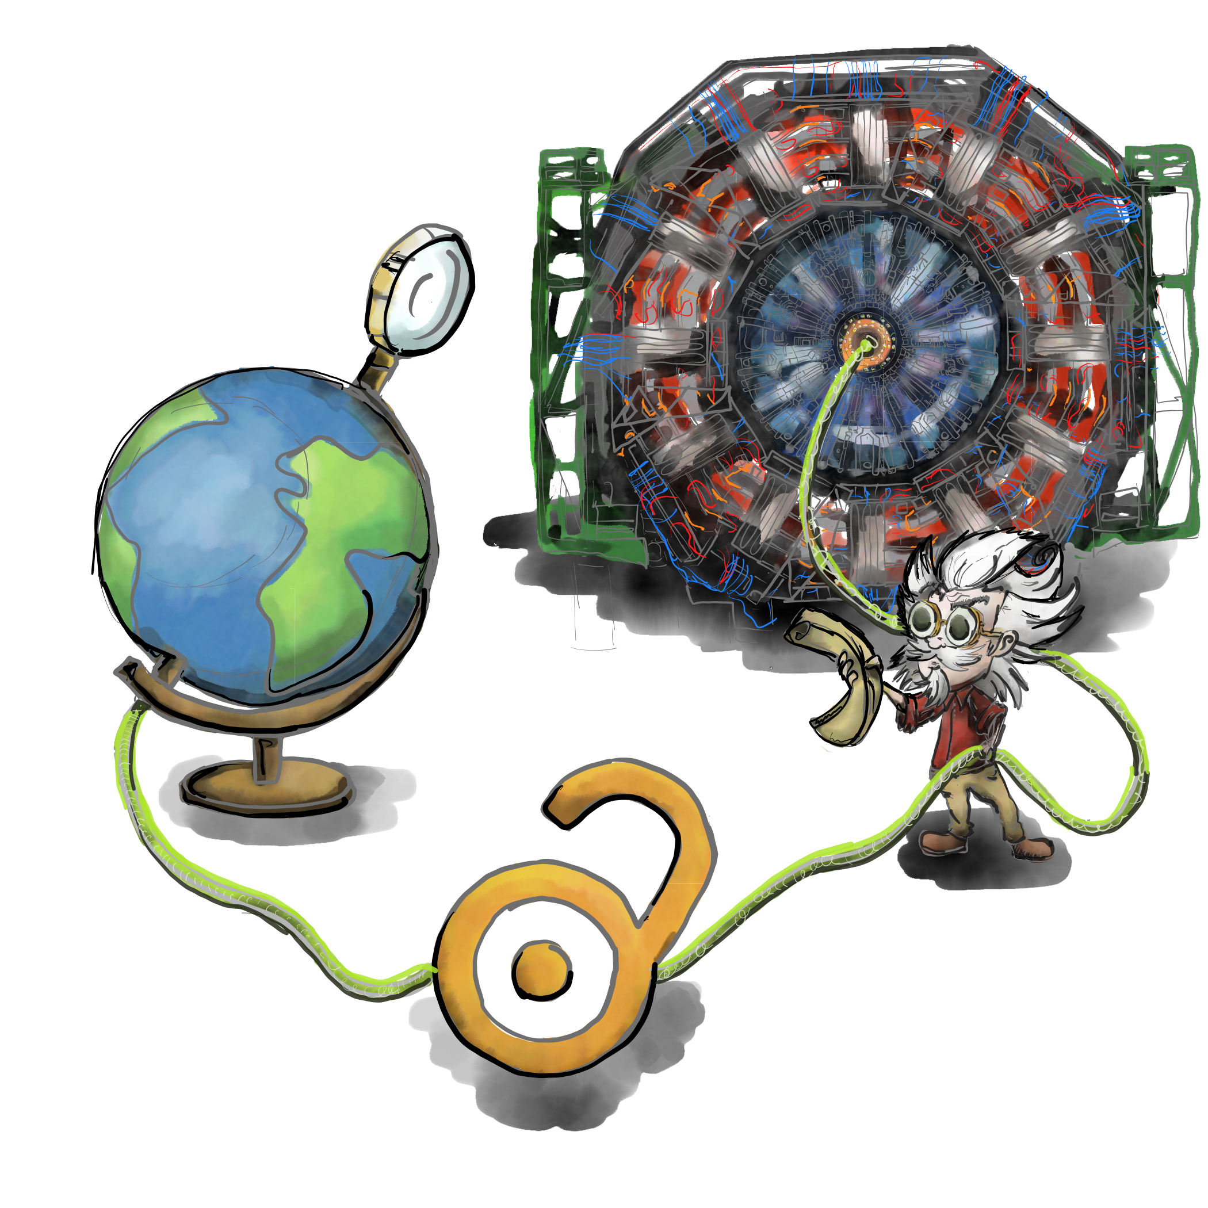
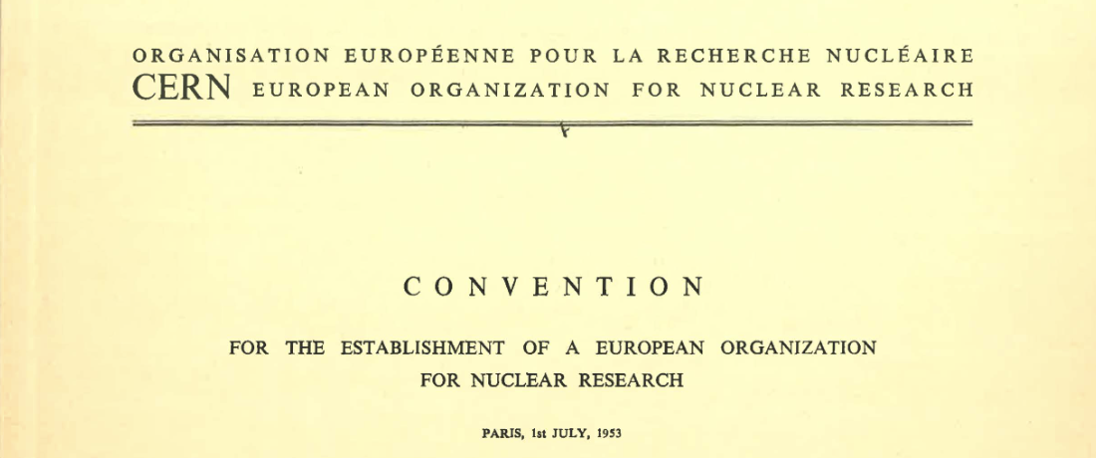
“…and the results of its experimental and theoretical work shall be published or otherwise made generally available”
CERN Founding Convention (1953)
Illustration by Stephanie van de Sandt

Slide 8
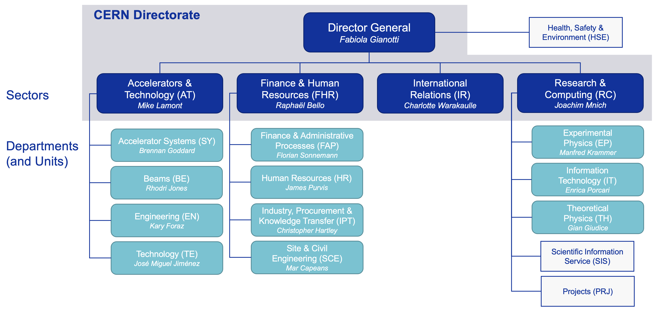
SIS and SCE within CERN
A central unit supporting all CERN departments

Slide 9
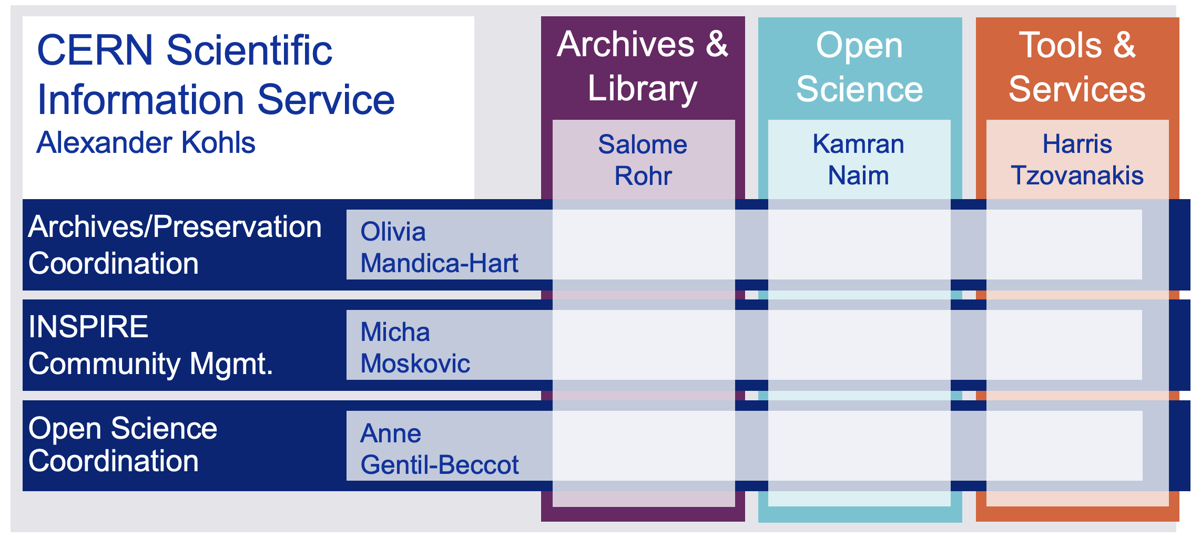
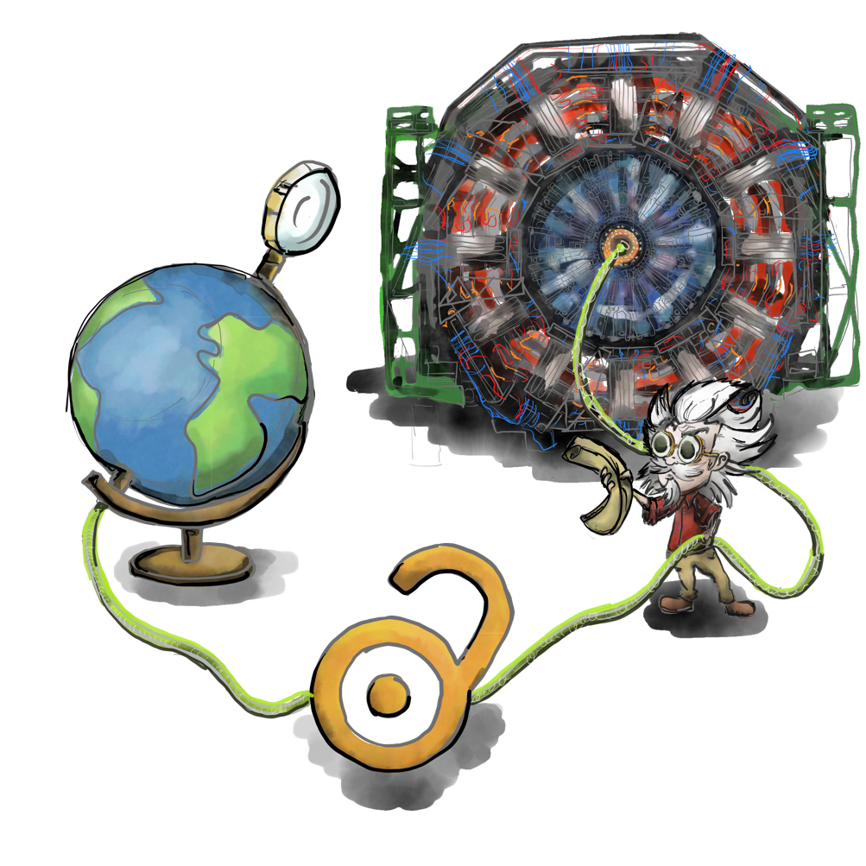
The CERN Scientific Information Service
Connecting the CERN Community with global research
The CERN Scientific Information Service aims at efficiently managing, preserving and disseminating scientific information to make it openly accessible and reusable to CERN and the worldwide High-Energy Physics community.
Le Service d’Information Scientifique du CERN a pour mission de gérer, conserver et diffuser efficacement l’information scientifique afin de la rendre accessible et utilisable pour le CERN et pour la communauté mondiale de la physique des hautes énergies.

Slide 10
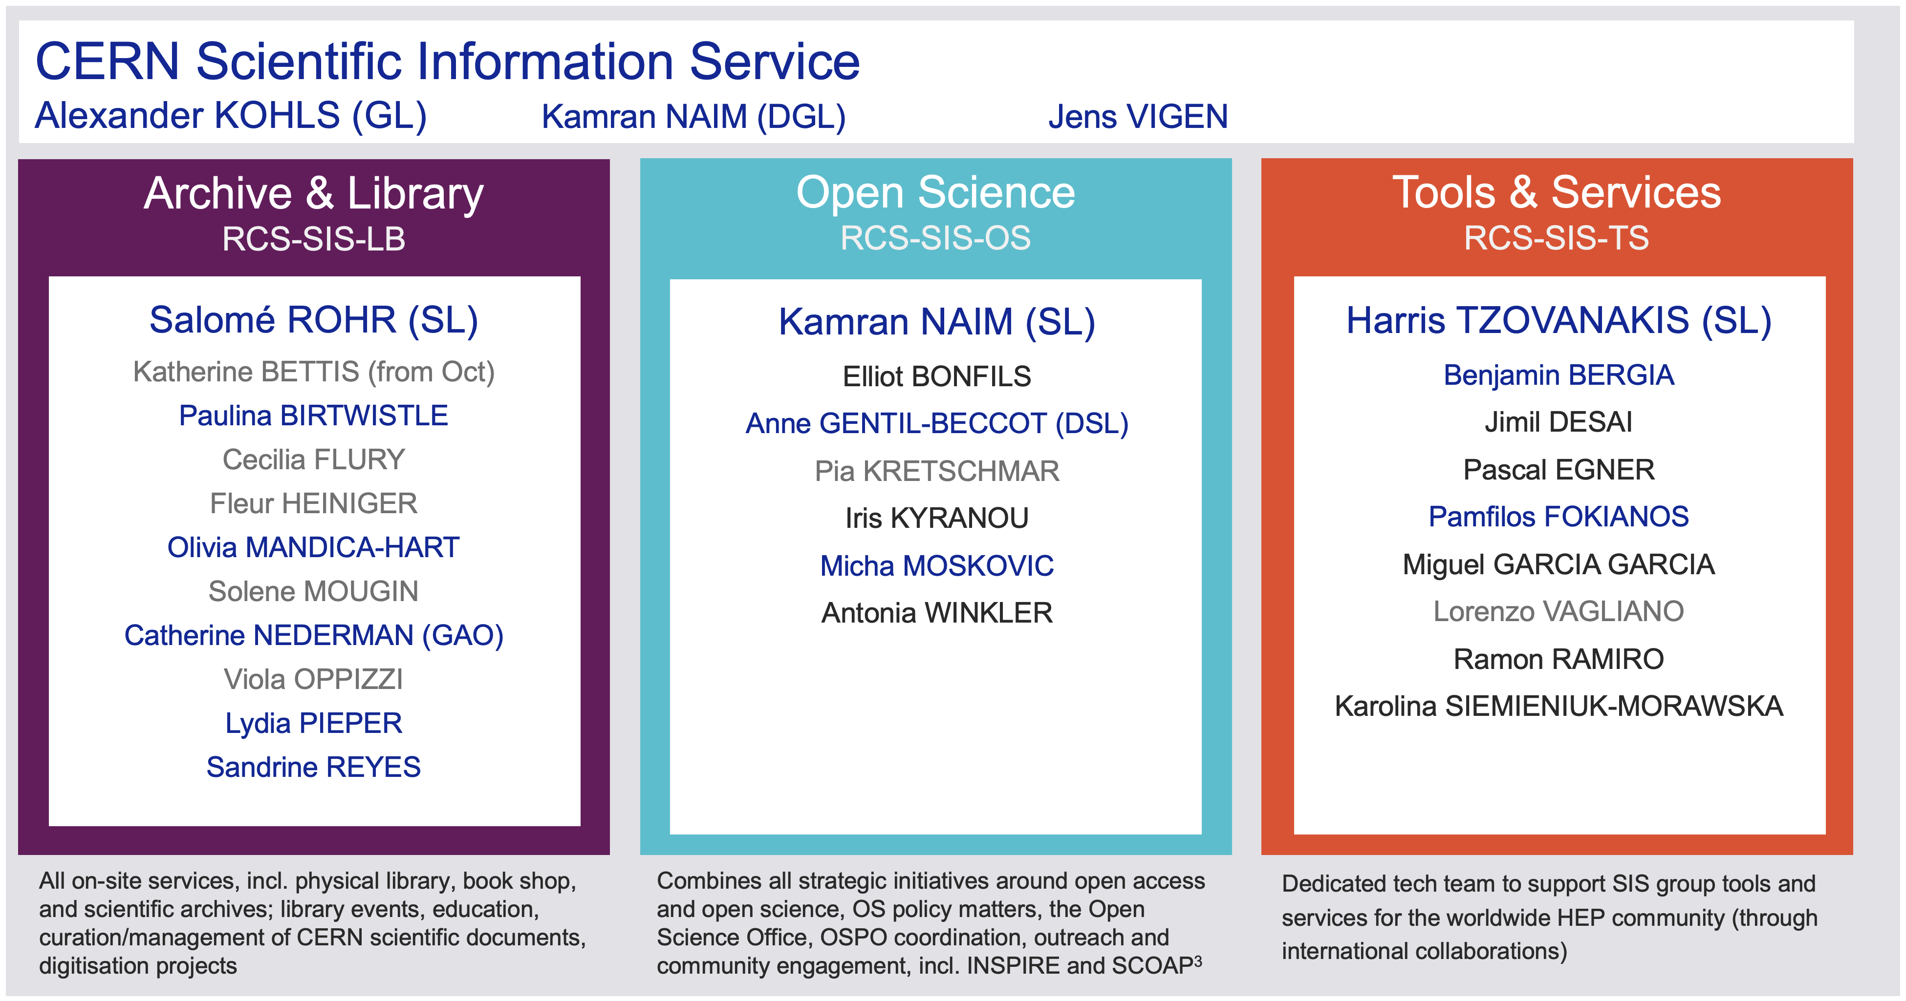
The CERN Scientific Information Service
Connecting the CERN Community with global research

Slide 11







CERN OSPO

