Slide 1
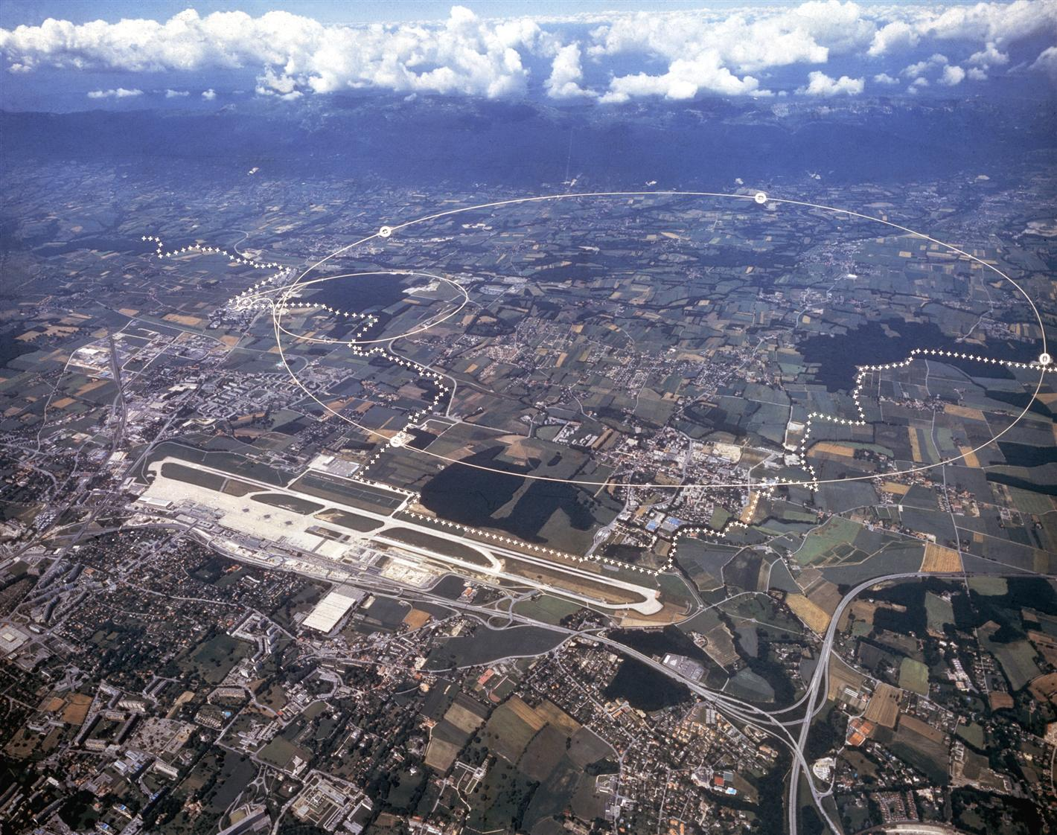



Exceeding high-luminosity LHC performance targets during the 2024 Pb-Pb ion run
Research partly supported
by the HL-LHC project
R. Bruce, R. Alemany Fernández, F. Alessio, T. Argyropoulos, H. Bartosik, R. Cai, F. Carra, R. Denz, S. Fartoukh, P. Hermes, M. Hostettler, J.M. Jowett, S. Kostoglou, A. Lechner, K. Li, B. Lindstrom, E. Maclean, D. Mirarchi, S. Morales Vigo, T. Persson, L. Puddu, S. Redaelli, V. Rodin, B. Salvachua, M. Slupecki, M. Solfaroli, J. Steckert, G. Sterbini, H. Timko, R. Tomás, N. Triantafyllou, F. Van der Veken, E. Waagaard, J. Wenninger, C. Young, M. Zielińska
2025.06.03

Slide 2
Contents
Introduction: The LHC and its heavy-ion programme
Outcome of the 2023 Pb ion run, and inputs to the 2024 configuration
Achievements in the 2024 Pb ion run
  Beam quality
  Machine availability and faults
  Luminosity performance
    Comparison to 2023 and projections for High-Luminosity LHC
Summary and outlook

Slide 3
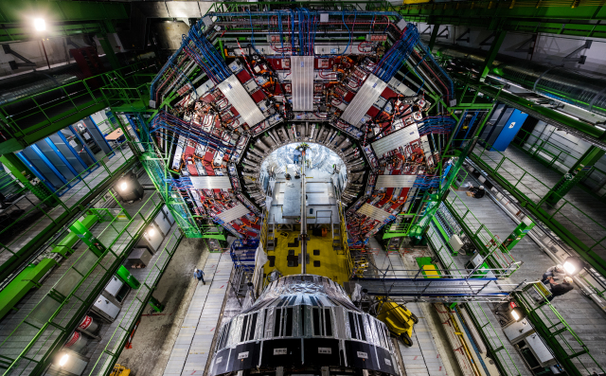

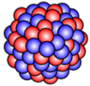
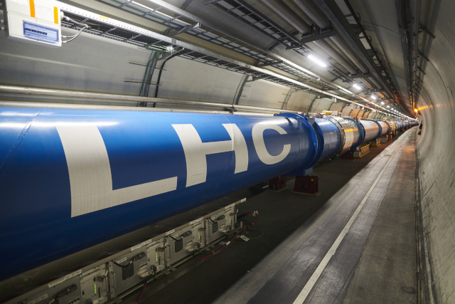
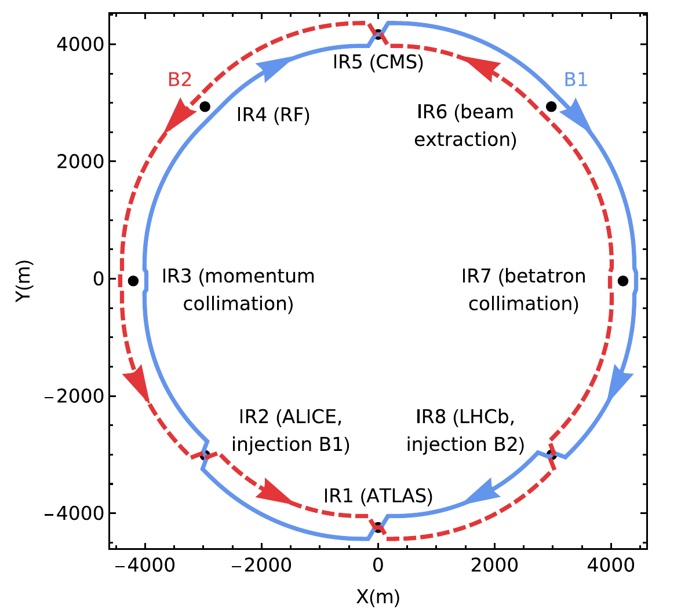
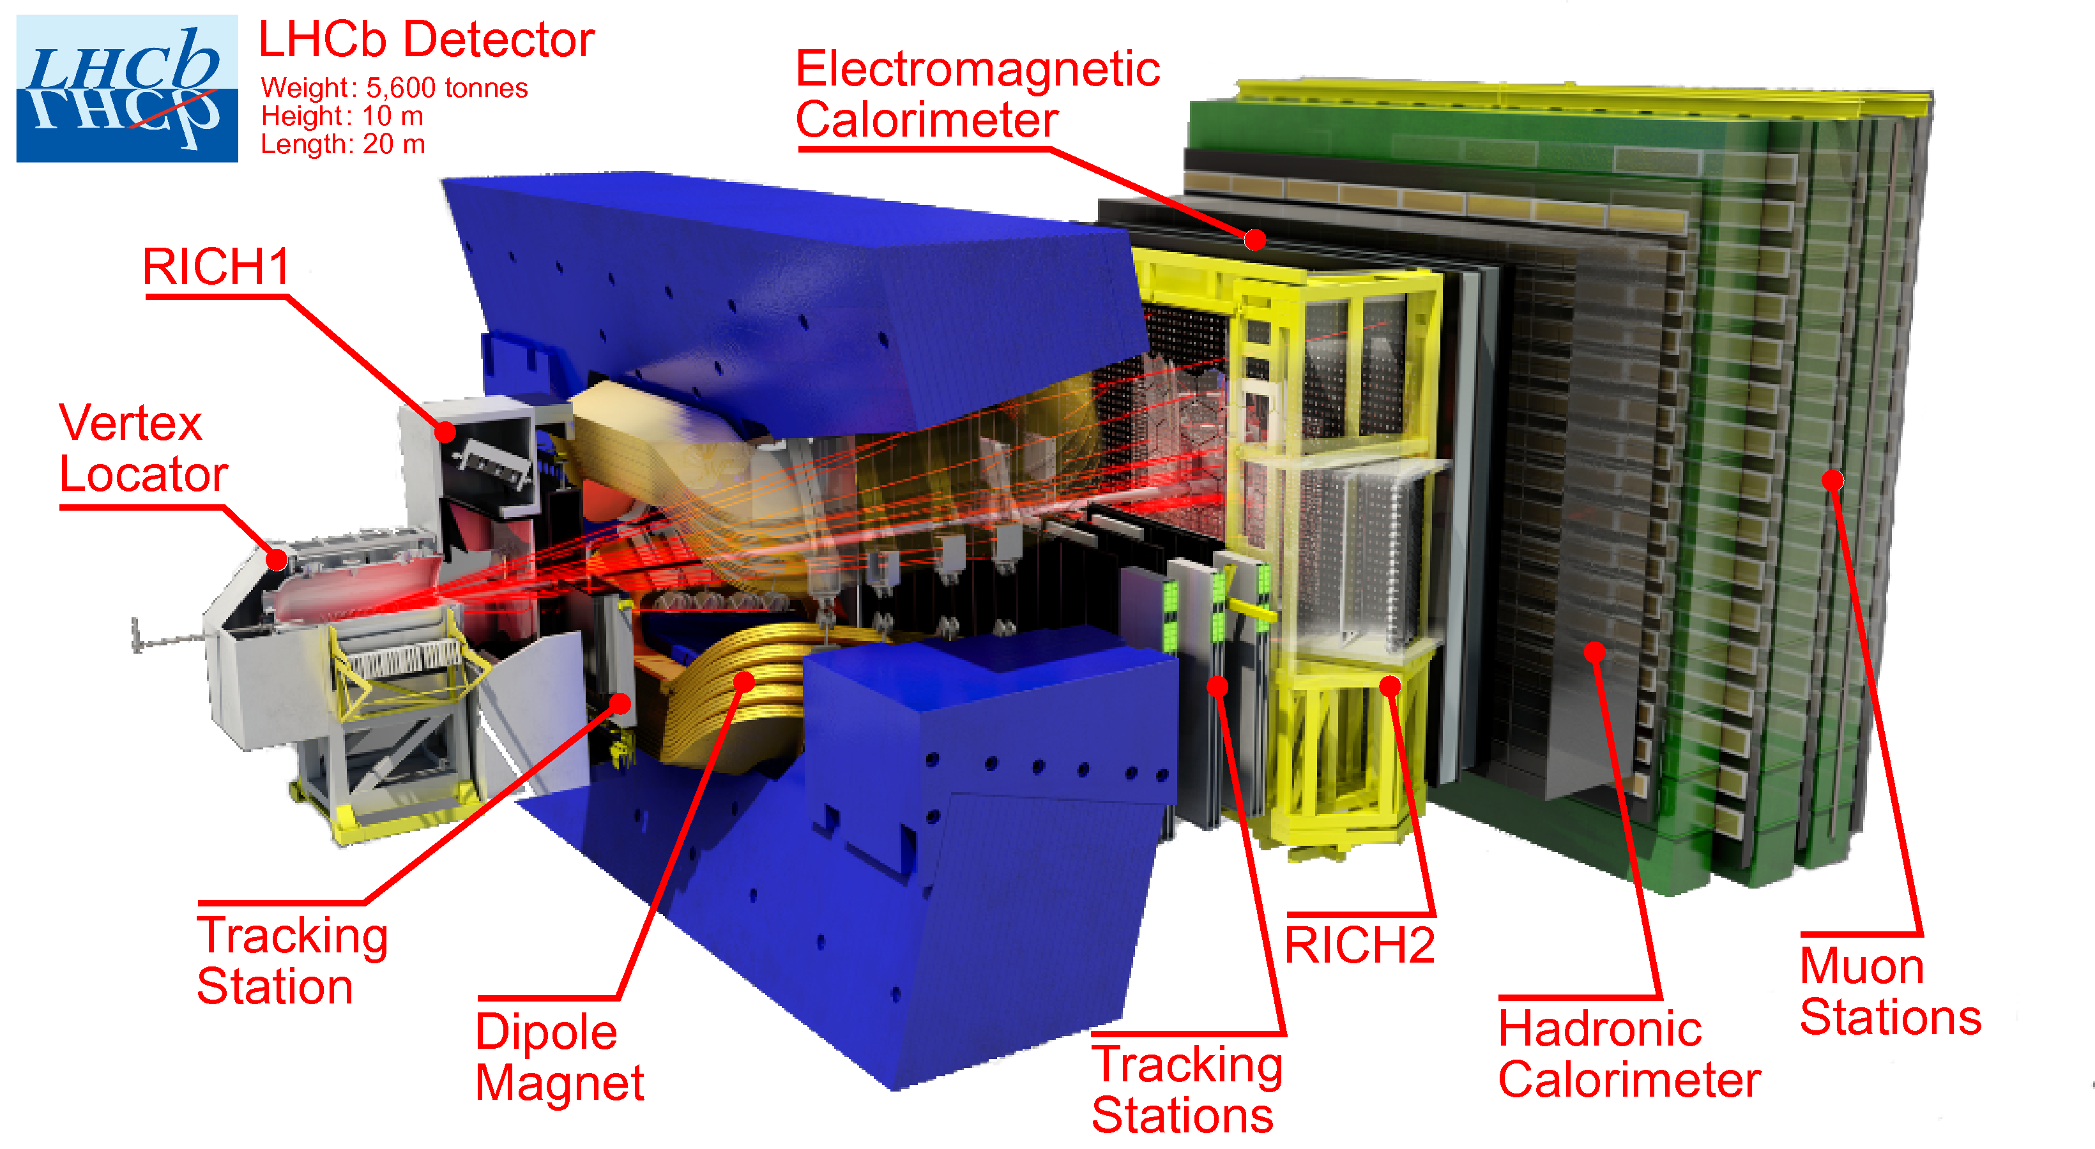
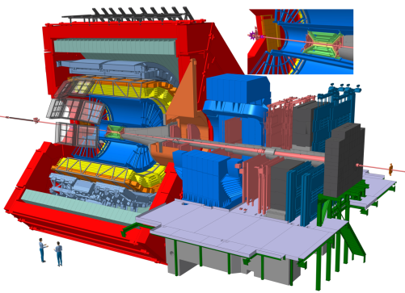



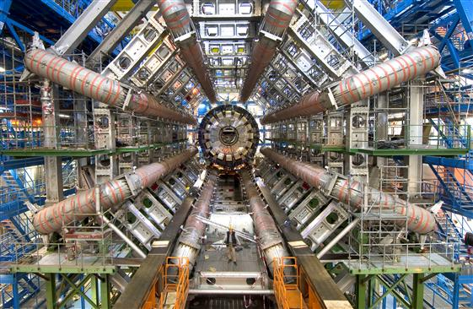
The CERN Large Hadron Collider
27 km ring, 2 counter-rotating beams
Accelerates and collides protons and heavy ions at 6.8 Z TeV
  4 main experiments
LHC heavy-ion programme
  Operation with fully stripped Pb ions typically one month per year
  All main experiments take ion data
  Mainly Pb-Pb, but also p-Pb

Slide 4
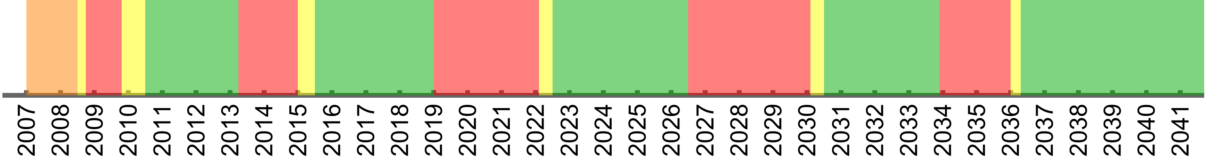
LHC heavy-ion programme
So far
  Pb-Pb (6 physics runs)
  p-Pb (2 physics runs)
  Short pilot runs in other configurations
    Past: p-Pb, Xe-Xe
    Upcoming (2025): p-O, O-O, Ne-Ne
  Yearly ion operation to continue
High-luminosity LHC (HL-LHC) + LHC Injector Upgrades (LIU)
  Goal: significantly increase LHC integrated luminosity
  Protons: LHC implementation mainly in long shutdown 3
  Pb ions: Upgrades already implemented in long shutdown 2
    For Pb-Pb, all HL-LHC upgrades available since 2023!
Pb-Pb or p-Pb
Pb-Pb or p-Pb
Pb-Pb or p-Pb
Pb-Pb or p-Pb
Pb-Pb or p-Pb
Pb-Pb or p-Pb
Pb-Pb or p-Pb
Pb-Pb or p-Pb
Pb-Pb or p-Pb
Pb-Pb or p-Pb
Pb-Pb
Pb-Pb
Pb-Pb
Pb-Pb
Pb-Pb
We are here
p-Pb
p-Pb
Pb-Pb
Long
Shutdown 2
LIU and
HL-LHC ion
upgrades
Long
Shutdown 3
HL-LHC
upgrades
Run 1
Run 2
Run 3
Run 4
Run 5
Long
Shutdown 1
3.5-4 TeV
6.37 - 6.5 TeV
6.8 TeV
6.8 TeV,
HL-LHC

Slide 5
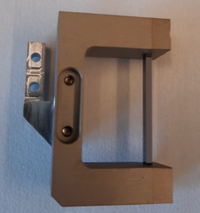
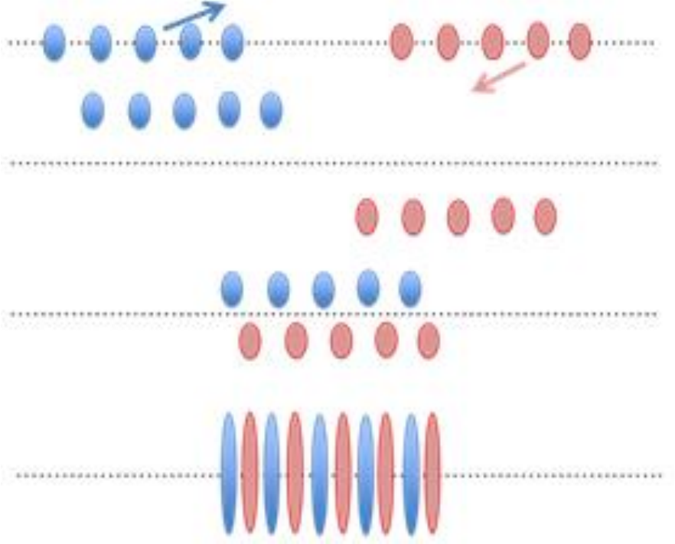
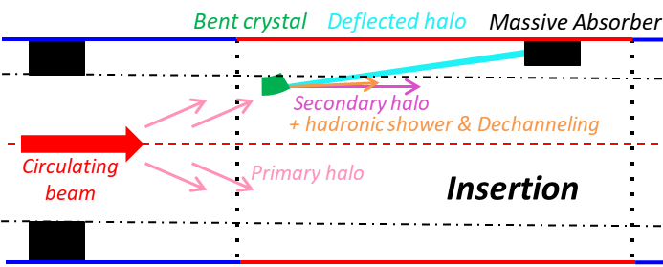
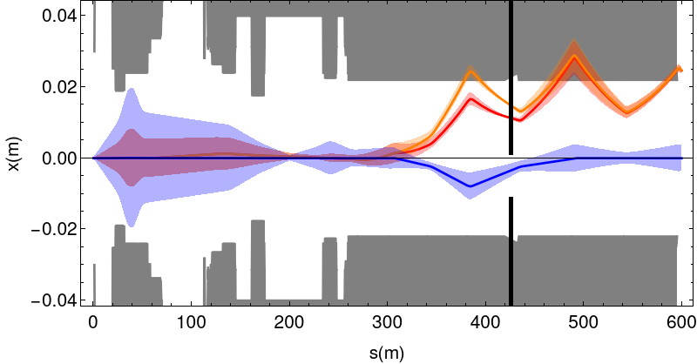
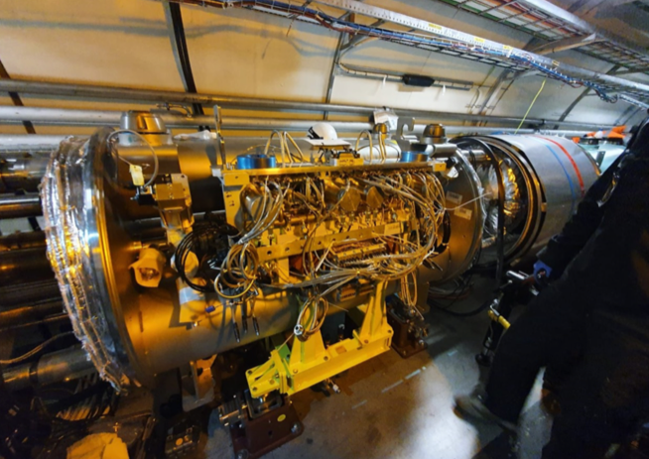
HL-LHC ion upgrades
Momentum slip-stacking
Higher intensity from injectors (LIU)
  ~70% more bunches thanks to “slip-stacking”
Crystal collimation
  Bent crystals channel beam halo onto absorber
  Needed to handle higher beam losses
Alleviation of collisional beam losses
  Orbit bumps + new collimators around ALICE
  Needed to sustain higher luminosity
Upgraded ALICE detector
(not HL-LHC project)
  Needed to tolerate higher event rate
ALICE collision point
collimator

Slide 6
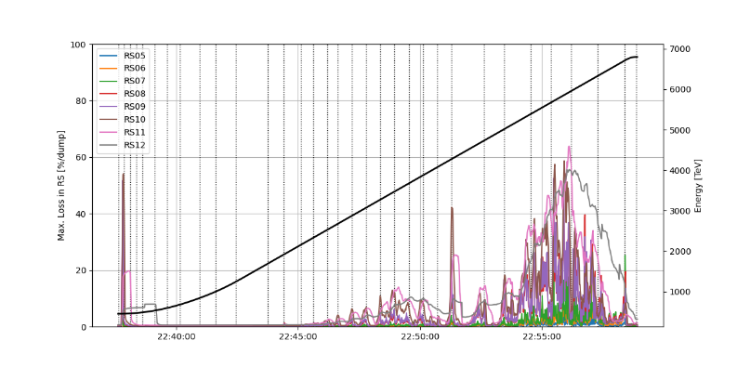
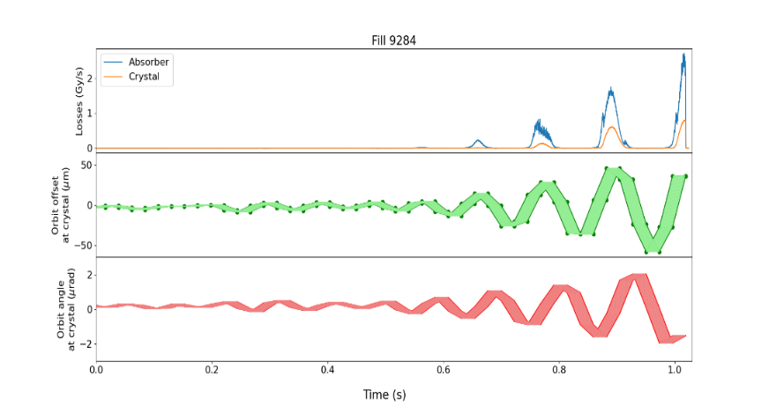
Outcome of the 2023 Pb-Pb run
Ratio to dump threshold (%)
100
New HL-LHC concepts successfully put in operation
Several problems encountered
  High beam losses caused unwanted beam aborts
    Beam losses in the energy ramp
    Beam losses due to 10 Hz orbit oscillations
  Intensity and emittance not reaching their targets
  Limiting background in ALICE experiment
    Mitigated in 2023, but lost significant time
  Angular drifts of crystal collimators
    Partly mitigated by automatic optimizations
  Single event upsets on quench detection system
    Triggered spurious firings of quench heaters → magnet quenches with long recovery time
Only 2/3 of integrated luminosity targets could be reached due to time lost and performance limits
80
60
Beam energy
Time lost and
intensity limit
40
Beam losses
20
0
22:40
22:45
22:50
22:55
time

Slide 7

Considerations for the 2024 Pb ion run
Shorter ion run in 2024
  18 days of physics operation - had 32 days in 2023
Target integrated luminosity anyway similar to total achieved in 2023
  For ALICE, ATLAS, CMS: of 1.9 nb⁻¹ - reached 2 nb⁻¹ in 2023
  Crucial to significantly increase performance
Main priority to mitigate 2023 problems → Action plan
    Improve machine availability and establish stable operation
    Operate with higher intensity
      Tolerate higher intensity in LHC and reduce losses
      Produce higher intensity in injectors

Slide 8
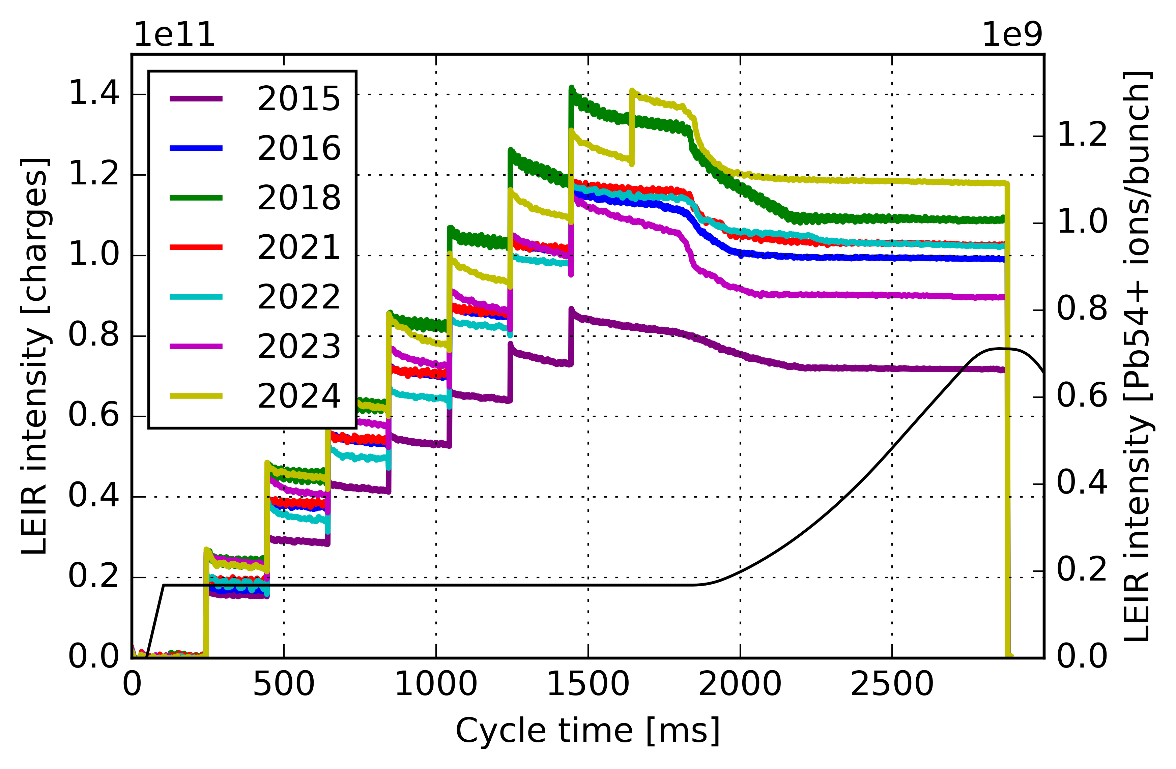
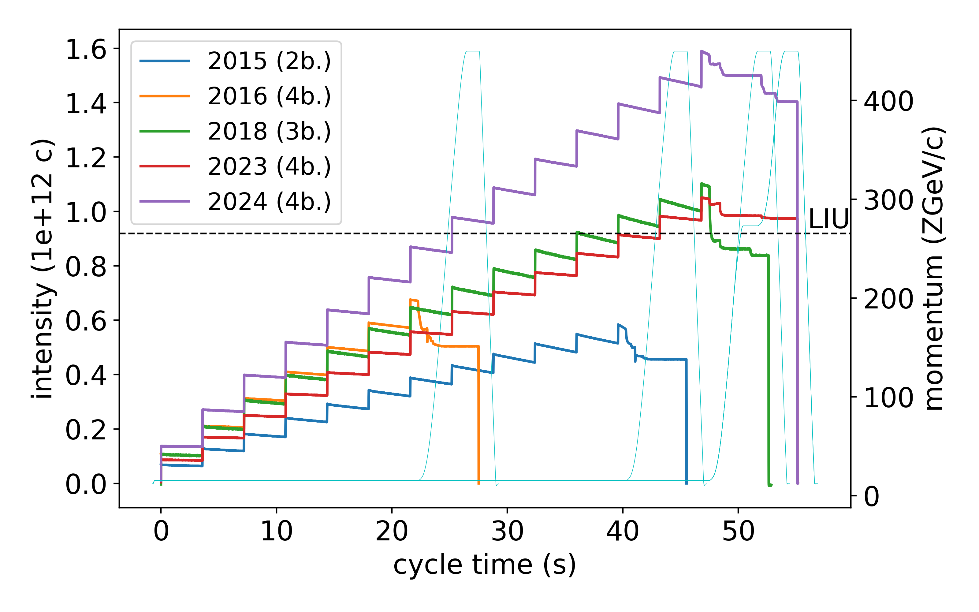
2024 Pb beams from the injectors
LEIR: top performance per year
Following improvements, excellent intensity from injectors in 2024
  Optimization throughout injector complex → record performance
  Very large improvement over 2023
2.6×10⁸ Pb/bunch at LHC injection
  Intensity >30% above LIU/HL-LHC target
  Almost factor 4 above LHC design from 2003
  Emittance larger than spec, but LHC still gains significantly overall due to higher intensity
SPS: top performance per year

Slide 9
LHC machine configuration with Pb ions
Change as little as possible in 2024 to avoid new problems
Parameter | 2023 | 2024
Beam energy (Z TeV) | 6.8 | 6.8
β* (m), ALICE, ATLAS, CMS | 0.5 | 0.5
β* (m), LHCb | 1.5 | 1.5
Net half crossing angle (µrad), ALICE | 98 | 78
Net half crossing angle (µrad), ATLAS, CMS | 170 | 150
Net half crossing angle (µrad), LHCb | -274 | -71
Collimator cut (σ) | 4.75 | 6.0

Slide 10
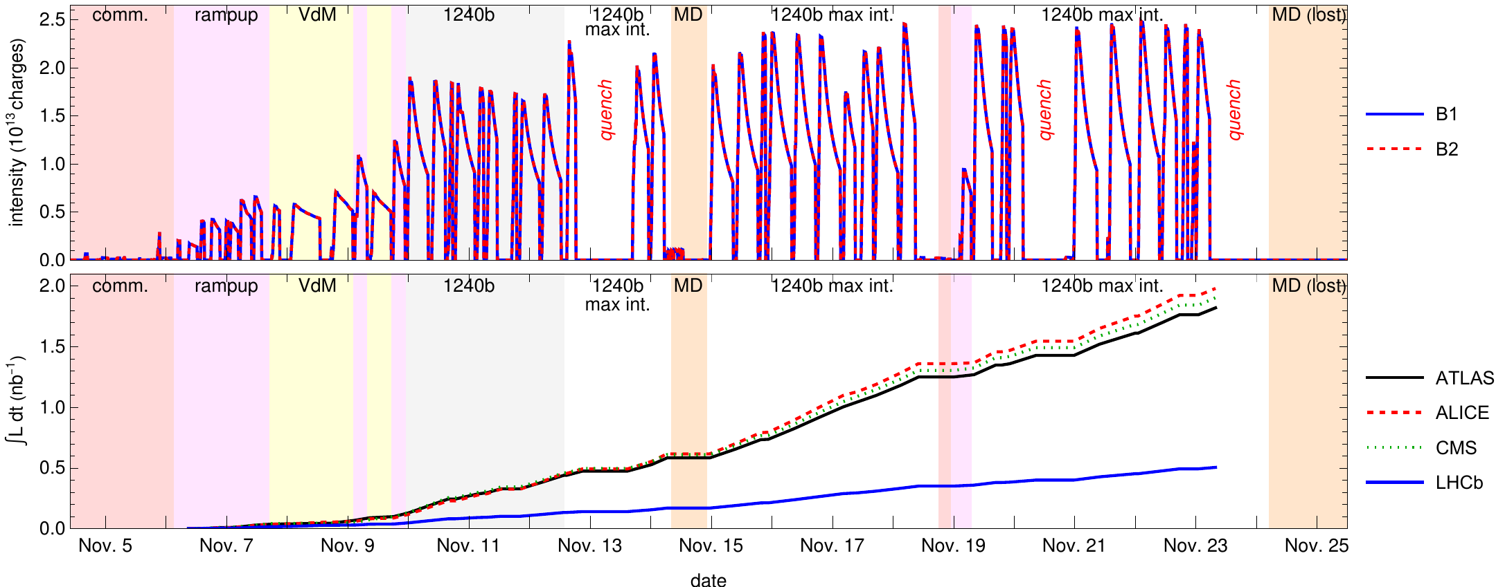
Overview of the LHC 2024 Pb-Pb run
Intensity rampup after initial commissioning
  Uncertain if LHC could handle full intensity - initially decreased bunch intensity
  Stable operation established → taking full bunch intensity from injectors
  Stable operation demonstrated also with full intensity
Good availability in general, but 3 quenches caused by radiation to electronics

Slide 11
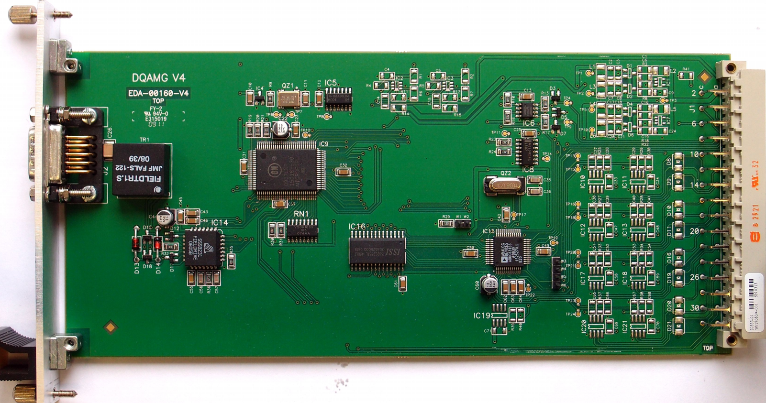
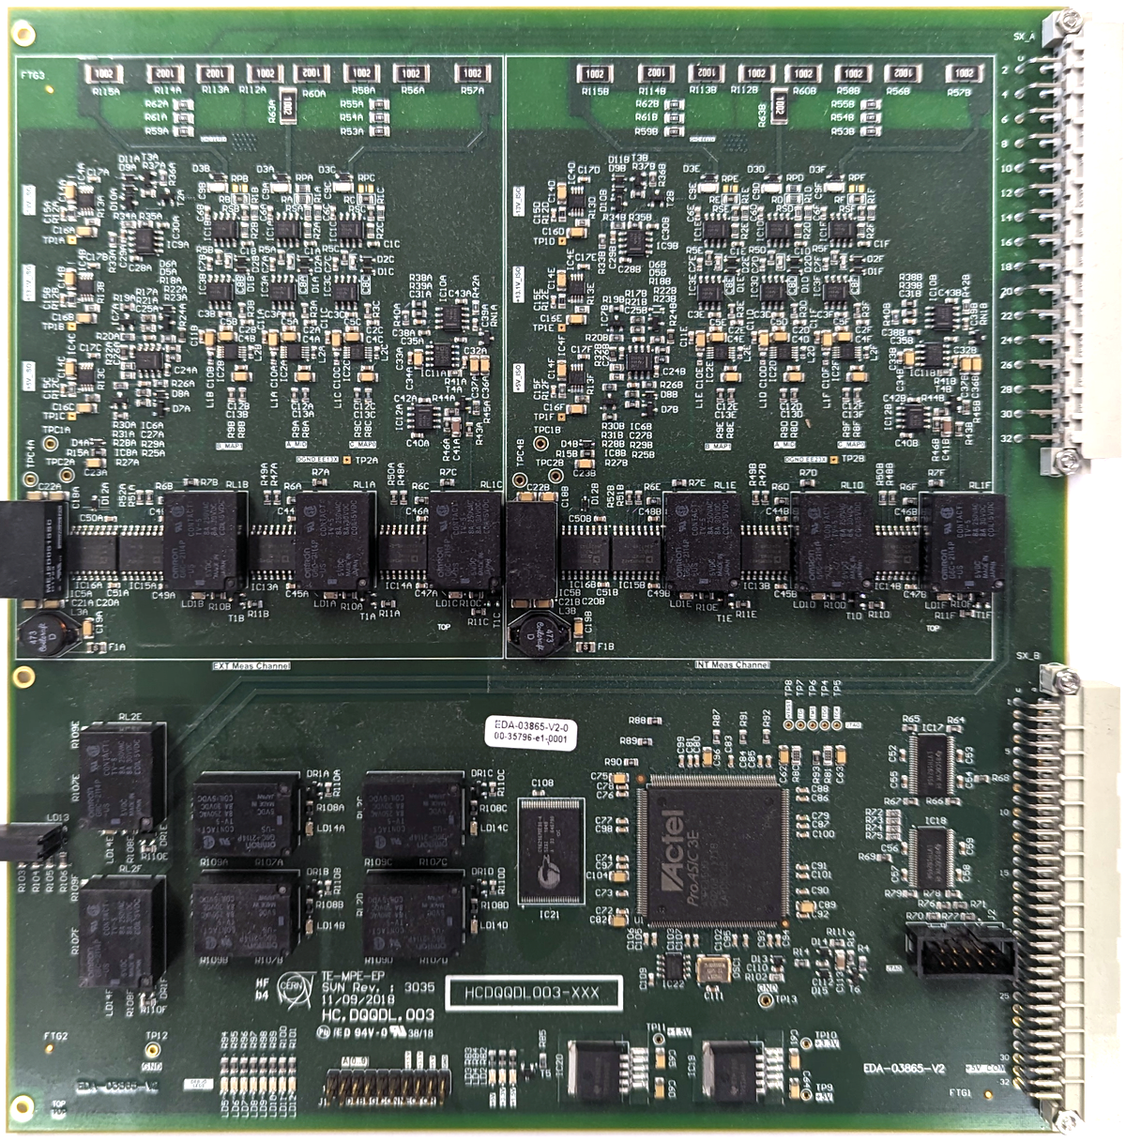
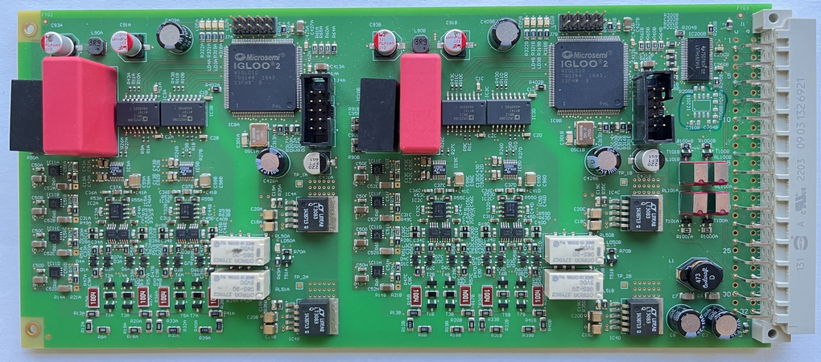
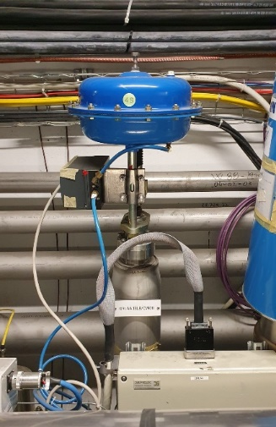
2024 experience with 2023 problems (1)
Single event upsets on quench detection system
  2023-type of events mitigated by new radiation-hard electronics cards
  New type of event caused 3 quenches →
  further electronics updates in 2025
Beam losses from 10 Hz oscillations
  traced to opening of cryogenic valve** → opened only without beam in 2024 → no further events observed
** Acknowledgement: K. Paraschou, B. Bradu

Slide 12
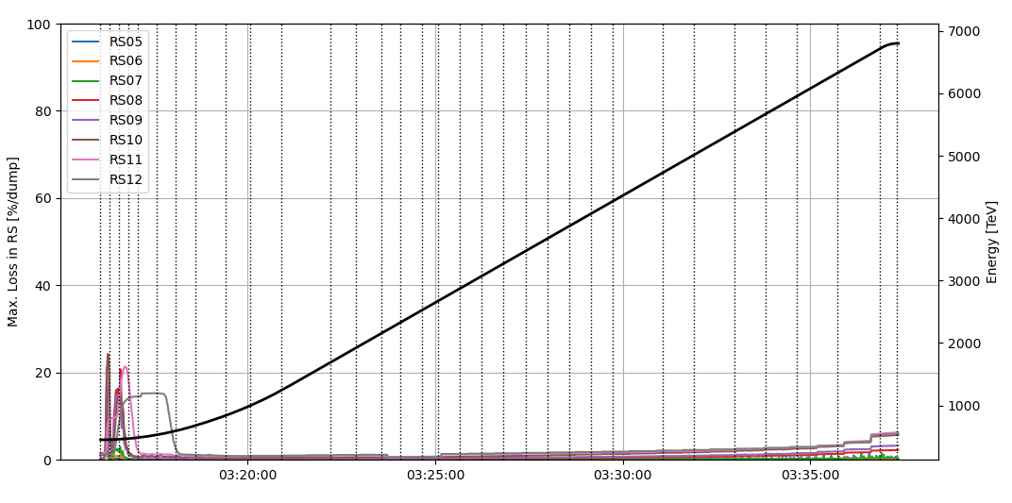
2024 experience with 2023 problems (2)
Beam losses in the ramp
  2024 losses only at a low and tolerable level, even at high intensity
    Cured by more open collimators, higher beam abort thresholds, less optics changes in ramp
Crystal channeling stability
  Relying on improved angular automatic optimization with controls upgrade
  No longer a performance bottleneck, but would be good to mitigate root cause
ALICE background
  Same mitigation as in 2023 (dispersion correction bump)
  Some residual background remains, but acceptable for operation
Mitigation measures largely very successful
2023 ramp: Fill 9316, 1080b, 16 MJ
2024 ramp: Fill 10400, 1240b, 27 MJ

Slide 13
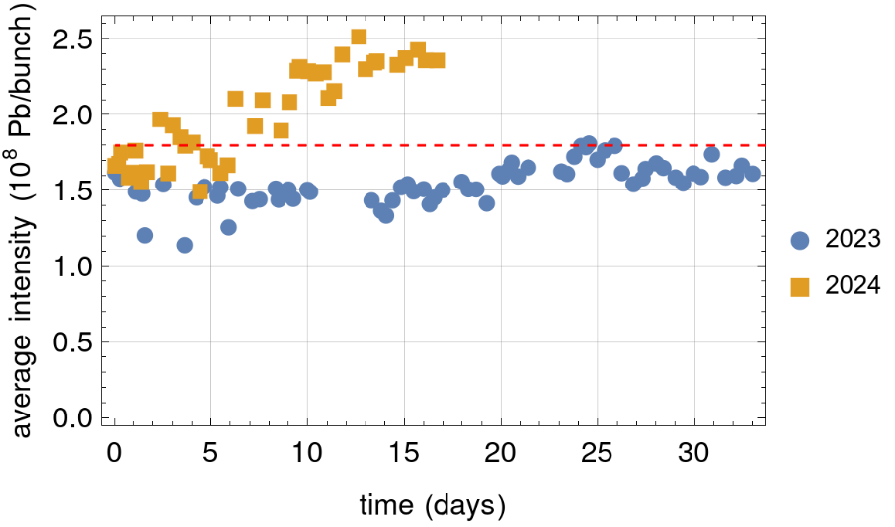
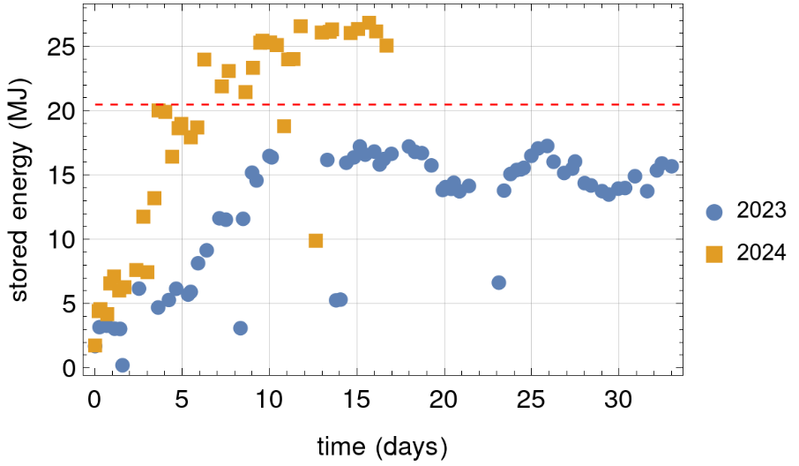
LHC Pb beam intensity
Bunch intensity at start of collisions
Bunch intensity (start of collisions)
  2024 best fill 2.5×10⁸ Pb/bunch,
  average 2.3×10⁸ Pb/bunch
    After taking full intensity from SPS
  2023: Average 1.6×10⁸ Pb/bunch
  Compare HL-LHC design: 1.8×10⁸
Stored beam energy (start of collisions)
  2024: up to 26.9 MJ
    In 2024, LHC could take this intensity without limitations from losses
  2023 up to 17.3 MJ
  HL-LHC design: 20.5 MJ
HL-LHC target
HL-LHC target

Slide 14
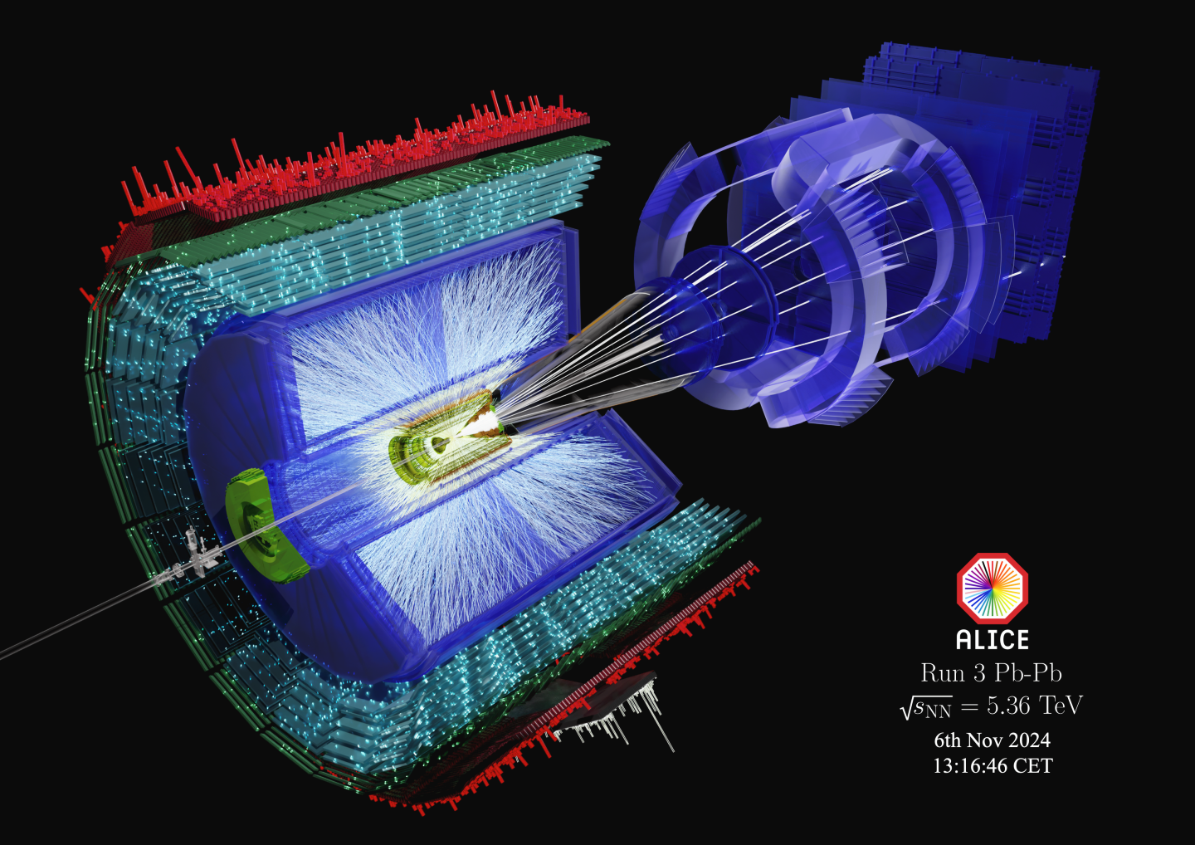
Pb ion collisions in the LHC
Courtesy ALICE- Image source
Notes:
1.9/nb * 7.8 barn = 1.5E10 total collision events

Slide 15
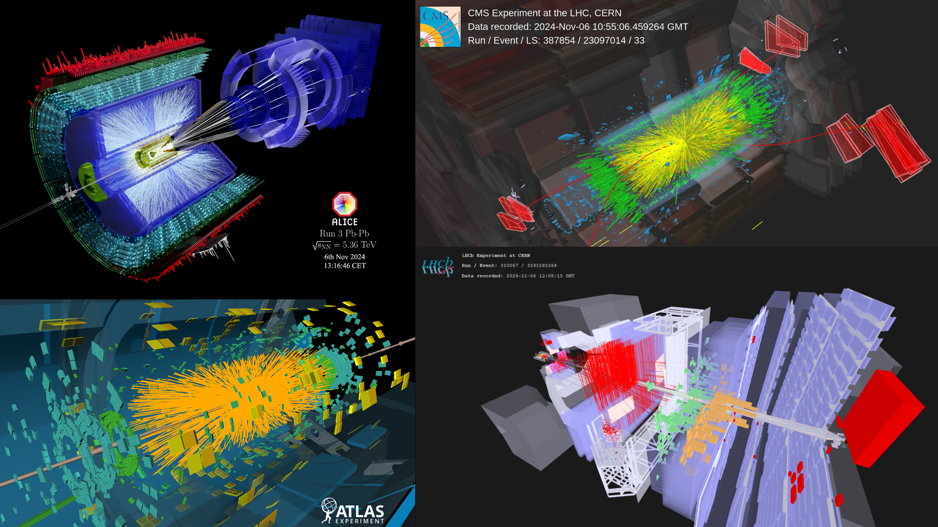
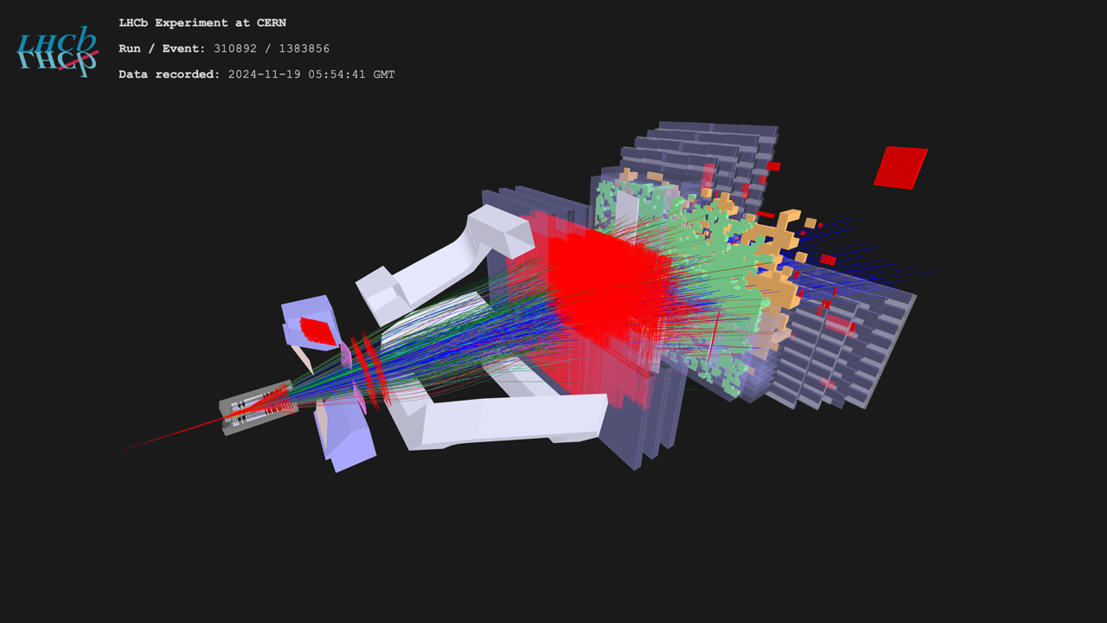
Pb ion collisions in the LHC
Images: Courtesy of LHC experiments

Slide 16
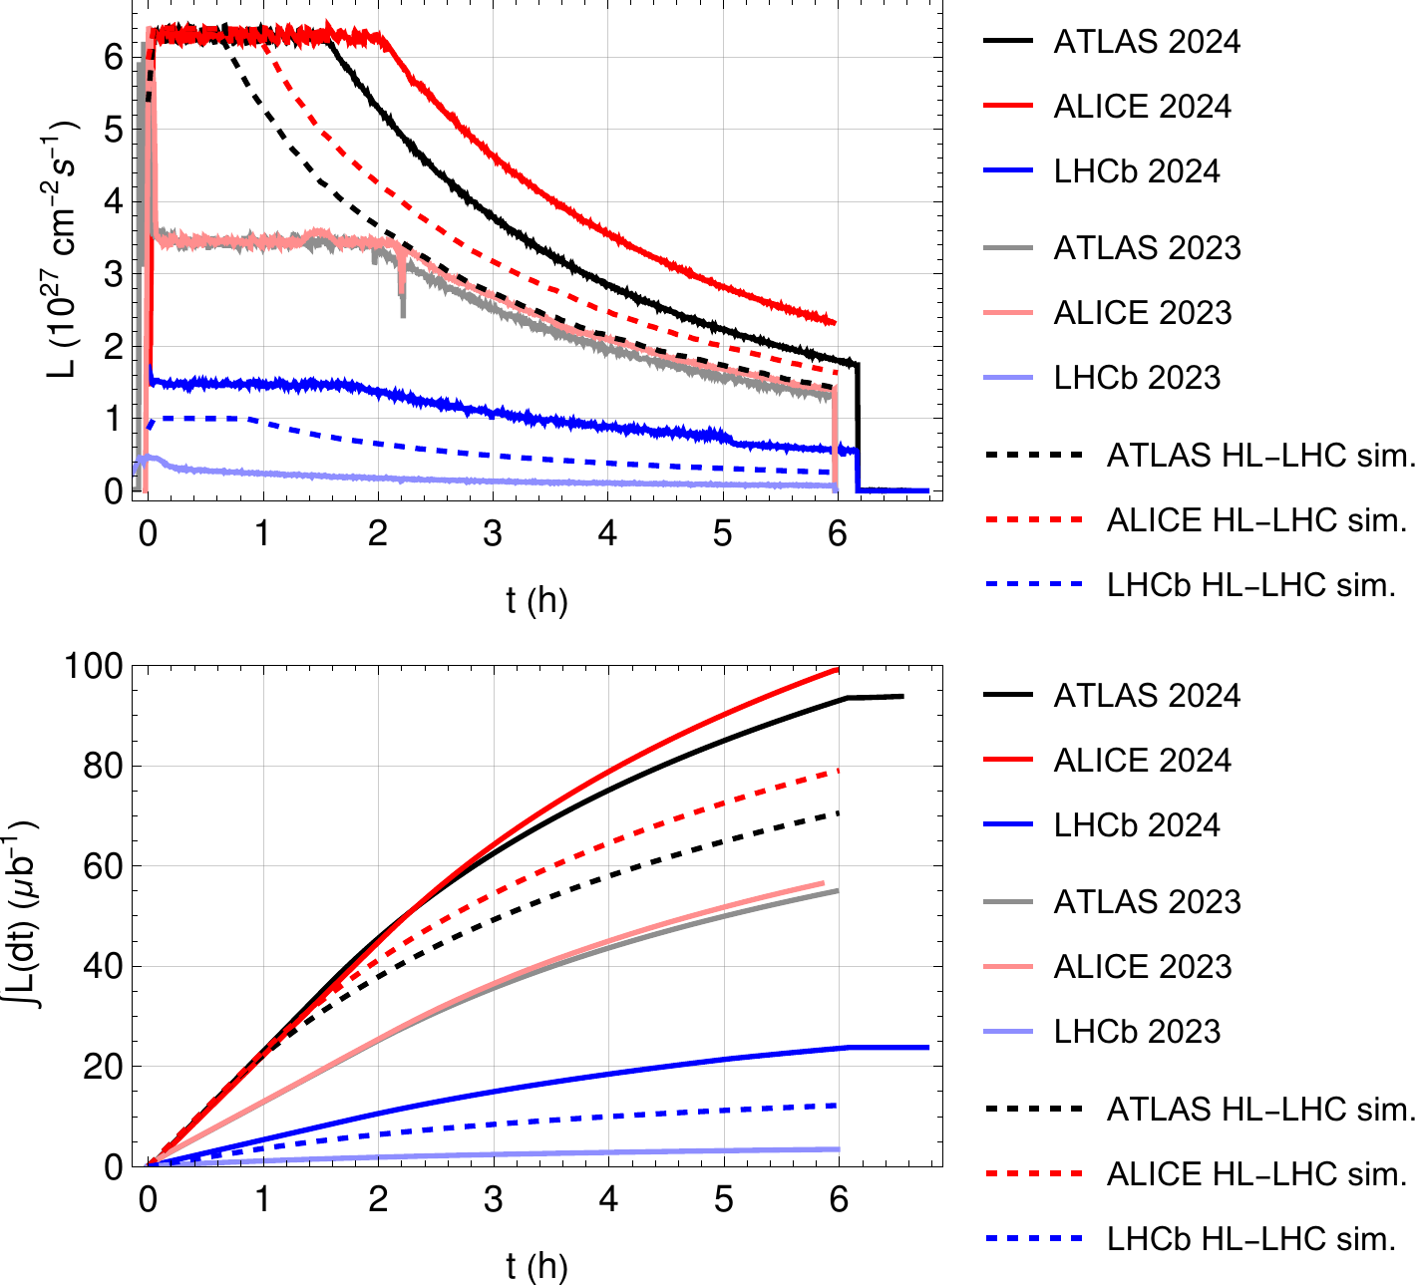
Luminosity performance in 2024 (single fills)
Best fills in 2023 and 2024
Luminosity levelled (separation)
  Limit on maximum event rate at ALICE
  Limit from collisional losses at LHCb
Achieved levelling time
  ~2h at ALICE → factor ~2 above HL-LHC prediction
  ~1.7h at LHCb → ~90% above HL-LHC prediction, at higher levelling target
    Note: more colliding bunches at LHCb than in design scenario, and smaller crossing angle
Integrated luminosity
  2024 fills surpassed by far 2023, and even HL-LHC
  After 6h, ALICE has about 80% more data than in 2023 and 30% more than HL-LHC prediction
  After 6h, LHCb has 80% more data than in HL-LHC prediction
Luminosity modelling and projections described in EPJ plus paper

Slide 17
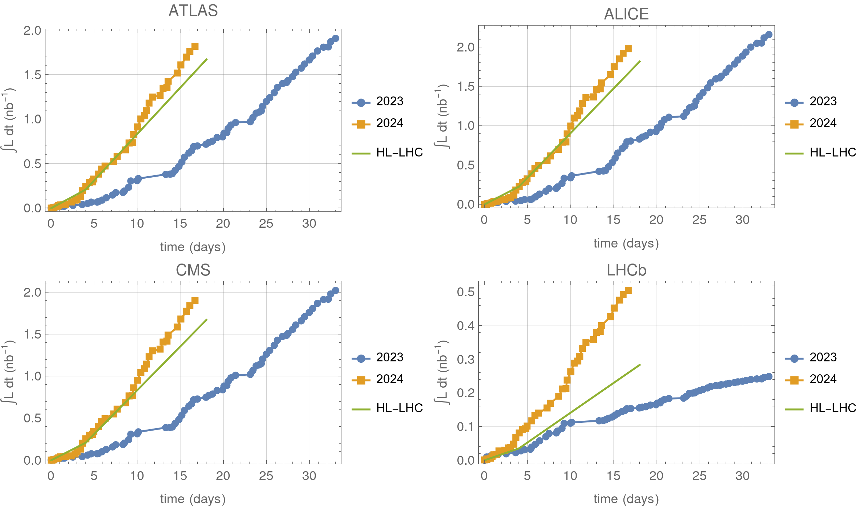
Integrated luminosity production
ALICE, ATLAS CMS
  Almost same luminosity in 2024 as 2023, in about half the time
  142 µb⁻¹ mean daily production
  (with max. no. bunches)
    118 µb⁻¹ projected for HL-LHC
  Reached target of 1.9 nb⁻¹
LHCb
  About double in 2024 the 2023 luminosity in about half the time
  37 µb⁻¹ mean daily production
  (with max. no. bunches)
    20 µb⁻¹ projected for HL-LHC
projection
projection

Slide 18
Summary and outlook
In 2024, for the first time, reached and significantly surpassed the projected HL-LHC Pb-Pb luminosity performance thanks to
  Successful mitigation of limitations encountered in 2023 (beam losses, availability, …. )
  Excellent performance from injectors with intensity >30% above target
All HL-LHC upgrades for Pb ion operation are already implemented and luminosity production with Pb-Pb has entered HL-LHC era!
Ion operation at LHC will continue
  Yearly runs with Pb-Pb or p-Pb
  Upcoming Pb-Pb run in November 2025
  Upcoming short low-intensity run in July 2025 with O-O, p-O and Ne-Ne

Slide 19
Thanks for the attention!

Slide 20
Backup

Slide 21
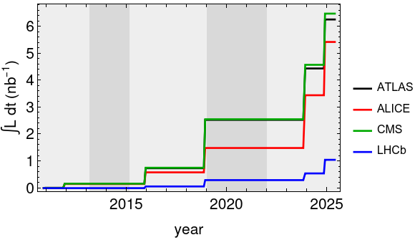
Physics targets for Pb-Pb
Pb-Pb integrated luminosity
Run 1
Run 2
Run 3
Initial target for Run 1 + Run 2 of 1 nb⁻¹
  Surpassed in 2018
Target for Run 3 + Run 4
  For ALICE, ATLAS, CMS : 13 nb⁻¹
  LHCb: 2 nb⁻¹ initially, now requesting more
  Relies on improved HL-LHC performance
So far in Run 3
  ALICE, ATLAS, CMS (mean): 3.9 nb⁻¹
  LHCb: 0.75 nb⁻¹
Total integrated Pb-Pb luminosity so far
  ATLAS: 6.3 nb⁻¹
  ALICE: 5.4 nb⁻¹
  CMS: 6.5 nb⁻¹
  LHCb: 1.05 nb⁻¹
Notes:
Plot and ALICE value excludes the unusable 0.2/nb taken with bad background conditions in 2023
HL-LHC: counted on 5 runs with 2.6/nb per run

Slide 22
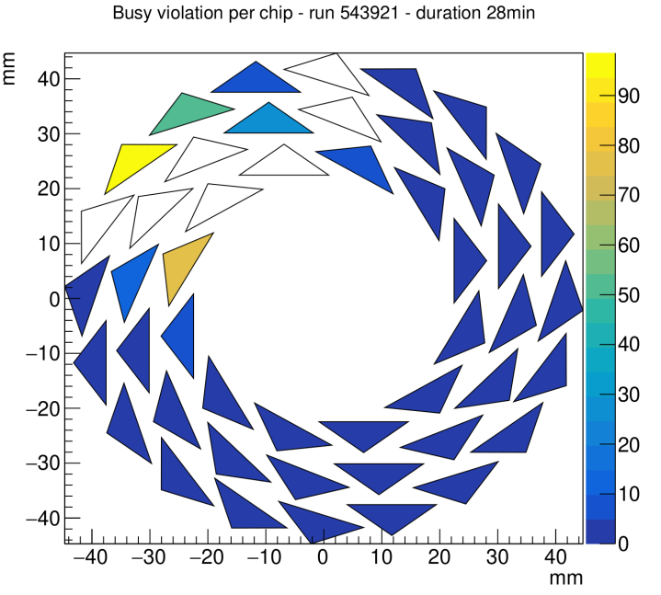
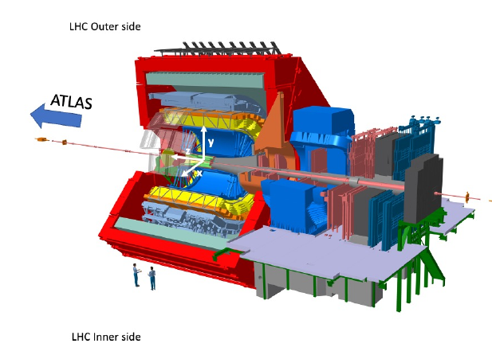
Observations of background in ALICE
Outside of the ring
Strong background observed in ALICE from the start of the ion run
  Some chips of ITS fully saturated
  About 25% of inner barrel acceptance affected
  Possibly observed only in 2023 due to smaller radius of upgraded detector compared to Run 2
Crash effort to find mitigation
  5 fills devoted to machine studies
  Campaign of simulation studies in parallel
ITS inner layer during 899b-fill
In white: fully saturated chips, not sending signals
ALICE detector
Courtesy of ALICE. From talk by S. Porteboef

Slide 23
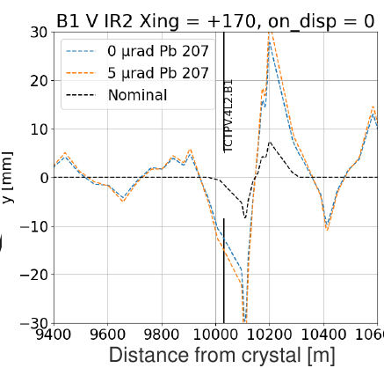
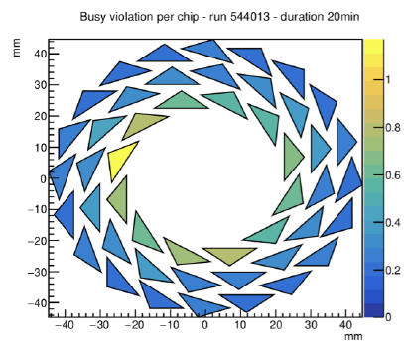
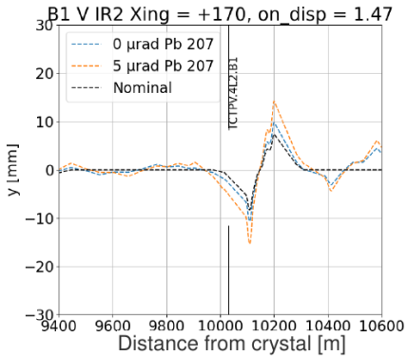
Mitigation of ALICE background
Without mitigation
R. Cai
Main source likely identified
  ²⁰⁷Pb⁸²⁺ produced by halo hitting vertical crystal in IR7
  Simulations show outscattered ²⁰⁷Pb⁸²⁺ ions pass all the way from IR7 to IR2 and hit TCTPV.4L2.B1
Mitigation: used orbit bump around IR1 to modify vertical dispersion
  Simulations show ²⁰⁷Pb⁸²⁺ dispersive trajectory steered differently and misses
  the TCTPV.4L2.B1
With this knob,
ALICE background
acceptable even
with full machine
  Bump added to
  the machine
  configuration in
  physics
With mitigation

Slide 24
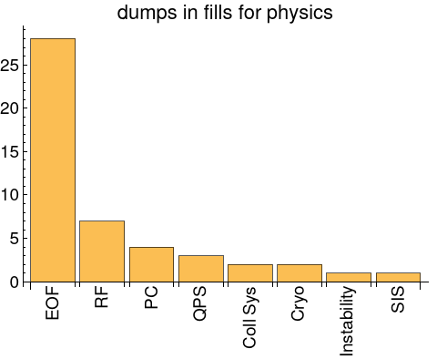
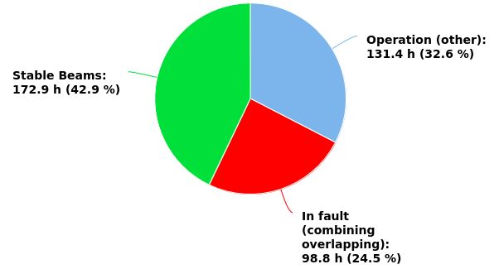
2024 availability and statistics
In physics period 2024:
  75% availability
  43% of time spent with colliding beams
    33% in 2023
  25% of time in fault
    33% in 2023
Fill statistics
  48 physics fills attempted
  45 made it to collision
  28 dumped by operator
Notes:
2023:
83 fills attempted for physics
67 fills reached collision
42 dumped by operator

Slide 25
Total integrated luminosity
In 2024, and so far in Run 3
Compare with HL targets – how many runs stlil needed

Slide 26
Plans to mitigate 2023 problems
Simulations, beam tests
Dispersion correction
Controls updates
Request for higher luminosity at LHCb
Crystal stability
Beam quality
ALICE background
Dispersion correction in ramp
Open collimators
Losses in ramp
Less optics change in ramp
Campaign of studies for improved beam quality
(injectors, LHC)
Radiation on QPS
Smaller crossing angle
More colliding bunches
Beam abort thresholds
10 Hz losses
Change QPS cards
Normal cryo mode
Delay cryo valve open

