Slide 1
Data-driven hysteresis compensation
In the CERN SPS main magnets
Anton Lu
V. Kain, C. Petrone, V. Di Capua, M. Taupadel, M. Schenk, A. Bellelli, A. Ganesh, M. Bonora.
Beams department, CERN
SUPS32 / WEAN2
Slides: bit.ly/ipac25-hysteresis
Notes:
Overview into the work done to implementing hysteresis compensation in the main magnetic circuits in the CERN SPS

Slide 2
Contents
Overview of the CERN SPS and hysteresis in the main magnets
Time series forecasting for field prediction
Cycle-by-cycle field compensation in the main dipoles
Outlook into higher order SPS magnets
Limitations in field measurements
Conclusions
Slides: bit.ly/ipac25-hysteresis

Slide 3
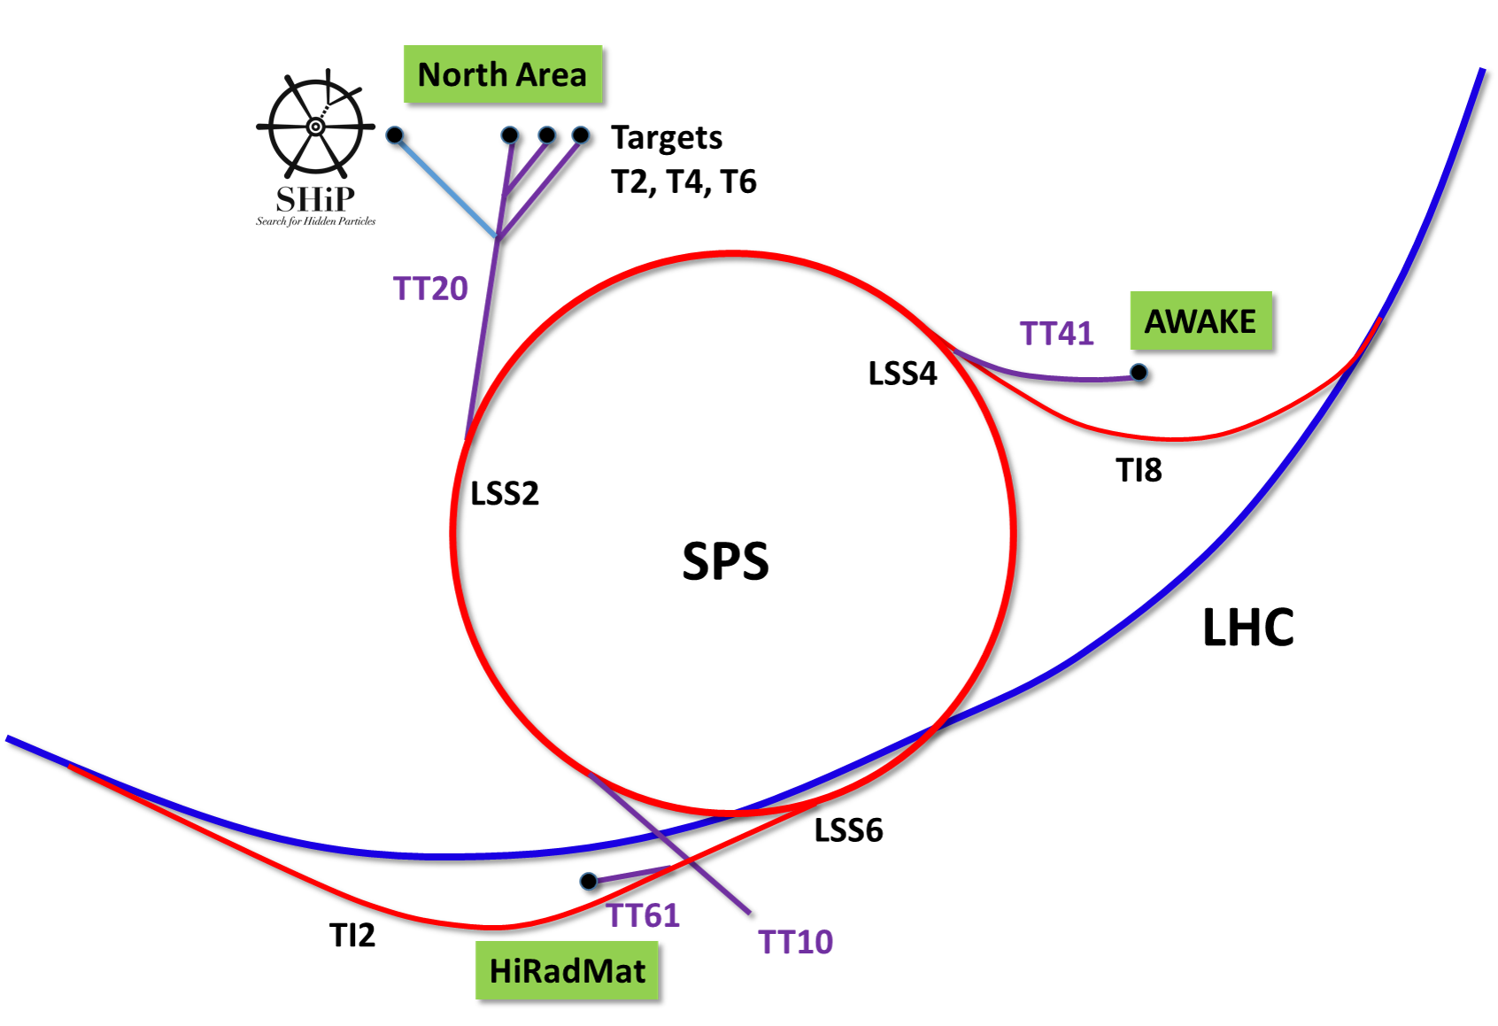
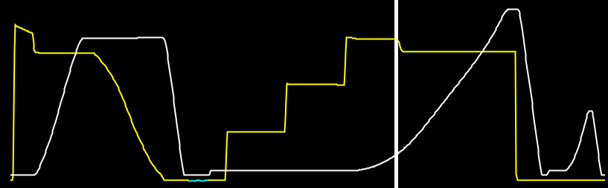
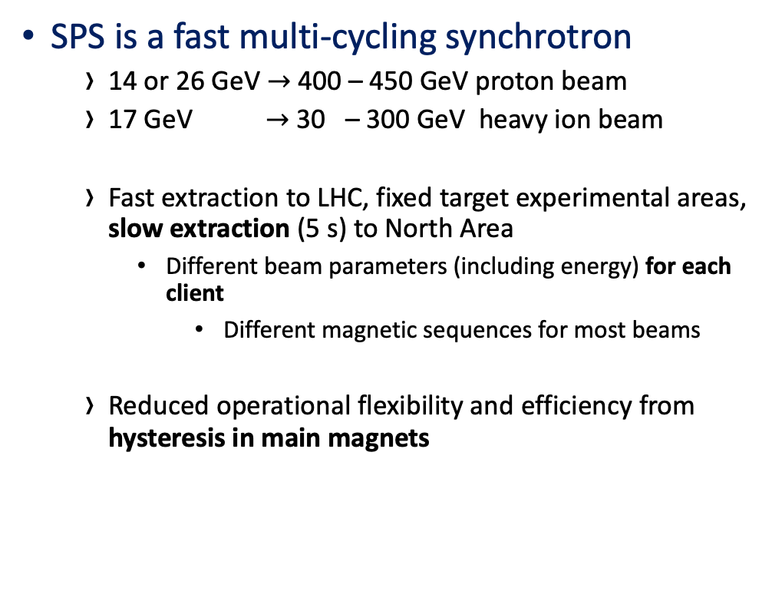
The CERN Super Proton Synchrotron
SPS is a fast multi-cycling synchrotron
  14 or 26 GeV $→$ 400 – 450 GeV proton beam
  17 GeV $→$ 30 – 300 GeV heavy ion beam
  Fast extraction to LHC, fixed target experimental areas, slow extraction (5 s) to North Area
    Different beam parameters (including energy) for each client
      Different magnetic sequences for most beams
  Reduced operational flexibility and efficiency from hysteresis in main magnets
Beam intensity
Magnetic cycle
450 GeV
400 GeV
26 GeV
14 GeV
Notes:
Main dipoles and quadrupole circuits are powered in series
700 bending dipoles in SPS
104 focusing, and 104 defocusing quadrupoles
3 - 6 s acceleration from injection to extraction
25 % of beam time nominally goes to the slow extracted beam to NA each year
SFTPRO uses half of the available beam time in SPS.
Will show animation of field errors caused by hysteresis
Mention the pre-cycle on the screenshot.
Mention that you will talk about it a little bit more on the next slide, and say also that it cannot be used for beam production.

Slide 4
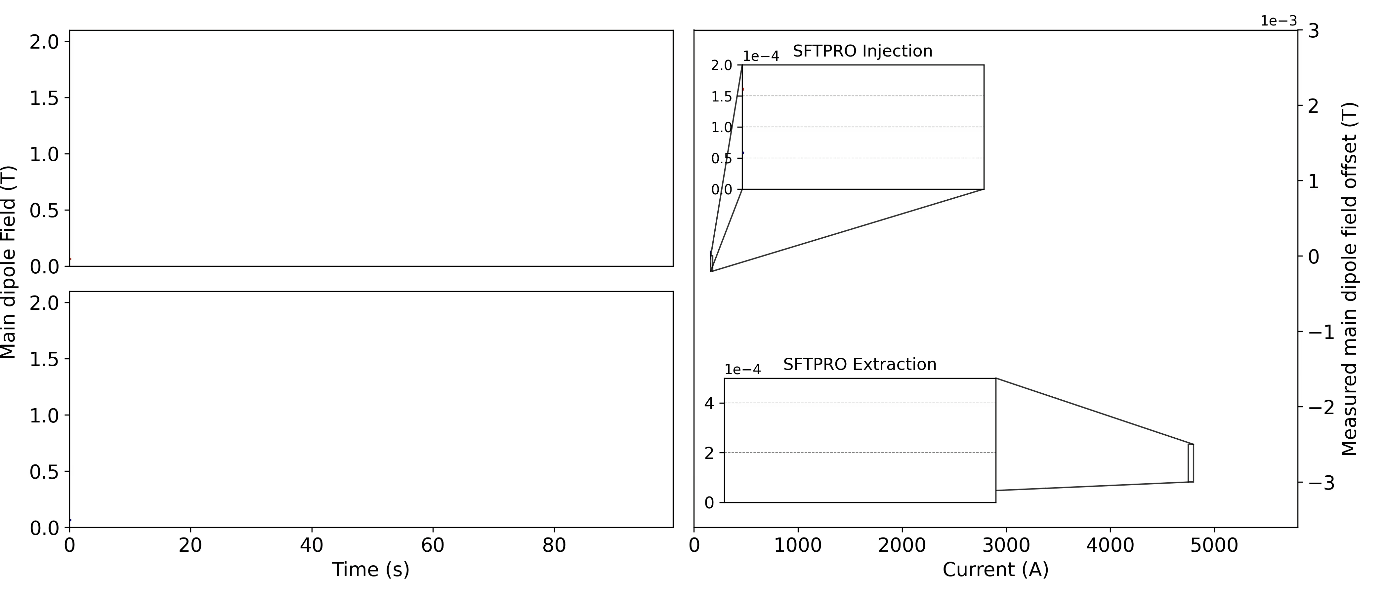


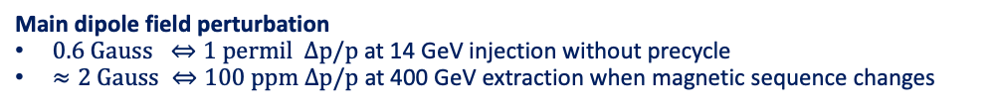
Magnetic hysteresis in multi-cycling synchrotrons
And limitations on beam operation
$$⇒$$
Injection losses due to
Hysteresis
Eddy current decay
(Extracted) beam quality degradation
Changing SX spill macrostructure
$$⇒$$
Waste of energy from precycling
5 kWh every 3.6s cycle
… for quasi-degauss
Main dipole field perturbation
$0.6 Gauss ⇔1 permil Δp/p$ at 14 GeV injection without precycle
$≈2 Gauss ⇔100 ppm Δp/p$ at 400 GeV extraction when magnetic sequence changes
Beam operation focuses on mitigation of hysteresis effects
  CERN Injectors: Precycling, constrained cycle sequences and manual parameter adjustments
Notes:
Time and energy-consuming precycle
Eddy current decays at injection
Changing magnetic fields (esp. at SFT extraction) when sequences change.
Severe impact on reproducibility, flexibility, and performance.
Cycle / magnetic sequences are often consistent …
… but manual changes to beam parameters are often required when sequences change
Feedback is only possible with high-precision online field measurements.
With this, we propose a method for hysteresis compensation in the SPS.
Mention the pre-cycle on the screenshot.
Mention that you will talk about it a little bit more on the next slide, and say also that it cannot be used for beam production.

Slide 5
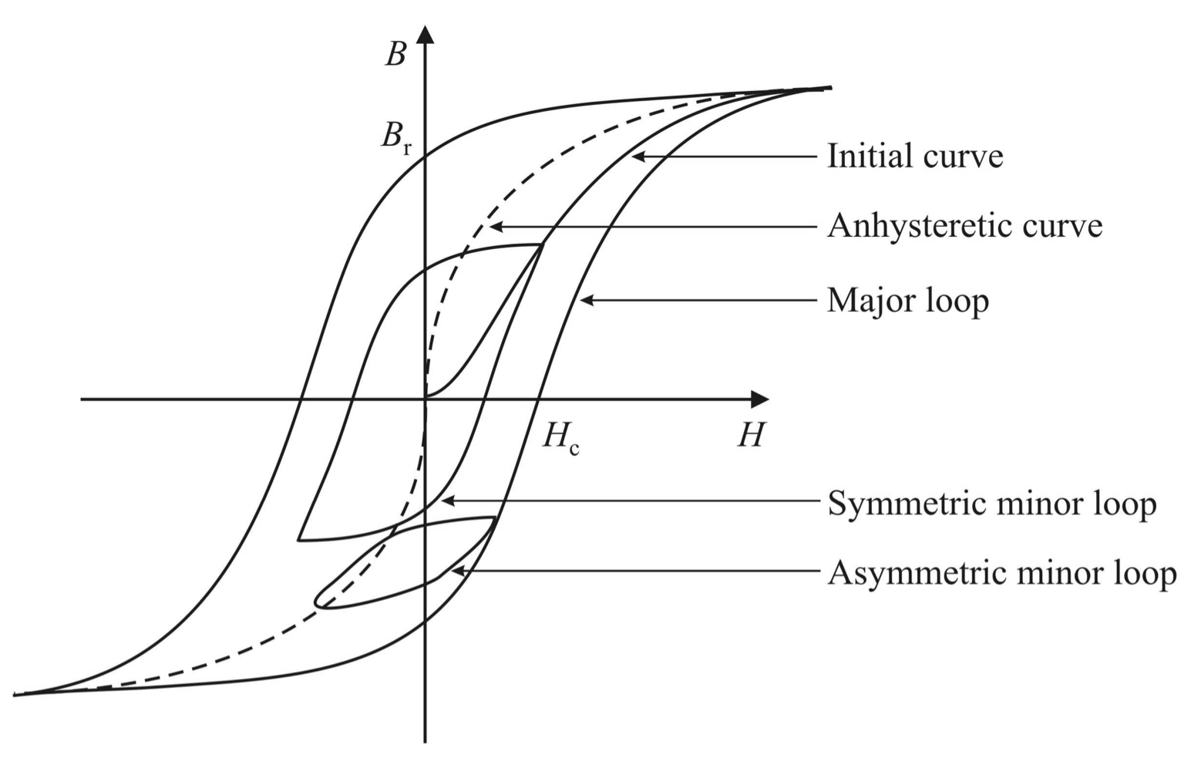
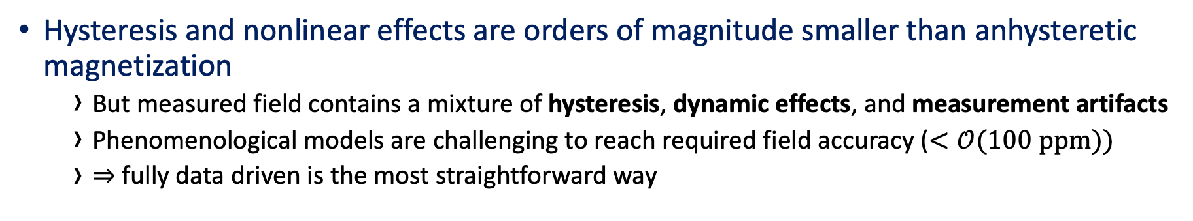
Hysteresis in the SPS main dipoles
Online measurements from the SPS
Reality
Expectations
Hysteresis and nonlinear effects are orders of magnitude smaller than anhysteretic magnetization
  But measured field contains a mixture of hysteresis, dynamic effects, and measurement artifacts
  Phenomenological models are challenging to reach required field accuracy ($<𝒪(100 ppm))$
  $⇒$ fully data driven is the most straightforward way
Notes:
* Classical methods cannot reach required accuracy
Feed-back correction requires an online field measurement system infrastructure, and integrating into the power converters
Normally, one models H to M or B
Main dipole data are available
The time axis is actually important for modeling dynamic effects
Field measurements are sequences -> go for seq2seq models
Machine learning is not restricted to hysteresis formalism

Slide 6
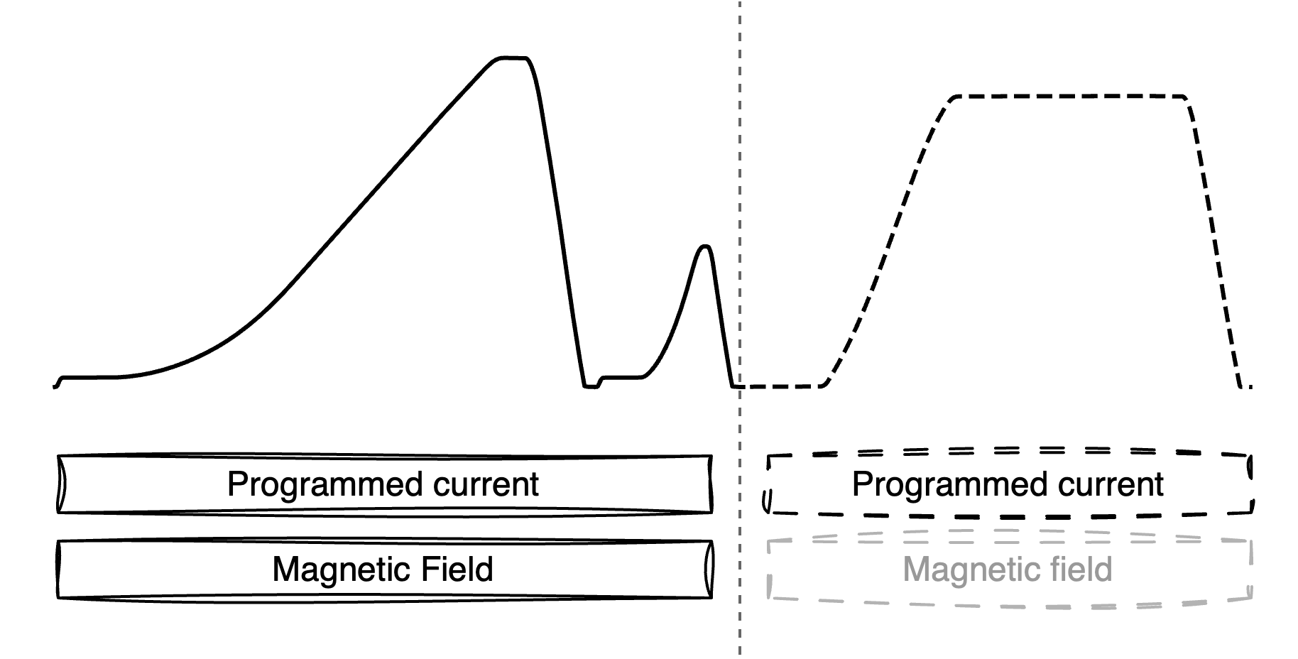
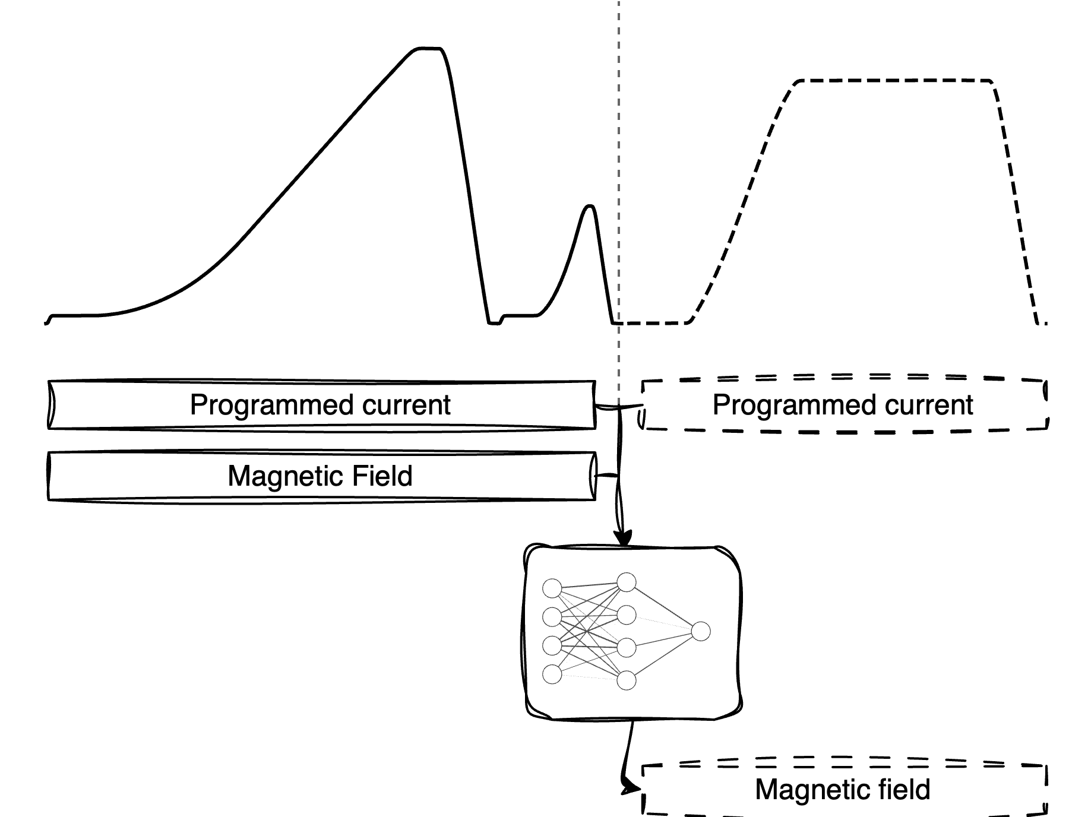
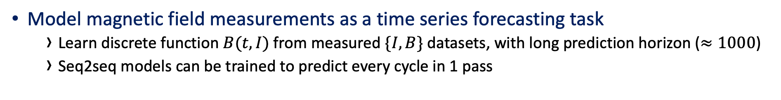
High-accuracy field prediction with machine learning
Time series forecasting for hysteresis prediction
Model magnetic field measurements as a time series forecasting task
  Learn discrete function $B(t, I)$ from measured $\{I, B\}$ datasets, with long prediction horizon ($≈1000$)
  Seq2seq models can be trained to predict every cycle in 1 pass
Notes:
Assuming we know the next cycle, which has a corresponding programmed current.
If we know what the field will be, and we know what we want it to be, we can feed-forward correct the difference

Slide 7
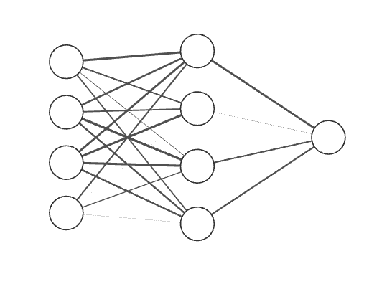
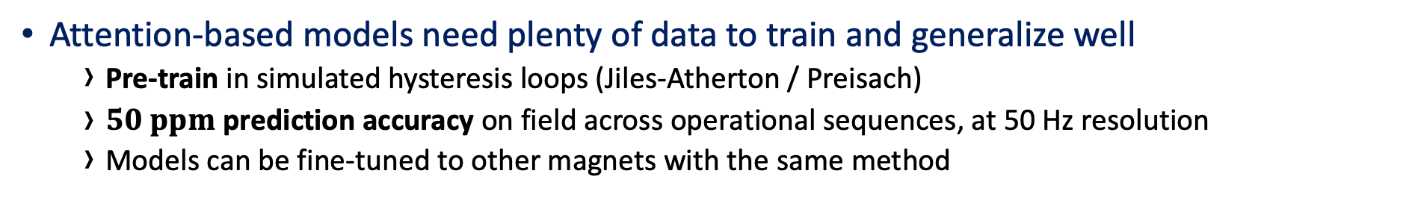
State-of-the-art timeseries forecasting with transformers
Data-driven field prediction
Model pretraining
Fine-tuning
Base model
Fine-tuned model
Simple hysteresis simulations
Magnetic measurements
Attention-based models need plenty of data to train and generalize well
  Pre-train in simulated hysteresis loops (Jiles-Atherton / Preisach)
  $50 ppm$ prediction accuracy on field across operational sequences, at 50 Hz resolution
  Models can be fine-tuned to other magnets with the same method
and fine-tune on measured data
Notes:
Data limitations
Unipolar powered magnet
Vanishingly small hysteresis features O(100 ppm), traditional methods will not work!
Low variation in training data from operational cycles
High accuracy requirements
Long prediction horizons
Simple Jiles-Atherton, or Preisach model simulations to learn hysteresis…
Multi-million parameter model, with inference time as low as 100 ms for 500 points (10 seconds cycle)
We can “zoom in” arbitrarily into features we are interested in when modeling with ML – the model will learn the patterns – classical models cannot do this!

Slide 8
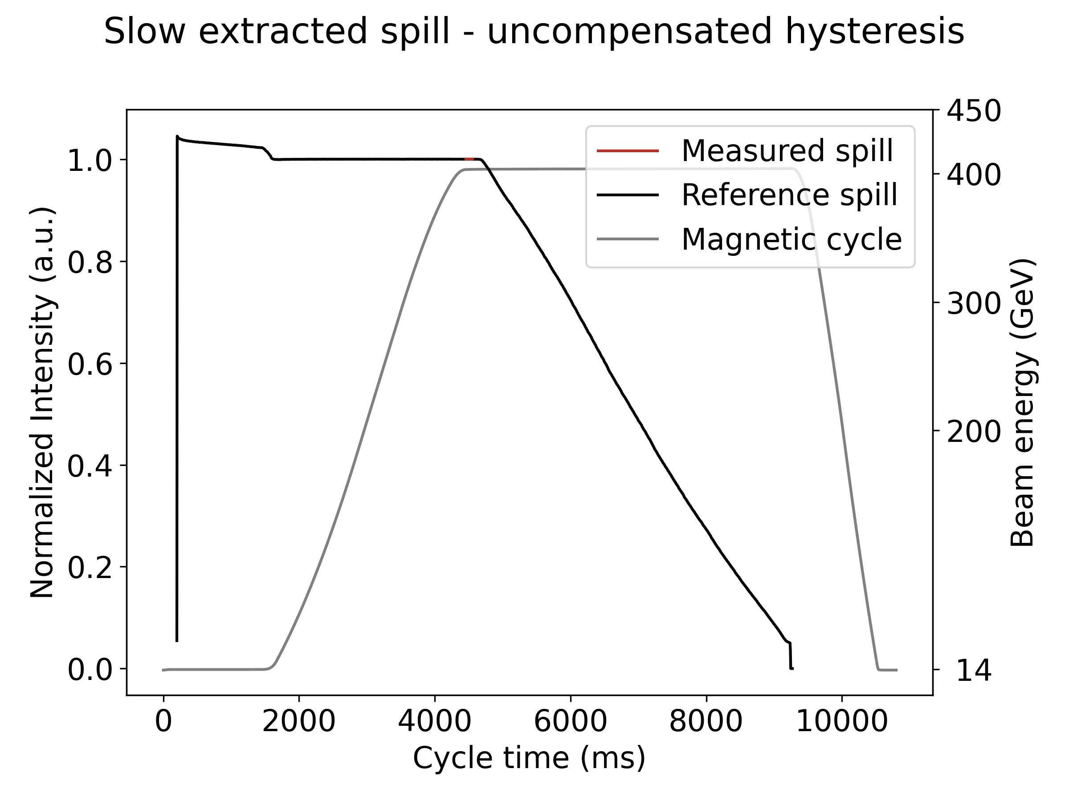
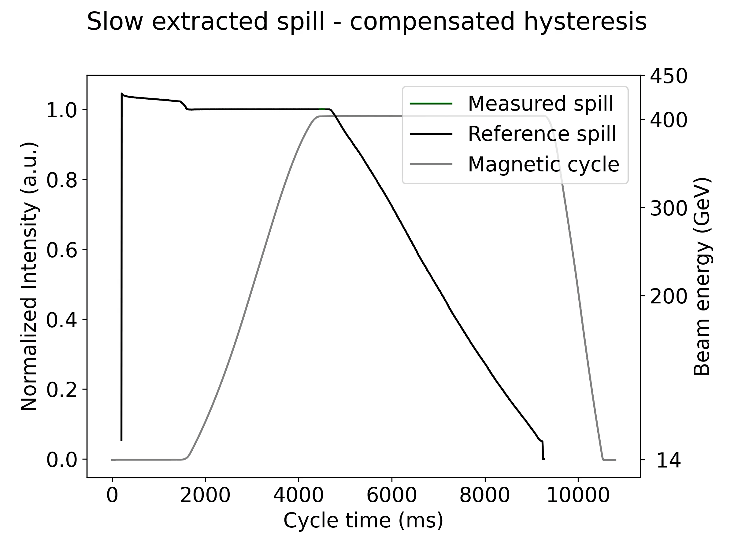
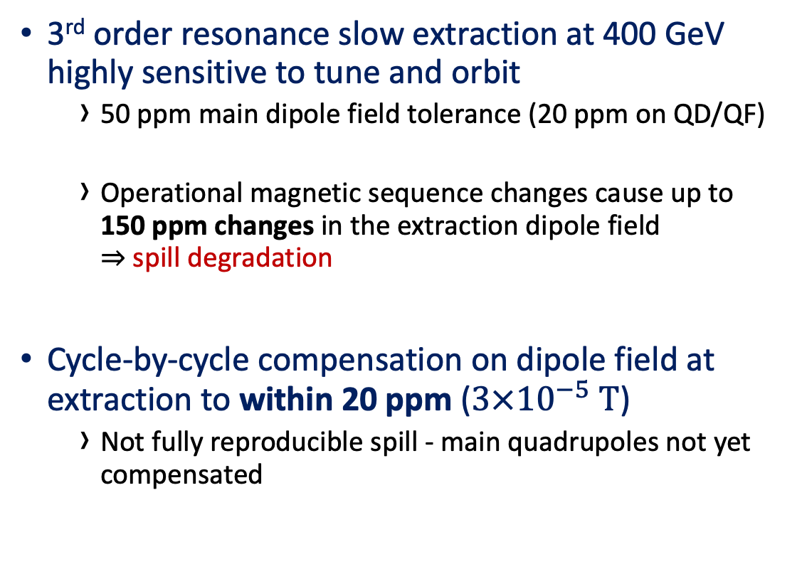
Compensation performance for SPS Fixed Target slow extraction
Hysteresis Compensation on SPS main dipoles
3rd order resonance slow extraction at 400 GeV highly sensitive to tune and orbit
  50 ppm main dipole field tolerance (20 ppm on QD/QF)
  Operational magnetic sequence changes cause up to
  150 ppm changes in the extraction dipole field
  $⇒$ spill degradation
Cycle-by-cycle compensation on dipole field at extraction to within 20 ppm ($3×{10}^{−5} T$)
  Not fully reproducible spill - main quadrupoles not yet compensated
Notes:
beam extracted over 5 s at ideally constant extracted intensity rate
50 ppm main dipole field ⬄ 1e-4 T
0.001
normally operators need to modify the horizontal tune at magnetic sequence change

Slide 9
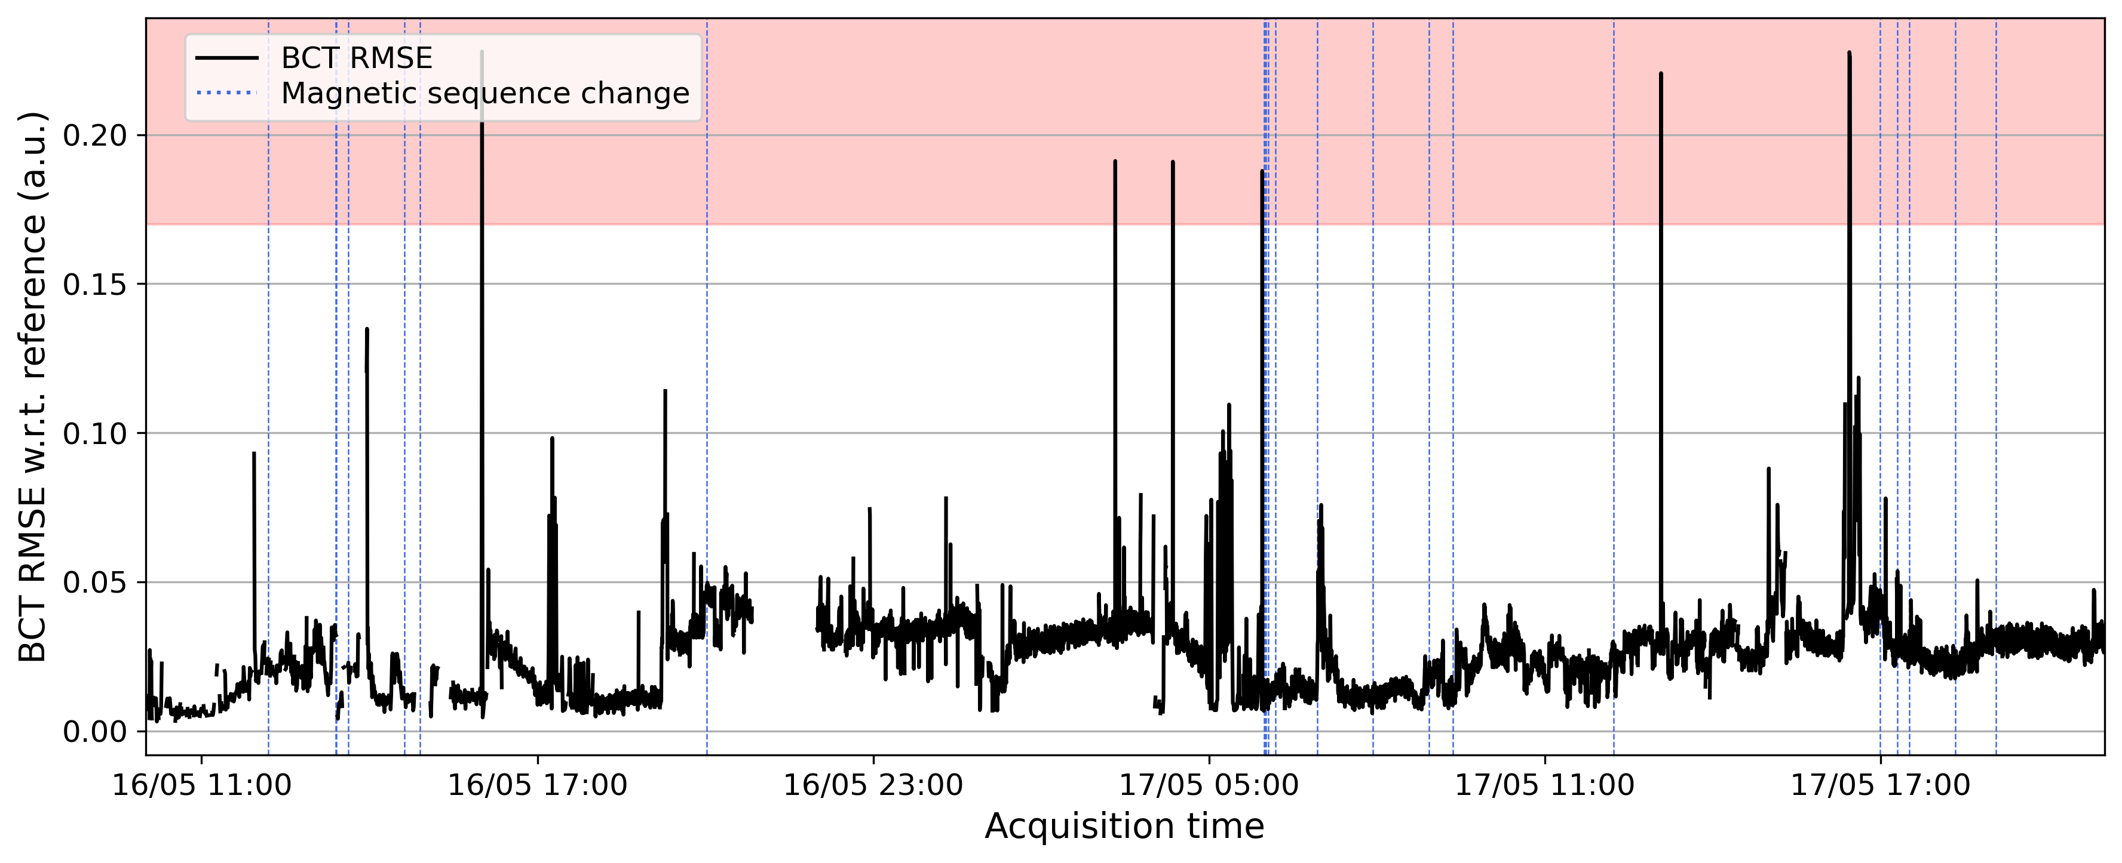

Continuous control of the SPS main dipoles for slow extraction
Hysteresis compensation on SPS main dipoles
Compensation runs reliably for long periods with past measured field as input
  Reproducible beam parameters at SX without intervention from operators for 36 hours
  Spill reproducibility defined as $RMSE (BCT_{ref}, BCT_{meas})$
  Occasionally poor reproducibility – may be hysteresis compensation, or other accelerator systems
Beam performance when uncompensated (and not manually corrected)
Notes:
No complaints from downstream experiments.
Field compensated within 3e-5 T, 20 ppm.
It’s possible to take a bad shot, but the model corrects itself after one or two iterations.
over 4000 extractions

Slide 10
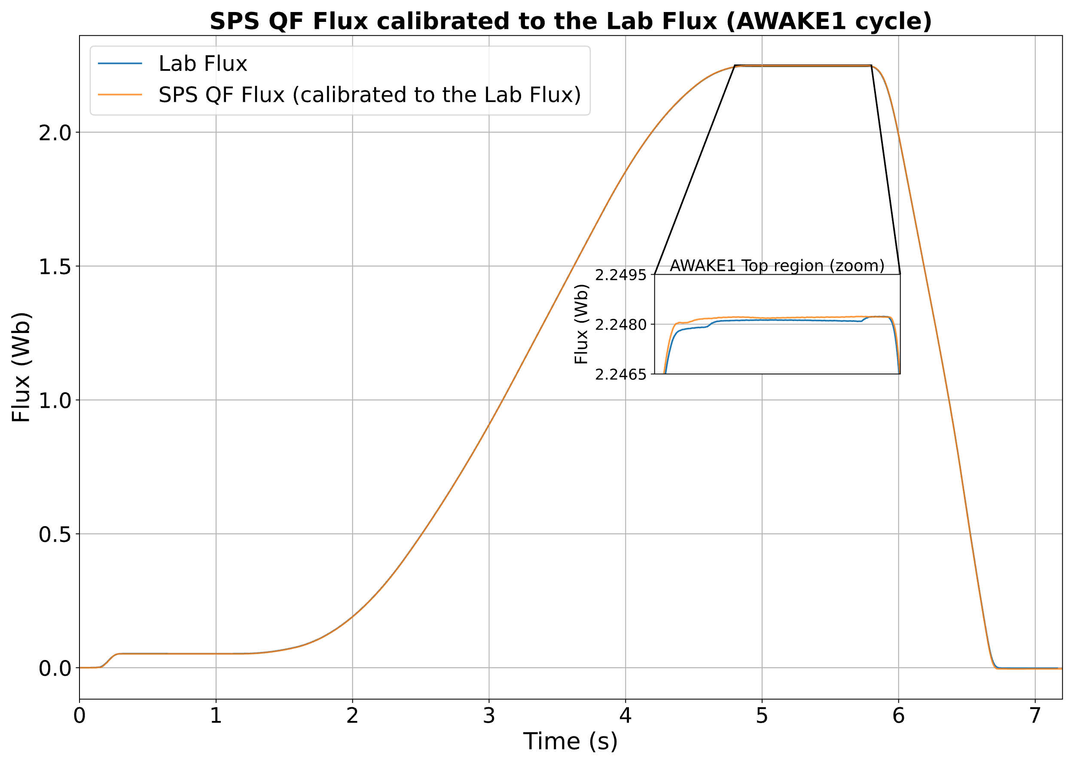
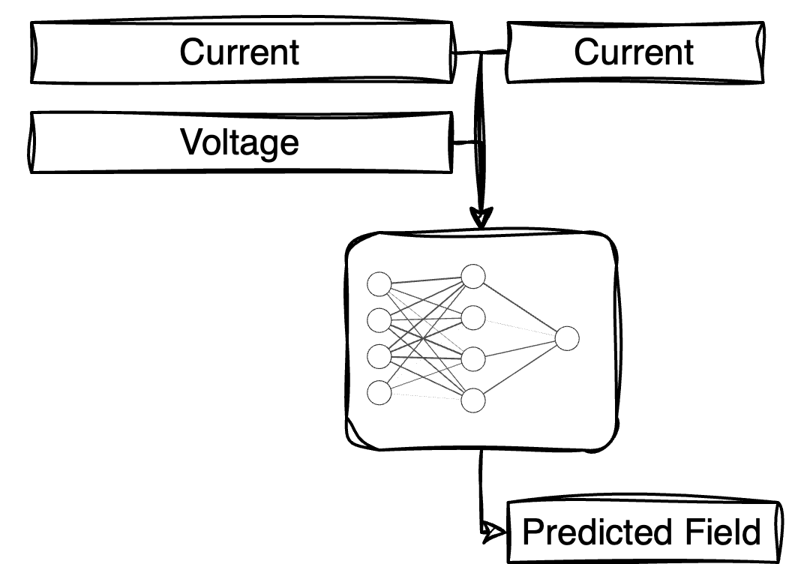
Hysteresis compensation for higher order magnets
SPS main quadrupoles and sextupoles
Higher order magnets in SPS have no real field measurement system
  Field compensation can go in open loop control with a robust magnetic model and autoregressive field predictions
  First results (1 h continuous control) look promising, but further work and longer studies needs to be done to quantify error propagation
  Magnet coil voltage can be used as virtual sensor if resistive voltage can be reliably isolated from inductive
    Every magnet is “equipped” with this “instrument”
    Can be modeled with the same proposed data-driven approach (TBC)
THPM041
A. Bellelli

Slide 11
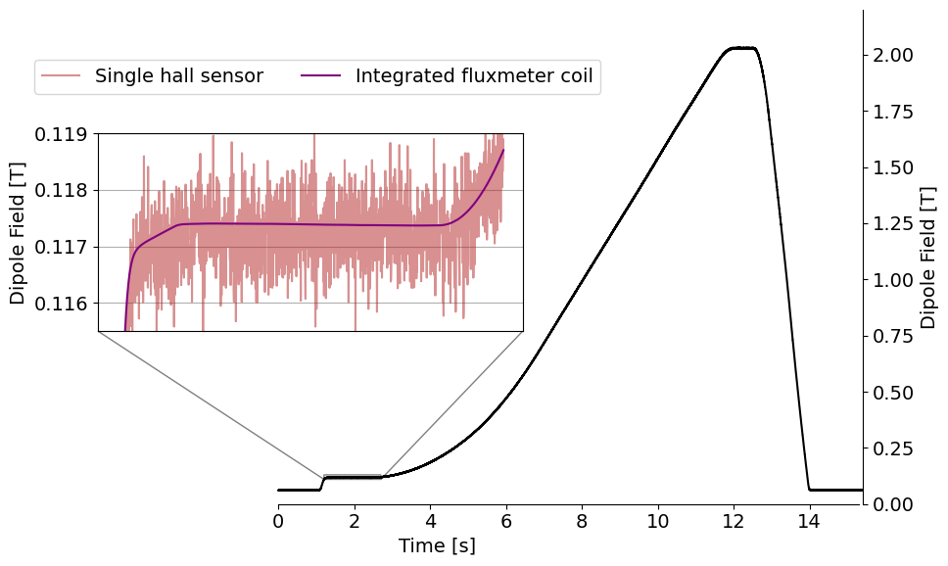
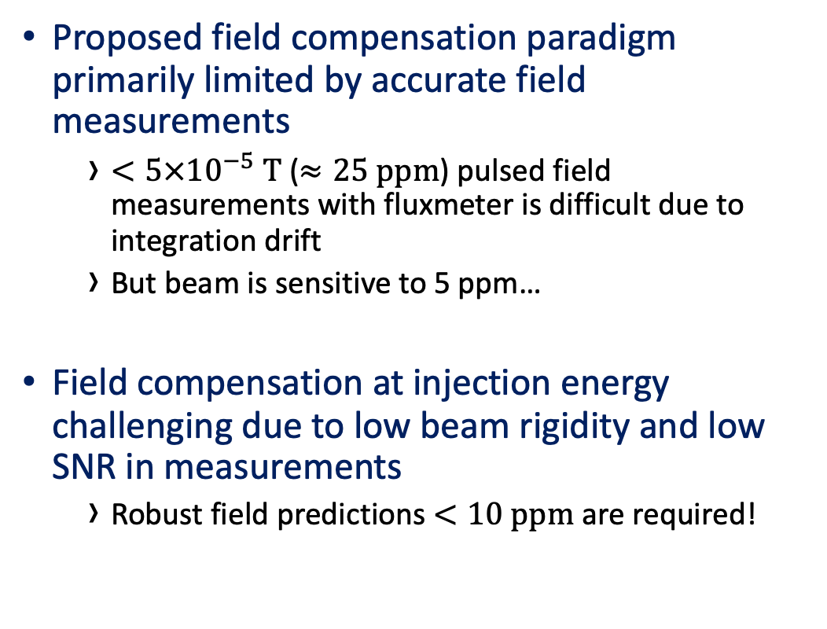
Limitations in field prediction
High-accuracy magnetic measurements
Proposed field compensation paradigm primarily limited by accurate field measurements
  $<5×{10}^{−5} T$ ($≈25 ppm$) pulsed field measurements with fluxmeter is difficult due to integration drift
  But beam is sensitive to 5 ppm…
Field compensation at injection energy challenging due to low beam rigidity and low SNR in measurements
  Robust field predictions $<10 ppm$ are required!
Notes:
You can only model as precisely as you measured
The reason why quadrupoles and sextupoles are not yet available for hysteresis compensation
50 ppm accuracy by averaging and filtering the hall sensors
Wrong field predictions, or halfway predictions, may dump the beam at injection

Slide 12
Summary & Conclusions
Flexible, high-accuracy, purely data-driven magnetic field predictions, from magnetic measurements
  Fine-tuned neural networks can be transfer-learned to other magnet families and measurements
  Operationally usable magnetic model and compensation schema for synchrotrons
    Improved field reproducibility and operational flexibility in CERN SPS
Online field compensation is being deployed to the SPS main dipoles
  Potentially significantly increased available beam time without the need for magnet precycling
    Critical for dynamic beam scheduling and automatic LHC filling at CERN
    SPS main quadrupoles must be compensated before the full benefit
  Further extension to the SPS main sextupoles and octupoles is foreseen

Slide 13
Thank you

Slide 14
Extra slides

Slide 15
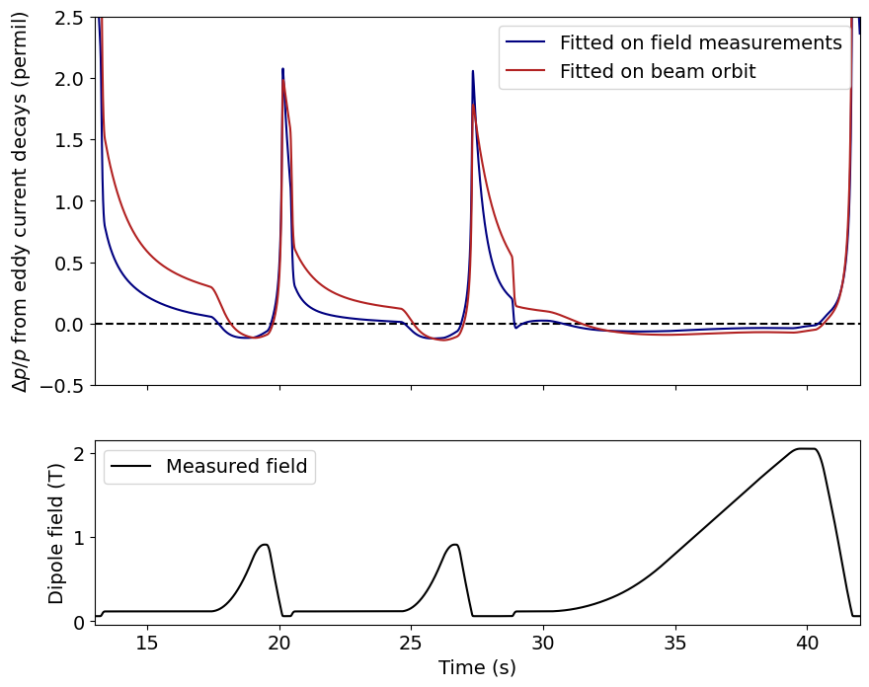
A note on eddy current compensation
Original magnetic field modeling aimed to capture dynamic effects from measurements…
  … but reference magnet measurements cannot capture eddy current decays in the accelerator
  Beam experiences dynamic effects that are incompatible with magnet design and field measurements
  Field contributions from eddy current decays must be fitted from beam data directly (i.e. radial position for main dipoles
Eddy current contribution can be added to ML field forecasting for feed-forward compensation
Notes:
Electrical installation in the tunnel is different from measurement lab (which also only has 1 magnet)
Generated dynamic effects can be modeled as superposition of exponentials (one from each contribution)
Eddy current effects dominate at injection, at over 0.6 permil dp/p without the precycle.
Original method aimed to capture dynamic effects as well. While we can capture them, now efforts are concentrated to removing them.
explain affirmatively the plot…saying essentially we have done this already etc… to be tested all together soon.

Slide 16
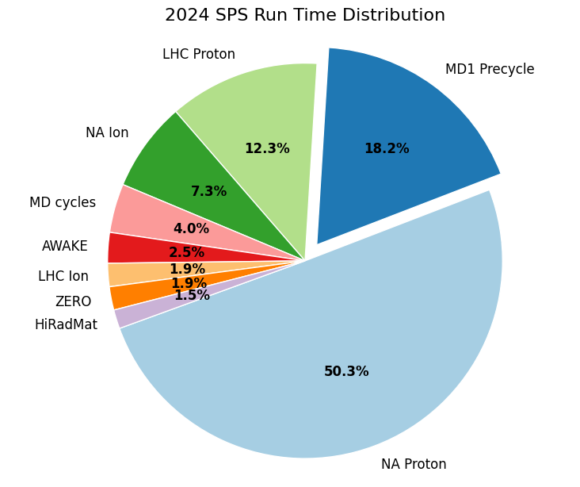
Towards a particle accelerator without precycling
Potential operational benefits
18 % of the 2024 SPS physics run was spent in precycling
  5 GWh of power for precycling only
Hysteresis compensation facilitates removal of precycle
  Significant increase in available beam time
  Improved flexibility for beam operation & cycle scheduling
Notes:
Times include downtime and MDs.
1 million francs per year electricity
Otherwise the only thing we gain is power savings by flattening the precycling

Slide 17


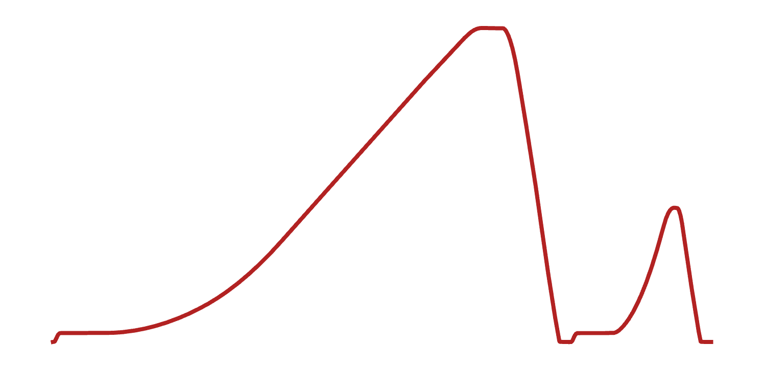
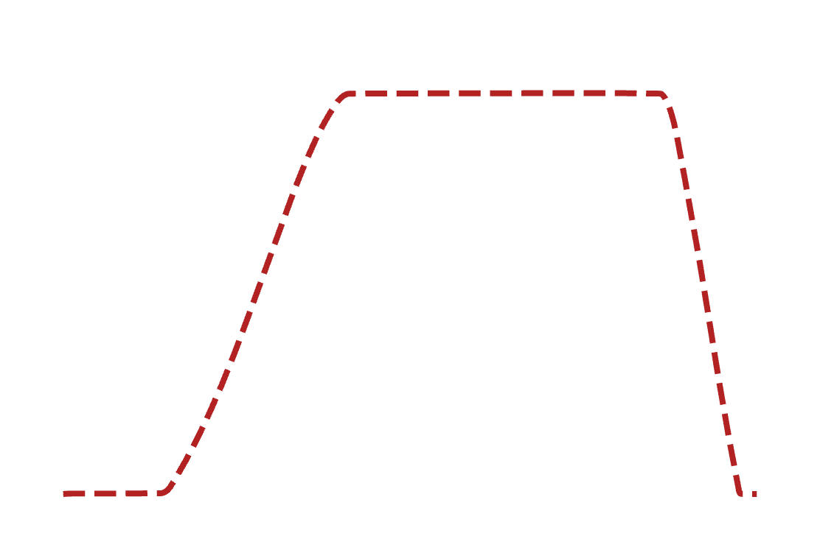





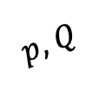


Transparent hysteresis compensation
Through feed-forward field compensation
Momentum / tune
Current
$p$, $Q$
$$I$$
$$B$$
$$B^{∗}$$
$$B$$
$$ΔI$$
$$\hat{B}$$
$$ΔB=B−\hat{B}$$
Compensate magnetic field to what the control system expects
Non-invasive to existing accelerator hardware
Notes:
Hierarchical control system translates momentum, tune etc to field to current, and sends the
Most magnetic circuits are controlled in current by translating momentum / tune / correction etc.
Control system is agnostic to actual field response in the machine
Instead: model magnetic field response $I→B$ from magnetic field measurements
Knowing next cycle to be played …
… feed-forward correct the field by applying a $ΔI$ for every cycle
$⇒$We now can achieve reproducible fields
Control paradigm is transparent to set $B$ / $K$

Slide 18
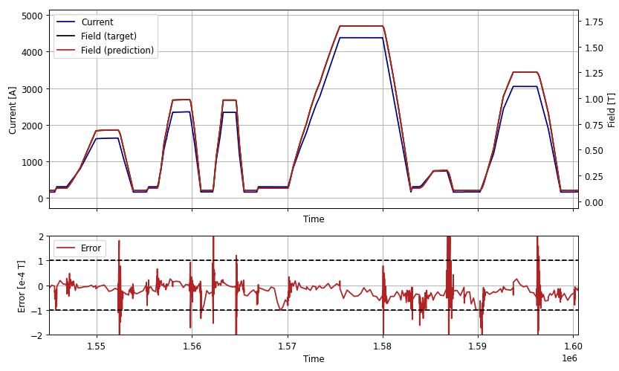
Fitting transformers on simulated hysteresis
An interlude…
Attention-based models need plenty of data to
train and generalize well
  Field measurements from operation can impossibly
  provide sufficient variety in data
Large amounts of pseudo-realistic, pseudo-random
waveforms can be generated and then simulated
  Jiles-Atherton and Flatley ODEs have
  implementations in Python / MatLab
  Pre-training learns common waveform shapes and
  generic hysteretic + dynamic behavior
Notes:
Generate large amounts of data on hysteresis simulation, with similar hysteretic vs. anhysteretic magneticization, add eddy current decays,
Pre-training is crucial for accurate and robust predictions – especially over long prediction horizons
Simulated data is noise-free and clean. Noise can easily be injected to inputs during training
First intended as a PoC for learning hysteresis – but we can re-use trained models for downstream

Slide 19
Fitting transformers on simulated hysteresis
An interlude…
Attention-based models need plenty of data to
train and generalize well
  Field measurements from operation can impossibly
  provide sufficient variety in data
Large amounts of pseudo-realistic, pseudo-random
waveforms can be generated and then simulated
  Jiles-Atherton and Flatley ODEs have
  implementations in Python / MatLab
  Pre-training learns common waveform shapes and
  generic hysteretic + dynamic behavior
✓ We can learn clean hysteretic data sufficiently well!
Notes:
Generate large amounts of data on hysteresis simulation, with similar hysteretic vs. anhysteretic magneticization, add eddy current decays,
Pre-training is crucial for accurate and robust predictions – especially over long prediction horizons
Simulated data is noise-free and clean. Noise can easily be injected to inputs during training
First intended as a PoC for learning hysteresis – but we can re-use trained models for downstream

